Slide 1
Acknowledgements
Robert Stroud James Fraser John Spence
Chris Nielsen Clemens Schulze-Briese Aina Cohen Ana Gonzalez
UCSF LBNL SLAC
ALS 8.3.1: TomAlberTron
UC Multicampus Research Programs and Initiatives (MRPI)
NIH NIGMS R01 GM124149
NIH NIGMS P30 GM124169
Integrated Diffraction Analysis Technologies (IDAT)
Plexxikon, Inc.
Synchrotron Radiation Structural Biology Resource (SLAC)
The Advanced Light Source is supported by the Director, Office of Science, Office of Basic Energy Sciences, Materials Sciences Division, of the US Department of Energy under contract No. DE-AC02-05CH11231 at Lawrence Berkeley National Laboratory.

Slide 2
PowerPoint File available:
http://bl831.als.lbl.gov/
~jamesh/powerpoint/
CSHL_beamline_2018.pptx

Slide 3
The “success rate” of data collection
100 s/dataset
200 days/year
~150 beamlines
~26,000,000 datasets/year
~10,000 PDBs in 2017

Slide 4
signal vs noise
“If you don’t have
good data,
then you have
no data at all.”
-Sung-Hou Kim

Slide 5
signal vs noise
easy
hard
impossible

Slide 6
signal vs noise
easy
hard
impossible
threshold of “solvability”

Slide 7
signal vs noise
“If you don’t have
good data,
then you must
learn statistics.”
-James Holton

Slide 8
Adding noise

Slide 9
Adding noise
1² + 1² = 1.4²

Slide 10
Adding noise
1² + 1² = 1.4²
3² + 1² = 3.2²
σ_{total}² = σ₁² + σ₂²

Slide 11
Adding noise
1² + 1² = 1.4²
3² + 1² = 3.2²
σ_{total}² = σ₁² + σ₂²

Slide 12
Adding noise
1² + 1² = 1.4²
3² + 1² = 3.2²
σ_{total}² = σ₁² + σ₂²

Slide 13
Adding noise
1² + 1² = 1.4²
3² + 1² = 3.2²
10² + 1² = 10.05²

Slide 14
And the dominant source of error is…
Resolution
  Disorder (including Radiation Damage)
  Background
Phases
  Non-isomorphism (including Radiation Damage)
  Vibration (beam, xtal, spindle, etc.)
  Detector calibration

Slide 15

100% SeMet incorporation
Trivial to solve

Slide 16

100% S -Met incorporation
Impossible to solve

Slide 17
Phase Problem: Se vs S
correlation coefficient
fraction not Selenium

Slide 18
Phase Problem: Se vs S
correlation coefficient
fraction not Selenium

Slide 19
Phase Problem: Se vs S
correlation coefficient
fraction not Selenium

Slide 20
Phase Problem: Se vs S
correlation coefficient
fraction not Selenium

Slide 21
Phase Problem: Se vs S
correlation coefficient
fraction not Selenium

Slide 22
MR simulation
corrupted model
Correlation coefficient to correct density
Rmsd from perfect search model (Å)

Slide 23
The
“threshold of solvability” is sharp!
How can we predict success/failure?
Know Thy Experiment

Slide 24
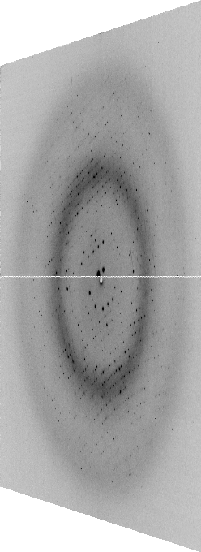

The “beam line”
X-ray
Source
Area Detector
Cite the “beamline paper!”
Protein Crystal
Notes:
Most notable acheivements are high brightness with very little “wasted” light. The discovery made by Howard Padmore? At ALS showed that a 2:1 demagnification cancels nearly all of the spherical abberations in the parabolic/torroid system. 30-50% of the total x-ray intensity passes through the 100um pinhole. The flux through the 100um pinhole at the superbend beamlines is comparable to that of the 5.0.2 wiggler or an APS bending magnet, but only 150 Watts of power must be dissipated by the beamline optics. In contrast, wiggler beamlines must disipate kilowatts. The optics here are much simpler and not exotic in any way. The system is stable and robust. There is never a need to re-focus the beam at a new wavelength. Only a 2-minute automatic tuneup is recommended for very large energy changes (more than 1-2 keV).

Slide 25
Where do the
X-rays come from?

Slide 26
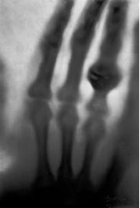
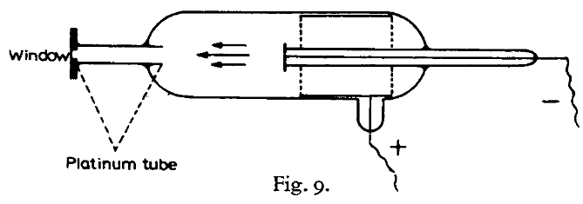
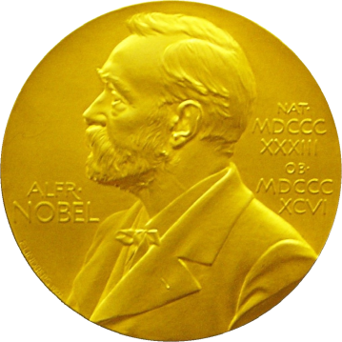
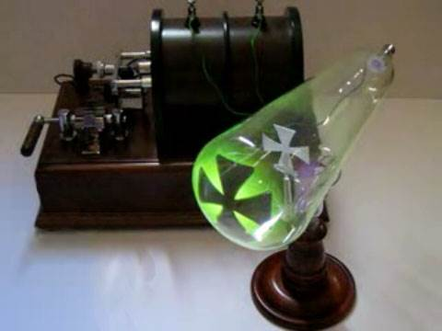
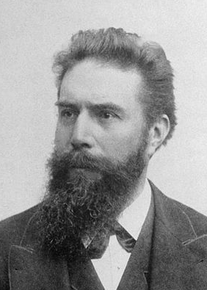
X-rays
(aka “Röntgenstrahlung”)
The discovery soon after this of X-rays by Röntgen (22), the first investigator to use the type of tube described above, is generally considered to be a good example of a lucky discovery.
P.E.A. von Lenard
1906 Nobel Lecture
Röntgen, W. C. (1898)."Ueber eine neue Art von Strahlen", Annalen der Physik 300, 1-11.

Slide 27
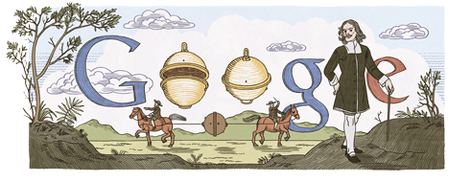
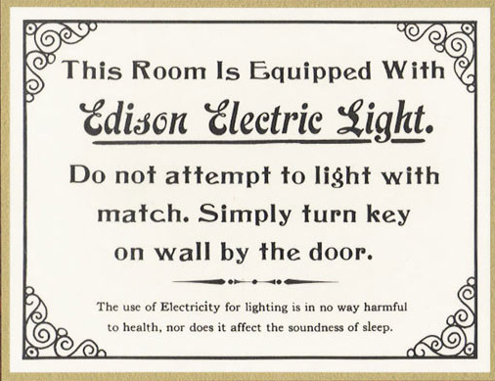
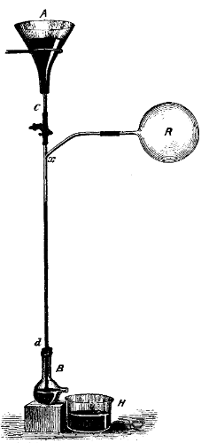
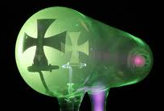
Electricity + vacuum = X-rays
1654 ~10 Torr
Otto von Guericke’s
“Magdeburg hemispheres”
1865 < 10⁻² Torr
Hg “fall tube” pump
Sprengel, H. (1865). "Researches on the vacuum", J. Chem. Soc. 18, 9b-21.
1870s < 10⁻³ Torr
1894 < 10⁻⁵ Torr
Sprengel pump
Redhead, Paul A., ed. Vacuum Science and Technology: Pioneers of the 20th Century. Vol. 2. Springer, 1994.
Benvenuti, C. & Chiggiato, P. (1993). "Obtention of pressures in the 10⁻¹⁴ torr range by means of a Zr-V-Fe non evaporable getter", Vacuum 44, 511-513.
1993 ~10⁻¹⁴ Torr

Slide 28
The “Home source”
e⁻

Slide 29
The “Home source”
e⁻
e⁻
+

Slide 30
The “Home source”
+

Slide 31
The “Home source”
e⁻
+

Slide 32
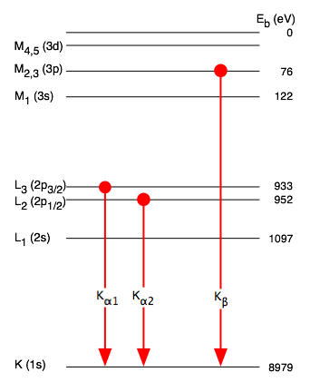
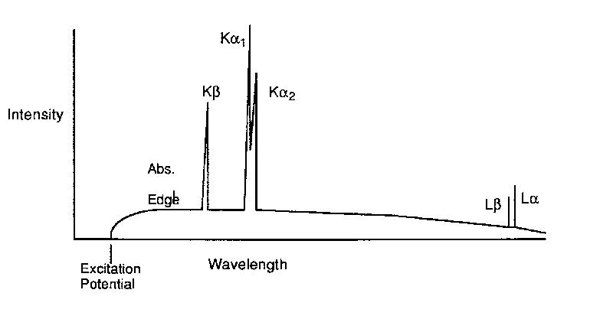
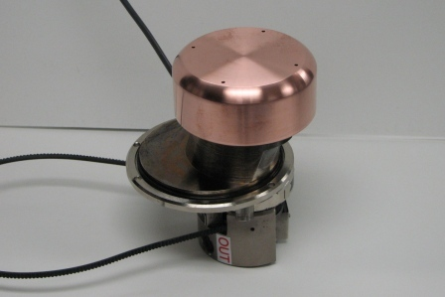
The “Home source”

Slide 33
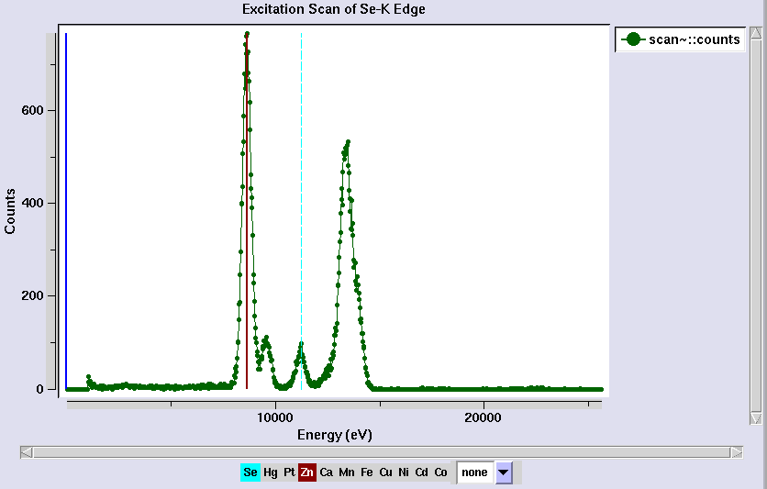
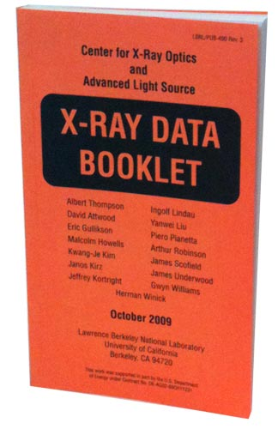
Metal identification
scattering
same
λ as
incident

Slide 34
“MAD scan” – absorption spectrum
fluorescence = yield * absorption
0.980888
0.980500
0.980113
0.979725
0.979338
0.978952
0.978565
0.978179
0.977794
0.977408
0.977023
0.976638
0.976254
“counts” (aka arbitrary units)
12398.42
energy
Wavelength (Å)

Slide 35
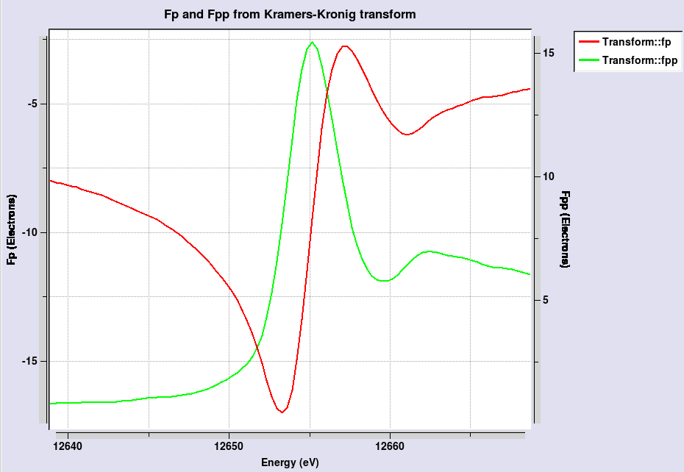
“MAD scan” – absorption spectrum
maximize
absolute
value of
fpp
maximize
difference
in fp

Slide 36
4-wavelength MAD

Slide 37
3-wavelength MAD

Slide 38
2-wavelength MAD

Slide 39
2-wavelength MAD

Slide 40
1-wavelength SAD

Slide 41
2-wavelength metal validation
phased
anomalous
difference
Fourier

Slide 42
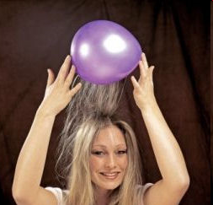
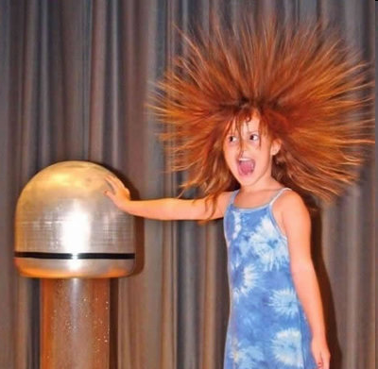
Electric charge
balloon
-
-
-
-
-
-
Wool Sweater
+ + + + + +

Slide 43

Electric field of a moving charge

Slide 44
Electric field of a moving charge
accelerating charges
make
electromagnetic waves
(light)

Slide 45
Bending Magnet
S
electron beam
X-rays !
N

Slide 46
Two Bending Magnets
S
N
electron beam
N
S
2x X-rays !

Slide 47
Wiggler
8x X-rays !
S
N
S
N
S
N
S
N
N
S
N
S
N
S
N
S

Slide 48
Undulator
> 8x X-rays !
S
N
S
N
S
N
S
N
N
S
N
S
N
S
N
S

Slide 49
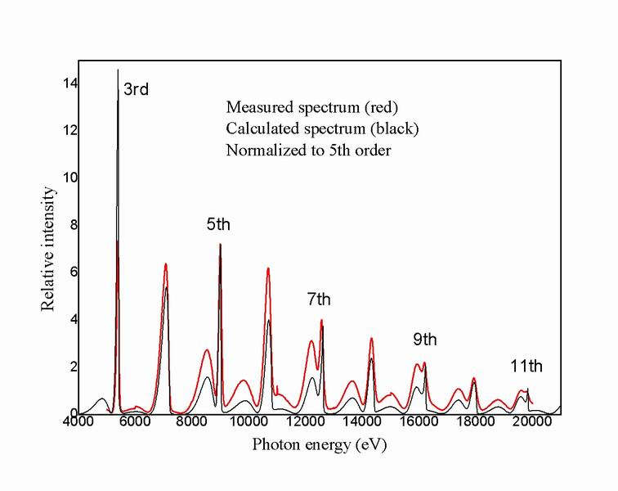
Undulator emission spectrum

Slide 50
XFEL Undulator
same X-rays
short pulse
S
N
S
N
S
N
S
N
S
N
S
N
S
N
S
N
N
S
N
S
N
S
N
S
N
S
N
S
N
S
N
S

Slide 51
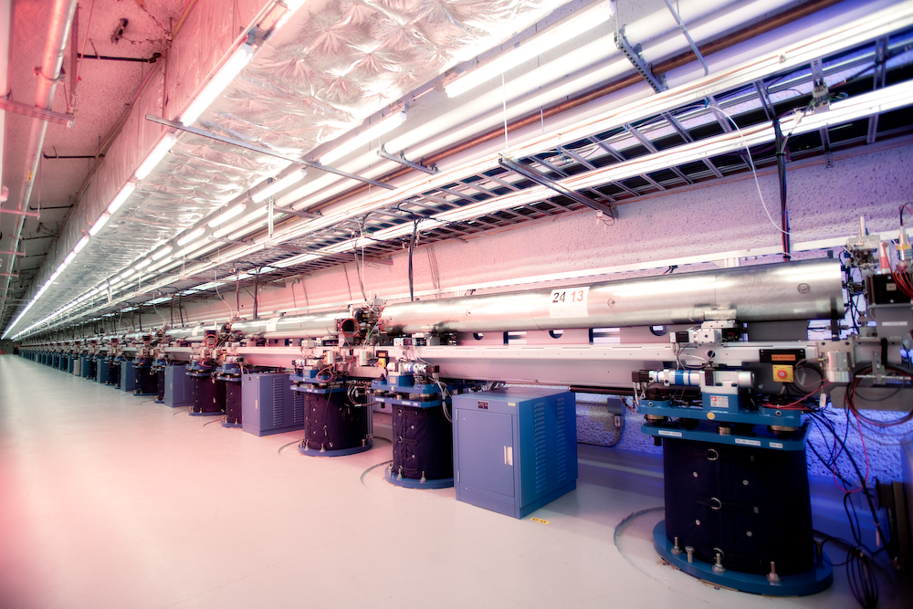
LCLS undulator hall

Slide 52
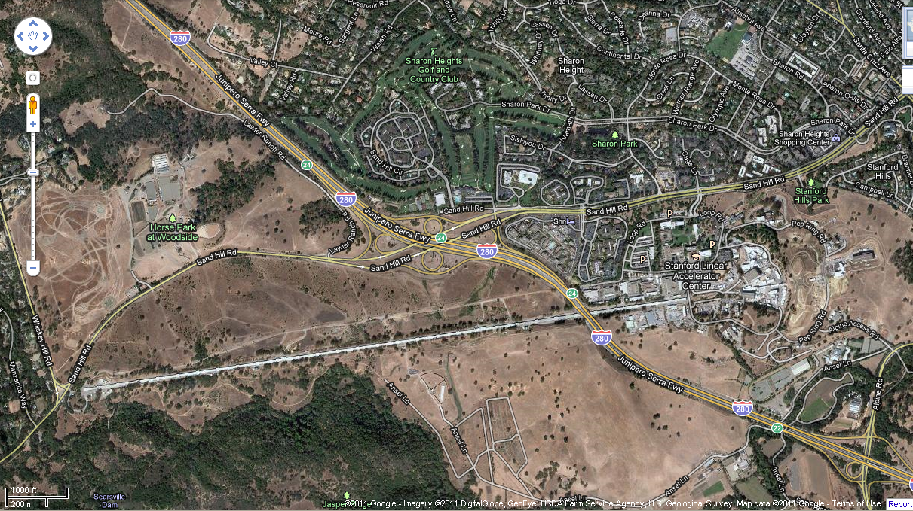
LCLS at SLAC

Slide 53
Accelerator-based light source terminology
Code name Translation
First Generation Bending Magnet
Second Generation Wiggler
Third Generation Undulator
Fourth Generation Free electron laser
..and diffraction-limited synchrotron

Slide 54
Diffraction-limited light source
λ ≈ 2 d sinθ
λ = x-ray wavelength
d = electron/x-ray beam size
θ = beam divergence
d = 1 Å / 100 µrad / 2 = 0.5 µm

Slide 55
The “beam line”
focused
beam
slits
Scatter
guard
Secondary
mirror
Primary
mirror
Source
Area Detector
Unfocused
beam
slits
Si(111)
monochromator
Sample

Slide 56
The “beam line”
focused
beam
slits
Scatter
guard
Secondary
mirror
Primary
mirror
Source
Area Detector
Unfocused
beam
slits
Si(111)
monochromator
Sample
Notes:
Most notable acheivements are high brightness with very little “wasted” light. The discovery made by Howard Padmore? At ALS showed that a 2:1 demagnification cancels nearly all of the spherical abberations in the parabolic/torroid system. 30-50% of the total x-ray intensity passes through the 100um pinhole. The flux through the 100um pinhole at the superbend beamlines is comparable to that of the 5.0.2 wiggler or an APS bending magnet, but only 150 Watts of power must be dissipated by the beamline optics. In contrast, wiggler beamlines must disipate kilowatts. The optics here are much simpler and not exotic in any way. The system is stable and robust. There is never a need to re-focus the beam at a new wavelength. Only a 2-minute automatic tuneup is recommended for very large energy changes (more than 1-2 keV).

Slide 57
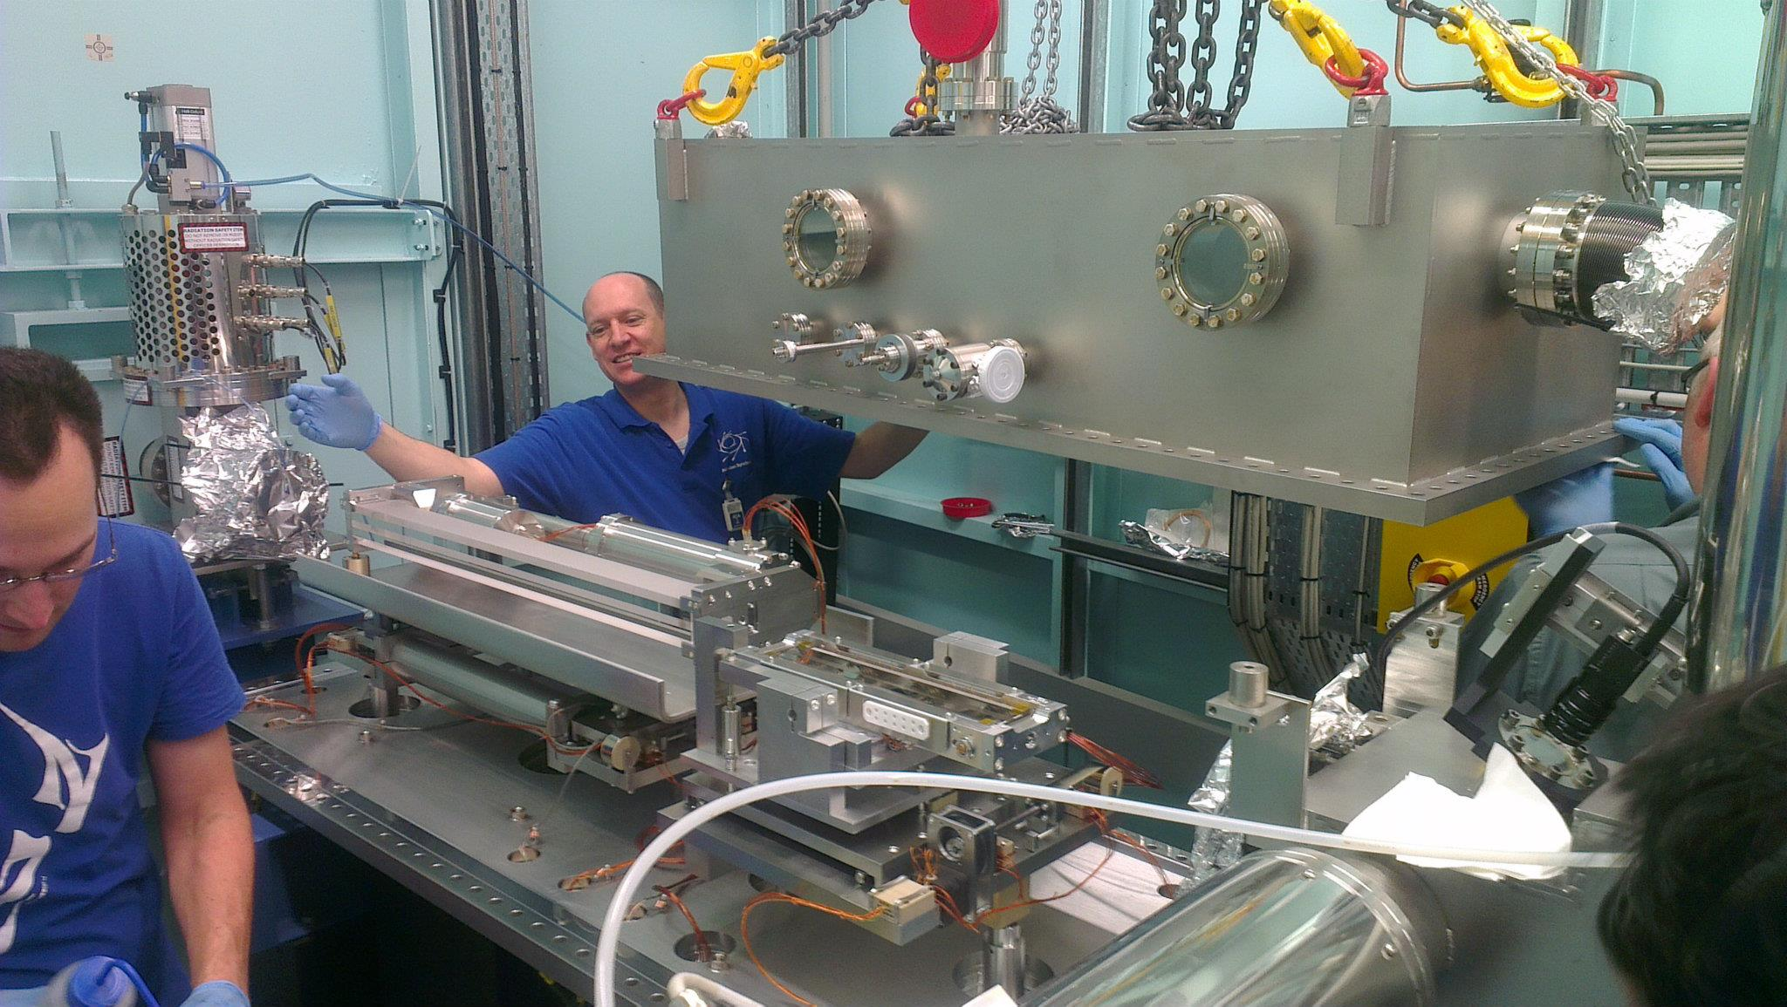
X-ray optics: mirrors
Notes:
Next slide please

Slide 58
Why are the mirrors so long?
Must be < 0.2°
3 mm
1000 mm
Notes:
Next slide please

Slide 59
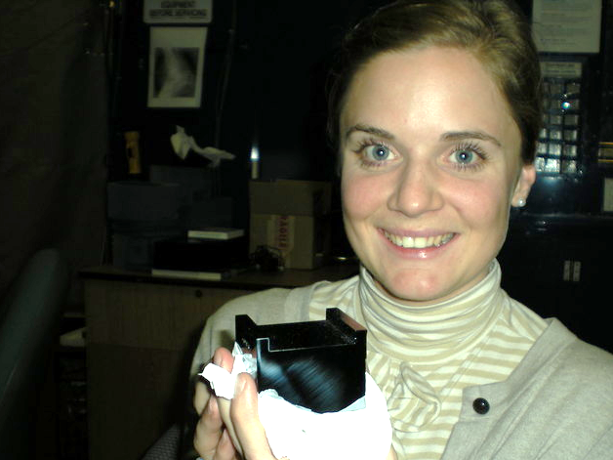
Single crystal

Slide 60
Monochromators
λ = 1 Å
Si
Notes:
Next slide please

Slide 61
Monochromators
nλ = 2d sin(θ)
λ = 1 Å
λ = 1 Å
Si
d = 3.135 Å
θ = 9.177°
Notes:
Next slide please

Slide 62
Monochromators
nλ = 2d sin(θ)
λ = 1.1 Å
Si
d = 3.135 Å
θ = 9.177°
Notes:
Next slide please

Slide 63
Monochromators
nλ = 2d sin(θ)
λ = 1.1 Å
λ = 1.1 Å
Si
d = 3.135 Å
θ = 10.104°
Notes:
Next slide please

Slide 64
Monochromators
nλ = 2d sin(θ)
λ = 1 Å
λ = 1 Å
Si
d = 3.135 Å
θ = 9.177°
Notes:
Next slide please

Slide 65
Monochromators
Si
λ = 1 Å
λ = 1 Å
Si
d = 3.135 Å
DCM = Double Crystal Monochromator
Notes:
Next slide please

Slide 66
Monochromators
Si
λ = 1.1 Å
λ = 1.1 Å
Si
d = 3.135 Å
DCM = Double Crystal Monochromator
Notes:
Next slide please

Slide 67
Monochromators
nλ = 2d sin(θ)
λ = 1.54 Å
λ = 1.54 Å
Mo/C
d = 24 Å
θ = 1.84°
Multilayer optics
Notes:
Next slide please

Slide 68
The truth about x-ray beams
Term units significance
Flux photons/s duration of experiment
Beam Size μm match to crystal
Divergence mrad spot size vs distance
Wavelength Å resolution and absorption
Dispersion Δλ/λ spot size
Flux density ph/s/area scattering/damage rate
Fluence ph/area scattering/damage

Slide 69
The truth about x-ray beams
Term units significance
Flux photons/s duration of experiment
Beam Size μm match to crystal
Divergence mrad spot size vs distance
Wavelength Å resolution and absorption
Dispersion Δλ/λ spot size
Flux density ph/s/area scattering/damage rate
Fluence ph/area scattering/damage

Slide 70
The number of photons scattered
before crystal is dead
is independent
of data collection time
1 um³ = 10⁶ photons
Henderson, 1990; Gonzalez & Nave, 1994; Glaeser et al., 2000; Sliz et al., 2003; Leiros et al., 2006; Owen et al., 2006; Garman & McSweeney, 2006; Garman & Nave, 2009; Holton, 2009

Slide 71
The truth about x-ray beams
quantity | units | home source | MX2
flux | Photons/second | 2.5 x 10⁹ | 2 x 10¹²
exposure | seconds | 400 | 1

Slide 72
The truth about x-ray beams
quantity | units | home source | MX2
flux | Photons/second | 2.5 x 10⁹ | 2 x 10¹²
exposure | seconds | 400 | 1
Dispersion | wavelength range / wavelength | 0.2% (Kα₁ - Kα₂) | 0.014% (Si111)
Divergence | milliRadian | 4.8 | 1.8 (h) 0.18 (v)
Beam size | microns | 100 | 24 (h) 12 (v)
Spectral brightness | Photons/s/mm²/ mR²/0.1%BW | 5.4 x 10⁹ | 1.5 x 10¹⁷

Slide 73
The truth about x-ray beams
quantity | units | home source | MX2
flux | Photons/second | 72 x 10⁶ | 2 x 10¹²
exposure | time | 4 hours | 1 second
Dispersion | wavelength range / wavelength | 0.2% (Kα₁ - Kα₂) | 0.014% (Si111)
Divergence | milliRadian | 4.8 | 1.8 (h) 0.18 (v)
Beam size | microns | 17 | 24 (h) 12 (v)
Spectral brightness | Photons/s/mm²/ mR²/0.1%BW | 5.4 x 10⁹ | 1.5 x 10¹⁷

Slide 74
The truth about x-ray beams
quantity | units | home source | MX2
flux | Photons/second | 1 x 10⁶ | 2 x 10¹²
exposure | time | 10 days | 1 second
Dispersion | wavelength range / wavelength | 0.2% (Kα₁ - Kα₂) | 0.014% (Si111)
Divergence | milliRadian | 0.6 | 1.8 (h) 0.18 (v)
Beam size | microns | 17 | 24 (h) 12 (v)
Spectral brightness | Photons/s/mm²/ mR²/0.1%BW | 5.4 x 10⁹ | 1.5 x 10¹⁷

Slide 75
The truth about x-ray beams
quantity | units | home source | MX2
flux | Photons/second | 8 x 10⁴ | 2 x 10¹²
exposure | time | 5 months | 1 second
Dispersion | wavelength range / wavelength | 0.014% (Si111) | 0.014% (Si111)
Divergence | milliRadian | 0.6 | 1.8 (h) 0.18 (v)
Beam size | microns | 17 | 24 (h) 12 (v)
Spectral brightness | Photons/s/mm²/ mR²/0.1%BW | 5.4 x 10⁹ | 1.5 x 10¹⁷

Slide 76
The truth about x-ray beams
Term units significance
Flux photons/s duration of experiment
Beam Size μm match to crystal
Divergence mrad spot size vs distance
Wavelength Å resolution and absorption
Dispersion Δλ/λ spot size
Flux density ph/s/area scattering/damage rate
Fluence ph/area scattering/damage

Slide 77
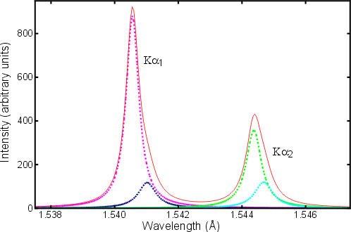
Two-color experiment (ca 1914)
(Cu source)
20 eV

Slide 78
Spot Shape
Ewald sphere
(h,k,l)

Slide 79
Spot Shape
Ewald sphere
(h,k,l)
d*

Slide 80
Spot Shape
Ewald sphere
(h,k,l)
spindle axis
d*

Slide 81
Spot Shape
Ewald sphere
Φ circle
(h,k,l)
spindle axis

Slide 82
Spot Shape
Ewald sphere
Φ circle
(h,k,l)
spindle axis

Slide 83
Spot Shape
Ewald sphere
Φ circle
(h,k,l)
diffracted ray
spindle axis

Slide 84
Spot Shape
Ewald sphere
Φ circle
(h,k,l)
λ*
d*
spindle axis
diffracted ray
λ*

Slide 85
Spot Shape
Ewald sphere
Φ circle
(h,k,l)
λ*
d*
spindle axis
diffracted ray
θ
λ*
λ = 2 d sin(θ)

Slide 86
spectral dispersion
Ewald sphere
Φ circle
(h,k,l)
λ*
d*
spindle axis
diffracted ray
λ*

Slide 87
spectral dispersion
Ewald sphere
Φ circle
(h,k,l)
λ’*
d*
spindle axis
diffracted ray
λ’*

Slide 88
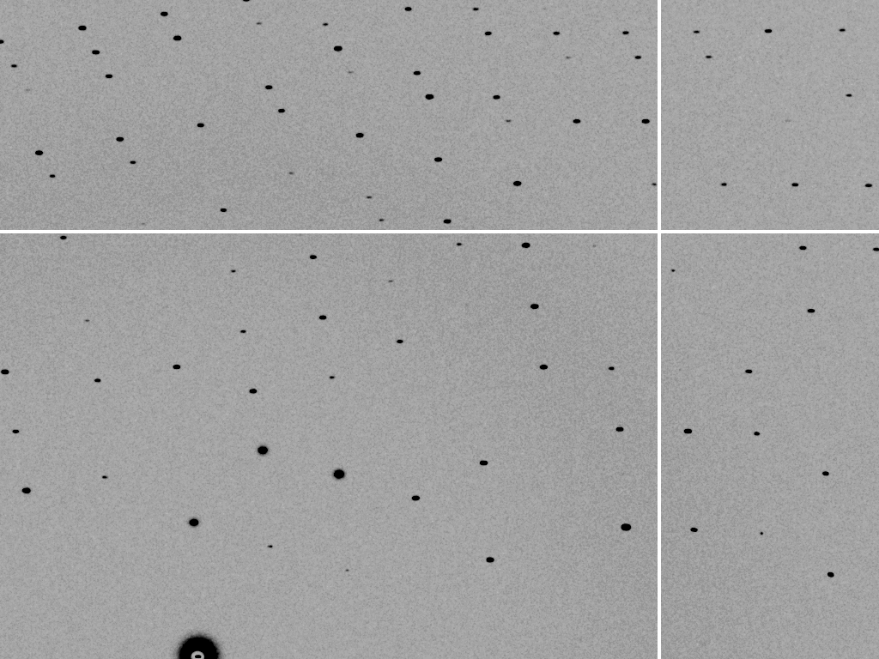
dispersion = 0

Slide 89

dispersion = 0.014% (Si 111)

Slide 90
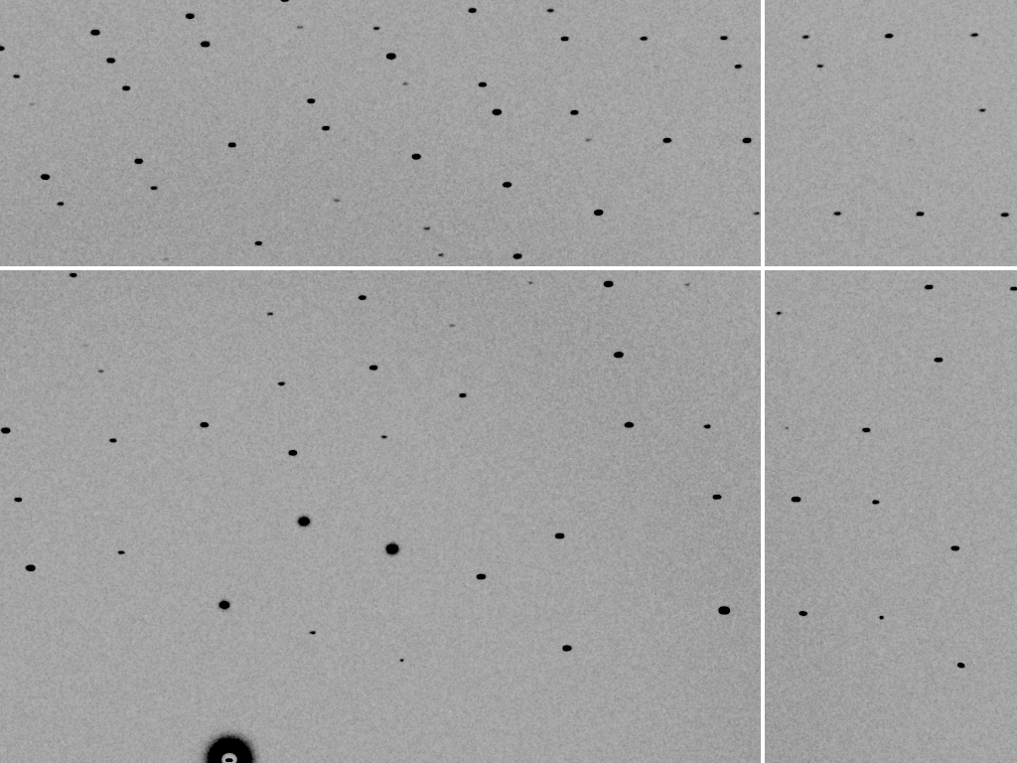
dispersion = 0.25% (CuK_{α})

Slide 91
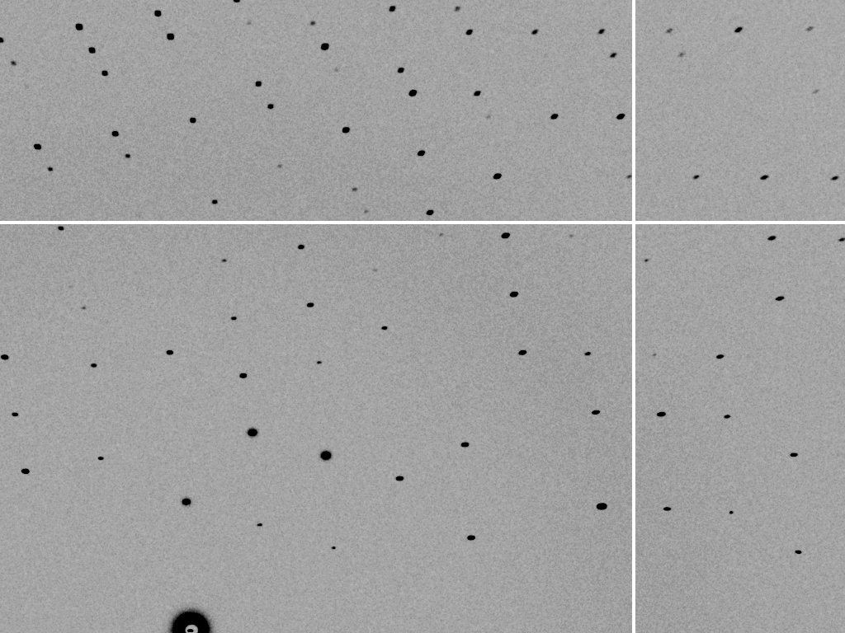
dispersion = 0.6%

Slide 92
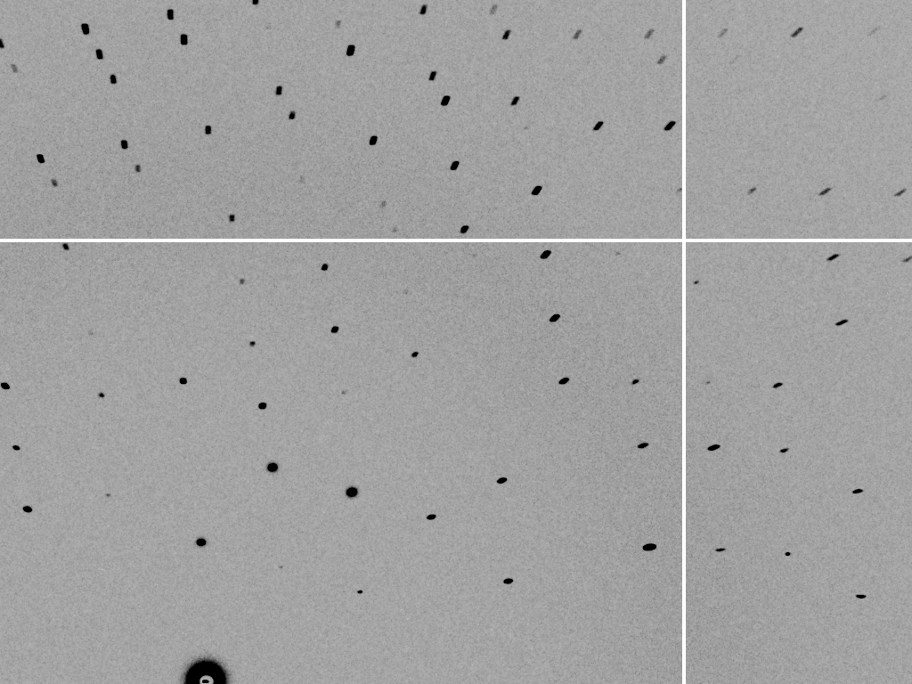
dispersion = 1.3%

Slide 93

dispersion = 2.6%

Slide 94
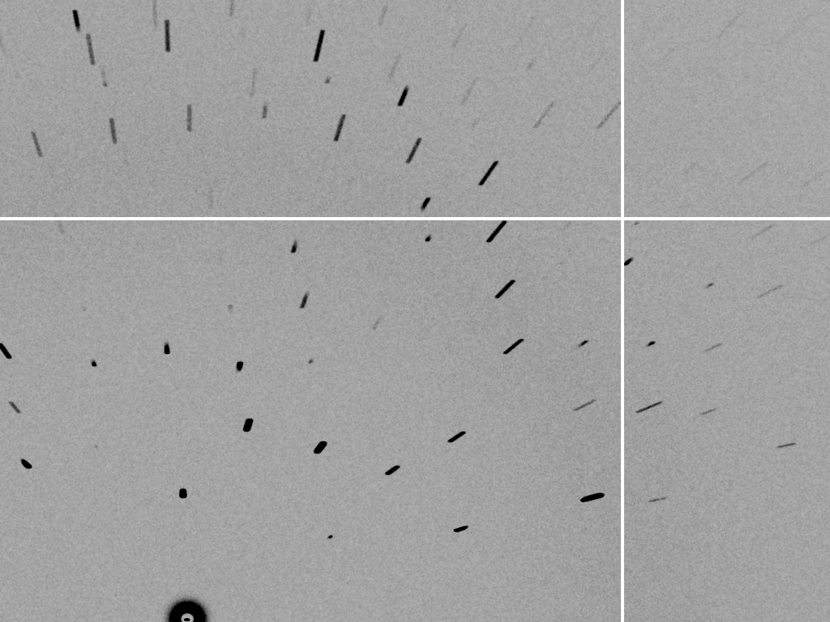
dispersion = 5.1%

Slide 95
The truth about x-ray beams
Term units significance
Flux photons/s duration of experiment
Beam Size μm match to crystal
Divergence mrad spot size vs distance
Wavelength Å resolution and absorption
Dispersion Δλ/λ spot size
Flux density ph/s/area scattering/damage rate
Fluence ph/area scattering/damage

Slide 96
beam divergence
Ewald sphere
Φ circle
(h,k,l)
λ*
d*
spindle axis
diffracted ray
λ*

Slide 97
beam divergence
Ewald sphere
Φ circle
(h,k,l)
d*
λ*
diffracted ray
spindle axis
λ*

Slide 98

divergence = 0 º

Slide 99

divergence = 0.3 º

Slide 100
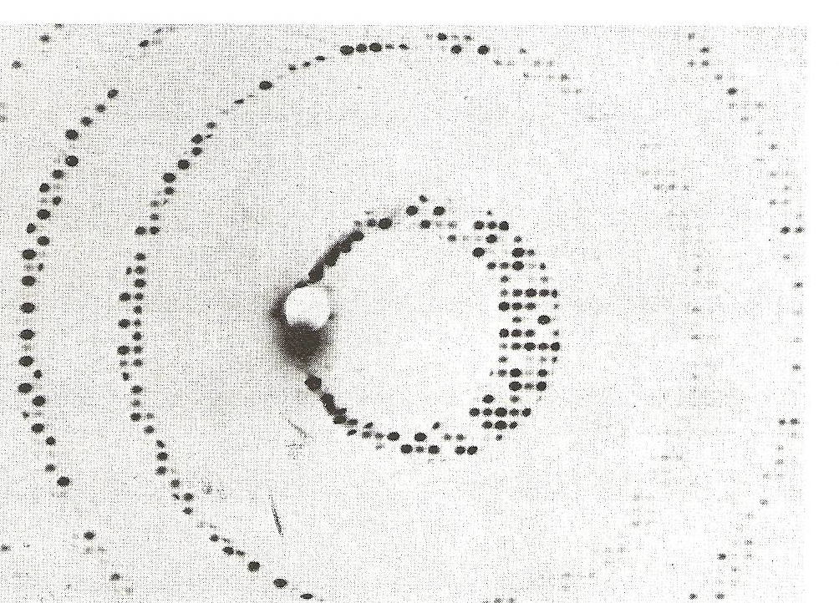
Divergence
Arndt & Wonacott (1977)

Slide 101
The truth about x-ray beams
Term units significance
Flux photons/s duration of experiment
Beam Size μm match to crystal
Divergence mrad spot size vs distance
Wavelength Å resolution and absorption
Dispersion Δλ/λ spot size
Flux density ph/s/area scattering/damage rate
Fluence ph/area scattering/damage

Slide 102
Air absorption
transmittance
Distance from sample (mm)

Slide 103
The truth about x-ray beams
Term units significance
Flux photons/s duration of experiment
Beam Size μm match to crystal
Divergence mrad spot size vs distance
Wavelength Å resolution and absorption
Dispersion Δλ/λ spot size
Flux density ph/s/area scattering/damage rate
Fluence ph/area scattering/damage

Slide 104
Data quality - simple rules:
  Put your crystal into the beam

Slide 105
Your sample is a lens!
(but not for x-rays)
90°

Slide 106
Your sample is a lens!
(but not for x-rays)
90°

Slide 107
Data quality - simple rules:
  Put your crystal into the beam
  Shoot the whole crystal

Slide 108
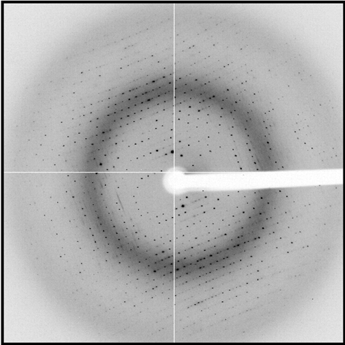
shoot the whole crystal

Slide 109
shoot the whole crystal

Slide 110
shoot the whole crystal

Slide 111
shoot the whole crystal

Slide 112
shoot the whole crystal

Slide 113
How many crystals do you see?
Shoot the crystal (singular)

Slide 114
Ewald’s “mosaic” picture

Slide 115
Ewald’s “mosaic” picture

Slide 116
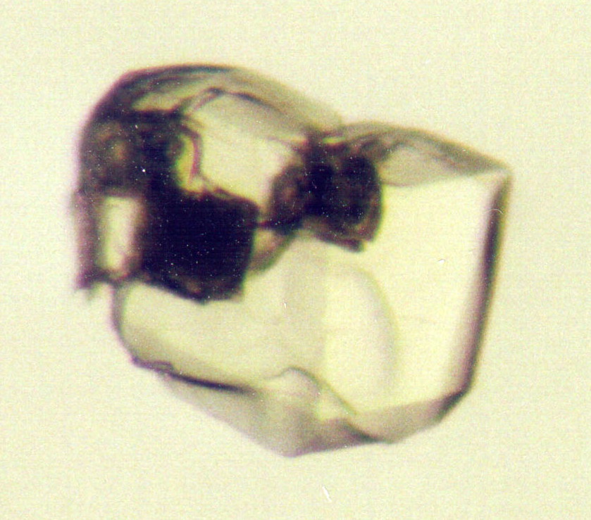
Ewald’s “mosaic” picture
What is
this stuff?

Slide 117
Darwin’s original picture

Slide 118
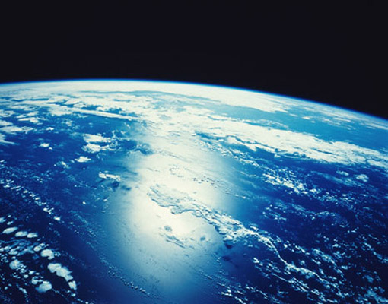
“mosaicity” with visible light

Slide 119

mosaic spread = 0 º

Slide 120

mosaic spread = 0.1º

Slide 121

mosaic spread = 0.2º

Slide 122

mosaic spread = 0.4º

Slide 123

mosaic spread = 0.6º

Slide 124

mosaic spread = 0.8º

Slide 125

mosaic spread = 1.0º

Slide 126

mosaic spread = 1.5º

Slide 127

mosaic spread = 2.0º

Slide 128

mosaic spread = 2.5º

Slide 129

mosaic spread = 3.2º

Slide 130

mosaic spread = 6.4º

Slide 131

mosaic spread = 12.8º

Slide 132
mosaic spread
Ewald sphere
Φ circle
(h,k,l)
λ*
d*
diffracted ray
d*
spindle axis
λ*

Slide 133
mosaic spread
Ewald sphere
Φ circle
(h,k,l)
d*
diffracted rays
d*
spindle axis

Slide 134
Data quality - simple rules:
  Put your crystal into the beam
  Shoot the whole crystal
  Shoot nothing but the crystal

Slide 135
shoot nothing but the crystal

Slide 136
shoot nothing but the crystal

Slide 137
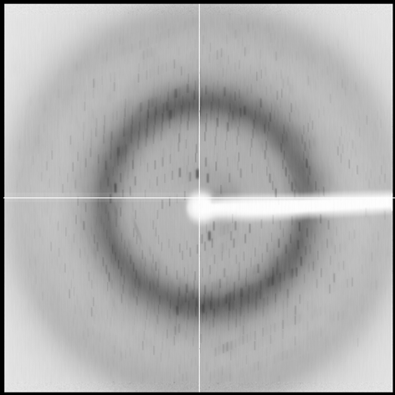
shoot nothing but the crystal

Slide 138
shoot nothing but the crystal

Slide 139
shoot nothing but the crystal

Slide 140
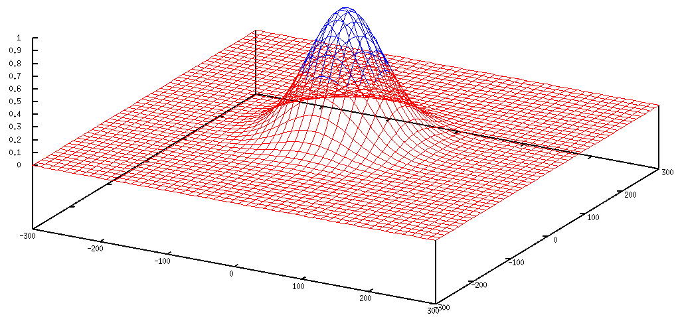
Gaussian beam
50% of flux
the other 50%

Slide 141
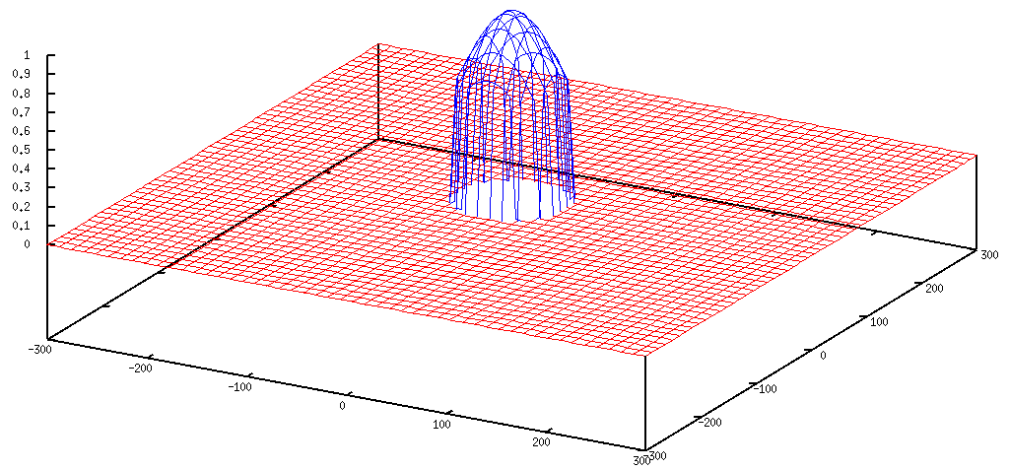
Collimated beam
100% of flux
0%

Slide 142
Tipping point for µfocus:
10 µm
~1 mrad =0.06°
~10 mm

Slide 143
scattering/absorptoin “rules”:
1 μm crystal ≈ 1 μm water
≈ 1 μm plastic
≈ 0.1 μm glass
≈ 1000 μm air
Optimum: support thickness = crystal thickness

Slide 144
Resolution (Å)
too big
too small
just right
X-ray beam size (μm)

Slide 145
Data quality - simple rules:
  Put your crystal into the beam
  Shoot the whole crystal
  Shoot nothing but the crystal
  Back off!

Slide 146
Background scattering

Slide 147
Mosquito tips cost $0.15 each
So do detector pixels!
We bought 6,224,001
Use them!
(they are reusable)

Slide 148
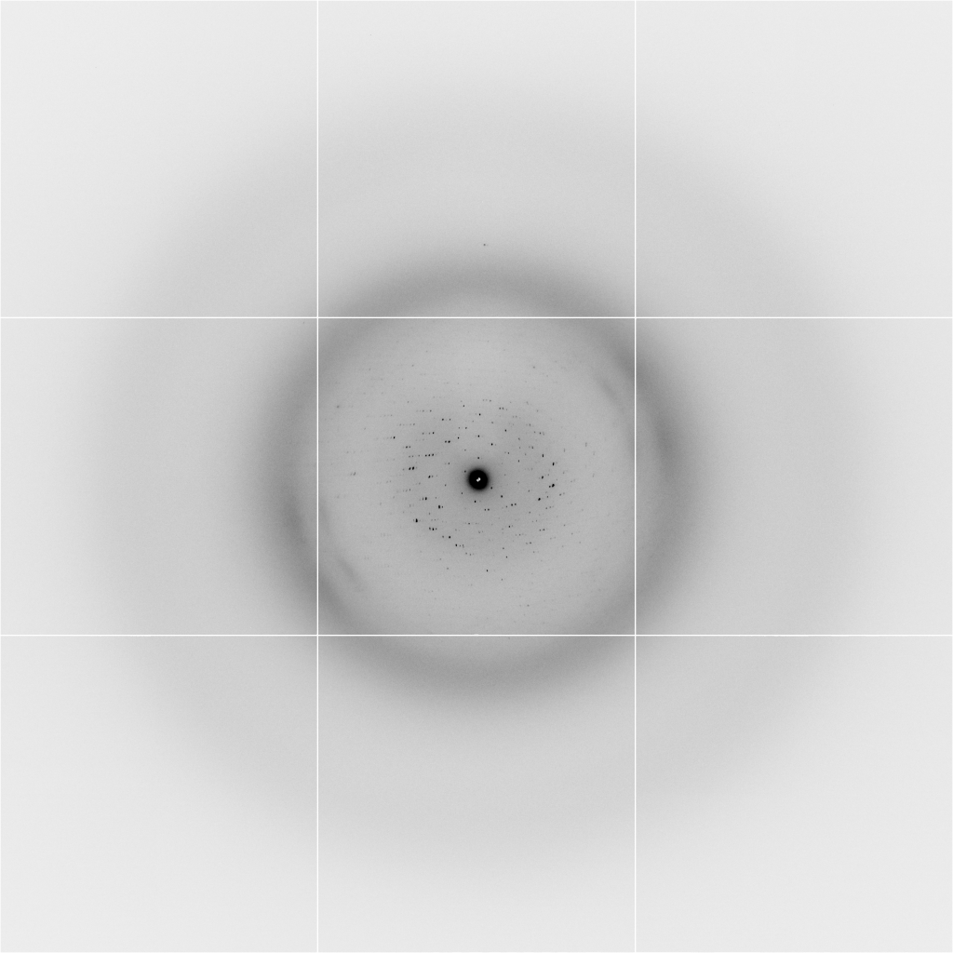
Background scattering
$100,000.00
$100,000.00
$100,000.00
real estate is
expensive
use it!
$100,000.00
$100,000.00
$100,000.00
$100,000.00
$100,000.00

Slide 149
Fine Slicing
background
background
Pflugrath, J. W. (1999)."The finer things in X-ray diffraction data collection", Acta Cryst. D 55, 1718-1725.

Slide 150

Optimal exposure time
(faint spots)
t_{hr} Optimal exposure time for data set (s)
t_{ref} exposure time of reference image (s)
bg_{ref} background level near weak spots on
reference image (ADU)
bg₀ ADC offset of detector (ADU)
bg_{hr} optimal background level (via t_{hr})
σ₀ rms read-out noise (ADU)
gain ADU/photon
m multiplicity of data set (including partials)
adjust exposure
so this is ~100

Slide 151
Optimal exposure time
(anomalous on a PAD)
2.03 ms
intensity
time

Slide 152
PAD full vs partial
Summed intensity
iteration

Slide 153
Optimal exposure time
(anomalous on a PAD)
PILATUS
>0.2 s/frame
EIGER
>0.0003 s/frame
t_{mad} Optimal exposure time (s)
t_{ro} read-out time (s)
2.03 ms on Pilatus³ S
0.95 ms on Pilatus³ X
0.003 ms on Eiger
Attenuate for MAD

Slide 154
And the dominant source of error is…
Resolution
  Disorder (including Radiation Damage)
  Background
Phases
  Non-isomorphism (including Radiation Damage)
  Vibration (beam, xtal, spindle, etc.)
  Detector calibration

Slide 155

Spatial Heterogeneity in Sharp Spot Sensitivity
~3x10⁵ photon/pixel Pilatus detector
Bragg
glitch
“tree rings”
Pick-up tool mark
oxygen
inclusions
1% high
average
1% low

Slide 156
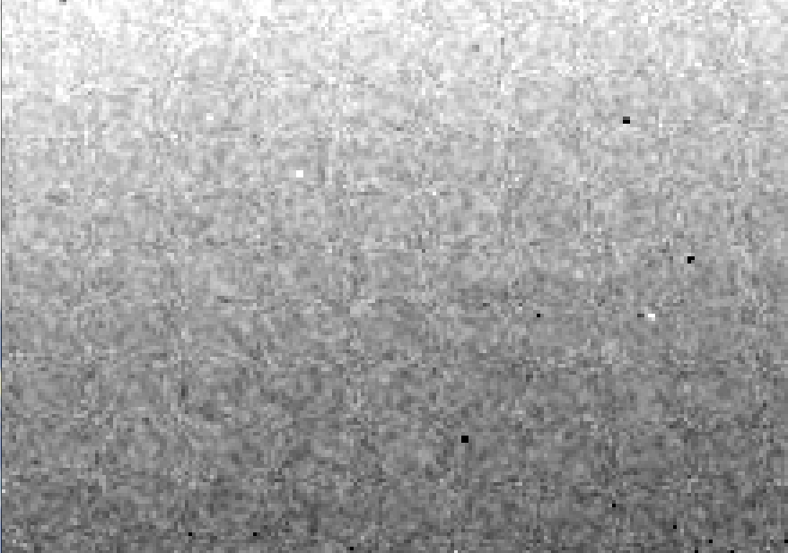
Detector calibration: 7235 eV

Slide 157
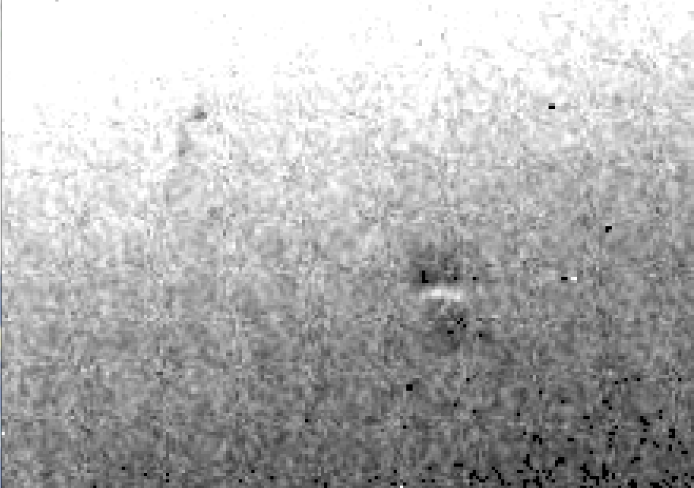
Detector calibration: 7247 eV

Slide 158
Gadox calibration vs energy
same = good!
Relative absorption depth
bad!
photon energy (keV)

Slide 159

Systematic error does not “average out”

Slide 160
Threshold of a revolution in phasing
CCD
old Pilatus
Goal
Solve-able proteins (%)
Best
Pilatus
Required signal-to-noise (I/σ)

Slide 161
Can you count to 1,000,000 ?
sqrt(1,000,000)
1,000,000
Theoretically:
= 0.1%
R_{meas} ≈ 0.1% ?
ISa = 1000
In reality:
ISa ~ 33
R_{meas =} ≈ 3%
sqrt(1,000)
1,000
= 3%
photon
spot
> 1000 is a waste!

Slide 162
Fractional error
^{mult >} (—)²
~3%
<ΔF/F>

Slide 163
anomalous signal
ΔF
F
√
# sites
MW (Da)
≈ 1.2 f”
World record!
ΔF/F = 0.5%
Wang, Dauter & Dauter (2006) Acta Cryst. D 62, 1475-1483.
Crick, F. H. C. & Magdoff, B. S. (1956) Acta Crystallogr. 9, 901-908.
Hendrickson, W. A. & Teeter, M. M. (1981) Nature 290, 107-113.

Slide 164

Holton & Frankel (2010) Acta D 66 393-408.

Slide 165
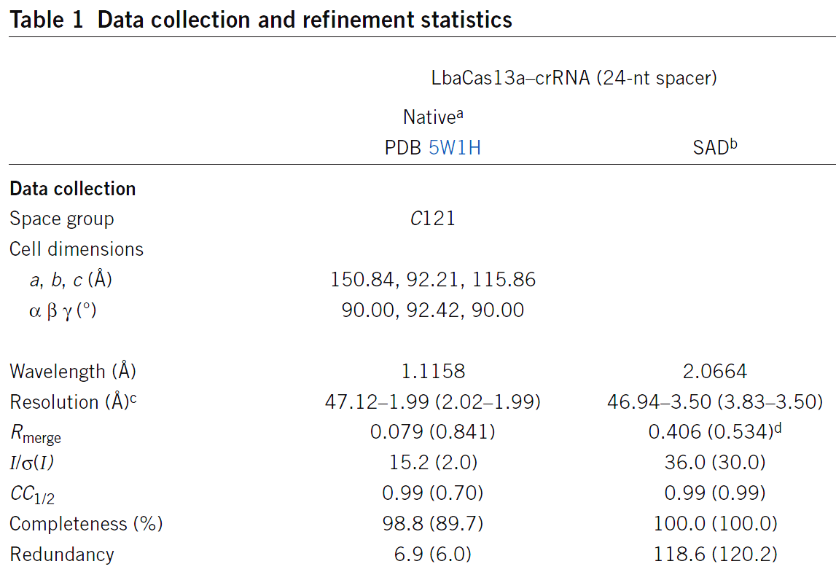
S-SAD merging 20 xtals
Knott et al. (2017). "Guide-bound CRISPR-Cas13a." Nature S&MB online

Slide 166
Systematic vs random error
intensity
observation

Slide 167
Data collection parameters:
16 crystals
360° each, inverse beam
7235 eV photon energy
< 1 MGy per xtal
Australian Synchrotron MX1
  35 kGy/s into 100 μm x 100 μm

Slide 168
140-fold multiplicity: 16 crystals, 360° each, inverse beam, 7235 eV
RESOLUTION COMPLETENESS R-FACTOR I/SIGMA R-meas CC(1/2) Anomal SigAno Nano
LIMIT OF DATA observed Corr
9.17 99.1% 3.9% 257.47 3.9% 100.0* 91* 5.024 450
6.49 100.0% 5.2% 214.33 5.2% 100.0* 86* 3.836 882
5.30 100.0% 7.2% 165.13 7.2% 100.0* 76* 3.257 1175
4.59 100.0% 7.2% 175.42 7.3% 100.0* 67* 2.589 1403
4.10 99.9% 7.7% 174.13 7.7% 100.0* 59* 2.264 1594
3.74 99.9% 9.4% 143.09 9.4% 100.0* 49* 1.953 1783
3.47 100.0% 11.2% 120.17 11.2% 100.0* 39* 1.696 1942
3.24 100.0% 14.1% 91.14 14.1% 100.0* 30* 1.333 2103
3.06 99.9% 19.5% 65.79 19.5% 100.0* 23* 1.117 2214
2.90 99.9% 29.0% 44.85 29.1% 99.9* 17* 1.008 2369
2.77 99.9% 40.5% 32.58 40.6% 99.8* 11* 0.901 2493
2.65 99.9% 52.8% 25.16 52.9% 99.8* 10* 0.866 2605
2.54 100.0% 67.4% 19.47 67.6% 99.6* 2 0.804 2705
2.45 100.0% 88.9% 14.58 89.2% 99.2* 4 0.831 2859
2.37 100.0% 109.3% 9.97 109.7% 98.1* 5 0.829 2925
2.29 100.0% 138.2% 6.87 138.9% 96.1* 1 0.760 3037
2.22 100.0% 197.1% 4.03 198.6% 83.5* -1 0.721 3159
2.16 100.0% 227.3% 2.41 230.8% 46.9* -1 0.677 3224
2.10 61.2% 154.4% 1.28 163.6% 47.0* -2 0.660 1999
2.05 47.9% 170.1% 0.68 196.5% 25.7* 3 0.629 1578
total 93.3% 15.7% 54.30 15.8% 100.0* 12* 1.217 42499

Slide 169
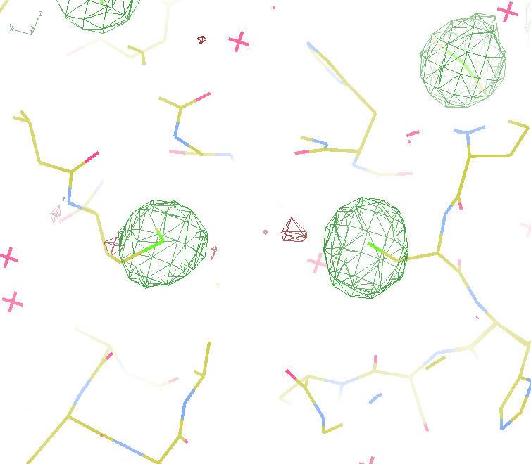
140-fold multiplicity
18 σ
16 σ
Phased anomalous difference Fourier

Slide 170
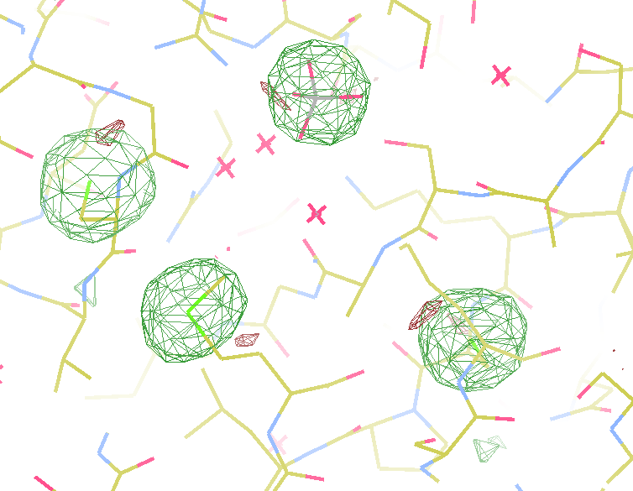
140-fold multiplicity
15σ = PO₄
Phased anomalous difference Fourier

Slide 171
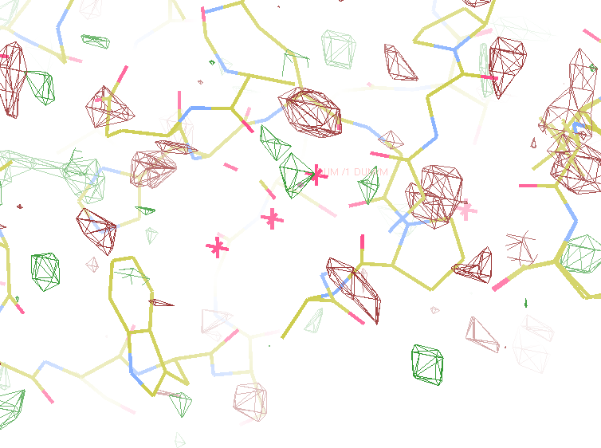
140-fold multiplicity
~2σ = Mg?
Phased anomalous difference Fourier

Slide 172
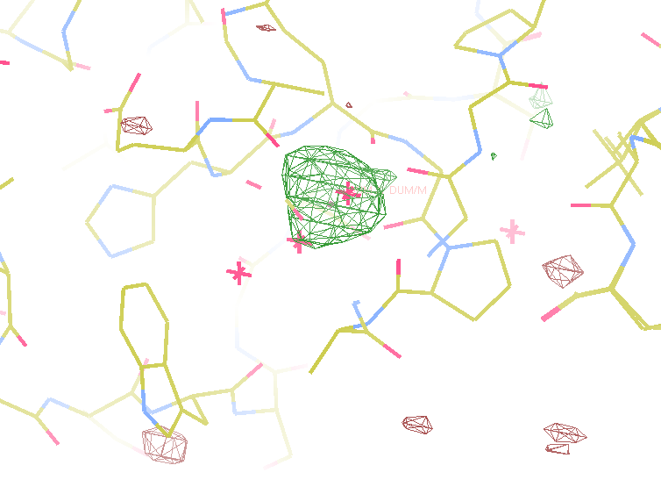
140-fold multiplicity
8.2σ = Mg?
DELFAN residual anomalous difference

Slide 173
Discerning Na⁺ from Mg⁺⁺
DELFAN peak height (σ)
N
O
F
Ne
Na
Mg
f’’ (electrons)

Slide 174
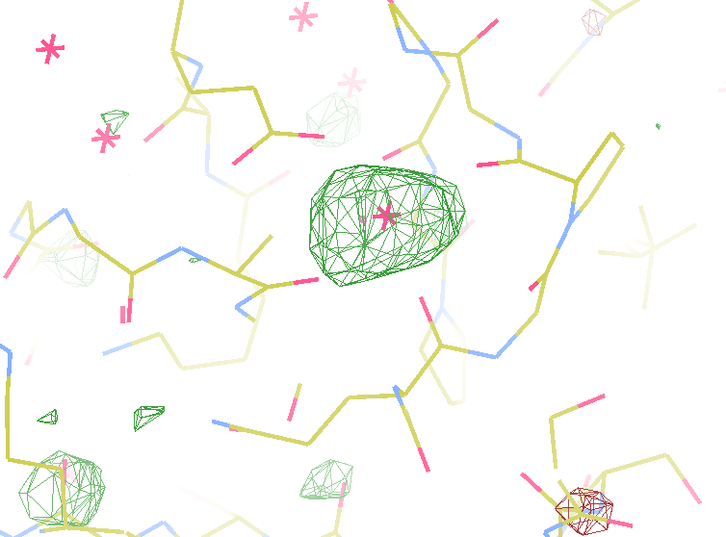
140-fold multiplicity
7.4σ = Na
DELFAN residual anomalous difference

Slide 175
XFEL Phasing success vs Figure of Merit
Adjusting:
Solvent content
Resolution
SDfac Sdadd
Cycles of dm
“mode”
“scheme”
NCS radius
NCS cycles
Phase blur
Correlation to final map
FOM from “dm”
http://cxidb.org/id54-SfjMJjaBny/id-54.html http://cxidb.org/id55-BWuBDSUrBy/id-55.html
Hunter et al. (2016)."Selenium anomalous phasing XFEL", Nature Comm. 7, 13388.

Slide 176
Data quality - simple rules:
  Put your crystal into the beam
  Shoot the whole crystal
  Shoot nothing but the crystal
  Back off!
  The crystal must rotate

Slide 177
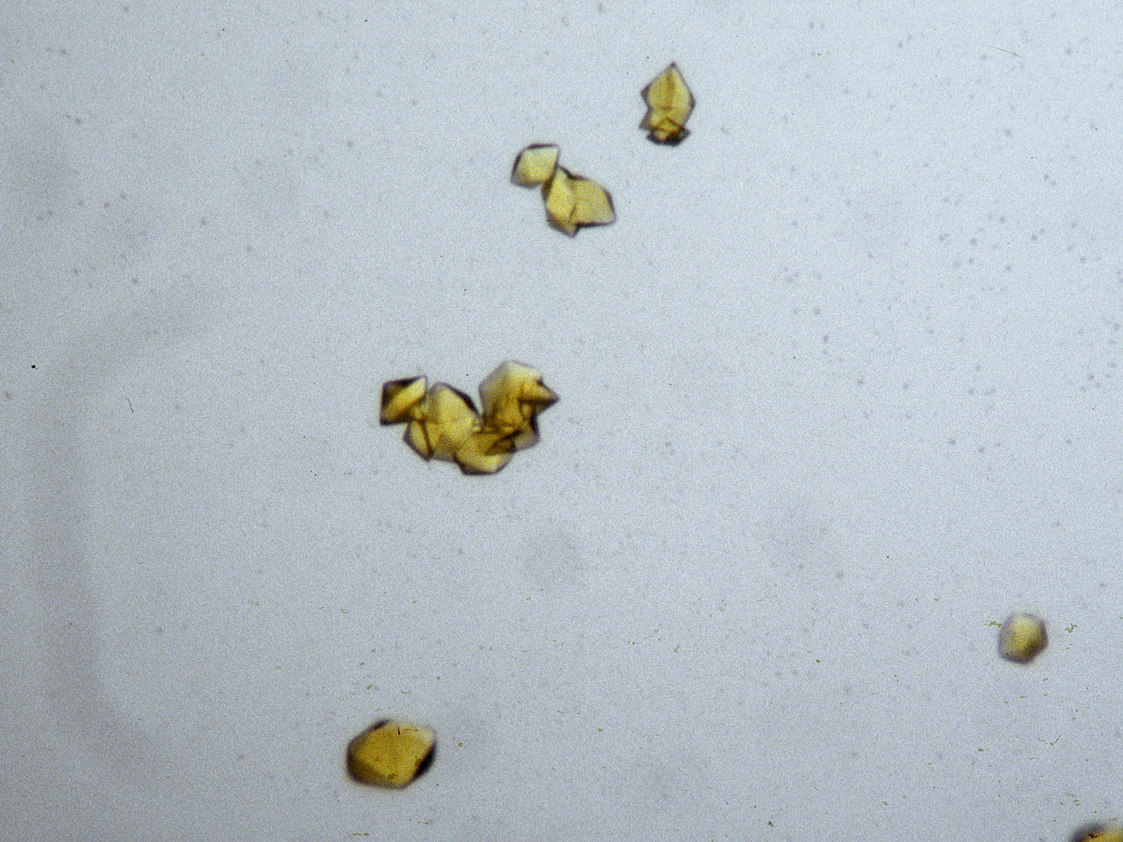
The crystal rotates!

Slide 178
The crystal rotates!
Membrane Protein Expression Center © 2012

Slide 179
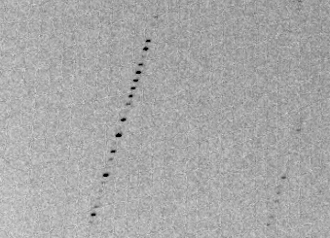
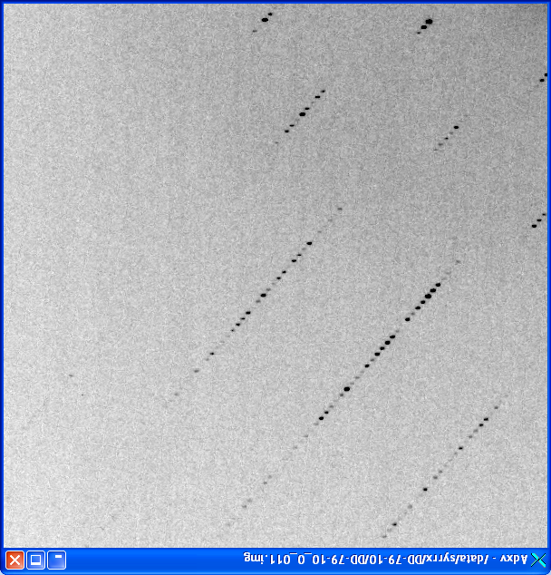
avoiding overlaps
c
c

Slide 180
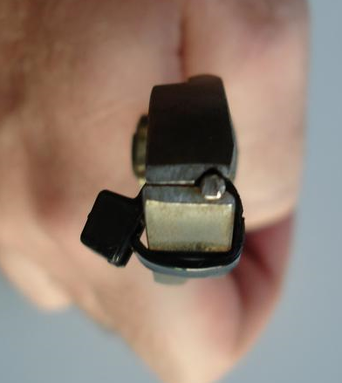
avoiding overlaps
c

Slide 181
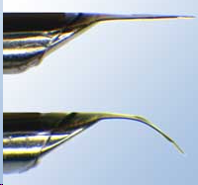

avoiding overlaps
c
http://www.mitegen.com/mic_catalog.php?c=DTMicroMounts

Slide 182
avoiding overlaps
c
http://www.mitegen.com/mic_catalog.php?c=orientedmounts

Slide 183
One xtal, no idea?
Suggested native protocol:
Do strategy
Start at specified phi
Complete fast as you can
Keep going to 360°
Move detector
Advance phi 10-30 deg
Increase photons/image 4x
goto 4

Slide 184
Adding images
% cat << EOF > MERGE2CBF.INP
NAME_TEMPLATE_OF_DATA_FRAMES= /data/you/weak_?????.cbf
DATA_RANGE= 1 10
NAME_TEMPLATE_OF_OUTPUT_FRAMES=/data/you/sum_???.cbf
NUMBER_OF_DATA_FRAMES_COVERED_BY_EACH_OUTPUT_FRAME= 10
EOF
% merge2cbf
Which is better?:
% xds_runme.com /data/you/weak_?????.cbf
% xds_runme.com /data/you/sum_?????.cbf
“lossy”
compression

Slide 185

“pretty” crystals

Slide 186

“pretty” crystals

Slide 187

“pretty” crystals

Slide 188
Summary
1 + 1 = 1.4
Match beam to “crystal”
Match goop thickness to crystal
Better beam = less time
Look at your spots!
Avoid overlaps
Crystal must rotate

Slide 189
Correct beam center
155.063 155.647
159.353 155.063
159.301 155.011
1512.73 1554.57
155.063 159.356 -250
ADXV
HKL2000
MOSFLM
XDS
DIALS

Slide 190
Where do photons go?
Protein
1A x-rays
Transmitted (98%)
beamstop

Slide 191
Elastic scattering

Slide 192
Elastic scattering

Slide 193

Where do photons go?
Protein
1A x-rays
elastic scattering (6%)
Transmitted (98%)
beamstop

Slide 194
Elastic scattering

Slide 195
Inelastic scattering

Slide 196
Where do photons go?
Protein
1A x-rays
elastic scattering (6%)
Transmitted (98%)
beamstop

Slide 197
Where do photons go?
Protein
1A x-rays
elastic scattering (6%)
Transmitted (98%)
beamstop
inelastic scattering (7%)

Slide 198
Where do photons go?
Protein
1A x-rays
elastic scattering (6%)
Transmitted (98%)
beamstop
inelastic scattering (7%)
Re-emitted (99%)
Absorbed (~0%)

Slide 199
Photoelectric absorption

Slide 200
Photoelectric absorption
e⁻
+

Slide 201
Fluorescence
+

Slide 202
Fluorescence
e⁻
+

Slide 203
Auger emission
+

Slide 204
Auger emission
e⁻
++

Slide 205
Sample atoms

Slide 206
Sample atoms

Slide 207
Primary ionization
e⁻
+

Slide 208
Secondary ionizations
e⁻
e⁻
+
e⁻
e⁻
+
+
+
+
+
e⁻
e⁻

Slide 209
Ionization track
e⁻
e⁻
e⁻
e⁻
+
e⁻
+
+
+
e⁻
e⁻
+
+
+
+
+
e⁻
+
e⁻
e⁻

Slide 210


Slide 211


Slide 212
Where do photons go?
Protein
1A x-rays
elastic scattering (6%)
Transmitted (98%)
beamstop
inelastic scattering (7%)
Re-emitted (99%)
Absorbed (~0%)

Slide 213
Where do photons go?
Protein
1A x-rays
elastic scattering (6%)
Transmitted (98%)
beamstop
inelastic scattering (7%)
Photoelectric (87%)
Re-emitted (99%)
Absorbed (~0%)

Slide 214
Where do photons go?
Protein
1A x-rays
elastic scattering (6%)
Transmitted (98%)
beamstop
inelastic scattering (7%)
Photoelectric (87%)
Re-emitted (99%)
Absorbed (~0%)
Re-emitted (~0%)
Absorbed (99%)

Slide 215
Where do photons go?
Protein
1A x-rays
elastic scattering (6%)
Transmitted (98%)
beamstop
inelastic scattering (7%)
Photoelectric (87%)
Re-emitted (99%)
Absorbed (~0%)
Re-emitted (~0%)
Absorbed (99%)
useful/absorbed energy: 7.3%

Slide 216
What do we want?
Resolution
Mosaicity
Nice, round spots
No overlaps
No twinning
Lots of crystals
…

Slide 217


Slide 218
What do we want?
Resolution
Mosaicity
Nice, round spots
No overlaps
No twinning
Lots of crystals
…
2. Phases

Slide 219

Phases
http://bl831.als.lbl.gov/~jamesh/movies/dephase.mpeg

Slide 220
And the dominant source of error is…
Resolution
  Disorder (including Radiation Damage)
  Background
Phases
  Non-isomorphism (including Radiation Damage)
  Vibration (beam, xtal, spindle, etc.)
  Detector calibration

Slide 221
What is “disorder”?

Slide 222
What is “disorder”?

Slide 223
What is “disorder”?

Slide 224

What is “disorder”?
order
order
B-factor
disorder

Slide 225
“B” factors
ATOM 122 N LEU A 13 -3.244 25.808 19.998 1.00 16.96 N
ATOM 123 CA LEU A 13 -2.877 25.448 21.355 1.00 15.29 C
ATOM 124 C LEU A 13 -2.792 23.966 21.561 1.00 17.54 C
ATOM 125 O LEU A 13 -1.814 23.493 22.143 1.00 16.35 O
ATOM 126 CB LEU A 13 -3.907 26.164 22.268 1.00 18.72 C
ATOM 127 CG LEU A 13 -3.577 25.982 23.738 1.00 21.19 C
ATOM 128 CD1 LEU A 13 -2.283 26.820 24.019 1.00 19.43 C
ATOM 129 CD2 LEU A 13 -4.702 26.474 24.639 1.00 24.65 C
ATOM 130 N SER A 14 -3.677 23.149 20.979 1.00 15.96 N
ATOM 131 CA SER A 14 -3.646 21.711 21.061 1.00 18.26 C
ATOM 132 C SER A 14 -2.373 21.203 20.360 1.00 18.71 C
ATOM 133 O SER A 14 -1.747 20.315 20.930 1.00 17.47 O
ATOM 134 CB SER A 14 -4.875 21.077 20.419 1.00 17.62 C
ATOM 135 OG ASER A 14 -4.825 19.665 20.388 0.50 20.89 O
ATOM 136 OG BSER A 14 -6.027 21.408 21.164 0.50 18.67 O
ATOM 137 N LYS A 15 -2.045 21.772 19.215 1.00 18.03 N
ATOM 138 CA LYS A 15 -0.799 21.361 18.555 1.00 18.12 C
ATOM 139 C LYS A 15 0.446 21.707 19.351 1.00 18.81 C
ATOM 140 O LYS A 15 1.400 20.948 19.411 1.00 17.77 O
ATOM 141 CB LYS A 15 -0.700 22.034 17.177 1.00 14.49 C
ATOM 142 CG LYS A 15 -1.727 21.368 16.256 1.00 16.12 C
ATOM 143 CD LYS A 15 -1.663 22.147 14.936 1.00 19.40 C
ATOM 144 CE ALYS A 15 -2.725 21.614 13.986 0.50 17.42 C
ATOM 145 CE BLYS A 15 -1.750 21.211 13.750 0.50 17.01 C
ATOM 146 NZ ALYS A 15 -2.346 21.674 12.559 0.50 18.61 N
ATOM 147 NZ BLYS A 15 -3.052 20.513 13.741 0.50 18.76 N

Slide 226


The B factor
Bragg, W. H. (1914)."XCVII. The intensity of reflexion of X rays by crystals", Philosophical Magazine Series 6 27, 881-899. Published May 1 1914

Slide 227

B factor from image analysis
B = 500

Slide 228

B factor from image analysis
B = 20

Slide 229
Bigger is better, but not by much
B = 20
B = 60
B = 0
B = 170
B = 330
B = 560
Resolution (Å)
B = 850
Crystal diameter (micron)

Slide 230
Diffraction Take-Home Lesson:
disorder
+ averaging
= poor resolution

Slide 231
What Causes Disorder?
Function
Radiation damage
Mosaicity
Strain
Xtal abuse
Dehydration

Slide 232
What Causes Disorder?
Function
Radiation damage
Mosaicity
Strain
Xtal abuse
Dehydration

Slide 233

Muybridge’s galloping horse (1878)

Slide 234

realistic “crystal” of horses

Slide 235

average structure: galloping horse

Slide 236

Ways to improve order
New crystal form
Purify
  - add a column
  - heat shock
Bind something
  - Known ligand
  - Silver bullets
Change the clone
  - chop off floppy bits
  - homolog
  - Ala -> Lys mutants
Make Protein Sit Still!!!
8000 cases in PDB of resolution improvement
80% of these are different crystal forms
> 1 Å improvement → 94% different forms
Newman J. (2006) Acta Cryst. D62 27-31.

Slide 237
What Causes Disorder?
Function
Radiation damage
Mosaicity
Strain
Xtal abuse
Dehydration

Slide 238
Types of radiation damage
Global
Specific

Slide 239
Types of radiation damage
Global
  scale factor
  B factor
  non-isomorphism
Specific
  depends on chemistry
  destroys phasing signal

Slide 240

Global damage
Howells, et al. (2009) J. Electron Spectrosc. Relat. Phenom. 170, 4-12.

Slide 241
resolution dependence of global damage
10³
100
maximum tolerable dose (MGy)
10
1
1 2 3 5 7 10 20 40 70 100
resolution (Å)
Howells et al. (2009) J. Electron. Spectrosc. Relat. Phenom. 170 4-12

Slide 242
resolution dependence of global damage
10³
10 MGy/Å
100
maximum tolerable dose (MGy)
10
1
1 2 3 5 7 10 20 40 70 100
resolution (Å)
Howells et al. (2009) J. Electron. Spectrosc. Relat. Phenom. 170 4-12

Slide 243
what the is a MGy?
1 MGy = 10⁶ J/kg
http://bl831.als.lbl.gov/
damage_rates.pdf
Holton J. M. (2009) J. Synchrotron Rad. 16 133-42

Slide 244
How long will my crystal last?
synch line type flux beamsize flux density dose max xtal min site
ph/s μm ph/μm2/s rate lifetime lifetime
APS 5ID-B POWDER 5e12 1000x300 1.7e+07 8.25 kGy/s 61 m 4 m
APS 8-BM MAD 1e11 200 2.5e+06 858 Gy/s 9.7 h 39 m
APS 14-BM-C MONO 6e11 130x200 2.3e+07 11 kGy/s 46 m 3 m
APS 14-ID-B LAUE 7e13 15x20 2.3e+11 132 MGy/s 0.23 s 0.015 s
APS 17-BM POWDER 8e11 200 2.0e+07 8.72 kGy/s 57 m 3.8 m
APS 17-ID MAD 7e11 200 1.8e+07 9.87 kGy/s 51 m 3.4 m
APS 18-ID SAXS 2e13 50x150 2.7e+09 2.69 MGy/s 11 s 0.74 s
APS 19-BM MAD 6e+08 60x50 2.0e+05 77.3 Gy/s 4.5 d 7.2 h
APS 19-ID MAD 3e+10 100x20 1.5e+07 7.81 kGy/s 64 m 4.3 m
APS 21-ID-D MAD 5e12 50 2.0e+09 1.13 MGy/s 27 s 1.8 s
APS 21-ID-F MONO 1e12 50 4.0e+08 190 kGy/s 2.6 m 11 s
APS 21-ID-G MONO 1e12 50 4.0e+08 190 kGy/s 2.6 m 11 s
APS 22-BM MAD 7e12 40x80 2.2e+09 750 kGy/s 40 s 2.7 s
APS 22-ID MAD 7e12 40x80 2.2e+09 750 kGy/s 40 s 2.7 s
APS 23-BM-B MAD 2e11 200? 5.0e+06 2.47 kGy/s 3.4 h 13 m
APS 23-ID-B MAD 6e12 80x20 3.8e+09 2.11 MGy/s 14 s 0.95 s
APS 23-ID-D MAD 1e13 75x25 5.3e+09 3.01 MGy/s 10 s 0.66 s
APS 24-ID-C MAD 2.5e12 40x60 1.0e+09 357 kGy/s 84 s 5.6 s
APS 24-ID-E MONO 2.85e12 20x120 1.2e+09 563 kGy/s 53 s 3.5 s
APS 31-ID MAD 2.6e12 120x80 2.7e+08 105 kGy/s 4.8 m 19 s
NSLS-II 17-ID-1 MAD 5e12 7x5 1.4e+11 67 MGy/s 0.45 s 0.03 s
NSLS-II 17-ID-2 MAD 2e12 1x1 1.3e+12 626 MGy/s 0.048 s 0.0032 s
NSLS X3A MAD 3.8e10 200 9.5e+05 451 Gy/s 18 h 74 m
NSLS X3B EXAFS 9e11 200x700 6.4e+06 6.48 kGy/s 77 m 5.1 m
NSLS X4A MAD 2e10 300 2.2e+05 136 Gy/s 61 h 4.1 h
NSLS X6A MAD 1.5e12 100x500 3.0e+07 10.3 kGy/s 49 m 3.2 m
NSLS X8C MAD 1.1e10 200? 2.8e+05 204 Gy/s 41 h 2.7 h

Slide 245


Slide 246

Holton & Frankel (2010) Acta D 66 393-408.

Slide 247


Multi-crystal strategies
Kendrew et al. (1960) "Structure of Myoglobin” Nature 185, 422-427.

Slide 248

Specific damage
final, refined phases

Slide 249

Specific damage
experimentally-obtained phases

Slide 250
Holton, J. M. (2007) J. Synch. Rad. 14, 51-72.

Slide 251
1.0
fraction
unconverted
0.0
Holton, J. M. (2007) J. Synch. Rad. 14, 51-72.

Slide 252
MGy reaction reference
~45 global damage Owen et al. (2006)
10/Å global damage Howells et al. (2009)
5 Se-Met Holton (2007)
4 Hg-S Ramagopal et al. (2004)
4 R-C-COOH Garman et al. (2015)
3 S-S Murray et al. (2002)
1 Br-RNA Olieric et al. (2007)
~1? Cl-C ???
0.5 Mn in PS II Yano et al. (2005)
0.06 putidaredoxin Corbett et al. (2007)
0.02 Fe in myoglobin Denisov et al. (2007)
Radiation Damage World Records
Holton (2009) J. Synchrotron Rad. 16 133-42

Slide 253
Life-halving concentration
molar, at the Se edge based on RADDOSE
Na | 44
Mg | 27
P | 9
S | 7
Cl | 5
K | 3.3
Ca | 2.7
Fe | 1.0
Cu | 0.67
Zn | 0.58
As | 0.44
Se | 0.42
Br | 2.9
I | 0.47
Gd | 0.21
Ta | 0.13
Pt | 0.17
Au | 0.16
Hg | 0.16
U | 0.23

Slide 254
Life-halving concentration
molar, at the Se edge based on RADDOSE
Na | 44
Mg | 27
P | 9
S | 7
Cl | 5
K | 3.3
Ca | 2.7
Fe | 1.0
Cu | 0.67
Zn | 0.58
As | 0.44
Se | 0.42
Br | 2.9
I | 0.47
Gd | 0.21
Ta | 0.13
Pt | 0.17
Au | 0.16
Hg | 0.16
U | 0.23

Slide 255

No Damage in the Dark!
4.6 5.0 5.4 5.8 6.2 6.6
Peak absorbance (electrons)
0 5 10 15 20 25
Experiment time (hours)

Slide 256
Self-calibrated damage limit
Where:
⟨I⟩_{DL} - average damage-limited intensity (photons/hkl) at a given resolution
10⁵ - converting R from μm to m, r_{e} from m to Å, ρ from g/cm³ to kg/m³ and MGy to Gy
r_{e} - classical electron radius (2.818 x 10⁻¹⁵ m/electron)
h - Planck’s constant (6.626 x 10⁻³⁴ J∙s)
c - speed of light (299792458 m/s)
f_{decayed} - fractional progress toward completely faded spots at end of data set
ρ - density of crystal (~1.2 g/cm³)
R - radius of the spherical crystal (μm)
λ - X-ray wavelength (Å)
f_{NH} - the Nave & Hill (2005) dose capture fraction (1 for large crystals)
n_{ASU} - number of proteins in the asymmetric unit
M_{r} - molecular weight of the protein (Daltons or g/mol)
V_{M} - Matthews’s coefficient (~2.4 Å³/Dalton)
H - Howells’s criterion (10 MGy/Å)
θ - Bragg angle
⟨ƒ_{a}²⟩ - number-averaged squared structure factor per protein atom (electron²)
⟨M_{a}⟩ - number-averaged atomic weight of a protein atom (~7.1 Daltons)
B - average (Wilson) temperature factor (Å²)
μ - attenuation coefficient of sphere material (m⁻¹)
μ_{en} - mass energy-absorption coefficient of sphere material (m⁻¹)
No flux
No symmetry
No exposure time
Holton & Frankel (2010) Acta D 66 393-408.

Slide 257
The number of photons scattered
before crystal is dead
is independent
of flux & time
1 um³ = 10⁵ photons (roomT)
1 um³ = 10⁶ photons (synch)
1 um³ = 10⁸ photons (XFEL)
(synch)
Henderson, 1990; Gonzalez & Nave, 1994; Glaeser et al., 2000; Sliz et al., 2003; Leiros et al., 2006; Owen et al., 2006; Garman & McSweeney, 2006; Garman & Nave, 2009; Holton, 2009

Slide 258

Dose slicing
unacceptable
completeness
N
photons
crystal’s useful life
N
photons
unacceptable
read noise
N
photons

Slide 259

X-ray data are 3D!

Slide 260

Data collection “strategy”
The “American Method”:
360° no matter what
(shoot first, questions later)
Dauter, Z. (1999). "Data-collection strategies." Acta Cryst. D 55(10): 1703-1717.

Slide 261

Dose slicing: is that a spot?

Slide 262

Dose slicing: is that a spot?

Slide 263

Dose slicing: is that a spot?

Slide 264

Dose slicing: is that a spot?

Slide 265
Dose slicing: is that a spot?

Slide 266

Dose slicing: is that a spot?

Slide 267
What if?
You only have a few small crystals…
Should you:
  Collect 360° from each?
  Collect 10° from each at 36x exposure?
  Glue 36 xtals together, then collect 360° ?
  Glue, and do 12960° faint exposures?

Slide 268
“true” resolution limit
CC vs right answer
Resolution (Å)

Slide 269
“true” resolution vs strategy
Dose slice collection scenario
fine | coarse | glue | Glue & fine
3.17700 | 3.14057 | 3.17604 | 3.12086
301,640,334 photons/xtal

Slide 270
processing procedure | resolution limit
 | fine | coarse | glue | glue&fine
XDS/XSCALE | 3.17700 | 3.14057 | 3.17604 | 3.12086
XDS/aimless | 3.16251 | 3.15922 | 3.16675 | 3.12162
XDS/noscale | 3.27289 | 3.15617 | 3.38929 | 3.12162
MOSFLM-defaults | x | x | x | x
MOSFLM-cheat | 3.19755 | 3.18166 | 3.20354 | 3.19755
HKL2000-defaults | x | x | x | x
HKL2000-expert | 3.21803 | 3.12646 | 3.11551 | 3.21803
HKL2000-cheat | 3.16119 | 3.10338 | 3.10338 | 3.16300
DIALS-defaults | x | x | 3.42125 | x
DIALS-expert | 3.10296 | 3.09547 | 3.07653 | 3.08465
d*Trek | ? | ? | 4.34076 | ?
EVAL15 | 3.14352 | 3.10383 | 3.09936 | 3.14105
EVAL15-sadabs | 3.13920 | 3.10797 | 3.10171 | 3.13700

Slide 271
Minimum exposure time:
~1 photon/pixel
  PAD w XDS, DIALS
~10 photon/pixel
PAD w HKL2k, MOSFLM
~30 photon/pixel
CCD detector

Slide 272
Optimal exposure time
(faint spots on CCD or IP)
t_{hr} Optimal exposure time for data set (s)
t_{ref} exposure time of reference image (s)
bg_{ref} background level near weak spots on
reference image (ADU)
bg₀ ADC offset of detector (ADU)
bg_{hr} optimal background level (via t_{hr})
σ₀ rms read-out noise (ADU)
gain ADU/photon
m multiplicity of data set (including partials)
adjust exposure
so this is ~15

Slide 273
What Causes Disorder?
Function
Radiation damage
Mosaicity
Strain
Xtal abuse
Dehydration

Slide 274
mosaic spread = 0 º

Slide 275
mosaic spread = 0.1º

Slide 276
mosaic spread = 0.2º

Slide 277
mosaic spread = 0.4º

Slide 278
mosaic spread = 0.6º

Slide 279
mosaic spread = 0.8º

Slide 280
mosaic spread = 1.0º

Slide 281
mosaic spread = 1.5º

Slide 282
mosaic spread = 2.0º

Slide 283
mosaic spread = 2.5º

Slide 284
mosaic spread = 3.2º

Slide 285
mosaic spread = 6.4º

Slide 286
mosaic spread = 12.8º

Slide 287
What Causes Disorder?
Function
Radiation damage
Mosaicity
Strain
Xtal abuse
Dehydration

Slide 288
stress and strain
What about
undamaged crystals?
radiation damage = defects

Slide 289
Purity is crucial!
important for
resolution
McPherson, A., Malkin, A. J., Kuznetsov, Y. G. & Plomp, M. (2001)."Atomic force microscopy applications in macromolecular crystallography", Acta Cryst. D 57, 1053-1060.
not important for
initial hits

Slide 290
What can I improve?
Purity!
is 95% good enough? 99%?
Purity!
conformational (homogeneous)
Purity!
kinetic (stable over time)

Slide 291
What Causes Disorder?
Function
Radiation damage
Mosaicity (η) > ~3 μm
Strain (B) < ~3 μm
Xtal abuse
Dehydration

Slide 292
What Causes Disorder?
Function
Radiation damage
Mosaicity > ~3 μm
Strain < ~3 μm
Xtal abuse
Dehydration

Slide 293
Xtal Abuse
physical contact
don’t touch the part you intend to shoot
osmotic shock
equilibrate, or calculate matching solution
changes in dielectric constant
Petsko (1975) J. Mol. Biol. 96, 381-388.
cooled density mismatch
Juers & Matthews (2004) Acta Cryst. D 60, 412-421.
basically: no sudden moves!

Slide 294
What Causes Disorder?
Function
Radiation damage
Mosaicity > ~3 μm
Strain < ~3 μm
Xtal abuse
Dehydration

Slide 295
opened drop: you have ~30 seconds!
equilibrated drop

Slide 296
OK! OK!
Now I am afraid!
What should I do?

Slide 297
Basic Principles
“Hell, there are NO RULES here - we're trying to accomplish something.”
Thomas A. Edison – inventor
“You’ve got to have an ASSAY.”
Arthur Kornberg – Nobel Laureate
“Control, control, you must learn CONTROL!”
Yoda – Jedi Master

Slide 298

The Best Assay

Slide 299
And the dominant source of error is…
Resolution
  Disorder (including Radiation Damage)
  Background
Phases
  Non-isomorphism (including Radiation Damage)
  Vibration (beam, xtal, spindle, etc.)
  Detector calibration

Slide 300
Native Summary
http://bl831.als.lbl.gov/xtalsize.html
http://bl831.als.lbl.gov/xtallife.html
http://bl831.als.lbl.gov/~jamesh/powerpoint/Uruguay_dtacoll_2017.pptx
100 ADU/pixel
10 μm for lysozyme
Do “strategy”
Follow by “American Method”
“Attenu-wait”: dose slicing
Assay, control and open mind

Slide 301
And the dominant source of error is…
Resolution
  Disorder (including Radiation Damage)
  Background
Phases
  Non-isomorphism (including Radiation Damage)
  Vibration (beam, xtal, spindle, etc.)
  Detector calibration

Slide 302
anomalous signal
ΔF
F
√
# sites
MW (Da)
≈ 1.2 f”
World record!
ΔF/F = 0.5%
Wang, Dauter & Dauter (2006) Acta Cryst. D 62, 1475-1483.
Crick, F. H. C. & Magdoff, B. S. (1956) Acta Crystallogr. 9, 901-908.
Hendrickson, W. A. & Teeter, M. M. (1981) Nature 290, 107-113.

Slide 303
R_{iso} vs dose
R_{iso} (%)
change in dose (MGy)
data taken from Banumathi, et al. (2004) Acta Cryst. D 60, 1085-1093.

Slide 304
R_{iso} vs dose
R_{iso} ≈ 0.7 %/MGy
R_{iso} (%)
change in dose (MGy)
data taken from Banumathi, et al. (2004) Acta Cryst. D 60, 1085-1093.

Slide 305



First diffraction from protein xtal
1934
Bernal, J. & Crowfoot, D. (1934). "X-ray photographs of crystalline pepsin", Nature 133, 794-795.

Slide 306
Dehydration: 1934
and 2017?
= 1.5 μL
100 μm
= 1.0 nL
2 mm
= 1.0 pL
10 μm
= 1.0 fL
1 μm

Slide 307
Non-isomorphism in lysozyme
Dear James
The story of the two forms of lysozyme crystals goes back to about 1964 when it was found that the diffraction patterns from different crystals could be placed in one of two classes depending on their intensities. This discovery was a big set back at the time and I can remember a lecture title being changed from the 'The structure of lysozyme' to 'The structure of lysozyme two steps forward and one step back'. Thereafter the crystals were screened based on intensities of the (11,11,l) rows to distinguish them (e.g. 11,11,4 > 11,11,5 in one form and vice versa in another). Data were collected only for those that fulfilled the Type II criteria. (These reflections were easy to measure on the linear diffractometer because crystals were mounted to rotate about the diagonal axis). As I recall both Type I and Type II could be found in the same crystallisation batch . Although sometimes the external morphology allowed recognition this was not infallible.
The structure was based on Type II crystals. Later a graduate student Helen Handoll examined Type I. The work, which was in the early days and before refinement programmes, seemed to suggest that the differences lay in the arrangement of water or chloride molecules (Lysozyme was crystallised from NaCl). But the work was never written up. Keith Wilson at one stage was following this up as lysozyme was being used to test data collection strategies but I do not know the outcome.
An account of this is given in International Table Volume F (Rossmann and Arnold edited 2001) p760.
Tony North was much involved in sorting this out and if you wanted more info he would be the person to contact. I hope this is helpful. Do let me know if you need more.
Best wishes
Louise

Slide 308
Non-isomorphism in lysozyme
Structure factor (e⁻)
Johnson’s ratio

Slide 309
Non-isomorphism in lysozyme
Structure factor (e⁻)
Johnson’s ratio

Slide 310


Slide 311

Non-isomorphism in lysozyme
RMSD = 1.70 Å
Δcell = 0.7 %
R_{iso} = 44.5%
RMSD = 0.18 Å
3aw6
3aw7
RH: 84.2%
vs 71.9%

Slide 312

Same structure, different cell
0.5% cell change → 15%
Crick & Magdoff (1956) “theory method isomorphous replacement”, Acta Cryst. 9, 901-8.

Slide 313
Same structure, different cell
0.5% cell change → 15%
Crick & Magdoff (1956) “theory method isomorphous replacement”, Acta Cryst. 9, 901-8.

Slide 314
Same cell, rotated protein
0.5° rotation → 16%
Crick & Magdoff (1956) “theory method isomorphous replacement”, Acta Cryst. 9, 901-8.

Slide 315
Same cell, rotated protein
0.5° rotation → 16%
Crick & Magdoff (1956) “theory method isomorphous replacement”, Acta Cryst. 9, 901-8.

Slide 316
Uniform stretch
5% change → 0%

Slide 317
Uniform stretch
5% change → 0%

Slide 318


Magdoff & Crick (1955) “Ribonuclease II. Accuracy of measurement and shrinkage”, Acta Cryst. 8, 461-8.
Crick & Magdoff (1956) “The theory of the method of isomorphous replacement for protein crystals”, Acta Cryst. 9, 901-8.

Slide 319
Elastic deformation
= non-isomorphism

Slide 320
Elastic deformation
= non-isomorphism

Slide 321
Plastic deformation
= poor diffraction

Slide 322
Plastic deformation
= poor diffraction

Slide 323
… but does it work for membrane proteins?
CCP4BB:
“We used it for a large membrane protein complex and diffraction improved from ~7 to 2.7 A. The crystal is fished out and put into mother liquor solution in the button, sealed with dialysis membrane and the button is then placed into about 5 mls of mother liquor with slightly higher PEG concentration. Then you just exchange outside buffer every day or so for solutions containing higher concentrations of PEG. We went from ~9 to 30 % PEG4000 in about a week. You can easily observe crystal under microscope and if it cracks - you went too far/too quickly with PEG and need to use a bit less next time. Also, this method allows you to control all other components of the dehydrating solution - we needed to decrease salt concentration at the same time as increasing PEG. You can also introduce/increase cryo-protectant concentration at the same time. With these crystals, otherwise excellent dehydration machines already mentioned did not work, possibly because the process had to be really slow.”
Efremov, R. G. & Sazanov, L. A. (2011)."Structure of the membrane domain of respiratory complex I", Nature 476, 414-420.
“To improve diffraction properties, crystals were slowly cooled to 4 C, placed into micro-dialysis buttons, and mother liquor was exchanged by dialysis for 0.1 M sodium acetate (pH 4.8), 0.15 M sodium tartrate (pH 5.0), 30% PEG4000, 0.1% sodium cholate and 12.5% glycerol over a period of 5 days.”

Slide 324
And the dominant source of error is…
Resolution
  Disorder (including Radiation Damage)
  Background
Phases
  Non-isomorphism (including Radiation Damage)
  Vibration (beam, xtal, spindle, etc.)
  Detector calibration

Slide 325
Phasing Summary
http://bl831.als.lbl.gov/xtalsize.html
http://bl831.als.lbl.gov/xtallife.html
http://bl831.als.lbl.gov/~jamesh/powerpoint/Uruguay_datacoll_2017.pptx
~3% error per spot, 1%/MGy
7235 eV for S-SAD
Multiplicity multiplicity multiplicity
“Attenu-wait”: dose slicing
>1000 photons/spot is a waste

Slide 326
But my reviewer says…
R_{merge} in high-resolution bin is >100% !
Answer: this is expected

Slide 327
Expected R_{merge} as I_{obs} → 0

Slide 328
Averaging Gaussian error
Average value
Number of samples averaged

Slide 329
Averaging Gauss/Gauss error
Average value
Number of samples averaged

Slide 330
R_{merge} at the resolution limit in PDB
Average outer-shell R_{merge}
Year

Slide 331
Take-home lesson:
R factors are
undefined
as I_{obs} → 0
Report as “ – “ in outer bin

Slide 332

Re-indexing cheat sheet
Dauter, Z. (1999). "Data-collection strategies." Acta Cryst. D 55(10): 1703-1717.

Slide 333
CCP4: aimless log
$TABLE: Analysis against resolution, XDSdataset:
$GRAPHS:I/sigma, Mean Mn(I)/sd(Mn(I)):0|0.216023x0|137.14:2,13,14:
:Rmerge, Rfull, Rmeas, Rpim v Resolution:0|0.216023x0|1.70834:2,4,5,6,7:
:Average I, RMSdeviation and Sd:0|0.216023x0|1650.8:2,10,11,12:
:Fractional bias:0|0.216023x0|0:2,15:
$$
N 1/d^2 Dmid Rmrg Rfull Rcum Rmeas Rpim Nmeas AvI RMSdev sd I/RMS Mn(I/sd) FrcBias $$ $$
1 0.0064 12.55 0.020 0.020 0.020 0.021 0.006 13115 1651 57 42 29.2 137.1 -
2 0.0191 7.24 0.027 0.027 0.024 0.028 0.008 24753 1171 47 42 25.0 105.2 -
3 0.0318 5.61 0.038 0.038 0.029 0.040 0.012 32197 857 46 43 18.4 79.6 -
4 0.0445 4.74 0.034 0.034 0.031 0.035 0.010 37743 1212 57 53 21.4 91.2 -
5 0.0572 4.18 0.036 0.036 0.032 0.038 0.011 42642 1181 59 57 19.9 83.8 -
6 0.0699 3.78 0.049 0.049 0.036 0.052 0.015 47224 883 59 57 15.1 65.1 -
7 0.0826 3.48 0.065 0.065 0.040 0.068 0.020 51052 685 59 58 11.7 50.9 -
8 0.0953 3.24 0.096 0.096 0.045 0.100 0.029 54636 448 56 56 8.0 35.0 -
9 0.1080 3.04 0.151 0.151 0.050 0.158 0.046 58072 268 53 53 5.1 22.7 -
10 0.1207 2.88 0.229 0.229 0.056 0.240 0.070 60731 171 51 51 3.3 15.4 -
11 0.1334 2.74 0.314 0.314 0.063 0.329 0.097 63807 125 51 51 2.4 11.3 -
12 0.1461 2.62 0.406 0.406 0.070 0.425 0.125 66241 98 51 52 1.9 8.7 -
13 0.1588 2.51 0.537 0.537 0.078 0.562 0.166 68272 76 53 53 1.4 6.5 -
14 0.1715 2.41 0.685 0.685 0.084 0.727 0.237 54170 61 53 54 1.1 4.4 -
15 0.1843 2.33 0.886 0.886 0.088 0.950 0.333 39781 48 55 56 0.9 3.1 -
16 0.1970 2.25 1.249 1.249 0.092 1.355 0.508 29754 35 57 59 0.6 2.1 -

Slide 334
CCP4: aimless log
$TABLE: Correlations CC(1/2) within dataset, XDSdataset:
$GRAPHS: Anom & Imean CCs v resolution:0|0.216023x0|1:2,4,7:
: RMS correlation ratio :0|0.216023x0|2.20344:2,6:
$$
N 1/d^2 Dmid CCanom Nanom RCRanom CC1/2 NImean $$ $$
1 0.0064 12.55 0.659 499 2.203 1.000 669
2 0.0191 7.24 0.550 975 1.853 1.000 1155
3 0.0318 5.61 0.527 1295 1.798 1.000 1479
16 0.1970 2.25 0.037 2123 1.038 0.711 2275
17 0.2097 2.18 0.043 1682 1.044 0.460 1877

Slide 335
XDS: CORRECT.LP or XSCALE.LP
SUBSET OF INTENSITY DATA WITH SIGNAL/NOISE >= -3.0 AS FUNCTION OF RESOLUTION
RESOLUTION NUMBER OF REFLECTIONS COMPLETENESS R-FACTOR R-FACTOR COMPARED I/SIGMA R-meas CC(1/2) Anomal SigAno Nano
LIMIT OBSERVED UNIQUE POSSIBLE OF DATA observed expected Corr
6.39 4103 2517 3135 80.3% 1.7% 1.8% 3018 33.77 2.3% 99.9* 21* 1.012 533
4.54 7339 4970 5544 89.6% 2.6% 2.6% 4585 22.56 3.6% 99.8* 9 0.914 796
3.72 9442 6724 7186 93.6% 2.8% 2.9% 5327 19.99 4.0% 99.7* 9 0.859 877
3.22 11077 7997 8486 94.2% 4.8% 4.9% 6094 12.27 6.8% 99.3* -1 0.784 913
2.88 12408 8851 9595 92.2% 10.0% 10.1% 7068 6.01 14.2% 97.8* -2 0.799 1012
2.63 13673 9561 10662 89.7% 20.8% 20.8% 8185 3.10 29.4% 88.8* -4 0.776 1274
2.44 14360 9852 11510 85.6% 34.5% 34.7% 8981 1.90 48.8% 75.9* 2 0.765 1525
2.28 9501 6495 12416 52.3% 61.8% 59.6% 5991 1.14 87.3% 53.5* -2 0.722 1031
2.15 4567 3307 13210 25.0% 120.5% 120.3% 2520 0.59 170.4% 21.9* 4 0.693 408
total 86470 60274 81744 73.7% 6.7% 6.7% 51769 8.97 9.5% 99.5* 2 0.804 8369

Slide 336
XDS: CORRECT.LP or XSCALE.LP
******************************************************************************
CORRECTION PARAMETERS FOR THE STANDARD ERROR OF REFLECTION INTENSITIES
******************************************************************************
The variance v0(I) of the intensity I obtained from counting statistics is
replaced by v(I)=a*(v0(I)+b*I^2). The model parameters a, b are chosen to
minimize the discrepancies between v(I) and the variance estimated from
sample statistics of symmetry related reflections. This model implicates
an asymptotic limit ISa=1/SQRT(a*b) for the highest I/Sigma(I) that the
experimental setup can produce (Diederichs (2010) Acta Cryst D66, 733-740).
a b ISa
3.806E+00 1.080E-04 49.32

Slide 337
Hygrostatic gradients
high
water activity
low
loop

Slide 338

Relative Pixel
Calibration
ALS 8.3.1
Pilatus3 6M
0.9793 Å x-rays
RMS = 0.8%
1% high
average
1% low

