Slide 1
And the dominant source of error is…
Resolution
Disorder (including Radiation Damage)
Background
Phases
Non-isomorphism (including Radiation Damage)
Vibration (beam, xtal, spindle, etc.)
Detector calibration

Slide 2
One xtal, no idea? Suggested anomalous protocol:
360° in < 5 MGy
move detector
4X exposure
goto 2
Se-Met
2 wavelengths are better than 1
- (peak + inf)/2, and remote
MAD, not M-SAD!
Wedge size: < 10% overhead

Slide 3
Bijvoet And Dispersive Anomalous Scattering
Halfway between
Inflection + peak
300 eV
higher

Slide 4
R_{iso} vs dose
R_{iso} (%)
change in dose (MGy)
data taken from Banumathi, et al. (2004) Acta Cryst. D 60, 1085-1093.

Slide 5
R_{iso} vs dose
R_{iso} ≈ 0.7 %/MGy
R_{iso} (%)
change in dose (MGy)
data taken from Banumathi, et al. (2004) Acta Cryst. D 60, 1085-1093.

Slide 6
anomalous signal
ΔF
F
√
# sites
MW (Da)
≈ 1.2 f”
World record!
ΔF/F = 0.5%
Wang, Dauter & Dauter (2006) Acta Cryst. D 62, 1475-1483.
Crick, F. H. C. & Magdoff, B. S. (1956) Acta Crystallogr. 9, 901-908.
Hendrickson, W. A. & Teeter, M. M. (1981) Nature 290, 107-113.

Slide 7
And the dominant source of error is…
Resolution
Disorder (including Radiation Damage)
Background
Phases
Non-isomorphism (including Radiation Damage)
Vibration (beam, xtal, spindle, etc.)
Detector calibration

Slide 8
Beam Flicker
pinhole
removed
normalized flux through pinhole
time (seconds)

Slide 9
Shutter Jitter
open
closed
shutter jitter

Slide 10
Optimal exposure time (anomalous on a PAD)
2.03 ms
intensity
time

Slide 11
PAD full vs partial
Summed intensity
iteration

Slide 12
Optimal exposure time (anomalous on a PAD)
PILATUS
>0.2 s/frame
EIGER
>0.0003 s/frame
t_{mad} Optimal exposure time (s)
t_{ro} read-out time (s)
2.03 ms on Pilatus³ S
0.95 ms on Pilatus³ X
0.003 ms on Eiger
= 20,000 frames
350 GB/dataset
Attenuate for MAD

Slide 13
And the dominant source of error is…
Resolution
Disorder (including Radiation Damage)
Background
Phases
Non-isomorphism (including Radiation Damage)
Vibration (beam, xtal, spindle, etc.)
Detector calibration

Slide 14
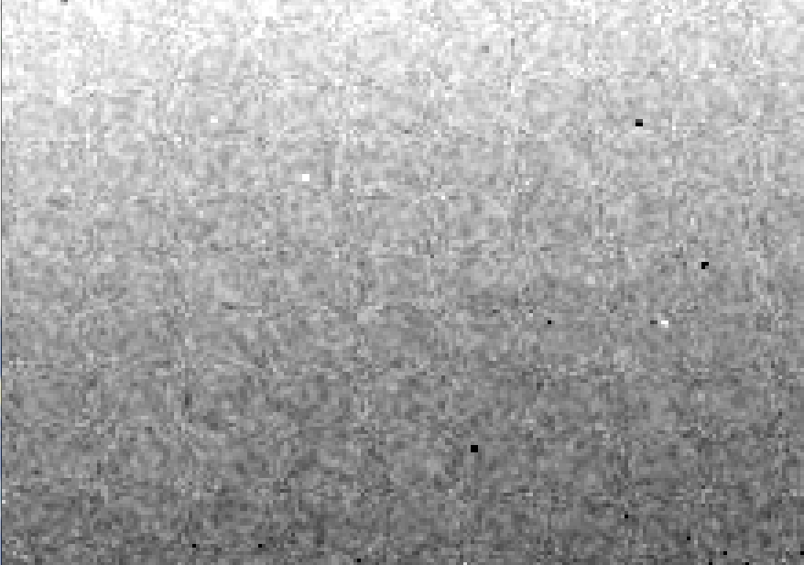
Detector calibration: 7235 eV

Slide 15
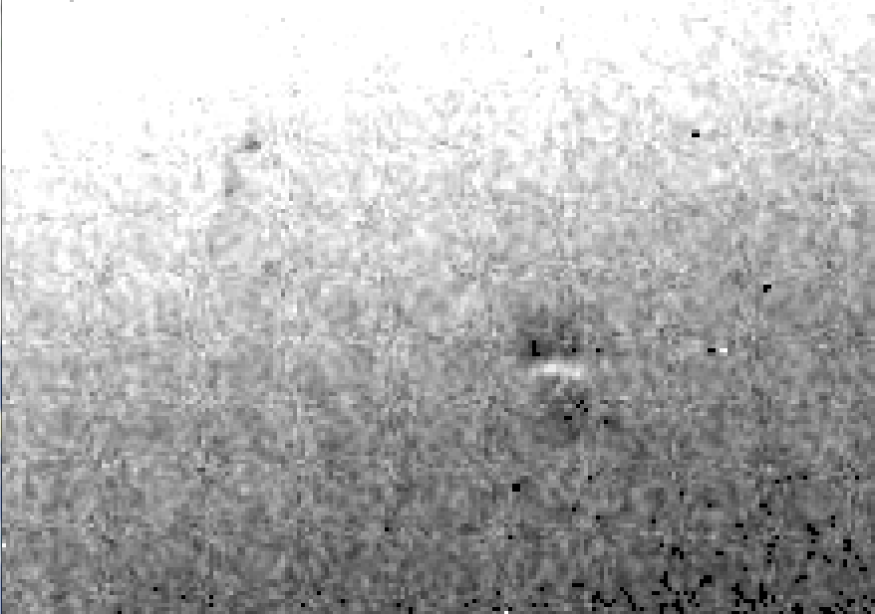
Detector calibration: 7247 eV

Slide 16
Gadox calibration vs energy
same = good!
Relative absorption depth
bad!
photon energy (keV)

Slide 17
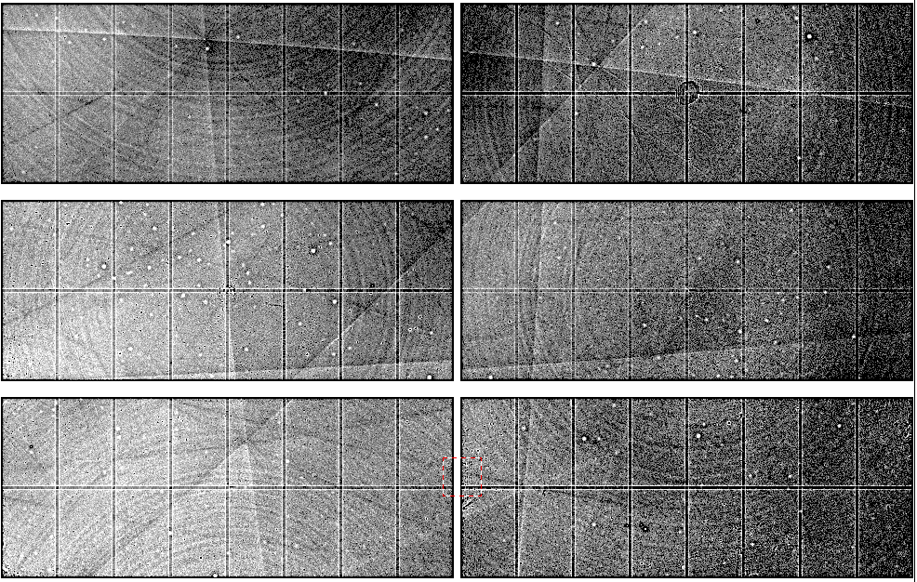
Spatial Heterogeneity in Sharp Spot Sensitivity
~3x10⁵ photon/pixel Pilatus detector
Bragg
glitch
“tree rings”
Pick-up tool mark
oxygen
inclusions
1% high
average
1% low

Slide 18
Systematic error does not “average out”

Slide 19
Threshold of a revolution in phasing
CCD
old Pilatus
Goal
Solve-able proteins (%)
Best
Pilatus
Required signal-to-noise (I/σ)

Slide 20
Fractional error
^{mult >} (—)²
~3%
<ΔF/F>

Slide 21
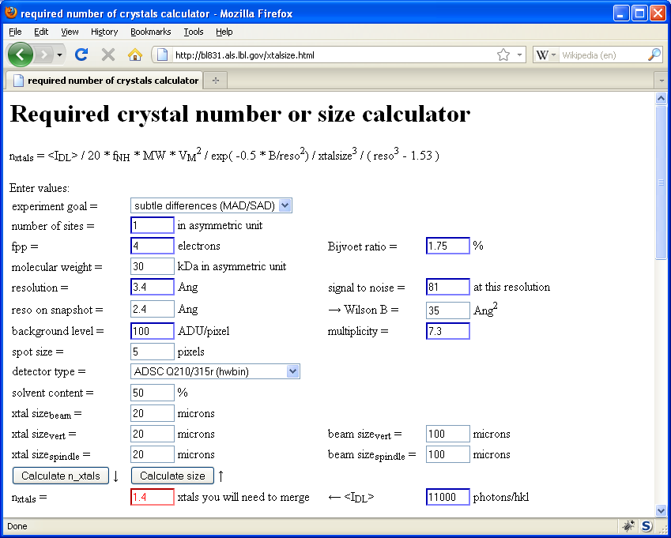
Holton & Frankel (2010) Acta D 66 393-408.

Slide 22
Data collection parameters:
16 crystals
360° each, inverse beam
7235 eV photon energy
< 1 MGy per xtal
Australian Synchrotron MX1
35 kGy/s into 100 μm x 100 μm

Slide 23
140-fold multiplicity: 16 crystals, 360° each, inverse beam, 7235 eV
RESOLUTION COMPLETENESS R-FACTOR I/SIGMA R-meas CC(1/2) Anomal SigAno Nano
LIMIT OF DATA observed Corr
9.17 99.1% 3.9% 257.47 3.9% 100.0* 91* 5.024 450
6.49 100.0% 5.2% 214.33 5.2% 100.0* 86* 3.836 882
5.30 100.0% 7.2% 165.13 7.2% 100.0* 76* 3.257 1175
4.59 100.0% 7.2% 175.42 7.3% 100.0* 67* 2.589 1403
4.10 99.9% 7.7% 174.13 7.7% 100.0* 59* 2.264 1594
3.74 99.9% 9.4% 143.09 9.4% 100.0* 49* 1.953 1783
3.47 100.0% 11.2% 120.17 11.2% 100.0* 39* 1.696 1942
3.24 100.0% 14.1% 91.14 14.1% 100.0* 30* 1.333 2103
3.06 99.9% 19.5% 65.79 19.5% 100.0* 23* 1.117 2214
2.90 99.9% 29.0% 44.85 29.1% 99.9* 17* 1.008 2369
2.77 99.9% 40.5% 32.58 40.6% 99.8* 11* 0.901 2493
2.65 99.9% 52.8% 25.16 52.9% 99.8* 10* 0.866 2605
2.54 100.0% 67.4% 19.47 67.6% 99.6* 2 0.804 2705
2.45 100.0% 88.9% 14.58 89.2% 99.2* 4 0.831 2859
2.37 100.0% 109.3% 9.97 109.7% 98.1* 5 0.829 2925
2.29 100.0% 138.2% 6.87 138.9% 96.1* 1 0.760 3037
2.22 100.0% 197.1% 4.03 198.6% 83.5* -1 0.721 3159
2.16 100.0% 227.3% 2.41 230.8% 46.9* -1 0.677 3224
2.10 61.2% 154.4% 1.28 163.6% 47.0* -2 0.660 1999
2.05 47.9% 170.1% 0.68 196.5% 25.7* 3 0.629 1578
total 93.3% 15.7% 54.30 15.8% 100.0* 12* 1.217 42499

Slide 24
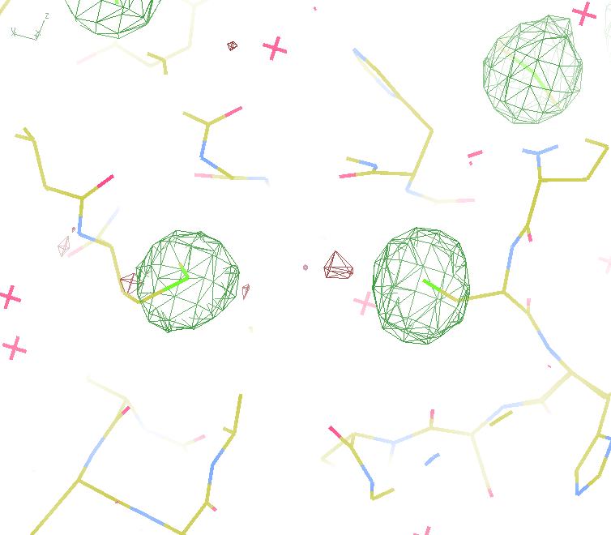
140-fold multiplicity
18 σ
16 σ
Phased anomalous difference Fourier

Slide 25
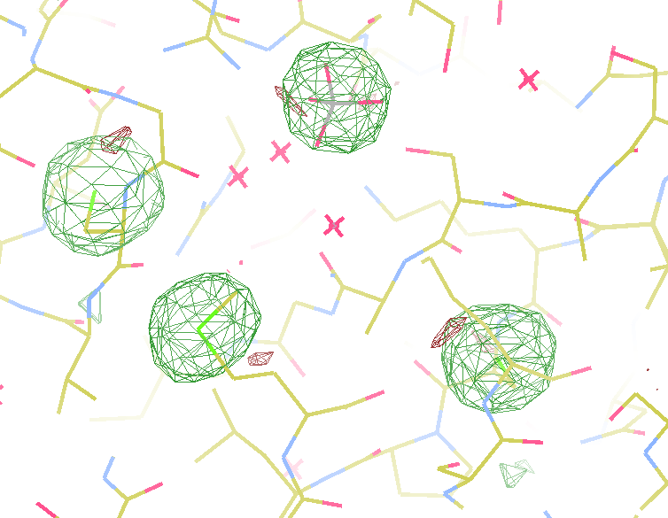
140-fold multiplicity
15σ = PO₄
Phased anomalous difference Fourier

Slide 26
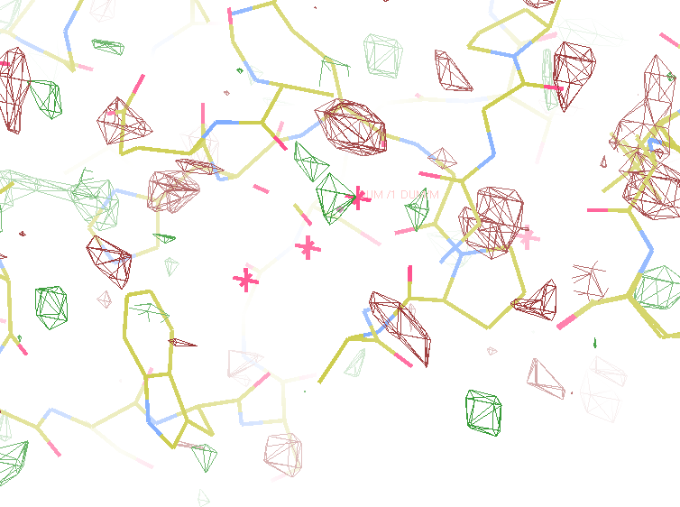
140-fold multiplicity
~2σ = Mg?
Phased anomalous difference Fourier

Slide 27
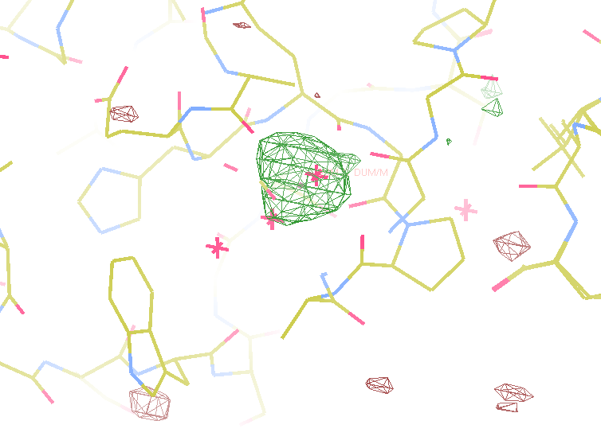
140-fold multiplicity
8.2σ = Mg?
DELFAN residual anomalous difference

Slide 28
Discerning Na⁺ from Mg⁺⁺
DELFAN peak height (σ)
N
O
F
Ne
Na
Mg
f’’ (electrons)

Slide 29
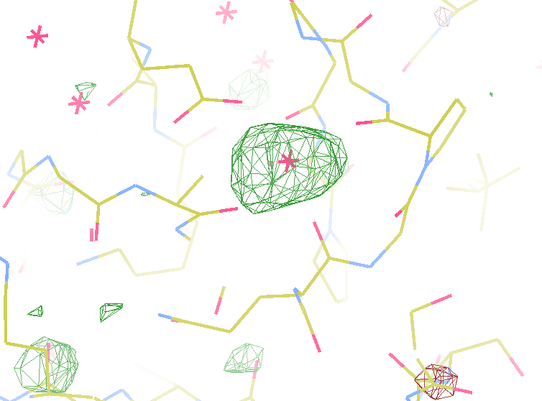
140-fold multiplicity
7.4σ = Na
DELFAN residual anomalous difference

Slide 30
S-SAD merging 20 xtals
Knott et al. (2017). "Guide-bound CRISPR-Cas13a." Nature S&MB online

Slide 31
Systematic vs random error
intensity
observation

Slide 32
Summary
http://bl831.als.lbl.gov/xtalsize.html
http://bl831.als.lbl.gov/~jamesh/mlfsom/
http://bl831.als.lbl.gov/~jamesh/powerpoint/ACMC_GBU_2013.ppt
100 ADU/pixel
10 μm for lysozyme
~3% error per spot, 1%/MGy
7235 eV for S-SAD
“Attenu-wait”: dose slicing

Slide 33
Summary
http://bl831.als.lbl.gov/xtalsize.html
http://bl831.als.lbl.gov/xtallife.html
http://bl831.als.lbl.gov/~jamesh/damage_rates.pdf
http://bl831.als.lbl.gov/~jamesh/powerpoint/CSHL_tipsNtrick_2017.pptx
15 ADU/pixel on Rayonix HS 300
> 0.1 s exposures (HS 300)
10 μm for lysozyme
~3% error per spot, 1%/MGy
7235 eV for S-SAD on CCD
“Attenu-wait”: dose slicing

Slide 34
Why harvest at all?
Radiation damage
10-100x reduced at ~100 K
Background scatter
tray >> xtal
Timing
nothing lasts forever
Shipping
cryo samples are glass beads

Slide 35
Why harvest at all?
Radiation damage
10-100x reduced at ~100 K
Background scatter
tray >> xtal
Timing
nothing lasts forever
Shipping
cryo samples are glass beads

Slide 36
X-ray transmission of materials
air
water
protein
crystal
transmission
glass
Depth into material (μm)

Slide 37
X-ray scattering of materials
glass
Differential cross section
(scattered photons/solid angle/incident photon/meter thickness)
plastic
paratone-N oil
25% glycerol
water
∞ 7.5 3.8 2.5 1.9 1.5
d-spacing (Ǻ)

Slide 38
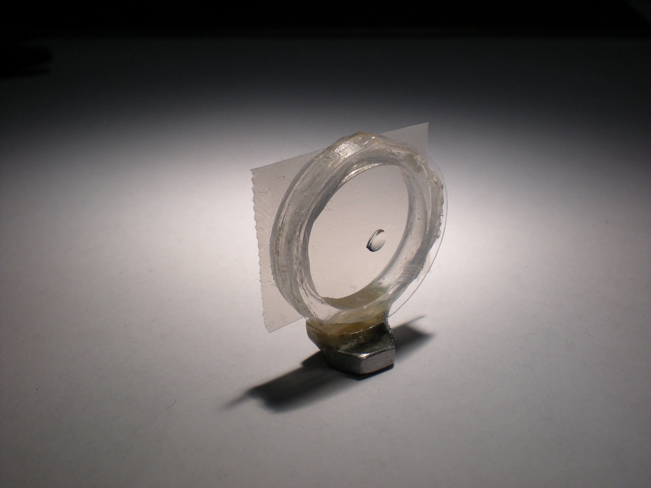
Crowfoot Cell

Slide 39
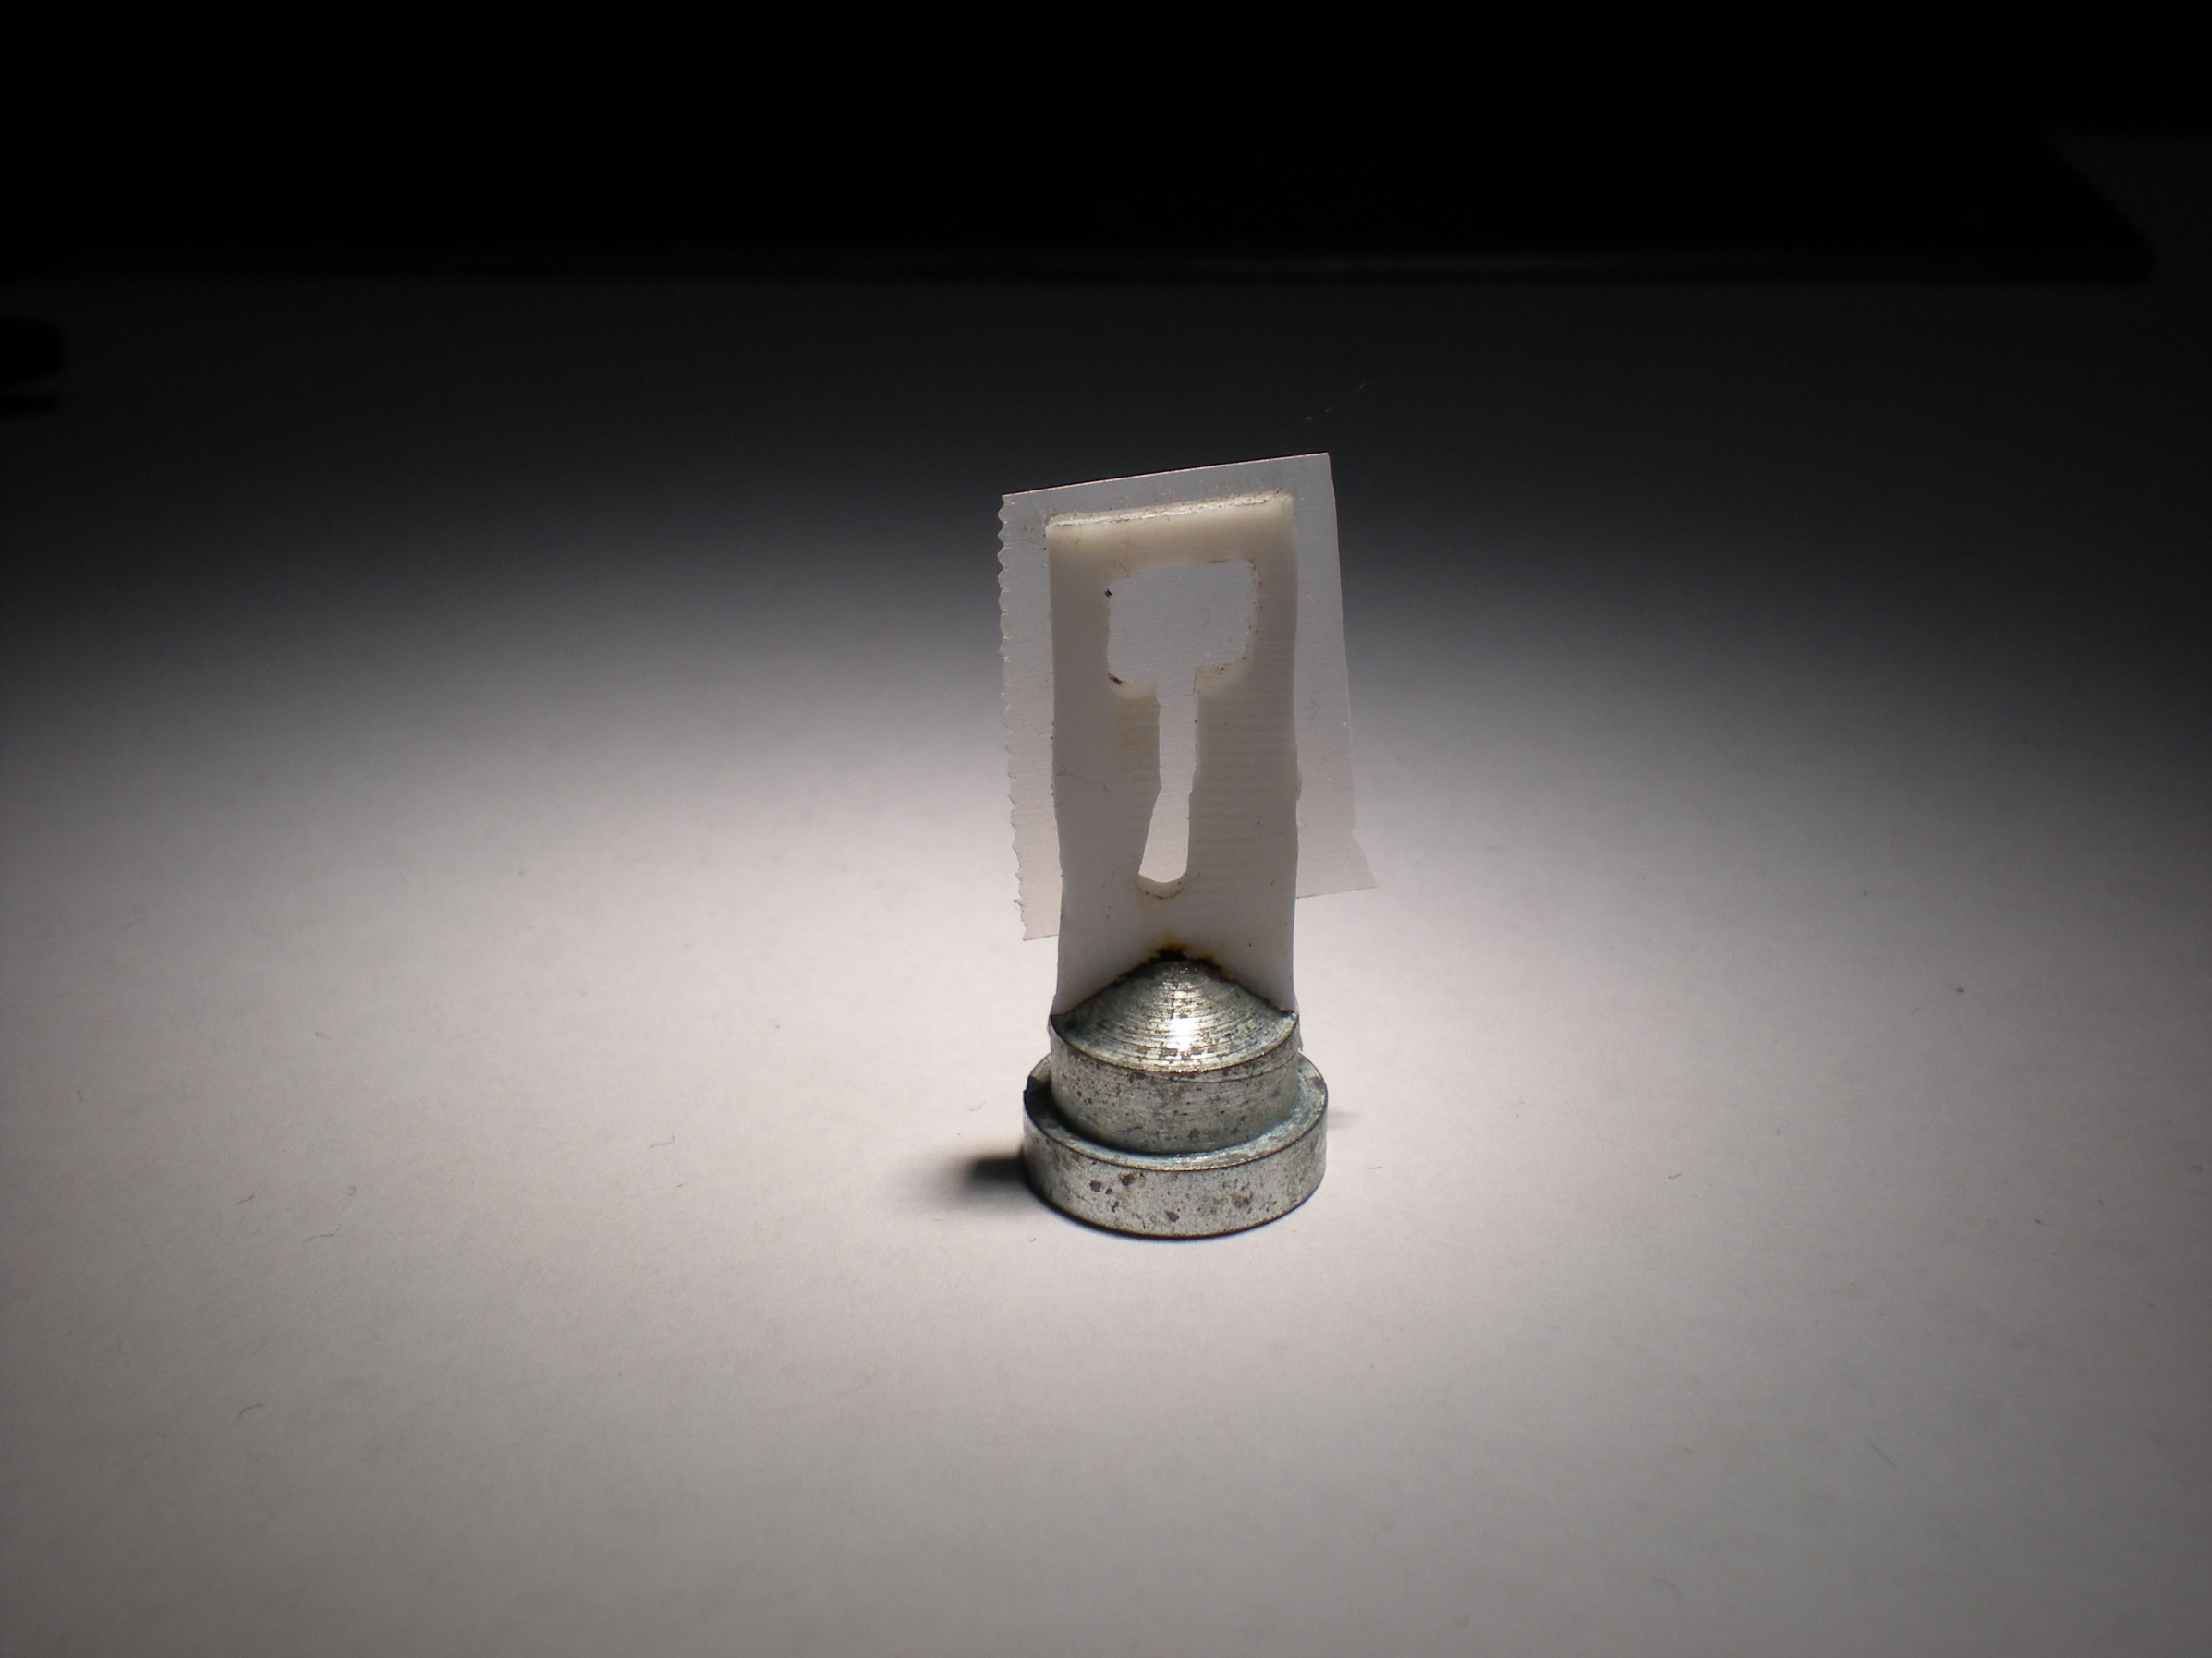
Crowfoot Cell

Slide 40
Crowfoot Cell
J. D. Bernal and D. Crowfoot, Nature (London) 133, 794 (1934).

Slide 41
SBS
format
crystallization
tray
mirror
pinhole
microscope
Notes:
Inspired by the ESRF microcrystal camera, the superbend endstations are all equipped with zero-paralax optics. The user sees their sample from the point of view of the x-ray beam. Sample alignment is not only more stable but more intuitive than an off-axis camera. Placing the crystal into the microscope crosshairs gaurantees that it will be hit by the beam.

Slide 42
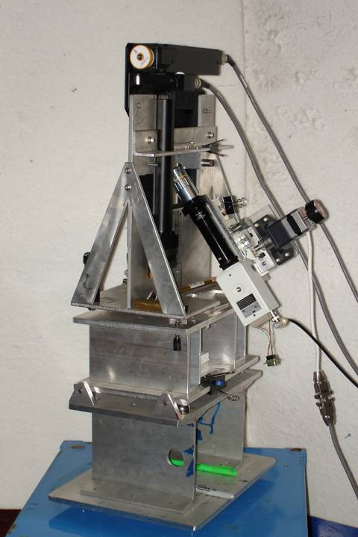
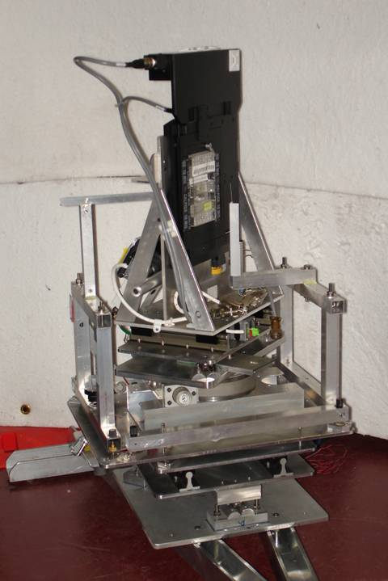
Plate goniometers
Notes:
The non-rotating “plate goniometer” (left) was developed last year. A new incarnation for taking rotation-camera data is now being developed (right). Either of these devices will accept most any crystallization tray that can be rotated 90 degrees to gravity and probe arbitrary points in each crystallization drop with a 50 um x-ray beam. Installing a plate goniometer takes ~30 minutes and the location ~300 mm downbeam from the “normal” protein crystallography sample mounting point makes this technology transferable to most any beamline.
Current status is that a 95% complete data set has been collected from a 50 um lysozyme crystal at room temperature, and trials are now underway to collect data sets from “real” crystals.

Slide 43
Notes:
non-rotating tray goniometer stage installed in ALS 8.3.1. Note that the “normal” cryo-pin goniometer on the left is still in place and a brass flight tube has been added to contain the air scatter from the main beam on its way to the tray goniometer.

Slide 44
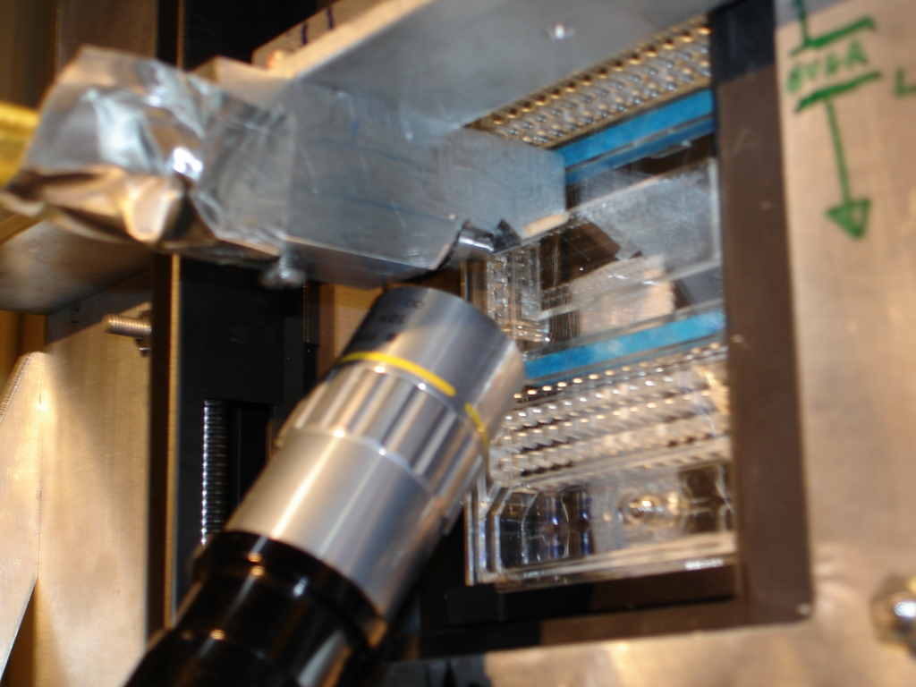

Slide 45
in-situ diffraction systems
25 μm wall
~50 μm tape
~50 μm tape
~50 μm tape
PDMS
PDMS
250 μm
100 μm
25 μm
200 μm
25 μm wall
MiTeGen
MicroRT™
Fluidigm
Topaz® DC
NatX-ray
CrystalQuick™ X
MiTeGen
in-situ-1
Crystal DirectTM
http://www.mitegen.com/products/micrort/micrort.shtml
http://www.fluidigm.com/home/fluidigm/docs/Datasheet_1.96DC.pdf
Soliman, A. et al. (2011). Acta Cryst. D 67, 646-656.
http://www.mitegen.com/mic_catalog.php?c=insituplates
Márquez, J. & Cipriani, F. (2014) Structural Genomics (Chen, Y. W., ed) pp. 197-203.
Notes:
Next slide please

Slide 46
What do we need?
Thin plastic = water = protein
Light low atomic number
Tight evaporation = nonisomorphism
Cheap $1-20/tray

Slide 47
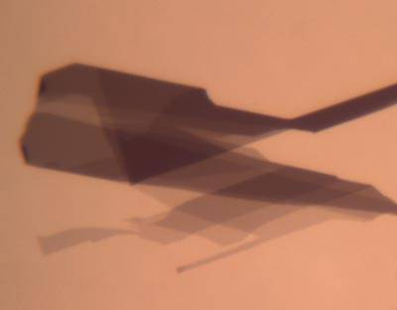
What we really need
Thin
Light
Tight
Cheap
GRAPHENE

Slide 48
Why harvest at all?
Radiation damage
10-100x reduced at ~100 K
Background scatter
tray >> xtal
Timing
nothing lasts forever
Shipping
cryo samples are glass beads

Slide 49
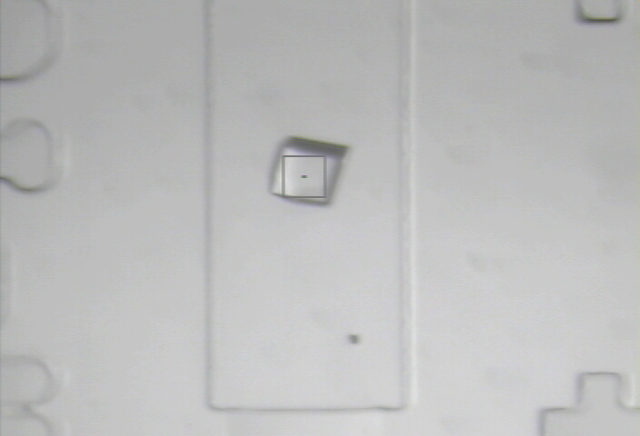

Slide 50
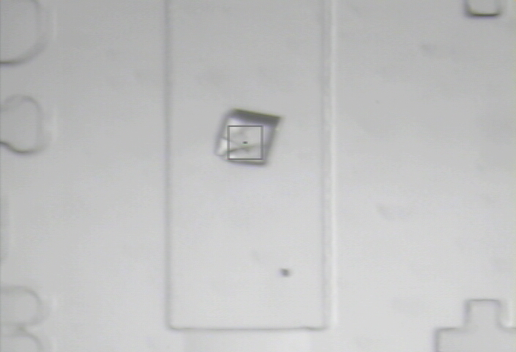
8000 Gy/s

Slide 51
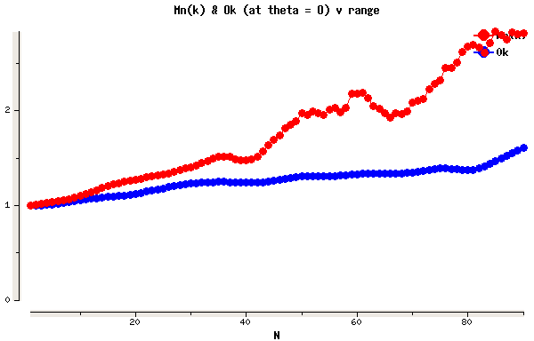
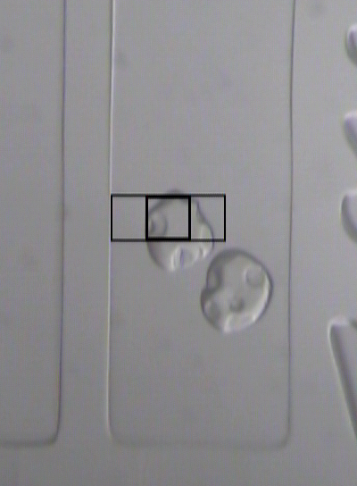
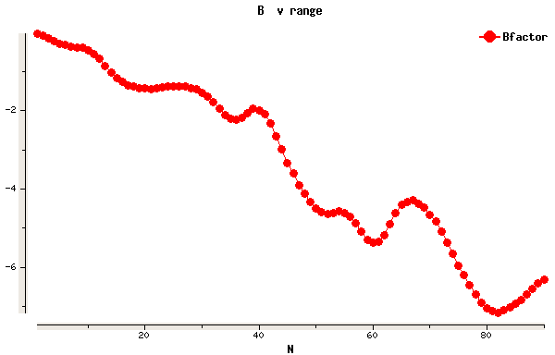
Example Data
lysozyme
50 μm beam
37 Gy/s (0.775 Å)
30s exposures at 20C
90° of data, 97% complete
I/σ = 1.5 at 1.9 Å
R_{merge} 18% (overall) 5% (low)
ΔB same as 20 min at 100K
2
1
0
scale vs batch
B factor
-2
-4
-6

Slide 52
Why harvest at all?
Radiation damage
10-100x reduced at ~100 K
Background scatter
tray >> xtal
Timing
nothing lasts forever
Shipping
cryo samples are glass beads

Slide 53
Why harvest at all?
Radiation damage
10-100x reduced at ~100 K
Background scatter
tray >> xtal
Timing
nothing lasts forever
Shipping
cryo samples are glass beads

Slide 54
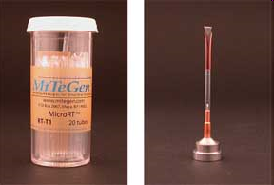
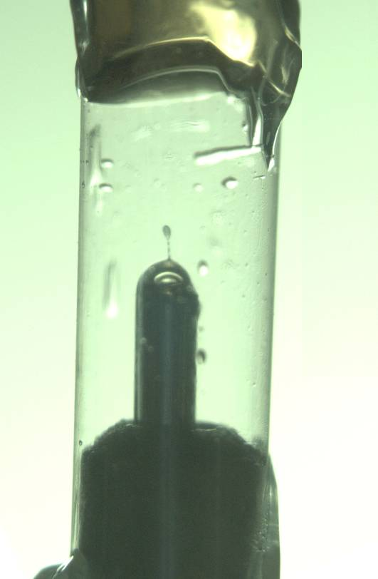
MiTeGen RT cell
http://www.mitegen.com/products/micrort/micrort.shtml

Slide 55
Summary
assay, control and open mind
purity, purity, purity
oil is your friend
Warkentin method
try room temp!
http://bl831.als.lbl.gov/~jamesh/powerpoint/
CSHL_tipsNtricks_2015.pptx

Slide 56
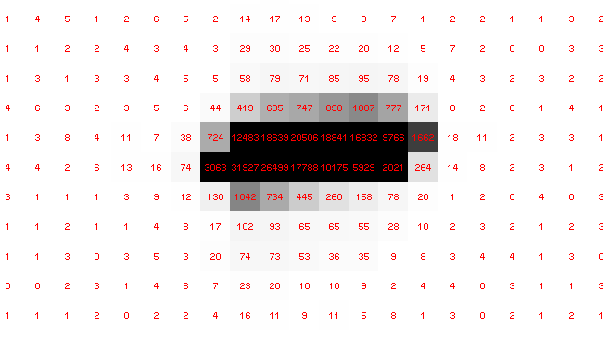
Pilatus pile-up for RT MX? same photons, different speeds
Sum of 193 shots with
193-fold attenuation

Slide 57
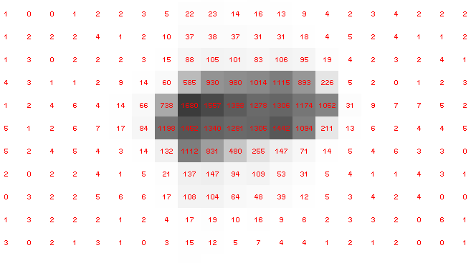
Pilatus pile-up for RT MX? same photons, different speeds
1 shot with
no attenuation

Slide 58
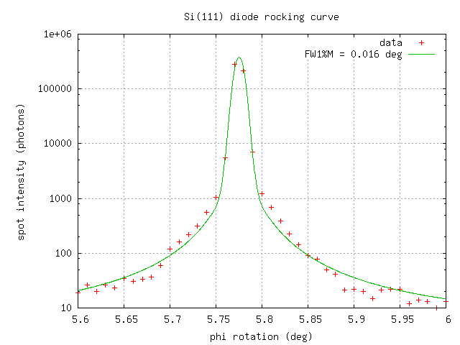
Pilatus pile-up for RT MX? same photons, different speeds
0.016° mosaic

