Slide 1
scattering
x-ray beam
sample
detector

Slide 2
scattering
x-ray beam
sample
detector

Slide 3
scattering
x-ray beam
sample
detector

Slide 4
scattering
x-ray beam
sample
detector

Slide 5
Bragg’s Law
to detector
nλ = 2d sin(θ)
atom #1
θ
d
to source
atom #2
d∙sin(θ)

Slide 6
Bragg’s Law
to detector
nλ = 2d sin(θ)
atom #1
θ
to source
d
atom #2
d∙sin(θ)

Slide 7
anomalous scattering
x-ray beam
sample
detector

Slide 8
anomalous scattering
x-ray beam
sample
detector

Slide 9
anomalous scattering
x-ray beam
sample
detector

Slide 10
anomalous scattering
x-ray beam
sample
detector

Slide 11
anomalous scattering
x-ray beam
sample
detector

Slide 12
4-wavelength MAD
f”
Holton, J. M. (2007) J. Synch. Rad. 14, 51-72.

Slide 13
3-wavelength MAD
f”
Holton, J. M. (2007) J. Synch. Rad. 14, 51-72.

Slide 14
Two-wavelength MAD
f”
Holton, J. M. (2007) J. Synch. Rad. 14, 51-72.

Slide 15
Is it element X ?
f”

Slide 16
Suggested anomalous protocol:
360° in < 5 MGy
move detector
4X exposure
goto 2
2 wavelengths are better than 1
- (peak + inf)/2, and remote
MAD, not M-SAD!

Slide 17
Phasing from native elements
Solve-able proteins (%)
Required signal-to-noise (I/σ)

Slide 18
Counting photons
σ(N_{photons}) >= √N_{photons}
I/σ(I) <= √N_{photons}
Signal-to-noise ratio

Slide 19
Anomalous differences
3%
I+
10 photons
I-
100 photons
100 photons

Slide 20
Anomalous differences
3%
I+
I-
14 photons
100 photons
100 photons

Slide 21
Anomalous differences
3%
I+
67 photons
I-
2000 photons

Slide 22
Anomalous differences
1%
I+
I-
200 photons
20,000 photons

Slide 23
Can you count to 1,000,000 ?
sqrt(1,000,000)
1,000,000
Theoretically:
= 0.1%
R_{meas} ≈ 0.1% ?
ISa = 1000
In reality:
ISa ~ 33
R_{meas =} ≈ 3%
sqrt(1,000)
1,000
= 3%
photon
spot
> 1000 is a waste!

Slide 24
systematic error

Slide 25
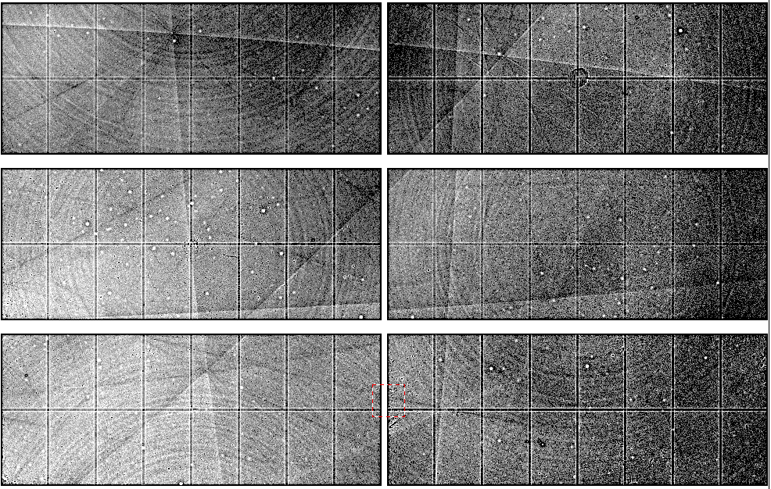
Pilatus: subtract smooth baseline
~3x10⁵ photon/pixel
Bragg
glitch
“tree rings”
Pick-up tool mark
oxygen
inclusions
1% high
average
1% low

Slide 26
Potential for improvement
Source of error | realistic simulation | No SHSSS | Perfect detector
Photon counting | + | + | +
Shutter jitter | + | + | -
Beam flicker | + | + | -
Sample absorption | + | + | -
Radiation damage | + | + | -
Imperfect spindle | + | + | -
vignette | + | + | -
Corner correction | + | + | -
SHSSS | + | - | -
R_{meas} (∞-10 Å) | 2.8% | 0.7% | 0.7%
I/σ asymptotic | 26.8 | 74.2 | 81.0
Holton et al (2014) "R-factor gap", FEBS Journal 281, 4046-4060.

Slide 27
Phasing from native elements
Current
technology
Goal
Solve-able proteins (%)
Required signal-to-noise (I/σ)

Slide 28
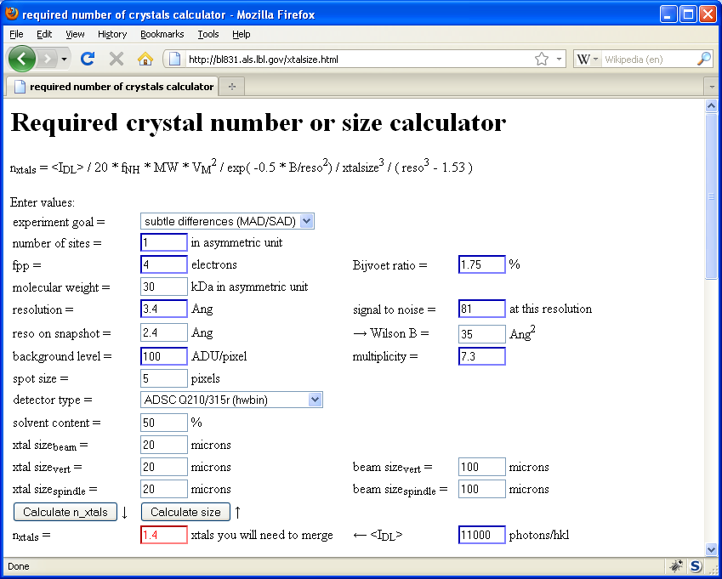
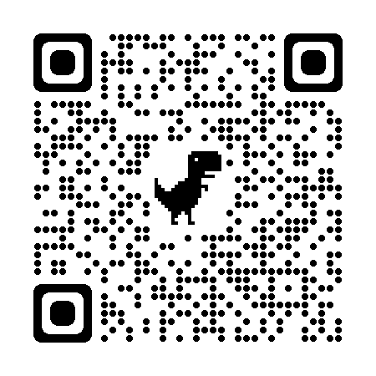
Holton & Frankel (2010) Acta D 66 393-408.

Slide 29
Fractional error
^{mult >} (—)²
~3%
<ΔF/F>

Slide 30
anomalous signal
ΔF
F
√
# sites
MW (Da)
≈ 1.2 f”
World record!
ΔF/F = 0.5%
Wang, Dauter & Dauter (2006) Acta Cryst. D 62, 1475-1483.
Crick, F. H. C. & Magdoff, B. S. (1956) Acta Crystallogr. 9, 901-908.
Hendrickson, W. A. & Teeter, M. M. (1981) Nature 290, 107-113.

Slide 31
Anomalous signal
6
“electrons”
4
1
2
f”
0

Slide 32
How can I tell: f” ?
http://skuld.bmsc.washington.edu/scatter/AS_form.html
“K” edge = 4
Atom. No. 20 – 40
Ca 4.0 Kr 14.3 keV
Fe 7.1 Sr 16.1
Zn 9.7 Mo 20
Se 12.6 Ru 22
Br 13.5 Pd 24
K edge ~ 0.7*Z-10.6
“L” edge = 10
Atom. No. 53 – 85
I 4.5 Os 10.9 keV
Xe 4.8 Au 11.9
Cs 5.0 Hg 12.3
La 5.6 Pb 13
Lu 9.2 Bi 13.4
L edge ~ 0.28*Z-10.2

Slide 33
CCP4: aimless log
$TABLE: Analysis against resolution, XDSdataset:
$GRAPHS:I/sigma, Mean Mn(I)/sd(Mn(I)):0|0.216023x0|137.14:2,13,14:
:Rmerge, Rfull, Rmeas, Rpim v Resolution:0|0.216023x0|1.70834:2,4,5,6,7:
:Average I, RMSdeviation and Sd:0|0.216023x0|1650.8:2,10,11,12:
:Fractional bias:0|0.216023x0|0:2,15:
$$
N 1/d^2 Dmid Rmrg Rfull Rcum Rmeas Rpim Nmeas AvI RMSdev sd I/RMS Mn(I/sd) FrcBias $$ $$
1 0.0064 12.55 0.020 0.020 0.020 0.021 0.006 13115 1651 57 42 29.2 137.1 -
2 0.0191 7.24 0.027 0.027 0.024 0.028 0.008 24753 1171 47 42 25.0 105.2 -
3 0.0318 5.61 0.038 0.038 0.029 0.040 0.012 32197 857 46 43 18.4 79.6 -
4 0.0445 4.74 0.034 0.034 0.031 0.035 0.010 37743 1212 57 53 21.4 91.2 -
5 0.0572 4.18 0.036 0.036 0.032 0.038 0.011 42642 1181 59 57 19.9 83.8 -
6 0.0699 3.78 0.049 0.049 0.036 0.052 0.015 47224 883 59 57 15.1 65.1 -
7 0.0826 3.48 0.065 0.065 0.040 0.068 0.020 51052 685 59 58 11.7 50.9 -
8 0.0953 3.24 0.096 0.096 0.045 0.100 0.029 54636 448 56 56 8.0 35.0 -
9 0.1080 3.04 0.151 0.151 0.050 0.158 0.046 58072 268 53 53 5.1 22.7 -
10 0.1207 2.88 0.229 0.229 0.056 0.240 0.070 60731 171 51 51 3.3 15.4 -
11 0.1334 2.74 0.314 0.314 0.063 0.329 0.097 63807 125 51 51 2.4 11.3 -
12 0.1461 2.62 0.406 0.406 0.070 0.425 0.125 66241 98 51 52 1.9 8.7 -
13 0.1588 2.51 0.537 0.537 0.078 0.562 0.166 68272 76 53 53 1.4 6.5 -
14 0.1715 2.41 0.685 0.685 0.084 0.727 0.237 54170 61 53 54 1.1 4.4 -
15 0.1843 2.33 0.886 0.886 0.088 0.950 0.333 39781 48 55 56 0.9 3.1 -
16 0.1970 2.25 1.249 1.249 0.092 1.355 0.508 29754 35 57 59 0.6 2.1 -

Slide 34
CCP4: aimless log
$TABLE: Correlations CC(1/2) within dataset, XDSdataset:
$GRAPHS: Anom & Imean CCs v resolution:0|0.216023x0|1:2,4,7:
: RMS correlation ratio :0|0.216023x0|2.20344:2,6:
$$
N 1/d^2 Dmid CCanom Nanom RCRanom CC1/2 NImean $$ $$
1 0.0064 12.55 0.659 499 2.203 1.000 669
2 0.0191 7.24 0.550 975 1.853 1.000 1155
3 0.0318 5.61 0.527 1295 1.798 1.000 1479
16 0.1970 2.25 0.037 2123 1.038 0.711 2275
17 0.2097 2.18 0.043 1682 1.044 0.460 1877

Slide 35
XDS: CORRECT.LP or XSCALE.LP
SUBSET OF INTENSITY DATA WITH SIGNAL/NOISE >= -3.0 AS FUNCTION OF RESOLUTION
RESOLUTION NUMBER OF REFLECTIONS COMPLETENESS R-FACTOR R-FACTOR COMPARED I/SIGMA R-meas CC(1/2) Anomal SigAno Nano
LIMIT OBSERVED UNIQUE POSSIBLE OF DATA observed expected Corr
6.39 4103 2517 3135 80.3% 1.7% 1.8% 3018 33.77 2.3% 99.9* 21* 1.012 533
4.54 7339 4970 5544 89.6% 2.6% 2.6% 4585 22.56 3.6% 99.8* 9 0.914 796
3.72 9442 6724 7186 93.6% 2.8% 2.9% 5327 19.99 4.0% 99.7* 9 0.859 877
3.22 11077 7997 8486 94.2% 4.8% 4.9% 6094 12.27 6.8% 99.3* -1 0.784 913
2.88 12408 8851 9595 92.2% 10.0% 10.1% 7068 6.01 14.2% 97.8* -2 0.799 1012
2.63 13673 9561 10662 89.7% 20.8% 20.8% 8185 3.10 29.4% 88.8* -4 0.776 1274
2.44 14360 9852 11510 85.6% 34.5% 34.7% 8981 1.90 48.8% 75.9* 2 0.765 1525
2.28 9501 6495 12416 52.3% 61.8% 59.6% 5991 1.14 87.3% 53.5* -2 0.722 1031
2.15 4567 3307 13210 25.0% 120.5% 120.3% 2520 0.59 170.4% 21.9* 4 0.693 408
total 86470 60274 81744 73.7% 6.7% 6.7% 51769 8.97 9.5% 99.5* 2 0.804 8369

Slide 36
XDS: CORRECT.LP or XSCALE.LP
******************************************************************************
CORRECTION PARAMETERS FOR THE STANDARD ERROR OF REFLECTION INTENSITIES
******************************************************************************
The variance v0(I) of the intensity I obtained from counting statistics is
replaced by v(I)=a*(v0(I)+b*I^2). The model parameters a, b are chosen to
minimize the discrepancies between v(I) and the variance estimated from
sample statistics of symmetry related reflections. This model implicates
an asymptotic limit ISa=1/SQRT(a*b) for the highest I/Sigma(I) that the
experimental setup can produce (Diederichs (2010) Acta Cryst D66, 733-740).
a b ISa
3.806E+00 1.080E-04 49.32

Slide 37
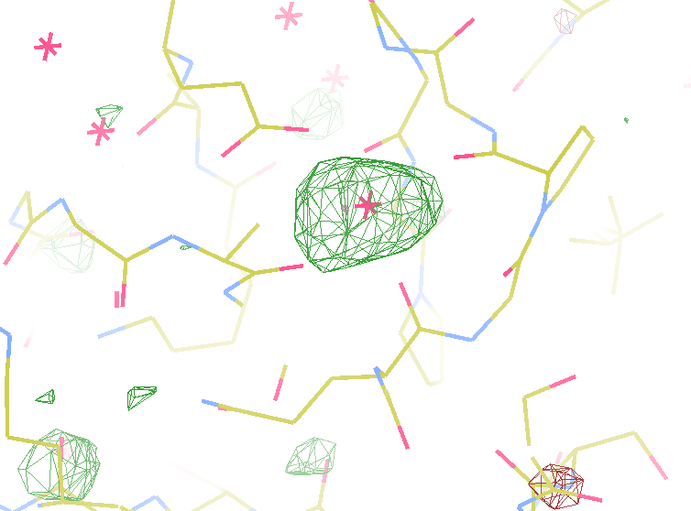
140-fold multiplicity
7.4σ = Na
DELFAN residual anomalous difference

Slide 38
Data collection parameters:
16 crystals
360° each, inverse beam
7235 eV photon energy
< 1 MGy per xtal
Australian Synchrotron MX1
35 kGy/s into 100 μm x 100 μm

Slide 39
“R” factors
R = % error

Slide 40
“R” factors
completely random: 0.59
starting MR solution: 0.4-0.55
something still wrong?: > 0.3
correct chain trace: < 0.2
small molecule: ~ 0.05

Slide 41
“R” factors
R_{cryst} (or just “R”)
observed vs calculated data (Fs)
R_{free}
cross-check with “random” subset of data
should be < 0.3 and < R_{cryst} + 0.1

Slide 42
Fitting data
structure factor (F)
spot index (h)

Slide 43
Fitting data
structure factor (F)
spot index (h)

Slide 44
Fitting data
structure factor (F)
spot index (h)

Slide 45
Fitting data
structure factor (F)
spot index (h)

Slide 46
“R” factors
R_{cryst} (or just “R”)
observed vs calculated data (Fs)
R_{free}
cross-check with “random” subset of data
should be < 0.3 and < R_{cryst} + 0.1
R_{sym} = R_{merge} (self-consistency of data: Is)

Slide 47
R_{merge}
blows up
as I_{obs} → 0
completely random: 0.59
weak data (high angle): 0.7- ∞
wrong symmetry choice?: ~0.2-0.55
small or disordered crystal: ~0.1-0.2
typical: ~ 0.05

Slide 48
“R” factors
R_{cryst} (or just “R”)
observed vs calculated data (Fs)
R_{free}
cross-check with “random” subset of data
should be < 0.3 and < R_{cryst} + 0.1
R_{sym} = R_{merge} (self-consistency of data: Is)
R_{rim} R_{pim} R_{meas}
R_{iso} R_{anom}
R_{diff}
R_{sym} is “unfair” to high multiplicity

