Slide 1
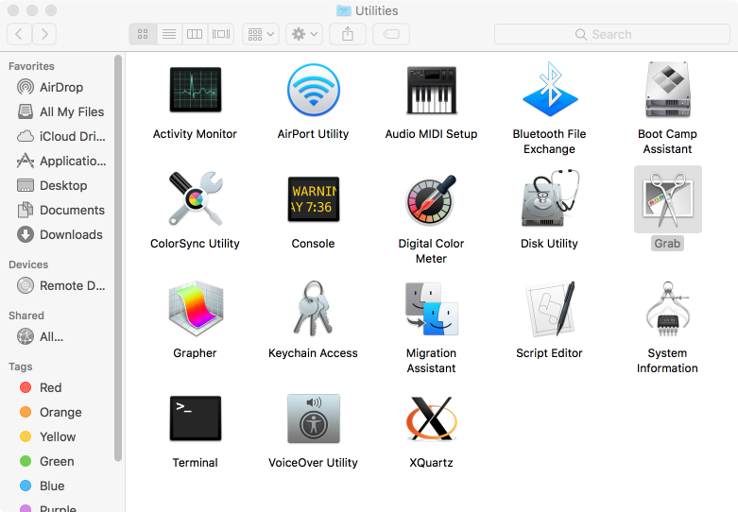

Slide 2
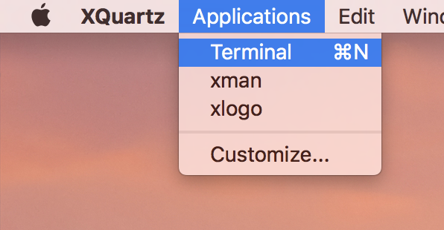

Slide 3
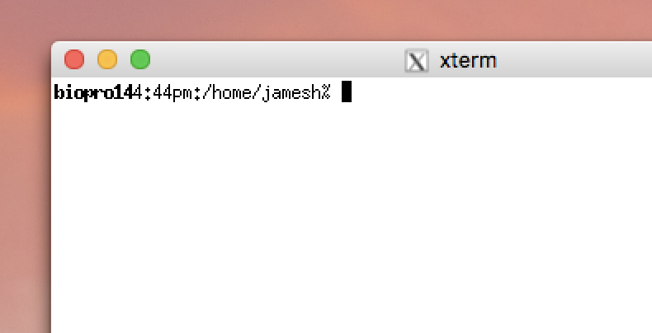
Cursor
does not move
with mouse
The “prompt”
Mouse
can be used
To select and paste
But all pasted text
Goes to the cursor

Slide 4
DIALS demo
prompt
Do not type!
underscore
~]$ cd
~]$ mkdir dials_tutorial
~]$ cd dials_tutorial
~]$ ln –sf ~/data .
~]$ dui
Space!
Enter
Space!
Space!
Space!

Slide 5
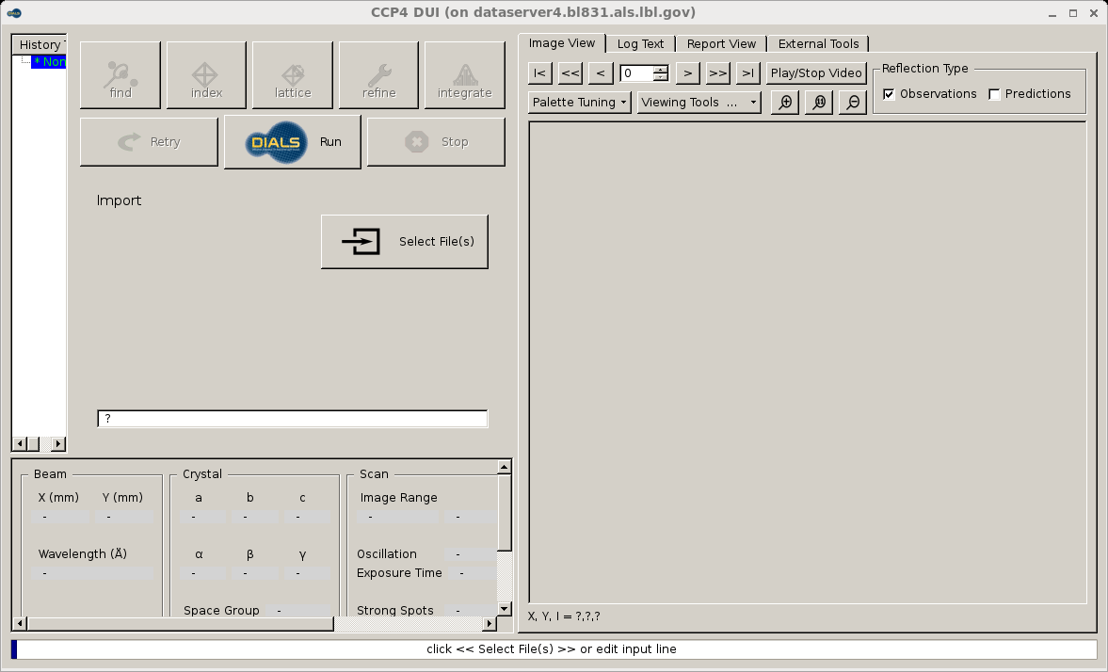

Slide 6
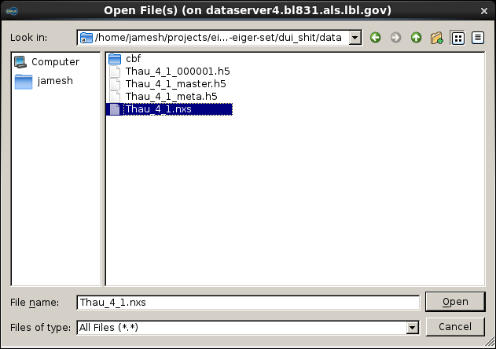

Slide 7
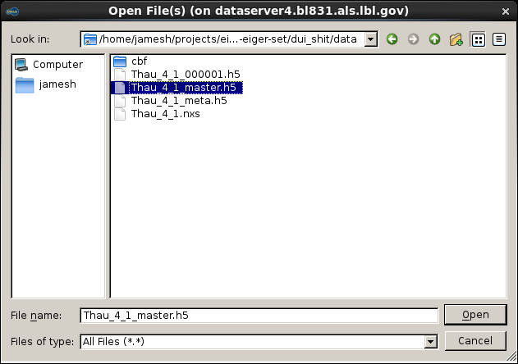

Slide 8
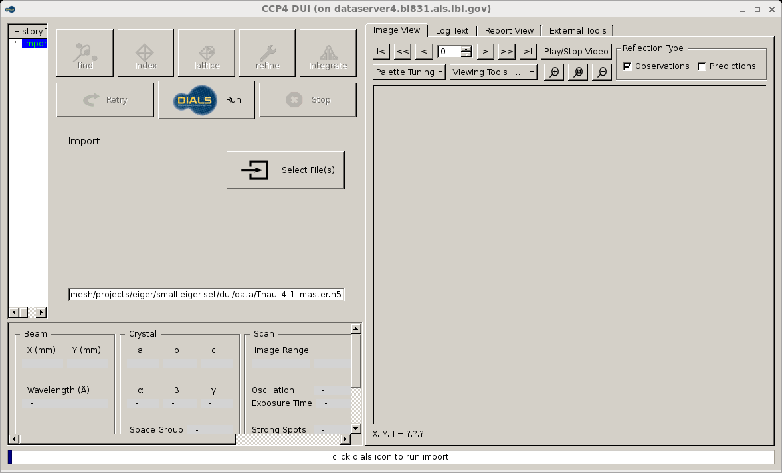

Slide 9
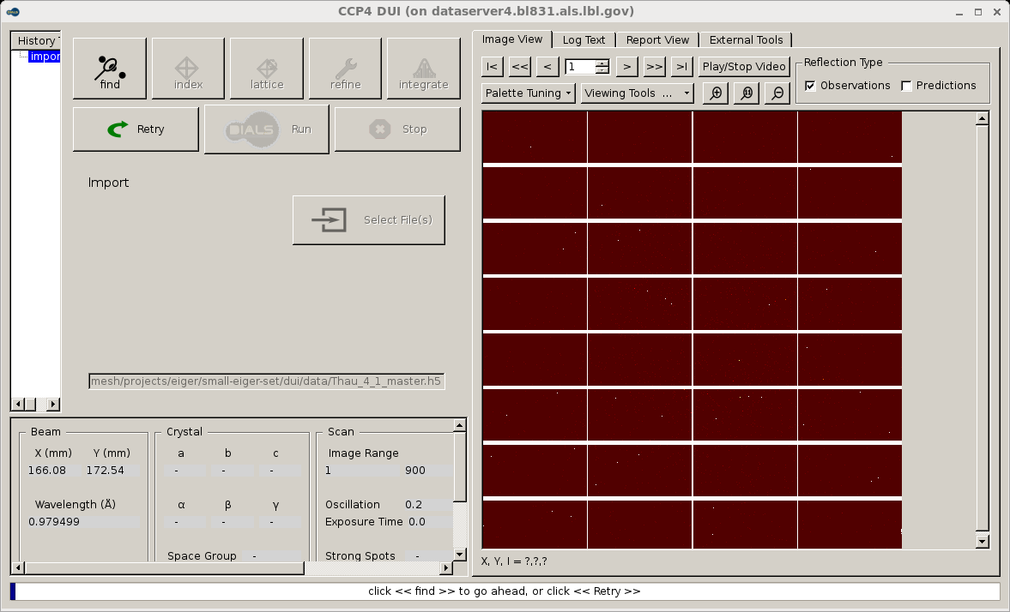

Slide 11
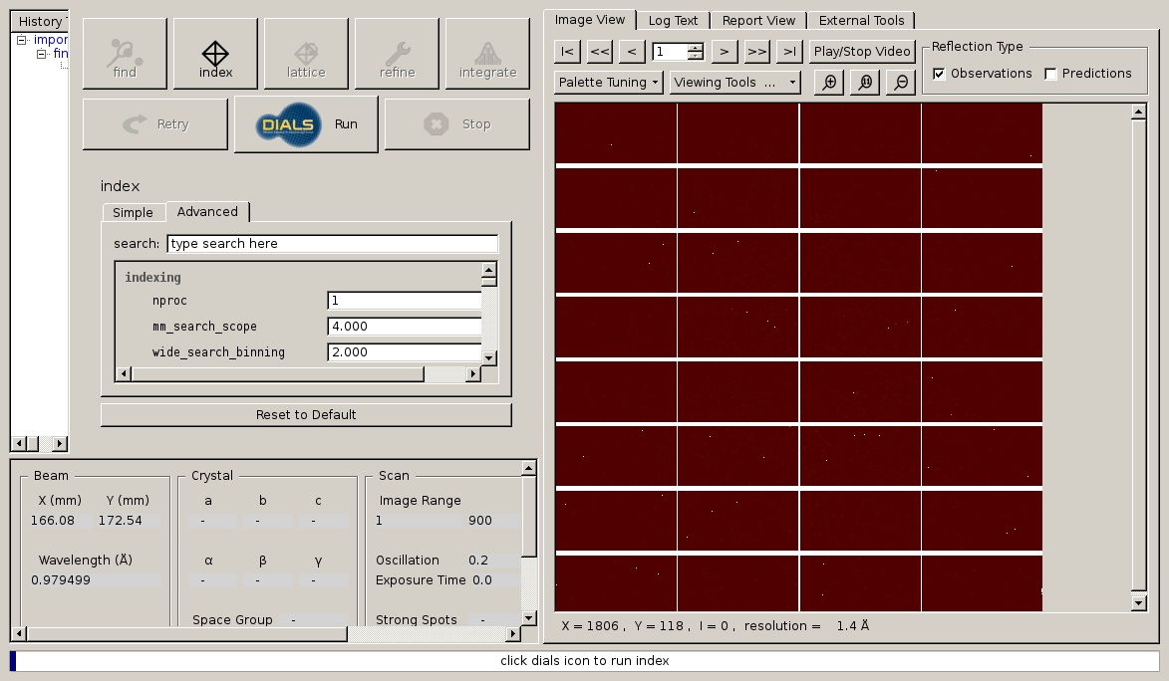

Slide 13
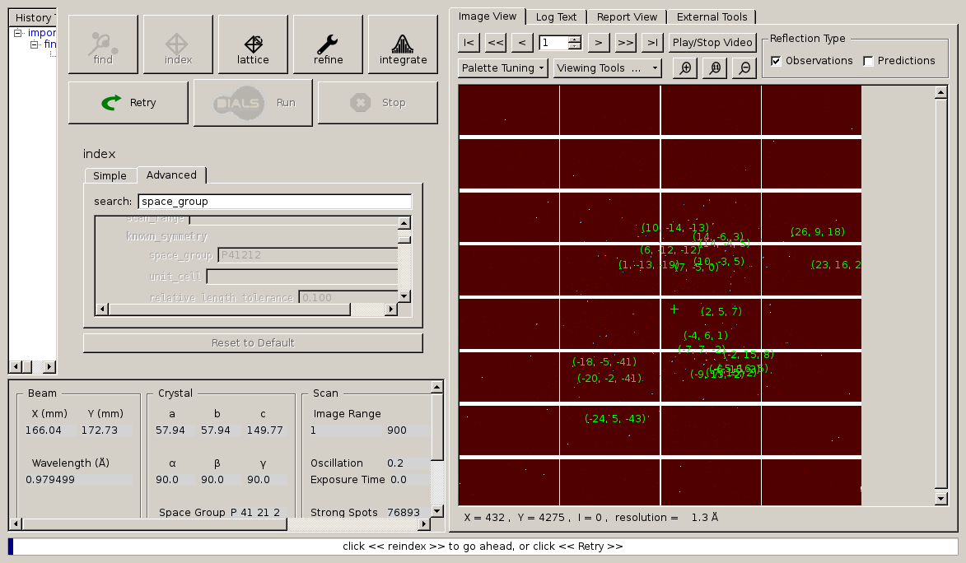

Slide 14
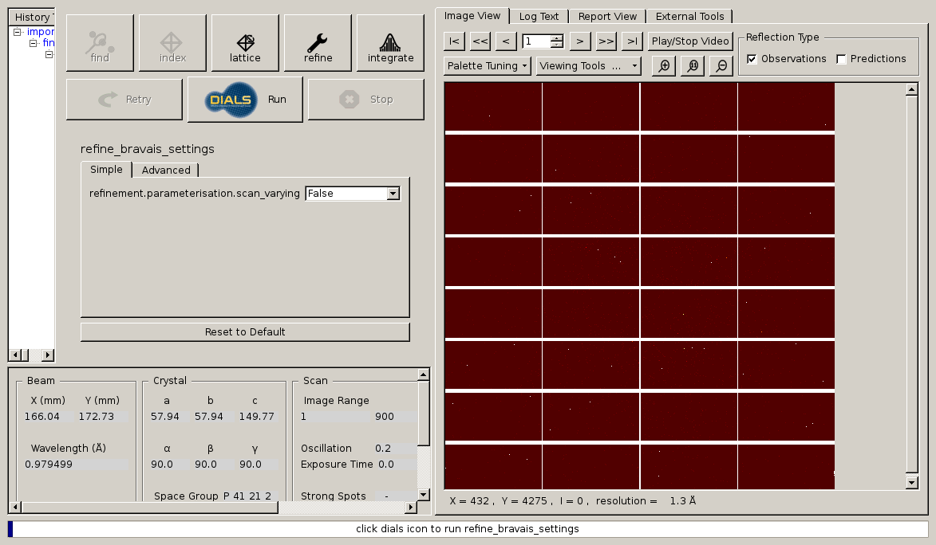

Slide 15
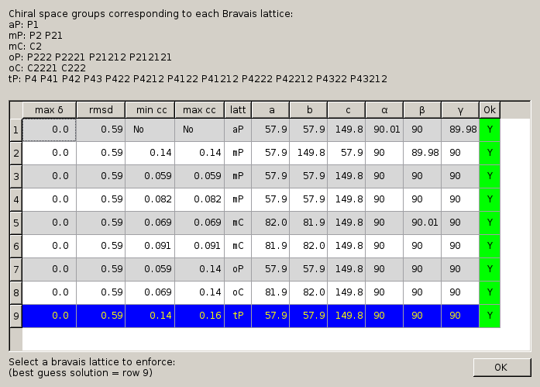

Slide 16
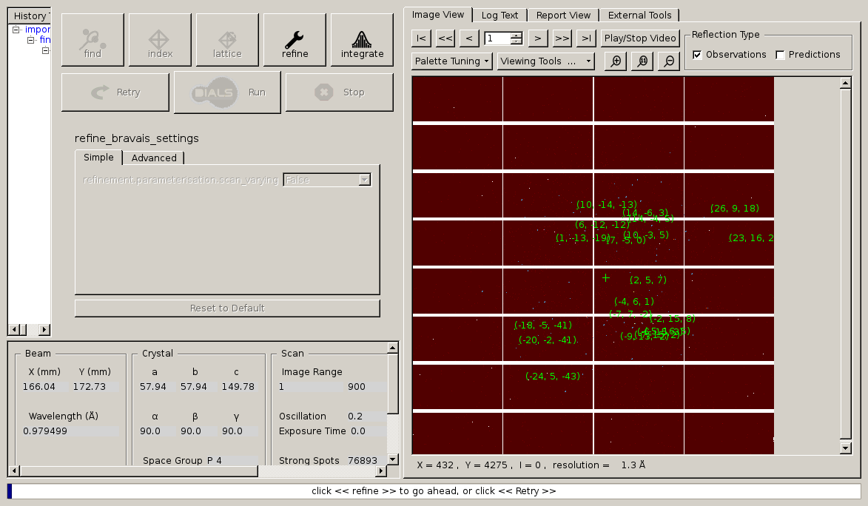

Slide 17
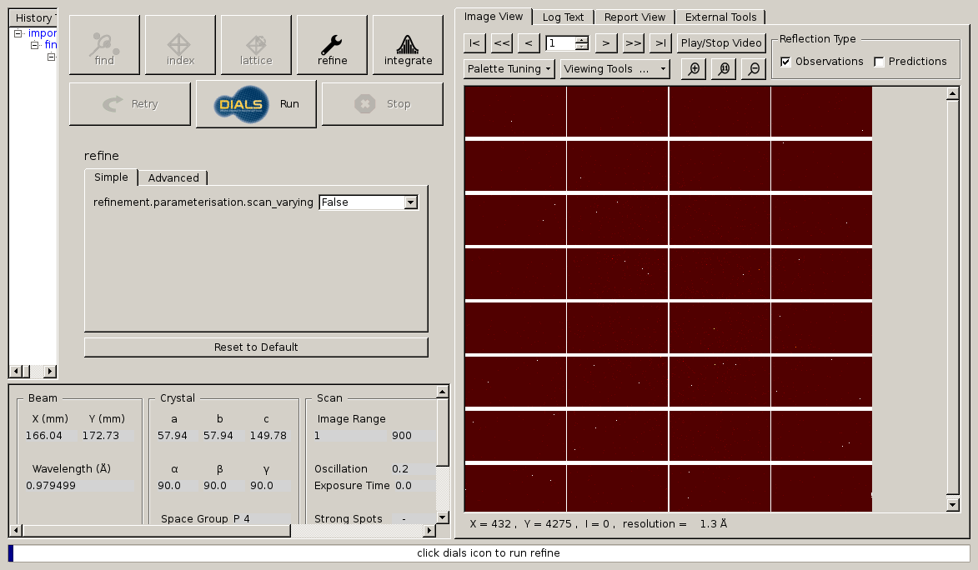

Slide 18
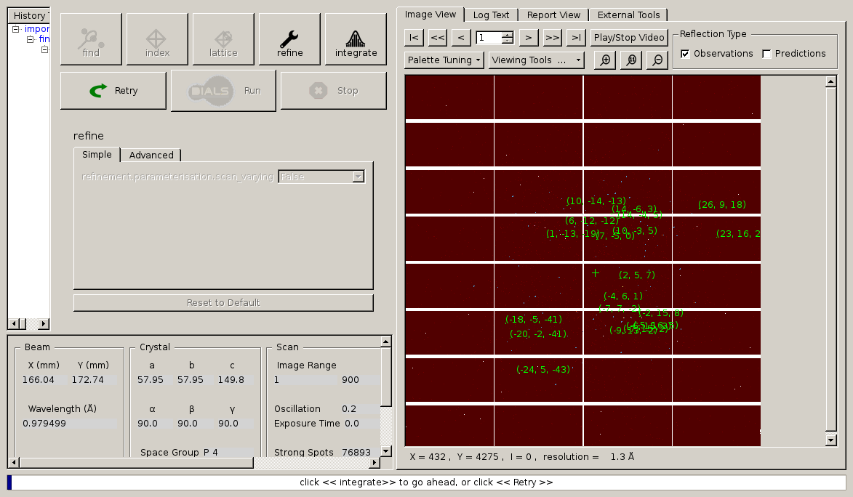

Slide 19
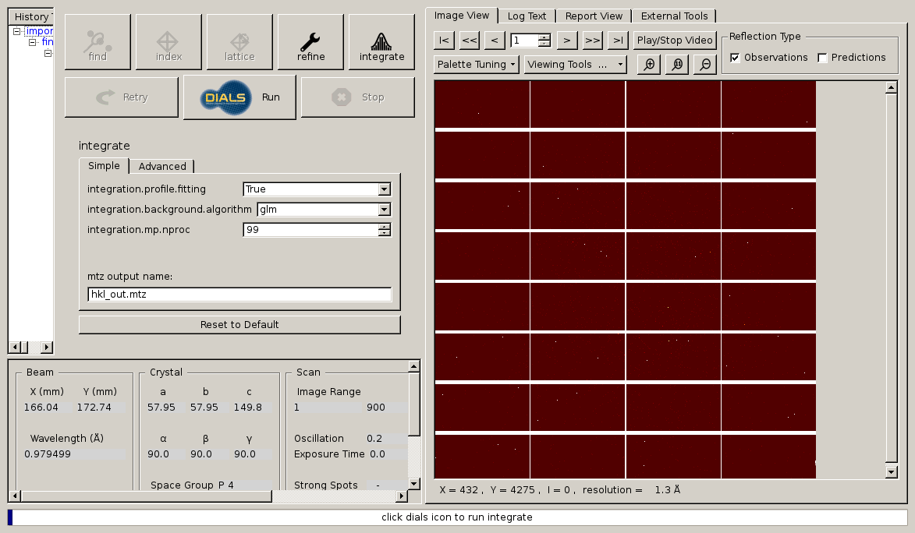

Slide 20
After DUI: scale merge refine!
$ echo | pointless hklin hkl_out.mtz hklout pointless.mtz |\
tee pointless.log
$ echo refine parallel | aimless hklin pointless.mtz \
hklout aimless.mtz | tee aimless.log
$ echo | truncate hklin aimless.mtz hklout truncated.mtz |\
tee truncate.log
$ wget http://www.rcsb.org/pdb/files/5x9L.pdb.gz
$ gunzip 5x9L.pdb.gz
$ echo | pointless xyzin 5x9L.pdb hklin truncated.mtz \
hklout reindexed.mtz | tee reindex.log
$ uniqueify reindexed.mtz
$ echo | refmac5 hklin reindexed-unique.mtz xyzin 5x9L.pdb \
hklout refmacout.mtz xyzout refmacout.pdb |\
tee refmac.log

Slide 21
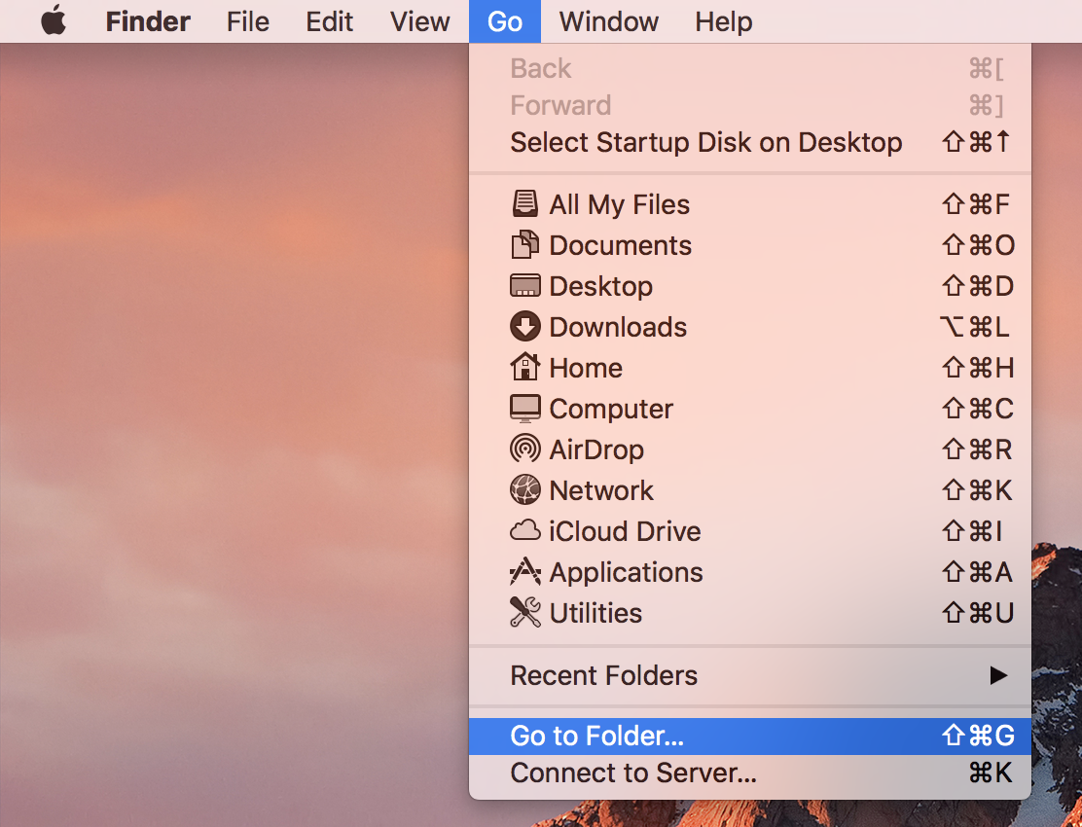
Left click
Left click

Slide 22
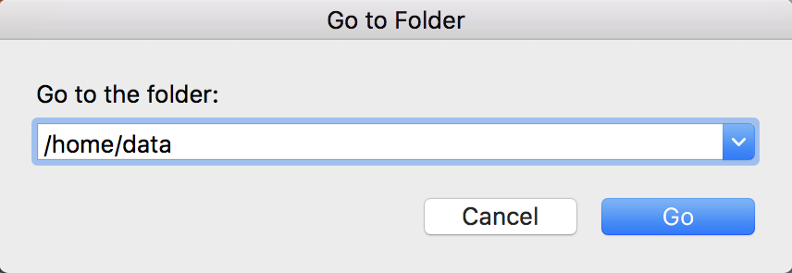
type
(with keyboard)

Slide 23
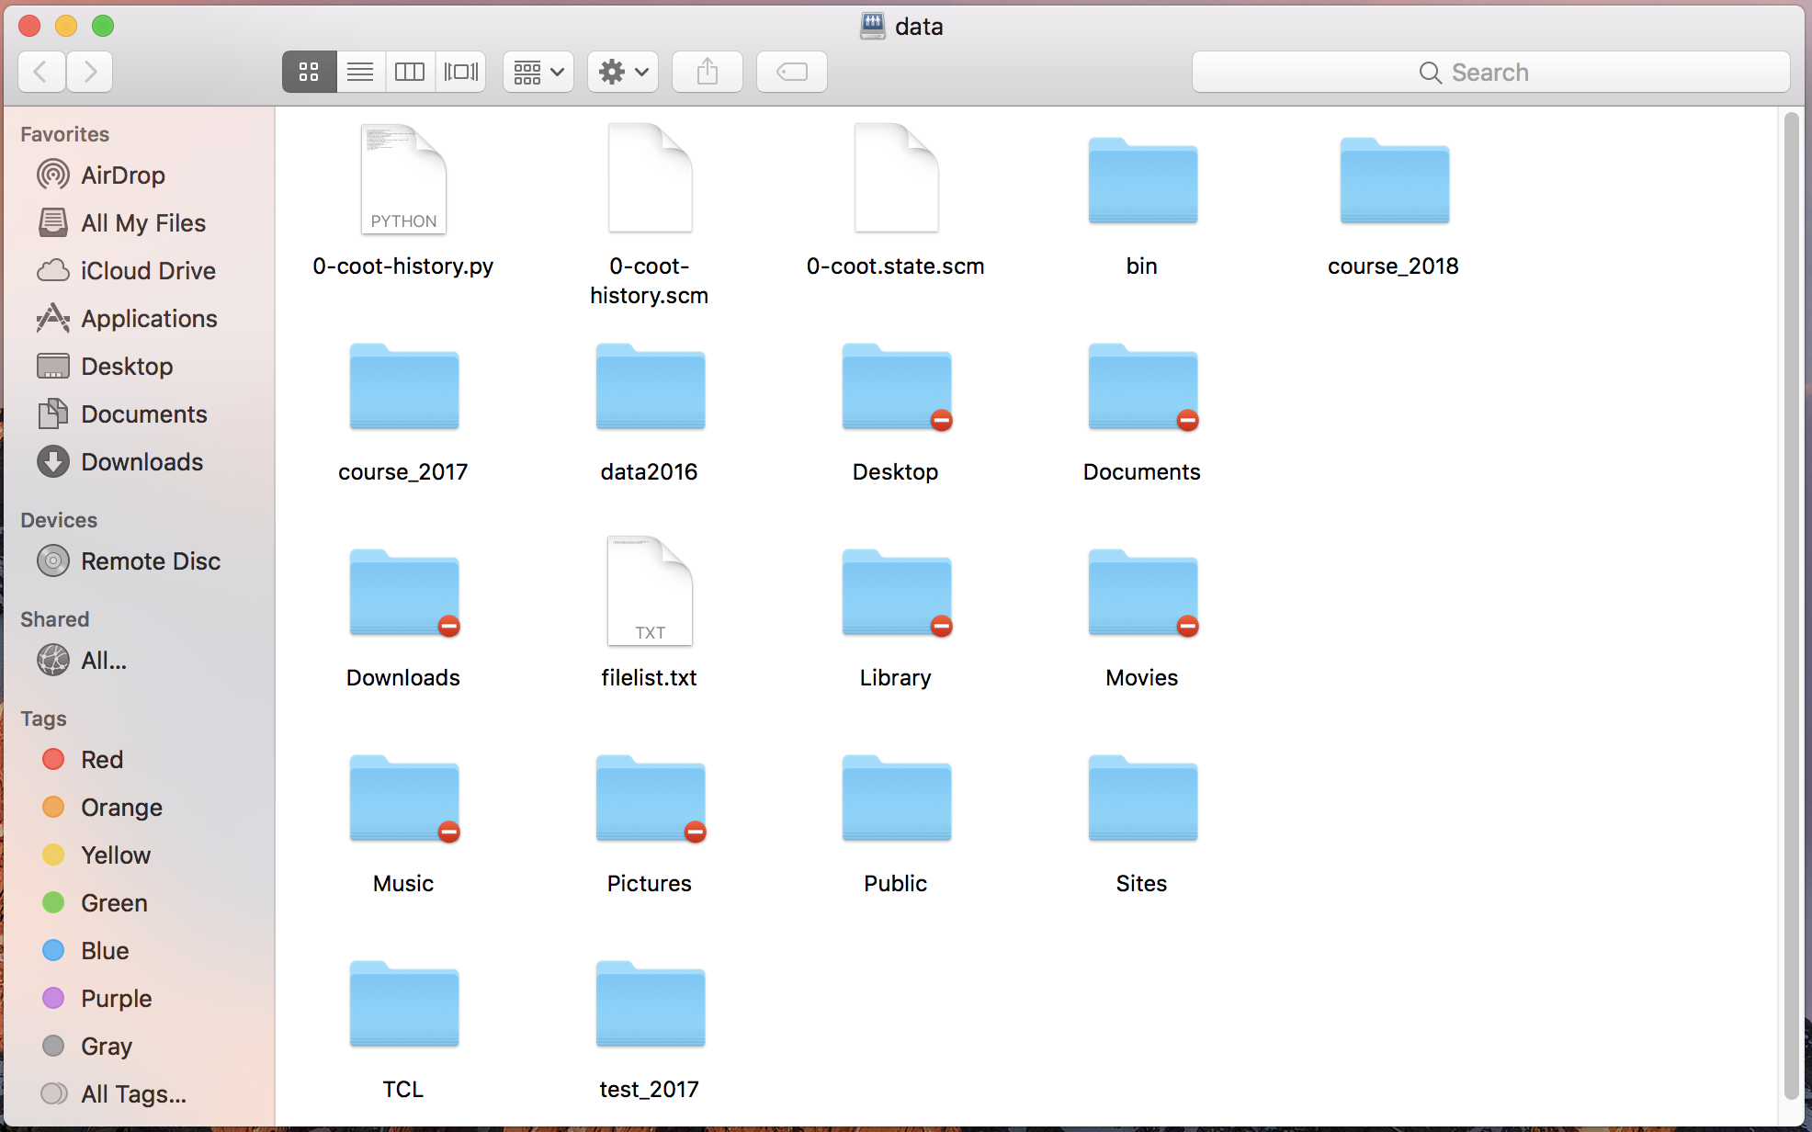
drag

Slide 24
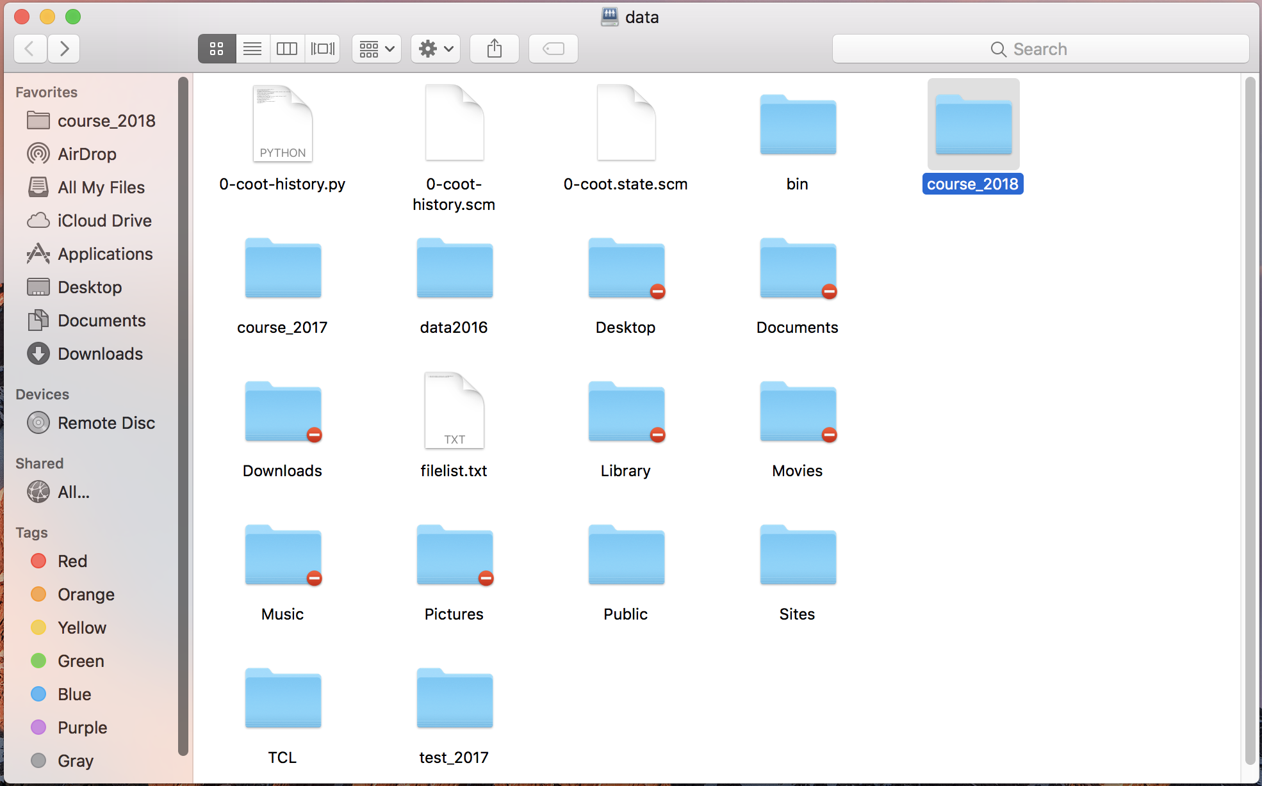

Slide 25
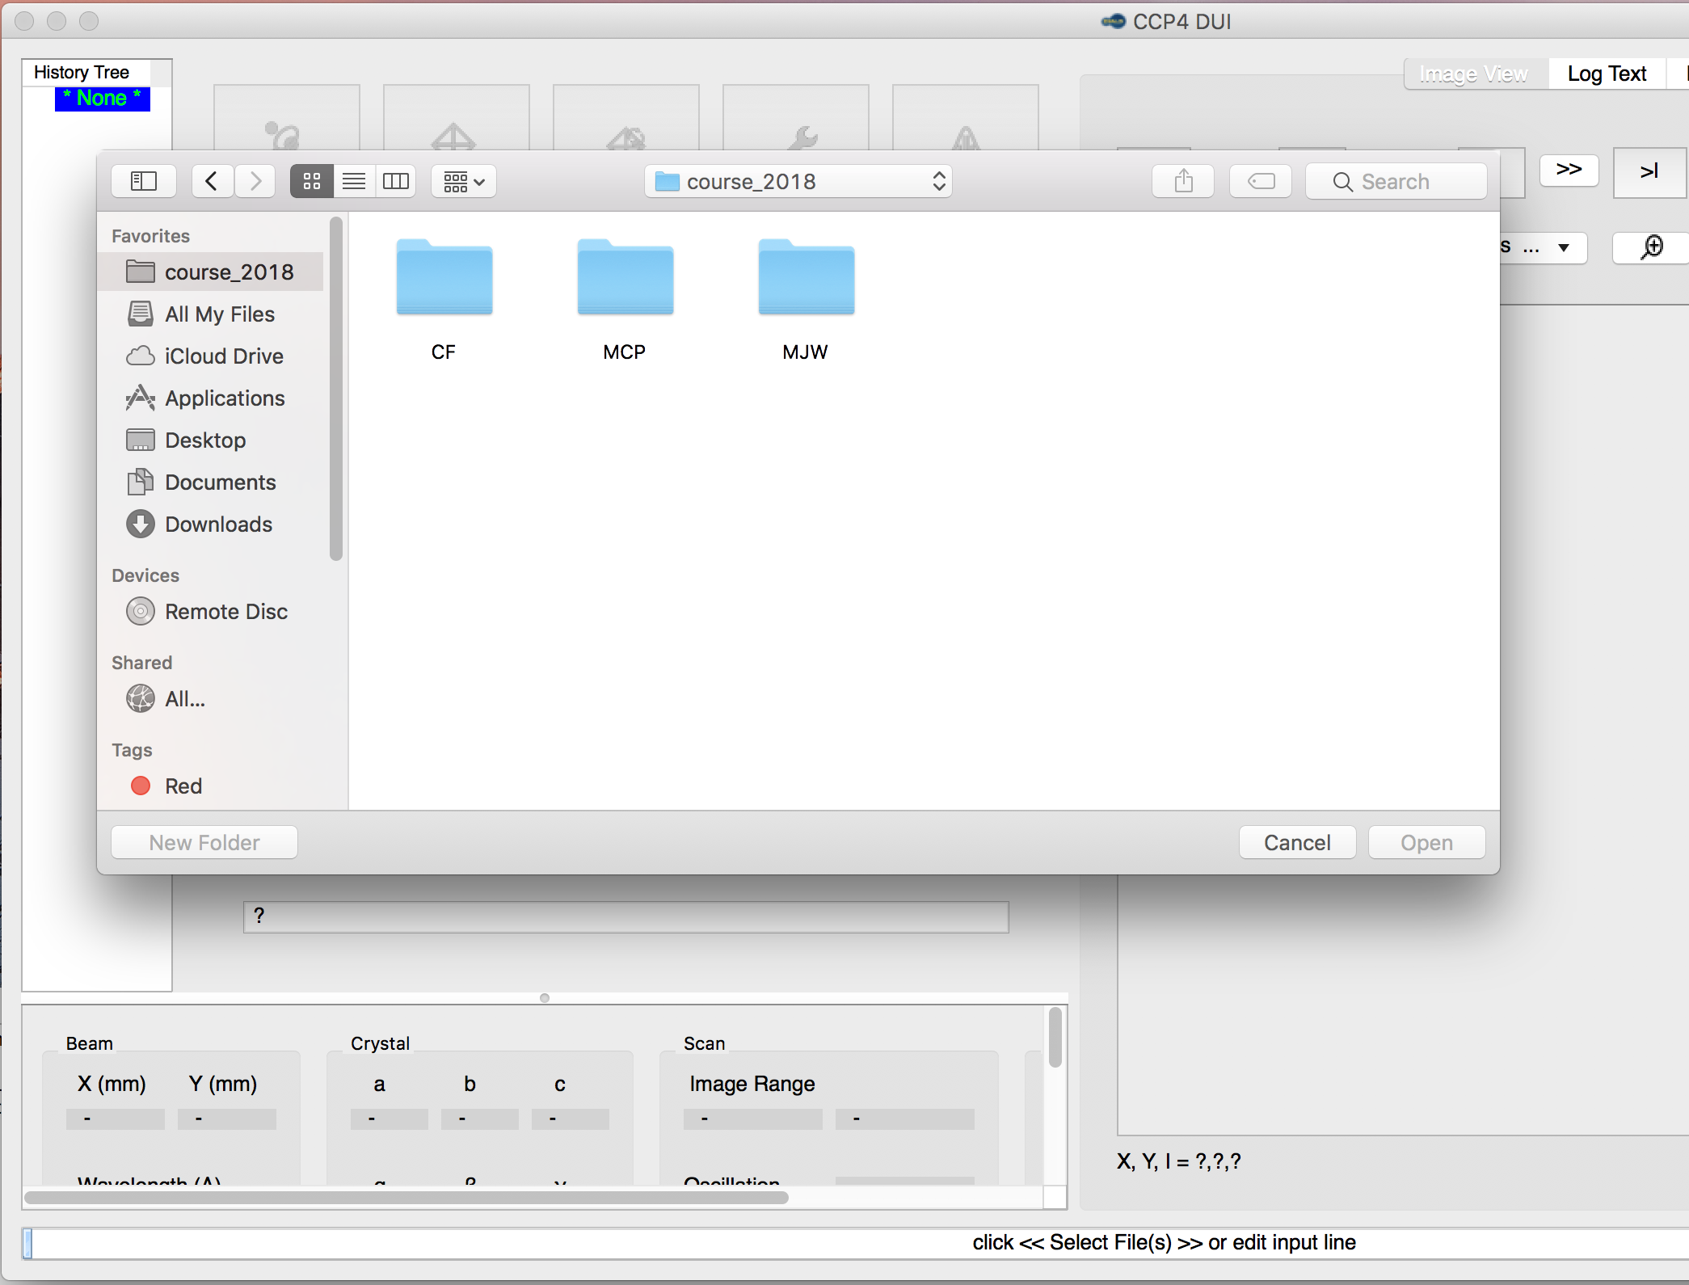

Slide 26
JMHolton@lbl.gov

Slide 27
Correct beam center
155.063 155.647
159.353 155.063
159.301 155.011
1512.73 1554.57
155.063 159.356 -250
ADXV
HKL2000
MOSFLM
XDS
DIALS

Slide 28
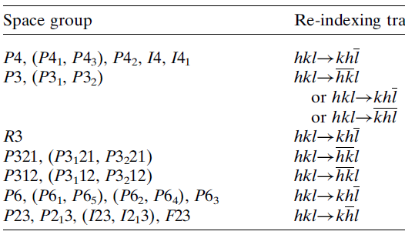
Re-indexing cheat sheet
Dauter, Z. (1999). "Data-collection strategies." Acta Cryst. D 55(10): 1703-1717.

Slide 29
How to run DIALS:
source /Applications/dials-v1-7-2/dials_env.csh
xia2 mosflm_beam_centre=151.4,144.8
/home/data/data2016/SERCAT-Sun/MM/MLYS/
dials.reciprocal_space_viewer

Slide 30
How to run DIALS the hard way:
% dials.import /home/ …. /MLYS/
% dials.find_spots datablock.json nproc=8
% dials.reciprocal_space_viewer datablock.json strong.pickle &
% dials.image_viewer datablock.json &
% dials.generate_mask untrusted.polygon=1958,2024,0,2005,0,2151,1956,2125 untrusted.circle=1964,2073,200
% open –t datablock.json

Slide 31
How to run DIALS the hard way:
% open -t datablock.json
Change origin to -144.8,151.4,-200
edit mask = mask.pickle
% dials.find_spots datablock.json nproc=8
% dials.index datablock.json strong.pickle \ space_group=P21 \ unit_cell=27.28,62.44,59.82,90,90.615,90
% dials.integrate experiments.json indexed.pickle
% dials.image_viewer integrated.pickle \ integrated_experiments.json

Slide 32
How to run DIALS the hard way:
% dials.export integrated_experiments.json integrated.pickle
% pointless hklin integrated.mtz hklout ptls.mtz | tee pointless.log
% egrep “Best|twin” pointless.log
% echo “refine parallel” |\
aimless hklin ptls.mtz hklout amls.mtz |\
tee aimless.log
% truncate hklin amls.mtz hklout truncated.mtz
% phenix.autosol truncated.mtz

Slide 33
XDS and xdsgui demo
prompt
Do not type!
underscore
~]$ cd
~]$ mkdir xds_tutorial
~]$ cd xds_tutorial
~]$ ln –sf ~/data/* /AA*/ data
~]$ xdsgui
Space!
Enter
Space!

Slide 34
$ echo symm P43212 |\
reindex hklin output_file_name.mtz hklout reindexed.mtz
$ uniqueify reindexed.mtz

Slide 35
Adding images
% cat << EOF > MERGE2CBF.INP
NAME_TEMPLATE_OF_DATA_FRAMES= /data/you/weak_?????.cbf
DATA_RANGE= 1 10
NAME_TEMPLATE_OF_OUTPUT_FRAMES=/data/you/sum_???.cbf
NUMBER_OF_DATA_FRAMES_COVERED_BY_EACH_OUTPUT_FRAME= 10
EOF
% merge2cbf
Which is better?:
% xds_runme.com /data/you/weak_?????.cbf
% xds_runme.com /data/you/sum_?????.cbf
“lossy”
compression

Slide 36
Merge multiple data sets?
% cat << EOF > MERGE2CBF.INP
NAME_TEMPLATE_OF_DATA_FRAMES= /data/you/weak_?????.cbf
DATA_RANGE= 1 10
NAME_TEMPLATE_OF_OUTPUT_FRAMES=/data/you/sum_???.cbf
NUMBER_OF_DATA_FRAMES_COVERED_BY_EACH_OUTPUT_FRAME= 10
EOF
% merge2cbf
Which is better?:
% xds_runme.com /data/you/weak_?????.cbf
% xds_runme.com /data/you/sum_?????.cbf
“lossy”
compression

Slide 37
Resolution cutoff?

Slide 38
Optimum resolution cutoff is:
Too optimistic: add nothing but noise
Too pessimistic: series-termination error
Happy medium?
Simulate:
Random atoms, compute F²
Add Gaussian noise, RMS = 1
Truncate
Subtract “right” map, RMS difference

Slide 39
Optimal resolution cutoff
Error in map (rms e⁻)
Resolution cutoff (Å)

Slide 40
Optimal resolution cutoff
Correlation Coefficient
Resolution cutoff (Å)

Slide 41
Optimal resolution cutoff
Correlation Coefficient
Resolution cutoff (Å)

Slide 42
Wilson Plot
2
log( intensity )
8
2.2 1.6 1.3 1.1 1.0 0.9 0.85 0.8 0.75 0.7
resolution (Å)

Slide 43
Optimum resolution cutoff is:
0.0 Å

Slide 44
But my reviewer says…
R_{merge} in high-resolution bin is >100% !
Answer: this is expected

Slide 45
Expected R_{merge} as I_{obs} → 0

Slide 46
Averaging Gaussian error
Average value
Number of samples averaged

Slide 47
Averaging Gauss/Gauss error
Average value
Number of samples averaged

Slide 48
R_{merge} at the resolution limit in PDB
Average outer-shell R_{merge}
Year

