Slide 1
PowerPoint File available:
http://bl831.als.lbl.gov/
~jamesh/powerpoint/
CSHL_SvN_2015.pptx

Slide 2
Acknowledgements
Robert Stroud James Fraser John Spence
Chris Nielsen Clemens Schulze-Briese Aina Cohen Ana Gonzalez
UCSF LBNL SLAC
ALS 8.3.1 creator: Tom Alber
Center for Structure of Membrane Proteins (CSMP)
Membrane Protein Expression Center II (MPEC)
Center for HIV Accessory and Regulatory Complexes (HARC)
UC Multicampus Research Programs and Initiatives (MRPI)
UCSF Program for Breakthrough Biomedical Research (PBBR) Integrated Diffraction Analysis Technologies (IDAT)
Plexxikon, Inc.
M D Anderson CRC
Synchrotron Radiation Structural Biology Resource (SLAC)
The Advanced Light Source is supported by the Director, Office of Science, Office of Basic Energy Sciences, Materials Sciences Division, of the US Department of Energy under contract No. DE-AC02-05CH11231 at Lawrence Berkeley National Laboratory.

Slide 3
The “success rate” of structure determination
100 s/dataset
200 days/year
~150 beamlines
~26,000,000 datasets/year
9640 PDBs in 2014

Slide 4
signal vs noise
“If you don’t have
good data,
then you have
no data at all.”
-Sung-Hou Kim

Slide 5
signal vs noise
easy
hard
impossible
threshold of “solvability”

Slide 6
signal vs noise
“If you don’t have
good data,
then you must
learn statistics.”
-James Holton

Slide 7
Adding noise
1² + 1² = 1.4²
3² + 1² = 3.2²
10² + 1² = 10.05²

Slide 8

100% SeMet incorporation
Trivial to solve

Slide 9

100% S -Met incorporation
Impossible to solve

Slide 10
Phase Problem: Se vs S
correlation coefficient
fraction Sulfur

Slide 11
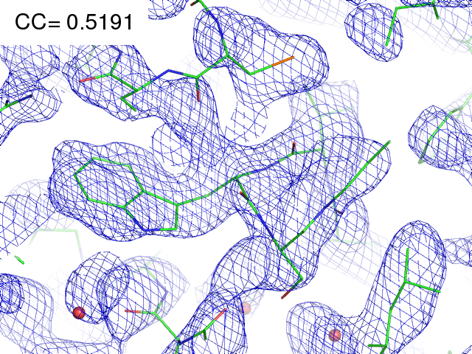
21% Se 79% S

Slide 12
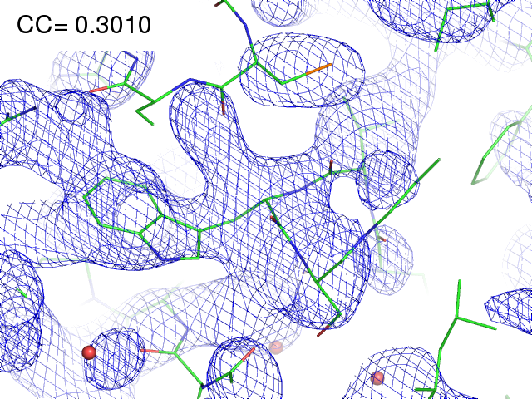
11% Se 89% S

Slide 13
Finding sites
25
20
15
10
5
0
Number of correct sites
peak height (σ)
fraction Sulfur

Slide 14
Finding sites
Number of correct sites
fraction Sulfur

Slide 15
MR simulation
corrupted model
Correlation coefficient to correct density
Rmsd from perfect search model (Å)

Slide 16
The transitions are sharp!
How can we predict success/failure?
Know Thy Experiment

Slide 17
Elastic scattering

Slide 18
Inelastic scattering

Slide 19
Photoelectric absorption
e⁻
+

Slide 20
Fluorescence
e⁻
+

Slide 21
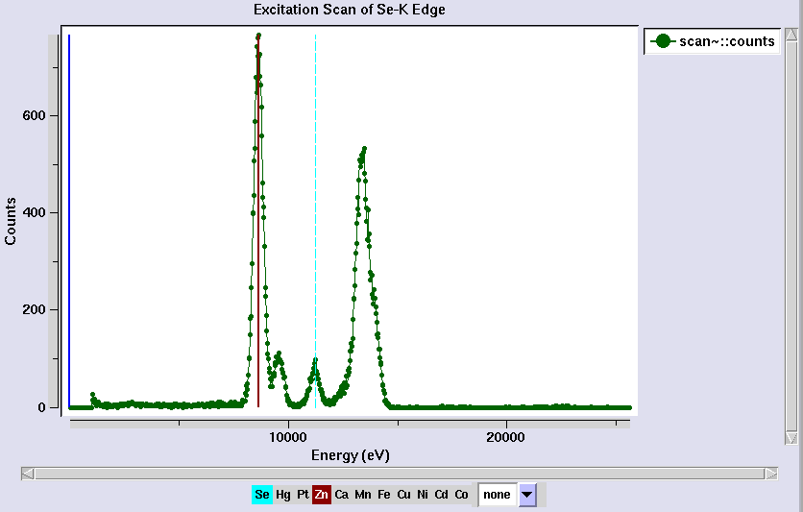
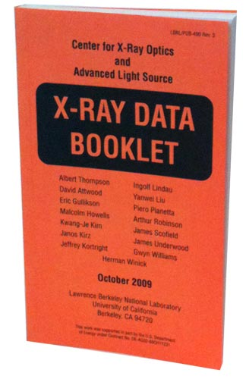
Metal identification

Slide 22
Auger emission
e⁻
++

Slide 23
Ionization track
e⁻
e⁻
e⁻
e⁻
+
e⁻
+
+
+
e⁻
e⁻
+
+
+
+
+
e⁻
+
e⁻
e⁻

Slide 24
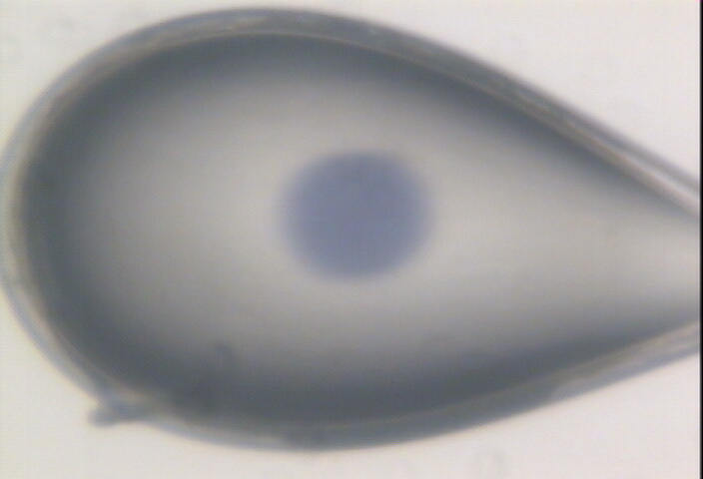

Slide 25

Where do photons go?
Protein
1A x-rays
elastic scattering (6%)
Transmitted (98%)
beamstop
inelastic scattering (7%)
Photoelectric (87%)
Re-emitted (99%)
Absorbed (~0%)
Re-emitted (~0%)
Absorbed (99%)
useful/absorbed energy: 7.3%

Slide 26
scattering
x-ray beam
sample
detector

Slide 27
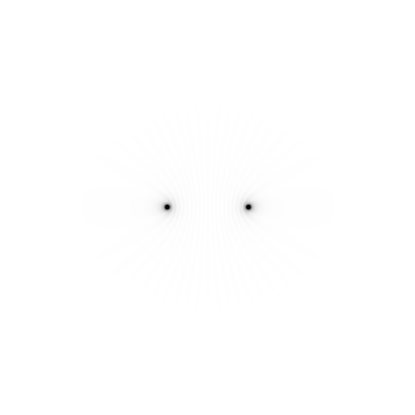
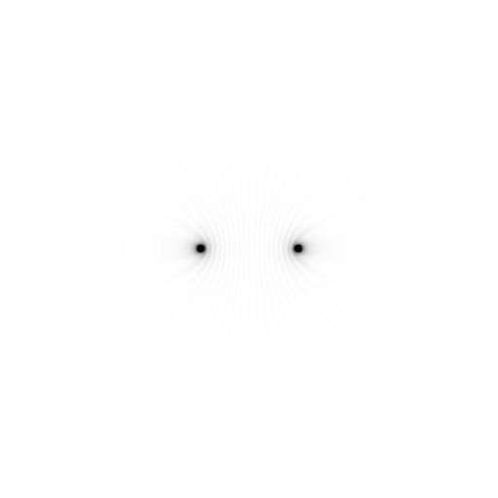
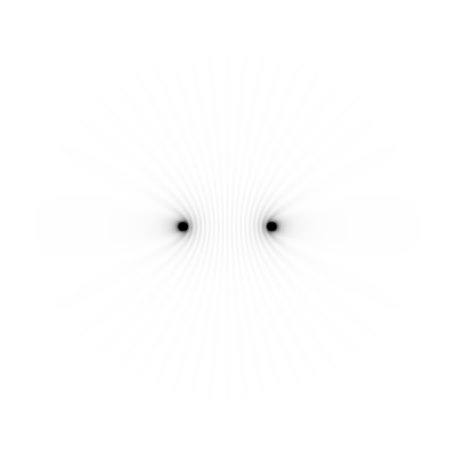
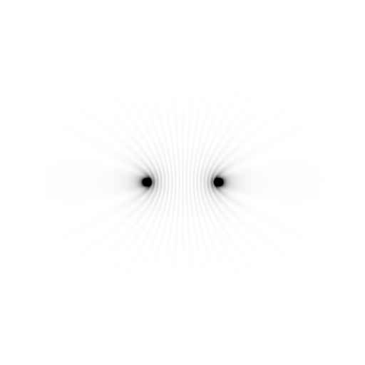
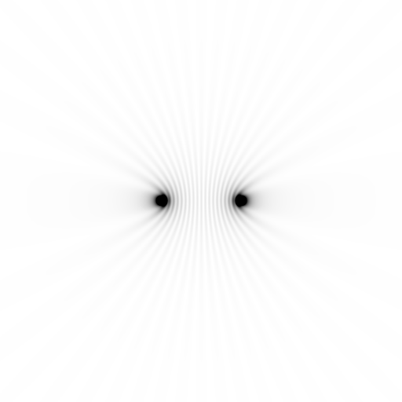
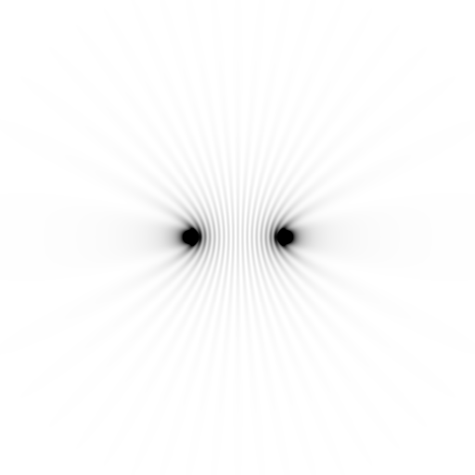
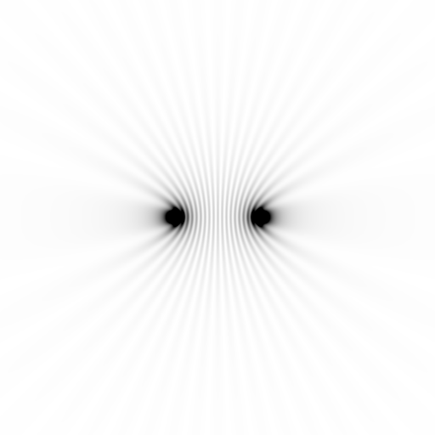
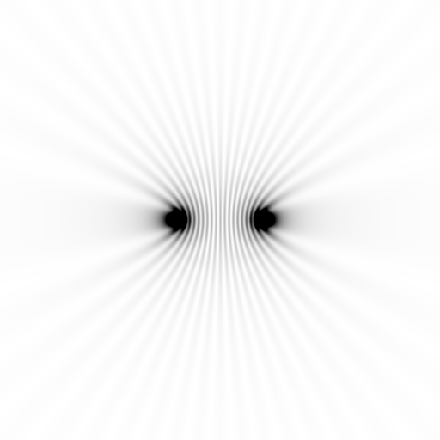
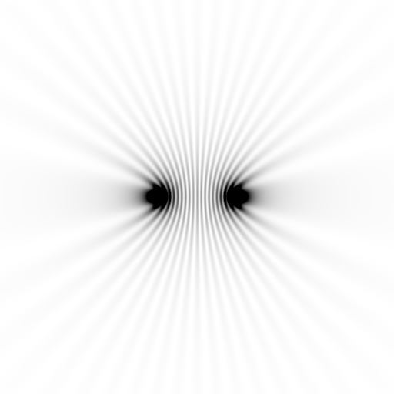
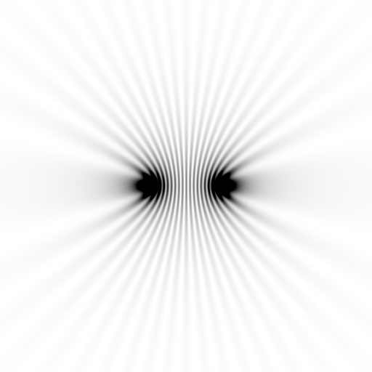
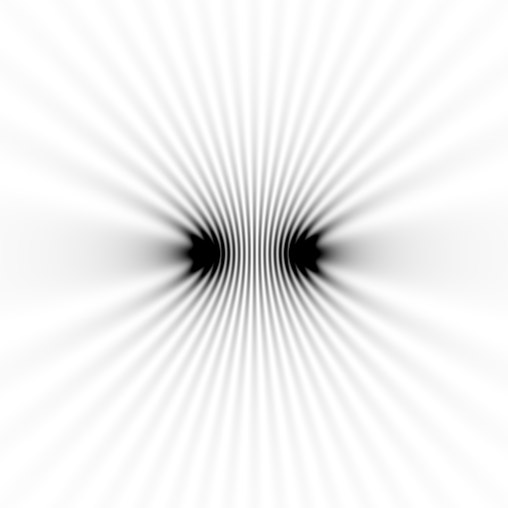
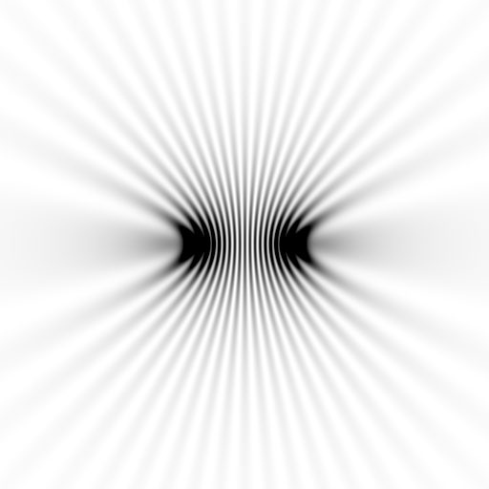
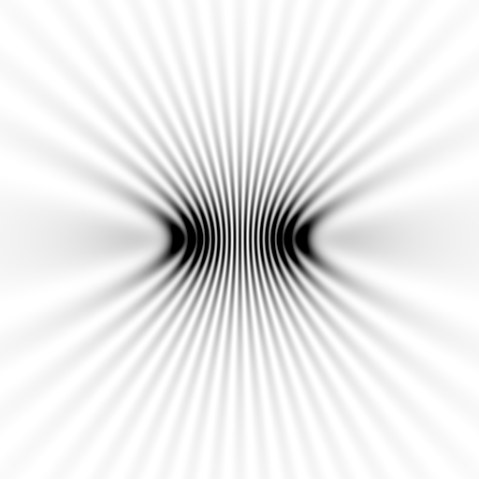
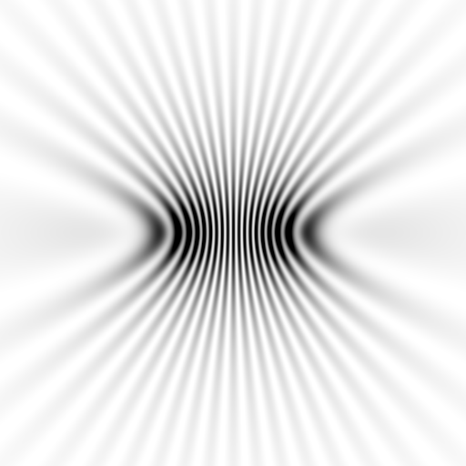
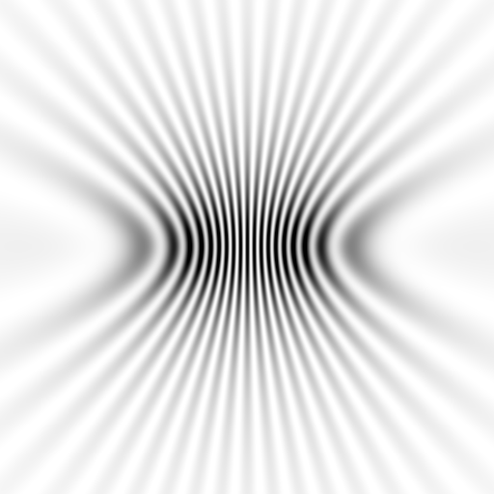
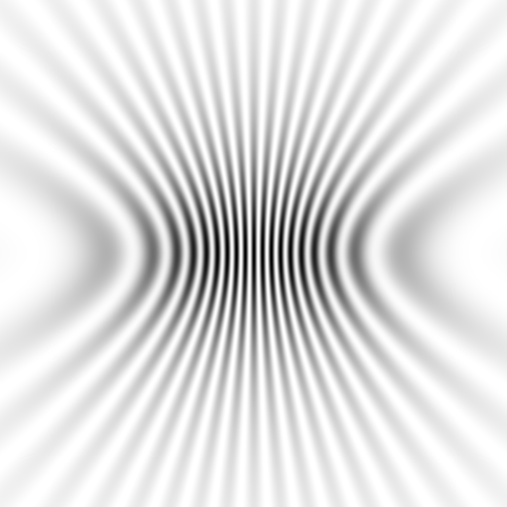
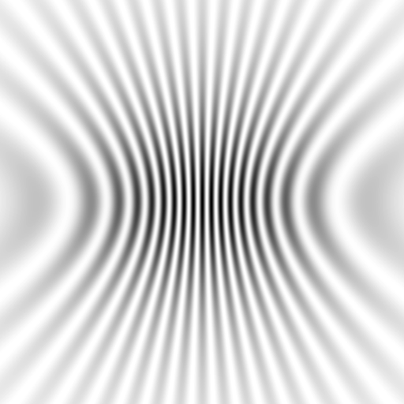
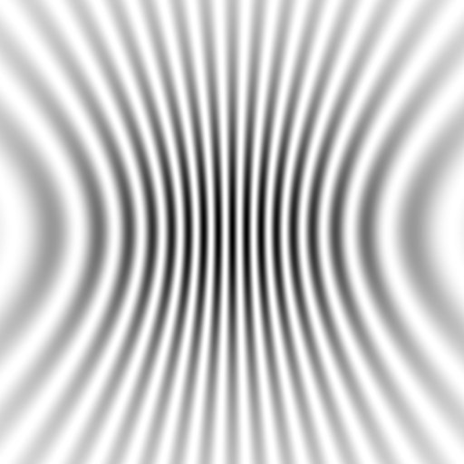





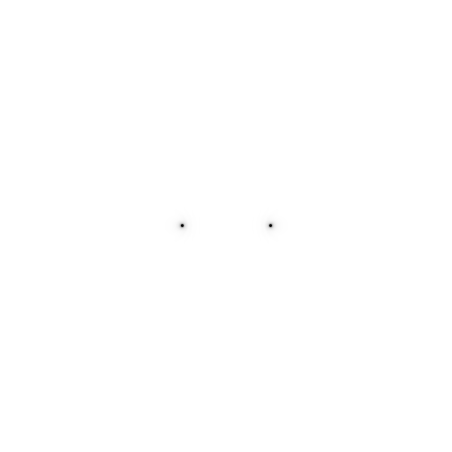
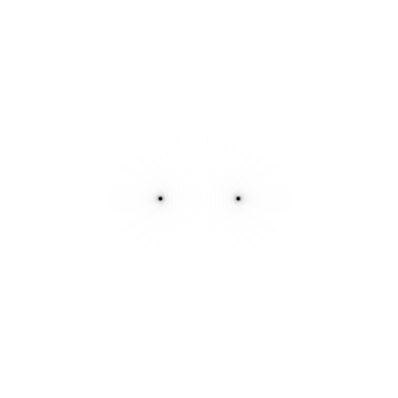


Slide 28
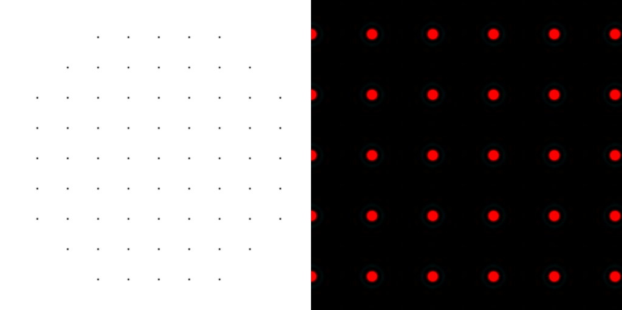
scattering from a lattice
colored by phase
sample
detector

Slide 29
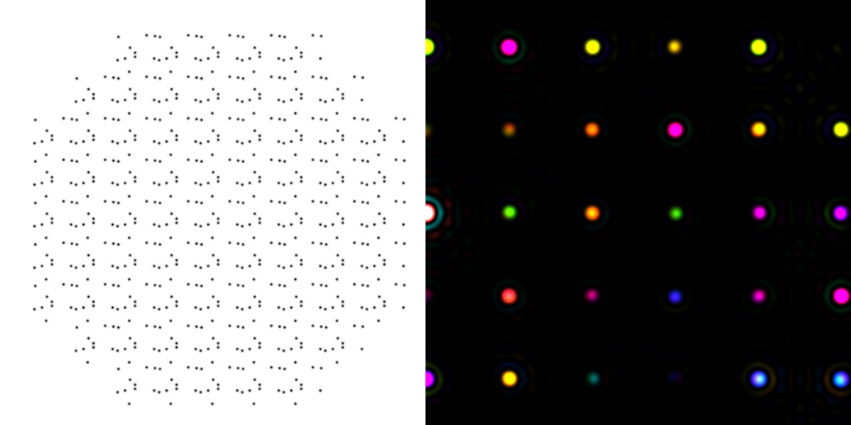

scattering from a crystal structure
colored by phase
sample
detector

Slide 30
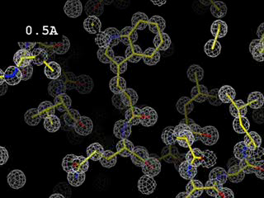
Resolution
http://bl831.als.lbl.gov/~jamesh/movies/resolution.mpeg

Slide 31
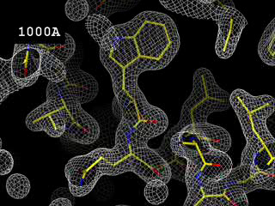
Resolution: low-angle cutoff
http://bl831.als.lbl.gov/~jamesh/movies/lo_cut.mpeg

Slide 32
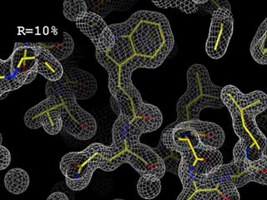
R-factor
http://bl831.als.lbl.gov/~jamesh/movies/rfactor.mpeg

Slide 33
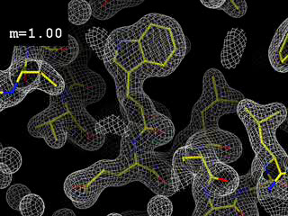
Figure of Merit
http://bl831.als.lbl.gov/~jamesh/movies/dephase.mpeg

Slide 34
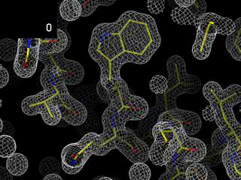
Overloads
http://bl831.als.lbl.gov/~jamesh/movies/overloads.mpeg

Slide 35
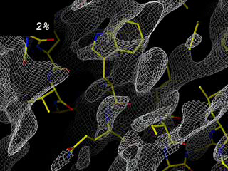
Completeness: missing wedge
http://bl831.als.lbl.gov/~jamesh/movies/osc.mpeg

Slide 36
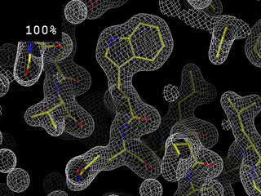
Completeness: random deletion
http://bl831.als.lbl.gov/~jamesh/movies/completeness.mpeg

Slide 37
At the beamline…
Resolution
  problem: background
  solution: use as few pixels as possible
Phases
  problem: fractional errors
  solution: use as many pixels as possible

Slide 38
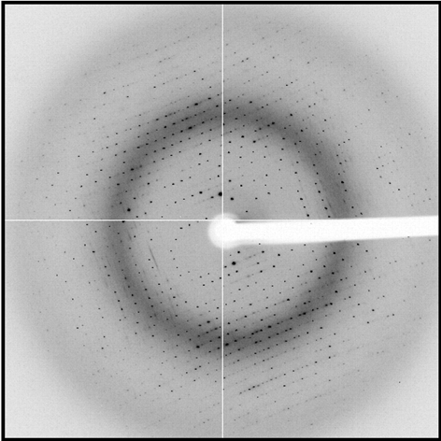
shoot the whole crystal

Slide 39
shoot the whole crystal

Slide 40
shoot the whole crystal

Slide 41
shoot nothing but the crystal

Slide 42
shoot nothing but the crystal

Slide 43
X-ray scattering “rules”:
1 μm crystal ≈ 1 μm water
≈ 1 μm plastic
≈ 0.1 μm glass
≈ 1000 μm air

Slide 44
Resolution (Å)
too big
too small
just right
X-ray beam size (μm)

Slide 45
Background scattering

Slide 46
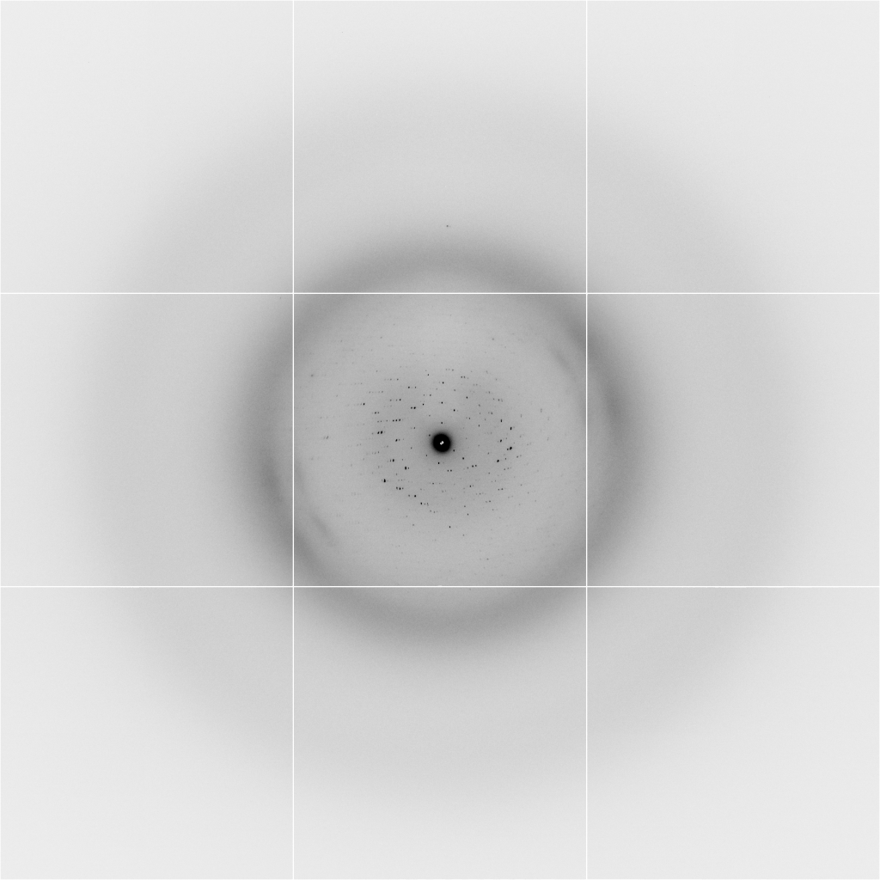
Background scattering
$100,000.00
$100,000.00
$100,000.00
real estate is
expensive
use it!
$100,000.00
$100,000.00
$100,000.00
$100,000.00
$100,000.00

Slide 47
The truth about x-ray beams
Term units significance
Flux photons/s duration of experiment
Beam Size μm match to crystal
Divergence mrad spot size vs distance
Wavelength Å resolution and absorption
Dispersion Δλ/λ spot size
Flux density ph/s/area scattering/damage rate
Fluence ph/area scattering/damage

Slide 48
The truth about x-ray beams
Term units significance
Flux photons/s duration of experiment
Beam Size μm match to crystal
Divergence mrad spot size vs distance
Wavelength Å resolution and absorption
Dispersion Δλ/λ spot size
Flux density ph/s/area scattering/damage rate
Fluence ph/area scattering/damage

Slide 49
The truth about x-ray beams
quantity | units | home source | APS 22-ID
flux | Photons/second | 7.6 x 10³ | 7 x 10¹²
exposure | time | 52 days | 1 second
Dispersion | wavelength range / wavelength | 0.014% (Si111) | 0.014% (Si111)
Divergence | milliRadian | 0.1 | 0.1
Beam size | microns | 56 | 40 (h) 80 (v)
Spectral brightness | Photons/s/mm²/ mR²/0.1%BW | 1.7 x 10¹⁰ | 1.5 x 10¹⁹

Slide 50
Fine Slicing
background
background
Pflugrath, J. W. (1999)."The finer things in X-ray diffraction data collection", Acta Cryst. D 55, 1718-1725.

Slide 51
Classes of error in MX
Dependence on signal
none sqrt proportional
CCD
Read-out
Photon
counting
Detector calibration
attenuation
partiality
Non-isomorphism
Radiation damage
none
1/sqrt
1/prop.
Time
Beam flicker
Shutter jitter
Sample vibration

Slide 52

Optimal exposure time
(faint spots)
t_{hr} Optimal exposure time for data set (s)
t_{ref} exposure time of reference image (s)
bg_{ref} background level near weak spots on
reference image (ADU)
bg₀ ADC offset of detector (ADU)
bg_{hr} optimal background level (via t_{hr})
σ₀ rms read-out noise (ADU)
gain ADU/photon
m multiplicity of data set (including partials)
adjust exposure
so this is ~15

Slide 53
beam size vs xtal size
  Put your crystal into the beam
  Shoot the whole crystal
  Shoot nothing but the crystal
  Back off!
  The crystal must rotate

Slide 54
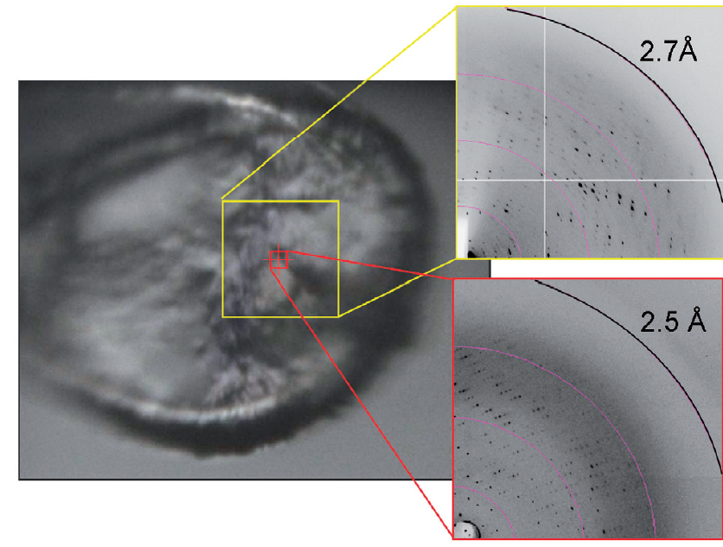
Get thee to a microbeam?
Evans et al. (2011)."Macromolecular microcrystallography", Crystallography Reviews 17, 105-142.

Slide 55
anomalous signal
ΔF
F
√
# sites
MW (Da)
≈ 1.2 f”
World record!
ΔF/F = 0.5%
Wang, Dauter & Dauter (2006) Acta Cryst. D 62, 1475-1483.
Crick, F. H. C. & Magdoff, B. S. (1956) Acta Crystallogr. 9, 901-908.
Hendrickson, W. A. & Teeter, M. M. (1981) Nature 290, 107-113.

Slide 56
Fractional error
^{mult >} (—)²
~3%
<ΔF/F>

Slide 57
Can you count to 1,000,000 ?
sqrt(1,000,000)
1,000,000
Theoretically:
= 0.1%
R_{meas} ≈ 0.1% ?
ISa = 1000
In reality:
ISa ~ 33
R_{meas =} ≈ 3%
sqrt(1,000)
1,000
= 3%
photon
spot
> 1000 is a waste!

Slide 58
Threshold of a revolution in phasing
Current
technology
Goal
Solve-able proteins (%)
Required signal-to-noise (I/σ)

Slide 59
Threshold of a revolution in phasing
Source of error | realistic simulation | No SHSSS | Perfect detector
Photon counting | + | + | +
Shutter jitter | + | + | -
Beam flicker | + | + | -
Sample absorption | + | + | -
Radiation damage | + | + | -
Imperfect spindle | + | + | -
vignette | + | + | -
Corner correction | + | + | -
SHSSS | + | - | -
R_{meas} (∞-10 Å) | 2.8% | 0.7% | 0.7%
I/σ asymptotic | 26.8 | 74.2 | 81.0
Holton et al (2014) "R-factor gap", FEBS Journal 281, 4046-4060.

Slide 60
Spatial Heterogeneity in Sharp Spot Sensitivity
Relative spot intensity
Spot centroid position (pixels)

Slide 61
SHSSS!
The dominant source of error for anomalous difference measurements
Spatial
Heterogeneity in
Sharp
Spot
Sensitivity
Flat
Field

Slide 62
Gadox calibration vs energy
same = good!
Relative absorption depth
bad!
photon energy (keV)

Slide 63

Pilatus: subtract smooth baseline
~3x10⁵ photon/pixel
Bragg
glitch
“tree rings”
Pick-up tool mark
oxygen
inclusions
1% high
average
1% low

Slide 64
PAD: need more than flood-field
θ
Bragg
glitch
width
incoming
photon
λ
oxygen
inclusion
thickness
detection
event
N
N
N

Slide 65
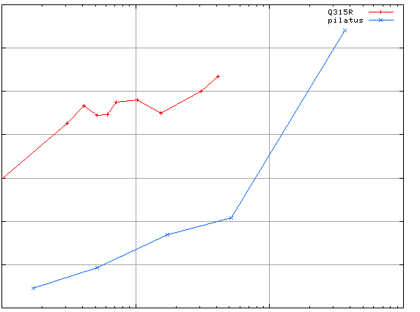
3.5
3.0
2.5
2.0
1.5
1.0
0.5
CCD detector
different
modules
anomalous mates are always on
different modules
SHSSS
Systematic component of R_{sseparate} (%)
Pilatus
SN001
Pilatus
SN113
0.1 1 10 100
distance between spots (mm)

Slide 66

Holton & Frankel (2010) Acta D 66 393-408.

Slide 67

Dose slicing
unacceptable
damage
N
photons
crystal’s useful life
N
photons
unacceptable
read noise
N
photons

Slide 68
140-fold multiplicity: 16 crystals, 360° each, inverse beam, 7235 eV
RESOLUTION COMPLETENESS R-FACTOR I/SIGMA R-meas CC(1/2) Anomal SigAno Nano
LIMIT OF DATA observed Corr
9.17 99.1% 3.9% 257.47 3.9% 100.0* 91* 5.024 450
6.49 100.0% 5.2% 214.33 5.2% 100.0* 86* 3.836 882
5.30 100.0% 7.2% 165.13 7.2% 100.0* 76* 3.257 1175
4.59 100.0% 7.2% 175.42 7.3% 100.0* 67* 2.589 1403
4.10 99.9% 7.7% 174.13 7.7% 100.0* 59* 2.264 1594
3.74 99.9% 9.4% 143.09 9.4% 100.0* 49* 1.953 1783
3.47 100.0% 11.2% 120.17 11.2% 100.0* 39* 1.696 1942
3.24 100.0% 14.1% 91.14 14.1% 100.0* 30* 1.333 2103
3.06 99.9% 19.5% 65.79 19.5% 100.0* 23* 1.117 2214
2.90 99.9% 29.0% 44.85 29.1% 99.9* 17* 1.008 2369
2.77 99.9% 40.5% 32.58 40.6% 99.8* 11* 0.901 2493
2.65 99.9% 52.8% 25.16 52.9% 99.8* 10* 0.866 2605
2.54 100.0% 67.4% 19.47 67.6% 99.6* 2 0.804 2705
2.45 100.0% 88.9% 14.58 89.2% 99.2* 4 0.831 2859
2.37 100.0% 109.3% 9.97 109.7% 98.1* 5 0.829 2925
2.29 100.0% 138.2% 6.87 138.9% 96.1* 1 0.760 3037
2.22 100.0% 197.1% 4.03 198.6% 83.5* -1 0.721 3159
2.16 100.0% 227.3% 2.41 230.8% 46.9* -1 0.677 3224
2.10 61.2% 154.4% 1.28 163.6% 47.0* -2 0.660 1999
2.05 47.9% 170.1% 0.68 196.5% 25.7* 3 0.629 1578
total 93.3% 15.7% 54.30 15.8% 100.0* 12* 1.217 42499

Slide 69
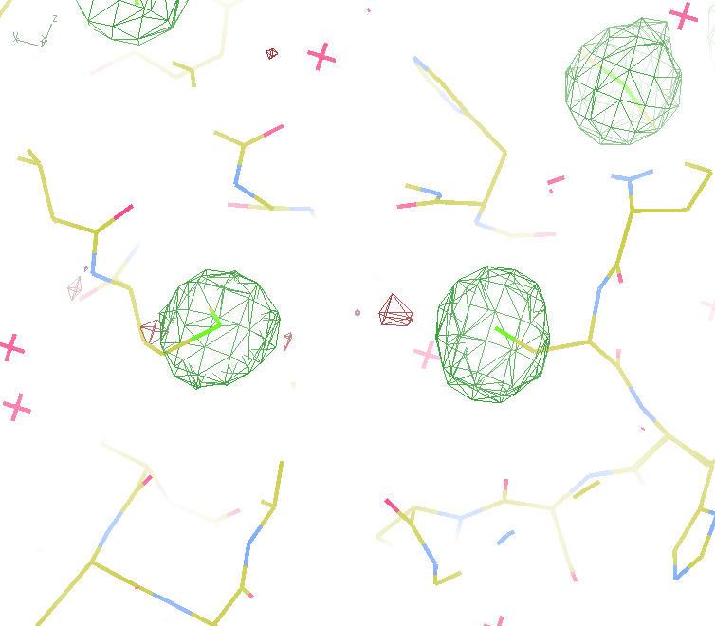
140-fold multiplicity
18 σ
16 σ
Phased anomalous difference Fourier

Slide 70
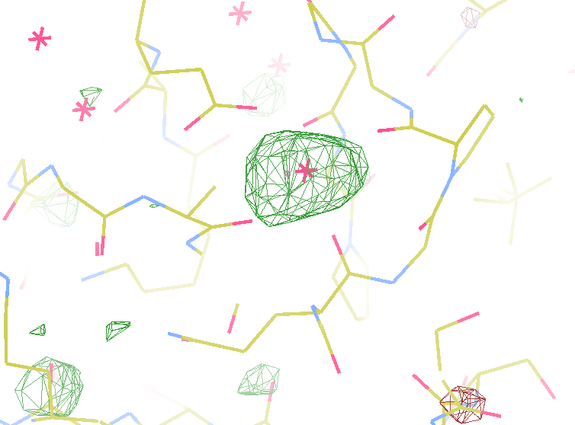
140-fold multiplicity
7.4σ = Na
DELFAN residual anomalous difference

Slide 71
Suggested anomalous protocol:
360° in < 5 MGy
move detector
4X exposure
goto 2
2 wavelengths are better than 1
- (peak + inf)/2, and remote
MAD, not M-SAD!

Slide 72
Summary
http://bl831.als.lbl.gov/xtalsize.html
http://bl831.als.lbl.gov/xtallife.html
http://bl831.als.lbl.gov/~jamesh/mlfsom/
http://bl831.als.lbl.gov/~jamesh/powerpoint/CSHL_tipsNtricks_2015.pptx
15 ADU/pixel
10 μm for lysozyme
~3% error per spot, 1%/MGy
7235 eV for S-SAD
“Attenu-wait”: dose slicing

