Slide 1
PowerPoint File available:
http://bl831.als.lbl.gov/
~jamesh/powerpoint/
CSHL_SvN_2015.pptx

Slide 2
Acknowledgements
Robert Stroud James Fraser John Spence
Chris Nielsen Clemens Schulze-Briese Aina Cohen Ana Gonzalez
UCSF LBNL SLAC
ALS 8.3.1 creator: Tom Alber
Center for Structure of Membrane Proteins (CSMP)
Membrane Protein Expression Center II (MPEC)
Center for HIV Accessory and Regulatory Complexes (HARC)
UC Multicampus Research Programs and Initiatives (MRPI)
UCSF Program for Breakthrough Biomedical Research (PBBR) Integrated Diffraction Analysis Technologies (IDAT)
Plexxikon, Inc.
M D Anderson CRC
Synchrotron Radiation Structural Biology Resource (SLAC)
The Advanced Light Source is supported by the Director, Office of Science, Office of Basic Energy Sciences, Materials Sciences Division, of the US Department of Energy under contract No. DE-AC02-05CH11231 at Lawrence Berkeley National Laboratory.

Slide 3
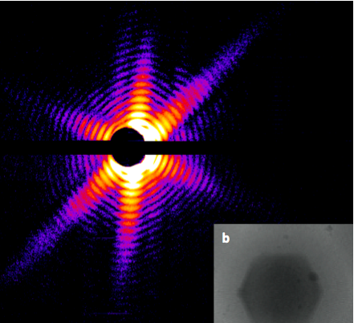
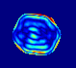
Snapshot from single virus particle
2 keV LCLS 200 fs Mimi virus single-shot.
_{200 nm}
_{Reconstructed image}
_{Resolution 20nm}
_{TEM}
Seibert, et al. (2011). Nature 470, 78-81.
Notes:
what limits single-particle resolution ?
get 100 times more photons/shot if correctly focussed beam
get 100 times more with submicron beam focus on CXI chamber
Problem – scattering goes from N^2 to N (Wilson statistics).
So use a-priori information – modelling Axel Brummer
Make beam smaller than jet to elliminate streak
₃

Slide 4
The “success rate” of structure determination
100 s/dataset
200 days/year
~150 beamlines
~26,000,000 datasets/year
9640 PDBs in 2014

Slide 5
signal vs noise
“If you don’t have
good data,
then you have
no data at all.”
-Sung-Hou Kim

Slide 6
signal vs noise
easy
hard
impossible

Slide 7
signal vs noise
easy
hard
impossible
threshold of “solvability”

Slide 8
signal vs noise
“If you don’t have
good data,
then you must
learn statistics.”
-James Holton

Slide 9
Adding noise

Slide 10
Adding noise
1² + 1² = 1.4²

Slide 11
Adding noise
1² + 1² = 1.4²
3² + 1² = 3.2²
σ_{total}² = σ₁² + σ₂²

Slide 12
Adding noise
1² + 1² = 1.4²
3² + 1² = 3.2²
σ_{total}² = σ₁² + σ₂²

Slide 13
Adding noise
1² + 1² = 1.4²
3² + 1² = 3.2²
σ_{total}² = σ₁² + σ₂²

Slide 14
Adding noise
1² + 1² = 1.4²
3² + 1² = 3.2²
10² + 1² = 10.05²

Slide 15

100% SeMet incorporation
Trivial to solve

Slide 16

100% S -Met incorporation
Impossible to solve

Slide 17
Phase Problem: Se vs S
correlation coefficient
fraction Sulfur

Slide 18
Phase Problem: Se vs S
correlation coefficient
fraction Sulfur

Slide 19
Phase Problem: Se vs S
correlation coefficient
fraction Sulfur

Slide 20
Phase Problem: Se vs S
correlation coefficient
fraction Sulfur

Slide 21
Phase Problem: Se vs S
correlation coefficient
fraction Sulfur

Slide 22
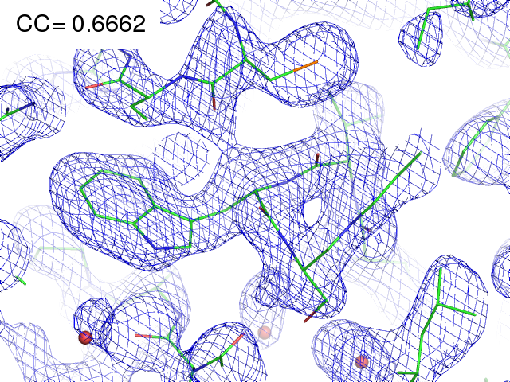
29% Se 71% S

Slide 23
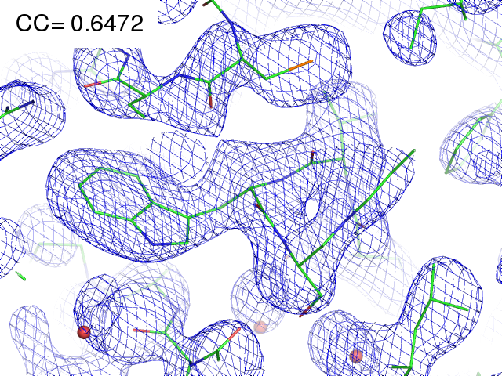
28% Se 72% S

Slide 24
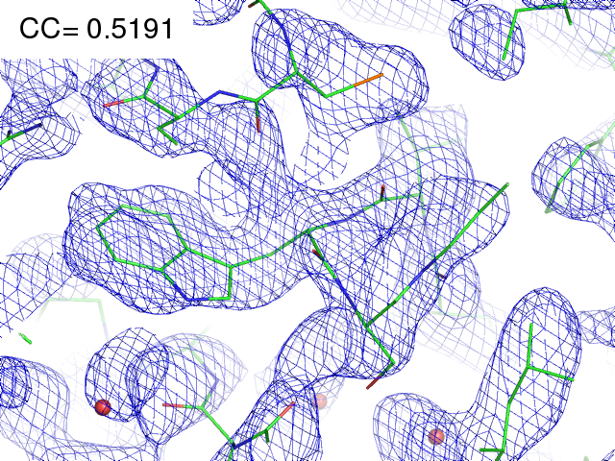
21% Se 79% S

Slide 25
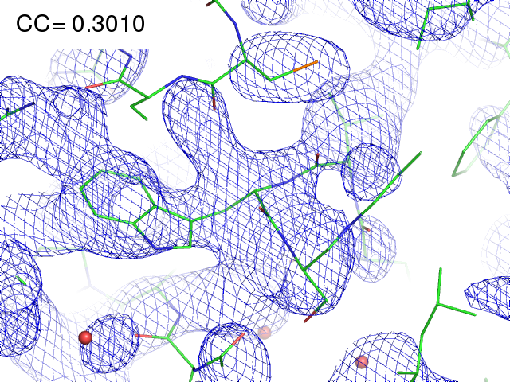
11% Se 89% S

Slide 26
Finding sites
Number of correct sites
fraction Sulfur

Slide 27
Finding sites
Number of correct sites
fraction Sulfur

Slide 28
Finding sites
Number of correct sites
fraction Sulfur

Slide 29
Finding sites
25
20
15
10
5
0
Number of correct sites
peak height (σ)
fraction Sulfur

Slide 30
Finding sites
Number of correct sites
fraction Sulfur

Slide 31
MR simulation
corrupted model
Correlation coefficient to correct density
Rmsd from perfect search model (Å)

Slide 32
The transitions are sharp!
How can we predict success/failure?
Know Thy Experiment

Slide 33
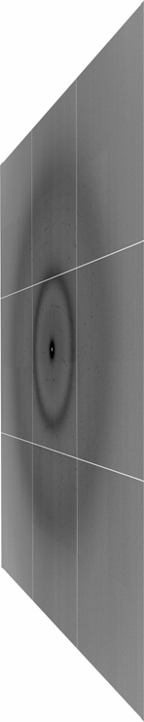

Beamline optics … simplified
pinhole
Scatter
guard
X-ray
Source
ADSC Quantum 315r
Protein Crystal
Notes:
Most notable acheivements are high brightness with very little “wasted” light. The discovery made by Howard Padmore? At ALS showed that a 2:1 demagnification cancels nearly all of the spherical abberations in the parabolic/torroid system. 30-50% of the total x-ray intensity passes through the 100um pinhole. The flux through the 100um pinhole at the superbend beamlines is comparable to that of the 5.0.2 wiggler or an APS bending magnet, but only 150 Watts of power must be dissipated by the beamline optics. In contrast, wiggler beamlines must disipate kilowatts. The optics here are much simpler and not exotic in any way. The system is stable and robust. There is never a need to re-focus the beam at a new wavelength. Only a 2-minute automatic tuneup is recommended for very large energy changes (more than 1-2 keV).

Slide 34
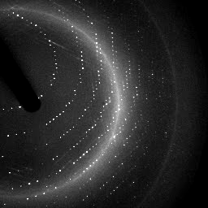
X-ray data are 3D!

Slide 35
Where do photons go?
Protein
1A x-rays
Transmitted (98%)
beamstop

Slide 36
Elastic scattering

Slide 37
Elastic scattering

Slide 38

Where do photons go?
Protein
1A x-rays
elastic scattering (6%)
Transmitted (98%)
beamstop

Slide 39
Elastic scattering

Slide 40
Inelastic scattering

Slide 41
Where do photons go?
Protein
1A x-rays
elastic scattering (6%)
Transmitted (98%)
beamstop

Slide 42
Where do photons go?
Protein
1A x-rays
elastic scattering (6%)
Transmitted (98%)
beamstop
inelastic scattering (7%)

Slide 43
Where do photons go?
Protein
1A x-rays
elastic scattering (6%)
Transmitted (98%)
beamstop
inelastic scattering (7%)
Re-emitted (99%)
Absorbed (~0%)

Slide 44
Photoelectric absorption

Slide 45
Photoelectric absorption
e⁻
+

Slide 46
Fluorescence
+

Slide 47
Fluorescence
e⁻
+

Slide 48
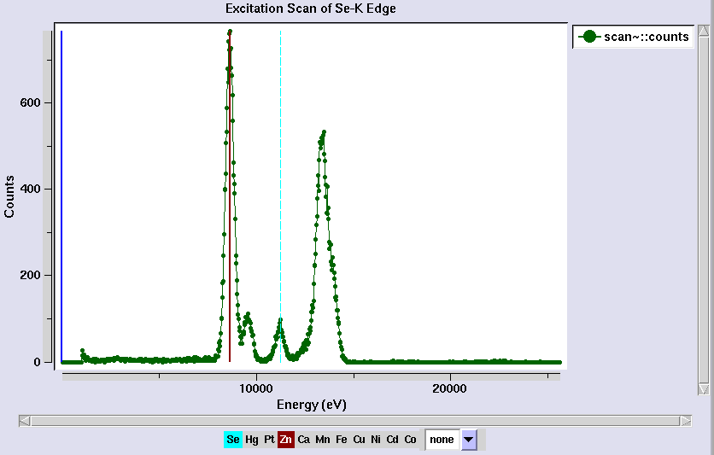
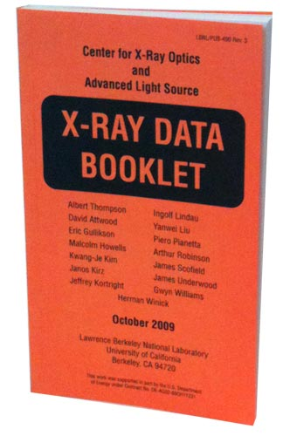
Metal identification

Slide 49
Auger emission
+

Slide 50
Auger emission
e⁻
++

Slide 51
Sample atoms

Slide 52
Sample atoms

Slide 53
Primary ionization
e⁻
+

Slide 54
Secondary ionizations
e⁻
e⁻
+
e⁻
e⁻
+
+
+
+
+
e⁻
e⁻

Slide 55
Ionization track
e⁻
e⁻
e⁻
e⁻
+
e⁻
+
+
+
e⁻
e⁻
+
+
+
+
+
e⁻
+
e⁻
e⁻

Slide 56
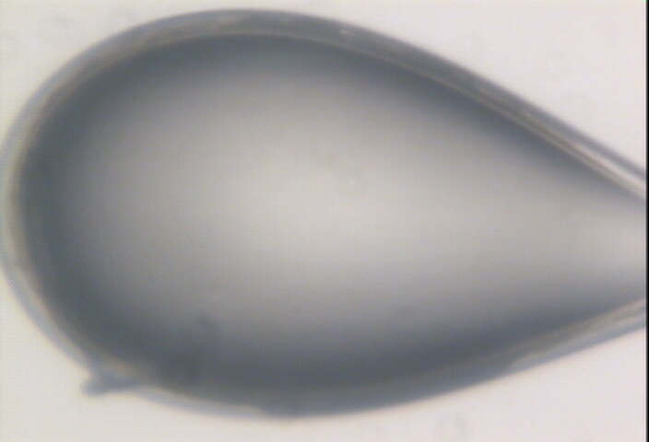

Slide 57
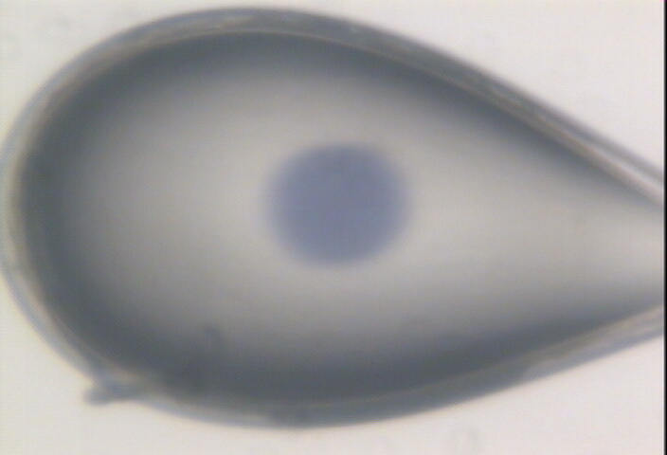

Slide 58
Where do photons go?
Protein
1A x-rays
elastic scattering (6%)
Transmitted (98%)
beamstop
inelastic scattering (7%)
Re-emitted (99%)
Absorbed (~0%)

Slide 59
Where do photons go?
Protein
1A x-rays
elastic scattering (6%)
Transmitted (98%)
beamstop
inelastic scattering (7%)
Photoelectric (87%)
Re-emitted (99%)
Absorbed (~0%)

Slide 60
Where do photons go?
Protein
1A x-rays
elastic scattering (6%)
Transmitted (98%)
beamstop
inelastic scattering (7%)
Photoelectric (87%)
Re-emitted (99%)
Absorbed (~0%)
Re-emitted (~0%)
Absorbed (99%)

Slide 61
Where do photons go?
Protein
1A x-rays
elastic scattering (6%)
Transmitted (98%)
beamstop
inelastic scattering (7%)
Photoelectric (87%)
Re-emitted (99%)
Absorbed (~0%)
Re-emitted (~0%)
Absorbed (99%)
useful/absorbed energy: 7.3%

Slide 62
scattering
x-ray beam
sample
detector

Slide 63
scattering
x-ray beam
sample
detector

Slide 64
scattering
x-ray beam
sample
detector

Slide 65
scattering
x-ray beam
sample
detector

Slide 66
Bragg’s Law
to detector
nλ = 2d sin(θ)
atom #1
θ
d
to source
atom #2
d∙sin(θ)

Slide 67
Bragg’s Law
to detector
nλ = 2d sin(θ)
atom #1
θ
to source
d
atom #2
d∙sin(θ)

Slide 68
anomalous scattering
x-ray beam
sample
detector

Slide 69
anomalous scattering
x-ray beam
sample
detector

Slide 70
anomalous scattering
x-ray beam
sample
detector

Slide 71
anomalous scattering
x-ray beam
sample
detector

Slide 72
anomalous scattering
x-ray beam
sample
detector

Slide 73
scattering
x-ray beam
sample
detector
detector

Slide 74
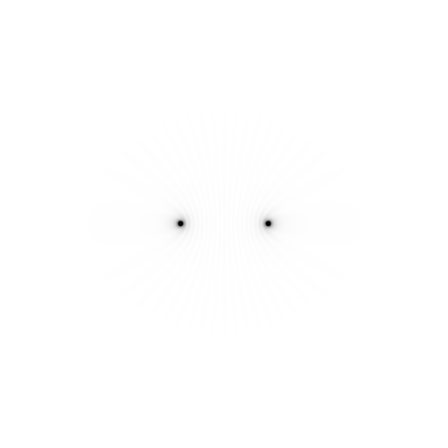
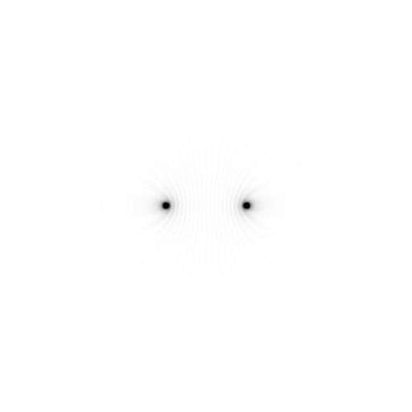
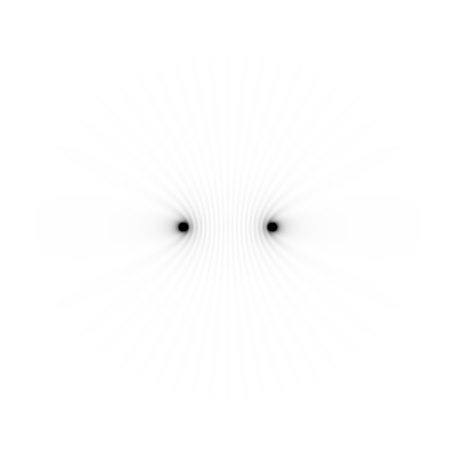
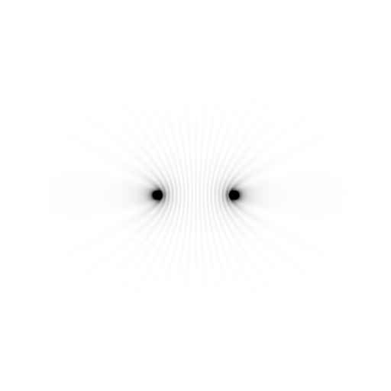
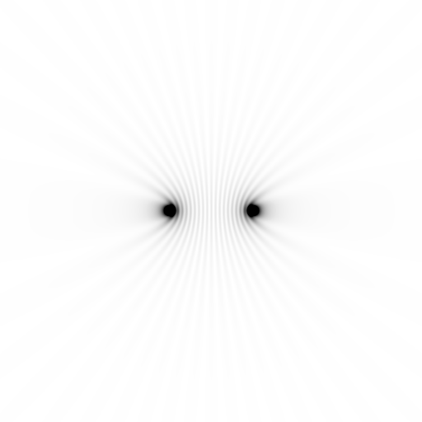
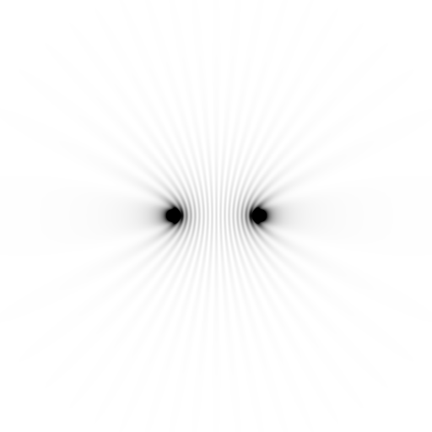
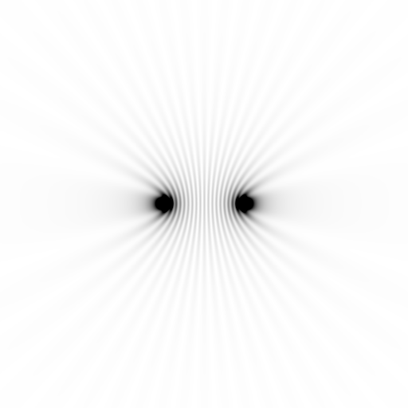
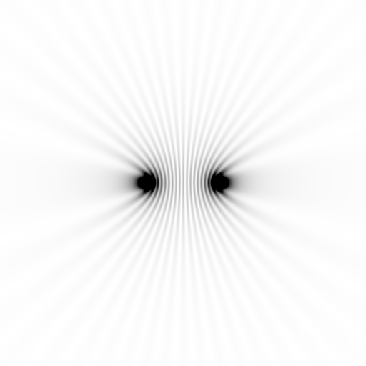
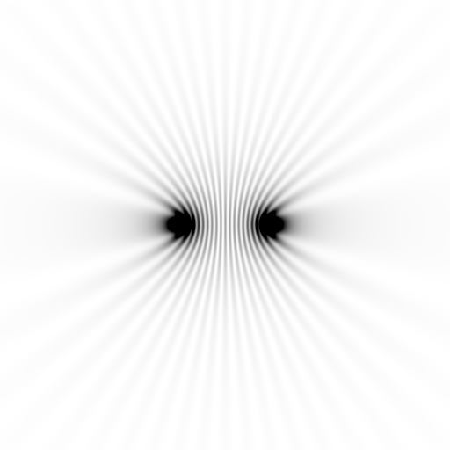
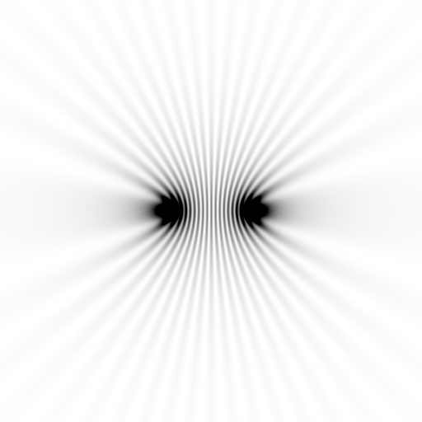
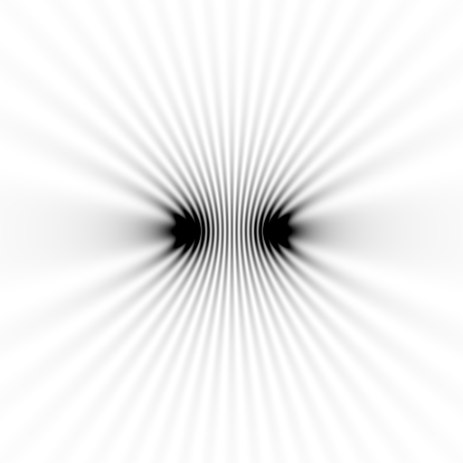
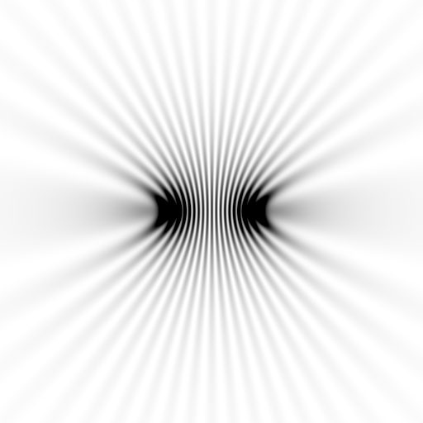
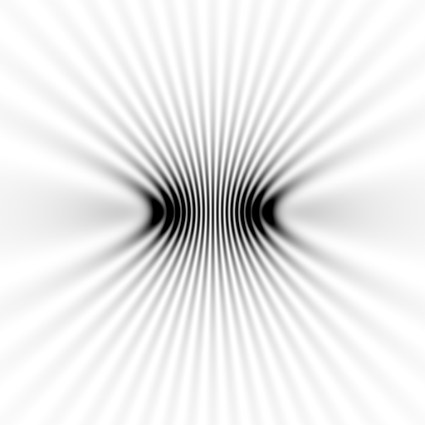
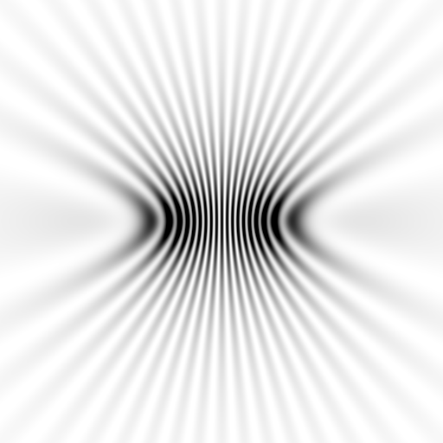
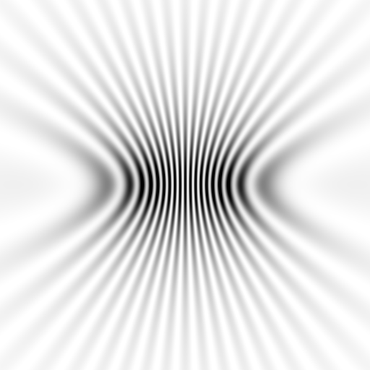
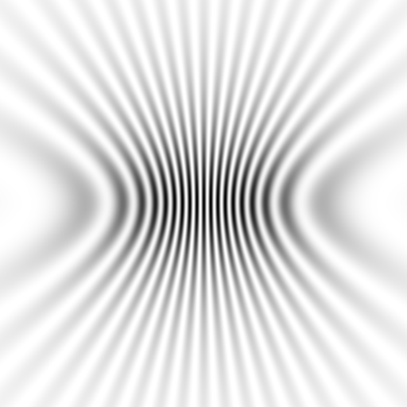
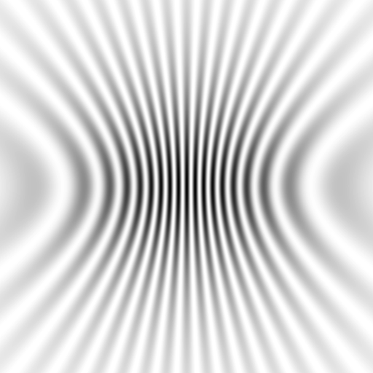
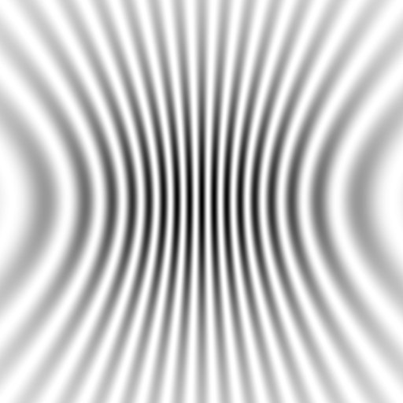





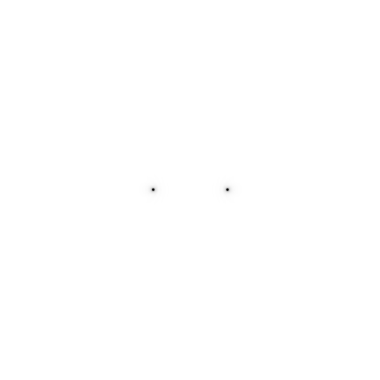
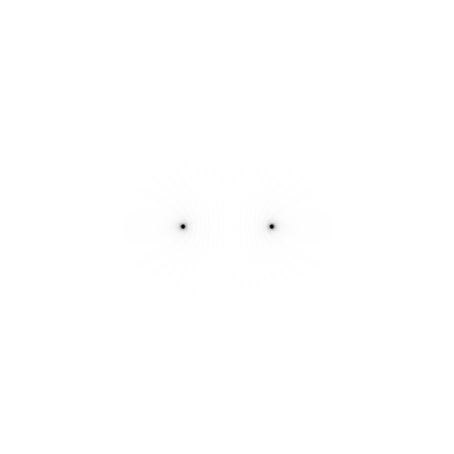


Slide 75
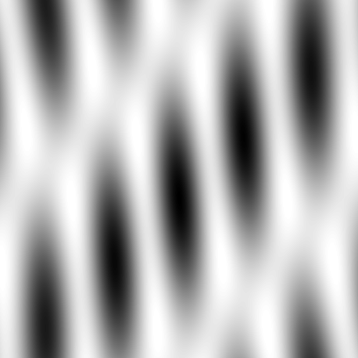



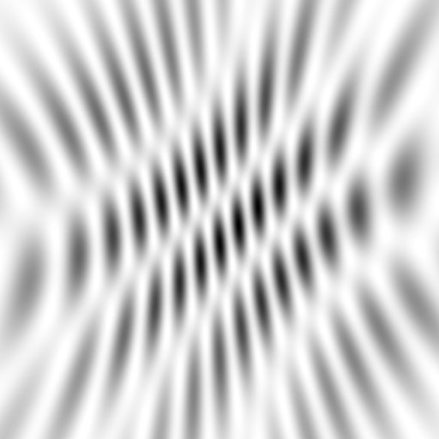
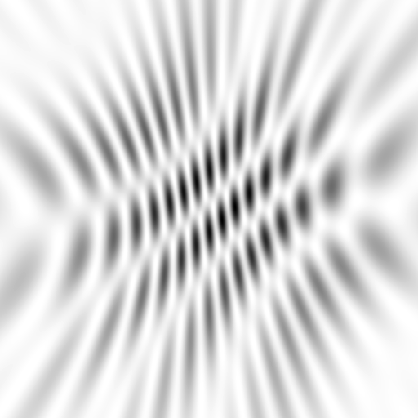
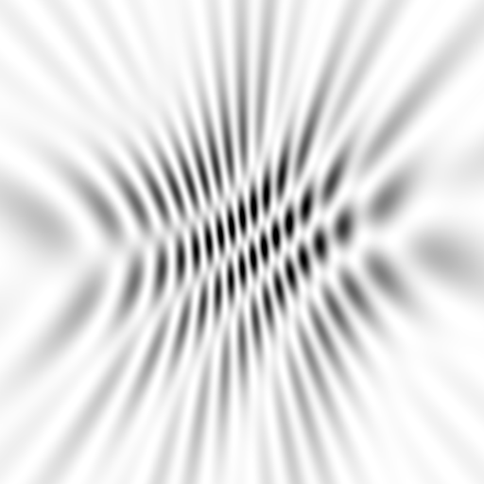
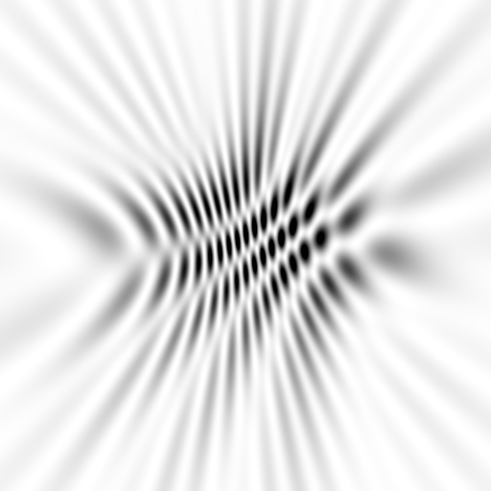
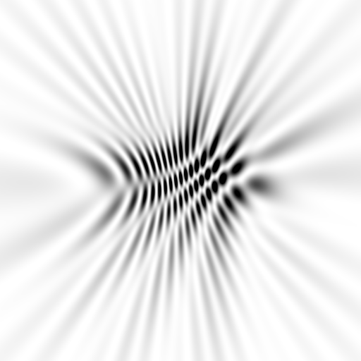
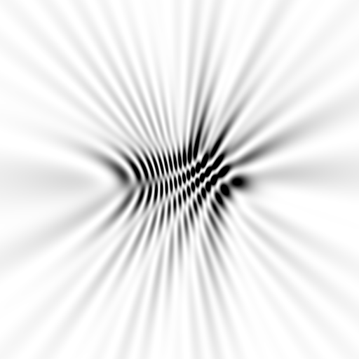
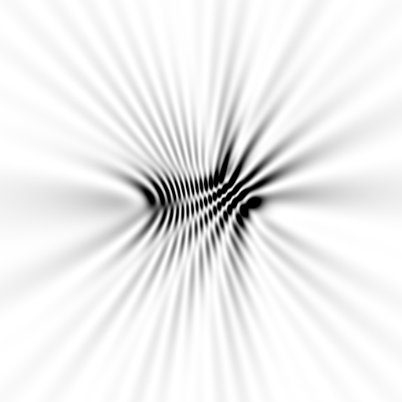
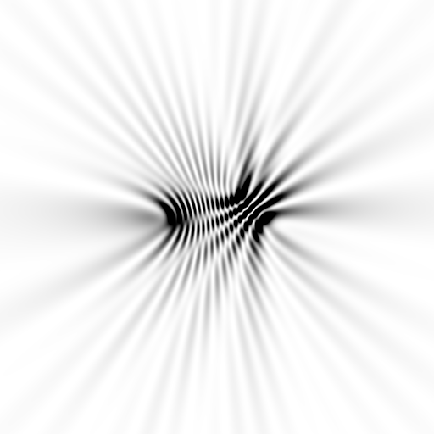
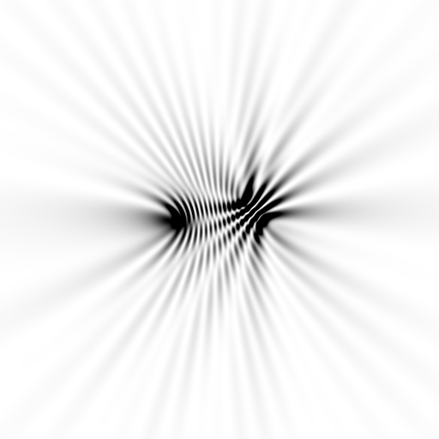
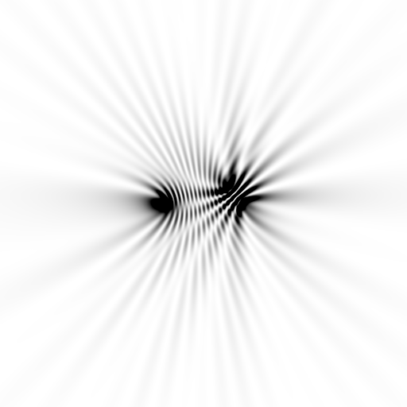
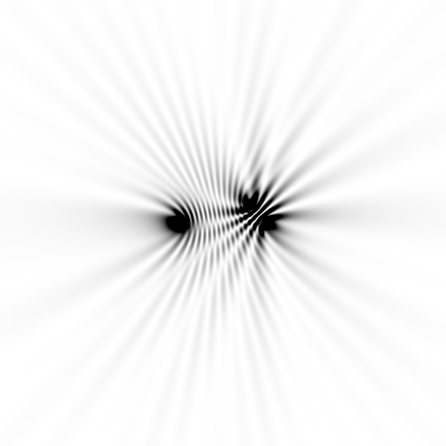






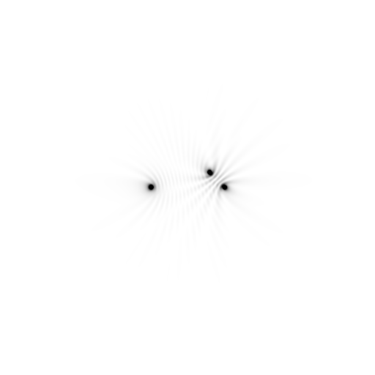





Slide 76




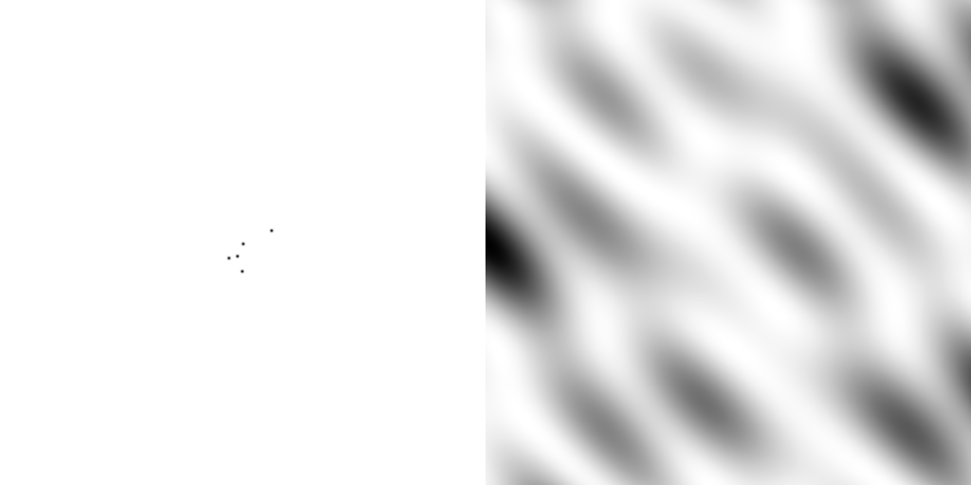
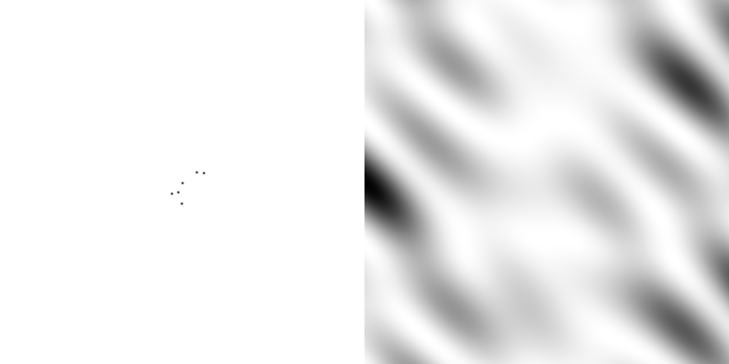
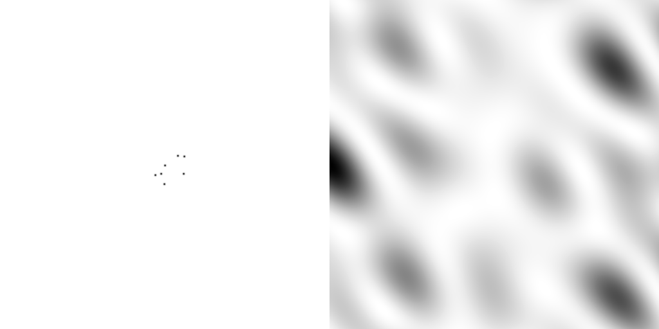
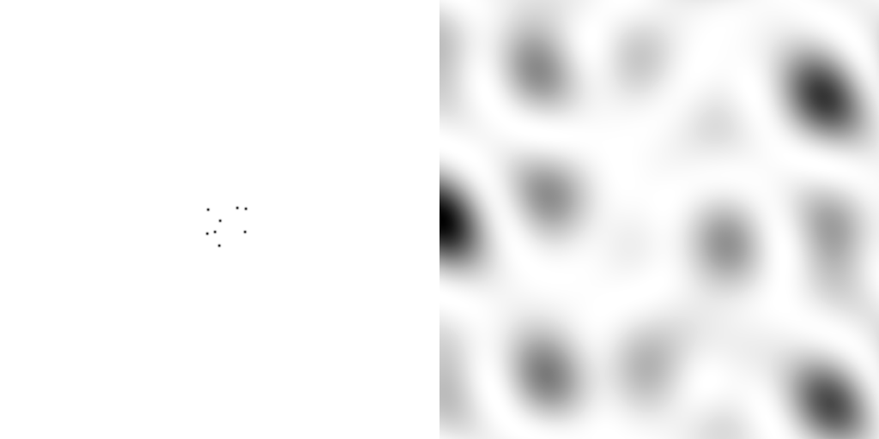
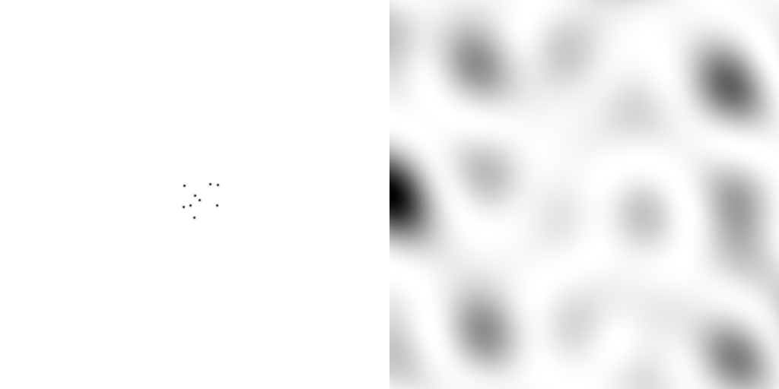

scattering from a structure
sample
detector

Slide 77

forward Fourier Transform
inverse Fourier Transform
no phase

Slide 78











inverse Fourier Transform
scattering from a structure
colored by phase
sample
detector

Slide 79




scattering from a lattice
colored by phase
sample
detector

Slide 80

scattering from a lattice
colored by phase
sample
detector

Slide 81

scattering from a lattice
colored by phase
sample
detector

Slide 82

scattering from a crystal structure
colored by phase
sample
detector

Slide 83

Resolution
http://bl831.als.lbl.gov/~jamesh/movies/resolution.mpeg

Slide 84

Resolution: low-angle cutoff
http://bl831.als.lbl.gov/~jamesh/movies/lo_cut.mpeg

Slide 85

R-factor
http://bl831.als.lbl.gov/~jamesh/movies/rfactor.mpeg

Slide 86

Figure of Merit
http://bl831.als.lbl.gov/~jamesh/movies/dephase.mpeg

Slide 87

Overloads
http://bl831.als.lbl.gov/~jamesh/movies/overloads.mpeg

Slide 88

Completeness: missing wedge
http://bl831.als.lbl.gov/~jamesh/movies/osc.mpeg

Slide 89

Completeness: random deletion
http://bl831.als.lbl.gov/~jamesh/movies/completeness.mpeg

Slide 90
At the beamline…
Resolution
  problem: background
  solution: use as few pixels as possible
Phases
  problem: fractional errors
  solution: use as many pixels as possible

Slide 91
beam size vs xtal size
  Put your crystal into the beam

Slide 92

Get thee to a microbeam?
Evans et al. (2011)."Macromolecular microcrystallography", Crystallography Reviews 17, 105-142.

Slide 93
beam size vs xtal size
  Put your crystal into the beam
  Shoot the whole crystal

Slide 94

shoot the whole crystal

Slide 95
shoot the whole crystal

Slide 96
shoot the whole crystal

Slide 97
beam size vs xtal size
  Put your crystal into the beam
  Shoot the whole crystal
  Shoot nothing but the crystal

Slide 98
shoot nothing but the crystal

Slide 99
shoot nothing but the crystal

Slide 100
X-ray scattering “rules”:
1 μm crystal ≈ 1 μm water
≈ 1 μm plastic
≈ 0.1 μm glass
≈ 1000 μm air

Slide 101
Resolution (Å)
too big
too small
just right
X-ray beam size (μm)

Slide 102
beam size vs xtal size
  Put your crystal into the beam
  Shoot the whole crystal
  Shoot nothing but the crystal
  Back off!

Slide 103
Background scattering

Slide 104

Background scattering
$100,000.00
$100,000.00
$100,000.00
real estate is
expensive
use it!
$100,000.00
$100,000.00
$100,000.00
$100,000.00
$100,000.00

Slide 105
The truth about x-ray beams
Term units significance
Flux photons/s duration of experiment
Beam Size μm match to crystal
Divergence mrad spot size vs distance
Wavelength Å resolution and absorption
Dispersion Δλ/λ spot size
Flux density ph/s/area scattering/damage rate
Fluence ph/area scattering/damage

Slide 106
The truth about x-ray beams
Term units significance
Flux photons/s duration of experiment
Beam Size μm match to crystal
Divergence mrad spot size vs distance
Wavelength Å resolution and absorption
Dispersion Δλ/λ spot size
Flux density ph/s/area scattering/damage rate
Fluence ph/area scattering/damage

Slide 107
The truth about x-ray beams
quantity | units | home source | APS 22-ID
flux | Photons/second | 1.7 x 10⁹ | 7 x 10¹²
exposure | seconds | 20 | 1

Slide 108
The truth about x-ray beams
quantity | units | home source | APS 22-ID
flux | Photons/second | 1.7 x 10⁹ | 7 x 10¹²
exposure | seconds | 20 | 1
Dispersion | wavelength range / wavelength | 0.2% (Kα₁ - Kα₂) | 0.014% (Si111)
Divergence | milliRadian | 10 | 0.1
Beam size | microns | 70 | 40 (h) 80 (v)
Spectral brightness | Photons/s/mm²/ mR²/0.1%BW | 1.7 x 10¹⁰ | 1.5 x 10¹⁹

Slide 109
The truth about x-ray beams
quantity | units | home source | APS 22-ID
flux | Photons/second | 1.2 x 10⁸ | 7 x 10¹²
exposure | seconds | 286 | 1
Dispersion | wavelength range / wavelength | 0.014% (Si111) | 0.014% (Si111)
Divergence | milliRadian | 10 | 0.1
Beam size | microns | 70 | 40 (h) 80 (v)
Spectral brightness | Photons/s/mm²/ mR²/0.1%BW | 1.7 x 10¹⁰ | 1.5 x 10¹⁹

Slide 110
The truth about x-ray beams
quantity | units | home source | APS 22-ID
flux | Photons/second | 1.2 x 10⁴ | 7 x 10¹²
exposure | time | 33 days | 1 second
Dispersion | wavelength range / wavelength | 0.014% (Si111) | 0.014% (Si111)
Divergence | milliRadian | 0.1 | 0.1
Beam size | microns | 70 | 40 (h) 80 (v)
Spectral brightness | Photons/s/mm²/ mR²/0.1%BW | 1.7 x 10¹⁰ | 1.5 x 10¹⁹

Slide 111
The truth about x-ray beams
quantity | units | home source | APS 22-ID
flux | Photons/second | 7.6 x 10³ | 7 x 10¹²
exposure | time | 52 days | 1 second
Dispersion | wavelength range / wavelength | 0.014% (Si111) | 0.014% (Si111)
Divergence | milliRadian | 0.1 | 0.1
Beam size | microns | 56 | 40 (h) 80 (v)
Spectral brightness | Photons/s/mm²/ mR²/0.1%BW | 1.7 x 10¹⁰ | 1.5 x 10¹⁹

Slide 112
Fine Slicing
background
background
Pflugrath, J. W. (1999)."The finer things in X-ray diffraction data collection", Acta Cryst. D 55, 1718-1725.

Slide 113
Classes of error in MX
Dependence on signal
none sqrt proportional
CCD
Read-out
Photon
counting
Detector calibration
attenuation
partiality
Non-isomorphism
Radiation damage
none
1/sqrt
1/prop.
Time
Beam flicker
Shutter jitter
Sample vibration

Slide 114

Optimal exposure time
(faint spots)
t_{hr} Optimal exposure time for data set (s)
t_{ref} exposure time of reference image (s)
bg_{ref} background level near weak spots on
reference image (ADU)
bg₀ ADC offset of detector (ADU)
bg_{hr} optimal background level (via t_{hr})
σ₀ rms read-out noise (ADU)
gain ADU/photon
m multiplicity of data set (including partials)
adjust exposure
so this is ~15

Slide 115
beam size vs xtal size
  Put your crystal into the beam
  Shoot the whole crystal
  Shoot nothing but the crystal
  Back off!
  The crystal must rotate

Slide 116
Get thee to a microbeam?
Evans et al. (2011)."Macromolecular microcrystallography", Crystallography Reviews 17, 105-142.

Slide 117
At the beamline…
Resolution
  problem: background
  solution: use as few pixels as possible
Phases
  problem: fractional errors
  solution: use as many pixels as possible

Slide 118
anomalous signal
ΔF
F
√
# sites
MW (Da)
≈ 1.2 f”
World record!
ΔF/F = 0.5%
Wang, Dauter & Dauter (2006) Acta Cryst. D 62, 1475-1483.
Crick, F. H. C. & Magdoff, B. S. (1956) Acta Crystallogr. 9, 901-908.
Hendrickson, W. A. & Teeter, M. M. (1981) Nature 290, 107-113.

Slide 119
Fractional error
^{mult >} (—)²
~3%
<ΔF/F>

Slide 120
Can you count to 1,000,000 ?
sqrt(1,000,000)
1,000,000
Theoretically:
= 0.1%
R_{meas} ≈ 0.1% ?
ISa = 1000
In reality:
ISa ~ 33
R_{meas =} ≈ 3%
sqrt(1,000)
1,000
= 3%
photon
spot
> 1000 is a waste!

Slide 121
Threshold of a revolution in phasing
Current
technology
Goal
Solve-able proteins (%)
Required signal-to-noise (I/σ)

Slide 122
Threshold of a revolution in phasing
Source of error | realistic simulation | No SHSSS | Perfect detector
Photon counting | + | + | +
Shutter jitter | + | + | -
Beam flicker | + | + | -
Sample absorption | + | + | -
Radiation damage | + | + | -
Imperfect spindle | + | + | -
vignette | + | + | -
Corner correction | + | + | -
SHSSS | + | - | -
R_{meas} (∞-10 Å) | 2.8% | 0.7% | 0.7%
I/σ asymptotic | 26.8 | 74.2 | 81.0
Holton et al (2014) "R-factor gap", FEBS Journal 281, 4046-4060.

Slide 123
Spatial Heterogeneity in Sharp Spot Sensitivity
Relative spot intensity
Spot centroid position (pixels)

Slide 124
Spatial Heterogeneity in Sharp Spot Sensitivity
Relative spot intensity
Spot centroid position (pixels)

Slide 125
SHSSS!
The dominant source of error for anomalous difference measurements
Spatial
Heterogeneity in
Sharp
Spot
Sensitivity
Flat
Field

Slide 126
SHSSS!
The dominant source of error for anomalous difference measurements
Spatial
Heterogeneity in
Sharp
Spot
Sensitivity
Flat
Field
90%
110%
x 1.11 =
100%
x 0.91 =
100%

Slide 127
SHSSS!
The dominant source of error for anomalous difference measurements
Spatial
Heterogeneity in
Sharp
Spot
Sensitivity
Sharp
Spot
20%
110%
x 1.11 =
22%
x 0.91 =
100%

Slide 128
SHSSS!
The dominant source of error for anomalous difference measurements
Spatial
Heterogeneity in
Sharp
Spot
Sensitivity
Sharp
Spot
90%
30%
Integral: 127.3
x 1.11 =
100%
x 0.91 =
27.3%

Slide 129
SHSSS!
The dominant source of error for anomalous difference measurements
Spatial
Heterogeneity in
Sharp
Spot
Sensitivity
Sharp
Spot
20%
110%
Integral: 122.2
x 1.11 =
22.2%
x 0.91 =
100%

Slide 130
SHSSS!
The dominant source of error for anomalous difference measurements
Spatial
Heterogeneity in
Sharp
Spot
Sensitivity
Sharp
Spot
90%
30%
Integral: 127.3
x 1.11 =
100%
x 0.91 =
27.3%

Slide 131

Detector calibration: 7235 eV

Slide 132

Detector calibration: 7247 eV

Slide 133
Gadox calibration vs energy
same = good!
Relative absorption depth
bad!
photon energy (keV)

Slide 134

Pilatus: subtract smooth baseline
~3x10⁵ photon/pixel
Bragg
glitch
“tree rings”
Pick-up tool mark
oxygen
inclusions
1% high
average
1% low

Slide 135
PAD: need more than flood-field
θ
incoming
photon
λ
detection
event
N
N
N

Slide 136
PAD: need more than flood-field
θ
Bragg
glitch
width
incoming
photon
λ
oxygen
inclusion
thickness
detection
event
N
N
N

Slide 137

Pilatus: 1-module shift

Slide 138

Pilatus: 1-module shift

Slide 139

Pilatus: 1-module shift

Slide 140

Pilatus: 1-module shift - aligned

Slide 141

Pilatus: 1-module shift - ratio
3% high
average
3% low

Slide 142

3.5
3.0
2.5
2.0
1.5
1.0
0.5
CCD detector
different
modules
anomalous mates are always on
different modules
SHSSS
Systematic component of R_{sseparate} (%)
Pilatus
SN001
Pilatus
SN113
0.1 1 10 100
distance between spots (mm)

Slide 143
Fractional error
^{mult >} (—)²
~3%
<ΔF/F>

Slide 144

Systematic error does not “average out”

Slide 145

Holton & Frankel (2010) Acta D 66 393-408.

Slide 146

Dose slicing
unacceptable
damage
N
photons
crystal’s useful life
N
photons
unacceptable
read noise
N
photons

Slide 147
Data collection parameters:
16 crystals
360° each, inverse beam
7235 eV photon energy
< 1 MGy per xtal
Australian Synchrotron MX1
  35 kGy/s into 100 μm x 100 μm

Slide 148
140-fold multiplicity: 16 crystals, 360° each, inverse beam, 7235 eV
RESOLUTION COMPLETENESS R-FACTOR I/SIGMA R-meas CC(1/2) Anomal SigAno Nano
LIMIT OF DATA observed Corr
9.17 99.1% 3.9% 257.47 3.9% 100.0* 91* 5.024 450
6.49 100.0% 5.2% 214.33 5.2% 100.0* 86* 3.836 882
5.30 100.0% 7.2% 165.13 7.2% 100.0* 76* 3.257 1175
4.59 100.0% 7.2% 175.42 7.3% 100.0* 67* 2.589 1403
4.10 99.9% 7.7% 174.13 7.7% 100.0* 59* 2.264 1594
3.74 99.9% 9.4% 143.09 9.4% 100.0* 49* 1.953 1783
3.47 100.0% 11.2% 120.17 11.2% 100.0* 39* 1.696 1942
3.24 100.0% 14.1% 91.14 14.1% 100.0* 30* 1.333 2103
3.06 99.9% 19.5% 65.79 19.5% 100.0* 23* 1.117 2214
2.90 99.9% 29.0% 44.85 29.1% 99.9* 17* 1.008 2369
2.77 99.9% 40.5% 32.58 40.6% 99.8* 11* 0.901 2493
2.65 99.9% 52.8% 25.16 52.9% 99.8* 10* 0.866 2605
2.54 100.0% 67.4% 19.47 67.6% 99.6* 2 0.804 2705
2.45 100.0% 88.9% 14.58 89.2% 99.2* 4 0.831 2859
2.37 100.0% 109.3% 9.97 109.7% 98.1* 5 0.829 2925
2.29 100.0% 138.2% 6.87 138.9% 96.1* 1 0.760 3037
2.22 100.0% 197.1% 4.03 198.6% 83.5* -1 0.721 3159
2.16 100.0% 227.3% 2.41 230.8% 46.9* -1 0.677 3224
2.10 61.2% 154.4% 1.28 163.6% 47.0* -2 0.660 1999
2.05 47.9% 170.1% 0.68 196.5% 25.7* 3 0.629 1578
total 93.3% 15.7% 54.30 15.8% 100.0* 12* 1.217 42499

Slide 149

140-fold multiplicity
18 σ
16 σ
Phased anomalous difference Fourier

Slide 150

140-fold multiplicity
15σ = PO₄
Phased anomalous difference Fourier

Slide 151

140-fold multiplicity
~2σ = Mg?
Phased anomalous difference Fourier

Slide 152

140-fold multiplicity
8.2σ = Mg?
DELFAN residual anomalous difference

Slide 153
Discerning Na⁺ from Mg⁺⁺
DELFAN peak height (σ)
N
O
F
Ne
Na
Mg
f’’ (electrons)

Slide 154

140-fold multiplicity
7.4σ = Na
DELFAN residual anomalous difference

Slide 155
Suggested anomalous protocol:
360° in < 5 MGy
move detector
4X exposure
goto 2
2 wavelengths are better than 1
- (peak + inf)/2, and remote
MAD, not M-SAD!

Slide 156
Summary
http://bl831.als.lbl.gov/xtalsize.html
http://bl831.als.lbl.gov/~jamesh/mlfsom/
http://bl831.als.lbl.gov/~jamesh/powerpoint/ACMC_GBU_2013.ppt
100 ADU/pixel
10 μm for lysozyme
~3% error per spot, 1%/MGy
7235 eV for S-SAD
“Attenu-wait”: dose slicing

Slide 157
Summary
http://bl831.als.lbl.gov/xtalsize.html
http://bl831.als.lbl.gov/xtallife.html
http://bl831.als.lbl.gov/~jamesh/mlfsom/
http://bl831.als.lbl.gov/~jamesh/powerpoint/CSHL_tipsNtricks_2015.pptx
15 ADU/pixel
10 μm for lysozyme
~3% error per spot, 1%/MGy
7235 eV for S-SAD
“Attenu-wait”: dose slicing

Slide 158
Why harvest at all?
Radiation damage
  10-100x reduced at ~100 K
Background scatter
    tray >> xtal
Timing
    nothing lasts forever
Shipping
    cryo samples are glass beads

Slide 159
Why harvest at all?
Radiation damage
  10-100x reduced at ~100 K
Background scatter
    tray >> xtal
Timing
    nothing lasts forever
Shipping
    cryo samples are glass beads

Slide 160
X-ray transmission of materials
air
water
protein
crystal
transmission
glass
Depth into material (μm)

Slide 161
X-ray scattering of materials
glass
Differential cross section
(scattered photons/solid angle/incident photon/meter thickness)
plastic
paratone-N oil
25% glycerol
water
∞ 7.5 3.8 2.5 1.9 1.5
d-spacing (Ǻ)

Slide 162

naked xtal

Slide 163

Crowfoot Cell

Slide 164

Crowfoot Cell

Slide 165

Crowfoot Cell
J. D. Bernal and D. Crowfoot, Nature (London) 133, 794 (1934).

Slide 166

Fluidigm RT/cryo mount
“Diffraction Capable” chip
http://www.fluidigm.com/products/topaz-chips.html

Slide 167


Plate goniometers
Notes:
The non-rotating “plate goniometer” (left) was developed last year. A new incarnation for taking rotation-camera data is now being developed (right). Either of these devices will accept most any crystallization tray that can be rotated 90 degrees to gravity and probe arbitrary points in each crystallization drop with a 50 um x-ray beam. Installing a plate goniometer takes ~30 minutes and the location ~300 mm downbeam from the “normal” protein crystallography sample mounting point makes this technology transferable to most any beamline.
Current status is that a 95% complete data set has been collected from a 50 um lysozyme crystal at room temperature, and trials are now underway to collect data sets from “real” crystals.

Slide 168

Notes:
non-rotating tray goniometer stage installed in ALS 8.3.1. Note that the “normal” cryo-pin goniometer on the left is still in place and a brass flight tube has been added to contain the air scatter from the main beam on its way to the tray goniometer.

Slide 169


Slide 170
Why harvest at all?
Radiation damage
  10-100x reduced at ~100 K
Background scatter
    tray >> xtal
Timing
    nothing lasts forever
Shipping
    cryo samples are glass beads

Slide 171


Slide 172

8000 Gy/s

Slide 173



Example Data
lysozyme
50 μm beam
37 Gy/s (0.775 Å)
30s exposures at 20C
90° of data, 97% complete
I/σ = 1.5 at 1.9 Å
R_{merge} 18% (overall) 5% (low)
ΔB same as 20 min at 100K
2
1
0
scale vs batch
B factor
-2
-4
-6

Slide 174
Room temperature damage rates
dose at half intensity (MGy)
dose rate (kGy/s)

Slide 175
Room temperature damage rates
dose at half intensity (MGy)
dose rate (kGy/s)

Slide 176
Every spot is an unpaired partial!
I_{spot} = k N_{cells}²
Ewald sphere
range

Slide 177
Every spot is an unpaired partial!
I_{spot} = k N_{cells}¹
Ewald sphere
range
Woolfson, M. M. (1997). An introduction to X-ray crystallography. Ch. 2 & 6

Slide 178


Internal consistency of data
1,850,000 images
112,000 > 10 peaks
33,000 indexed
16,500 good preds
rigid-body:
R_{cryst} = 0.252
R_{free} = 0.232

Slide 179
what is “partiality”?
F(h,k,l)
Ewald sphere
λ₁*
λ₂*
F(h,k,l)
F(0,0,0)

Slide 180
Why harvest at all?
Radiation damage
  10-100x reduced at ~100 K
Background scatter
    tray >> xtal
Timing
    nothing lasts forever
Shipping
    cryo samples are glass beads

Slide 181
Why harvest at all?
Radiation damage
  10-100x reduced at ~100 K
Background scatter
    tray >> xtal
Timing
    nothing lasts forever
Shipping
    cryo samples are glass beads

Slide 182


MiTeGen RT cell
http://www.mitegen.com/products/micrort/micrort.shtml

Slide 183



Free-mounting system
http://www.proteros.de/

Slide 184
Summary
assay, control and open mind
purity, purity, purity
oil is your friend
Warkentin method
try room temp!
http://bl831.als.lbl.gov/~jamesh/powerpoint/
CSHL_tipsNtricks_2015.pptx

Slide 185


avoiding overlaps
c
c

Slide 186

avoiding overlaps
c

Slide 187
At the beamline…
Resolution
  problem: background
  solution: use as few pixels as possible
Phases
  problem: fractional errors
  solution: use as many pixels as possible

Slide 188
Major Phasing techniques
Molecular Replacement
Multiple Isomorphous Replacement
Multiwavelength Anomalous Diffraction
Single-wavelength Anomalous Diffraction

Slide 189
inverse Fourier Transform
no phase

Slide 190


inverse Fourier Transform
no phase

Slide 191
Major Phasing techniques
Molecular Replacement
Multiple Isomorphous Replacement
Multiwavelength Anomalous Diffraction
Single-wavelength Anomalous Diffraction

Slide 192
“R” factors
R = % error

Slide 193
“R” factors
completely random: 0.59
starting MR solution: 0.4-0.55
something still wrong?: > 0.3
correct chain trace: < 0.2
small molecule: ~ 0.05

Slide 194
“R” factors
R_{cryst} (or just “R”)
observed vs calculated data (Fs)
R_{free}
cross-check with “random” subset of data
should be < 0.3 and < R_{cryst} + 0.1

Slide 195
Fitting data
structure factor (F)
spot index (h)

Slide 196
Fitting data
structure factor (F)
spot index (h)

Slide 197
Fitting data
structure factor (F)
spot index (h)

Slide 198
Fitting data
structure factor (F)
spot index (h)

Slide 199
“R” factors
R_{cryst} (or just “R”)
observed vs calculated data (Fs)
R_{free}
cross-check with “random” subset of data
should be < 0.3 and < R_{cryst} + 0.1
R_{sym} = R_{merge} (self-consistency of data: Is)

Slide 200
R_{merge}
blows up
as I_{obs} → 0
completely random: 0.59
weak data (high angle): 0.7- ∞
wrong symmetry choice?: ~0.2-0.55
small or disordered crystal: ~0.1-0.2
typical: ~ 0.05

Slide 201
“R” factors
R_{cryst} (or just “R”)
observed vs calculated data (Fs)
R_{free}
cross-check with “random” subset of data
should be < 0.3 and < R_{cryst} + 0.1
R_{sym} = R_{merge} (self-consistency of data: Is)
R_{rim} R_{pim} R_{meas}
R_{iso} R_{anom}
R_{diff}
R_{sym} is “unfair” to high multiplicity

Slide 202
Is the structure any good?
Molecular replacement:
  R/R_{free} (compare with R_{merge})
MAD/SAD/MIR
  R and FOM
All cases
  does the map look like the model?!

Slide 203
“B” factors
B ≈ 4d² + 12
d = resolution in Å
essentially, the “resolution” of an atom

Slide 204
Is the structure any good?
“do the data presented justify the conclusions drawn?”

Slide 205

Detector calibration: 7247 eV
target:
oil
distance:
900 mm
2θ: 12°

Slide 206

Detector calibration: 7235 eV
target:
oil
distance:
900 mm
2θ: 12°

Slide 207

Detector calibration: ALS 8.3.1

Slide 208

Detector calibration errors: detector 2

Slide 209

Detector calibration errors: detector 3

