Slide 1

Dose slicing
unacceptable
damage
N
photons
crystal’s useful life
N
photons
unacceptable
read noise
N
photons

Slide 2
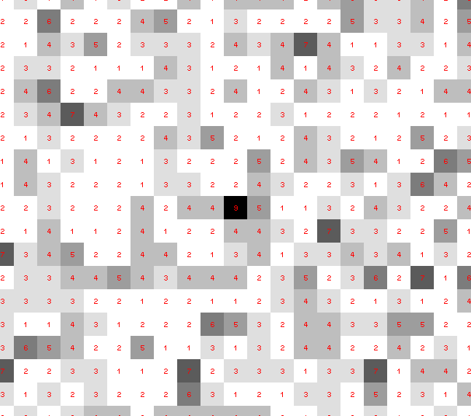
Dose slicing: is that a spot?

Slide 3
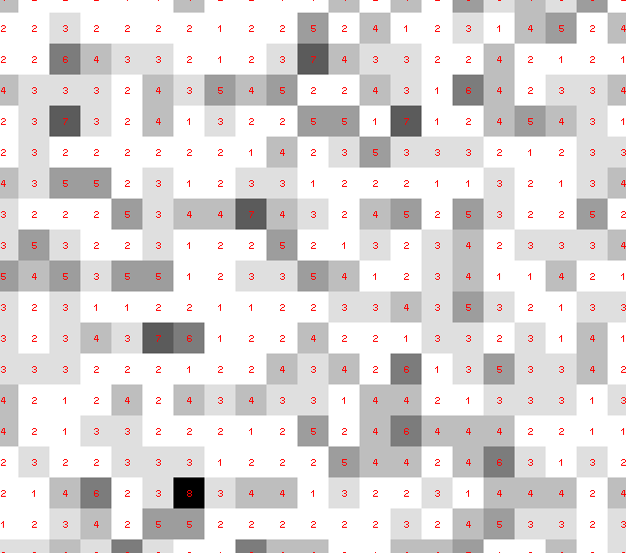
Dose slicing: is that a spot?

Slide 4
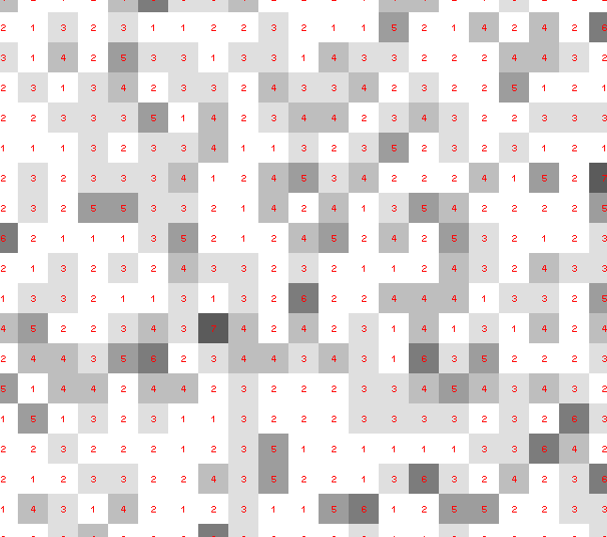
Dose slicing: is that a spot?

Slide 5
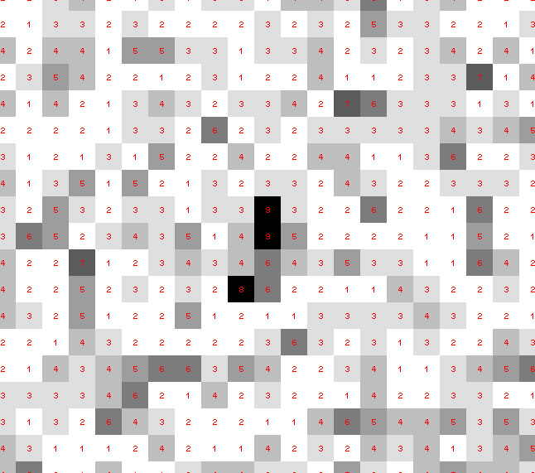
Dose slicing: is that a spot?

Slide 6
Dose slicing: is that a spot?

Slide 7
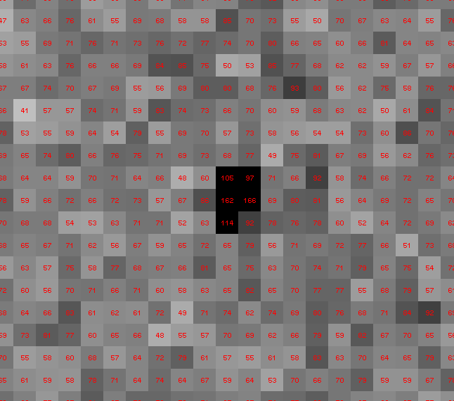
Dose slicing: is that a spot?

Slide 8
What if…
You only have a few small crystals?
Should you:
  Collect 360° from each?
  Collect 10° from each at 36x exposure?
  Glue 36 xtals together, then collect 360° ?
  Glue together and do 12960° ?
  http://bl1231.als.lbl.gov/~jamesh/dose_slice/results.html
5 μm & 1 MGy = 301,640,334 photons

Slide 9
“true” resolution limit
CC vs right answer
Resolution (Å)

Slide 10
“true” resolution vs strategy
processing procedure | Dose slice collection scenario
 | fine | coarse | glue | gluefine
XDS/XSCALE | 3.03874 | 3.02970 | 3.0270 | 3.02948
XDS/aimless | 3.13351 | 3.03531 | 3.02638 | 3.05292
XDS/noscale | 3.01449 | 3.03048 | 3.02576 | 3.31013
301,640,334 photons

Slide 11
processing procedure | collection scenario
 | fine | coarse | glue | glue_fine
XDS/XSCALE | 3.03874 | 3.02970 | 3.0270 | 3.02948
XDS/aimless | 3.13351 | 3.03531 | 3.02638 | 3.05292
XDS/noscale | 3.01449 | 3.03048 | 3.02576 | 3.31013
MOSFLM-defaults | x | x | x | x
MOSFLM-cheat | 3.51254 | 3.04355 | 3.08244 | x
MOSFLM/noscale | 3.51311 | 3.04287 | 3.21664 | x
HKL2000-defaults | x | x | x | x
HKL2000-cheat | 3.04147 | 3.01415 | 3.01415 | 3.03948
DIALS-defaults | x | x | 3.32378 | x
DIALS-cheat | 2.92007 | x | 2.98204 | 2.92007
DIALS-noscale | 2.96392 | x | 3.26126 | 5.14852
d*Trek | ? | ? | ? | ?
EVAL15 | ? | ? | ? | ?

Slide 12
How to run DIALS:
source /home/jamesh/dials-dev20161016/dials_env.csh
xia2 –dials -beam 151.16,144.09
/home/data/data2016/SERCAT-Sat/MM/BT/
dials.reciprocal_space_viewer

Slide 13
How to run XDS:
cd
mkdir –p processing/SERCAT-Sun/MM/LYSAU1
cd processing/SERCAT-Sun/MM/LYSAU1
ln –sf /home/data/data2016/SERCAT-Sat/MM/LYSAU1/ ./data
xdsgui

Slide 14
“B” factors
ATOM 122 N LEU A 13 -3.244 25.808 19.998 1.00 16.96 N
ATOM 123 CA LEU A 13 -2.877 25.448 21.355 1.00 15.29 C
ATOM 124 C LEU A 13 -2.792 23.966 21.561 1.00 17.54 C
ATOM 125 O LEU A 13 -1.814 23.493 22.143 1.00 16.35 O
ATOM 126 CB LEU A 13 -3.907 26.164 22.268 1.00 18.72 C
ATOM 127 CG LEU A 13 -3.577 25.982 23.738 1.00 21.19 C
ATOM 128 CD1 LEU A 13 -2.283 26.820 24.019 1.00 19.43 C
ATOM 129 CD2 LEU A 13 -4.702 26.474 24.639 1.00 24.65 C
ATOM 130 N SER A 14 -3.677 23.149 20.979 1.00 15.96 N
ATOM 131 CA SER A 14 -3.646 21.711 21.061 1.00 18.26 C
ATOM 132 C SER A 14 -2.373 21.203 20.360 1.00 18.71 C
ATOM 133 O SER A 14 -1.747 20.315 20.930 1.00 17.47 O
ATOM 134 CB SER A 14 -4.875 21.077 20.419 1.00 17.62 C
ATOM 135 OG ASER A 14 -4.825 19.665 20.388 0.50 20.89 O
ATOM 136 OG BSER A 14 -6.027 21.408 21.164 0.50 18.67 O
ATOM 137 N LYS A 15 -2.045 21.772 19.215 1.00 18.03 N
ATOM 138 CA LYS A 15 -0.799 21.361 18.555 1.00 18.12 C
ATOM 139 C LYS A 15 0.446 21.707 19.351 1.00 18.81 C
ATOM 140 O LYS A 15 1.400 20.948 19.411 1.00 17.77 O
ATOM 141 CB LYS A 15 -0.700 22.034 17.177 1.00 14.49 C
ATOM 142 CG LYS A 15 -1.727 21.368 16.256 1.00 16.12 C
ATOM 143 CD LYS A 15 -1.663 22.147 14.936 1.00 19.40 C
ATOM 144 CE ALYS A 15 -2.725 21.614 13.986 0.50 17.42 C
ATOM 145 CE BLYS A 15 -1.750 21.211 13.750 0.50 17.01 C
ATOM 146 NZ ALYS A 15 -2.346 21.674 12.559 0.50 18.61 N
ATOM 147 NZ BLYS A 15 -3.052 20.513 13.741 0.50 18.76 N

Slide 15
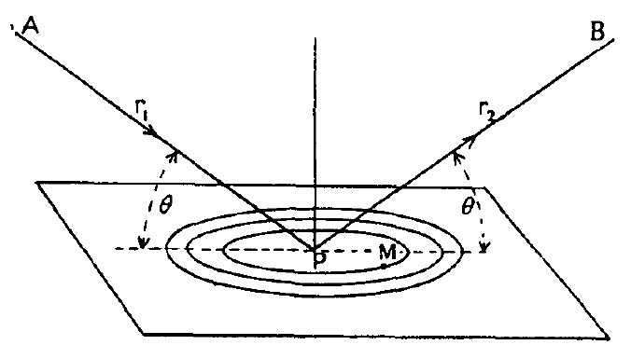
“B” factors
B = 8π² u_{x}²
u_{x} = RMS variation perpendicular to plane

Slide 16
“B” factors
B ≈ 4d² + 12
d = resolution in Å
essentially, the “resolution” of an atom

Slide 17
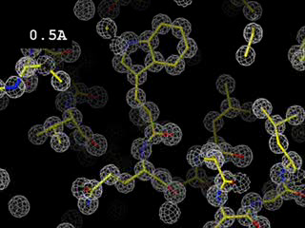
Resolution
http://bl831.als.lbl.gov/~jamesh/movies/resolution.mpeg

Slide 18
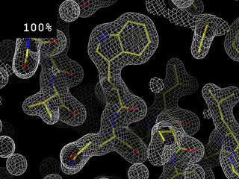
Completeness: random deletion
http://bl831.als.lbl.gov/~jamesh/movies/completeness.mpeg

Slide 19
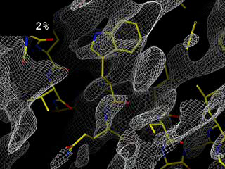
Completeness: missing wedge
http://bl831.als.lbl.gov/~jamesh/movies/osc.mpeg

Slide 20
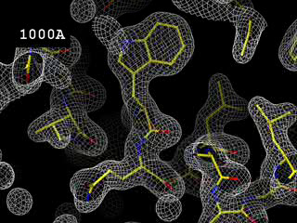
Resolution: low-angle cutoff
http://bl831.als.lbl.gov/~jamesh/movies/lo_cut.mpeg

Slide 21
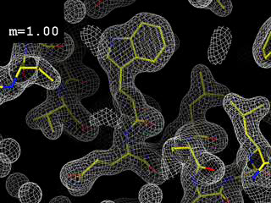
Figure of Merit
http://bl831.als.lbl.gov/~jamesh/movies/dephase.mpeg

Slide 22
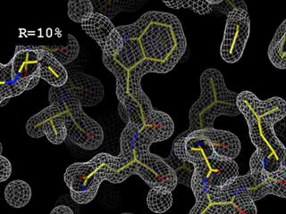
R-factor
http://bl831.als.lbl.gov/~jamesh/movies/rfactor.mpeg

Slide 23
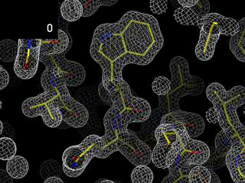
Overloads
http://bl831.als.lbl.gov/~jamesh/movies/overloads.mpeg

Slide 24
“R” factors
R = % error

Slide 25
“R” factors
completely random: 0.59
starting MR solution: 0.4-0.55
something still wrong?: > 0.3
correct chain trace: < 0.2
small molecule: ~ 0.05

Slide 26
“R” factors
R_{cryst} (or just “R”)
observed vs calculated data (Fs)
R_{free}
cross-check with “random” subset of data
should be < 0.3 and < R_{cryst} + 0.1

Slide 27
Fitting data
structure factor (F)
spot index (h)

Slide 28
Fitting data
structure factor (F)
spot index (h)

Slide 29
Fitting data
structure factor (F)
spot index (h)

Slide 30
Fitting data
structure factor (F)
spot index (h)

Slide 31
“R” factors
R_{cryst} (or just “R”)
observed vs calculated data (Fs)
R_{free}
cross-check with “random” subset of data
should be < 0.3 and < R_{cryst} + 0.1
R_{sym} = R_{merge} (self-consistency of data: Is)

Slide 32
R_{merge}
blows up
as I_{obs} → 0
completely random: 0.59
weak data (high angle): 0.7- ∞
wrong symmetry choice?: ~0.2-0.55
small or disordered crystal: ~0.1-0.2
typical: ~ 0.05

Slide 33
“R” factors
R_{cryst} (or just “R”)
observed vs calculated data (Fs)
R_{free}
cross-check with “random” subset of data
should be < 0.3 and < R_{cryst} + 0.1
R_{sym} = R_{merge} (self-consistency of data: Is)
R_{rim} R_{pim} R_{meas}
R_{iso} R_{anom}
R_{diff}
R_{sym} is “unfair” to high multiplicity

Slide 34
Is the structure any good?
Molecular replacement:
  R/R_{free} (compare with R_{merge})
MAD/SAD/MIR
  R and FOM
All cases
  does the map look like the model?!

Slide 35
Is the structure any good?
“do the data presented justify the conclusions drawn?”

Slide 36

100% SeMet incorporation
Trivial to solve

Slide 37

100% S -Met incorporation
Impossible to solve

Slide 38
Finding sites
Number of correct sites
fraction Sulfur

Slide 39
Finding sites
Number of correct sites
fraction Sulfur

Slide 40
Finding sites
Number of correct sites
fraction Sulfur

Slide 41
Finding sites
25
20
15
10
5
0
Number of correct sites
peak height (σ)
fraction Sulfur

Slide 42
Finding sites
Number of correct sites
fraction Sulfur

Slide 43
Why harvest at all?
Radiation damage
  10-100x reduced at ~100 K
Background scatter
    tray >> xtal
Timing
    nothing lasts forever
Shipping
    cryo samples are glass beads

Slide 44
Why harvest at all?
Radiation damage
  10-100x reduced at ~100 K
Background scatter
    tray >> xtal
Timing
    nothing lasts forever
Shipping
    cryo samples are glass beads

Slide 45
X-ray transmission of materials
air
water
protein
crystal
transmission
glass
Depth into material (μm)

Slide 46
X-ray scattering of materials
glass
Differential cross section
(scattered photons/solid angle/incident photon/meter thickness)
plastic
paratone-N oil
25% glycerol
water
∞ 7.5 3.8 2.5 1.9 1.5
d-spacing (Ǻ)

Slide 47
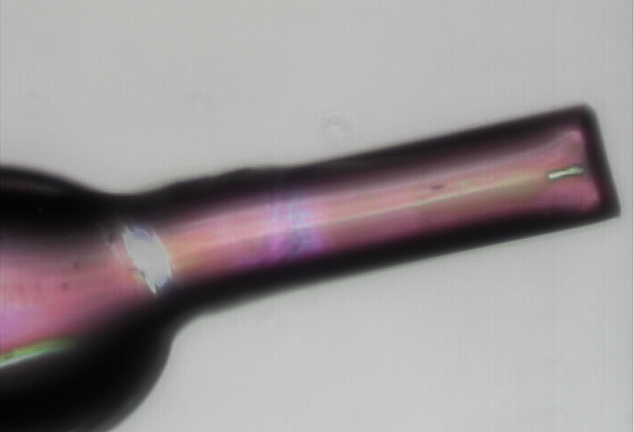
naked xtal

Slide 48
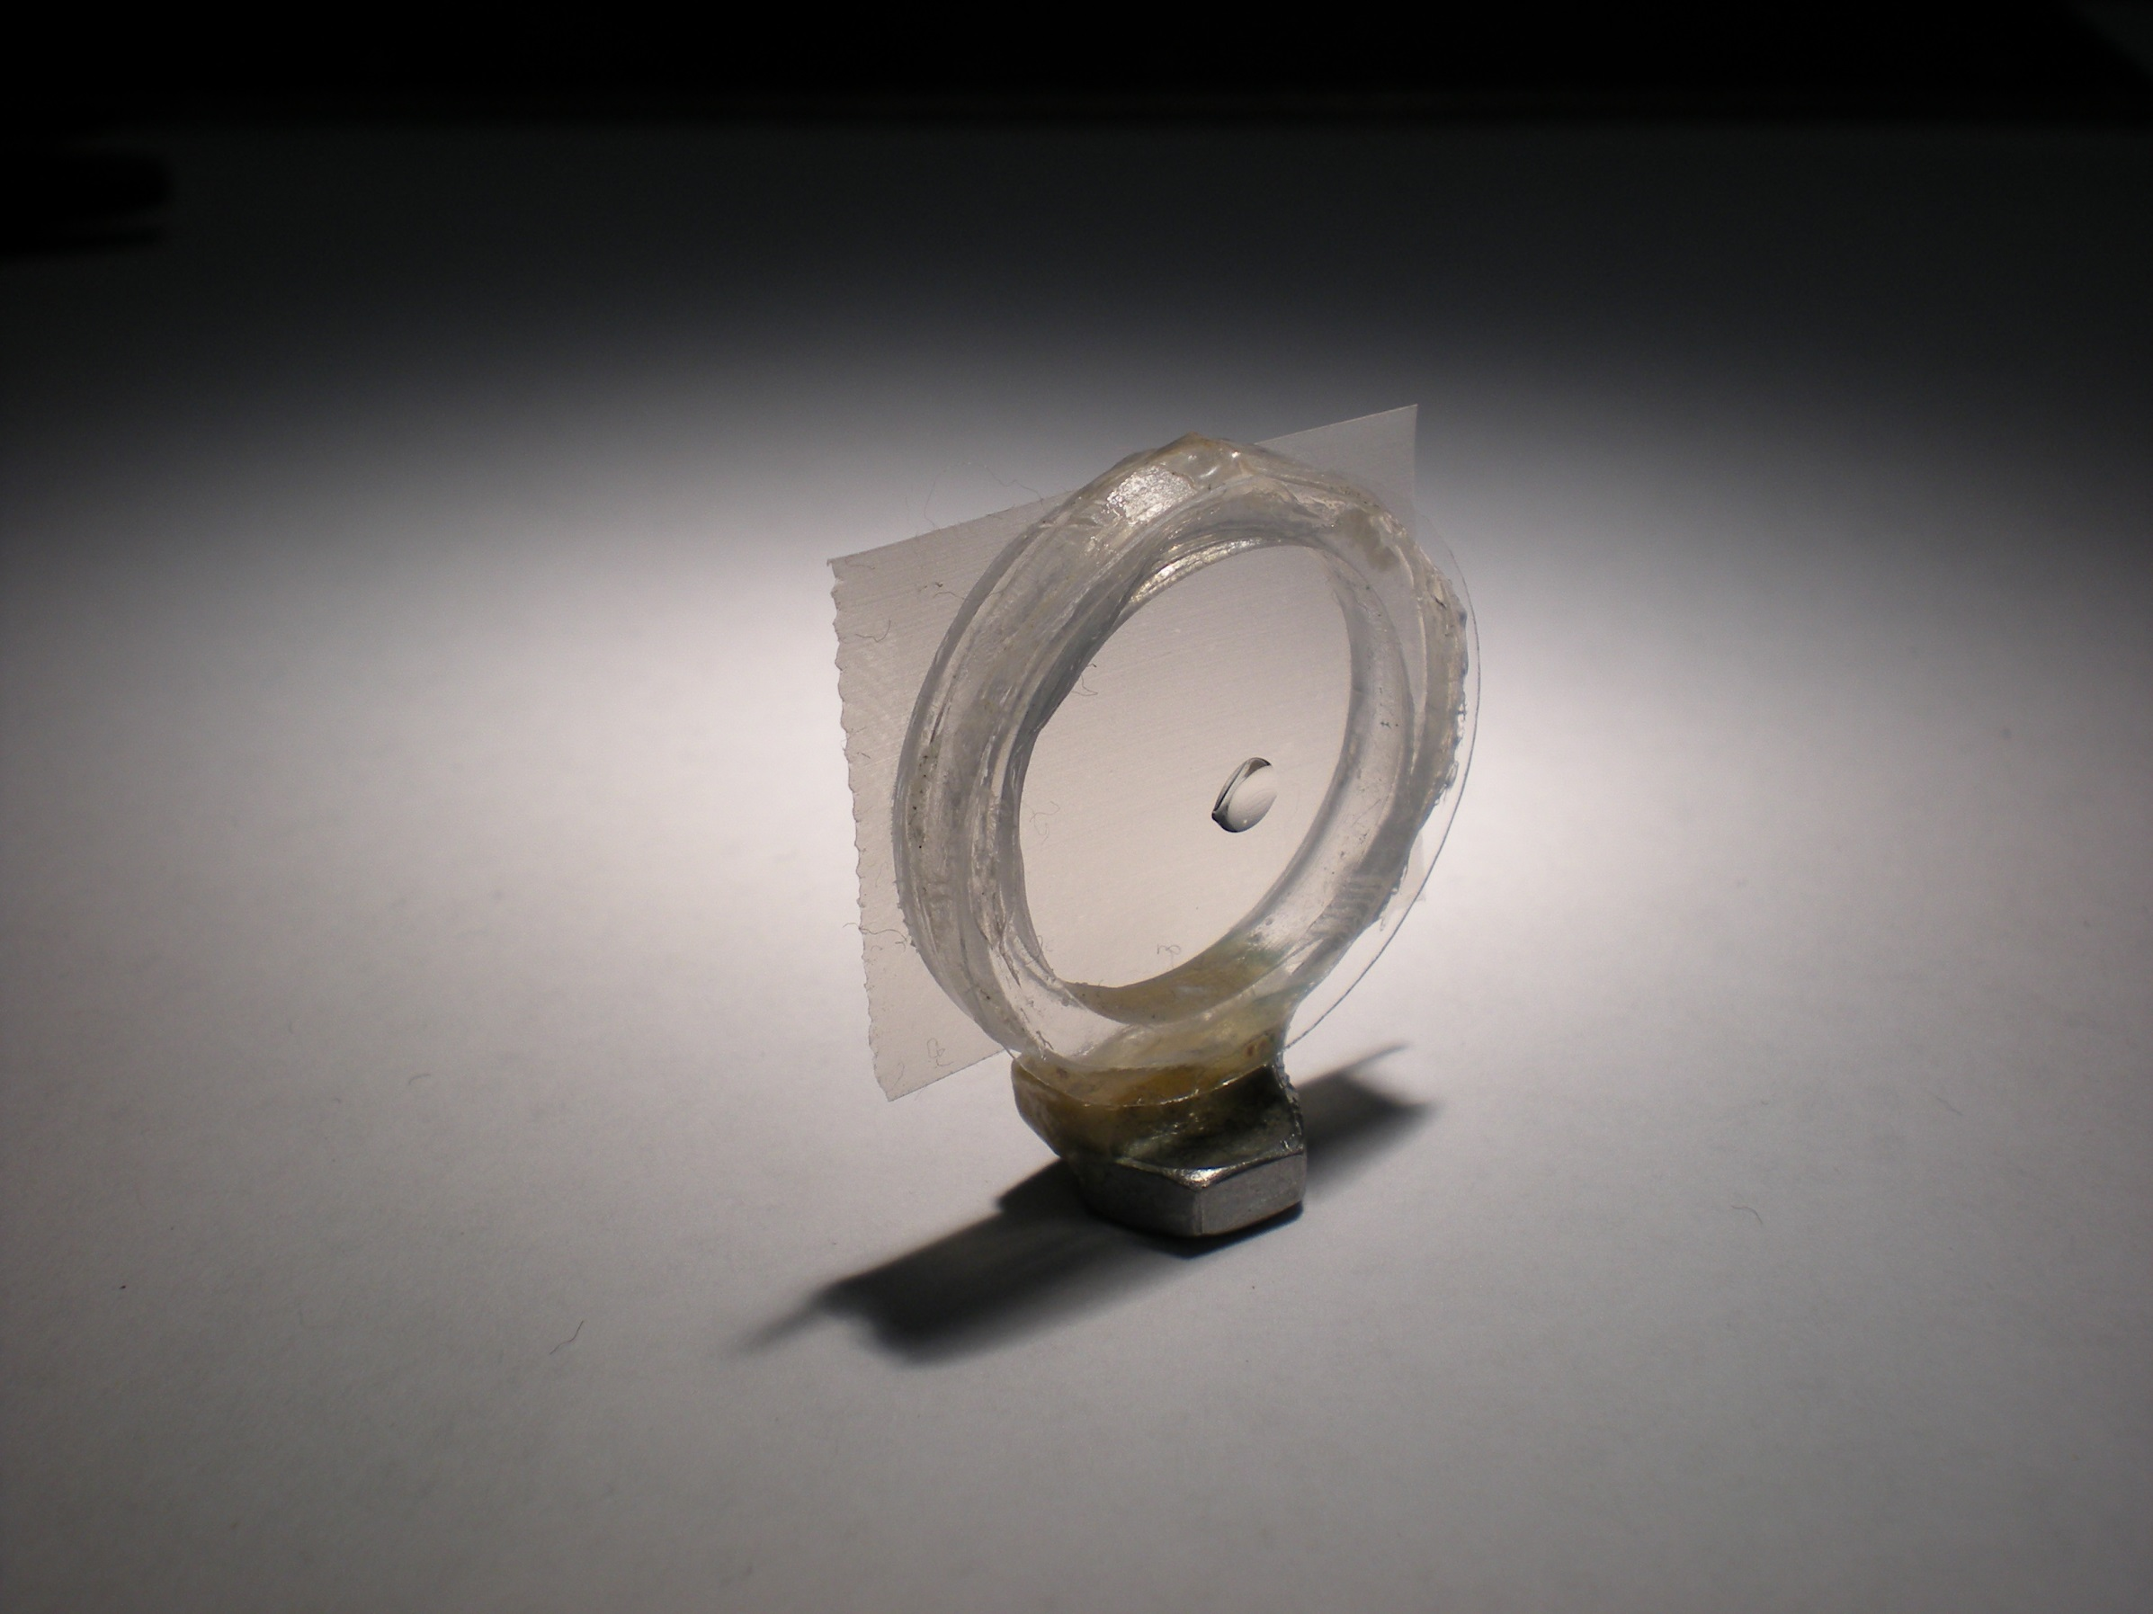
Crowfoot Cell

Slide 49
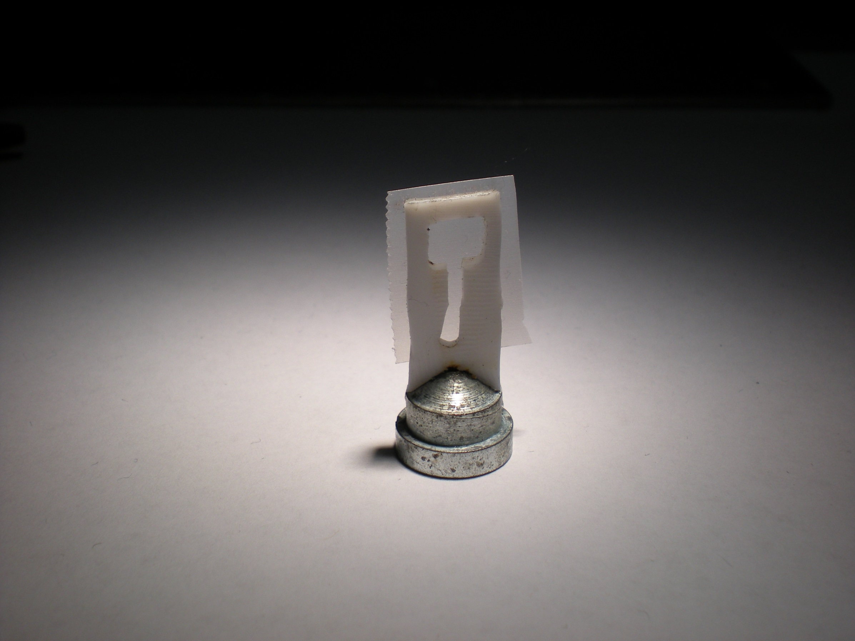
Crowfoot Cell

Slide 50
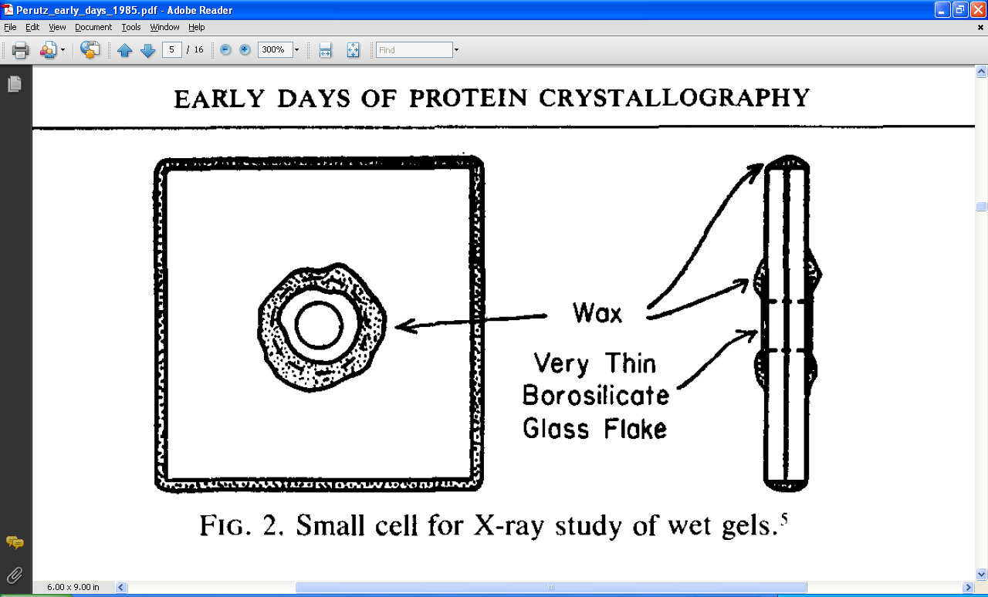
Crowfoot Cell
J. D. Bernal and D. Crowfoot, Nature (London) 133, 794 (1934).

Slide 51
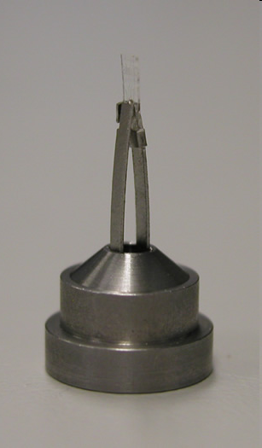
Fluidigm RT/cryo mount
“Diffraction Capable” chip
http://www.fluidigm.com/products/topaz-chips.html

Slide 52
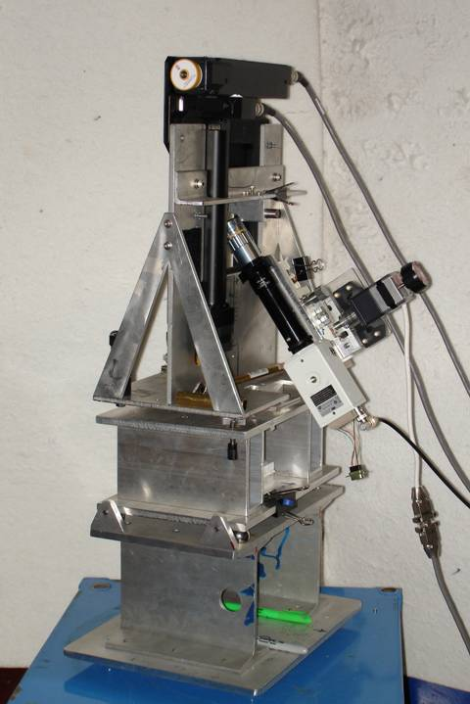
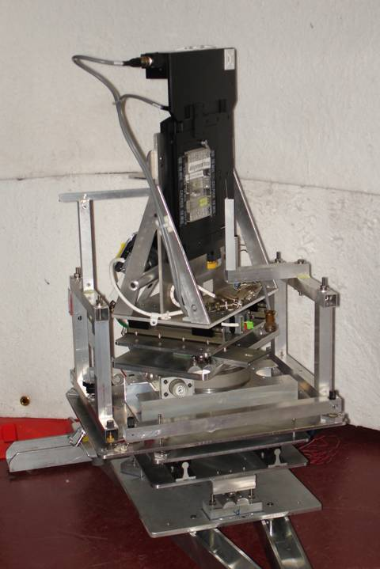
Plate goniometers
Notes:
The non-rotating “plate goniometer” (left) was developed last year. A new incarnation for taking rotation-camera data is now being developed (right). Either of these devices will accept most any crystallization tray that can be rotated 90 degrees to gravity and probe arbitrary points in each crystallization drop with a 50 um x-ray beam. Installing a plate goniometer takes ~30 minutes and the location ~300 mm downbeam from the “normal” protein crystallography sample mounting point makes this technology transferable to most any beamline.
Current status is that a 95% complete data set has been collected from a 50 um lysozyme crystal at room temperature, and trials are now underway to collect data sets from “real” crystals.

Slide 53
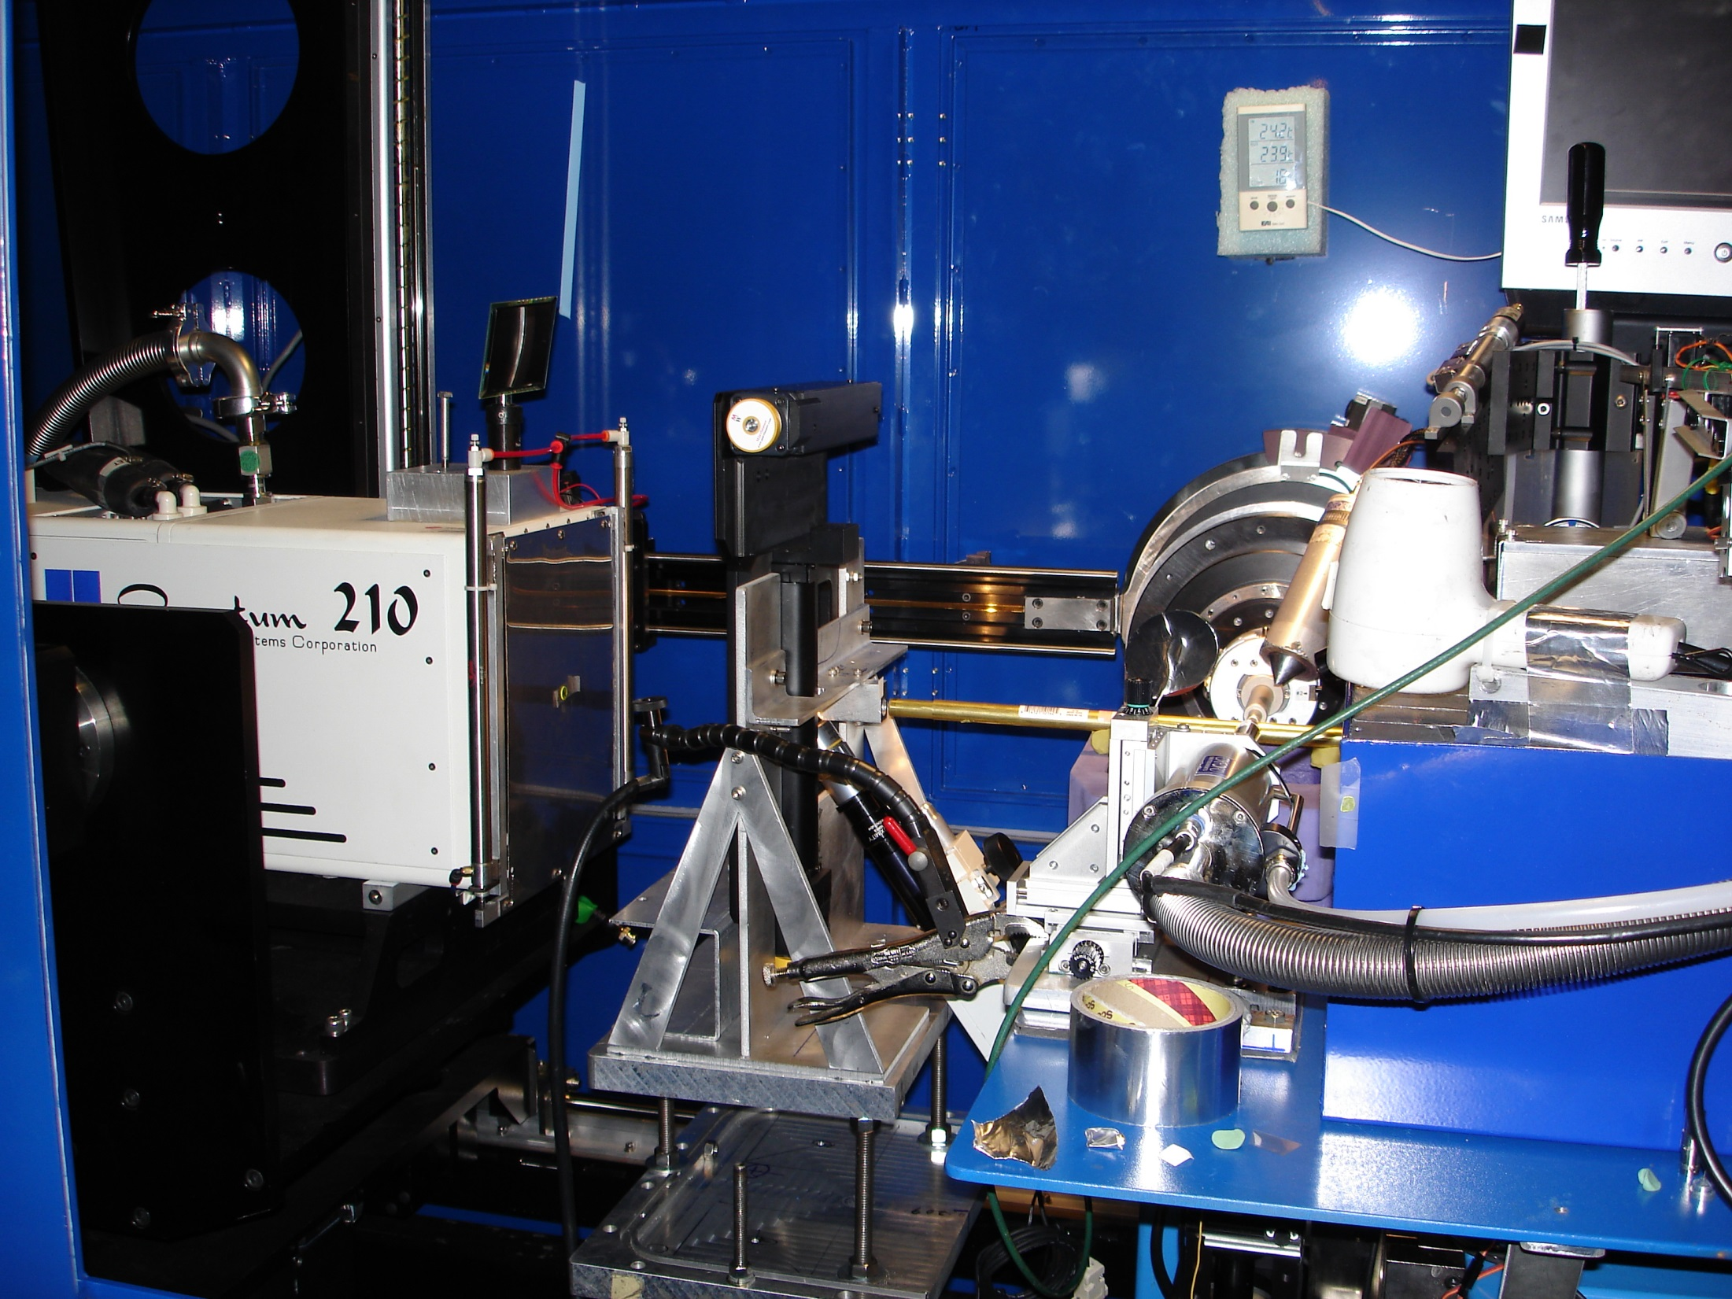
Notes:
non-rotating tray goniometer stage installed in ALS 8.3.1. Note that the “normal” cryo-pin goniometer on the left is still in place and a brass flight tube has been added to contain the air scatter from the main beam on its way to the tray goniometer.

Slide 54
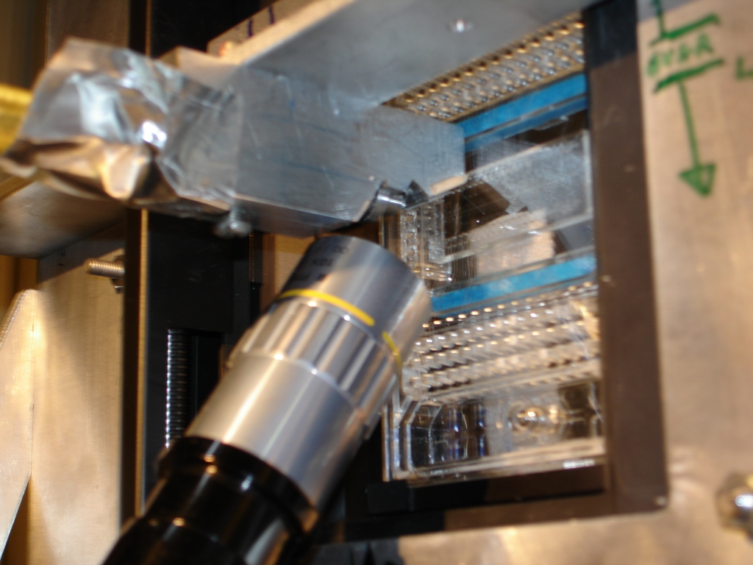

Slide 55
Why harvest at all?
Radiation damage
  10-100x reduced at ~100 K
Background scatter
    tray >> xtal
Timing
    nothing lasts forever
Shipping
    cryo samples are glass beads

Slide 56
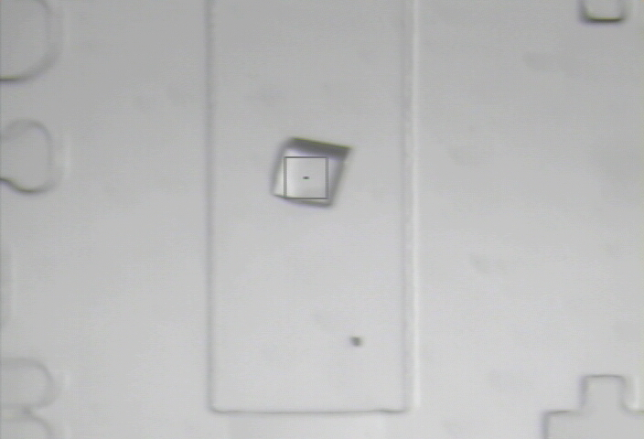

Slide 57
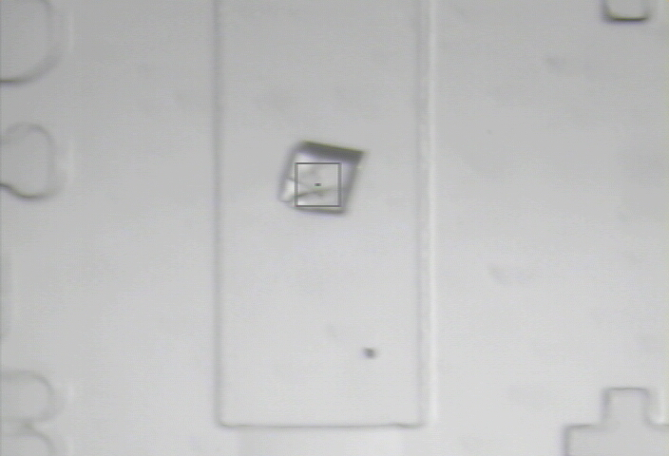
8000 Gy/s

Slide 58
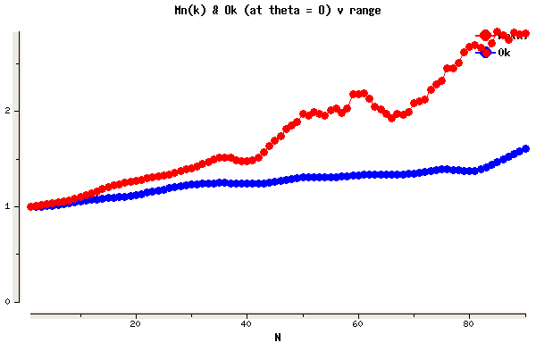
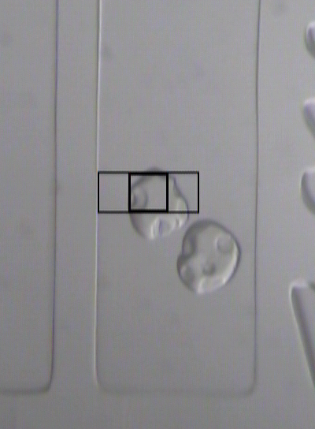
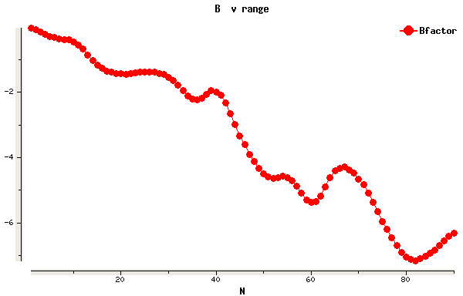
Example Data
lysozyme
50 μm beam
37 Gy/s (0.775 Å)
30s exposures at 20C
90° of data, 97% complete
I/σ = 1.5 at 1.9 Å
R_{merge} 18% (overall) 5% (low)
ΔB same as 20 min at 100K
2
1
0
scale vs batch
B factor
-2
-4
-6

Slide 59
Room temperature damage rates
dose at half intensity (MGy)
dose rate (kGy/s)

Slide 60
Room temperature damage rates
dose at half intensity (MGy)
dose rate (kGy/s)

Slide 61
Every spot is an unpaired partial!
I_{spot} = k N_{cells}²
Ewald sphere
range

Slide 62
Every spot is an unpaired partial!
I_{spot} = k N_{cells}¹
Ewald sphere
range
Woolfson, M. M. (1997). An introduction to X-ray crystallography. Ch. 2 & 6

Slide 63
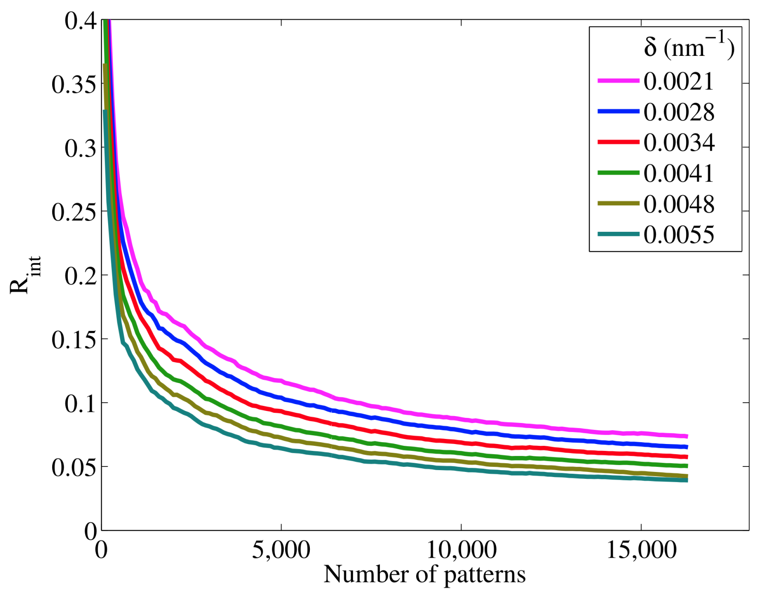
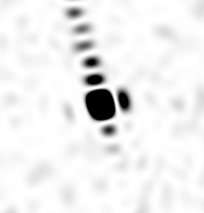
Internal consistency of data
1,850,000 images
112,000 > 10 peaks
33,000 indexed
16,500 good preds
rigid-body:
R_{cryst} = 0.252
R_{free} = 0.232

Slide 64
what is “partiality”?
F(h,k,l)
Ewald sphere
λ₁*
λ₂*
F(h,k,l)
F(0,0,0)

Slide 65
Why harvest at all?
Radiation damage
  10-100x reduced at ~100 K
Background scatter
    tray >> xtal
Timing
    nothing lasts forever
Shipping
    cryo samples are glass beads

Slide 66
Why harvest at all?
Radiation damage
  10-100x reduced at ~100 K
Background scatter
    tray >> xtal
Timing
    nothing lasts forever
Shipping
    cryo samples are glass beads

Slide 67
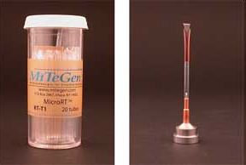
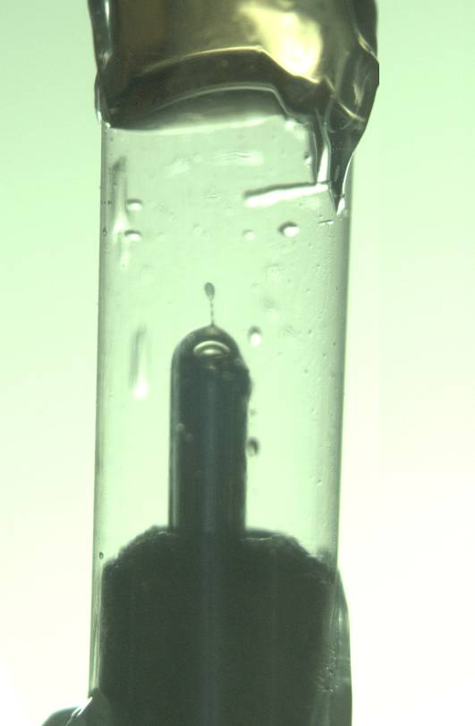
MiTeGen RT cell
http://www.mitegen.com/products/micrort/micrort.shtml

Slide 68
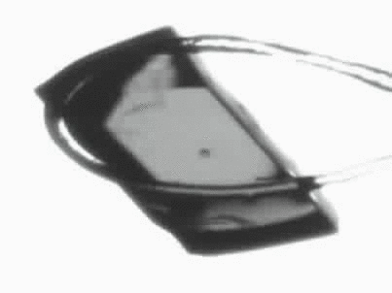
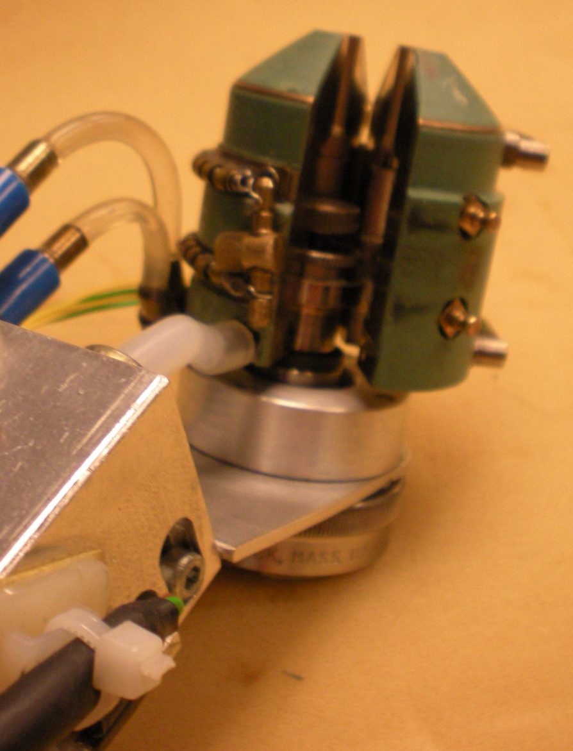
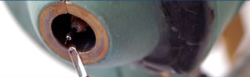
Free-mounting system
http://www.proteros.de/

Slide 69
At the beamline…
Resolution
  problem: background
  solution: use as few pixels as possible
Phases
  problem: fractional errors
  solution: use as many pixels as possible

Slide 70
beam size vs xtal size
  Put your crystal into the beam

Slide 71
beam size vs xtal size
  Put your crystal into the beam
  Shoot the whole crystal

Slide 72
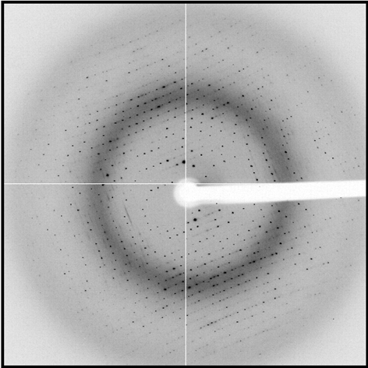
shoot the whole crystal

Slide 73
shoot the whole crystal

Slide 74
shoot the whole crystal

Slide 75
beam size vs xtal size
  Put your crystal into the beam
  Shoot the whole crystal
  Shoot nothing but the crystal

Slide 76
shoot nothing but the crystal

Slide 77
shoot nothing but the crystal

Slide 78
X-ray scattering “rules”:
1 μm crystal ≈ 1 μm water
≈ 1 μm plastic
≈ 0.1 μm glass
≈ 1000 μm air

Slide 79
Resolution (Å)
too big
too small
just right
X-ray beam size (μm)

Slide 80
beam size vs xtal size
  Put your crystal into the beam
  Shoot the whole crystal
  Shoot nothing but the crystal
  Back off!

Slide 81
Mosquito tips cost $0.15 each
So do Pilatus pixels!
We bought 6,224,001
Use them!
(they are reusable)

Slide 82
Background scattering

Slide 83
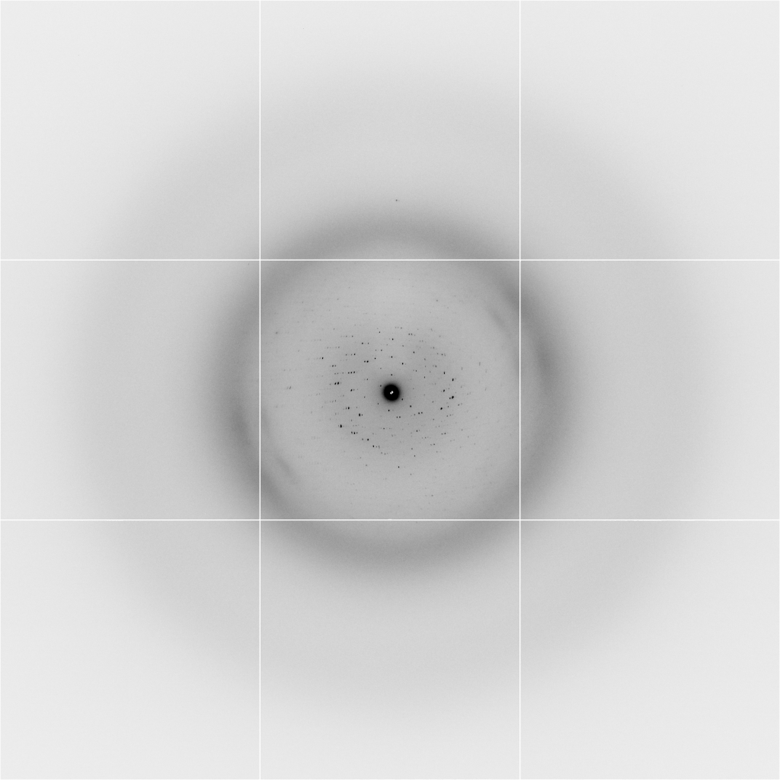
Background scattering
$100,000.00
$100,000.00
$100,000.00
real estate is
expensive
use it!
$100,000.00
$100,000.00
$100,000.00
$100,000.00
$100,000.00

Slide 84
beam size vs xtal size
  Put your crystal into the beam
  Shoot the whole crystal
  Shoot nothing but the crystal
  Back off!
  The crystal must rotate

Slide 85
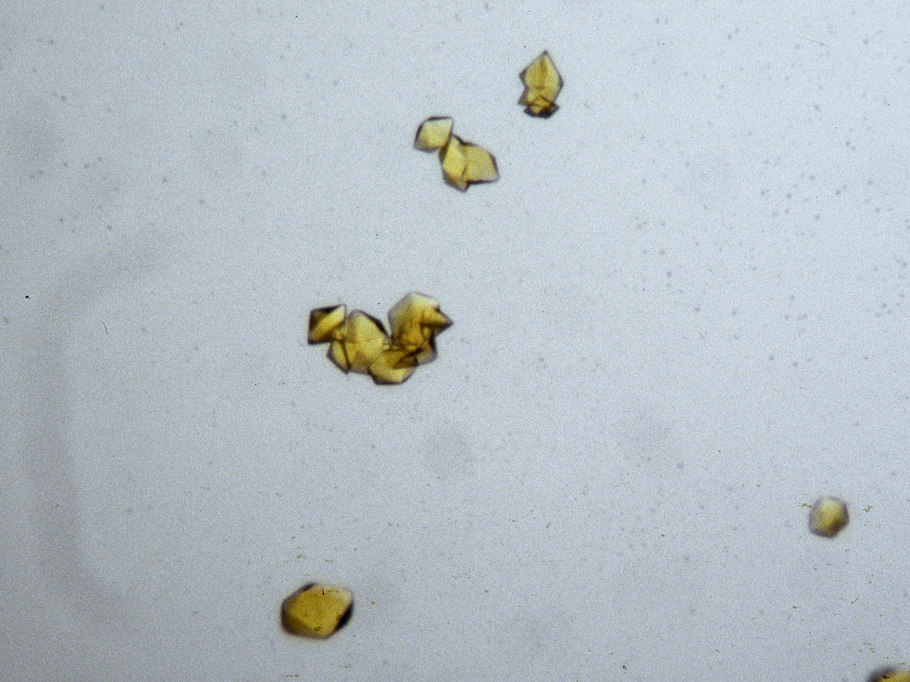
The crystal rotates!

Slide 86
The crystal rotates!
Membrane Protein Expression Center © 2012

