Slide 1
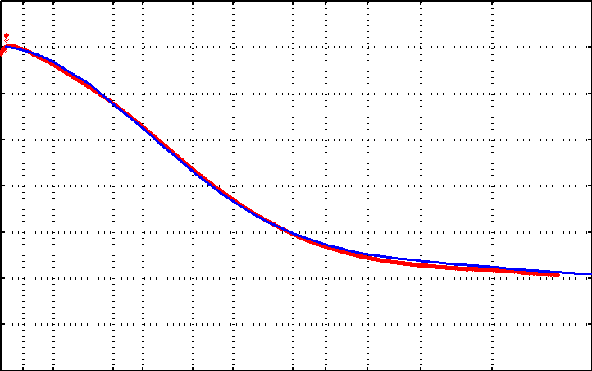
Background scattering
The form-factor of the cryostream
measured
theoretical
0 2 4 6 8 10 12 14 16
Electron equivalents
20 10 5 4 3 2.5 2 1.8 1.6 1.4 1.2 1
Resolution (Ǻ)

Slide 2
Background scattering
R. W. James (1947)
N_{A} ρV
I_{bg} = I_{beam} t r_{e}²
P A | f(s) |²
Mr
I_{bg} - scattered photons/steradian
I_{beam} - incident (photons/s/m² )
t - exposure time (s)
r_{e} - classical electron radius (2.818x10⁻¹⁵ m)
N_{A} - Avogadro number (6.02x10²³)
ρ - density of material (g/m³)
Mr - molecular weight (g/mol)
V - volume of material (in m3)
P - polarization factor
(1+cos²(2θ) -Pfac∙cos(2Φ)sin²(2θ))/2
A - absorption factor
exp(-μ_{xtal}∙l_{path})
f(s) - molecular structure amplitude (electrons)
s - scattering length (sin(θ)/λ)

Slide 3
Background scattering
Se edge with detector at 100 mm
xtal size x 1000 = air gap
Photons/s/pixel
∞ 7.5 3.8 2.5 1.9 1.5 1.2 1.1
Resolution (Ǻ)

Slide 4
Background scattering
R. W. James (1947)
N_{A} ρV
I_{bg} = I_{beam} t r_{e}²
P A | f(s) |²
Mr
I_{bg} - scattered photons/steradian
I_{beam} - incident (photons/s/m² )
t - exposure time (s)
r_{e} - classical electron radius (2.818x10⁻¹⁵ m)
N_{A} - Avogadro number (6.02x10²³)
ρ - density of material (g/m³)
Mr - molecular weight (g/mol)
V - volume of material (in m3)
P - polarization factor
(1+cos²(2θ) -Pfac∙cos(2Φ)sin²(2θ))/2
A - absorption factor
exp(-μ_{xtal}∙l_{path})
f(s) - molecular structure amplitude (electrons)
s - scattering length (sin(θ)/λ)

Slide 5
Solid angle of a pixel

Slide 6
Solid angle of a pixel
xtal-to-det
r

Slide 7
Solid angle of a pixel
xtal-to-det
r
Ω

Slide 8
Diffuse scattering
R. W. James (1947)
V_{xtal}
Σ
I_{ds} = I_{beam} t r_{e}²
P A
|f_{a}(s)|² (1-exp(-2B_{a}∙s²))
V_{ASU}
a
I_{ds} - scattered photons/steradian
I_{beam} - incident (photons/s/m² )
t - exposure time (s)
r_{e} - classical electron radius (2.818x10⁻¹⁵ m)
V_{xtal} - volume of crystal (in m³)
V_{ASU} - asymmetric unit (in m³)
P - polarization factor
A - absorption factor
a - particular atom in the ASU
f_{a}(s) - atomic structure amplitude (electrons)
s - scattering length (sin(θ)/λ)
B_{a} - atomic B factor

Slide 9
Diffuse scattering
R. W. James (1947)
V_{xtal}
Σ
I_{ds} = I_{beam} t r_{e}²
P A
|f_{a}(s)|² (1-exp(-2B_{a}∙s²))
V_{ASU}
a
I_{ds} - scattered photons/steradian
I_{beam} - incident (photons/s/m² )
t - exposure time (s)
r_{e} - classical electron radius (2.818x10⁻¹⁵ m)
V_{xtal} - volume of crystal (in m³)
V_{ASU} - asymmetric unit (in m³)
P - polarization factor
A - absorption factor
a - particular atom in the ASU
f_{a}(s) - atomic structure amplitude (electrons)
s - scattering length (sin(θ)/λ)
B_{a} - atomic B factor

Slide 10
Compton scattering
R. W. James (1947)
V_{xtal} P A
Σ
I_{compton} = I_{beam} t r_{e}²
Z_{a}- |f_{a}(s)|
V_{ASU} 1+κ (1-cos(θ))²
a
I_{compton} - scattered photons/steradian
I_{beam} - incident (photons/s/m² )
t - exposure time (s)
r_{e} - classical electron radius (2.818x10⁻¹⁵ m)
V_{xtal} - volume of crystal (in m³)
V_{ASU} - asymmetric unit (in m³)
P - polarization factor
A - absorption factor
a - particular atom in the ASU
θ - Bragg angle
κ - photon energy (keV) / 511 keV
Z_{a} - atomic number
f_{a}(s) - atomic structure amplitude (electrons)
s - scattering length (sin(θ)/λ)

Slide 11
Compton scattering
R. W. James (1947)
V_{xtal} P A
Σ
I_{compton} = I_{beam} t r_{e}²
Z_{a}- |f_{a}(s)|
V_{ASU} 1+κ (1-cos(θ))²
a
I_{compton} - scattered photons/steradian
I_{beam} - incident (photons/s/m² )
t - exposure time (s)
r_{e} - classical electron radius (2.818x10⁻¹⁵ m)
V_{xtal} - volume of crystal (in m³)
V_{ASU} - asymmetric unit (in m³)
P - polarization factor
A - absorption factor
a - particular atom in the ASU
θ - Bragg angle
κ - photon energy (keV) / 511 keV
Z_{a} - atomic number
f_{a}(s) - atomic structure amplitude (electrons)
s - scattering length (sin(θ)/λ)

Slide 12
scattering
x-ray beam
sample
detector

Slide 13
scattering
x-ray beam
sample
detector

Slide 14
scattering
x-ray beam
sample
detector

Slide 15
scattering
x-ray beam
sample
detector

Slide 16
Bragg’s Law
to detector
nλ = 2d sin(θ)
atom #1
θ
d
to source
atom #2
d∙sin(θ)

Slide 17
Bragg’s Law
to detector
nλ = 2d sin(θ)
atom #1
θ
to source
d
atom #2
d∙sin(θ)

Slide 18
anomalous scattering
x-ray beam
sample
detector

Slide 19
anomalous scattering
x-ray beam
sample
detector

Slide 20
anomalous scattering
x-ray beam
sample
detector

Slide 21
anomalous scattering
x-ray beam
sample
detector

Slide 22
anomalous scattering
x-ray beam
sample
detector

Slide 23
scattering
x-ray beam
sample
detector
detector

Slide 24
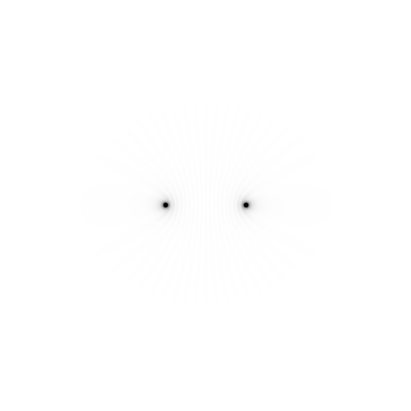
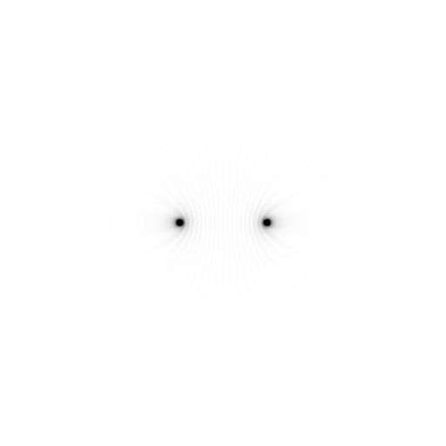
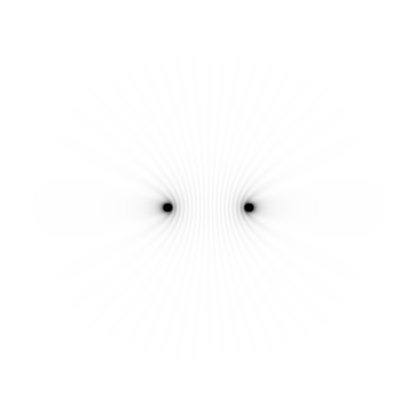
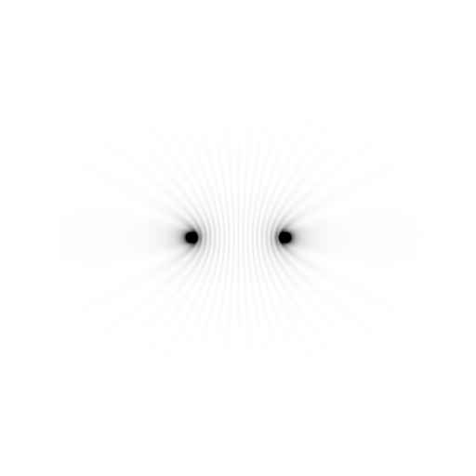
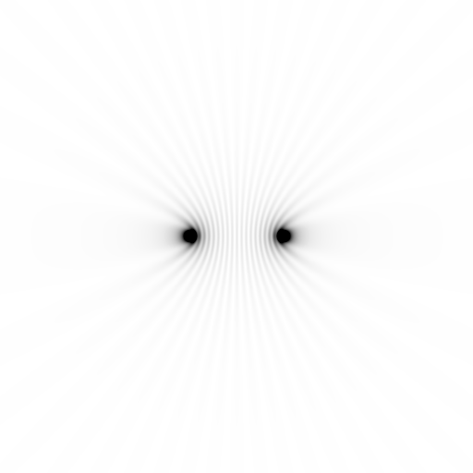
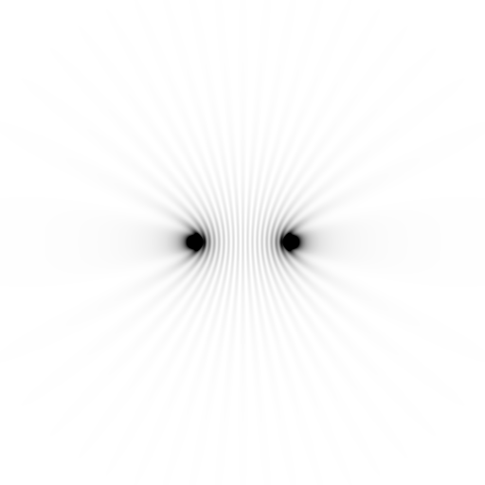
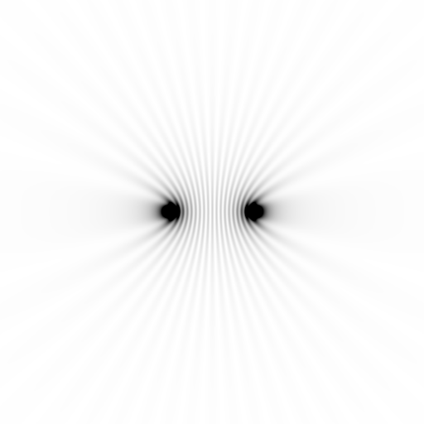
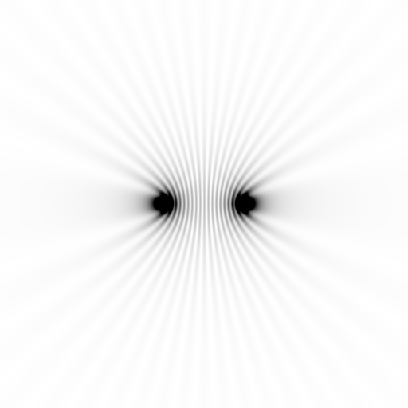
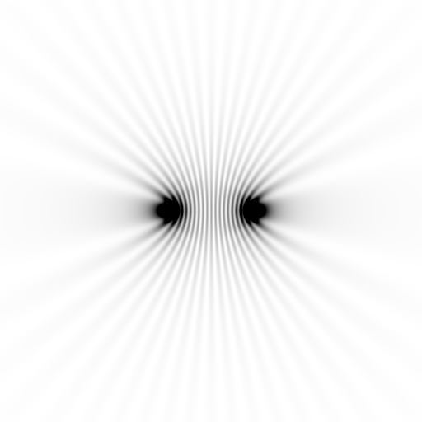
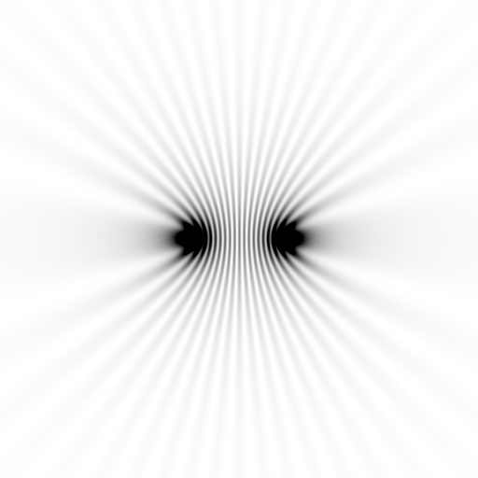
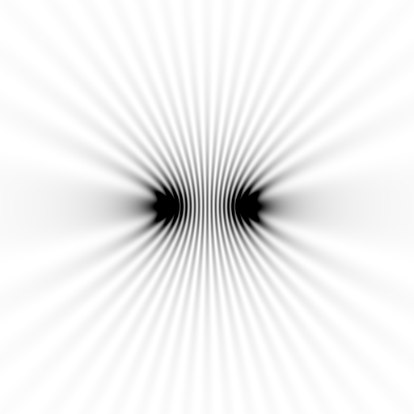
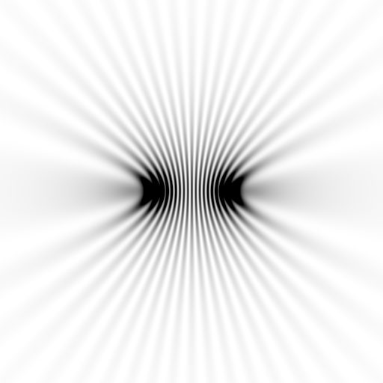
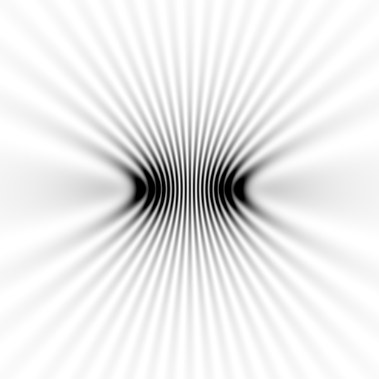
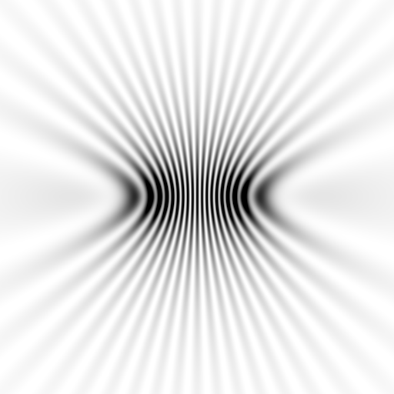
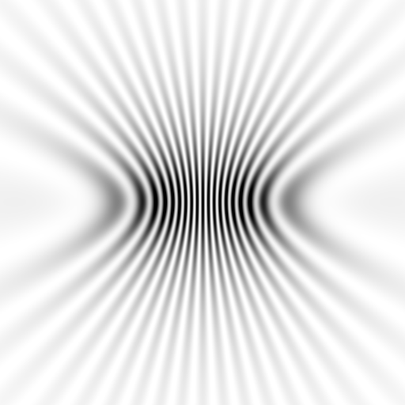
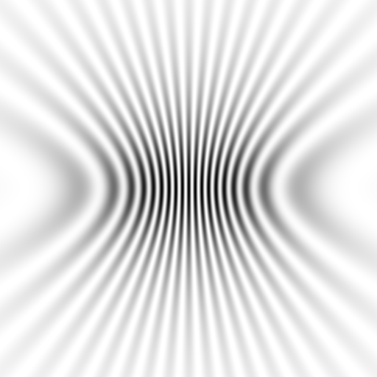
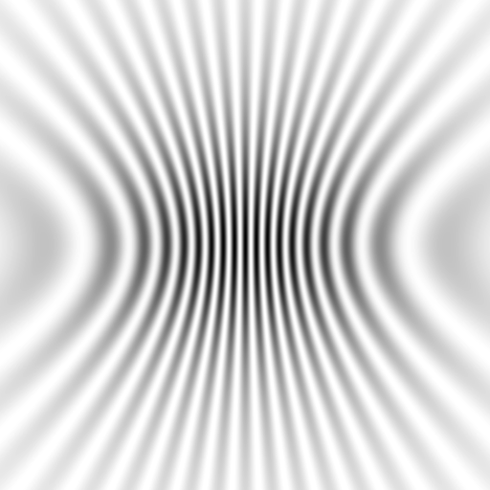
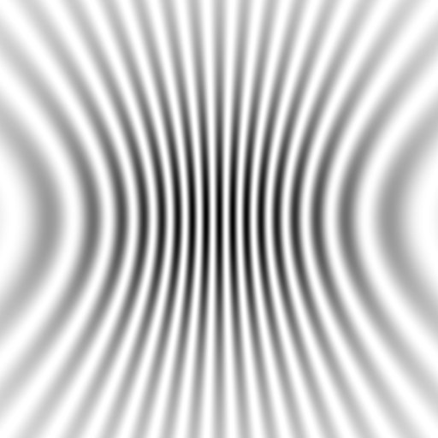
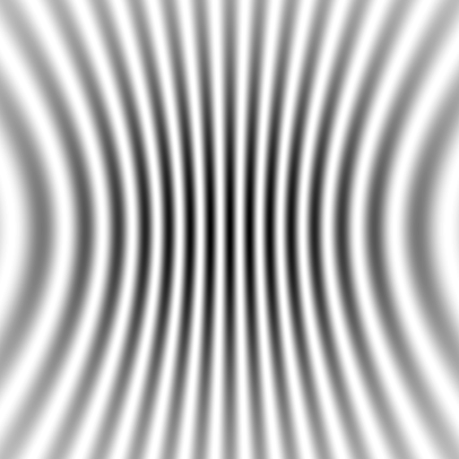
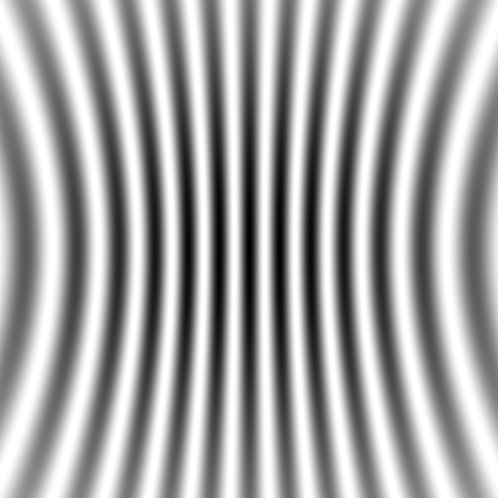
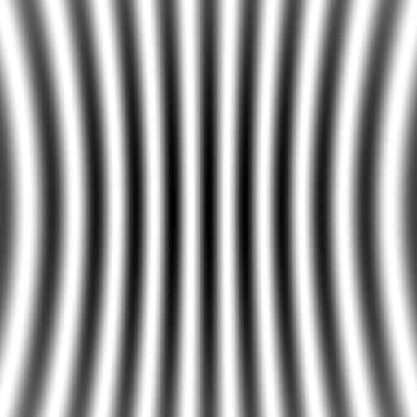
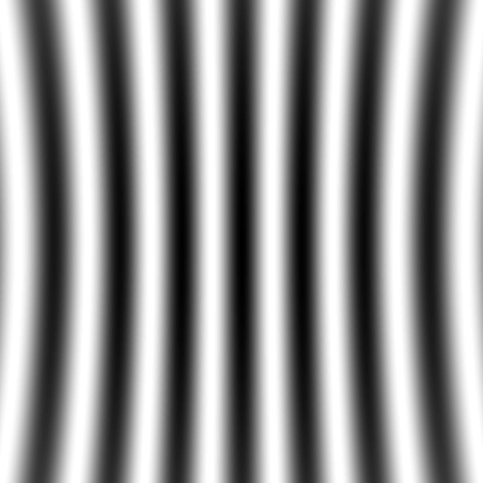

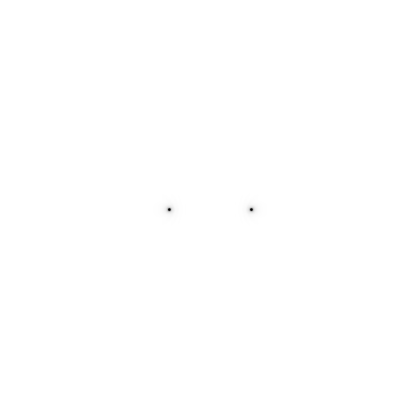
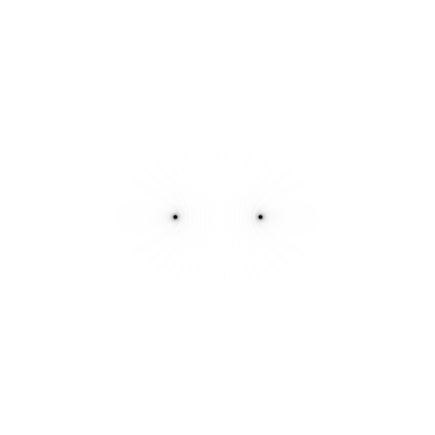
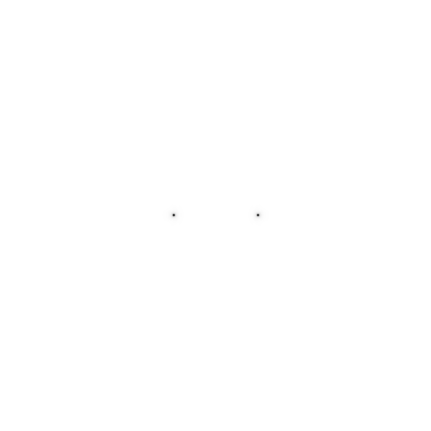

Slide 25
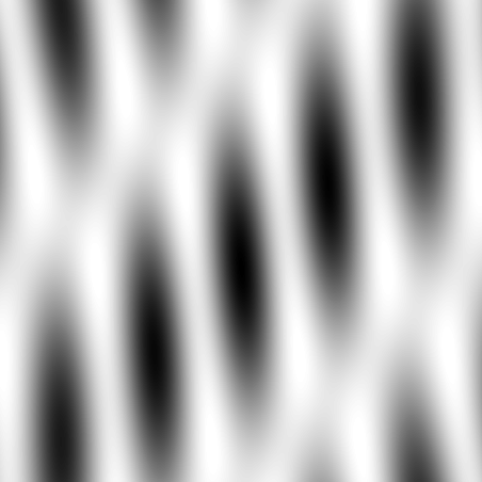
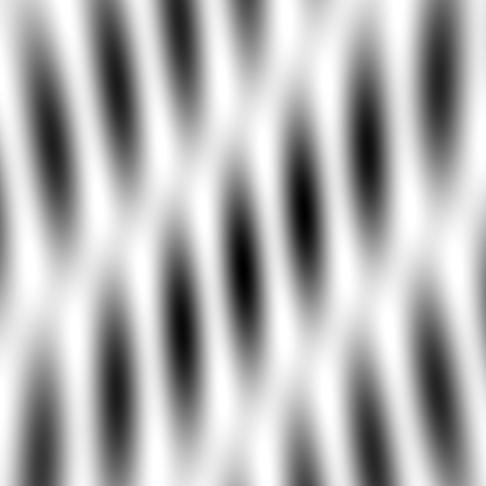
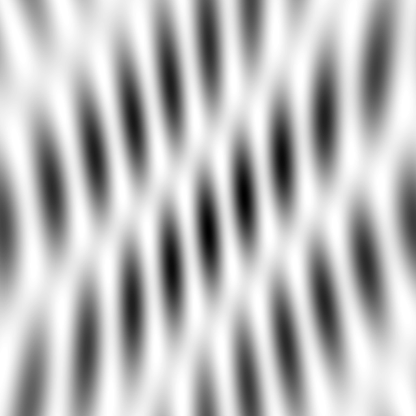
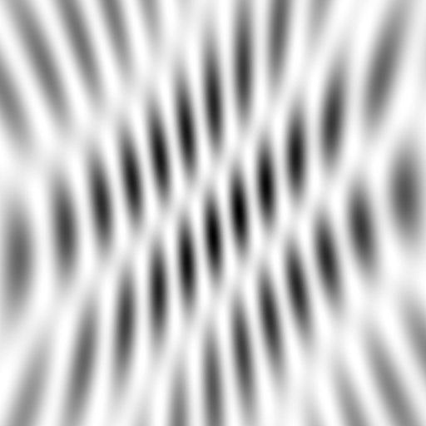
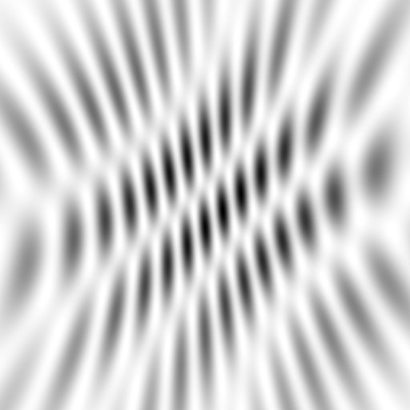
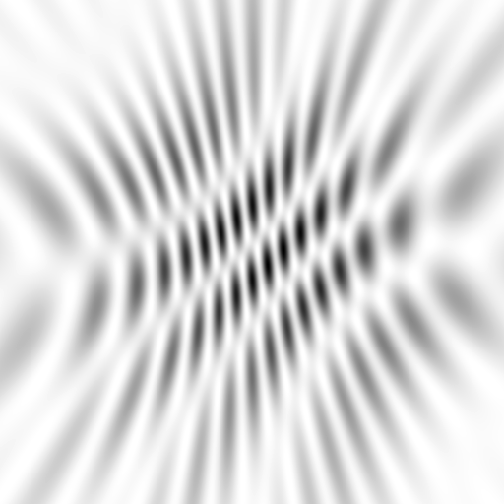
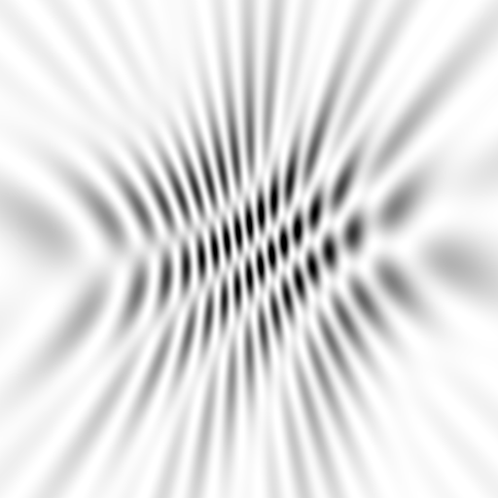
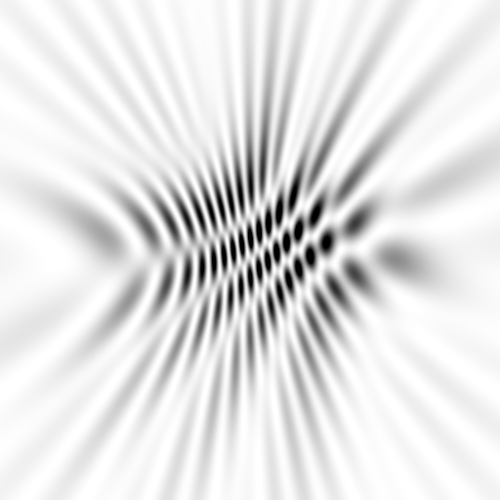
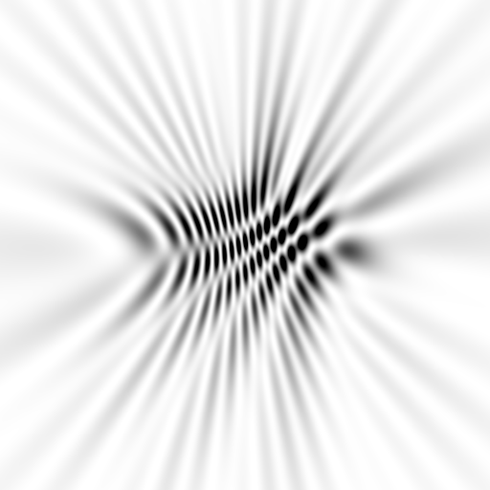
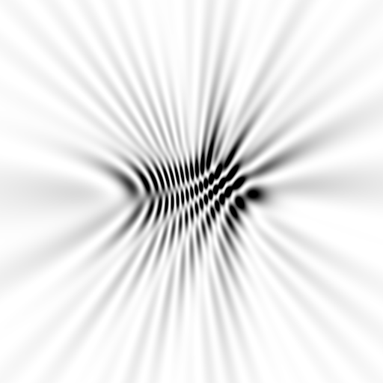
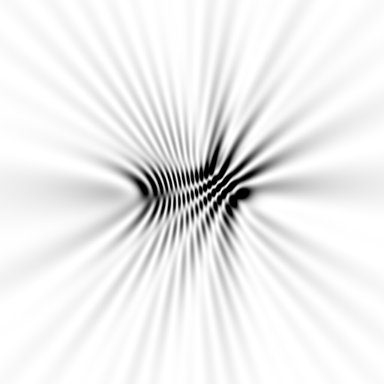
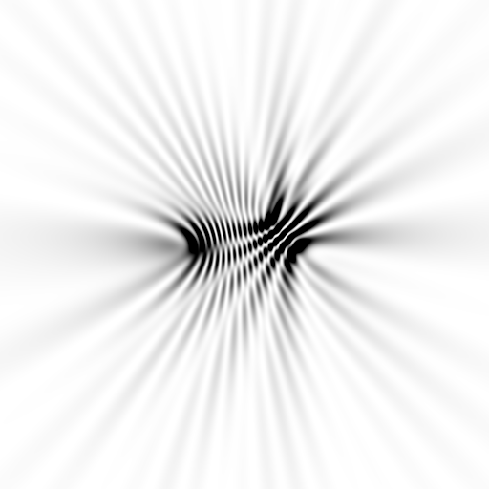
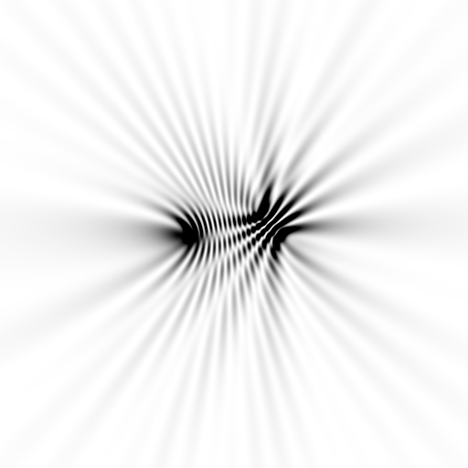
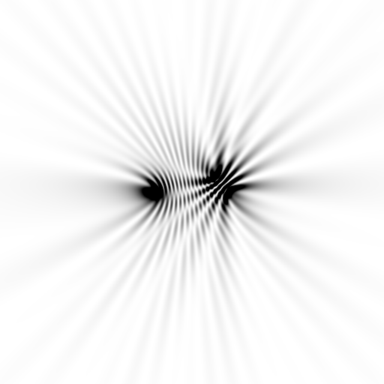
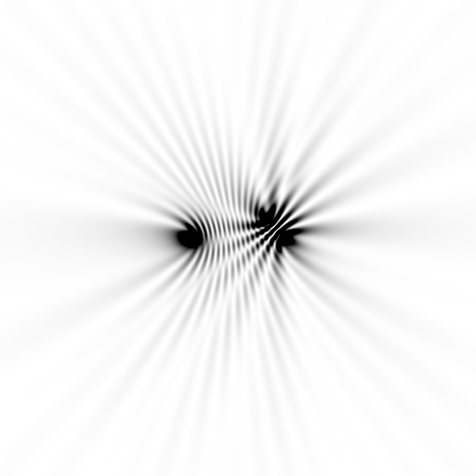






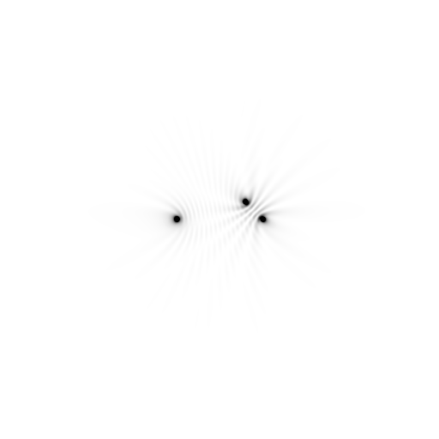





Slide 26
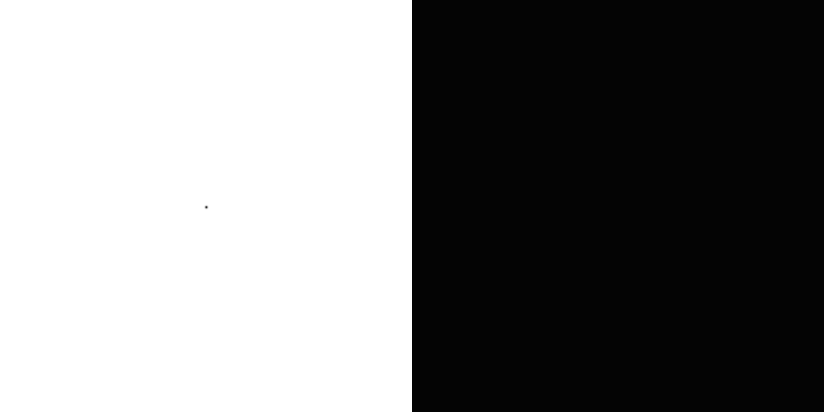


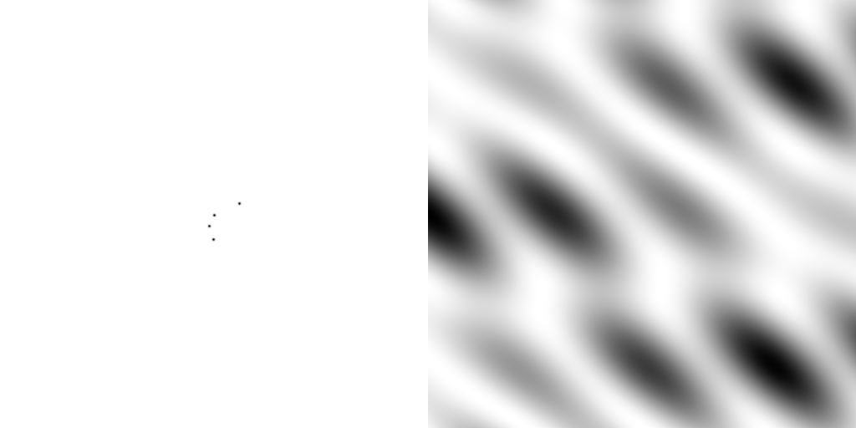
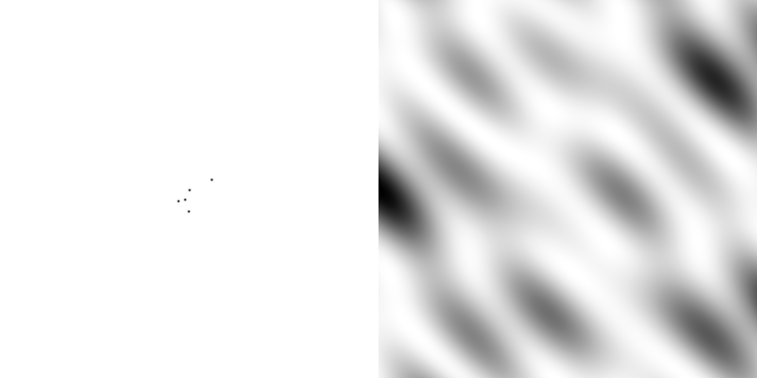
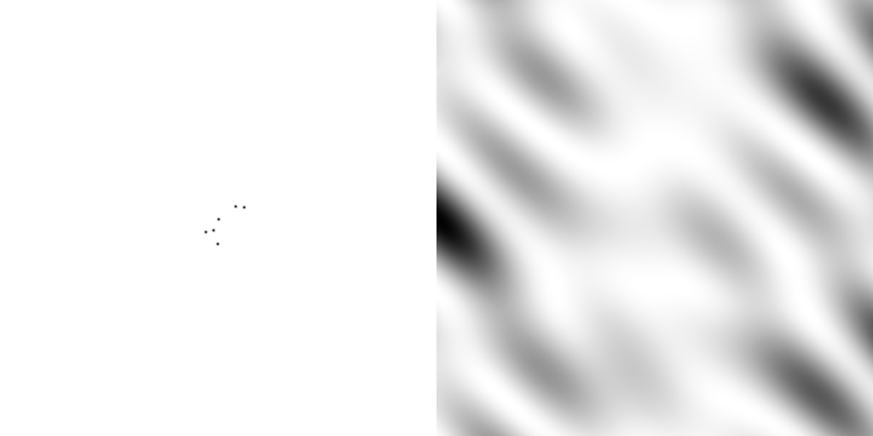
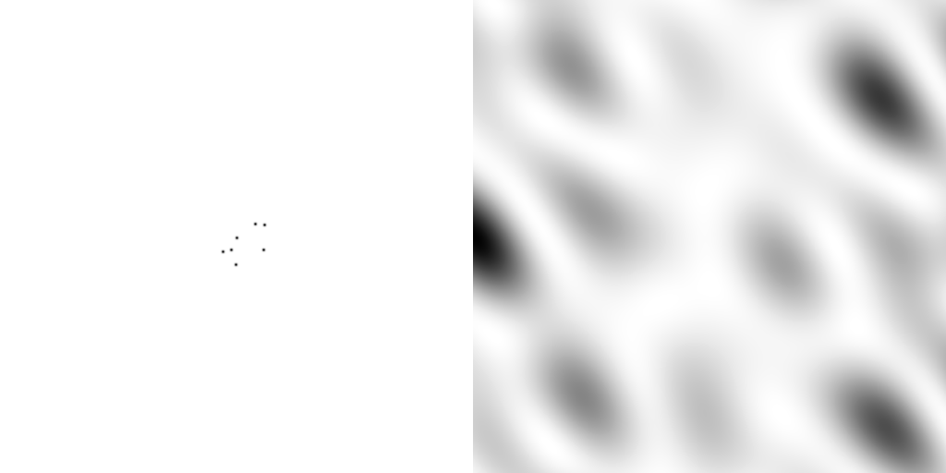
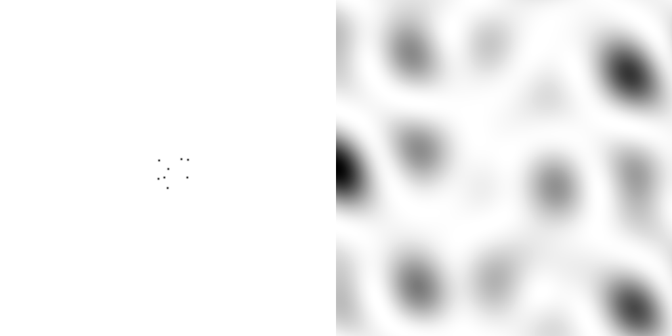
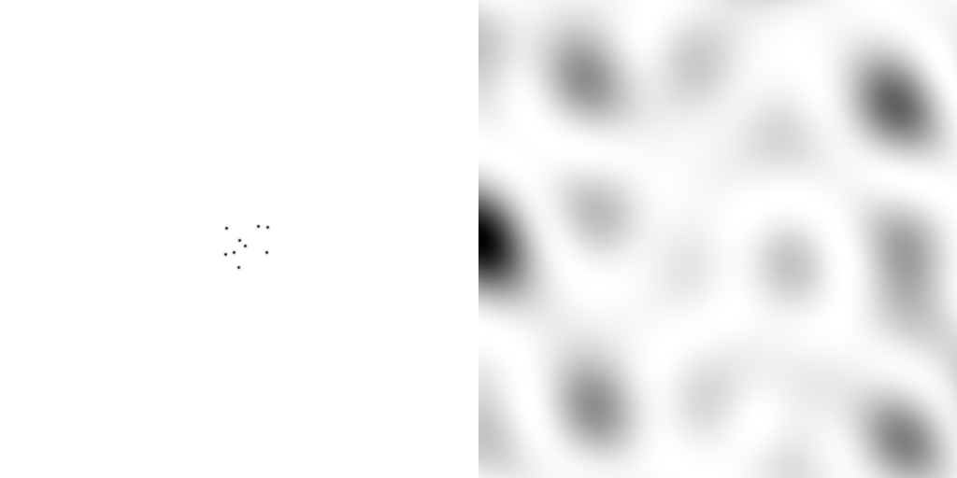
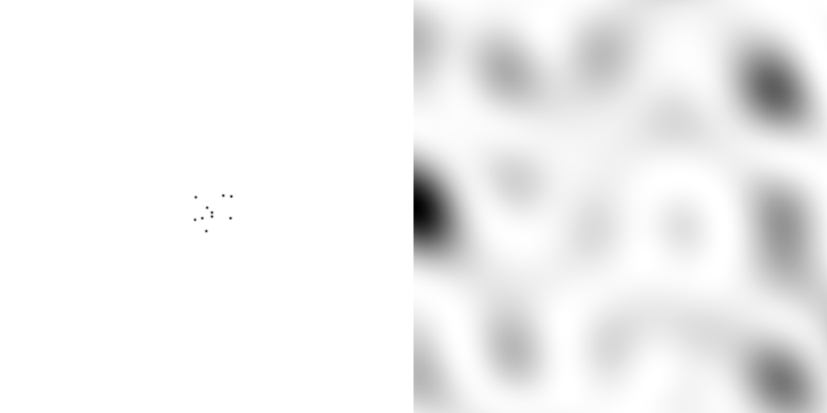
scattering from a structure
sample
detector

Slide 27

forward Fourier Transform
inverse Fourier Transform
no phase

Slide 28











inverse Fourier Transform
scattering from a structure
colored by phase
sample
detector

Slide 29




scattering from a lattice
colored by phase
sample
detector

Slide 30

scattering from a lattice
colored by phase
sample
detector

Slide 31

scattering from a lattice
colored by phase
sample
detector

Slide 32

scattering from a crystal structure
colored by phase
sample
detector

Slide 33

crystal expansion
Protein crystal in sucrose, NaWO4 and oil

Slide 34

crystal expansion
Protein crystal in sucrose, NaWO4 and oil

Slide 35

crystal expansion
Protein crystal in sucrose, NaWO4 and oil

Slide 36

crystal expansion
Protein crystal in sucrose, NaWO4 and oil

Slide 37

Distention of cryo with dose
before

Slide 38

Distention of cryo with dose
after

Slide 39

Distention of cryo with dose
High pressure hydrogen bubbles
Leapman, R. D. & Sun, S. (1995). Ultramicroscopy, 59, 71–79.

Slide 40


stress and strain
intensity
∞ 10 5 3 2.7 2.5 2.0 1.8 1.5
resolution (Å)

Slide 41
stress and strain
intensity
∞ 10 5 3 2.7 2.5 2.0 1.8 1.5
resolution (Å)

Slide 42

strong reflection

Slide 43
weak reflection

Slide 44
“B” factors
electron density (e⁻/Å³)
position (Å)

Slide 45
“B” factors
electron density (e⁻/Å³)
position (Å)

Slide 46
“B” factors
electron density (e⁻/Å³)
position (Å)

Slide 47
“B” factors
electron density (e⁻/Å³)
position (Å)

Slide 48
“B” factors
electron density (e⁻/Å³)
position (Å)

Slide 49
“B” factors
electron density (e⁻/Å³)
position (Å)

Slide 50
“B” factors
electron density (e⁻/Å³)
position (Å)

Slide 51
“B” factors
electron density (e⁻/Å³)
position (Å)

Slide 52
A Fourier view of scattering
density (ρ)
intensity
distance (Å)
angle (°)

Slide 53
A Fourier view of scattering
density (ρ)
intensity
distance (Å)
angle (°)

Slide 54
A Fourier view of scattering
density (ρ)
intensity
distance (Å)
angle (°)

Slide 55
A Fourier view of scattering
density (ρ)
intensity
distance (Å)
angle (°)

Slide 56

Anisotropic diffraction

Slide 57

“Anisotropic” diffraction

Slide 58

Completeness: missing wedge
http://bl831.als.lbl.gov/~jamesh/movies/osc.mpeg

Slide 59

Completeness: random deletion
http://bl831.als.lbl.gov/~jamesh/movies/completeness.mpeg

Slide 60

Resolution
http://bl831.als.lbl.gov/~jamesh/movies/resolution.mpeg

Slide 61

Resolution: low-angle cutoff
http://bl831.als.lbl.gov/~jamesh/movies/lo_cut.mpeg

Slide 62

R-factor
http://bl831.als.lbl.gov/~jamesh/movies/rfactor.mpeg

Slide 63

Figure of Merit
http://bl831.als.lbl.gov/~jamesh/movies/dephase.mpeg

Slide 64

Overloads
http://bl831.als.lbl.gov/~jamesh/movies/overloads.mpeg

Slide 65
Spot Shape
Ewald sphere
(h,k,l)

Slide 66
Spot Shape
Ewald sphere
(h,k,l)
d*

Slide 67
Spot Shape
Ewald sphere
(h,k,l)
spindle axis
d*

Slide 68
Spot Shape
Ewald sphere
Φ circle
(h,k,l)
spindle axis

Slide 69
Spot Shape
Ewald sphere
Φ circle
(h,k,l)
spindle axis

Slide 70
Spot Shape
Ewald sphere
Φ circle
(h,k,l)
diffracted ray
spindle axis

Slide 71
Spot Shape
Ewald sphere
Φ circle
(h,k,l)
λ*
d*
spindle axis
diffracted ray
λ*

Slide 72
Spot Shape
Ewald sphere
Φ circle
(h,k,l)
λ*
d*
spindle axis
diffracted ray
θ
λ*
λ = 2 d sin(θ)

Slide 73
mosaic spread
Ewald sphere
Φ circle
(h,k,l)
λ*
d*
diffracted ray
d*
spindle axis
λ*

Slide 74
mosaic spread
Ewald sphere
Φ circle
(h,k,l)
d*
diffracted rays
d*
spindle axis

Slide 75

mosaic spread = 0 º

Slide 76

mosaic spread = 0.1º

Slide 77

mosaic spread = 0.2º

Slide 78

mosaic spread = 0.4º

Slide 79

mosaic spread = 0.6º

Slide 80

mosaic spread = 0.8º

Slide 81

mosaic spread = 1.0º

Slide 82

mosaic spread = 1.5º

Slide 83

mosaic spread = 2.0º

Slide 84

mosaic spread = 2.5º

Slide 85

mosaic spread = 3.2º

Slide 86

mosaic spread = 6.4º

Slide 87

mosaic spread = 12.8º

Slide 88
Trick Question:
What is the space group?
a = 63 b = 63 c = 63
α = 90 β = 90 γ = 90

Slide 89
What you know when:
Autoindexing: Lattice (14)
Scaling: Point Group (43)
Refinement: Space Group (84)

Slide 90
Incompatible chemistries for crystallization
Mg + PO4
Ca + SO4
Tris + gold
Tris + temperature
Lipid + oil
Salt + peg
Salt + detergent
Zn + PO4
Ca + PO4
Ca + hi pH
Ag + Cl
Osmotic shock
Tris + gluteraldehyde

Slide 91
Good, bad and ugly crystals?
https://hamptonresearch.com/gallery.aspx

