Slide 1

Acknowledgements
https://bl831.als.lbl.gov/~jamesh/powerpoint/CCP4_tangle_2025.pptx
James Fraser Nevan Krogan
Paul Adams John Tainer Greg Hura Nick Sauter
Pavel Afonine Tom Terwilliger Nigel Moriarty, Dorothee Liebschner
Aina Cohen
UCSF LBNL SLAC
ALS 8.3.1: TomAlberTron
NIH NIGMS R01 GM124149 (Holton)
NIH NIAID P50 AI150476 (Krogan)
NIH NIGMS P30 GM124169 (Adams)
DOE-BER IDAT (Hura)
NIH NIGMS P30 GM133894 (Hodgson)
The Advanced Light Source is supported by the Director, Office of Science, Office of Basic Energy Sciences, Materials Sciences Division, of the US Department of Energy under contract No. DE-AC02-05CH11231 at Lawrence Berkeley National Laboratory.

Slide 2
Why is a beamline guy doing refinement things?
https://bl831.als.lbl.gov/~jamesh/powerpoint/CCP4_tangle_2025.pptx
Because: the future of crystallography has alternate conformations
Single-conf models
poor resolution
Low signal/noise
Phase Problem
Dynamics?
Mechanism?
Small signal?
Overlapping states?

Slide 3
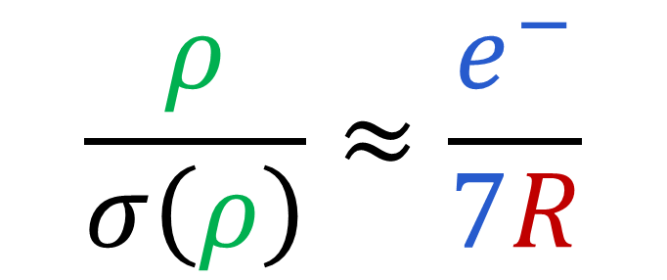
Map Noise: via Parseval’s Theorem
$$\frac{ρ}{σ\left(ρ\right)}≈\frac{e^{−}}{7R}$$
e⁻ number of electrons in peak
7 number of electrons in typical atom
R R_{iso} or R_{free}
ρ electron density peak
σ rms deviation expected

Slide 4
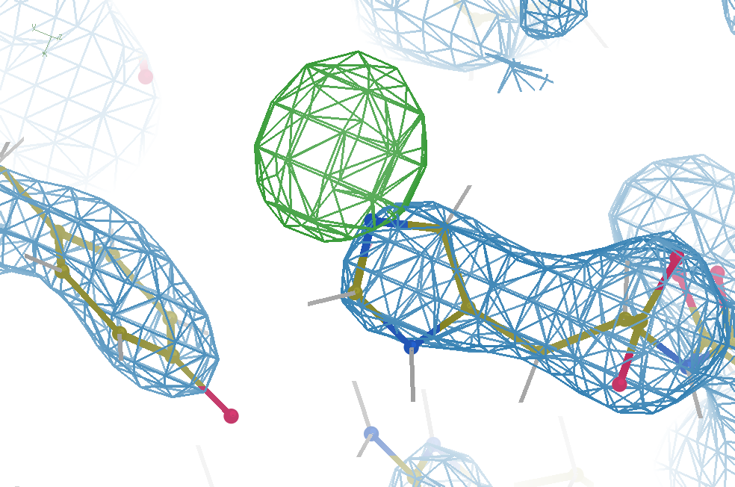
Hydrogen: visible at 3.5 Å resolution!
R_{work} = 0.04
R_{free} = 0.05
6σ = 1 e⁻
cut at 5 Å :
R_{free} = 0.01
Simulation:
Realistic noise
“perfect” model

Slide 5
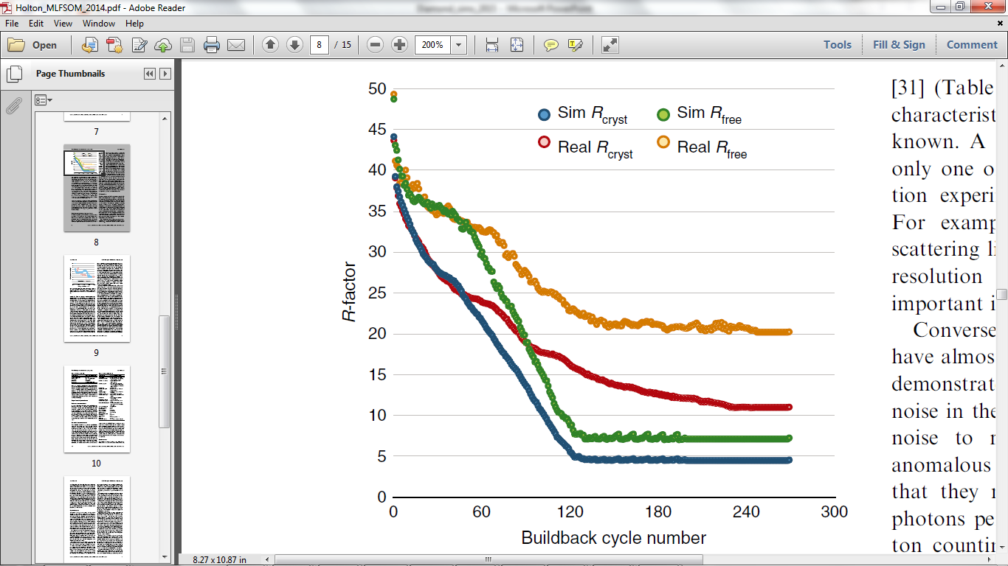
Model building: real vs sim data
multi
single
single
single
multi
multi
multi
single
Holton et al. (2014) "The R-factor gap", FEBS J. 281, 4046-4060.

Slide 6
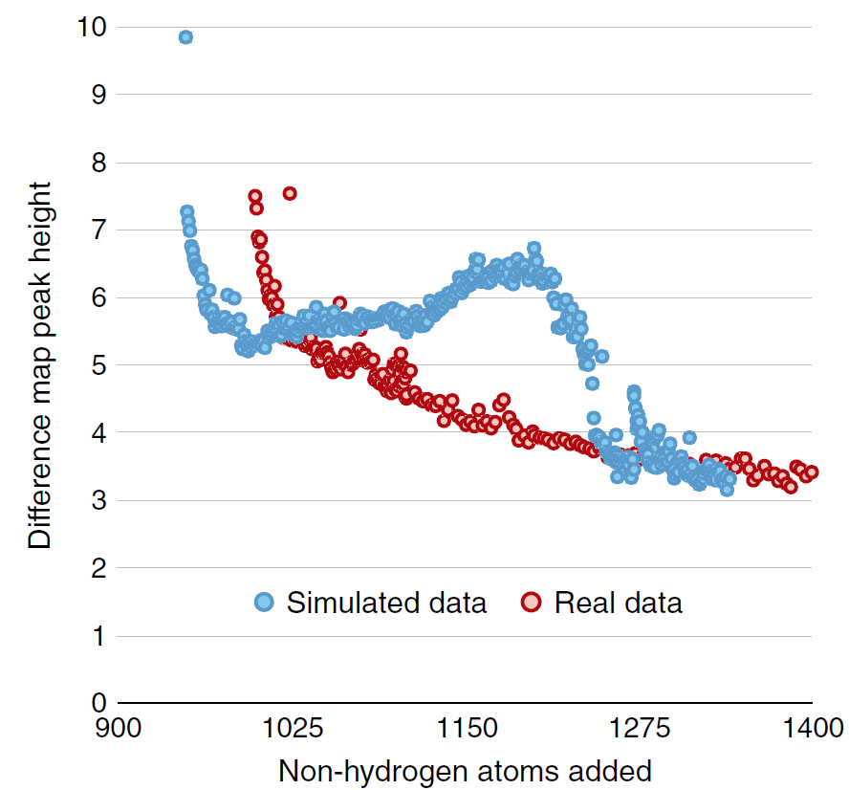
Model building: real vs sim data
multi
single conf
Single conf ground
Multi conf ground truth
Holton et al. (2014) "The R-factor gap", FEBS J. 281, 4046-4060.

Slide 7
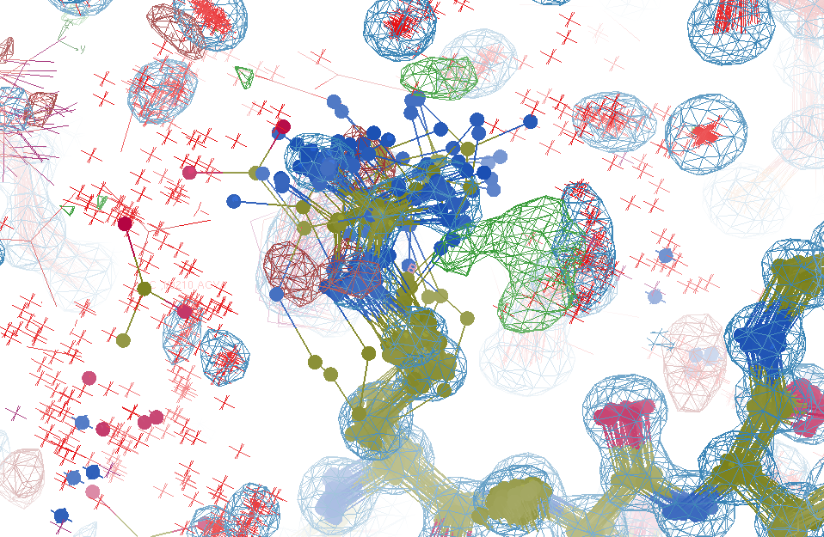
R_{work}: 0.0823
R_{free}: 0.1106
bond: 0.014 Å
angle: 1.92°
Real Data
1.2 σ
48-copy ensemble
3 params
per observation
MoPro: 1.15
Clash: 0.49
Cβdev: 20
Rota: 1.7%
Rama: 0.03%
reso: 1.0 Å
6σ

Slide 8
Over-Fitting data
Map density
position

Slide 9
Over-Fitting data
Map density
position

Slide 10
Over-Fitting data
Map density
position

Slide 11
Over-Fitting data
R_{work} ≈ 0
N_{params}= N_{obs}
Map density
position

Slide 12
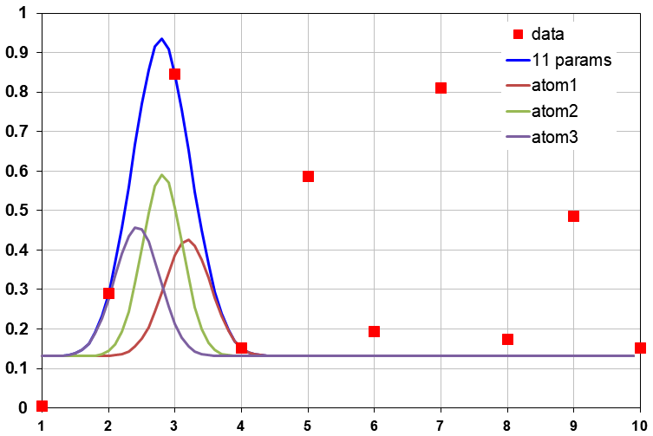
Under-Fitting data
R_{work} > 0
N_{params}> N_{obs}
Map density
position

Slide 13
R_{work}: 0.0823
R_{free}: 0.1106
bond: 0.014 Å
angle: 1.92°
under-fitting:
R_{work} > 0
MoPro: 1.15
Clash: 0.49
Cβdev: 20
Rota: 1.7%
Rama: 0.03%
reso: 1.0 Å
6σ

Slide 14
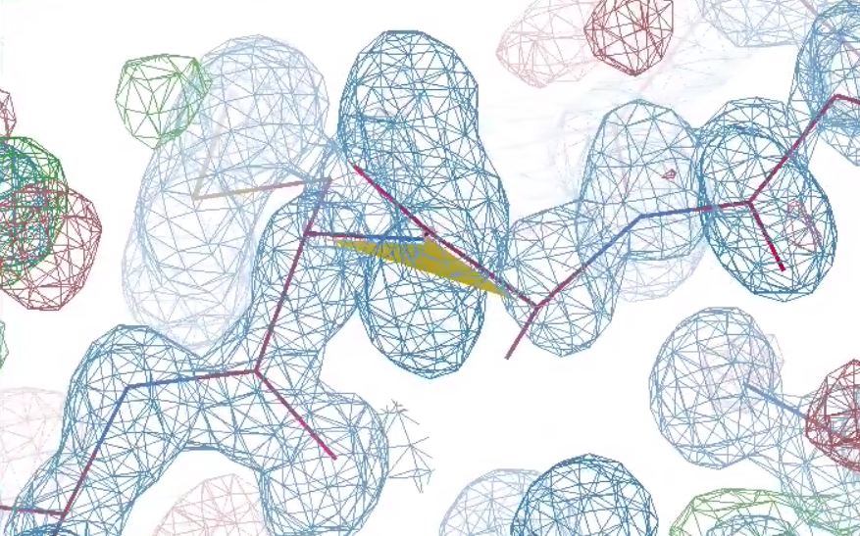
What is holding it back?
1 member of 48-copy
ensemble
3 parameters
per observation!
30°
peptide
bond twist

Slide 15
Why does ensemble refinement suck?
(3 parameters/observation and R_{work} still high!)
The chains are “tangled”

Slide 16
What do you mean, “tangled”?
Ground Truth
Local Minimum

Slide 17
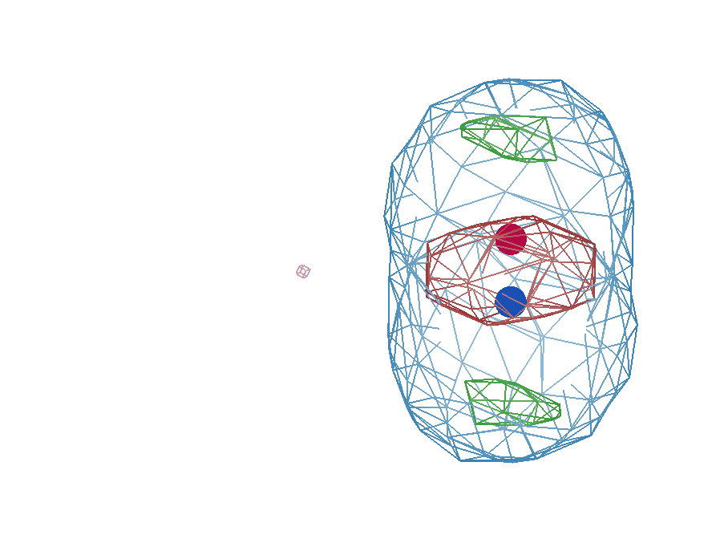
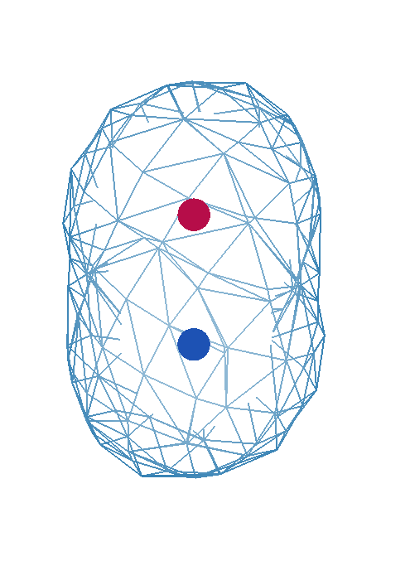
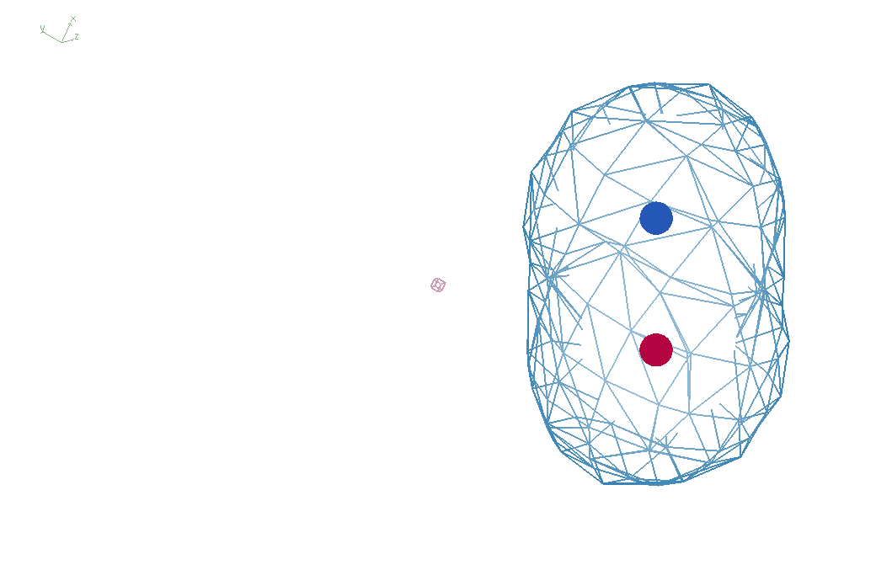
It takes two to tangle
density
fit
Chemical
strain
energy
A
A
B
B
B
A
tangled
barrier
untangled

Slide 18
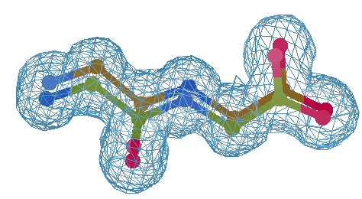
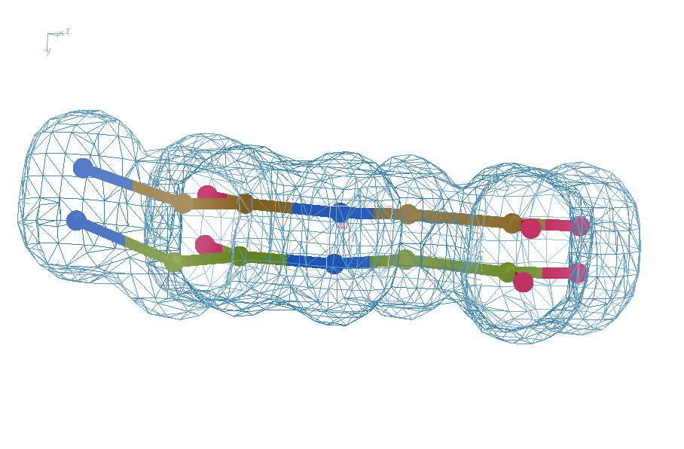
Refine from right answer
R = 0.8%
rms bond = 0.0002

Slide 19
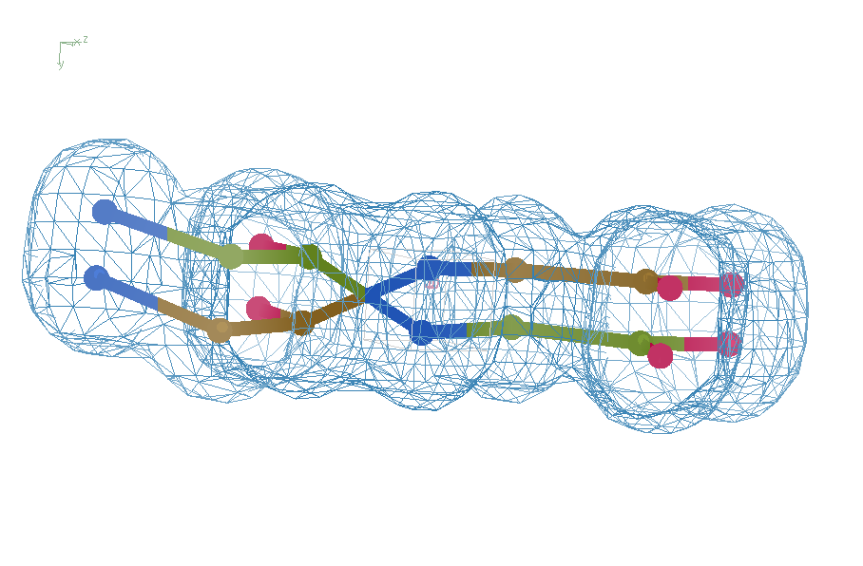
swap assignments
R = 0.8%
rms bond = 0.04

Slide 20
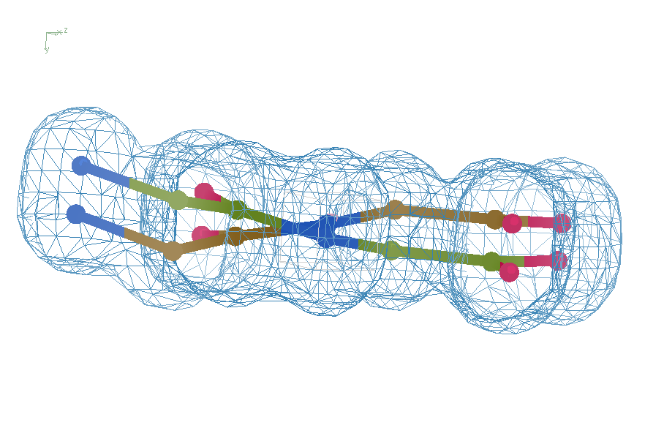
Refine – low x-ray weight
R = 14.3%
rms bond = 0.0002

Slide 21
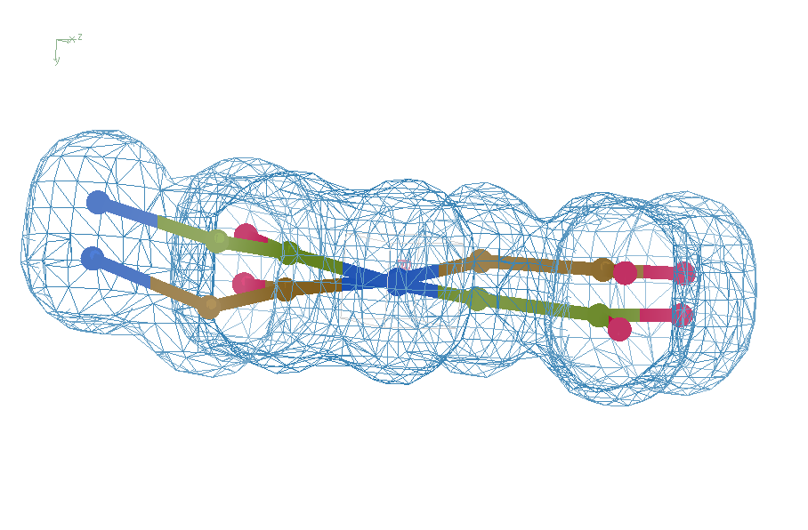
Refine – step 61
R = 6.8%
rms bond = 0.001

Slide 22
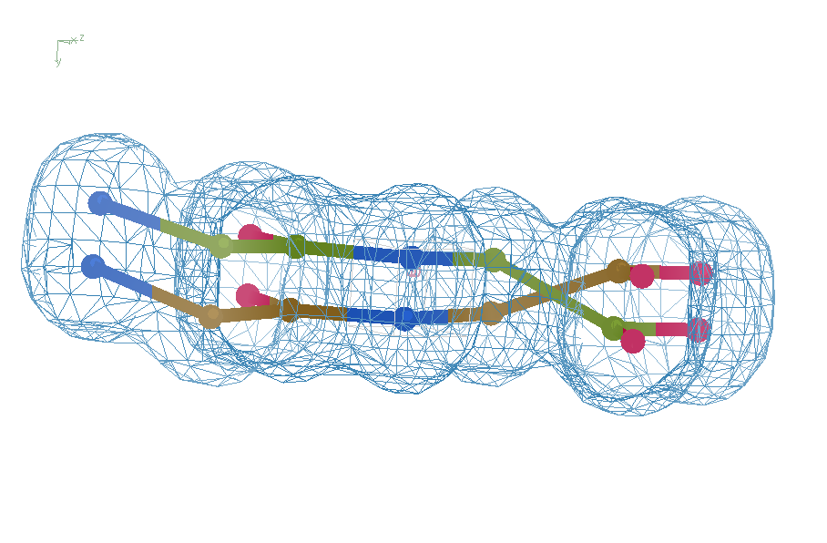
Refine – high x-ray weight
R = 1.2%
rms bond = 0.06

Slide 23
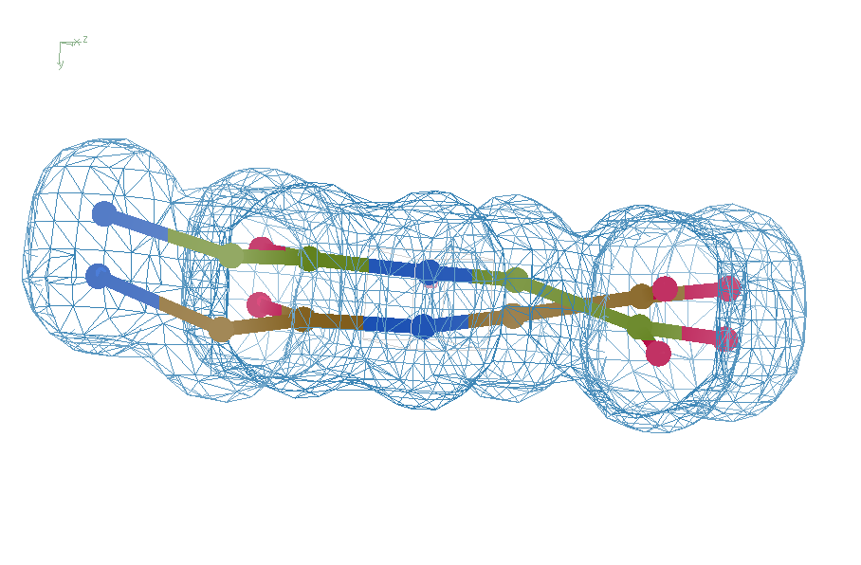
Refine – low x-ray weight
R = 14.3%
rms bond = 0.0002

Slide 24
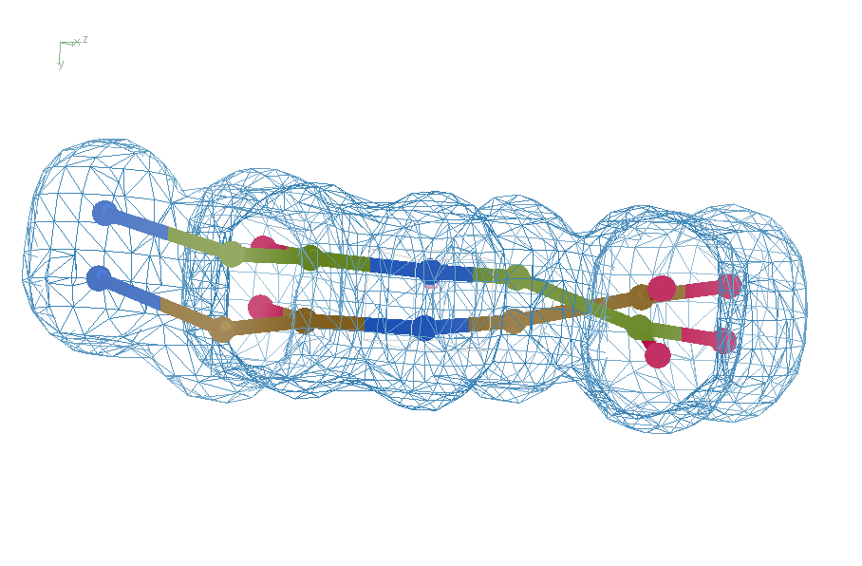
Refine from wrong starting point
R = 7.07%
rms bond = 0.001

Slide 25
Right answer
R = 0.8%
rms bond = 0.0002

Slide 26
UNTANGLE: sim-data Ground Truth
As simple as possible:
  2 conformers
  50:50 occupancy
Accessible
  64 residues
  78 waters
Every chance of success
  1.0 Å reso
  “one thing wrong”
  flat bulk solvent
  no false outliers
  phenix, refmac, shelxl
  clear score
  Experimental error only
  perfect phases

Slide 27

The UNTANGLE Challenge
best.pdb
refme.mtz
11) Build better than the best:
as-good or better wE, R_{free} as best.pdb
non-equivalent ensemble
10) Recover best.pdb from refme.mtz
true phases, auto-building allowed
no cheating (don’t use best.pdb as guide)
Prove: true ensemble is unique
and can be recovered
$1000
$500
https://github.com/jmholton/UnTangle

Slide 28
verified Score sheet
wE | R_{work} | R_{free} | method
185 | 20.6 | 21.4 | Alphafold2
109.6 | 8.87 | 9.44 | Phenix.ensemble_refine
97.3 | 8.84 | 9.27 | qFit best
91.7 | 3.64 | 4.27 | manual
80.5 | 4.31 | 4.75 | lotswrong
65.2 | 6.35 | 6.93 | Amber24
54.6 | 5.87 | 6.57 | single conf w aniso B
33.5 | 2.94 | 3.32 | One thing wrong: Ala39
23.5 | 2.95 | 3.31 | One thing wrong: Val1
21.4 | 3.12 | 3.48 | Rectified Simulated annealing
18.1 | 17.9 | 18.4 | Phenix autobuild
18.2 | 2.79 | 3.14 | best (ground truth)

Slide 29
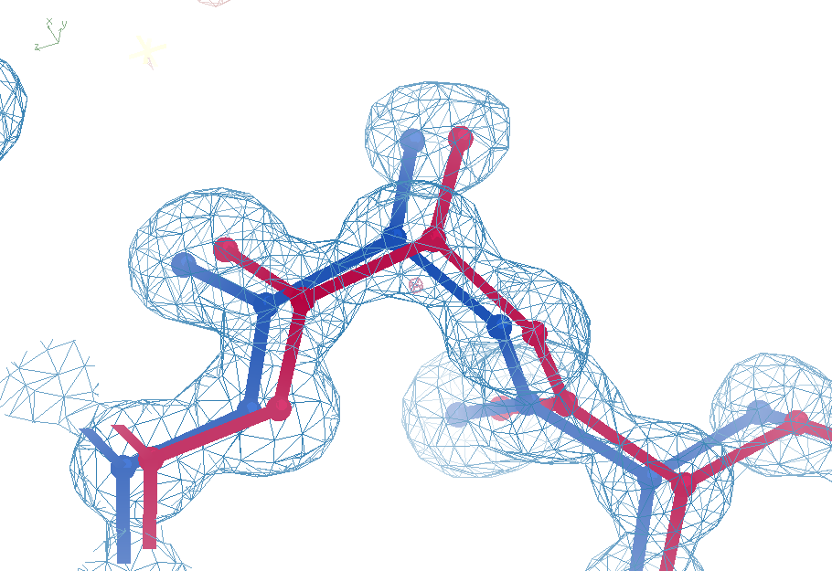
Sim challenge data
Ala39
-0.2σ
wE=18.2
N-C_{α}
bond
-0.3σ
0.8σ
angle
A B conformers

Slide 30
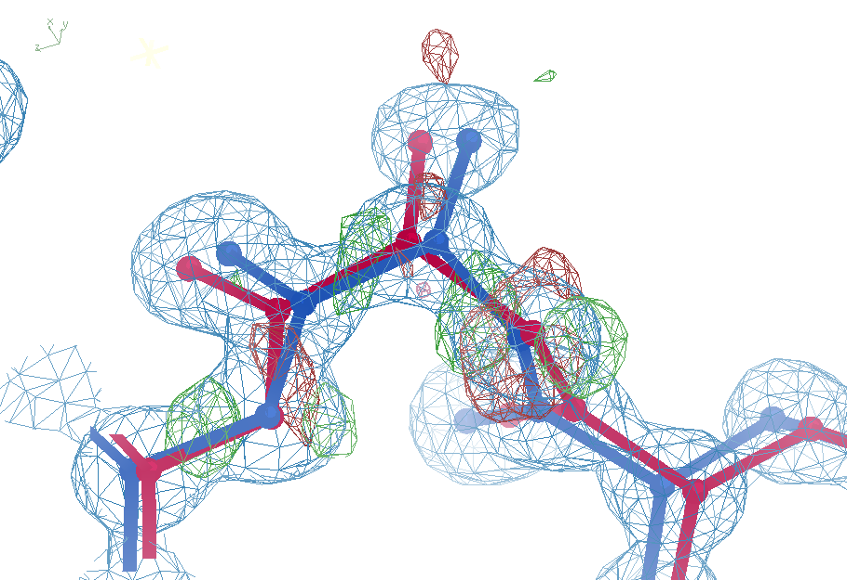

Sim challenge data: “otw39”
Ala39
+11σ
wE=63.5
N-C_{α}
bond
-9σ
It’s a TRAP!
5σ
angle
A B conformers

Slide 31
Sim challenge data: “otw39”
Ala39
+11σ
wE=63.5
N-C_{α}
bond
-9σ
5σ
angle
A B conformers

Slide 32
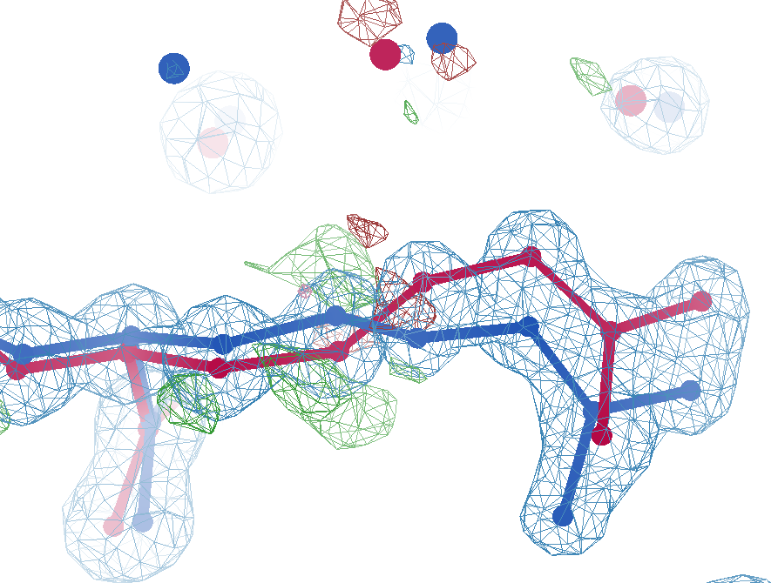
sim data
Arg62
wE=63.5
2.8 Å
4σ
C_{γ}-C_{δ}
bond
2.7σ torsion
A B conformers

Slide 33
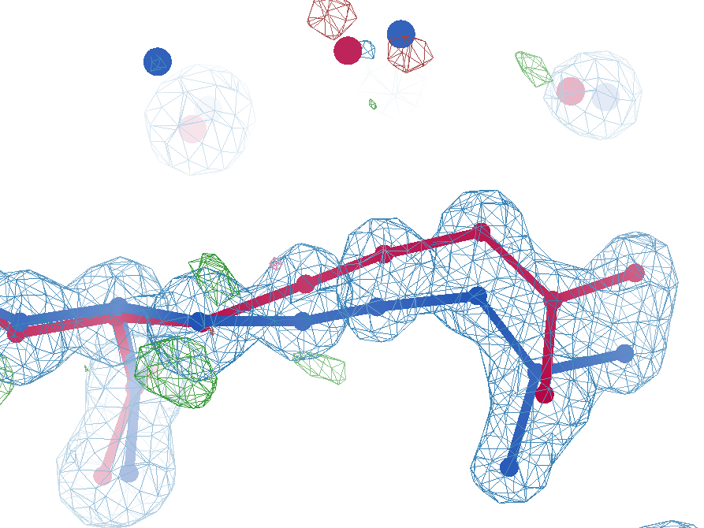
sim data
Arg62
wE=50.7
2.8 Å
2σ
angle
A B conformers

Slide 34
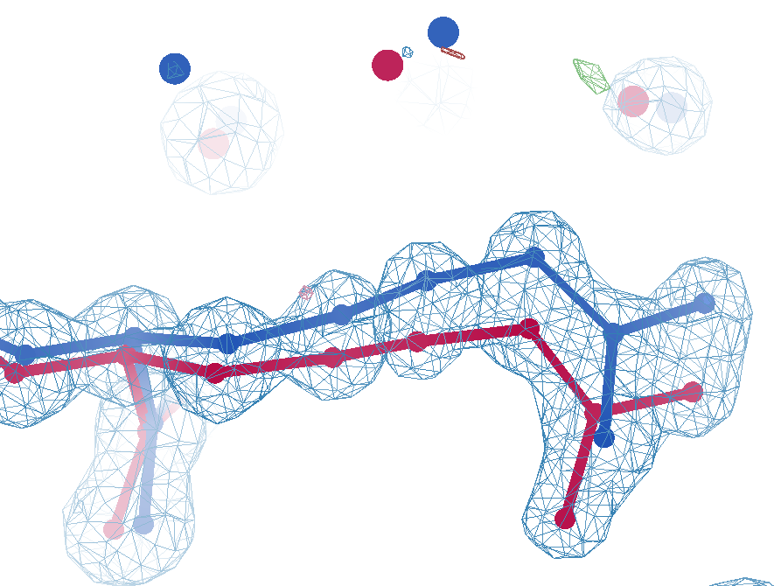
sim data
Arg62
wE=18.2
3.0 Å
0.3σ
C_{γ}-C_{δ}
bond
1σ
angle
1.6σ torsion
A B conformers

Slide 35
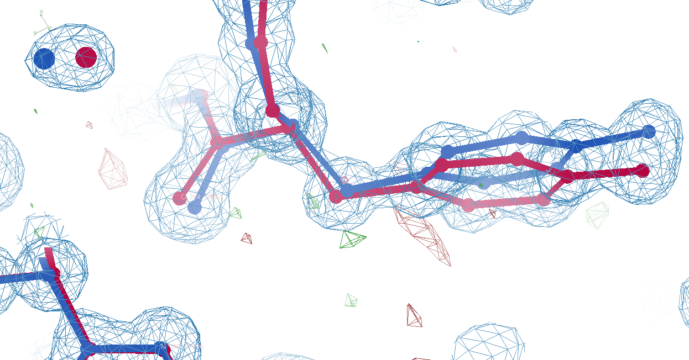
Tyr14
sim data
wE=33.1
3.0 Å
A B conformers

Slide 36
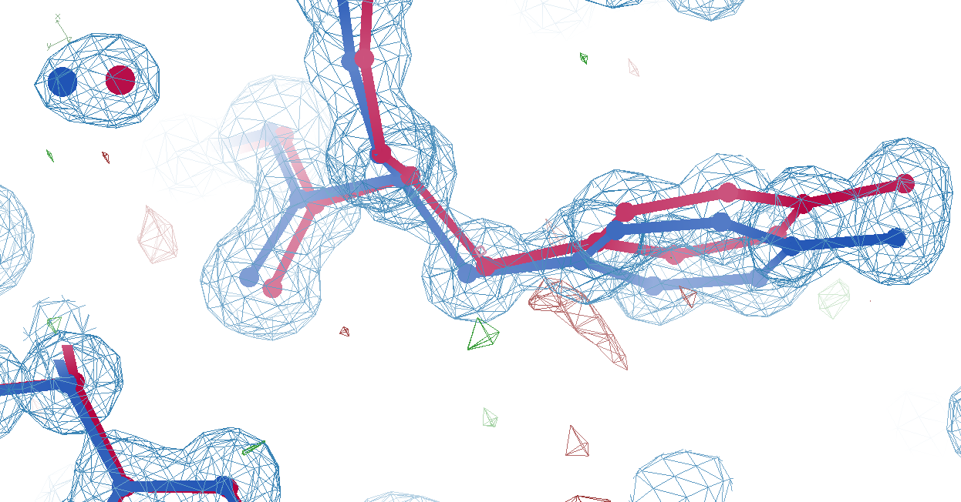
Tyr14
sim data
wE=18.2
3.2 Å
A B conformers

Slide 37
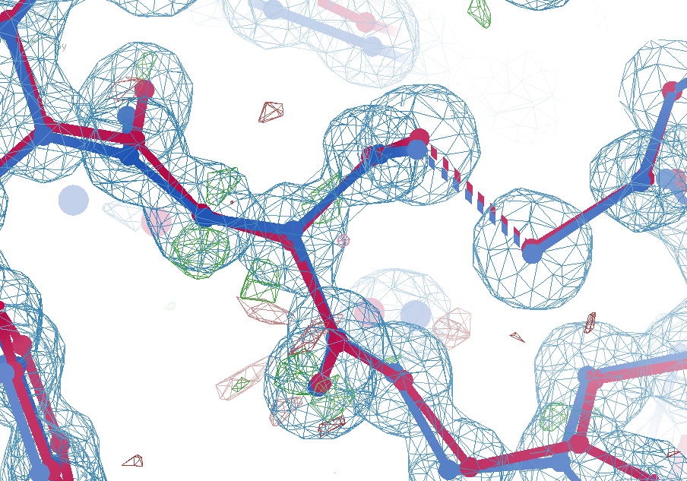
Cys16
sim data
wE=21.4
2.7σ
angle
A B conformers

Slide 38
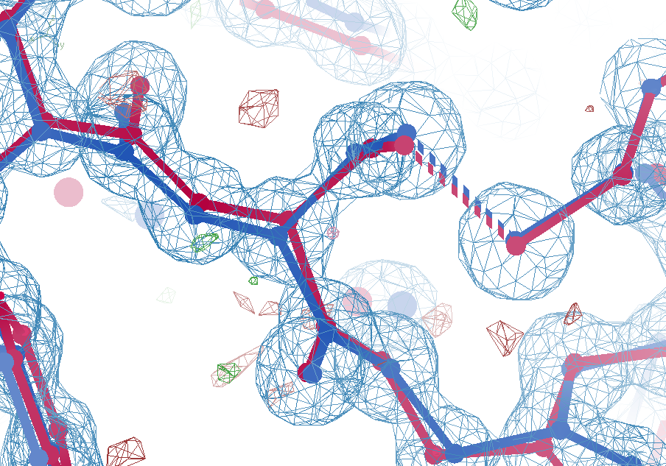
Cys16
sim data
wE=18.2
1.5σ
angle
A B conformers

Slide 39
wE score: key concepts
sqrt()
erf()
Energy ↔ dev/sigma ↔ Probability
Probability outlier is not noise
  “clip” outlier energy at “10”
  Not so sharp transition to outlier
Tighter Non-bond (Lennard-Jones)

Slide 40
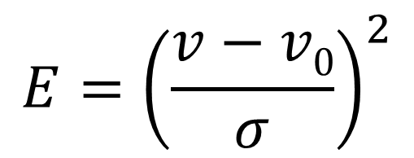
Statistical Potential
$$E={\left(\frac{v−v0}{σ}\right)}^{2}$$
E “energy”
v model value
v₀ ideal value
σ rms deviation expected
1 x 6σ ← 40x 1σ
1 x 6σ ≈ 36x 1σ
Outlier problem:
solution: weight by
“probability its not noise”

Slide 41
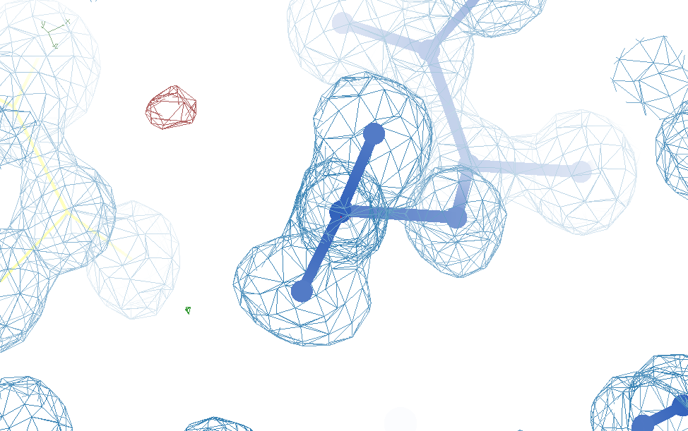
Glu32
Genuine outlier
in ground truth
real data
-80°
Torsion outlier

Slide 42
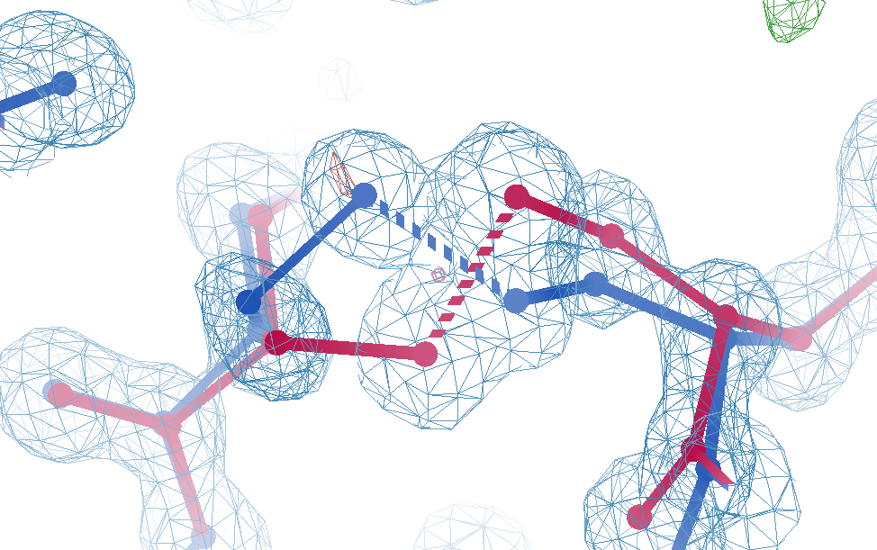
Cys12
Genuine outlier
in ground truth
real data
-107°
torsion outlier
A B conformers

Slide 43
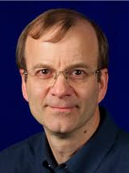
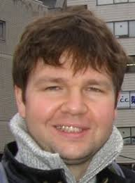
New Tools!
Tom
Terwilliger
phenix.holton_geometry_validation test.pdb
phenix.create_alt_conf phenix_autobuild.pdb refme.mtz \
nproc=48
phenix.refine \
model.pdb refme.mtz \
main.number_of_mac=10 \
fit_altlocs_method=masking \
ordered_solvent=true \
include_altlocs=true \
ordered_solvent.mode=every_macro_cycle_after_first \
refine_oat=true
Pavel Afonine

Slide 44
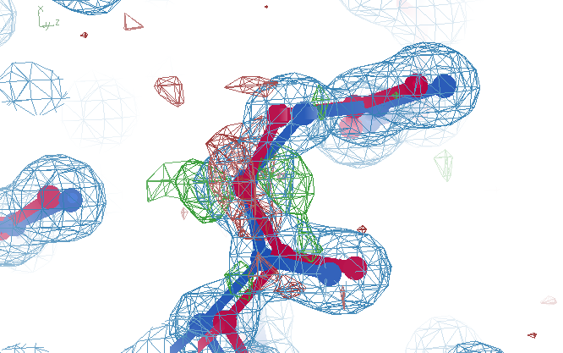
Better than the best?
Ala39
wE=17.2
A B conformers

Slide 45
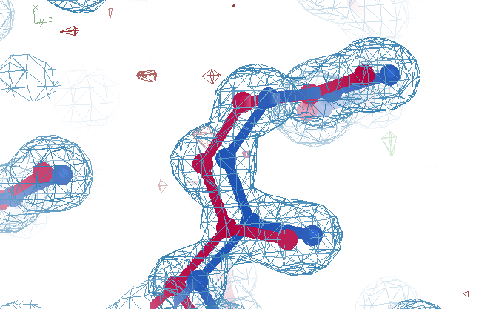
best?
Ala39
wE=18.2
A B conformers

Slide 46
Summary
https://bl831.als.lbl.gov/~jamesh/powerpoint/CCP4_tangle_2025.pptx
Rfree < 3% → single e⁻
  Not over-fitting
Main barrier: tangled ensemble
Sensible scoring function
  Probability its not noise
  some outliers are real
Recover underlying ensemble
  Might be required!
Cooperative motions
$1000
$500

Slide 47
verified Score sheet
wE | R_{work} | R_{free} | method
185 | 20.6 | 21.4 | Alphafold2
109.6 | 8.87 | 9.44 | Phenix.ensemble_refine
97.3 | 8.84 | 9.27 | qFit best
91.7 | 3.64 | 4.27 | manual
80.5 | 4.31 | 4.75 | lotswrong
65.2 | 6.35 | 6.93 | Amber24
54.6 | 5.87 | 6.57 | single conf w aniso B
33.5 | 2.94 | 3.32 | One thing wrong: Ala39
23.5 | 2.95 | 3.31 | One thing wrong: Val1
21.4 | 3.12 | 3.48 | Rectified Simulated annealing
18.1 | 17.9 | 18.4 | Phenix autobuild
18.2 | 2.79 | 3.14 | best (ground truth)

Slide 48
wE score: key concepts
Probability outlier is not noise
  “clip” outlier energy at “10”
  Not so sharp transition to outlier
Tighter Non-bond (Lennard-Jones)

Slide 49
Sensible scoring function
  Statistical potential
    bonds, angles, planes, torsions, chiral
  Lennard-Jones vdW
    non-bond and clashes
  Probability -> σ dev
    - Rota, rama
  Peptide bond
    σ → 5°
  C_{β}dev
    σ = 0.05 Å
4
2
van der Waals
Phenix/refmac
0
Energy
-1
1
2
3
4
5
Atomic separation (Å)

Slide 50
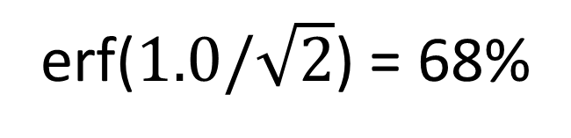
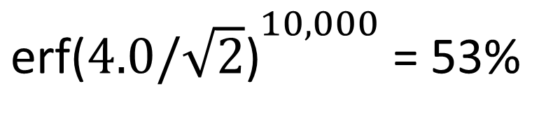
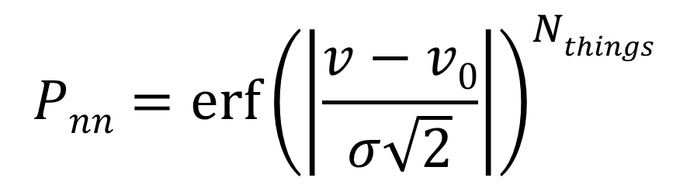
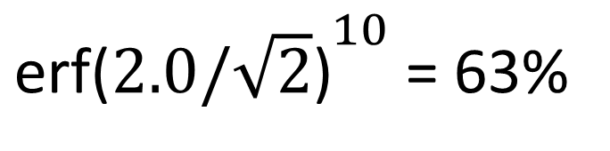
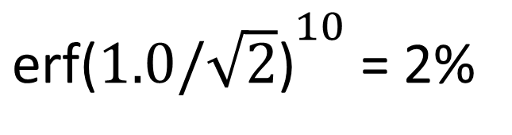
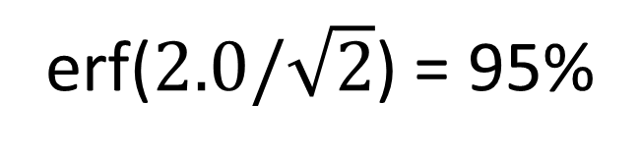
Probability that it’s not noise
$$Pnn={\operatorname{erf}\left(\left|\frac{v−v0}{σ\sqrt{2}}\right|\right)}^{Nthings}$$
P_{nn} probability
v-v₀ deviation from ideal
σ rms deviation expected
erf() integral of a Gaussian
N_{things} number of trials
erf($1.0/\sqrt{2}$) = 68%
${\text{erf}\text{(}1.0/\sqrt{2}\text{)}}^{10}$ = 2%
erf($2.0/\sqrt{2}$) = 95%
${\text{erf}\text{(}2.0/\sqrt{2}\text{)}}^{10}$ = 63%
${\text{erf}\text{(}4.0/\sqrt{2}\text{)}}^{10,000}$ = 53%

Slide 51
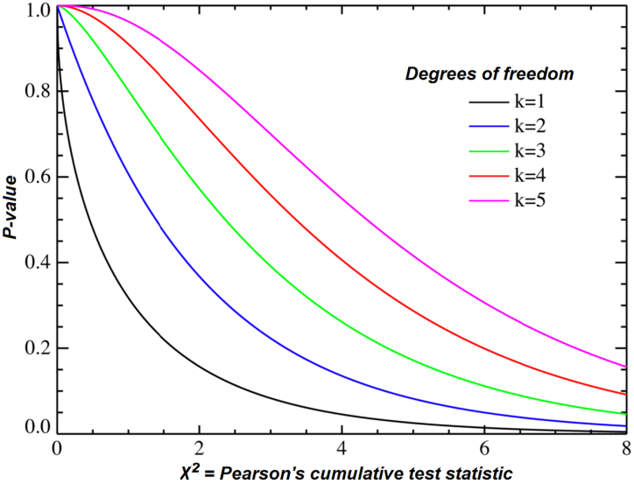
Probability that it’s not noise average/sum of N_{things}
χ² test
N_{things}
Probability
That its
Gaussian
tie breaker

Slide 52
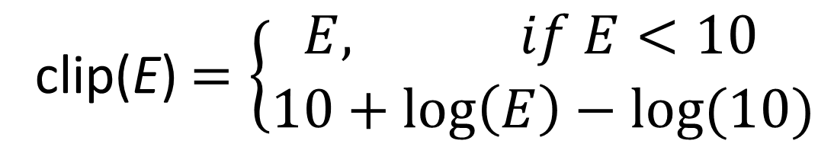
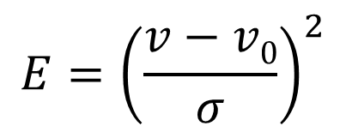
“clip” for tolerating true outliers
clip(E) $=\left\{\begin{matrix}E, if E<10 \\ 10+\log\left(E\right)−log⁡(10)\end{matrix}\right.$
Statistical Energy
$$E={\left(\frac{v−v0}{σ}\right)}^{2}$$
10
wE
Colloquially:
OK! OK! Its an outlier! Let’s not agonize about it
N=10
5
N=10,000
10σ vs 10.1σ not more important
than 3.3σ vs 3.0σ
0
3
6
8
max sigma deviate

Slide 53
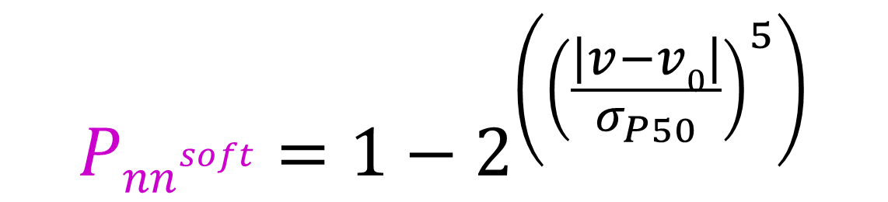
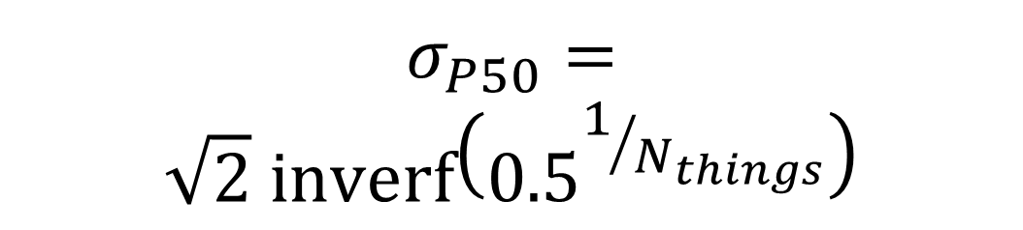
Probability that it’s not noise softer
$${Pnn}^{soft}=1−2^{\left({\left(\frac{\left|v−v0\right|}{σ_{P50}}\right)}^{5}\right)}$$
1
P_{nn} probability
v-v₀ deviation from ideal
σ rms deviation expected
inverf() inverse erf()
N_{things} number of trials
P
N=1
0.5
N=1 soft
$$σ_{P50}=$$
$$\sqrt{2} \text{inverf}\left({0.5}^{1/{N_{things}}}\right)$$
N=10,000
soft
N=10,000
0
1
2
3
4
5
6
max sigma deviate

Slide 54
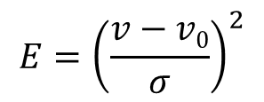
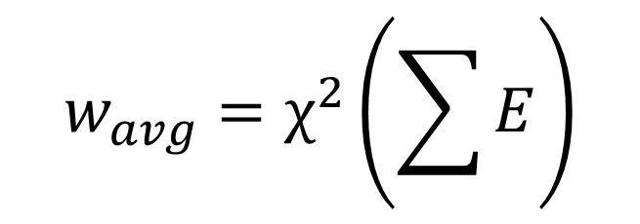
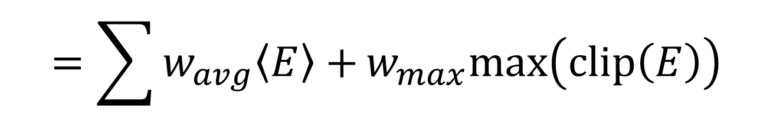
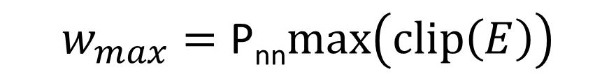
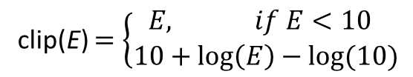
weighted Energy scoring function
$$=\sum{w_{avg}\left\langle E\right\rangle +}w_{max}max\left(clip\left(E\right)\right)$$
wE
validation types
phenix.holton_geometry_validation
$$w_{max}=\text{P}\text{nn}max\left(clip\left(E\right)\right)$$
10
$$w_{avg}=χ^{2}\left(\sum{E}\right)$$
wE
N=10
5
N=10,000
N_{bonds}
$$E={\left(\frac{v−v0}{σ}\right)}^{2}$$
max() = worst outlier
0
clip(E) $=\left\{\begin{matrix}E, if E<10 \\ 10+\log\left(E\right)−log⁡(10)\end{matrix}\right.$
3
6
8
max sigma deviate

Slide 55
Glu32
Genuine outlier
in ground truth
real data
-80°
Torsion outlier

Slide 56
Cys12
Genuine outlier
in ground truth
real data
-107°
torsion outlier
A B conformers

Slide 57

Better than the best
Ser40
wE=18.8
A B conformers

Slide 58

Better than the best
Ser40
wE=18.2
A B conformers

Slide 59

UNTANGLE scoring function
$$score=wE+{\left(\frac{Rfree−σ_{R}}{σ_{R}}\right)}^{2}$$
score UNTANGLE Challenge score
wE weighted energy avg + worst
σ_{R} experimental error (2%)
https://github.com/jmholton/UnTangle

Slide 60

wE=18.2

Slide 61

wE=21.4

Slide 62

Muybridge’s galloping horse (1872)

Slide 63

average structure: galloping horse

Slide 64

Horses have bones
+/- 0.01

Slide 65
Horses have bones

Slide 66

Muybridge’s galloping horse 0

Slide 67

Muybridge’s galloping horse 1

Slide 68

Muybridge’s galloping horse 2

Slide 69

Muybridge’s galloping horse 3

Slide 70

Muybridge’s galloping horse 4

Slide 71

Muybridge’s galloping horse 5

Slide 72

Muybridge’s galloping horse 6

Slide 73

Muybridge’s galloping horse 7

Slide 74

Muybridge’s galloping horse 8

Slide 75

Muybridge’s galloping horse 9

Slide 76

Muybridge’s galloping horse 10

Slide 77

Muybridge’s galloping horse 11

Slide 78

Muybridge’s galloping horse 12

Slide 79

Muybridge’s galloping horse 13

Slide 80

Muybridge’s galloping horse 14

Slide 81
ensemble refine ???

Slide 82
Differences
horse
molecule
~2 m
Stiff backbone
Bone sigma ~ 1 mm
4 joints/leg
Continuous angle
No torision
Concerted motion
~100 Å
Stiff backbone
Bond sigma = 0.01 Å
0-4 chi angles
Angle sigma ~ 1°
Rotamers
Concerted motion

