Slide 1
Acknowledgements
http://bl831.als.lbl.gov/~jamesh/powerpoint/CCP4_SW_2018.pptx
Robert Stroud James Fraser
Nick Sauter John Tainer Aina Cohen Mike Soltis Ana Gonzalez
Paul Adams Axel Brunger Art Lyubimov
UCSF LBNL SLAC
ALS 8.3.1 creator: Tom Alber
UC Multicampus Research Programs and Initiatives (MRPI)
R01 GM124149 to Holton
P30 GM124169 to Adams (ALS-ENABLE)
R01 GM117126 to Sauter (DIALS)
one-time NIH-DOE Inter-agency agreement (IAA)
Integrated Diffraction Analysis Technologies (IDAT)
Plexxikon, Inc.
Synchrotron Radiation Structural Biology Resource (SLAC)
The Advanced Light Source is supported by the Director, Office of Science, Office of Basic Energy Sciences, Materials Sciences Division, of the US Department of Energy under contract No. DE-AC02-05CH11231 at Lawrence Berkeley National Laboratory.

Slide 2
What was old is new again
Looking back at first principles
to face the challenges ahead

Slide 3
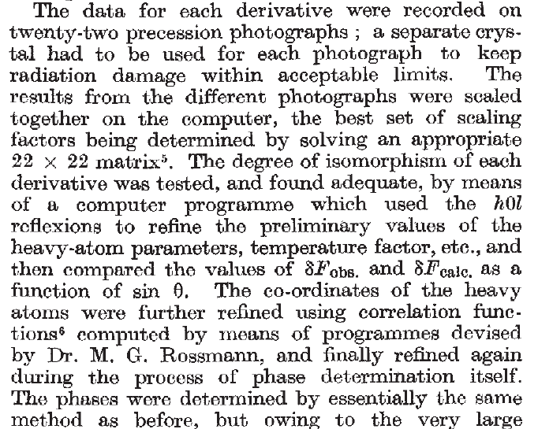
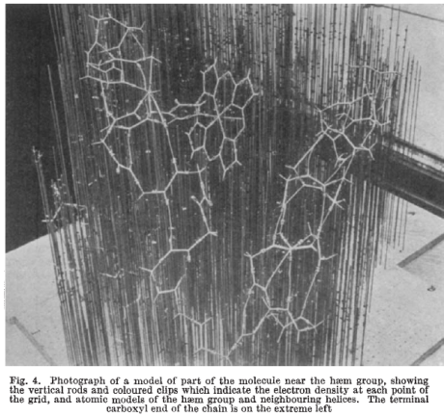
Multi-crystal strategies
Kendrew et al. (1960) "Structure of Myoglobin” Nature 185, 422-427.

Slide 4
Multi-crystal strategies
Kendrew et al. (1960) "Structure of Myoglobin” Nature 185, 422-427.

Slide 5
Non-isomorphism in lysozyme
Dear James
The story of the two forms of lysozyme crystals goes back to about 1964 when it was found that the diffraction patterns from different crystals could be placed in one of two classes depending on their intensities. This discovery was a big set back at the time and I can remember a lecture title being changed from the 'The structure of lysozyme' to 'The structure of lysozyme two steps forward and one step back'. Thereafter the crystals were screened based on intensities of the (11,11,l) rows to distinguish them (e.g. 11,11,4 > 11,11,5 in one form and vice versa in another). Data were collected only for those that fulfilled the Type II criteria. (These reflections were easy to measure on the linear diffractometer because crystals were mounted to rotate about the diagonal axis). As I recall both Type I and Type II could be found in the same crystallisation batch . Although sometimes the external morphology allowed recognition this was not infallible.
The structure was based on Type II crystals. Later a graduate student Helen Handoll examined Type I. The work, which was in the early days and before refinement programmes, seemed to suggest that the differences lay in the arrangement of water or chloride molecules (Lysozyme was crystallised from NaCl). But the work was never written up. Keith Wilson at one stage was following this up as lysozyme was being used to test data collection strategies but I do not know the outcome.
An account of this is given in International Table Volume F (Rossmann and Arnold edited 2001) p760.
Tony North was much involved in sorting this out and if you wanted more info he would be the person to contact. I hope this is helpful. Do let me know if you need more.
Best wishes
Louise

Slide 6
Non-isomorphism in lysozyme
Structure factor (e⁻)
Johnson’s ratio

Slide 7
Non-isomorphism in lysozyme
Structure factor (e⁻)
Johnson’s ratio

Slide 8
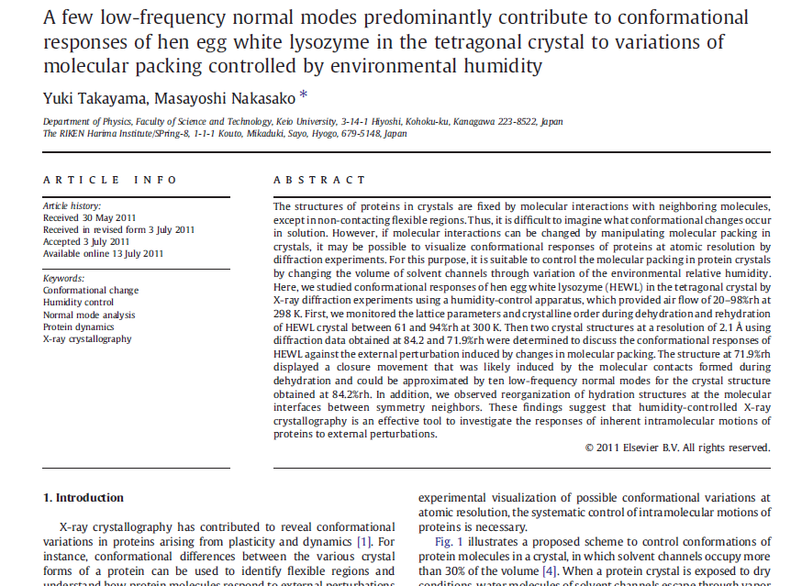

Slide 9

Non-isomorphism in lysozyme
RMSD = 1.70 Å
Δcell = 0.7 %
R_{iso} = 44.5%
RMSD = 0.18 Å
RH: 84.2%
vs 71.9%
3aw6
3aw7

Slide 10
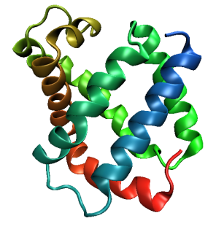
Same structure, different cell
0.5% cell change → 15%
Crick & Magdoff (1956) “theory method isomorphous replacement”, Acta Cryst. 9, 901-8.

Slide 11
Same structure, different cell
0.5% cell change → 15%
Crick & Magdoff (1956) “theory method isomorphous replacement”, Acta Cryst. 9, 901-8.

Slide 12
Same cell, rotated protein
0.5° rotation → 16%
Crick & Magdoff (1956) “theory method isomorphous replacement”, Acta Cryst. 9, 901-8.

Slide 13
Same cell, rotated protein
0.5° rotation → 16%
Crick & Magdoff (1956) “theory method isomorphous replacement”, Acta Cryst. 9, 901-8.

Slide 14
Uniform stretch
5% change → 0%

Slide 15
Uniform stretch
5% change → 0%

Slide 16
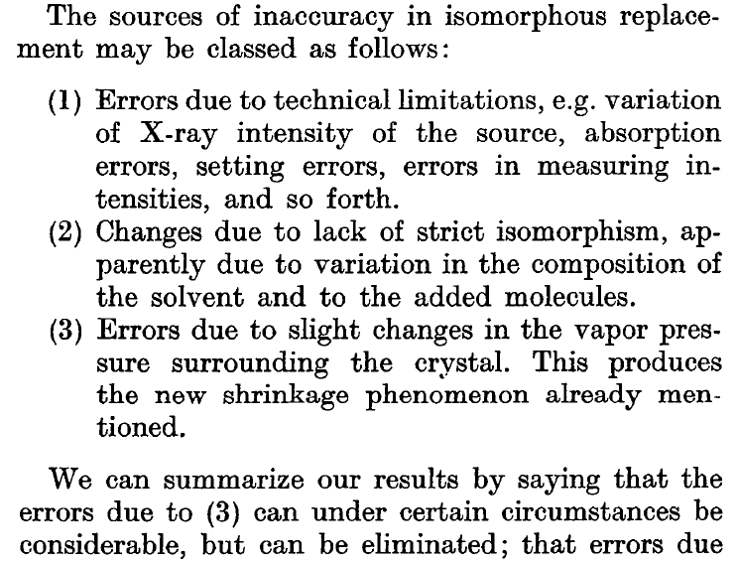
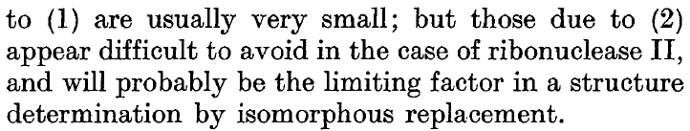
Magdoff & Crick (1955) “Ribonuclease II. Accuracy of measurement and shrinkage”, Acta Cryst. 8, 461-8.
Crick & Magdoff (1956) “The theory of the method of isomorphous replacement for protein crystals”, Acta Cryst. 9, 901-8.

Slide 17
Elastic deformation
= non-isomorphism

Slide 18
Elastic deformation
= non-isomorphism

Slide 19
Plastic deformation
= poor diffraction

Slide 20
Plastic deformation
= poor diffraction

Slide 21
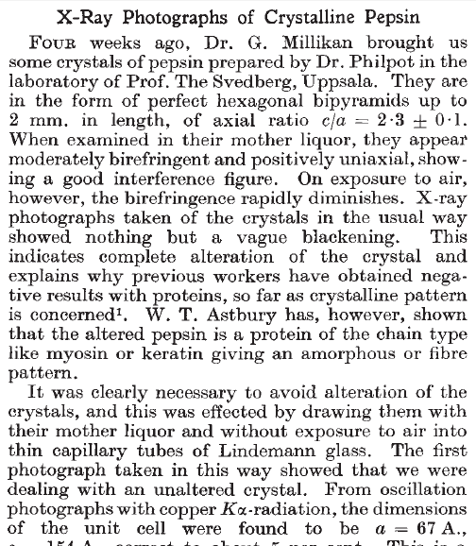
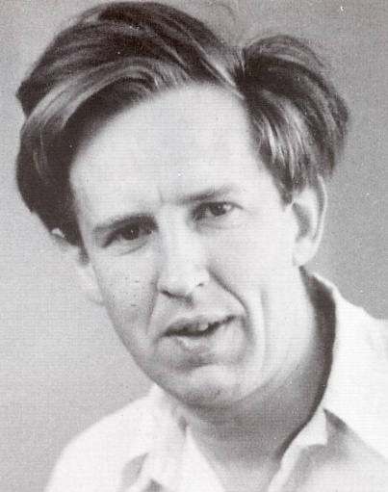
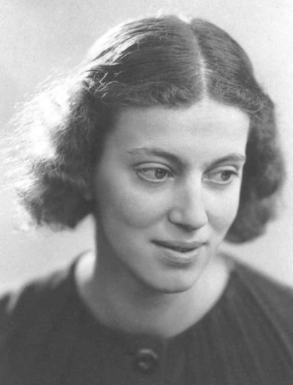
First diffraction from protein xtal
1934
Bernal, J. & Crowfoot, D. (1934). "X-ray photographs of crystalline pepsin", Nature 133, 794-795.

Slide 22
Dehydration: 1934
and 2018?
= 1.5 μL
100 μm
= 1.0 nL
2 mm
= 1.0 pL
10 μm
= 1.0 fL
1 μm

Slide 23
opened drop: you have ~30 seconds!
equilibrated drop

Slide 24
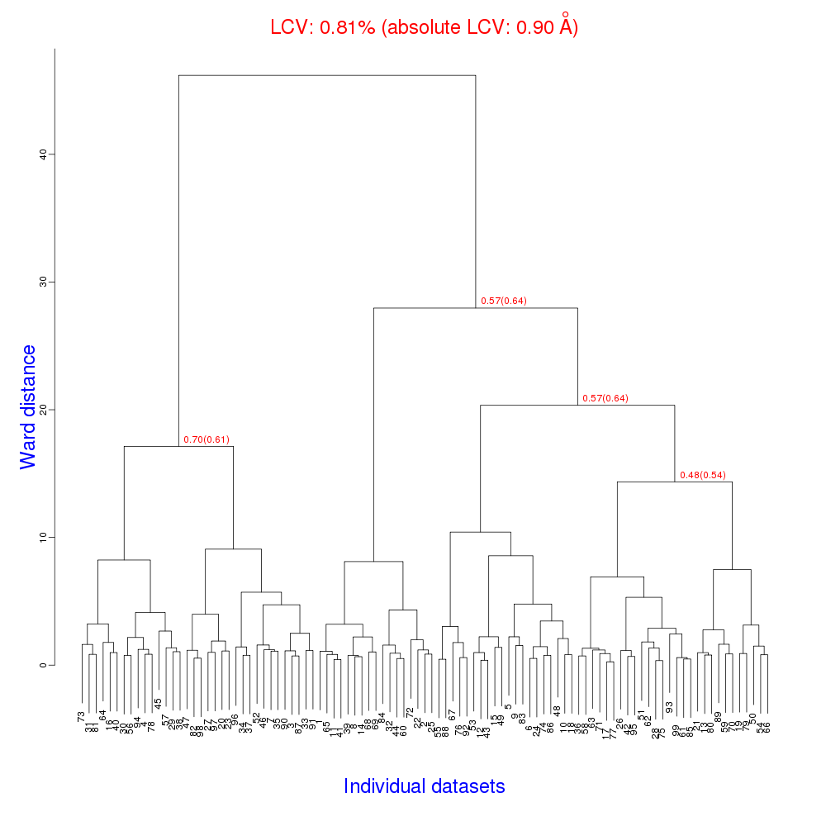
Cell clustering: 100 datasets
Reality:
Perfect isomorphism
(simulated data)

Slide 25
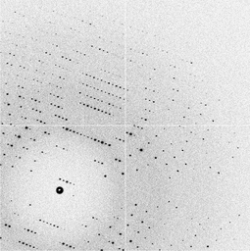
Micro-focus challenge
5 µm xtals
5 µm beam
~ 5 img / xtal
P2₁2₁2₁
XDS thinks:
P422
http://bl831.als.lbl.gov/~jamesh/challenge/microfocus/

Slide 26
Trick Question:
What is the space group?
a = 63 b = 63 c = 63
α = 90 β = 90 γ = 90

Slide 27
Pitfalls: sub-space groups
P622
What else?
P6₁22 P6₅22 P6₂22 P6₄22 P6₃22
P6 P6₁ P6₅ P6₂ P6₄ P6₃
P3₁2 P321 P3₁12 P3₁21 P3₂12 P3₂21
P3 P3₁ P3₂
P2 P2₁ C2 C222 C222₁
P1

Slide 28
Multi-crystal merge preparation
Take each pair of datasets
“othercell” to find all possible re-indexings
Apply all re-indexing operators in turn
Evaluate best agreement (R, CC)
Cluster by acceptable distance (20-30%)
Re-index clusters to common lattice
Apply xscale_isocluster, CODGAS, others?

Slide 29
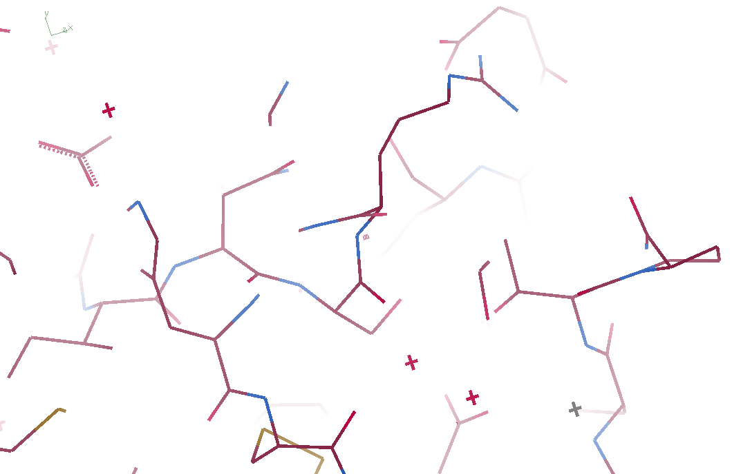
3aw6

Slide 30
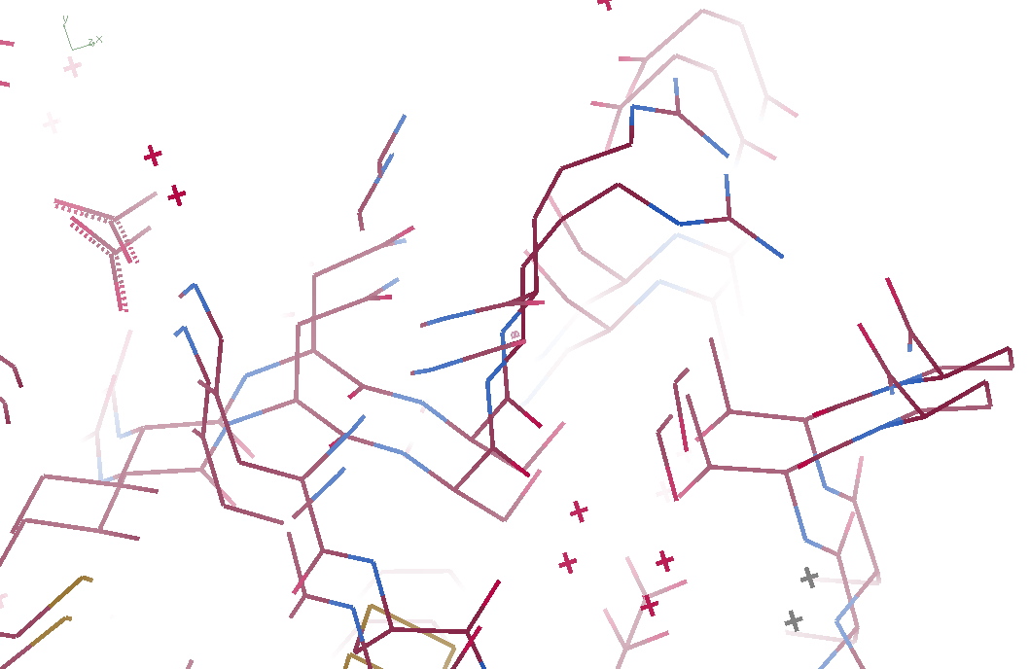
3aw6 3aw7

Slide 31
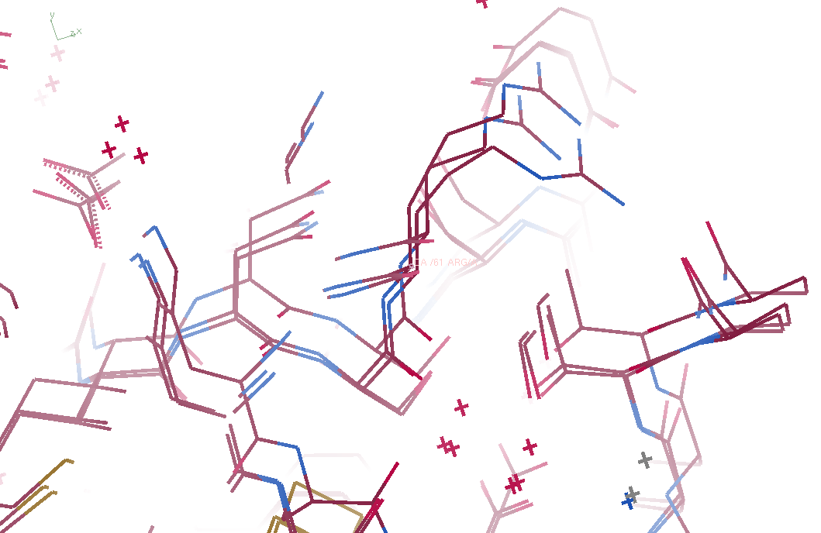
3aw6, 3aw7, “bent” 3aw6

Slide 32
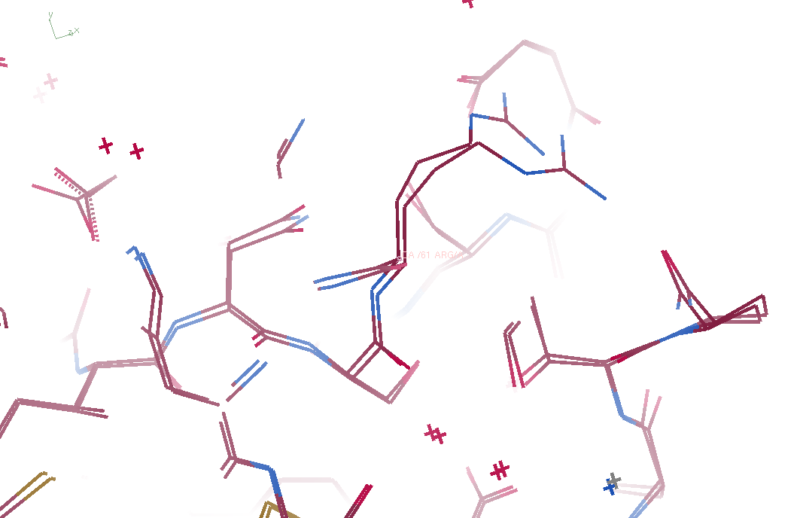
3aw7, “bent” 3aw6

Slide 33
“map bender” procedure
Convert to fractional coordinates
Basis functions: spatial sin waves

Slide 34
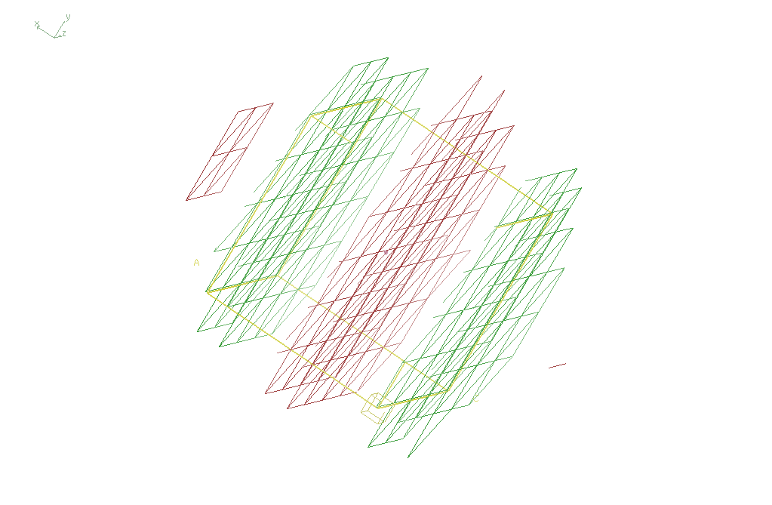
Basis function 1 0 0

Slide 35
“map bender” procedure
Convert to fractional coordinates
Basis functions: spatial sin waves
  Repeats with unit cell
  Low-order h,k,l indices first
Fit function to Δx vs x,y,z across P1 cell
Repeat with Δy, Δz
Apply to PDB file and interpolate map grid
Usually 3-5 orders comparable to LSQ

Slide 36
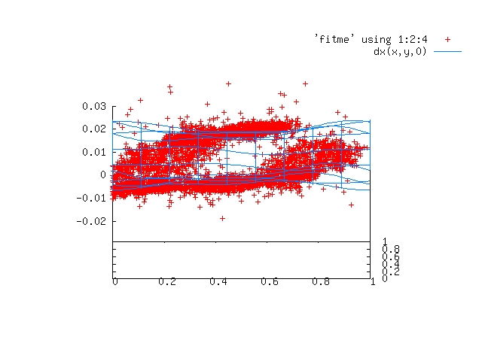

Slide 37
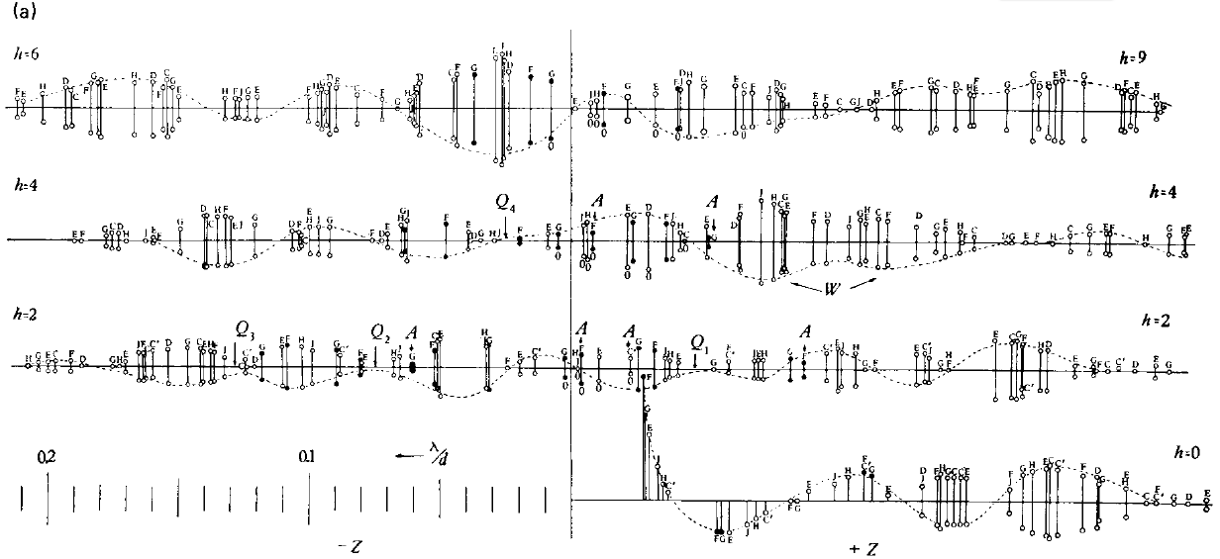
Bragg’s “minimum wavelength principle”
Perutz (1985). “Early Days of Cryst…” Methods in Enzymology, Vol. 114, 3-18.
Bragg & Perutz (1952)."external form haemoglobin I", Acta Cryst. 5, 277-283.

Slide 38
Structure Factor Equation
F_{hkl} = f_{atom} exp(-2π i (hx + ky + lz))
Σ
dF_{hkl}
dh
= f_{atom} (-2π i hx) exp(-2π i (hx + ky + lz))
Σ
?

Slide 39
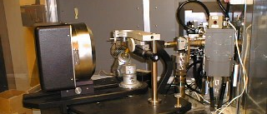
Photon-counting detectors
Cork, et al. (1974). J. Appl. Cryst. 7 319-23.
Hamlin, et. al. (1981). J. Appl. Cryst. 14 85-93.

Slide 40
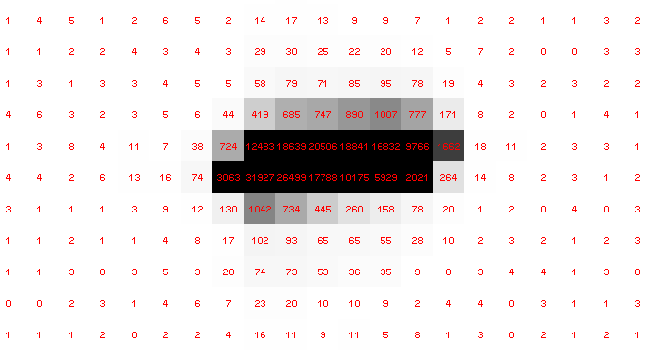
Pilatus pile-up for RT MX: same photons, different speeds
Collaboroators:
Aina Cohen
Ana Gonzalez

Slide 41
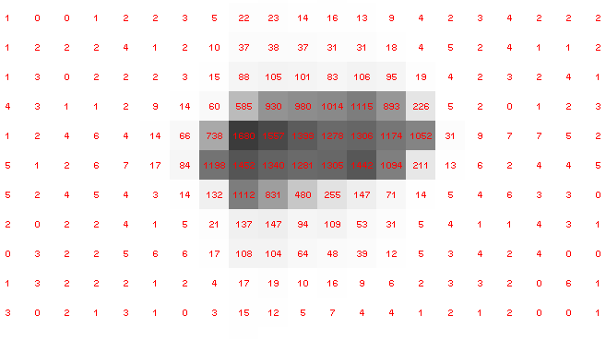
Pilatus pile-up for RT MX: same photons, different speeds
Collaboroators:
Aina Cohen
Ana Gonzalez

Slide 42
Multi-crystal strategies
Kendrew et al. (1960) "Structure of Myoglobin” Nature 185, 422-427.

Slide 43
Rad dam take-home lesson:
The number of photons scattered
before crystal is dead
is independent
of flux & time
1 um³ = 10⁵ photons (roomT)
1 um³ = 10⁶ photons (synch)
1 um³ = 10⁸ photons (XFEL)
(synch)
Henderson, 1990; Gonzalez & Nave, 1994; Glaeser et al., 2000; Sliz et al., 2003; Leiros et al., 2006; Owen et al., 2006; Garman & McSweeney, 2006; Garman & Nave, 2009; Holton, 2009

Slide 44

Dose slicing
unacceptable
completeness
N
photons
crystal’s useful life
N
photons
unacceptable
read noise
N
photons

Slide 45
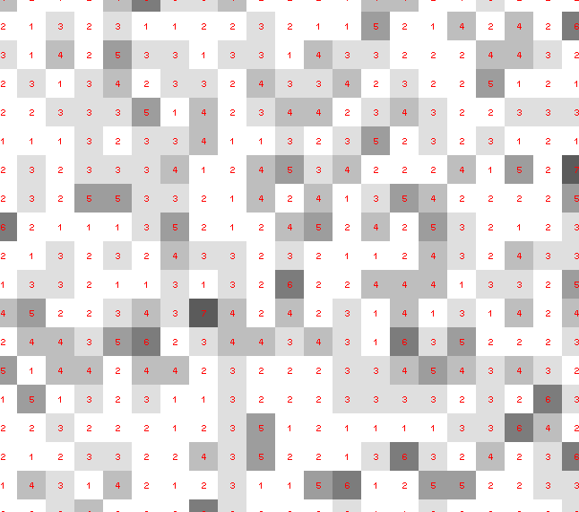
Dose slicing: is that a spot?

Slide 46
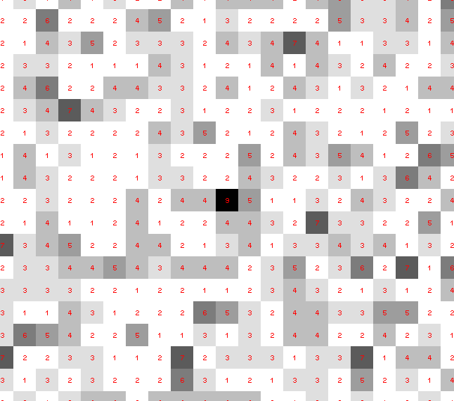
Dose slicing: is that a spot?

Slide 47
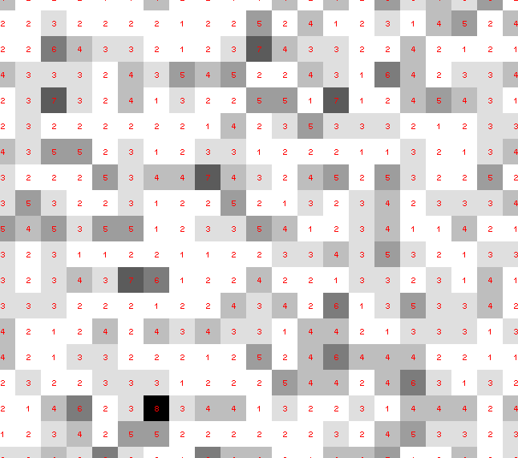
Dose slicing: is that a spot?

Slide 48
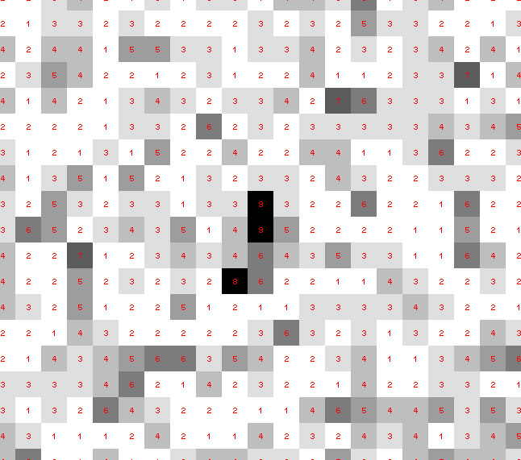
Dose slicing: is that a spot?

Slide 49
Dose slicing: is that a spot?

Slide 50
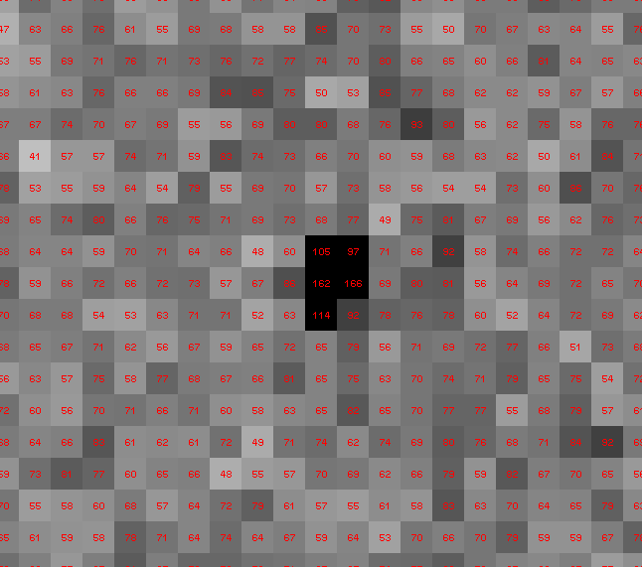
Dose slicing: is that a spot?

Slide 51
What if?
You only have a few small crystals…
Should you:
  Collect 360° from each?
  Collect 10° from each at 36x exposure?
  Glue 36 xtals together, then collect 360° ?
  Glue, and do 12960° faint exposures?

Slide 52
“true” resolution limit
CC vs right answer
Resolution (Å)

Slide 53
“true” resolution vs strategy
Dose slice collection scenario
fine | coarse | glue | Glue & fine
3.17700 | 3.14057 | 3.17604 | 3.12086
301,640,334 photons/xtal

Slide 54
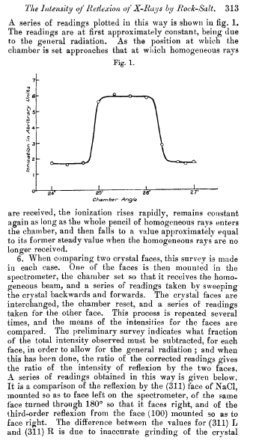
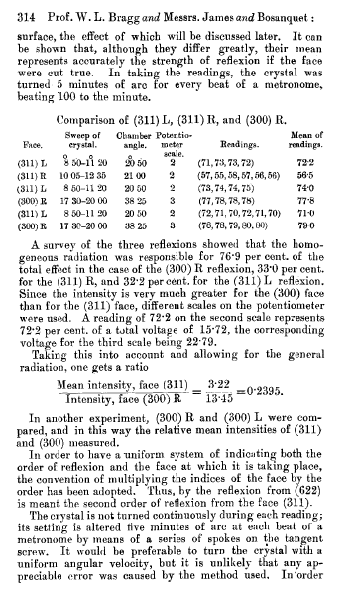
Bragg, James & Bosanquet (1921). Philos. Mag. Ser. 6, 41, 309–337.

Slide 55
The “partiality problem”
0.006°
1 μm xtal
1 Å x-rays

Slide 56
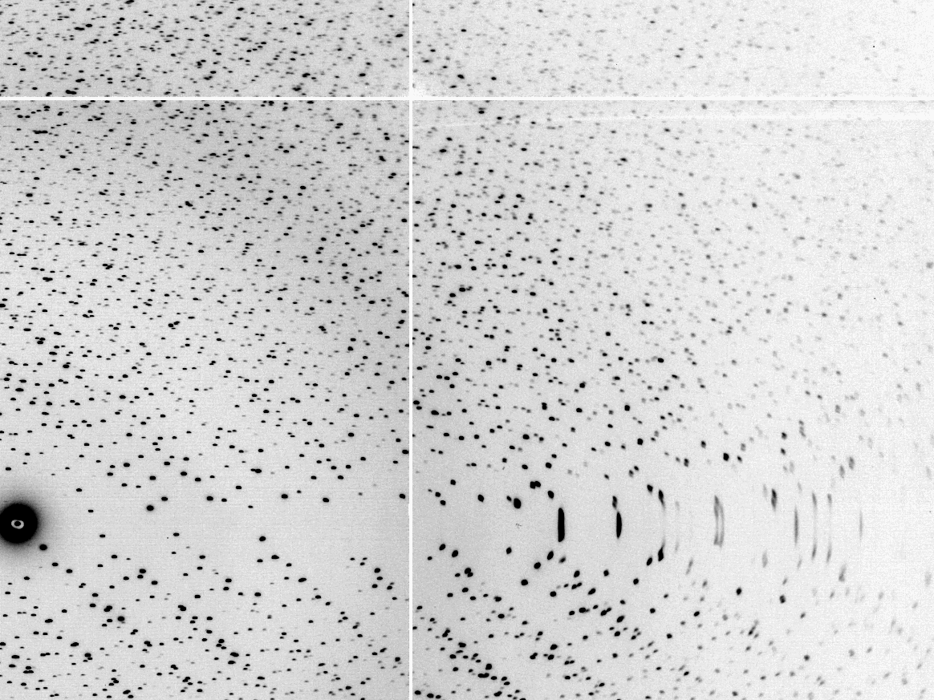
The “Lorentz zone”

Slide 57
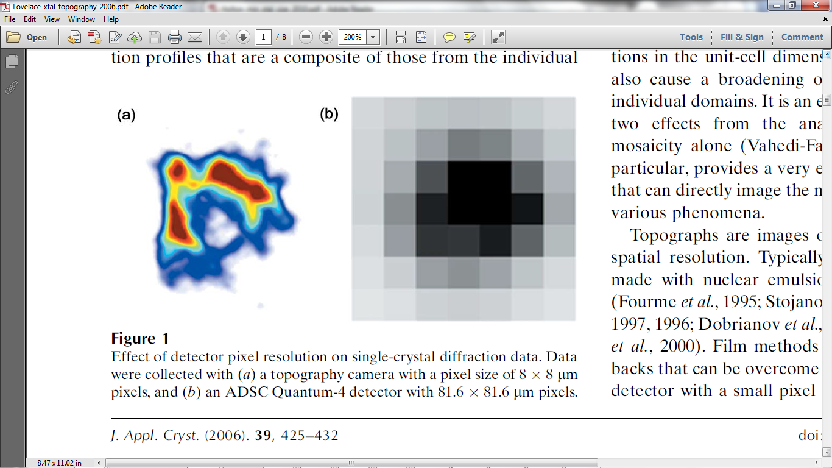
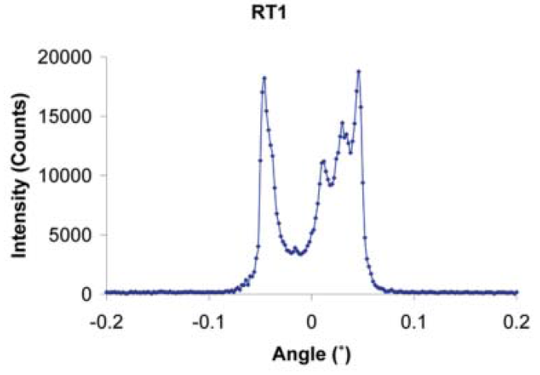
The true nature of “mosaic spread”
Lovelace JJ, Murphy CR, Pahl R, Brister K & Borgstahl GEO (2006)."Tracking reflections through cryogenic cooling with topography", J. Appl. Cryst. 39, 425-432.

Slide 58
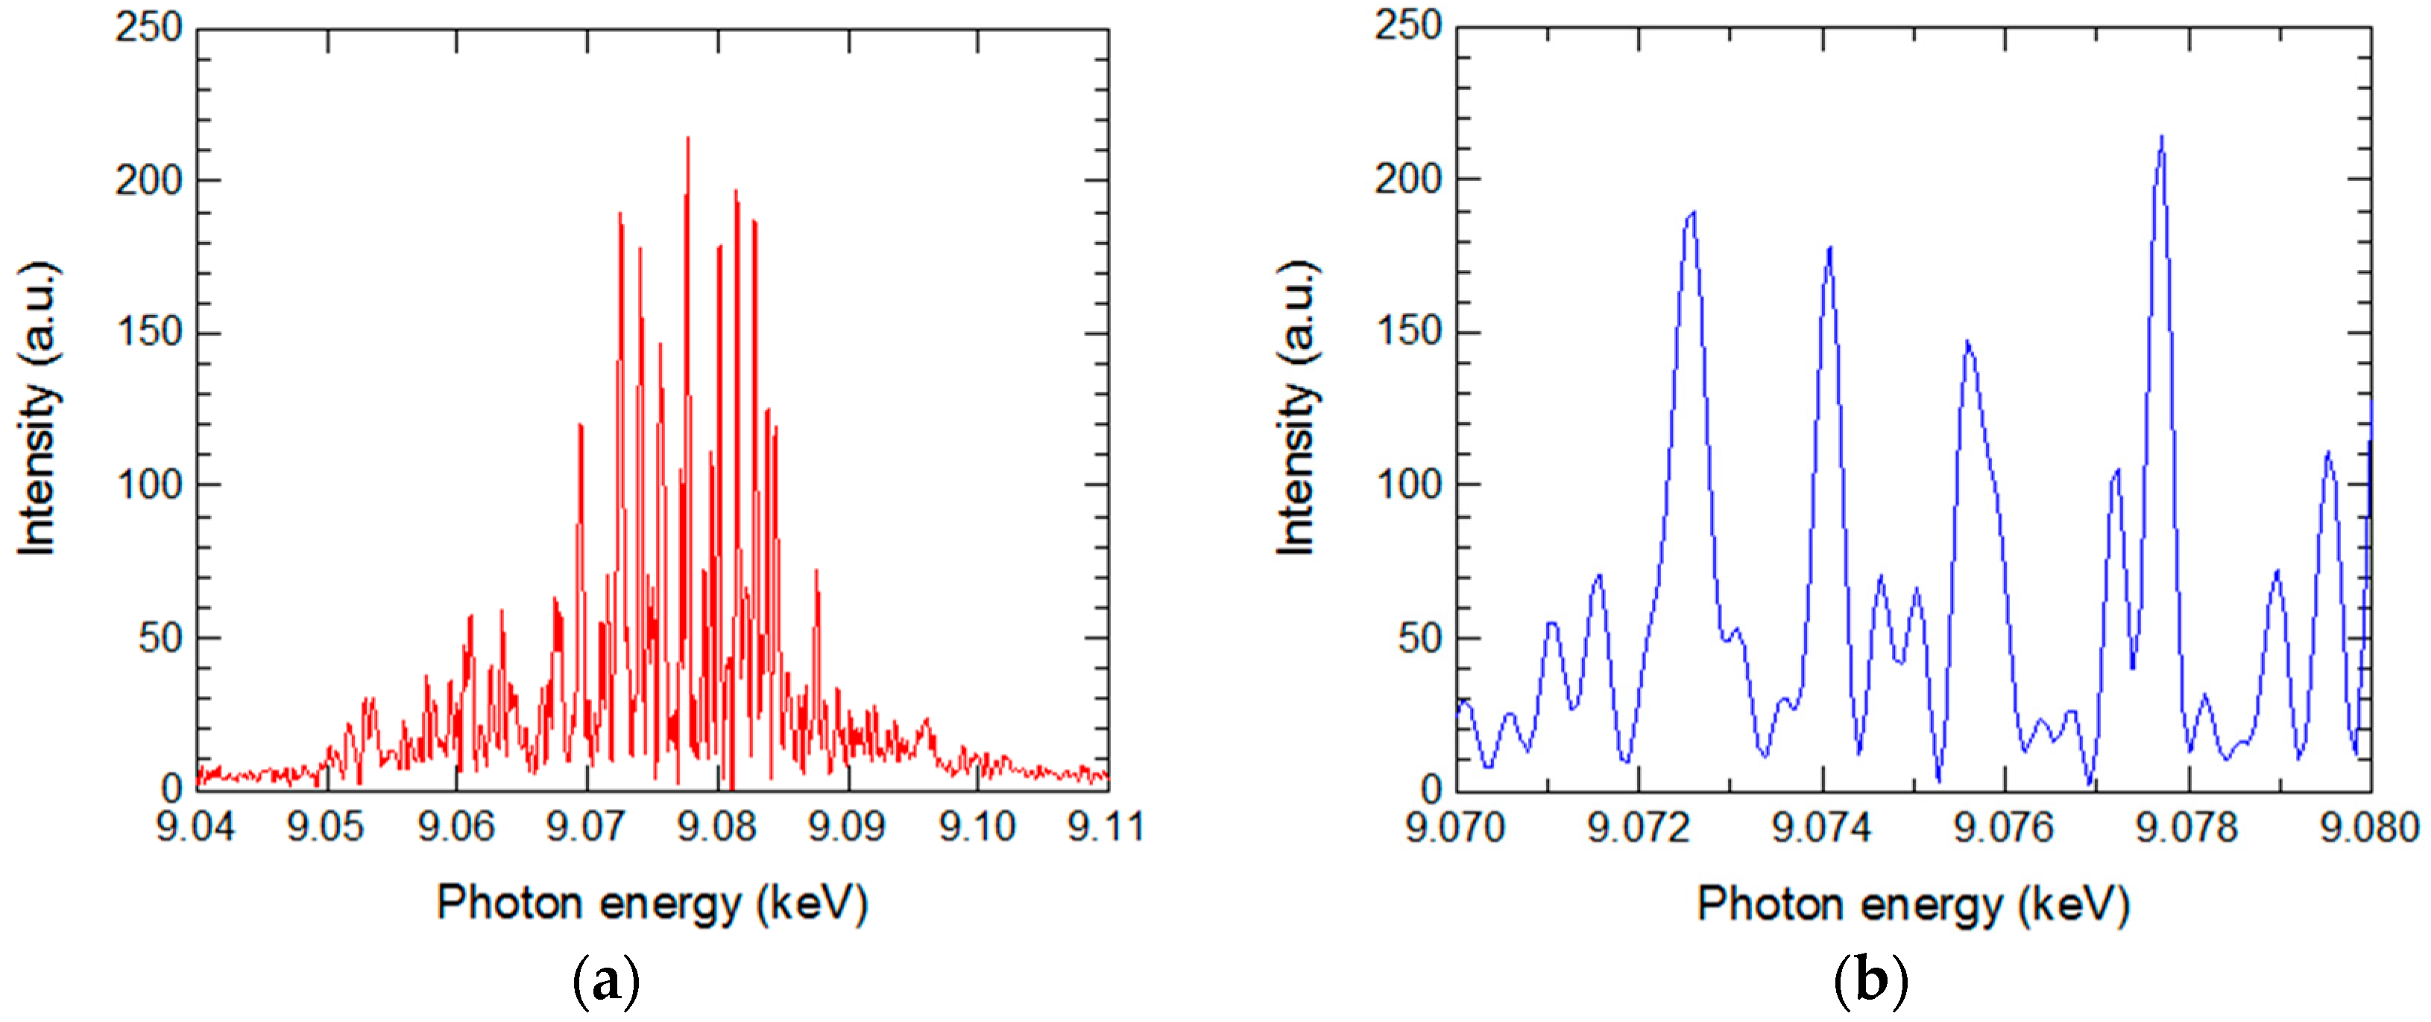
SASE spectrum of XFEL
Inubushi et al. Applied Sciences 2017, 7(6), 584

Slide 59
Convolution: the great leveler
∫
∞
(f ⊗ g)(x) = f(u)g(x-u)du
⁻∞
⊗ =
⊗ =

Slide 60
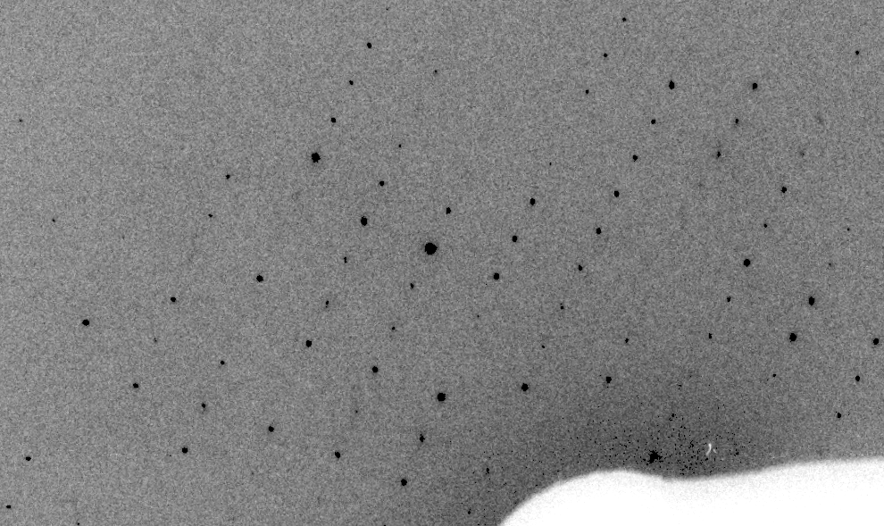
Real XFEL still
Lyubimov et al. (2016).
eLife 5, e18740.

Slide 61
XFEL: “fit” simulation to reality
Dispersion
Divergence
Mosaicity
Wavelength
Unit cell parameters (3)
Crystal orientation (3)
Mosaic domain size (3)
Beam center (2)
Beam direction (2)
Detector distance

Slide 62
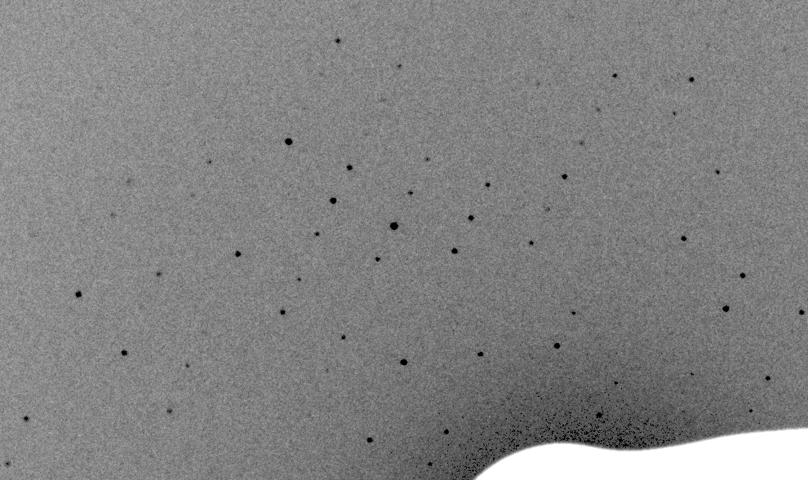
Simulation of XFEL still
Lyubimov et al. (2016).
eLife 5, e18740.

Slide 63
Real XFEL still
Lyubimov et al. (2016).
eLife 5, e18740.

Slide 64
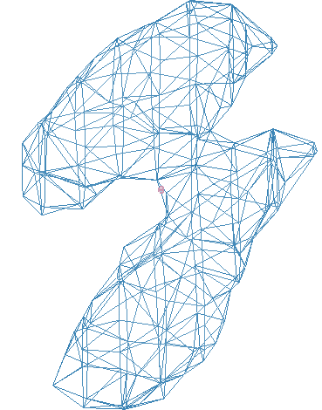
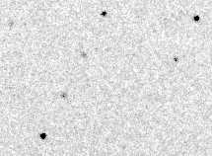
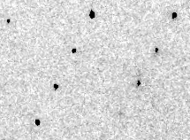
Simulation of XFEL still
phix
phiy
phiz
real
VS
phix
phiy
phiz

Slide 65
Fitting individual “mosaic domains”
Fraction pixels predicted
Best of
262,140 trials
Angle about y axis (°)

Slide 66
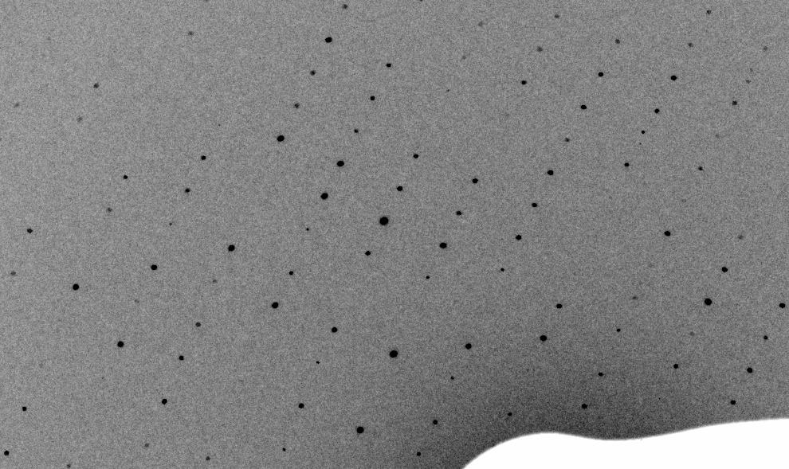
3-domain Simulation of XFEL still

Slide 67
Real XFEL still

Slide 68
1-domain Simulation of XFEL still

Slide 69

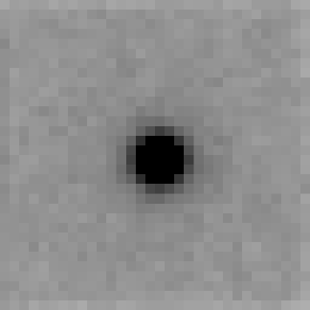
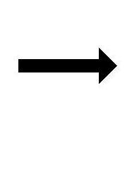
Now available in CCTBX !
At-scale simulation of diffraction data
https://github.com/cctbx
Documentation and examples:
http://bl831.als.lbl.gov/~jamesh/simtbx

Slide 70
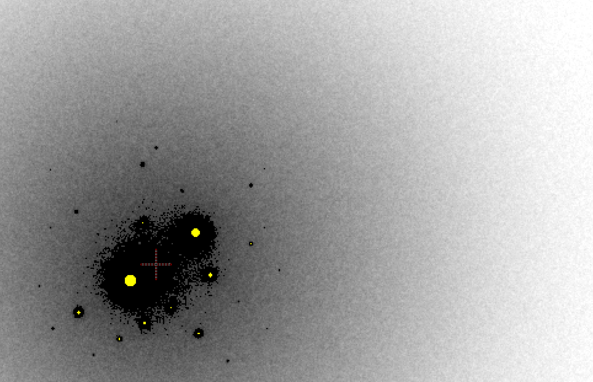
B factor from image inspection
B = 500

Slide 71
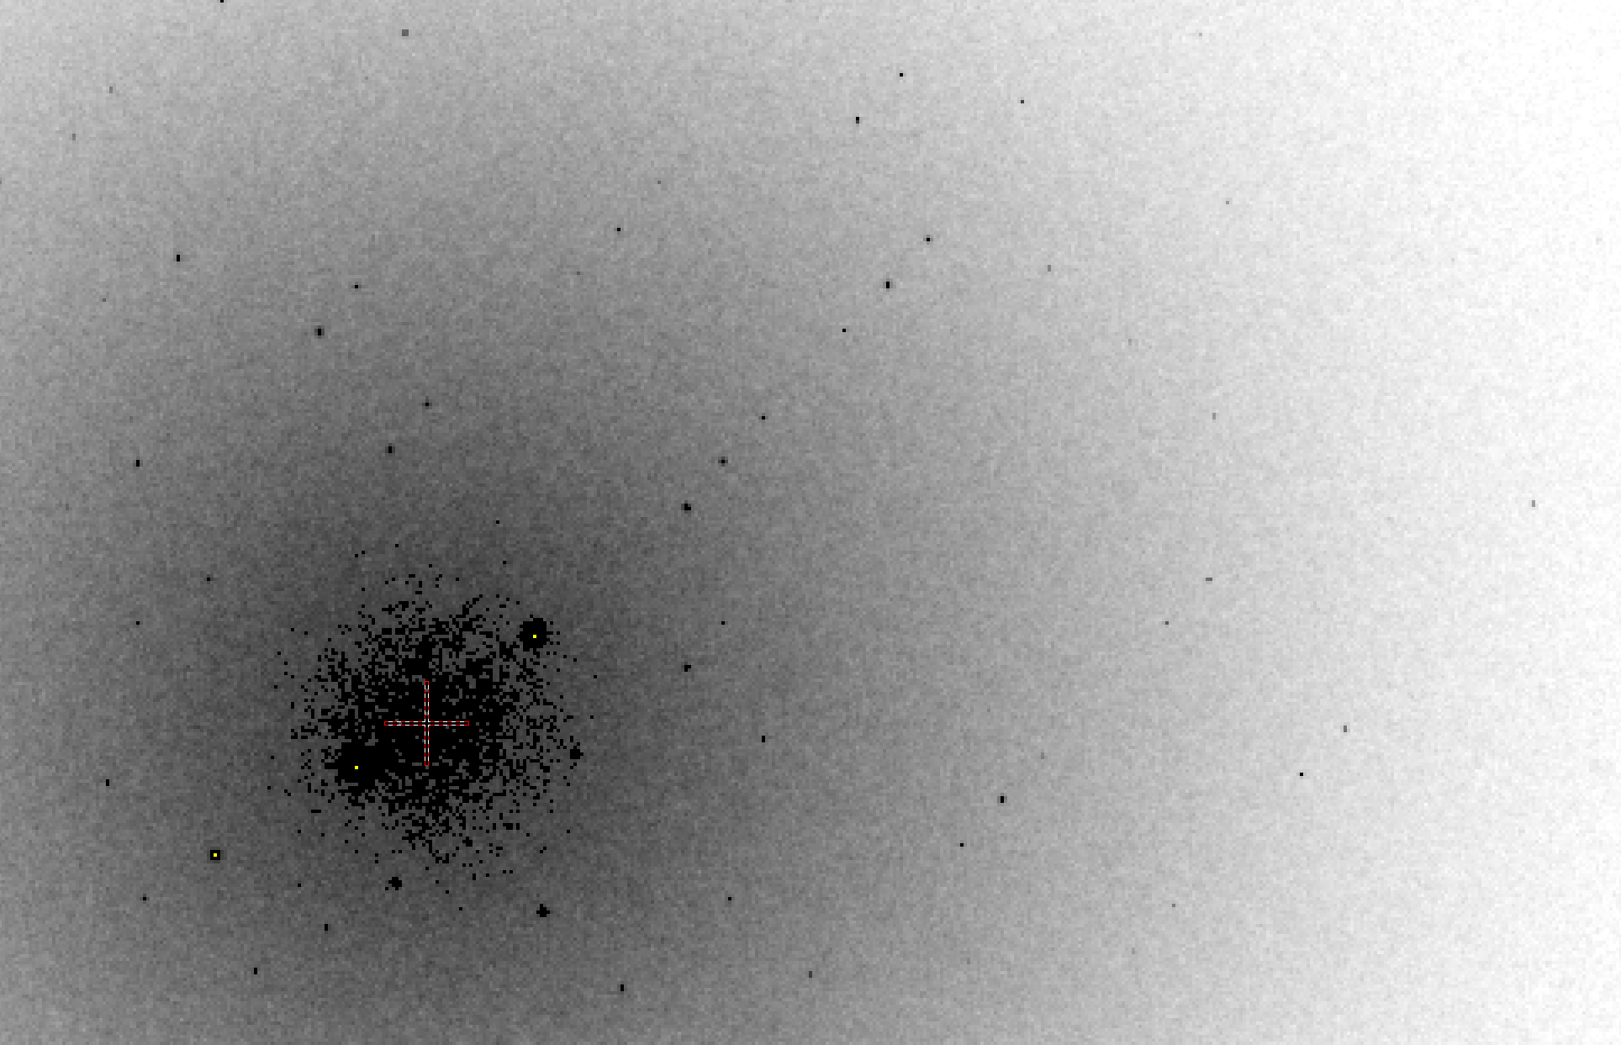
B factor from image inspection
B = 20

Slide 72
Bigger is better, but not by much
B = 20
B = 60
B = 0
B = 170
B = 330
B = 560
Resolution (Å)
B = 850
Crystal diameter (micron)

Slide 73
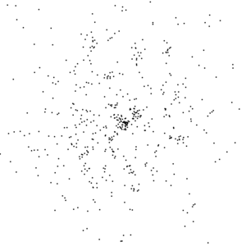
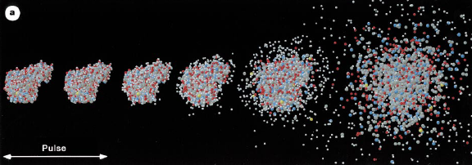
Realistic single-particle prediction
10¹² photon/pulse
100 nm focus

Slide 74
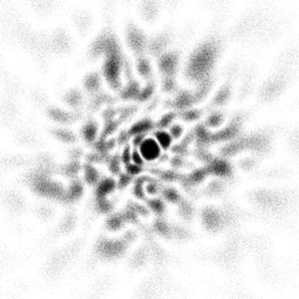
Realistic single-particle prediction
10¹² photon/pulse
3 nm focus

Slide 75

lysozyme: real and reciprocal

Slide 76
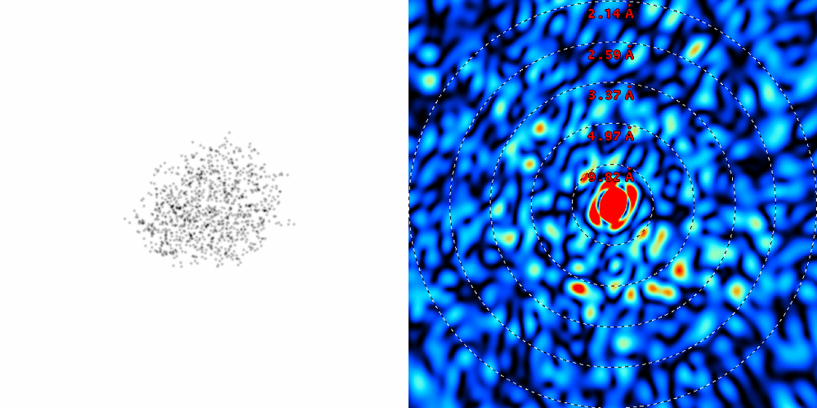
lysozyme: thermal motion

Slide 77
Diffraction Take-Home Lesson:
disorder
+ averaging
= poor resolution

Slide 78
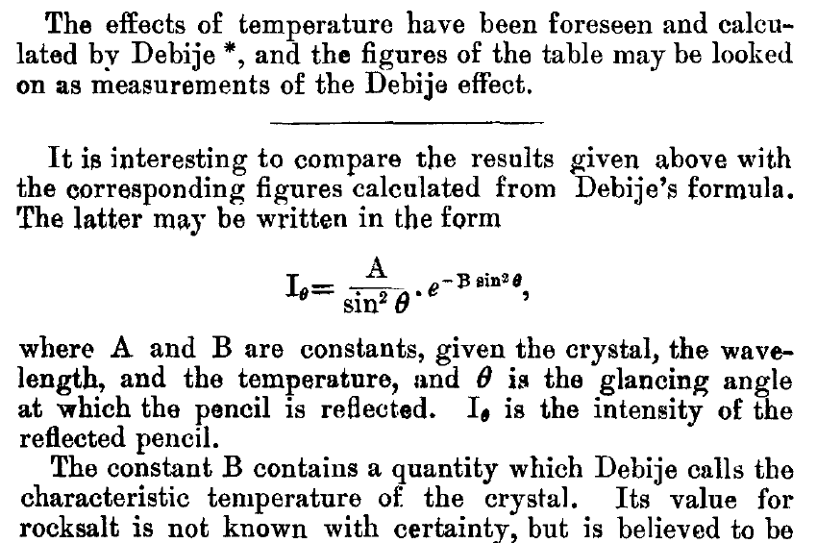
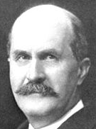
The B factor
Bragg, W. H. (1914)."XCVII. The intensity of reflexion of X rays by crystals", Philosophical Magazine Series 6 27, 881-899. Published May 1 1914

Slide 79
URLs & Summary
http://bl831.als.lbl.gov/~jamesh/powerpoint/
CCP4_SW_2018.pptx
http://bl831.als.lbl.gov/~jamesh/bin_stuff/
Multi-crystal: consider re-indexing
Non-isomorphism: careful humidity
Cell does not always tell
3D mosaic structure from single still
How low can you dose?
How to make molecules sit still?

Slide 80
Expected R_{merge} as I_{obs} → 0

Slide 81
Averaging Gaussian error
Average value
Number of samples averaged

Slide 82
Averaging Gauss/Gauss error
Average value
Number of samples averaged

Slide 83
R_{merge} at the resolution limit in PDB
Average outer-shell R_{merge}
Year

Slide 84
what is “partiality”?
F(h,k,l)
Ewald sphere
λ₁*
λ₂*
F(h,k,l)
F(0,0,0)

Slide 85
X-ray scattering “rules”:
Optimum: support thickness = crystal thickness
1 μm crystal ≈ 1 μm water
≈ 1 μm plastic
≈ 0.1 μm glass
≈ 1000 μm air
~ 50 mm He
≈ 370 mm sat water vapor @ 4C

