Slide 2
Acknowledgements
http://bl831.als.lbl.gov/~jamesh/powerpoint/CBMS_WB_2022.pptx
Robert Stroud James Fraser Nevan Krogan
Paul Adams John Tainer Greg Hura Nick Sauter
Aina Cohen Art Lyubimov Jeney Wierman
UCSF LBNL SLAC
ALS 8.3.1: TomAlberTron
NIH NIGMS R01 GM124149
NIH NIAID P50 AI150476
NIH NIGMS P30 GM124169
DOE-BER Integrated Diffraction Analysis Technologies (IDAT)
NIH NIGMS P30 GM133894
The Advanced Light Source is supported by the Director, Office of Science, Office of Basic Energy Sciences, Materials Sciences Division, of the US Department of Energy under contract No. DE-AC02-05CH11231 at Lawrence Berkeley National Laboratory.

Slide 3
Systematic Errors! … and how to eliminate them
Radiation Damage
Non-isomorphism
Bulk(-ish) solvent
Tangled refinement

Slide 4
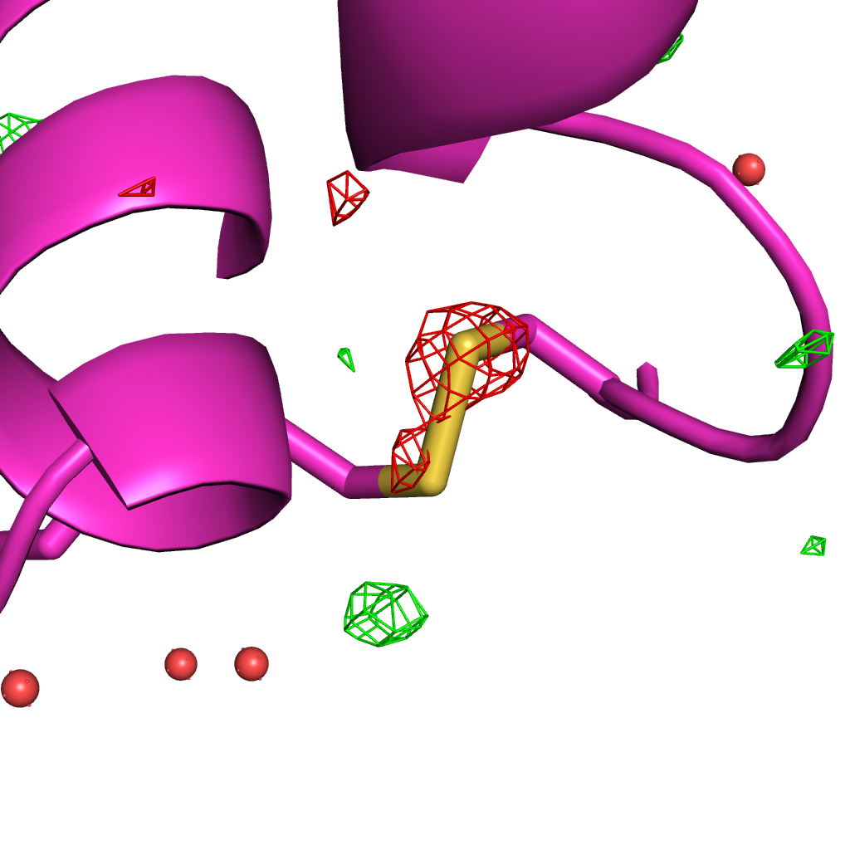
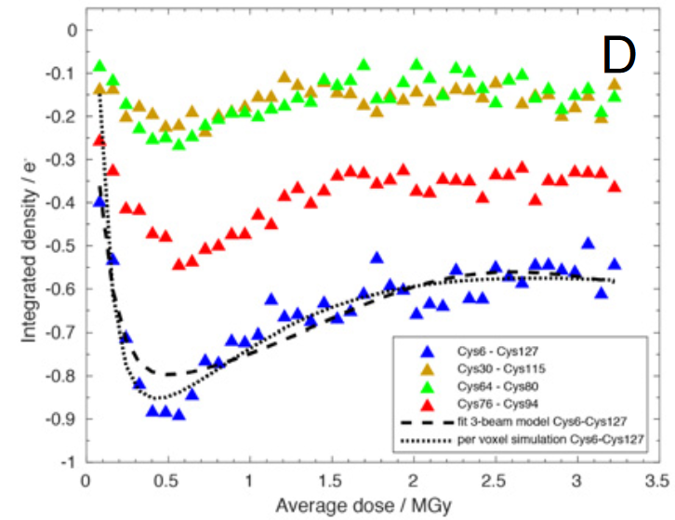
Systematic error: Illumination contrast appears to “reverse” damage
Room temperature high-dose rate series
0.35 MGy
Cys127
Cys6
de la Mora, et al. (2020) PNAS USA 117, 4142-4151

Slide 5
False “Damage reversal”: from beam profile
X-ray beam
crystal

Slide 6
False “Damage reversal”: from beam profile
Cold beam
Hot beam
crystal

Slide 7
False “Damage reversal”: from beam profile
Cold beam
Hot beam
crystal

Slide 8
False “Damage reversal”: from beam profile
Cold beam
Hot beam
crystal

Slide 9
False “Damage reversal”: from beam profile
Cold beam
Hot beam
crystal

Slide 10
False “Damage reversal”: from beam profile
Cold beam
Hot beam
crystal

Slide 11
False “Damage reversal”: from drift
X-ray beam
crystal

Slide 12
Systematic error: Illumination contrast appears to “reverse” damage
Room temperature high-dose rate series
1
cold
occupancy
hot
observed
0
time
de la Mora, et al. (2020) PNAS USA 117, 4142-4151

Slide 13
0 Gy

Slide 14
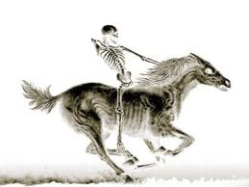
100 MGy

Slide 15
What is the dose?
50 MGy ?

Slide 16
MGy reaction reference
~45 global damage Owen et al. (2006)
10/Å global damage Howells et al. (2009)
5 Se-Met Holton (2007)
4 Hg-S Ramagopal et al. (2004)
4 R-C-COOH Garman et al. (2015)
3 S-S Murray et al. (2002)
1 Br-RNA Olieric et al. (2007)
~1? Cl-C ???
0.5 Mn in PS II Yano et al. (2005)
0.06 putidaredoxin Corbett et al. (2007)
0.02 Fe in myoglobin Denisov et al. (2007)
Radiation Damage World Records
Holton (2009) J. Synchrotron Rad. 16 133-42

Slide 17
Take home:
“dose contrast”
makes rad dam
Hard to correct

Slide 18
Beam Shape Dichotomy
Flat-top beam
Uniform dose in illuminated region
Sharp edges: sensitive to drift
Gaussian beam
Softer edges
High dose contrast
Best of both?
“dose flattening”

Slide 19
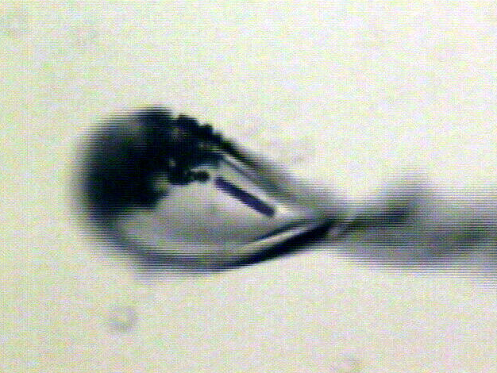
“rastering” to find the crystal
X-ray beam
ice
Membrane
protein crystal

Slide 20
“rastering” for flat dose

Slide 21
“rastering” for virtual beam

Slide 22
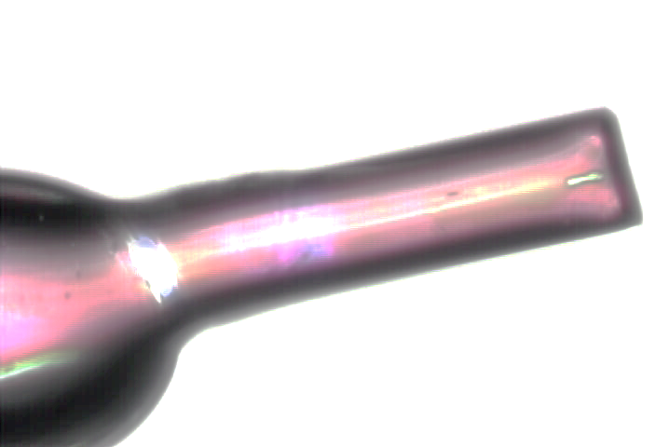
Old way: shoot and scoot
phi
0°
360°
position along crystal

Slide 23
Old way: shoot and scoot
phi
0°
360°
position along crystal

Slide 24
Old way: shoot and scoot
phi
0°
360°
position along crystal

Slide 25
Painting mode: raster as collection
phi
phi
0°
1080°
0°
360°
position along crystal

Slide 26
Painting mode: raster as collection
phi
phi
0°
1080°
0°
360°
position along crystal

Slide 27
Painting mode: raster as collection
phi
phi
0°
1080°
0°
360°
position along crystal

Slide 28
Painting mode: raster as collection
phi
phi
0°
1080°
0°
360°
position along crystal

Slide 29
How many images?
360° / 0.1° * ( 100 µm / 1 µm )²
⁼ 36x10⁶
28,000 photons/image

Slide 30
Lossless data rate
bits
s
= log₂(pixels) * flux * thick * 1.2x10⁻⁵
where: bits/s = entropy-limited compressed data rate
pixels = number of pixels in the detector
flux = photons/s onto the sample thick = sample thickness in microns
EG: 1e12 ph/s * 100um thick = 3.4 GBytes/s
The 1.2e-5 scattered photons per incident photon can be derived form the cross section of oxygen (0.2 cm^2/g) and the rough density of protein crystals (1.2 g/cm^3), and the fact that about half of all scattered photons hit a flat detector: 0.2*1.2*1e-4/2 = 1.155e-5 That is, flux*thickness*1.2e-5 is the rate of photon arrivals and log2(pixels) is the number of bits required to store the location of one photon in the entropy-limited regime. Lossless compression cannot be better than this because individual photon arrivals are genuinely random.

Slide 31
How to lose information
long exposures
>1 photon/image = order of arrivals
Wide phi slice
sum over angle
Large beams
sum over profile area
Pink/divergent beam
sum over lambda/angle
Background
non-crystal stuff
Systematics
Dose contrast, drift, read-out gap

Slide 32
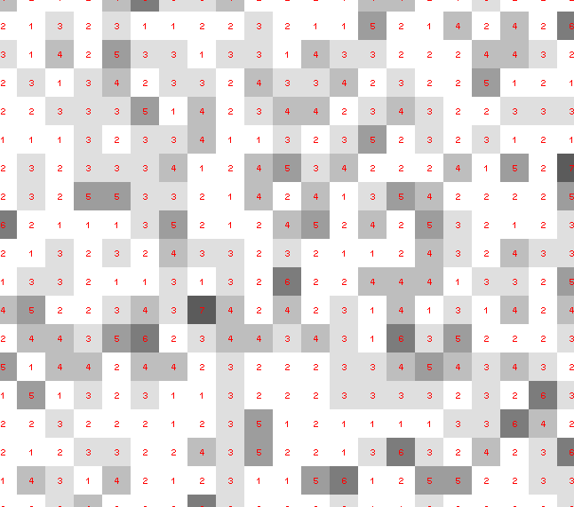
Dose slicing: is that a spot?

Slide 33
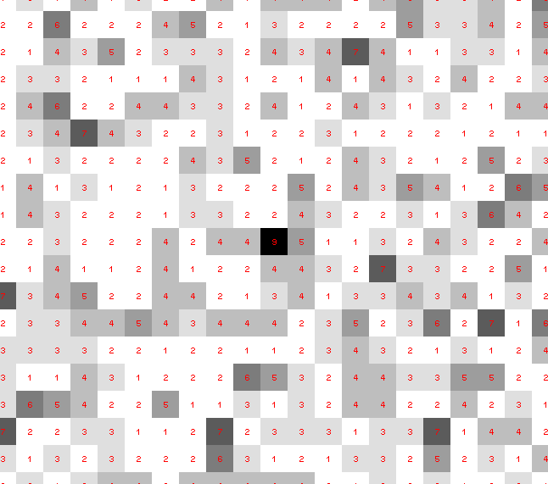
Dose slicing: is that a spot?

Slide 34
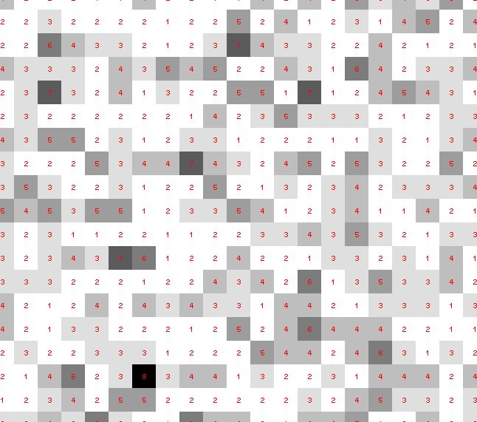
Dose slicing: is that a spot?

Slide 35
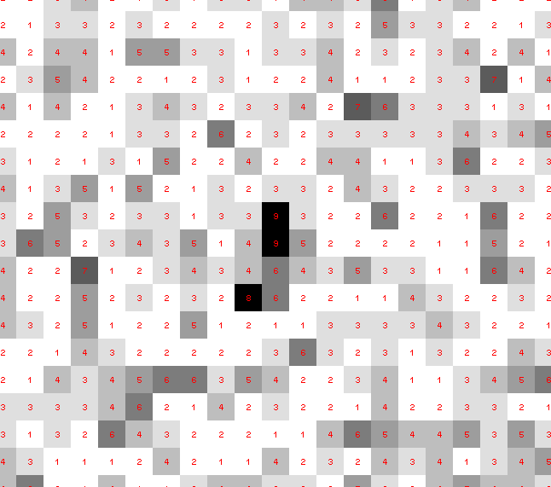
Dose slicing: is that a spot?

Slide 36
Dose slicing: is that a spot?

Slide 37
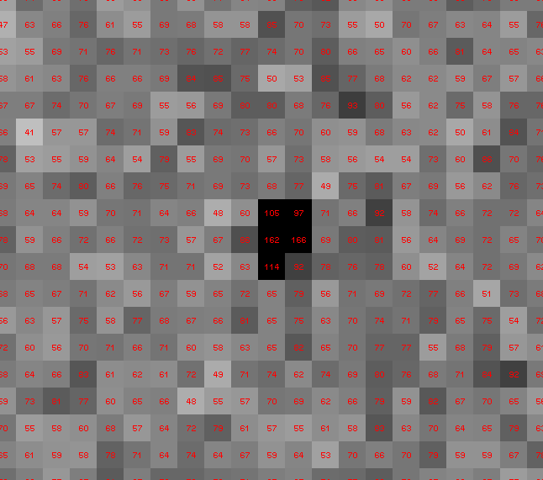
Dose slicing: is that a spot?

Slide 38
Single Photons Carry Information
About Radiation Damage
4
4
photons
photons
0
0
4
4
photons
photons
0
0
time
time

Slide 39
Take home:
“dose flattening”
makes rad dam
correctable
(if we can use weak images)

Slide 40
Systematic Errors! … and how to eliminate them
Radiation Damage
Non-isomorphism
Bulk(-ish) solvent
Tangled refinement

Slide 41
Non-isomorphism
is annoying
means you:
can’t merge
can’t
add
can’t
subtract
Caused by:
rad dam
humidity
temperature
Growth conditions
Cryo-cooling
Everything

Slide 42
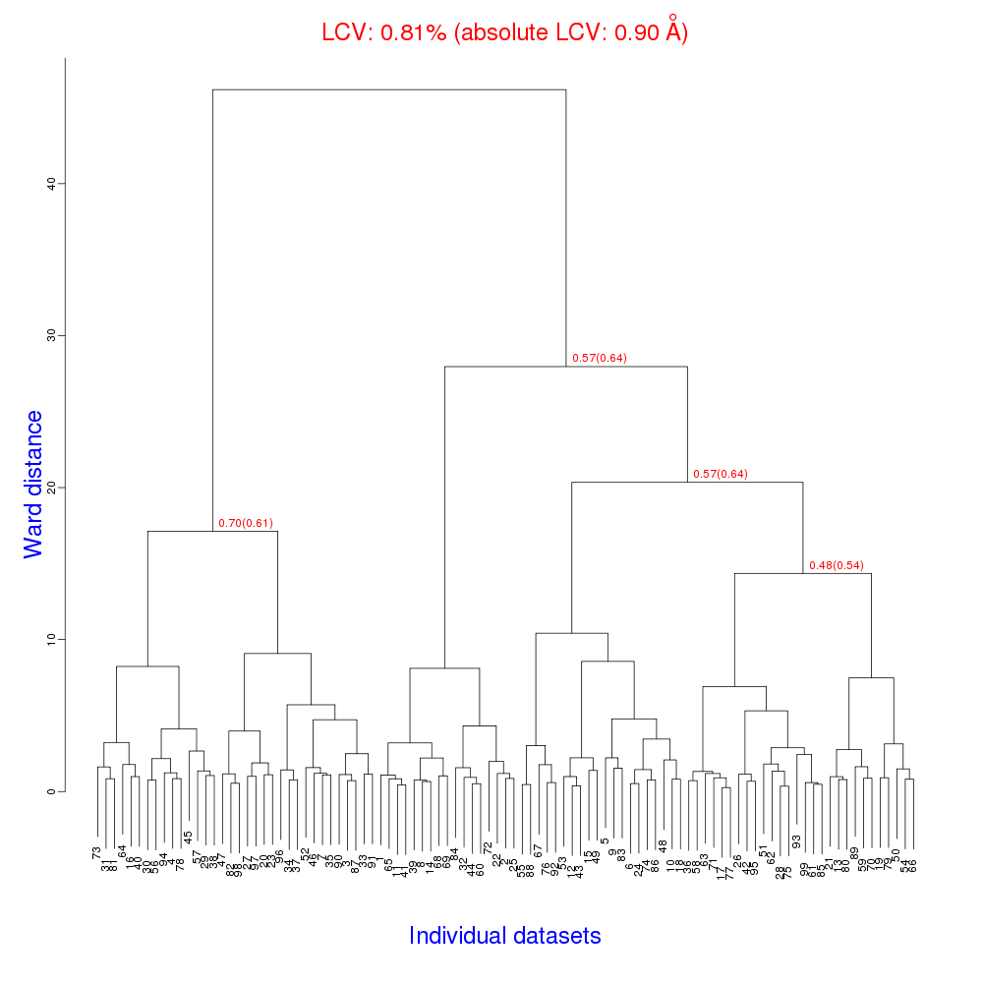
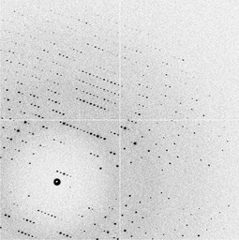
Cell clustering: 100 datasets
Reality:
Perfect isomorphism
(simulated data)
Holton, J. (2019). Acta Cryst. D 75, 113-122.

Slide 43
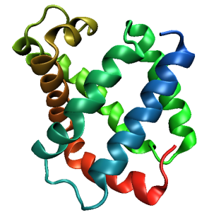
Same structure, different cell
0.5% cell change → 15%
Crick & Magdoff (1956) “theory method isomorphous replacement”, Acta Cryst. 9, 901-8.

Slide 44
Same structure, different cell
0.5% cell change → 15%
Crick & Magdoff (1956) “theory method isomorphous replacement”, Acta Cryst. 9, 901-8.

Slide 45
Uniform stretch
5% change → 0%

Slide 46
Uniform stretch
5% change → 0%

Slide 47
Hygrostatic gradients
high
water activity
low
jet
loop

Slide 48
Non-isomorphism in lysozyme
RMSD = 1.70 Å
Δcell = 0.7 %
R_{iso} = 44.5%
RMSD = 0.18 Å LSQ
RH: 84.2%
vs 71.9%
3aw6
3aw7

Slide 49
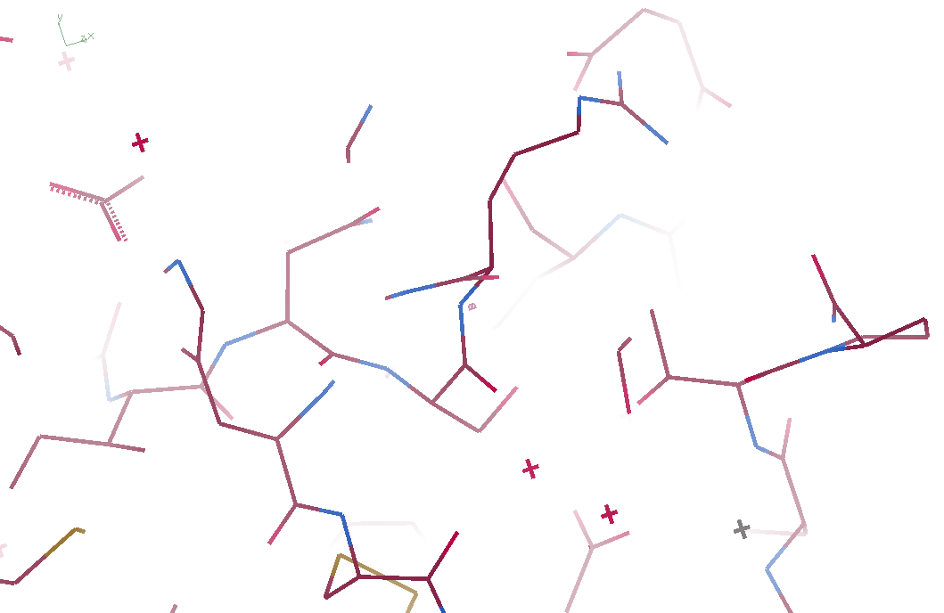
3aw6

Slide 50
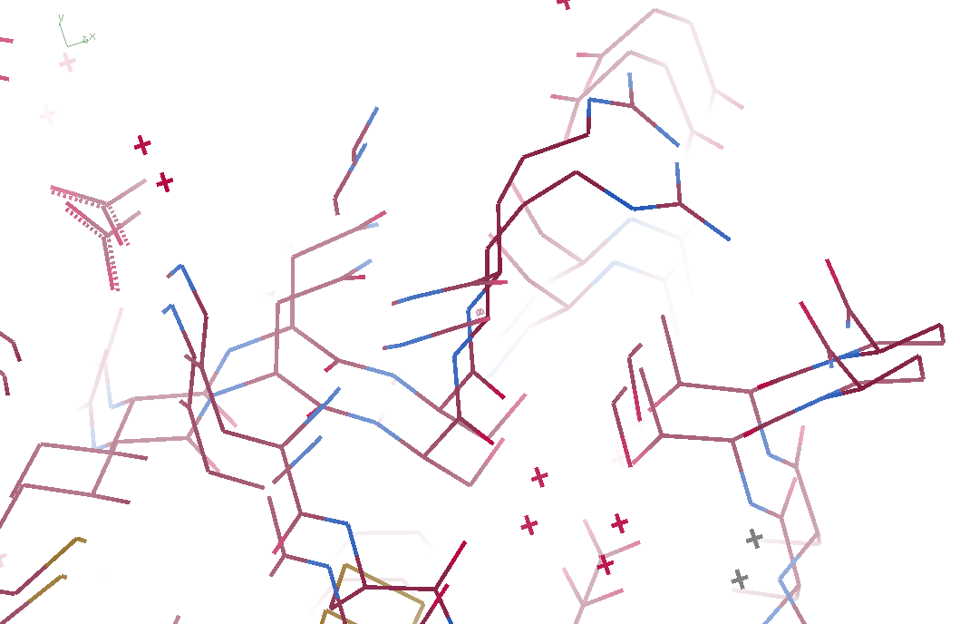
3aw6 3aw7

Slide 51
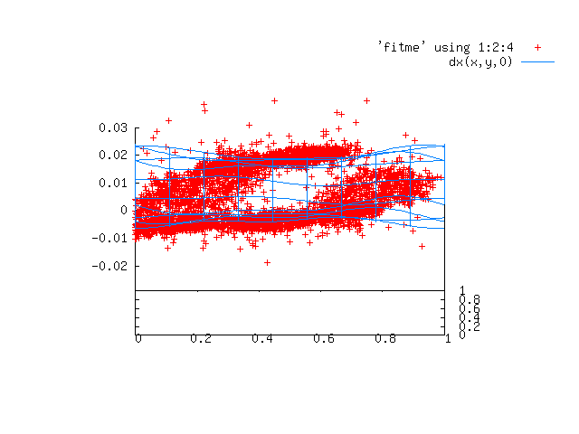
Periodic Spatial Distortion Vector Field

Slide 52
3aw6 3aw7

Slide 53
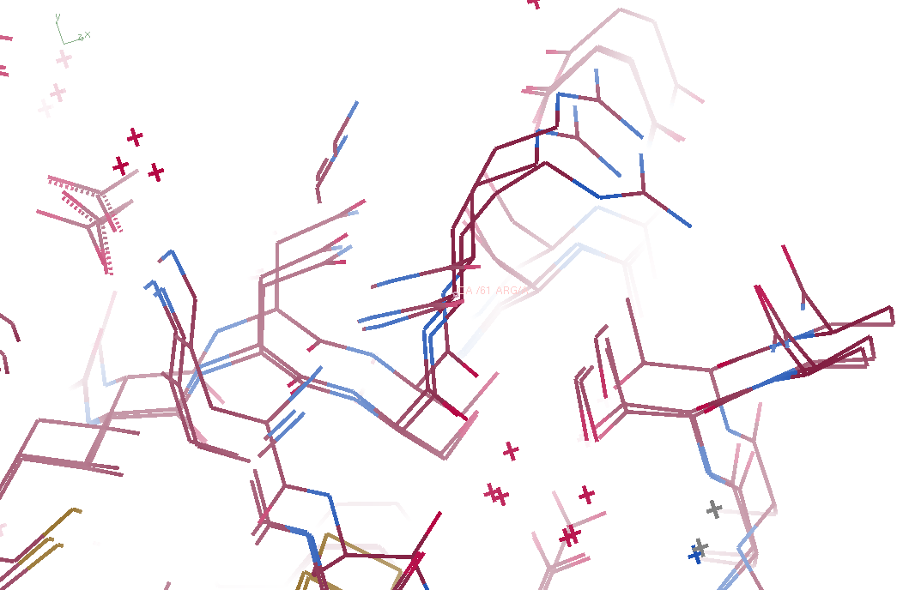
3aw6, 3aw7, “bent” 3aw6

Slide 54
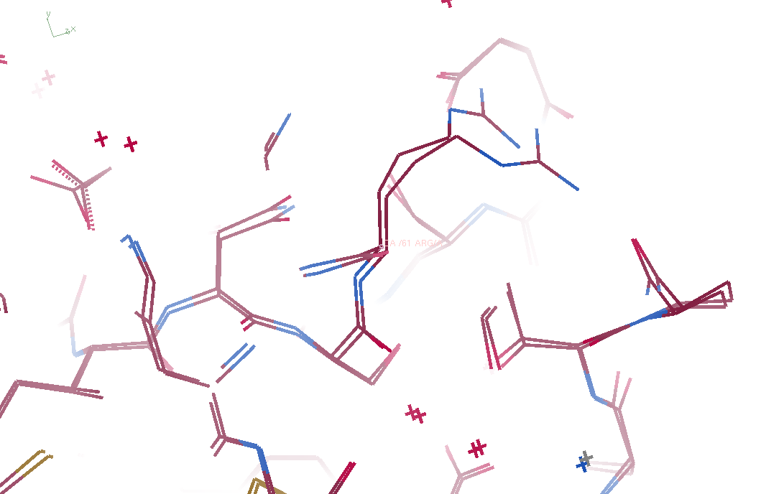
3aw7, “bent” 3aw6

Slide 55
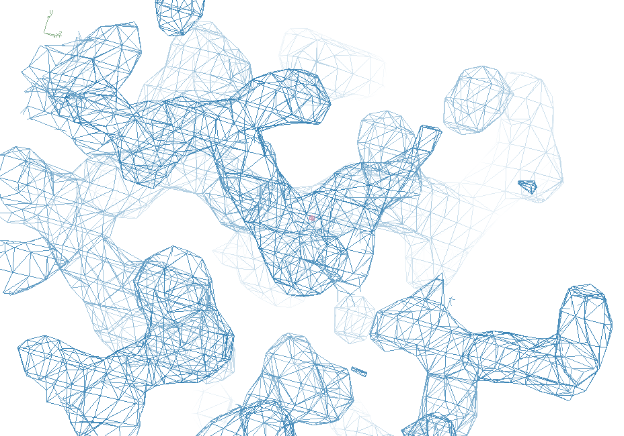
3aw7

Slide 56
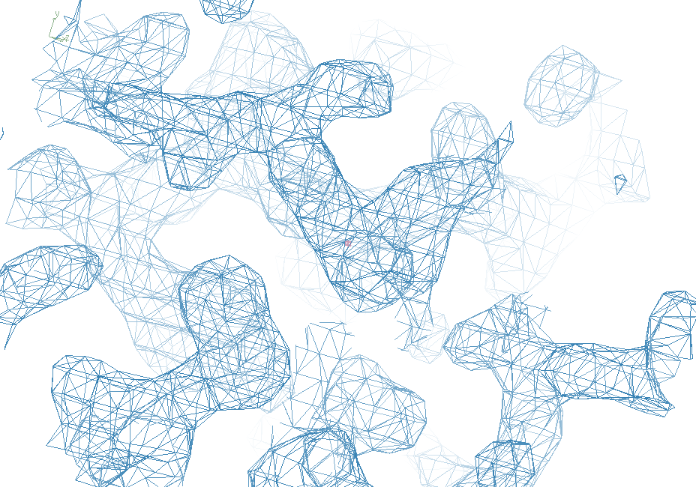
“bent” 3aw7

Slide 57
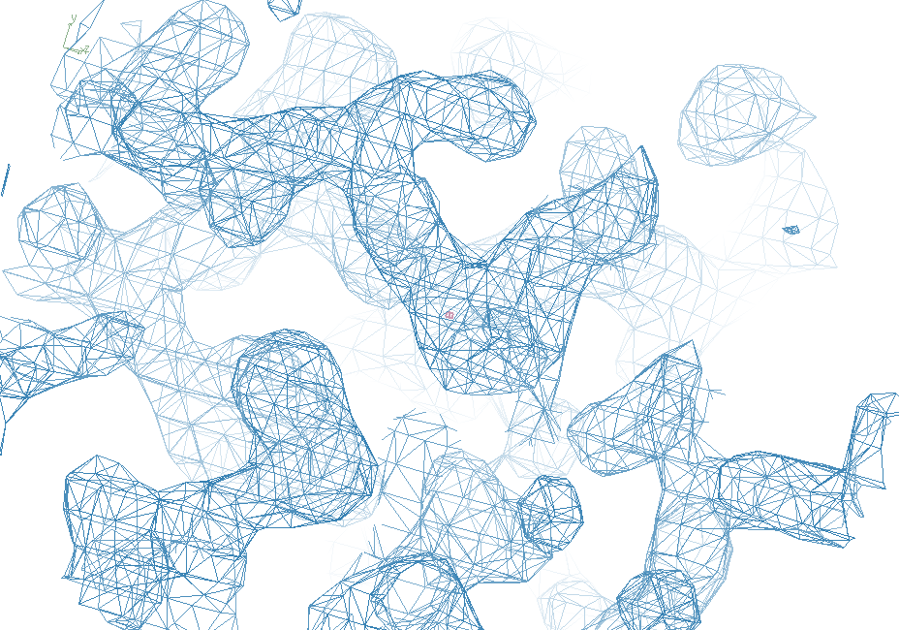
3aw6

Slide 58
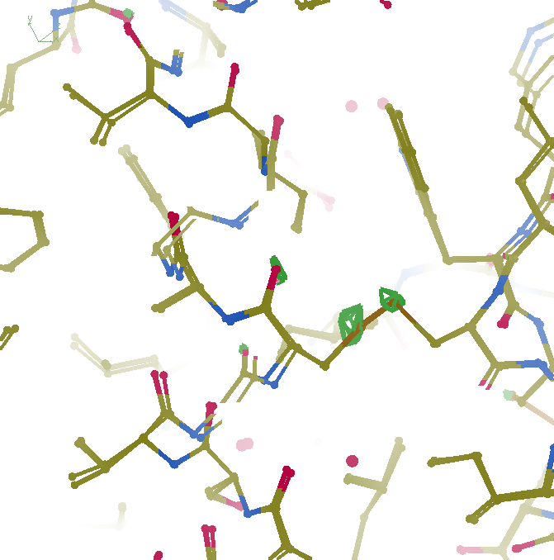
F_{obs}-F_{obs} difference
3σ 1.8 Å
“unbent”

Slide 59
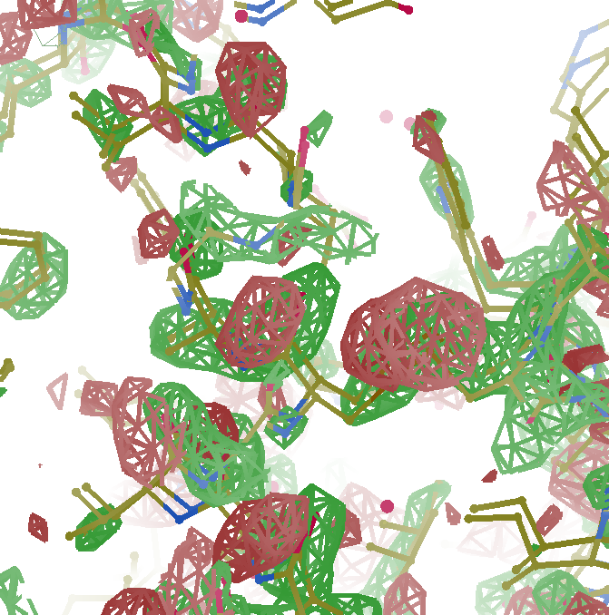
F_{obs}-F_{obs} difference
3σ 1.8 Å
old way

Slide 60
Take home:
Non-isomorphism
is now correctable
(in real space)

Slide 61
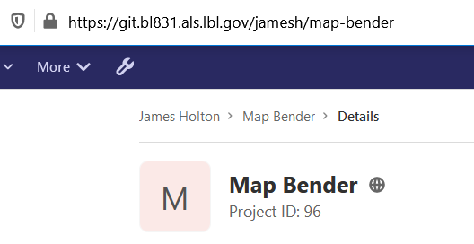
Downloading “map bender”

Slide 62
Systematic Errors! … and how to eliminate them
Radiation Damage
Non-isomorphism
Bulk(-ish) solvent
Tangled refinement

Slide 63
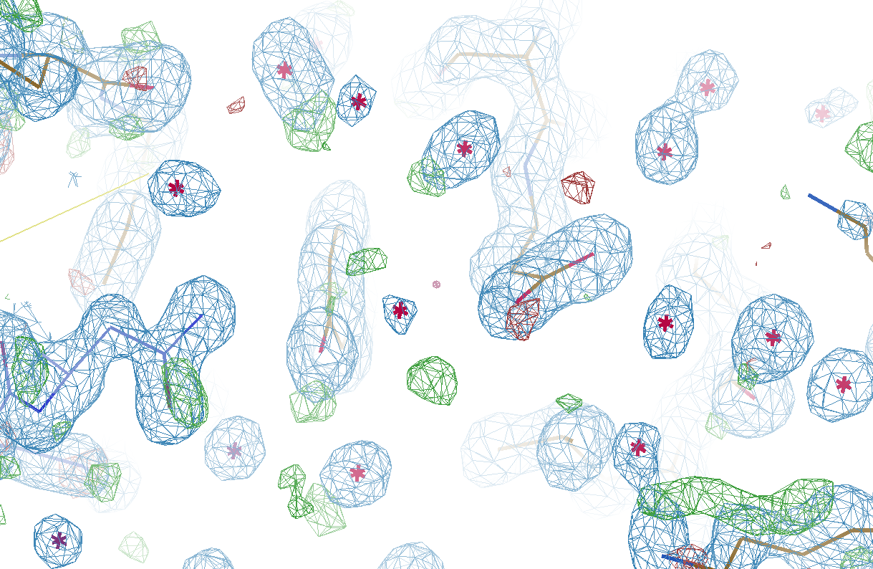
Refined
3si4
R_{work} = 0.17023
R_{free} = 0.19309
waters = 401

Slide 64
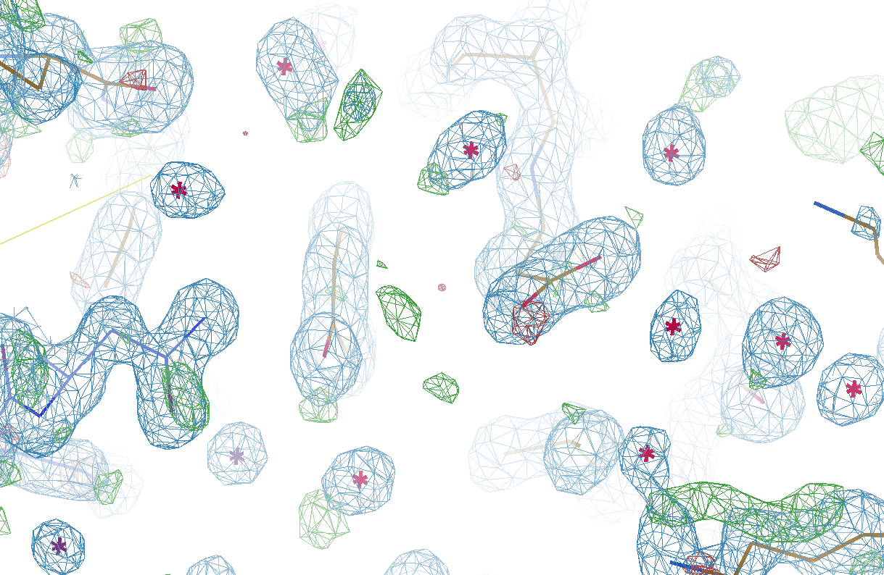
Watershed-ed
3si4
R_{work} = 0.17727
R_{free} = 0.19281
waters = 291

Slide 65
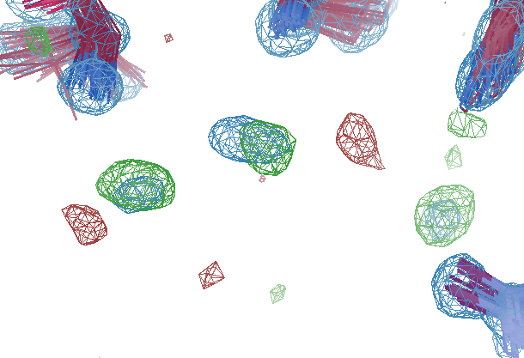
Fo-Fc peak in solvent but “water” makes it worse…
R_{work} 11.71
R_{free} 13.46
bond 0.007 Å
angle 1.78°

Slide 66
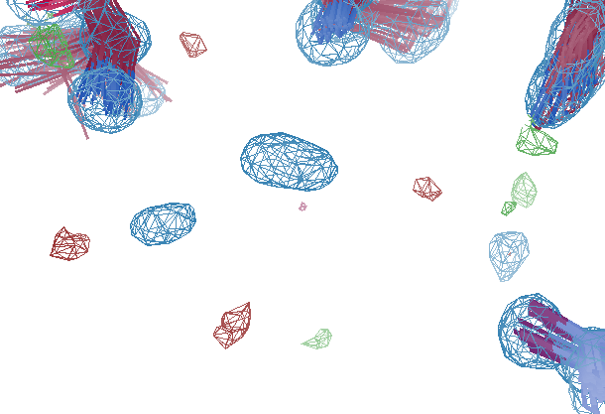
After solvent “touch-up”
R_{work} 11.10
R_{free} 12.97
bond 0.006 Å
angle 1.49°

Slide 67
Probability that it’s not noise
$$P\left(ρ\right)={\operatorname{erf}\left(\left|\frac{ρ}{σ\left(ρ\right)\sqrt{2}}\right|\right)}^{{V_{asu}}/{{2V}_{shan}}}$$
$$={\left(\frac{\sqrt{\left(B+9.5\right)log⁡(2)}}{π}\right)}^{3}$$
$$V_{shan}=d^{3}$$
P() probability
ρ electron density
σ(ρ) rms value of difference map
erf() error function – integral of a Gaussian
V_{asu} volume of asymmetric unit
V_{shan} volume of “Shannon voxel”
d true resolution
B Debye-Waller factor
9.484 intrinsic width of C atom
B = 8π²rms² exp(-x²) has rms = 1
fwhm = 2*sqrt(2*log(2))*rms

Slide 68
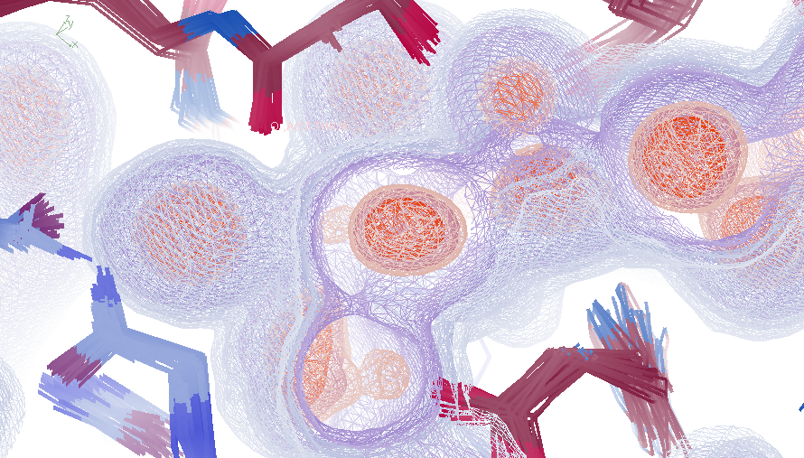
“Bulk” solvent average from 100 ns MD
R_{work} 11.10
R_{free} 12.97
bond 0.006 Å
angle 1.49°

Slide 69
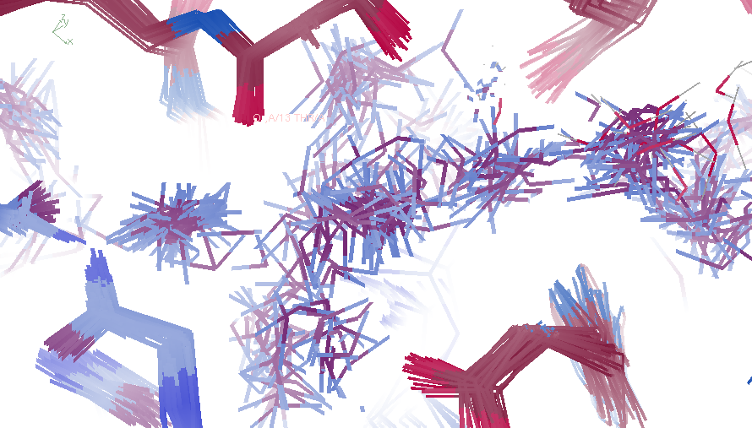
Best so far
R_{work} 11.94
R_{free} 21.13
bond 0.005 Å
angle 1.29°
8564 waters for AMBER

Slide 70
Explicit solvent: refinement is unstable
R factor (%)
Phenix macro-cycle

Slide 71
Model complexity vs R_{free}
1aho
Method of refinement | R_{work} | R_{free}
Refmac5: defaults, isotropic B | .1617 | .1797

Slide 72
Model complexity vs R_{free}
1aho
Method of refinement | R_{work} | R_{free}
Refmac5: defaults, isotropic B | .1617 | .1797
3D-RISM solvent | .1578 | .1739

Slide 73
Model complexity vs R_{free}
1aho
Method of refinement | R_{work} | R_{free}
Refmac5: defaults, isotropic B | .1617 | .1797
3D-RISM solvent | .1578 | .1739
100 ns averaged MD solvent protein fixed | .1440 | .1666

Slide 74
Model complexity vs R_{free}
1aho
Method of refinement | R_{work} | R_{free}
Refmac5: defaults, isotropic B | .1617 | .1797
3D-RISM solvent | .1578 | .1739
100 ns averaged MD solvent protein fixed | .1440 | .1666
2-8 conformers/residue Iterative solvent from restrained MD | .1089 | .1239

Slide 75
Model complexity vs R_{free}
1aho
Method of refinement | R_{work} | R_{free}
Refmac5: defaults, isotropic B | .1617 | .1797
3D-RISM solvent | .1578 | .1739
100 ns averaged MD solvent protein fixed | .1440 | .1666
2-8 conformers/residue Iterative solvent from restrained MD | .1089 | .1239
48-copy supercell refinement mixed MD & ordered + watershed + touchup | .0928 | .1161

Slide 76
Take home:
Solvent region contains error
(but not all of it)

Slide 77
Why does ensemble refinement suck? (3 parameters/observation and R_{work} still high!) The chains are “tangled”

Slide 78
Systematic Errors! … and how to eliminate them
Radiation Damage
Non-isomorphism
Bulk(-ish) solvent
Tangled refinement

Slide 79
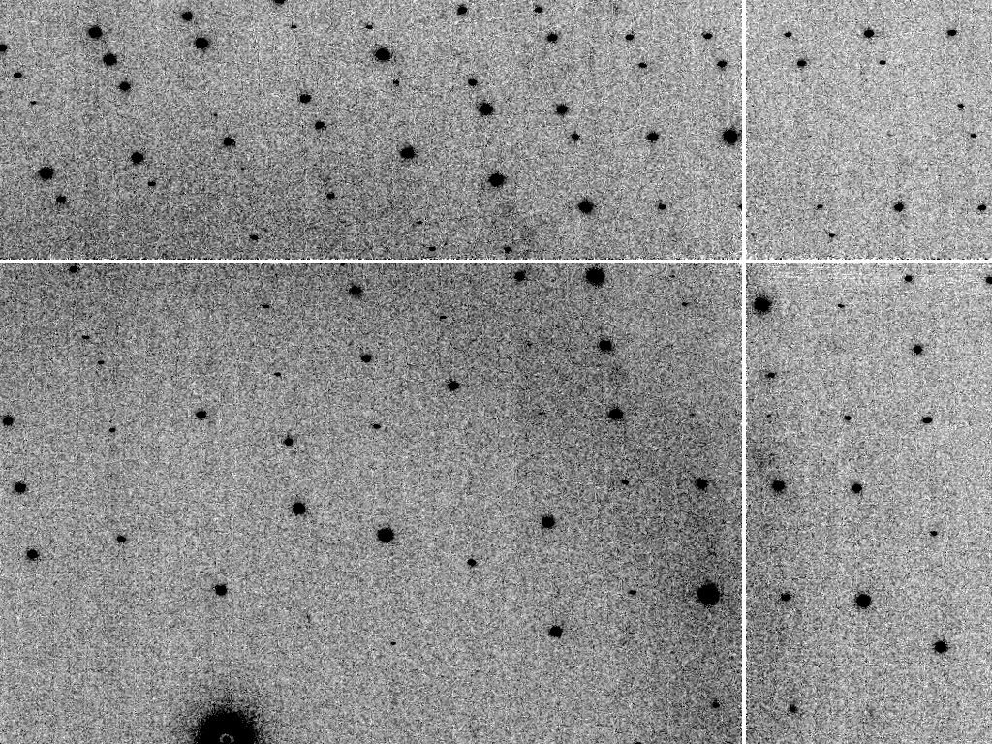
Is it Real? Or is it MLFSOM
simulated
real
Holton et al (2014) "R-factor gap", FEBS Journal 281, 4046-4060.

Slide 80
Simulated | statistic | Real
5.4% | R_{merge} | 6.2%
18.9 | I/sd | 16.2
1.9 | I/sd (1.4 Ǻ) | 1.6
1.7 4.0 0.020 | SDCORR | 1.0 2.2 0.065
36.8 | PADFPH | 31.46
3.871 | mlphare f” | 3.476
0.178 | FOM | 0.192
0.545 | FOMDM | 0.664
0.6270 | CC(1H87) | 0.6090

Slide 81
Simulated | statistic | Real
5.4% | R_{merge} | 6.2%
18.9 | I/sd | 16.2
1.9 | I/sd (1.4 Ǻ) | 1.6
1.7 4.0 0.020 | SDCORR | 1.0 2.2 0.065
36.8 | PADFPH | 31.46
3.871 | mlphare f” | 3.476
0.178 | FOM | 0.192
0.545 | FOMDM | 0.664
0.6270 | CC(1H87) | 0.6090
0.050 | R_{cryst} | 0.184
0.070 | R_{free} | 0.231

Slide 82
Model building: real vs sim data
Holton et al. (2014) "The R-factor gap", FEBS J. 281, 4046-4060.

Slide 83
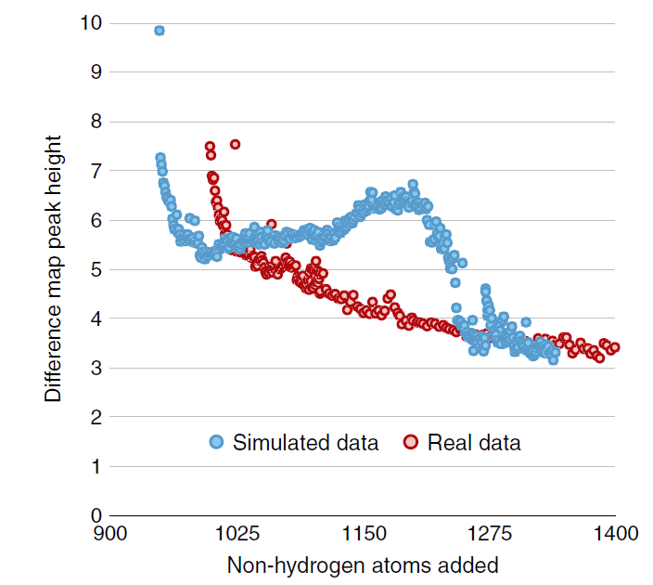
Model building: real vs sim data
Fo-Fc difference map peak height
Holton et al. (2014) "The R-factor gap", FEBS J. 281, 4046-4060.

Slide 84
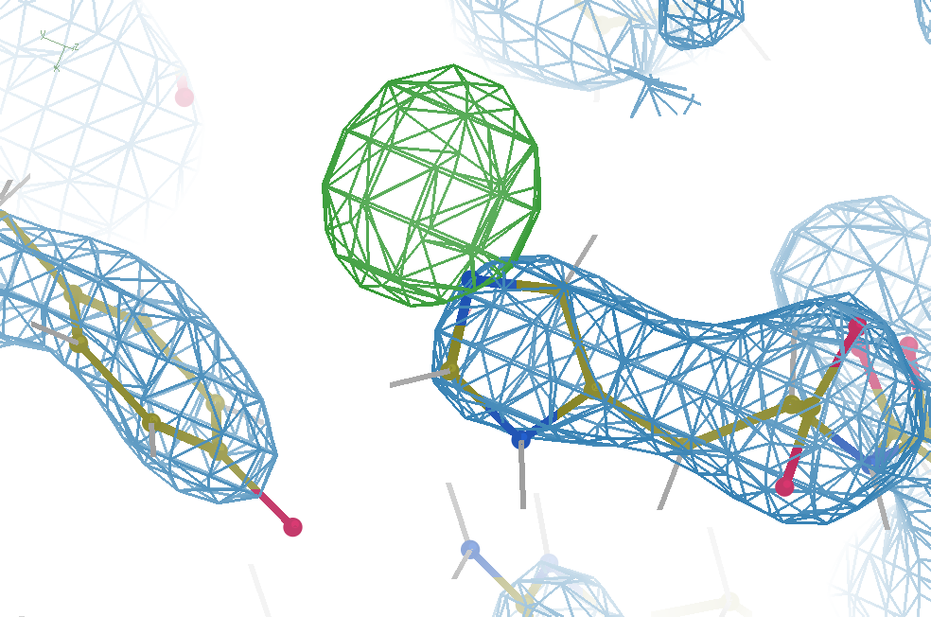
Hydrogen: visible at 3.5 Å resolution!
R_{work} = 0.04
R_{free} = 0.05
d_{min} = 3.5 Å
6σ = 1 e⁻
Simulation:
Realistic noise
“perfect” model

Slide 85
Big Question:
Why doesn’t this work
with real data?

Slide 86
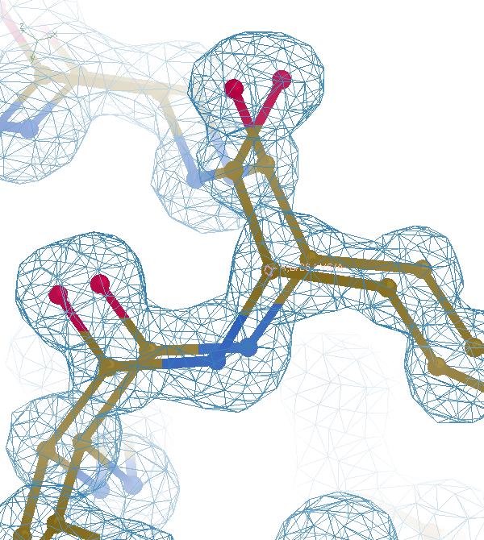

Slide 88
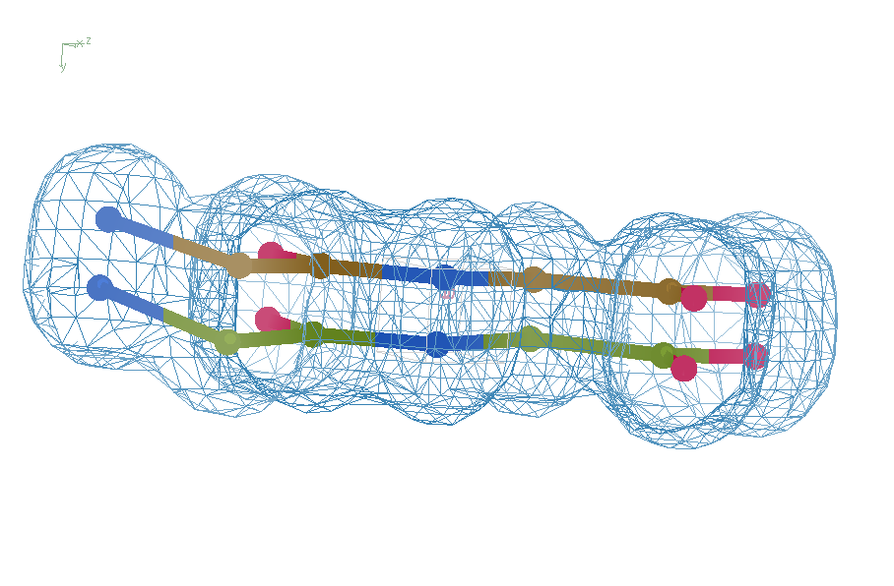
Right answer
R = 0.8%
rms bond = 0.0002

Slide 89
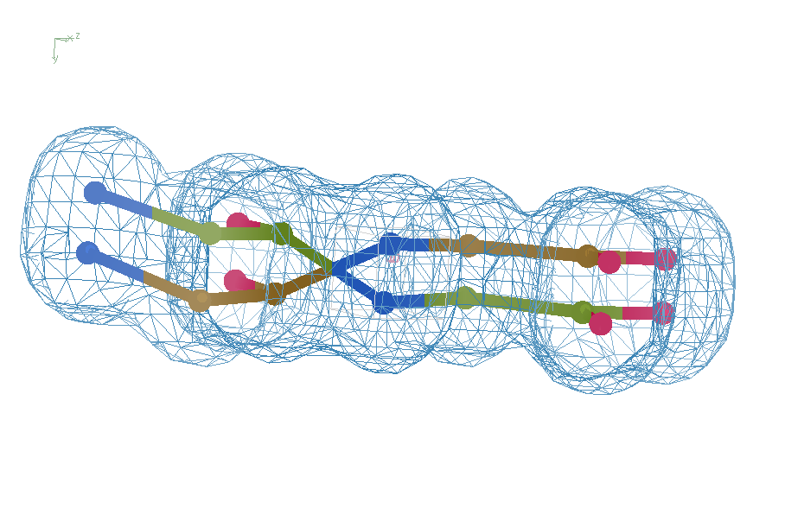
swap assignments
R = 0.8%
rms bond = 0.04

Slide 90
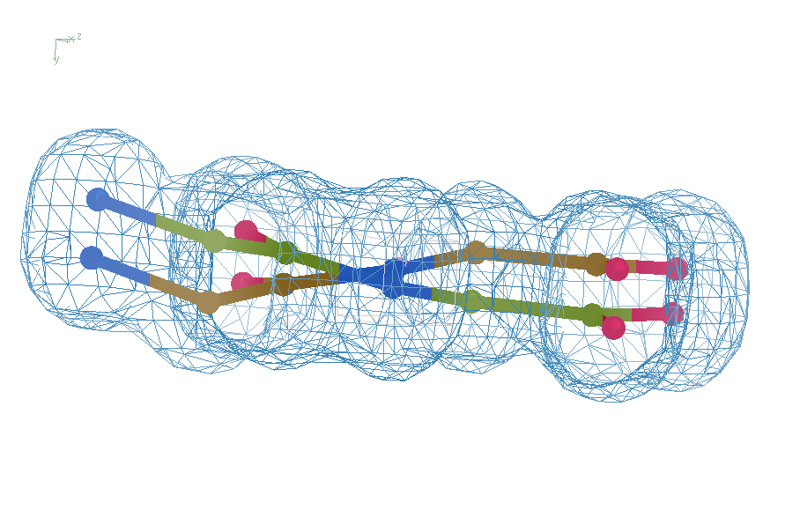
Refine – low x-ray weight
R = 14.3%
rms bond = 0.0002

Slide 91
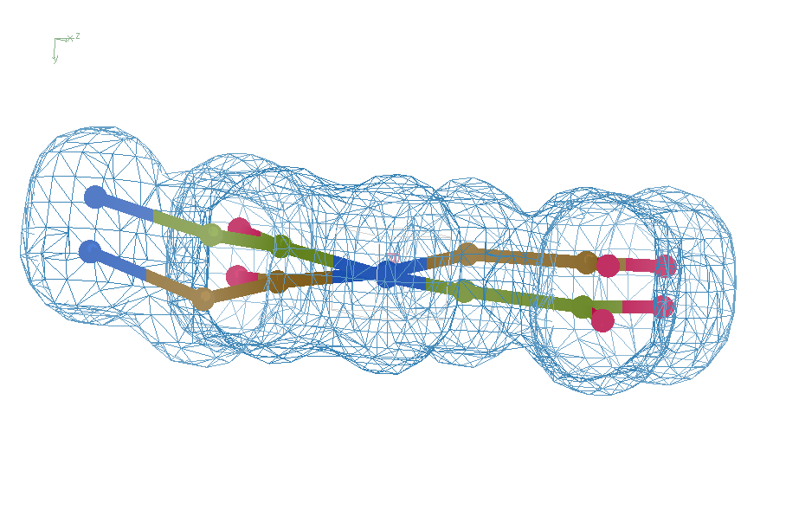
Refine – step 61
R = 6.8%
rms bond = 0.001

Slide 92
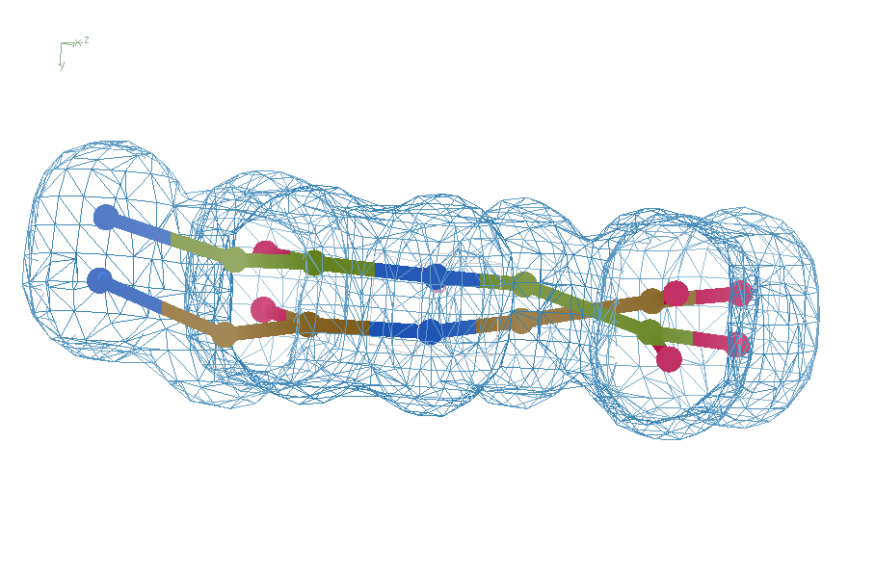
Refine – step 62
R = 5.7%
rms bond = 0.003

Slide 93
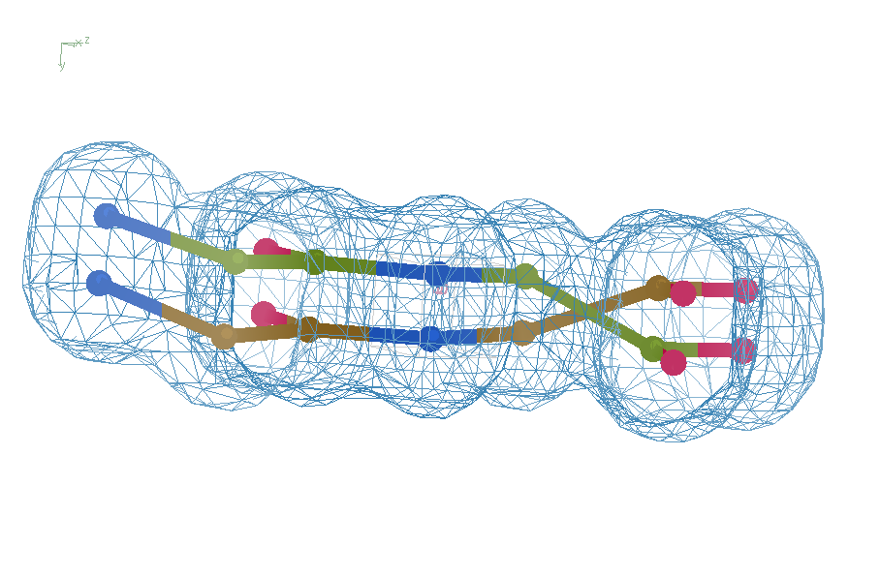
Refine – high x-ray weight
R = 1.2%
rms bond = 0.06

Slide 94
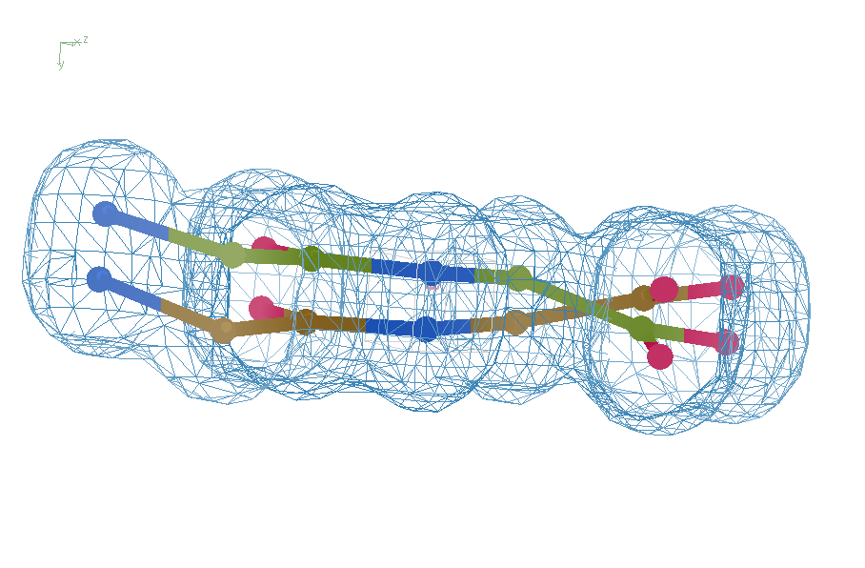
Final compromise
R = 7.07%
rms bond = 0.001

Slide 95
Right answer
R = 0.8%
rms bond = 0.0002

Slide 96
What if … ?
Exactly two conformations
50:50
Geometry/energy excellent
Solvent model-able
Can correct assignments be found?
If so, what would R_{free} be?
~4%

Slide 97
flipme.pdb
Refine
Score & Sort
control
Multiply together:
R_{work} Clashscore
VdW_Energy Cβ_{dev}
Worst & average Z-scores:
rama rotamer
sin(ω)
bonds angles planes
Chirals dihedrals
Flip_1
Flip_2
Flip_3 …
Flip_4 …

Slide 98
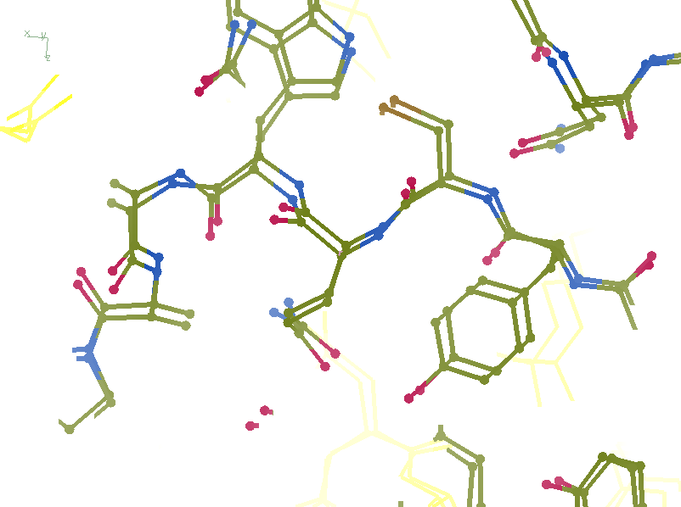
R_{work}: 0.1226
R_{free}: 0.1385
bond: 0.0319
Angle: 3.57
MoPro: 2.12
Clash: 6.52
Cβdev: 11
Rota: 2.78
Rama: 1.61

Slide 99
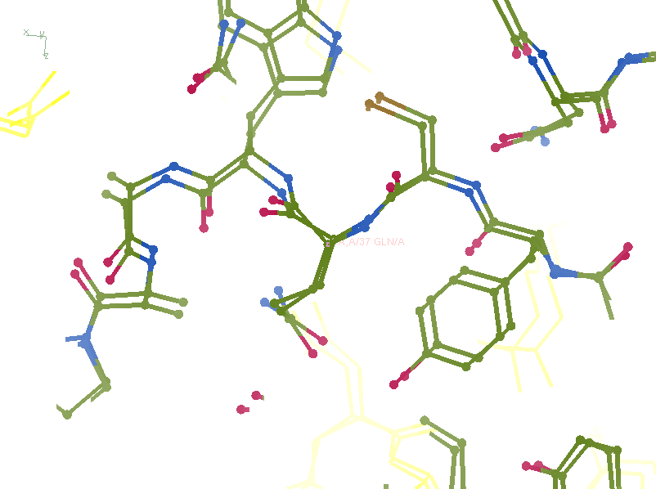
R_{work}: 0.1107
R_{free}: 0.1250
bond: 0.024
Angle: 4.11
MoPro: 0.89
Clash: 0.54
Cβdev: 1
Rota: 0.93
Rama: 0

Slide 100
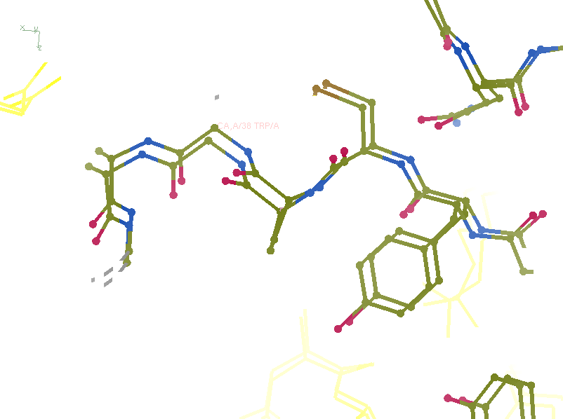
R_{work}: 0.0815
R_{free}: 0.0805
bond: 0.0101
Angle: 1.83
MoPro: 0.72
Clash: 0
Cβdev: 0
Rota: 0
Rama: 0

Slide 101
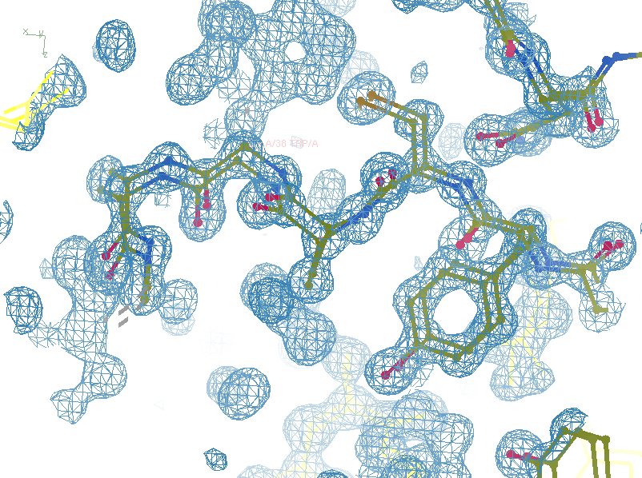
R_{work}: 0.0815
R_{free}: 0.0805
bond: 0.0101
Angle: 1.83
MoPro: 0.72
Clash: 0
Cβdev: 0
Rota: 0
Rama: 0

Slide 102
Take home:
Single-electron changes
are visible at 3.5 Å
(but only if R_{free} ~ 5%)

Slide 103
Summary
http://bl831.als.lbl.gov/~jamesh/powerpoint/
CBMS_WB_2022.pptx
“dose contrast” avoided with dose flattening
Two photons are better than two
Non-isomorphism is correctable (real space)
Solvent “touch up” doesn’t hurt
Ensemble tangling limits refinement
Hydrogens at 3.5 Å

