Slide 1
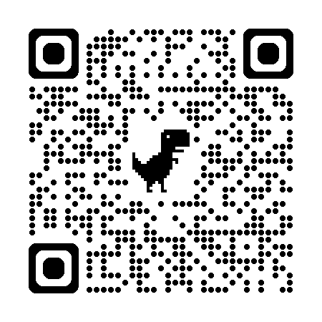
Acknowledgements
https://bl831.als.lbl.gov/~jamesh/powerpoint/Bio_GM_2025.pptx
James Fraser Nevan Krogan
Paul Adams John Tainer Greg Hura Nick Sauter
Pavel Afonine Tom Terwilliger Nigel Moriarty, Dorothee Liebschner Helen Ginn
Aina Cohen
UCSF LBNL SLAC
ALS 8.3.1: TomAlberTron
NIH NIGMS R01 GM124149 (Holton)
NIH NIAID P50 AI150476 (Krogan)
NIH NIGMS P30 GM124169 (Adams)
DOE-BER IDAT (Hura)
NIH NIGMS P30 GM133894 (Hodgson)
The Advanced Light Source is supported by the Director, Office of Science, Office of Basic Energy Sciences, Materials Sciences Division, of the US Department of Energy under contract No. DE-AC02-05CH11231 at Lawrence Berkeley National Laboratory.

Slide 2
https://bl831.als.lbl.gov/~jamesh/powerpoint/Bio_GM_2025.pptx
The last Å
between prediction and reality
Because: the future of crystallography has alternate conformations
Single-conf models
poor resolution
Low signal/noise
Phase Problem
Dynamics?
Mechanism?
Small signal?
Overlapping states?

Slide 3
The last Å: near, but far
ATOM 122 N LEU A 13 -3.244 25.808 19.998 1.00 16.96 N
ATOM 123 CA LEU A 13 -2.877 25.448 21.355 1.00 15.29 C
ATOM 124 C LEU A 13 -2.792 23.966 21.561 1.00 17.54 C
ATOM 125 O LEU A 13 -1.814 23.493 22.143 1.00 16.35 O
ATOM 126 CB LEU A 13 -3.907 26.164 22.268 1.00 18.72 C
ATOM 127 CG LEU A 13 -3.577 25.982 23.738 1.00 21.19 C
ATOM 128 CD1 LEU A 13 -2.283 26.820 24.019 1.00 19.43 C
ATOM 129 CD2 LEU A 13 -4.702 26.474 24.639 1.00 24.65 C
ATOM 130 N SER A 14 -3.677 23.149 20.979 1.00 15.96 N
ATOM 131 CA SER A 14 -3.646 21.711 21.061 1.00 18.26 C
ATOM 132 C SER A 14 -2.373 21.203 20.360 1.00 18.71 C
ATOM 133 O SER A 14 -1.747 20.315 20.930 1.00 17.47 O
ATOM 134 CB SER A 14 -4.875 21.077 20.419 1.00 17.62 C
ATOM 135 OG ASER A 14 -4.825 19.665 20.388 0.50 20.89 O
ATOM 136 OG BSER A 14 -6.027 21.408 21.164 0.50 18.67 O
ATOM 137 N LYS A 15 -2.045 21.772 19.215 1.00 18.03 N
ATOM 138 CA LYS A 15 -0.799 21.361 18.555 1.00 18.12 C
ATOM 139 C LYS A 15 0.446 21.707 19.351 1.00 18.81 C
ATOM 140 O LYS A 15 1.400 20.948 19.411 1.00 17.77 O
ATOM 141 CB LYS A 15 -0.700 22.034 17.177 1.00 14.49 C
ATOM 142 CG LYS A 15 -1.727 21.368 16.256 1.00 16.12 C
ATOM 143 CD LYS A 15 -1.663 22.147 14.936 1.00 19.40 C
ATOM 144 CE ALYS A 15 -2.725 21.614 13.986 0.50 17.42 C
ATOM 145 CE BLYS A 15 -1.750 21.211 13.750 0.50 17.01 C
ATOM 146 NZ ALYS A 15 -2.346 21.674 12.559 0.50 18.61 N
ATOM 147 NZ BLYS A 15 -3.052 20.513 13.741 0.50 18.76 N

Slide 4
The last Å: near, but far
ATOM 122 N LEU A 13 -3.000 26.000 20.000 1.00 16.96 N
ATOM 123 CA LEU A 13 -3.000 25.000 21.000 1.00 15.29 C
ATOM 124 C LEU A 13 -3.000 24.000 22.000 1.00 17.54 C
ATOM 125 O LEU A 13 -2.000 23.000 22.000 1.00 16.35 O
ATOM 126 CB LEU A 13 -4.000 26.000 22.000 1.00 18.72 C
ATOM 127 CG LEU A 13 -4.000 26.000 24.000 1.00 21.19 C
ATOM 128 CD1 LEU A 13 -2.000 27.000 24.000 1.00 19.43 C
ATOM 129 CD2 LEU A 13 -5.000 26.000 25.000 1.00 24.65 C
ATOM 130 N SER A 14 -4.000 23.000 21.000 1.00 15.96 N
ATOM 131 CA SER A 14 -4.000 22.000 21.000 1.00 18.26 C
ATOM 132 C SER A 14 -2.000 21.000 20.000 1.00 18.71 C
ATOM 133 O SER A 14 -2.000 20.000 21.000 1.00 17.47 O
ATOM 134 CB SER A 14 -5.000 21.000 20.000 1.00 17.62 C
ATOM 135 OG ASER A 14 -5.000 20.000 20.000 0.50 20.89 O
ATOM 136 OG BSER A 14 -6.000 21.000 21.000 0.50 18.67 O
ATOM 137 N LYS A 15 -2.000 22.000 19.000 1.00 18.03 N
ATOM 138 CA LYS A 15 -1.000 21.000 19.000 1.00 18.12 C
ATOM 139 C LYS A 15 0.000 22.000 19.000 1.00 18.81 C
ATOM 140 O LYS A 15 1.000 21.000 19.000 1.00 17.77 O
ATOM 141 CB LYS A 15 -1.000 22.000 17.000 1.00 14.49 C
ATOM 142 CG LYS A 15 -2.000 21.000 16.000 1.00 16.12 C
ATOM 143 CD LYS A 15 -2.000 22.000 15.000 1.00 19.40 C
ATOM 144 CE ALYS A 15 -3.000 22.000 14.000 0.50 17.42 C
ATOM 145 CE BLYS A 15 -2.000 21.000 14.000 0.50 17.01 C
ATOM 146 NZ ALYS A 15 -2.000 22.000 13.000 0.50 18.61 N
ATOM 147 NZ BLYS A 15 -3.000 21.000 14.000 0.50 18.76 N

Slide 5
R-factor Gap small vs macro molecules
Publication criterion for chemical crystallography:
Model-data difference < error in data
R1 < 2*R_{sigma}
R1 = F_{o} vs F_{c} for I/σ(I) > 3
R_{sigma} = <σ(I)>/<I>
There are no PDB entries that pass this test!
Holton et al. (2014) "The R-factor gap", FEBS J. 281, 4046-4060.

Slide 6
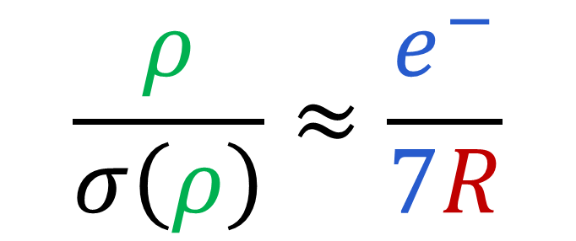
Map Noise: R factors matter via Parseval’s Theorem
$$\frac{ρ}{σ\left(ρ\right)}≈\frac{e^{−}}{7R}$$
e⁻ number of electrons in peak
7 number of electrons in typical atom
R R_{iso} or R_{free}
ρ electron density peak
σ rms deviation expected

Slide 7
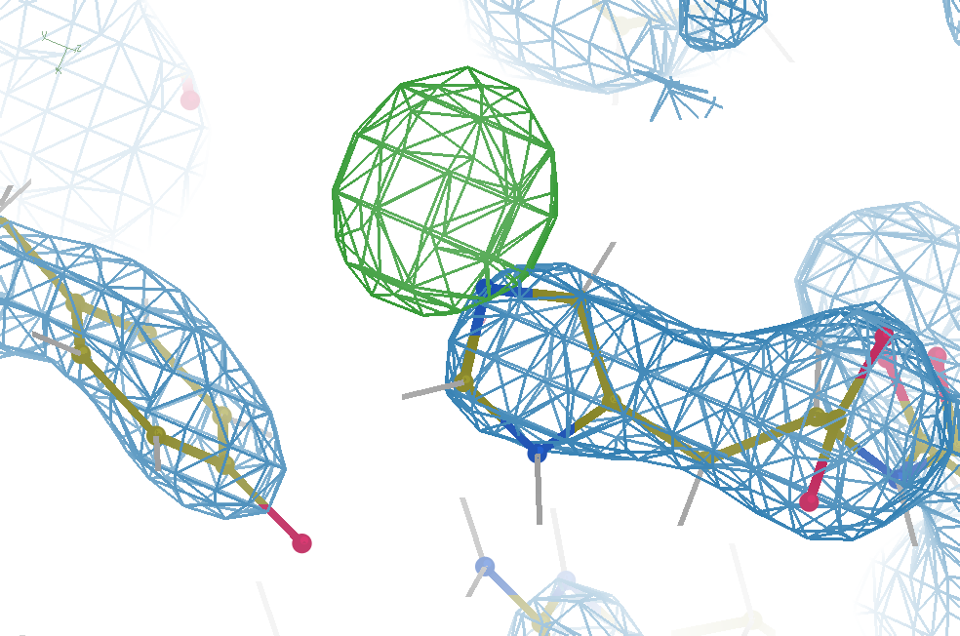
Hydrogen: visible at 3.5 Å resolution!
R_{work} = 0.04
R_{free} = 0.05
6σ = 1 e⁻
cut at 5 Å :
R_{free} = 0.01
Simulation:
Realistic noise
“perfect” model

Slide 8
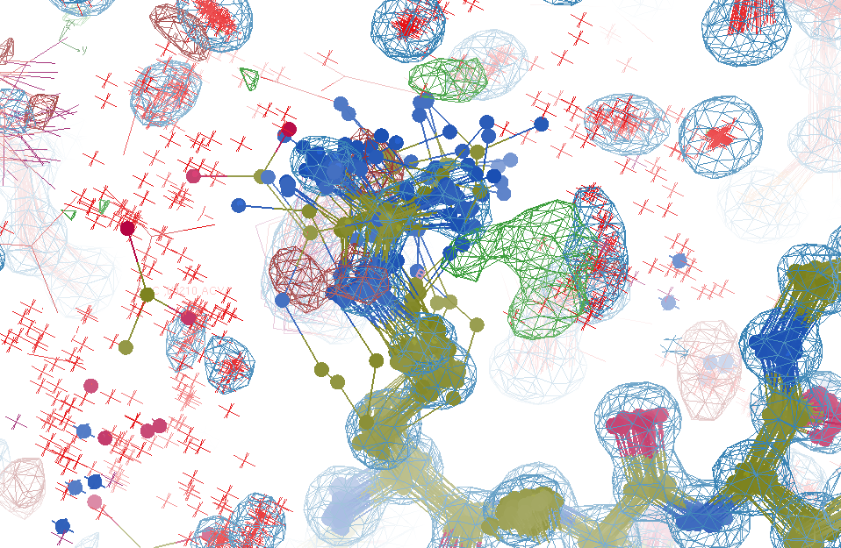
R_{work}: 0.0823
R_{free}: 0.1106
bond: 0.014 Å
angle: 1.92°
Real Data
1.2 σ
48-copy ensemble
3 params
per observation
MoPro: 1.15
Clash: 0.49
Cβdev: 20
Rota: 1.7%
Rama: 0.03%
reso: 1.0 Å
6σ

Slide 9
Over-Fitting data
Map density
position

Slide 10
Over-Fitting data
Map density
position

Slide 11
Over-Fitting data
Map density
position

Slide 12
Over-Fitting data
R_{work} ≈ 0
N_{params}= N_{obs}
Map density
position

Slide 13
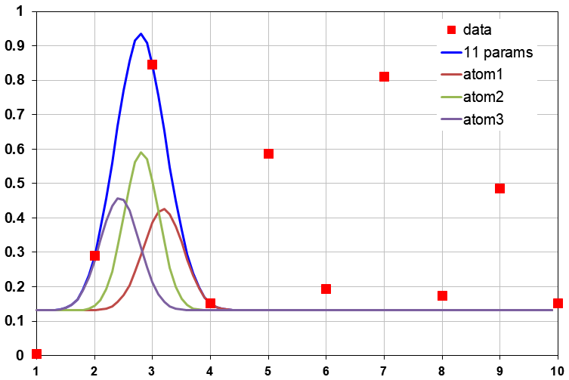
Under-Fitting data
R_{work} > 0
N_{params}> N_{obs}
Map density
position

Slide 14
R_{work}: 0.0823
R_{free}: 0.1106
bond: 0.014 Å
angle: 1.92°
under-fitting:
R_{work} > 0
MoPro: 1.15
Clash: 0.49
Cβdev: 20
Rota: 1.7%
Rama: 0.03%
reso: 1.0 Å
6σ

Slide 15
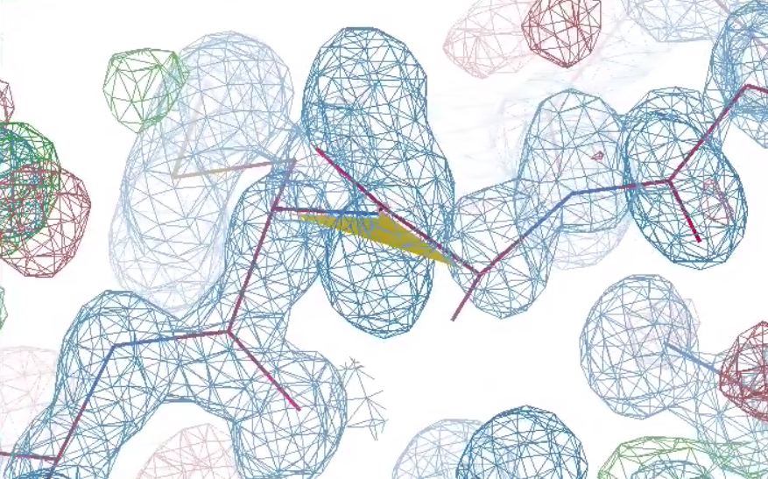
What is holding this back?
1 member of 48-copy
ensemble
R_{work}: 0.0823
R_{free}: 0.1106
bond: 0.014 Å
angle: 1.92°
MoPro: 1.15
Clash: 0.49
Cβdev: 20
Rota: 1.7%
Rama: 0.03%
reso: 1.0 Å
30°
peptide
bond twist

Slide 16
Why does ensemble refinement suck?
(3 parameters/observation and R_{work} still high!)
The chains are “tangled”

Slide 17
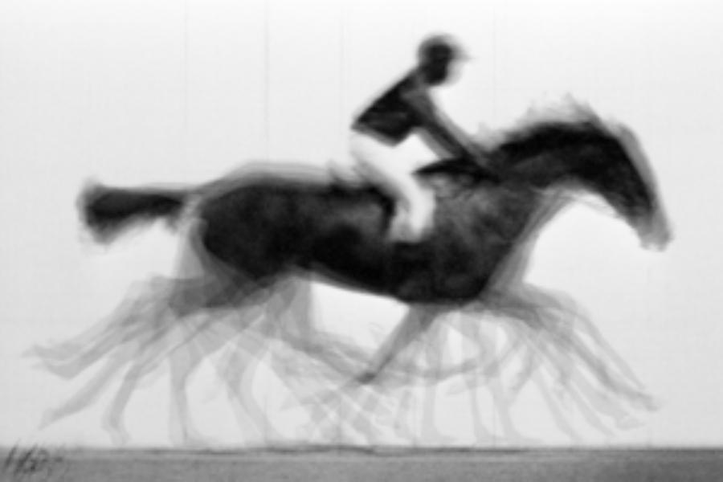
ensemble refine ???
A solution exists!
But ensemble refine
will fail to find it

Slide 18
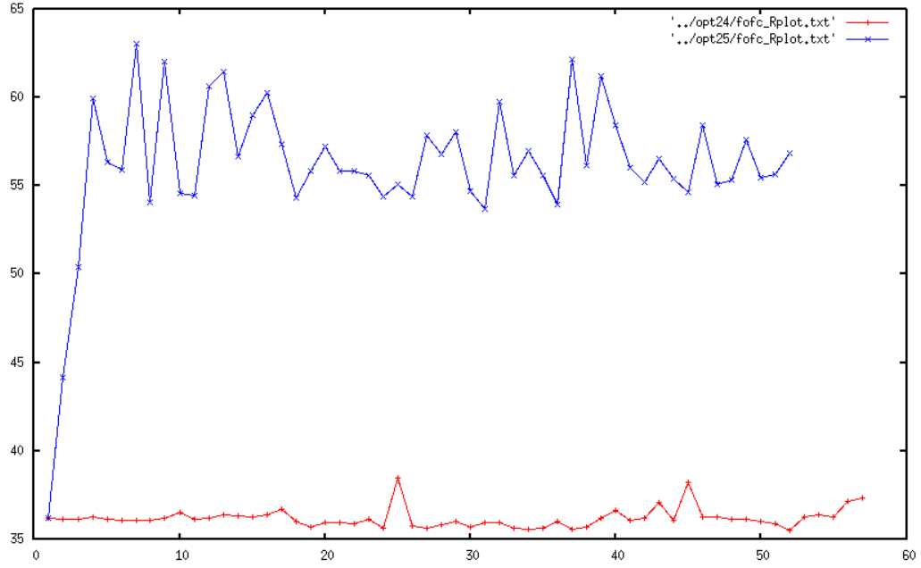
Molecular Dynamics of crystals
65
60
55
50
45
40
35
unrestrained
R_{free} (%)
restrained
Time (ns)

Slide 19
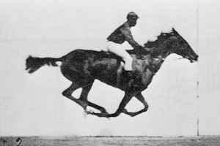

The UNTANGLE Challenge
best.pdb
refme.mtz
(simulated)
11) Build better than the best:
as-good or better wE, R_{free} as best.pdb
alternate interpretation ensemble
10) Recover best.pdb from refme.mtz
true phases, auto-building allowed
no cheating (don’t use best.pdb as guide)
Prove: true ensemble is
unique and recoverable
$1000
$500
https://github.com/jmholton/UnTangle

Slide 20
What do you mean, “tangled”?
Ground Truth
Local Minimum

Slide 21
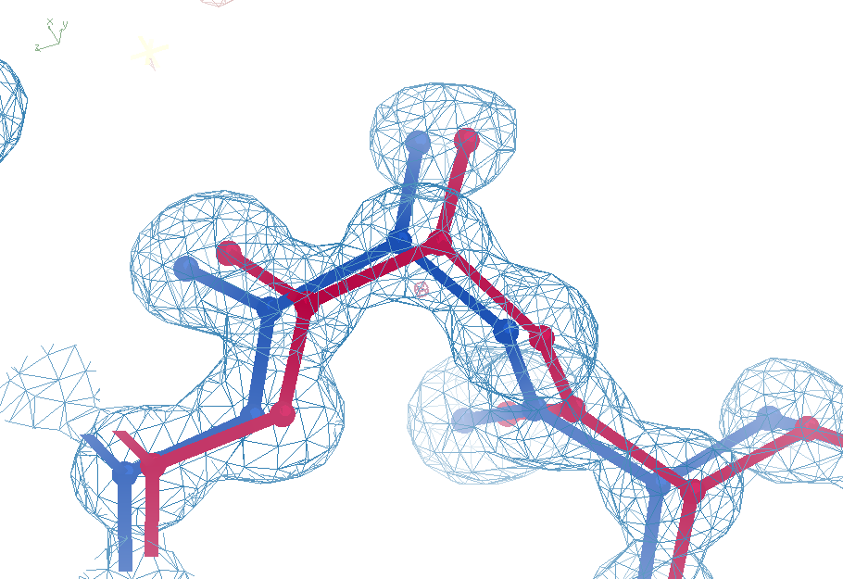
Sim challenge data
Ala39
-0.2σ
wE=18.2
N-C_{α}
bond
-0.3σ
0.8σ
angle
A B conformers

Slide 22
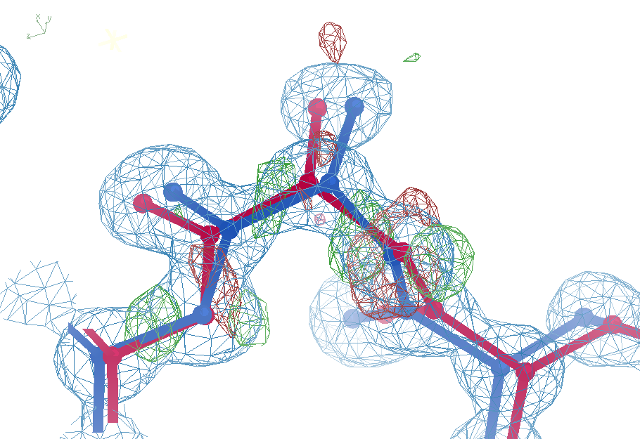

Sim challenge data: “otw39”
Ala39
+11σ
wE=63.5
N-C_{α}
bond
-9σ
It’s a TRAP!
5σ
angle
A B conformers

Slide 23
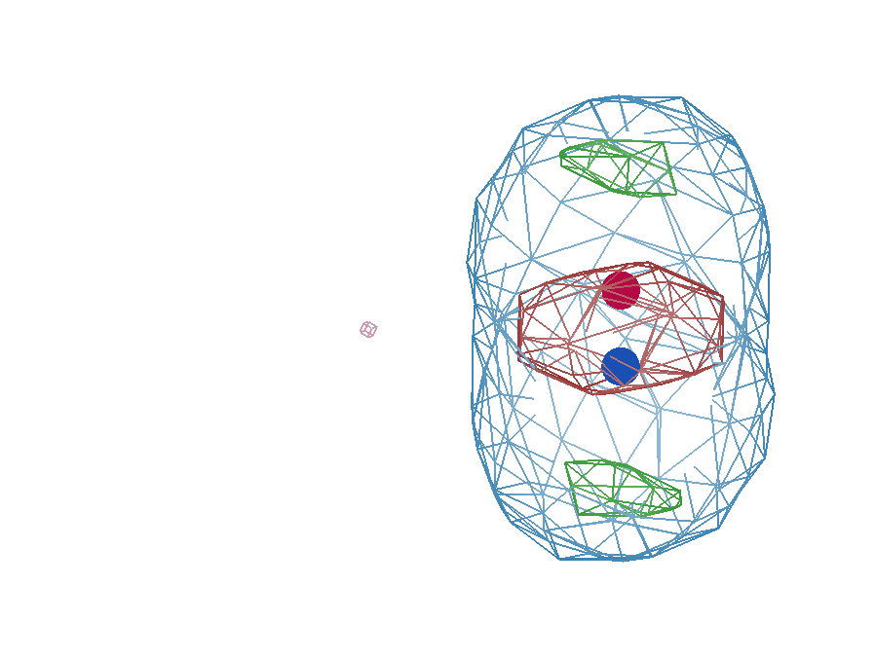
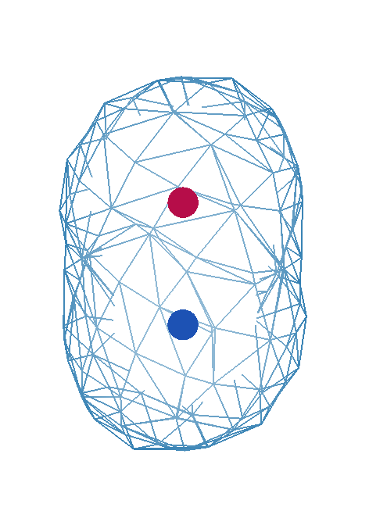
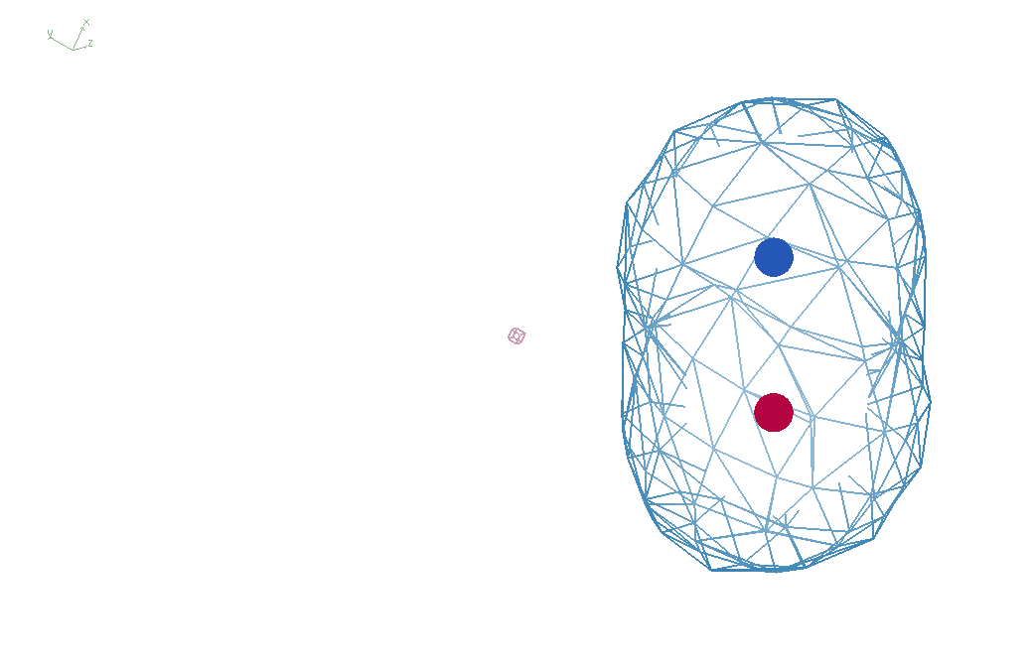
It takes two to tangle
density
fit
Chemical
strain
energy
A
A
B
B
B
A
tangled
barrier
untangled

Slide 24
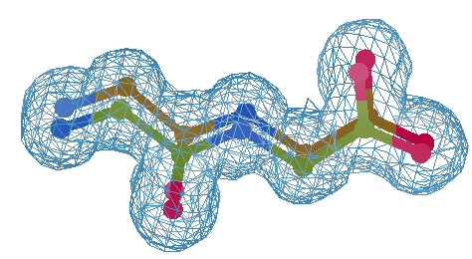
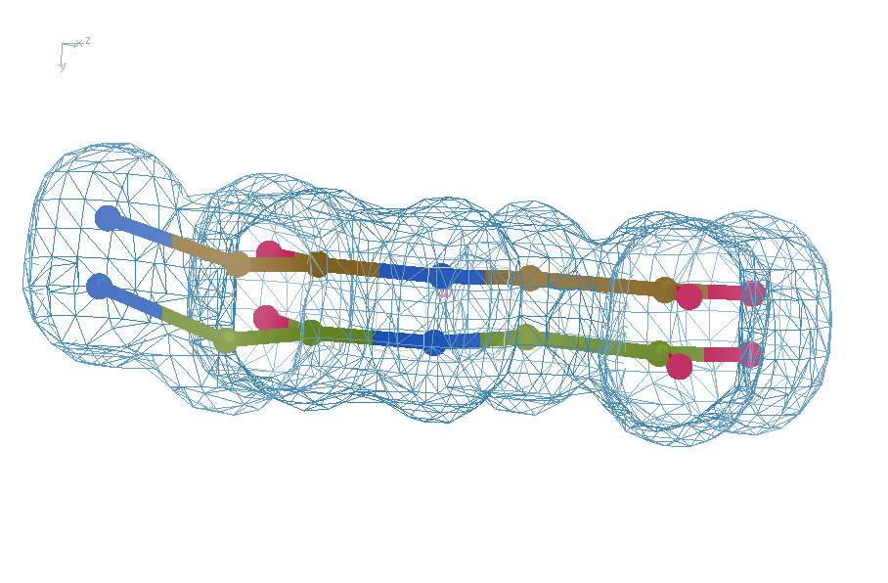
Refine from right answer
R = 0.8%
rms bond = 0.0002

Slide 25
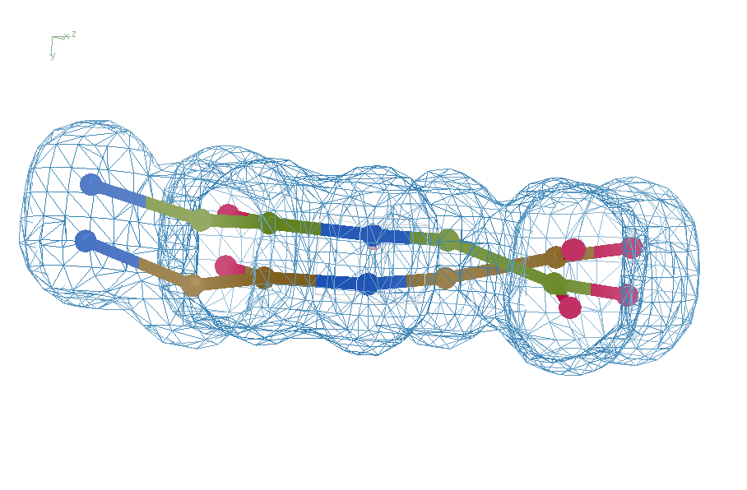
Refine from wrong starting point
R = 7.07%
rms bond = 0.001

Slide 26
UNTANGLE: sim-data Ground Truth
As simple as possible:
  2 conformers
  50:50 occupancy
Accessible
  64 residues
  78 waters
Every chance of success
  1.0 Å reso
  “one thing wrong”
  flat bulk solvent
  no false outliers
  phenix, refmac, shelxl
  clear score
  Experimental error only
  perfect phases

Slide 27
verified Score sheet
wE | R_{work} | R_{free} | method
185 | 20.6 | 21.4 | Alphafold2
109.6 | 8.87 | 9.44 | Phenix.ensemble_refine
97.3 | 8.84 | 9.27 | qFit best
91.7 | 3.64 | 4.27 | manual
80.5 | 4.31 | 4.75 | lotswrong
65.2 | 6.35 | 6.93 | Amber24
54.6 | 5.87 | 6.57 | single conf w aniso B
33.5 | 2.94 | 3.32 | One thing wrong: Ala39
23.5 | 2.95 | 3.31 | One thing wrong: Val1
21.4 | 3.12 | 3.48 | Rectified Simulated annealing
18.1 | 17.9 | 18.4 | Phenix autobuild
18.2 | 2.79 | 3.14 | best (ground truth)

Slide 28
verified Score sheet
wE | R_{work} | R_{free} | method
185 | 20.6 | 21.4 | Alphafold2
109.6 | 8.87 | 9.44 | Phenix.ensemble_refine
97.3 | 8.84 | 9.27 | qFit best
91.7 | 3.64 | 4.27 | manual
80.5 | 4.31 | 4.75 | lotswrong
65.2 | 6.35 | 6.93 | Amber24
54.6 | 5.87 | 6.57 | single conf w aniso B
33.5 | 2.94 | 3.32 | One thing wrong: Ala39
23.5 | 2.95 | 3.31 | One thing wrong: Val1
21.4 | 3.12 | 3.48 | Rectified Simulated Annealing
18.1 | 17.9 | 18.4 | Phenix autobuild
18.2 | 2.79 | 3.14 | best (ground truth)

Slide 29
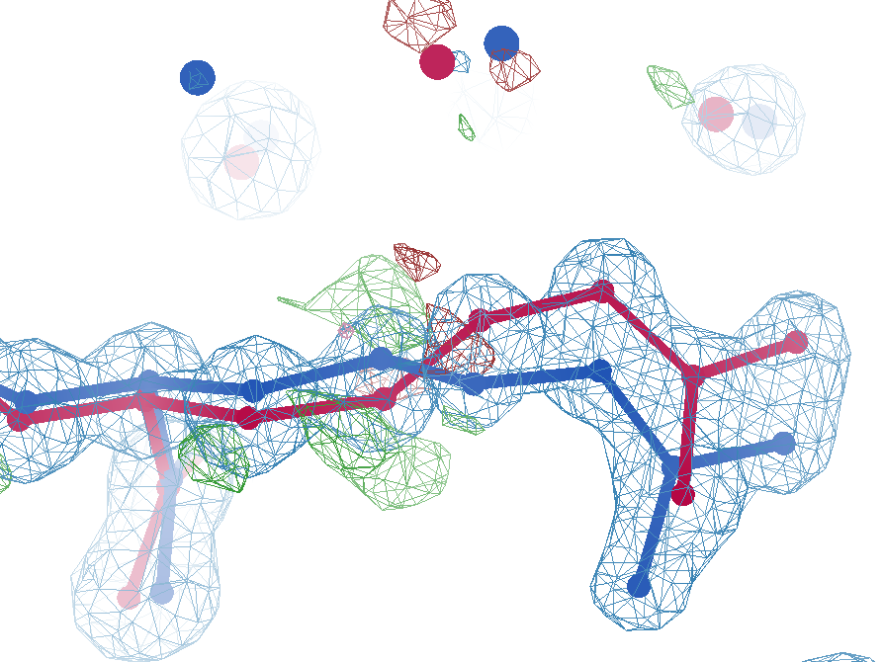
sim data
Arg62
wE=63.5
2.8 Å
4σ
C_{γ}-C_{δ}
bond
2.7σ torsion
A B conformers

Slide 30
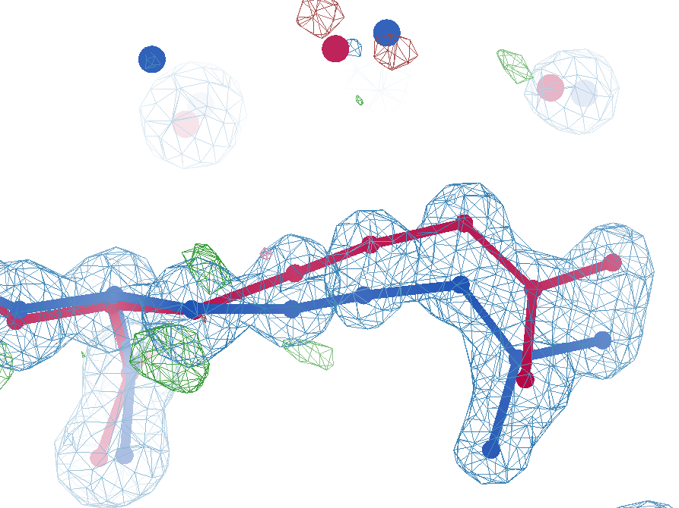
sim data
Arg62
wE=50.7
2.8 Å
2σ
angle
A B conformers

Slide 31
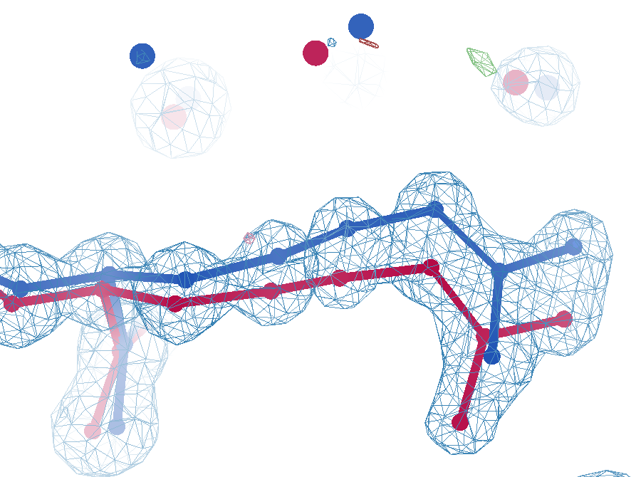
sim data
Arg62
wE=18.2
3.0 Å
0.3σ
C_{γ}-C_{δ}
bond
1σ
angle
1.6σ torsion
A B conformers

Slide 32
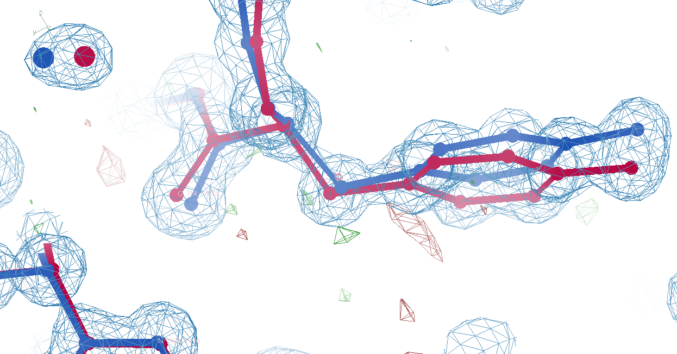
Tyr14
sim data
wE=33.1
3.0 Å
A B conformers

Slide 33
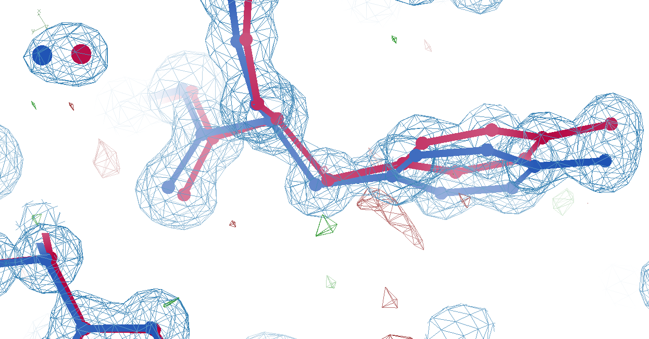
Tyr14
sim data
wE=18.2
3.2 Å
A B conformers

Slide 34
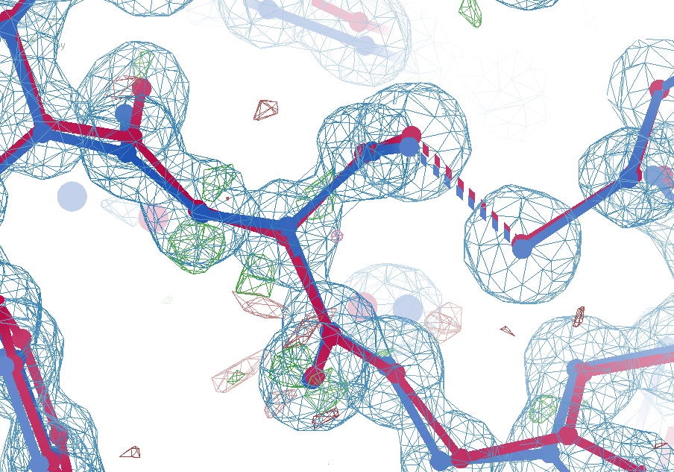
Cys16
sim data
wE=21.4
2.7σ
angle
A B conformers

Slide 35
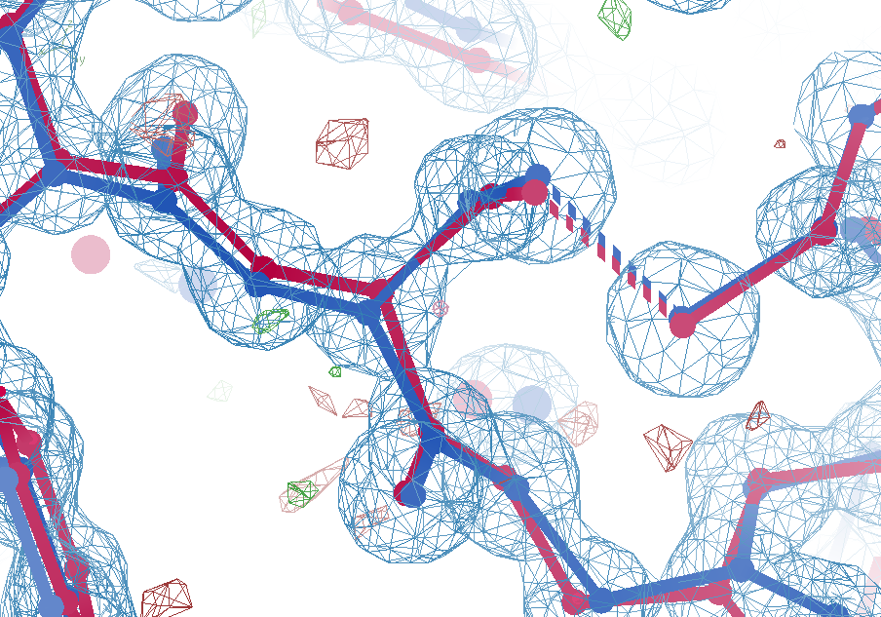
Cys16
sim data
wE=18.2
1.5σ
angle
A B conformers

Slide 36
wE score: key concepts
sqrt()
erf()
Energy ↔ dev/sigma ↔ Probability
Probability outlier is not noise
  “clip” energy to tolerate real outliers
  Not so sharp transition to outlier
Tighter Non-bond (Lennard-Jones)

Slide 37
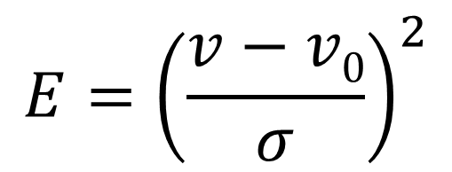
Statistical Potential
$$E={\left(\frac{v−v0}{σ}\right)}^{2}$$
E “energy”
v model value
v₀ ideal value
σ rms deviation expected
1 x 6σ ← 40x 1σ
1 x 6σ ≈ 36x 1σ
Outlier problem:
solution: weight by
“probability its not noise”

Slide 38
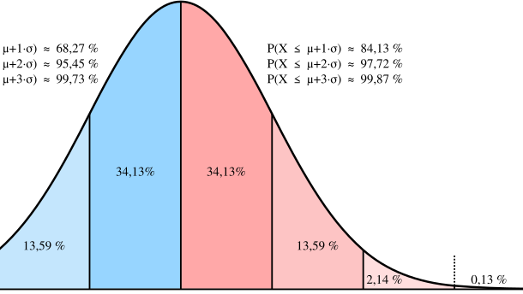
Probability that it’s not noise
erf()
←68%→
← 95% →
-1σ 0 1σ 2σ 3σ

Slide 39
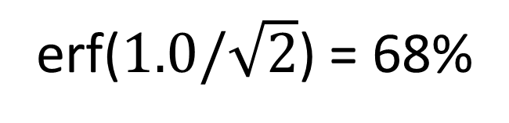
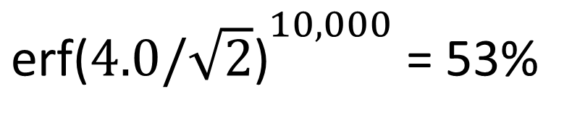
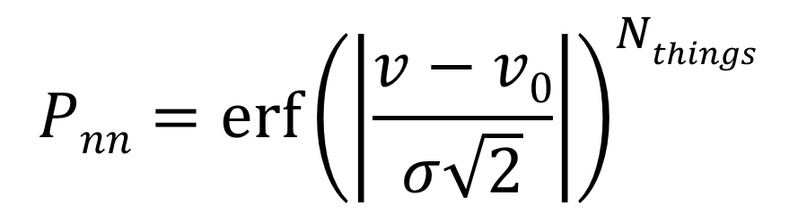
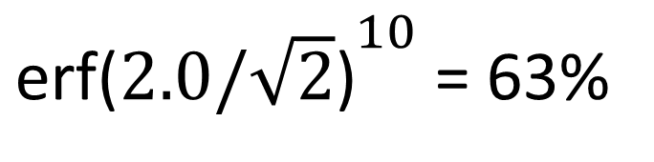
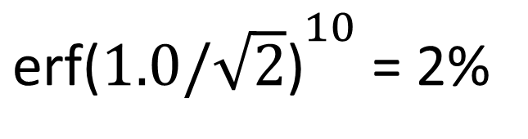
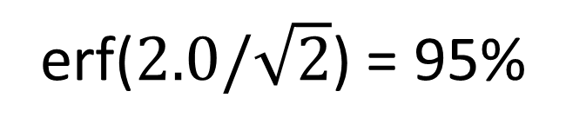
Probability that it’s not noise
$$Pnn={\operatorname{erf}\left(\left|\frac{v−v0}{σ\sqrt{2}}\right|\right)}^{Nthings}$$
P_{nn} probability
v-v₀ deviation from ideal
σ rms deviation expected
erf() integral of a Gaussian
N_{things} number of trials
erf($1.0/\sqrt{2}$) = 68%
${\text{erf}\text{(}1.0/\sqrt{2}\text{)}}^{10}$ = 2%
erf($2.0/\sqrt{2}$) = 95%
${\text{erf}\text{(}2.0/\sqrt{2}\text{)}}^{10}$ = 63%
${\text{erf}\text{(}4.0/\sqrt{2}\text{)}}^{10,000}$ = 53%

Slide 40
New Untangling Ideas!
Variable Labels - Tronrud
ROPE - Ginn
phenix.create_alt_conf - Terwilliger
Rectified Simulated Annealing
Bespoke harmonic restraints in MD

Slide 41
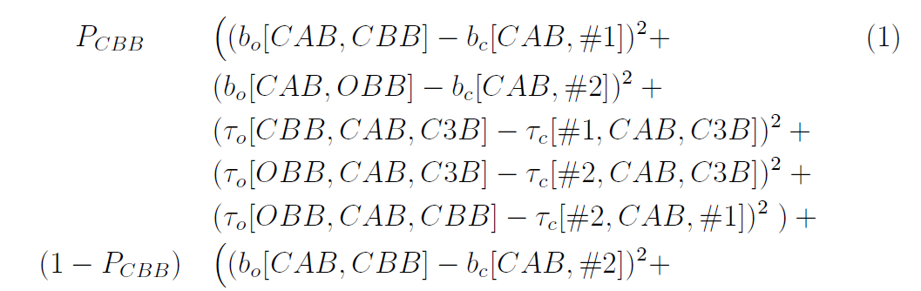
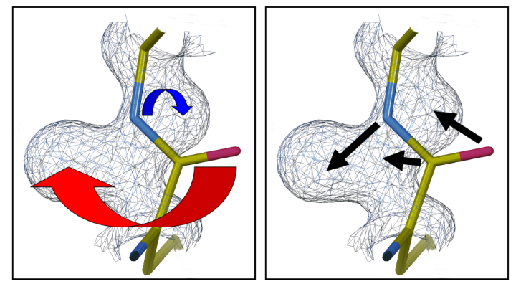
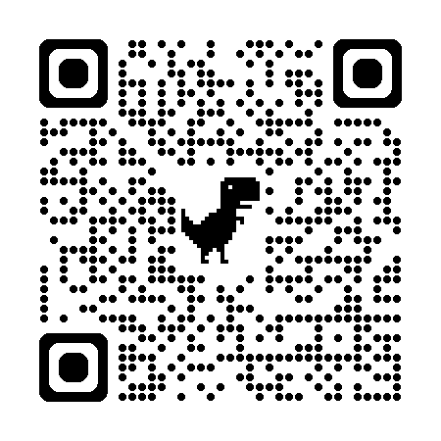
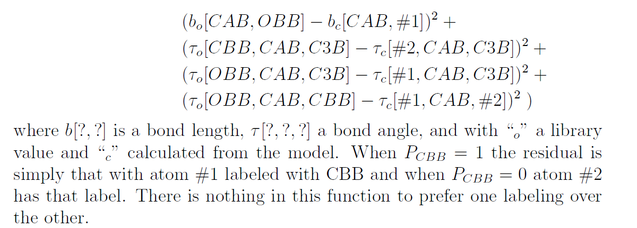
Tronrud’s
“Variable Labels” proposal
New ideas!
unimplemented

Slide 42
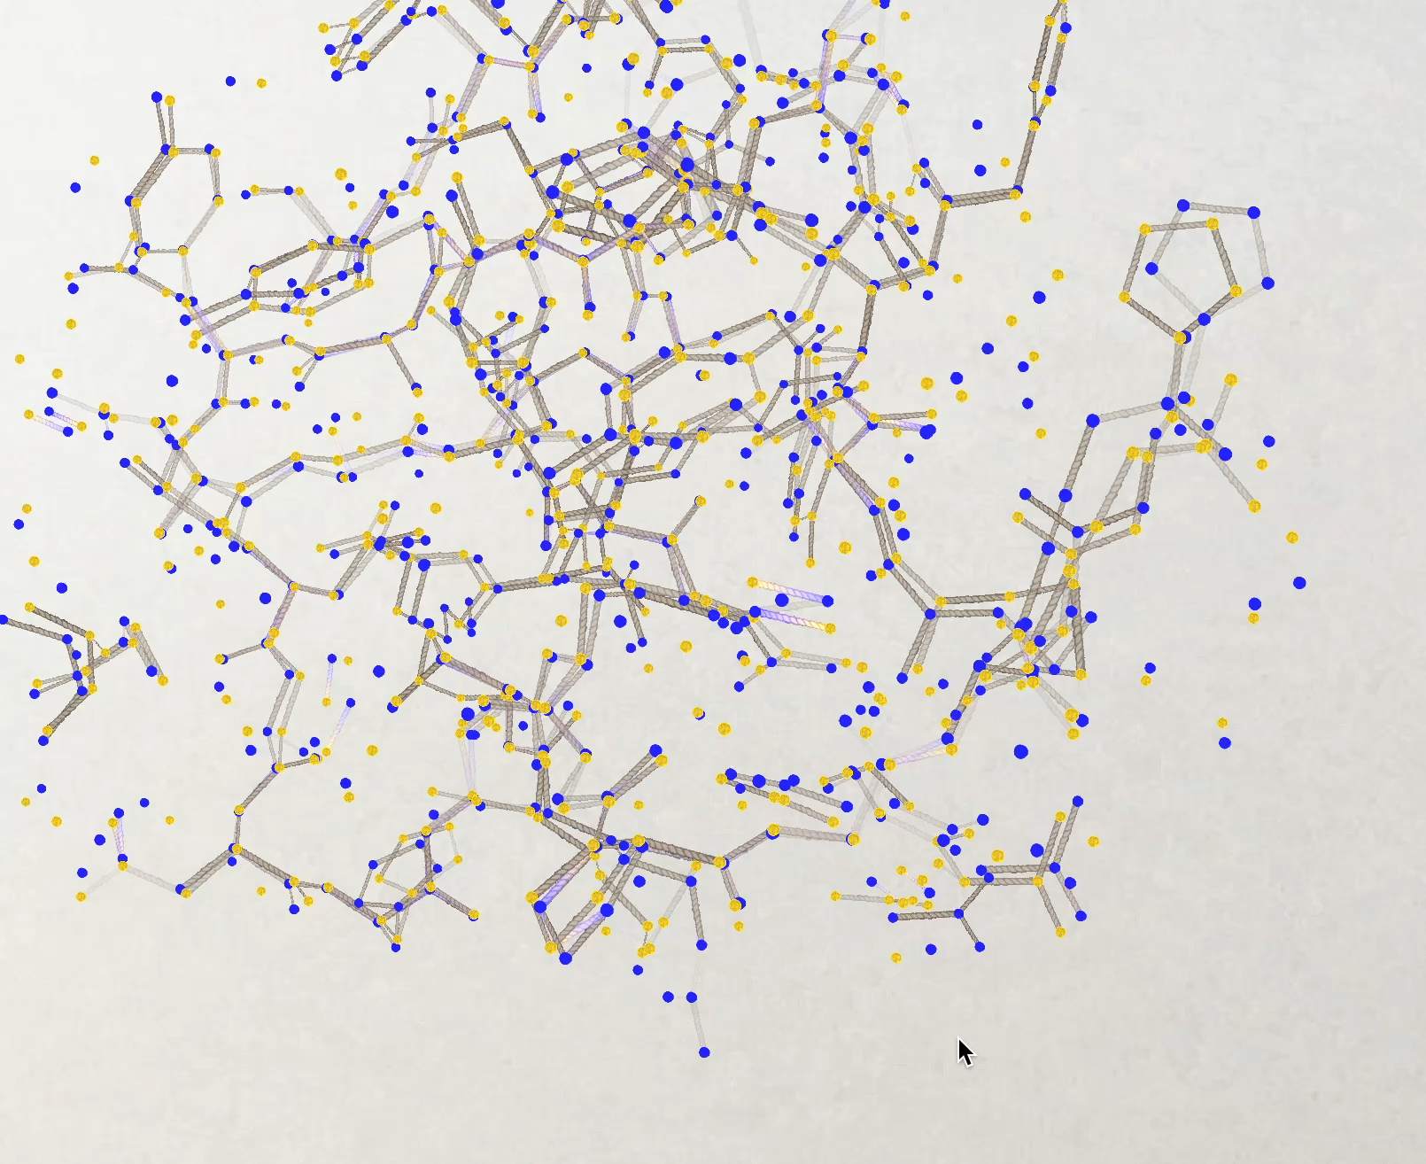
New tools!
Helen Ginn ROPE-based program
GUI showing both conformers A and B and bonds drawn between them according to the following rules:
good geometry, for
or
bad geometry, for
or
good geometry, for
or
bad geometry, for
or
Conformer A
Best
wE = 39
Conformer B
This indicates the bottom atom conformers need untangling. Clicking on the atoms flips the conformers over right to the end of the chain.

Slide 43
GUI showing both conformers A and B and bonds drawn between them according to the following rules:
good geometry, for
or
bad geometry, for
or
good geometry, for
or
bad geometry, for
or
Conformer A
Conformer B
This indicates the bottom atom conformers need untangling. Clicking on the atoms flips the conformers over right to the end of the chain.

Slide 44
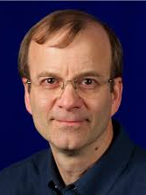
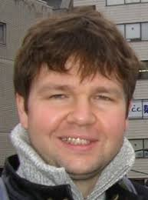
New Tools!
Tom
Terwilliger
phenix.holton_geometry_validation test.pdb
phenix.create_alt_conf phenix_autobuild.pdb refme.mtz \
nproc=48
phenix.refine \
model.pdb refme.mtz \
main.number_of_mac=10 \
fit_altlocs_method=masking \
ordered_solvent=true \
include_altlocs=true \
ordered_solvent.mode=every_macro_cycle_after_first \
refine_oat=true
Pavel Afonine

Slide 45
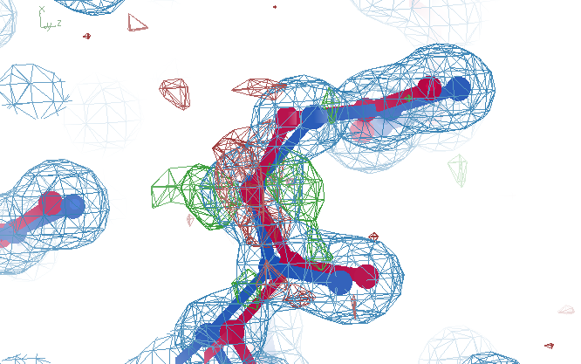
Better than the best?
Ala39
wE=17.2
A B conformers

Slide 46
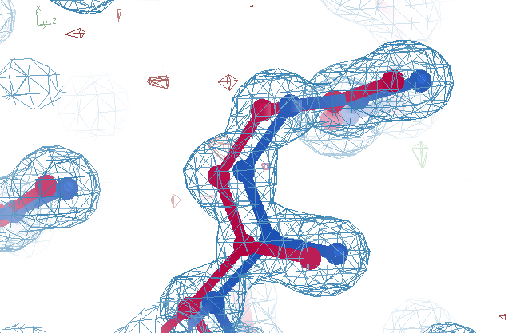
best?
Ala39
wE=18.2
A B conformers

Slide 47
verified Score sheet
wE | R_{work} | R_{free} | method
185 | 20.6 | 21.4 | Alphafold2
109.6 | 8.87 | 9.44 | Phenix.ensemble_refine
97.3 | 8.84 | 9.27 | qFit best
91.7 | 3.64 | 4.27 | manual
80.5 | 4.31 | 4.75 | lotswrong
65.2 | 6.35 | 6.93 | Amber24
54.6 | 5.87 | 6.57 | single conf w aniso B
33.5 | 2.94 | 3.32 | One thing wrong: Ala39
23.5 | 2.95 | 3.31 | One thing wrong: Val1
21.4 | 3.12 | 3.48 | Rectified Simulated Annealing
18.1 | 17.9 | 18.4 | Phenix autobuild
18.2 | 2.79 | 3.14 | best (ground truth)

Slide 48
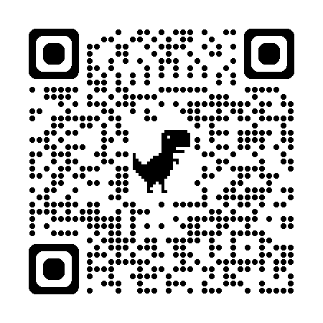
“rectified” Simulated Annealing
Default simulated annealing in phenix
Run score on result
Run score on starting model
Probe difference map
Atom by atom: is worse? Move it back
Iterate
Parallel seeds and temperatures
https://github.com/jmholton/rectified_simulated_annealing

Slide 49
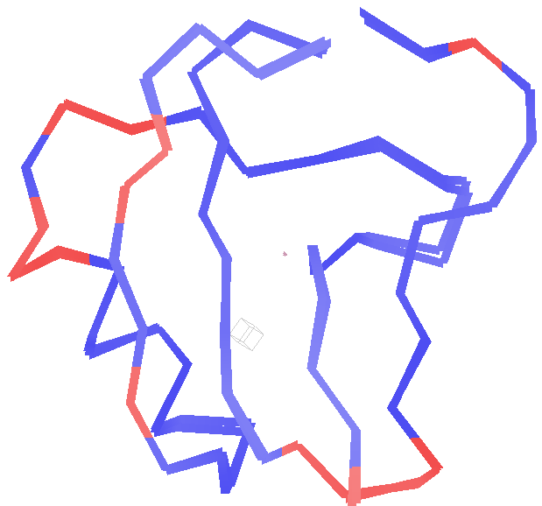
Long-range traps from rectified SA
wE=21.4
Match ground-truth
swapped relative
To ground truth

Slide 50
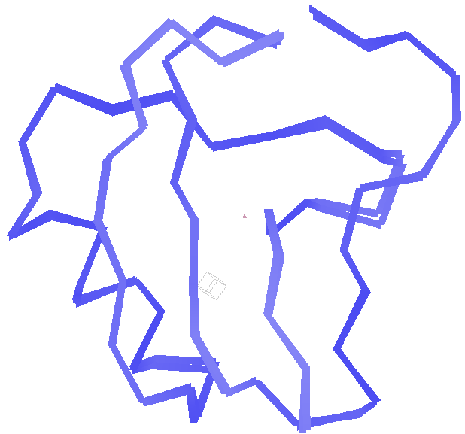
best.pdb
wE=18.2
Match ground-truth
Nothing
swapped relative
To ground truth

Slide 51
verified Score sheet
wE | R_{work} | R_{free} | method
185 | 20.6 | 21.4 | Alphafold2
109.6 | 8.87 | 9.44 | Phenix.ensemble_refine
97.3 | 8.84 | 9.27 | qFit best
91.7 | 3.64 | 4.27 | manual
80.5 | 4.31 | 4.75 | lotswrong
65.2 | 6.35 | 6.93 | Amber24
54.6 | 5.87 | 6.57 | single conf w aniso B
33.5 | 2.94 | 3.32 | One thing wrong: Ala39
23.5 | 2.95 | 3.31 | One thing wrong: Val1
21.4 | 3.12 | 3.48 | Rectified Simulated Annealing
18.1 | 17.9 | 18.4 | Phenix autobuild
18.2 | 2.79 | 3.14 | best (ground truth)

Slide 52
Molecular Dynamics of crystals
65
60
55
50
45
40
35
unrestrained
R_{free} (%)
restrained
Time (ns)

Slide 53
“bespoke” harmonic restraints in MD
A
A
or
B
B
Stays tangled
agnostic

Slide 54
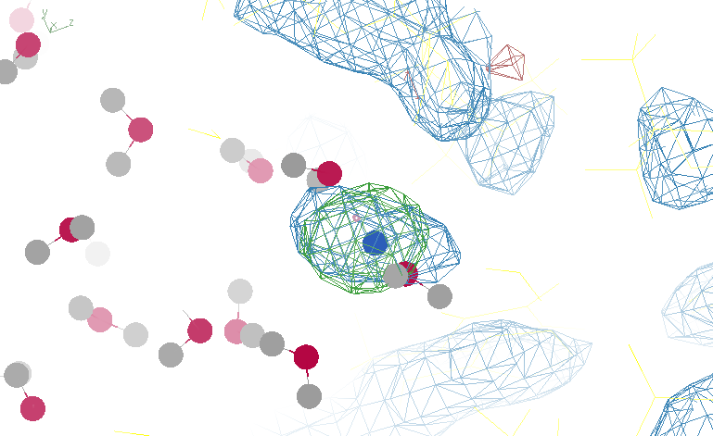
Reference point with too-low weight

Slide 55
Real Data
1.2 σ
6σ

Slide 56
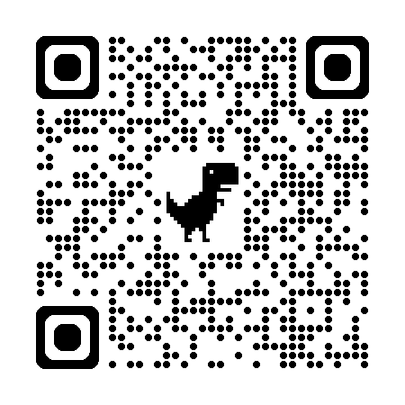
“bespoke” harmonic restraints in MD
Reference points at density centroids
Random alt-loc assignment (at first)
Harmonic weight = e- density
0.5 ns run – average ASU density
F_{obs}-F_{calc} difference map
update weights (green=more ; red=less)
Re-discover nearest reference points
Release very bad restraints: grow back?
Reduce all weights by ~1%
iterate
https://github.com/jmholton/bespoke_amber_restraints

Slide 57
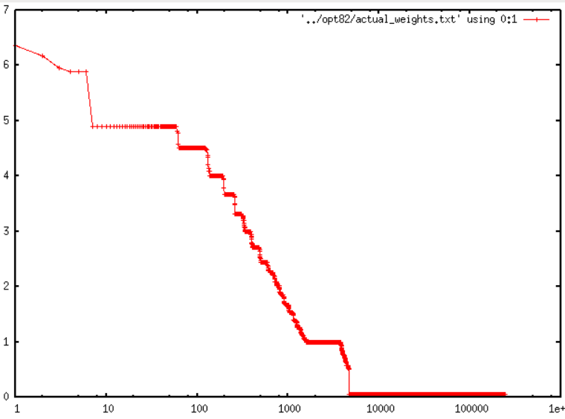
Less than 2% of atoms need restraints
7
6
5
4
3
2
1
0
R_{free} = 27%
no X-ray term!
?
Restraint weight (kcal/Å²)
1.8%
1 10 100 1000 10000 1e5 1e6
Sorted atom count

Slide 58
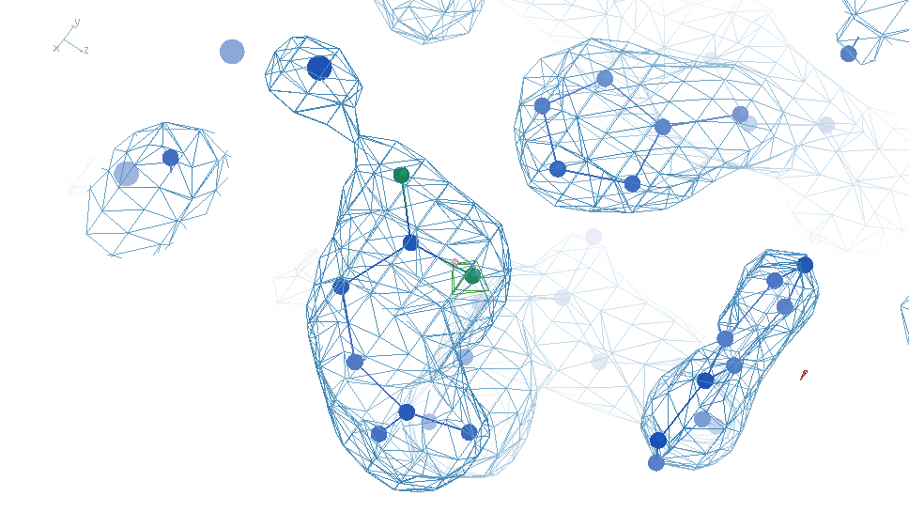
Most-challenged restraint

Slide 59
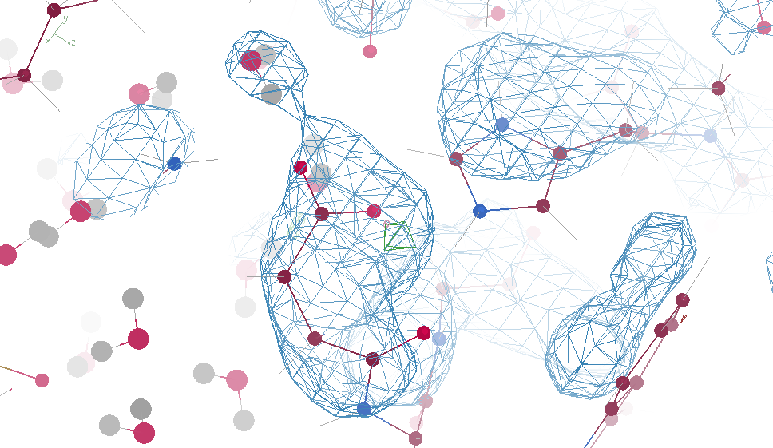
“flying” MD snapshot

Slide 60
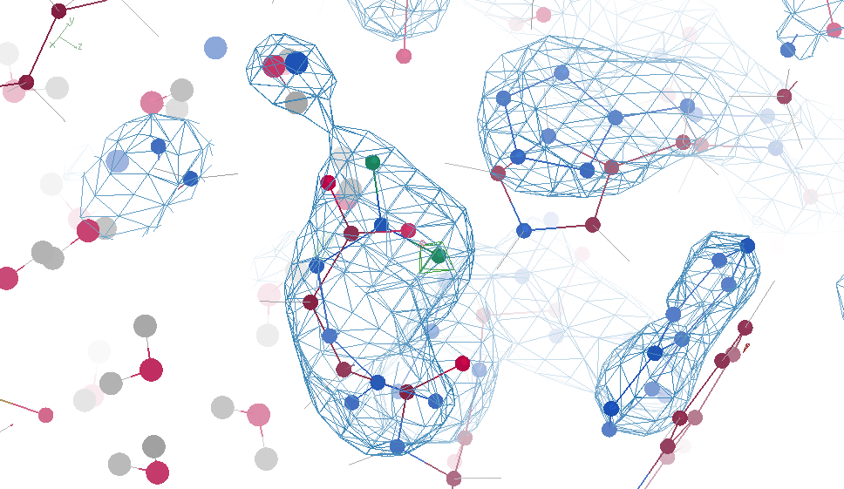

Slide 61

Solved, but weird, problem!
Vacuum bubbles at 10k atm
Bespoke restraints
No restraints

Slide 62

Restraints lead to “sloshing”
sparse restraints
without alignment
No restraints

Slide 63
Future improvements
https://bl831.als.lbl.gov/~jamesh/powerpoint/Bio_GM_2025.pptx
All-outlier score (not just worst)
Density score (not just R_{free})
Sigma(I) generation
More realistic ground truth
Bespoke MD restraint tool kit
Tronrud’s Variable Labels

Slide 64
Summary
https://bl831.als.lbl.gov/~jamesh/powerpoint/Bio_GM_2025.pptx
Rfree < 3% → single e⁻
  Not over-fitting
Main barrier: tangled ensemble
Weighted E scoring function
  Probability its not noise
  some outliers are real
Recover underlying ensemble
  Might be required!
Cooperative motions
$1000
$500

Slide 65
verified Score sheet
wE | R_{work} | R_{free} | method
185 | 20.6 | 21.4 | Alphafold2
109.6 | 8.87 | 9.44 | Phenix.ensemble_refine
97.3 | 8.84 | 9.27 | qFit best
91.7 | 3.64 | 4.27 | manual
80.5 | 4.31 | 4.75 | lotswrong
65.2 | 6.35 | 6.93 | Amber24
54.6 | 5.87 | 6.57 | single conf w aniso B
33.5 | 2.94 | 3.32 | One thing wrong: Ala39
23.5 | 2.95 | 3.31 | One thing wrong: Val1
21.4 | 3.12 | 3.48 | Rectified Simulated Annealing
18.1 | 17.9 | 18.4 | Phenix autobuild
18.2 | 2.79 | 3.14 | best (ground truth)

Slide 66
wE score: key concepts
sqrt()
erf()
Energy ↔ dev/sigma ↔ Probability
Probability outlier is not noise
  “clip” energy to tolerate real outliers
  Not so sharp transition to outlier
Tighter Non-bond (Lennard-Jones)

Slide 67


“clip” for tolerating true outliers
clip(E) $=\left\{\begin{matrix}E, if E<10 \\ 10+\log\left(E\right)−log⁡(10)\end{matrix}\right.$
Statistical Energy
$$E={\left(\frac{v−v0}{σ}\right)}^{2}$$
10
wE
Colloquially:
OK! OK! Its an outlier! Let’s not agonize about it
N=10
5
N=10,000
10σ vs 10.1σ not more important
than 3.3σ vs 3.0σ
0
3
6
8
max sigma deviate

Slide 68

Glu32
Genuine outlier
in ground truth
real data
-80°
Torsion outlier

Slide 69

Cys12
Genuine outlier
in ground truth
real data
-107°
torsion outlier
A B conformers

Slide 70
wE score: key concepts
sqrt()
erf()
Energy ↔ dev/sigma ↔ Probability
Probability outlier is not noise
  “clip” energy to tolerate real outliers
  Not so sharp transition to outlier
Tighter Non-bond (Lennard-Jones)

Slide 71


Probability that it’s not noise softer
$${Pnn}^{soft}=1−2^{\left({\left(\frac{\left|v−v0\right|}{σ_{P50}}\right)}^{5}\right)}$$
1
P_{nn} probability
v-v₀ deviation from ideal
σ rms deviation expected
inverf() inverse erf()
N_{things} number of trials
P
N=1
0.5
N=1 soft
$$σ_{P50}=$$
$$\sqrt{2} \text{inverf}\left({0.5}^{1/{N_{things}}}\right)$$
N=10,000
soft
N=10,000
0
1
2
3
4
5
6
max sigma deviate

Slide 72

Probability that it’s not noise average/sum of N_{things}
χ² test
N_{things}
Probability
That its
Gaussian
tie breaker

Slide 73
wE score: key concepts
sqrt()
erf()
Energy ↔ dev/sigma ↔ Probability
Probability outlier is not noise
  “clip” energy to tolerate real outliers
  Not so sharp transition to outlier
Tighter Non-bond (Lennard-Jones)

Slide 74
wE scoring function
  Statistical potential
    bonds, angles, planes, torsions, chiral
  Lennard-Jones vdW
    non-bond and clashes
  Probability -> σ dev
    - Rota, rama
  Peptide bond
    σ → 4°
  C_{β}dev
    σ = 0.05 Å
4
2
van der Waals
Phenix/refmac
0
Energy
-1
1
2
3
4
5
Atomic separation (Å)

Slide 75





weighted Energy scoring function
$$=\sum{w_{avg}\left\langle E\right\rangle +}w_{max}max\left(clip\left(E\right)\right)$$
wE
validation types
phenix.holton_geometry_validation
$$w_{max}=\text{P}\text{nn}max\left(clip\left(E\right)\right)$$
10
$$w_{avg}=χ^{2}\left(\sum{E}\right)$$
wE
N=10
5
N=10,000
N_{bonds}
$$E={\left(\frac{v−v0}{σ}\right)}^{2}$$
max() = worst outlier
0
clip(E) $=\left\{\begin{matrix}E, if E<10 \\ 10+\log\left(E\right)−log⁡(10)\end{matrix}\right.$
3
6
8
max sigma deviate

Slide 76


UNTANGLE scoring function
$$score=wE+{\left(\frac{Rfree−σ_{R}}{σ_{R}}\right)}^{2}$$
score UNTANGLE Challenge score
wE weighted energy avg + worst
σ_{R} experimental error (2%)
https://github.com/jmholton/UnTangle

Slide 77

One-atom trap
Ser40
wE=18.8
A B conformers

Slide 78

One-atom trap
Ser40
wE=18.2
A B conformers

