Slide 1
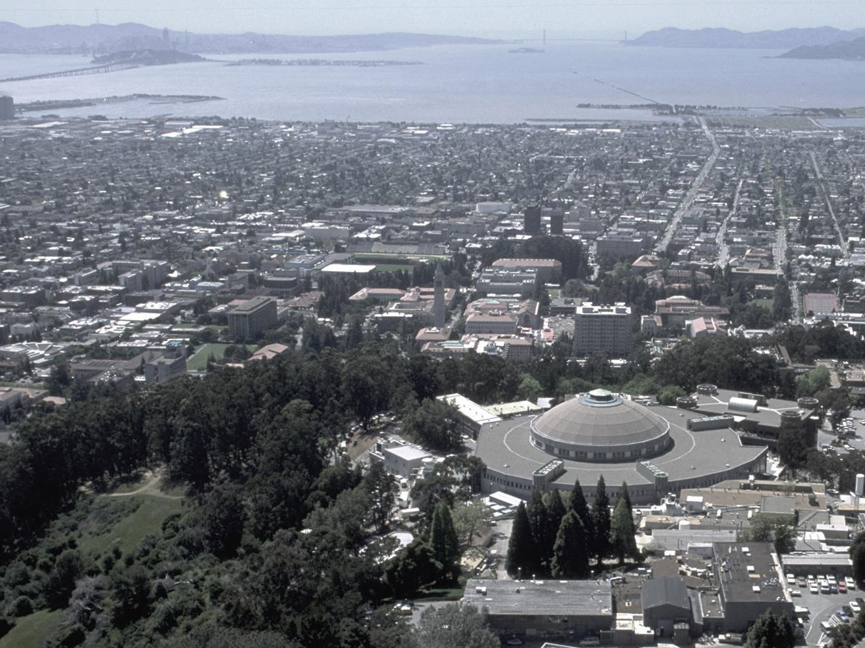
Advanced Light Source
8.2.1
Berkeley
Center for
Structural
Biology
8.2.2
8.3.1
UC
SF
8.3.2
Micro -CT
5.0.2
5.0.3
5.0.1
5.3.1
XFP
5.4 BSISB - infrared
ALS
Biosciences
2021
MBC 4.2.2
3.2.1 XFP
12.3.1 SIBYLS
MX & SAXS
2.1 NCXT
2.0.1 Gemini

Slide 2
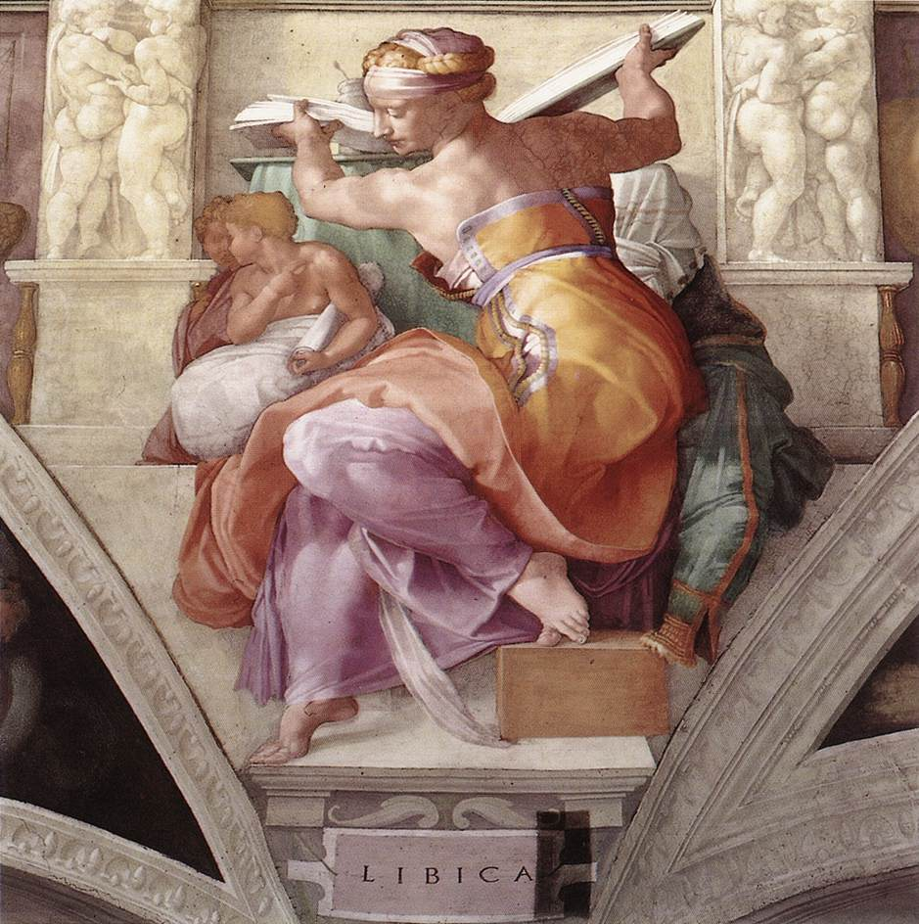
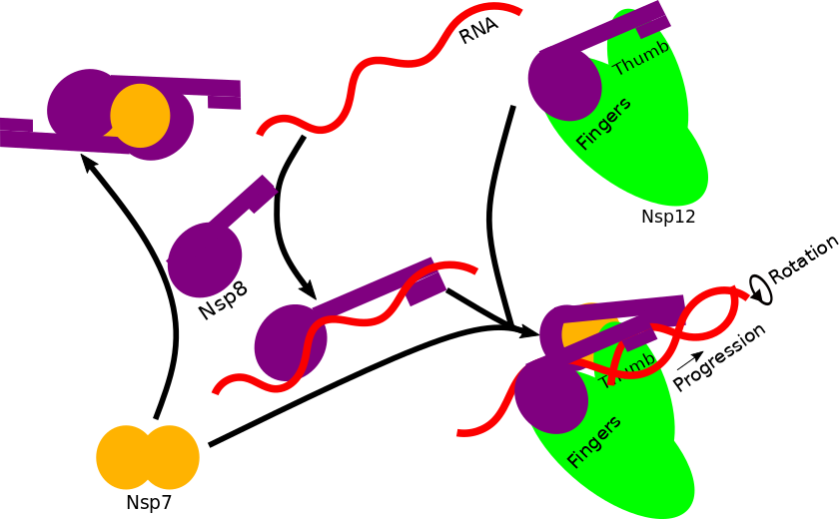
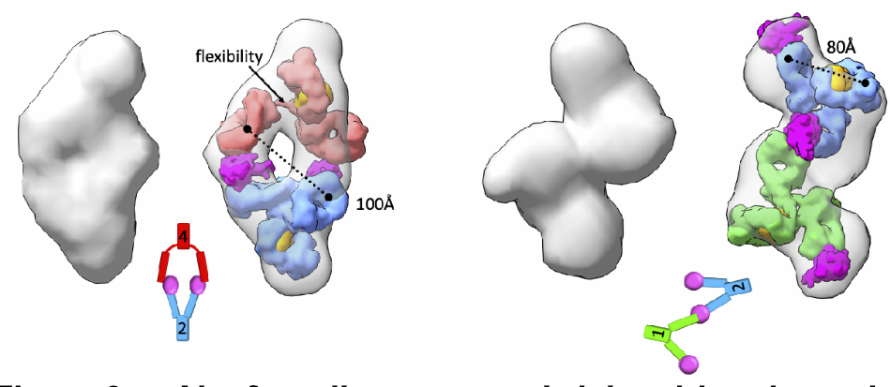
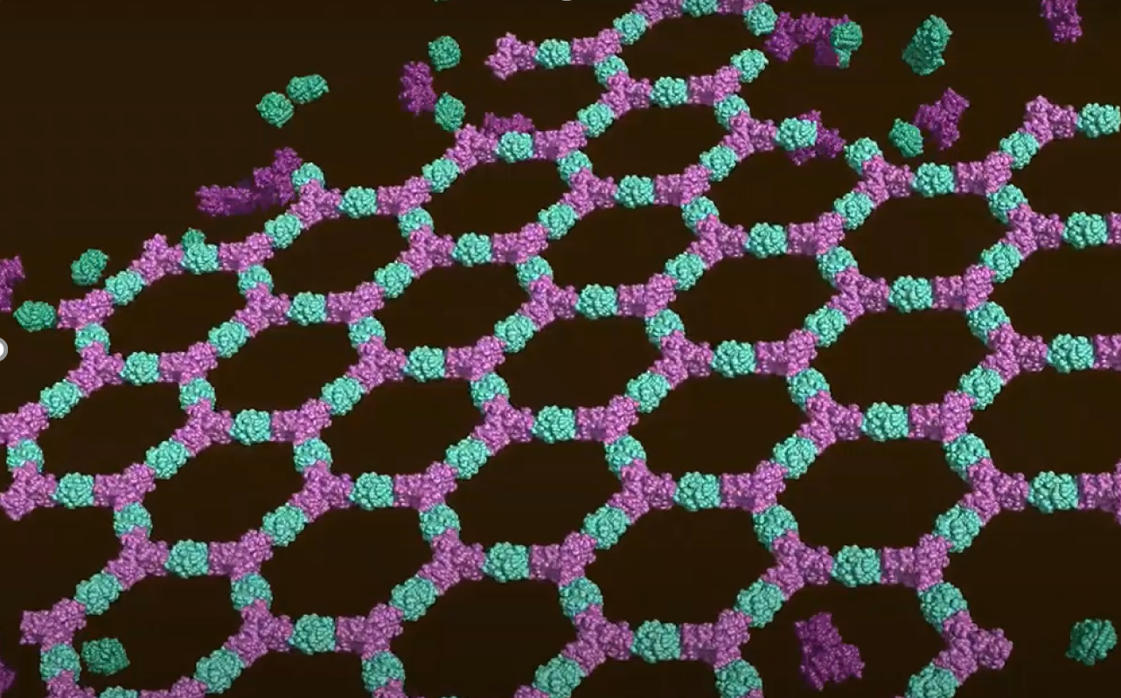
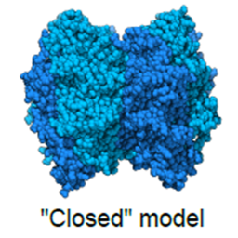
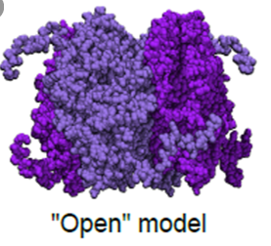
COVID19 Response Led by SIBYLS Staff
Rigid antibodies improve detection of SARS-CoV-2 – Published
SARS-CoV-2 replication-transcription complex Under Review
SIBYLS (12.3.1):
Bio-SAXS beamline
Program Established in 2003
Annual Budget:
~3million$/year
43 Publications in 2020:
4 Science, Nature or Cell
9 high impact
(Nature Associated, PNAS)
2020 Utilization:
80 unique labs served
4x increase in diagnostic sensitivity to SARS-CoV-2
Identified New Target for Therapeutic Treatment
DOE Mission: Bio-Sequestration and Synthetic Biology
Rubisco: Primary Plant CO₂ “Fixer”
Nature Plants
2 Protein Rigid Sheets - Nature
Characterize Primitive Rubisco for Bio-engineering
Novel Bio-Material

Slide 3
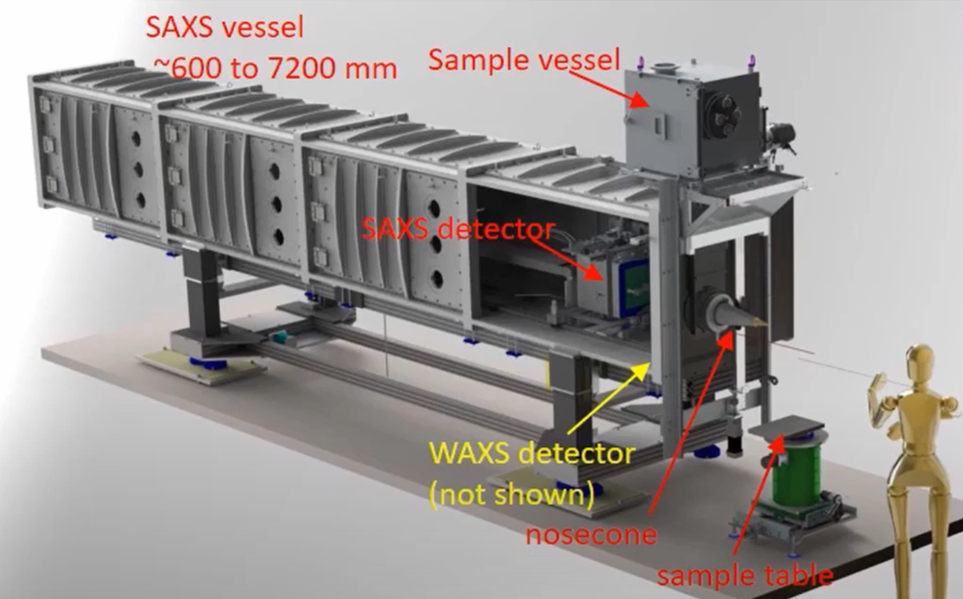
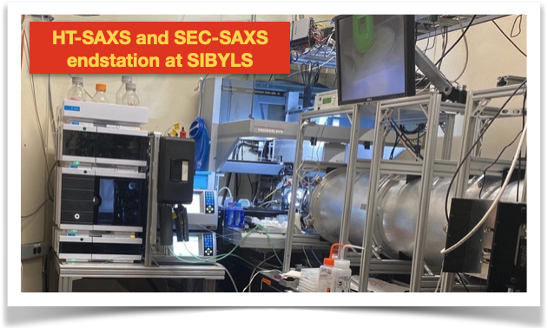
5 year plan – to build a world class Bio-SAXS/WAXS beamline at SIBYLS
Concerns:
If productivity drops due to new/inconsistent shutdowns, how do we maintain momentum for upgrade?

Slide 4
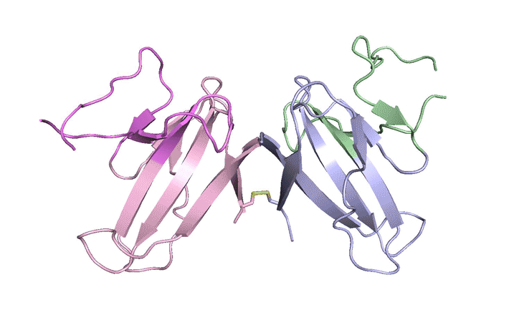
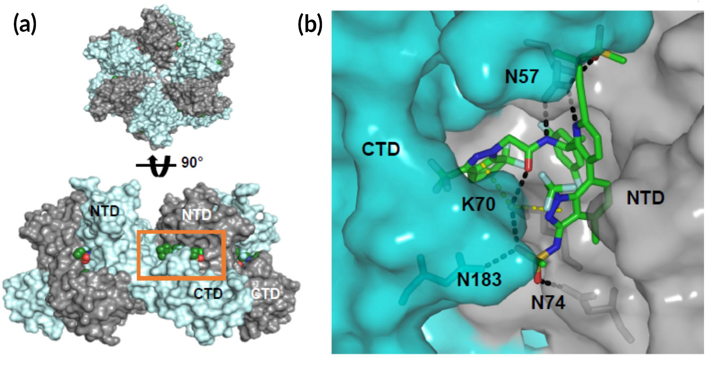
Berkeley Center for Structural Biology
SARS-CoV-2 ORF8 mystery protein
Dr. J. Hurley, UC Berkeley
Operating six MX beamlines (2.0.1,5.0.1/2/3,8.2.1/2)
BCSB staff: 8 FTE
20% of ALS impactful publications are associated with data collected at BCSB beamlines
~350 users/year, 500 visits
26,219 crystals were analyzed in 2020 supporting science and drug discovery programs
100% remote users in the pandemic
Automated data collection pipeline
15+ Groups using our beamlines in the effort against COVID-19 pandemic
Experimental Drug Target HIV in a Novel Way
(Gilead Sciences Inc.)

Slide 5
BCSB external funding (HHMI, PRT, NIH) ~100M
HHMI Principal investigators (~40/year)
Participating Research Team
Duke U.
East Carolina U.
Emory U.
Medical U. South Carolina
Rosalind Franklin U.
U. Kentucky
U. Alabama
U. Georgia
U. of Missouri-Kansas City
U. North Carolina
U. Pittsburgh
U. South Carolina
U. South Florida
U. Texas MD Anderson
U. Virginia
Amgen
Celgene/BMS
Eli Lilly
Genentech
Gilead
GlaxoSmithKline
GNF
Monsanto/Bayer
Novartis
Regeneron
Takeda
Vertex
NIH-NCI
NIH-NINDS
NIH-NLHBI
Fred Hutch CRC
CDC
Georgia Inst. Technology
Scripps Research Inst.
St-Jude Children Res. Hosp.
Accelero Biostructures
Cocrystal Discovery
IniXium
Nurix
Vividion
(Market Cap > $1T)

Slide 6
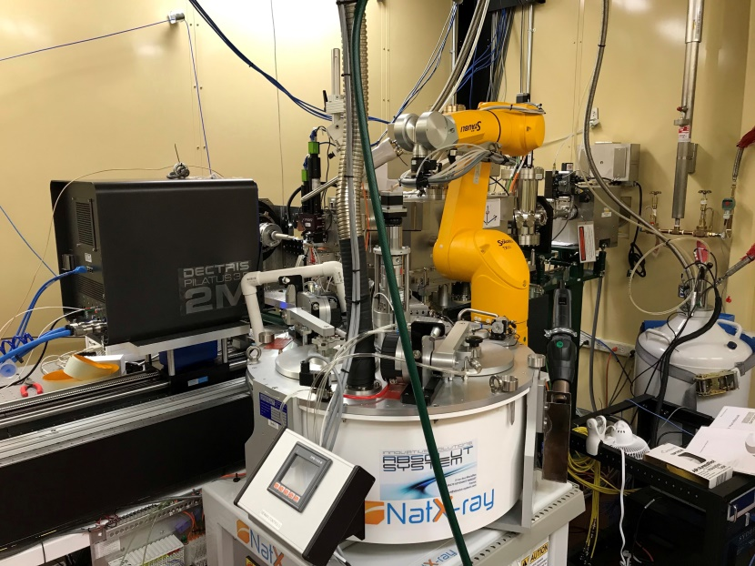
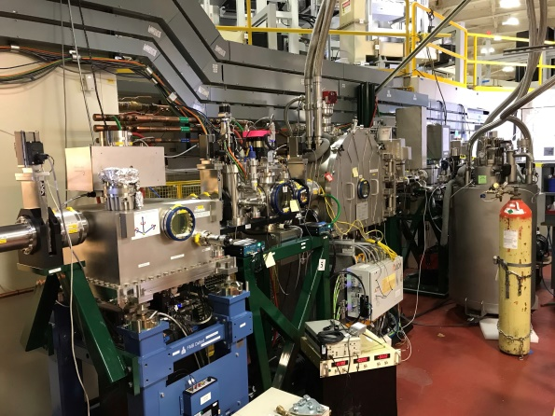
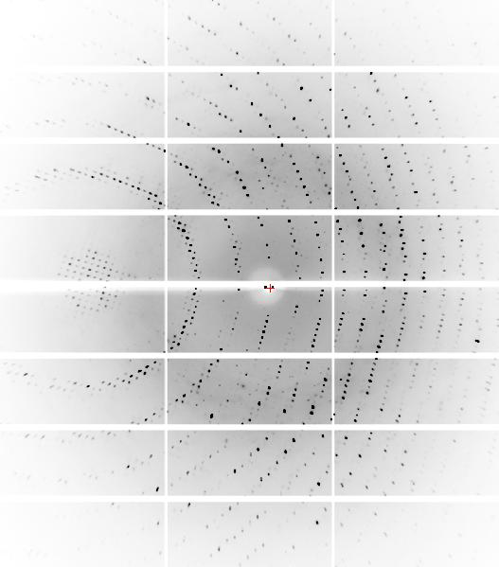
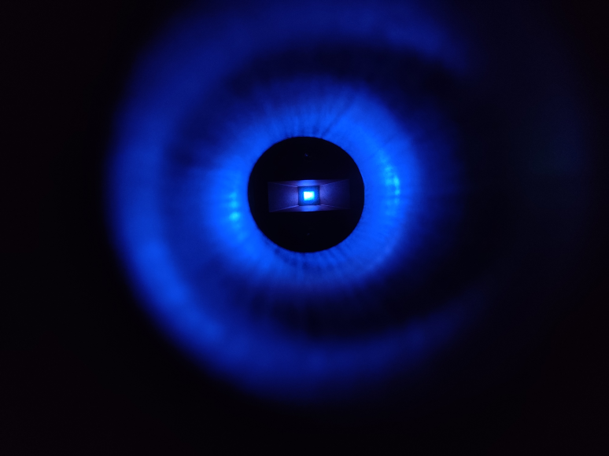
GEMINI beamline → Micron-size crystals

Slide 7
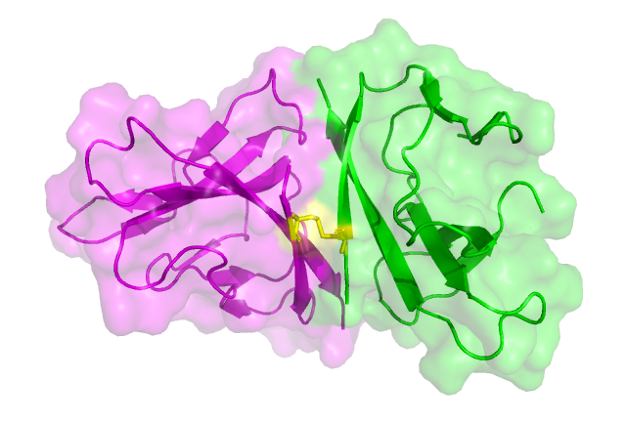
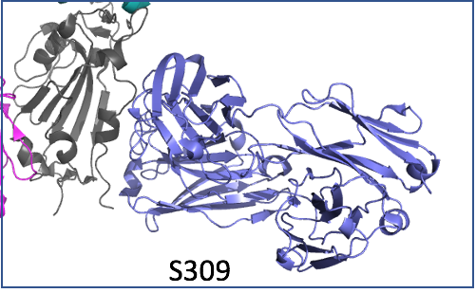
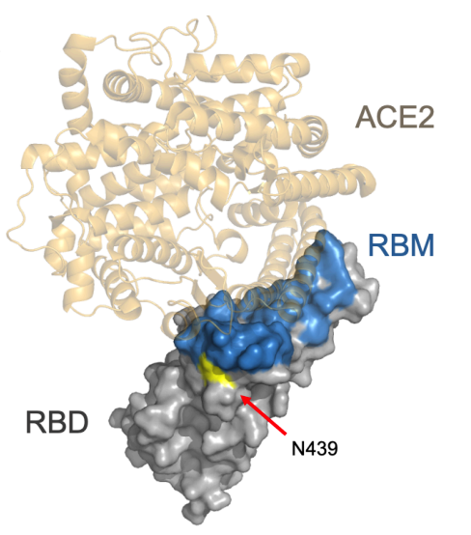
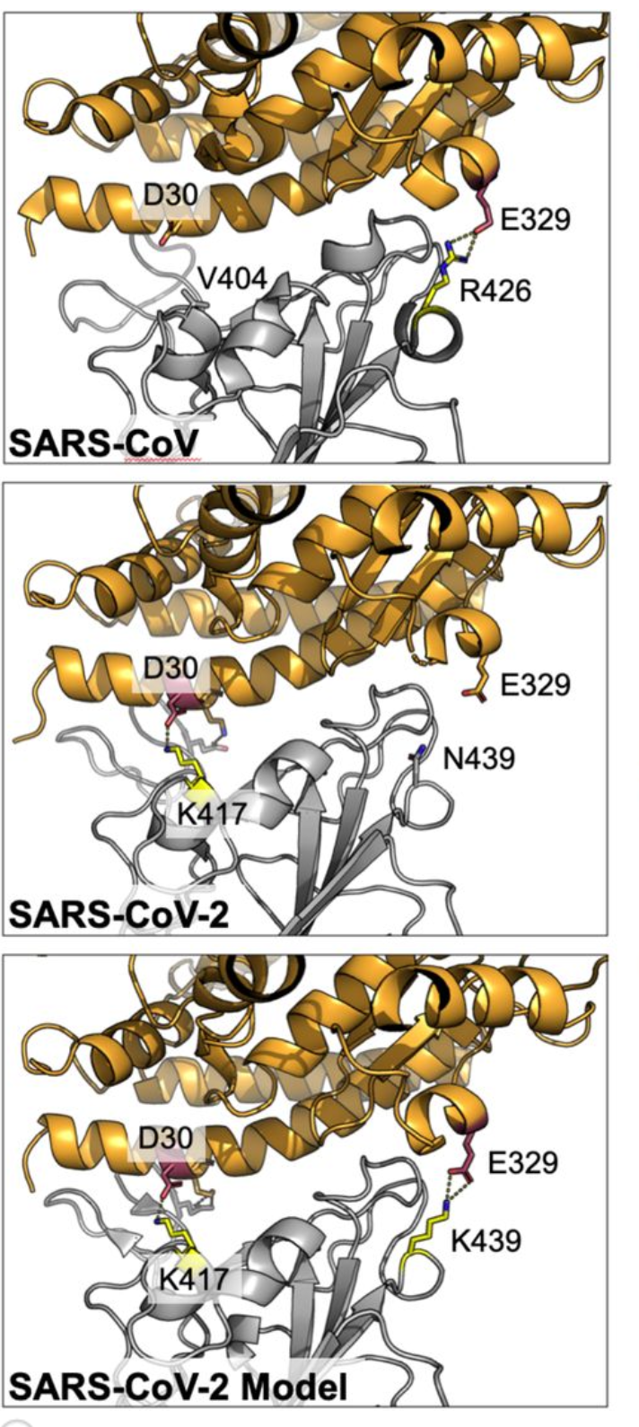
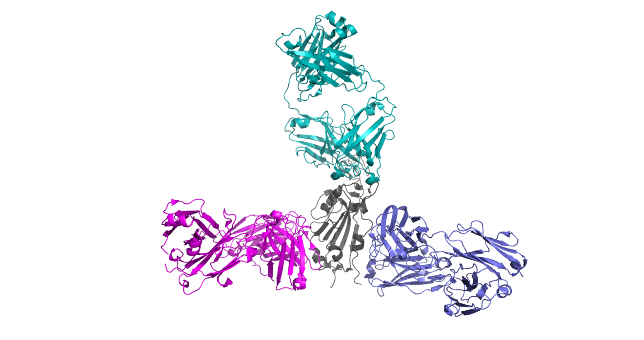
MBC
Molecular
Biology
Consortium
ALS Beamline 4.2.2: Mar 2020 – Mar 2021
COVID-19 treatment
Pandemic Operations
Samples screened: 4510
Datasets collected: 1254
65% screened/collected by 4.2.2 staff
Significant Covid-19 work with Vir Biotechnology
SARS-CoV-2 ORF8 protein
Remote collection
PDB 7JX6
Fremont Lab WUSTL
VIR-7831
85% reduction in hospitalization or death
Phase 3 trials over
EUA submitted
Structural mapping immunodominant sites of SARS-CoV-2 spike protein
SARS-CoV-2 variant immune evasion
Antibodies that resist SARS-CoV-2 viral escape
L. Picolli, et. al., Cell Jan. 2020*
DOI: 10.1016/j.cell.2020.09.037
E.C. Thompson, et. al., Cell Mar. 2021*
DOI: 10.1016/j.cell.2021.01.037
T. Starr, et. al. Submitted*
*4.2.2. staff authorship

Slide 8
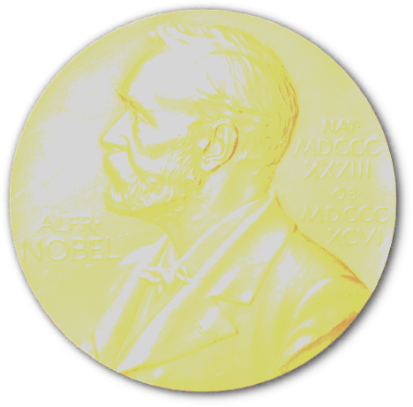
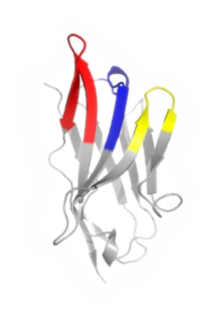
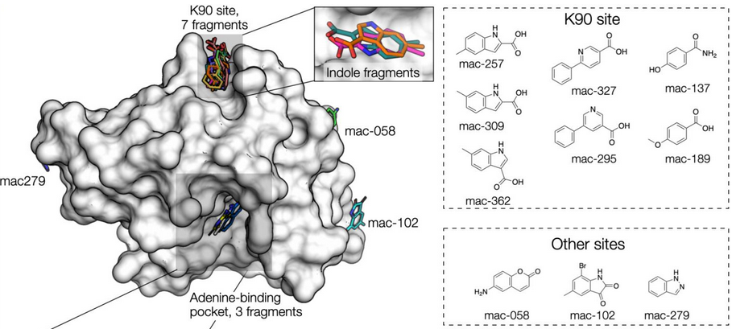
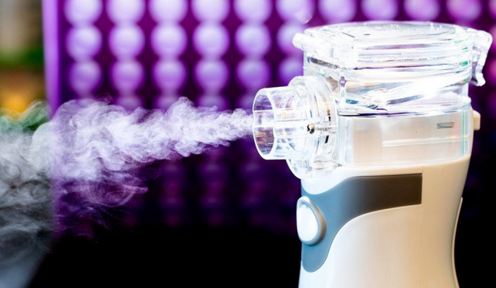
ALS 8.3.1 – TomAlberTron - Highlights
Doudna
CRISPR PDBs
6
8.3.1
6
cryoEM
2
SLS
COVID protection:
nanobody aerosol
UCSF-Oxford SARS-CoV-2
fragment screen
Schoof et al., Science 370 (2020)
Schuller et al., Science Advances in press (2021)

Slide 9
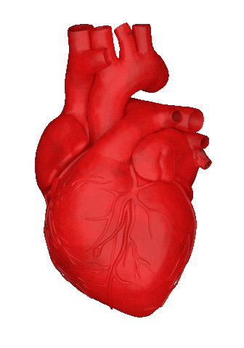
TomAlberTron’s User Community
1000+ users, 60+ institutions
PRT investment: $16 M since 2001
Return: 1826 PDB 720 pubs 250 hi-impact
$132+ M (NIH) $935+ M (Plexxikon)
Median visit-to-next-visit interval:
11 ± 8 days

Slide 11
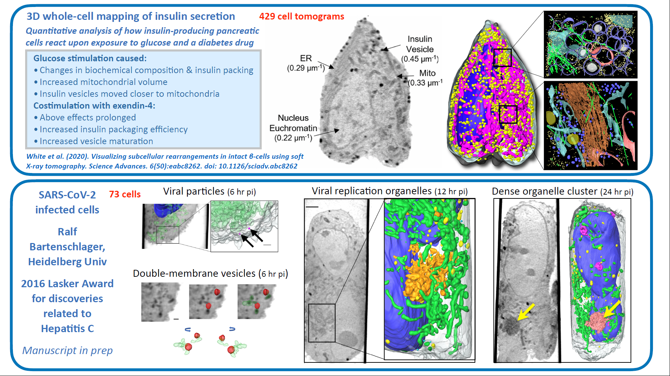

Slide 14
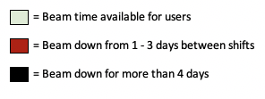
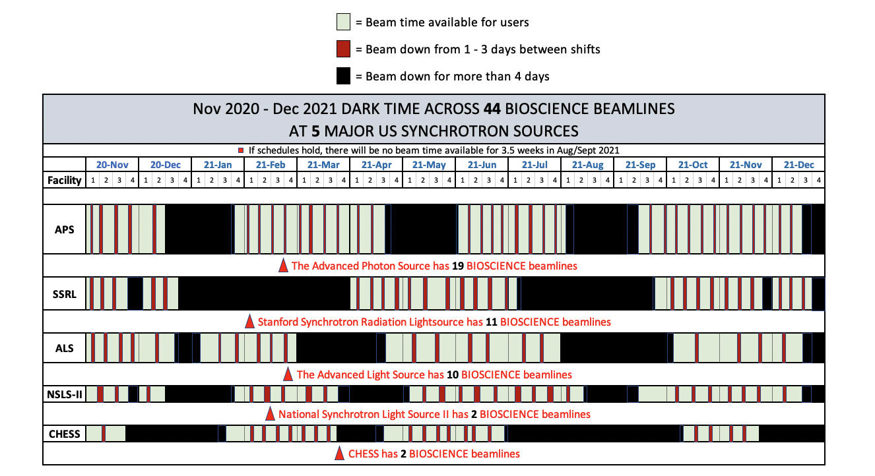
The Future of Light
2000-2020 5000 hours/year
2021-2025 3000 hours/year
0 hours/year
70% flux
APS Shutdown 2023
APS Shutdown 2022

