Slide 1
Hidden Correlations
Your data may be trying to tell you something
https://bl831.als.lbl.gov/~jamesh/powerpoint/BioTA_GM_2022.pptx

Slide 2
What if … ?
Exactly two conformations
50:50
Geometry/energy excellent
Solvent model-able
Can correct assignments be found?
If so, what would R_{free} be?
~4%

Slide 3
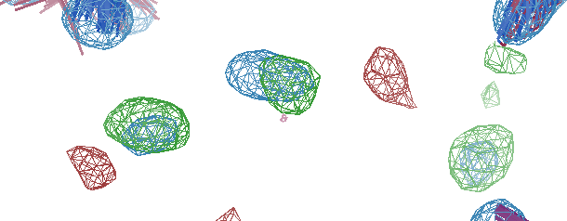
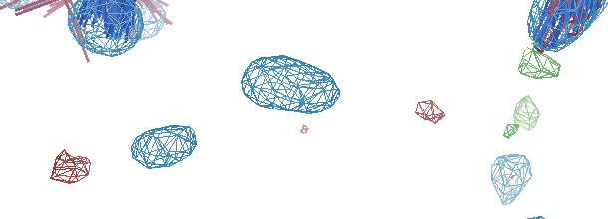
Before
R_{work} | 0.1171 |  | 0.1110
R_{free} | 0.1346 |  | 0.1297
bond Å | 0.007 |  | 0.006
angle° | 1.78 |  | 1.49
After

Slide 4
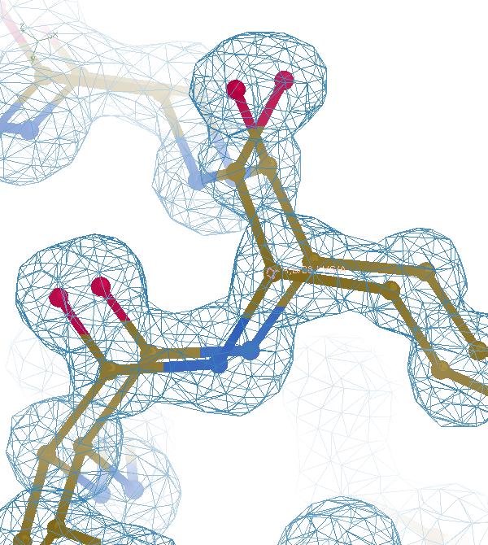

Slide 6
Why does ensemble refinement suck? (3 parameters/observation and R_{work} still high!) The chains are “tangled”

Slide 7
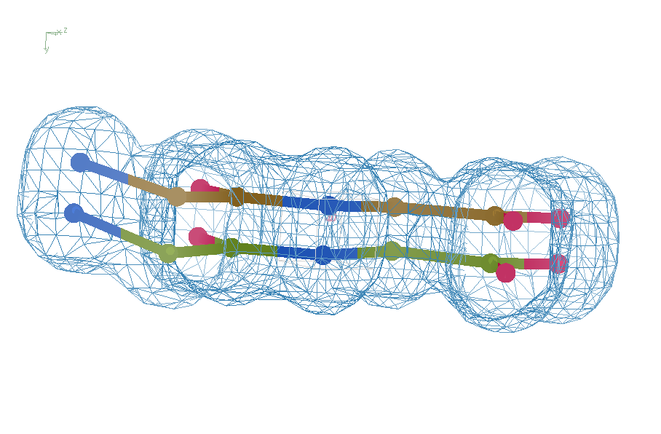
Right answer
R = 0.8%
rms bond = 0.0002

Slide 8
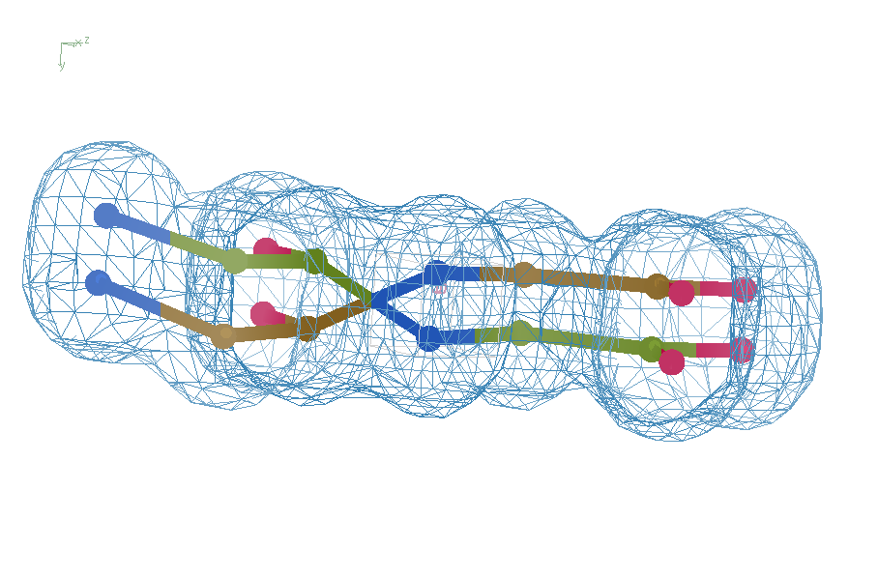
swap assignments
R = 0.8%
rms bond = 0.04

Slide 9
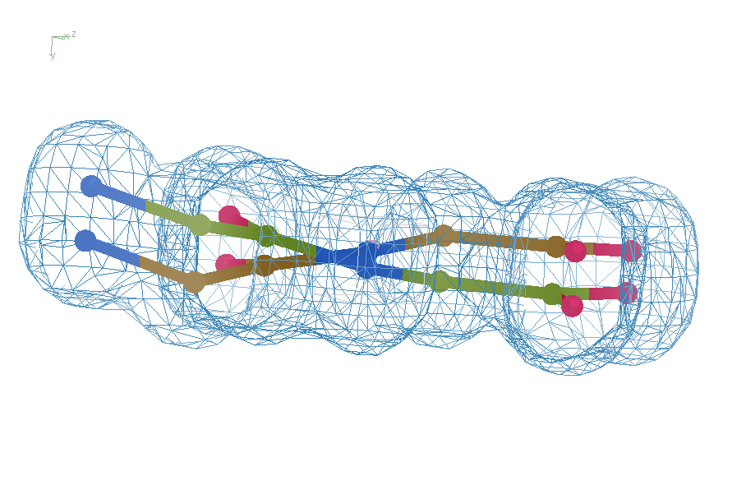
Refine – low x-ray weight
R = 14.3%
rms bond = 0.0002

Slide 10
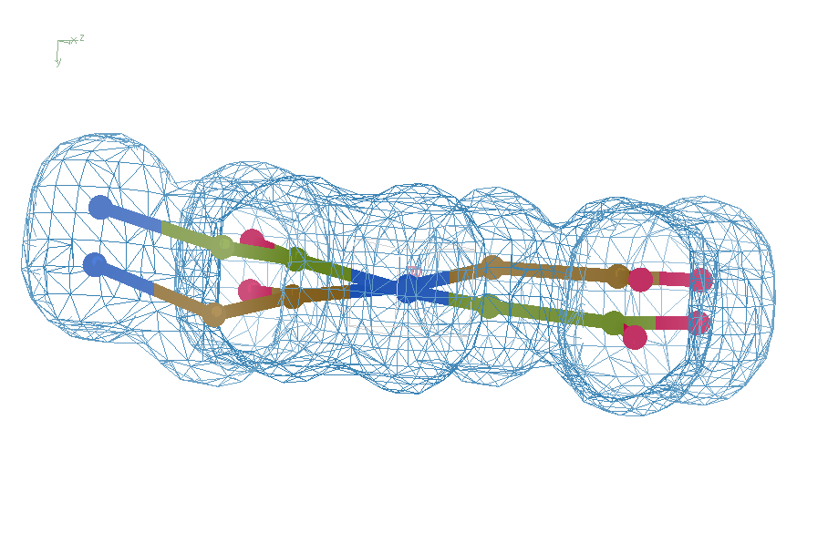
Refine – step 61
R = 6.8%
rms bond = 0.001

Slide 11
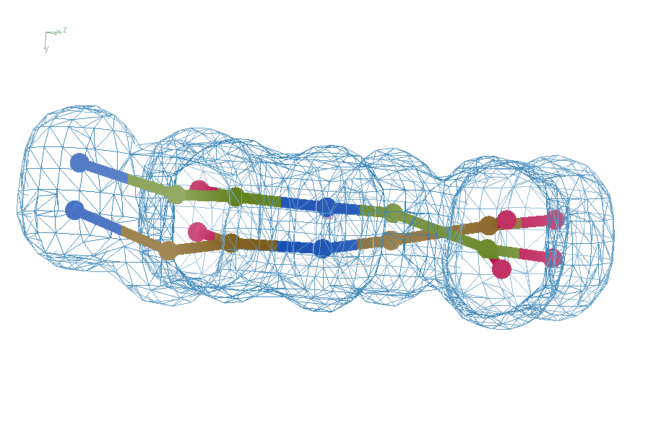
Refine – step 62
R = 5.7%
rms bond = 0.003

Slide 12
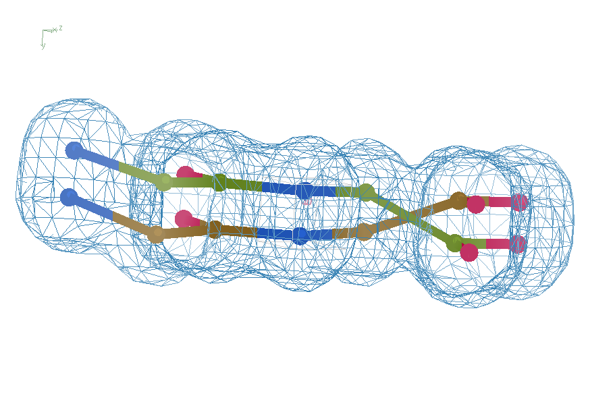
Refine – high x-ray weight
R = 1.2%
rms bond = 0.06

Slide 13
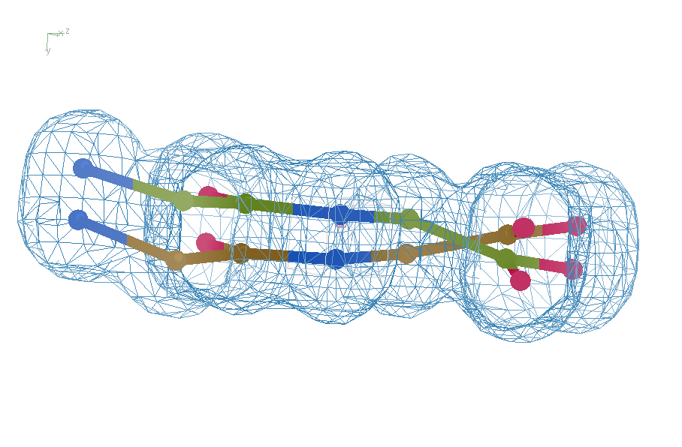
Final compromise
R = 7.07%
rms bond = 0.001

Slide 14
Right answer
R = 0.8%
rms bond = 0.0002

Slide 15
flipme.pdb
Refine
Score & Sort
control
Multiply together:
R_{work} Clashscore
VdW_Energy Cβ_{dev}
Worst & average Z-scores:
rama rotamer
sin(ω)
bonds angles planes
Chirals dihedrals
Flip_1
Flip_2
Flip_3 …
Flip_4 …

Slide 16
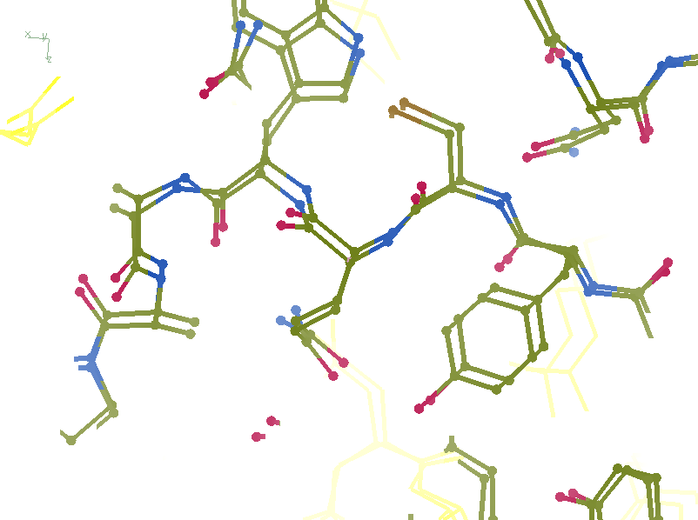
R_{work}: 0.1226
R_{free}: 0.1385
bond: 0.0319
Angle: 3.57
MoPro: 2.12
Clash: 6.52
Cβdev: 11
Rota: 2.78
Rama: 1.61

Slide 17
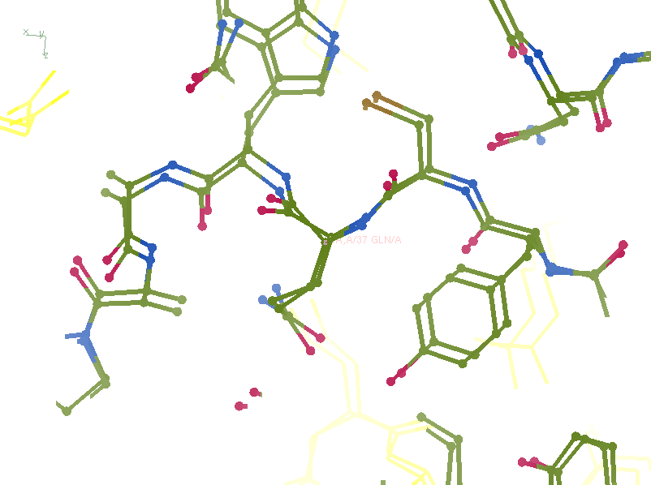
R_{work}: 0.1107
R_{free}: 0.1250
bond: 0.024
Angle: 4.11
MoPro: 0.89
Clash: 0.54
Cβdev: 1
Rota: 0.93
Rama: 0

Slide 18
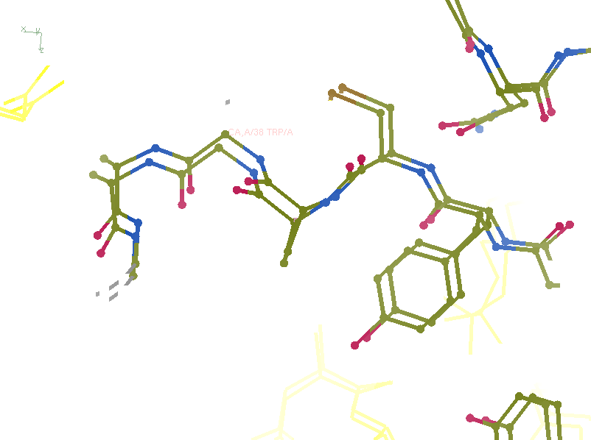
R_{work}: 0.0815
R_{free}: 0.0805
bond: 0.0101
Angle: 1.83
MoPro: 0.72
Clash: 0
Cβdev: 0
Rota: 0
Rama: 0

Slide 19
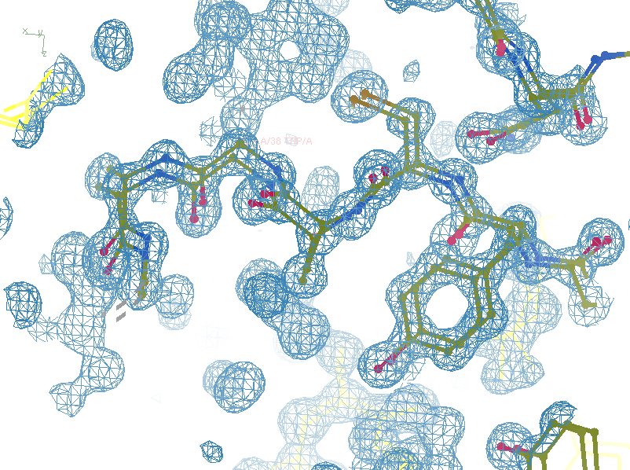
R_{work}: 0.0815
R_{free}: 0.0805
bond: 0.0101
Angle: 1.83
MoPro: 0.72
Clash: 0
Cβdev: 0
Rota: 0
Rama: 0

Slide 20
New Refinement Program: AMBER
 | refmac | phenix | amber
user-supplied bulk solvent
CDL geometry
*.cif ligands
GPUs

Slide 21
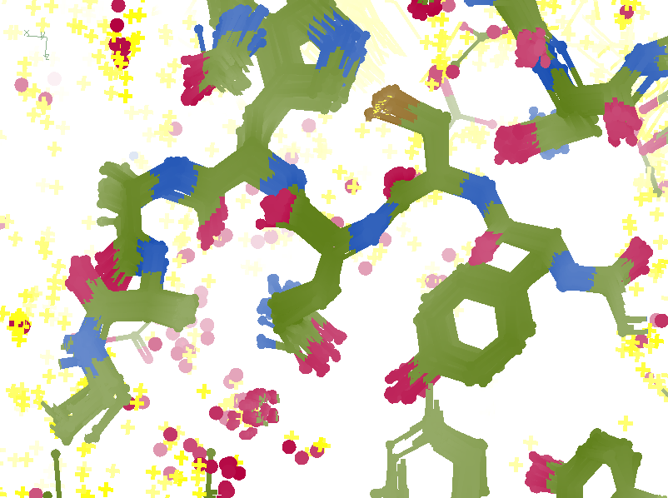
R_{work}: 0.0833
R_{free}: 0.1191
bond: 0.0141
Angle: 1.98
MoPro: 1.30
Clash: 0.72
Cβdev: 22
Rota: 2.04
Rama: 0.17

