Slide 1
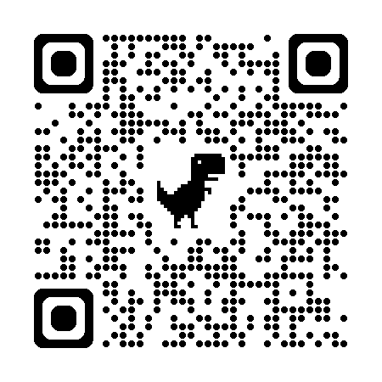
Key Challenges to
Unlocking the True Power of Macromolecular Crystallography
Signal-to-noise can be awesome
Stills should be better
Non-isomorphism is annoying
Radiation damage is correctable
R-factor gap
  Tangled ensemble models
  Uneven solvent

Slide 2
Acknowledgements
https://bl831.als.lbl.gov/~jamesh/powerpoint/BioSci_GM_2026.pptx
In order of response:
David von Stetten
Meitian Wang
Manfred Weiss
Judith Juanhuix Gibert
Bill Shepard
Ilme Schlichting
Kunio Hirata
Armin Wanger
Tom Caradoc-Davies
UCSF LBNL SLAC
ALS 8.3.1: TomAlberTron
Astera.org diff-USE (Fraser)
NIH NIGMS R35 GM158447 (Holton)
NIH NIAID P50 AI150476 (Krogan)
NIH NIGMS P30 GM124169 (Adams)
DOE-BER IDAT (Hura)
NIH NIGMS P30 GM133894 (Hodgson)
The Advanced Light Source is supported by the Director, Office of Science, Office of Basic Energy Sciences, Materials Sciences Division, of the US Department of Energy under contract No. DE-AC02-05CH11231 at Lawrence Berkeley National Laboratory.

Slide 3
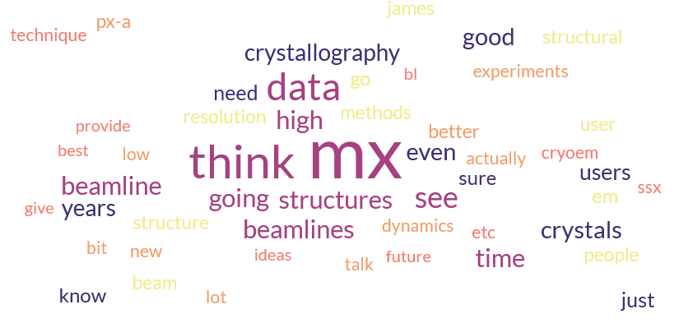
From round the world

Slide 4
From round the world
Study function and dynamics
  Fixed target, “serial”, capture intermediates
Multi-crystal multi-data
  Fragment screening
  Time-resolved (laser?, mixer?, tape?)
“room” (core) temperature
Element identification
Very high resolution

Slide 5
From round the world
“Fewer Beamlines”
cryoEM
  “interesting” things don’t crystallize
Alphafold is the new “low resolution”
Data curation, training students
Multilayers?, high energy? In-vacuum?
Source upgrades
China?
industrialized?

Slide 6
Magic Microscope
Visualize a single molecule
spatial resolution 1 Å
temporal resolution: ~100 fs
Watch same molecule indefinitely
No damage to molecule/patient
Ability to tap / tug
Handheld & common
Q: what would you look at first?
Q2: how long before end of disease?
second

Slide 7
Goals of Methods Development
Impossible → Expensive
Expensive → Cheaper
  Difficult → Easier

Slide 8
The last Å
between prediction and reality
Because: the future of crystallography has alternate conformations
Single-conf models
poor resolution
Low signal/noise
Phase Problem
Dynamics?
Mechanism?
Small signal?
Overlapping states?

Slide 9
The last Å: near, but far
ATOM 122 N LEU A 13 -3.244 25.808 19.998 1.00 16.96 N
ATOM 123 CA LEU A 13 -2.877 25.448 21.355 1.00 15.29 C
ATOM 124 C LEU A 13 -2.792 23.966 21.561 1.00 17.54 C
ATOM 125 O LEU A 13 -1.814 23.493 22.143 1.00 16.35 O
ATOM 126 CB LEU A 13 -3.907 26.164 22.268 1.00 18.72 C
ATOM 127 CG LEU A 13 -3.577 25.982 23.738 1.00 21.19 C
ATOM 128 CD1 LEU A 13 -2.283 26.820 24.019 1.00 19.43 C
ATOM 129 CD2 LEU A 13 -4.702 26.474 24.639 1.00 24.65 C
ATOM 130 N SER A 14 -3.677 23.149 20.979 1.00 15.96 N
ATOM 131 CA SER A 14 -3.646 21.711 21.061 1.00 18.26 C
ATOM 132 C SER A 14 -2.373 21.203 20.360 1.00 18.71 C
ATOM 133 O SER A 14 -1.747 20.315 20.930 1.00 17.47 O
ATOM 134 CB SER A 14 -4.875 21.077 20.419 1.00 17.62 C
ATOM 135 OG ASER A 14 -4.825 19.665 20.388 0.50 20.89 O
ATOM 136 OG BSER A 14 -6.027 21.408 21.164 0.50 18.67 O
ATOM 137 N LYS A 15 -2.045 21.772 19.215 1.00 18.03 N
ATOM 138 CA LYS A 15 -0.799 21.361 18.555 1.00 18.12 C
ATOM 139 C LYS A 15 0.446 21.707 19.351 1.00 18.81 C
ATOM 140 O LYS A 15 1.400 20.948 19.411 1.00 17.77 O
ATOM 141 CB LYS A 15 -0.700 22.034 17.177 1.00 14.49 C
ATOM 142 CG LYS A 15 -1.727 21.368 16.256 1.00 16.12 C
ATOM 143 CD LYS A 15 -1.663 22.147 14.936 1.00 19.40 C
ATOM 144 CE ALYS A 15 -2.725 21.614 13.986 0.50 17.42 C
ATOM 145 CE BLYS A 15 -1.750 21.211 13.750 0.50 17.01 C
ATOM 146 NZ ALYS A 15 -2.346 21.674 12.559 0.50 18.61 N
ATOM 147 NZ BLYS A 15 -3.052 20.513 13.741 0.50 18.76 N

Slide 10
The last Å: near, but far
ATOM 122 N LEU A 13 -3.000 26.000 20.000 1.00 16.96 N
ATOM 123 CA LEU A 13 -3.000 25.000 21.000 1.00 15.29 C
ATOM 124 C LEU A 13 -3.000 24.000 22.000 1.00 17.54 C
ATOM 125 O LEU A 13 -2.000 23.000 22.000 1.00 16.35 O
ATOM 126 CB LEU A 13 -4.000 26.000 22.000 1.00 18.72 C
ATOM 127 CG LEU A 13 -4.000 26.000 24.000 1.00 21.19 C
ATOM 128 CD1 LEU A 13 -2.000 27.000 24.000 1.00 19.43 C
ATOM 129 CD2 LEU A 13 -5.000 26.000 25.000 1.00 24.65 C
ATOM 130 N SER A 14 -4.000 23.000 21.000 1.00 15.96 N
ATOM 131 CA SER A 14 -4.000 22.000 21.000 1.00 18.26 C
ATOM 132 C SER A 14 -2.000 21.000 20.000 1.00 18.71 C
ATOM 133 O SER A 14 -2.000 20.000 21.000 1.00 17.47 O
ATOM 134 CB SER A 14 -5.000 21.000 20.000 1.00 17.62 C
ATOM 135 OG ASER A 14 -5.000 20.000 20.000 0.50 20.89 O
ATOM 136 OG BSER A 14 -6.000 21.000 21.000 0.50 18.67 O
ATOM 137 N LYS A 15 -2.000 22.000 19.000 1.00 18.03 N
ATOM 138 CA LYS A 15 -1.000 21.000 19.000 1.00 18.12 C
ATOM 139 C LYS A 15 0.000 22.000 19.000 1.00 18.81 C
ATOM 140 O LYS A 15 1.000 21.000 19.000 1.00 17.77 O
ATOM 141 CB LYS A 15 -1.000 22.000 17.000 1.00 14.49 C
ATOM 142 CG LYS A 15 -2.000 21.000 16.000 1.00 16.12 C
ATOM 143 CD LYS A 15 -2.000 22.000 15.000 1.00 19.40 C
ATOM 144 CE ALYS A 15 -3.000 22.000 14.000 0.50 17.42 C
ATOM 145 CE BLYS A 15 -2.000 21.000 14.000 0.50 17.01 C
ATOM 146 NZ ALYS A 15 -2.000 22.000 13.000 0.50 18.61 N
ATOM 147 NZ BLYS A 15 -3.000 21.000 14.000 0.50 18.76 N

Slide 11
Key Challenges to
Unlocking the True Power of Macromolecular Crystallography
Signal-to-noise can be awesome
Stills should be better
Non-isomorphism is annoying
Radiation damage is correctable
R-factor gap
  Tangled ensemble models
  Uneven solvent

Slide 12
Key Challenges to
Unlocking the True Power of Macromolecular Crystallography
Signal-to-noise can be awesome
Stills should be better
Non-isomorphism is annoying
Radiation damage is correctable
R-factor gap
  Tangled ensemble models
  Uneven solvent

Slide 13
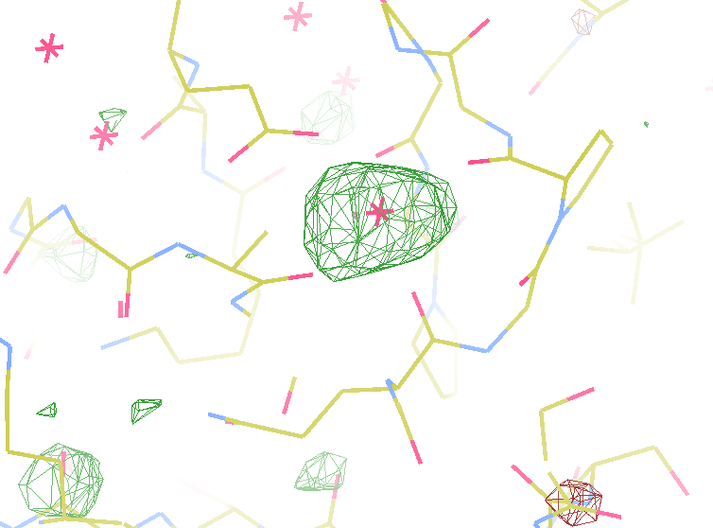
140-fold multiplicity
I/Sa = 260
16 xtals
7.4σ = Na
DELFAN residual anomalous difference
data Courtesy of Tom & Janet

Slide 14
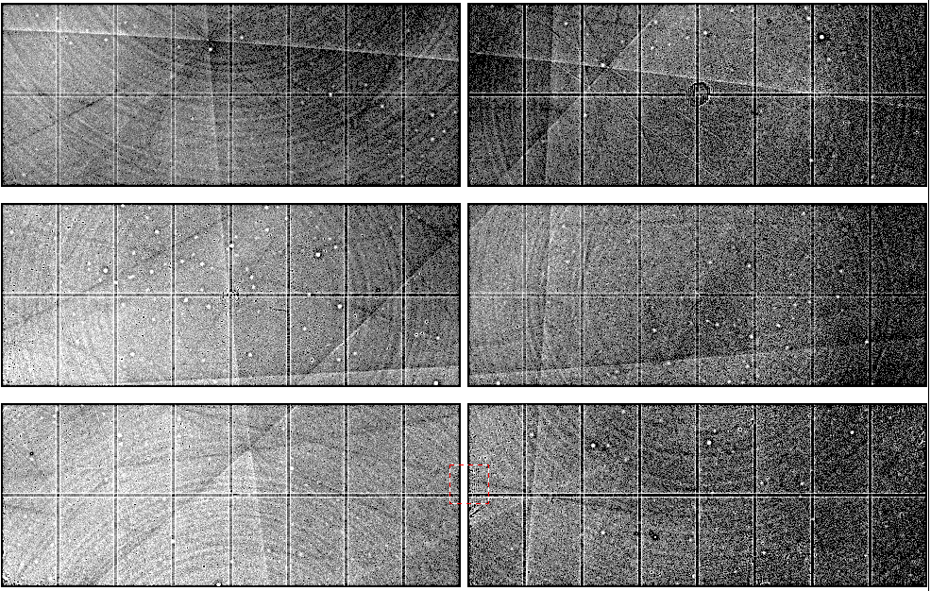
Dominant source of error for Anomalous
~3x10⁵ photon/pixel Pilatus detector
Bragg
glitch
“tree rings”
Pick-up tool mark
oxygen
inclusions
1% high
average
1% low

Slide 15
Prediction:
In-situ detector calibration will
Identify light metals
down to Na
(perhaps F?)
Why? Because ultra-high multiplicity can

Slide 16
Stills should be better
why do we keep trying to integrate over them?

Slide 17
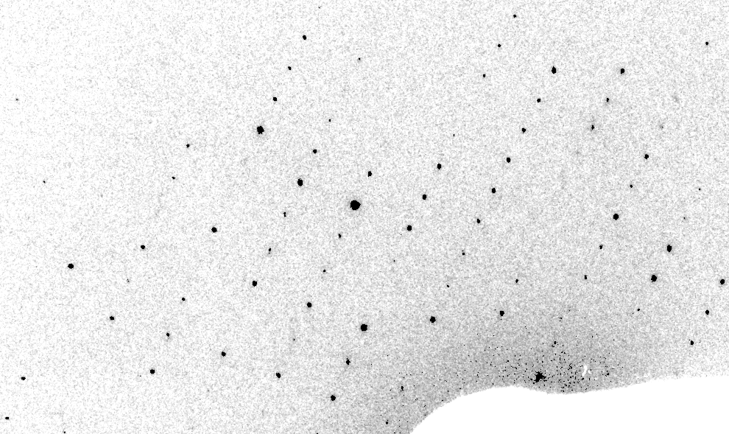
Real XFEL still
Lyubimov et al. (2016).
eLife 5, e18740.

Slide 18
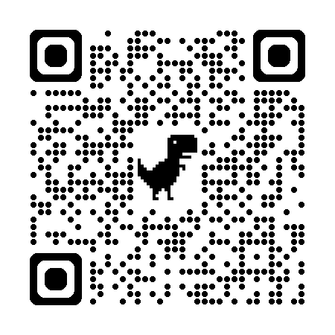
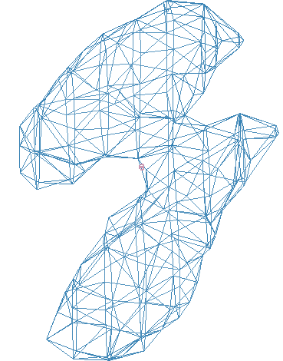
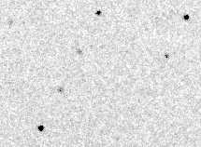
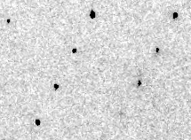
Simulation fit to XFEL still
phix
https://pmc.ncbi.nlm.nih.gov/articles/PMC11801403/
phiy
phiz
real
VS
“texture”
phix
phiy
phiz

Slide 19
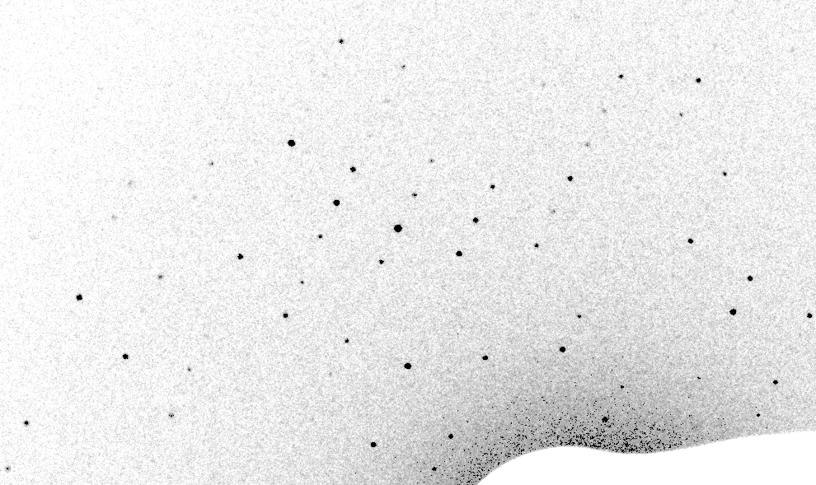
Best “round relp” simulation

Slide 20
Real XFEL still
Lyubimov et al. (2016).
eLife 5, e18740.

Slide 21
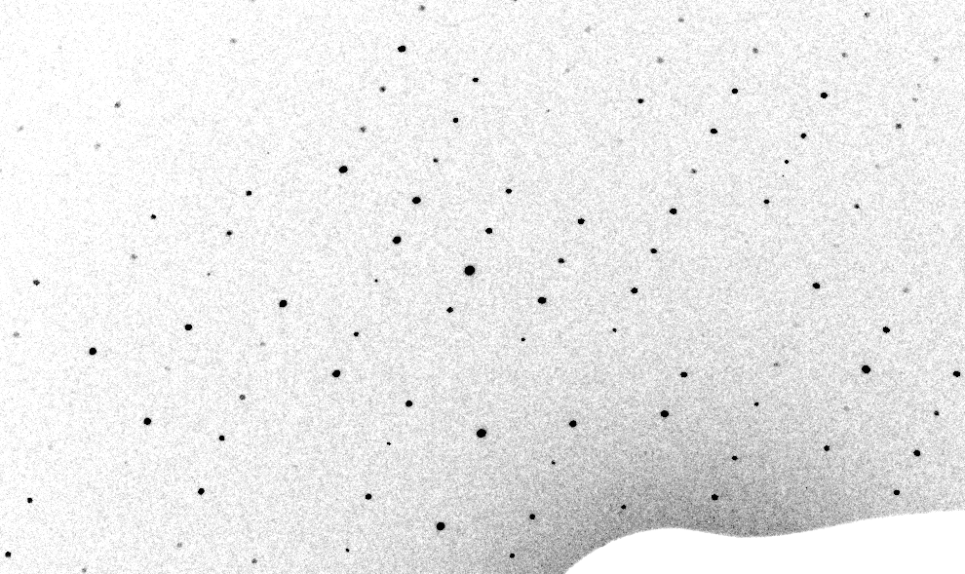
3-cluster texture simulation

Slide 22
Texture sufficient for poor stats
500 images Results from iota: cctbx & prime
texture | 1 cluster | 3 clusters
R_{true}* | 4% | 16%
R_{merge} | 23% | 66%
I/σ | 32 (1.1) | 19 (1.2)
CC_{1/2} | 99 (69) | 99 (58)
resolution | 1.55 | 1.94
*Agreement with F value fed into simulation

Slide 23
Prediction:
Incorporating texture
in serial data processing will
reduce image count requirement
from ~10,000 to ~100
Why? Because rotation data lack texture error

Slide 24
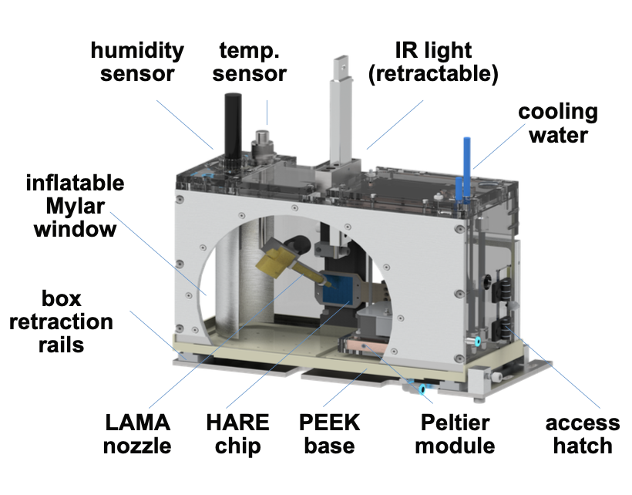
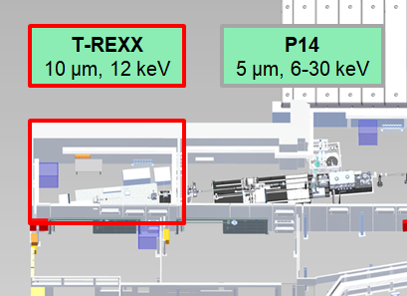
T-REXX beamline - Sample environment chamber
relative humidity: up to 98%
temperature: 8 – 70 °C
still a prototype, but in constant use
[Schulz et al., Nature Commun. 16, 6553 (2025)]

Slide 25
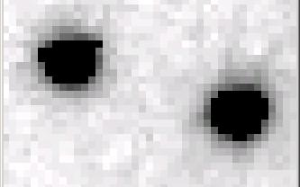
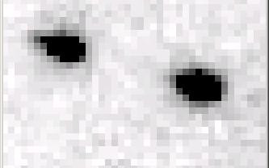
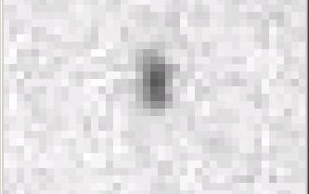
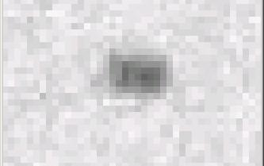
Si(111) vs multilayers
0.014%
Si(111)
spectral
dispersion
1%
multilayer
4 Å
beamstop
resolution
1.9 Å
beamstop

Slide 26
Wide-bandpass MX?
Mono | Si(111) | multilayer | Difference (%) | good
Energy (eV) | 11111 | 12027.5 | +8.2 | Same
Scale | 1.0000 | 1.0964 | +9.6 | Yes
R_{merge} (%) | 7.5 | 8.4 | +12 | No
R_{anom} (%) | 5.6 | 5.5 | -1.8 | Same
I/sd | 13.2 | 12.3 | -6.8 | Same
I/sd (1.5Å) | 2.3 | 1.8 | -21.7 | No
Ano Patt | 5.96 | 4.75 | -20.3 | Same
Ano Phased | 41 | 39.33 | -4.1 | Same
FOM | 0.238 | 0.192 | -19.3 | Same
CC | 0.555 | 0.647 | -6.1 | Yes
R_{cryst} (%) | 26.70 | 26.48 | -0.2 | Same
Ligand peak | 8.213 | 8.250 | +0.4 | Same

Slide 27
Finding:
Multilayers are good for everything
Except resolution
☹
Why? Because mosaicity

Slide 28
Non-isomorphism
is annoying
means you:
can’t merge
can’t
add
can’t
subtract
Caused by:
rad dam
humidity
temperature
Growth conditions
Cryo-cooling
Everything

Slide 29
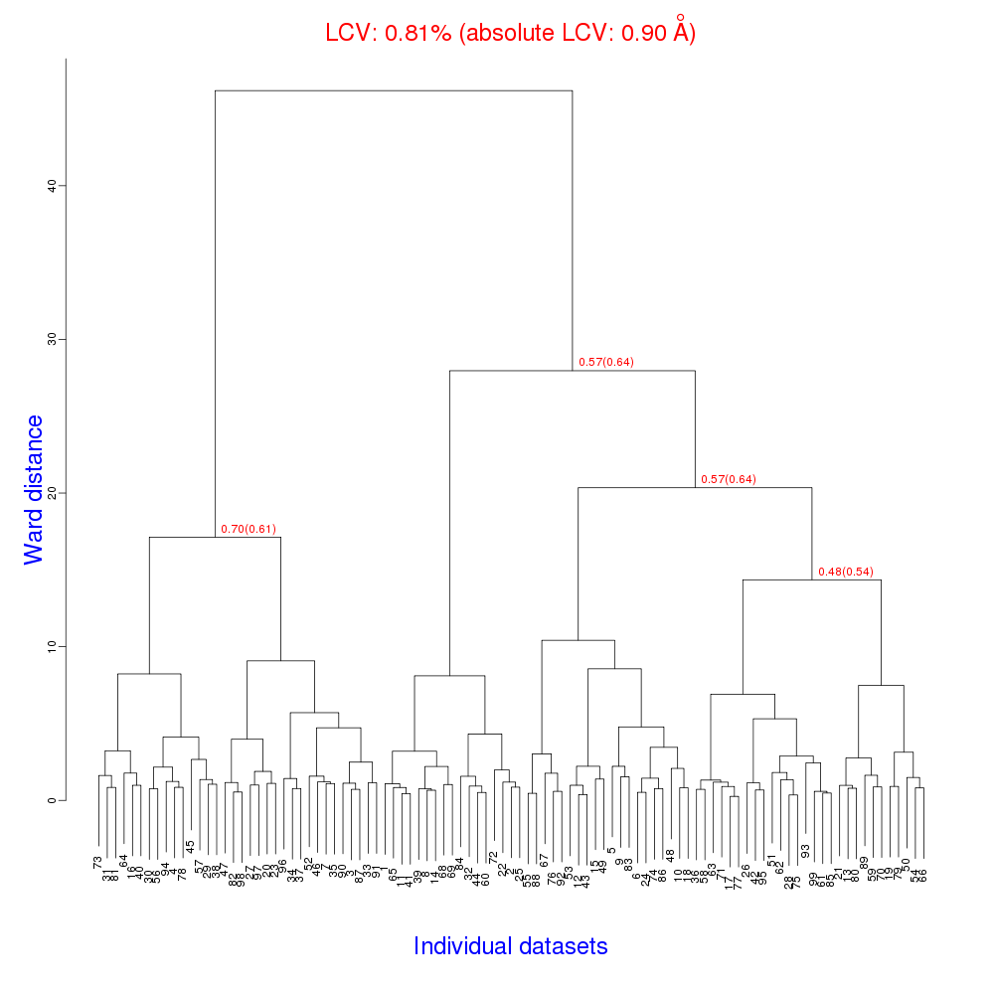
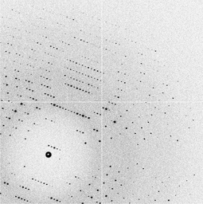
Cell clustering: 100 datasets
Reality:
Perfect isomorphism
(simulated data)
Holton, J. (2019). Acta Cryst. D 75, 113-122.

Slide 30
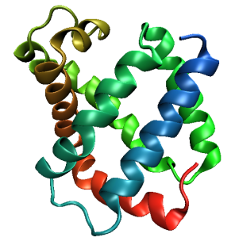
Same structure, different cell
0.5% cell change → 15%
Crick & Magdoff (1956) “theory method isomorphous replacement”, Acta Cryst. 9, 901-8.

Slide 31
Same structure, different cell
0.5% cell change → 15%
Crick & Magdoff (1956) “theory method isomorphous replacement”, Acta Cryst. 9, 901-8.

Slide 32
Uniform stretch
5% change → 0%

Slide 33
Uniform stretch
5% change → 0%

Slide 34
Hygrostatic gradients
high
water activity
low
jet
loop

Slide 35
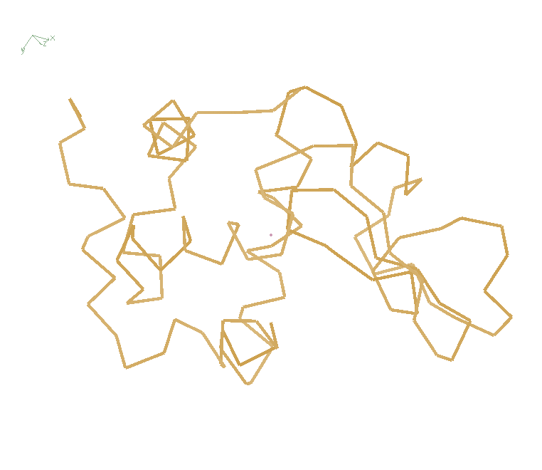
Non-isomorphism in lysozyme
RMSD = 1.70 Å
Δcell = 0.7 %
R_{iso} = 44.5%
RMSD = 0.18 Å LSQ
RH: 84.2%
vs 71.9%
3aw6
3aw7

Slide 36
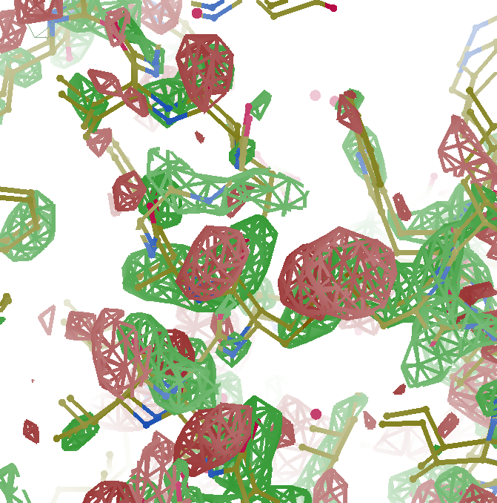
F_{obs}-F_{obs} difference
3σ 1.8 Å
old way

Slide 37
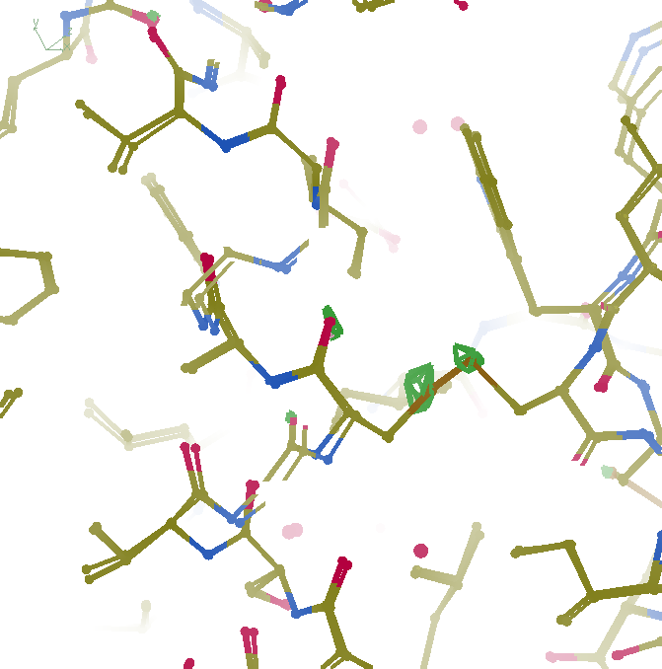
F_{obs}-F_{obs} difference
3σ 1.8 Å
“unbent”

Slide 38
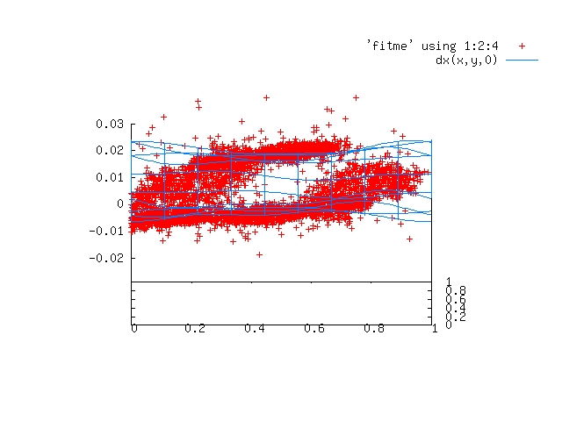
Periodic Spatial Distortion Vector Field

Slide 39
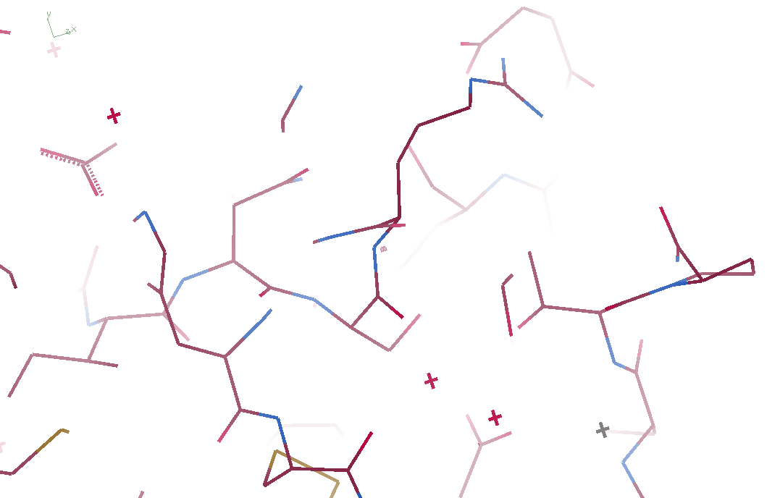
3aw6

Slide 40
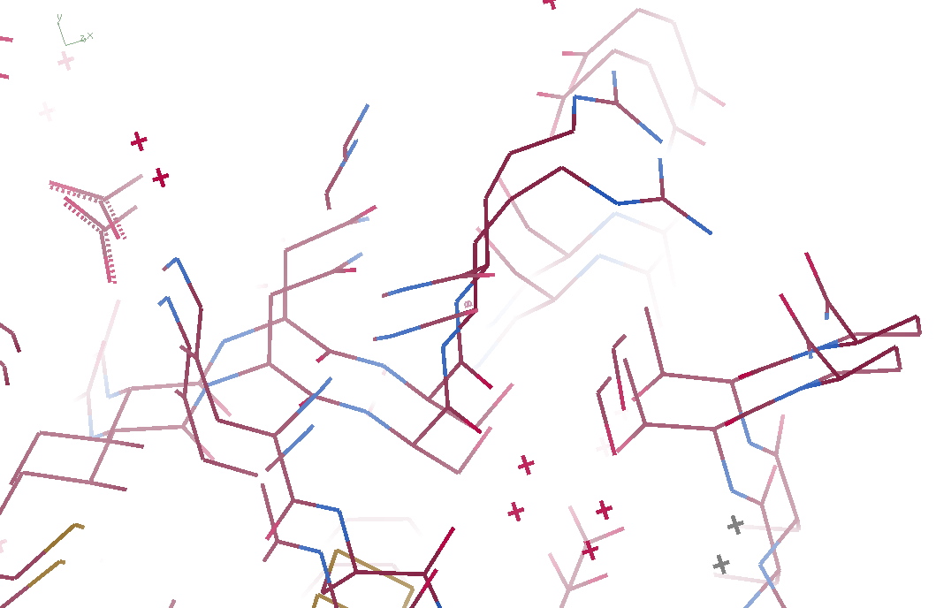
3aw6 3aw7

Slide 41
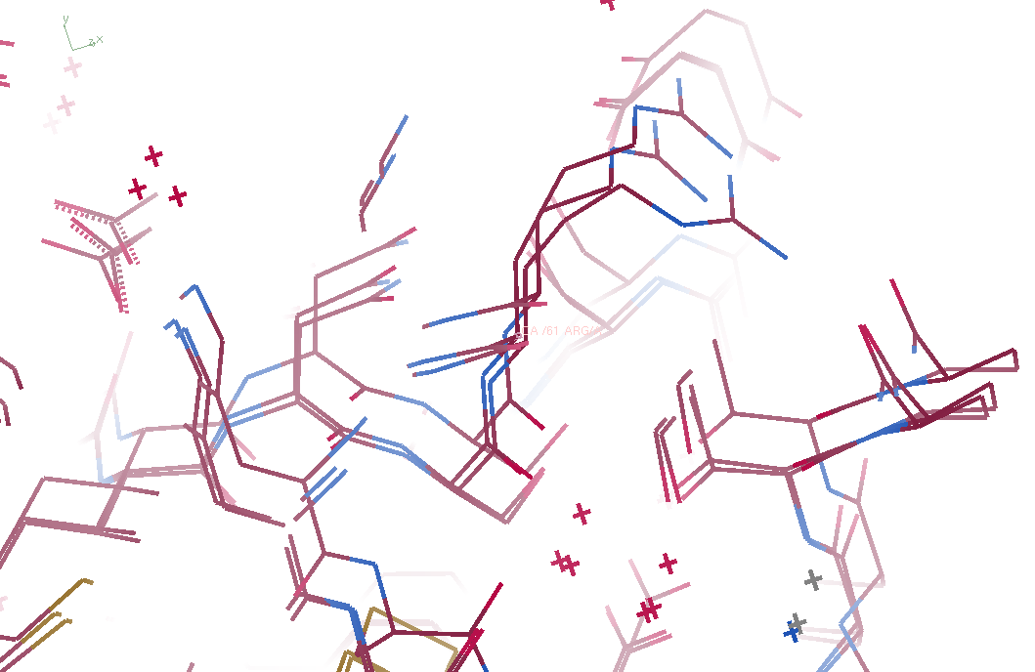
3aw6, 3aw7, “bent” 3aw6

Slide 42
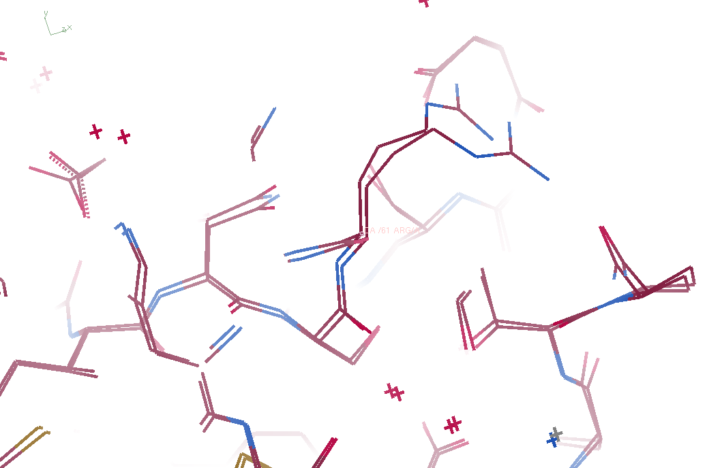
3aw7, “bent” 3aw6

Slide 43
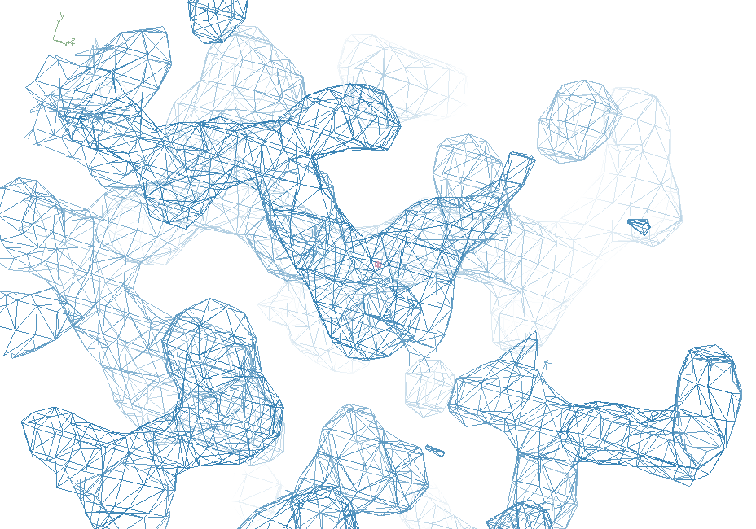
3aw7

Slide 44
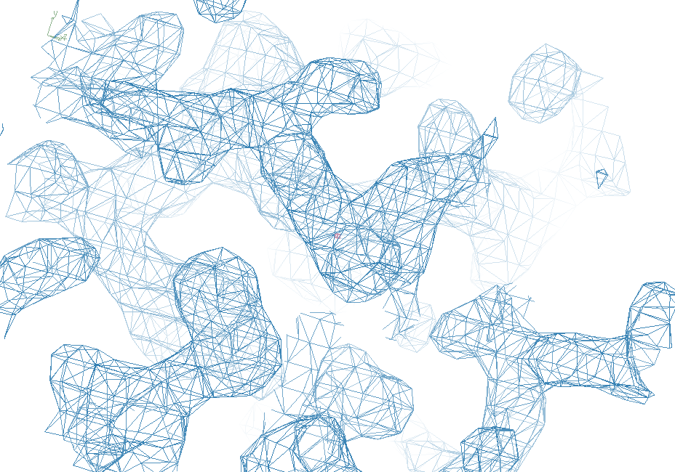
“bent” 3aw7

Slide 45
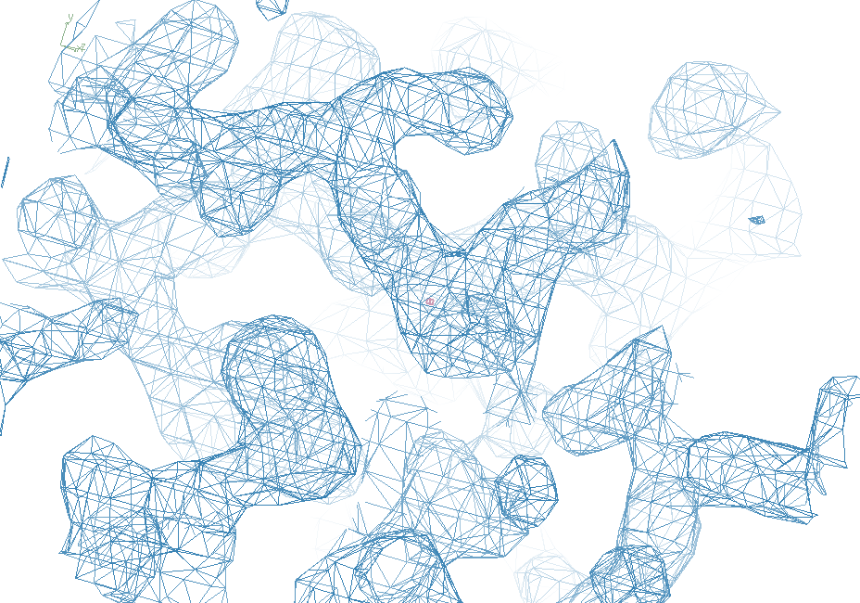
3aw6

Slide 46
Prediction:
Correcting non-isomorphism
will allow
infinite averaging
allowing arbitrary signal/noise
Why? Because it works for cryoEM

Slide 47
Radiation Damage
is correctable
if we make it linear

Slide 48
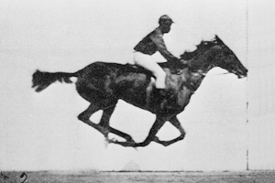
0 Gy

Slide 49
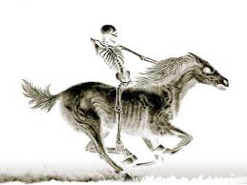
100 MGy

Slide 50
What is the dose?
50 MGy ?

Slide 51
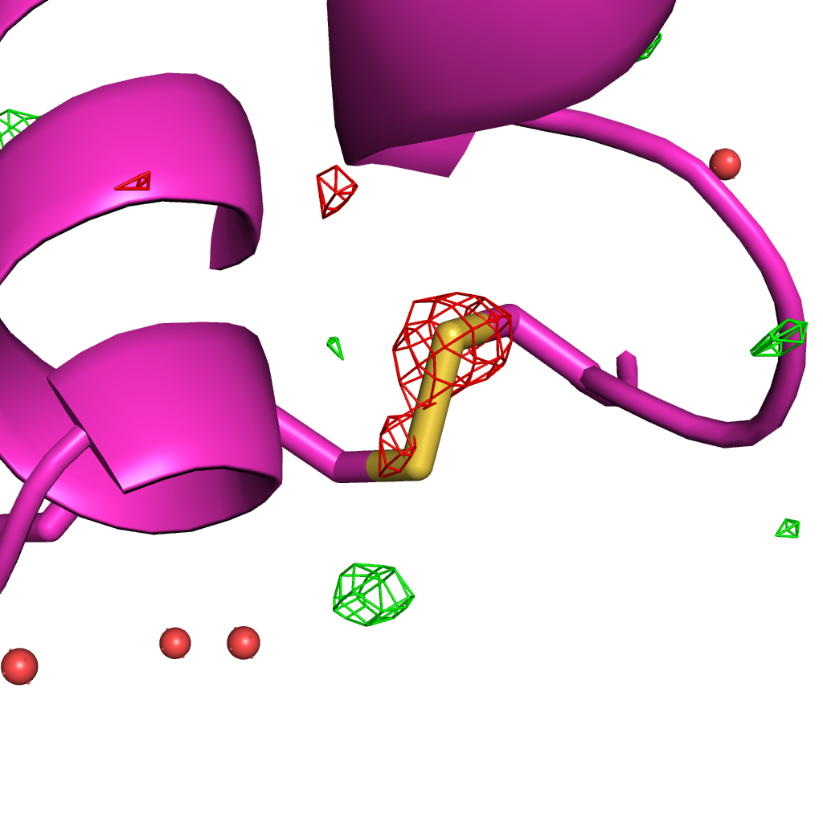
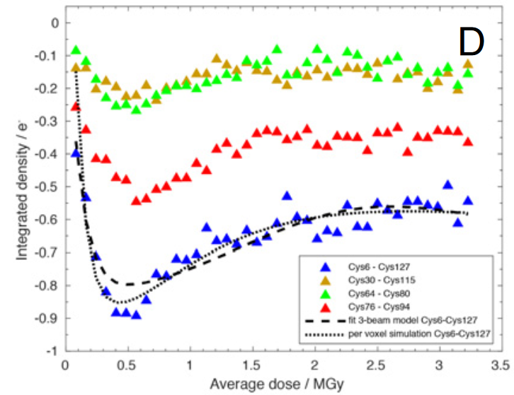
Systematic error: Illumination contrast appears to “reverse” damage
Room temperature high-dose rate series
0.35 MGy
Cys127
Cys6
de la Mora, et al. (2020) PNAS USA 117, 4142-4151

Slide 52
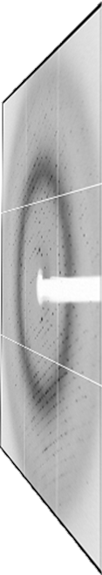
False Damage reversal: from “hole burning”
X-ray beam
crystal

Slide 53
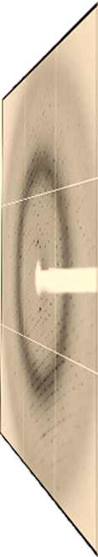
False Damage reversal: from “hole burning”
X-ray beam
crystal

Slide 54
Painting with X-rays
0°
img_000045

Slide 55
Painting with X-rays
0.2°
img_000100

Slide 56
Painting with X-rays
30°
img_015000

Slide 57
Painting with X-rays
90°
img_045000

Slide 58
Painting with X-rays
360°
img_180000

Slide 59
Painting with X-rays
1080°
img_540000

Slide 60
Beam Shape Dichotomy
Flat-top beam
  Uniform dose in illuminated region
  Sharp edges: sensitive to drift
Gaussian beam
  Softer edges
  High dose contrast
“Painting mode”
  Best of both: “dose flattening”

Slide 61
How many images?
360° / 0.1° * ( 100 µm / 1 µm )²
⁼ 36x10⁶
28,000 photons/image

Slide 62
Lossless data rate
bits
s
= log₂(pixels) * flux * thick * 1.2x10⁻⁵
where:
bits/s = entropy-limited compressed data rate
pixels = number of pixels in the detector
flux = photons/s onto the sample
thick = sample thickness in microns
EG: 1e12 ph/s * 100um thick = 3.4 GBytes/s
The 1.2e-5 scattered photons per incident photon can be derived form the cross section of oxygen (0.2 cm^2/g) and the rough density of protein crystals (1.2 g/cm^3), and the fact that about half of all scattered photons hit a flat detector: 0.2*1.2*1e-4/2 = 1.155e-5
That is, flux*thickness*1.2e-5 is the rate of photon arrivals and log2(pixels) is the number of bits required to store the location of one photon in the entropy-limited regime. Lossless compression cannot be better than this because individual photon arrivals are genuinely random.

Slide 63
How to lose information
long exposures
  >1 photon/image = order of arrivals
Wide phi slice
  sum over angle
Large beams
  sum over profile area
Pink/divergent beam
  sum over lambda/angle
Background
  non-crystal stuff
Systematics
  Dose contrast, drift, read-out gap

Slide 64
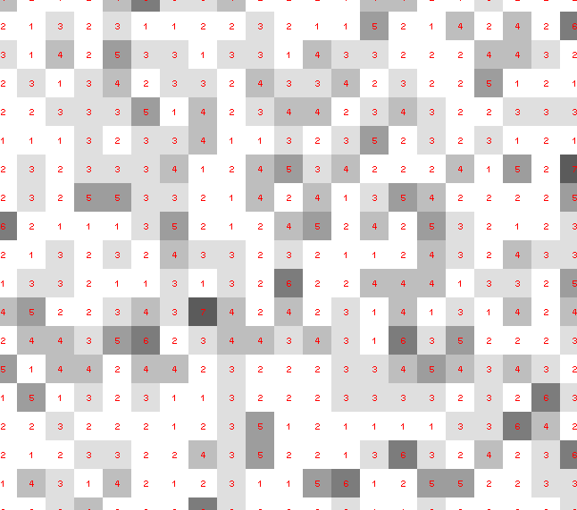
Dose slicing: is that a spot?

Slide 65
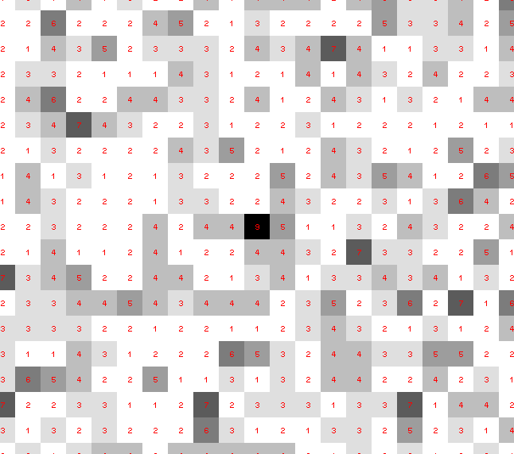
Dose slicing: is that a spot?

Slide 66
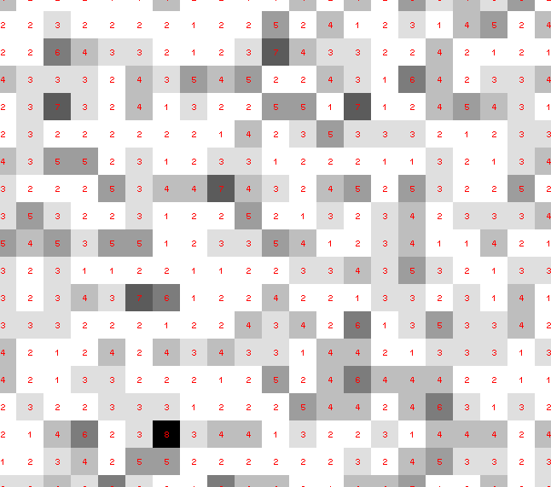
Dose slicing: is that a spot?

Slide 67
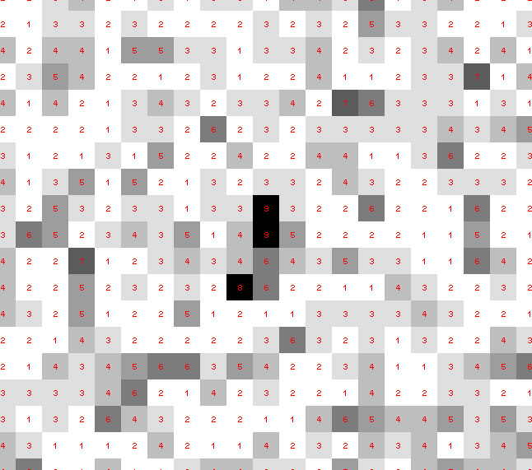
Dose slicing: is that a spot?

Slide 68
Dose slicing: is that a spot?

Slide 69
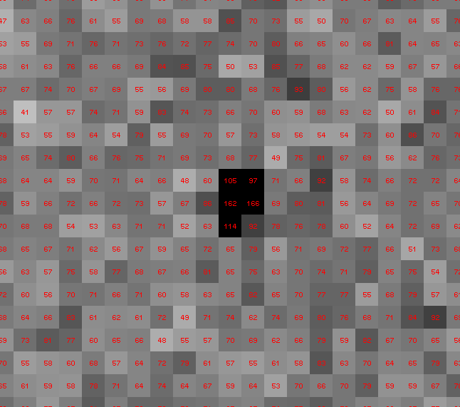
Dose slicing: is that a spot?

Slide 70
Single Photons Carry Information
About Radiation Damage
4
4
photons
photons
0
0
4
4
photons
photons
0
0
time
time

Slide 71
Prediction:
“painting mode” data collection =
damage-free data from synchrotron
zero-dose extrapolation that works
Why? Because everything is linear (to first order)

Slide 72
The R-factor Gap
1 + 1 = 1.4

Slide 73
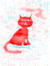
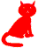
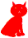
Dominant source of error in MX:
Cowtan’s Cat
+
=
Amplitudes
Phases
2F_{o}-F_{c}
http://www.ysbl.york.ac.uk/~cowtan/fourier/coeff.html

Slide 74
map error: simplest possible case
electron density (e⁻/Å³)
fractional coordinate

Slide 75
map error: simplest possible case
electron density (e⁻/Å³)
fractional coordinate

Slide 76
map error: simplest possible case
electron density (e⁻/Å³)
fractional coordinate

Slide 77
map error: simplest possible case
electron density (e⁻/Å³)
fractional coordinate

Slide 78
map error: simplest possible case
electron density (e⁻/Å³)
fractional coordinate

Slide 79
map error: simplest possible case
electron density (e⁻/Å³)
fractional coordinate

Slide 80
map error: simplest possible case
electron density (e⁻/Å³)
fractional coordinate

Slide 81
map error: simplest possible case
electron density (e⁻/Å³)
fractional coordinate

Slide 82
map error: 3-atom case
electron density (e⁻/Å³)
fractional coordinate

Slide 83
map error: 3-atom case
electron density (e⁻/Å³)
fractional coordinate

Slide 84
map error: 3-atom case
electron density (e⁻/Å³)
fractional coordinate

Slide 85
map error: 3-atom case
electron density (e⁻/Å³)
fractional coordinate

Slide 86
map error: 3-atom case
electron density (e⁻/Å³)
fractional coordinate

Slide 87
map error: 3-atom case
electron density (e⁻/Å³)
fractional coordinate

Slide 88
map error: 3-atom case
electron density (e⁻/Å³)
fractional coordinate

Slide 89
map error: 3-atom case
electron density (e⁻/Å³)
fractional coordinate

Slide 90
map error: 3-atom case
electron density (e⁻/Å³)
fractional coordinate

Slide 91
map error: 3-atom case
electron density (e⁻/Å³)
fractional coordinate

Slide 92
map error: 3-atom case
electron density (e⁻/Å³)
fractional coordinate

Slide 93
map error: asymmetric case
electron density (e⁻/Å³)
fractional coordinate

Slide 94
map error: asymmetric case
electron density (e⁻/Å³)
fractional coordinate

Slide 95
map error: asymmetric case
electron density (e⁻/Å³)
fractional coordinate

Slide 96
map error: asymmetric case
electron density (e⁻/Å³)
fractional coordinate

Slide 97
map error: asymmetric case
electron density (e⁻/Å³)
fractional coordinate

Slide 98
map error: asymmetric case
electron density (e⁻/Å³)
fractional coordinate

Slide 99
map error: asymmetric case
electron density (e⁻/Å³)
fractional coordinate

Slide 100
map error: asymmetric case
electron density (e⁻/Å³)
fractional coordinate

Slide 101
map error: asymmetric case
electron density (e⁻/Å³)
fractional coordinate

Slide 102
map error: asymmetric case
electron density (e⁻/Å³)
fractional coordinate

Slide 103
Magic?
Can CNN (fully-connected layer) “de-noise” phase errors?
NOT
noise !
+
AI?
density
known
recovered

Slide 104
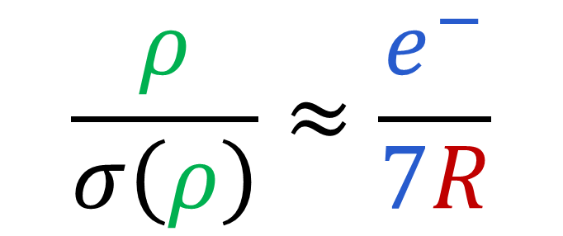
Map Noise: via Parseval’s Theorem
$$\frac{ρ}{σ\left(ρ\right)}≈\frac{e^{−}}{7R}$$
e⁻ number of electrons in peak
7 number of electrons in typical atom
R R_{iso} or R_{free}
ρ electron density peak
σ rms deviation expected

Slide 105
Dominant source of error in MX:
Cowtan’s Cat
+
=
Amplitudes
perfect
model
2F_{o}-F_{c}
http://www.ysbl.york.ac.uk/~cowtan/fourier/coeff.html

Slide 106
Prediction:
Closing the R-factor gap will
Simultaneously reveal correlated motions and low-lying map features
down to <1 e⁻
Why? Because small molecules can
and the data are good enough

Slide 107
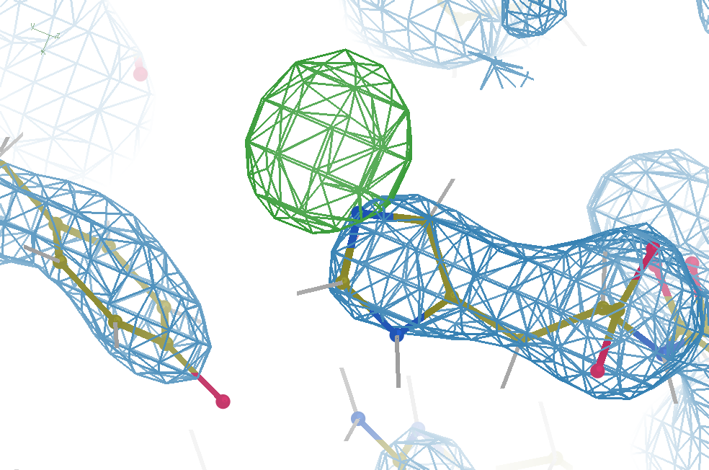
Hydrogen: visible at 3.5 Å resolution!
R_{work} = 0.04
R_{free} = 0.05
d_{min} = 3.5 Å
6σ = 1 e⁻
Simulation:
Realistic noise
“perfect” model

Slide 108
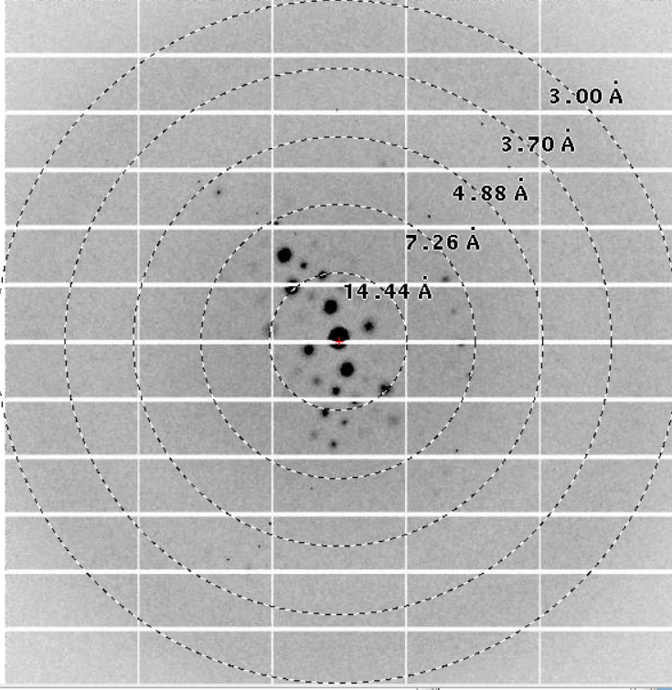
Reso | complete | R-factor | I/SIGMA | R-meas | CC(1/2) | AnoCC
10.82 | 82.4% | 2.1% | 80.11 | 2.3% | 100.0* | 62
7.65 | 100.0% | 2.2% | 81.73 | 2.3% | 100.0* | 74*
6.25 | 100.0% | 2.6% | 75.80 | 2.7% | 100.0* | 56*
5.41 | 100.0% | 2.7% | 71.37 | 2.8% | 100.0* | 49*
4.84 | 100.0% | 3.3% | 67.52 | 3.4% | 100.0* | 22
4.42 | 100.0% | 3.7% | 61.05 | 3.8% | 100.0* | 29
4.09 | 100.0% | 5.5% | 39.98 | 5.7% | 99.9* | 31
3.83 | 100.0% | 7.7% | 29.05 | 8.0% | 99.9* | 8
3.61 | 100.0% | 17.2% | 14.49 | 17.9% | 99.3* | 4
3.42 | 100.0% | 30.9% | 8.12 | 32.3% | 98.1* | -2
3.26 | 100.0% | 80.5% | 3.19 | 83.9% | 88.6* | -13
3.12 | 100.0% | 204.5% | 1.33 | 212.9% | 59.2* | -10
3.00 | 100.0% | 607.3% | 0.37 | 633.3% | 1.5 | -14
total | 99.5% | 3.3% | 31.86 | 3.5% | 100.0* | 6

Slide 109
Adding noise
14%² + 14%² +3%² ≈ 20%²
R_{protein}+R_{solv} +R_{sym} ≈ R_{cryst}

Slide 110
Adding noise
14%² + 14%² +0%² ≈ 20%²
R_{protein}+R_{solv} +R_{sym} ≈ R_{cryst}

Slide 111
Adding noise
14%² + 14%² = 20%²
R_{protein} + R_{solvent} ≈ R_{cryst}

Slide 112
Adding noise
14%² + 0%² = 14%²
R_{protein} + R_{solvent} ≈ R_{cryst}
_{tangling echoes}

Slide 113

The UNTANGLE Challenge
https://github.com/jmholton/UnTangle

Slide 114
A

Slide 115
B

Slide 116
A

Slide 117
?
?
B

Slide 119
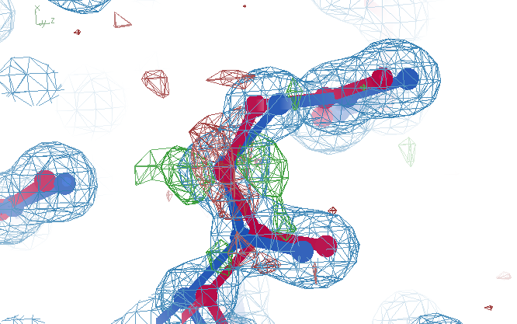
tangled
Ala39
wE=17.2
R_{free}=3.71
A B conformers

Slide 120
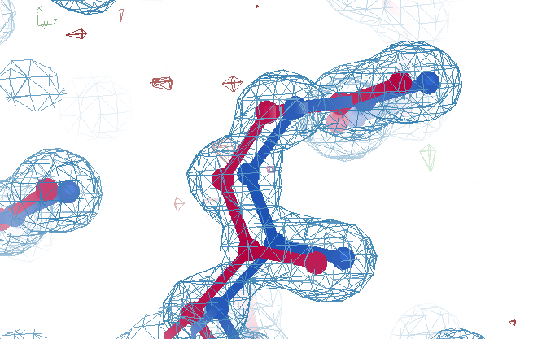
untangled
Ala39
wE=18.2
R_{free}=3.14
A B conformers

Slide 121



density misfit
Chemical
strain
energy
A
A
B
B
B
A
tangled
barrier
untangled

Slide 122








Travelling Salesman Problem Analogy
Spencer Passmore - Swinburne University, Melbourne, Australia
2 possible costs per bond
(AA-BB, AB-BA)
4 possible costs per angle
(AAA-BBB, BAA-ABB, ABA-BAB, AAB-BBA)
../build1/
Minimum:
Minimize
we find 20 or so structures with the lowest values for C, then perform restrained refinement

Slide 123

Long-range traps from rectified SA
wE=21.4
R_{free}=3.48
Match ground-truth
swapped relative
To ground truth

Slide 124

best.pdb
wE=18.2
R_{free}=3.14
Match ground-truth
Nothing
swapped relative
To ground truth

Slide 125
Prediction:
Untangling Ensemble Models will
reveal correlated motions
Why? Because nothing else fits better

Slide 126

Diffuse Scatter
Ground
Truth

Slide 127

Diffuse Scatter
Long
Range
Traps

Slide 128
Correct
ensemble
Diffuse Scatter
Wrong
ensemble

Slide 129

Diffuse Scatter
Lots
Wrong

Slide 130
Correct
ensemble
Diffuse Scatter
Lots
Wrong

Slide 131

Correct
ensemble
Diffuse Scatter
Val1

Slide 132


Diffuse Scatter
Ala39
swapped

Slide 133

Correct
ensemble
Diffuse Scatter
Ala39
swapped

Slide 134

Diffuse scatter: at scale

Slide 135


Diffuse scatter: at scale

Slide 136
Prediction:
Diffuse Scatter will
reveal correlated motions
Why? Because anything is possible
with enough averaging

Slide 137

Ensemble model flattens differences
All difference
features
are in
the solvent!
real data

Slide 138
Things I’ve tried that didn’t work
Molecular dynamics
Simulated annealing
High-copy ensemble refinement
  “liquid helium” solvent
  48-copy protein
SQUEEZE
Sharp-edged masks
“touch up”

Slide 139

Molecular Dynamics of crystals
65
60
55
50
45
40
35
unrestrained
R_{free} (%)
restrained
Time (ns)

Slide 140
Solvent models vs real data
Method | R_{work} | R_{free}
Default refmac5: flat bulk solvent | .1784 | .1898
RISM – protein fixed multi-conformer weighted | .1578 | .1739
Molecular dynamics average bulk solvent | .1440 | .1666
MD avg bulk solvent + watershed + 48 copies protein | .1059 | .1295

Slide 141

many-conformer & explicit solvent
R_{work} = 0.0309
R_{free} = 0.0678
vs F_{sim}
Problem: diverges with more cycles

Slide 142
High-copy ensembe refinement is unstable
R factor (%)
Phenix macro-cycle

Slide 143
Crowded-atom problem

Slide 144
Crowded-atom problem

Slide 145
How to stabilize refinement?
Do just 1 macro cycle
Apply overall scale factor to occupancies
Scale all changes back so that:
  max XYZ shift <= 0.01 Å
  Max occ shift <= 0.01
  Max B shift <= 1
Repeat 1

Slide 146
Small steps = stable refinement
R factor (%)
Phenix macro-cycle

Slide 147
Status of macromolecular representation:
Even if we start with the “right answer”
it will blow up.
Need better model

Slide 148


Ton Spek’s SQUEEZE
https://doi.org/10.1107/S2053229614024929

Slide 149

Even a “do nothing” FFT can impact map

Slide 150

Solvent “touch-up”
Δ Electron density (σ)
position along x (Å)

Slide 151

Solvent “touch-up”
Δ Electron density (σ)
Δ Electron density (σ)
probability
position along x (Å)
position along x (Å)

Slide 152

Solvent “touch-up”
Δ Electron density (σ)
probability
position along x (Å)

Slide 153

Solvent “touch-up”
Δ Electron density (σ)
probability
position along x (Å)

Slide 154

Solvent “touch-up”
Δ Electron density (σ)
probability
position along x (Å)

Slide 155

Solvent “touch-up”
Δ Electron density (σ)
position along x (Å)

Slide 156

Solvent “touch-up”
Δ Electron density (σ)
probability
position along x (Å)

Slide 157

Solvent “touch-up”
Δ Electron density (σ)
position along x (Å)

Slide 158
Key Challenges to
Unlocking the True Power of Macromolecular Crystallography
Signal-to-noise can be awesome
Stills should be better
Non-isomorphism is annoying
Radiation damage is correctable
R-factor gap
  Untangling ensemble models
  Capturing solvent

