Slide 1
Acknowledgements
Tom Caradoc-Davies Ed Domning George Meigs
Aina Cohen Ana Gonzalez Mike Soltis
UCSF LBNL SLAC
ALS 8.3.1 creator: Tom Alber
UC Multicampus Research Programs and Initiatives (MRPI)
UCSF Program for Breakthrough Biomedical Research (PBBR)
one-time NIH-DOE Inter-agency agreement (IAA)
Integrated Diffraction Analysis Technologies (IDAT)
Plexxikon, Inc.
M D Anderson CRC
Synchrotron Radiation Structural Biology Resource (SLAC)
The Advanced Light Source is supported by the Director, Office of Science, Office of Basic Energy Sciences, Materials Sciences Division, of the US Department of Energy under contract No. DE-AC02-05CH11231 at Lawrence Berkeley National Laboratory.

Slide 2
Conclusions
Measure your beam stability through a pinhole!
No such thing as “shutterless”
Pile up: problem for RT MX?
Solution: attenu-wait?

Slide 3
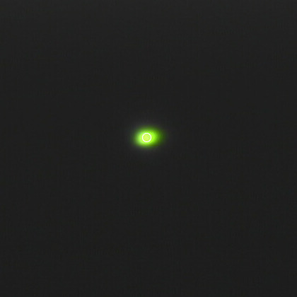
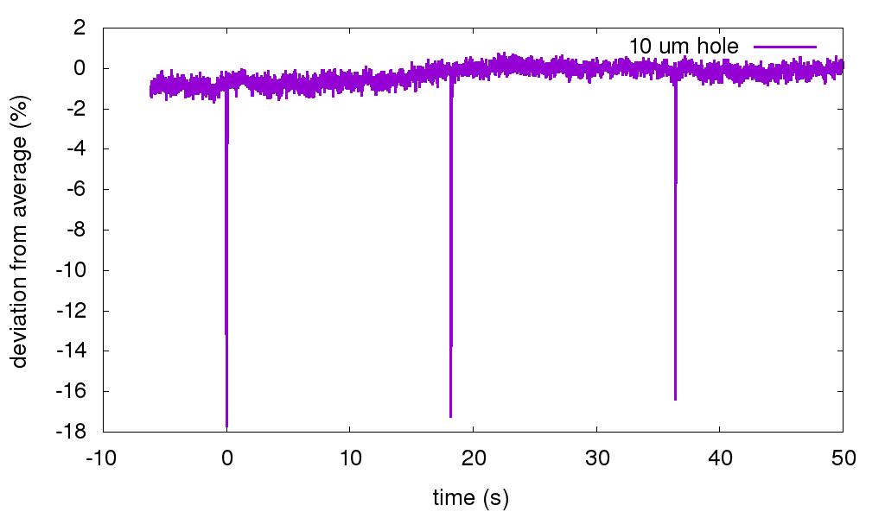
Measured Beam Flicker
Silicon PIN photodiode after pinhole

Slide 4
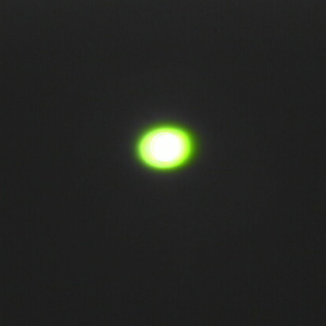
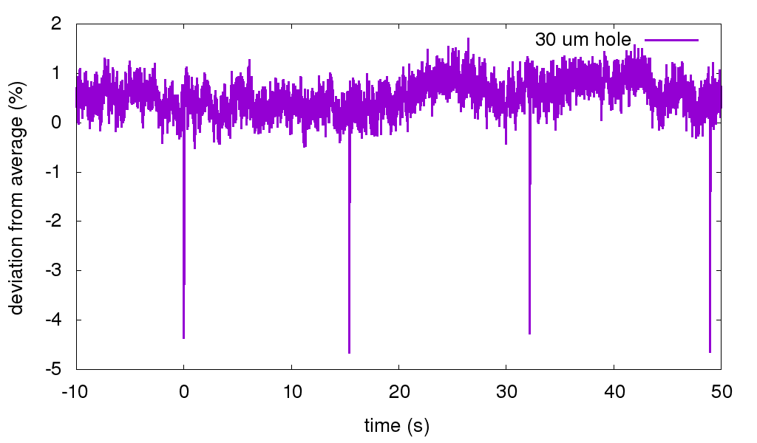
Measured Beam Flicker
Silicon PIN photodiode after pinhole

Slide 5
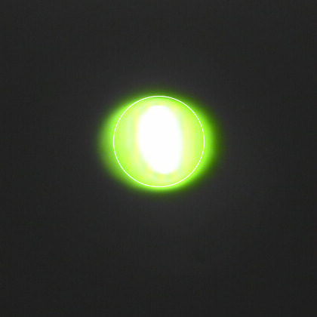
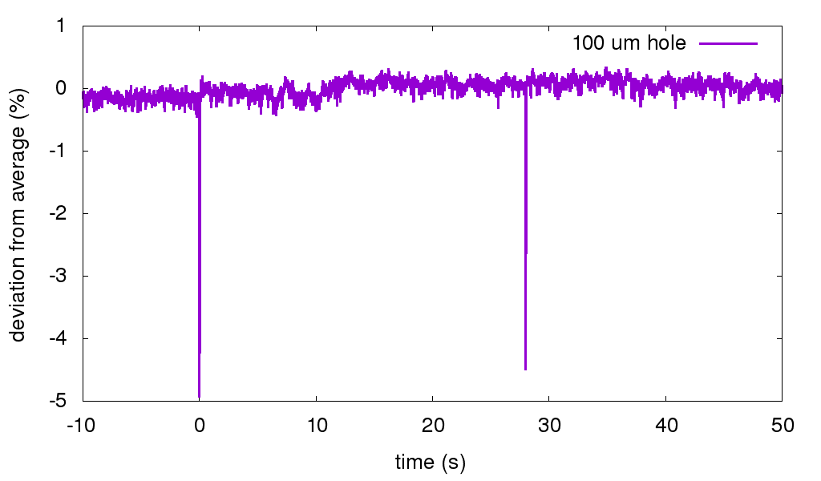
Measured Beam Flicker
Silicon PIN photodiode after pinhole

Slide 6
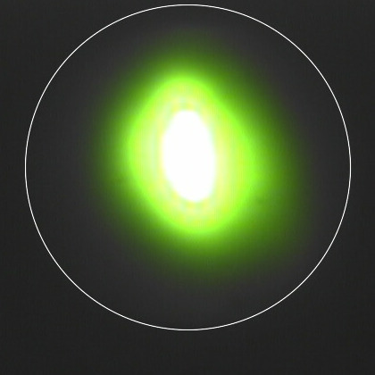
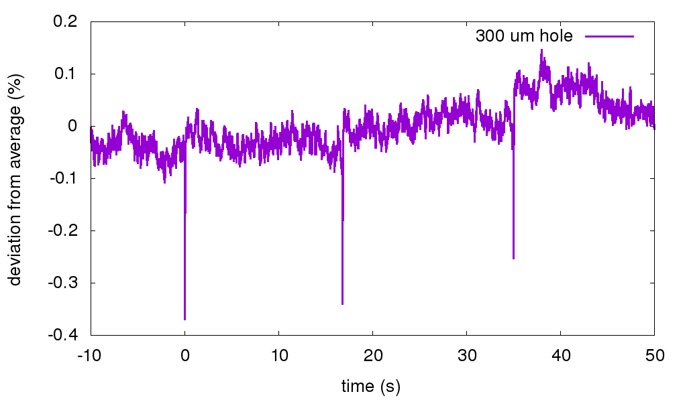
Measured Beam Flicker
Silicon PIN photodiode after pinhole

Slide 7
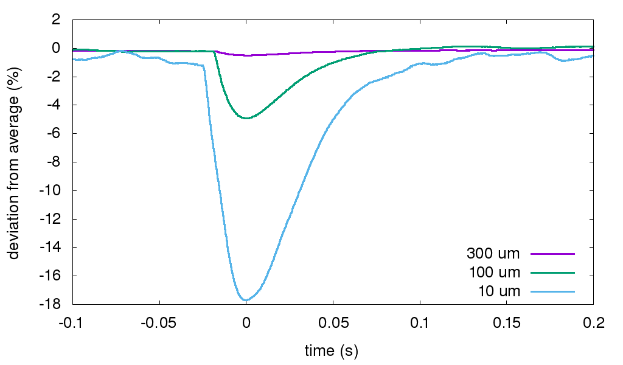
Top-up pulse vs pinhole size

Slide 8
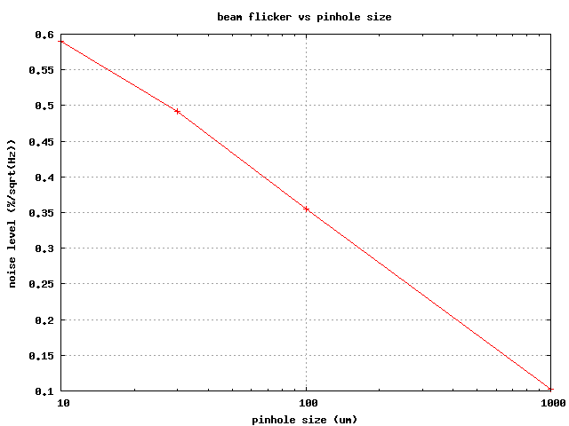
RMS flicker vs pinhole size
Noise level ( % / sqrt(Hz) )
10 100 1000
Pinhole size (μm)

Slide 9
What is the beam doing?
Not this

Slide 10
What is the beam doing?
Not this

Slide 11
What is the beam doing?
Must be this?

Slide 12
Beam Flicker
pinhole
removed
normalized flux through pinhole
time (seconds)

Slide 13
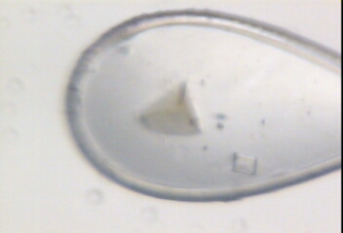
This is an Aperture!

Slide 14
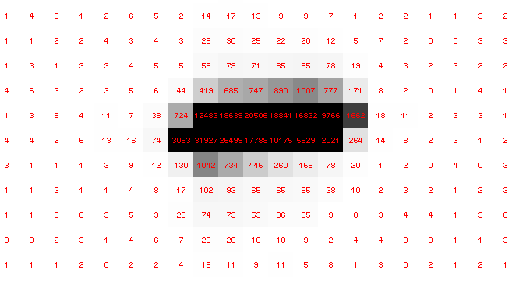
Pilatus pile-up for RT MX? same photons, different speeds
Sum of 193 shots with
193-fold attenuation

Slide 15
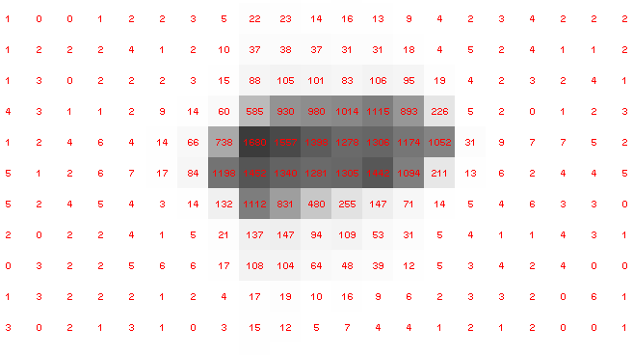
Pilatus pile-up for RT MX? same photons, different speeds
1 shot with
no attenuation

Slide 16
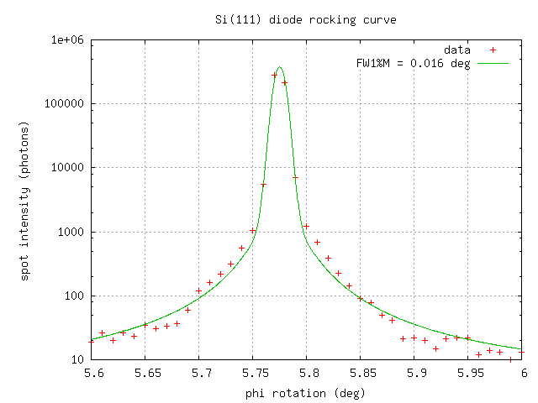
Pilatus pile-up for RT MX? same photons, different speeds
0.016° mosaic

Slide 17
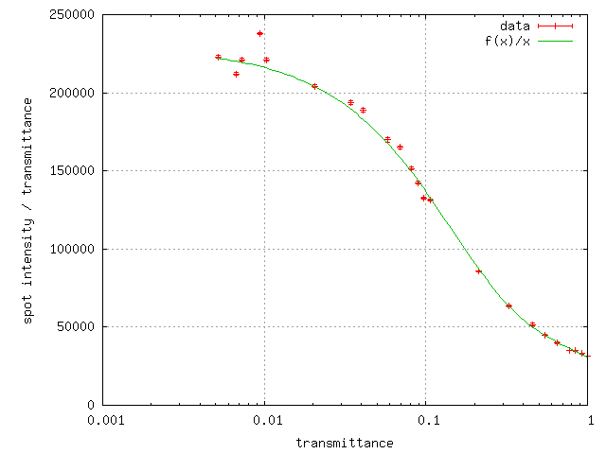
Pilatus pile-up for RT MX? same photons, different speeds
20 deg/s
0.016 deg mosaic

Slide 18
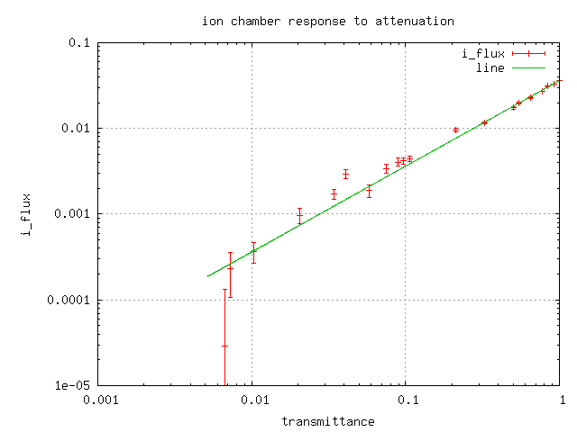
Pilatus pile-up for RT MX? same photons, different speeds

Slide 19
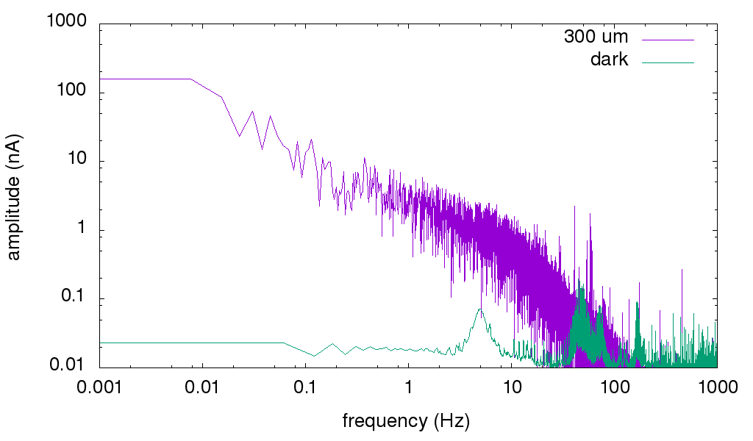
Flicker noise power spectrum

Slide 20
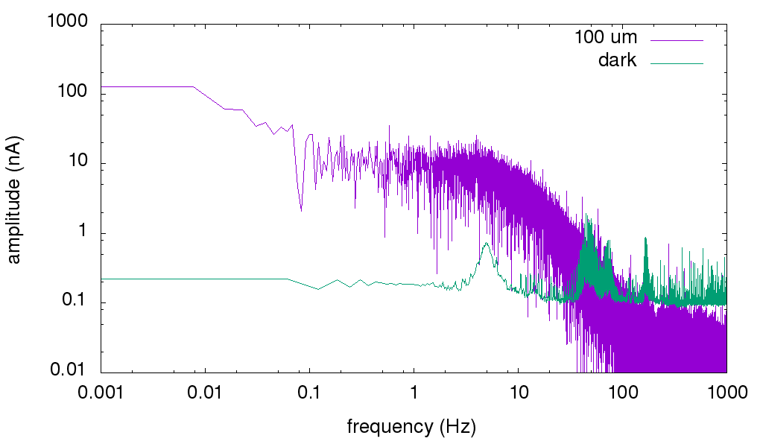
Flicker noise power spectrum

Slide 21
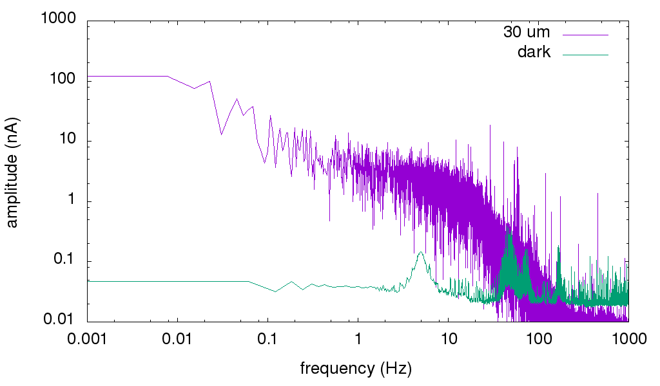
Flicker noise power spectrum

Slide 22
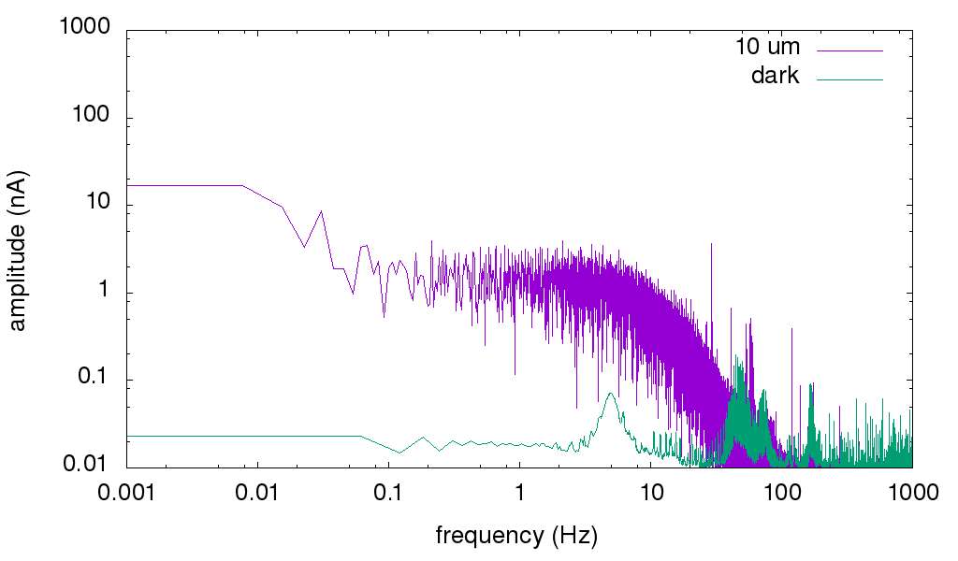
Flicker noise power spectrum

Slide 23
Shutter Jitter
PHIZ from MOSFLM (deg)
frame number

Slide 24
Shutter Jitter
PHIZ from MOSFLM (deg)
frame number

Slide 25
Shutter Jitter
shutter timing error (ms)
rms 0.47 ms
frame number

Slide 26
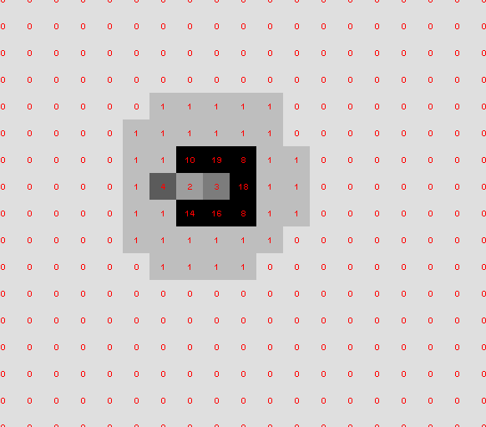
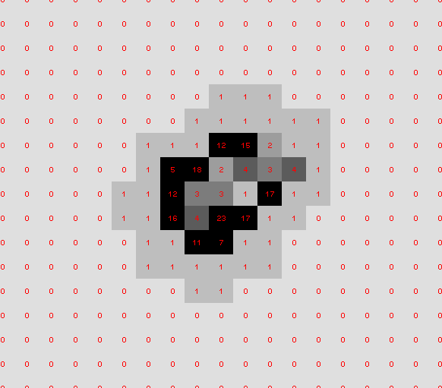
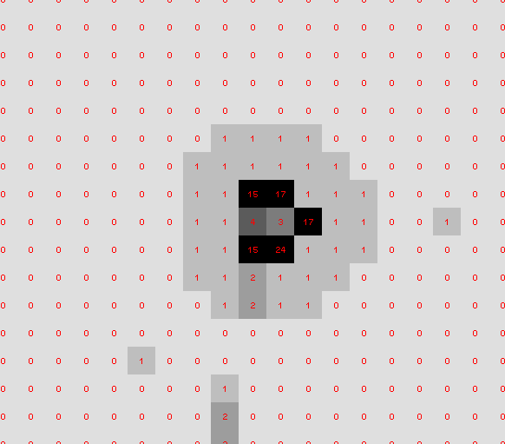
What are these?

Slide 27
Conclusions
Measure your beam stability through a pinhole!
No such thing as “shutterless”
Pile up: problem for RT MX?
Solution: attenu-wait?

