Slide 1
ALS 8.3.1 Upcoming Upgrades
Unattended screening
Kappa goniostat
Adjustable beam size 300 μm – 10 μm
Multilayers for rastering
ALS-U in 2022

Slide 2
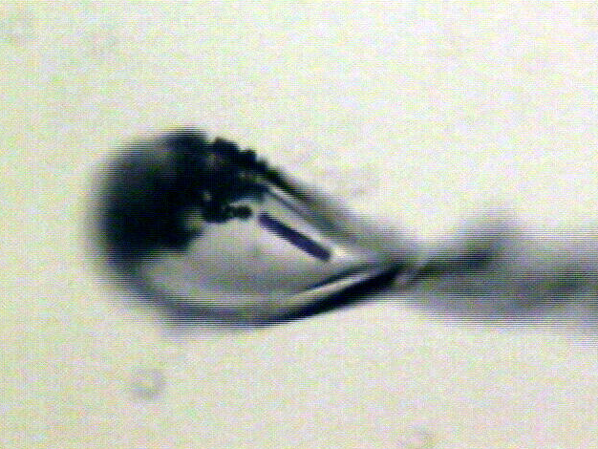
“rastering” to find the crystal
X-ray beam
ice
Membrane
protein crystal

Slide 3
Why not just “raster” everything?
Rastering Needs:
Small beam
Very high flux
fast detector
Rapid image analysis
Small search area

Slide 4
Rastering is robust, but slow
Damage & diffraction = flux / area
Gy/s = ph/s /2000 / um²
Example: flux= 10¹² ph/s, 1 mm² beam = 500 Gy/s
100% sample life → 30 MGy / 500 Gy/s = 17 hours
10% sample life → 3 MGy / 500 Gy/s = 1.7 hours
1% sample life → 300 kGy / 500 Gy/s = 10 min
Holton (2009)."beginner's guide rad dam", J. Synch. Rad. 16, 133-142.

Slide 5
Rastering is robust, but slow
Damage & diffraction = flux / area
Gy/s = ph/s /2000 / um²
Example: 10% life, 1 mm² sample, flux= 10¹² ph/s
10x10 μm beam: 0.6 s
100x100 μm beam: 60s x 10x10 shots =
x 100x100 shots =
1.7 hours
1.7 hours
1% life → 10 min
1% life & 10¹³ ph/s → 1 min
Holton (2009)."beginner's guide rad dam", J. Synch. Rad. 16, 133-142.

Slide 6
Rastering is robust, but slow
Damage & diffraction = flux / area
time/mm² is fixed by flux
Example: ALS 8.3.1 – 200 kGy/s = 15 s for 10% lifedose
50 μm hole: 20x20 shots = 210 s/mm²
30 μm hole: 33x33 shots = 320 s/mm²
10 μm hole: 100x100 shots = 2730 s/mm²
10 μm hole + multilayer: 70 s/mm²
Holton (2009)."beginner's guide rad dam", J. Synch. Rad. 16, 133-142.

Slide 7
Rastering is robust, but slow
Damage & diffraction = flux / area
time/mm² is fixed by flux
Example: ALS 8.3.1 – 200 kGy/s ; 1% lifedose
50 μm hole: 20x20 shots = 21 s/mm²
30 μm hole: 33x33 shots = 32 s/mm²
10 μm hole: 100x100 shots = 273 s/mm²
10 μm hole + multilayer: 7 s/mm²
Holton (2009)."beginner's guide rad dam", J. Synch. Rad. 16, 133-142.

Slide 8
Rastering is robust, but slow
Damage & diffraction = flux / area
time/mm² is fixed by flux
Example: ALS 8.3.1 – 200 kGy/s ; 1% lifedose
50 μm hole: 20x20 shots = 21 s/mm² 20 Hz
30 μm hole: 33x33 shots = 32 s/mm² 35 Hz
10 μm hole: 100x100 shots = 273 s/mm² 37 Hz
10 μm hole + multilayer: 7 s/mm² 2 kHz
Holton (2009)."beginner's guide rad dam", J. Synch. Rad. 16, 133-142.

Slide 9
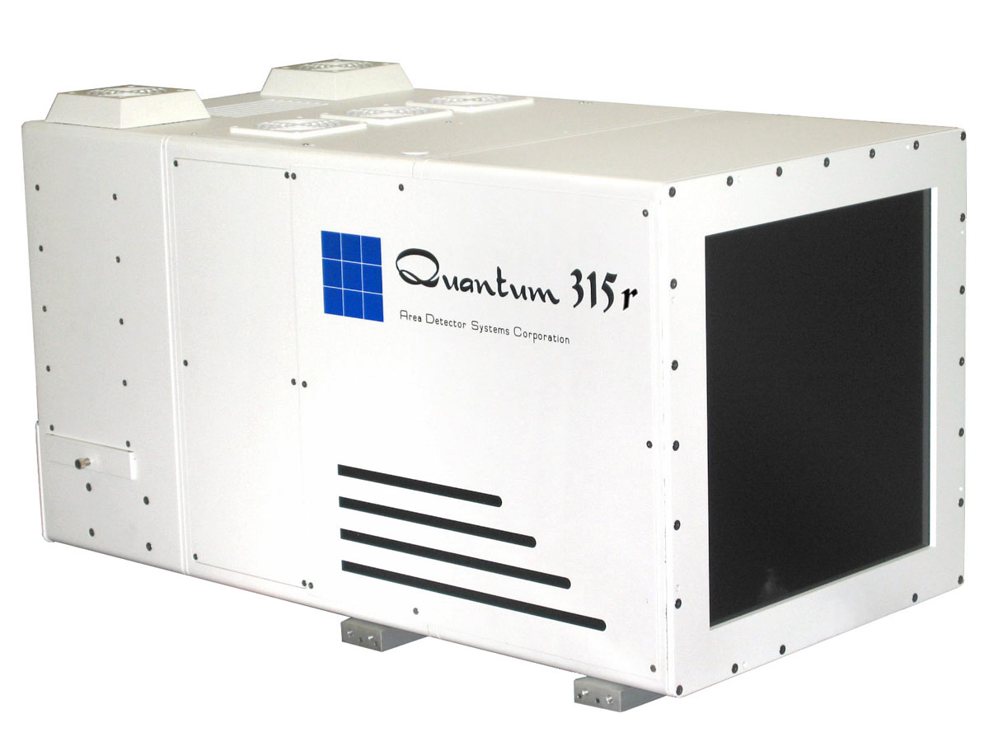
Low cost, portable rastering solution
Collaboration: 8.3.1 and MBC beamlines
Existing
Retractable
Front cover
Sample crystal
In cryo-loop
(not to scale)
Existing MX detector
0.4 frames/s
Photon/noise = 0.4
New
CMOS detector
($70,000)
20 frames/s
photon/noise = 2
http://researchdetectors.com/cmos_1m.html

Slide 10
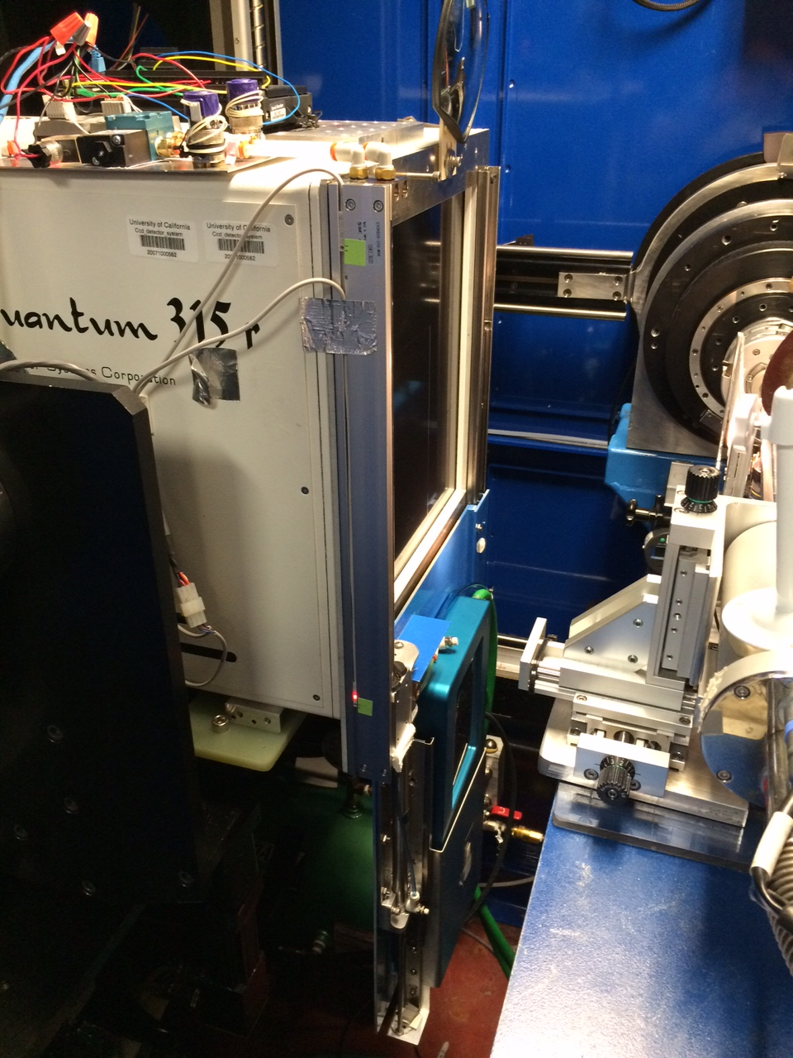

Slide 11
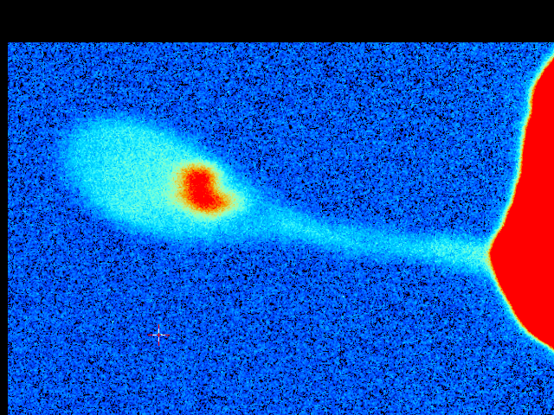
Cone-Beam Online X-ray
Absorption Radiography
(CBOXAR)
3%
2%
1%
0
MX
area
detector
beam center
crystal in loop
Cu foil
X-ray excited
fluorescent
X-ray source
x-ray beam

Slide 12
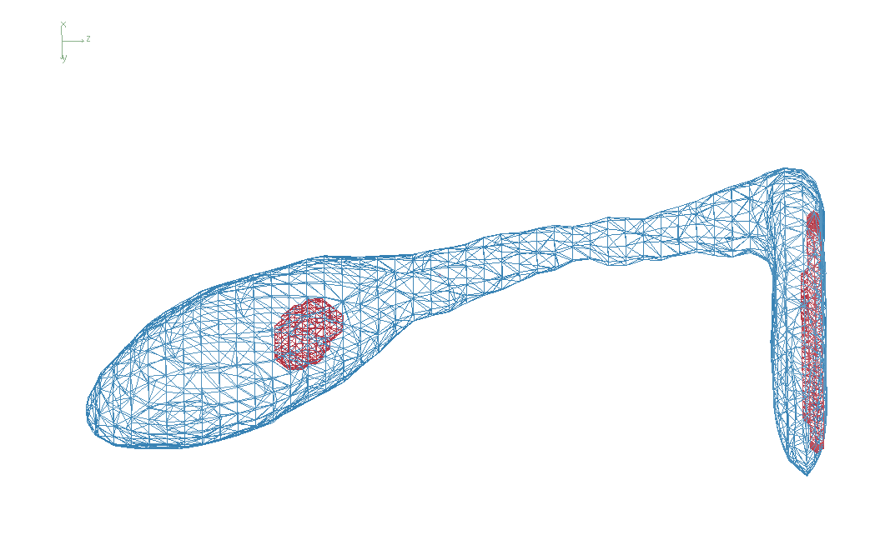
Cone-Beam Online X-ray Absorption Radiograph (CBOXAR)

Slide 13
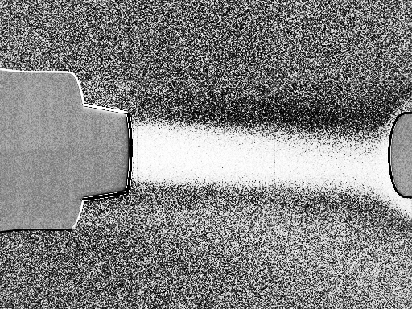
Contrast of 90% solvent
protein xtal in pure water: 0.2%
0.2% high
average
0.2% low
Cryo-jet
nozzle
cold gas
Goniometer
magnet

Slide 14
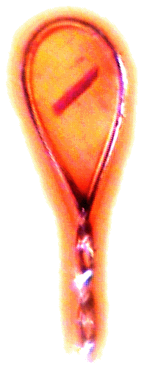
Zero-parallax simplifies alignment
Styrofoam™ backlight
backstop
prism
pinhole
microscope

Slide 15
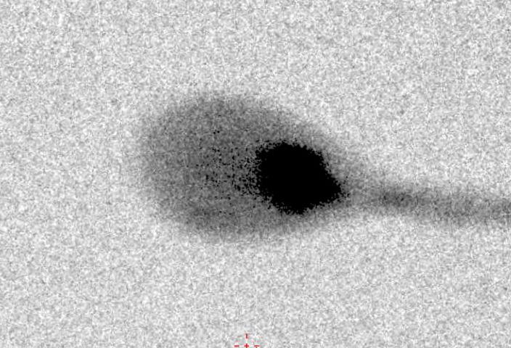
Zero-parallax simplifies alignment
X-ray

Slide 16
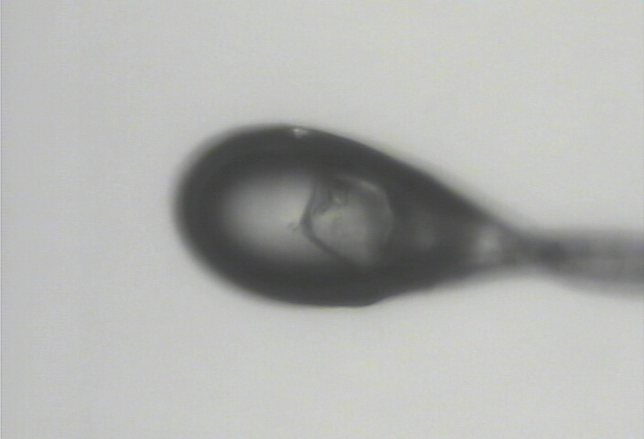
Zero-parallax simplifies alignment
visible light

Slide 17
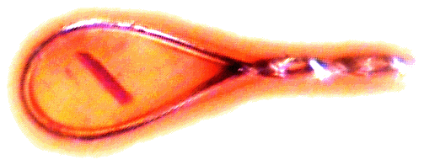
Automatic and Unattended Optical Re-Alignment (AUORA)
beamline
microscope
reference
image

Slide 18
Automatic and Unattended Optical Re-Alignment (AUORA)
search

Slide 19
Automatic and Unattended Optical Re-Alignment (AUORA)
search

Slide 20
Automatic and Unattended Optical Re-Alignment (AUORA)
search

Slide 21
Automatic and Unattended Optical Re-Alignment (AUORA)
search

Slide 22
Automatic and Unattended Optical Re-Alignment (AUORA)
search

Slide 23
Automatic and Unattended Optical Re-Alignment (AUORA)
match

Slide 24
Automatic and Unattended Optical Re-Alignment (AUORA)
move

Slide 25
Automatic and Unattended Optical Re-Alignment (AUORA)
4.5 s Acquire 360°
3.0 s Algorithm
5.0 s Motor moves
aligned

Slide 26
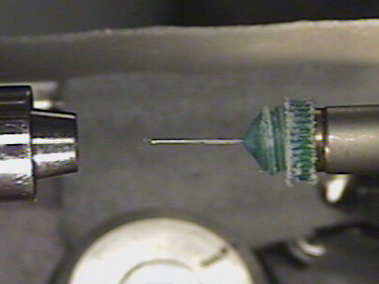

Slide 27
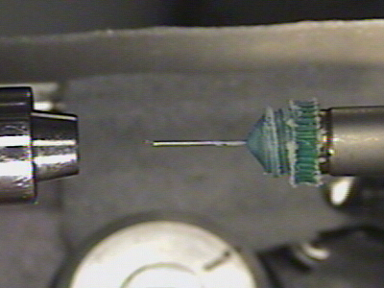

Slide 28
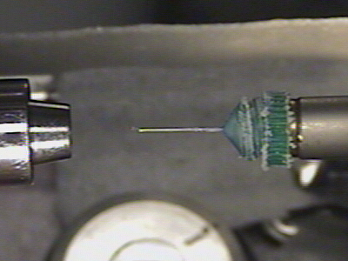

Slide 29
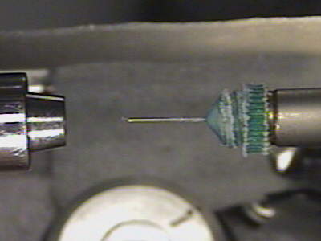

Slide 30
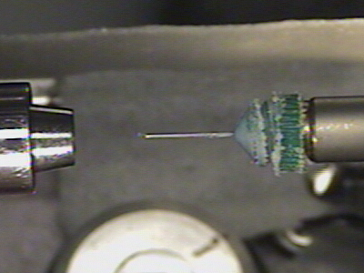

Slide 31
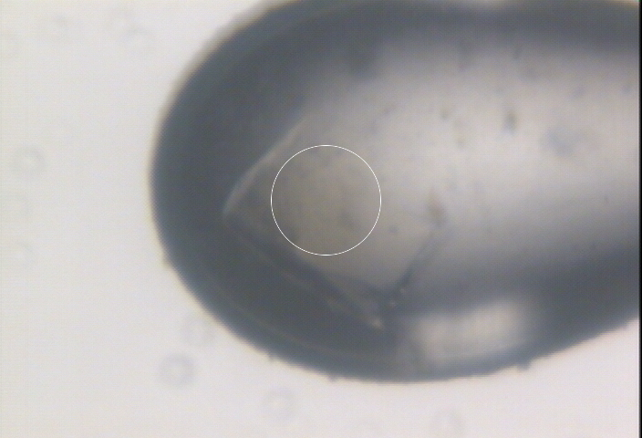

Slide 32
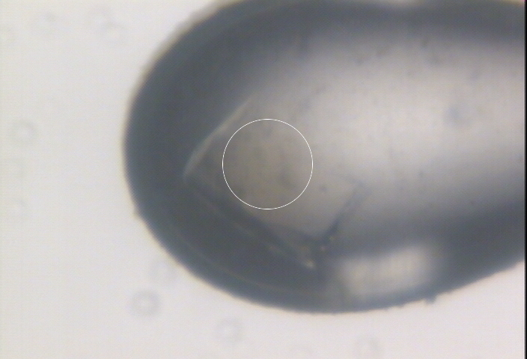

Slide 33
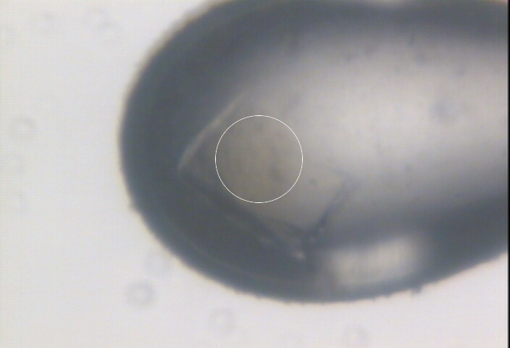

Slide 34
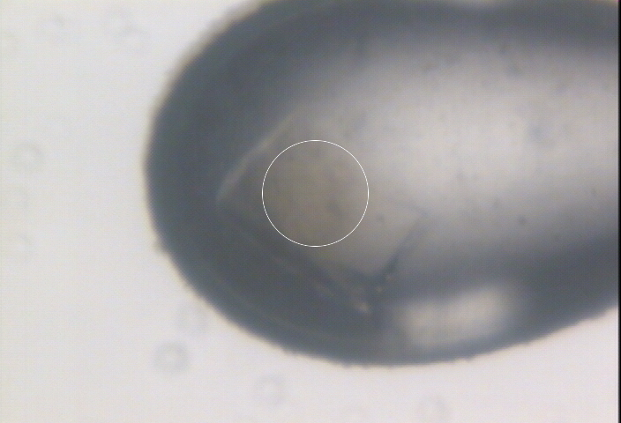

Slide 35
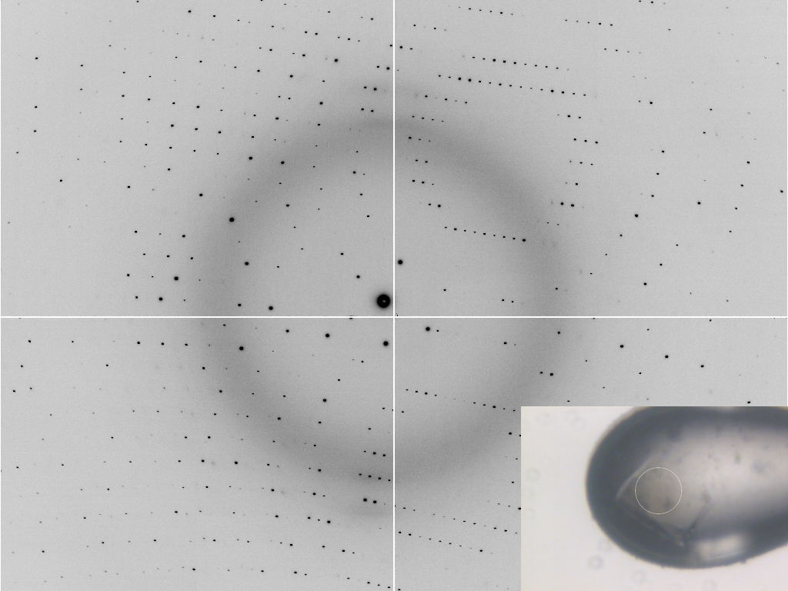

Slide 36
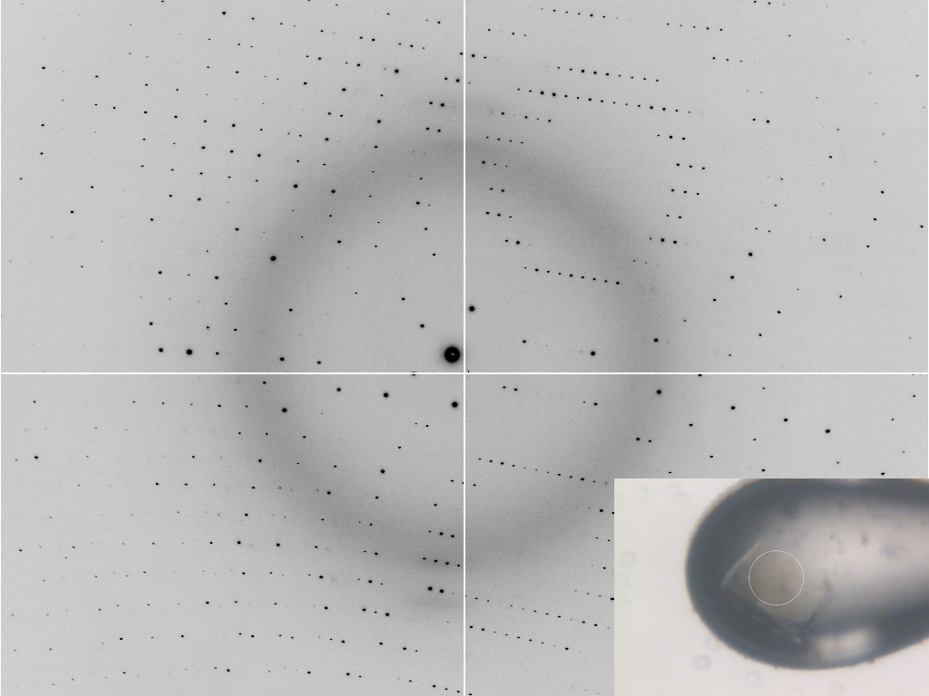

Slide 37
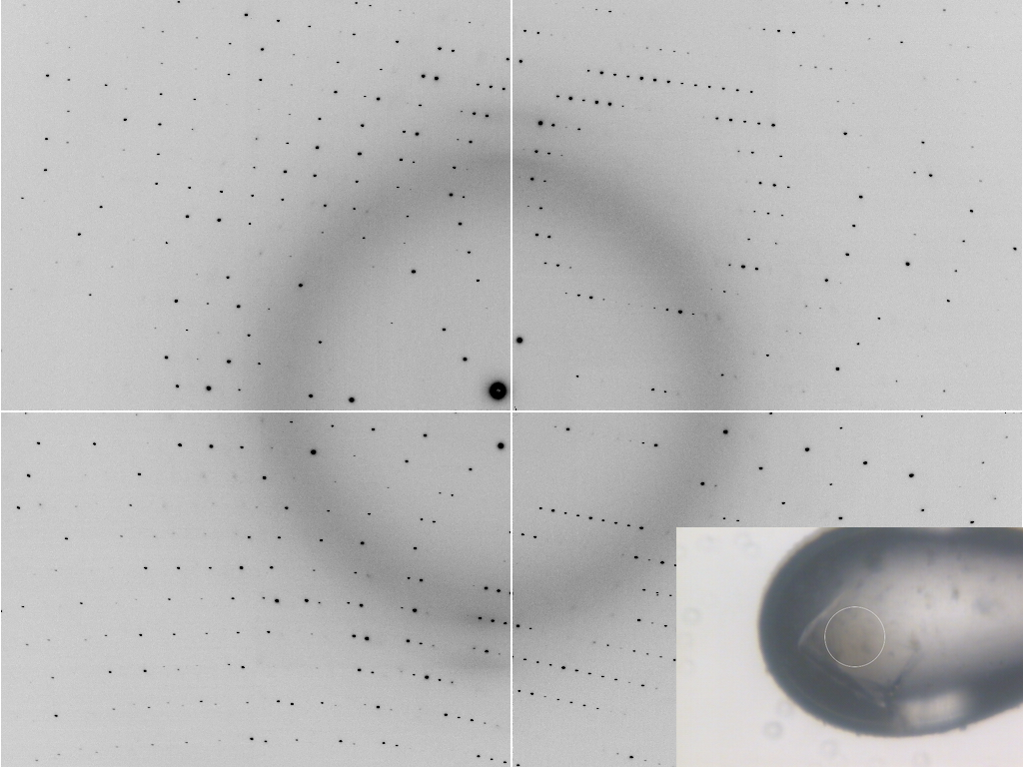

Slide 38
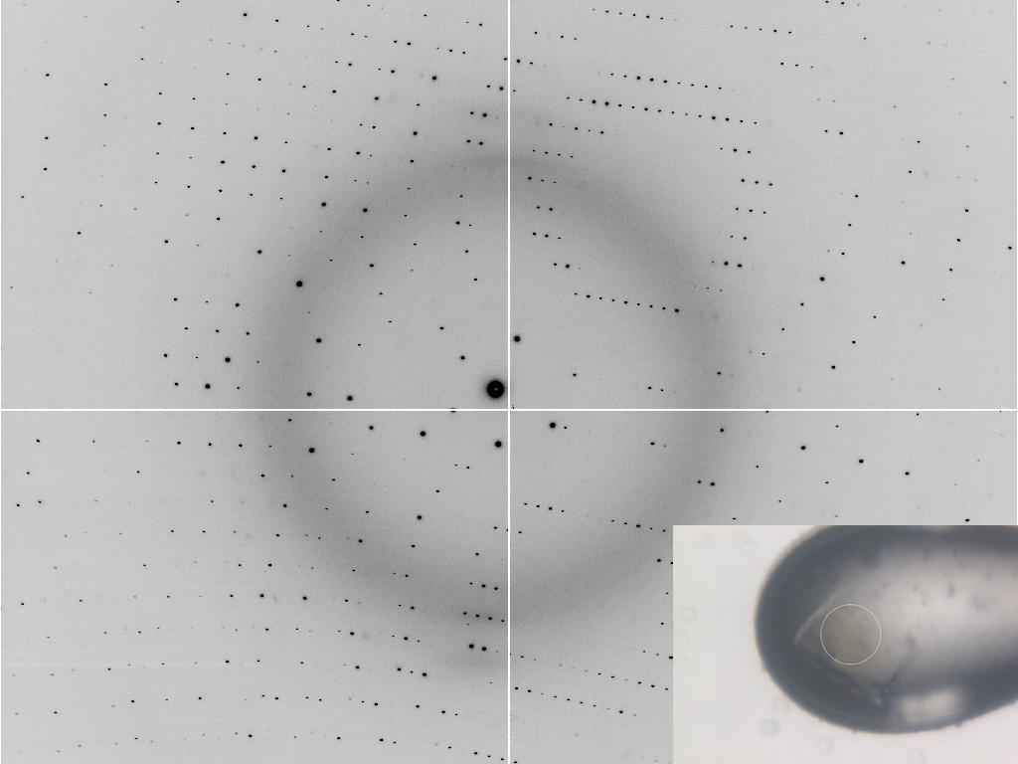

Slide 40
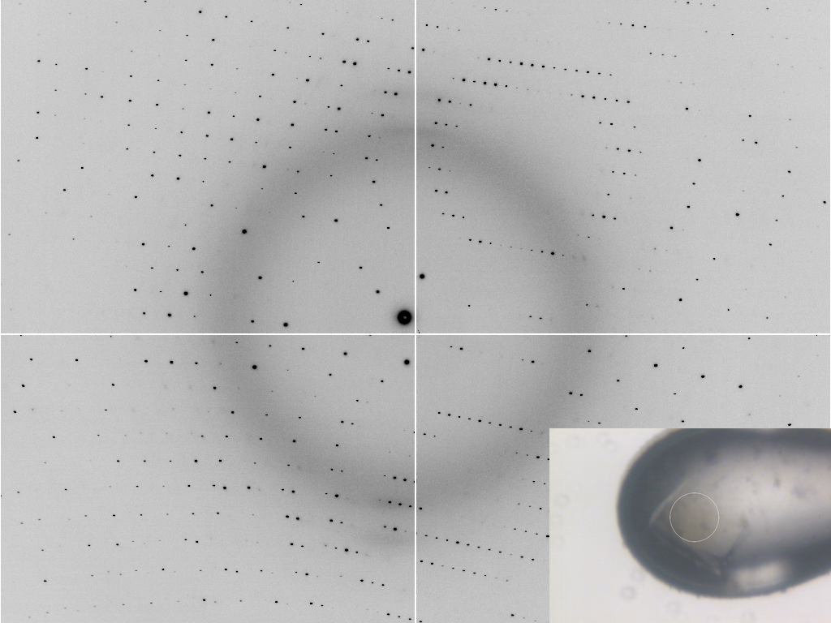

Slide 41
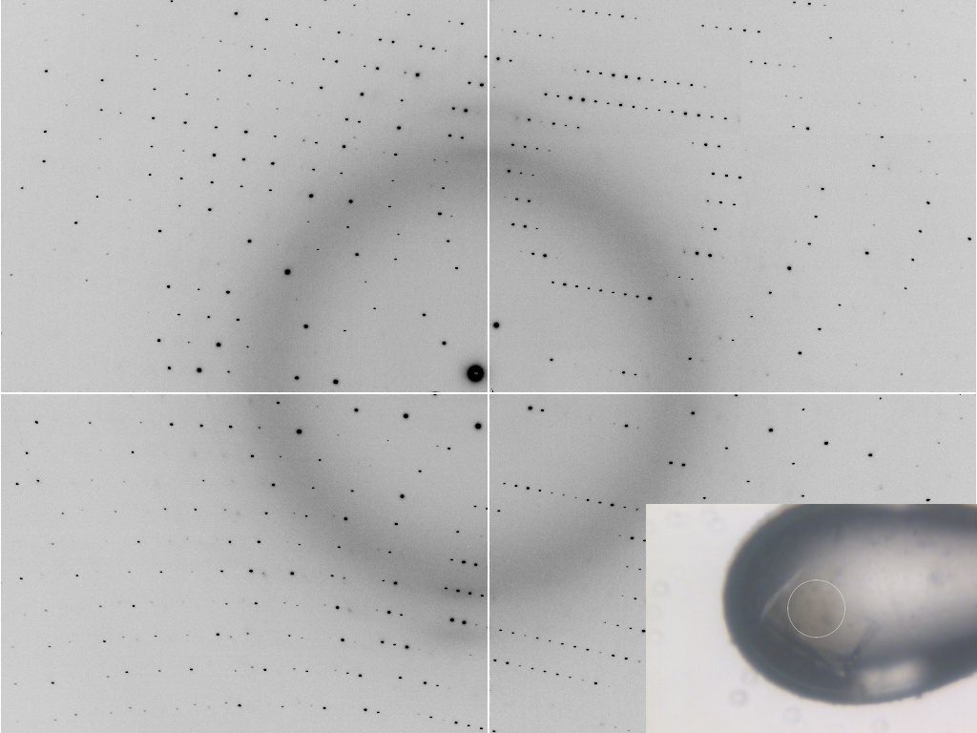

Slide 42
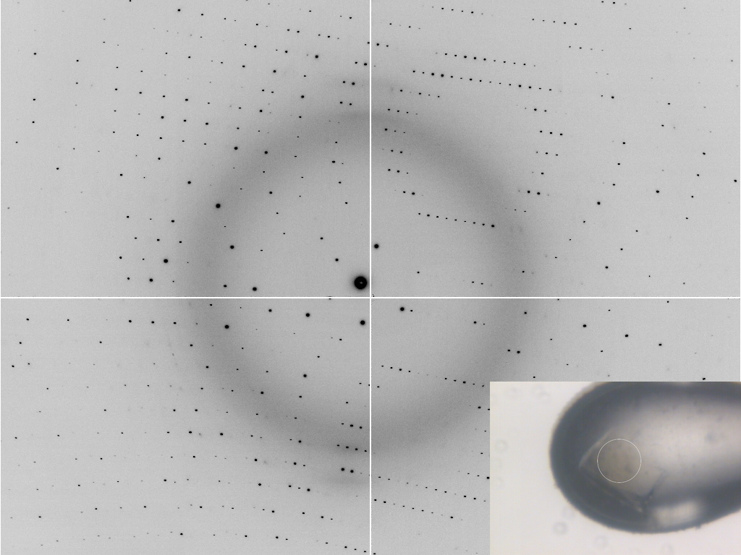

Slide 43
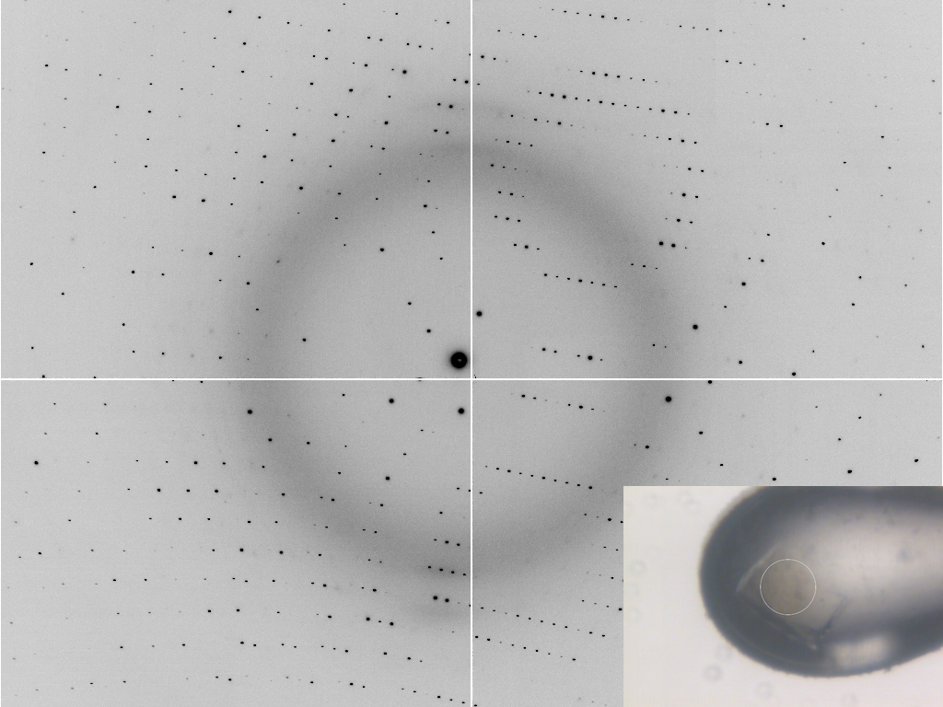

Slide 45
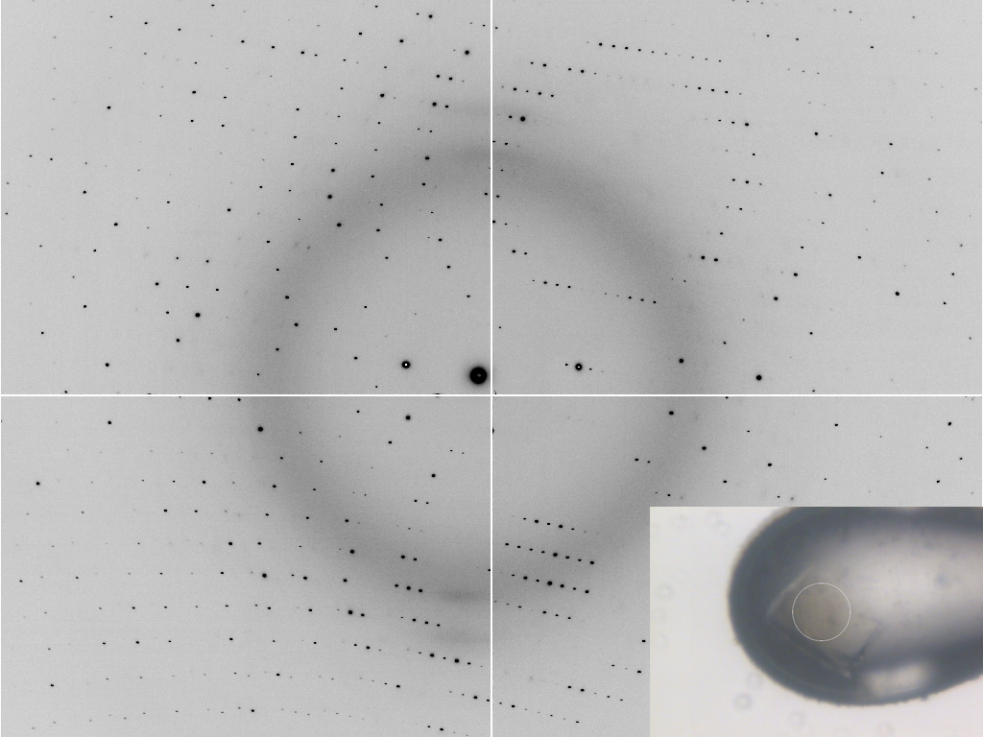

Slide 46
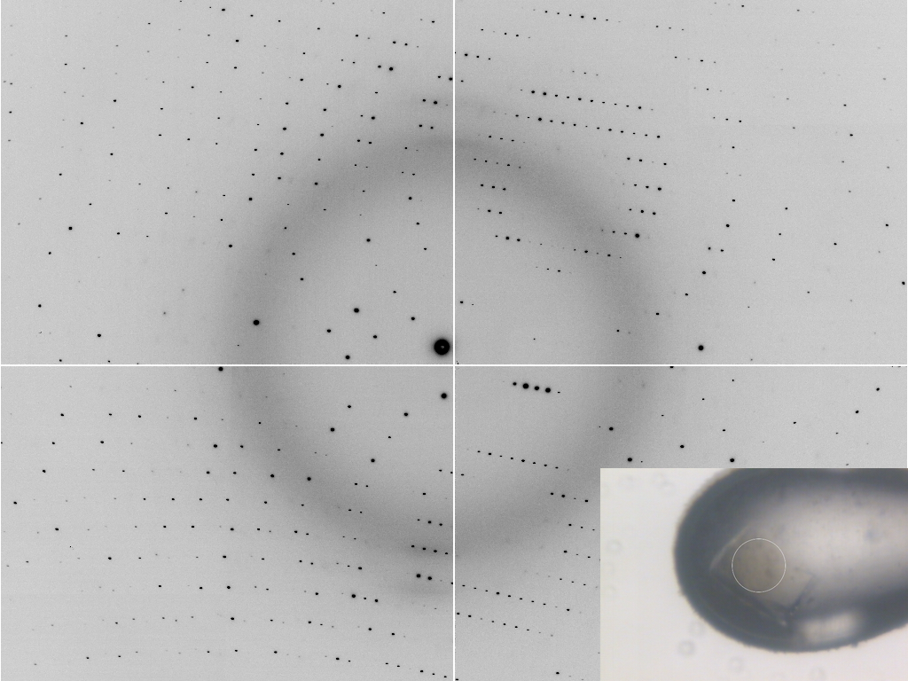

Slide 48
Automatic and Unattended Optical Re-Alignment (AUORA)
~12 s mount→shutter Accuracy: ~2 pix ~1-2 °

Slide 49
ALS 8.3.1 Upcoming Upgrades
Unattended screening
Kappa goniostat
Adjustable beam size 300 μm – 10 μm
Multilayers for rastering
ALS-U in 2022

Slide 50
SmarAct’s
“SmarGon”
Commercialized
PRIGo

Slide 51
ALS 8.3.1 Upcoming Upgrades
Unattended screening
Kappa goniostat
Adjustable beam size 300 μm – 10 μm
Multilayers for rastering
ALS-U in 2022

Slide 52
“8-shooter” adjustable beam size
rotary
pinholes:
300
100
75
50
30
25
10
“small”

Slide 53
Resolution (Å)
too big
too small
just right
X-ray beam size (μm)

Slide 54
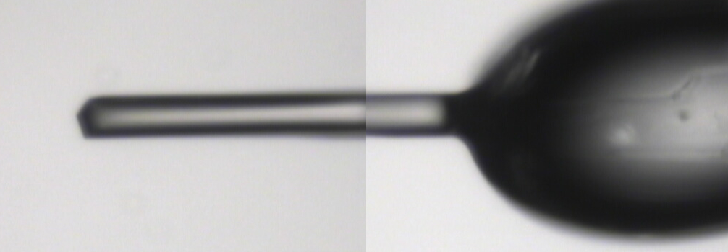
~0 MGy

Slide 55
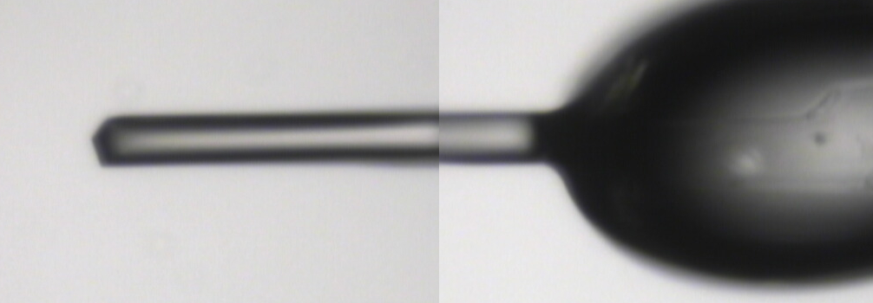
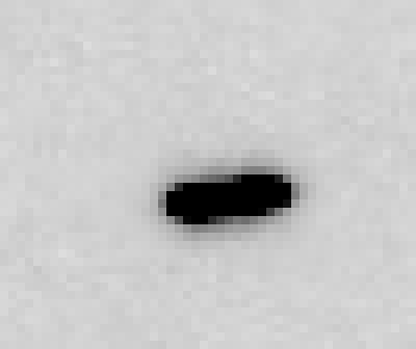
5 MGy

Slide 56
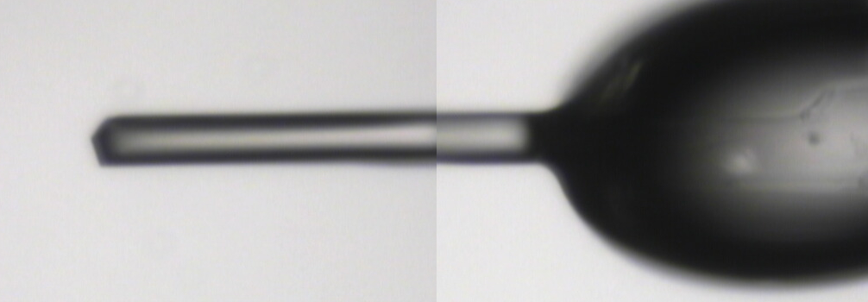
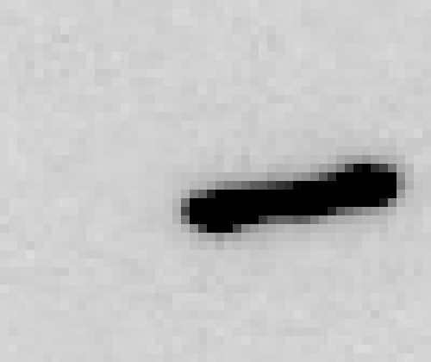
11 MGy

Slide 57
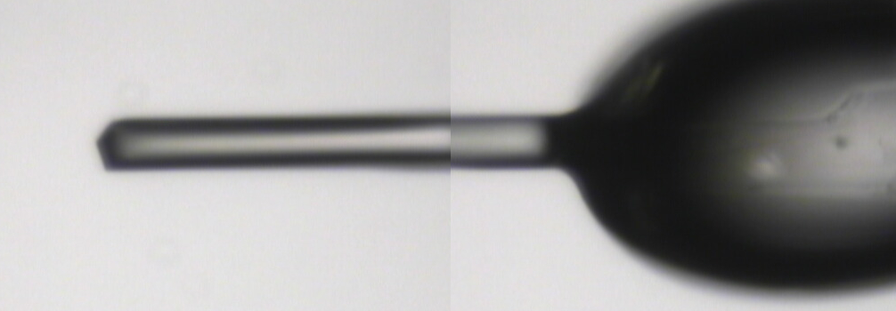
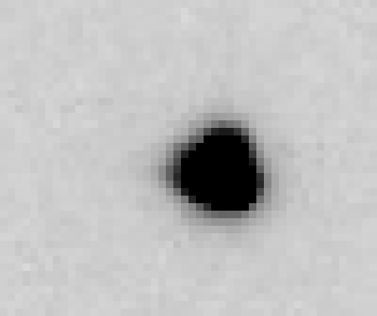
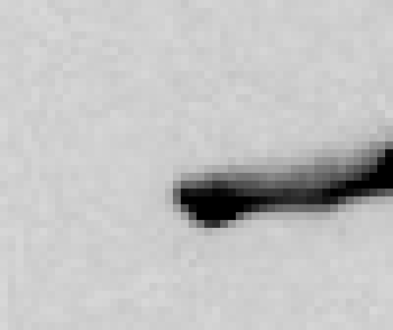
16 MGy

Slide 58
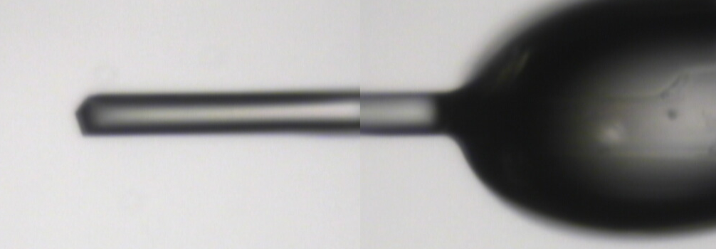
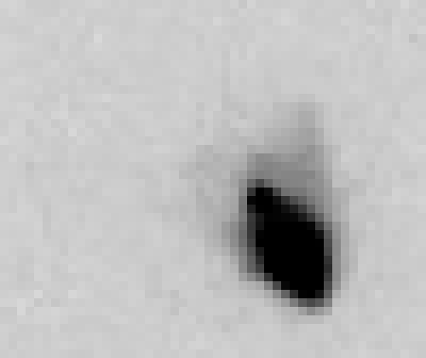
22 MGy

Slide 59
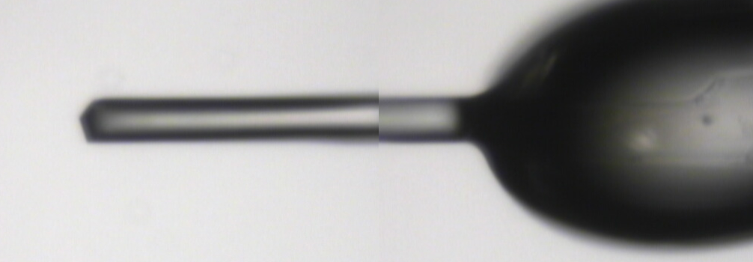
26 MGy

Slide 60
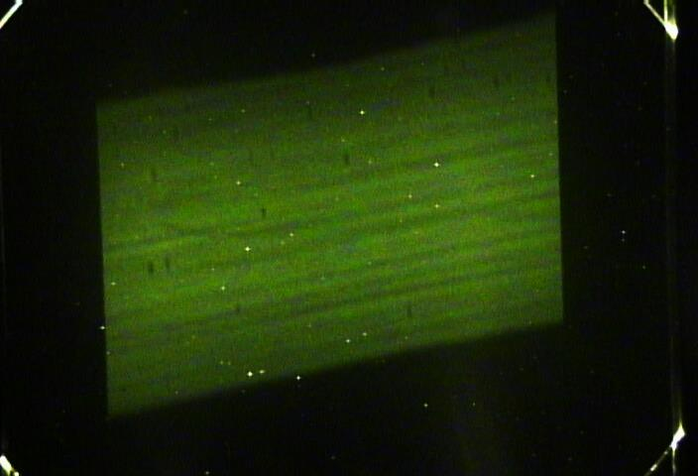
De-focused beam intensity profile

Slide 61
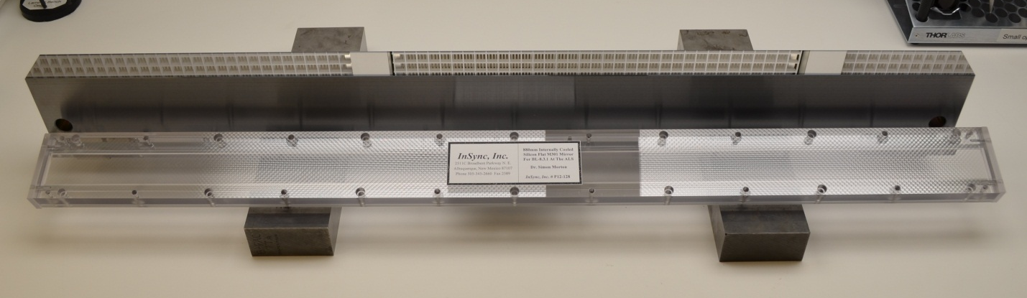
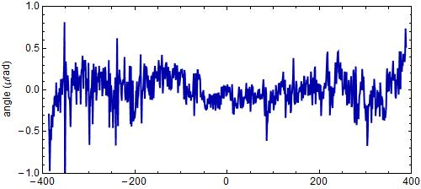
“The flattest thing we have ever seen”
- LBNL Metrology Group
Old mirror: 800 nRad
New mirror: < 200 nRad

Slide 62
ALS 8.3.1 Upcoming Upgrades
Unattended screening
Kappa goniostat
Adjustable beam size 300 μm – 10 μm
Multilayers for rastering
ALS-U in 2022

Slide 63
Fast “death ray” switching
0.014 % (5 min)
Existing mono
Si(111)
ML
Si(111)
ML

Slide 64
Fast “death ray” switching
1 % (~4 s)
Existing mono
Si(111)
ML
ML
Si(111)

Slide 65
Si(111) vs multilayers
0.014%
Si(111)
spectral
dispersion
1%
multilayer
4 Å
resolution
1.9 Å

Slide 66
Wide-bandpass MX?
Mono | Si(111) | multilayer | Difference (%) | good
Energy (eV) | 11111 | 12027.5 | +8.2 | Same
Scale | 1.0000 | 1.0964 | +9.6 | Yes
R_{merge} (%) | 7.5 | 8.4 | +12 | No
R_{anom} (%) | 5.6 | 5.5 | -1.8 | Same
I/sd | 13.2 | 12.3 | -6.8 | Same
I/sd (1.5Å) | 2.3 | 1.8 | -21.7 | No
Ano Patt | 5.96 | 4.75 | -20.3 | Same
Ano Phased | 41 | 39.33 | -4.1 | Same
FOM | 0.238 | 0.192 | -19.3 | Same
CC | 0.555 | 0.647 | -6.1 | Yes
R_{cryst} (%) | 26.70 | 26.48 | -0.2 | Same
Ligand peak | 8.213 | 8.250 | +0.4 | Same

Slide 67
Wide bandpass reveals mosaicity from a still
low mosaic
high mosaic
Δ_{radial} = 2ηD/cos²2θ
Snell EH, Weisgerber S, Helliwell JR, Holzer K & Schroer K (1995)."Improvements in lysozyme protein crystal perfection through microgravity growth", Acta crystallographica. Section D, Biological crystallography 51, 1099-1102.

Slide 68
“rastering” to find the crystal
X-ray beam
ice
Membrane
protein crystal

Slide 69
Cone-Beam Online X-ray
Absorption Radiography
(CBOXAR)
3%
2%
1%
0
MX
area
detector
beam center
crystal in loop
Cu foil
X-ray excited
fluorescent
X-ray source
x-ray beam

Slide 70
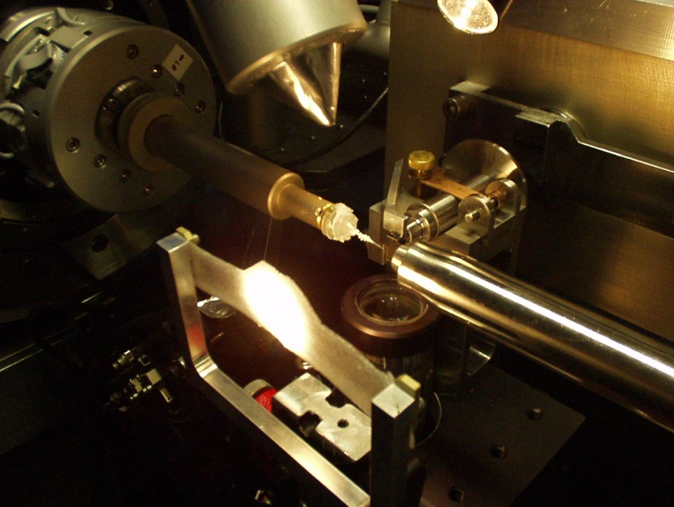
Interleaved Scheduling
experiment queue
beamline
Minor 30s
Choe 120s
Alberta 60s
Alberta 60s
Choe 30s
Minor 30s

Slide 71
ALS 8.3.1 Upcoming Upgrades
Unattended screening
Kappa goniostat
Adjustable beam size 300 μm – 10 μm
Multilayers for rastering
ALS-U in 2022

Slide 72
ALS-U ring upgrade in 2022
Pros
Cons
Diffraction-limited source
Coherent up to 2 keV
Smaller source
6x flux onto 6 μm xtal
Undulator:
5x flux of 8.3.1
~2x more flux after ALS-U
0.7 μm beam vs 10 μm
Serial xtallography
Fine, fast rastering
1 year of dark
No coherence effect in MX
No flux increase (ph/s)
No change for xtals > 36 μm
$10M to keep superbend
Undulator = 5x 8.3.1 at ALS
Only 1 more undulator slot
Xtals die in 2.4 ms
Are your xtals 0.7 μm ?

Slide 73
ALS-U: Small, soft beams

Slide 74
ALS-U: Small, soft beams
Diamond
($100, reusable)

Slide 75
ALS-U: Small, soft beams
oil ?
Diamond
($100, reusable)

Slide 76
ALS-U: Small, soft beams
oil ?
Diamond
($100, reusable)

Slide 77
ALS-U: Small, soft beams
oil ?
λ=2d sinθ
2.5 Å data
with 5 Å X-rays
Only analytic absorption correction:
International Tables for Crystallography, Vol. C, 2nd ed., chapter 6.3

Slide 78
2472.7 2473.5
Anomalous f” (electrons)
Photon Energy (eV)
Bohic et al. Anal. Chem. 2008; 80(24):9557. doi: 10.1021/ac801817k

Slide 79
S-MAD Sample size Dilemma

Slide 80
Threshold of a revolution in phasing
Single-spot limit
latest PAD
(uncalibrated)
Single-spot limit
Perfect detector
Solve-able proteins (%)
Single-spot limit
CCD
& early PAD
Required signal-to-noise (I/σ)

Slide 81
ALS 8.3.1 Upcoming Upgrades
Unattended screening
Kappa goniostat
Adjustable beam size 300 μm – 10 μm
Multilayers for rastering
ALS-U in 2022

