Slide 1
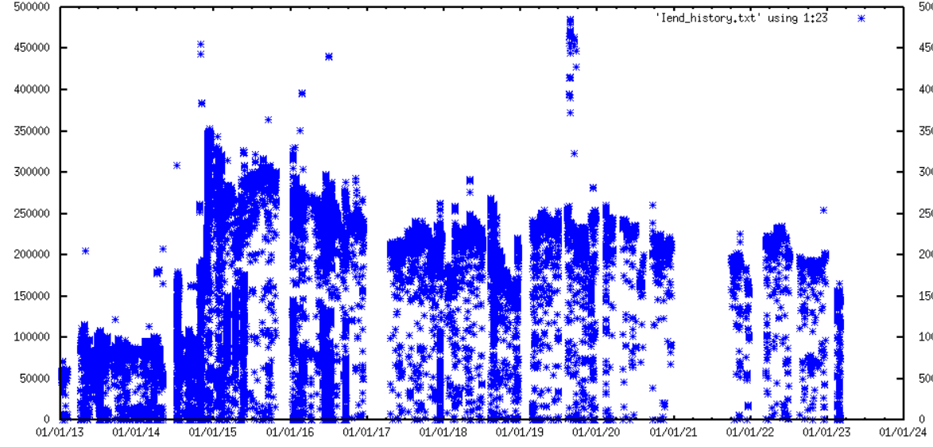
Tuned-up flux at sample (nA)
History at BL831
2013 2014 2015 2016 2017 2018 2019 2020 2021 2022 2023

Slide 2
108994.002
Expiring Sep 31, 2023
$400k LDRD
to make 8.3.1 focus smaller
Problem #1 : can’t see the focus

Slide 3
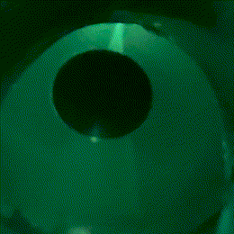

Slide 4
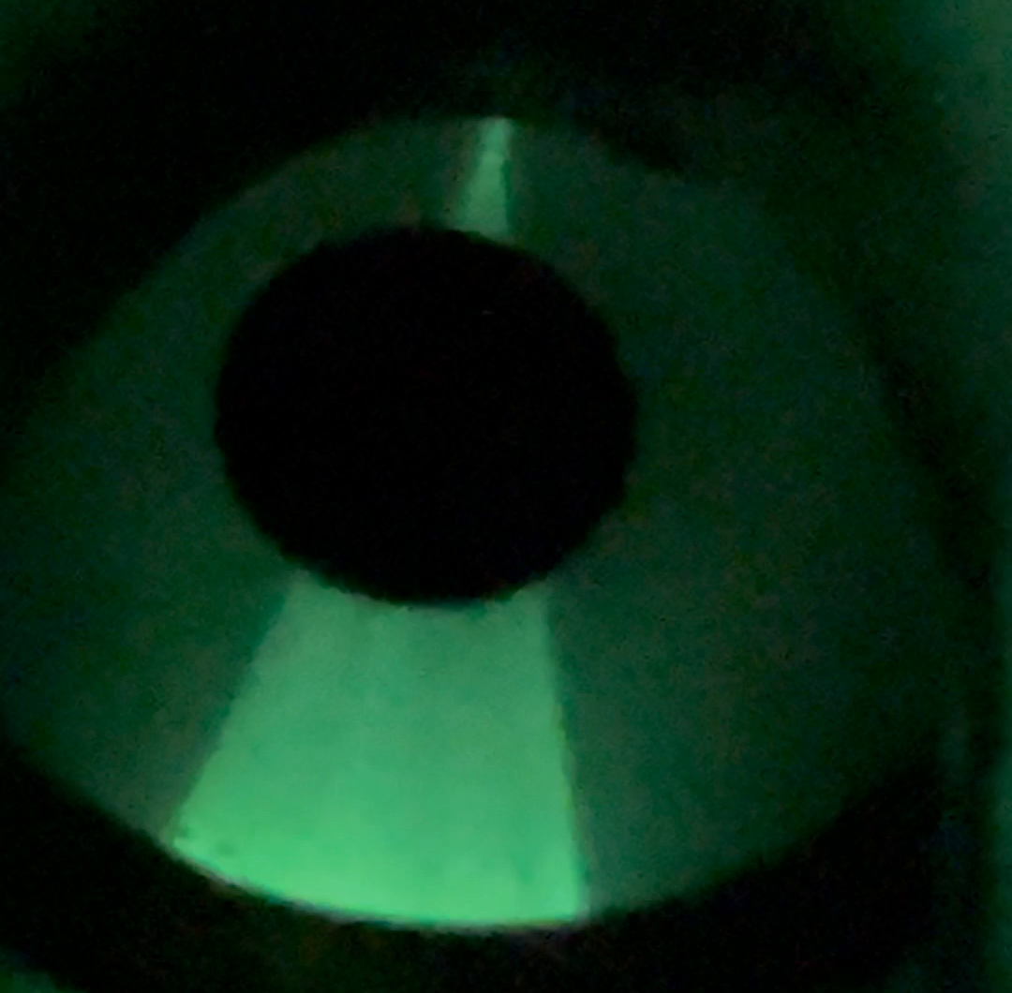
focus
accessible

Slide 5
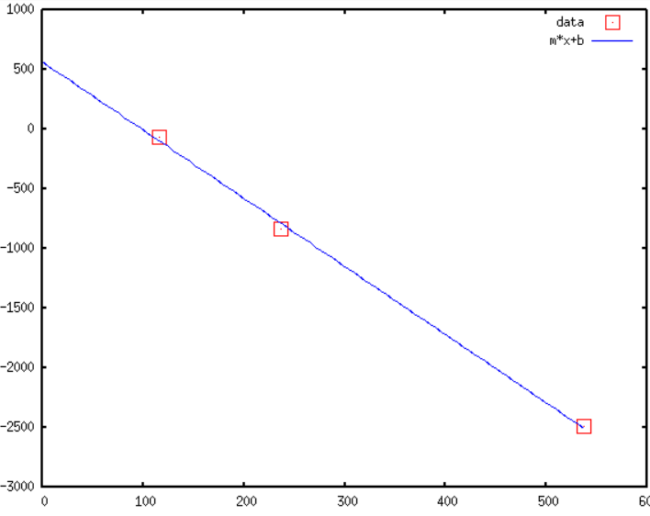
focus position vs M2 Tilt
1.0
0.5
0
-0.5
-1.0
-1.5
-2.0
-2.5
-3.0
Beam height (mm)
0 100 200 300 400 500 600
distance from sample (mm)

Slide 6
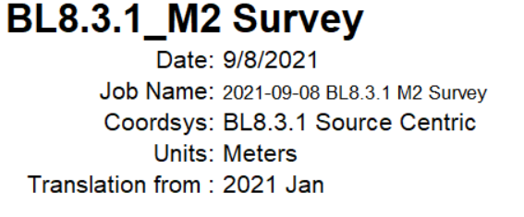
Grant total move: 1.4 mm “up”

Slide 7
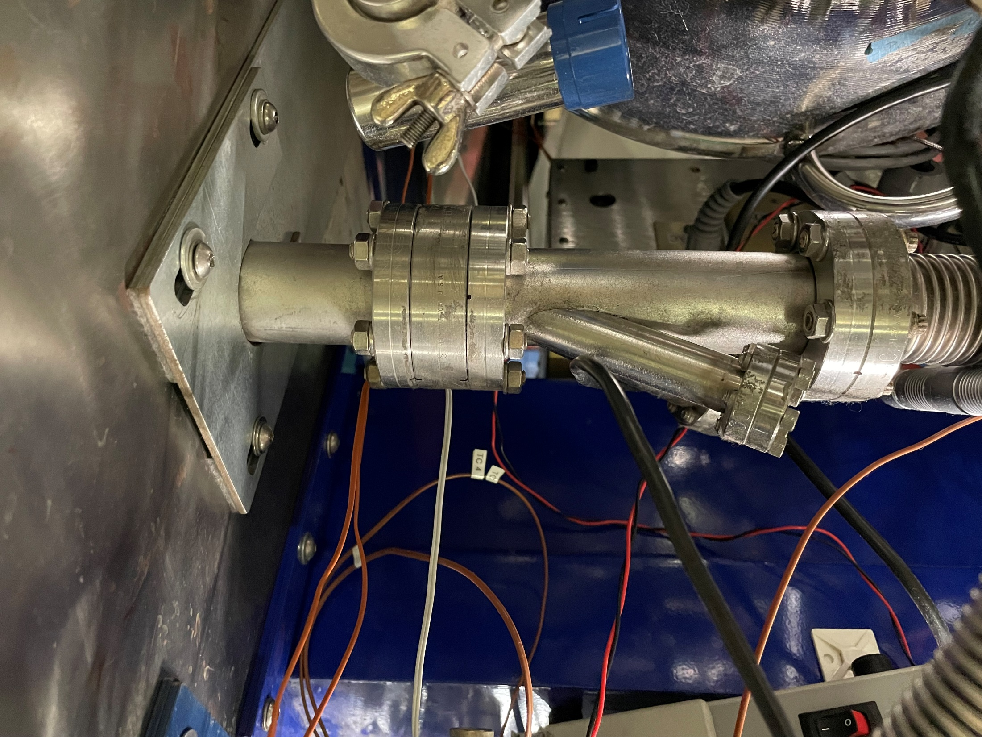
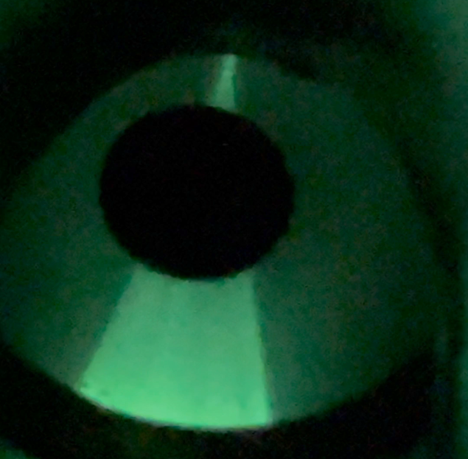
#2
chain
#1
beam

Slide 8
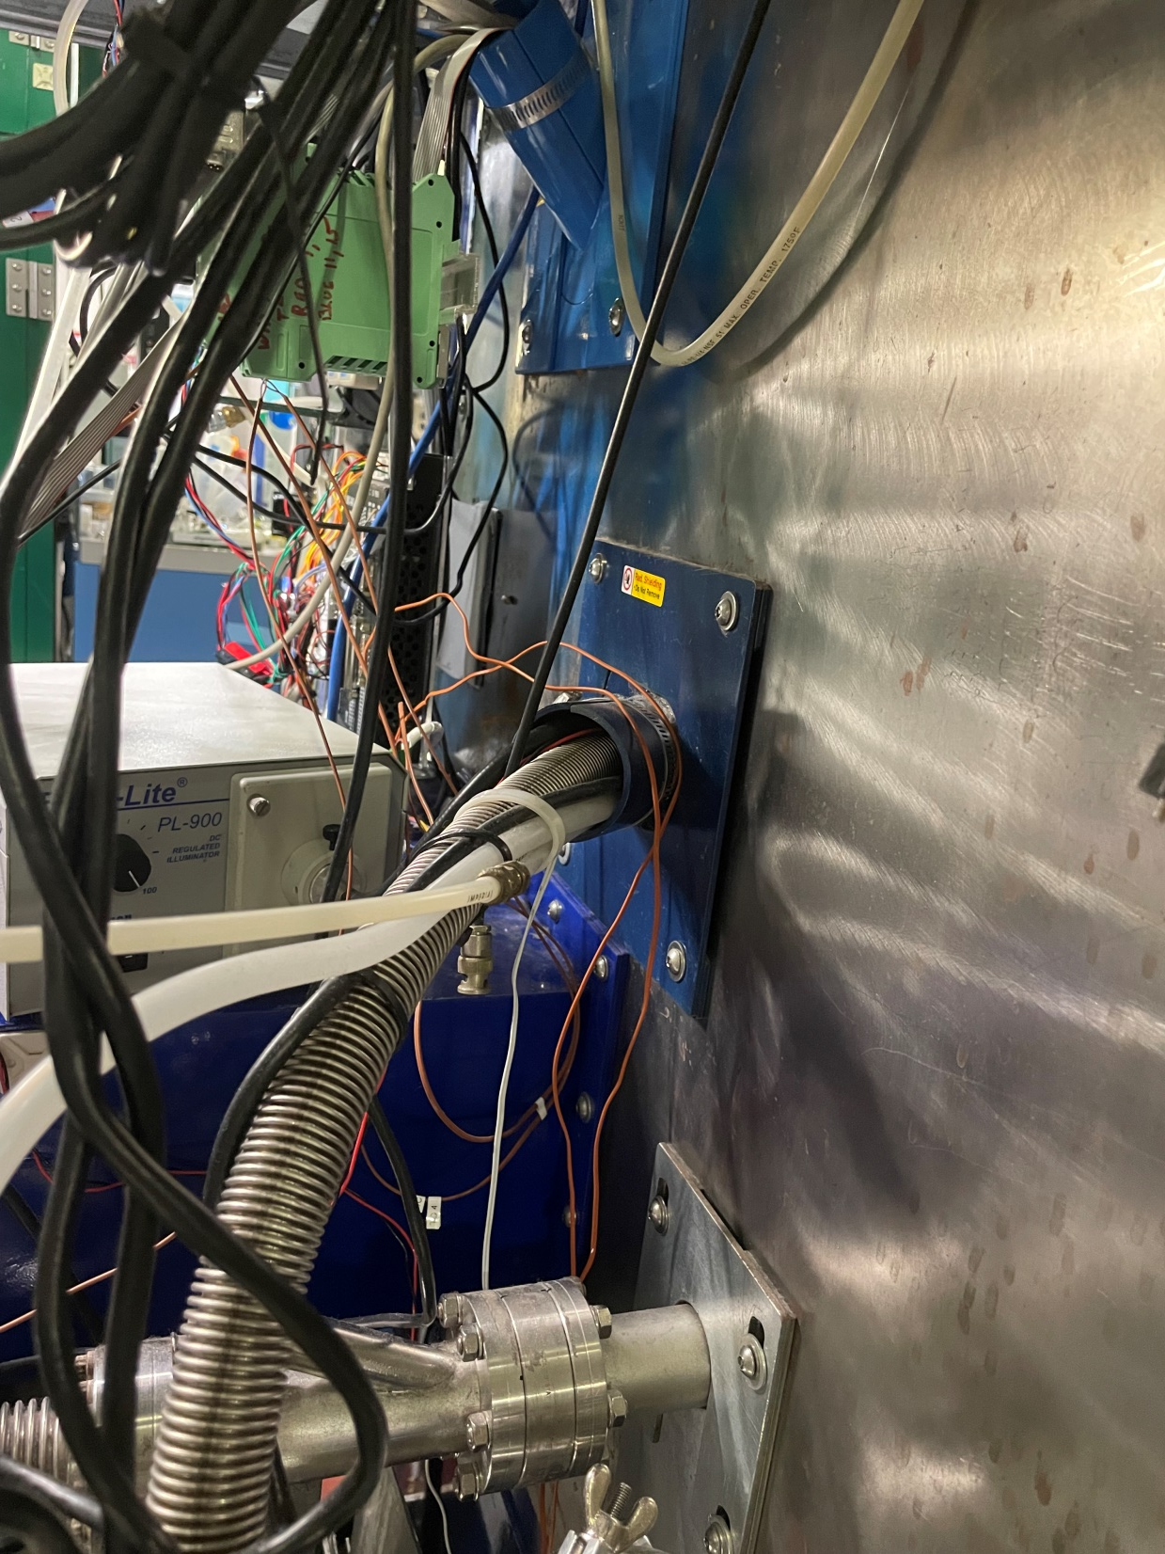
#4 wires
#3 tubing
#2 chain
#1 beam

Slide 9
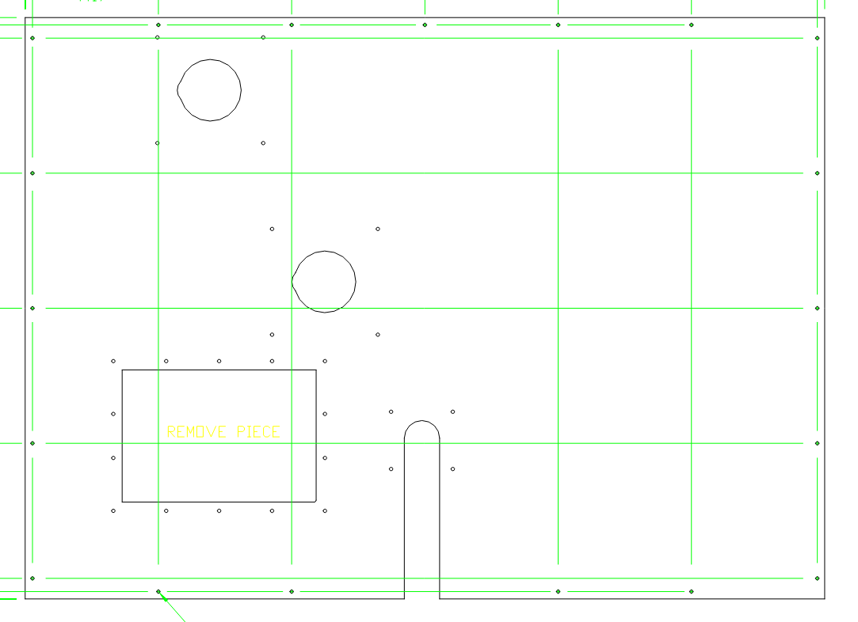
#4
Fixed panel drawing
#3
#2
#1

Slide 10
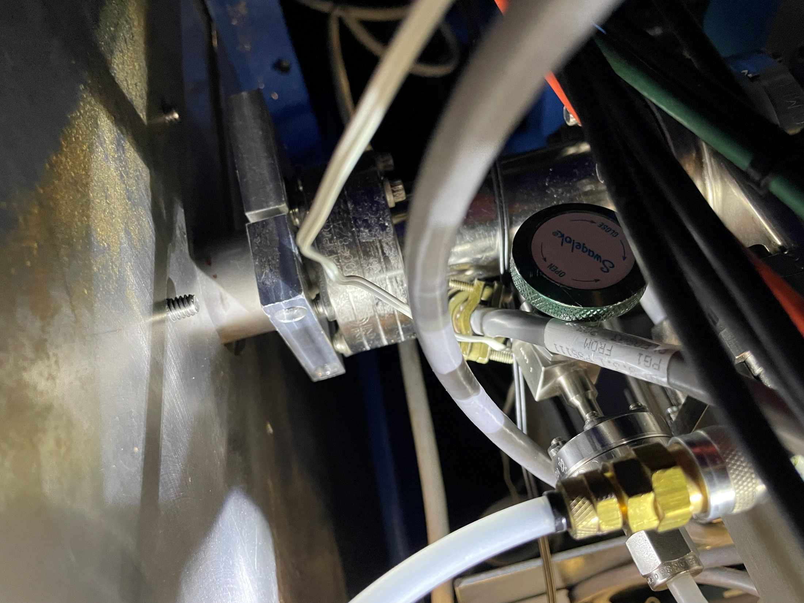
Inside hutch

Slide 11
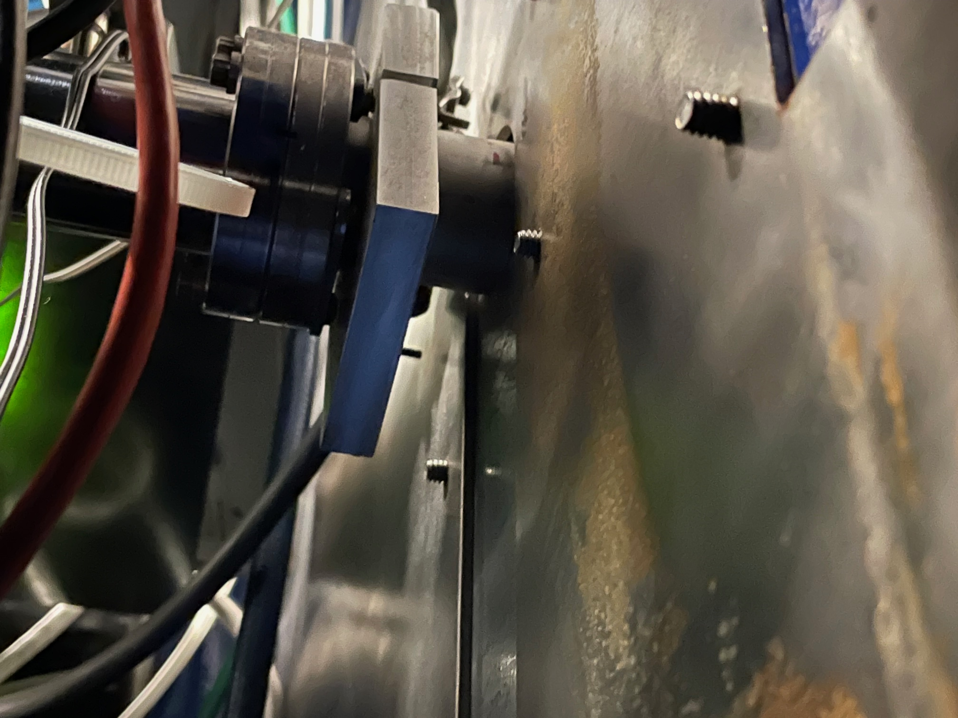
#2
chain
#1
beam
Inside
hutch

Slide 12
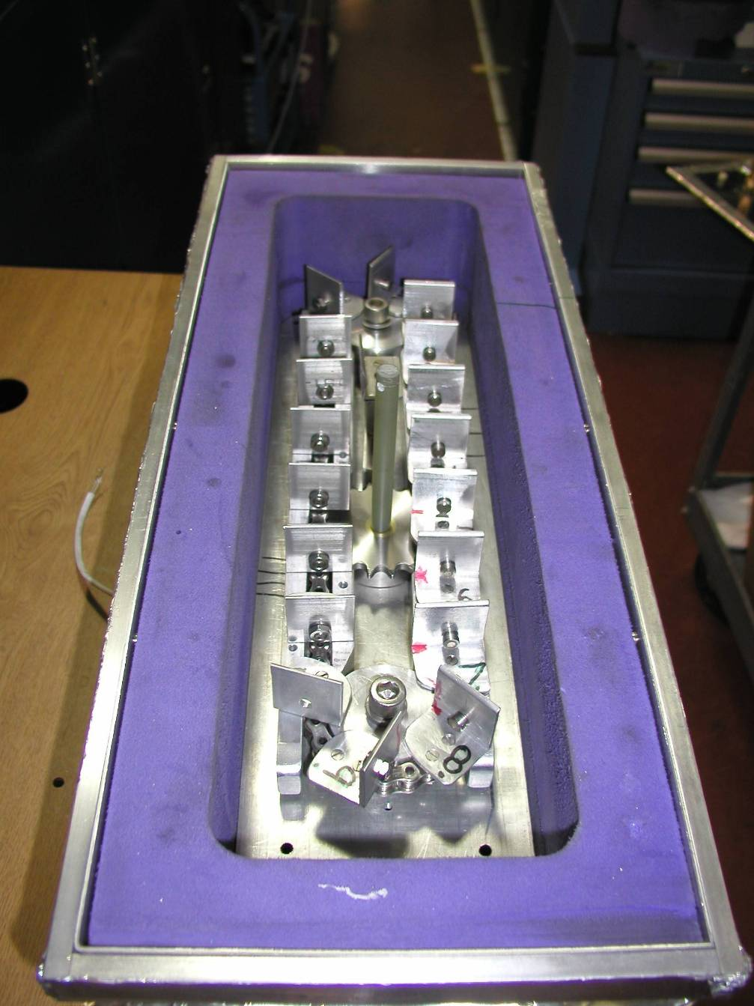
Labyrinth
#2 “chain”

Slide 13
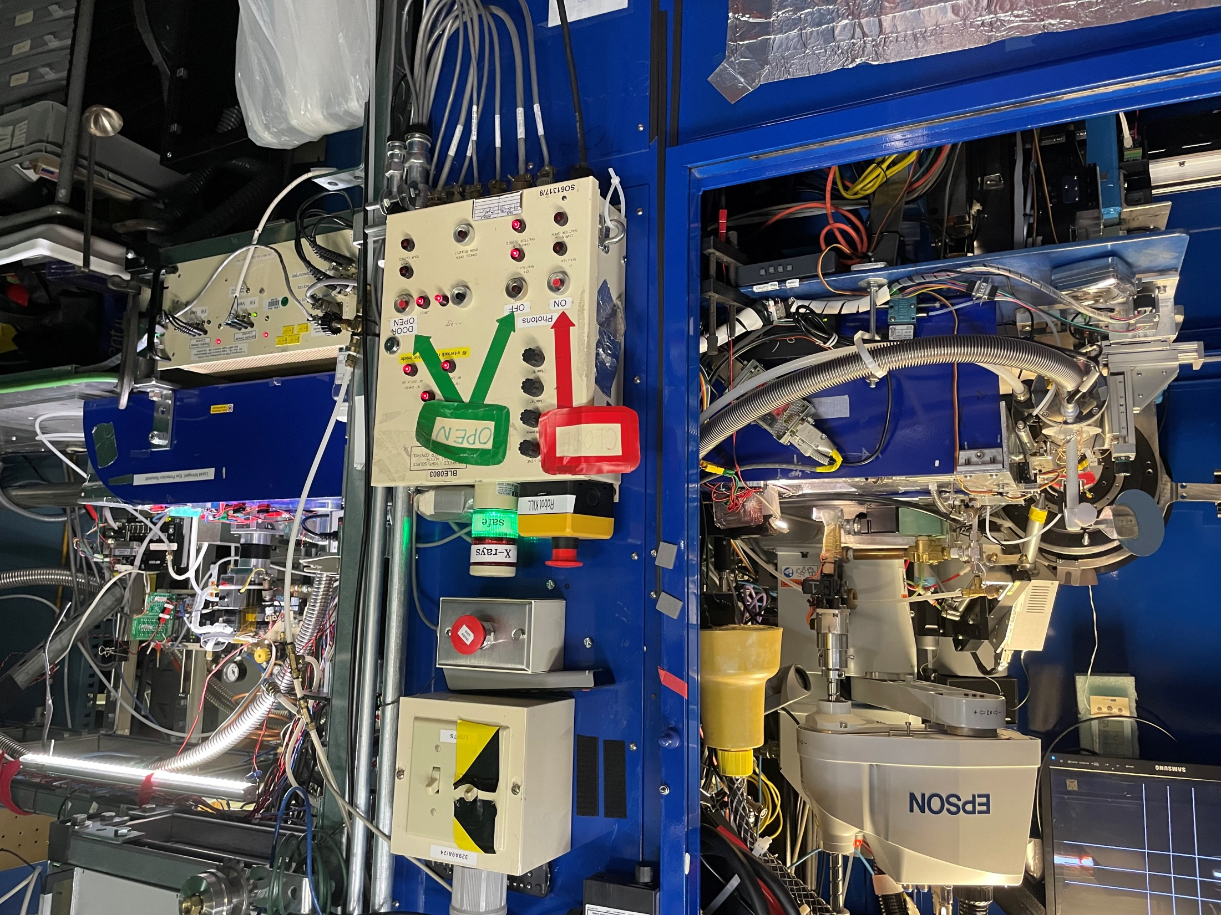
Labyrinth
#2 “chain”

Slide 14
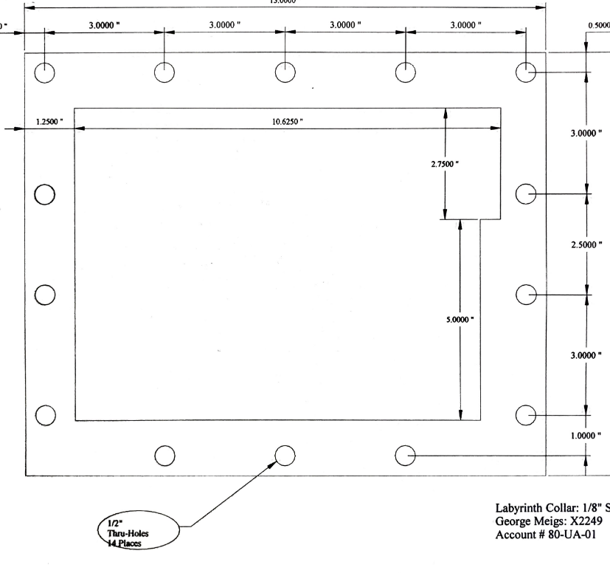
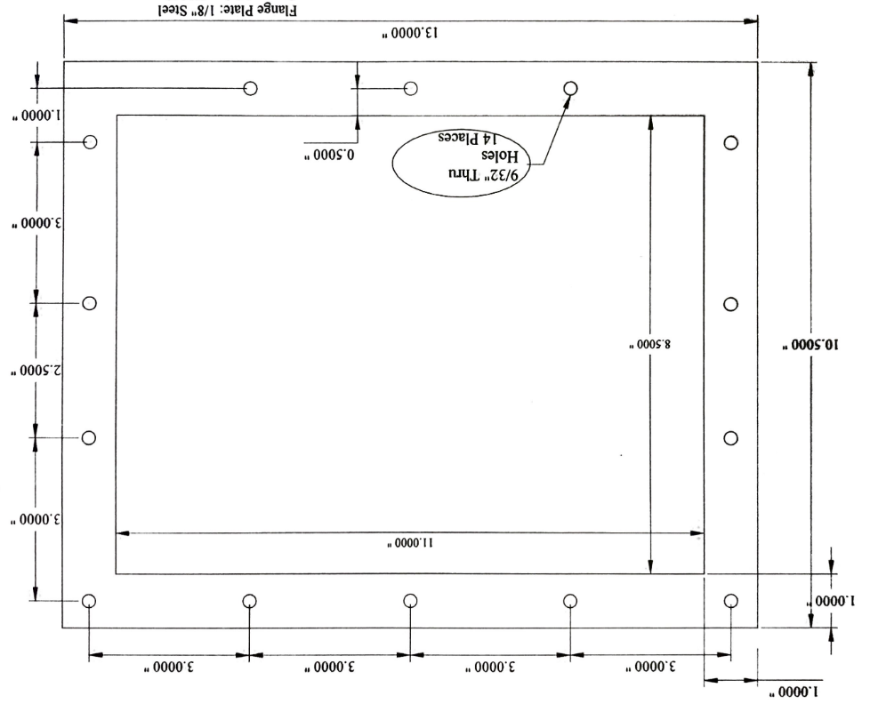

Slide 16
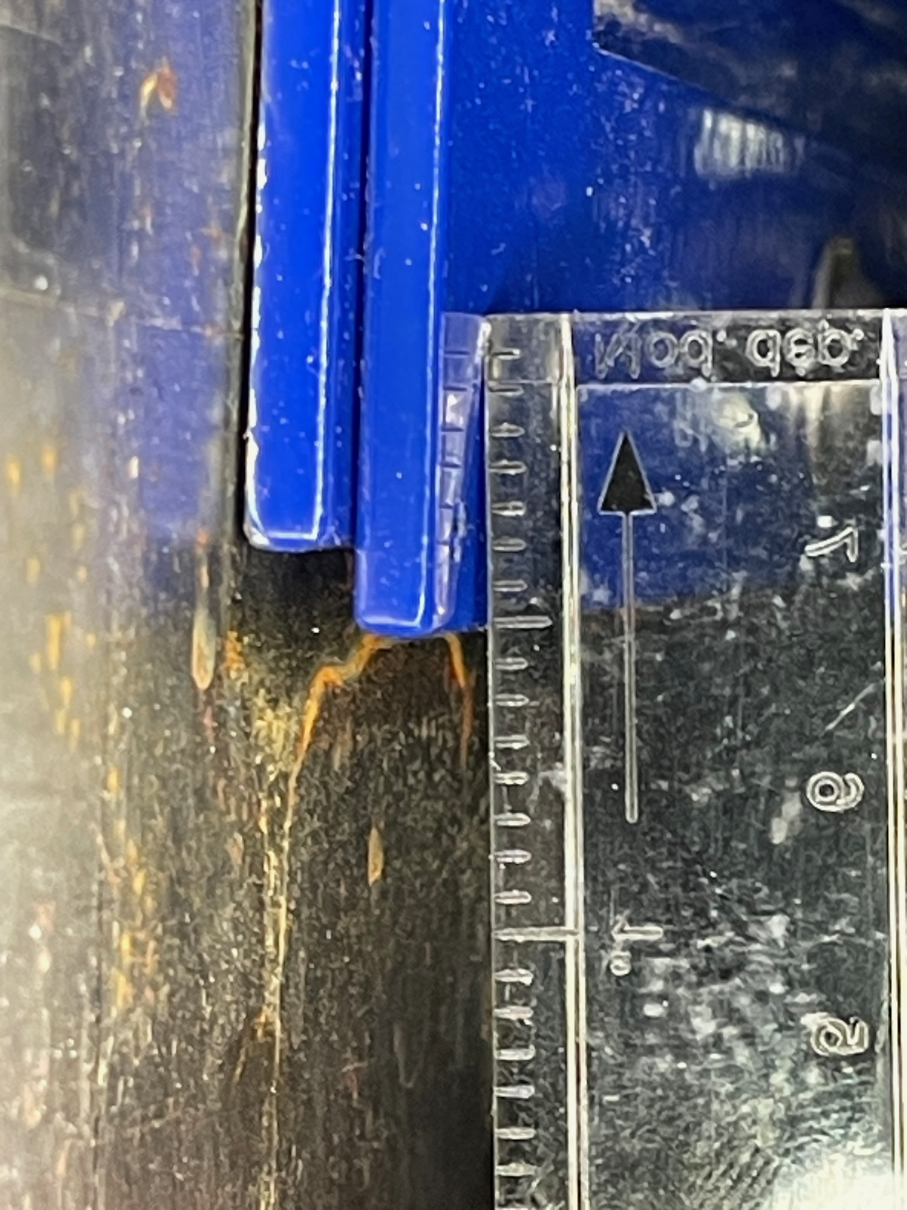
Tapped holes
1/2” holes
9/32” holes

Slide 17
Proposed work
focus
Move two hutch-penetration clamshell labyrinths “up” by 1.4 mm
Anticipate possibly having to extend existing slotted screw holes
Slot extension need not exceed thickness of shielding: 1/8”
Make new labyrinth flange that is 1/4” wider to ensure ½” holes are covered

Slide 18
Current configuration
screw
1/4”
9/32”
23/64”
fixed
fixed
collar
1/2” hole in collar
collar
flange
flange
1”

Slide 19
Proposed configuration
screw
1/4”
9/32”
23/64”
fixed
fixed
collar
3/4” hole in collar
collar
new flange
new flange
1 + 1/4”

Slide 20
Current configuration
fixed
panel
23/64”
screw
9/32”

Slide 21
Proposed configuration
fixed
panel
23/64”
screw
9/32”

Slide 22
Current configuration
1/4”
hole
1/2”
screw
collar
9/32”

Slide 23
Proposed configuration
1/4”
hole
5/8”
screw
collar
9/32”

Slide 24
Current configuration
23/64”
screw
9/32”
1”
flange

Slide 25
Proposed configuration
1/4”
23/64”
1 1/4”
screw
9/32”
flange

Slide 26
Overlay
1/4”
hole
fixed
panel
23/64”
5/8”
screw
screw
9/32”
collar
9/32”

