Slide 1
BL8.3.1 mono cryo upgrade Motivation
ALS-U $650M to make beam smaller
With current optics: no benefit from ALS-U
High-profile programs at ALS MX beamlines
i.e. 2020 Nobel Prize
30x brightness gain is possible with ALS-U (5x at ALS)
$800k joint LDRD project: MBIB and ALS to match hard X-ray optics to ALS-U source properties
Must spearhead optics upgrades for ALS-U success
Cryo-cooling monochromators required

Slide 2
Planned work overview
focus
Cryo-cooling upgrade to BL8.3.1 monochromator
Keep original tank & all lead (Pb) sheets
Similar to 8.2.1, 5.0.2 monos
Less radical: contents are Kohzu, not Oxford
$110k vs $700k
Same type FMB Oxford cryo-cooler
Simpler, longer Si(111) crystals
No more Z2 motor
Safety systems: EPS, seismic, burst discs
Document & draw Kohzu mono contents

Slide 3
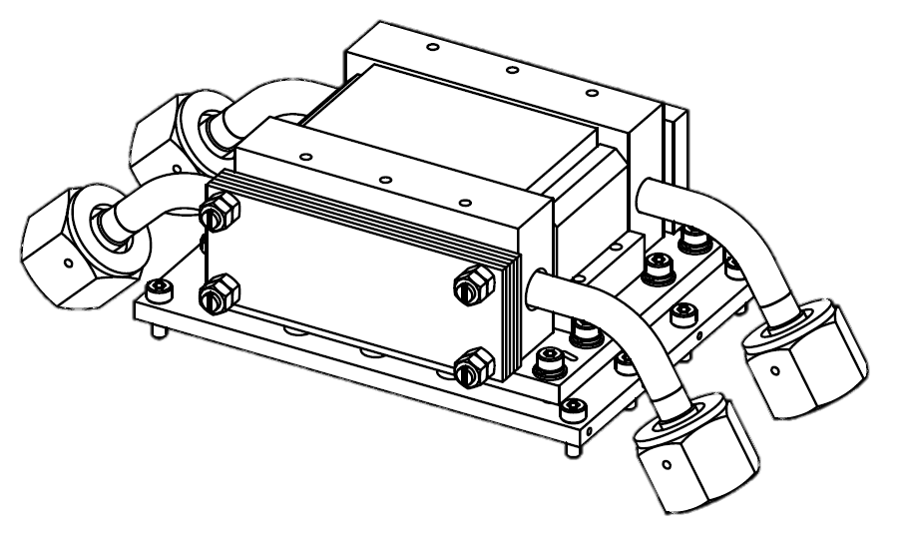
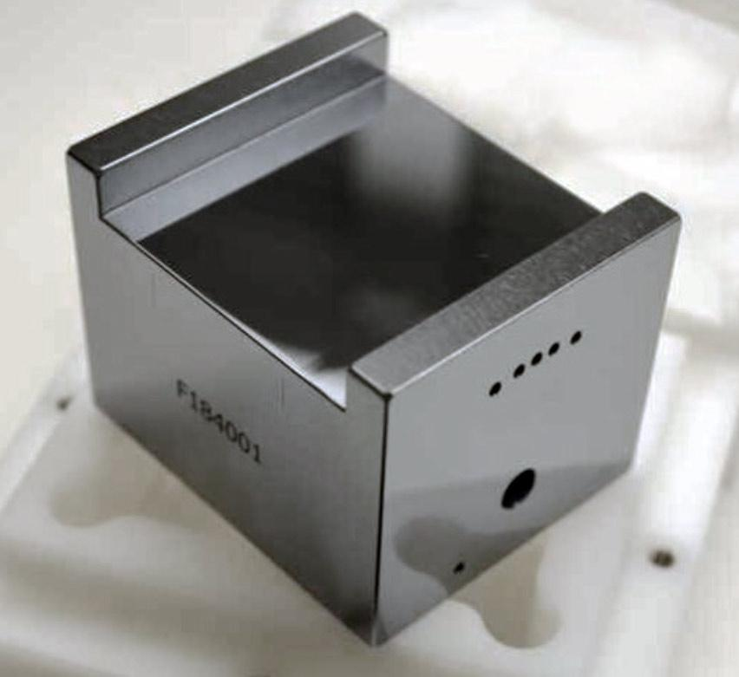
1st crystal
Si(111)
Thermal load: 60 W
new
50L x 60W x 38T mm
old
Si(111)
70L x 40W x 40T mm

Slide 4
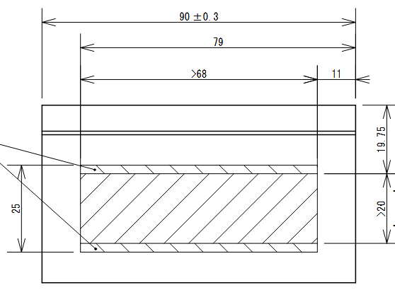
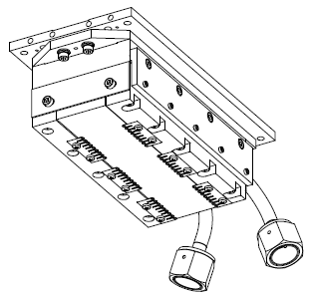
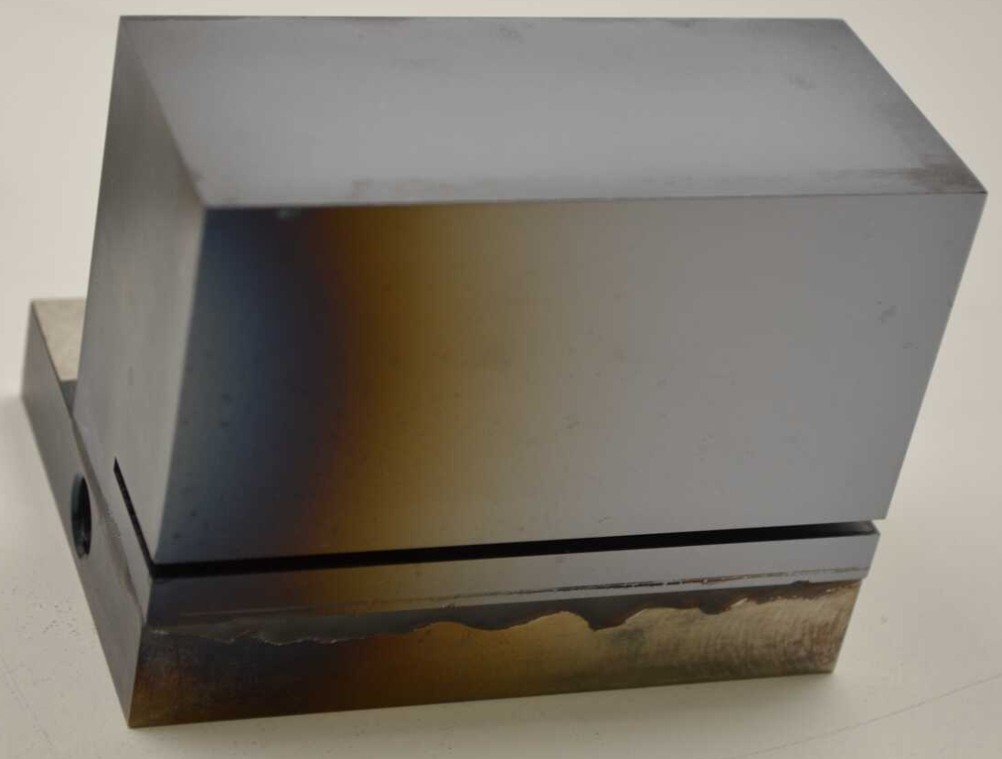
2nd crystal
Thermal load: << 1 W
new
old
90L x 51W x 40T mm
165L x 40W x 30T mm

Slide 5
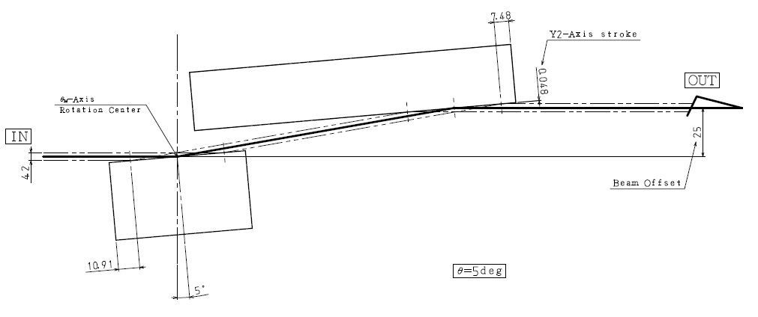
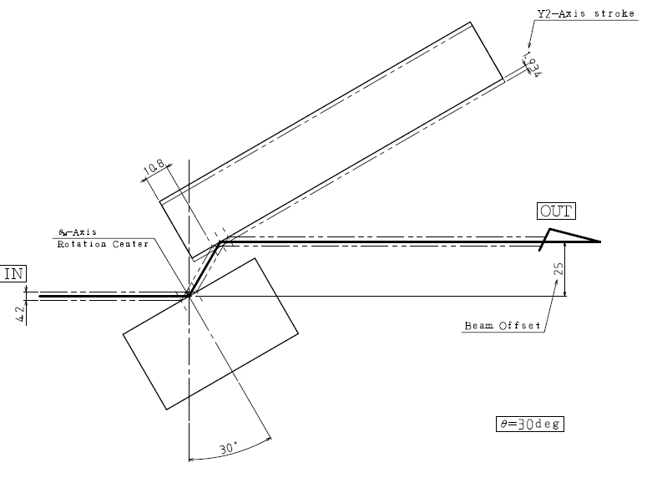
No more Z2 motor

Slide 6
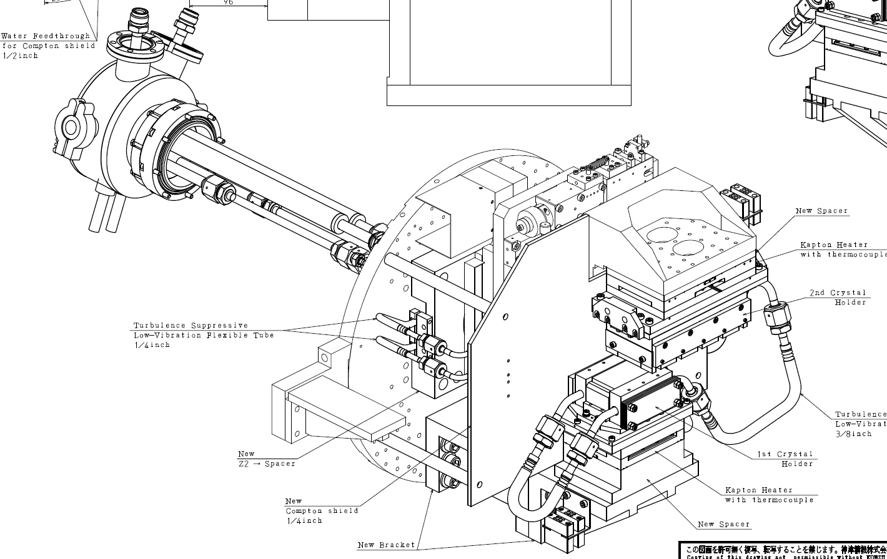
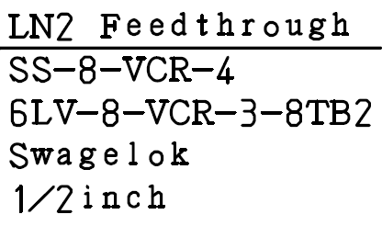
Kohzu’s upgrade kit

Slide 7
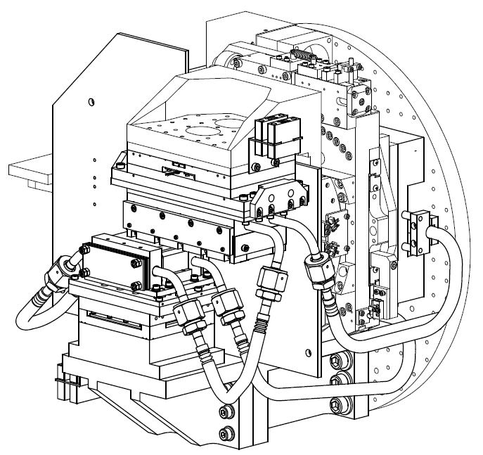
Kohzu’s upgrade kit

Slide 8
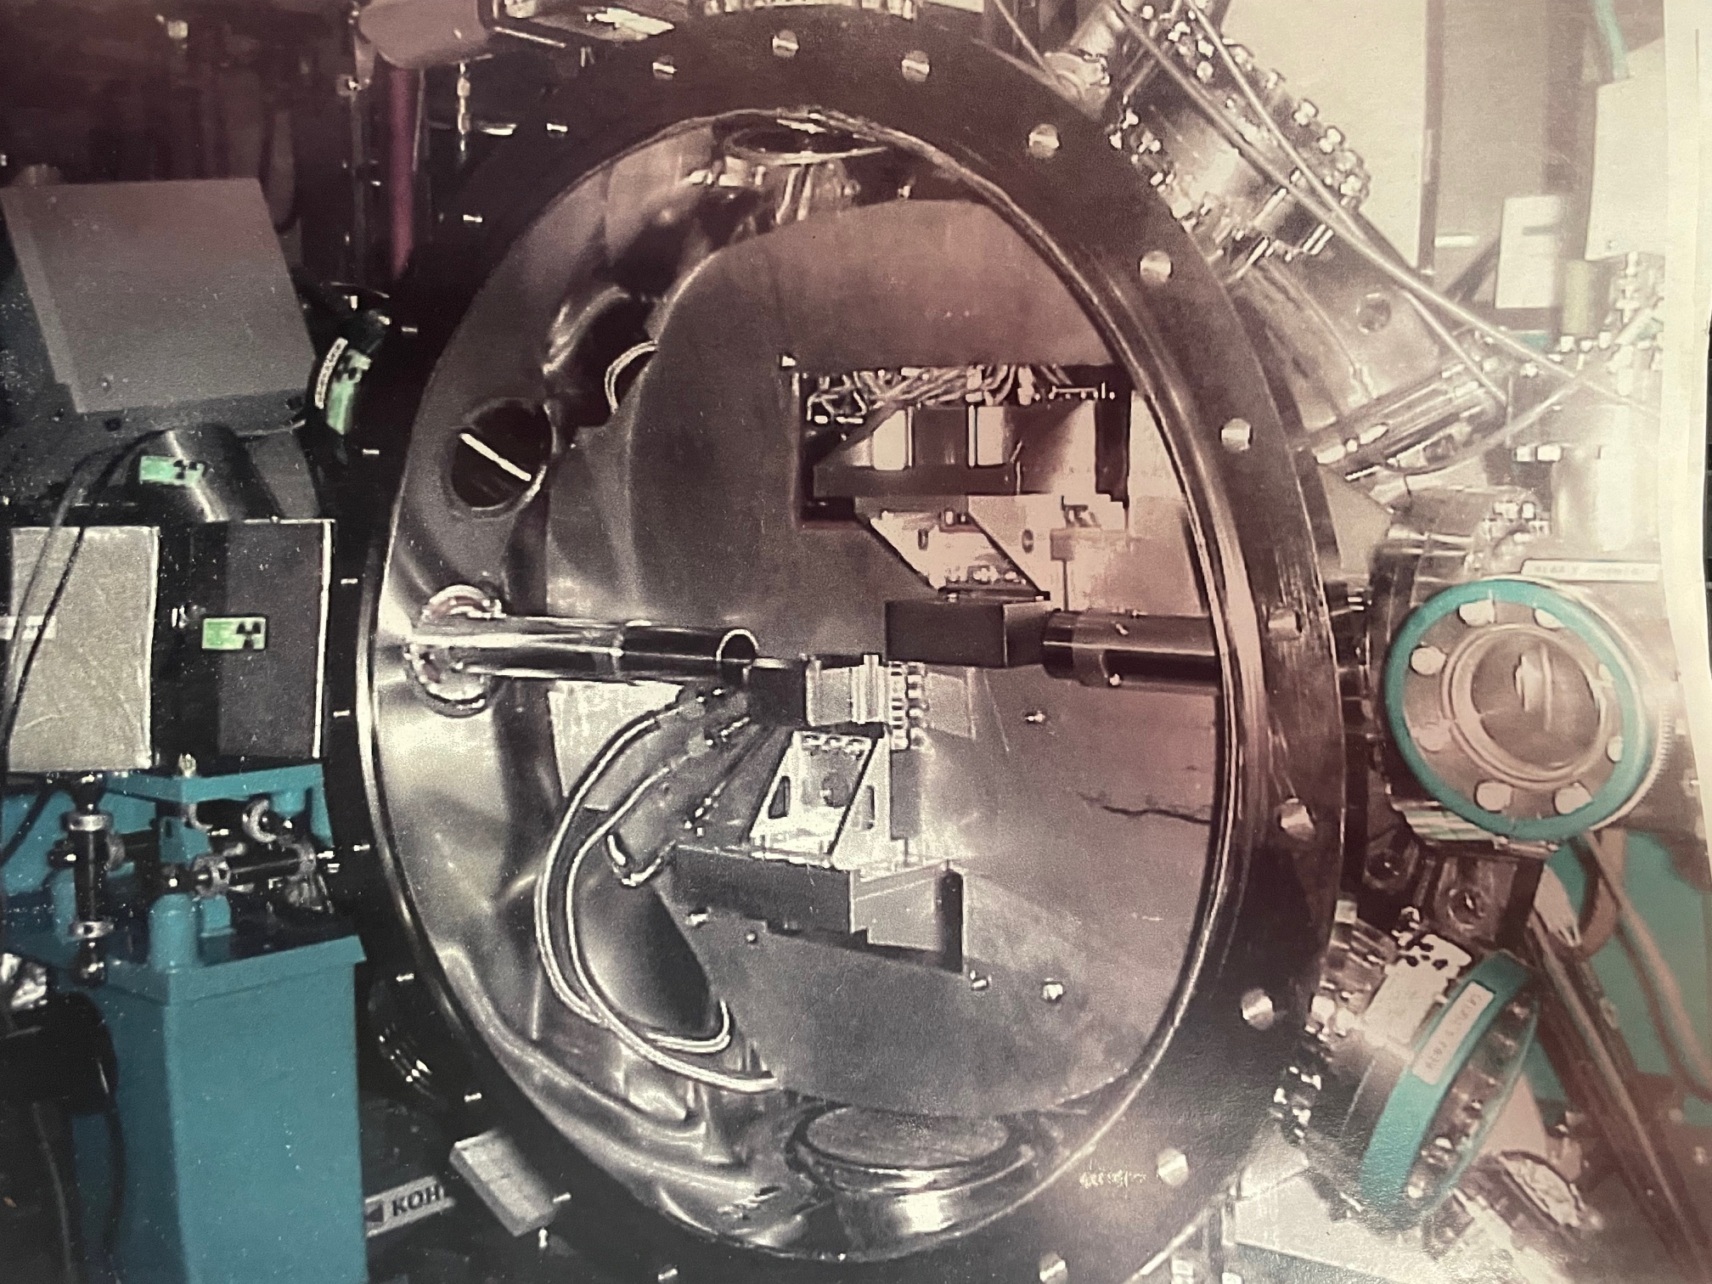

Slide 9
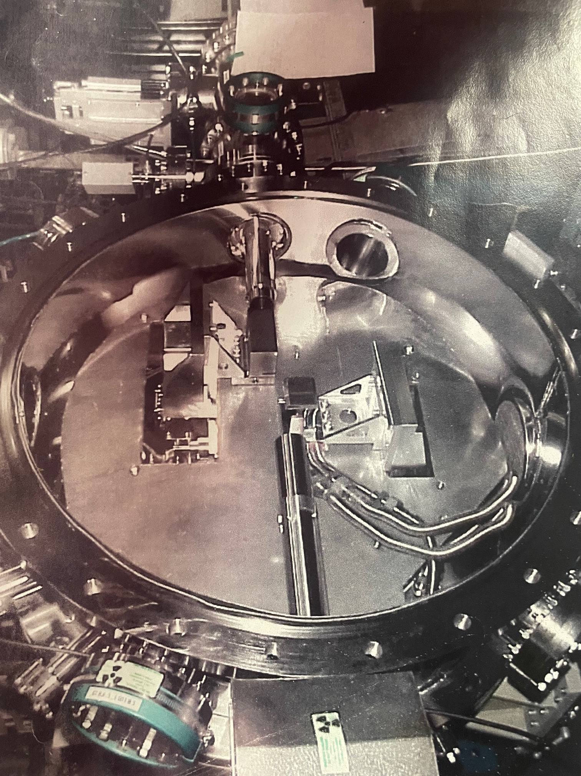

Slide 10
115
42
25 x 88
36
70
250
600 dia
227
35
64
152
91

Slide 11
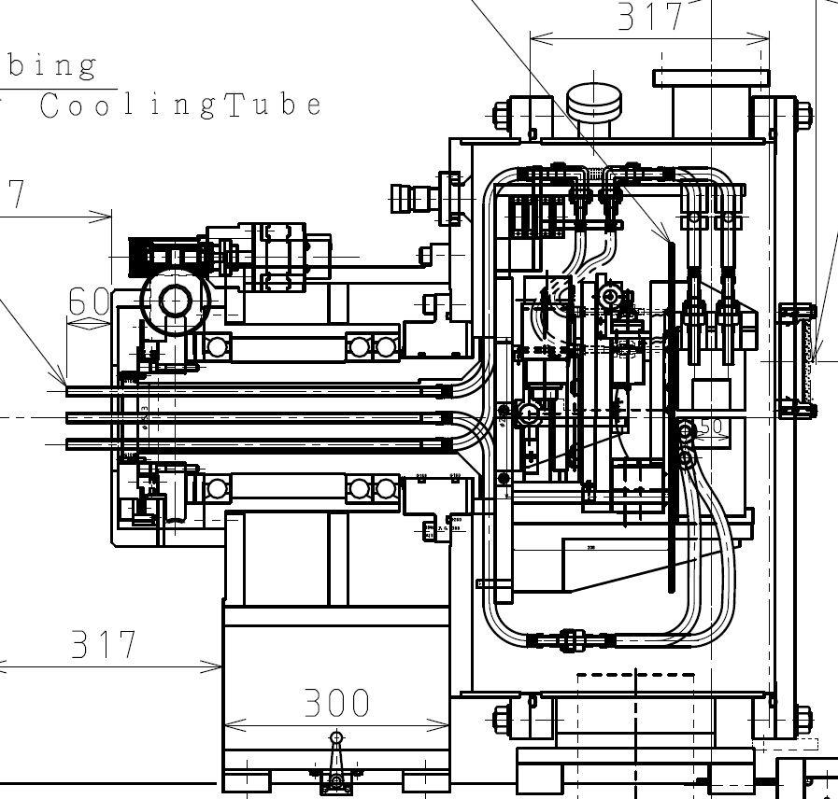
Current BL8.3.1 Mono Contents
3 mm Lead (Pb)
(Cu) Compton Shield
30mm SS
“hanging”
Pb
panel

Slide 12
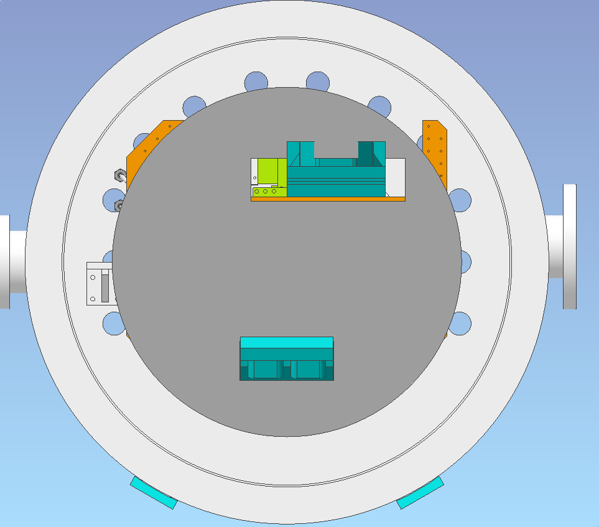
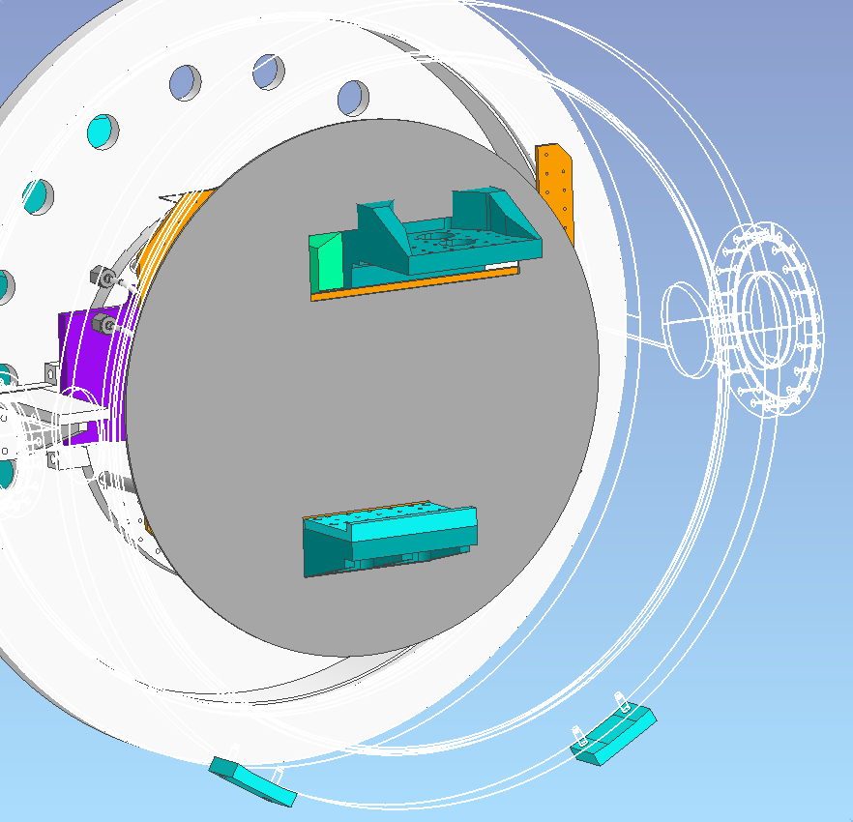
Current situation

Slide 13
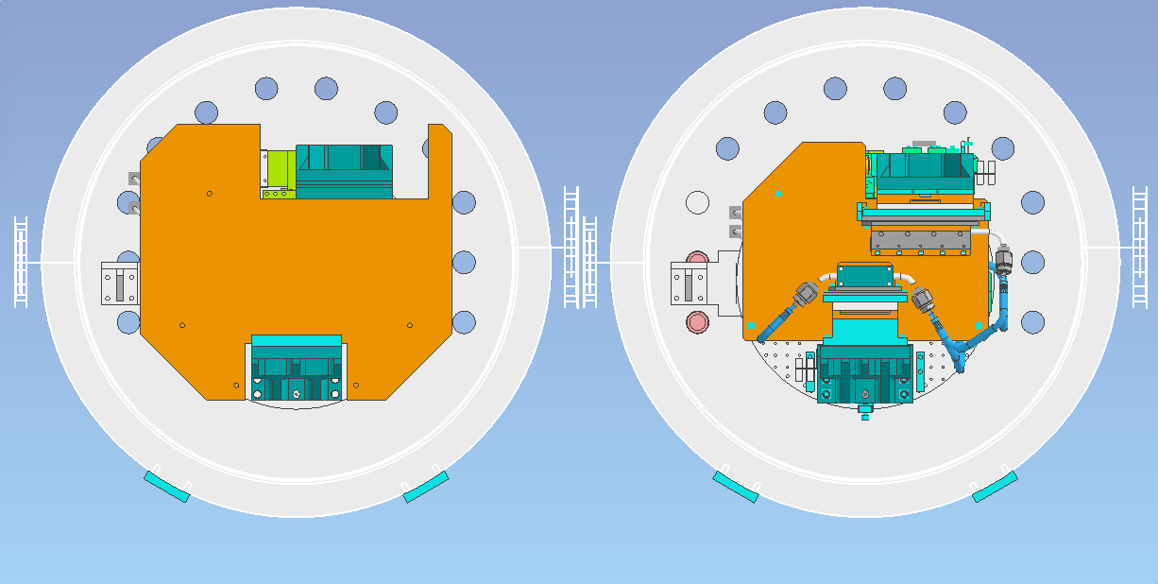
Current
After modification
227
227
35
35

Slide 14
Current
After modification

Slide 15
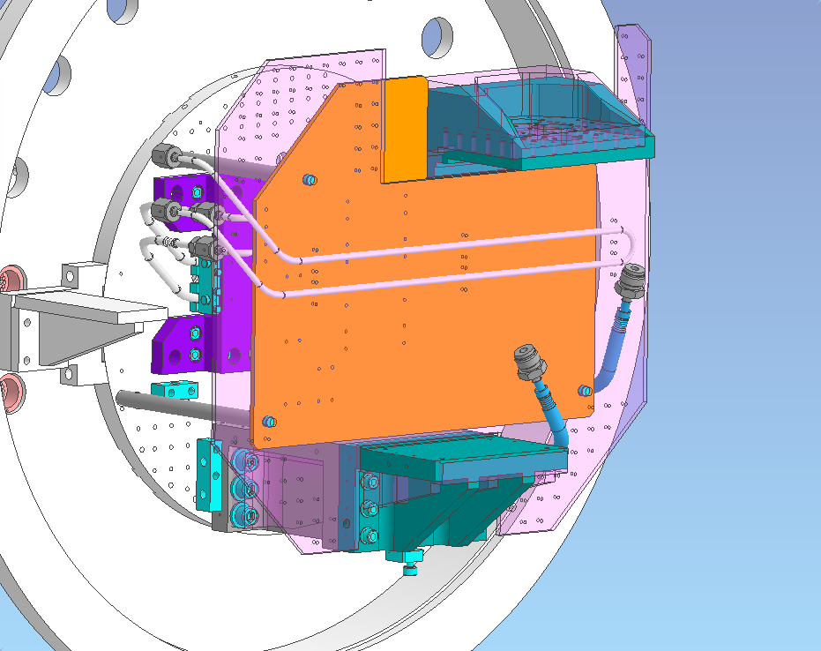
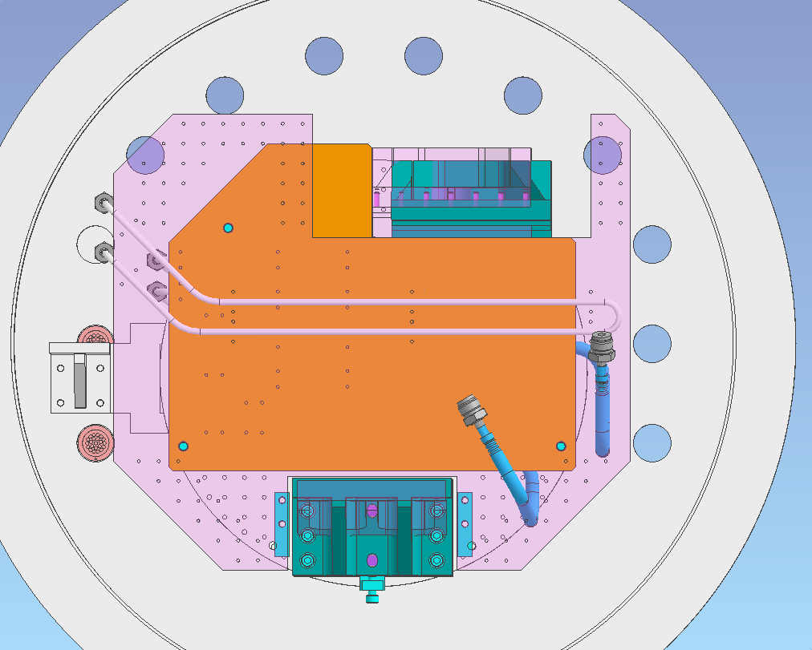
After modification compared a current shield (pink)

Slide 17
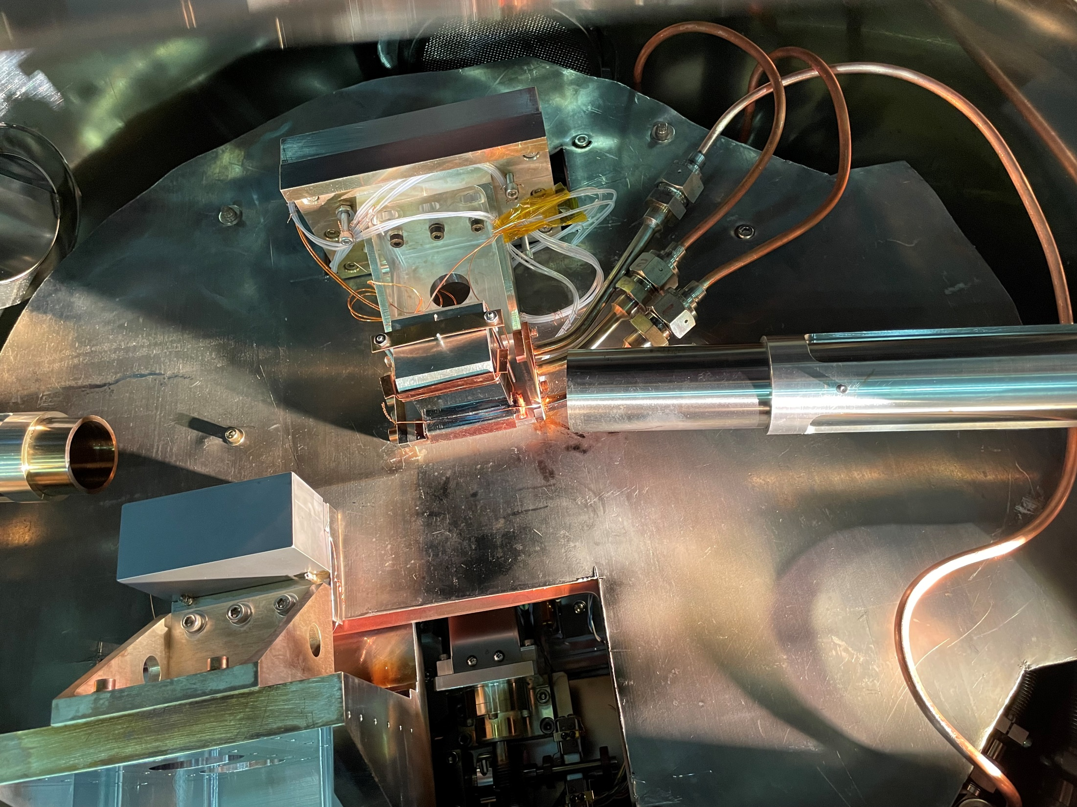
Design compromise:
Cooling line vibration
vs continuous Pb

Slide 18
Kohzu’s proposed install schedule
JULY-31 (Wed): Start working at ALS AUG-1 (Thu): Working AUG-2 (Fri): Finish & start pumping down AUG-3 (Sat): Holiday AUG-4 (Sun): Holiday AUG-5 (Mon): Leak check, Tidying-up, Done
Takashi Suzuoki <suzuoki@kohzu.co.jp> Daisuke Shindo <shindo@kohzu.co.jp>

Slide 19
Don’t need help with:
Remove/replace “hanging” Pb plate
Mono internals install – Kohzu techs
Connect and strain-relief cryo lines
Condensate drip management

Slide 20
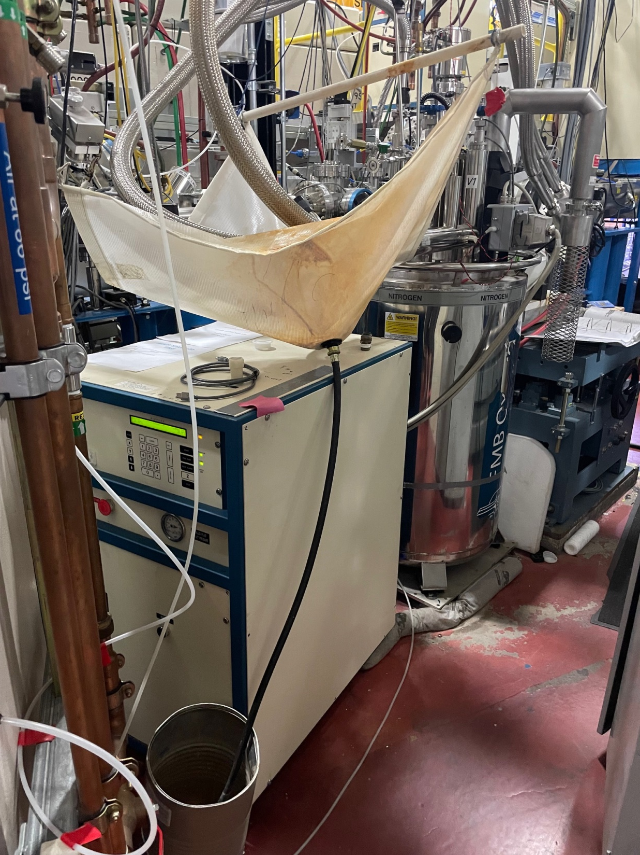
Condensate drip management
Current setup on BL8.2.1

Slide 21
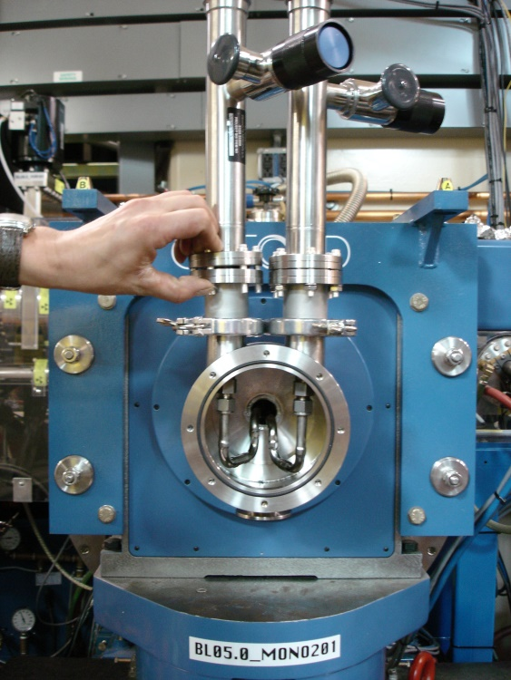
Condensate drip prevention
Will work with BCSB on fill lines
Best solutions
Vacuum insulate lines and joints
Passive/active heated Al cladding
clear enclosure, purged with N₂
N₂

Slide 22
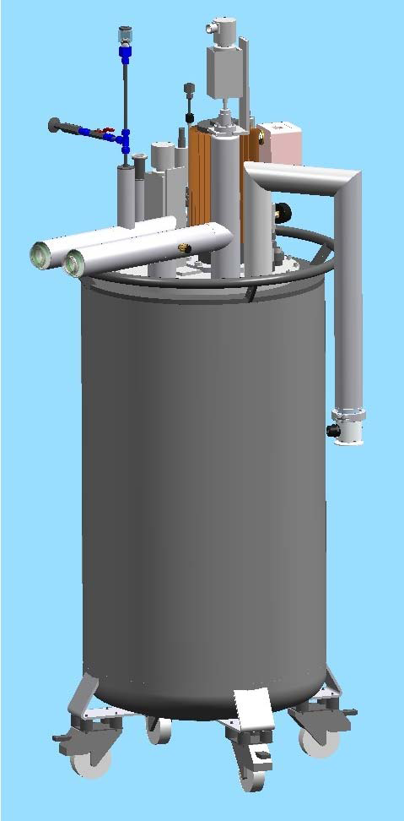
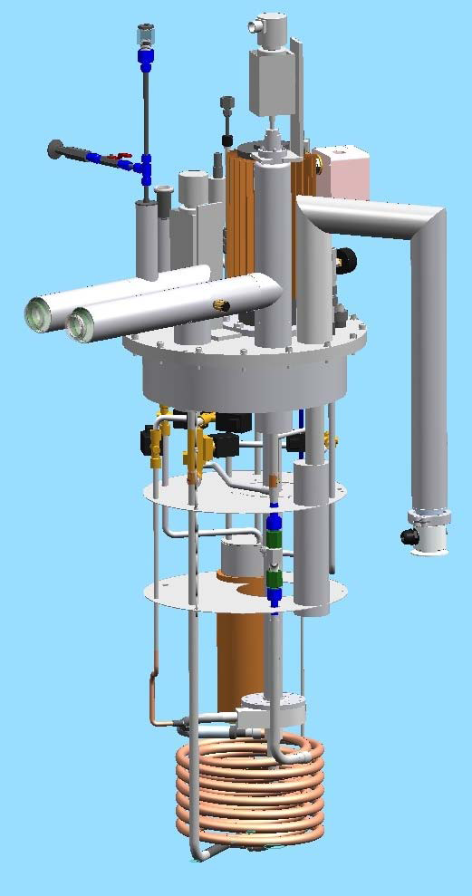
Cryogen, overpressure and vacuum safety
Cryostat is entirely vacuum insulated
all external surfaces at approximately room temperature
Boiloff gas discharge heated and directed down
All closed (or potentially closed) volumes have burst disks and/or pressure relief protection
Cryocooler has independent monitoring system with limits, audible klaxon alarms and emergency staff paging capability
Mono cooling circuit includes direct vacuum/cryogen seals hence:-
Tank will be fitted with overpressure burst disk
In-vacuum electronics protected by pressure interlock covering low conductivity pressure regime
Ring vacuum is protected by front-end double Be window
In-vacuum leaks of dry LN preferable to water

Slide 23
Could use help with…
EPS – integrate Cryostat “ok” relay output
Seismic – same as other cryostats
Replace eight wheels with 2” floor anchors
< 100 lbs/anchor
Spec burst discs
Electrical power feed
Cryo-cooler placement

Slide 24
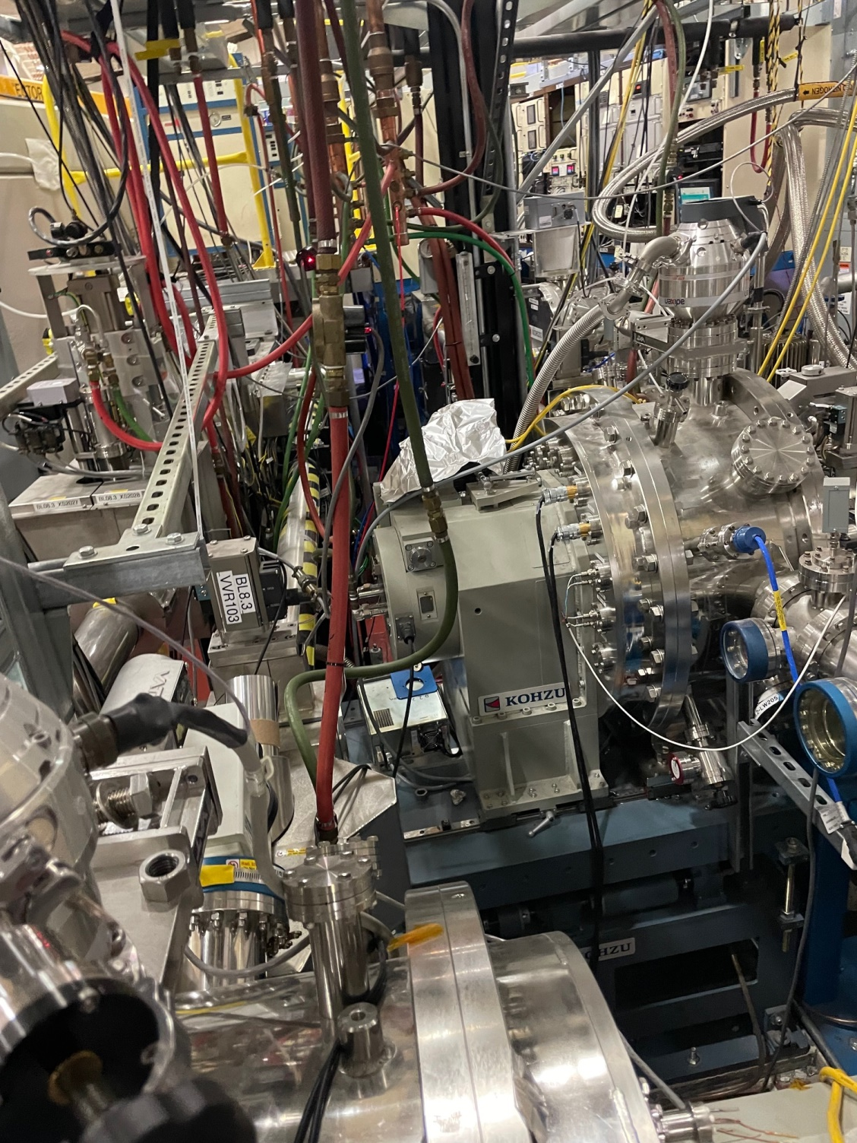
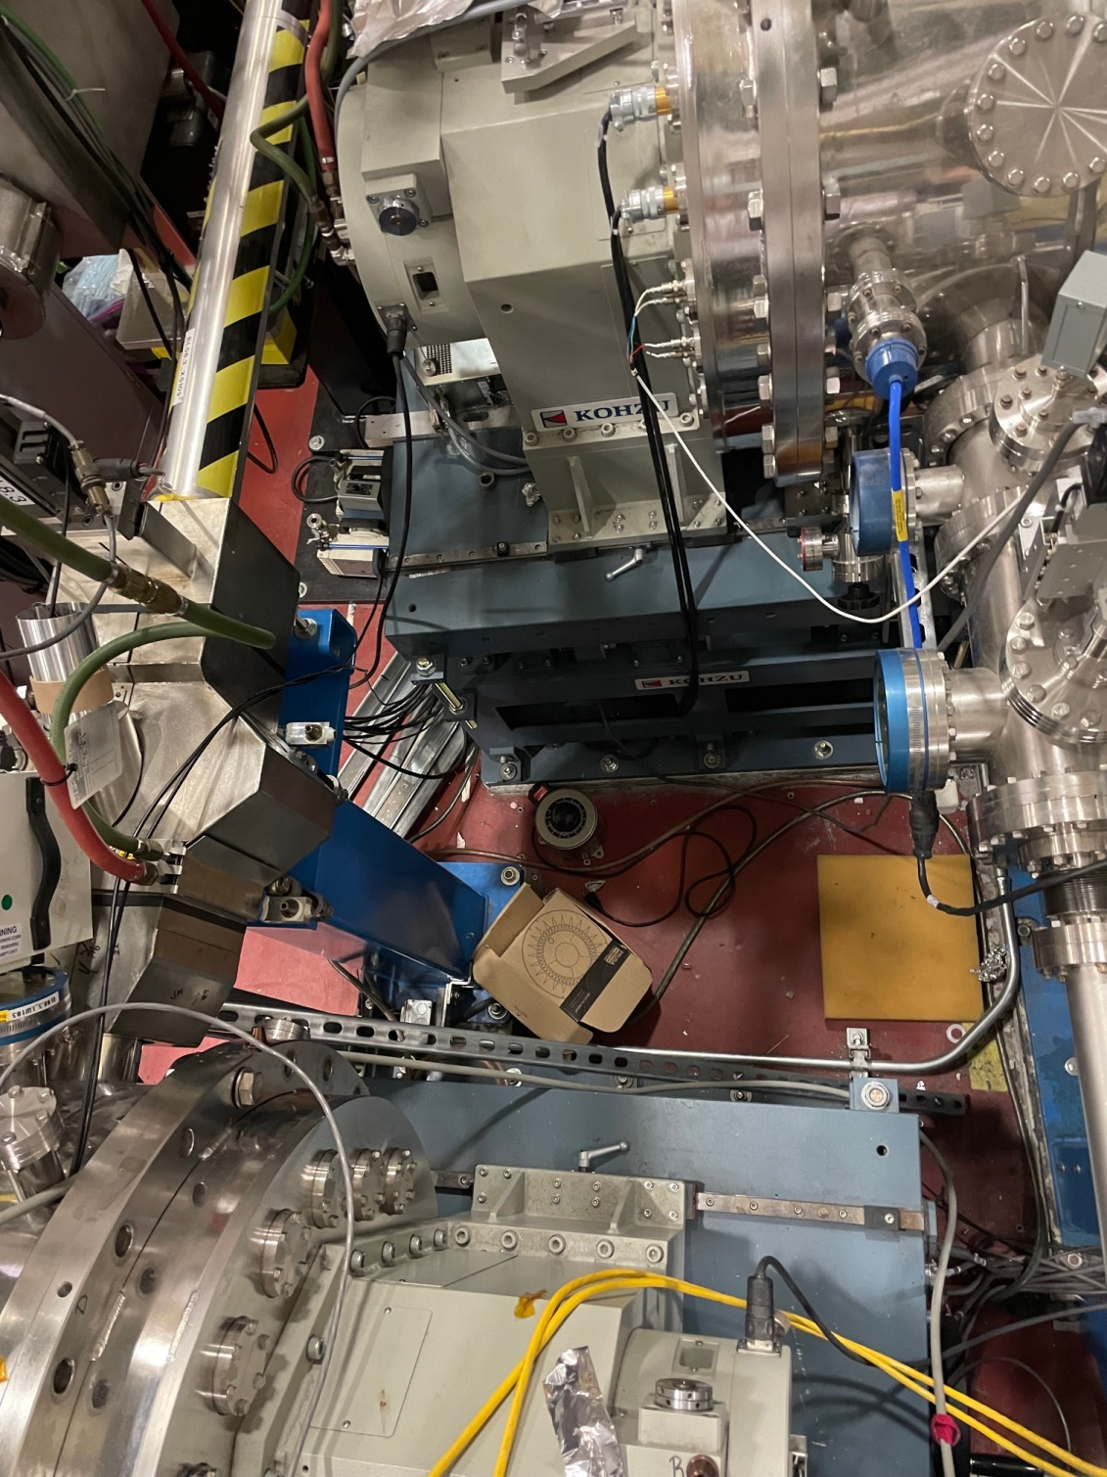
Cryo cooler placement

Slide 25
Back-out plan and crazy ideas
Re-install old mono parts
not expected, last resort
Modify Pb to fit cryo rig - preferable
Modify cryo rig to fit Pb - possible
Run water through new mono parts
In event of total cryo show-stopper
Daisy-chain 8.2.1 and 8.3.1 monos
May be valuable solution in future
Alternate cooler: N2 gas at 10 L/s
Very much lower cost

Slide 26
Expected schedule
Jun 25 – open mono, measure Pb plate
July 1 – completed power, EPS
July 30 – burst discs, cooler placement
Aug 5 – Kohzu upgrade complete
Sep 15 – Cryo cooler install complete
Oct 13 – BL Commissioning

Slide 27
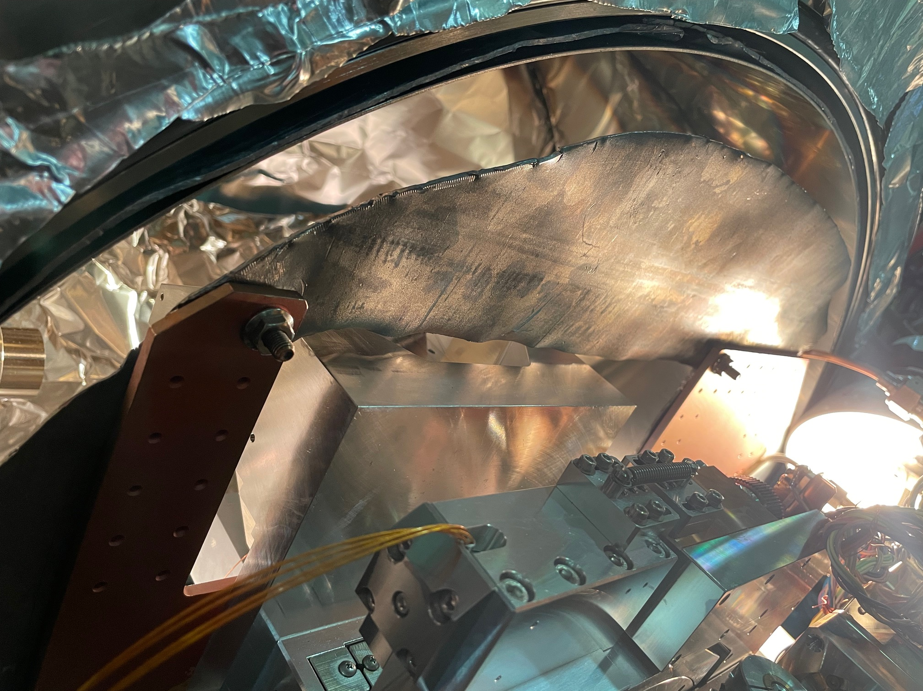
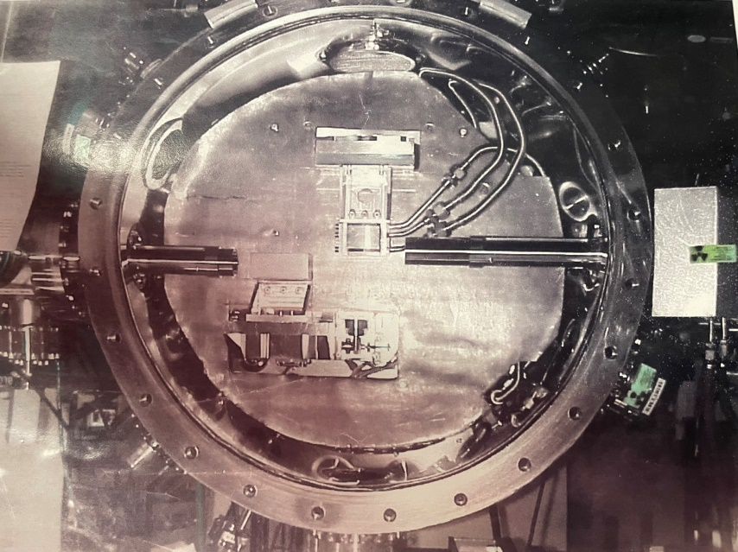
“hanging”
Pb
sheet
Cu
Compton
Shield

