Slide 1
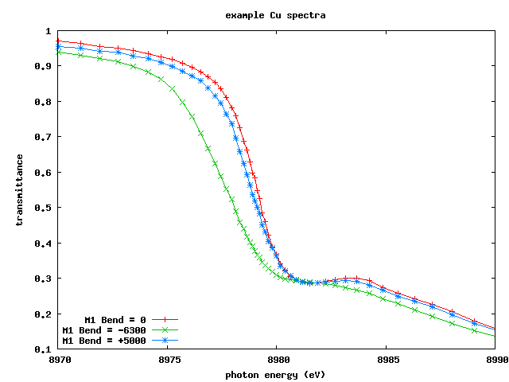
BL 8.3.1
Optics &
diagnostics
sample
YAG
shutter
YAG
Cu
foil
7▫
YAG
diag
Theta2 Y2
Chi2 Z2
Izero
Imono
Out
pinhole
Parabola
(bent flat)
2 benders
1 tilt
C2
M1
M2
torroid
2 benders
1 tilt
C1
div
Slits
Can cross beam in
all 4 directions
Imono
In
Theta
SB8
Al foil
stack

Slide 2
Mono= -2 mm
Mono= 0 mm
Mono= +2 mm
Sweeping
Theta2
over
Si(333)
Rocking
Curve
Unscaled mono = 0 mm
Visible Range:
~13 µRad
(end to end
Theta2 position)

Slide 3
Mono= -2 mm
Mono= 0 mm
Mono= +2 mm
Sweeping
Theta2
over
Si(333)
Rocking
Curve
3 different
C1 crystals
Unscaled
Visible Range:
~13 µRad
(end to end
Theta2 position)

Slide 4
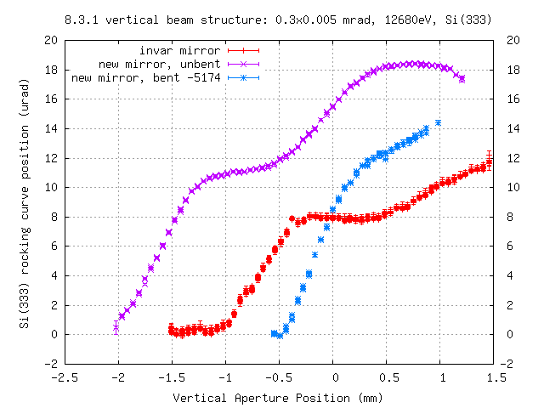

Slide 5
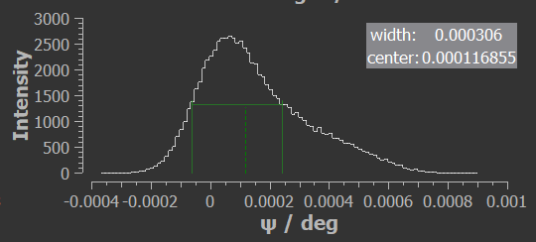
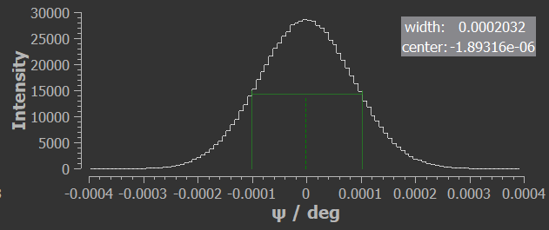
Ray-UI suggests native M1 dispersion
cylinder ~ 14 urad width at base
parabola
~7 urad

Slide 6
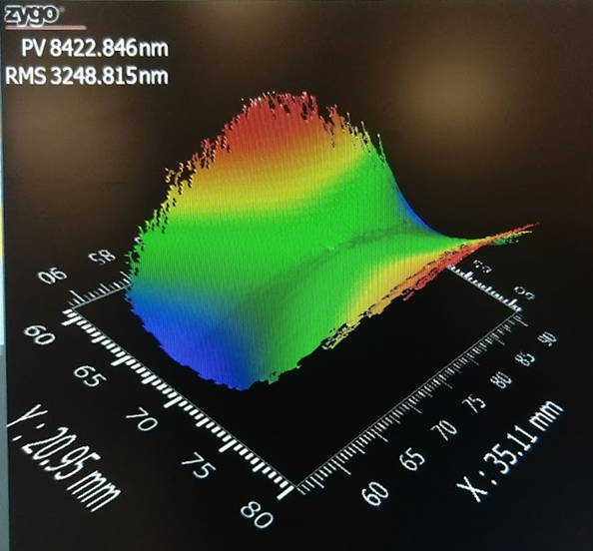
Surface figure of reflecting surface of cleaned C1

Slide 7
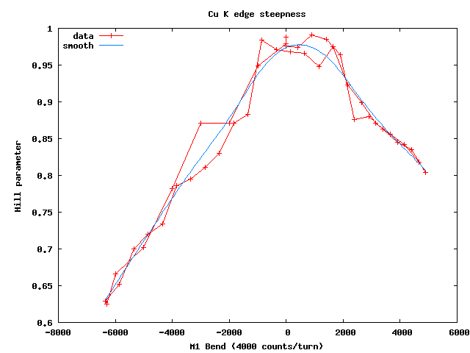
Bend = 0
Bend = +5000
edge steepness
Bend = -6700
M1 Bend

