Slide 1

Acknowledgements
https://bl831.als.lbl.gov/~jamesh/powerpoint/Altos_tangle_2024.pptx
Robert Stroud James Fraser Nevan Krogan
Paul Adams John Tainer Greg Hura Nick Sauter
Aina Cohen Art Lyubimov Jeney Wierman
UCSF LBNL SLAC
ALS 8.3.1: TomAlberTron
NIH NIGMS R01 GM124149 (Holton)
NIH NIAID P50 AI150476 (Krogan)
NIH NIGMS P30 GM124169 (Adams)
DOE-BER IDAT (Hura)
NIH NIGMS P30 GM133894 (Hodgson)
The Advanced Light Source is supported by the Director, Office of Science, Office of Basic Energy Sciences, Materials Sciences Division, of the US Department of Energy under contract No. DE-AC02-05CH11231 at Lawrence Berkeley National Laboratory.

Slide 2

The UNTANGLE Challenge
best.pdb
refme.mtz
1) Build better than the best:
as-good or better wE, R_{free} as best.pdb
non-equivalent ensemble
2) Recover best.pdb from refme.mtz
true phases, auto-building allowed
no cheating (don’t use best.pdb as guide)
Prove: true ensemble is unique
and can be recovered
$1000
$500
https://github.com/jmholton/UnTangle

Slide 3
Score sheet
wE | R_{work} | R_{free} | method
185 | 20.6 | 21.4 | Alphafold2
109.6 | 8.87 | 9.44 | Phenix.ensemble_refine
97.3 | 8.84 | 9.27 | qFit best
91.7 | 3.64 | 4.27 | manual
80.5 | 4.31 | 4.75 | lotswrong
54.6 | 5.87 | 6.57 | single conf w aniso B
33.5 | 2.94 | 3.32 | One thing wrong: Ala39
23.5 | 2.95 | 3.31 | One thing wrong: Val1
21.4 | 3.12 | 3.48 | Rectified Simulated annealing
18.1 | 17.9 | 18.4 | Phenix autobuild
18.2 | 2.79 | 3.14 | best (ground truth)

Slide 4
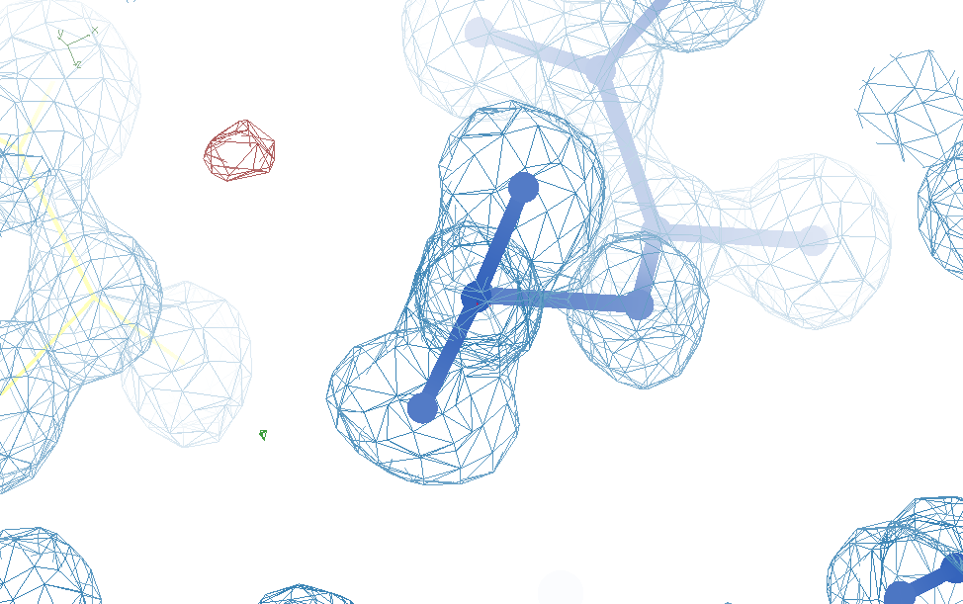
Glu32
Genuine outlier
in ground truth
real data
-80°
Torsion outlier

Slide 5
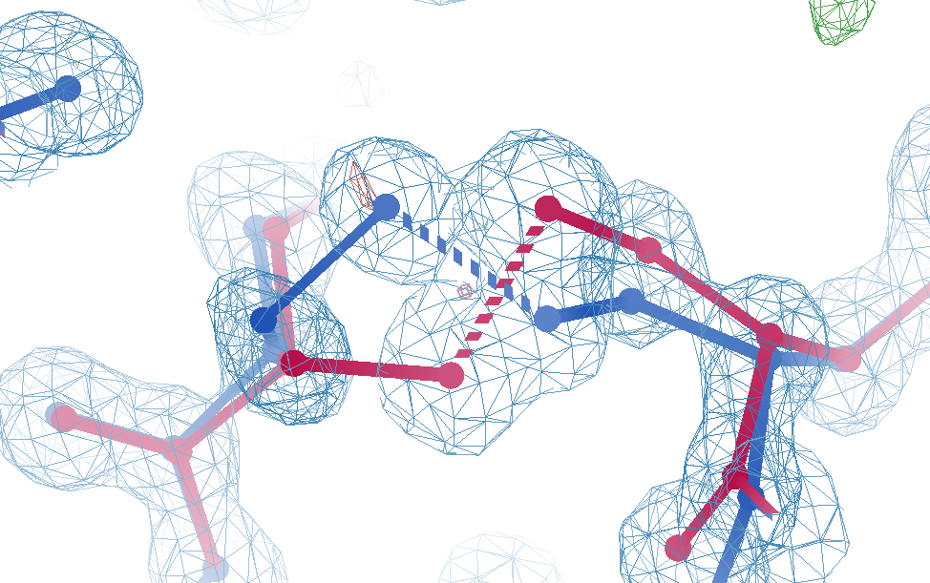
Cys12
Genuine outlier
in ground truth
real data
-107°
torsion outlier
A B conformers

Slide 6
What do you mean, “tangled”?
Ground Truth
Local Minimum

Slide 7
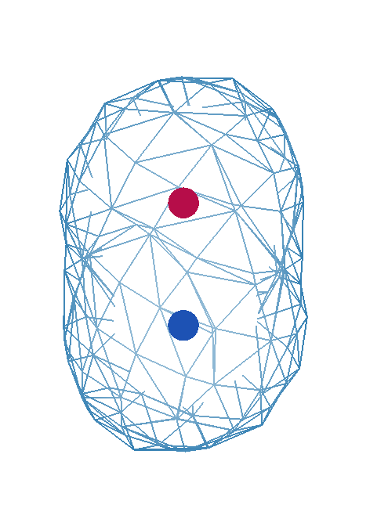
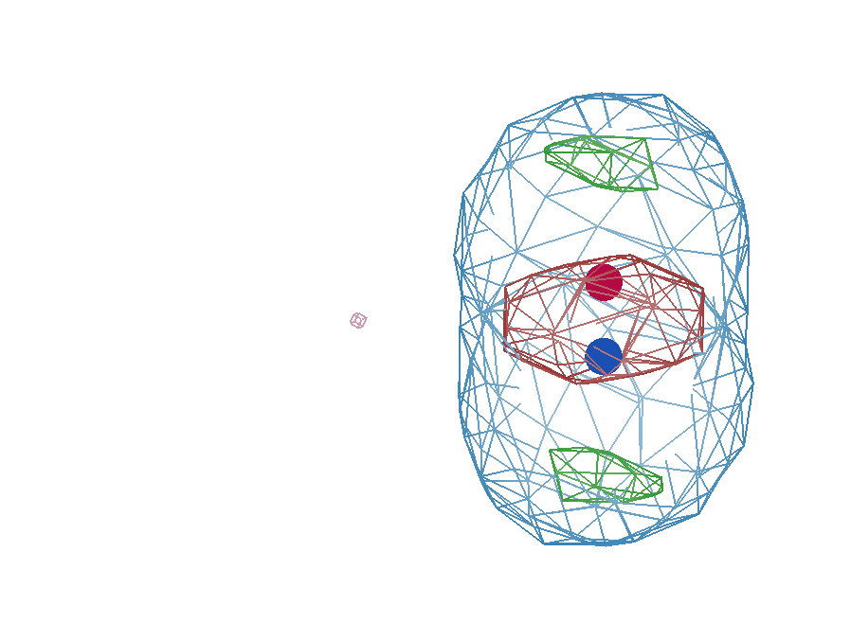
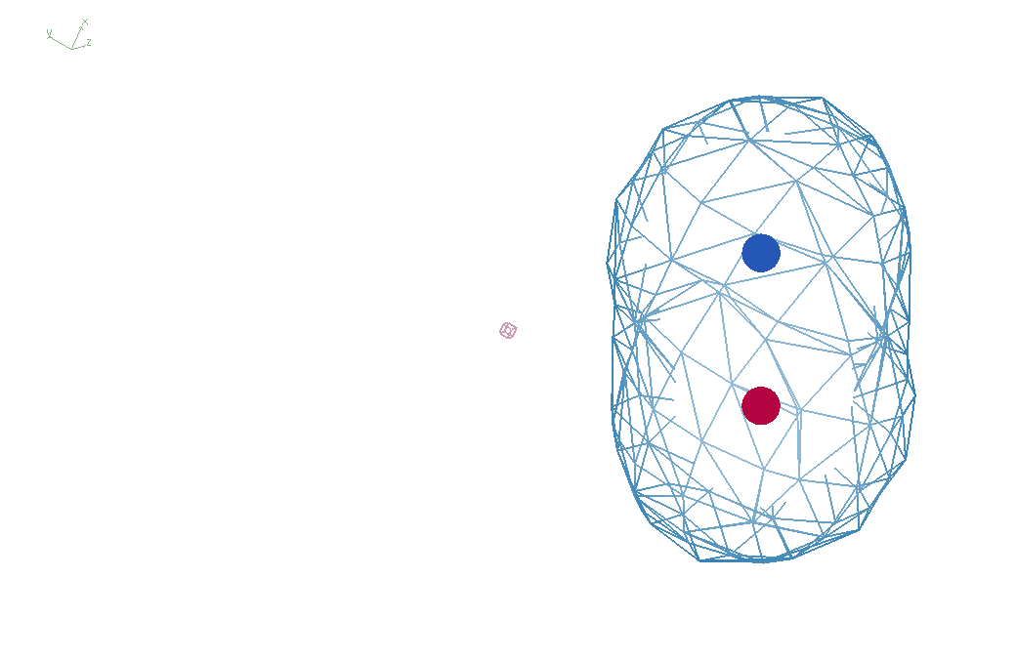
It takes two to tangle
density
fit
Chemical
strain
energy
A
A
B
B
B
A

Slide 8
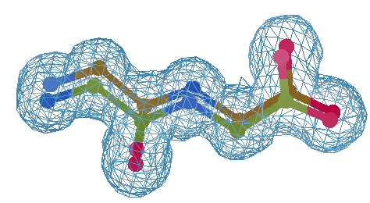
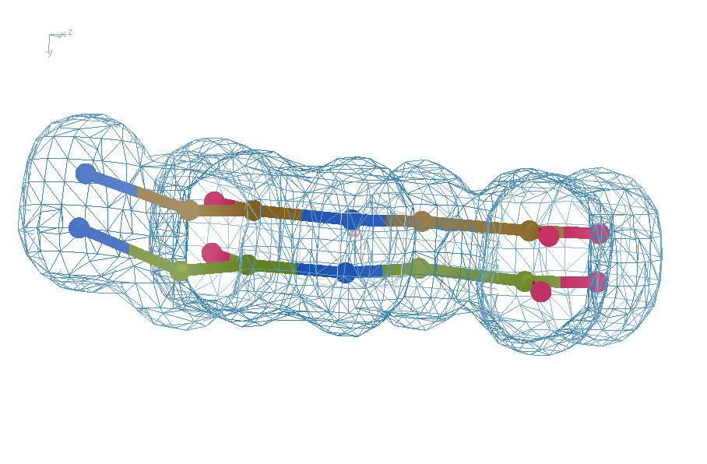
Right answer
R = 0.8%
rms bond = 0.0002

Slide 9
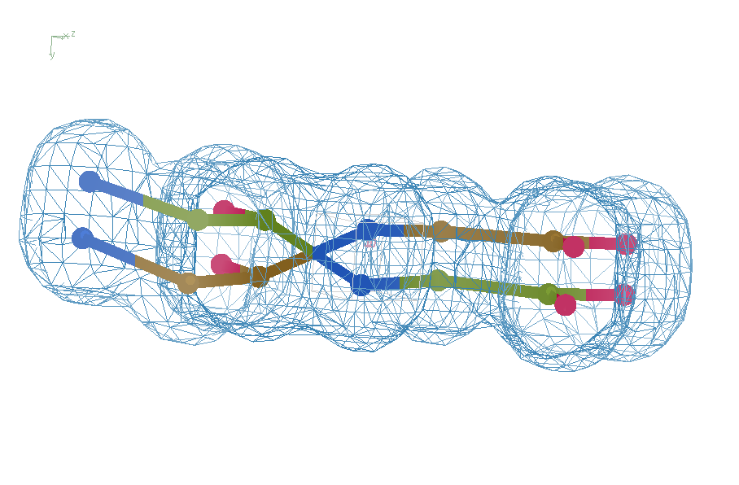
swap assignments
R = 0.8%
rms bond = 0.04

Slide 10
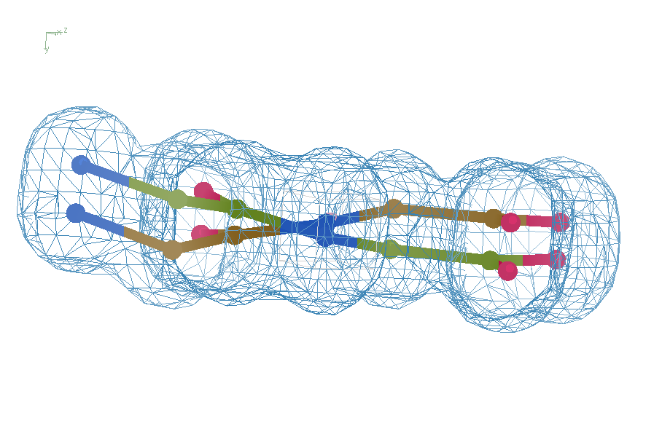
Refine – low x-ray weight
R = 14.3%
rms bond = 0.0002

Slide 11
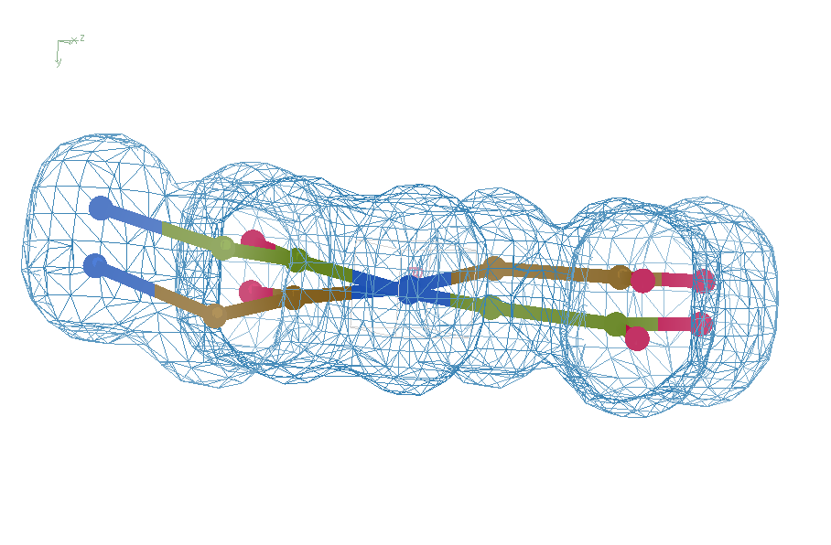
Refine – step 61
R = 6.8%
rms bond = 0.001

Slide 12
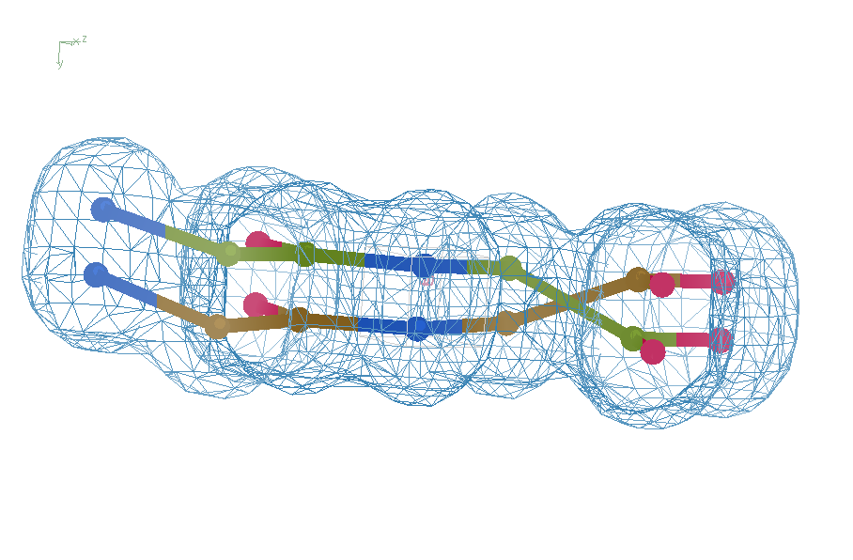
Refine – high x-ray weight
R = 1.2%
rms bond = 0.06

Slide 13
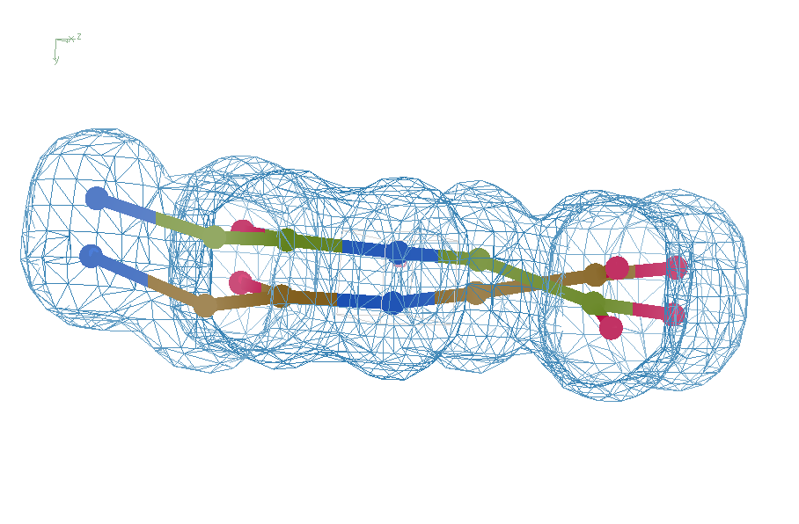
Refine – low x-ray weight
R = 14.3%
rms bond = 0.0002

Slide 14
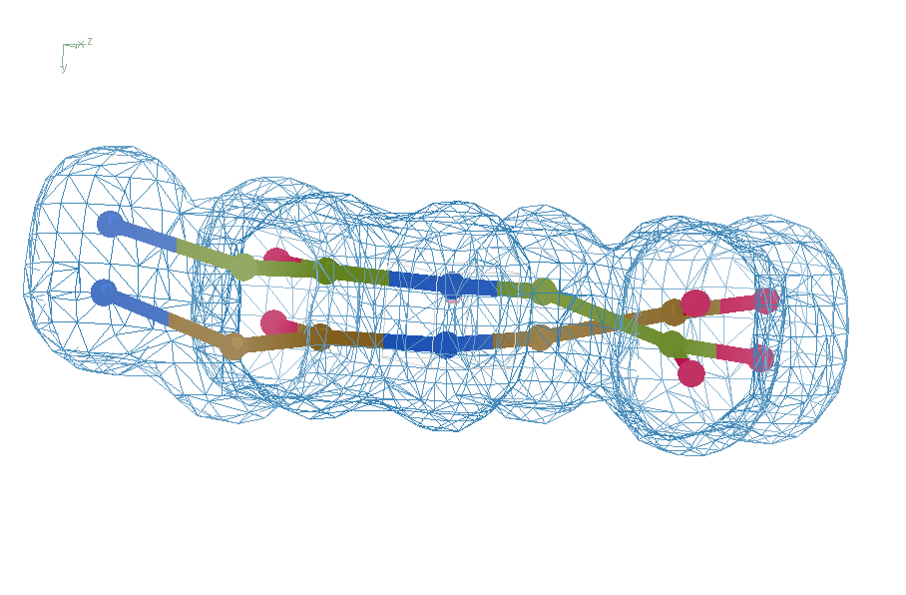
Final compromise
R = 7.07%
rms bond = 0.001

Slide 15
Right answer
R = 0.8%
rms bond = 0.0002

Slide 16
Sim-data Ground Truth
As simple as possible:
  2 conformers
  50:50 occupancy
Accessible
  64 residues
  78 waters
Every chance of success
  1.0 Å reso
  one thing wrong
  flat bulk solvent
  no false outliers
  phenix, refmac, shelxl
  clear score
  Experimental error only
  perfect phases

Slide 17
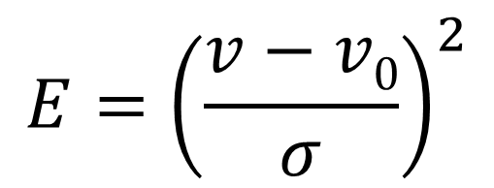
Statistical Potential
$$E={\left(\frac{v−v0}{σ}\right)}^{2}$$
E “energy”
v model value
v₀ ideal value
σ rms deviation expected
1 x 6σ ≈ 36x 1σ
Outlier problem:
solution: weight by
“probability its not noise”

Slide 18
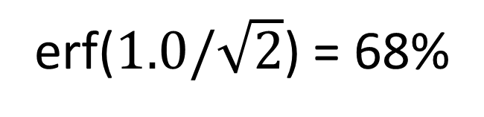
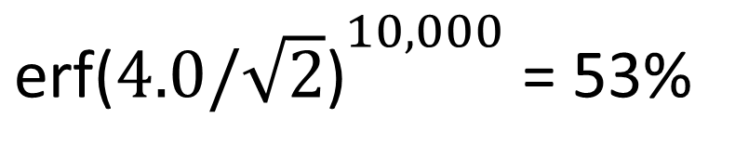
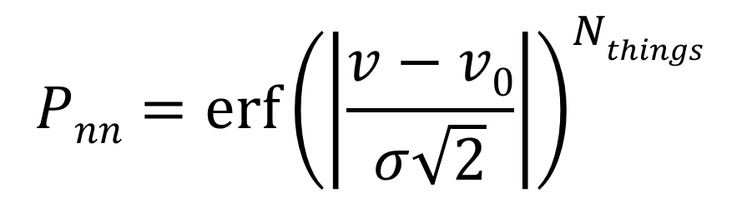
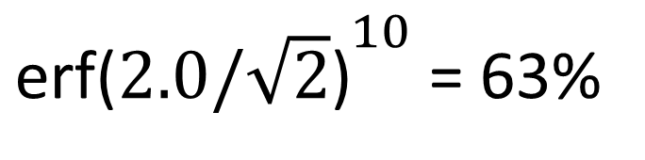
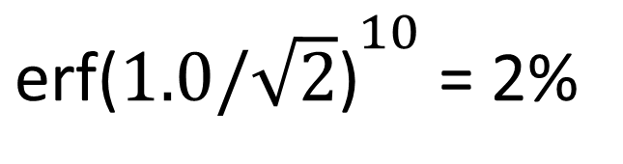
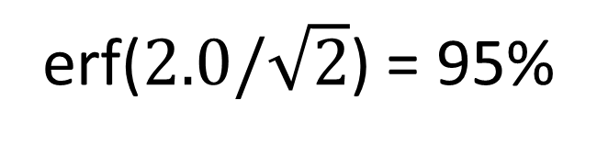
Probability that it’s not noise
$$Pnn={\operatorname{erf}\left(\left|\frac{v−v0}{σ\sqrt{2}}\right|\right)}^{Nthings}$$
P_{nn} probability
v-v₀ deviation from ideal
σ rms deviation expected
erf() integral of a Gaussian
N_{things} number of trials
erf($1.0/\sqrt{2}$) = 68%
${\text{erf}\text{(}1.0/\sqrt{2}\text{)}}^{10}$ = 2%
erf($2.0/\sqrt{2}$) = 95%
${\text{erf}\text{(}2.0/\sqrt{2}\text{)}}^{10}$ = 63%
${\text{erf}\text{(}4.0/\sqrt{2}\text{)}}^{10,000}$ = 53%

Slide 19
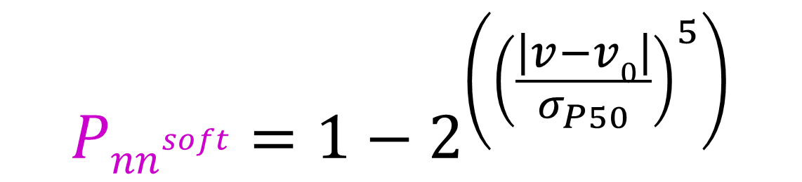
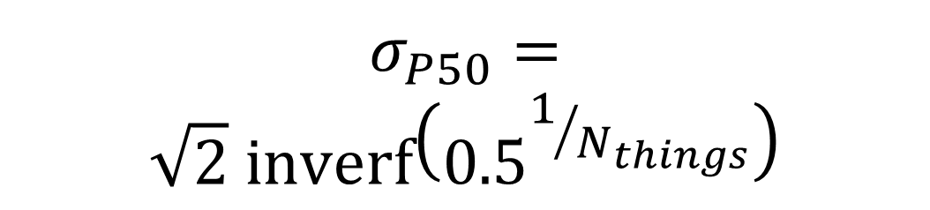
Probability that it’s not noise softer
$${Pnn}^{soft}=1−2^{\left({\left(\frac{\left|v−v0\right|}{σ_{P50}}\right)}^{5}\right)}$$
1
P_{nn} probability
v-v₀ deviation from ideal
σ rms deviation expected
inverf() inverse erf()
N_{things} number of trials
P
N=1
0.5
N=1 soft
$$σ_{P50}=$$
$$\sqrt{2} \text{inverf}\left({0.5}^{1/{N_{things}}}\right)$$
N=10,000
soft
N=10,000
0
1
2
3
4
5
6
max sigma deviate

Slide 20
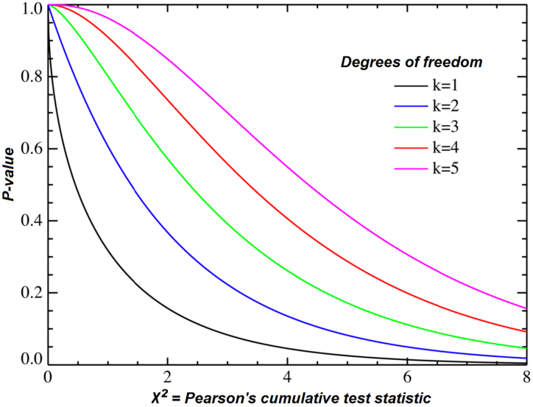
Probability that it’s not noise average/sum of N_{things}
χ² test
N_{things}
Probability
That its
Gaussian
tie breaker

Slide 21
Sensible scoring function
  Statistical potential
    bonds, angles, planes, torsions, chiral
  Leonard-Jones vdW
    non-bond and clashes
  Probability -> σ dev
    - Rota, rama
  Peptide bond
    σ → 5°
  C_{β}dev
    σ = 0.05 Å
4
2
van der Waals
Phenix/refmac
0
Energy
-1
1
2
3
4
5
Atomic separation (Å)

Slide 22
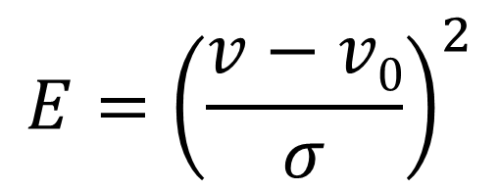
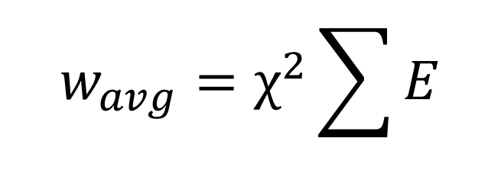
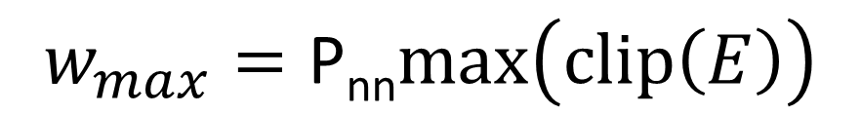
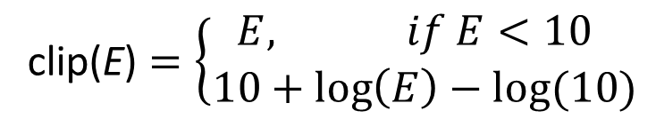
weighted Energy scoring function
$$w_{avg}=χ^{2}\sum{E}$$
$$w_{max}=\text{P}\text{nn}max\left(clip\left(E\right)\right)$$
N_{things}
$$E={\left(\frac{v−v0}{σ}\right)}^{2}$$
10
wE
N=10
max() = worst outlier
5
N=10,000
Sum over all validation types
0
clip(E) $=\left\{\begin{matrix}E, if E<10 \\ 10+\log\left(E\right)−log⁡(10)\end{matrix}\right.$
3
6
8
max sigma deviate

Slide 23
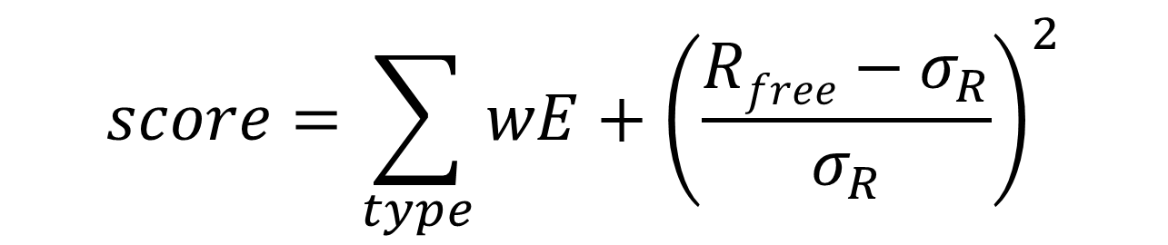
weighted Energy scoring function
$$score=\sum_{type}{wE}+{\left(\frac{Rfree−σ_{R}}{σ_{R}}\right)}^{2}$$
score UNTANGLE Challenge score
type bonds, angles, clashes, etc.
wE weighted energy avg + worst
σ_{R} experimental error (2%)
https://github.com/jmholton/UnTangle

Slide 24

Why is a beamline guy doing refinement things?
https://bl831.als.lbl.gov/~jamesh/powerpoint/Ringberg_tangle_2024.pptx
Because: the future of crystallography has alternate conformations
Single-conf models
poor resolution
Low signal/noise
Phase Problem
Dynamics?
Mechanism?
Small signal?
Overlapping states?

Slide 25
Untangling models
https://bl831.als.lbl.gov/~jamesh/powerpoint/Ringberg_tangle_2024.pptx
https://github.com/jmholton/UnTangle
for less noisy maps

Slide 26
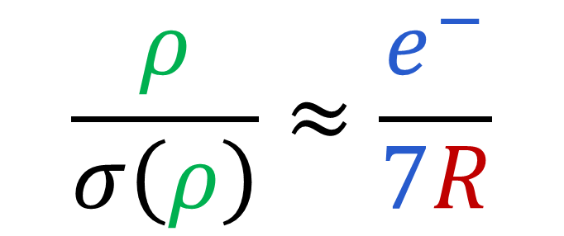
via Parseval’s Theorem
$$\frac{ρ}{σ\left(ρ\right)}≈\frac{e^{−}}{7R}$$
e⁻ number of electrons in peak
7 number of electrons in typical atom
R R_{iso} or R_{free}
ρ electron density peak
σ rms deviation expected

Slide 27
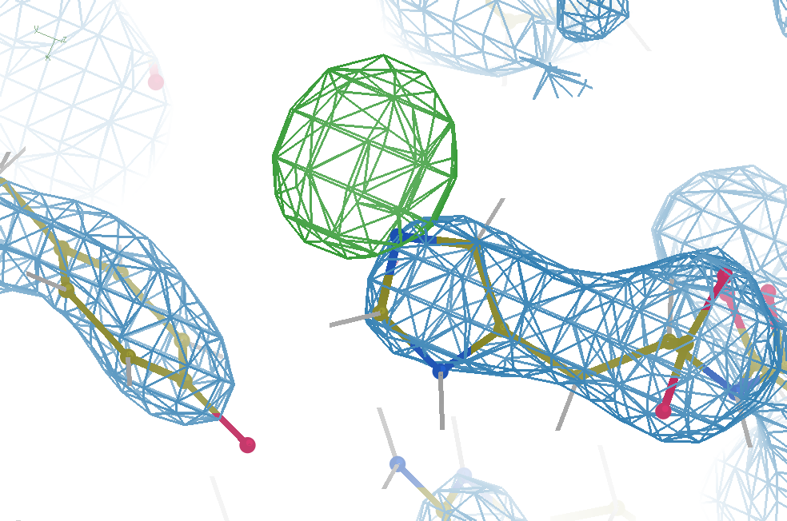
Hydrogen: visible at 3.5 Å resolution!
R_{work} = 0.04
R_{free} = 0.05
6σ = 1 e⁻
cut at 5 Å :
R_{free} = 0.01
Simulation:
Realistic noise
“perfect” model

Slide 28
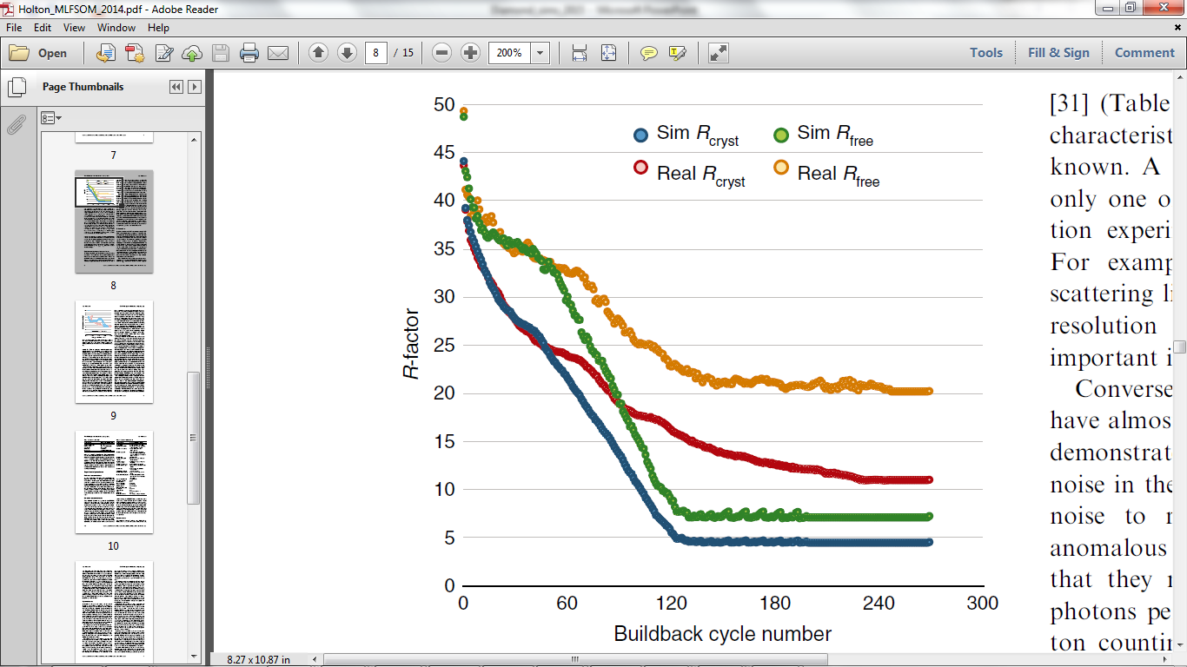
Model building: real vs sim data
multi
single
single
single
multi
multi
multi
single
Holton et al. (2014) "The R-factor gap", FEBS J. 281, 4046-4060.

Slide 29
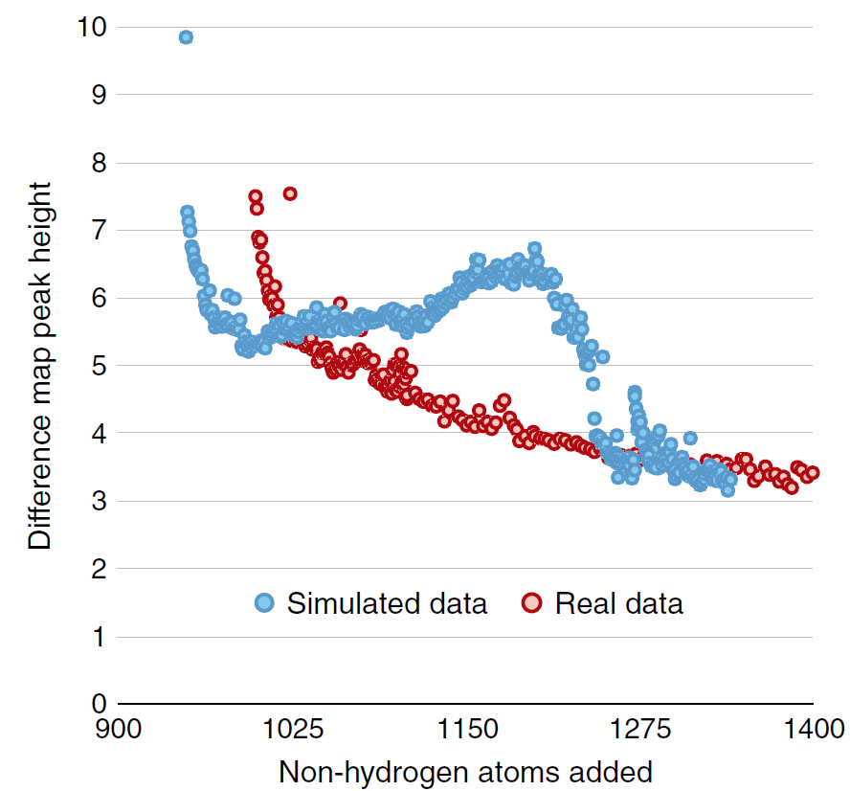
Model building: real vs sim data
multi
single conf
Single conf ground
Multi conf ground truth
Holton et al. (2014) "The R-factor gap", FEBS J. 281, 4046-4060.

Slide 30
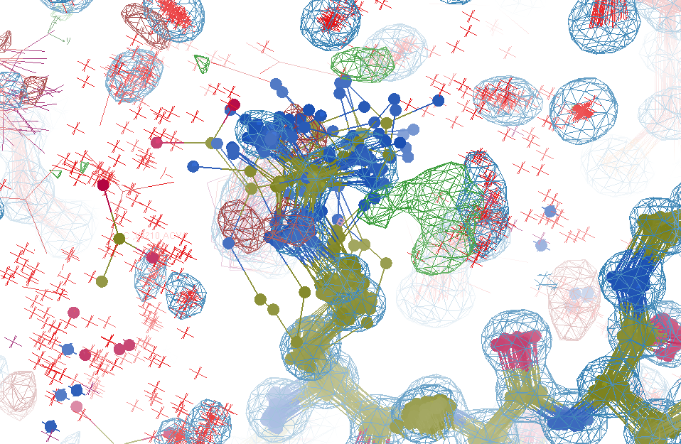
R_{work}: 0.0823
R_{free}: 0.1106
bond: 0.014 Å
angle: 1.92°
Real Data
1.2 σ
48-copy ensemble
3 params
per observation
MoPro: 1.15
Clash: 0.49
Cβdev: 20
Rota: 1.7%
Rama: 0.03%
reso: 1.0 Å
6σ

Slide 31
Over-Fitting data
Map density
position

Slide 32
Over-Fitting data
Map density
position

Slide 33
Over-Fitting data
Map density
position

Slide 34
Over-Fitting data
R_{work} ≈ 0
N_{params}= N_{obs}
Map density
position

Slide 35
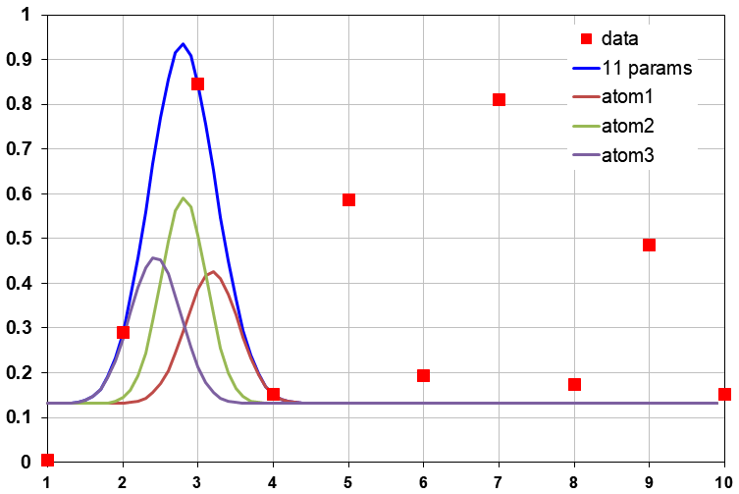
Under-Fitting data
R_{work} > 0
N_{params}> N_{obs}
Map density
position

Slide 36
R_{work}: 0.0823
R_{free}: 0.1106
bond: 0.014 Å
angle: 1.92°
under-fitting:
R_{work} > 0
MoPro: 1.15
Clash: 0.49
Cβdev: 20
Rota: 1.7%
Rama: 0.03%
reso: 1.0 Å
6σ

Slide 37
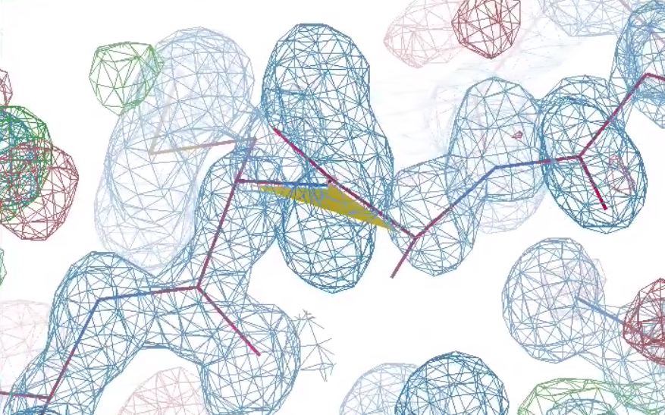
What is holding it back?
48-copy ensemble
3 parameters
per observation!
30°
peptide
bond twist

Slide 38
Why does ensemble refinement suck?
(3 parameters/observation and R_{work} still high!)
The chains are “tangled”

Slide 39
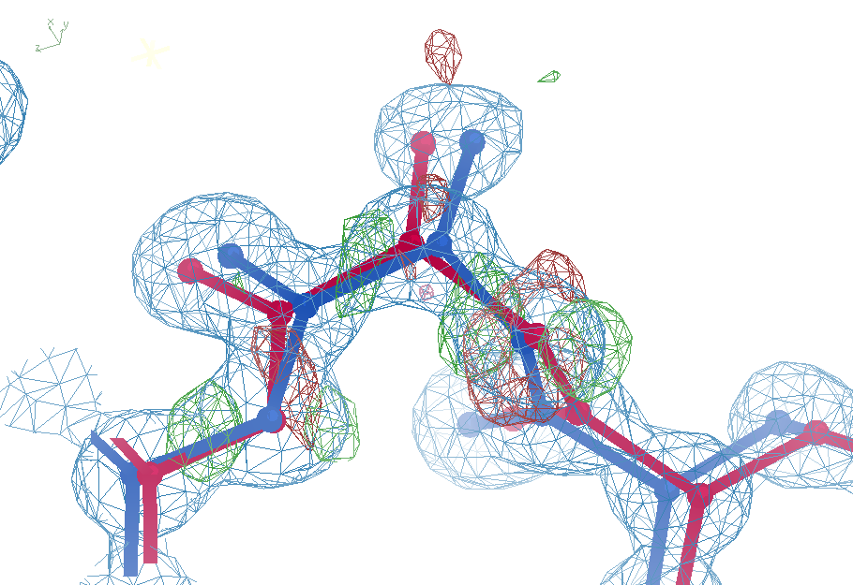
sim data
Ala39
+11σ
wE=63.5
N-C_{α}
bond
-9σ
5σ
angle
A B conformers

Slide 40
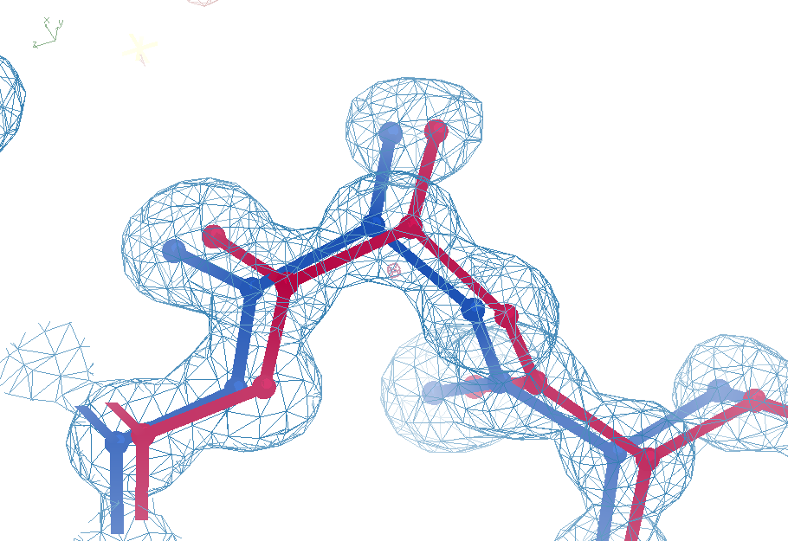
sim data
Ala39
-0.2σ
wE=18.2
N-C_{α}
bond
-0.3σ
0.8σ
angle
A B conformers

Slide 41
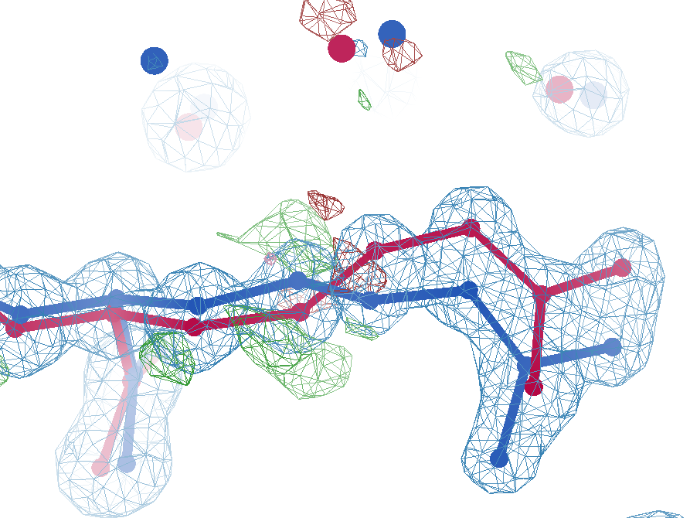
sim data
Arg62
wE=63.5
2.8 Å
4σ
C_{γ}-C_{δ}
bond
2.7σ torsion
A B conformers

Slide 42
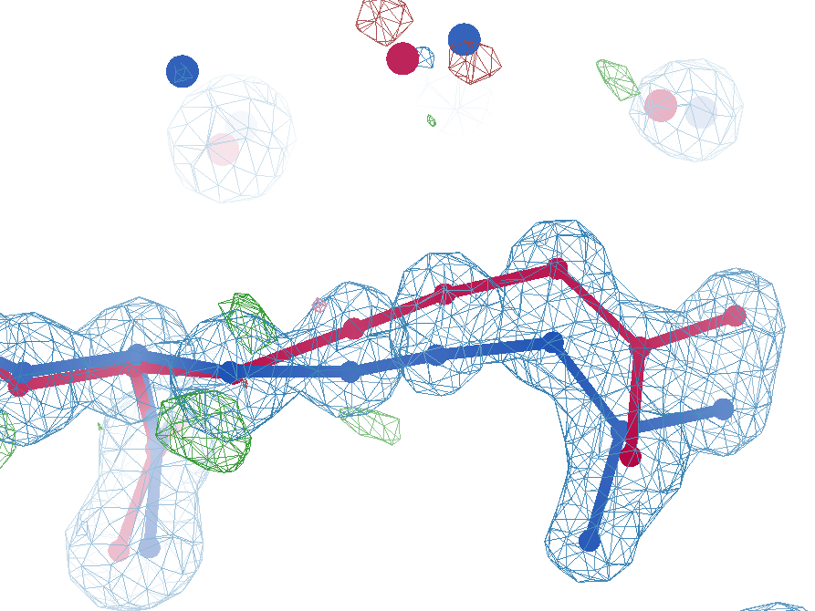
sim data
Arg62
wE=50.7
2.8 Å
2σ
angle
A B conformers

Slide 43
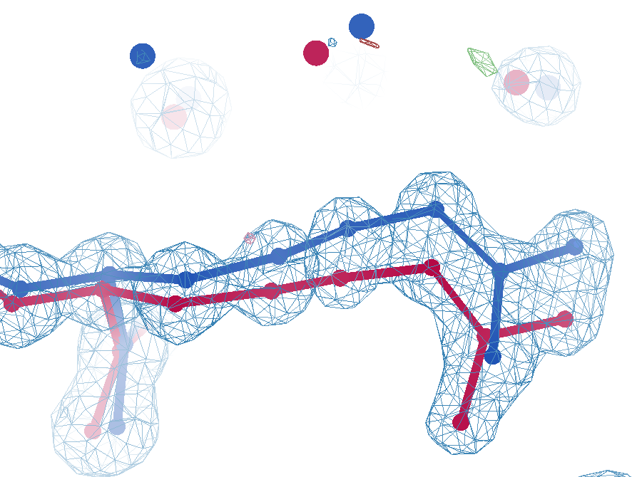
sim data
Arg62
wE=18.2
3.0 Å
0.3σ
C_{γ}-C_{δ}
bond
1σ
angle
1.6σ torsion
A B conformers

Slide 44
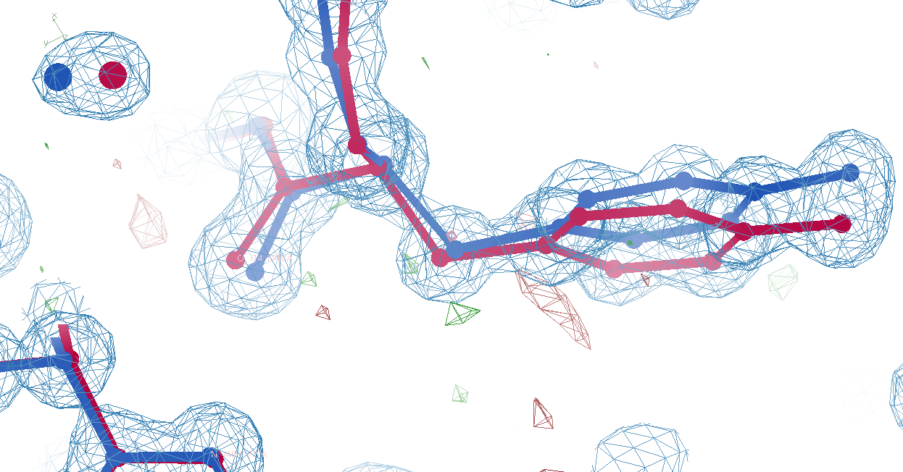
Tyr14
sim data
wE=33.1
3.0 Å
A B conformers

Slide 45
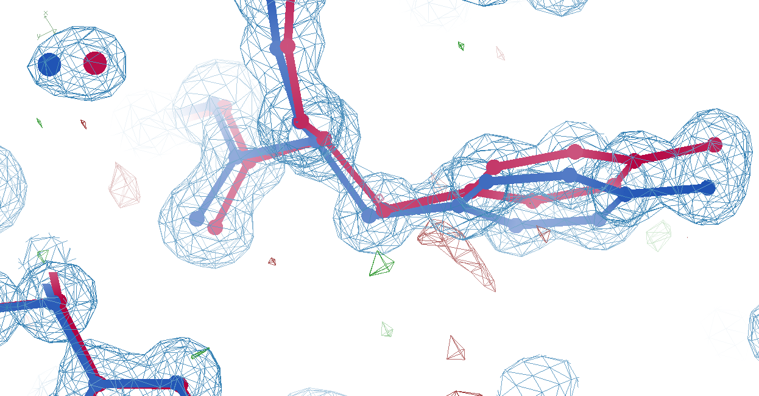
Tyr14
sim data
wE=18.2
3.2 Å
A B conformers

Slide 46
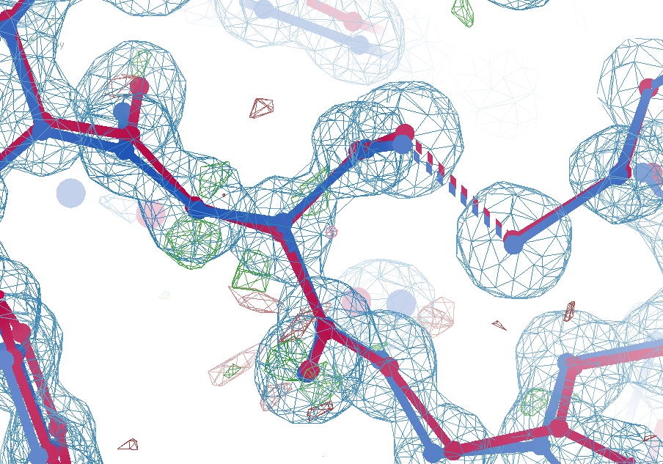
Cys16
sim data
wE=21.4
2.7σ
angle
A B conformers

Slide 47
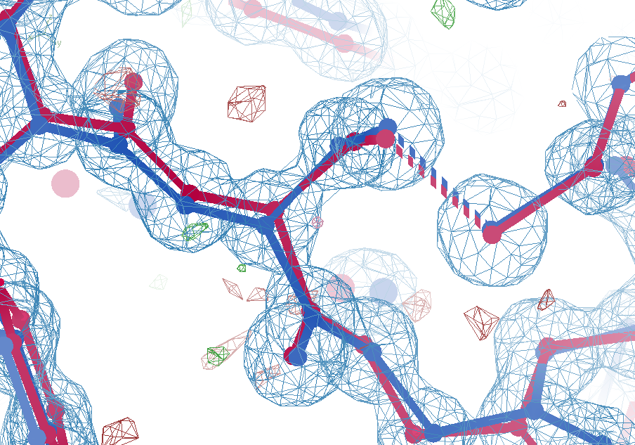
Cys16
sim data
wE=18.2
1.5σ
angle
A B conformers

Slide 48
Summary
https://bl831.als.lbl.gov/~jamesh/powerpoint/Altos_tangle_2024.pptx
Rfree < 3% → single e⁻
  Not over-fitting
Main barrier: tangled ensemble
Sensible scoring function
  Probability its not noise
  some outliers are real
Recover underlying ensemble
  Might be required!
Cooperative motions

Slide 49
The Challenge
best.pdb
refme.mtz
1) Build better than the best:
as-good or better wE, R_{free} as best.pdb
non-equivalent ensemble
2) Recover best.pdb from refme.mtz
true phases, auto-building allowed
no cheating (don’t use best.pdb as guide)
Prove: true ensemble is unique
and can be recovered
$1000
$500
https://github.com/jmholton/UnTangle

Slide 50
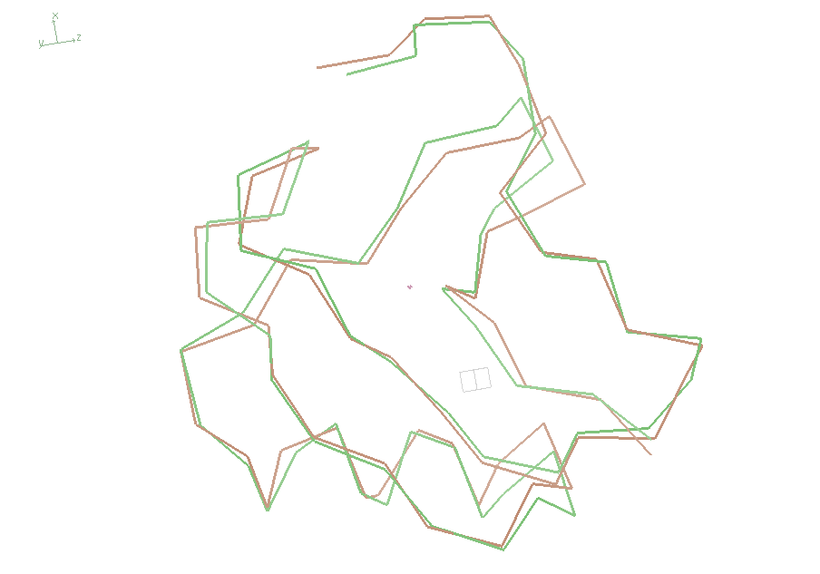
wE=18.2

Slide 51
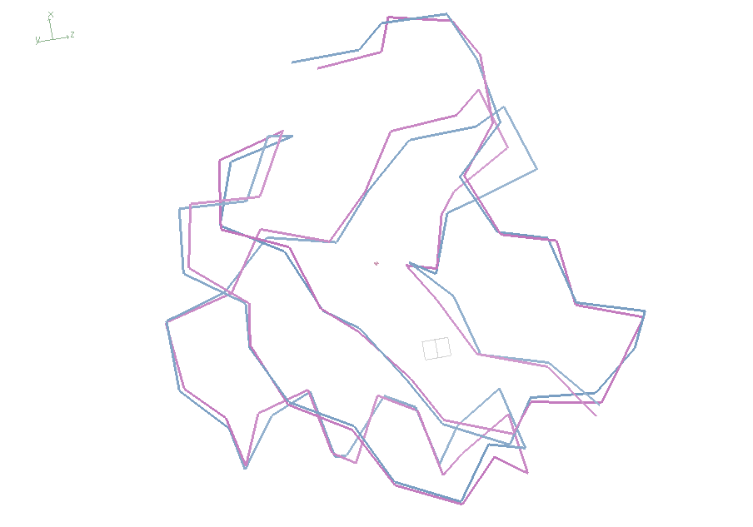
wE=21.4

Slide 52
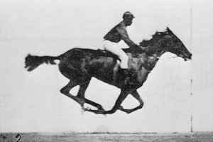
Muybridge’s galloping horse (1872)

Slide 53
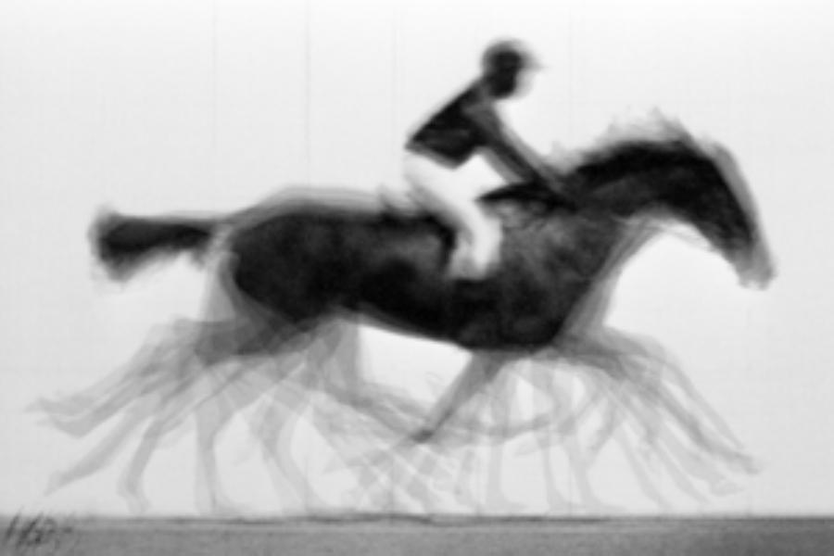
average structure: galloping horse

Slide 54
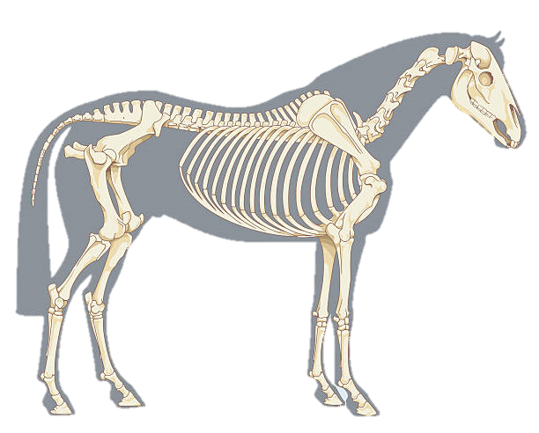
Horses have bones
+/- 0.01

Slide 55
Horses have bones

Slide 56

Muybridge’s galloping horse 0

Slide 57
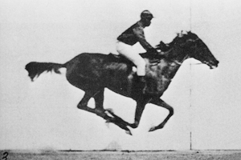
Muybridge’s galloping horse 1

Slide 58

Muybridge’s galloping horse 2

Slide 59

Muybridge’s galloping horse 3

Slide 60

Muybridge’s galloping horse 4

Slide 61

Muybridge’s galloping horse 5

Slide 62

Muybridge’s galloping horse 6

Slide 63

Muybridge’s galloping horse 7

Slide 64

Muybridge’s galloping horse 8

Slide 65

Muybridge’s galloping horse 9

Slide 66

Muybridge’s galloping horse 10

Slide 67

Muybridge’s galloping horse 11

Slide 68

Muybridge’s galloping horse 12

Slide 69

Muybridge’s galloping horse 13

Slide 70

Muybridge’s galloping horse 14

Slide 71
ensemble refine ???

Slide 72
Differences
horse
molecule
~2 m
Stiff backbone
Bone sigma ~ 1 mm
4 joints/leg
Continuous angle
No torision
Concerted motion
~100 Å
Stiff backbone
Bond sigma = 0.01 Å
0-4 chi angles
Angle sigma ~ 1°
Rotamers
Concerted motion

Slide 73

The last Å between prediction and observation

Slide 74

The last Å between prediction and observation

Slide 75
Trapped
+11σ
wE=63.5
N-C_{α}
bond
-9σ
5σ
angle
A B conformers

Slide 76
Correct
-0.2σ
wE=18.2
N-C_{α}
bond
-0.3σ
0.8σ
angle
A B conformers

