Slide 1
PowerPoint File available:
http://bl831.als.lbl.gov/
~jamesh/powerpoint/
AS_SvN_2014.pptx

Slide 2
Acknowledgements
Tom Peat Janet Newman Christine Gee
Jason Price Kay Diederichs Tom Caradoc-Davies
Pavel Janowski David Cerutti David Case
Center for Structure of Membrane Proteins
Membrane Protein Expression Center II
Center for HIV Accessory and Regulatory Complexes
W. M. Keck Foundation
Plexxikon, Inc.
M D Anderson CRC
University of California Berkeley
University of California San Francisco
National Science Foundation
University of California Campus-Laboratory Collaboration Grant
Henry Wheeler
The Advanced Light Source is supported by the Director, Office of Science, Office of Basic Energy Sciences, Materials Sciences Division, of the US Department of Energy under contract No. DE-AC02-05CH11231 at Lawrence Berkeley National Laboratory.

Slide 3
signal vs noise
“If you don’t have
good data,
then you have
no data at all.”
-Sung-Hou Kim

Slide 4
signal vs noise
easy
hard
impossible

Slide 5
signal vs noise
easy
hard
impossible
threshold of “solvability”

Slide 6
The “success rate” of structure determination
100 s/dataset
200 days/year
~150 beamlines
~26,000,000 datasets/year
9597 PDBs in 2013

Slide 7
Grand Challenges in Structural Biology
Phase Problem
spots, but no maps
Amplitude Problem
    Crystals, but no spots
R-factor Gap
    Can’t/shouldn’t publish

Slide 8
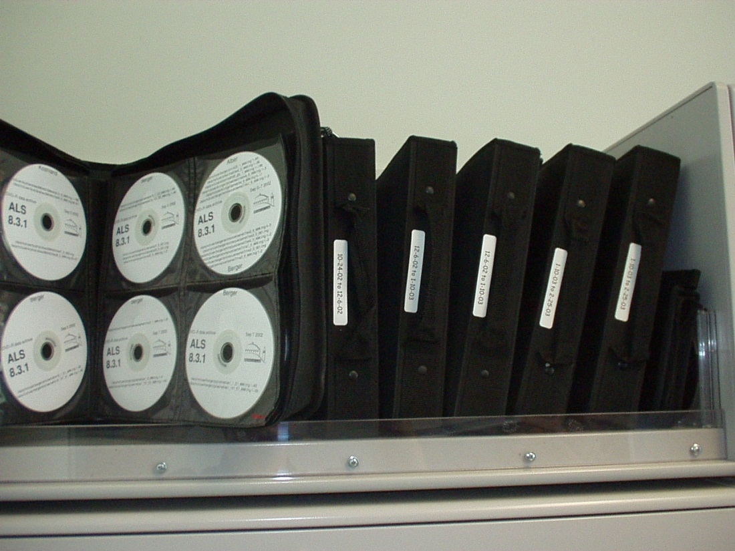
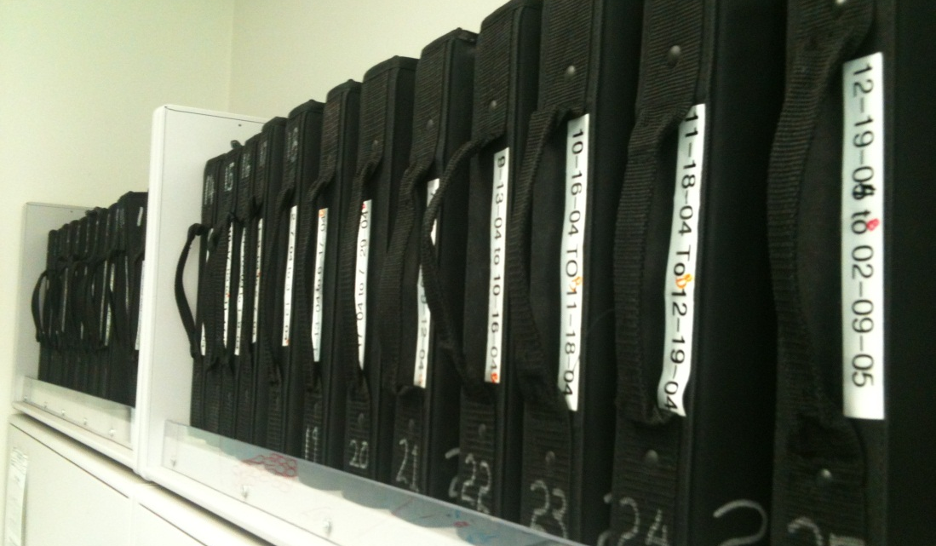
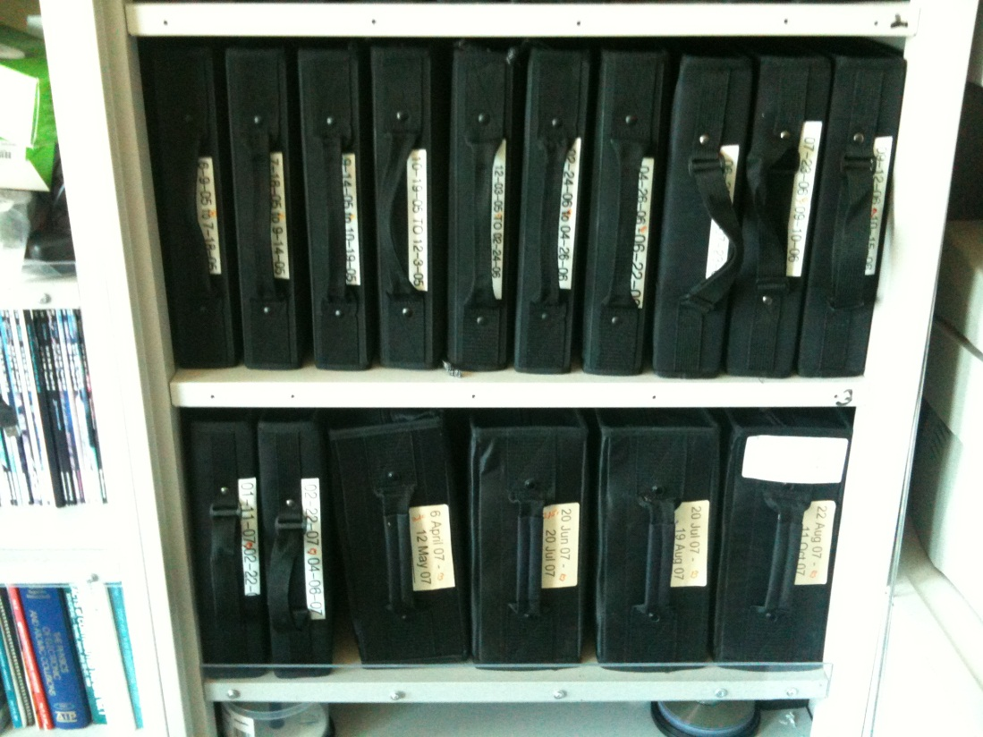
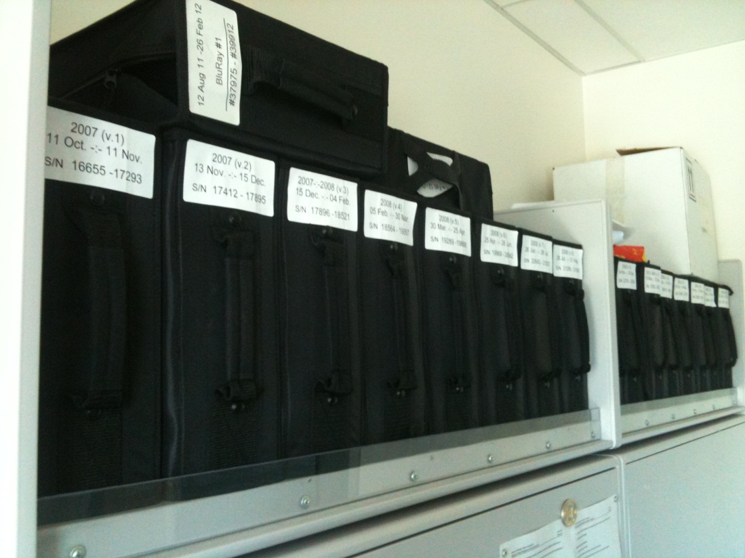
“Success rate” of structures
~2500 datasets/year
~100 PDBs/year

Slide 9

100% SeMet incorporation
Trivial to solve

Slide 10

100% S -Met incorporation
Impossible to solve

Slide 11
Phase Problem: Se vs S
correlation coefficient
fraction Sulfur

Slide 12
Phase Problem: Se vs S
correlation coefficient
fraction Sulfur

Slide 13
Phase Problem: Se vs S
correlation coefficient
fraction Sulfur

Slide 14
Phase Problem: Se vs S
correlation coefficient
fraction Sulfur

Slide 15
Phase Problem: Se vs S
correlation coefficient
fraction Sulfur

Slide 16
Phase Problem: Se vs S
correlation coefficient
fraction Sulfur

Slide 17
Molecular Replacement
corrupted model
Correlation coefficient to correct density
Rmsd from perfect search model (Å)

Slide 18
The transition is sharp!
Phase Problem
How can we predict success/failure?

Slide 19

Holton & Frankel (2010) Acta D 66 393-408.

Slide 20
signal vs noise
“If you don’t have
good data,
then you must
learn statistics.”
-James Holton

Slide 21
Adding noise
1² + 1² = 1.4²
3² + 1² = 3.2²
σ_{total}² = σ₁² + σ₂²

Slide 22
Adding noise
1² + 1² = 1.4²
3² + 1² = 3.2²
σ_{total}² = σ₁² + σ₂²

Slide 23
Adding noise
1² + 1² = 1.4²
3² + 1² = 3.2²
10² + 1² = 10.05²

Slide 24
anomalous signal
ΔF
F
√
# sites
MW (Da)
≈ 1.2 f”
Crick, F. H. C. & Magdoff, B. S. (1956) Acta Crystallogr. 9, 901-908.
Hendrickson, W. A. & Teeter, M. M. (1981) Nature 290, 107-113.

Slide 25
Holton & Frankel (2010) Acta D 66 393-408.

Slide 26
Sources of error for anomalous differences
Shutter jitter (rms 0.5 ms)
Beam flicker (0.15%/sqrt(Hz))
Attenuation correction (< 2%)
Radiation damage (1%/MGy)
Detector calibration (3%)

Slide 27
Sources of error for anomalous differences
Shutter jitter (rms 0.5 ms)
Beam flicker (0.15%/sqrt(Hz))
Attenuation correction (< 2%)
Radiation damage (1%/MGy)
Detector calibration (3%)

Slide 28
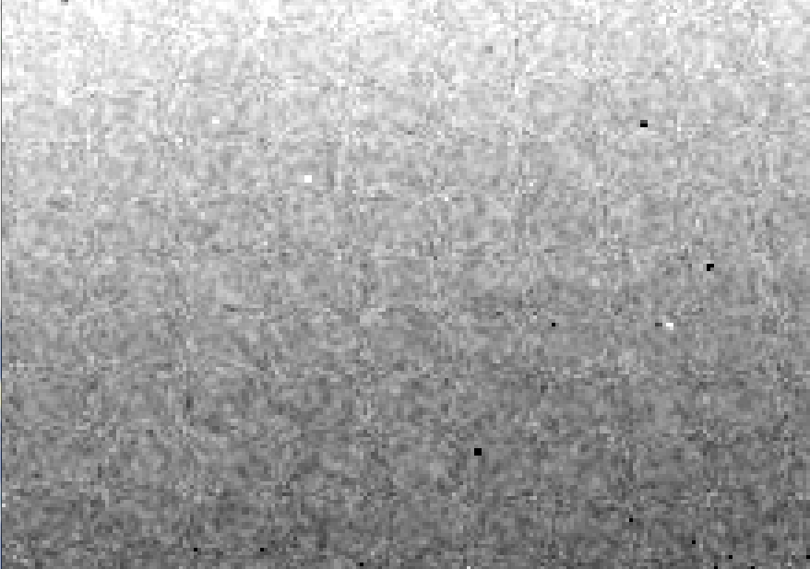
Detector calibration: 7235 eV

Slide 29
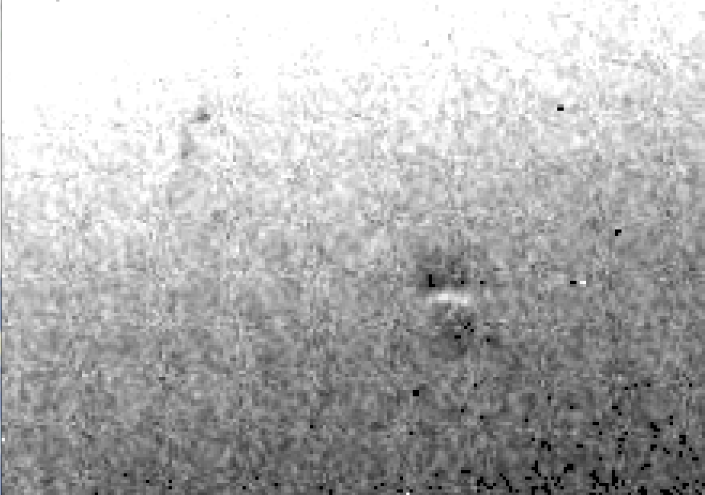
Detector calibration: 7247 eV

Slide 30
Gadox calibration vs energy
same = good!
Relative absorption depth
bad!
photon energy (keV)

Slide 31
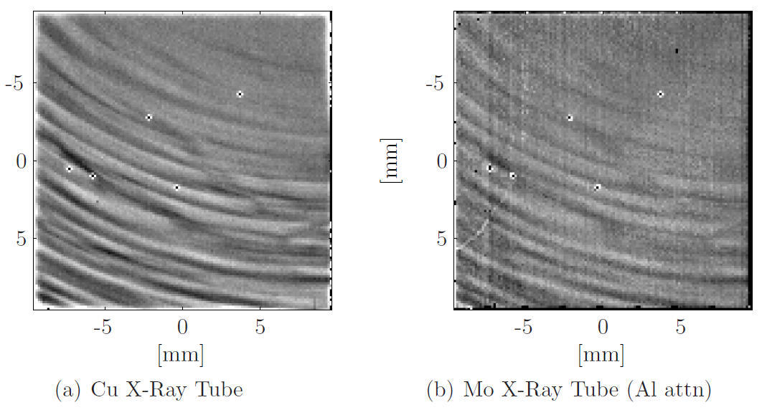
Spatial Heterogeneity in Sharp Spot Sensitivity
Pilatus is not immune!
Dan Schuette PhD Thesis (2008) Fig 6.22 page 198, Gruner Lab, Cornell University.

Slide 32
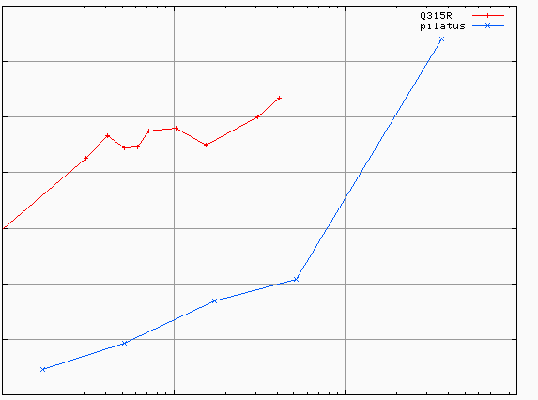
Spatial Heterogeneity in Sharp Spot Sensitivity (SHSSS): Q315r vs Pilatus
3.5
3.0
2.5
2.0
1.5
1.0
0.5
different
modules
Q315r
average change in spot intensity (%)
anomalous mates typically
> 100 mm apart
Pilatus
0.1 1 10 100
distance between spots (mm)

Slide 33
Required multiplicity
^{mult >} (—)²
~3%
<ΔF/F>

Slide 34
Holton & Frankel (2010) Acta D 66 393-408.

Slide 35
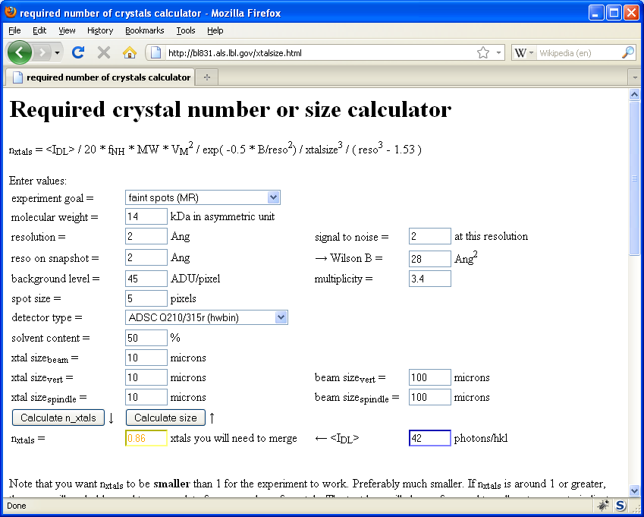
Holton & Frankel (2010) Acta D 66 393-408.

Slide 36
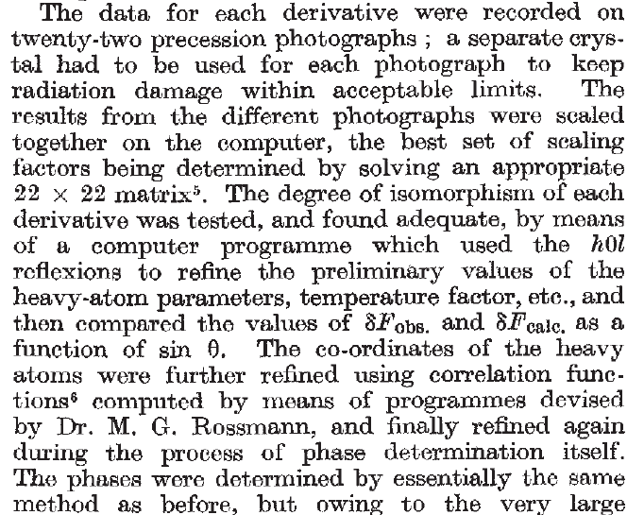
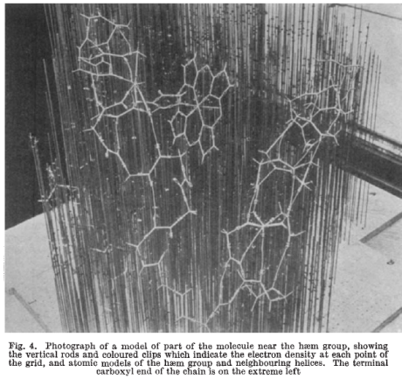
Multi-crystal strategies
Kendrew et al. (1960) "Structure of Myoglobin” Nature 185, 422-427.

Slide 37
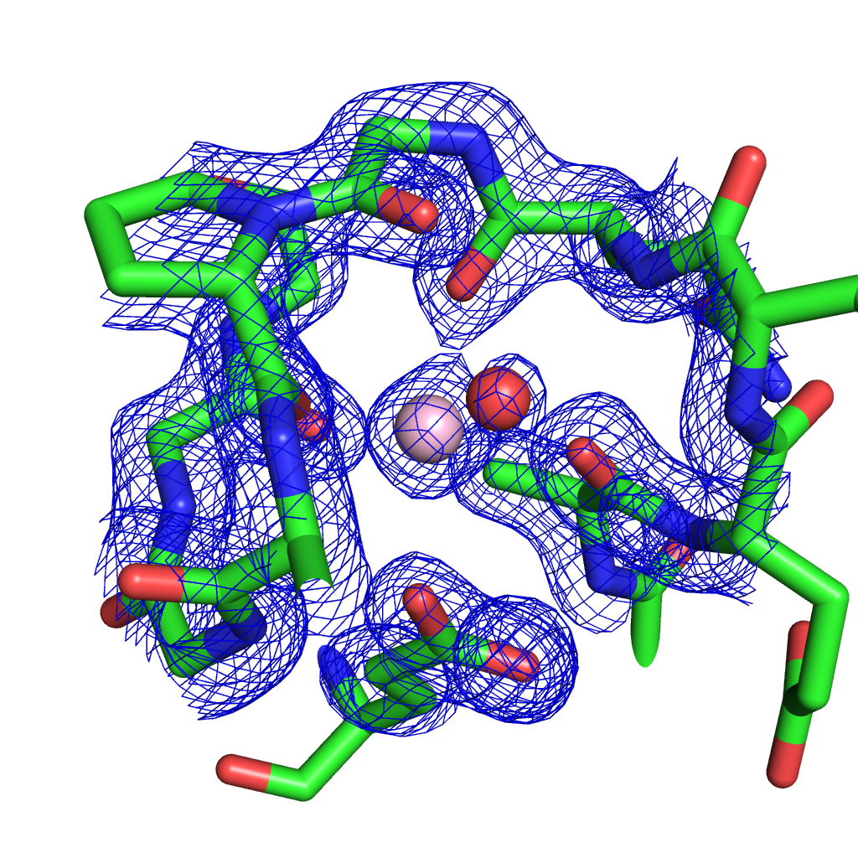
Metal site: is it Mg⁺⁺ ? Or Na⁺ ?
P351
G353
E347
E297
Peat, TS et al. (2013) Cyanuric acid hydrolase: evolutionary innovation by structural concatenation, Mol Microbiol. 88, 1149-1163.
A
B

Slide 38
Data collection parameters:
16 crystals
360° each, inverse beam
7235 eV photon energy
< 1 MGy per xtal
Australian Synchrotron MX1
  35 kGy/s into 100 μm x 100 μm

Slide 39
140-fold multiplicity: 16 crystals, 360° each, inverse beam, 7235 eV
RESOLUTION COMPLETENESS R-FACTOR I/SIGMA R-meas CC(1/2) Anomal SigAno Nano
LIMIT OF DATA observed Corr
9.17 99.1% 3.9% 257.47 3.9% 100.0* 91* 5.024 450
6.49 100.0% 5.2% 214.33 5.2% 100.0* 86* 3.836 882
5.30 100.0% 7.2% 165.13 7.2% 100.0* 76* 3.257 1175
4.59 100.0% 7.2% 175.42 7.3% 100.0* 67* 2.589 1403
4.10 99.9% 7.7% 174.13 7.7% 100.0* 59* 2.264 1594
3.74 99.9% 9.4% 143.09 9.4% 100.0* 49* 1.953 1783
3.47 100.0% 11.2% 120.17 11.2% 100.0* 39* 1.696 1942
3.24 100.0% 14.1% 91.14 14.1% 100.0* 30* 1.333 2103
3.06 99.9% 19.5% 65.79 19.5% 100.0* 23* 1.117 2214
2.90 99.9% 29.0% 44.85 29.1% 99.9* 17* 1.008 2369
2.77 99.9% 40.5% 32.58 40.6% 99.8* 11* 0.901 2493
2.65 99.9% 52.8% 25.16 52.9% 99.8* 10* 0.866 2605
2.54 100.0% 67.4% 19.47 67.6% 99.6* 2 0.804 2705
2.45 100.0% 88.9% 14.58 89.2% 99.2* 4 0.831 2859
2.37 100.0% 109.3% 9.97 109.7% 98.1* 5 0.829 2925
2.29 100.0% 138.2% 6.87 138.9% 96.1* 1 0.760 3037
2.22 100.0% 197.1% 4.03 198.6% 83.5* -1 0.721 3159
2.16 100.0% 227.3% 2.41 230.8% 46.9* -1 0.677 3224
2.10 61.2% 154.4% 1.28 163.6% 47.0* -2 0.660 1999
2.05 47.9% 170.1% 0.68 196.5% 25.7* 3 0.629 1578
total 93.3% 15.7% 54.30 15.8% 100.0* 12* 1.217 42499

Slide 40
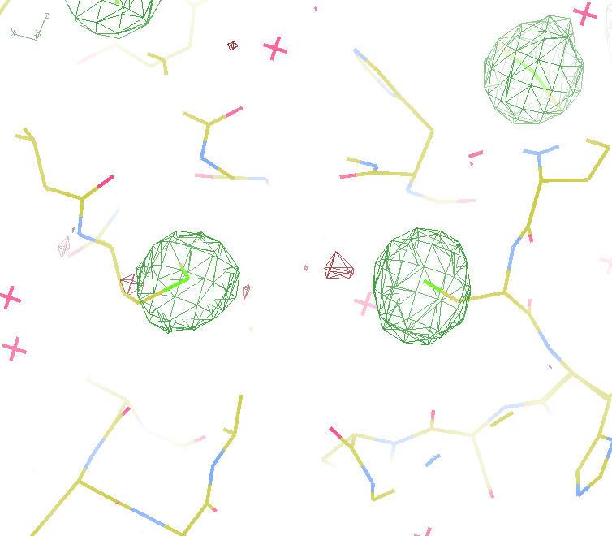
140-fold multiplicity
18 σ
16 σ
Phased anomalous difference Fourier

Slide 41
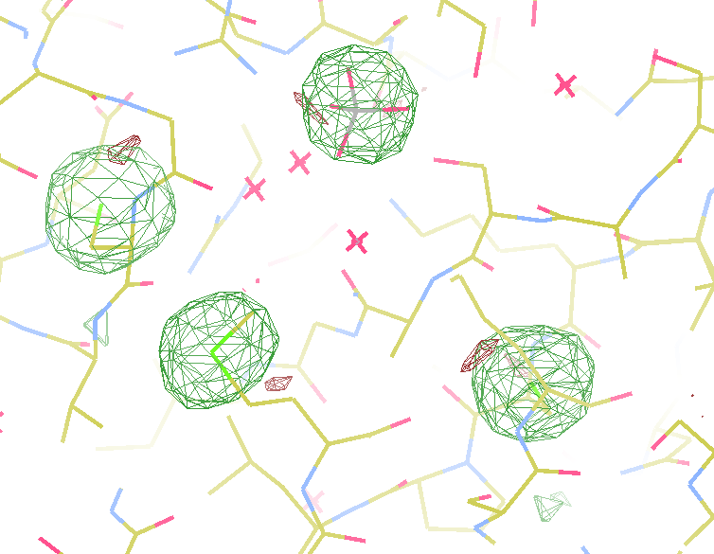
140-fold multiplicity
15σ = PO₄
Phased anomalous difference Fourier

Slide 42
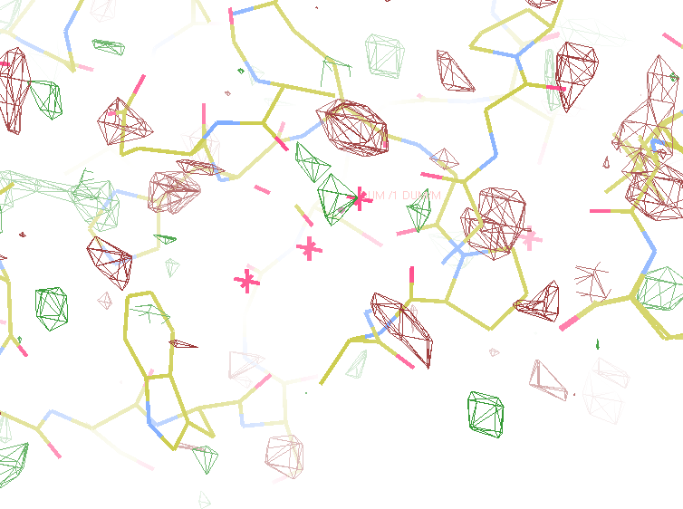
140-fold multiplicity
~2σ = Mg?
Phased anomalous difference Fourier

Slide 43
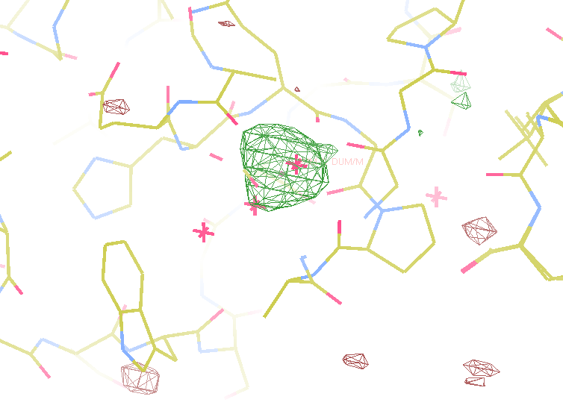
140-fold multiplicity
8.2σ = Mg?
DELFAN residual anomalous difference

Slide 44
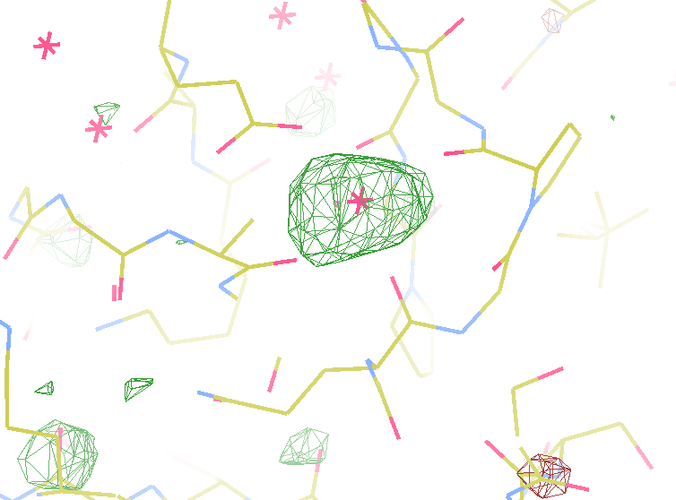
140-fold multiplicity
7.4σ = Mg?
DELFAN residual anomalous difference

Slide 45
How do you do it ?
Implications
7-8 σ is enough for phasing!
Reproducibility!
Careful with humidity
All mounts exactly same time
Blow on the cryo
Low dose!

Slide 46
How do you do it ?
Implications
7-8 σ is enough for phasing!
Reproducibility!
Careful with humidity
All mounts exactly same time
Blow on the cryo
Low dose!

Slide 47
Sources of error for anomalous differences
Shutter jitter (rms 0.5 ms)
Beam flicker (0.15%/sqrt(Hz))
Attenuation correction (< 2%)
Radiation damage (1%/MGy)
Detector calibration (3%)

Slide 48
R_{iso} vs dose
R_{iso} (%)
change in dose (MGy)
data taken from Banumathi, et al. (2004) Acta Cryst. D 60, 1085-1093.

Slide 49
R_{iso} vs dose
R_{iso} ≈ 0.7 %/MGy
R_{iso} (%)
change in dose (MGy)
data taken from Banumathi, et al. (2004) Acta Cryst. D 60, 1085-1093.

Slide 50
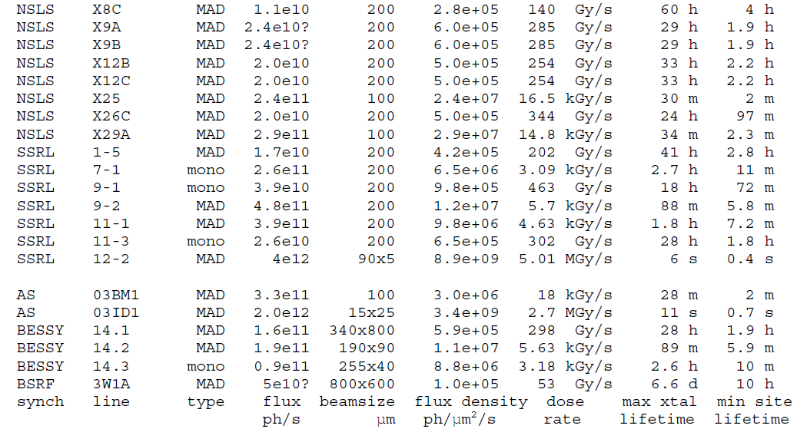
How long will my crystal last?
http://bl831.als.lbl.gov/damage_rates.pdf

Slide 51
How do you do it ?
Implications
7-8 σ is enough for phasing!
Reproducibility!
Careful with humidity
All mounts exactly same time
Blow on the cryo
Low dose!

Slide 52
plunge cooling
warm, moist air
ice
cold N₂
liquid N₂
foam insulation

Slide 53
plunge cooling
warm, moist air
ice
cold N₂
liquid N₂
foam insulation

Slide 54
plunge cooling
warm, moist air
ice
cold N₂
liquid N₂
foam insulation

Slide 55
Warkentin method
liquid N₂
foam insulation
Warkentin (2006) J. Appl. Crystallogr. 39, 805-811.

Slide 56
How do you do it ?
Implications
7-8 σ is enough for phasing!
Reproducibility!
Careful with humidity
All mounts exactly same time
Blow on the cryo
Low dose!

Slide 57
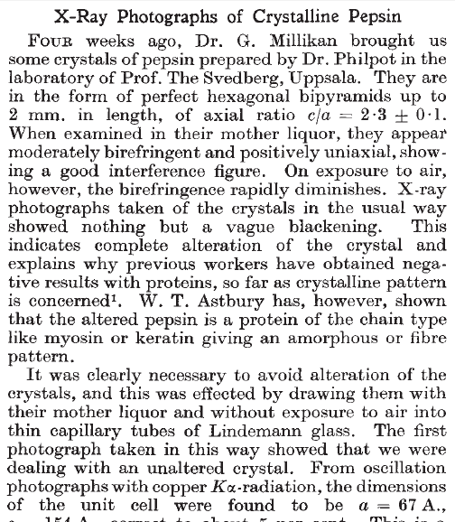
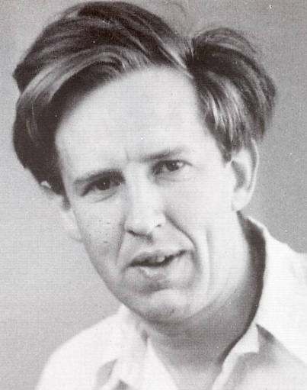
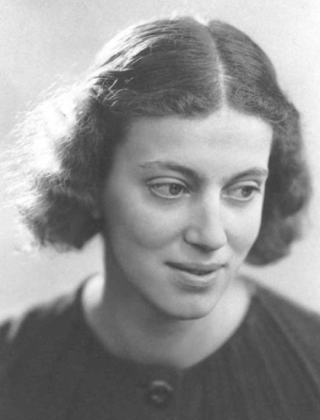
First diffraction from protein xtal
1934
Bernal, J. & Crowfoot, D. (1934). "X-ray photographs of crystalline pepsin", Nature 133, 794-795.

Slide 58

Non-isomorphism in lysozyme
RH 84.2% vs 71.9%
RMSD = 0.18 Å
R_{iso} = 44.5%

Slide 59
Elastic deformation
= non-isomorphism

Slide 60
Elastic deformation
= non-isomorphism

Slide 61
Plastic deformation
= poor diffraction

Slide 62
Plastic deformation
= poor diffraction

Slide 63
Dehydration: 1934
and 2014?
= 1.5 μL
100 μm
= 1.0 nL
2 mm
= 1.0 pL
10 μm

Slide 64
Grand Challenges in Structural Biology
Phase Problem
spots, but no maps
Amplitude Problem
    Crystals, but no spots
R-factor Gap
    Can’t/shouldn’t publish

Slide 65
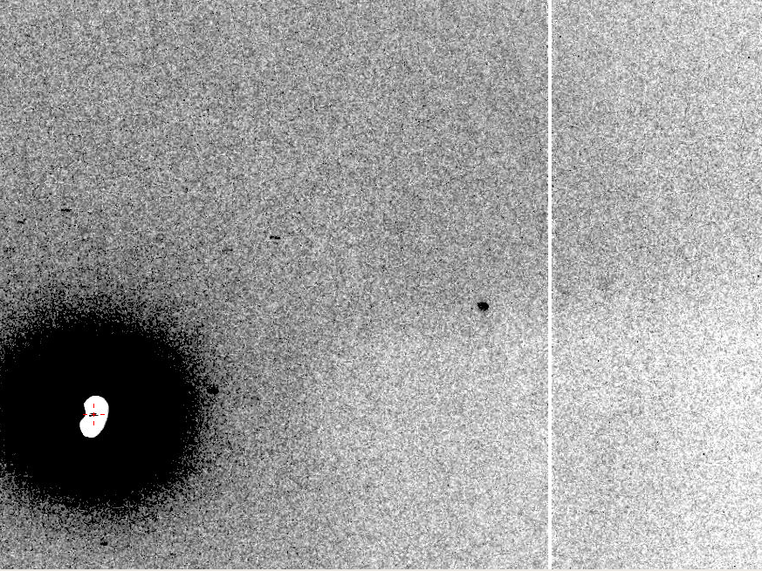
Now What?
10 Å

Slide 66
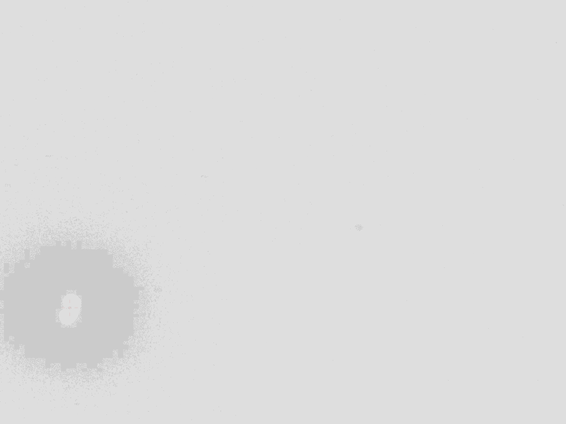
Ways to improve diffraction
New crystal form
Purify
  - add a column
  - heat shock
Bind something
  - Known ligand
  - Silver bullets
Change the clone
  - chop off floppy bits
  - homolog
  - Ala -> Lys mutants
Make Protein Sit Still!!!
Newman J. (2006) Acta Cryst. D62 27-31.

Slide 67
Sources of error for weak spots
Beam intensity sqrt(seconds)
Radiation damage (10 MGy/Å)
Crystal size (size³)
Background sqrt(I_{spot}+I_{bg})
Disorder (e^{-B})

Slide 68
Darwin’s Formula
V_{xtal}
λ³ L
I_{spot} = I_{beam} r_{e}²
P A | F₀e^{-Bs2} |²
V_{cell}
ωV_{cell}
I_{spot} - photons/spot (fully-recorded)
I_{beam} - incident (photons/s/m² )
r_{e} - classical electron radius (2.818x10⁻¹⁵ m)
V_{xtal} - volume of crystal (in m³)
V_{cell} - volume of unit cell (in m³)
λ - x-ray wavelength (in meters!)
ω - rotation speed (radians/s)
L - Lorentz factor (speed/speed)
P - polarization factor
A - attenuation factor
F₀ - structure factor at T = 0
B - Debye-Waller-Ott factor
s - 0.5/d-spacing
C. G. Darwin (1914)

Slide 69
Darwin’s Formula
V_{xtal}
λ³ L
I_{spot} = I_{beam} r_{e}²
P A | F₀e^{-Bs2} |²
V_{cell}
ωV_{cell}
I_{spot} - photons/spot (fully-recorded)
I_{beam} - incident (photons/s/m² )
r_{e} - classical electron radius (2.818x10⁻¹⁵ m)
V_{xtal} - volume of crystal (in m³)
V_{cell} - volume of unit cell (in m³)
λ - x-ray wavelength (in meters!)
ω - rotation speed (radians/s)
L - Lorentz factor (speed/speed)
P - polarization factor
A - attenuation factor
F₀ - structure factor at T = 0
B - Debye-Waller-Ott factor
s - 0.5/d-spacing
C. G. Darwin (1914)

Slide 70
Darwin’s Formula
V_{xtal}
λ³ L
I_{spot} = I_{beam} r_{e}²
P A | F₀e^{-Bs2} |²
V_{cell}
ωV_{cell}
I_{spot} - photons/spot (fully-recorded)
I_{beam} - incident (photons/s/m² )
r_{e} - classical electron radius (2.818x10⁻¹⁵ m)
V_{xtal} - volume of crystal (in m³)
V_{cell} - volume of unit cell (in m³)
λ - x-ray wavelength (in meters!)
ω - rotation speed (radians/s)
L - Lorentz factor (speed/speed)
P - polarization factor
A - attenuation factor
F₀ - structure factor at T = 0
B - Debye-Waller-Ott factor
s - 0.5/d-spacing
C. G. Darwin (1914)

Slide 71
Cryo damage
10³
100
maximum tolerable dose (MGy)
10
1
1 2 3 5 7 10 20 40 70 100
resolution (Å)
Howells et al. (2009) J. Electron. Spectrosc. Relat. Phenom. 170 4-12

Slide 72
Cryo damage
10³
10 MGy/Å
100
maximum tolerable dose (MGy)
10
1
1 2 3 5 7 10 20 40 70 100
resolution (Å)
Howells et al. (2009) J. Electron. Spectrosc. Relat. Phenom. 170 4-12

Slide 73
How long will my crystal last?
http://bl831.als.lbl.gov/damage_rates.pdf

Slide 74
Self-calibrated damage limit
Where:
⟨I⟩_{DL} - average damage-limited intensity (photons/hkl) at a given resolution
10⁵ - converting R from μm to m, r_{e} from m to Å, ρ from g/cm³ to kg/m³ and MGy to Gy
r_{e} - classical electron radius (2.818 x 10⁻¹⁵ m/electron)
h - Planck’s constant (6.626 x 10⁻³⁴ J∙s)
c - speed of light (299792458 m/s)
f_{decayed} - fractional progress toward completely faded spots at end of data set
ρ - density of crystal (~1.2 g/cm³)
R - radius of the spherical crystal (μm)
λ - X-ray wavelength (Å)
f_{NH} - the Nave & Hill (2005) dose capture fraction (1 for large crystals)
n_{ASU} - number of proteins in the asymmetric unit
M_{r} - molecular weight of the protein (Daltons or g/mol)
V_{M} - Matthews’s coefficient (~2.4 Å³/Dalton)
H - Howells’s criterion (10 MGy/Å)
θ - Bragg angle
⟨ƒ_{a}²⟩ - number-averaged squared structure factor per protein atom (electron²)
⟨M_{a}⟩ - number-averaged atomic weight of a protein atom (~7.1 Daltons)
B - average (Wilson) temperature factor (Å²)
μ - attenuation coefficient of sphere material (m⁻¹)
μ_{en} - mass energy-absorption coefficient of sphere material (m⁻¹)
No flux
No symmetry
Holton & Frankel (2010) Acta D 66 393-408.

Slide 75
Self-calibrated damage limit
Where:
⟨I⟩_{DL} - average damage-limited intensity (photons/hkl) at a given resolution
10⁵ - converting R from μm to m, r_{e} from m to Å, ρ from g/cm³ to kg/m³ and MGy to Gy
r_{e} - classical electron radius (2.818 x 10⁻¹⁵ m/electron)
h - Planck’s constant (6.626 x 10⁻³⁴ J∙s)
c - speed of light (299792458 m/s)
f_{decayed} - fractional progress toward completely faded spots at end of data set
ρ - density of crystal (~1.2 g/cm³)
R - radius of the spherical crystal (μm)
λ - X-ray wavelength (Å)
f_{NH} - the Nave & Hill (2005) dose capture fraction (1 for large crystals)
n_{ASU} - number of proteins in the asymmetric unit
M_{r} - molecular weight of the protein (Daltons or g/mol)
V_{M} - Matthews’s coefficient (~2.4 Å³/Dalton)
H - Howells’s criterion (10 MGy/Å)
θ - Bragg angle
⟨ƒ_{a}²⟩ - number-averaged squared structure factor per protein atom (electron²)
⟨M_{a}⟩ - number-averaged atomic weight of a protein atom (~7.1 Daltons)
B - average (Wilson) temperature factor (Å²)
μ - attenuation coefficient of sphere material (m⁻¹)
μ_{en} - mass energy-absorption coefficient of sphere material (m⁻¹)
Holton & Frankel (2010) Acta D 66 393-408.

Slide 76
Sources of error for weak spots
Beam intensity sqrt(seconds)
Radiation damage (10 MGy/Å)
Crystal size (size³)
Background sqrt(I_{spot}+I_{bg})
Disorder (e^{-B})

Slide 77
Sources of error for weak spots
Beam intensity sqrt(seconds)
Radiation damage (10 MGy/Å)
Crystal size (size³)
Background sqrt(I_{spot}+I_{bg})
Disorder (e^{-B})

Slide 78
Holton & Frankel (2010) Acta D 66 393-408.

Slide 79
Darwin’s Formula
V_{xtal}
λ³ L
I_{spot} = I_{beam} r_{e}²
P A | F₀e^{-Bs2} |²
V_{cell}
ωV_{cell}
I_{spot} - photons/spot (fully-recorded)
I_{beam} - incident (photons/s/m² )
r_{e} - classical electron radius (2.818x10⁻¹⁵ m)
V_{xtal} - volume of crystal (in m³)
V_{cell} - volume of unit cell (in m³)
λ - x-ray wavelength (in meters!)
ω - rotation speed (radians/s)
L - Lorentz factor (speed/speed)
P - polarization factor
A - attenuation factor
F₀ - structure factor at T = 0
B - Debye-Waller-Ott factor
s - 0.5/d-spacing
C. G. Darwin (1914)

Slide 80
Diffraction Take-Home Lesson:
Disorder
Trumps
Everything!

Slide 81
What Causes Disorder?
Function
Radiation damage
Mosaicity
Strain
Xtal abuse
Dehydration

Slide 82
What Causes Disorder?
Function
Radiation damage
Mosaicity
Strain
Xtal abuse
Dehydration

Slide 83

Muybridge’s galloping horse (1878)

Slide 84
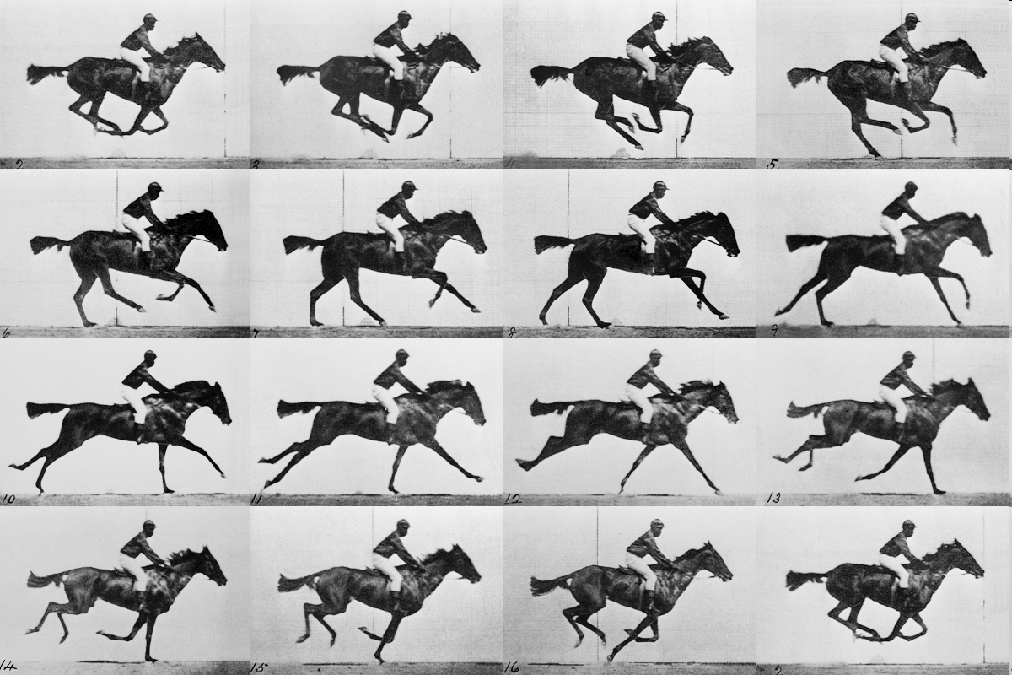
realistic “crystal” of horses

Slide 85
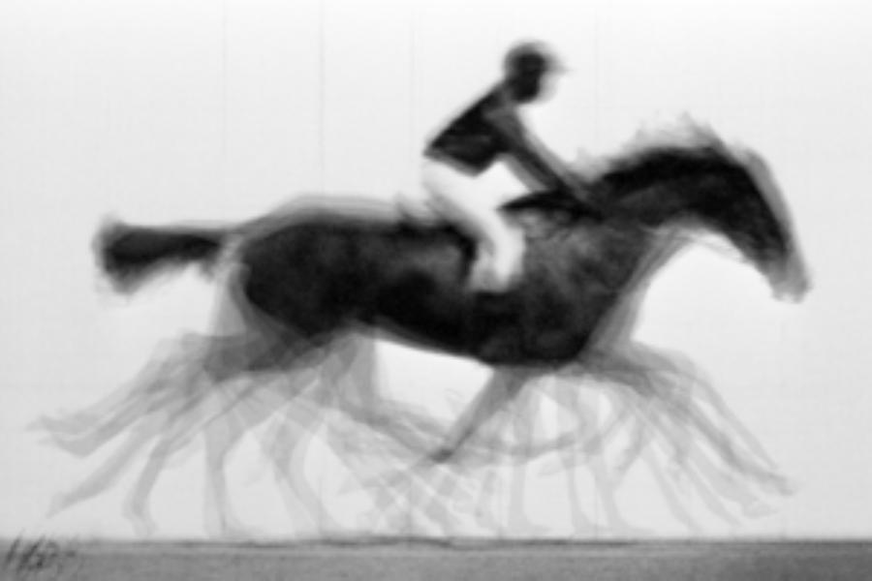
average structure: galloping horse

Slide 86
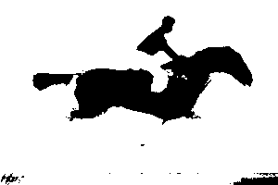
average structure: 1-sigma contour

Slide 87

lysozyme: real and reciprocal

Slide 88
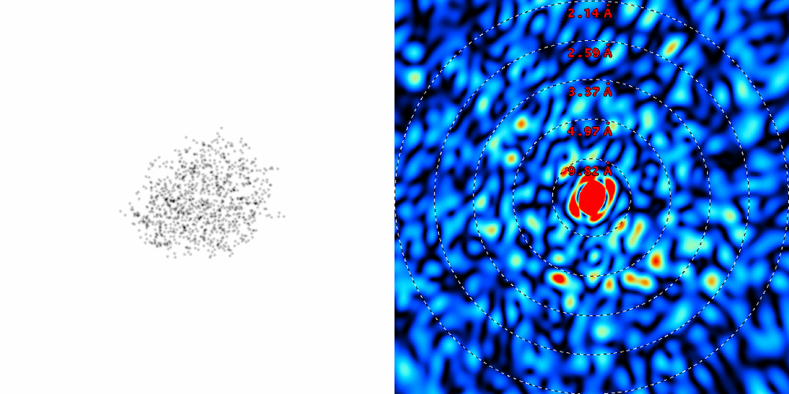
lysozyme: thermal motion
RMS displacement from B factors

Slide 89
Sources of error for weak spots
Beam intensity sqrt(seconds)
Radiation damage (10 MGy/Å)
Crystal size (size³)
Background sqrt(I_{spot}+I_{bg})
Disorder (e^{-B})

Slide 90
Sources of error for weak spots
Beam intensity sqrt(seconds)
Radiation damage (10 MGy/Å)
Crystal size (size³)
Background sqrt(I_{spot}+I_{bg})
Disorder (e^{-B})

Slide 91
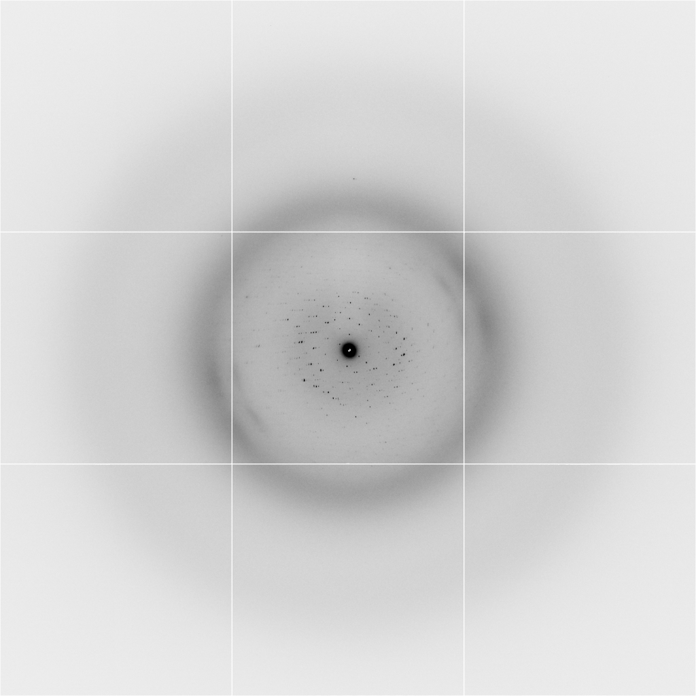
Background scattering
$100,000.00
$100,000.00
$100,000.00
real estate is
expensive
use it!
$100,000.00
$100,000.00
$100,000.00
$100,000.00
$100,000.00

Slide 92
Background scattering

Slide 93
Fine Slicing
background
background
Pflugrath, J. W. (1999)."The finer things in X-ray diffraction data collection", Acta Cryst. D 55, 1718-1725.

Slide 94
X-ray scattering “rules”:
1 μm crystal ≈ 1 μm water
≈ 1 μm plastic
≈ 0.1 μm glass
≈ 1000 μm air
you want:
air gap < 1000x xtal size

Slide 95
Non-crystal stuff in the beam
Too much
Just right
Too little

Slide 96
Sources of error for weak spots
Beam intensity sqrt(seconds)
Radiation damage (10 MGy/Å)
Crystal size (size³)
Background sqrt(I_{spot}+I_{bg})
Disorder (e^{-B})

Slide 97
Sources of error for weak spots
Beam intensity sqrt(seconds)
Radiation damage (10 MGy/Å)
Crystal size (size³)
Background sqrt(I_{spot}+I_{bg})
Disorder (e^{-B})

Slide 98
Exposure time problem:
Too long = radiation damage
Too short = read-out noise
Solution: “dose slicing”

Slide 99

Exposure time: “dose slicing”
unacceptable
damage
N
photons
crystal’s useful life
N
photons
unacceptable
read noise
N
photons

Slide 100

Optimal exposure time
(faint spots)
t_{hr} Optimal exposure time for data set (s)
t_{ref} exposure time of reference image (s)
bg_{ref} background level near weak spots on
reference image (ADU)
bg₀ ADC offset of detector (ADU)
bg_{hr} optimal background level (via t_{hr})
σ₀ rms read-out noise (ADU)
gain ADU/photon
m multiplicity of data set (including partials)
adjust exposure
so this is ~100

Slide 101
Grand Challenges in Structural Biology
Phase Problem
spots, but no maps
Amplitude Problem
    Crystals, but no spots
R-factor Gap
    Can’t/shouldn’t publish

Slide 102
R-factor Gap?
Publication criterion for chemical crystallography:
R1 < 2*R_{sigma}
R1 = F_{o} vs F_{c} for I/σ(I) > 3
R_{sigma} = <σ(I)>/<I>
There are no PDB entries that pass this test!
Holton et al. (2014). FEBS J. 281, 4046-60.

Slide 103
Is this good enough?
d_{max} = 4.5 Å
R_{cryst} = 27%
R_{free} = 38%

Slide 104
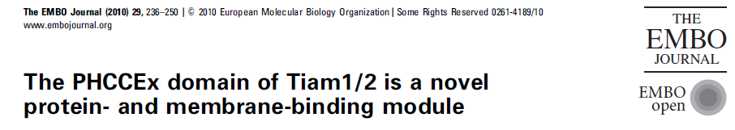
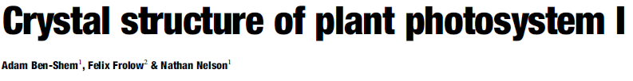
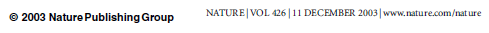
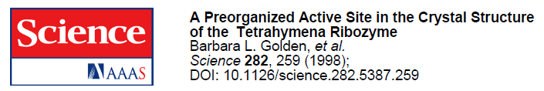
Is this good enough?
3a8n 4.5 Å R_{merge} = 0.15 R/R_{free} = 0.306/0.396
1qzv 4.44 Å R_{merge} = 0.099 R/R_{free} = 0.41/0.42
1grz 5 Å R_{merge} = 0.052 R/R_{free} = 0.369/0.428

Slide 105
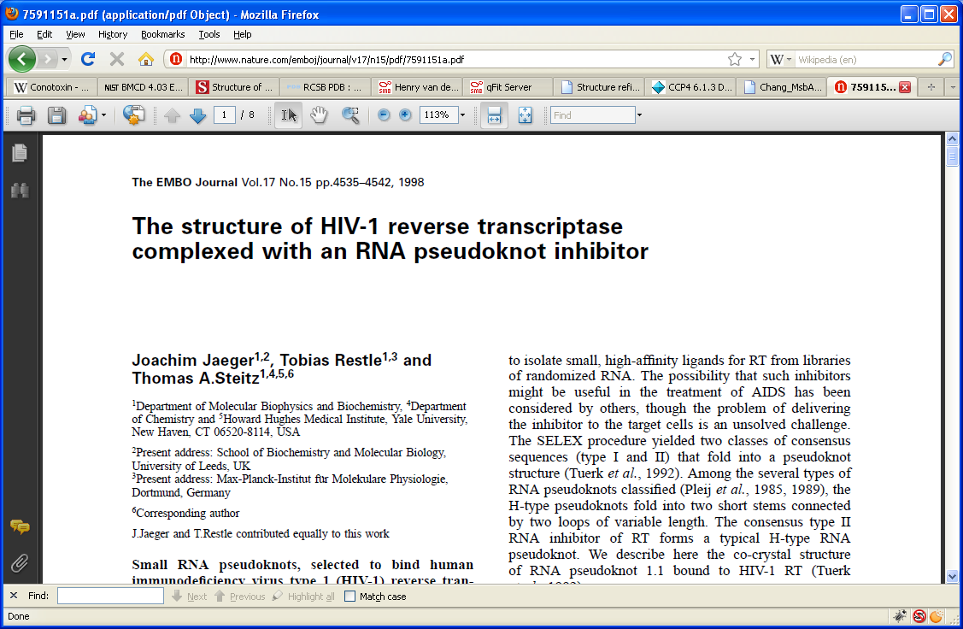
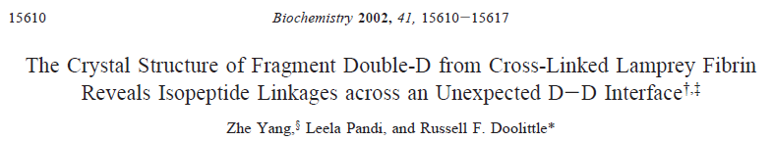
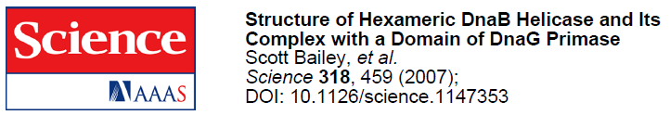
Is this good enough?
1hvu 4.75 Å R_{merge} = 0.064 R/R_{free} = 0.34/0.413
1n8e 4.5 Å R_{merge} = 0.138 R/R_{free} = 0.415/0.416
2r6e 5.02 Å R_{merge} = 0.058 R/R_{free} = 0.394/0.397

Slide 106
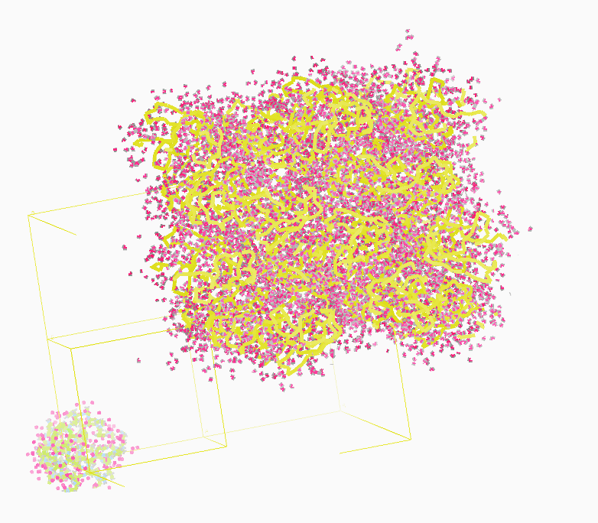
Molecular Dynamics Simulation
using real
crystal’s lattice
1aho
Scorpion toxin
0.96 Å resolution
64 residues
Solvent: H₂0 + acetate
Cerutti et al. (2010).J. Phys. Chem. B 114, 12811-12824.

Slide 107
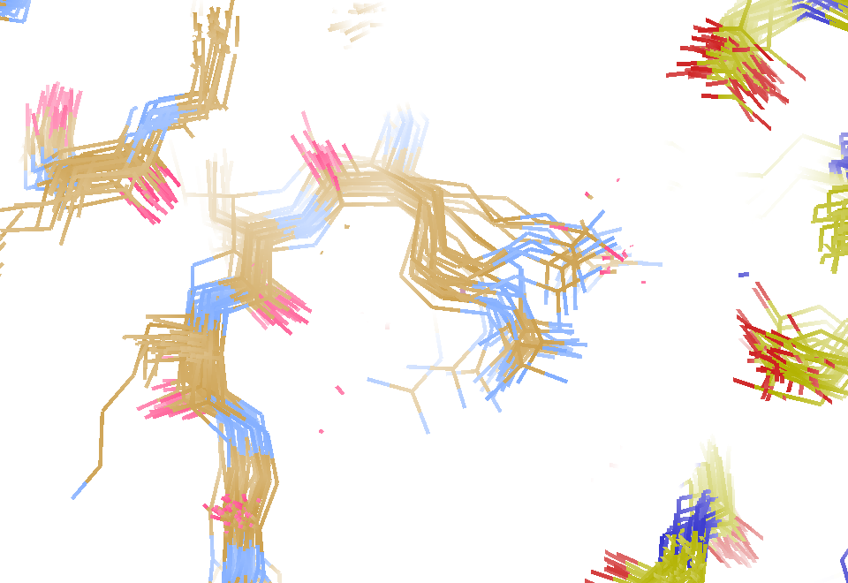
30 conformers from 24,000

Slide 108
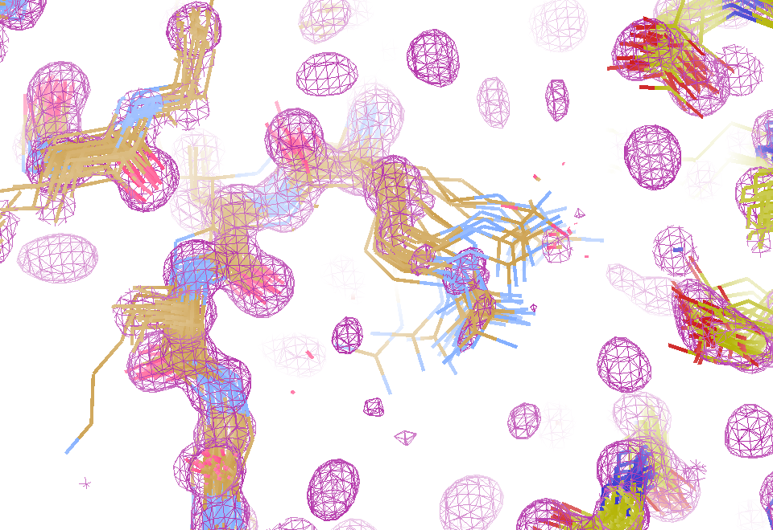
Electron density from 24,000 conformers

Slide 109
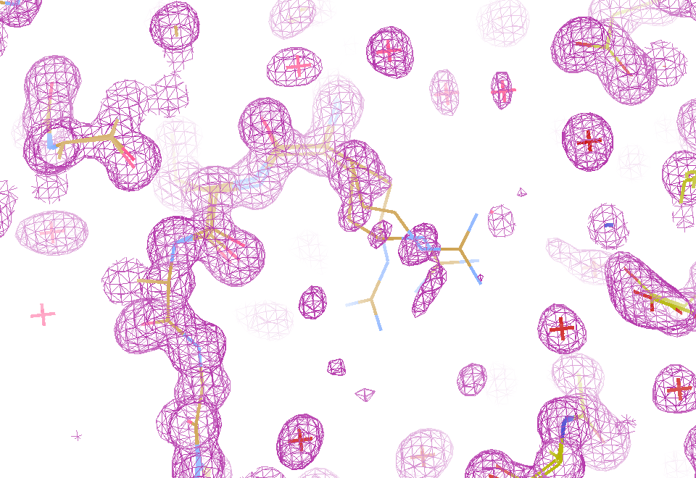
Electron density from 24,000 conformers

Slide 110
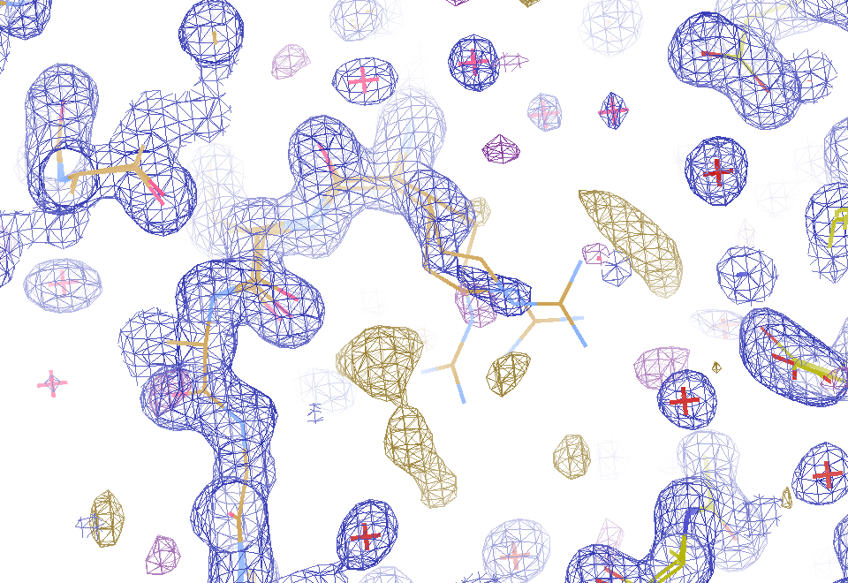
2F_{sim}-F_{calc} and F_{sim}-F_{calc} maps
1.0 Å data
R_{cryst}= 0.137
R_{free} = 0.159
1 “sigma” 2F_{sim}-F_{c}
2.5 “sigma” F_{sim}-F_{c}

Slide 111
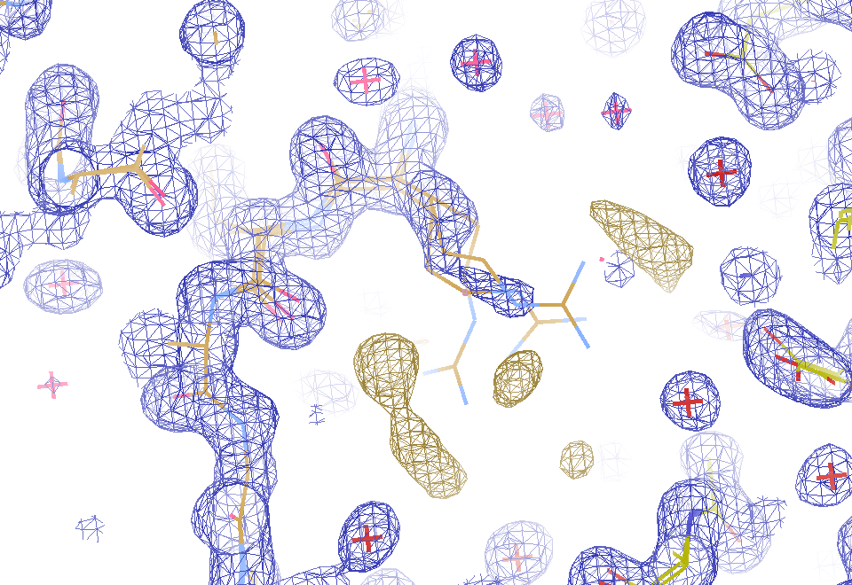
2F_{sim}-F_{calc} and (F_{sim} Φ_{sim}) - (F_{calc} Φ_{calc}) maps
1.0 Å data
R_{cryst}= 0.137
R_{free} = 0.159
1 “sigma” 2F_{sim}-F_{c}
F_{right} – (2F_{sim}-F_{c})

Slide 112
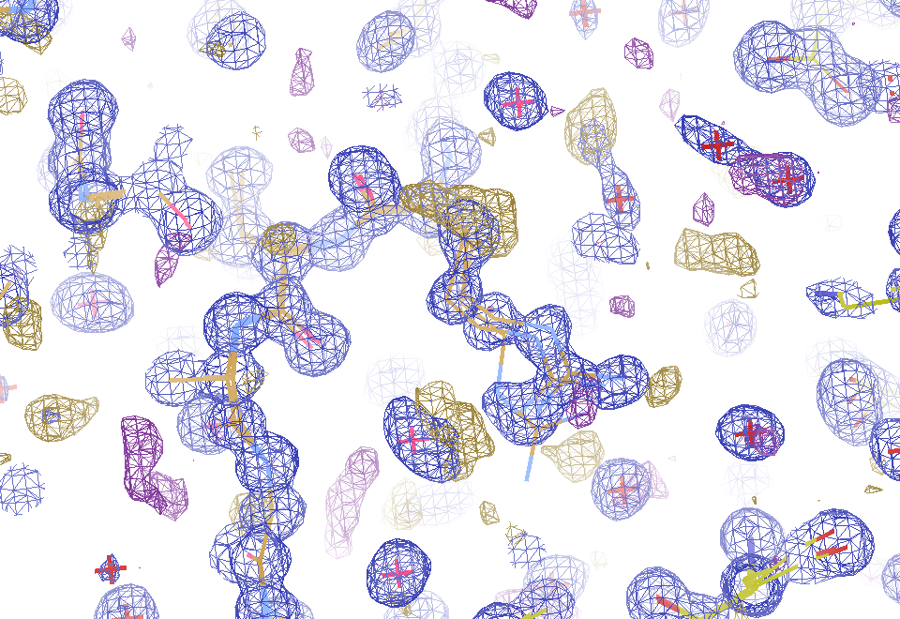
Regular model with real data!
1.0 Å data
R_{cryst}= 0.116
R_{free} = 0.135
1 “sigma” 2F_{sim}-F_{c}
2.5 “sigma” F_{sim}-F_{c}

Slide 113
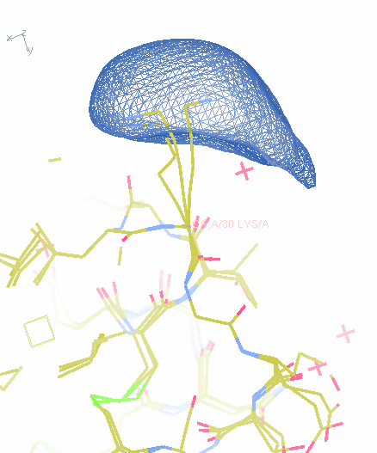
MD: predicted density for one atom

Slide 114
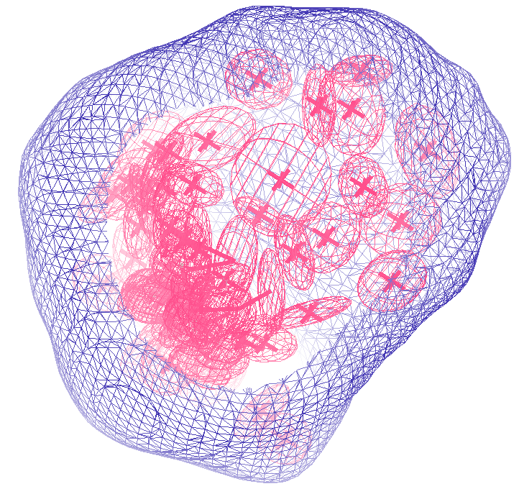
How many conformers are there?
Answer: 40
R_{cryst} = 0.0506
R_{free} = 0.0556
vs F_{sim}

Slide 115
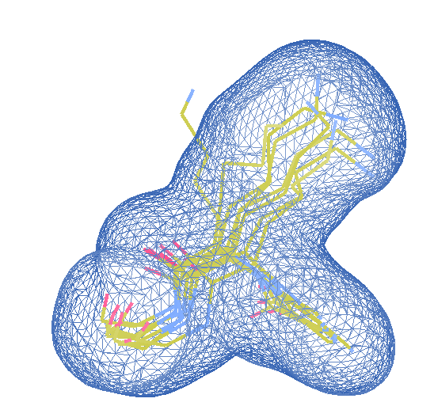
How many conformers are there?
Answer: 8
R_{cryst} = 0.0297
R_{free} = 0.0293
vs F_{sim}

Slide 116
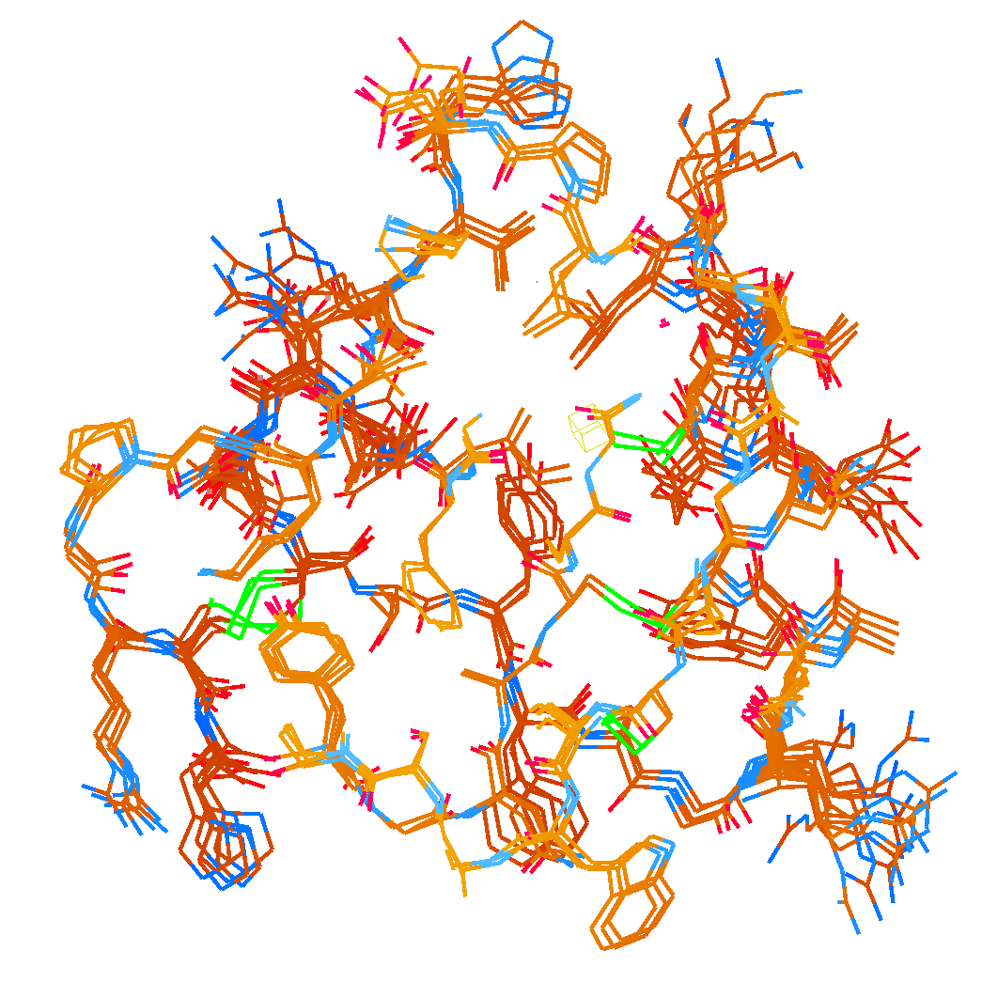
How many conformers are there?
Answer: 2-14
R_{cryst} = 0.0441
R_{free} = 0.0516
vs F_{sim}

Slide 117
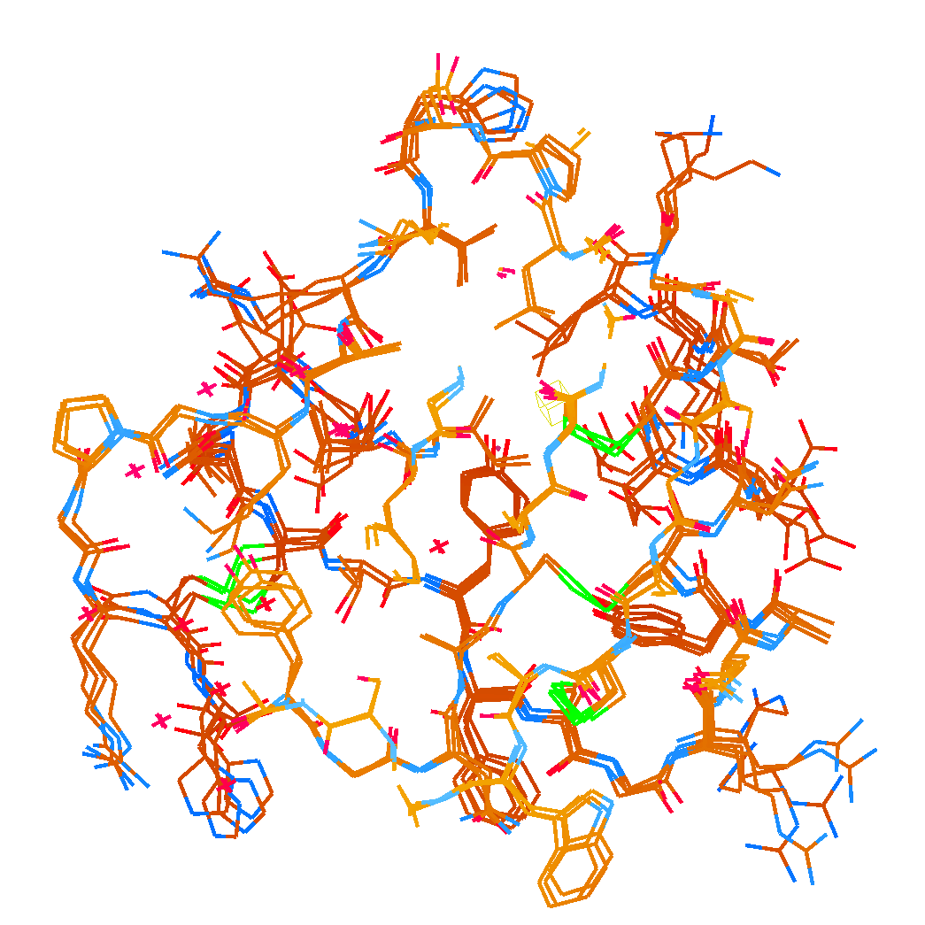
How many conformers are there?
Answer: 1-7
R_{cryst} = 0.1546
R_{free} = 0.1749
vs F_{obs}
1aho:
R_{cryst} = 0.1630
R_{free} = n/d

Slide 118
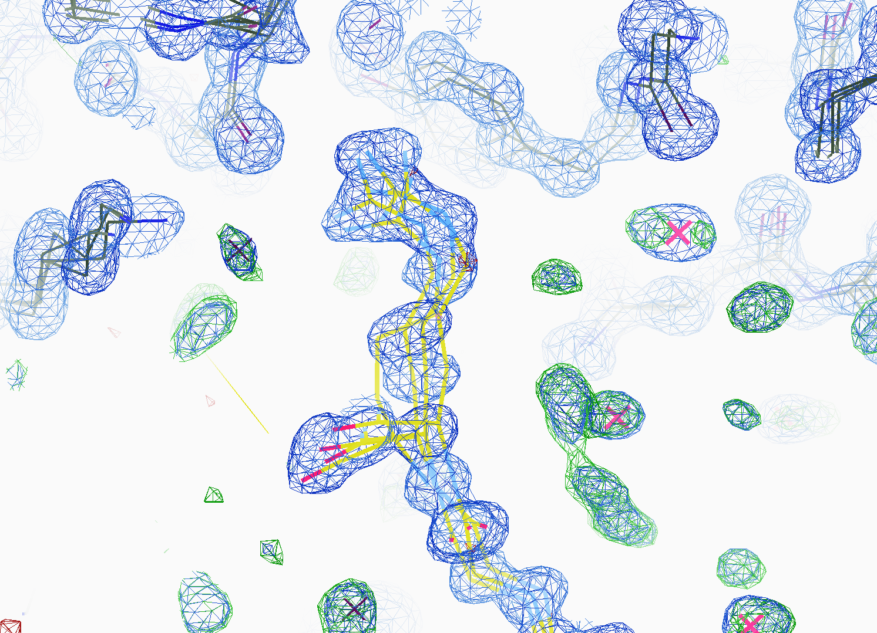
How many conformers are there?
All difference
features
are in
the solvent!
real data

Slide 119
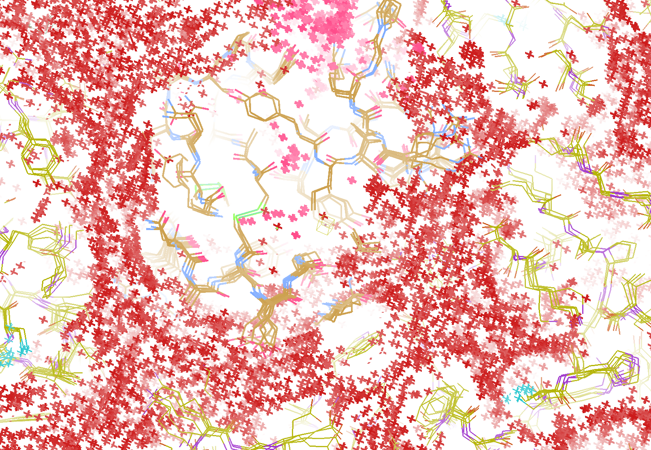
How “rough” is the solvent?
R_{cryst} = 0.0309
R_{free} = 0.0678
vs F_{sim}

Slide 120

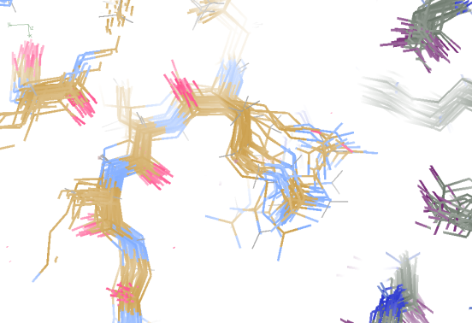
Molecular Dynamics vs Observation
1aho 64-residue scorpion toxin in water to 1.0 Å resolution
refined_vs_Fsim.pdb
F_{calc}
F_{sim}
R_{cryst}= 0.137

Slide 121

Molecular Dynamics vs Observation
1aho 64-residue scorpion toxin in water to 1.0 Å resolution
refined_vs_Fsim.pdb
1aho.cif
1aho.pdb
F_{calc}
F_{sim}
F_{obs}
F_{calc}
R_{free} = 0.69
R_{cryst}= 0.137
R_{free} =
R_{cryst}= 0.116
R_{free} = 0.48 to 4 Å
rmsd = 1.05 Å
LSQ rmsd = 0.43Å

Slide 122

Molecular Dynamics vs Observation
RMSD
1.05 Å

Slide 123

Molecular Dynamics vs Observation
RMSD
0.45 Å
aligned

Slide 124

Molecular Dynamics vs Observation
Sodium acetate trihydrate
5 atoms
3 waters
0.9 Å resolution
C2/c
R_{free} = 0.03

Slide 125

Molecular Dynamics vs Observation
fav8
8 residues
4 waters
1.0 Å resolution
P1

Slide 126



Molecular Dynamics vs Observation
“fav8” 8-residue aromatic peptide with 4 waters to 1.0 Å resolution
refined_vs_Fsim.pdb
fav8.fcf
fav8.cif
F_{calc}
F_{sim}
F_{obs}
F_{calc}
R_{cryst}= 0.13
R_{free}= 0.23
R_{cryst}= 0.16
R_{free} = 0.20 to 2Å
R1 = 0.041
With 4σ cutoff!
rmsd = 0.20 Å
LSQ rmsd = 0.091Å & 0.15 Å

Slide 127

MD-predicted water structure
Simulated
density
Janowski et al (2013) JACS 135, 7938-7948

Slide 128

MD-predicted water structure
Simulated
density
2mF_{o}-DF_{c}
Janowski et al (2013) JACS 135, 7938-7948

Slide 129

MD-predicted Val rotamer
Janowski et al (2013) JACS 135, 7938-7948

Slide 130


MD-predicted Val rotamer
confs | R_{work} | R_{free}
one | 4.11% | 5.84%
A & B | 3.89% | 5.53%
Janowski et al (2013) JACS 135, 7938-7948

Slide 131
Grand Challenges in Structural Biology
Phase Problem
super-high multiplicity isomorphous crystals
Amplitude Problem
Disorder trumps everything
Revolution in sample handling?
R-factor Gap
There is “life” below 1 sigma
MD-inspired models on horizon?
http://bl831.als.lbl.gov/~jamesh/powerpoint/AS_SvN_2014.pptx

Slide 132
Summary
http://bl831.als.lbl.gov/xtalsize.html
http://bl831.als.lbl.gov/~jamesh/powerpoint/AS_SvN_2014.pptx
100 ADU/pixel
dose slicing
~3% error per spot, 1%/MGy
7235 eV for S-SAD
There is “life” below 1 sigma

