Slide 1
Where do the
X-rays come from?

Slide 2
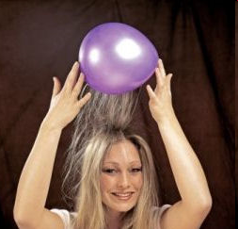
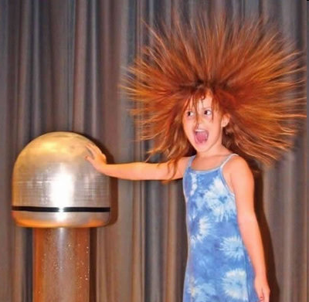
Electric charge
balloon
-
-
-
-
-
-
Wool Sweater
+ + + + + +

Slide 3

Electric field of a moving charge
accelerating charges
make
electromagnetic waves
(light)

Slide 4
Bending Magnet
S
electron beam
X-rays !
N

Slide 5
Two Bending Magnets
S
N
electron beam
N
S
2x X-rays !

Slide 6
Wiggler
8x X-rays !
S
N
S
N
S
N
S
N
N
S
N
S
N
S
N
S

Slide 7
Undulator
> 8x X-rays !
S
N
S
N
S
N
S
N
N
S
N
S
N
S
N
S

Slide 8
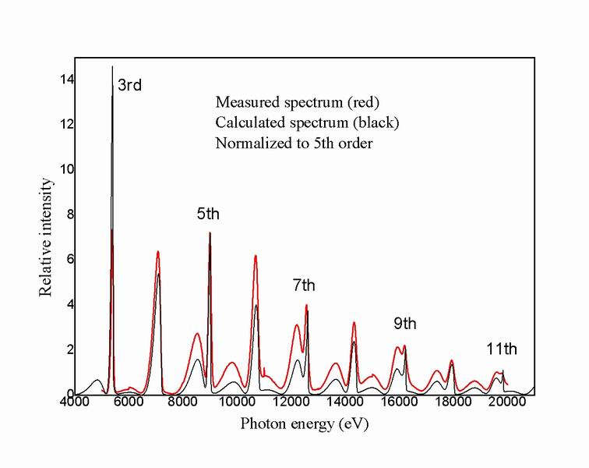
Undulator emission spectrum

Slide 9
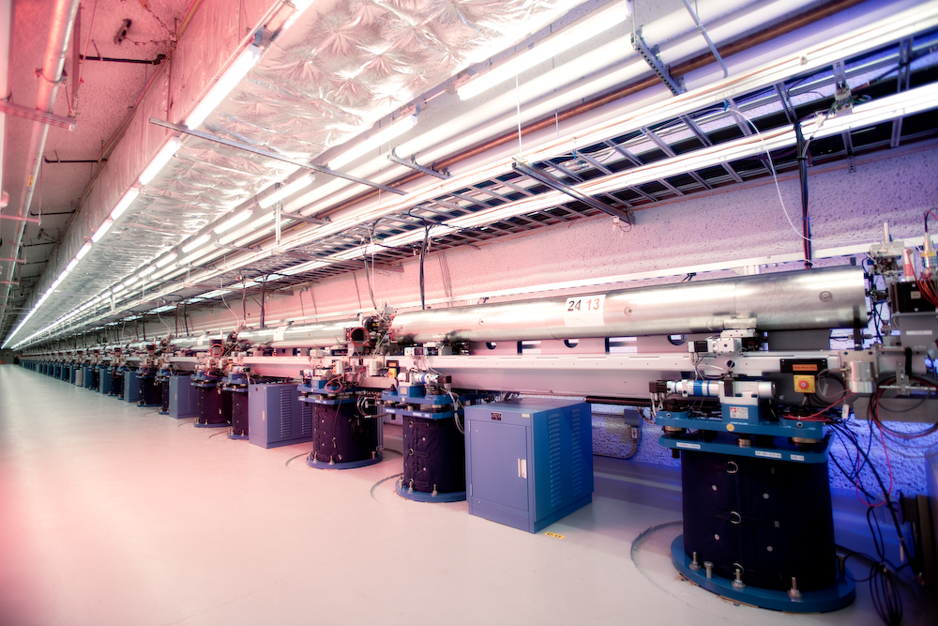
LCLS undulator hall

Slide 10
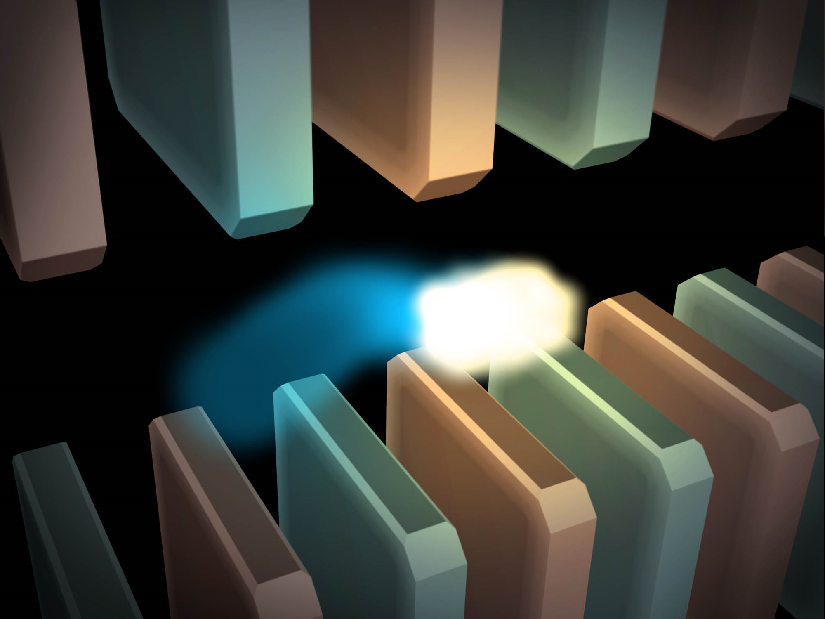
Electric field of a moving charge

Slide 11
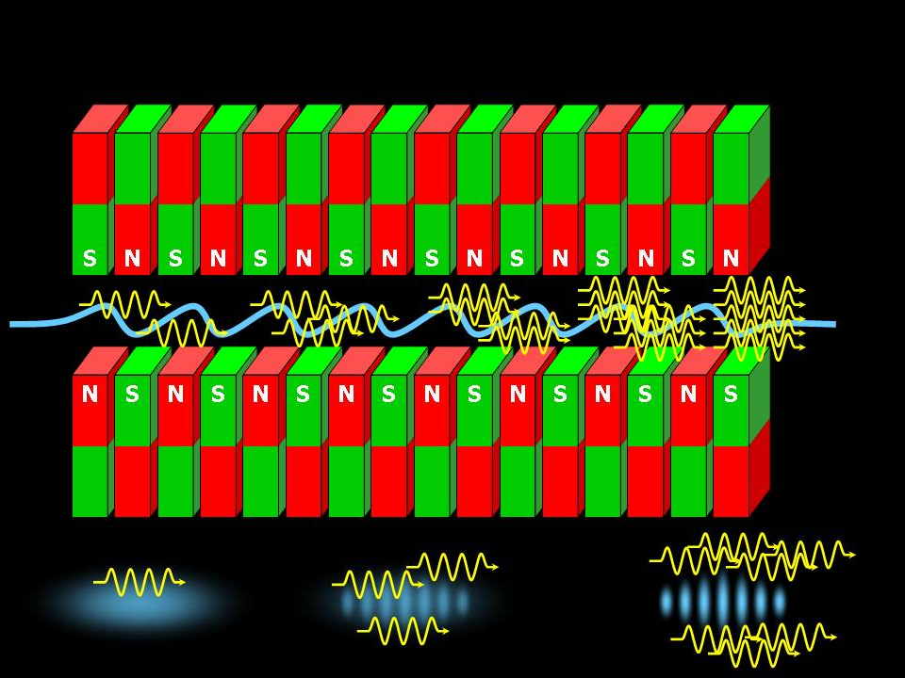
SASE effect

Slide 12
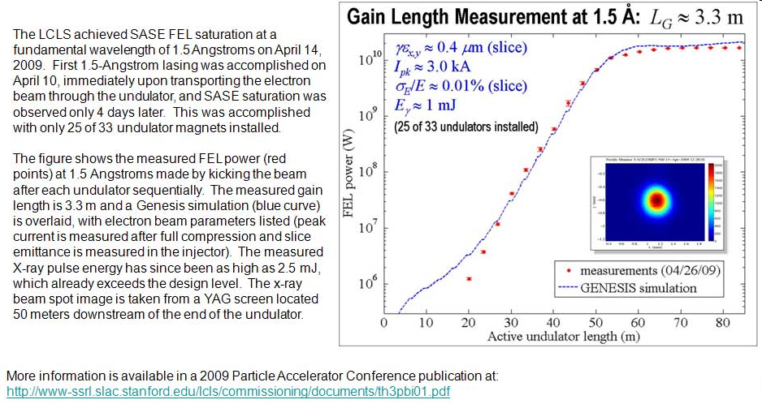
Self-Amplified Stimulated Emission (SASE) effect

Slide 13
Accelerator-based light source terminology
Code name Translation
First Generation Bending Magnet
Second Generation Wiggler
Third Generation Undulator
Fourth Generation Free electron laser

Slide 14
What does all that stuff in the concrete tunnel do?

Slide 15
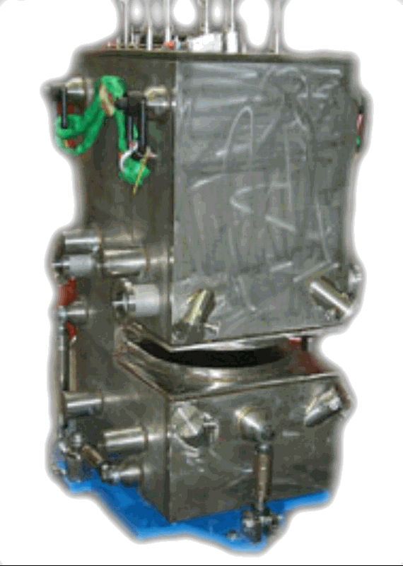
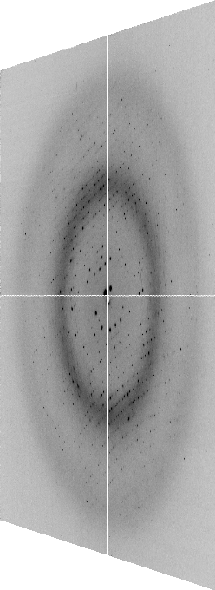

X-ray optics
Superbend
pinhole
Scatter
guard
Plane
Parabolic
mirror
Torroidal
mirror
ADSC Quantum 210
divergence
slits
Si(111)
monochromator
Protein Crystal
2:1 demagnification cancels spherical aberrations
comparable flux to a wiggler with < 1% of the heat
Notes:
Most notable acheivements are high brightness with very little “wasted” light. The discovery made by Howard Padmore? At ALS showed that a 2:1 demagnification cancels nearly all of the spherical abberations in the parabolic/torroid system. 30-50% of the total x-ray intensity passes through the 100um pinhole. The flux through the 100um pinhole at the superbend beamlines is comparable to that of the 5.0.2 wiggler or an APS bending magnet, but only 150 Watts of power must be dissipated by the beamline optics. In contrast, wiggler beamlines must disipate kilowatts. The optics here are much simpler and not exotic in any way. The system is stable and robust. There is never a need to re-focus the beam at a new wavelength. Only a 2-minute automatic tuneup is recommended for very large energy changes (more than 1-2 keV).

Slide 16
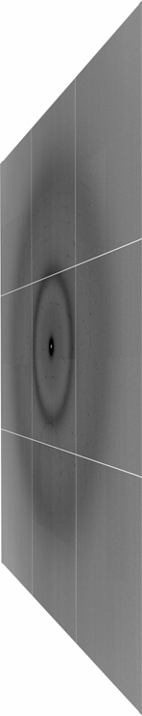
X-ray optics
MacDowell et. al. (2004) J. Sync. Rad. 11 447-455
pinhole
Scatter
guard
X-ray
Source
ADSC Quantum 315r
Protein Crystal
Notes:
Most notable acheivements are high brightness with very little “wasted” light. The discovery made by Howard Padmore? At ALS showed that a 2:1 demagnification cancels nearly all of the spherical abberations in the parabolic/torroid system. 30-50% of the total x-ray intensity passes through the 100um pinhole. The flux through the 100um pinhole at the superbend beamlines is comparable to that of the 5.0.2 wiggler or an APS bending magnet, but only 150 Watts of power must be dissipated by the beamline optics. In contrast, wiggler beamlines must disipate kilowatts. The optics here are much simpler and not exotic in any way. The system is stable and robust. There is never a need to re-focus the beam at a new wavelength. Only a 2-minute automatic tuneup is recommended for very large energy changes (more than 1-2 keV).

Slide 17
The truth about x-ray beams
Term units significance
Flux photons/s duration of experiment
Beam Size μm match to crystal
Divergence mrad spot size vs distance
Wavelength Å resolution and absorption
Emittance size x div constant limited by source/optics
Flux density ph/s/area scattering/damage rate
Fluence ph/area radiation damage

Slide 18
beam divergence
Ewald sphere
Φ circle
(h,k,l)
λ*
d*
spindle axis
diffracted ray
λ*

Slide 19
beam divergence
Ewald sphere
Φ circle
(h,k,l)
d*
λ*
diffracted ray
spindle axis
λ*

Slide 20
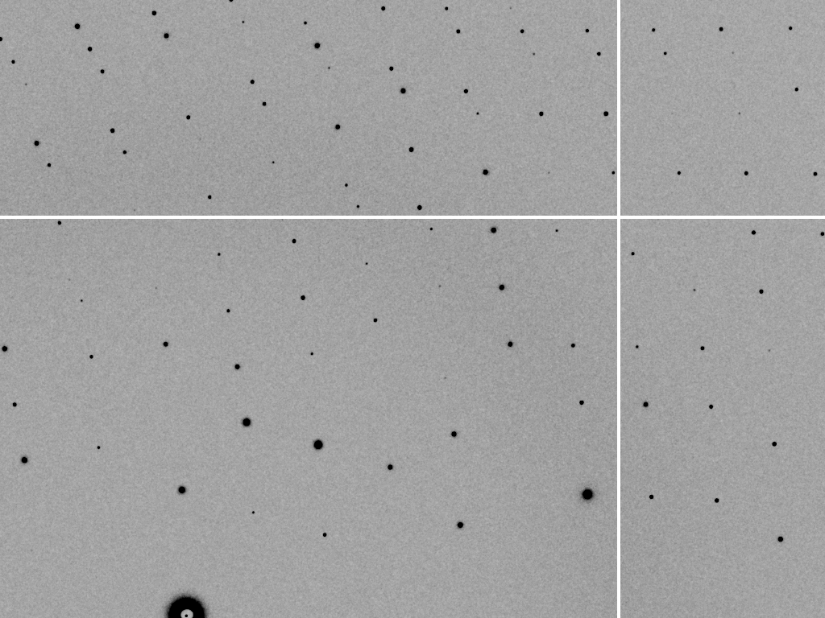
divergence = 0 º

Slide 21
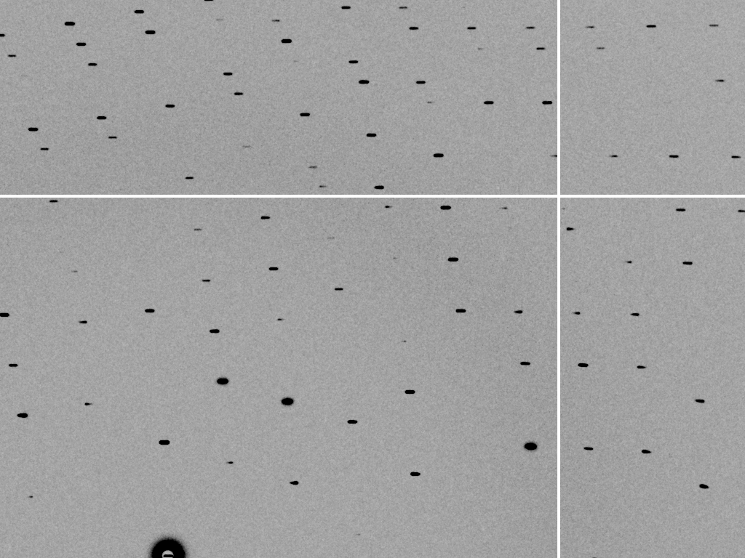
divergence = 0.3 º

Slide 22
spectral dispersion
Ewald sphere
Φ circle
(h,k,l)
λ*
d*
spindle axis
diffracted ray
λ*

Slide 23
spectral dispersion
Ewald sphere
Φ circle
(h,k,l)
λ’*
d*
spindle axis
diffracted ray
λ’*

Slide 24
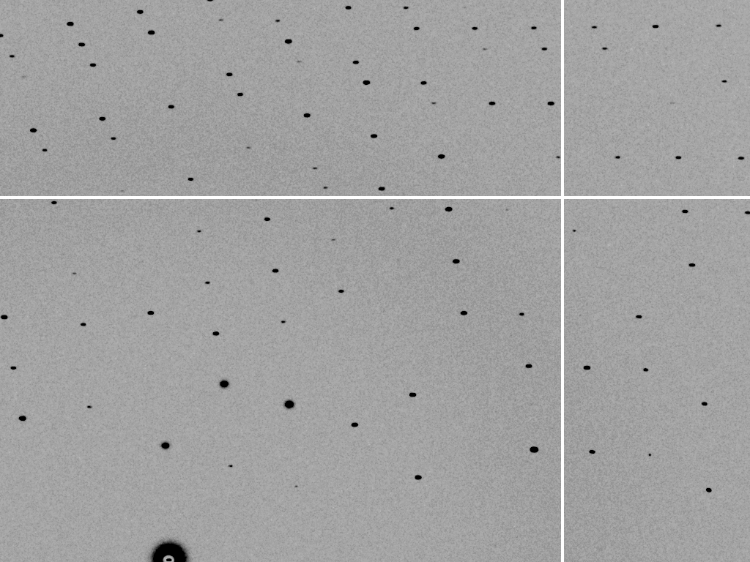
dispersion = 0

Slide 25

dispersion = 0.014% (Si 111)

Slide 26
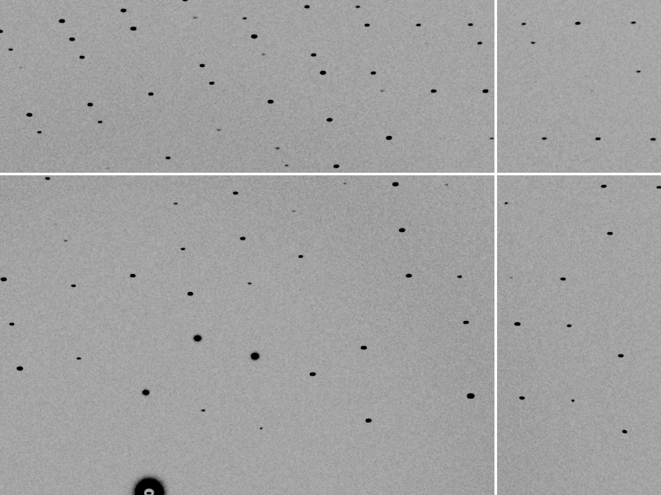
dispersion = 0.25% (CuK_{α})

Slide 27

dispersion = 1.3%

Slide 28

dispersion = 5.1%

Slide 29
mosaic spread
Ewald sphere
Φ circle
(h,k,l)
λ*
d*
diffracted ray
d*
spindle axis
λ*

Slide 30
mosaic spread
Ewald sphere
Φ circle
(h,k,l)
d*
diffracted rays
d*
spindle axis

Slide 31

mosaic spread = 0 º

Slide 32

mosaic spread = 1.0º

Slide 33

mosaic spread = 6.4º

Slide 34

mosaic spread = 12.8º

Slide 35
Law of Convolution
1² + 1² = 1.4²
3² + 1² = 3.2²
σ_{total}² = σ₁² + σ₂²

Slide 36
Where do the
X-rays go?

Slide 37

Where do photons go?
Protein
1A x-rays
elastic scattering (6%)
Transmitted (98%)
beamstop
inelastic scattering (7%)
Photoelectric (87%)
Re-emitted (99%)
Absorbed (~0%)
Re-emitted (~0%)
Absorbed (99%)
useful/absorbed energy: 7.3%

Slide 38
Elastic scattering

Slide 39
Elastic scattering

Slide 40
How big is an atom?
C
N
O
H
S
U
1 Ångstrom (Å)
1 nanometer (10⁻⁹ m)

Slide 41
How big is an atom?
U
S
C
N
O
H
as seen by X-rays

Slide 42
Elastic scattering

Slide 43
Inelastic scattering

Slide 44
Photoelectric absorption

Slide 45
Photoelectric absorption
e⁻
+

Slide 46
Fluorescence
+

Slide 47
Fluorescence
e⁻
+

Slide 48
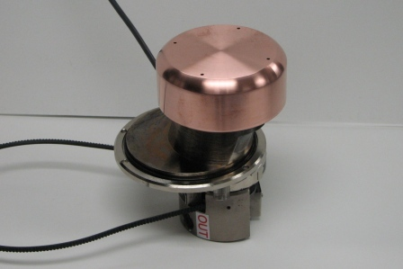
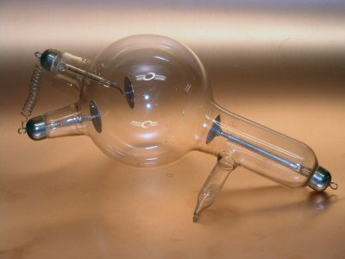
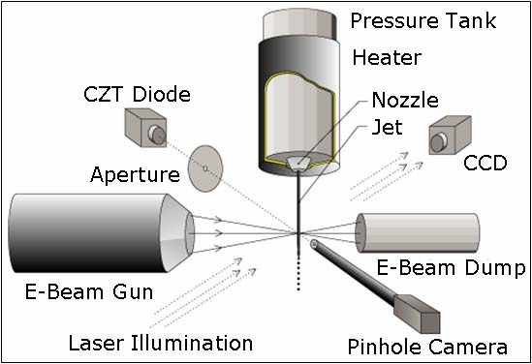
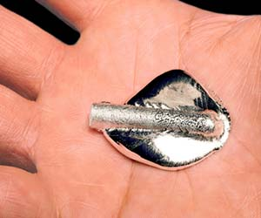
Fluorescence-based x-ray sources

Slide 49
What limits the source?
Fluorescence-based source:
Thermal distortion of anode
Accelerator-based source
Quality of optics
Electric bill

Slide 50
How much brighter is the synchrotron?
Gallium liquid METALJET
1.4 x 10⁸ photons/s/mm²/mrad²/0.1%BW
MX2:
2 x 10¹² photons/s
10 μm beam size
0.1 mrad divergence
0.014% BW (Si 111)
= 1.4 x 10¹⁹ photons/s/mm²/mrad²/0.1%BW
3000 years
With same beam size, divergence & dispersion
1 s at MX2 =

Slide 51
Auger emission
+

Slide 52
Auger emission
e⁻
++

Slide 53
Secondary ionization
+
e⁻
e⁻

Slide 54
Excitation
e⁻

Slide 55
Ionization track
e⁻
e⁻
e⁻
e⁻
+
e⁻
+
+
+
e⁻
e⁻
+
+
+
+
+
e⁻
+
e⁻
e⁻

Slide 56
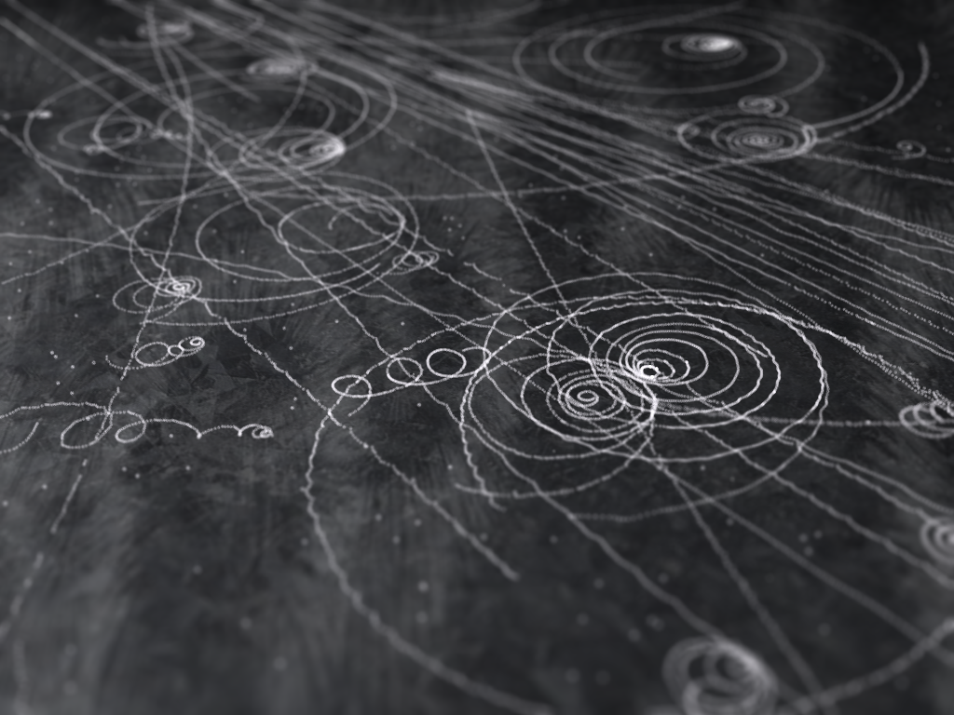
Ionization track

Slide 57
Ionization track
initial effects
Homogeneous reactions

Slide 58
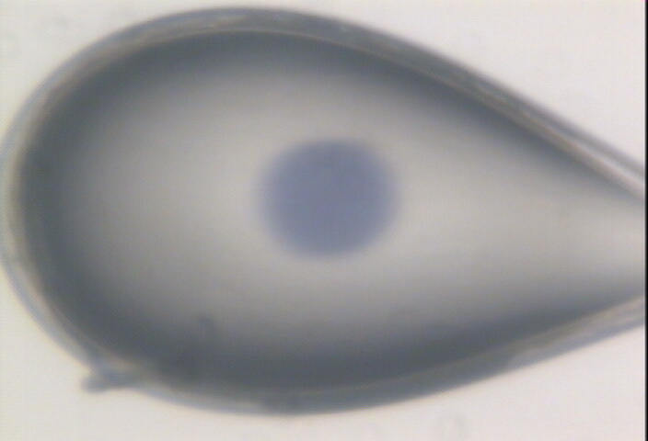

Slide 59
Timescales of radiation damage
LCLS
ALS
bunch
Garret et. al. (2005) Chem. Rev. 105, 355-389

Slide 60
Where do photons go?
Protein
1A x-rays
elastic scattering (6%)
Transmitted (98%)
beamstop
inelastic scattering (7%)
Photoelectric (87%)
Re-emitted (99%)
Absorbed (~0%)
Re-emitted (~0%)
Absorbed (99%)
useful/absorbed energy: 7.3%

Slide 61
Where does all that absorbed energy go?

Slide 62
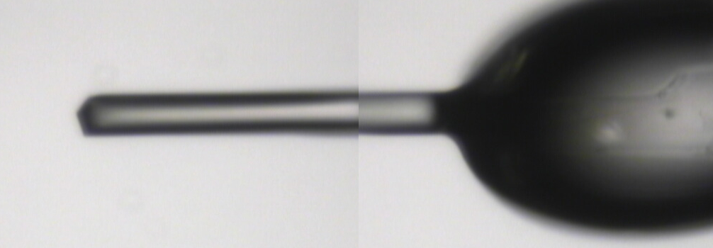
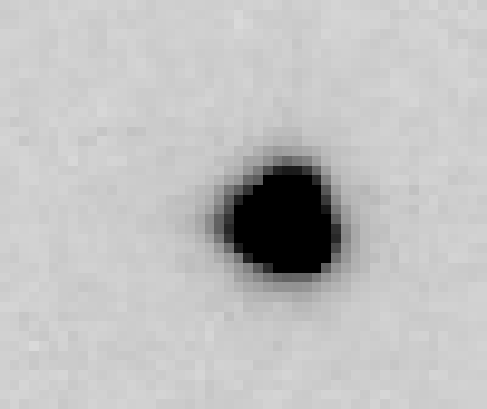

16 MGy

Slide 63
Global damage
10³
10 MGy/Å
100
maximum tolerable dose (MGy)
10
1
1 2 3 5 7 10 20 40 70 100
resolution (Å)
Howells et al. (2009) J. Electron. Spectrosc. Relat. Phenom. 170 4-12

Slide 64
10 MGy/Å
what the is a MGy?
http://bl831.als.lbl.gov/
damage_rates.pdf
Holton J. M. (2009) J. Synchrotron Rad. 16 133-42

Slide 65
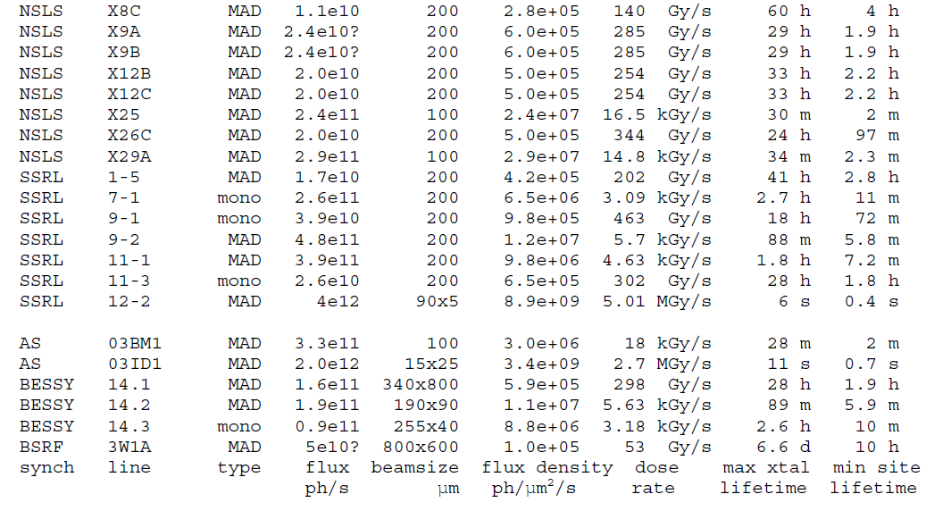
How long will my crystal last?

Slide 66
Specific damage rates
world records:
MGy reaction reference
~45 global damage Owen et al. (2006)
5 Se-Met Holton (2007)
4 Hg-S Ramagopal et al. (2004)
3 S-S Murray et al. (2002)
1 Br-RNA Olieric et al. (2007)
? Cl-C ???
0.5 Mn in PS II Yano et al. (2005)
0.02 Fe in myoglobin Denisov et al. (2007)
Holton (2009) J. Synchrotron Rad. 16 133-42

Slide 67
Damage is done
by photons/area
proportional to dose (MGy)
not time
not heat

Slide 68
The amount of data you get
before crystal is dead
is independent
of data collection time
Henderson, 1990; Gonzalez & Nave, 1994; Glaeser et al., 2000; Sliz et al., 2003; Leiros et al., 2006; Owen et al., 2006; Garman & McSweeney, 2006; Garman & Nave, 2009; Holton, 2009

Slide 69
How does “dose” fade spots?
A simple case…

Slide 70
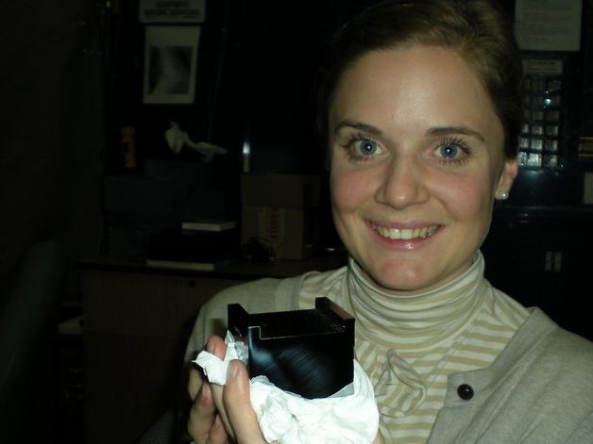
D_{1/2} ~ 10 Gy
D_{1/2} >> 10¹² Gy

Slide 71
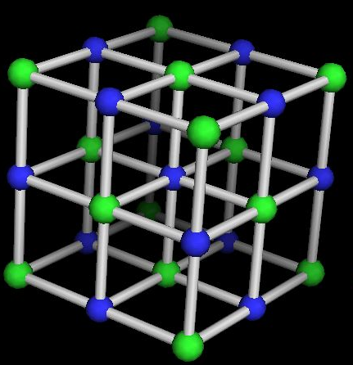
Sodium Chloride is Immortal!
D_{1/2} > 1 GGy

Slide 72
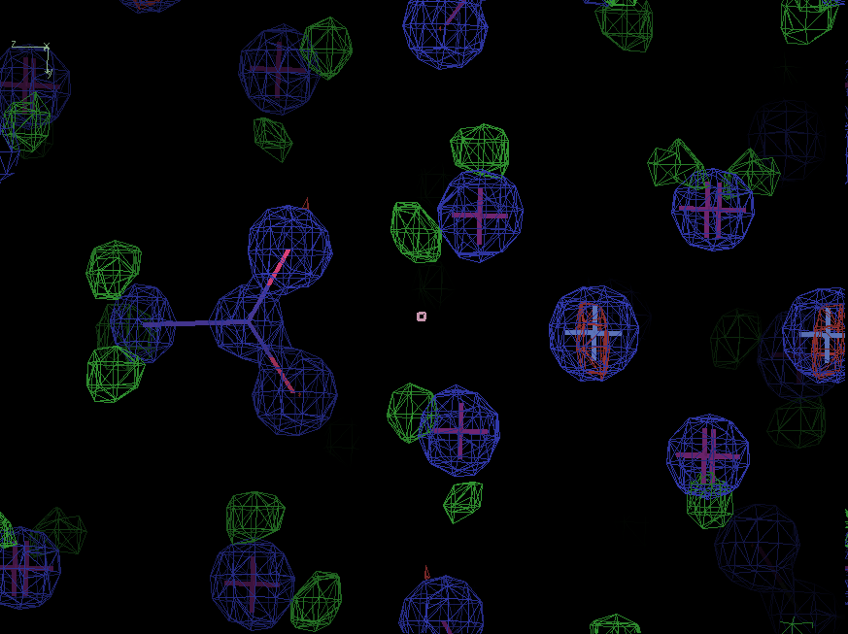
Sodium acetate trihydrate
D_{1/2} = 15 MGy
resolution: 0.92 Å
C2/c
R/Rfree: ~4%
avg B: ~ 0

Slide 73
stress and strain
What about
undamaged crystals?
radiation damage = defects

Slide 74
Purity is crucial!
important for
resolution
McPherson, A., Malkin, A. J., Kuznetsov, Y. G. & Plomp, M. (2001)."Atomic force microscopy applications in macromolecular crystallography", Acta Cryst. D 57, 1053-1060.
not important for
initial hits

Slide 75
What can I do to maximize what
I get out of my crystal?

Slide 76
beam size vs xtal size
  Put your crystal into the beam
  Shoot the whole crystal
  Shoot nothing but the crystal
  Back off!
  The crystal must rotate

Slide 77
beam size vs xtal size
  Put your crystal into the beam
  Shoot the whole crystal

Slide 78
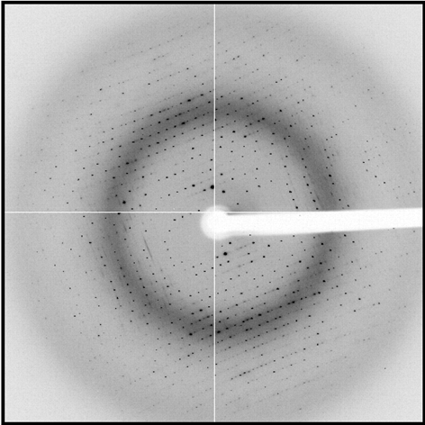
shoot the whole crystal

Slide 79
shoot the whole crystal

Slide 80
shoot the whole crystal

Slide 81
shoot nothing but the crystal

Slide 82
shoot nothing but the crystal

Slide 83
How many crystals do you see?

Slide 84
mosaic spread = 12.8º

Slide 85
X-ray scattering “rules”:
1 μm crystal ≈ 1 μm water
≈ 1 μm plastic
≈ 0.1 μm glass
≈ 1000 μm air

Slide 86
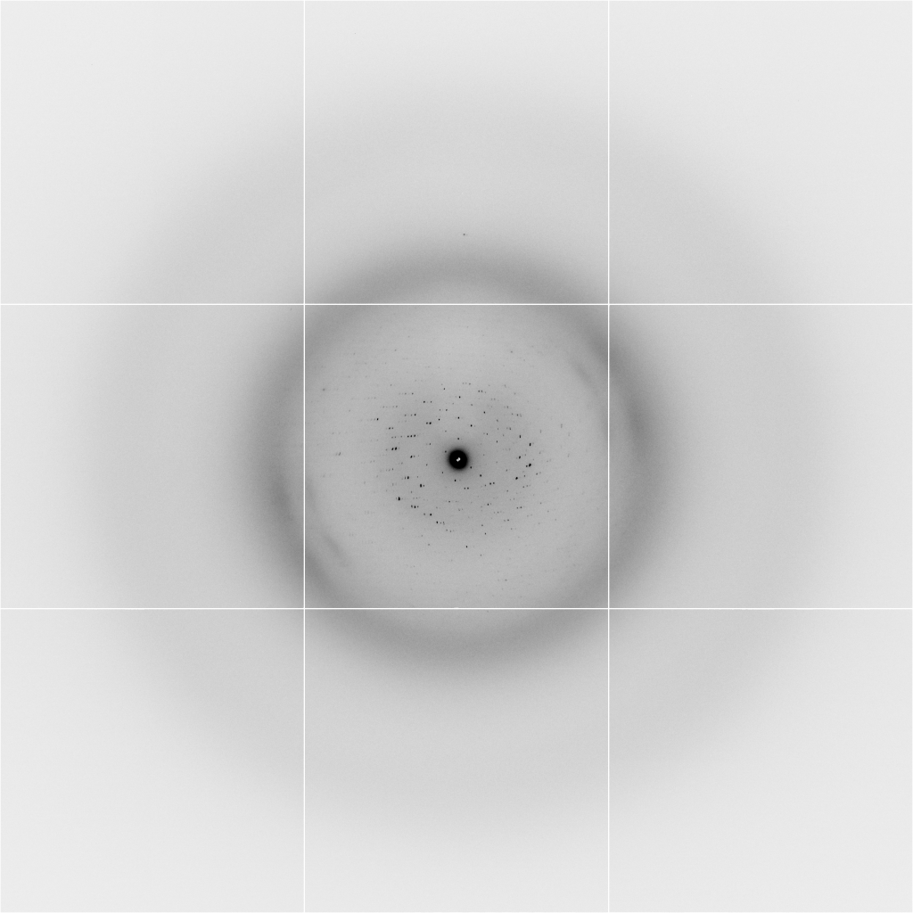
Background scattering
$100,000.00
$100,000.00
$100,000.00
real estate is
expensive
use it!
$100,000.00
$100,000.00
$100,000.00
$100,000.00
$100,000.00

Slide 87
Fine Slicing
background
background
Pflugrath, J. W. (1999)."The finer things in X-ray diffraction data collection", Acta Cryst. D 55, 1718-1725.

Slide 88

Optimal exposure time
(faint spots)
t_{hr} Optimal exposure time for data set (s)
t_{ref} exposure time of reference image (s)
bg_{ref} background level near weak spots on
reference image (ADU)
bg₀ ADC offset of detector (ADU)
bg_{hr} optimal background level (via t_{hr})
σ₀ rms read-out noise (ADU)
gain ADU/photon
m multiplicity of data set (including partials)
adjust exposure
so this is ~100

Slide 89
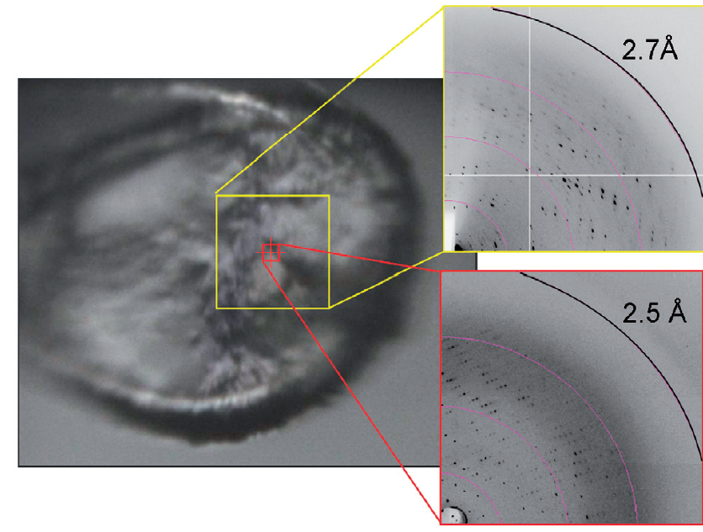
Get thee to a microbeam?
Evans et al. (2011)."Macromolecular microcrystallography", Crystallography Reviews 17, 105-142.

Slide 90
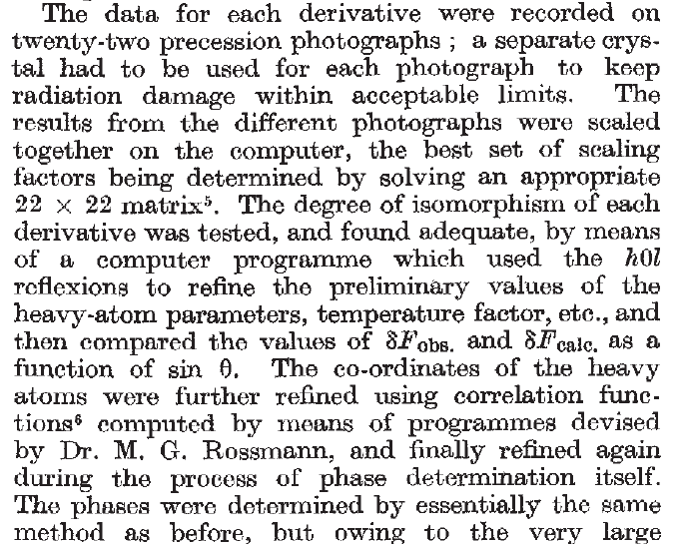
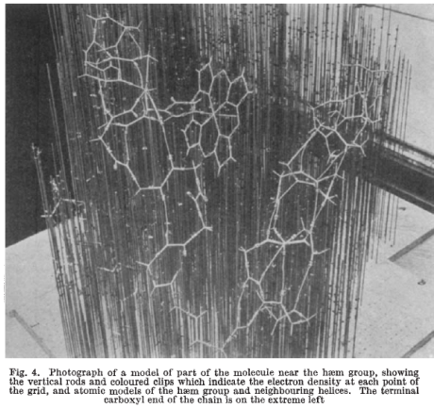
Multi-crystal strategies
Kendrew et al. (1960) "Structure of Myoglobin” Nature 185, 422-427.

Slide 91
Basic Principles
“Hell, there are NO RULES here - we're trying to accomplish something.”
Thomas A. Edison – inventor
“You’ve got to have an ASSAY.”
Arthur Kornberg – Nobel Laureate
“Control, control, you must learn CONTROL!”
Yoda – Jedi Master

Slide 92
Summary
Shoot the crystal
Do not bend!
Multi-crystal strategies
assay, control and open mind
Membrane Protein Expression Center © 2013

