Slide 1
Diffraction
When “scattering”
is not random

Slide 2
scattering
x-ray beam
sample
detector
detector

Slide 3
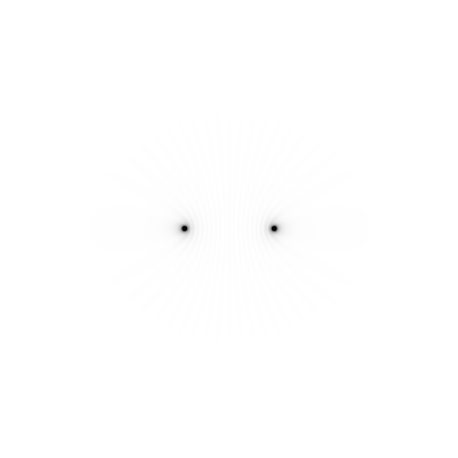
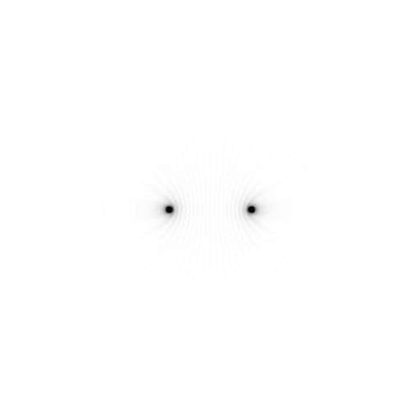
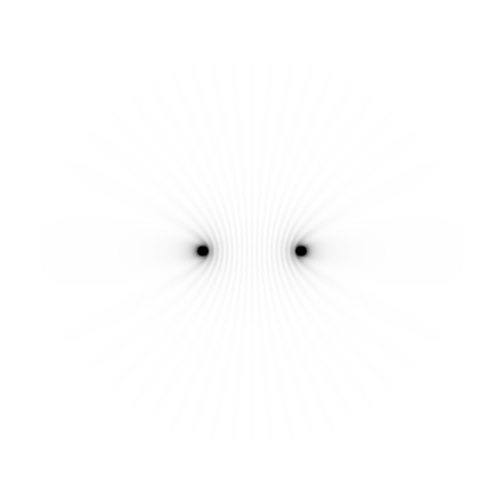
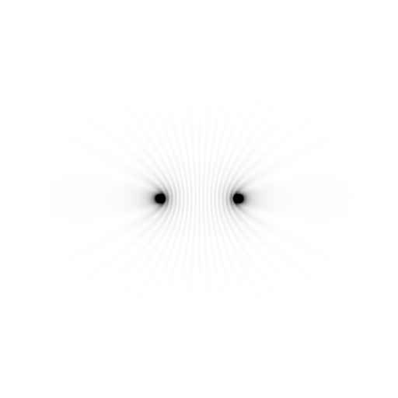
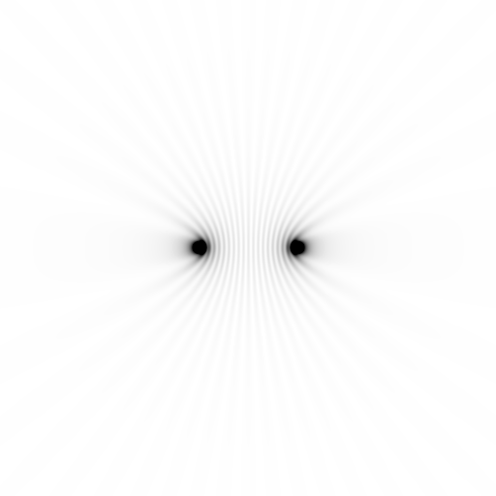
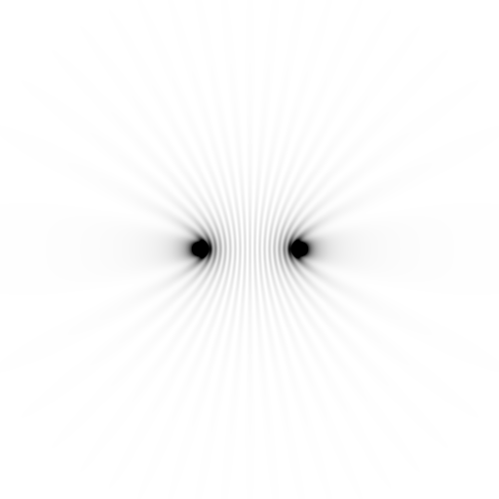
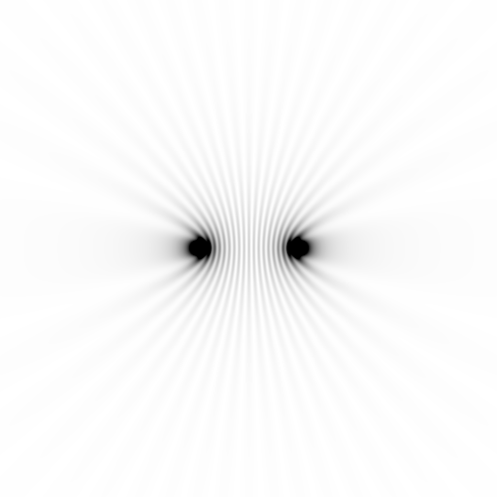
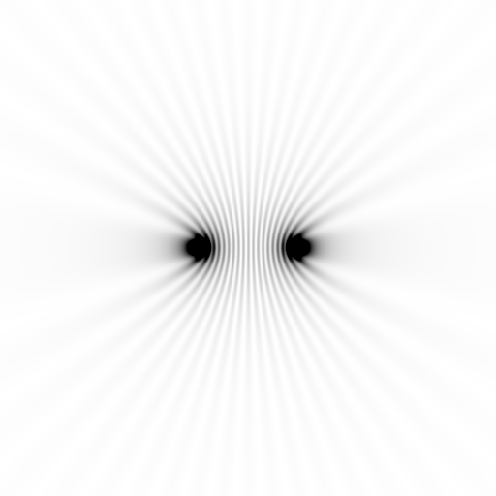
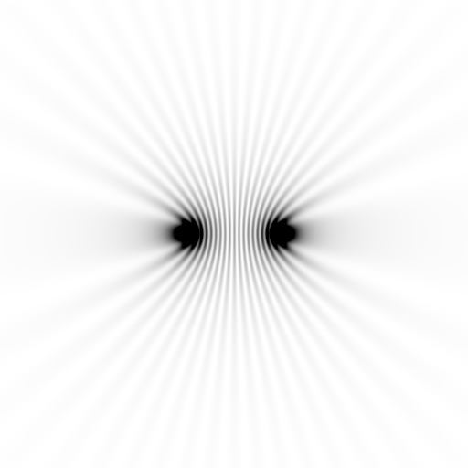
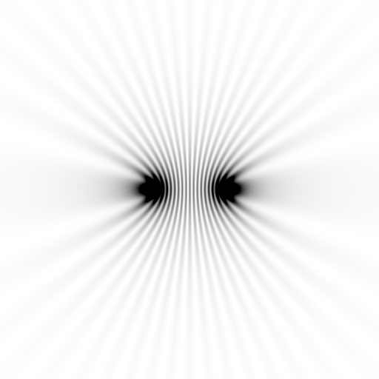
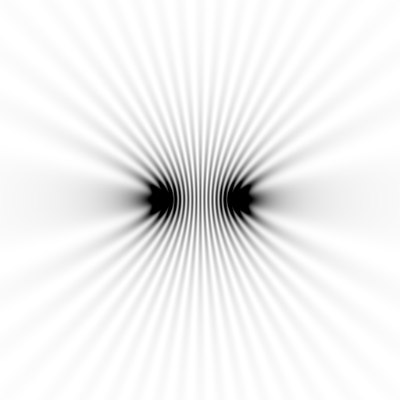
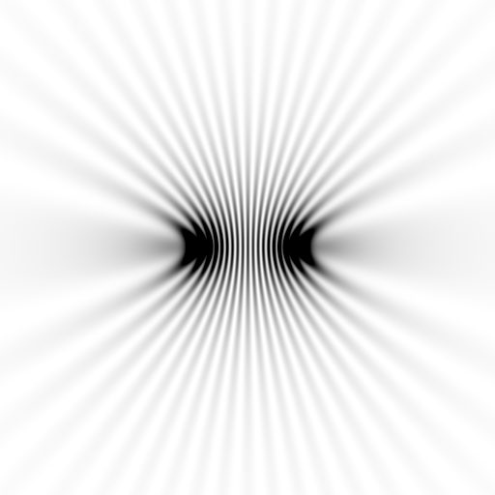
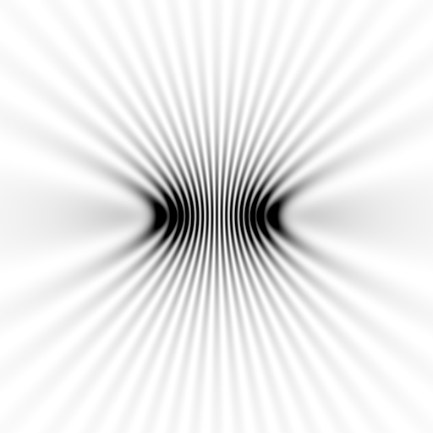
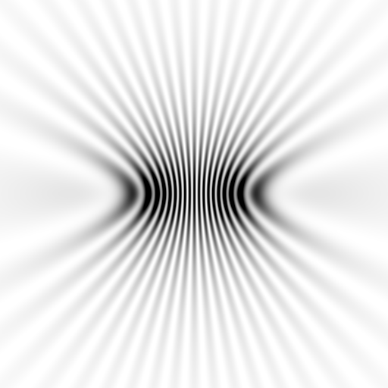
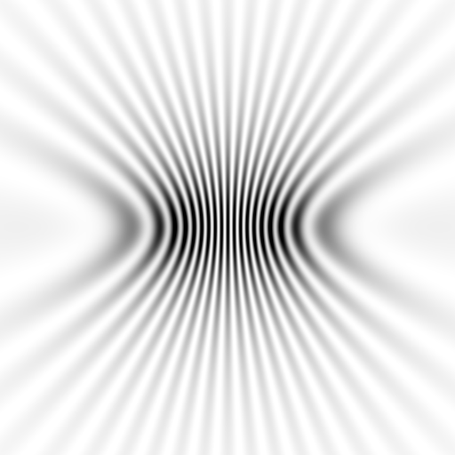
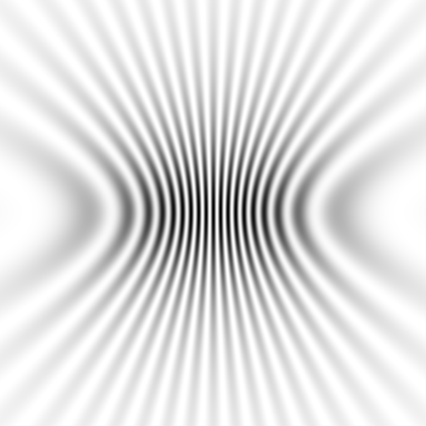
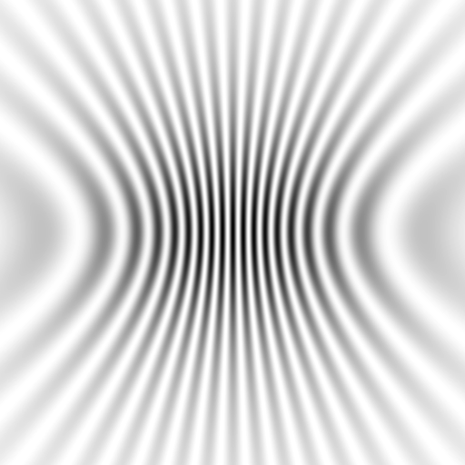
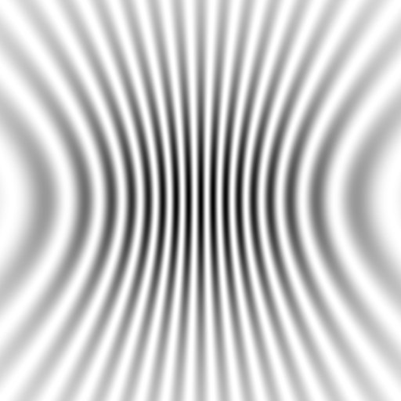
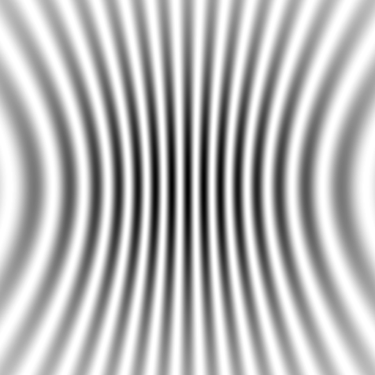
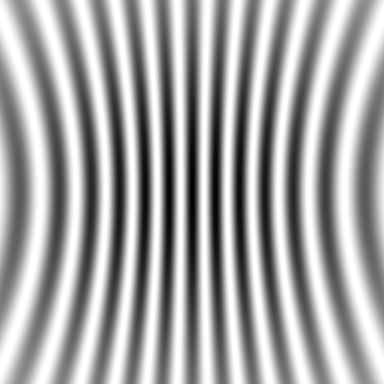
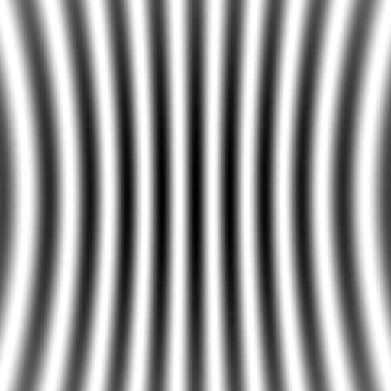
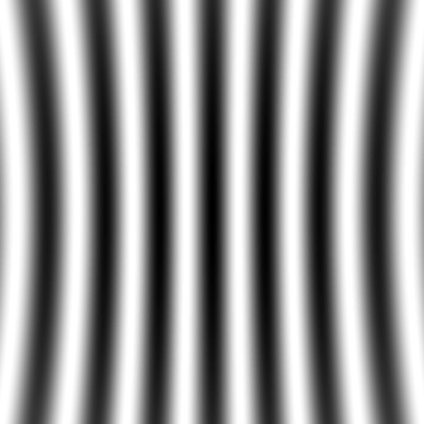
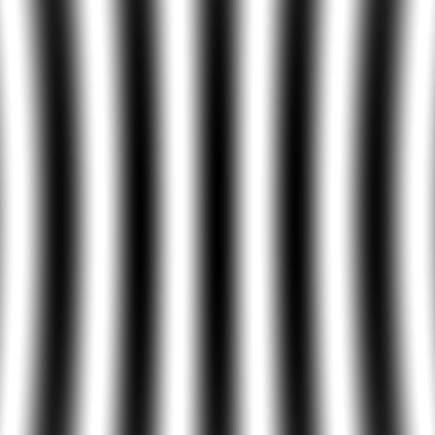
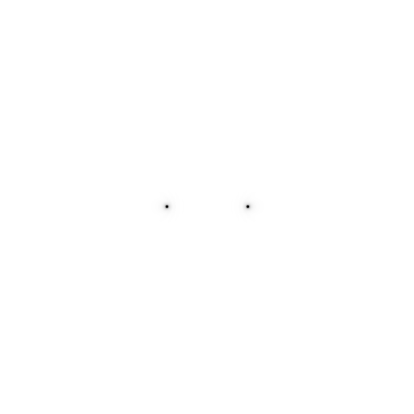
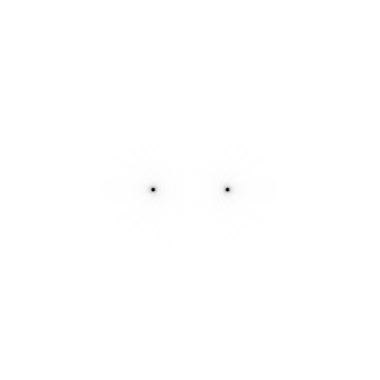
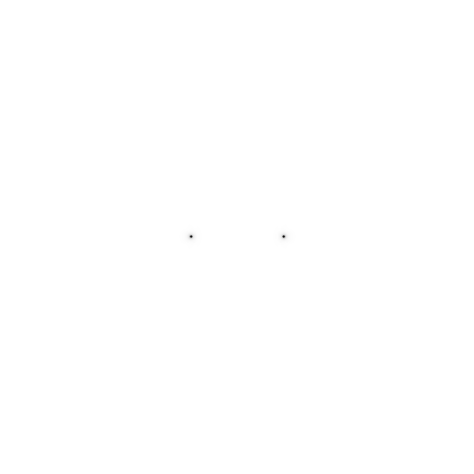

Slide 4
Scattering: atom by atom
intensity
h index

Slide 5
Scattering: atom by atom
intensity
h index

Slide 6
Scattering: atom by atom
intensity
h index

Slide 7
Scattering: atom by atom
intensity
h index

Slide 8
Scattering: atom by atom
intensity
h index

Slide 9
Scattering: atom by atom
intensity
h index

Slide 10
Scattering: atom by atom
intensity
h index

Slide 11
Scattering: atom by atom
intensity
h index

Slide 12
Scattering: atom by atom
intensity
h index

Slide 13
scattering
x-ray beam
sample
detector

Slide 14
scattering
x-ray beam
sample
detector

Slide 15
scattering
x-ray beam
sample
detector

Slide 16
Bragg’s Law
to detector
nλ = 2d sin(θ)
atom #1
θ
d
to source
atom #2
d∙sin(θ)

Slide 17
Bragg’s Law
to detector
nλ = 2d sin(θ)
atom #1
θ
d
to source
atom #2
d∙sin(θ)

Slide 18
Bragg’s Law
to detector
nλ = 2d sin(θ)
atom #1
θ
to source
d
atom #2
d∙sin(θ)

Slide 19
“near”-ly Bragg’s Law
detector
atom #1
source
d
atom #2

Slide 20
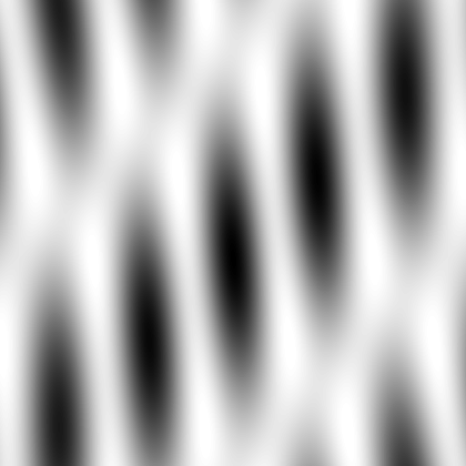
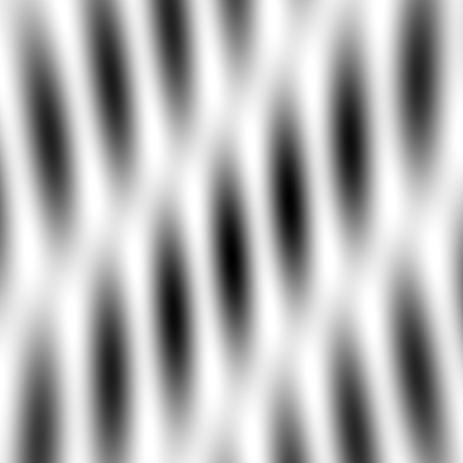
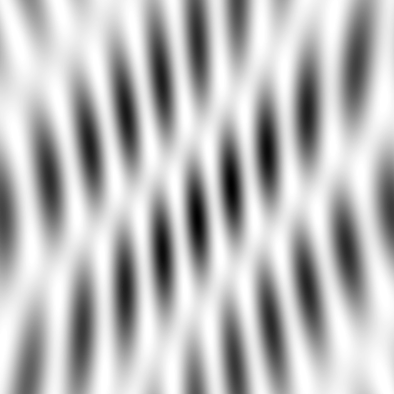
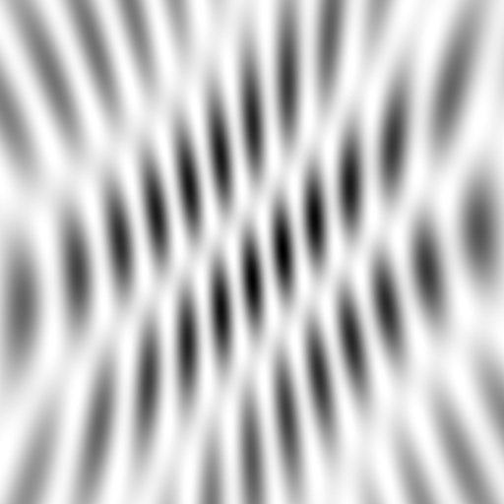
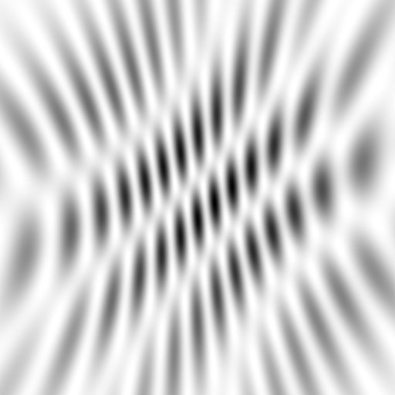
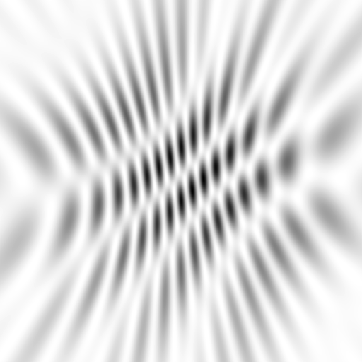
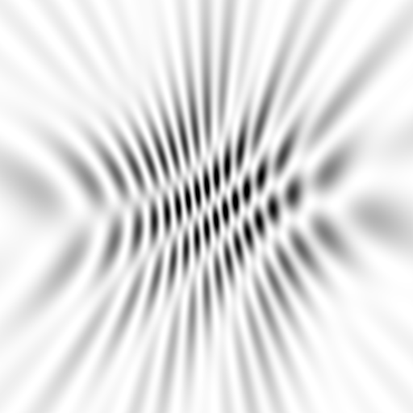
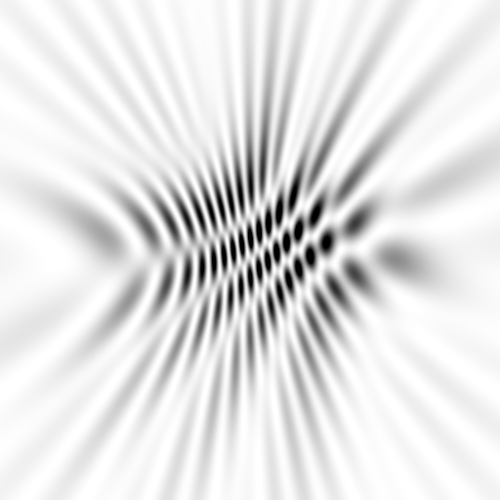
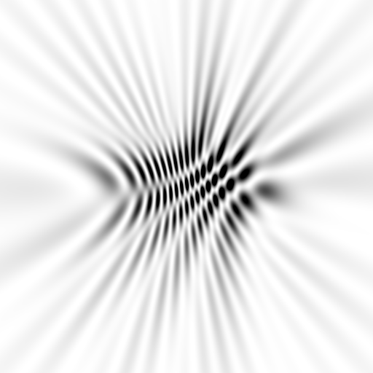
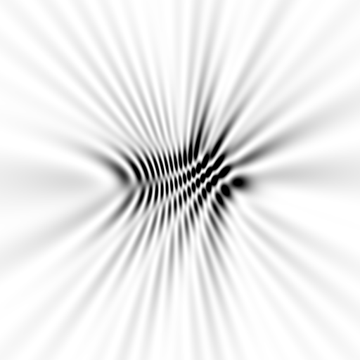
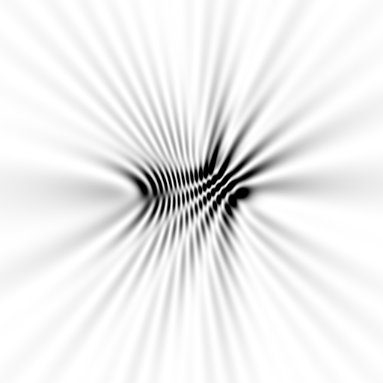
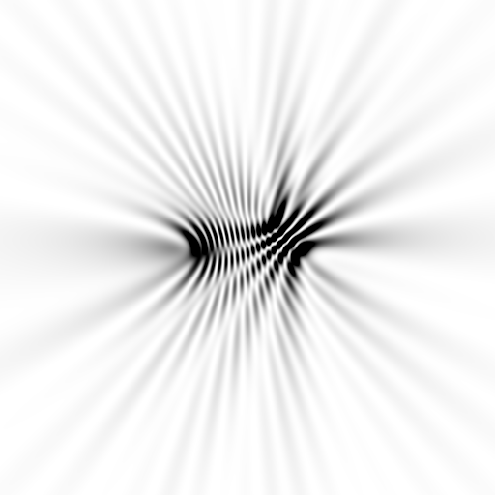
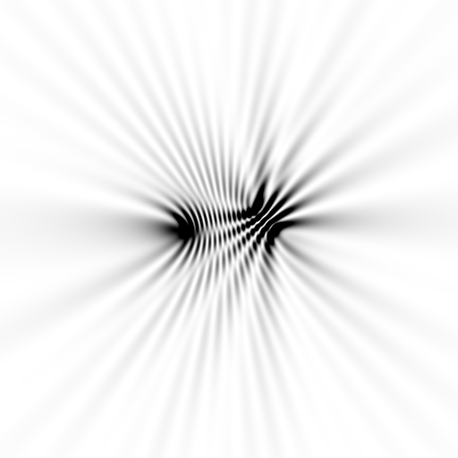
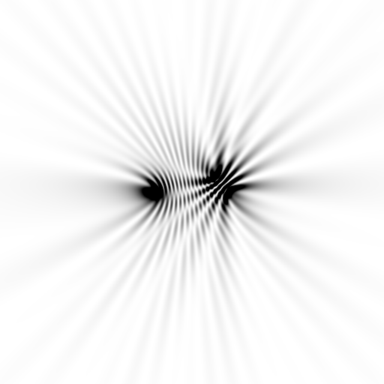
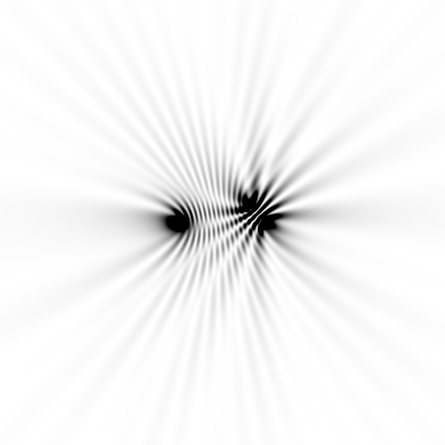






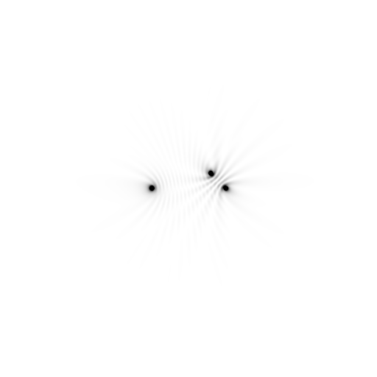





Slide 21



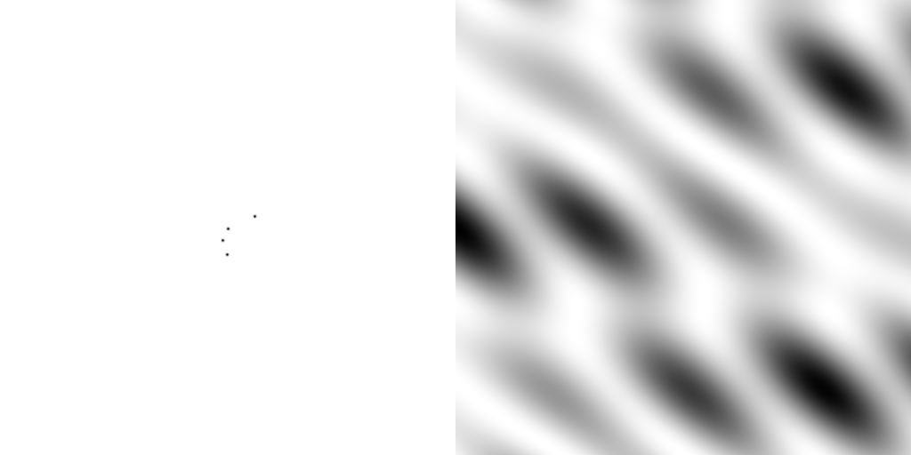
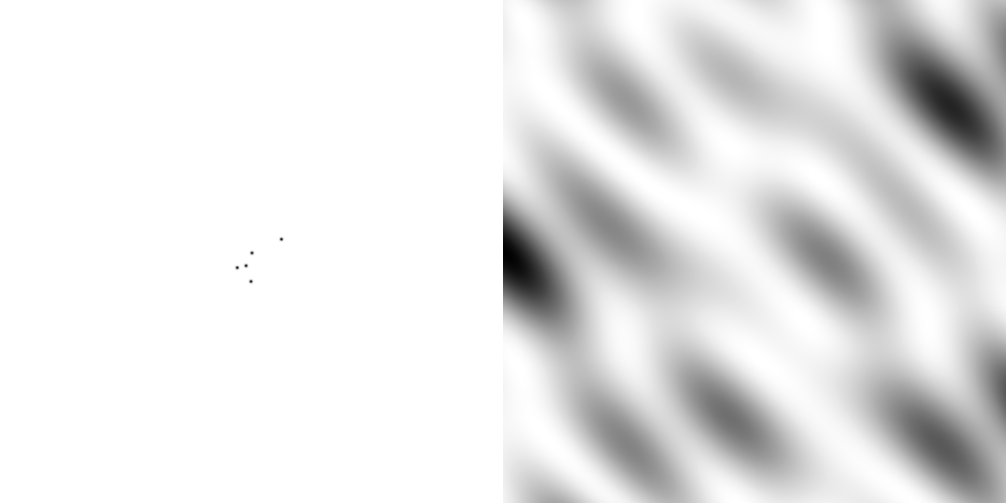
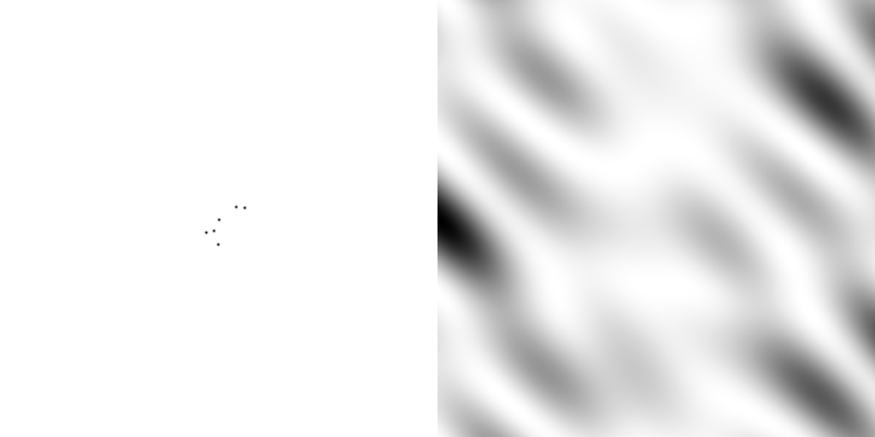
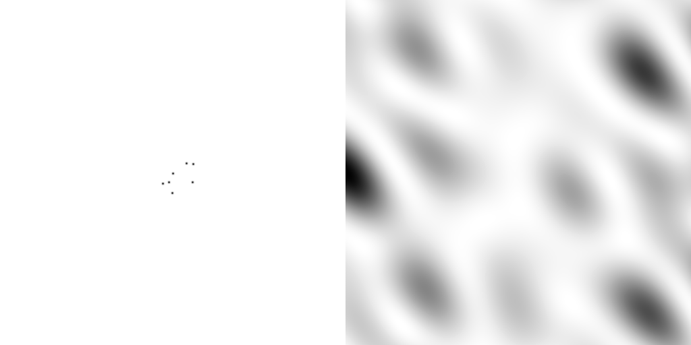
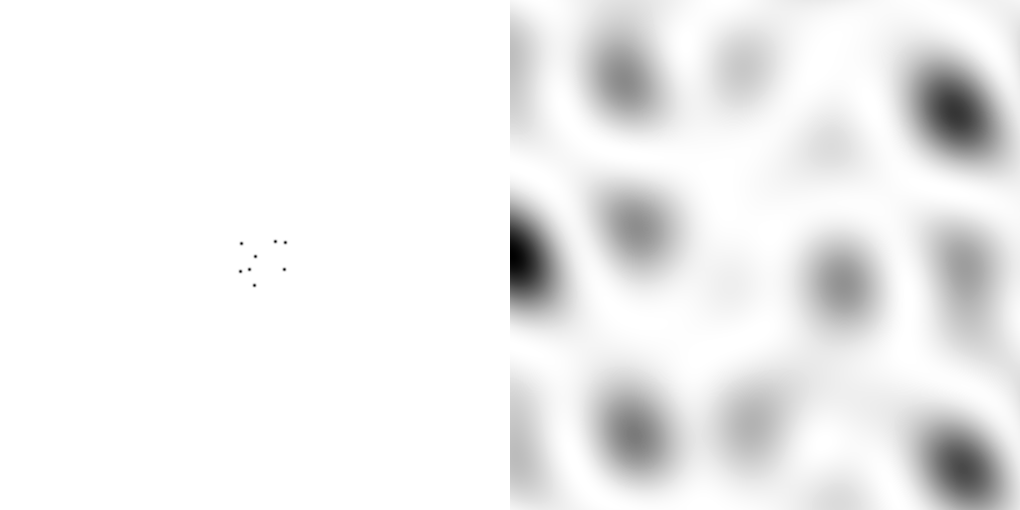
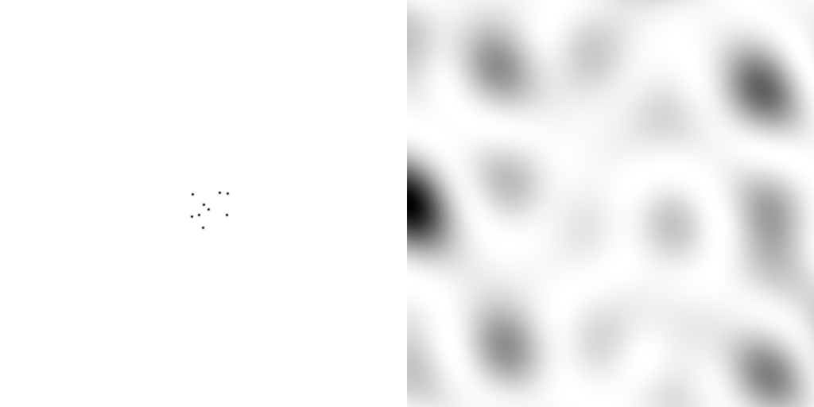
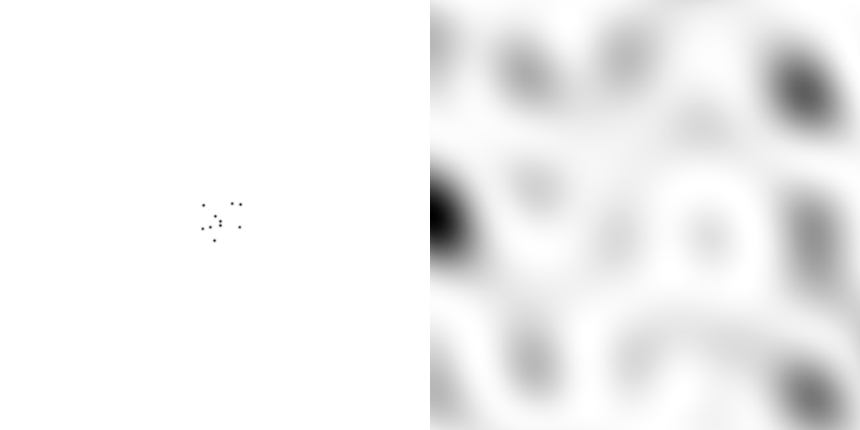
scattering from a structure
sample
detector

Slide 22
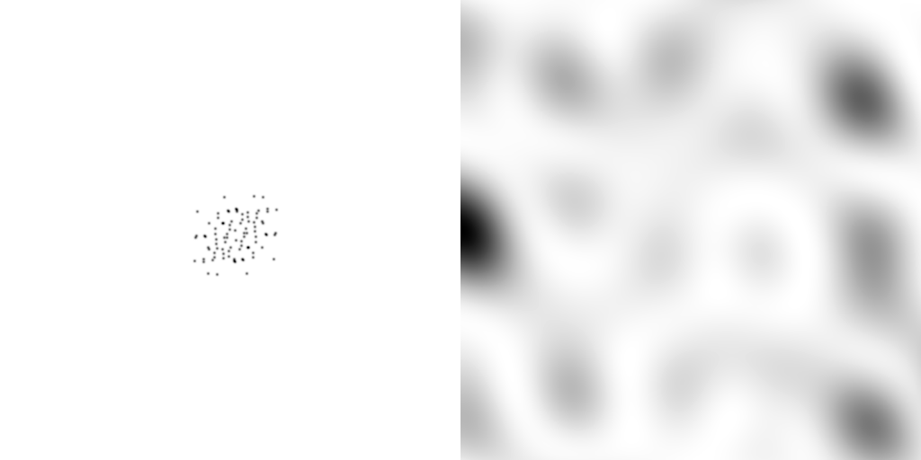
forward Fourier Transform
inverse Fourier Transform
no phase

Slide 23











inverse Fourier Transform
scattering from a structure
colored by phase
sample
detector

Slide 24




scattering from a lattice
colored by phase
sample
detector

Slide 25

scattering from a lattice
colored by phase
sample
detector

Slide 26

scattering from a lattice
colored by phase
sample
detector

Slide 27

scattering from a crystal structure
colored by phase
sample
detector

Slide 28

lysozyme: real and reciprocal

Slide 29


X-ray data are 3D!

Slide 30
Spot Shape
Ewald sphere
(h,k,l)

Slide 31
Spot Shape
Ewald sphere
(h,k,l)
d*

Slide 32
Spot Shape
Ewald sphere
(h,k,l)
spindle axis
d*

Slide 33
Spot Shape
Ewald sphere
Φ circle
(h,k,l)
spindle axis

Slide 34
Spot Shape
Ewald sphere
Φ circle
(h,k,l)
spindle axis

Slide 35
Spot Shape
Ewald sphere
Φ circle
(h,k,l)
diffracted ray
spindle axis

Slide 36
Spot Shape
Ewald sphere
Φ circle
(h,k,l)
λ*
d*
spindle axis
diffracted ray
λ*

Slide 37
Spot Shape
Ewald sphere
Φ circle
(h,k,l)
λ*
d*
spindle axis
diffracted ray
θ
λ*
λ = 2 d sin(θ)

Slide 38
Spot shape
Ewald sphere
Φ circle
(h,k,l)
λ*
d*
spindle axis
diffracted ray
λ*

Slide 39
beam divergence
Ewald sphere
Φ circle
(h,k,l)
λ*
d*
spindle axis
diffracted ray
λ*

Slide 40
beam divergence
Ewald sphere
Φ circle
(h,k,l)
d*
λ*
diffracted ray
spindle axis
λ*

Slide 41

divergence = 0 º

Slide 42

divergence = 0.3 º

Slide 43
beam divergence
Ewald sphere
Φ circle
(h,k,l)
λ*
d*
spindle axis
diffracted ray
λ*

Slide 44
spectral dispersion
Ewald sphere
Φ circle
(h,k,l)
λ*
d*
spindle axis
diffracted ray
λ*

Slide 45
spectral dispersion
Ewald sphere
Φ circle
(h,k,l)
λ’*
d*
spindle axis
diffracted ray
λ’*

Slide 46

dispersion = 0

Slide 47

dispersion = 0.014% (Si 111)

Slide 48

dispersion = 0.25% (CuK_{α})

Slide 49

dispersion = 0.6%

Slide 50

dispersion = 1.3%

Slide 51

dispersion = 2.6%

Slide 52

dispersion = 5.1%

Slide 53
mosaic spread
Ewald sphere
Φ circle
(h,k,l)
λ*
d*
diffracted ray
d*
spindle axis
λ*

Slide 54
mosaic spread
Ewald sphere
Φ circle
(h,k,l)
d*
diffracted rays
d*
spindle axis

Slide 55

mosaic spread = 0 º

Slide 56

mosaic spread = 0.1º

Slide 57

mosaic spread = 0.2º

Slide 58

mosaic spread = 0.4º

Slide 59

mosaic spread = 0.6º

Slide 60

mosaic spread = 0.8º

Slide 61

mosaic spread = 1.0º

Slide 62

mosaic spread = 1.5º

Slide 63

mosaic spread = 2.0º

Slide 64

mosaic spread = 2.5º

Slide 65

mosaic spread = 3.2º

Slide 66

mosaic spread = 6.4º

Slide 67

mosaic spread = 12.8º

Slide 68
Ewald’s “mosaic” picture
What is
this stuff?

Slide 69
Darwin’s original picture

Slide 70

“mosaicity” with visible light

Slide 71

mosaic block = “coherence length”
James R. W. (1962) Optical Principles of the Diffraction of X rays. Ox Bow press.

Slide 72








Scattering: line of atoms
10 atoms
50 atoms
100 atoms
200 atoms
300 atoms
400 atoms
500 atoms
1000 atoms
0.1 μm
0.5 μm
1 μm
2 μm
3 μm
4 μm
5 μm
10 μm
intensity (photons/SR/atom)
position on detector (mm)

Slide 73
Scattering: line of atoms
x-ray beam
peak
intensity
integrated
intensity
“crystal”
detector

Slide 74

Scattering: line of atoms
mosaic
block
size
mosaic
spread
peak intensity (photons/SR)
B factor
depends on detector distance !!!
integrated intensity never changes
number of atoms in line

Slide 75
spot shape
Ewald sphere
Ewald sphere
Ewald sphere
Ewald sphere
Φ circle
Φ circle
Φ circle
Φ circle
(h,k,l)
(h,k,l)
(h,k,l)
(h,k,l)
λ’*
λ*
d*
d*
d*
λ*
d*
spindle axis
spindle axis
spindle axis
diffracted rays
d*
spindle axis
diffracted ray
diffracted ray
diffracted ray
λ’*
λ*
λ*

Slide 76


Point Spread Function
“no” PSF
“realistic” PSF

Slide 77
Law of Convolution
1² + 1² = 1.4²
3² + 1² = 3.2²
σ_{total}² = σ₁² + σ₂²

Slide 78
anomalous scattering
x-ray beam
sample
detector

Slide 79
anomalous scattering
x-ray beam
sample
detector

Slide 80
anomalous scattering
x-ray beam
sample
detector

Slide 81
anomalous scattering
x-ray beam
sample
detector

Slide 82
anomalous scattering
x-ray beam
sample
detector

Slide 83
What is “disorder”?

Slide 84
What is “disorder”?

Slide 85
What is “disorder”?

Slide 86

What is “disorder”?
order
order
B-factor
disorder

Slide 87

Debye-Waller-Ott factor
James R. W. (1962) Optical Principles of the Diffraction of X rays. Ox Bow press.

Slide 88
Debye-Waller-Ott factor
F = F₀ exp( - A∙s - B∙s² - C∙s³ - … )
F - structure factor
A - something Debye said was zero
B - canonical Debye-Waller factor
C - something else Debye said was zero
s - 0.5/d
d - resolution of spot (Å)

Slide 89
Debye-Waller-Ott factor
Reciprocal Space
Gaussian
normalized total intensity
Exponential
∞ 5 2.5 1.7 1.25 1.0
Resolution (Ǻ)

Slide 90
Debye-Waller-Ott factor
Direct Space
Gaussian
normalized number of atoms
Lorentzian
magnitude of displacement (Å)

Slide 91
Wilson plot
R_{cryst}/R_{free}
0.355/0.514
scaled <F²>
4.1 3.5 3.2 2.9 2.7 2.5 2.4 2.2 2.1
resolution (Å)
(sin(θ)/λ)²

Slide 92
Wilson plot
R_{cryst}/R_{free}
0.355/0.514
0.257/0.449
0.209/0.407
scaled <F²>
4.1 3.5 3.2 2.9 2.7 2.5 2.4 2.2 2.1
resolution (Å)
(sin(θ)/λ)²

Slide 93
Wilson plot
R_{cryst}/R_{free}
0.355/0.514
0.257/0.449
0.209/0.407
scaled <F²>
4.1 3.5 3.2 2.9 2.7 2.5 2.4 2.2 2.1
resolution (Å)
(sin(θ)/λ)²

Slide 94
“B” factors
ATOM 122 N LEU A 13 -3.244 25.808 19.998 1.00 16.96 N
ATOM 123 CA LEU A 13 -2.877 25.448 21.355 1.00 15.29 C
ATOM 124 C LEU A 13 -2.792 23.966 21.561 1.00 17.54 C
ATOM 125 O LEU A 13 -1.814 23.493 22.143 1.00 16.35 O
ATOM 126 CB LEU A 13 -3.907 26.164 22.268 1.00 18.72 C
ATOM 127 CG LEU A 13 -3.577 25.982 23.738 1.00 21.19 C
ATOM 128 CD1 LEU A 13 -2.283 26.820 24.019 1.00 19.43 C
ATOM 129 CD2 LEU A 13 -4.702 26.474 24.639 1.00 24.65 C
ATOM 130 N SER A 14 -3.677 23.149 20.979 1.00 15.96 N
ATOM 131 CA SER A 14 -3.646 21.711 21.061 1.00 18.26 C
ATOM 132 C SER A 14 -2.373 21.203 20.360 1.00 18.71 C
ATOM 133 O SER A 14 -1.747 20.315 20.930 1.00 17.47 O
ATOM 134 CB SER A 14 -4.875 21.077 20.419 1.00 17.62 C
ATOM 135 OG ASER A 14 -4.825 19.665 20.388 0.50 20.89 O
ATOM 136 OG BSER A 14 -6.027 21.408 21.164 0.50 18.67 O
ATOM 137 N LYS A 15 -2.045 21.772 19.215 1.00 18.03 N
ATOM 138 CA LYS A 15 -0.799 21.361 18.555 1.00 18.12 C
ATOM 139 C LYS A 15 0.446 21.707 19.351 1.00 18.81 C
ATOM 140 O LYS A 15 1.400 20.948 19.411 1.00 17.77 O
ATOM 141 CB LYS A 15 -0.700 22.034 17.177 1.00 14.49 C
ATOM 142 CG LYS A 15 -1.727 21.368 16.256 1.00 16.12 C
ATOM 143 CD LYS A 15 -1.663 22.147 14.936 1.00 19.40 C
ATOM 144 CE ALYS A 15 -2.725 21.614 13.986 0.50 17.42 C
ATOM 145 CE BLYS A 15 -1.750 21.211 13.750 0.50 17.01 C
ATOM 146 NZ ALYS A 15 -2.346 21.674 12.559 0.50 18.61 N
ATOM 147 NZ BLYS A 15 -3.052 20.513 13.741 0.50 18.76 N

Slide 95
“B” factors
electron density (e⁻/Å³)
position (Å)

Slide 96
“B” factors
electron density (e⁻/Å³)
position (Å)

Slide 97
“B” factors
electron density (e⁻/Å³)
position (Å)

Slide 98
“B” factors
electron density (e⁻/Å³)
position (Å)

Slide 99
“B” factors
B ≈ 4d² + 12
d = resolution in Å
essentially, the “resolution” of an atom

Slide 100

Resolution
http://bl831.als.lbl.gov/~jamesh/movies/resolution.mpeg

Slide 101

Resolution: low-angle cutoff
http://bl831.als.lbl.gov/~jamesh/movies/lo_cut.mpeg

Slide 102

R-factor
http://bl831.als.lbl.gov/~jamesh/movies/rfactor.mpeg

Slide 103

Figure of Merit
http://bl831.als.lbl.gov/~jamesh/movies/dephase.mpeg

Slide 104

Overloads
http://bl831.als.lbl.gov/~jamesh/movies/overloads.mpeg

Slide 105

Completeness: missing wedge
http://bl831.als.lbl.gov/~jamesh/movies/osc.mpeg

Slide 106

Completeness: random deletion
http://bl831.als.lbl.gov/~jamesh/movies/completeness.mpeg

Slide 107
Debye-Waller-Ott factor
How can the distribution of atom displacements
NOT
be Gaussian?
(central limit theorem)
what can cause a Lorentzian distribution?

Slide 108

stress and strain

Slide 109
stress and strain
normalized number of atoms
magnitude of displacement (fractional)

Slide 110
stress and strain
normalized number of atoms
magnitude of displacement (fractional)

Slide 111
stress and strain
normalized number of atoms
magnitude of displacement (fractional)

Slide 112
Purity is crucial!
important for
resolution
McPherson, A., Malkin, A. J., Kuznetsov, Y. G. & Plomp, M. (2001)."Atomic force microscopy applications in macromolecular crystallography", Acta Cryst. D 57, 1053-1060.
not important for
initial hits

Slide 113
What can I improve?
Purity!
is 95% good enough? 99%?
Purity!
conformational (homogeneous)
Purity!
kinetic (stable over time)

Slide 114
What can I improve?
add a column
fractional recrystallization
heat shock
mutate Lys
avoid stress
Newman J. (2006) Acta Cryst. D62 27-31.

Slide 115
causes of stress
physical contact
don’t touch the part you intend to shoot
osmotic shock
equilibrate, or calculate matching solution
changes in dielectric constant
Petsko (1975) J. Mol. Biol. 96, 381-388.
cooled density mismatch
Juers & Matthews (2004) Acta Cryst. D 60, 412-421.
basically: no sudden moves!

Slide 116
causes of stress
physical contact
don’t touch the part you intend to shoot
osmotic shock
equilibrate, or calculate matching solution
changes in dielectric constant
Petsko (1975) J. Mol. Biol. 96, 381-388.
cooled density mismatch
Juers & Matthews (2004) Acta Cryst. D 60, 412-421.

Slide 117
Minimum size for complete data set
1 Å
X-rays
2 Å
spots
B = 24
50%
solvent
crystal diameter (μm)
100 Da 1 kDa 10 kDa 100 kDa 1 MDa 10 MDa
molecular weight
Holton & Frankel (2010) Acta D 66 393-408.

Slide 118
We’d love to use multiple crystals
but we have a problem with
non-isomorphism

Slide 119
Non-isomorphism in lysozyme
Dear James
The story of the two forms of lysozyme crystals goes back to about 1964 when it was found that the diffraction patterns from different crystals could be placed in one of two classes depending on their intensities. This discovery was a big set back at the time and I can remember a lecture title being changed from the 'The structure of lysozyme' to 'The structure of lysozyme two steps forward and one step back'. Thereafter the crystals were screened based on intensities of the (11,11,l) rows to distinguish them (e.g. 11,11,4 > 11,11,5 in one form and vice versa in another). Data were collected only for those that fulfilled the Type II criteria. (These reflections were easy to measure on the linear diffractometer because crystals were mounted to rotate about the diagonal axis). As I recall both Type I and Type II could be found in the same crystallisation batch . Although sometimes the external morphology allowed recognition this was not infallible.
The structure was based on Type II crystals. Later a graduate student Helen Handoll examined Type I. The work, which was in the early days and before refinement programmes, seemed to suggest that the differences lay in the arrangement of water or chloride molecules (Lysozyme was crystallised from NaCl). But the work was never written up. Keith Wilson at one stage was following this up as lysozyme was being used to test data collection strategies but I do not know the outcome.
An account of this is given in International Table Volume F (Rossmann and Arnold edited 2001) p760.
Tony North was much involved in sorting this out and if you wanted more info he would be the person to contact. I hope this is helpful. Do let me know if you need more.
Best wishes
Louise

Slide 120
Non-isomorphism in lysozyme
Structure factor (e⁻)
Johnson’s ratio

Slide 121
Non-isomorphism in lysozyme
Structure factor (e⁻)
Johnson’s ratio

Slide 122


Slide 123

Non-isomorphism in lysozyme
RH 84.2% vs 71.9%
RMSD = 0.18 Å
R_{iso} = 44.5%

Slide 124
Non-isomorphism in lysozyme
Dear James
The story of the two forms of lysozyme crystals goes back to about 1964 when it was found that the diffraction patterns from different crystals could be placed in one of two classes depending on their intensities. This discovery was a big set back at the time and I can remember a lecture title being changed from the 'The structure of lysozyme' to 'The structure of lysozyme two steps forward and one step back'. Thereafter the crystals were screened based on intensities of the (11,11,l) rows to distinguish them (e.g. 11,11,4 > 11,11,5 in one form and vice versa in another). Data were collected only for those that fulfilled the Type II criteria. (These reflections were easy to measure on the linear diffractometer because crystals were mounted to rotate about the diagonal axis). As I recall both Type I and Type II could be found in the same crystallisation batch . Although sometimes the external morphology allowed recognition this was not infallible.
The structure was based on Type II crystals. Later a graduate student Helen Handoll examined Type I. The work, which was in the early days and before refinement programmes, seemed to suggest that the differences lay in the arrangement of water or chloride molecules (Lysozyme was crystallised from NaCl). But the work was never written up. Keith Wilson at one stage was following this up as lysozyme was being used to test data collection strategies but I do not know the outcome.
An account of this is given in International Table Volume F (Rossmann and Arnold edited 2001) p760.
Tony North was much involved in sorting this out and if you wanted more info he would be the person to contact. I hope this is helpful. Do let me know if you need more.
Best wishes
Louise

Slide 125
opened drop: you have ~30 seconds!
equilibrated drop

Slide 126

Response to dehydration
www.proteros.de

Slide 127

Response to dehydration
www.proteros.de

Slide 128

Response to dehydration
www.proteros.de

Slide 129

Response to dehydration
www.proteros.de

Slide 130

Response to dehydration
www.proteros.de

Slide 131

Response to dehydration
www.proteros.de

Slide 132

Response to dehydration
www.proteros.de

Slide 133

Response to dehydration
www.proteros.de

Slide 134

Ostwald Ripening
http://xray.bmc.uu.se/terese/tutorial6.html

Slide 135

Response to dehydration
www.proteros.de

Slide 136
Elastic deformation

Slide 137
Elastic deformation

Slide 138
Plastic deformation

Slide 139


Vicker’s hardness
Tachibana et al. (1999) J. Cryst. Growth 198, 661-664.
Koizumi et al. (2009) Physical Review E 79, 61917.

Slide 140
Summary
X-rays “see” electrons
Crystal quality is key
Spot shape is telling

