Slide 1
Acknowledgements
Robert Stroud James Fraser Paul Adams John Tainer
Chris Nielsen Clemens Schulze-Briese Aina Cohen Ana Gonzalez
UCSF LBNL SLAC
ALS 8.3.1: TomAlberTron
UC Multicampus Research Programs and Initiatives (MRPI)
NIH NIGMS R01 GM124149
NIH NIGMS P30 GM124169
Integrated Diffraction Analysis Technologies (IDAT)
Plexxikon, Inc.
Synchrotron Radiation Structural Biology Resource (SLAC)
The Advanced Light Source is supported by the Director, Office of Science, Office of Basic Energy Sciences, Materials Sciences Division, of the US Department of Energy under contract No. DE-AC02-05CH11231 at Lawrence Berkeley National Laboratory.

Slide 2
Painting with X-rays
Virtual beams to match any sample
(Some assembly required)

Slide 3
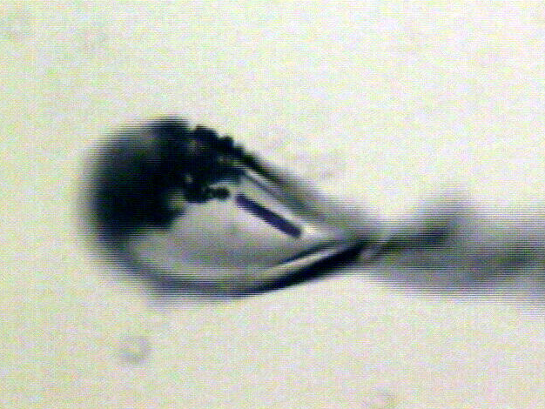
Beam size?

Slide 4
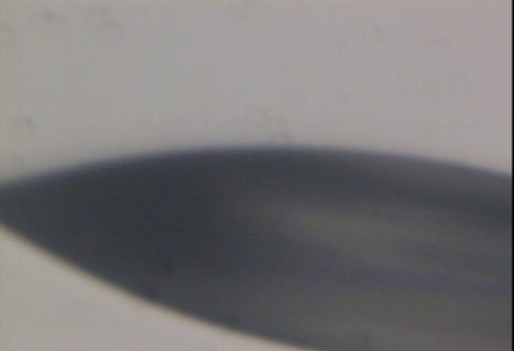
“dose contrast” effects
before

Slide 5
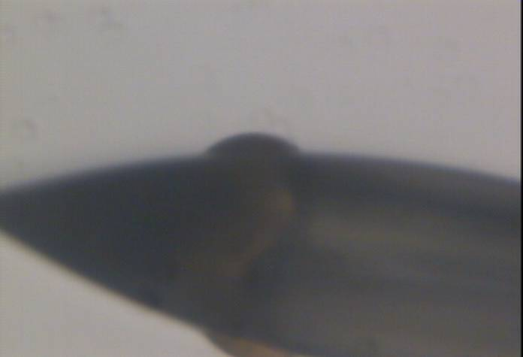
“dose contrast” effects
after

Slide 6
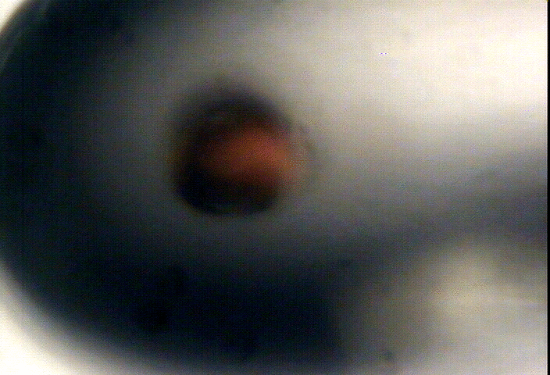
“dose contrast” effects

Slide 7
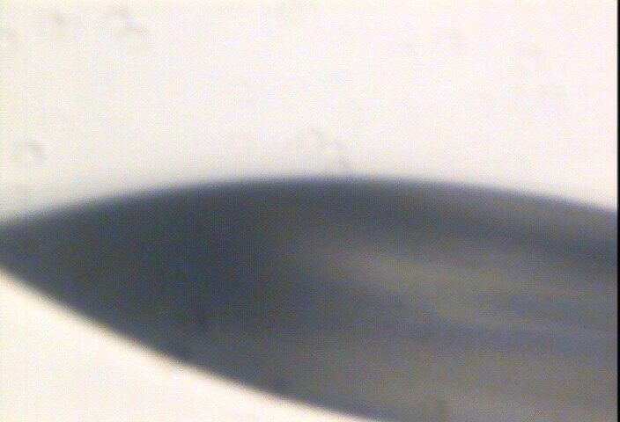
“dose contrast” effects

Slide 8
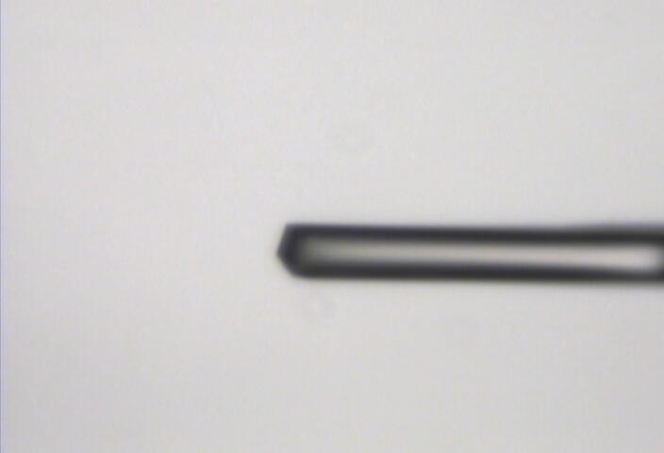
“Cleanup beam” method for flat dose profile
normalized photons/area
position relative to beam center (μm)

Slide 9
“Cleanup beam” method for flat dose profile
normalized photons/area
position relative to beam center (μm)

Slide 10
“Cleanup beam” method for flat dose profile
normalized photons/area
position relative to beam center (μm)

Slide 11
“Cleanup beam” method for flat dose profile
normalized photons/area
position relative to beam center (μm)

Slide 12
“Cleanup beam” method for flat dose profile
normalized photons/area
position relative to beam center (μm)

Slide 13
Exponential spot fading: flat dose
integrated spot intensity
dose (MGy)

Slide 14
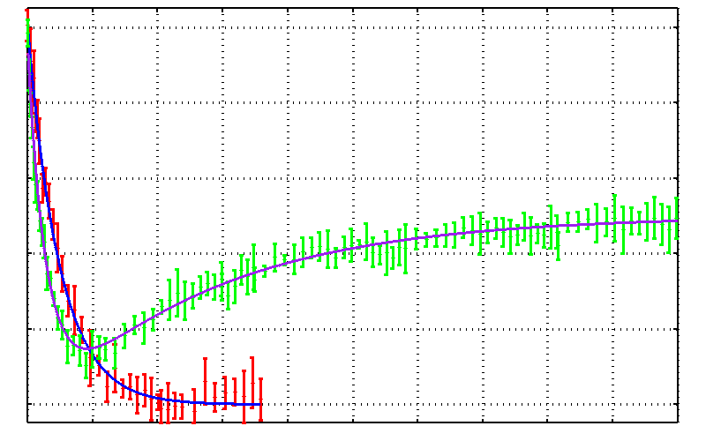
No dose flattening: damage repair?
25mM SeMet in 50 mM bis-tris
Half-dose = 17.0 ± 0.7 MGy
25% glycerol
Half-dose = 10 ± 0.4 MGy
25% threhalose
Drift!
0.0 0.2 0.4 0.6 0.8 1.0
Fraction Se-Met undamaged
Reverse half-dose = 93 ± 5 MGy
0 100 200 300 400 500
Absorbed Dose (MGy)

Slide 15
dose flattening: two shots
beam1
beam2
Flux density (x10⁶ ph/µm²)
Position (FWHM)

Slide 16
dose flattening: two shots
beam1
beam2
Flux density (x10⁶ ph/µm²)
Position (FWHM)

Slide 17
dose flattening: two shots
beam1
beam2
Flux density (x10⁶ ph/µm²)
Position (FWHM)

Slide 18
dose flattening: two shots
beam1
beam2
Flux density (x10⁶ ph/µm²)
Position (FWHM)

Slide 19
dose flattening: two shots
beam1
beam2
Flux density (x10⁶ ph/µm²)
Position (FWHM)

Slide 20
dose flattening: two shots
beam1
beam2
Flux density (x10⁶ ph/µm²)
Position (FWHM)

Slide 21
dose flattening: two shots
beam1
beam2
Flux density (x10⁶ ph/µm²)
Position (FWHM)

Slide 22
dose flattening: two shots
beam1
beam2
Flux density (x10⁶ ph/µm²)
Position (FWHM)

Slide 23
dose flattening: two shots
beam1
beam2
0.849 FWHM
Flux density (x10⁶ ph/µm²)
FWHM
Position (FWHM)

Slide 24
dose flattening: 3 shots
0.798 FWHM
Flux density (x10⁶ ph/µm²)
Position (FWHM)

Slide 25
dose flattening: 3 shots
0.781 FWHM
12%
Flux density (x10⁶ ph/µm²)
Position (FWHM)

Slide 26
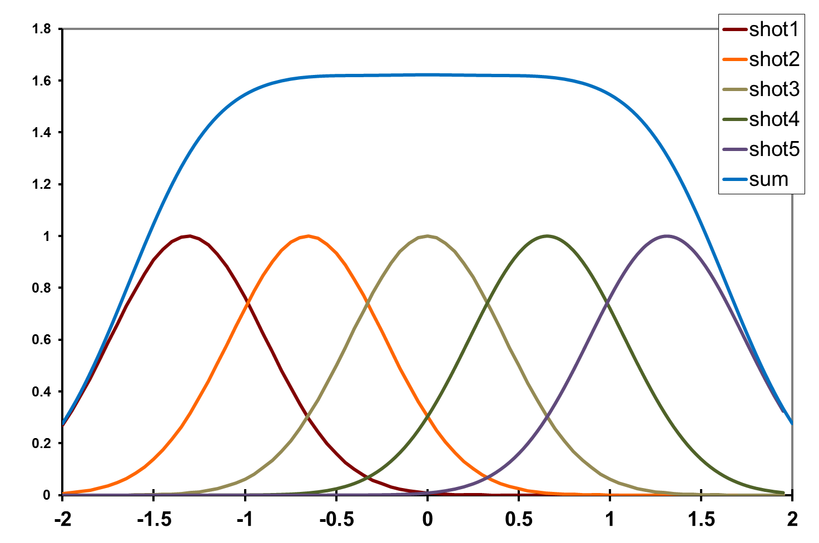
dose flattening: 5 shots
0.656 FWHM
Flux density (x10⁶ ph/µm²)
Position (FWHM)

Slide 27
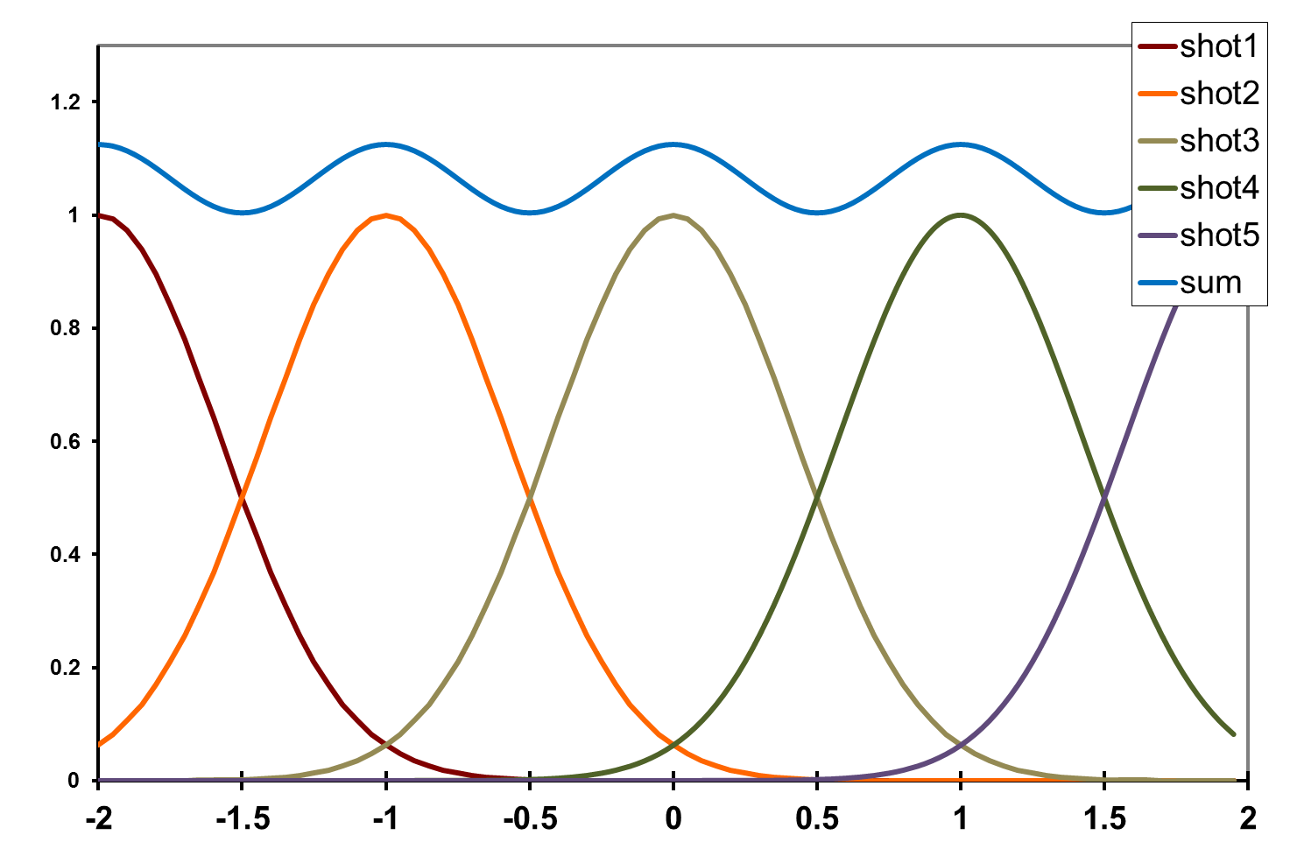
dose flattening: shot train
12%
1.0 FWHM
Flux density (x10⁶ ph/µm²)
Position (FWHM)

Slide 28
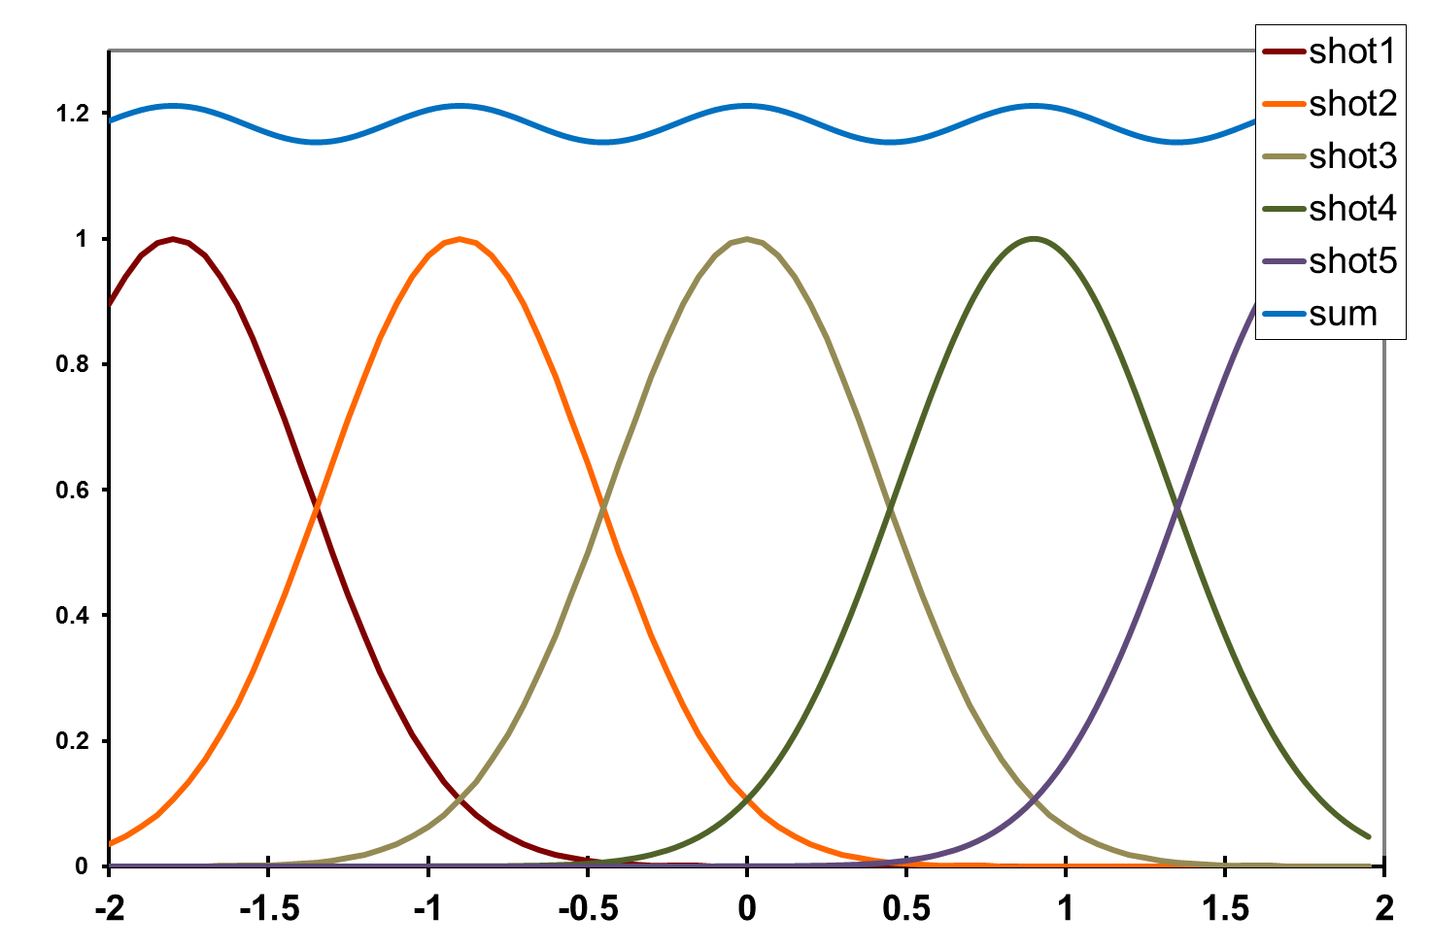
dose flattening: shot train
4.5%
0.9 FWHM
Flux density (x10⁶ ph/µm²)
Position (FWHM)

Slide 29
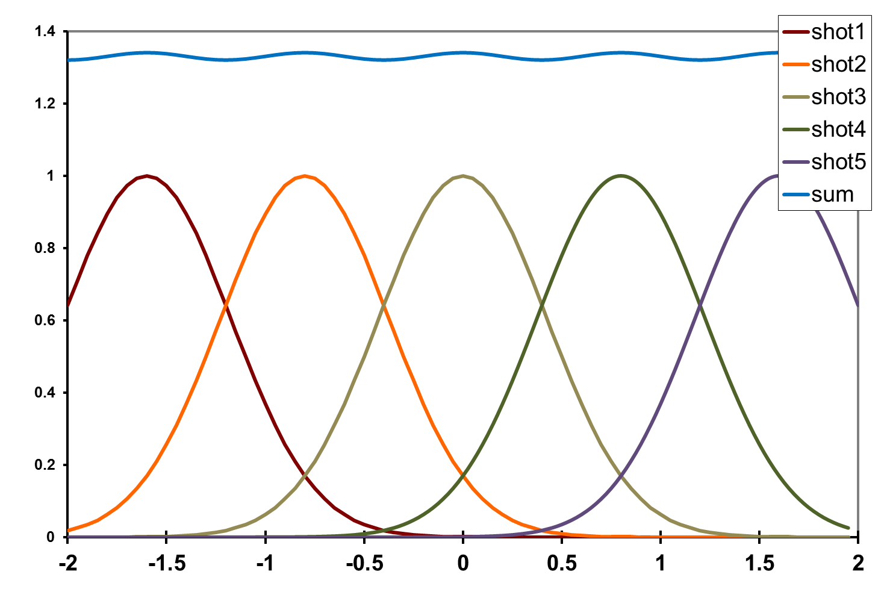
dose flattening: shot train
1.5%
0.8 FWHM
Flux density (x10⁶ ph/µm²)
Position (FWHM)

Slide 30
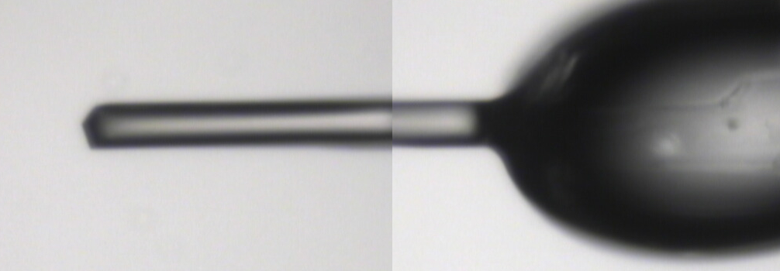
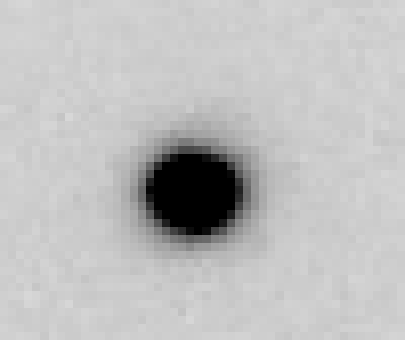
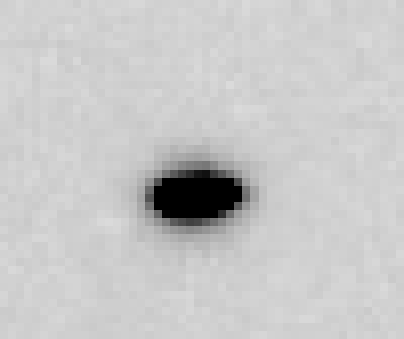
~0 MGy

Slide 31
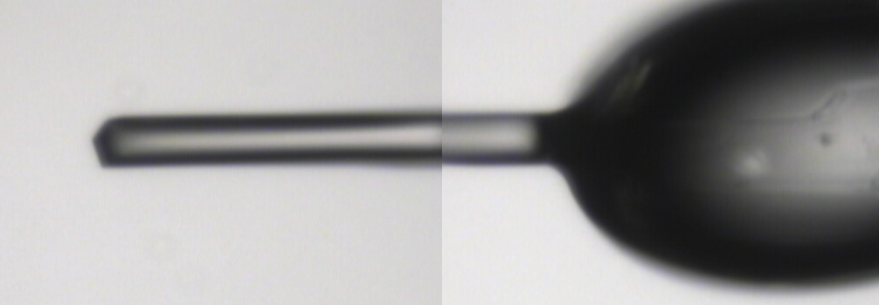
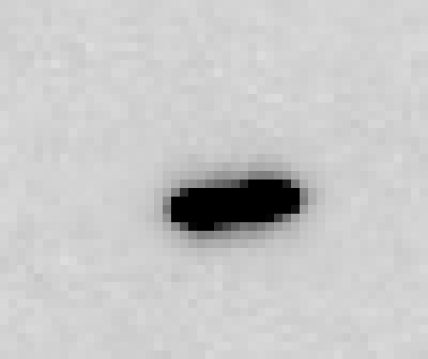
5 MGy

Slide 32
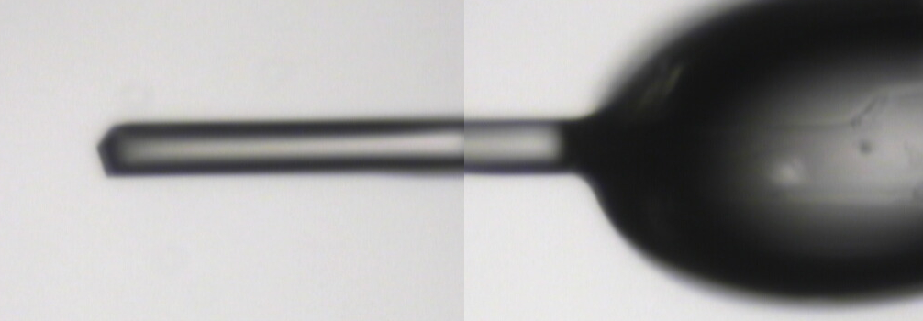
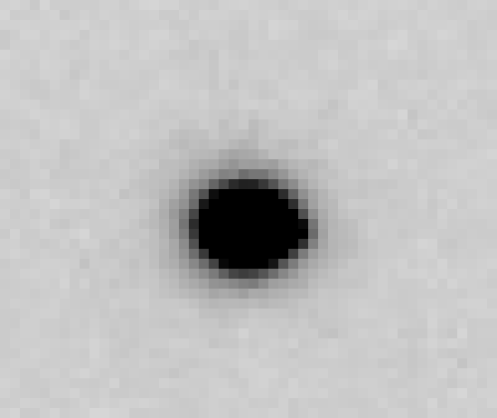
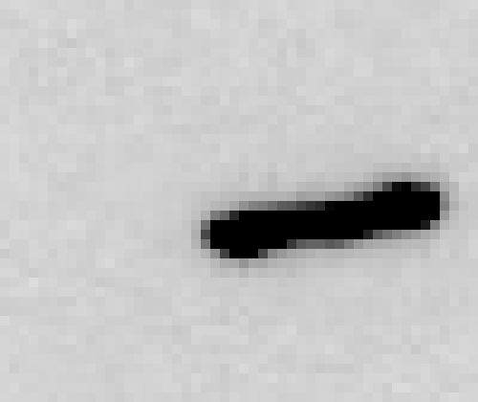
11 MGy

Slide 33
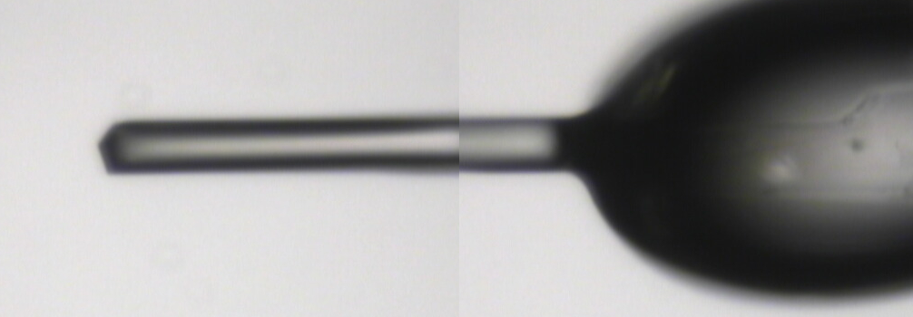
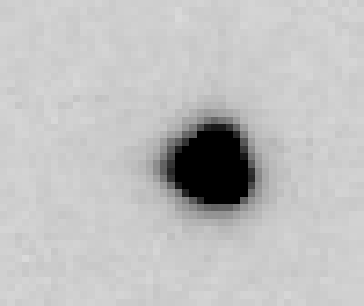
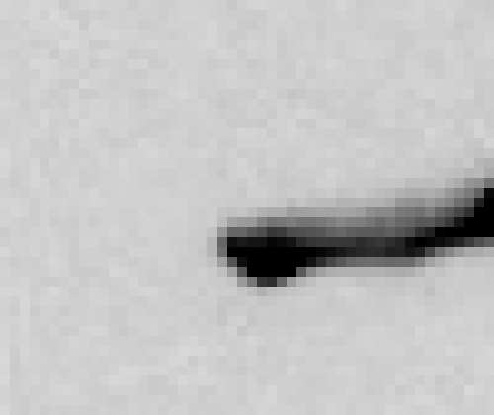
16 MGy

Slide 34
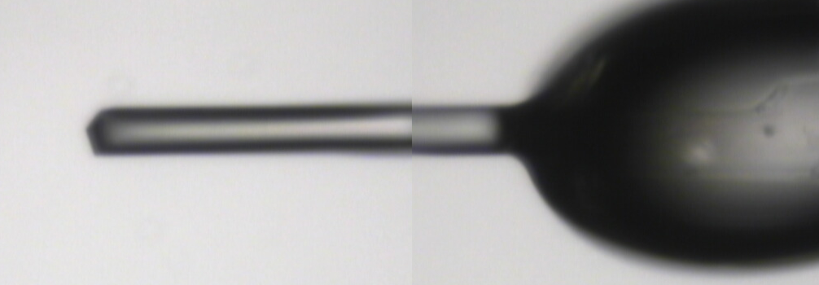
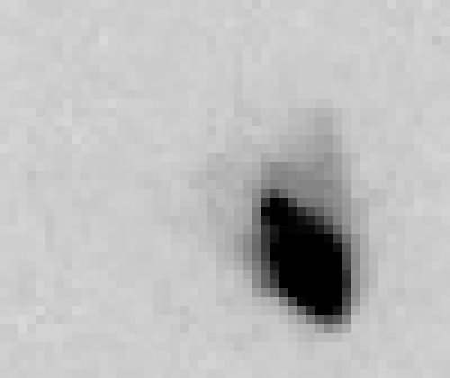
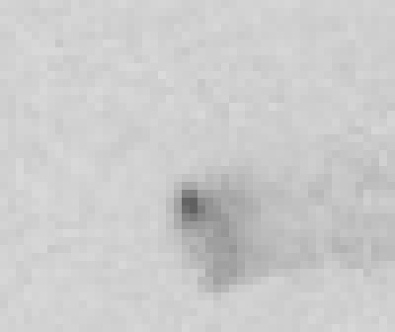
22 MGy

Slide 35
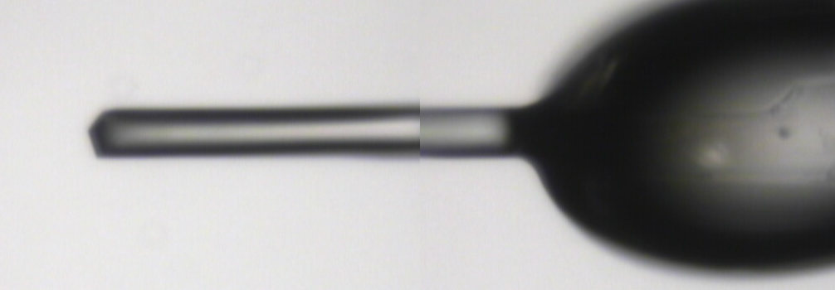
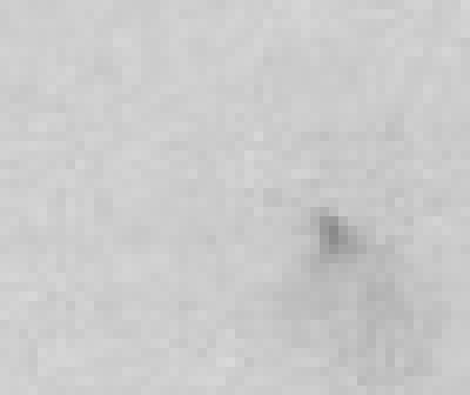
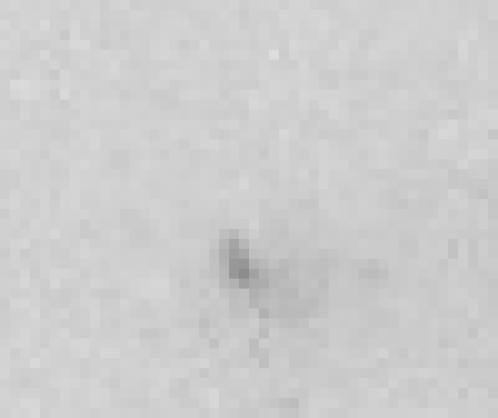
26 MGy

Slide 36
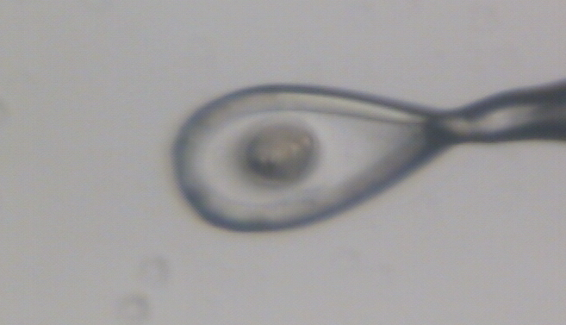
Dose contrast: differential expansion
Protein crystal in sucrose, NaWO4 and oil

Slide 37
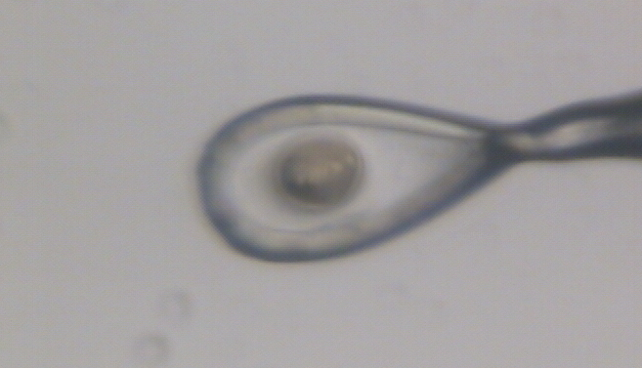
Dose contrast: differential expansion
Protein crystal in sucrose, NaWO4 and oil

Slide 38
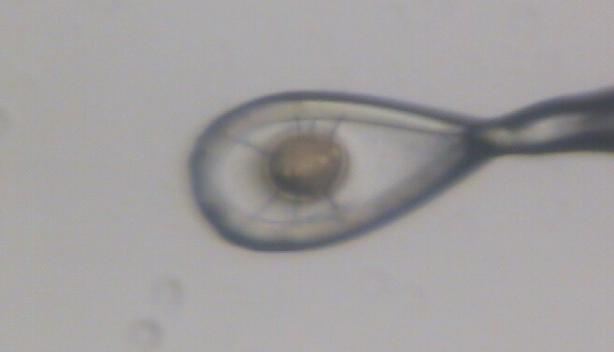
Dose contrast: differential expansion
Protein crystal in sucrose, NaWO4 and oil

Slide 39
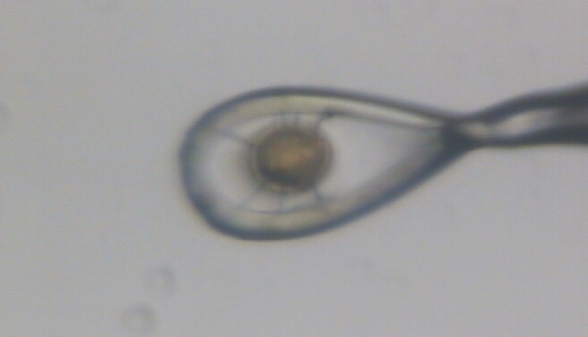
Dose contrast: differential expansion
Protein crystal in sucrose, NaWO4 and oil

Slide 40
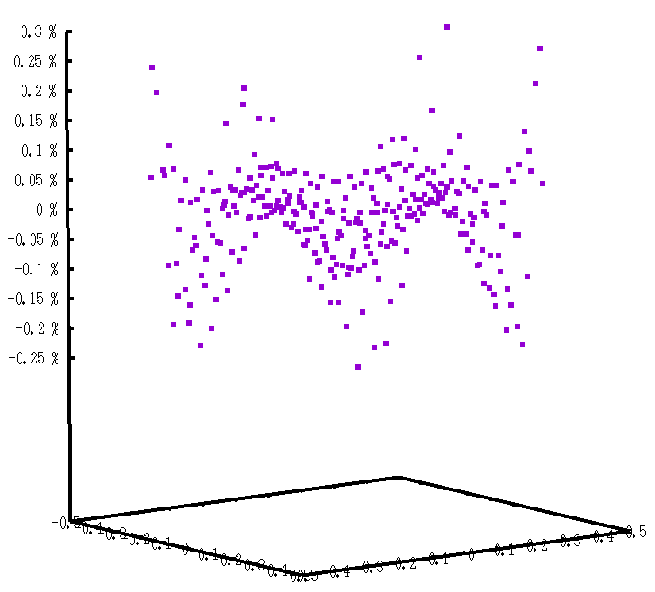
In 2D: hexagonal pattern
Avg dose = 180% peak
0.3%
0.2%
0.1%
0
-0.1%
-0.2%
-0.3%
122%
exposure
0.9 FWHM
Position (FWHM)

Slide 41
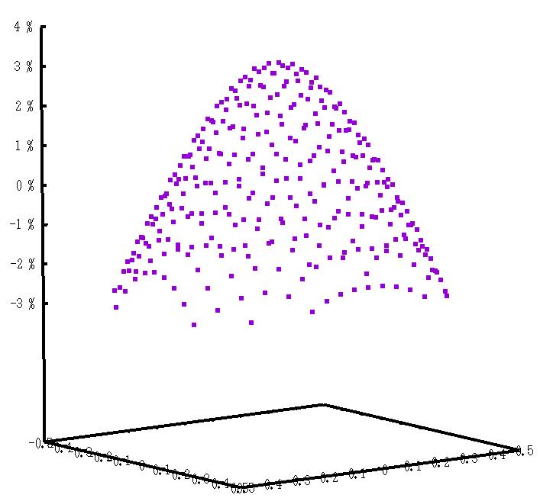
In 2D: hexagonal pattern
Avg dose = 164% peak
3%
2%
1%
0
-1%
-2%
-3%
100%
exposure
0.89 FWHM
Position (FWHM)

Slide 42
In 2D: moving train
Avg dose = 120% +/- 1.5% peak
0.8 FWHM
Position (FWHM)

Slide 43
“rastering” to find the crystal
X-ray beam
ice
Membrane
protein crystal

Slide 44
“rastering” for flat dose

Slide 45
“rastering” for virtual beam

Slide 46
Sample is 3D

Slide 47
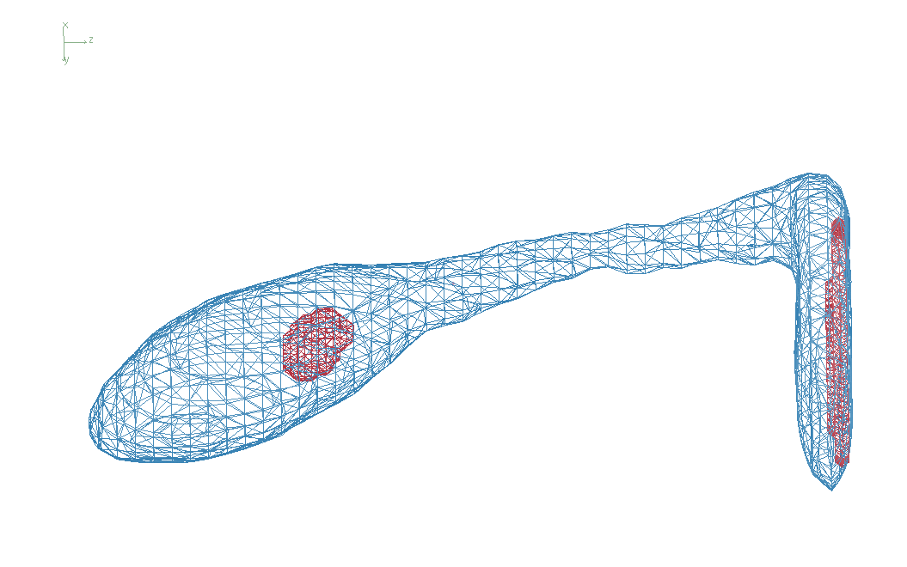
3D mapping of sample

Slide 48
Sample is 3D

Slide 49
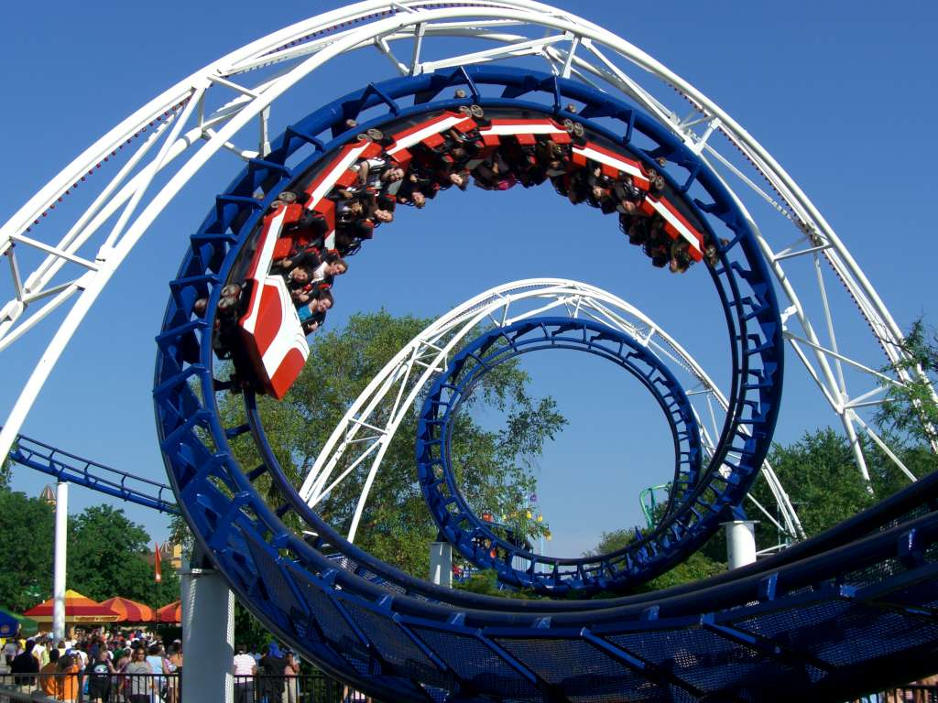
2-motor scans offset data
360°
phi
0°
position

Slide 50
2-motor scans offset data
360°
phi
0°
position

Slide 51
“rastering” for flat dose

Slide 52
How many images?
360° / 0.1° * ( 1000 µm / 1 µm )²
⁼ 3.6x10⁹
28,000 ph/image

Slide 53
The Entropy Limit
bits
s
= log₂(N_{pixels}) * flux * t_{sample} * 1.2x10⁻⁵
minimum data rate with no information loss
N_{pixels} = 4150*4371 for Eiger
flux = photons/s onto the sample
t_{sample} = sample thickness in µm
1.2x10⁻⁵ = 10⁻⁴ cm/µm * cross section of oxygen (0.2 cm²/g)
* density of protein crystal (1.2 g/cm³ )
* ~1/2 of total scattering intersects detector
E.G. 34 GByte/s for 10¹³ photons/s and 100 µm sample

Slide 54
How to loose information
long exposures
  >1 photon/image = order of arrivals
Wide phi slice
  sum over angle
Large beams
  sum over area
Pink/divergent beam
  sum over lambda/angle
Background
  non-crystal stuff
Systematics
  Dose contrast

Slide 55
How long will it take?
Damage & diffraction = flux / area
Gy/s = ph/s /2000 / um²
Example: flux= 10¹² ph/s, 1 mm² beam = 500 Gy/s
100% sample life → 30 MGy / 500 Gy/s = 17 hours
10% sample life → 3 MGy / 500 Gy/s = 1.7 hours
1% sample life → 300 kGy / 500 Gy/s = 10 min
Holton (2009)."beginner's guide rad dam", J. Synch. Rad. 16, 133-142.

Slide 56
The number of photons scattered
before crystal is dead
is independent
of flux & time
1 um³ = 10⁵ photons (roomT)
1 um³ = 10⁶ photons (synch)
1 um³ = 10⁸ photons (XFEL)
(synch)
Henderson, 1990; Gonzalez & Nave, 1994; Glaeser et al., 2000; Sliz et al., 2003; Leiros et al., 2006; Owen et al., 2006; Garman & McSweeney, 2006; Garman & Nave, 2009; Holton, 2009

Slide 57

Dose slicing
low
completeness
N
photons
crystal’s useful life
N
photons
too much
read noise
N
photons

Slide 58
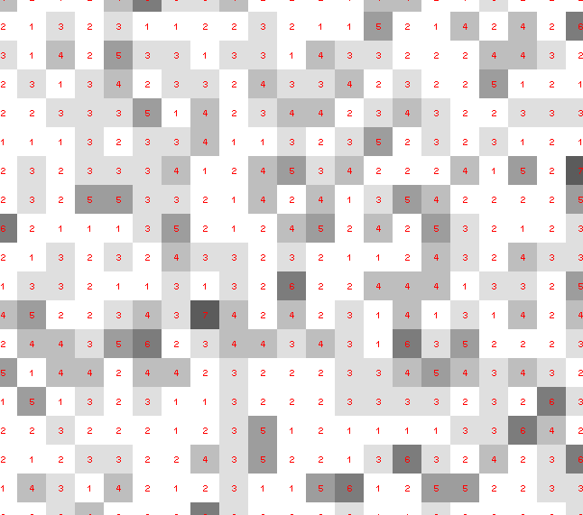
Dose slicing: is that a spot?

Slide 59
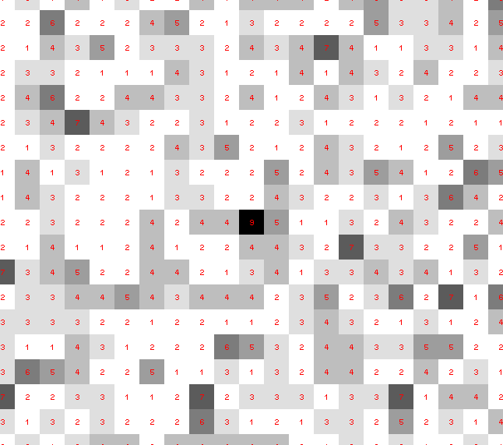
Dose slicing: is that a spot?

Slide 60
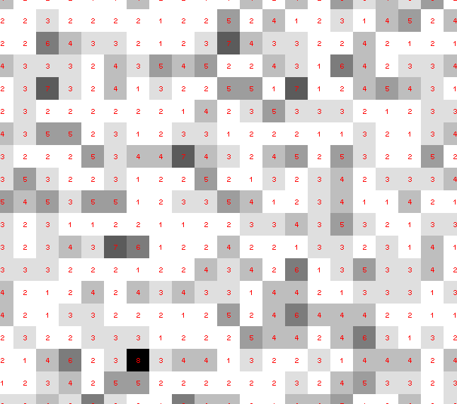
Dose slicing: is that a spot?

Slide 61
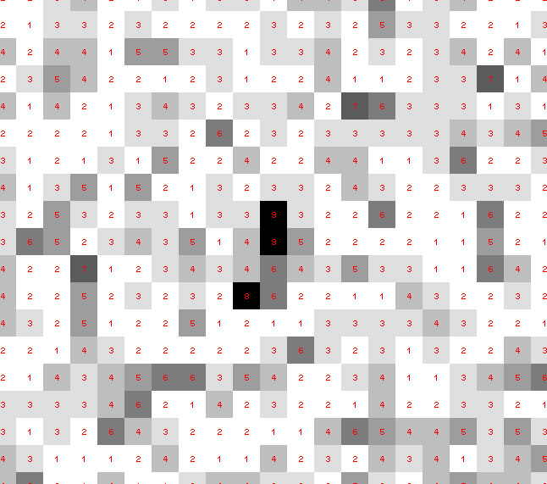
Dose slicing: is that a spot?

Slide 62
Dose slicing: is that a spot?

Slide 63
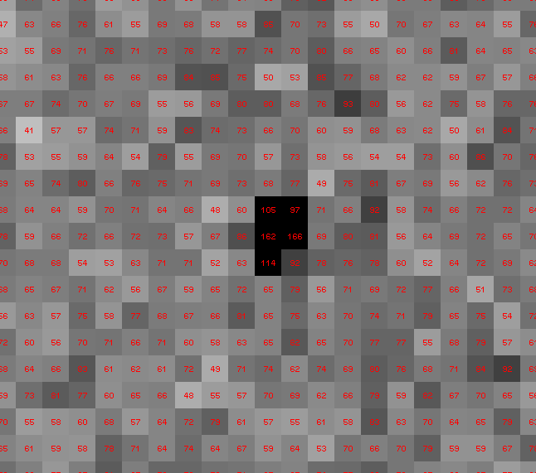
Dose slicing: is that a spot?

Slide 64
What if?
You only have a few small crystals…
Should you:
  Collect 360° from each?
  Collect 10° from each at 36x exposure?
  Glue 36 xtals together, then collect 360° ?

Slide 65
“true” resolution limit
CC vs right answer
Resolution (Å)

Slide 66
“true” resolution vs strategy
Dose slice collection scenario
fine | coarse | glue
3.17700 | 3.14057 | 3.17604
301,640,334 photons/xtal

Slide 67
How to loose information
long exposures
  >1 photon/image = order of arrivals
Wide phi slice
  sum over angle
Large beams
  sum over area
Pink/divergent beam
  sum over lambda/angle
Background
  non-crystal stuff
Systematics
  Dose contrast

Slide 68
Sample is 3D
10 µm
25 µm
1 µm
90°

Slide 69
X-ray scattering “rules”:
Optimum: support thickness = crystal thickness
1 μm crystal ≈ 1 μm water
≈ 1 μm plastic
≈ 0.1 μm glass
≈ 1000 μm air
~ 50 mm He
≈ 370 mm sat water vapor @ 4C

Slide 70
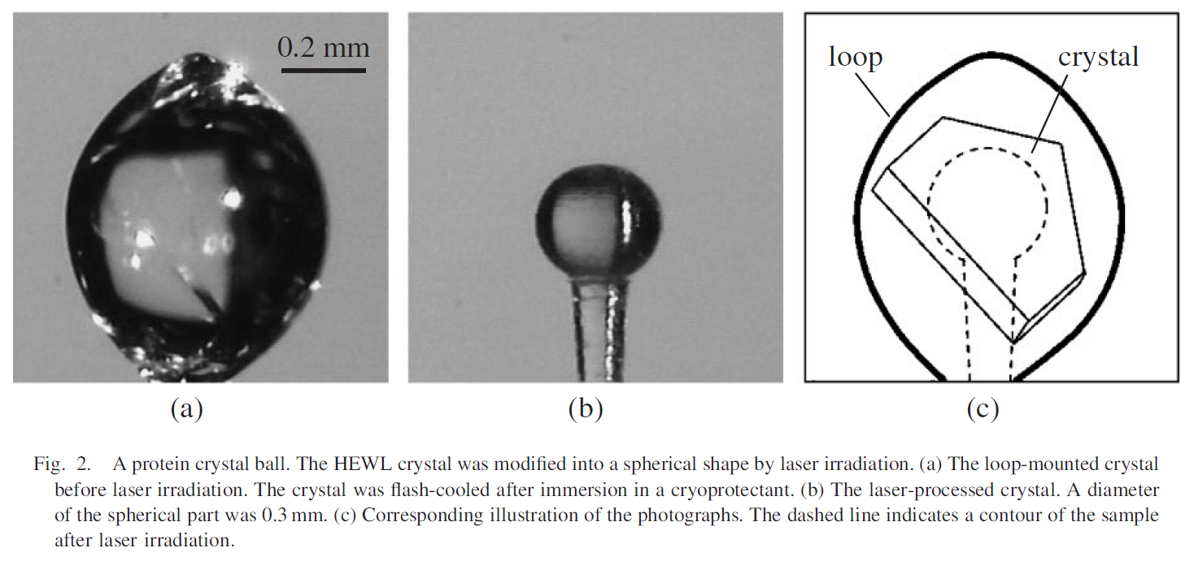
Laser cutting under cryo
Spot diameter: 15 µm
Could be diffraction limited?
Laser details:
193 nm M² < 2
< 1 ns pulse ~1 µJ
1-4 kHz ~70 C temp rise
200-1400 s cutting time
Kitano, H., et al., Protein Cryocrystallography Using Laser-Processed Crystal. Japanese Journal of Applied Physics, 2005. 44: p. L54.

Slide 71
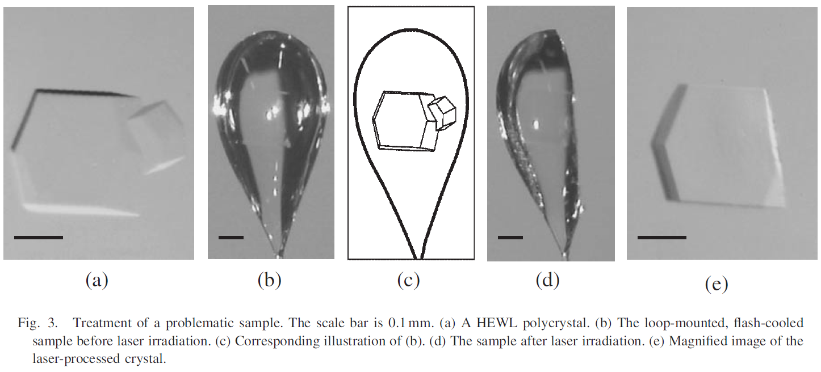
Laser cutting under cryo
Spot diameter: 15 µm
Could be diffraction limited?
Laser details:
193 nm M² < 2
< 1 ns pulse ~1 µJ
1-4 kHz ~70 C temp rise
200-1400 s cutting time
Kitano, H., et al., Protein Cryocrystallography Using Laser-Processed Crystal. Japanese Journal of Applied Physics, 2005. 44: p. L54.

Slide 72
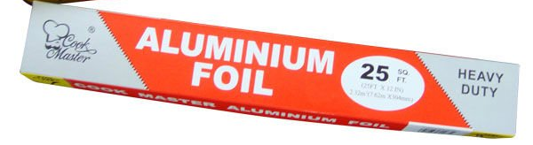
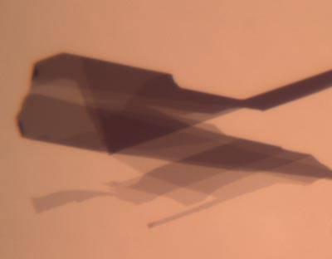
What we really need
Thin
Light
Tight
Cheap
GRAPHENE

Slide 73
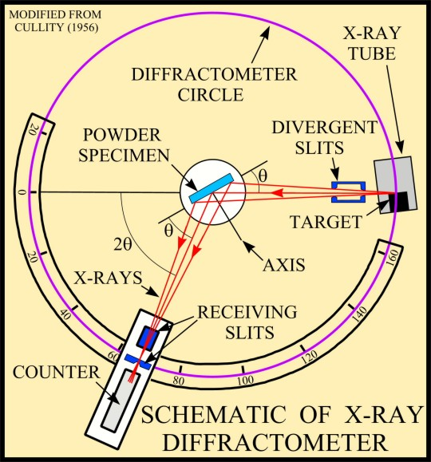
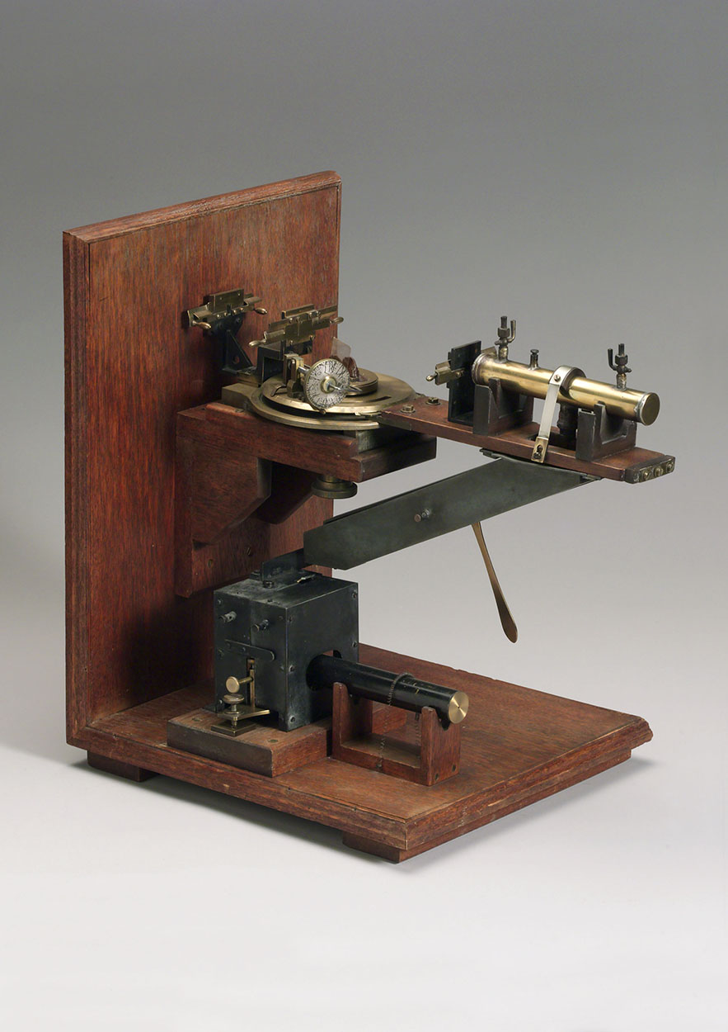
Back to basics? Bragg vs Laue

Slide 74
Diffraction without penetration

Slide 75
Diffraction without penetration
Diamond
($100, reusable)

Slide 76
Diffraction without penetration
oil / plastic
Diamond
($100, reusable)

Slide 77
Diffraction without penetration
oil / plastic
Diamond
($100, reusable)

Slide 78
Diffraction without penetration
oil / plastic
λ=2d sinθ
2.5 Å data
with 5 Å X-rays
Only analytic absorption correction:
International Tables for Crystallography, Vol. C, 2nd ed., chapter 6.3

Slide 79
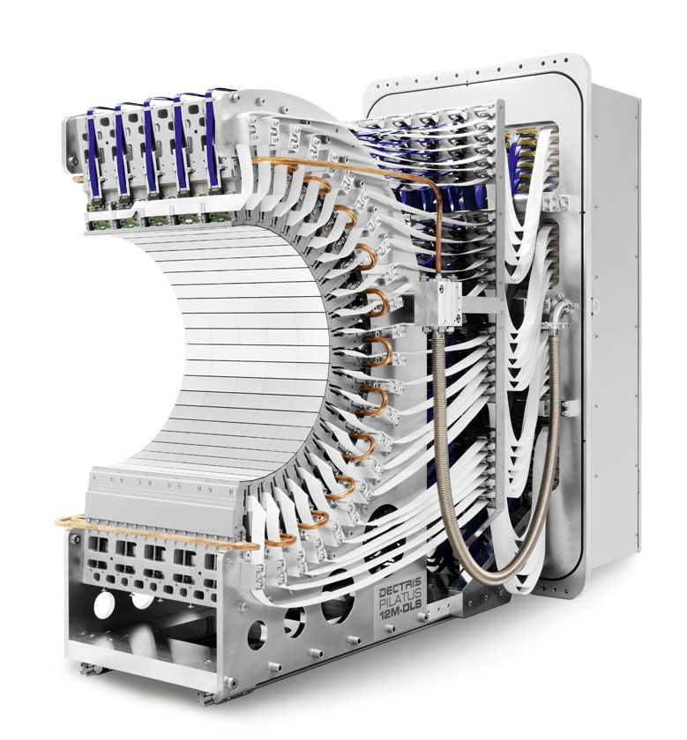
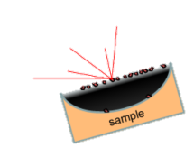
Pilatus 12M Detector
Micro- soft- beamline for native-element phasing
imaging at atomic resolution with elemental contrast

Slide 80
2472.7 2473.5
Anomalous f” (electrons)
Photon Energy (eV)
Bohic et al. Anal. Chem. 2008; 80(24):9557. doi: 10.1021/ac801817k

Slide 81
Summary
http://bl831.als.lbl.gov/~jamesh/powerpoint/
APS-U_painting_2018.pptx
“dose contrast” avoided with flat beams
0.8 FWHM = very flat
data beam can be virtual
Long exposures = lossy compression
10⁶ photons / um³
must reduce background
Back to Bragg for S-MAD ?

Slide 82
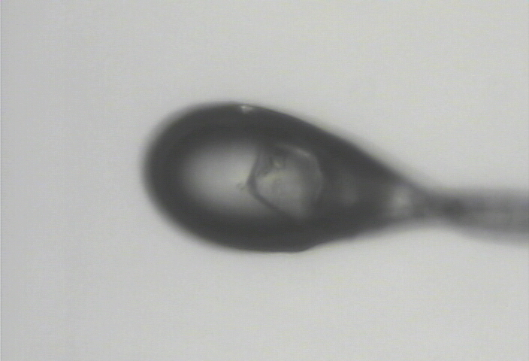
Zero-parallax simplifies alignment
visible light

Slide 83

Zero-parallax simplifies alignment
X-ray

Slide 84



Cone-Beam Online X-ray
Absorption Radiography
(CBOXAR)
3%
2%
1%
0
MX
area
detector
beam center
crystal in loop
Cu foil
X-ray excited
fluorescent
X-ray source
x-ray beam

Slide 85

shoot the whole crystal

Slide 86
shoot the whole crystal

Slide 87
shoot the whole crystal

Slide 88
How many crystals do you see?
Shoot the “crystal” (singular)

Slide 89
Timescales of radiation damage
Garret et. al. (2005) Chem. Rev. 105, 355-389

Slide 90
Timescales of radiation damage
LCLS
ALS
bunch
Garret et. al. (2005) Chem. Rev. 105, 355-389

Slide 91
Ionization track
Heterogeneous reactions
Homogeneous reactions

Slide 92
Rough values of energy quanta
1 MeV 100 GJ/mol Medical radiation therapy
100 keV 10 GJ/mol Medical imaging
10 keV 1 GJ/mol X-ray crystallography
1 keV 100 MJ/mol S and P K-edges
100 eV 10 MJ/mol “water window”
10 eV 1 MJ/mol C≡C bond
1 eV 100 kJ/mol C-C bond, visible light
100 meV 10 kJ/mol hydrogen bond
10 meV 1 kJ/mol heat (~300 K)

Slide 93
Resolution (Å)
too big
too small
just right
X-ray beam size (μm)

Slide 94

Gaussian beam
50% of flux
the other 50%

Slide 95

Collimated beam
100% of flux
0%

Slide 96

shoot nothing but the crystal

Slide 97
shoot nothing but the crystal

Slide 98
shoot nothing but the crystal

Slide 99
PAD full vs partial
2.03 ms
intensity
time

Slide 100
Rastering is robust, but slow
Damage & diffraction = flux / area
Gy/s = ph/s /2000 / um²
Example: 10% life, 1 mm² sample, flux= 10¹² ph/s
10x10 μm beam: 0.6 s
100x100 μm beam: 60s x 10x10 shots =
x 100x100 shots =
1.7 hours
1.7 hours
1% life → 10 min
1% life & 10¹³ ph/s → 1 min
Holton (2009)."beginner's guide rad dam", J. Synch. Rad. 16, 133-142.

Slide 101
Rastering is robust, but slow
Damage & diffraction = flux / area
time/mm² is fixed by flux
Example: ALS 8.3.1 – 200 kGy/s = 15 s for 10% lifedose
50 μm hole: 20x20 shots = 210 s/mm²
30 μm hole: 33x33 shots = 320 s/mm²
10 μm hole: 100x100 shots = 2730 s/mm²
10 μm hole + multilayer: 70 s/mm²
Holton (2009)."beginner's guide rad dam", J. Synch. Rad. 16, 133-142.

Slide 102
Rastering is robust, but slow
Damage & diffraction = flux / area
time/mm² is fixed by flux
Example: ALS 8.3.1 – 200 kGy/s ; 1% lifedose
50 μm hole: 20x20 shots = 21 s/mm²
30 μm hole: 33x33 shots = 32 s/mm²
10 μm hole: 100x100 shots = 273 s/mm²
10 μm hole + multilayer: 7 s/mm²
Holton (2009)."beginner's guide rad dam", J. Synch. Rad. 16, 133-142.

Slide 103
Rastering is robust, but slow
Damage & diffraction = flux / area
time/mm² is fixed by flux
Example: ALS 8.3.1 – 200 kGy/s ; 1% lifedose
50 μm hole: 20x20 shots = 21 s/mm² 20 Hz
30 μm hole: 33x33 shots = 32 s/mm² 35 Hz
10 μm hole: 100x100 shots = 273 s/mm² 37 Hz
10 μm hole + multilayer: 7 s/mm² 2 kHz
Holton (2009)."beginner's guide rad dam", J. Synch. Rad. 16, 133-142.

Slide 104
Photoelectron escape advantage
Complete data set from single xtal
Required crystal diameter (μm)
escape model
None
Simple
MCNP
100 Da 1 kDa 10 kDa 100 kDa 1 MDa 10 MDa
molecular weight
Holton & Frankel (2010)

Slide 105

Water ring shift
saturated sucrose in 250mM WO4

Slide 106
Water ring shift
saturated sucrose in 250mM WO4
0 MGy

Slide 107

Water ring shift
saturated sucrose in 250mM WO4
37 MGy

Slide 108

Water ring shift
saturated sucrose in 250mM WO4
80 MGy

Slide 109

Water ring shift
saturated sucrose in 250mM WO4
184 MGy

Slide 110
Water ring shift
saturated sucrose in 250mM WO4
Photons/s/pixel
∞ 7.5 3.8 2.5 1.9 1.5
Resolution (Ǻ)

Slide 111
Water ring shift
saturated sucrose in 250mM WO4
Photons/s/pixel
∞ 7.5 3.8 2.5 1.9 1.5
Resolution (Ǻ)

Slide 112
Water ring shift
saturated sucrose in 250mM WO4
Photons/s/pixel
∞ 7.5 3.8 2.5 1.9 1.5
Resolution (Ǻ)

Slide 113
Water ring shift
saturated sucrose in 250mM WO4
Photons/s/pixel
∞ 7.5 3.8 2.5 1.9 1.5
Resolution (Ǻ)

Slide 114
Water ring shift
saturated sucrose in 250mM WO4
Photons/s/pixel
∞ 7.5 3.8 2.5 1.9 1.5
Resolution (Ǻ)

Slide 115
Water ring shift
saturated sucrose in 250mM WO4
Water ring position (Ǻ)
Absorbed dose (MGy)

Slide 116

Protein crystal background

Slide 117
Protein crystal background

Slide 118
Water ring shift
GCN4-p1-N16A trigonal crystal
Water ring position (Ǻ)
Absorbed dose (MGy)

Slide 119
Water ring shift
GCN4-p1-N16A trigonal crystal
crystal background
saturated sucrose
Water ring position (Ǻ)
Absorbed dose (MGy)

Slide 120

Water ring shift
bubbles?
Richard D. Leapman, Songquan Sun, Ultramicroscopy (1995)

Slide 121

Water ring shift
Hydrogen bubbles?
Richard D. Leapman, Songquan Sun, Ultramicroscopy (1995)

Slide 122
Water ring shift
GCN4-p1-N16A trigonal crystal
crystal background
saturated sucrose
Water ring position (Ǻ)
Absorbed dose (MGy)

Slide 123

Lattice damage

Slide 124

Macroscopic damage

