Slide 1
Acknowledgements
Robert Stroud James Fraser John Spence
Chris Nielsen Clemens Schulze-Briese Aina Cohen Ana Gonzalez
UCSF LBNL SLAC
ALS 8.3.1 creator: Tom Alber
Center for Structure of Membrane Proteins (CSMP)
Membrane Protein Expression Center II (MPEC)
Center for HIV Accessory and Regulatory Complexes (HARC)
UC Multicampus Research Programs and Initiatives (MRPI)
UCSF Program for Breakthrough Biomedical Research (PBBR) Integrated Diffraction Analysis Technologies (IDAT)
Plexxikon, Inc.
M D Anderson CRC
Synchrotron Radiation Structural Biology Resource (SLAC)
The Advanced Light Source is supported by the Director, Office of Science, Office of Basic Energy Sciences, Materials Sciences Division, of the US Department of Energy under contract No. DE-AC02-05CH11231 at Lawrence Berkeley National Laboratory.

Slide 2
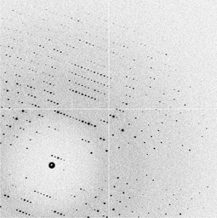
The challenge:
I dare anyone to write an automation program for solving the structure by SAD phasing using only the data in these images: img files tarballs of all of these images are available here: 001 002 003
Don't let the unit cell fool you. This is not lysozyme. This is titin (1g1c), with the unit cell squeezed a bit so that two are exactly the same length. Although the space group is P212121, there will be an indexing ambiguity that you must resolve.
These data are a realistic simulation of the radiation damage situation faced with a lysozyme-sized protein growing ~5 micron crystals and shot with a 6 micron beam.
The exposure time was adjusted to get decent resolution on the first image, but unfortunately, you don't get very many shots before the crystal dies! And once you start trying to scale and merge the data, it gets even worse. The rad dam creates "non-isomorphism" that rapidly becomes unmanageable, despite the fact that the damage model used here is actually a very simple equation

Slide 3
non-isomorphism

Slide 4
non-isomorphism
not same structure thing

Slide 5
Non-isomorphism in lysozyme
Dear James
The story of the two forms of lysozyme crystals goes back to about 1964 when it was found that the diffraction patterns from different crystals could be placed in one of two classes depending on their intensities. This discovery was a big set back at the time and I can remember a lecture title being changed from the 'The structure of lysozyme' to 'The structure of lysozyme two steps forward and one step back'. Thereafter the crystals were screened based on intensities of the (11,11,l) rows to distinguish them (e.g. 11,11,4 > 11,11,5 in one form and vice versa in another). Data were collected only for those that fulfilled the Type II criteria. (These reflections were easy to measure on the linear diffractometer because crystals were mounted to rotate about the diagonal axis). As I recall both Type I and Type II could be found in the same crystallisation batch . Although sometimes the external morphology allowed recognition this was not infallible.
The structure was based on Type II crystals. Later a graduate student Helen Handoll examined Type I. The work, which was in the early days and before refinement programmes, seemed to suggest that the differences lay in the arrangement of water or chloride molecules (Lysozyme was crystallised from NaCl). But the work was never written up. Keith Wilson at one stage was following this up as lysozyme was being used to test data collection strategies but I do not know the outcome.
An account of this is given in International Table Volume F (Rossmann and Arnold edited 2001) p760.
Tony North was much involved in sorting this out and if you wanted more info he would be the person to contact. I hope this is helpful. Do let me know if you need more.
Best wishes
Louise

Slide 6
Non-isomorphism in lysozyme
Structure factor (e⁻)
Johnson’s ratio

Slide 7
Non-isomorphism in lysozyme
Structure factor (e⁻)
Johnson’s ratio

Slide 8
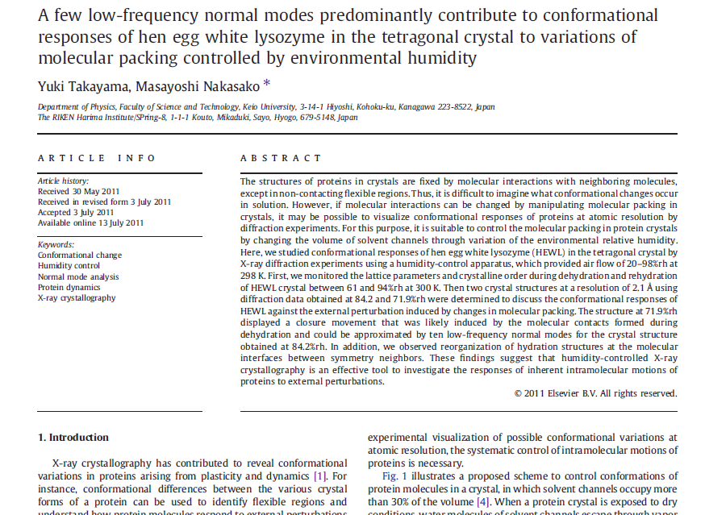

Slide 9
Non-isomorphism in lysozyme
RMSD = 0.18 Å
Δcell = 0.7 %
R_{iso} = 44.5%
3aw6
3aw7
RH: 84.2%
vs 71.9%

Slide 10
Non-isomorphism in lysozyme
RMSD = 0.18 Å
Δcell = 0.7 %
R_{iso} = 44.5%
3aw6
3aw7
RH: 84.2%
vs 71.9%

Slide 11
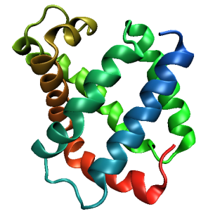
Same structure, different cell
0.5% cell change → 15%
Crick & Magdoff (1956) “theory method isomorphous replacement”, Acta Cryst. 9, 901-8.

Slide 12
Same structure, different cell
0.5% cell change → 15%
Crick & Magdoff (1956) “theory method isomorphous replacement”, Acta Cryst. 9, 901-8.

Slide 13
Same cell, rotated protein
0.5° rotation → 16%
Crick & Magdoff (1956) “theory method isomorphous replacement”, Acta Cryst. 9, 901-8.

Slide 14
Same cell, rotated protein
0.5° rotation → 16%
Crick & Magdoff (1956) “theory method isomorphous replacement”, Acta Cryst. 9, 901-8.

Slide 15
Same cell, shifted protein
0.1 Å shift → 17%
Crick & Magdoff (1956) “theory method isomorphous replacement”, Acta Cryst. 9, 901-8.

Slide 16
Same cell, shifted protein
0.1 Å shift → 17%
Crick & Magdoff (1956) “theory method isomorphous replacement”, Acta Cryst. 9, 901-8.

Slide 17
Uniform stretch
5% change → 0%

Slide 18
Uniform stretch
5% change → 0%

Slide 19
cell angle
0.5° cell angle → 16%
Crick & Magdoff (1956) “theory method isomorphous replacement”, Acta Cryst. 9, 901-8.

Slide 20
cell angle
0.5° cell angle → 16%
Crick & Magdoff (1956) “theory method isomorphous replacement”, Acta Cryst. 9, 901-8.

Slide 21
Δa
ΔΦ
0.5% cell change → 15%
0.5° rotation → 16%
Δx
Δβ
0.1 Å shift → 17%
0.5° cell angle → 16%
Crick & Magdoff (1956) “theory method isomorphous replacement”, Acta Cryst. 9, 901-8.

Slide 22
Magdoff & Crick (1955) “Ribonuclease II. Accuracy of measurement and shrinkage”, Acta Cryst. 8, 461-8.
Crick & Magdoff (1956) “The theory of the method of isomorphous replacement for protein crystals”, Acta Cryst. 9, 901-8.

Slide 23
Non-isomorphism in lysozyme
Dear James
The story of the two forms of lysozyme crystals goes back to about 1964 when it was found that the diffraction patterns from different crystals could be placed in one of two classes depending on their intensities. This discovery was a big set back at the time and I can remember a lecture title being changed from the 'The structure of lysozyme' to 'The structure of lysozyme two steps forward and one step back'. Thereafter the crystals were screened based on intensities of the (11,11,l) rows to distinguish them (e.g. 11,11,4 > 11,11,5 in one form and vice versa in another). Data were collected only for those that fulfilled the Type II criteria. (These reflections were easy to measure on the linear diffractometer because crystals were mounted to rotate about the diagonal axis). As I recall both Type I and Type II could be found in the same crystallisation batch . Although sometimes the external morphology allowed recognition this was not infallible.
The structure was based on Type II crystals. Later a graduate student Helen Handoll examined Type I. The work, which was in the early days and before refinement programmes, seemed to suggest that the differences lay in the arrangement of water or chloride molecules (Lysozyme was crystallised from NaCl). But the work was never written up. Keith Wilson at one stage was following this up as lysozyme was being used to test data collection strategies but I do not know the outcome.
An account of this is given in International Table Volume F (Rossmann and Arnold edited 2001) p760.
Tony North was much involved in sorting this out and if you wanted more info he would be the person to contact. I hope this is helpful. Do let me know if you need more.
Best wishes
Louise

Slide 24
“same drop” ?

Slide 25
Dehydration: 1964 vs 2015?
= 1.5 μL
100 μm
= 1.0 nL
2 mm
= 1.0 pL
10 μm
= 1.0 fL
1 μm

Slide 26
plunge cooling
warm, moist air
ice
cold, dry N₂
liquid N₂
foam insulation

Slide 27
plunge cooling
warm, moist air
ice
cold N₂
liquid N₂
foam insulation

Slide 28
Warkentin method
liquid N₂
foam insulation
Warkentin (2006) J. Appl. Crystallogr. 39, 805-811.

Slide 29
Juers method
Farley (2014) Acta D 70 2111-24. doi: 10.1107/S1399004714012310

Slide 30
Elastic deformation = non-isomorphism

Slide 31
Elastic deformation = non-isomorphism

Slide 32
Plastic deformation = poor diffraction

Slide 33
Plastic deformation = poor diffraction

Slide 34
What if we can’t control it?

Slide 35
Proteins move! Your crystal may be trying to tell you something…
Beernink, Endrizzi, Alber & Schachman (1999). PNAS USA 96, 5388-5393.

Slide 36
X-ray Data Sets
Singular values & vectors
data
set
h,k,l | structure factors (F)
 | #1 | #2 | #3 | #4
5,3,4 | 523.7 | 559.8 | 579.9 | 603.2
5,4,4 | 168.2 | 166.6 | 177.2 | 196.1
5,5,4 | 34.9 | 26.4 | 19.2 | 17.3
6,1,4 | 305.7 | 301.1 | 298.1 | 296.3
6,2,4 | 353.0 | 353.9 | 356.2 | 366.9
6,3,4 | 300.9 | 285.3 | 273.5 | 259.4
6,3,5 | 223.8 | 226.3 | 234.6 | 251.4
… | … | … | … | …
h,k,l | 100% | 17 % | 13 % | 9 %
 | 1st | 2nd | 3rd | 4th
5,3,4 | -1.46 | -0.02 | 1.84 | -0.72
5,4,4 | -0.88 | -0.29 | -0.34 | 0.15
5,5,4 | -0.42 | -0.65 | 1.02 | 1.47
6,1,4 | -0.90 | -0.85 | 1.44 | -0.40
6,2,4 | -1.20 | -0.37 | 0.67 | 0.01
6,3,4 | -0.75 | 0.31 | 0.48 | 0.00
6,3,5 | -0.75 | -0.85 | 0.72 | -0.82
… | … | … | … | …
value
vector
Singular value decomp.
SVD
-0.68
-0.24
0.32 …
CC1
Data sets
Positioned
in
“Correlation
Space”
Correlation
Coefficients
CC1 CC2 CC3
CC2
data set #1
data set #2
data set #3
CC3

Slide 37
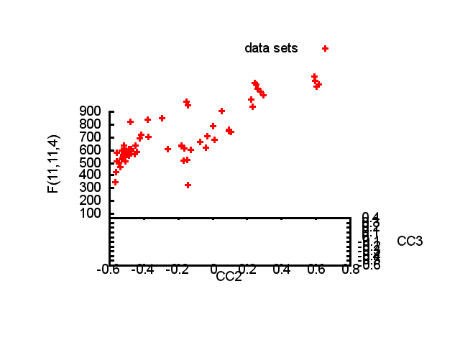

Slide 38
Structure factor (electrons)
Correlation to 2nd & 3rd singular vectors

Slide 39
Structure factor (electrons)
Correlation to 2nd & 3rd singular vectors

Slide 40
Structure factor (electrons)
Correlation to 2nd & 3rd singular vectors

Slide 41
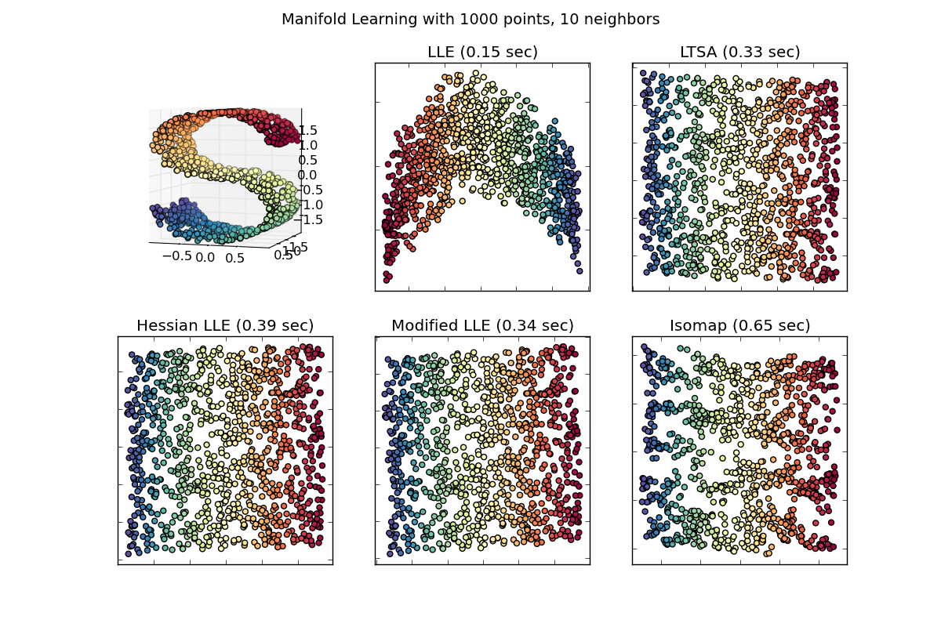
Manifold Embedding: solution for systematics?

Slide 42
What was that about phasing?
Over-sample molecular transform

Slide 43
Inter-Bragg spots over-sample unit cell
Thanks John Spence!

Slide 44
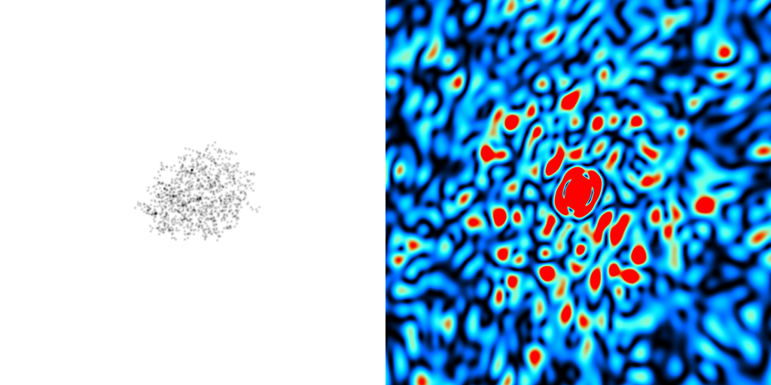
scattering from a crystal structure
False color intensity
sample
detector

Slide 45
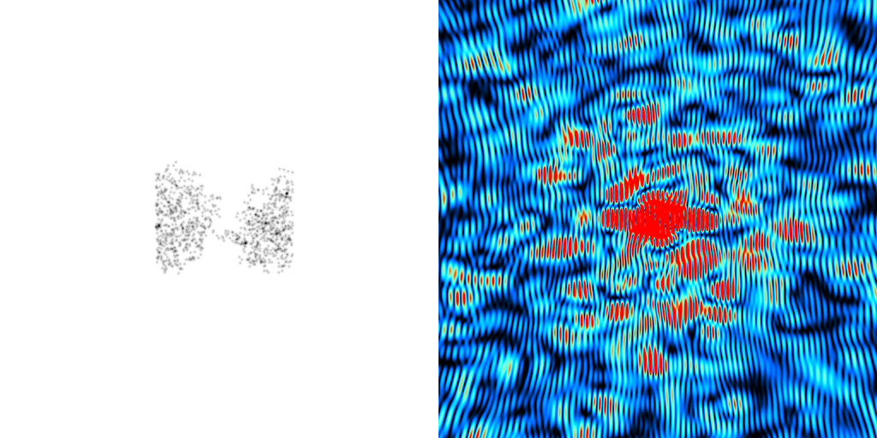
scattering from a crystal structure
False color intensity
sample
detector

Slide 46
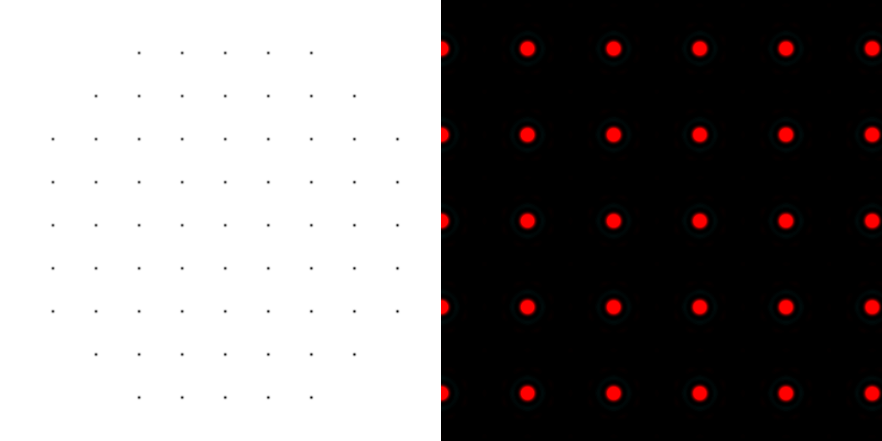
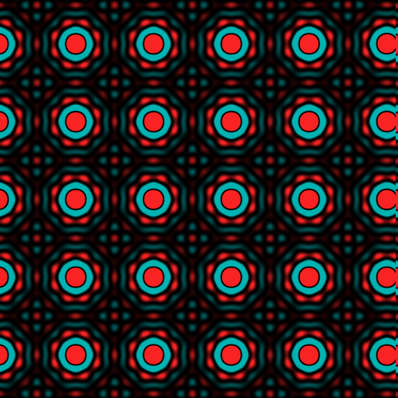
scattering from a lattice
colored by phase
sample
detector

Slide 47
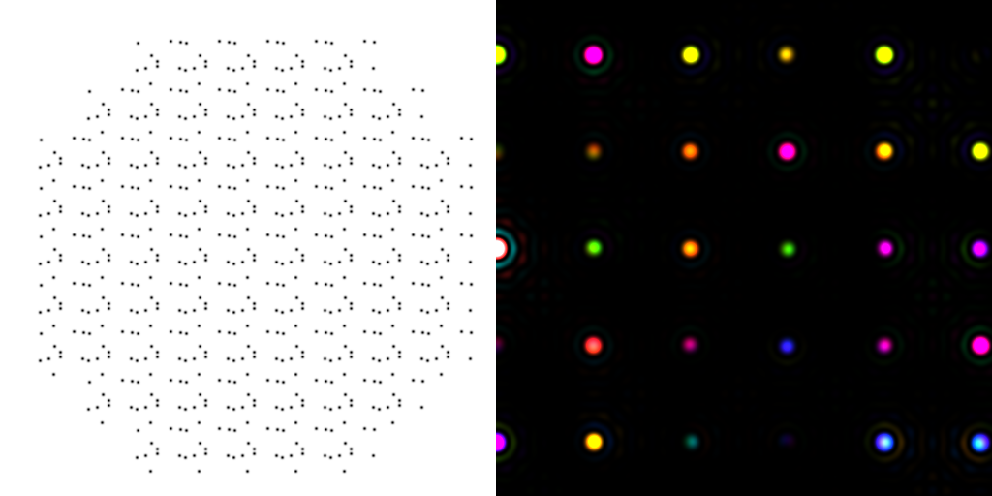
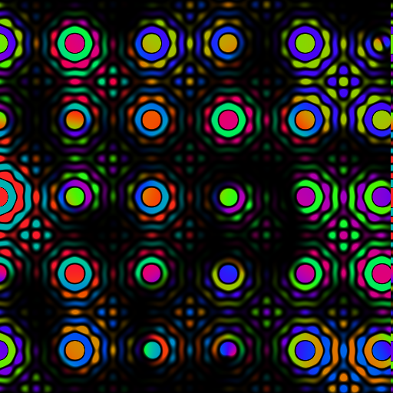
scattering from a crystal structure
colored by phase
sample
detector

Slide 48
scattering from a crystal structure
colored by phase
sample
detector

Slide 49
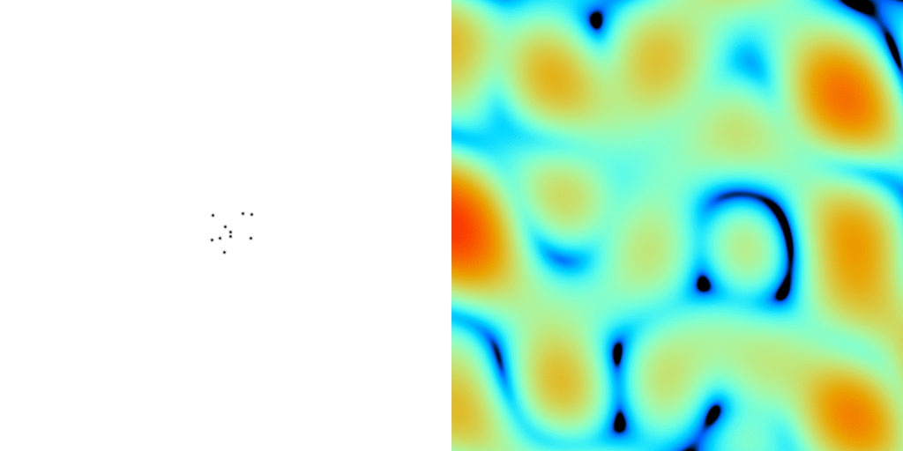
scattering from a crystal structure
False color intensity
sample
detector

Slide 50
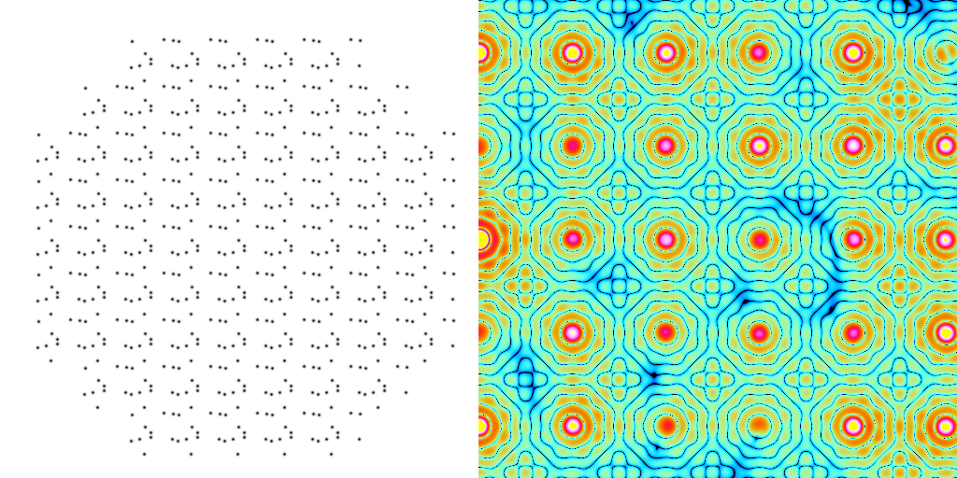
scattering from a crystal structure
False color intensity
sample
detector

Slide 51
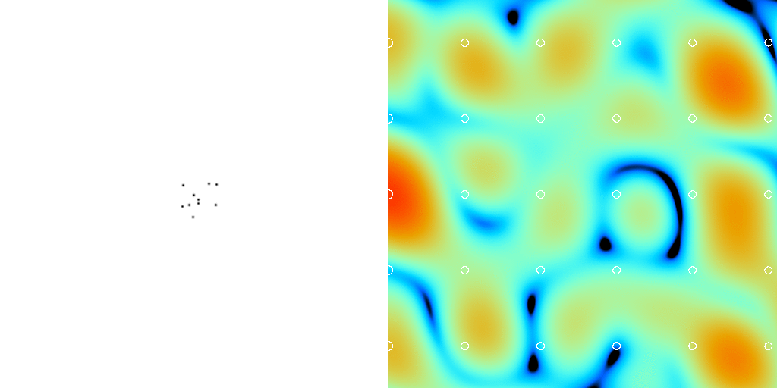
scattering from a crystal structure
False color intensity
sample
detector

Slide 52
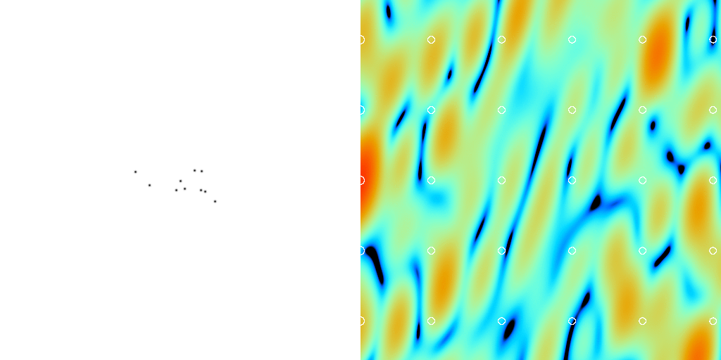
scattering from a crystal structure
False color intensity
sample
detector

Slide 53
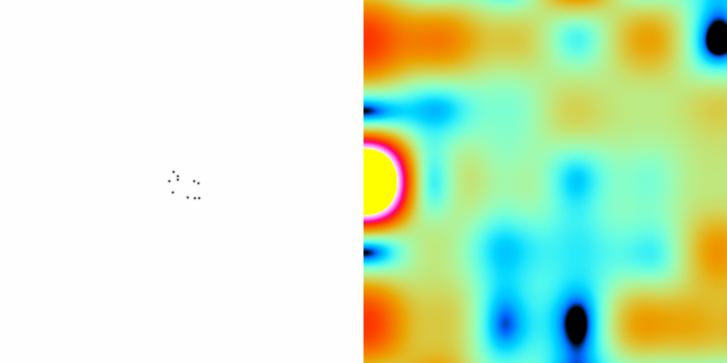
scattering from a crystal structure
False color intensity
sample
detector

Slide 54
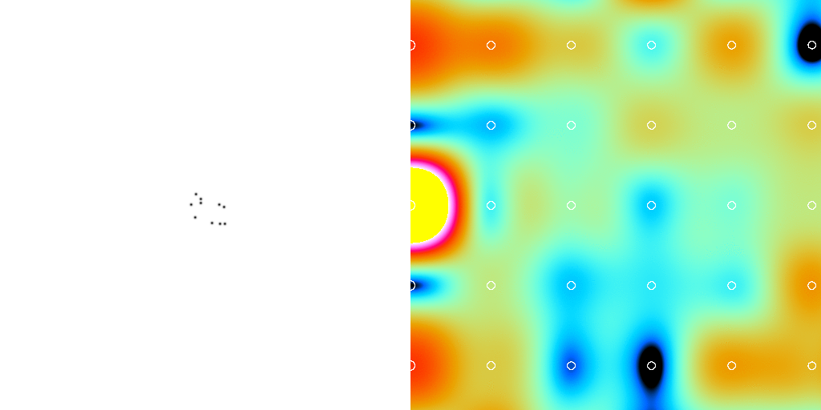
scattering from a crystal structure
False color intensity
sample
detector

Slide 55
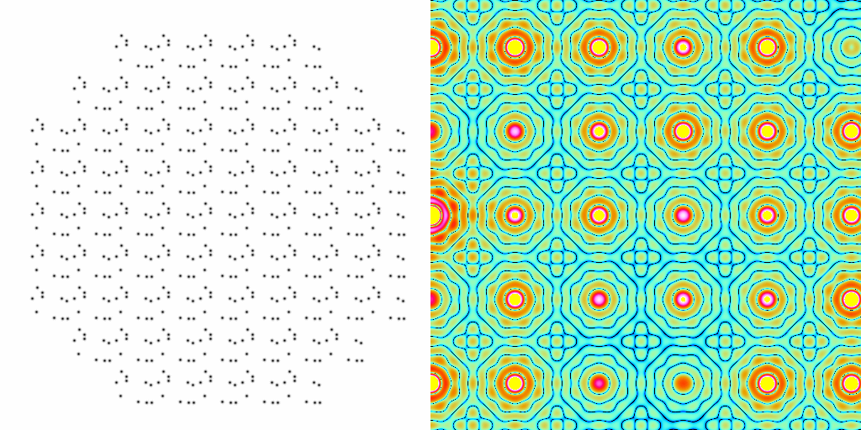
scattering from a crystal structure
False color intensity
sample
detector

Slide 56
Inter-Bragg spots over-sample unit cell?
Thanks John Spence!

Slide 57
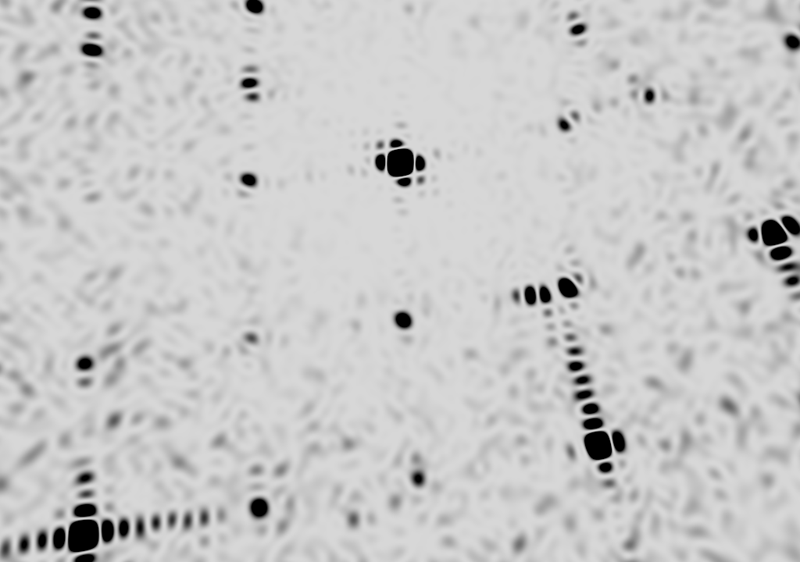
square

Slide 58
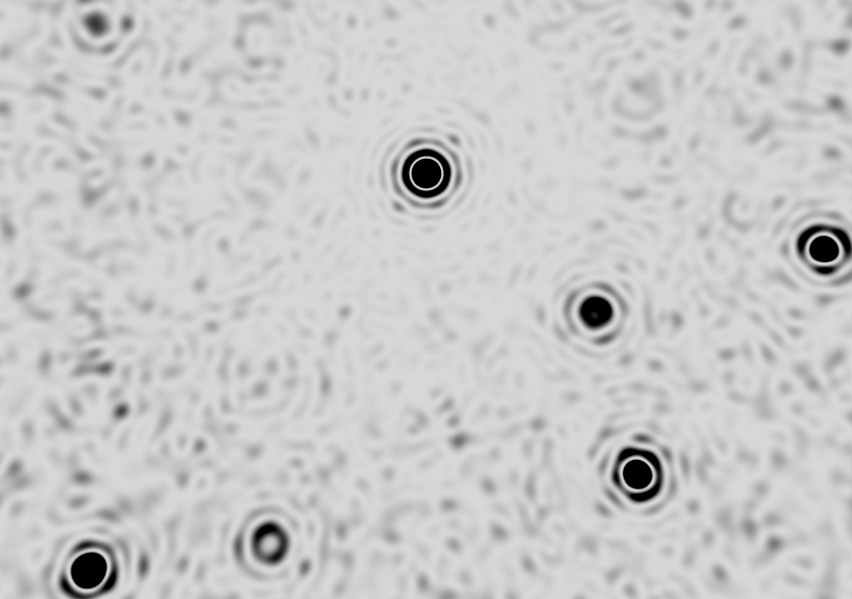
round

Slide 59
What was that about phasing?
How else to access the
molecular transform?

Slide 60
Non-isomorphism in lysozyme
RMSD = 0.18 Å
R_{iso} = 44.5%
3aw6
3aw7

Slide 61
Structure factor (electrons)
Correlation to 2nd & 3rd singular vectors

Slide 62
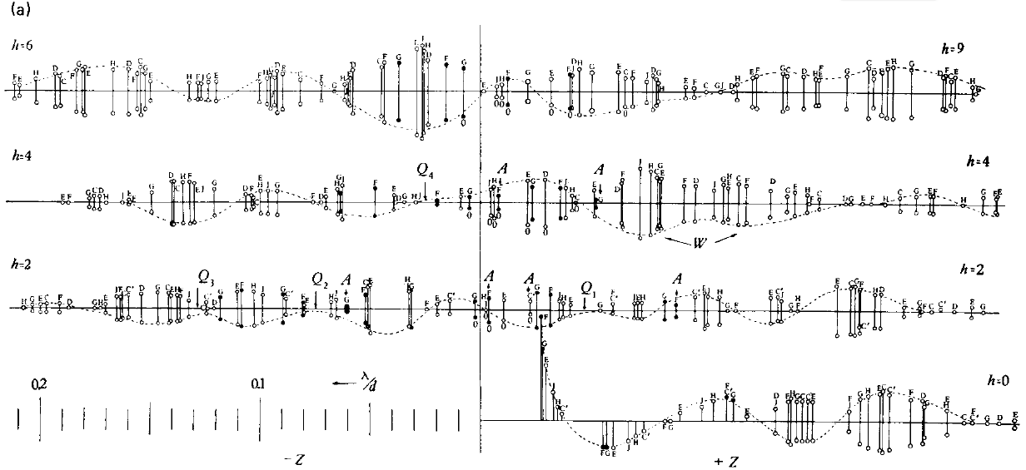
Bragg’s “minimum wavelength principle”
Perutz (1985). “Early Days of Cryst…” Methods in Enzymology, Vol. 114, 3-18.
Bragg & Perutz (1952)."external form haemoglobin I", Acta Cryst. 5, 277-283.

Slide 63
How do you solve the phase problem for macromolecules?
“… by some physical artifice, such as the introduction of a heavy atom, or the observation of intensity changes on dehydration which have not hitherto been carried out in practice."
- J.D. Bernal (1939) “Structure of Proteins”
Nature, 143, 663

Slide 64
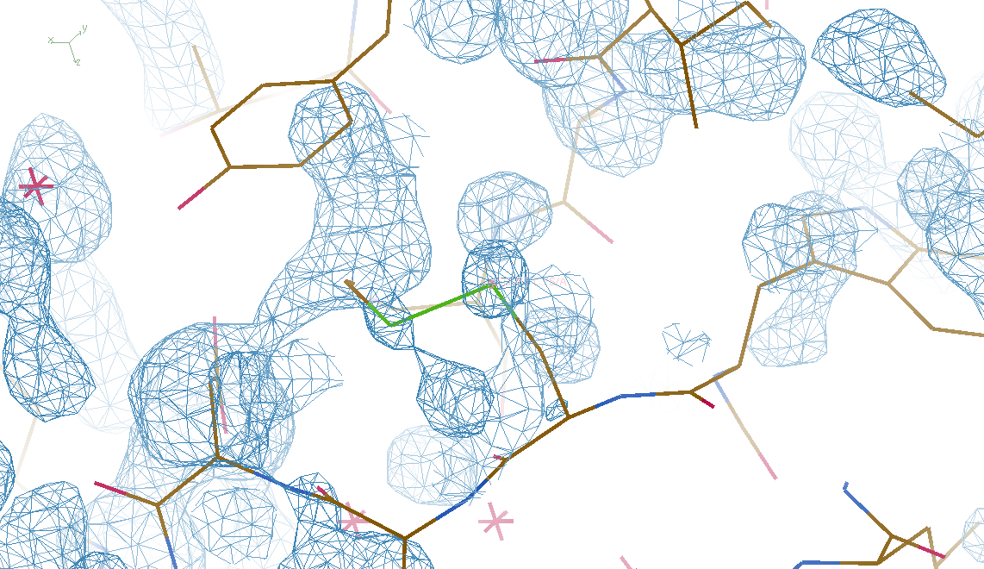
4 deg rotation: 8 “xtals”: before
CC = 0.02

Slide 65
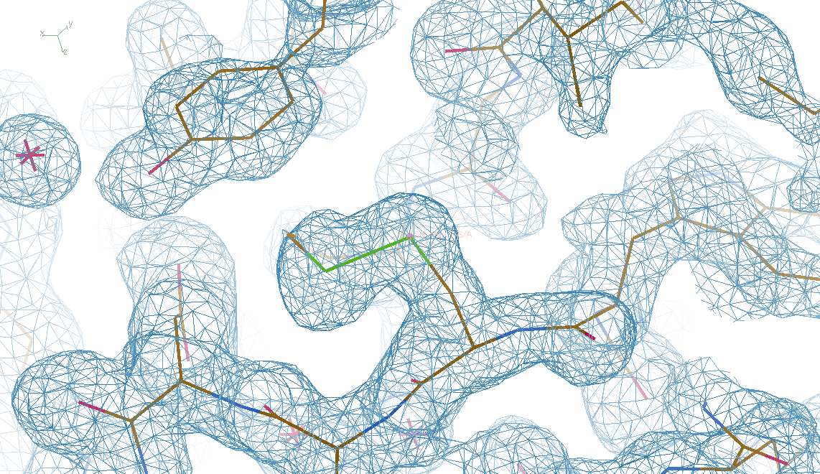
4 deg rotation: 8 “xtals”: after
CC = 0.8

Slide 66
Summary
Careful with dehydration!
SVD instead of avearging
Inter-Bragg stuff = xtal surface
Non-isomorphism as “NCS” phasing?
http://bl831.als.lbl.gov/~jamesh/
challenge/microfocus/
http://bl831.als.lbl.gov/~jamesh/
powerpoint/ALS_UM_multixtal_2015.pptx

Slide 67
Super-cell formalism for diffuse scatter
intensity (F²)
sinθ/λ
Notes:
one cell

Slide 68
Super-cell formalism for diffuse scatter
intensity (F²)
sinθ/λ
Notes:
9 cells

Slide 69
Super-cell formalism for diffuse scatter
intensity (F²)
sinθ/λ
Notes:
supercell

Slide 70
Super-cell formalism for diffuse scatter
intensity (F²)
sinθ/λ
Notes:
supercell with disorder

Slide 71
Super-cell formalism for diffuse scatter
intensity (F²)
sinθ/λ
Notes:
average electron density

Slide 72
Super-cell formalism for diffuse scatter
intensity (F²)
one-cell hkl index

Slide 73
Super-cell formalism for diffuse scatter
intensity (F²)
one-cell hkl index

Slide 74
Super-cell formalism for diffuse scatter
intensity (F²)
one-cell hkl index
Notes:
average cell intensity is relative to “zero”

Slide 75
Super-cell formalism for diffuse scatter
intensity (F²)
one-cell hkl index
Notes:
supercell density gives clue to diffuse scatter, but Bragg peaks are still relative to zero

Slide 76
Super-cell formalism for diffuse scatter
intensity (F²)
one-cell hkl index
Notes:
supercell density gives clue to diffuse scatter, but Bragg peaks are still relative to zero

Slide 77
Super-cell formalism for diffuse scatter
intensity (F²)
“Caspar hole” ???
one-cell hkl index
Notes:
high-angle Brragg peaks have zero intensity and so create “holes” is the background?!

Slide 78
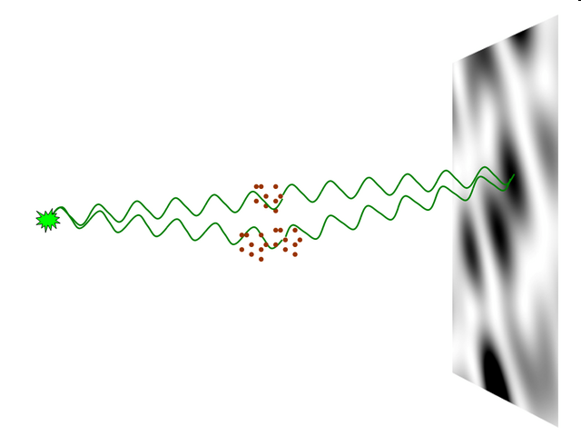
nearBragg program
http://bl831.als.lbl.gov/~jamesh/nearBragg/
“assumption-free” total scattering
no Fourier Transform
no unit cells
no “mosaicity”
arbitrary “atoms”
arbitrary “source”
coherent or not

Slide 79
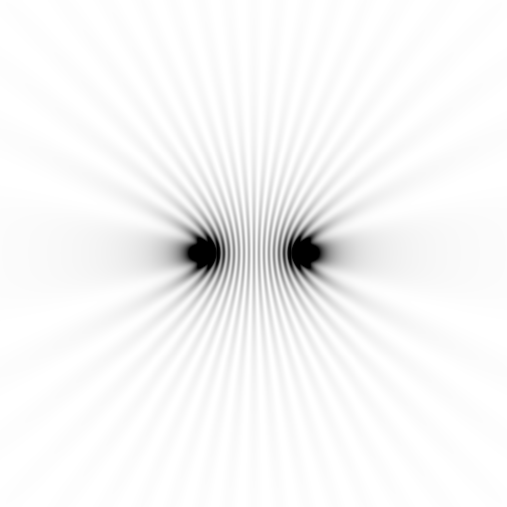
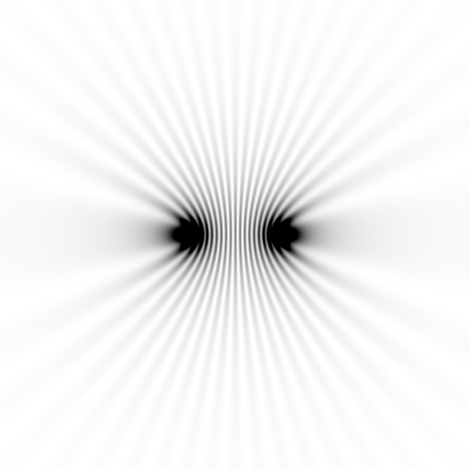
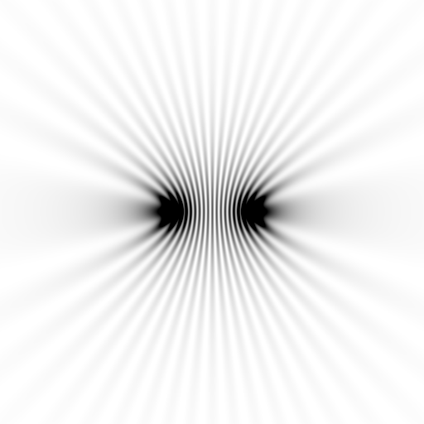
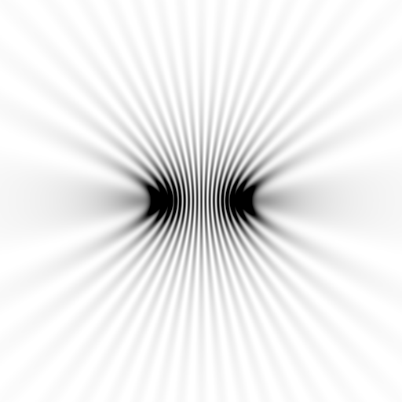
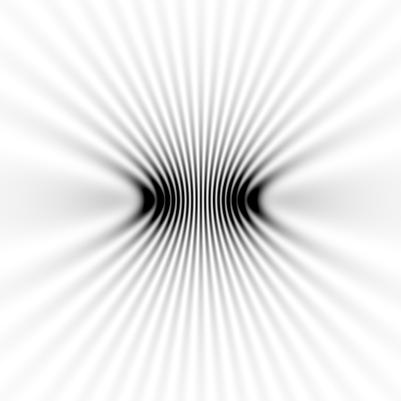
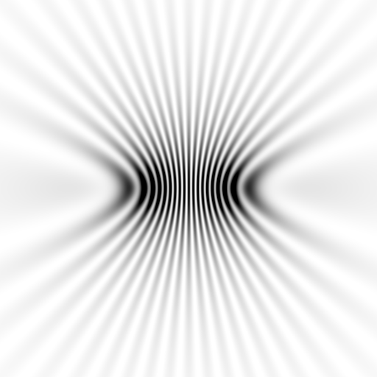
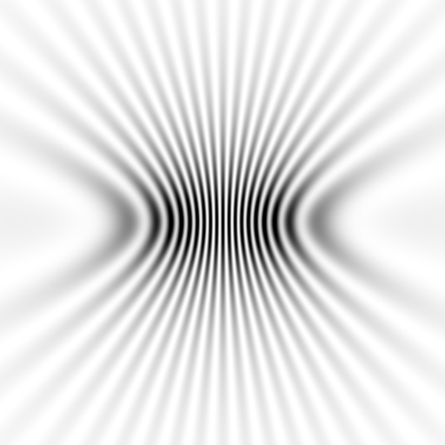
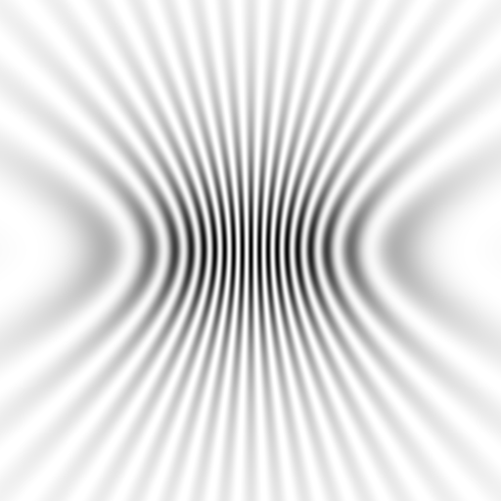
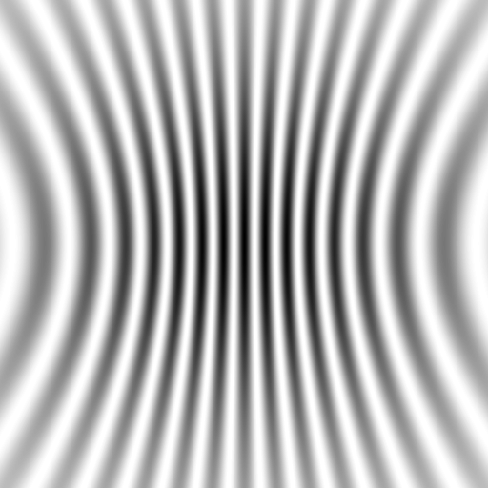
Notes:
to-scale calculation with detector at different distances from a pair of atoms

Slide 80
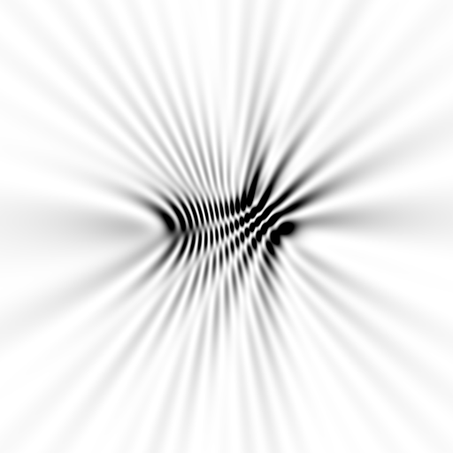
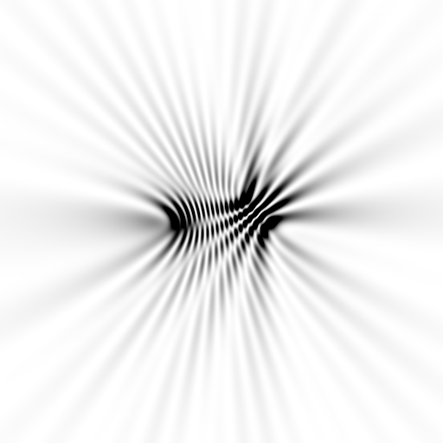
Notes:
to-scale calculation with detector at different distances from a three atoms

Slide 81
average total scattering from points
intensity (relative to one atom)
deviation from Bragg angle
Notes:
when nearBragg is used instead of supercell, the Bragg peaks “ride” on the background and do NOT produce “holes”

Slide 82
fastBragg
http://bl831.als.lbl.gov/~jamesh/fastBragg/
sin(πN·hkl)
I_{pixel} = I_{beam} r_{e}² Ω
P A | F(hkl) |²
sin(π·hkl)

Slide 83
fastBragg program
http://bl831.als.lbl.gov/~jamesh/fastBragg/
Optimized for nanocrystals
Square or round
Takes h,k,l and F
Supports 1 unit cell
no “mosaicity”
arbitrary “source”
arbitrary “phi” steps

Slide 84
fastBragg program
http://bl831.als.lbl.gov/~jamesh/fastBragg/

Slide 85
fastBragg program
http://bl831.als.lbl.gov/~jamesh/fastBragg/

Slide 86
fastBragg program
http://bl831.als.lbl.gov/~jamesh/fastBragg/

Slide 87
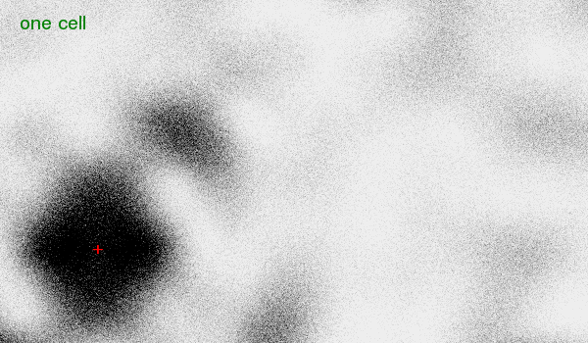
fastBragg program
http://bl831.als.lbl.gov/~jamesh/fastBragg/

Slide 88
fastBragg program
http://bl831.als.lbl.gov/~jamesh/fastBragg/
8x larger

Slide 89
fastBragg program
http://bl831.als.lbl.gov/~jamesh/fastBragg/
64x larger

Slide 90
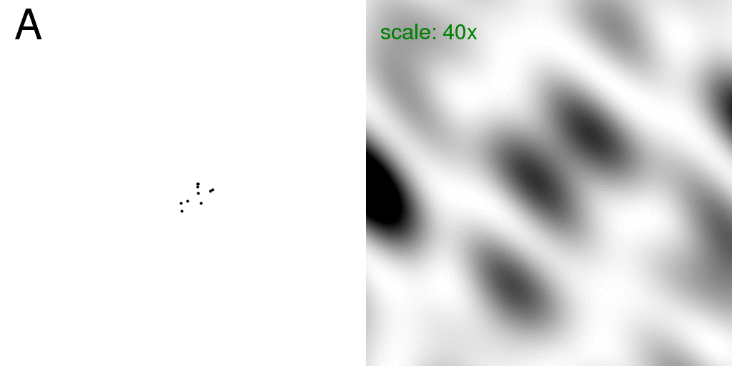
Total scattering from a structure
Move one atom
sample
detector

Slide 91
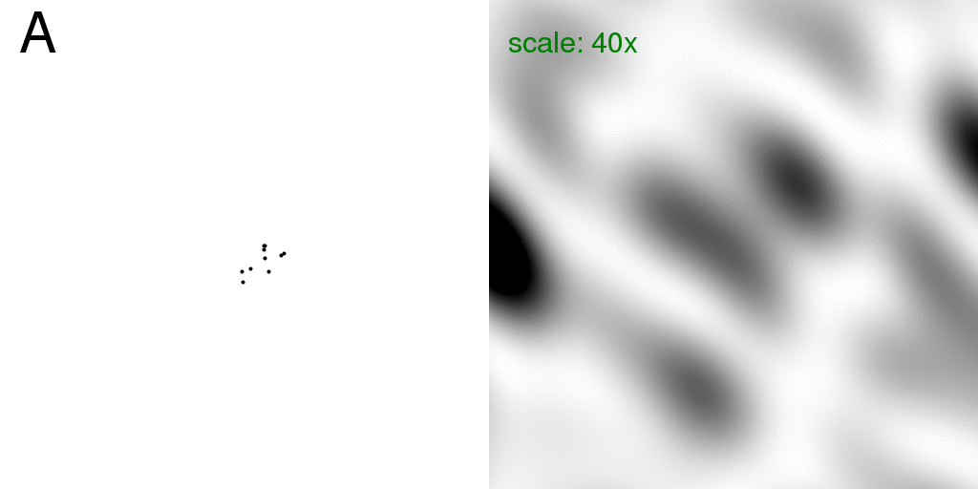
Total scattering from a structure
Intensity sum: F₁²+F₂²
sample
detector

Slide 92
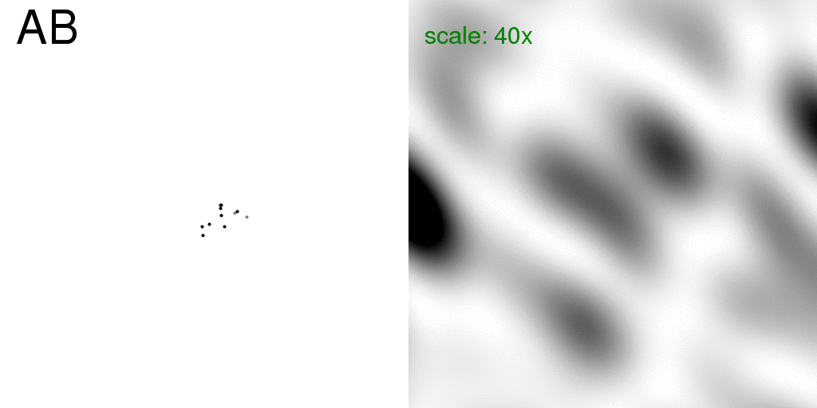
Total scattering from a structure
Coherent sum: (F₁+F₂)²
sample
detector

Slide 93
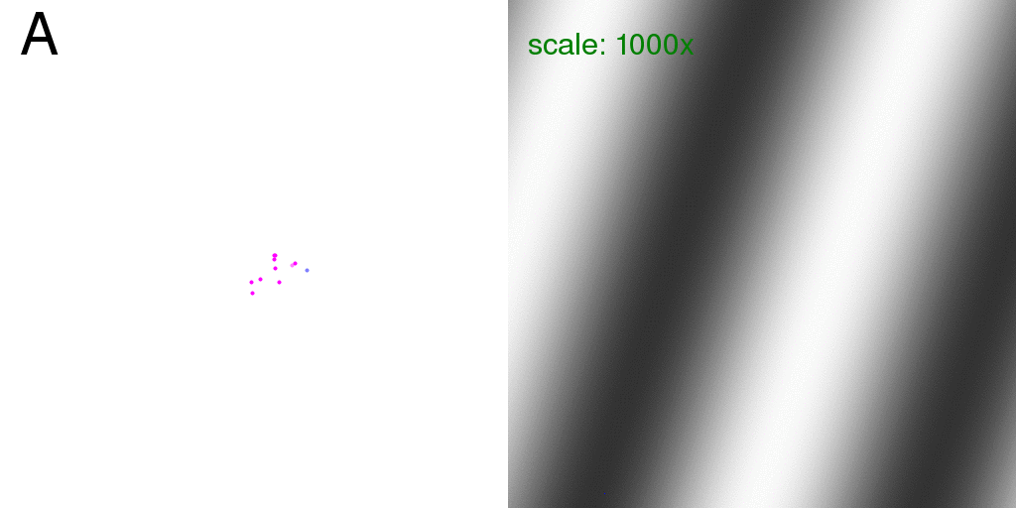
Total scattering from a structure
Incoherent – coherent difference: ( F₁²+F₂²) - (F₁+F₂)²
sample
detector

Slide 94
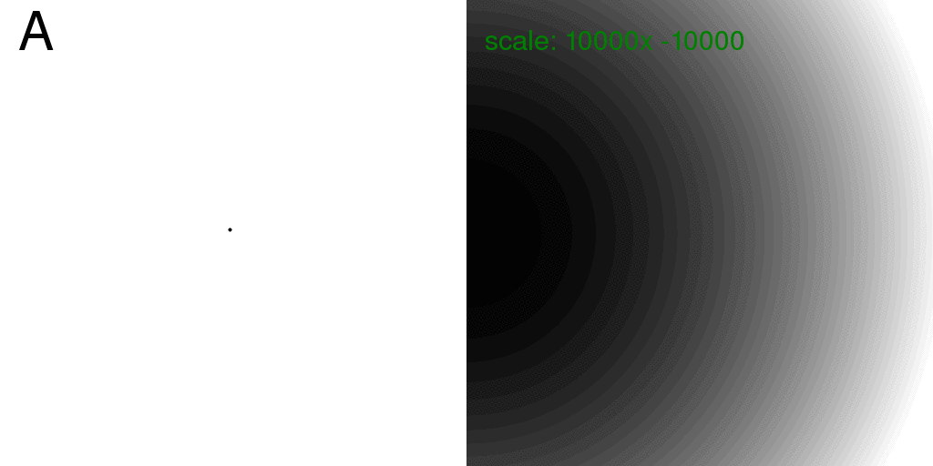
Total scattering from one atom
Intensity sum: F₁²+F₂²
sample
detector

Slide 95
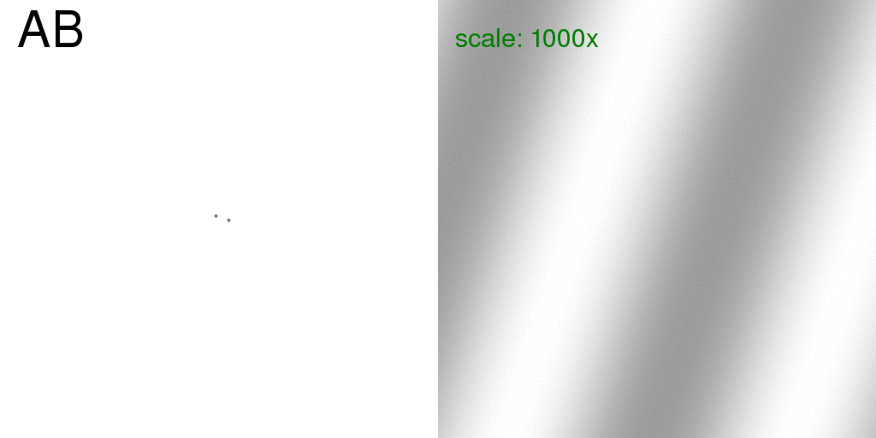
Total scattering from two ½ atoms
Coherent sum: (F₁+F₂)²
sample
detector

Slide 96
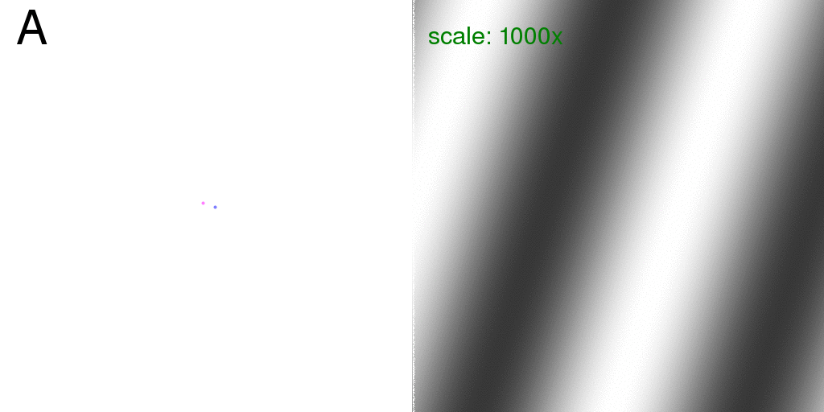
Total scattering from one atom
Incoherent – coherent difference: ( F₁²+F₂²) - (F₁+F₂)²
sample
detector

Slide 97
Total scattering from a structure
Incoherent – coherent difference: ( F₁²+F₂²) - (F₁+F₂)²
sample
detector

Slide 98
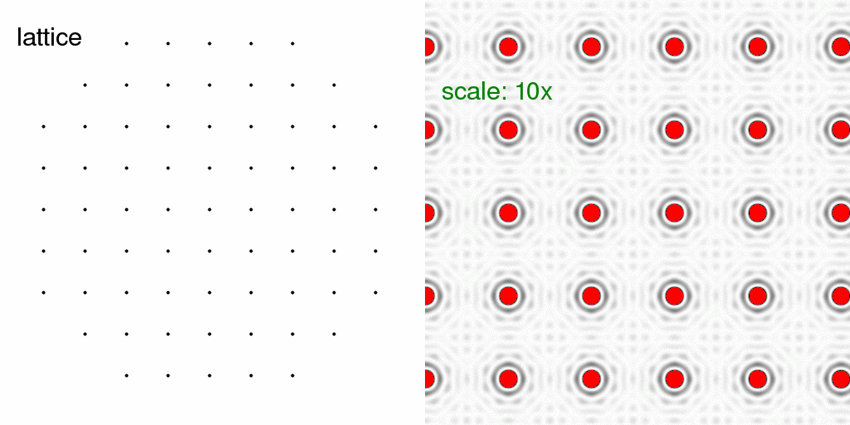
Total scattering from a lattice
Intensity sum: F₁²+F₂²
sample
detector

Slide 99
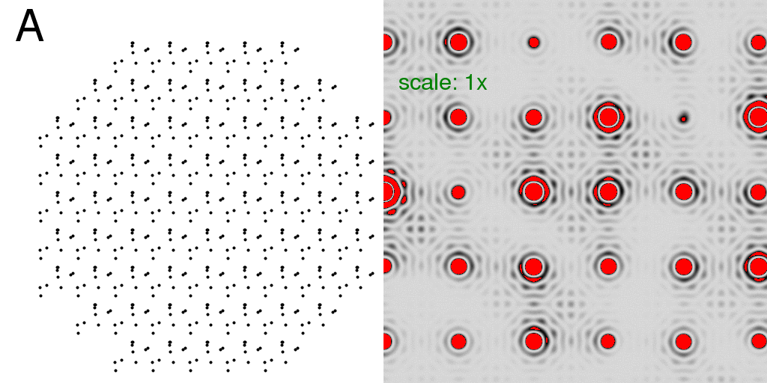
Total scattering from a crystal
Intensity sum: F₁²+F₂²
sample
detector

Slide 100
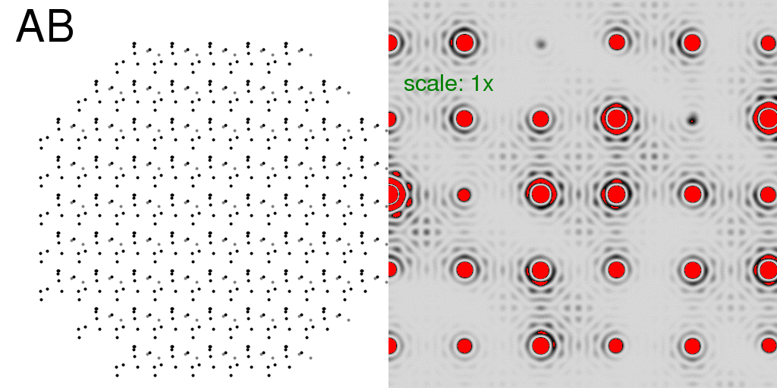
Total scattering from a crystal
Coherent sum: (F₁+F₂)²
sample
detector

Slide 101
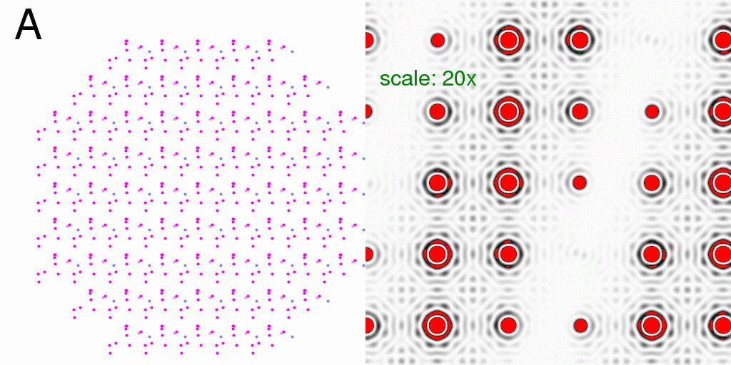
Total scattering from a crystal
Incoherent – coherent difference: ( F₁²+F₂²) - (F₁+F₂)²
sample
detector

Slide 102
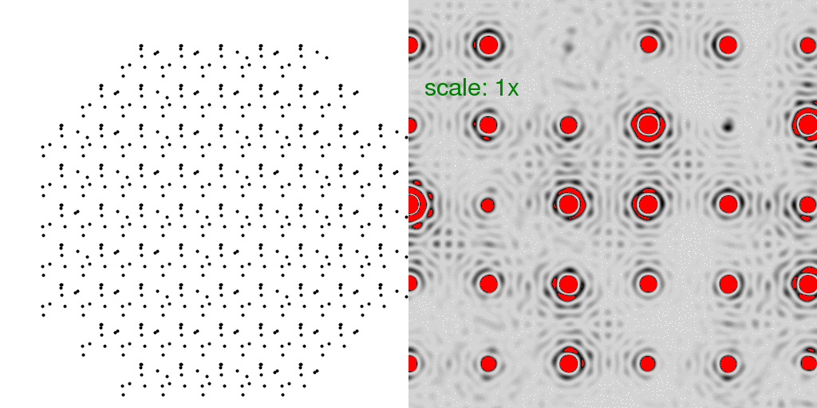
Total scattering from a crystal
Intensity: random fluctuations
sample
detector

Slide 103
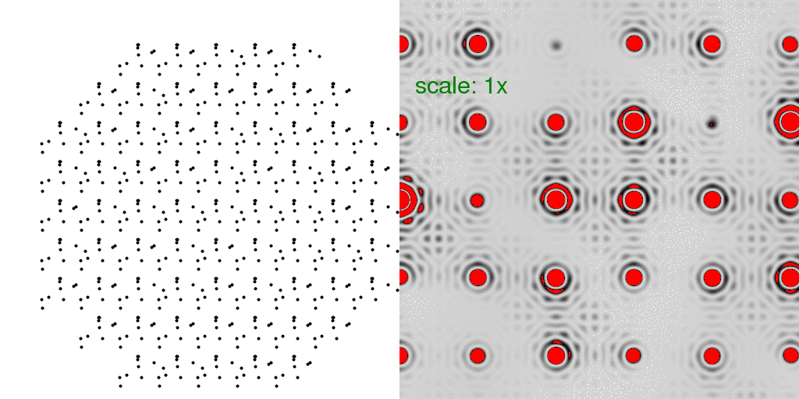
Total scattering from a crystal
Intensity sum: F₁²+F₂²+F₃²+F₄²+ …
sample
detector

Slide 104
Total scattering from a crystal
Random fluctuations - Coherent average
sample
detector

Slide 105
Total scattering from a crystal
Incoherent-coherent difference:
(F₁²+F₂²+F₃²+F₄²+ …) - (F₁+F₂+F₃+F₄+ …)²
sample
detector

Slide 106
Total scattering from one atom
Incoherent – coherent difference: ( F₁²+F₂²) - (F₁+F₂)²
sample
detector

Slide 107
Total scattering from a crystal
“Dilatation” movements
sample
detector

Slide 108
Total scattering from a crystal
Incoherent-coherent difference:
(F₁²+F₂²+F₃²+F₄²+ …) - (F₁+F₂+F₃+F₄+ …)²
sample
detector

Slide 109
Simulation: but can you use it?
http://bl831.als.lbl.gov/example_data_sets/Illuin/lyso_DS

