Slide 1
Acknowledgements
Robert Stroud James Fraser Paul Adams John Tainer
Chris Nielsen Clemens Schulze-Briese Aina Cohen Ana Gonzalez
UCSF LBNL SLAC
ALS 8.3.1: TomAlberTron
UC Multicampus Research Programs and Initiatives (MRPI)
NIH NIGMS R01 GM124149
NIH NIGMS P30 GM124169
Integrated Diffraction Analysis Technologies (IDAT)
Plexxikon, Inc.
Synchrotron Radiation Structural Biology Resource (SLAC)
The Advanced Light Source is supported by the Director, Office of Science, Office of Basic Energy Sciences, Materials Sciences Division, of the US Department of Energy under contract No. DE-AC02-05CH11231 at Lawrence Berkeley National Laboratory.

Slide 2
Protein Crystallography
Scattering in structural biology

Slide 3
Protein Crystallography
Scattering in structural biology

Slide 4
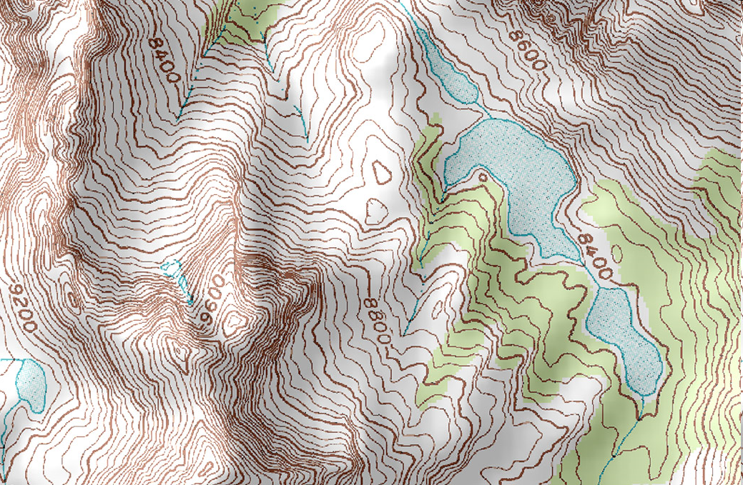
Geography

Slide 5
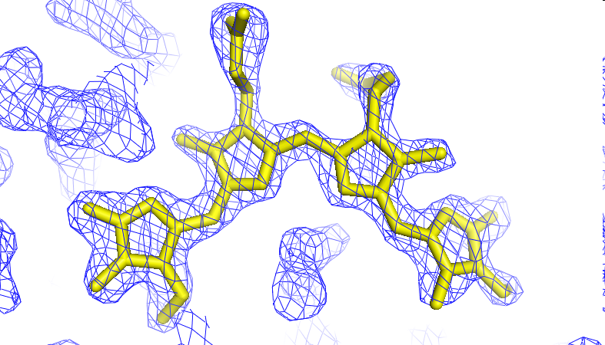
Crystallography

Slide 6
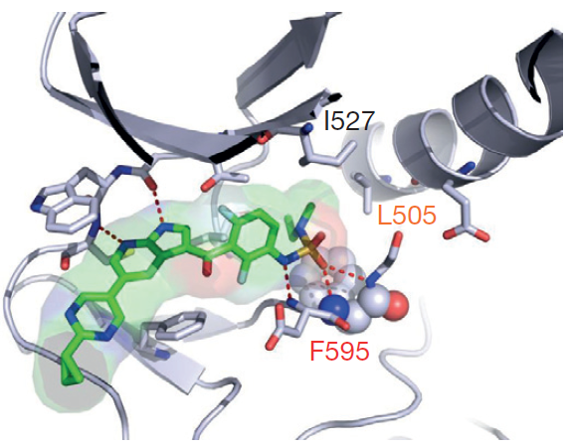
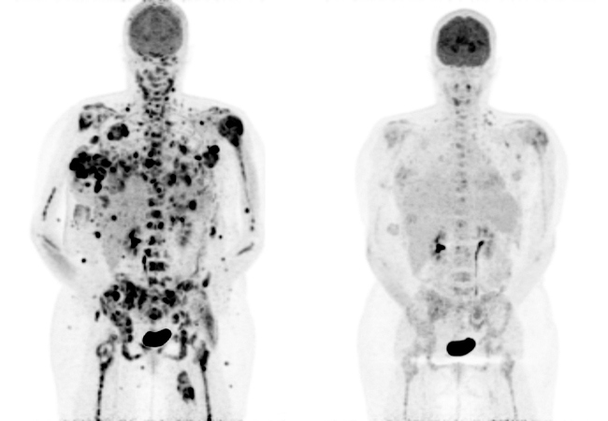
Cure for Cancer
Zelboraf® for BRAF positive metastatic melanoma
PLX3397 for Tenosynovial Giant Cell Tumor (TGCT)
15
days
→
Near-exclusive use of ALS 8.3.1
Zhang C, et al. (2015) Nature. 526, 583-6.
Notes:
The title may sound ostentatious, but we really did play a central role in finding a cure for one very nasty type of cancer. This was one of the few clinical trials that was stopped early so that the patients in the control group could be treated. Plexxikon now has a promising new candidate for TGCT, and still others in the pipline. I mention this here because Plexxikon almost exclusively uses ALS 8.3.1, and we have a 16-year relationship with them. The sale of Plexxikon to Daiichi Sankyo brought nearly $1B into the California economy, and was a significant justification for the MRPI program.

Slide 7
What is Protein?

Slide 8
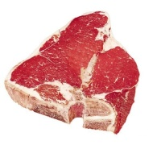
What is Protein?

Slide 9
What is Protein?
50% (dry weight) of cells

Slide 10
What is Protein?
carbon
oxygen
nitrogen
Amino Acid

Slide 11
20 Amino Acids
glycine
alanine
serine
cysteine
valine
proline
arginine
methionine
lysine
phenylalanine
tyrosine
histidine
tryptophan
threonine
isoleucine
leucine
glutamate
glutamine
aspartate
asparagine

Slide 12
Essential Amino Acids
glycine
alanine
serine
cysteine
valine
proline
arginine
methionine
lysine
phenylalanine
tyrosine
histidine
tryptophan
threonine
isoleucine
leucine
glutamate
glutamine
aspartate
asparagine

Slide 13
20 Amino Acids

Slide 14
20 Amino Acids

Slide 15
20 Amino Acids

Slide 16
20 Amino Acids

Slide 17
20 Amino Acids

Slide 18
20 Amino Acids

Slide 19
20 Amino Acids

Slide 20
20 Amino Acids

Slide 21
20 Amino Acids

Slide 22
20 Amino Acids

Slide 23
20 Amino Acids

Slide 24
20 Amino Acids

Slide 25
20 Amino Acids

Slide 26
20 Amino Acids

Slide 27
20 Amino Acids

Slide 28
20 Amino Acids

Slide 29
20 Amino Acids

Slide 30
20 Amino Acids

Slide 31
20 Amino Acids

Slide 32
20 Amino Acids

Slide 33
20 Amino Acids

Slide 34
20 Amino Acids

Slide 35
20 Amino Acids

Slide 36
Protein

Slide 37
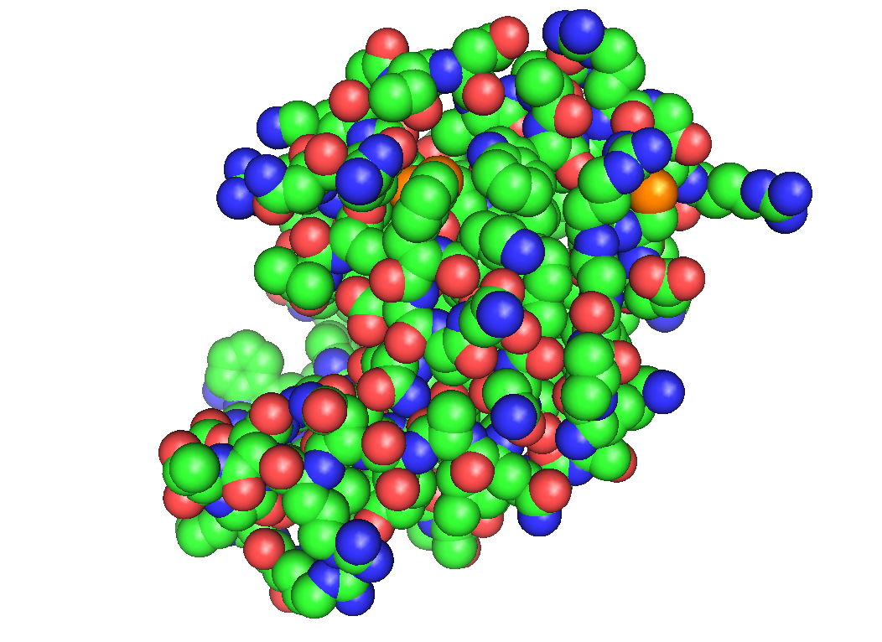
Protein

Slide 38
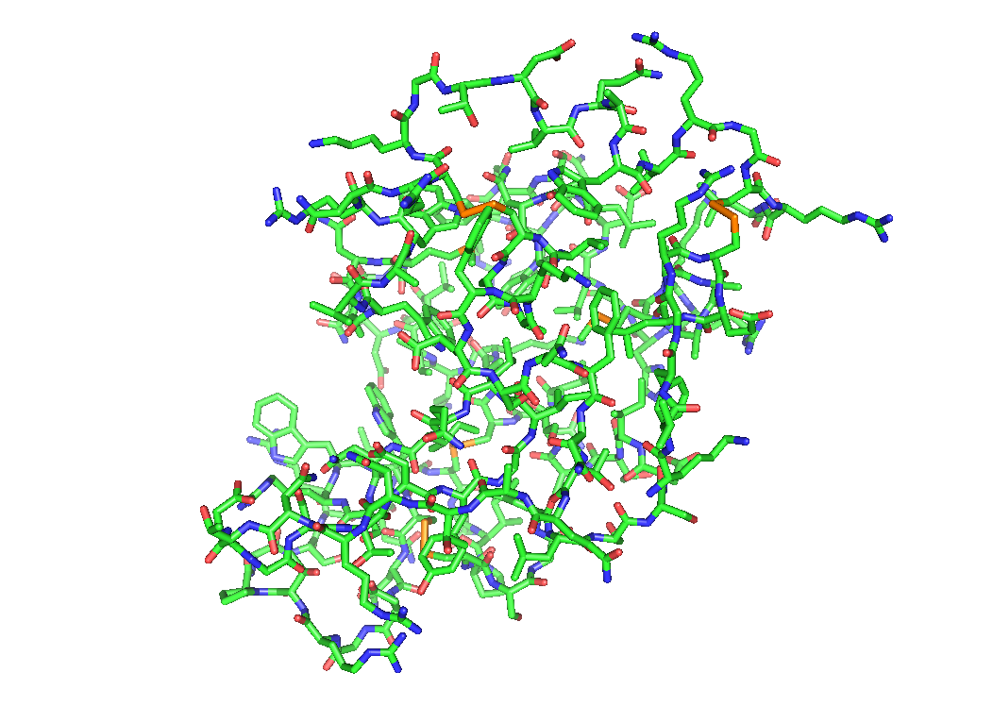
Protein

Slide 39
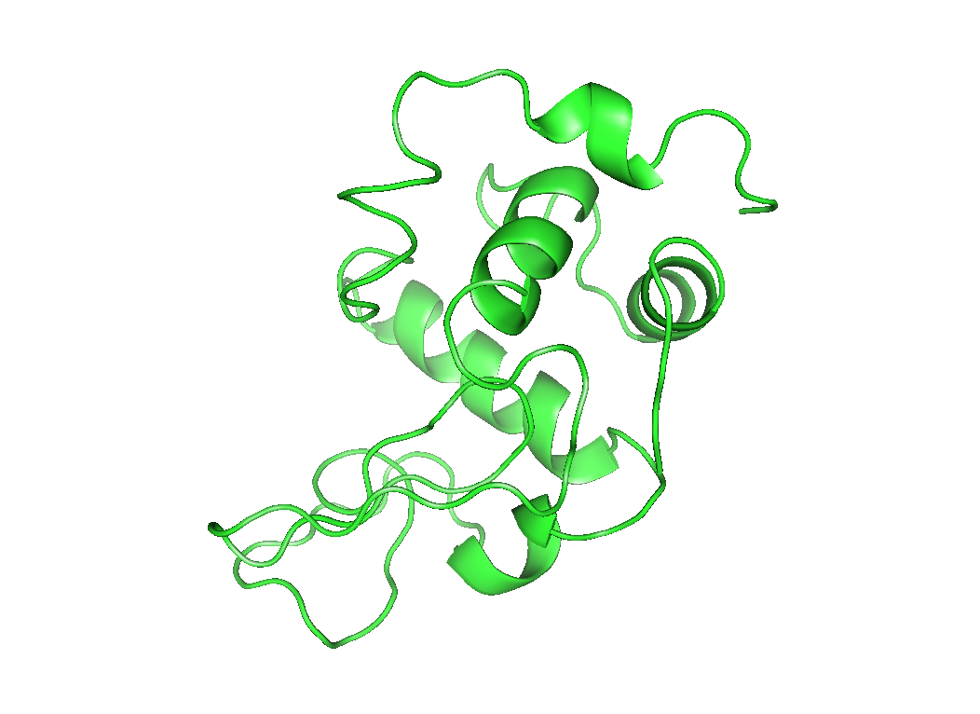
Protein

Slide 40
What is Protein?
50% (dry weight) of cells
~30,000 different kinds in humans
Large molecules (1000-1000000 atoms)
Incredibly well-organized
All 30,000 necessary for life

Slide 41
What do Proteins do?

Slide 42
What do Proteins do?
Break down food

Slide 43
What do Proteins do?
Break down food
Build new molecules

Slide 44
What do Proteins do?
Break down food
Build new molecules
Hold cells together

Slide 45
What do Proteins do?
Break down food
Build new molecules
Hold cells together
Move objects

Slide 46
Aspartate Transcarbamoylase
aspartate

Slide 47
Aspartate Transcarbamoylase
asparagine

Slide 48
Aspartate Transcarbamoylase

Slide 49
Proteins Move

Slide 50
How big are proteins?

Slide 51
How big are proteins?
30 nm

Slide 52
How can you see proteins?
30 nm

Slide 53
How can you see proteins?
Visible light
500 nm

Slide 54
How can you see proteins?
0.1 nm = 1 Å
X-ray light
500 nm

Slide 55
scattering
x-ray beam
sample
detector
detector

Slide 57
scattering
x-ray beam
sample
detector

Slide 58
scattering
x-ray beam
sample
detector

Slide 59
scattering
x-ray beam
sample
detector

Slide 60
Bragg’s Law
to detector
nλ = 2d sin(θ)
atom #1
θ
d
to source
atom #2
d∙sin(θ)

Slide 61
Bragg’s Law
to detector
nλ = 2d sin(θ)
atom #1
θ
to source
d
atom #2
d∙sin(θ)

Slide 62
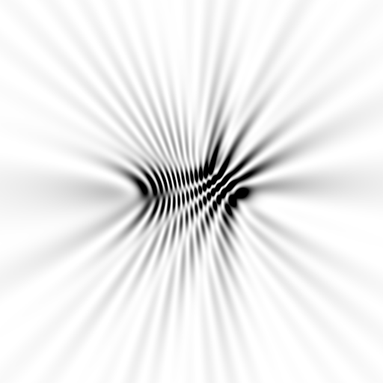
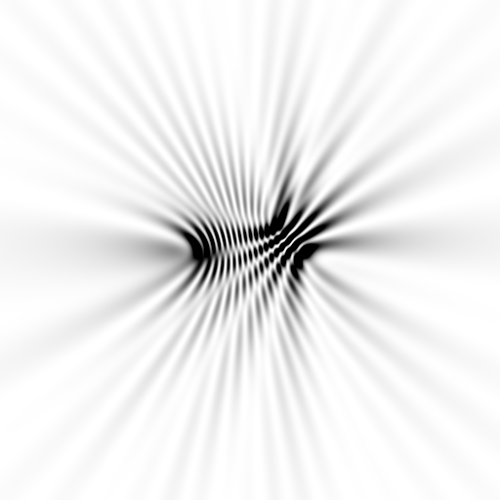

Slide 63
scattering from a structure
sample
detector

Slide 64
forward Fourier Transform
inverse Fourier Transform
no phase

Slide 65
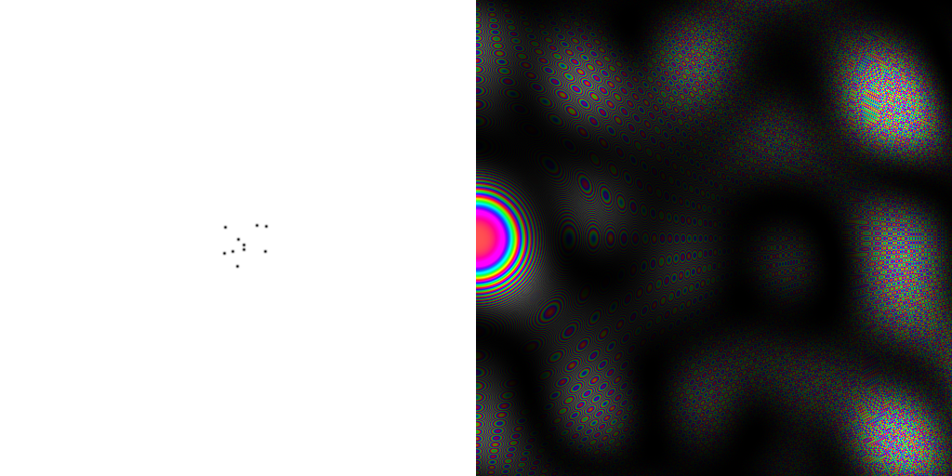
inverse Fourier Transform
scattering from a structure
colored by phase
sample
detector

Slide 66
scattering from a lattice
colored by phase
sample
detector

Slide 67
scattering from a lattice
colored by phase
sample
detector

Slide 68
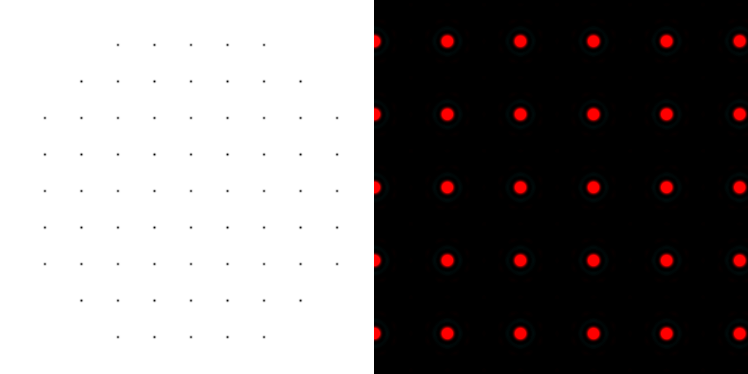
scattering from a lattice
colored by phase
sample
detector

Slide 69
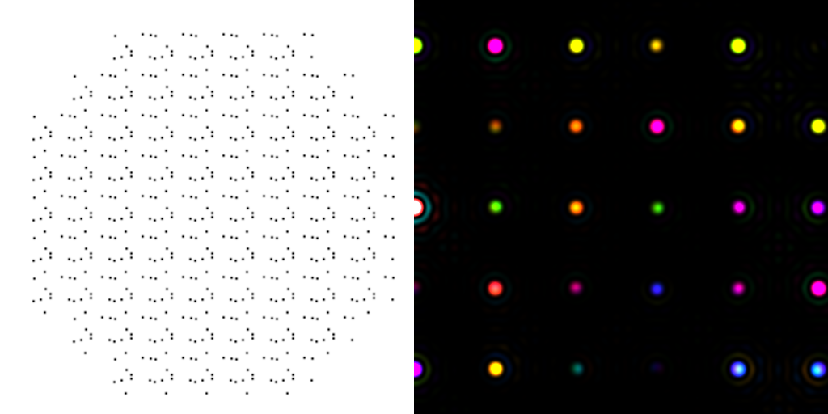
scattering from a crystal structure
colored by phase
sample
detector

Slide 70
Major Phasing techniques
Molecular Replacement
Multiple Isomorphous Replacement
Multiwavelength Anomalous Diffraction
Single-wavelength Anomalous Diffraction

Slide 71
inverse Fourier Transform
no phase

Slide 72
inverse Fourier Transform
no phase

Slide 73
Major Phasing techniques
Molecular Replacement
Multiple Isomorphous Replacement
Multiwavelength Anomalous Diffraction
Single-wavelength Anomalous Diffraction

Slide 74
anomalous scattering
x-ray beam
sample
detector

Slide 75
anomalous scattering
x-ray beam
sample
detector

Slide 76
anomalous scattering
x-ray beam
sample
detector

Slide 77
anomalous scattering
x-ray beam
sample
detector

Slide 78
anomalous scattering
x-ray beam
sample
detector

Slide 79
Major Phasing techniques
Molecular Replacement
Multiple Isomorphous Replacement
Multiwavelength Anomalous Diffraction
Single-wavelength Anomalous Diffraction

Slide 80
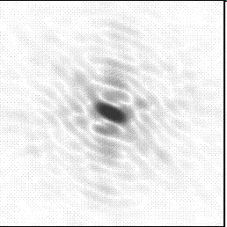
Molecular Replacement
correct structure and intensities
?
http://www.ysbl.york.ac.uk/~cowtan/fourier/coeff.html

Slide 81
Molecular Replacement
use something similar as a starting model

Slide 82
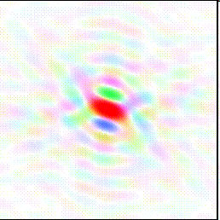
Model Building
current model is missing something

Slide 83
Model Building
phases from model

Slide 84
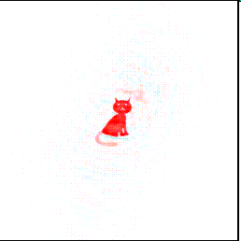
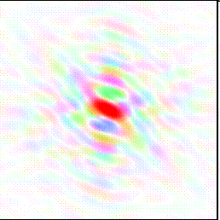
Model Building
missing bits show up in “difference map”

Slide 85
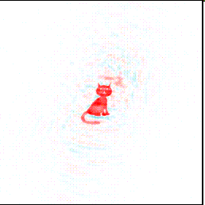
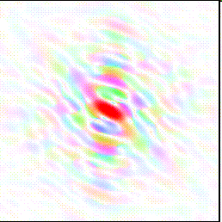
Model Building
missing bits show up better in F_{O} + (F_{O} - F_{C}) map

Slide 86
Electron-density map

Slide 87
Build an atomic model

Slide 88
Build an atomic model

Slide 89
How do I get one of those structures?
0. Purify
protein
3. Calculate
e⁻ density
1. Grow
crystals
5. Refine
models
2. Collect
data
4. Build
model

Slide 90
The Genetic Code
1st base | 2nd base |  |  |  |  |  |  |  | 3rd base
 | U |  | C |  | A |  | G
U | UUU | (Phe/F) Phenylalanine | UCU | (Ser/S) Serine | UAU | (Tyr/Y) Tyrosine | UGU | (Cys/C) Cysteine | U
 | UUC |  | UCC |  | UAC |  | UGC |  | C
 | UUA | (Leu/L) Leucine | UCA |  | UAA | Stop (Ochre) | UGA | Stop (Opal) ^{[B]} | A
 | UUG |  | UCG |  | UAG | Stop (Amber) | UGG | (Trp/W) Tryptophan | G
C | CUU |  | CCU | (Pro/P) Proline | CAU | (His/H) Histidine | CGU | (Arg/R) Arginine | U
 | CUC |  | CCC |  | CAC |  | CGC |  | C
 | CUA |  | CCA |  | CAA | (Gln/Q) Glutamine | CGA |  | A
 | CUG |  | CCG |  | CAG |  | CGG |  | G
A | AUU | (Ile/I) Isoleucine | ACU | (Thr/T) Threonine | AAU | (Asn/N) Asparagine | AGU | (Ser/S) Serine | U
 | AUC |  | ACC |  | AAC |  | AGC |  | C
 | AUA |  | ACA |  | AAA | (Lys/K) Lysine | AGA | (Arg/R) Arginine | A
 | AUG^{[A]} | (Met/M) Methionine | ACG |  | AAG |  | AGG |  | G
G | GUU | (Val/V) Valine | GCU | (Ala/A) Alanine | GAU | (Asp/D) Aspartic acid | GGU | (Gly/G) Glycine | U
 | GUC |  | GCC |  | GAC |  | GGC |  | C
 | GUA |  | GCA |  | GAA | (Glu/E) Glutamic acid | GGA |  | A
 | GUG |  | GCG |  | GAG |  | GGG |  | G

Slide 91
How do you make protein?
E. coli
ribosome
lysozyme

Slide 92
How do you make protein?
PCR
gene
plasmid
E. coli
DNA
extract

Slide 93
How do you make protein?
PCR
gene
cut
plasmid
plasmid

Slide 94
How do you make protein?
PCR
gene
E. coli
E. coli
growth
recombinant
plasmid
plasmid
E. coli
transform

Slide 95
How do you make protein?
E. coli
E. coli
lysis

Slide 96
Closely-related impurities
-
-
-
+
+
+
+
+
+
-
-
-
-
-
-
+
-
+
+
+
+
-
+
+
-
-
+
-
-
+
+
-
+
-
-
+
-
-
+
-
+
+
+
-
-

Slide 97
Purification by electrophoresis
-
-
-
-
-
-
-
-
-
+
+
+
+
+
+
+
+
+
+
+
-
+
-
-
+
+
-
-
+
+

Slide 98
Purification by gel filtration
-
+
+
-
+
-
-
+
+
-

Slide 99
Purification by ion exchange
+
+
+
+
+
-
-
+
+
+
-
-
+ + + + + + + + + + + + + + + + +

Slide 100
Purification by ion exchange
+
+
+
+
more salt
+
+
+
+
+
+
+
+
+
+
+
+
+
+
+
+
+
+
+
+
+
+
+
+
+
+
-
-
+
+
+
-
-
+ + + + + + + + + + + + + + + + +

Slide 101
Purification by ion exchange
+ + + + + +
+ + + + + +
even more salt
+ + + + +
+ + + + +
+ + + + + +
+ + + + + +
+ + + + + + + +
+ + + + + + + +
+ + + + + + + + +
+ + + + + + + + +
-
+
+
-
+ + + + + + + + + + + + + + + + +

Slide 102
Purification
+ + + +
-
-
-
+
+ + + + + + + +
+
+
+
+
+
-
-
-
- - - -
Arne W. K. Tiselius
1902-1971
1948 Nobel Chem.

Slide 103
Protein Purification

Slide 104
How much do proteins cost?
Gold: $1,200/ounce
Lysozyme: $1,500/ounce
HIV protease: ~$10⁹/ounce
Antimatter: ~$10¹⁵/ounce

Slide 105
How do I get one of those structures?
0. Purify
protein
3. Calculate
e⁻ density
1. Grow
crystals
5. Refine
models
2. Collect
data
4. Build
model

Slide 106
Crstallize it
http://www.csiro.au/c3/index.htm
$650 hamptonresearch.com
http://www.hwi.buffalo.edu/faculty_research/crystallization.html

Slide 107
Crystallize it

Slide 108
Crystallize it

Slide 109
Crystallization drop
large
reagent
reservoir
protein +
reagent
mother liquor
protein

Slide 110
Now What?

Slide 111
crystal mounting loop

Slide 113
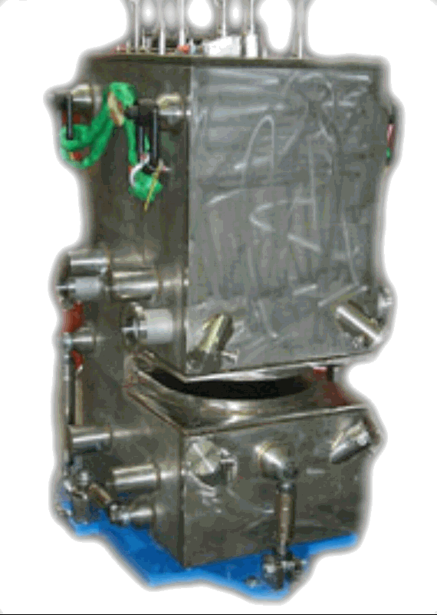
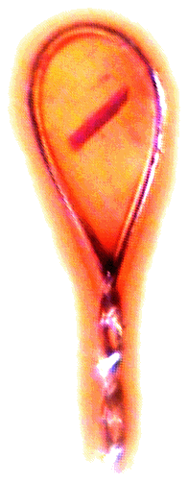
ALS 8.3.1 optics
Superbend
pinhole
Scatter
guard
Plane
Parabolic
mirror
Torroidal
mirror
Dectris Pilatus3 6M
divergence
slits
Si(111)
monochromator
Protein Crystal
MacDowell et. al. (2004) J. Sync. Rad. 11 447-455
Notes:
Next slide please

Slide 114
ALS 8.3.1 optics
Superbend
pinhole
Scatter
guard
Plane
Parabolic
mirror
Torroidal
mirror
Dectris Pilatus3 6M
divergence
slits
Si(111)
monochromator
Protein Crystal
MacDowell et. al. (2004) J. Sync. Rad. 11 447-455
Notes:
Most notable acheivements are high brightness with very little “wasted” light. The discovery made by Howard Padmore? At ALS showed that a 2:1 demagnification cancels nearly all of the spherical abberations in the parabolic/torroid system. 30-50% of the total x-ray intensity passes through the 100um pinhole. The flux through the 100um pinhole at the superbend beamlines is comparable to that of the 5.0.2 wiggler or an APS bending magnet, but only 150 Watts of power must be dissipated by the beamline optics. In contrast, wiggler beamlines must disipate kilowatts. The optics here are much simpler and not exotic in any way. The system is stable and robust. There is never a need to re-focus the beam at a new wavelength. Only a 2-minute automatic tuneup is recommended for very large energy changes (more than 1-2 keV).

Slide 118
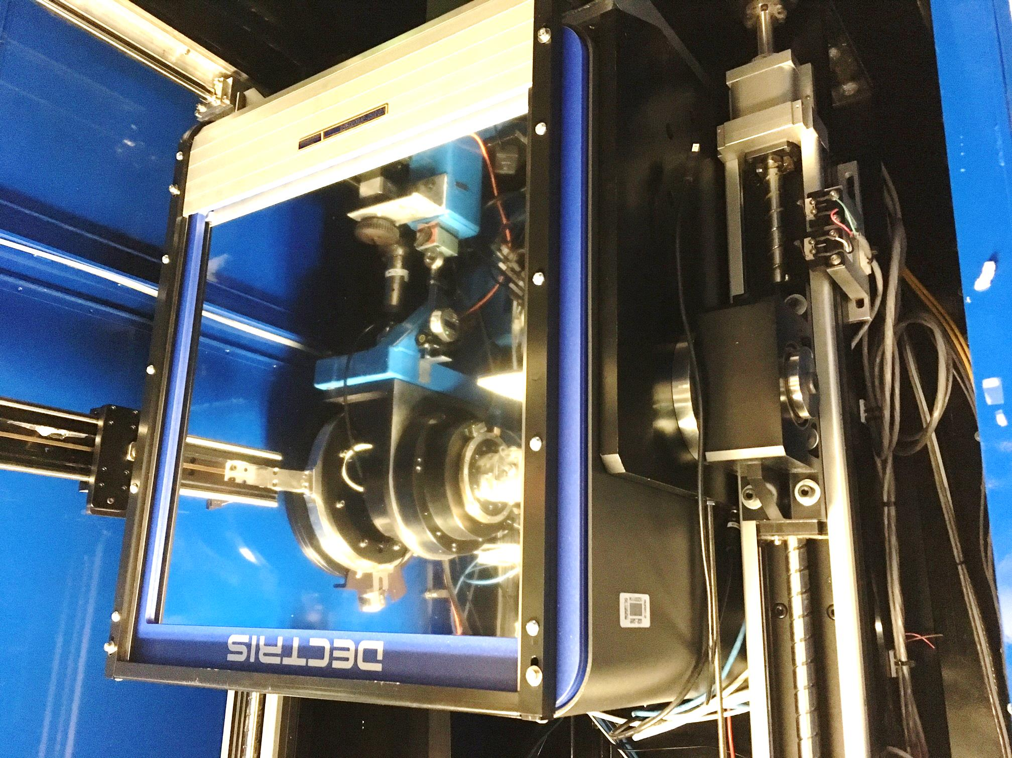
Pilatus 6M
Pixel Array
Detector
6x10⁶ pixels
$0.15/each
Single-photon
25 Hz images

Slide 120
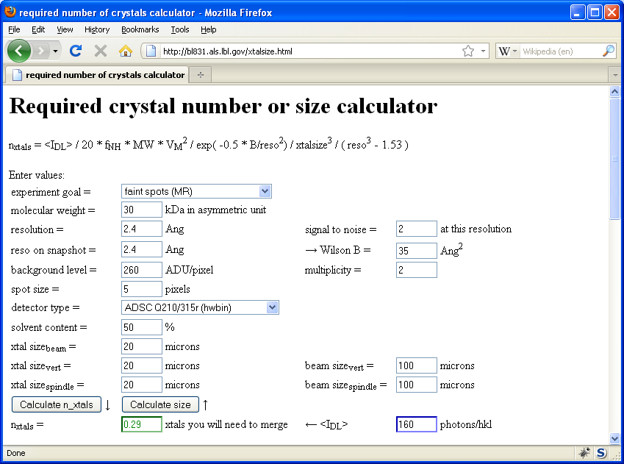
Will my experiment work?
Holton & Frankel (2010) Acta D 66 393-408.

Slide 121
resolution dependence of radiation damage
10³
100
maximum tolerable dose (MGy)
10
1
1 2 3 5 7 10 20 40 70 100
resolution (Å)
Howells et al. (2009) J. Electron. Spectrosc. Relat. Phenom. 170 4-12

Slide 122
resolution dependence of radiation damage
10³
100
maximum tolerable dose (MGy)
10
1
1 2 3 5 7 10 20 40 70 100
resolution (Å)
Howells et al. (2009) J. Electron. Spectrosc. Relat. Phenom. 170 4-12

Slide 123
10 MGy/Å
what the is a MGy?
http://bl831.als.lbl.gov/
damage_rates.pdf
Holton J. M. (2009) J. Synchrotron Rad. 16 133-42

Slide 124
Meaning of “resolution”

Slide 125
ALS-ENABLE organization
Paul Adams
PI
John Tainer Deputy
James Fraser Deputy
Corie Ralston
Core 1
Rapid Response Crystallography
Greg Hura
Core 2
Small angle scattering
James Holton
Core 3
Specialized Crystallography
Jay Nix
Training and Outreach

Slide 126
USER PORTAL
SEND PROPOSAL
Assessment by project leads
Core 1
Rapid MX
SCHEDULE SHIPMENT
Manual reprocessing
Core 2
SCHEDULE MEETING WITH TEAM LEADS
Solution state
CENTRAL DATABASE
Core 3
VIEW YOUR DATA
Specialized MX
Automatic reprocessing
SCHEDULE REMOTE ACCESS BEAMTIME
Remote
access
Metrics analysis
User actions (send proposals, view data, schedule meetings and beamtime)
Staff actions (assess proposals, collect and process data, feedback on data)
Automated actions (saving, transmitting, analyzing data and metrics)

Slide 127
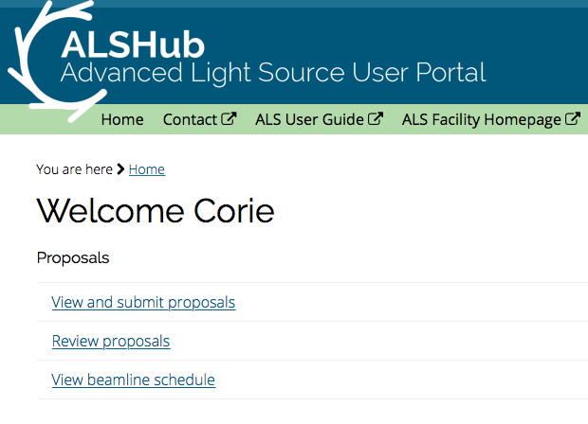
ALS-ENABLE site and data access
Applying for beamtime
Data archiving
Data portal

Slide 128
ALS-ENABLE website

Slide 129
Structural Biology Summary
Lots of effort to make it easier
It is still hard
Success/failure is predictable
High-end scattering detectors
Built-in XAS spectrometers

Slide 130
Core 1: Autocollection Core 2: SEC-SAXS Core 3: Multi-crystal MX, multi-temperature MX, plate screening
ALS-ENABLE Year 1 projects

Slide 131
Looking ahead to ALS-U
Beam Profile Comparison
Brightness
Today’s ALS
Future ALS

Slide 132
Stages of a DOE project
Conceptual Design, Engineering, Construction, Commissioning, Operations
INITIATION
DEFINITION
EXECUTION
CLOSEOUT
CRITICAL
DECISION
CD-0
CD-1
CD-2
CD-3
CD-4
Approve Mission Need
(Sept 27, 2016)
Approve Cost Range
Approve Performance Baseline
Approve
Start of Construction
Project Completion
Identify Mission-Related Need
We are here
ALS-U is currently in the conceptual design phase
Next stage is preliminary design—leads to performance baseline
Baseline (CD-2) is when the scope, cost, and schedule are fixed
Received $5M from DOE/BES in FY17 and $30M in FY18

Slide 133
ALS-ENABLE @ ALS-U
No plans to change sector 5
Superbends may move their source points, necessitating beamline and endstation moves
ALS will pay for any necessary beamline moves
Completion is still between 5 and 10 years away
Some consolidation/moving of MX and SAXS beamlines may occur

Slide 134
The team and the funding
ALS-ENABLE funded through NIH grant P30GM124169

Slide 135
nanoBragg program
http://bl831.als.lbl.gov/~jamesh/nanoBragg/
Optimized for nanocrystals
Square or round
Takes h,k,l and F
Supports 1 unit cell
no “mosaicity”
arbitrary “source”
arbitrary “phi” steps

Slide 136
nanoBragg program
http://bl831.als.lbl.gov/~jamesh/nanoBragg/

Slide 137
nanoBragg program
http://bl831.als.lbl.gov/~jamesh/nanoBragg/

Slide 138
nanoBragg program
http://bl831.als.lbl.gov/~jamesh/nanoBragg/

Slide 139
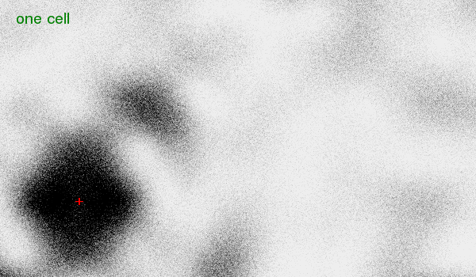
nanoBragg program
http://bl831.als.lbl.gov/~jamesh/nanoBragg/

Slide 140
nanoBragg program
http://bl831.als.lbl.gov/~jamesh/nanoBragg/
8x larger

Slide 141
nanoBragg program
http://bl831.als.lbl.gov/~jamesh/nanoBragg/
64x larger

Slide 142
How to install: nanoBragg
wget http://bl831.als.lbl.gov/
~jamesh/nanoBragg/nanoBragg.c
gcc –o nanoBragg nanoBragg.c –lm
./nanoBragg

Slide 143
How to run: nanoBragg for single particle
pdbset xyzin lysozyme.pdb xyzout bigcell.pdb << EOF
CELL 250 250 250 90 90 90
SPACEGROUP 1
EOF
phenix.fmodel bigcell.pdb high_resolution=10 k_sol=0.35 b_sol=46.5 mask.solvent_radius=0.5 mask.shrink_truncation_radius=0.16
mtz_to_P1hkl.com bigcell.pdb.mtz
nanoBragg –cell 250 250 250 90 90 90 –misset 10 20 30 -hkl P1.hkl -lambda 1 -distance 1000 -detsize 100 -fluence 1e32 -N 1
adxv noiseimage.img

Slide 144
How to run: nonBragg for SAXS
pdbset xyzin lysozyme.pdb xyzout bigcell.pdb << EOF
CELL 250 250 250 90 90 90
SPACEGROUP 1
EOF
phenix.fmodel bigcell.pdb high_resolution=10 k_sol=0.35 b_sol=46.5 mask.solvent_radius=0.5 mask.shrink_truncation_radius=0.16
mtz_to_stol.com bigcell.pdb.mtz
nonBragg -stol mtz.stol -lambda 1 -dispersion 0 \
-distance 1000 -detsize 100 -pixel 0.172 \
-flux 1e13 -thick 1.2 -MW 14000 -density 0.01
adxv noiseimage.img

Slide 145
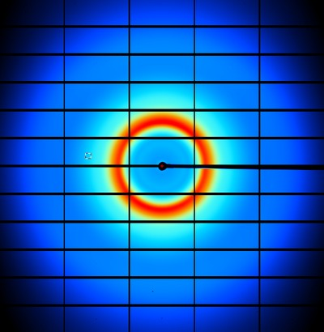
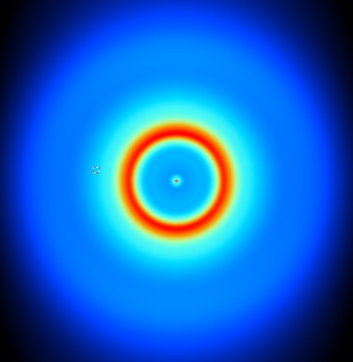
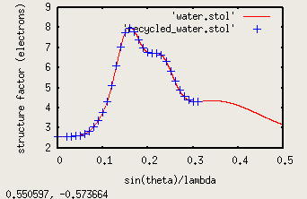
nonBragg for background

Slide 146
How to install: nonBragg
wget http://bl831.als.lbl.gov/
~jamesh/nonBragg/nonBragg.c
gcc –o nonBragg nonBragg.c –lm
./nonBragg

Slide 147
How to run: nanoBragg for single particle
UBtoA.awk << EOF > A.mat
CELL 250 250 250 90 90 90
RANDOM
EOF
nanoBragg -hkl P1.hkl -lambda 1 -distance 1000 -detsize 100 -fluence 1e32 -N 1 –mat A.mat
adxv noiseimage.img
UBtoA.awk << EOF > A.mat
CELL 250 250 250 90 90 90
MISSET 10 20 30
RANDOM 1 12345
EOF

Slide 148
How to run: nearBragg for single particle
egrep “^ATOM|^HETAT” lysozyme.pdb |\
awk ‘{print substr($0,31,36)}’ |\
cat >! atoms.txt
./rotate.awk -v phix=10 -v phiy=20 -v phiz=30 atoms.txt >! rotated.txt
nearBragg –atoms rotated.txt -lambda 1 -distance 1000 -detsize 100 -fluence 1e32
(200s)
adxv intimage.img

Slide 149
How to run: nearBragg for single particle
egrep “^ATOM|^HETAT” lysozyme.pdb |\
awk ‘{print substr($0,31,36)}’ |\
cat >! atoms.txt
./rotate.awk -v phix=10 -v phiy=20 -v phiz=30 atoms.txt >! rotated.txt
nearBragg –atoms rotated.txt -lambda 1 -distance 1000 -detsize 100 -fluence 1e32
(200s)
noisify –header intimage.bin –floatfile floatimage.bin
adxv noiseimage.img

Slide 150
Meaning of “coherence length”

Slide 151
Is the structure any good?
Molecular replacement:
R/R_{free} (compare with R_{merge})
MAD/SAD/MIR
R and FOM
All cases
does the map look like the model?!

Slide 152
“R” factors
R = % error

Slide 153
“R” factors
completely random: 0.59
starting MR solution: 0.4-0.55
something still wrong?: > 0.3
correct chain trace: < 0.2
small molecule: ~ 0.05

Slide 154
“R” factors
R_{cryst} (or just “R”)
observed vs calculated data (Fs)
R_{free}
cross-check with “random” subset of data
should be < 0.3 and < R_{cryst} + 0.1

Slide 155
Fitting data
structure factor (F)
spot index (h)

Slide 156
Fitting data
structure factor (F)
spot index (h)

Slide 157
Fitting data
structure factor (F)
spot index (h)

Slide 158
Fitting data
structure factor (F)
spot index (h)

Slide 159
“R” factors
R_{cryst} (or just “R”)
observed vs calculated data (Fs)
R_{free}
cross-check with “random” subset of data
should be < 0.3 and < R_{cryst} + 0.1
R_{sym} = R_{merge} (self-consistency of data: Is)

Slide 160
R_{merge}
blows up
as I_{obs} → 0
completely random: 0.59
weak data (high angle): 0.7- ∞
wrong symmetry choice?: ~0.2-0.55
small or disordered crystal: ~0.1-0.2
typical: ~ 0.05

Slide 161
“R” factors
R_{cryst} (or just “R”)
observed vs calculated data (Fs)
R_{free}
cross-check with “random” subset of data
should be < 0.3 and < R_{cryst} + 0.1
R_{sym} = R_{merge} (self-consistency of data: Is)
R_{rim} R_{pim} R_{meas}
R_{iso} R_{anom}
R_{diff}
R_{sym} is “unfair” to high multiplicity

