Slide 1
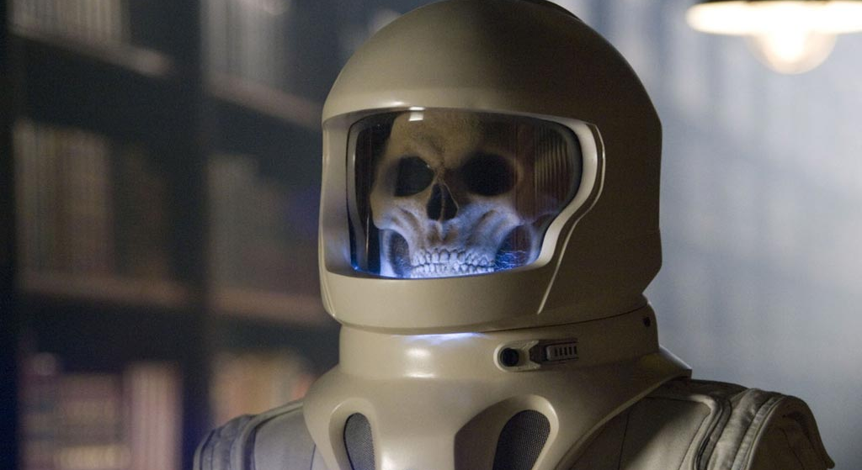
ALS-U passes CD-1
Hey! Who turned out the lights?

Slide 2
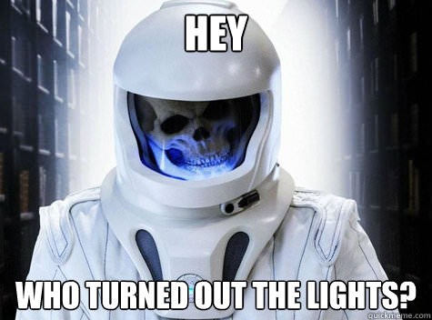
ALS-U: July 2024

Slide 3
Multi-bend Achromat (MBA) gradual bend = smaller beam
ALS
ALS-U
https://als.lbl.gov/als-u/als-u-approach/

Slide 4
Multi-bend Achromat (MBA) gradual bend = smaller beam
ALS
https://als.lbl.gov/als-u/als-u-approach/

Slide 5
Multi-bend Achromat (MBA) gradual bend = smaller beam
ALS-U
ALS
https://als.lbl.gov/als-u/als-u-approach/

Slide 6
https://als.lbl.gov/als-u/als-u-approach/

Slide 7
https://als.lbl.gov/als-u/als-u-approach/

Slide 8
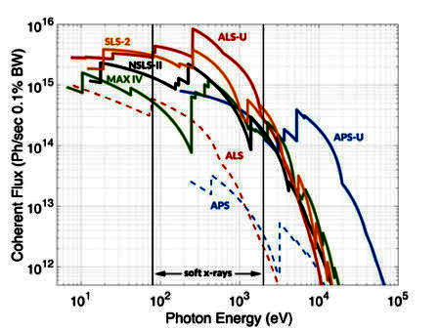
ALS-U source properties
Se Met

Slide 9
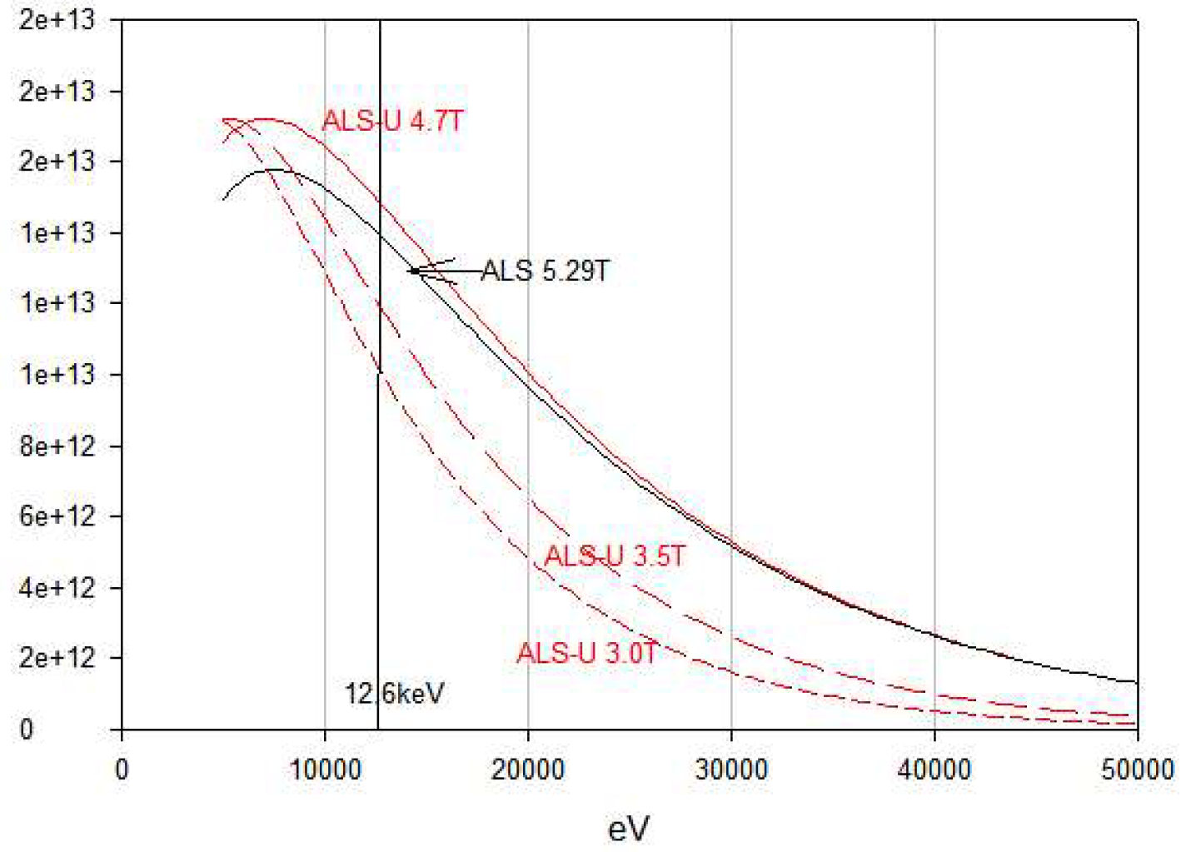
Flux at 8.3.1 before & after upgrade
1.4e12
1.3e12
6% better
needs justification
1.1e12
1.0e12
15%-30% worse
Will happen if
we remain quiet
8.5e11
7.1e11
Photons/s on sample
5.7e11
4.3e11
2.9e11
1.4e11

Slide 10
What this means for MX
12 months of dark, starting July 2024
Plan A: no action
75% of previous flux
Hutch move: ~ 480 mm
60 x 80 → 54 x 84 µm beam (horiz x vert)
$800k to retain staff
Plan B: Join “Gemini” undulator beamline
15x → 30x flux of 8.3.1
15 µm → 1 µm beam
$100k = 2 days/year
Retain current staff ?

Slide 11
Plan for MX
Plan C: Optics upgrade for 8.3.1
Multilayer, cryo-cooled mono, diaboloid mirror
~60x flux
Beam size 9 x 38 µm (horiz x vert)
~$1.6M
Plan D: move to SSRL
New BL12-1 is multilayer micro-focus
Bring Pilatus detector with us
$ ?
?? days/year

