Slide 1
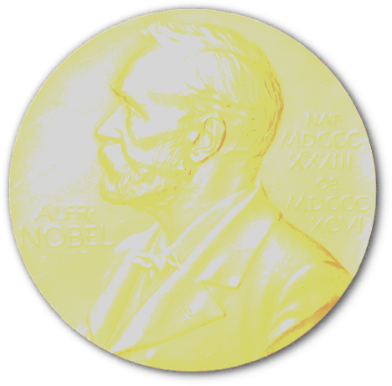
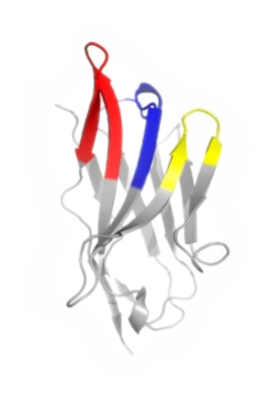
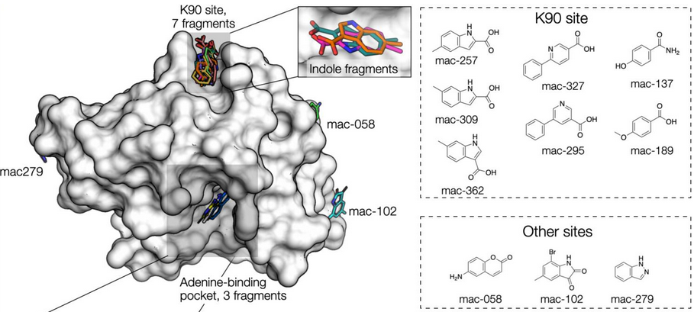
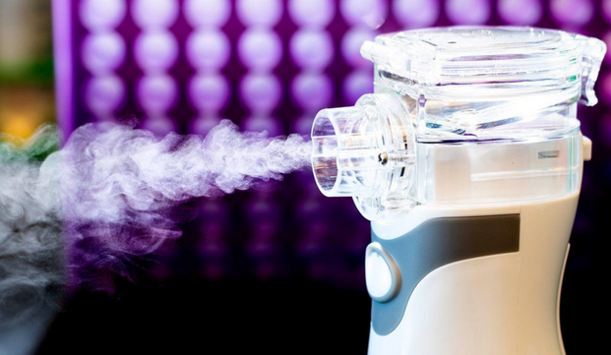
ALS 8.3.1 – TomAlberTron - Highlights
Doudna
CRISPR PDBs
6
8.3.1
6
cryoEM
2
SLS
COVID protection:
nanobody aerosol
UCSF-Oxford SARS-CoV-2
fragment screen
Schoof et al., Science 370 (2020)
Schuller et al., Science Advances in press (2021)

Slide 2
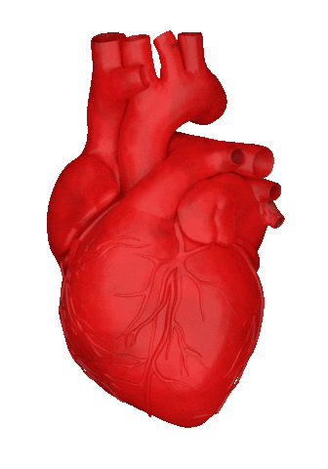
TomAlberTron’s User Community
1000+ users, 60+ institutions
PRT investment: $16 M since 2001
Return: 1826 PDB 720 pubs 250 hi-impact
$132+ M (NIH) $935+ M (Plexxikon)
Median visit-to-next-visit interval:
11 ± 8 days

Slide 3
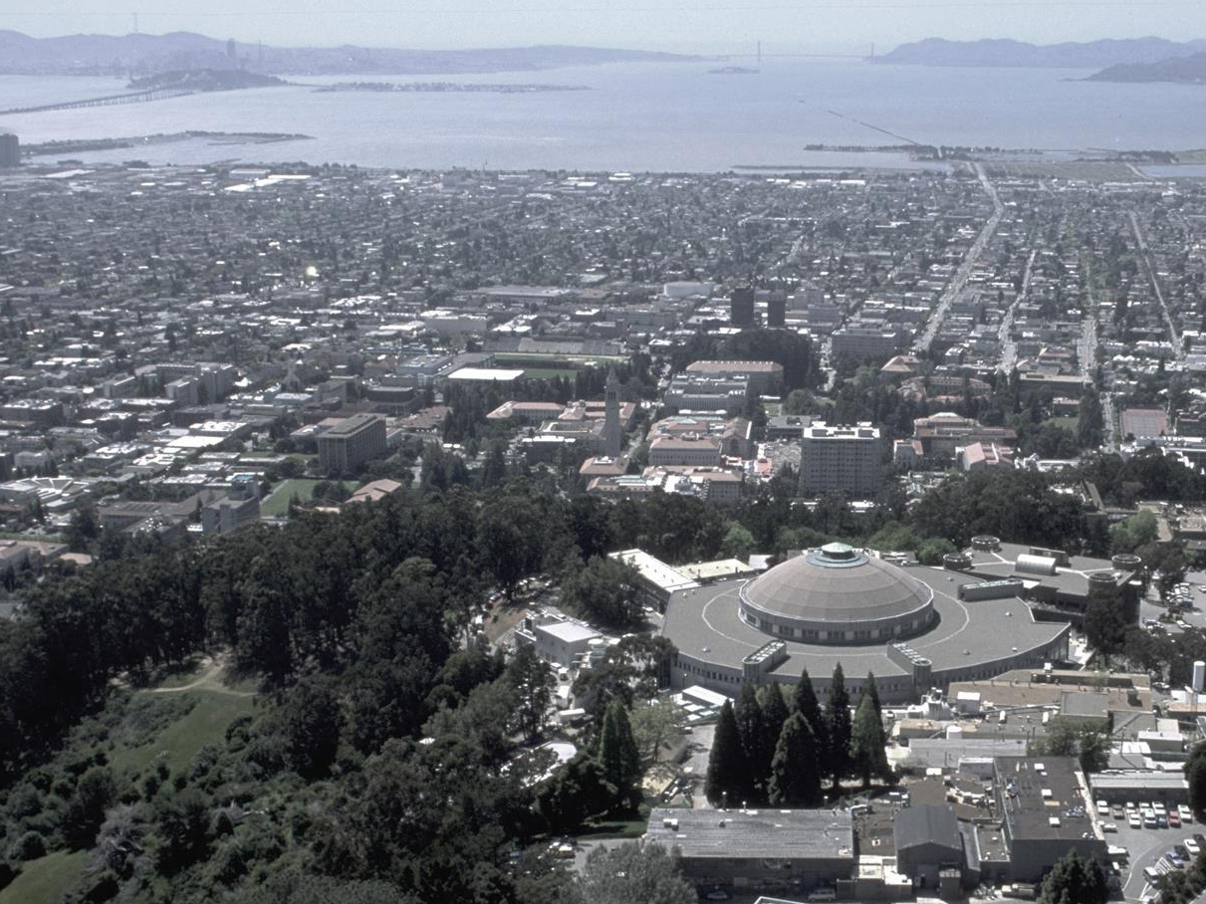
Advanced Light Source
8.2.1
Berkeley
Center for
Structural
Biology
8.2.2
8.3.1
UC
SF
5.0.2
5.0.3
5.0.1
5.4 BSISB
ALS
Biosciences
2021
MBC 4.2.2
12.3.1 SIBYLS
MX & SAXS
2.1
NCXT
2.0.1 Gemini

Slide 4
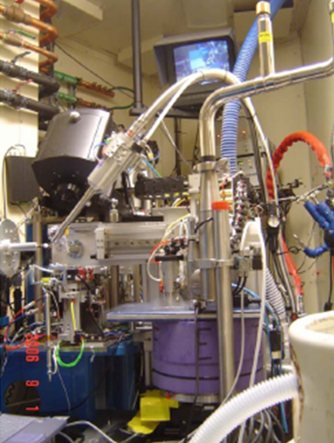
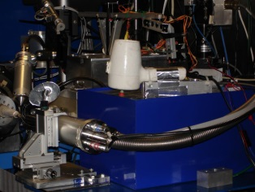
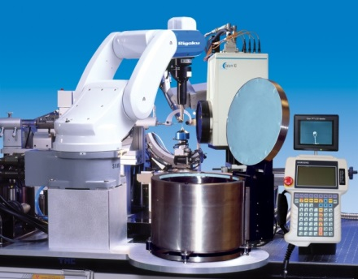
ALS robots
8.2.1
ACTOR
Berkeley
Auto-
Mounter
8.2.2
8.3.1
Cool Hand Luke
5.0.2
5.0.3
5.0.1
MBC 4.2.2
ACTOR
ALS MX robots
Stanford
Auto-
Mounter
12.3.1 SIBYLS

