Slide 1
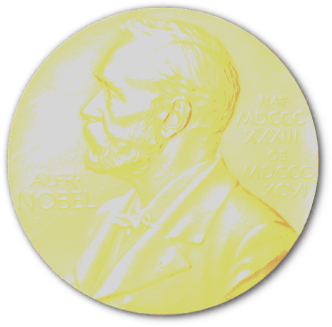
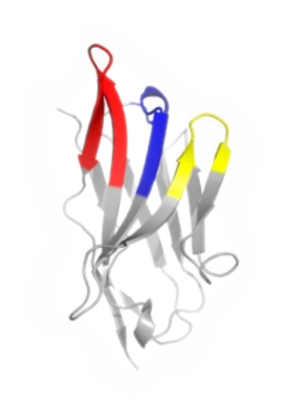
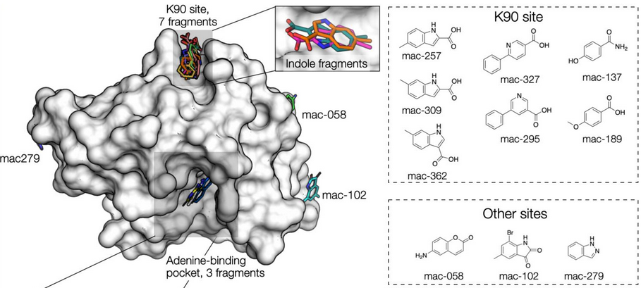
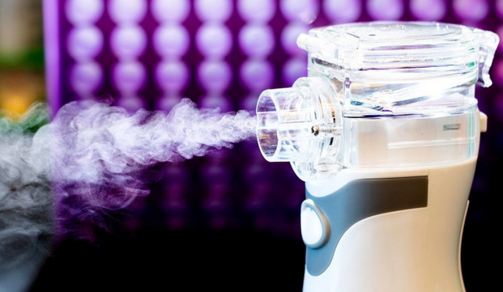
ALS 8.3.1 – TomAlberTron - Highlights
Doudna
CRISPR PDBs
6
8.3.1
6
cryoEM
2
SLS
COVID protection:
nanobody aerosol
UCSF-Oxford SARS-CoV-2
fragment screen
Schoof et al., Science 370 (2020)
Schuller et al., Science Advances in press (2021)

Slide 2
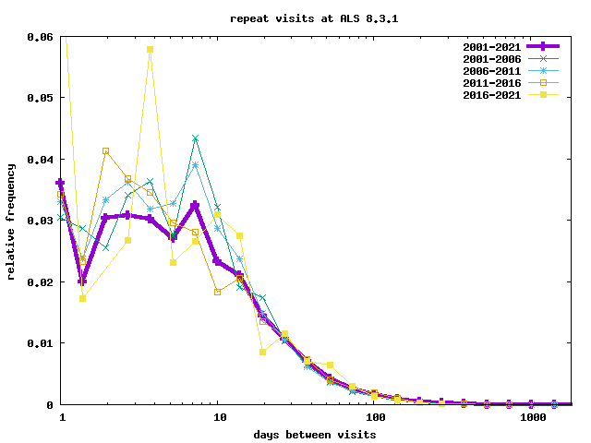
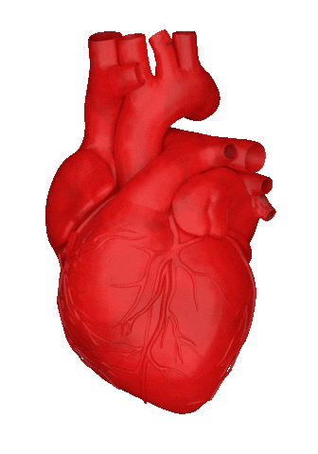
ALS 8.3.1 MX User Community

Slide 3
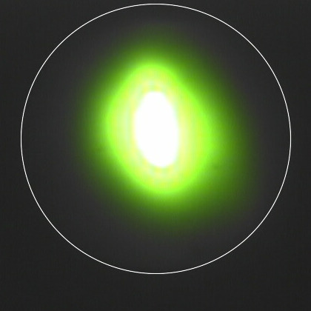
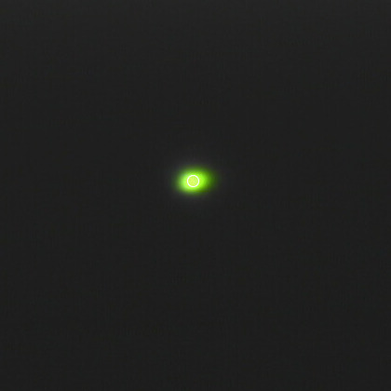
What do we need from ASL-U?
80 x 60
10 x 10

