Slide 1
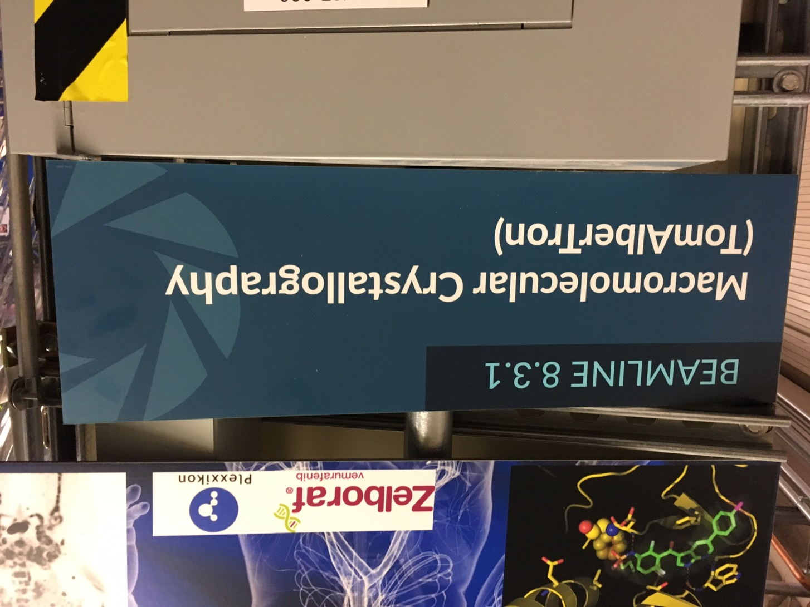
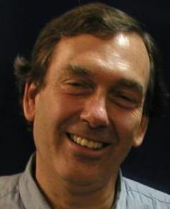
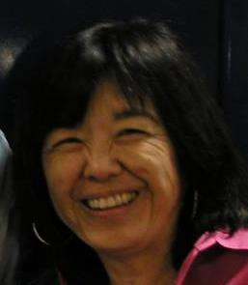
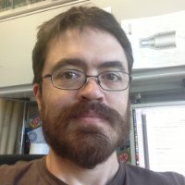
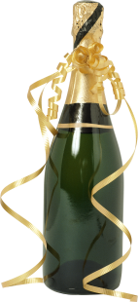
It’s Official … TomAlberTron
Tanamachi
Classen
Meigs
Burnett

Slide 2
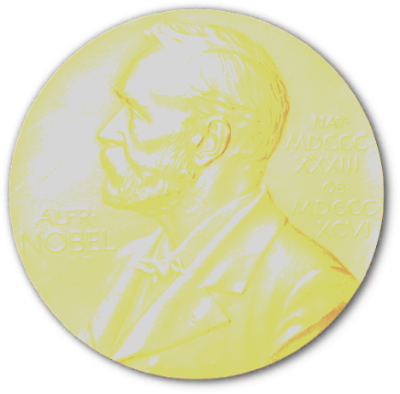
Science highlights: 2020 Nobel Chemistry
Doudna
CRISPR PDBs
6
8.3.1
6
cryoEM
2
SLS

Slide 3
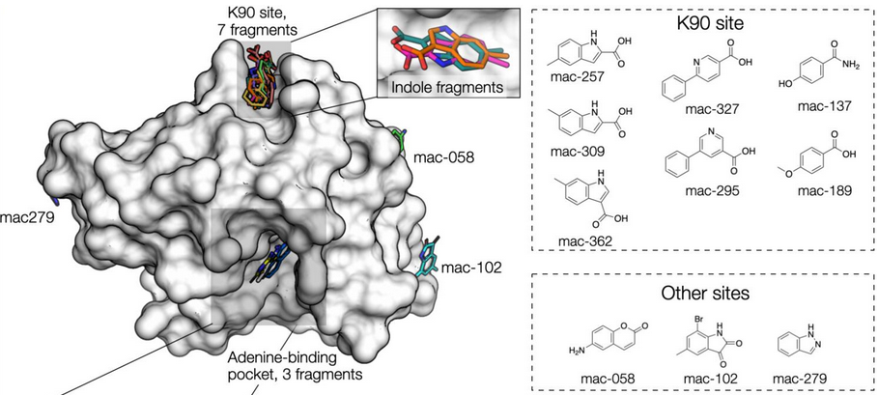
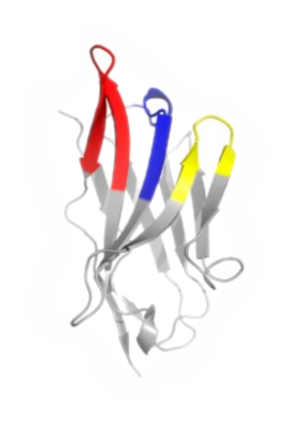
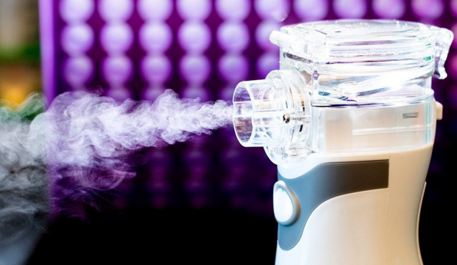
Science Highlights: COVID-19
UCSF-Oxford SARS-CoV-2
fragment screen
COVID protection:
nanobody aerosol
Schuller et al., Science Advances 7 eabf8711 (2021)
Schoof et al., Science 370 (2020)

Slide 4
TomAlberTron’s User Community
1000+ users, 60+ institutions
PRT investment: $16 M since 2001
Return: 1826 PDB 720 pubs 250 hi-impact
$132+ M (NIH)
$935+ M (Plexxikon)

Slide 5
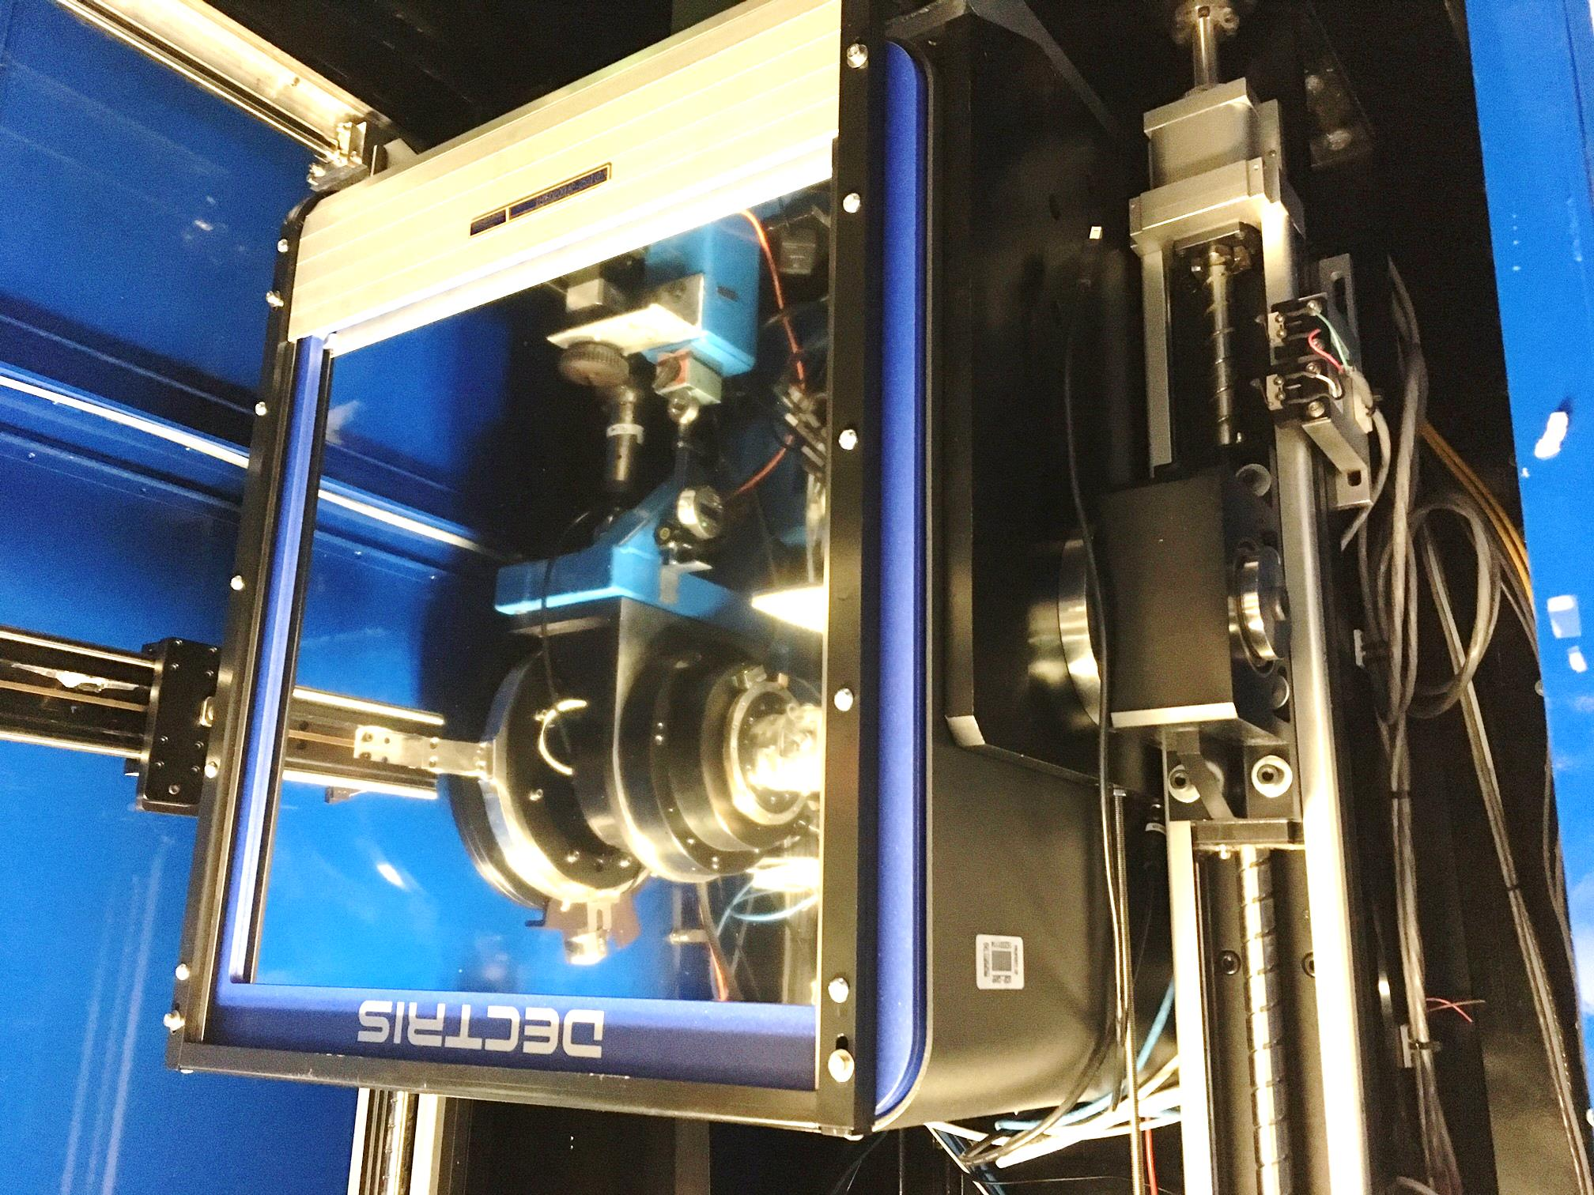
1.5 mm
Pilatus³ S 6M
Pixel Array
Detector
6x10⁶ pixels
$0.15/each
2 ms readout
25 Hz images

Slide 6
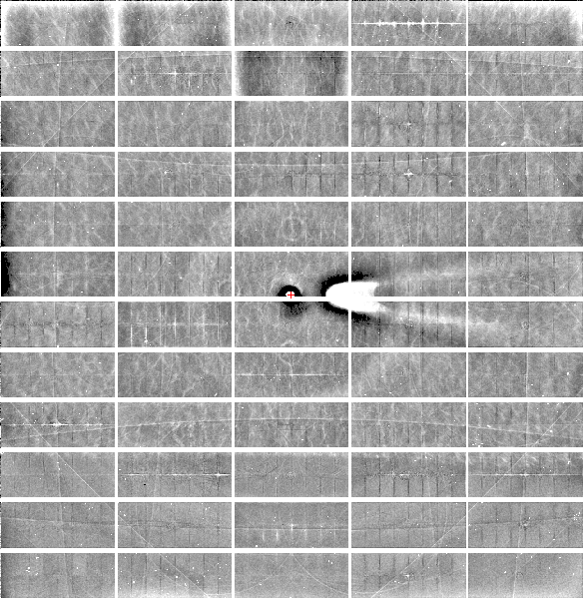
Relative Pixel
Calibration
ALS 8.3.1
Pilatus3 6M
0.9793 Å x-rays
RMS = 0.8%
1% high
average
1% low

Slide 7
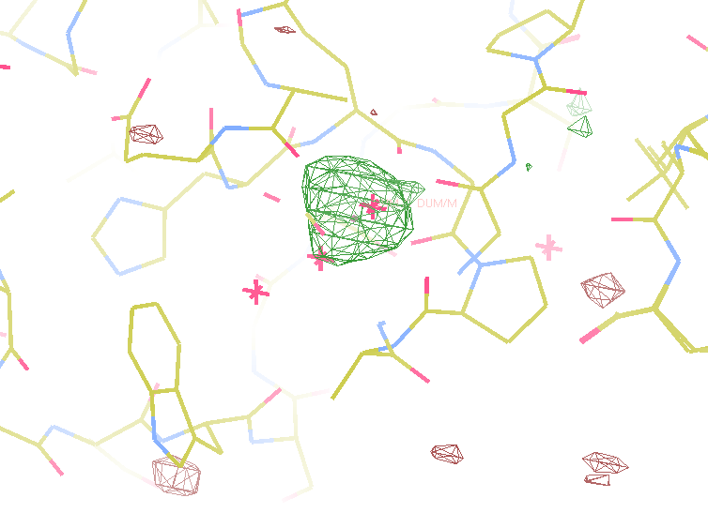
Better calibration = better anomalous
8.2σ = Na
DELFAN residual anomalous difference
140x multiplicity data by Tom Peat & Janet Newman

Slide 8
Milliseconds matter!
0.95 ms
2.03 ms
intensity
time

Slide 9
Pilatus³ M 6M
Pixel Array
Detector
6x10⁶ pixels
$0.15/each
1 ms readout
100 Hz images
Pilatus³ S 6M
Pixel Array
Detector
6x10⁶ pixels
$0.15/each
2 ms readout
25 Hz images

Slide 10
ALS 8.3.1 data collection history
images x 10⁶

Slide 11
Recent upgrades
Dectris Pilatus3 6M upgraded
Computing to keep up

Slide 12
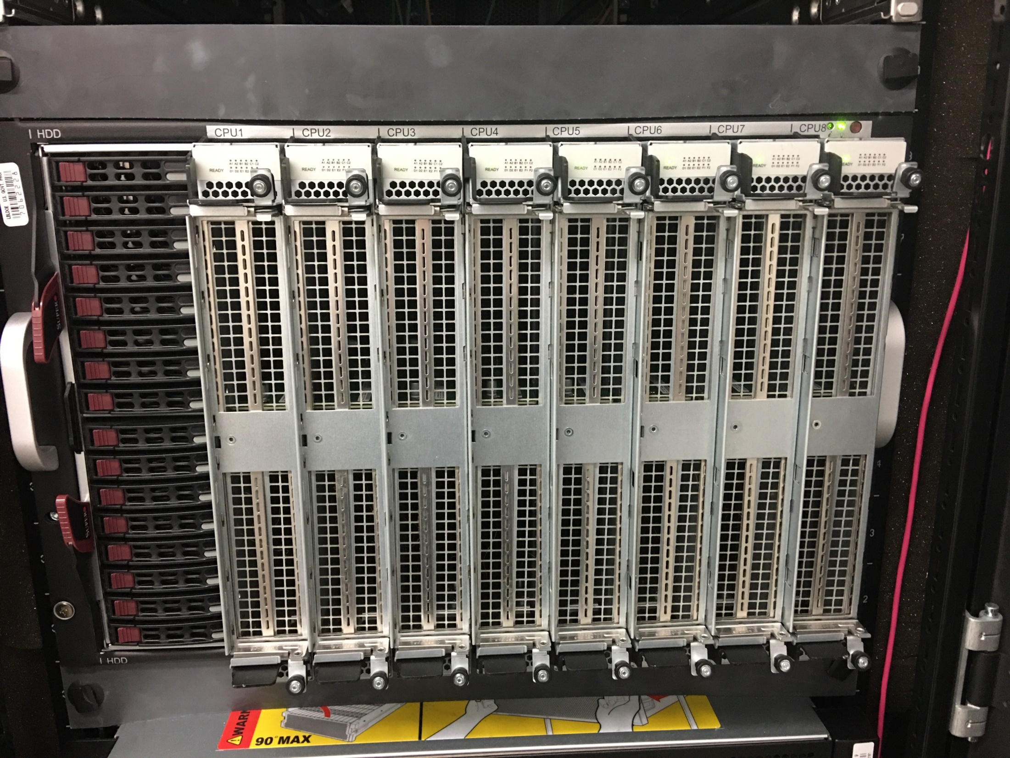
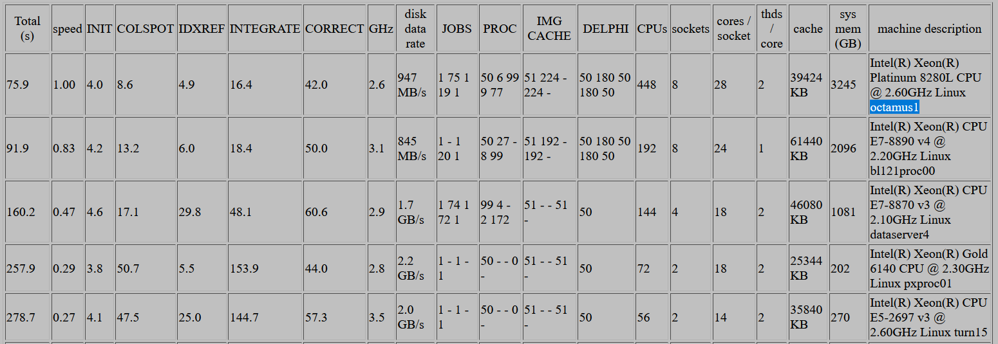
octamus1
$90k
3 TB
RAM
50 TB
SSD
8x Xeon Platinum 8280L
28 cores/socket
4 GHz (turbo)
3600-image Pilatus 6M processing benchmark
https://bl831.als.lbl.gov/~jamesh/benchmarks/

Slide 13
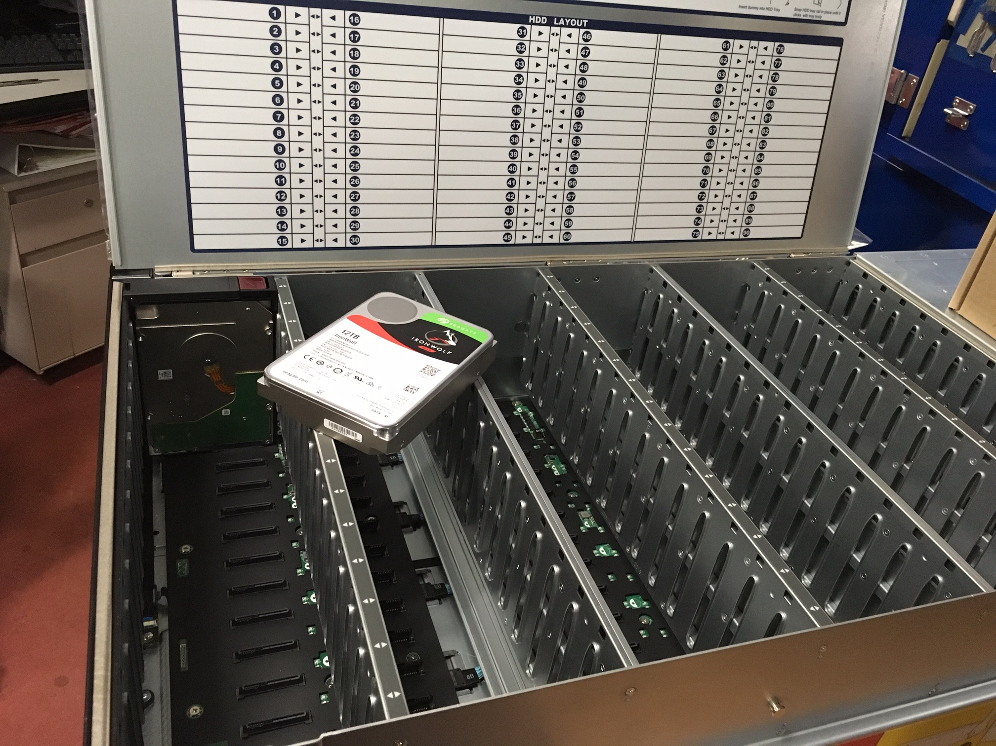
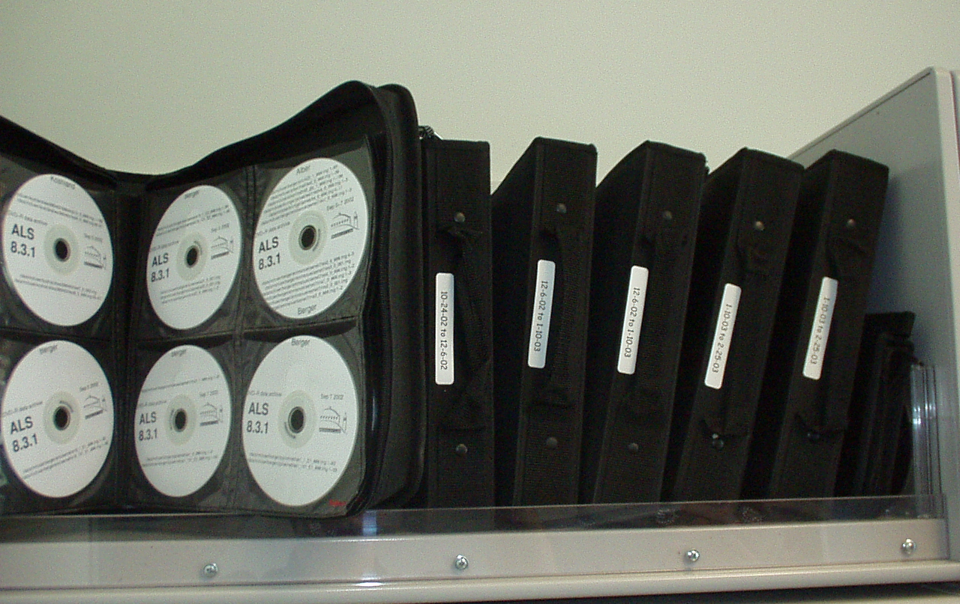
petabyte
90 hot-swap drive bays
64 occupied
ZFS RAID
$12k (empty)

Slide 14
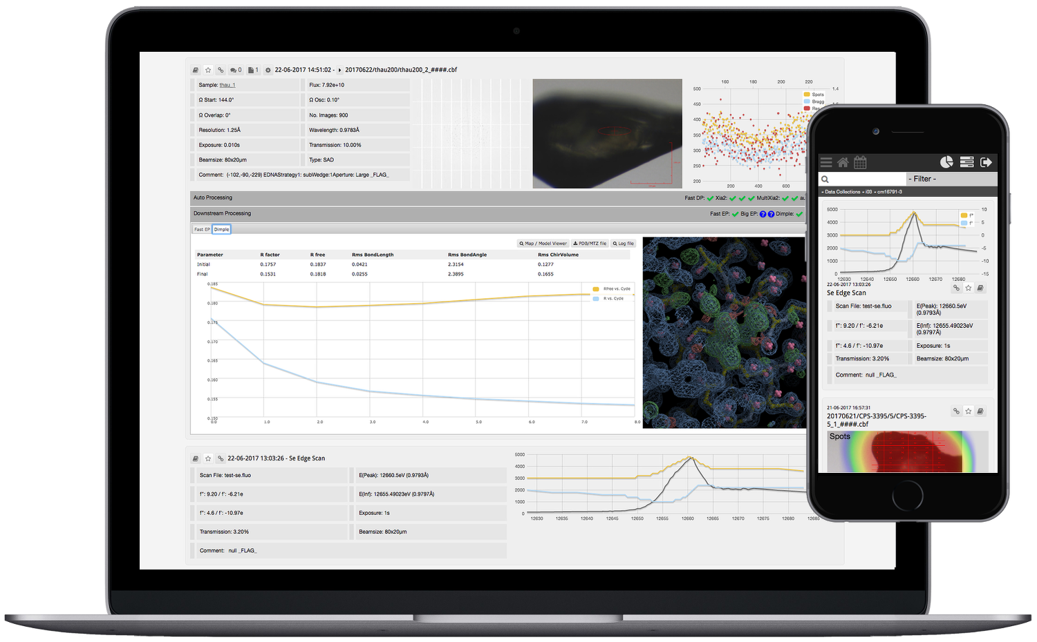
SynchWeb / ISPyB
Alpha Fold Me!
Alpha Fold Me!

Slide 15
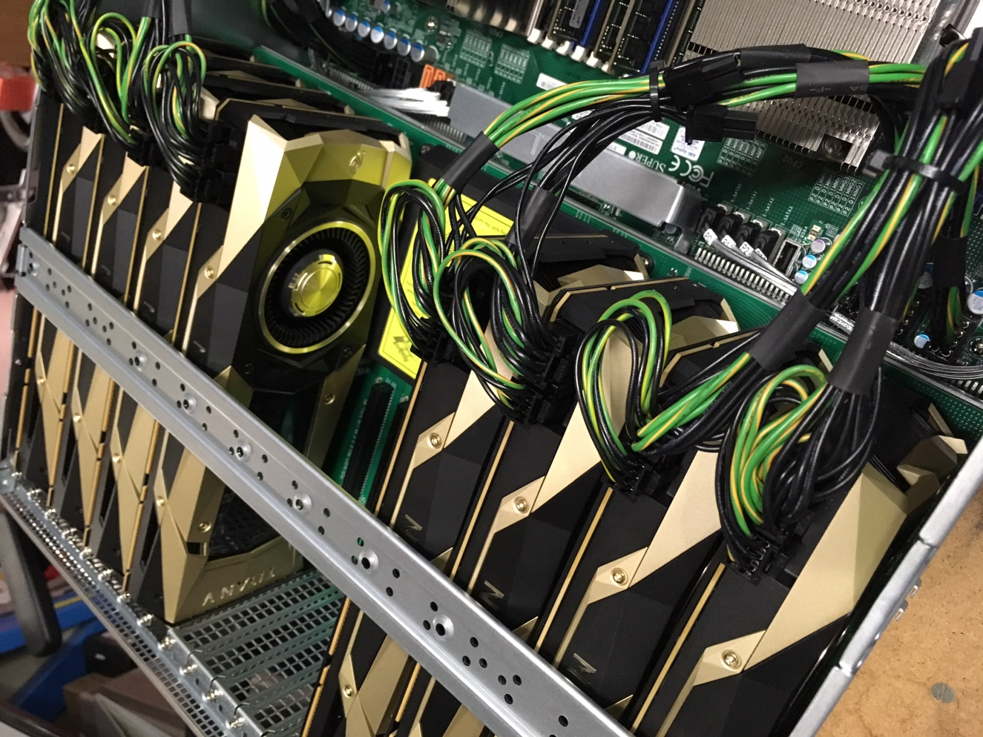
voltron
8x Titan V ~ 0.8 Pflop $50k

Slide 16
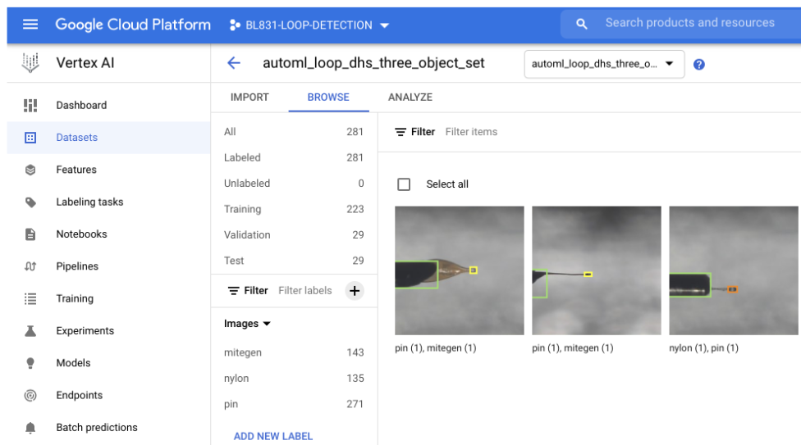
Modernizing loop center: beamline AI
Scott Classen
Shawfeng Dong
Feng Chen Liu

Slide 17
Recent upgrades
Dectris Pilatus3 6M upgraded
Computing to keep up
Robotics upgrade

Slide 18
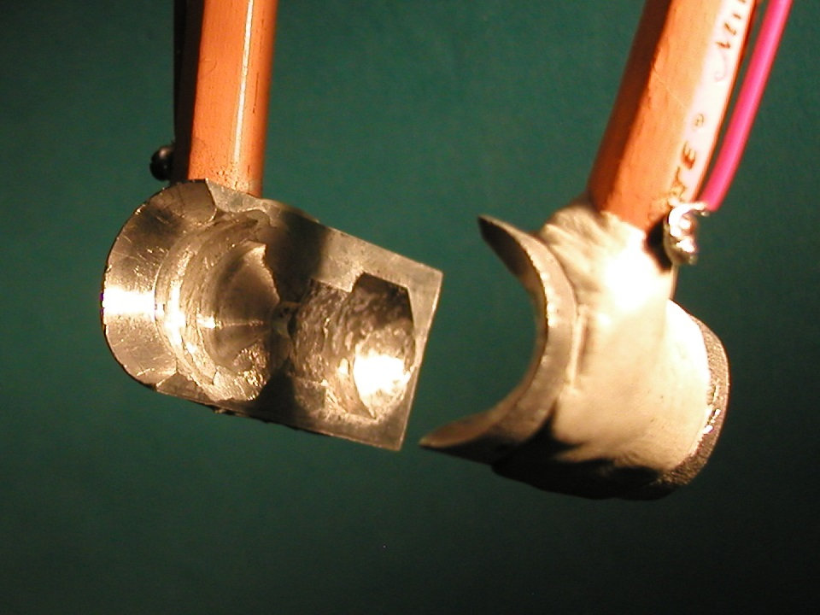
SuperTong

Slide 19
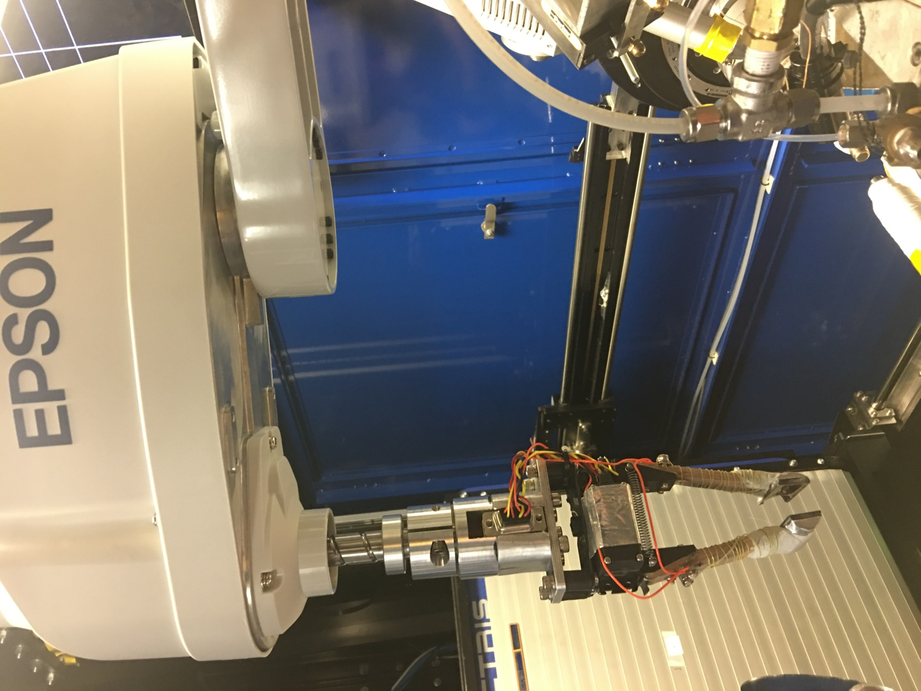

Slide 20
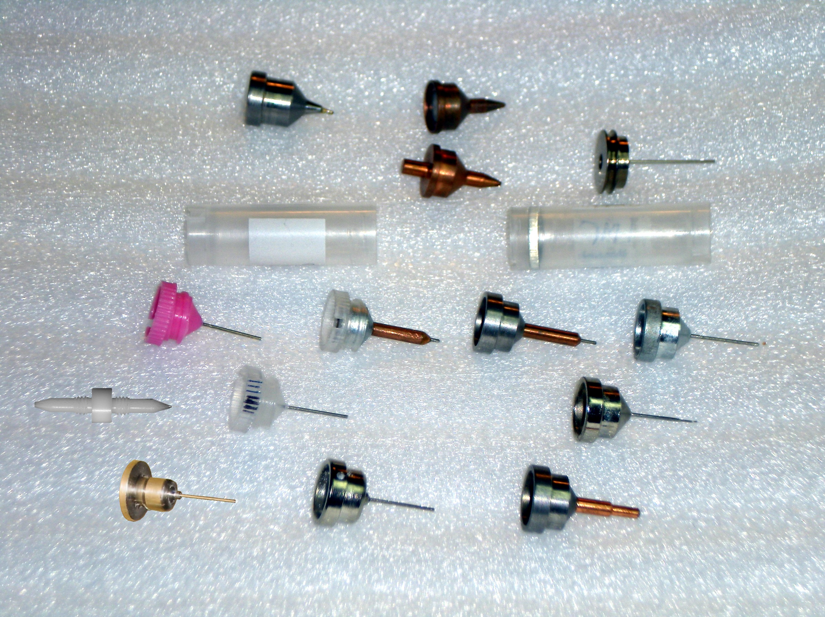
Prepare for the Great Synchrotron Shuffle
Caltech
SSRL
Yale
Hampton screw cap
Hampton magnetic
H. colored
H. copper
H. magnetic
H. hybrid
H. screw cap
Syrrx
SPring-8
Oxford
SPINE
MiTeGen RT

Slide 21
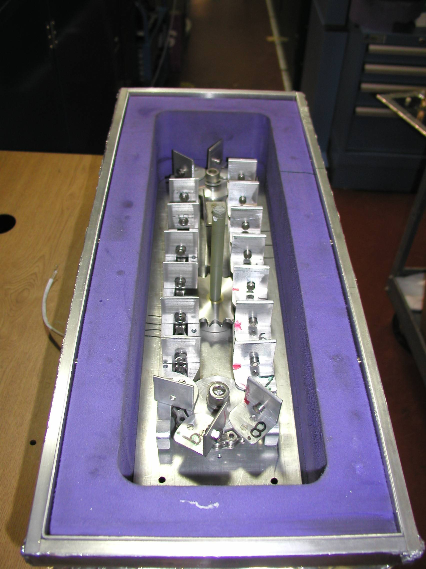
Carousel open

Slide 22
TomAlberTron capabilities
200s data sets in shutterless mode
Physiological temperature (up to 45 C)
in-situ screening from trays
15-100 μm beam sizes
True BLU-ICE interface
Excellent detector calibration
Infinite capacity sample carousel
Automation and ease-of-use
In-person crystallography

Slide 23
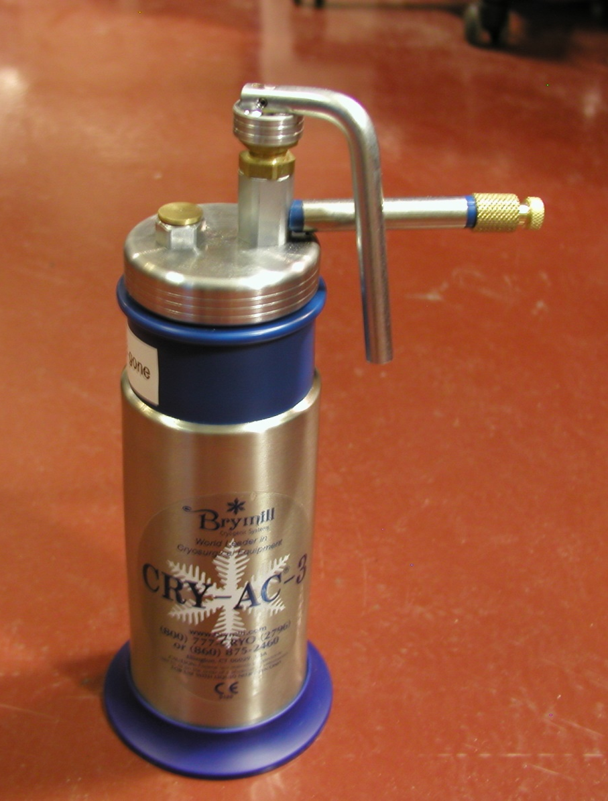
Giving remote the “human touch”
Overall best way to remove ice
requires human hand
Pressure + liquid
Removes stubborn ice
Proximity
No warm gas
Minimal cold gas
Must be compact
Must refill

Slide 24
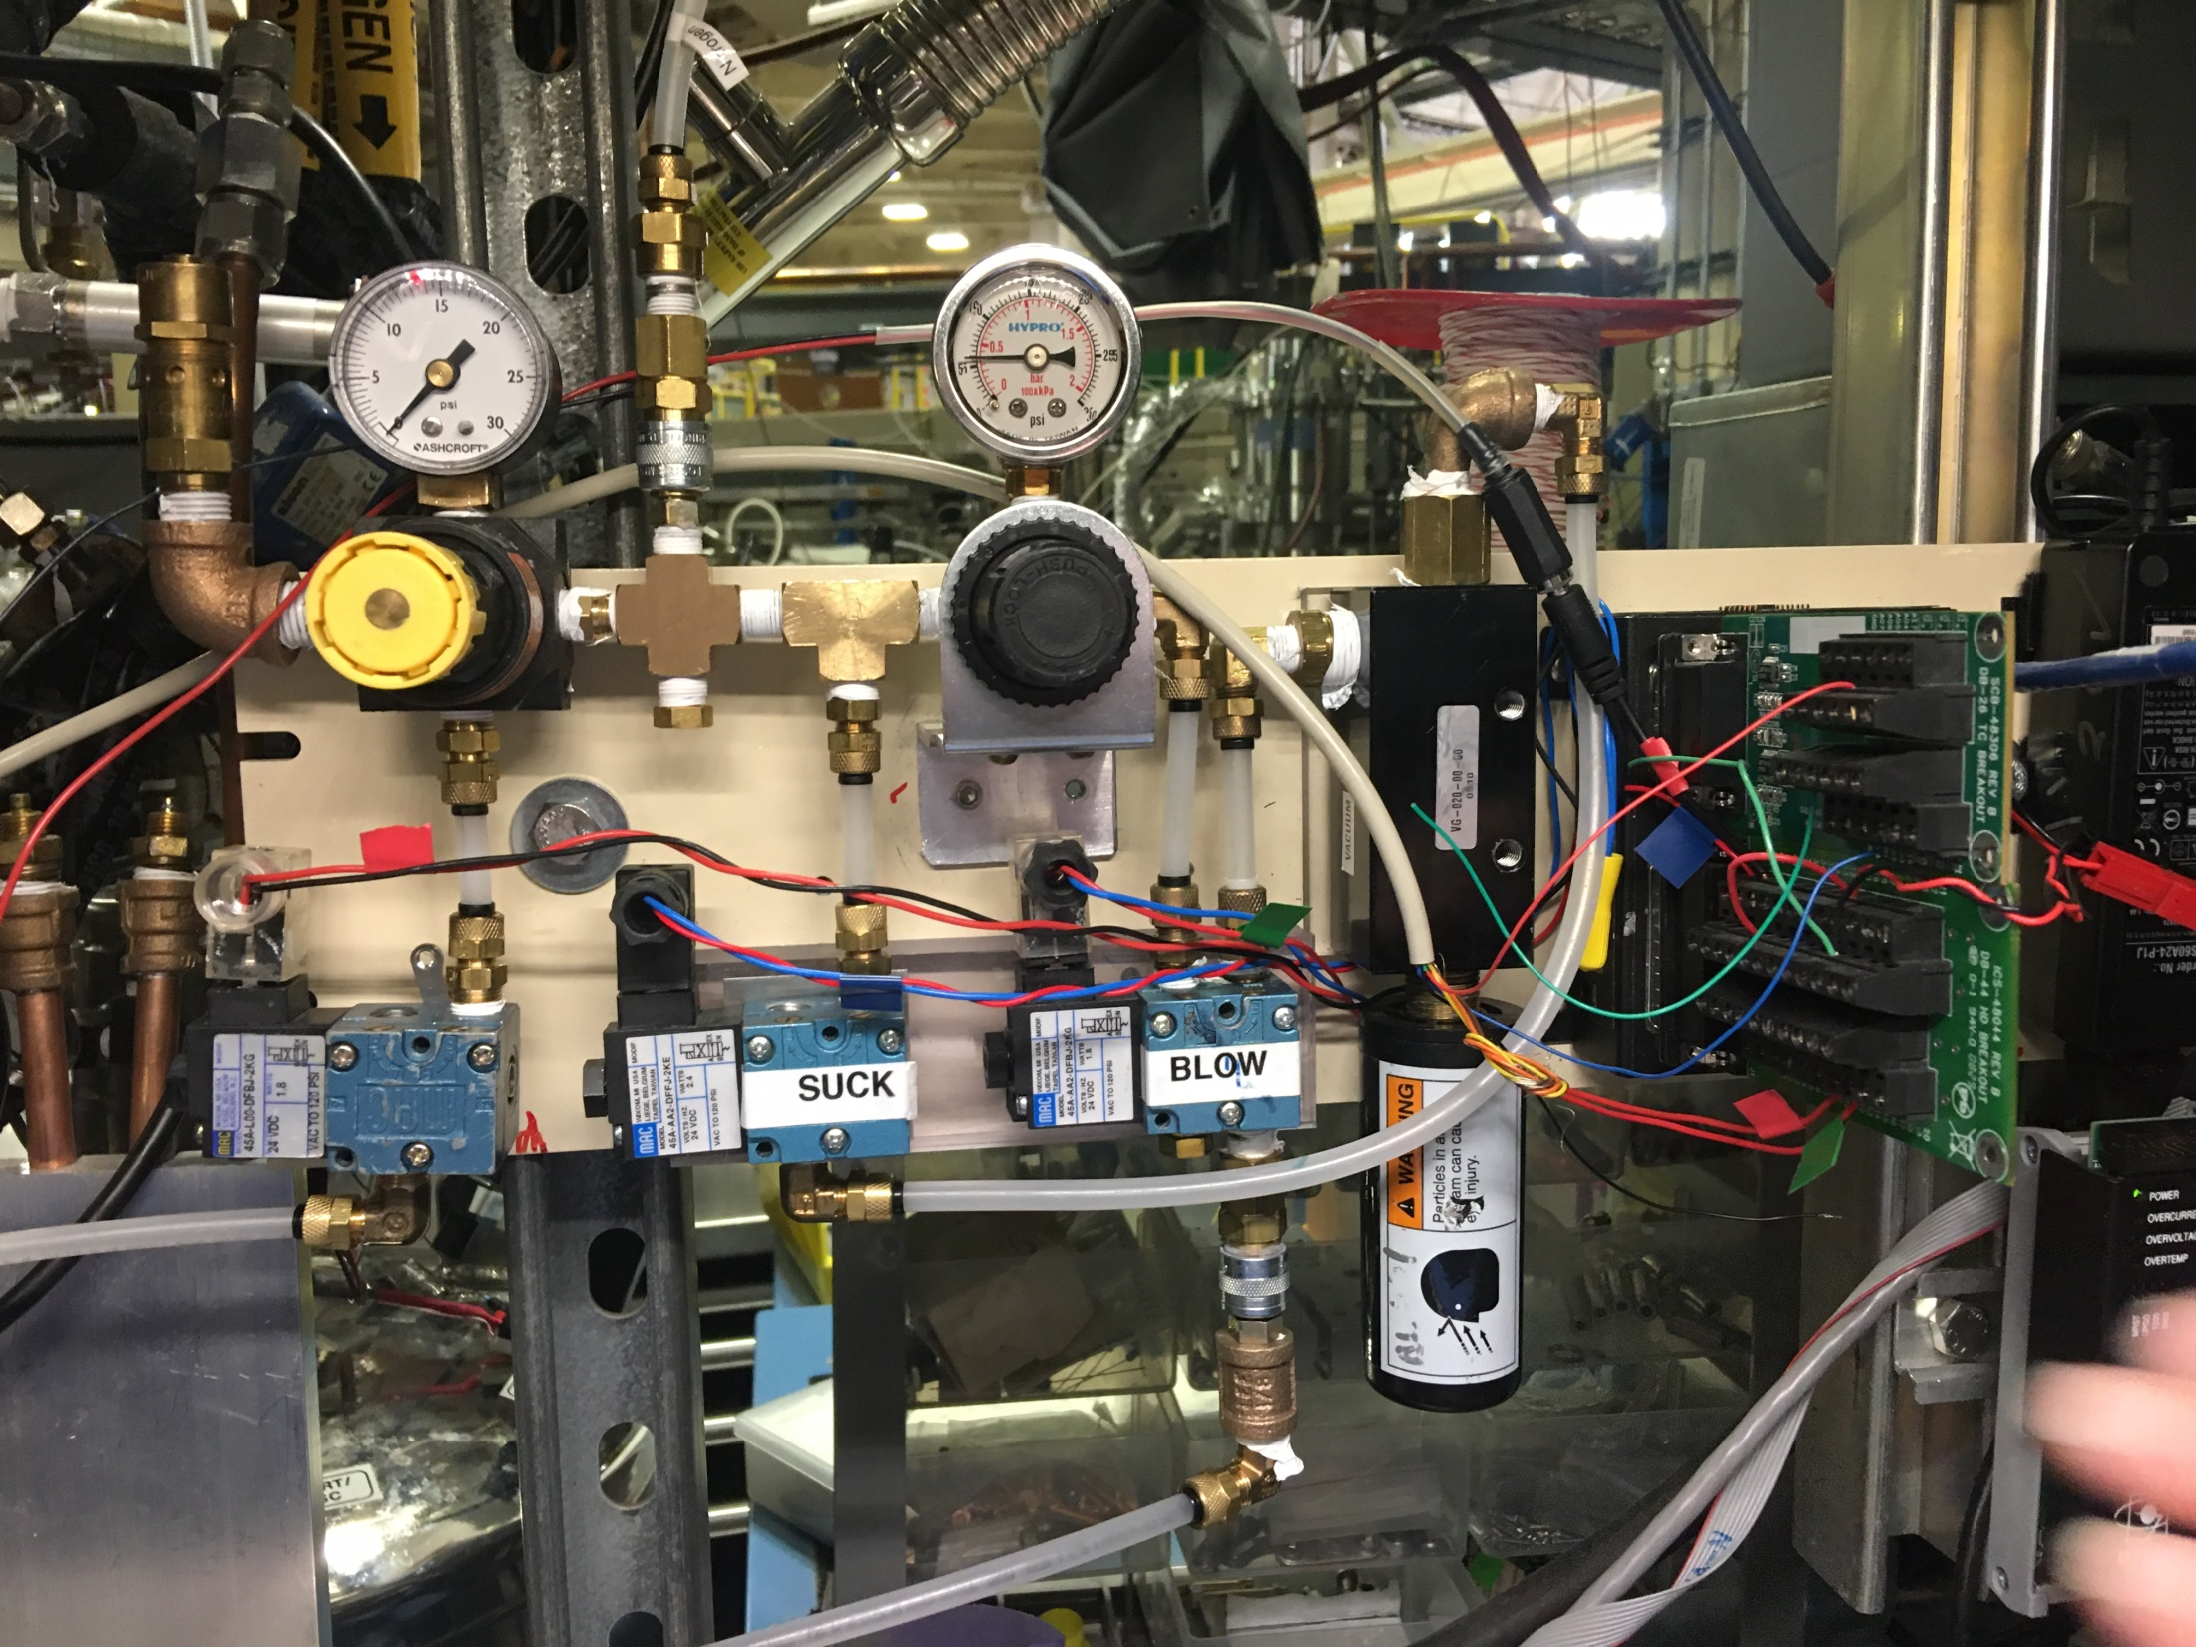

Slide 25
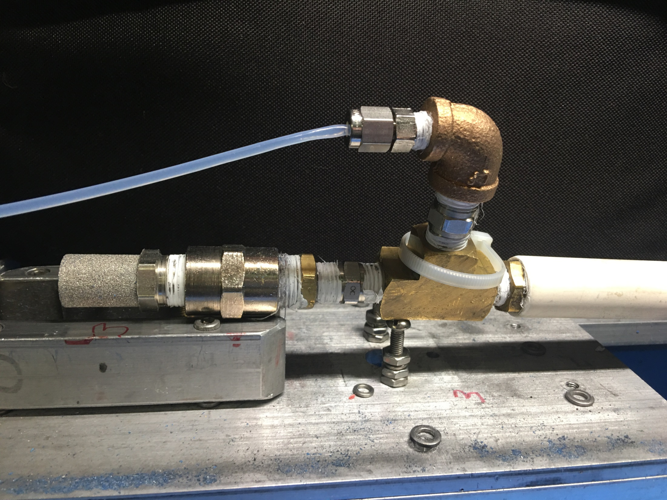

Slide 27
SBS
format
crystallization
tray
mirror
pinhole
microscope
Notes:
Inspired by the ESRF microcrystal camera, the superbend endstations are all equipped with zero-paralax optics. The user sees their sample from the point of view of the x-ray beam. Sample alignment is not only more stable but more intuitive than an off-axis camera. Placing the crystal into the microscope crosshairs gaurantees that it will be hit by the beam.

Slide 28
in-situ diffraction trays
~50 μm tape
~50 μm tape
~50 μm tape
PDMS
PDMS
250 μm
100 μm
25 μm
200 μm
1000 μm
Fluidigm
Topaz® DC
Microlytic
Crystal Former™
NatX-ray
CrystalQuick™ X
MiTeGen
in-situ-1
CrystalDirect
Notes:
Next slide please

Slide 29
Lockdown impact on TomAlberTron

Slide 30
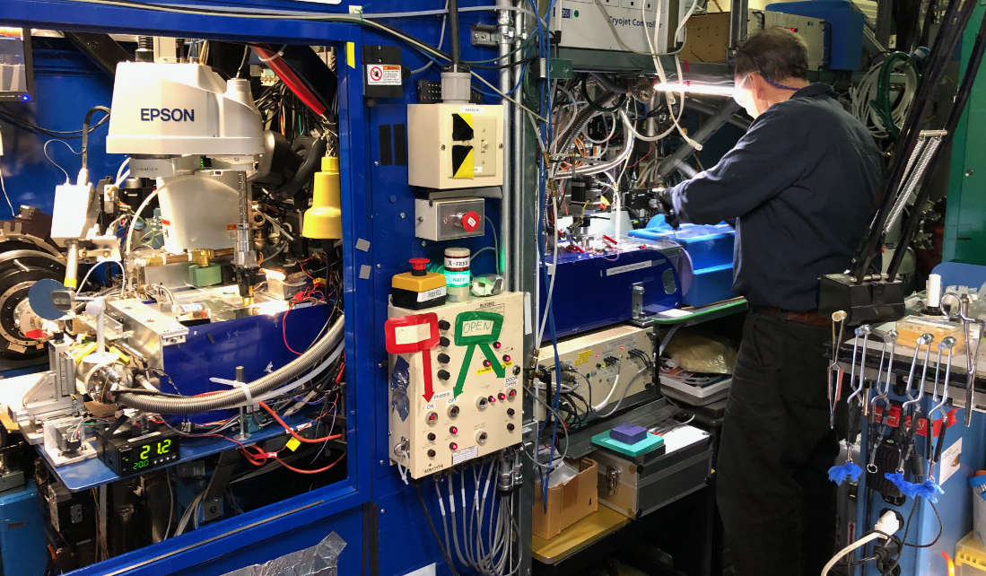
Robotics upgrade

Slide 31
Future Plans
“puck unpacker” – wide sample range
Make remote more like in-person
Survive ALS-U

Slide 32
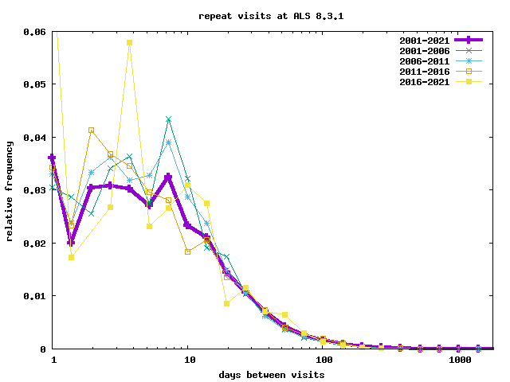
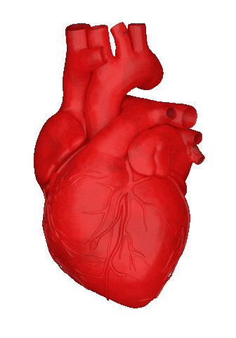
Long ALS-U shutdowns will impact MX
22 ± 17 days

Slide 33
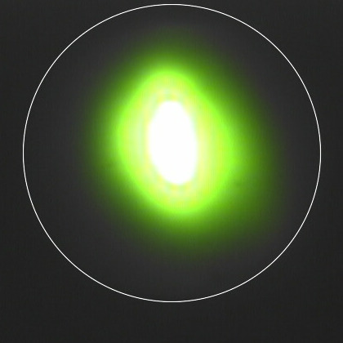
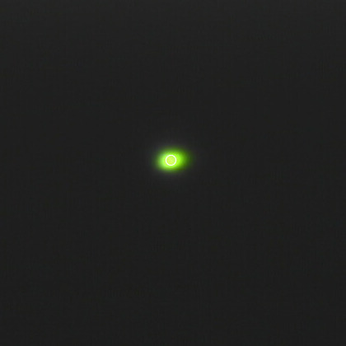
Benefit from ASL-U?
80 x 60
10 x 10
Thank you:
Howard Padmore
Alastair MAcDowell
60 x 40

Slide 34
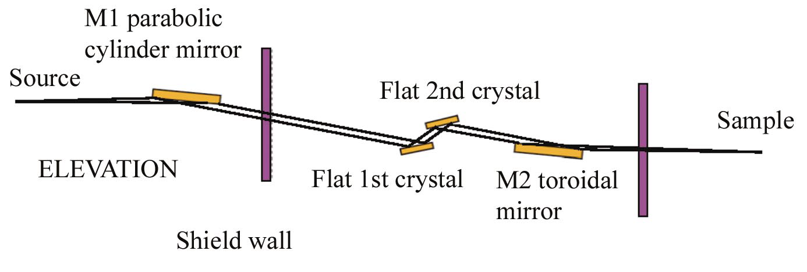
Al
foil
Convergence
Slits
5 cm YAG
diagnostic

Slide 35
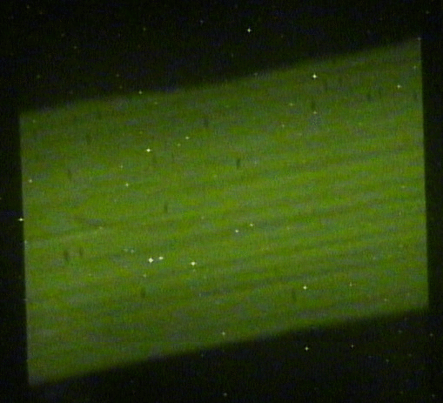
Y2

Slide 36
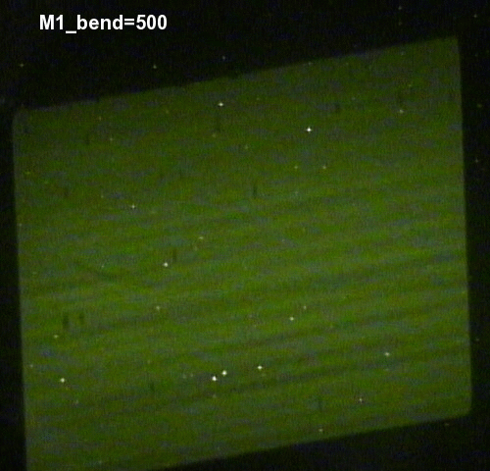

Slide 37
Mono= -2 mm
Mono= 0 mm
Mono= +2 mm
Sweeping
Theta2
over
Si(333)
Rocking
Curve
Unscaled mono = 0 mm

Slide 38
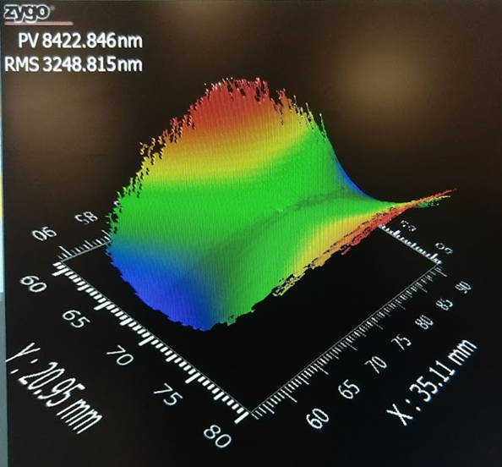
Culprit?: 1st mono crystal

Slide 39
Summary
http://bl831.als.lbl.gov/~jamesh/powerpoint/
ALS831_MOU_2021.pptx
ALS 8.3.1 is TomAlberTron
Diverse users & samples
In-person advantage
Future AI
Surviving ALS-U?

