Slide 1
Acknowledgements
Pawel Janowski Pavel Afonine
David Cerutti Dave Case
UCSF LBNL SLAC
ALS 8.3.1 creator: Tom Alber
Integrated Diffraction Analysis Technologies (IDAT)
Center for Structure of Membrane Proteins (CSMP)
Membrane Protein Expression Center II (MPEC)
Center for HIV Accessory and Regulatory Complexes (HARC)
UC Multicampus Research Programs and Initiatives (MRPI)
UCSF Program for Breakthrough Biomedical Research (PBBR) Plexxikon, Inc.
M D Anderson CRC
The Advanced Light Source is supported by the Director, Office of Science, Office of Basic Energy Sciences, Materials Sciences Division, of the US Department of Energy under contract No. DE-AC02-05CH11231 at Lawrence Berkeley National Laboratory.

Slide 3
Crystallographer’s view on “models”
What is the resolution?
What is the R factor?
What is the observations/parameters?
Is it “phase bias”?
Is it “model bias”?
Are you “fitting noise”?

Slide 4
Crystallographer’s view on “models”
What is the resolution?
What is the R factor?
What is the observations/parameters?
Is it “phase bias”?
Is it “model bias”?
Are you “fitting noise”?

Slide 5
“R” factors
R = % error

Slide 6
“R” factors for macromolecules
R_{work} (or just “R”)
observed vs calculated data (Fs)
R_{free}
cross-check with “random” subset of data
should be < 0.3 and < R_{work} + 0.1

Slide 7
Crystallographer’s view on “models”
What is the resolution?
What is the R factor?
What is the observations/parameters?
Is it “phase bias”?
Is it “model bias”?
Are you “fitting noise”?

Slide 8
Fitting data
structure factor (F)
spot index (h)

Slide 9
Fitting data
structure factor (F)
spot index (h)

Slide 10
Fitting data
structure factor (F)
spot index (h)

Slide 11
Fitting data
structure factor (F)
spot index (h)

Slide 12
Fitting data
structure factor (F)
R_{free}
spot index (h)

Slide 13
“R” factors for macromolecules
R_{work} (or just “R”)
observed vs calculated data (Fs)
R_{free}
cross-check with “random” subset of data
should be < 0.3 and < R_{work} + 0.1
R_{sym} = R_{merge} (self-consistency of data: Is)

Slide 14
“R” factors for macromolecules
R_{work} (or just “R”)
observed vs calculated data (Fs)
R_{free}
cross-check with “random” subset of data
should be < 0.3 and < R_{work} + 0.1
R_{sym} = R_{merge} (self-consistency of data: Is)
R_{rim} R_{pim} R_{meas}
R_{iso} R_{anom}
R_{diff}

Slide 15
“R” factors
completely random: 0.59
starting MR solution: 0.4-0.55
“correct” structure: < 0.2
self-consistency of data: ~ 0.05

Slide 16
“R-factor Gap” for macromolecules
Publication criterion for chemical crystallography:
R1 < 2*R_{sigma}
R1 = F_{o} vs F_{c} for I/σ(I) > 3
R_{sigma} = <σ(I)>/<I>
There are no PDB entries that pass this test!
Holton et al. (2014) "The R-factor gap", FEBS J. 281, 4046-4060.

Slide 17
Darwin’s Formula
V_{xtal}
λ³ L
I_{spot} = I_{beam} r_{e}²
P A | F₀e^{-Bs2} |²
V_{cell}
ωV_{cell}
I_{spot} - photons/spot (fully-recorded)
I_{beam} - incident (photons/s/m² )
r_{e} - classical electron radius (2.818x10⁻¹⁵ m)
V_{xtal} - volume of crystal (in m³)
V_{cell} - volume of unit cell (in m³)
λ - x-ray wavelength (in meters!)
ω - rotation speed (radians/s)
L - Lorentz factor (speed/speed)
P - polarization factor
A - attenuation factor
F₀ - structure factor at T = 0
B - Debye-Waller-Ott factor
s - 0.5/d-spacing
C. G. Darwin (1914)

Slide 18
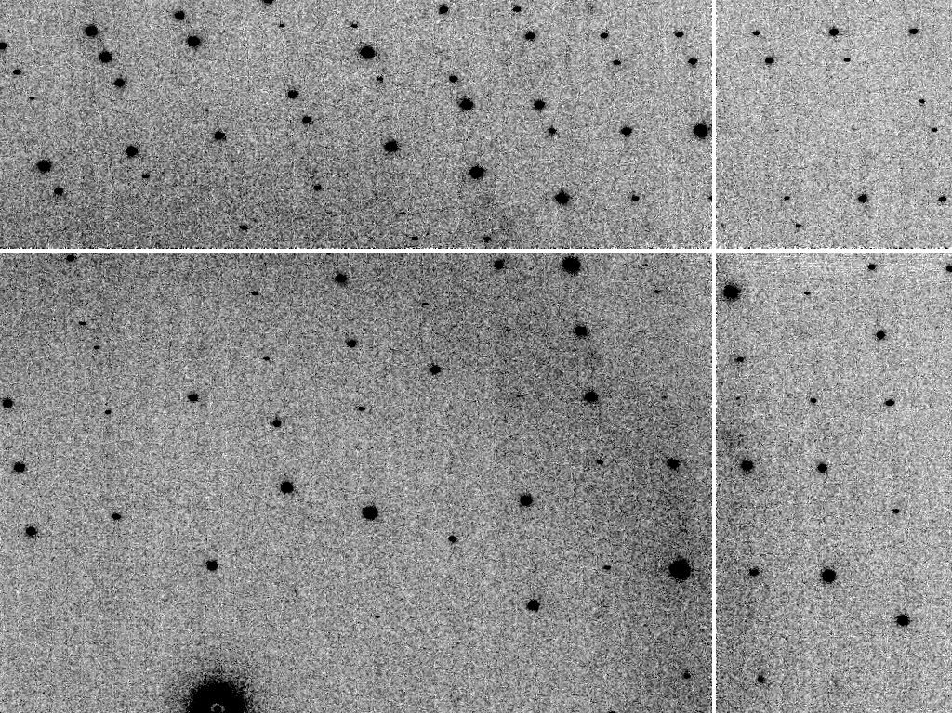
Is it Real? Or is it MLFSOM
simulated
real

Slide 19
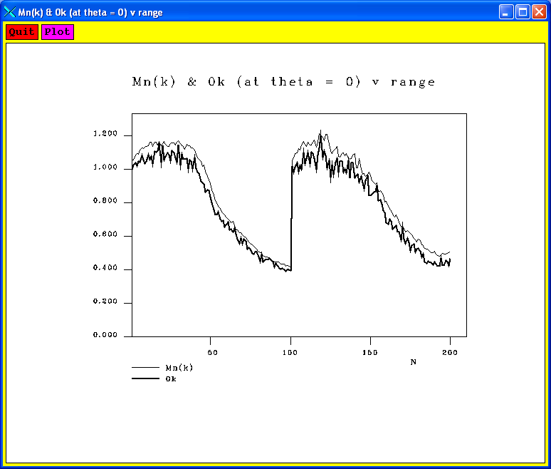
Simulated diffraction image (2008)
simulated
real

Slide 20
Simulated | statistic | Real
5.4% | R_{merge} | 6.2%
18.9 | I/sd | 16.2
1.9 | I/sd (1.4 Ǻ) | 1.6
1.7 4.0 0.020 | SDCORR | 1.0 2.2 0.065
36.8 | PADFPH | 31.46
3.871 | mlphare f” | 3.476
0.178 | FOM | 0.192
0.545 | FOMDM | 0.664
0.6270 | CC(1H87) | 0.6090
0.070 | R_{work} | 0.184
0.080 | R_{free} | 0.231

Slide 21
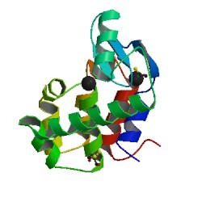
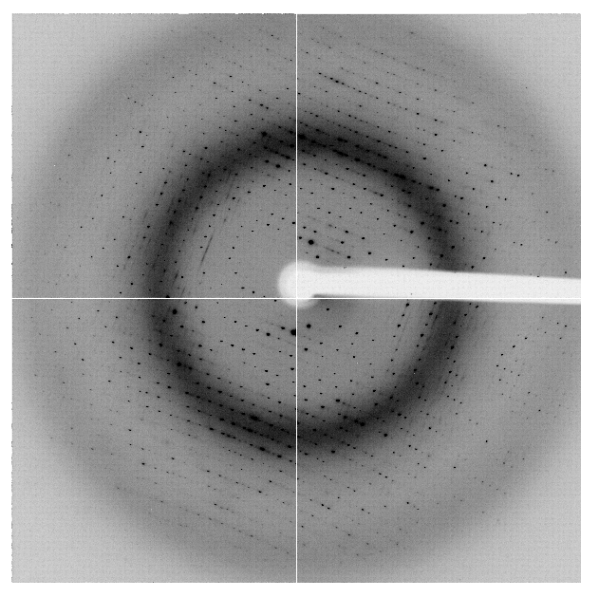
“R-factor Gap” for macromolecules
single-conformer PDB file
R_{merge} = 6%
R_{work} = 7%
R_{free} = 8%
MLFSOM
Elves
1H87; conf “A”

Slide 22
“R-factor Gap” for macromolecules
multi-conformer PDB file
R_{merge} = 6%
R_{work} = 17%
R_{free} = 20%
MLFSOM
Elves
1H87

Slide 23
“R-factor Gap” for macromolecules
multi-conformer PDB file
R_{merge} = 6%
R_{work} = 7%
R_{free} = 8%
MLFSOM
Elves
1H87

Slide 24
“R-factor Gap” for macromolecules
MX data quality is not limiting
Hypotheses:
Hidden systematic error?
Model-building problem?
Representation problem?

Slide 25
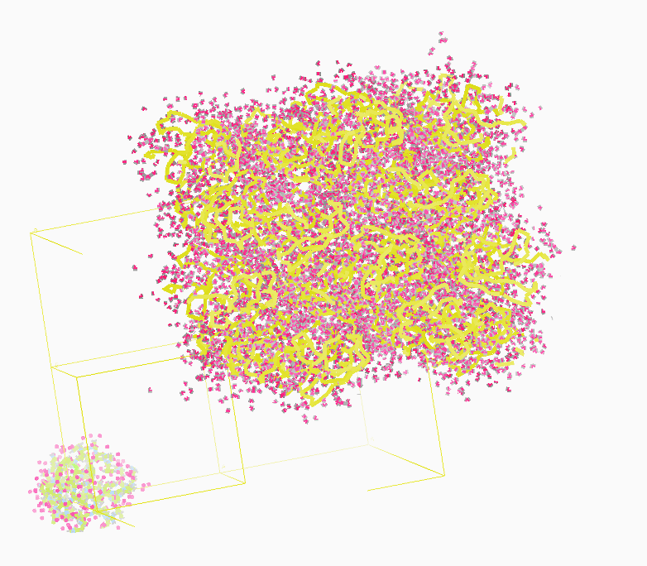
Molecular Dynamics Simulation
using real
crystal’s lattice
1aho
Scorpion toxin
0.96 Å resolution
64 residues
Solvent: H₂0 + acetate
Cerutti et al. (2010).J. Phys. Chem. B 114, 12811-12824.

Slide 26
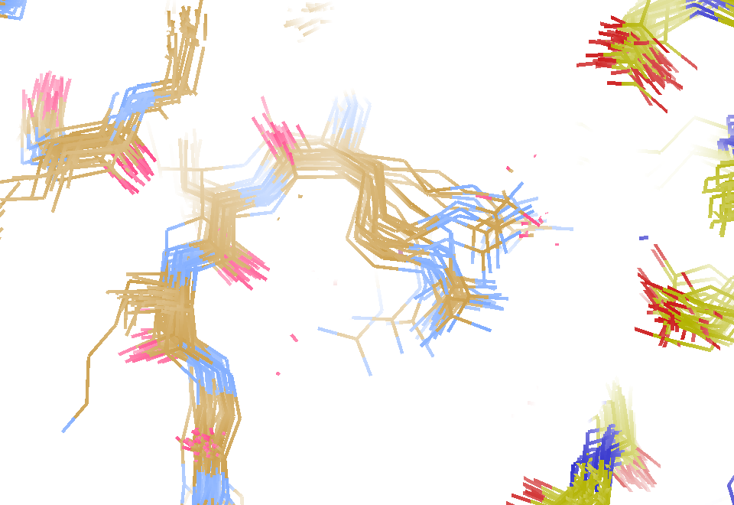
MD simulation: 30 conformers from 24,000
Cerutti et al. (2010).J. Phys. Chem. B 114, 12811-12824.

Slide 27
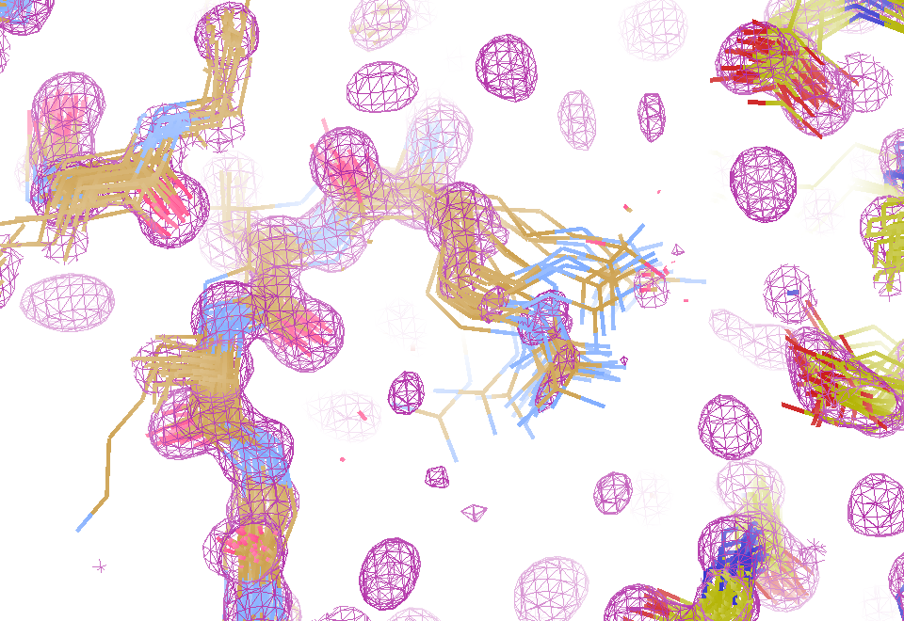
Electron density from 24,000 conformers

Slide 28
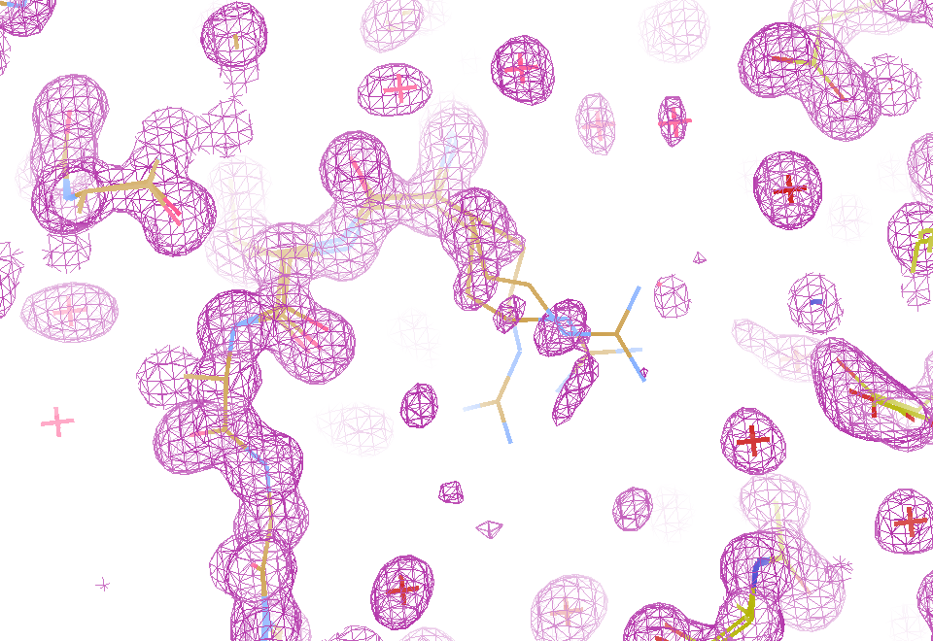
Electron density from 24,000 conformers

Slide 29
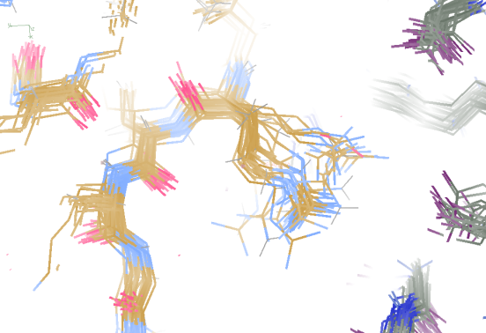
Molecular Dynamics vs X-rays
1aho 64-residue scorpion toxin in water to 1.0 Å resolution
refined_vs_Fsim.pdb
F_{calc}
F_{sim}
R_{work} = 0.137

Slide 30
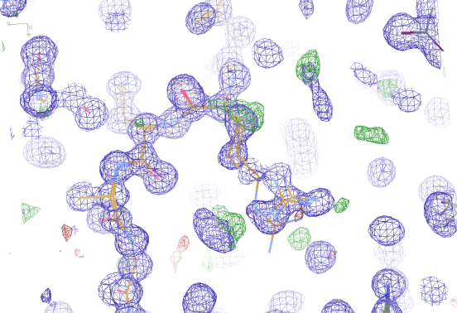
Molecular Dynamics vs X-rays
1aho 64-residue scorpion toxin in water to 1.0 Å resolution
refined_vs_Fsim.pdb
1aho.cif
1aho.pdb
F_{calc}
F_{sim}
F_{obs}
F_{calc}
R_{free} = 0.69
R_{work} = 0.137
R_{free} =
R_{work} = 0.116
R_{free} = 0.48 to 4 Å
rmsd = 1.05 Å
LSQ rmsd = 0.43Å

Slide 31
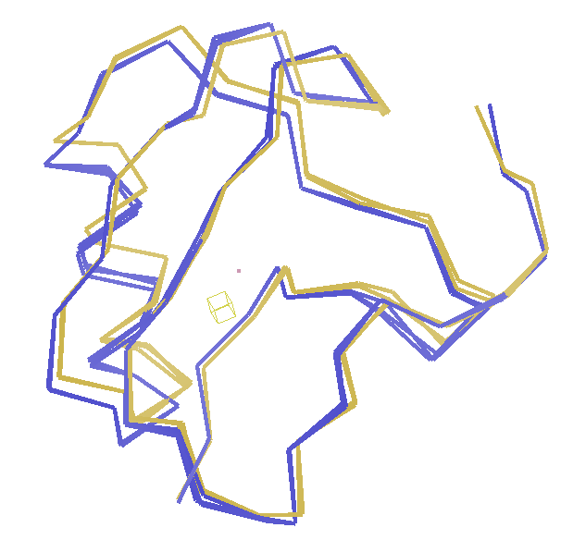
Molecular Dynamics vs X-rays
RMSD
1.05 Å

Slide 32
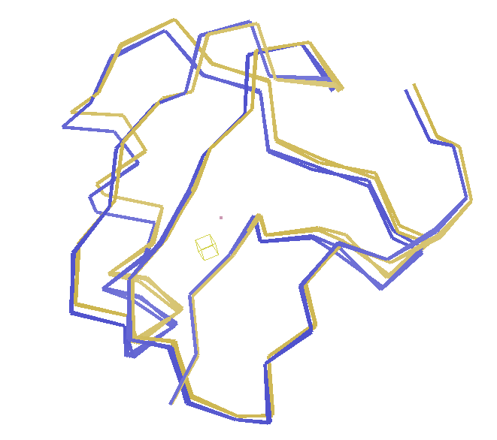
Molecular Dynamics vs X-rays
RMSD
0.45 Å
aligned

Slide 33
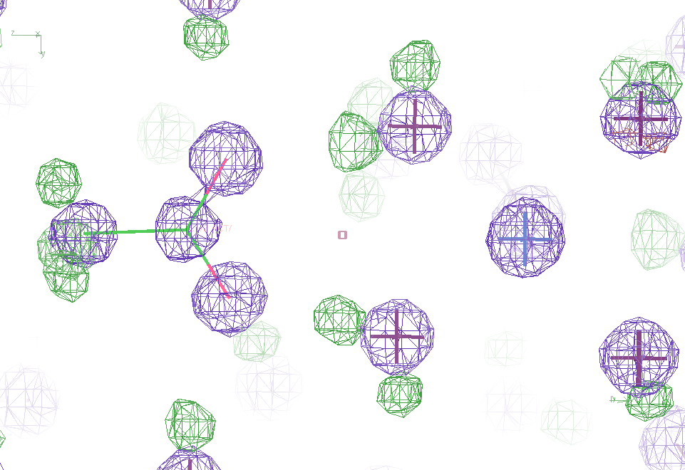
Molecular Dynamics vs X-rays
Sodium acetate trihydrate
5 atoms
3 waters
0.9 Å resolution
C2/c
R_{vault} = 0.03

Slide 34
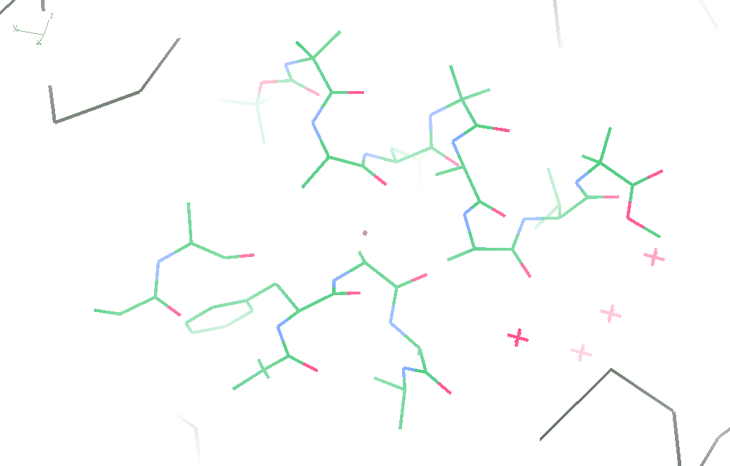
Molecular Dynamics vs X-rays
fav8
8 residues
4 waters
1.0 Å resolution
P1

Slide 35
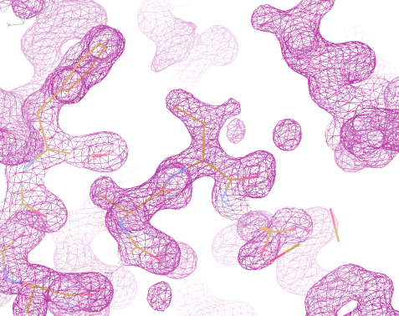
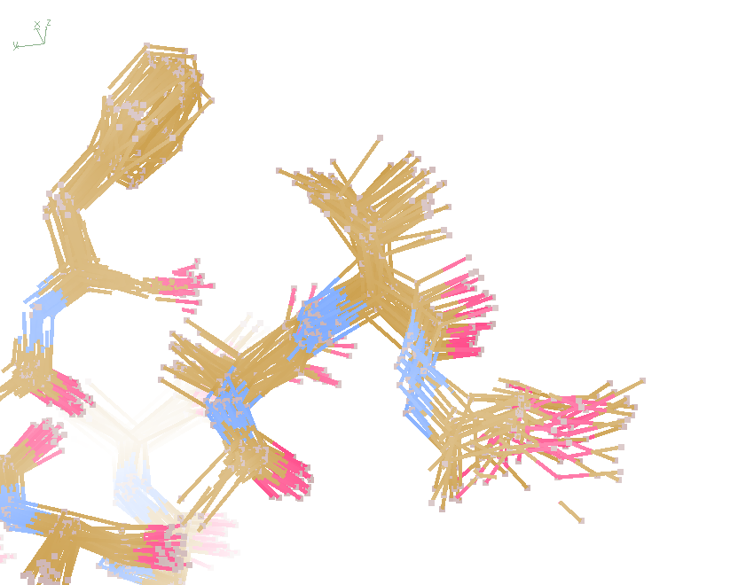
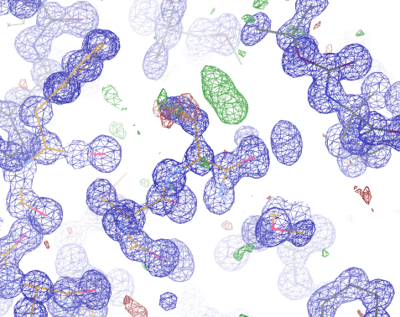
Molecular Dynamics vs X-rays
“fav8” 8-residue aromatic peptide with 4 waters to 1.0 Å resolution
refined_vs_Fsim.pdb
fav8.fcf
fav8.cif
F_{calc}
F_{sim}
F_{obs}
F_{calc}
R_{work} = 0.13
R_{free}= 0.23
R_{work} = 0.16
R_{free} = 0.20 to 2Å
R1 = 0.041
With 4σ cutoff!
rmsd = 0.20 Å
LSQ rmsd = 0.091Å & 0.15 Å

Slide 36
MD-predicted Val rotamer
Janowski et al (2013) JACS 135, 7938-7948

Slide 37
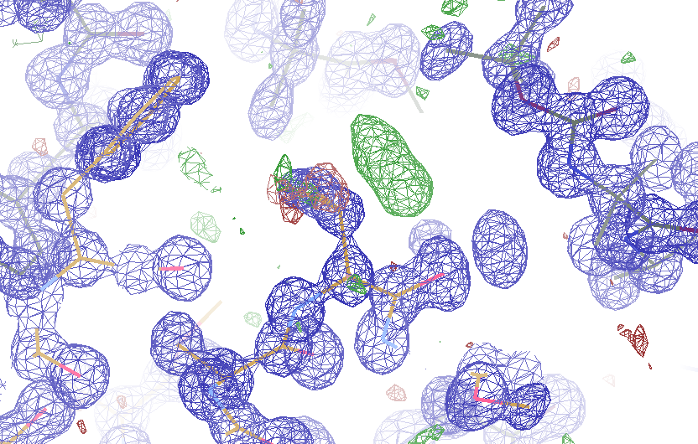
MD-predicted Val rotamer
confs | R_{work} | R_{free}
one | 4.11% | 5.84%
A & B | 3.89% | 5.53%
Janowski et al (2013) JACS 135, 7938-7948

Slide 38
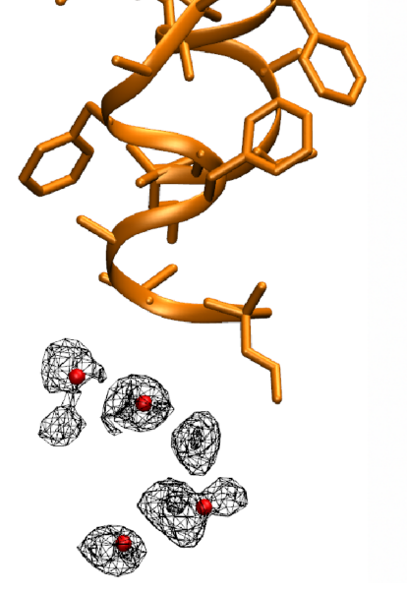
MD-predicted water structure
Simulated
density
Janowski et al (2013) JACS 135, 7938-7948

Slide 39
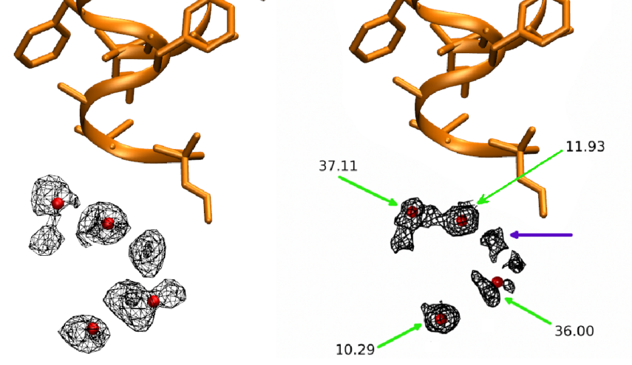
MD-predicted water structure
Simulated
density
2mF_{o}-DF_{c}
Janowski et al (2013) JACS 135, 7938-7948

Slide 40
How many waters are there?
R_{free} : F_{sim} vs F_{obs} (%)
Water molecules / unit cell

Slide 41
Electron density from 24,000 conformers

Slide 42
MLFSOM simulation

Slide 43
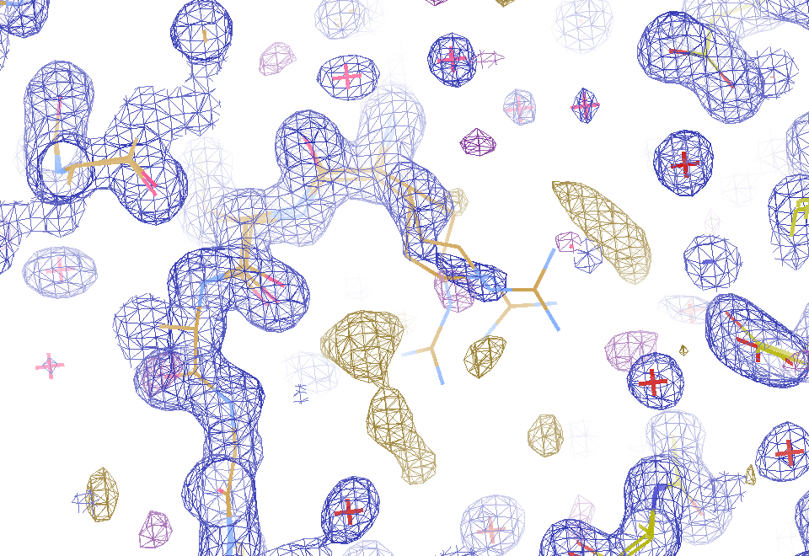
2F_{sim}-F_{calc} and F_{sim}-F_{calc} maps
1.0 Å data
R_{work} = 0.137
R_{free} = 0.159
1 “sigma” 2F_{sim}-F_{c}
2.5 “sigma” F_{sim}-F_{c}

Slide 44
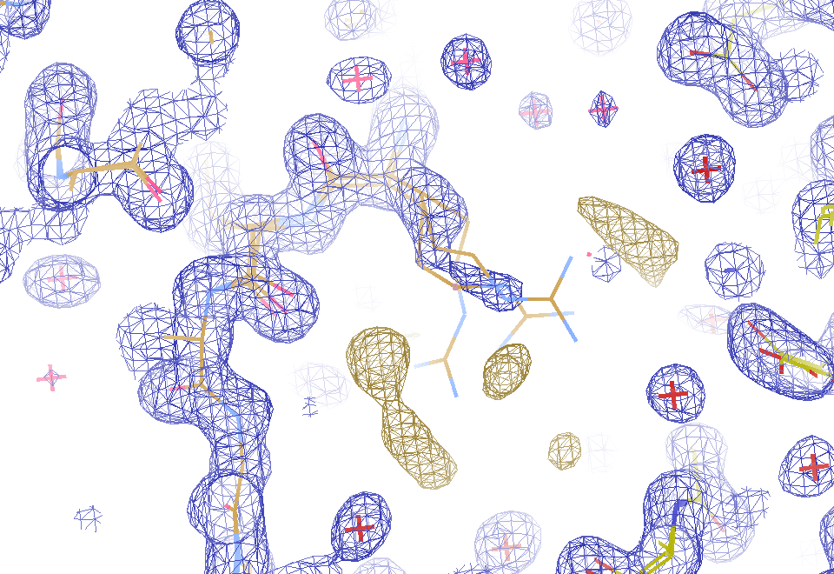
2F_{sim}-F_{calc} and (F_{sim} Φ_{sim}) - (F_{calc} Φ_{calc}) maps
1.0 Å data
R_{work} = 0.137
R_{free} = 0.159
1 “sigma” 2F_{sim}-F_{c}
F_{right} – (2F_{sim}-F_{c})

Slide 45
MD simulation: 30 conformers from 24,000
Cerutti et al. (2010).J. Phys. Chem. B 114, 12811-12824.

Slide 46
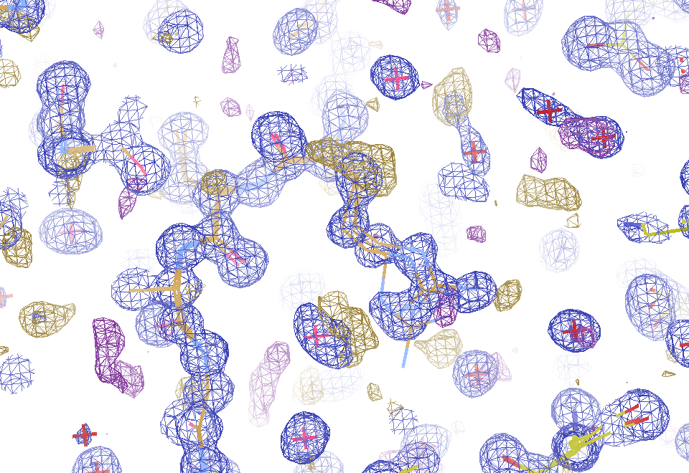
Conventional model vs X-ray data
1.0 Å data
R_{work} = 0.116
R_{free} = 0.135
1 “sigma” 2F_{sim}-F_{c}
2.5 “sigma” F_{sim}-F_{c}

Slide 47
2F_{sim}-F_{calc} and F_{sim}-F_{calc} maps
1.0 Å data
R_{work} = 0.137
R_{free} = 0.159
1 “sigma” 2F_{sim}-F_{c}
2.5 “sigma” F_{sim}-F_{c}

Slide 48
Crystallographer’s view on “models”
What is the resolution?
What is the R factor?
What is the observations/parameters?
Is it “phase bias”?
Is it “model bias”?
Are you “fitting noise”?
No
No
No

Slide 49
“R-factor Gap” for macromolecules
MX data quality is not limiting
Hypotheses:
Hidden systematic error?
Model-building problem?
Representation problem?

Slide 50
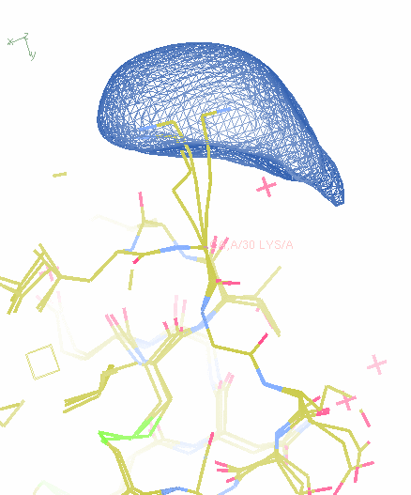
What of we knew “everything”?
How to
describe it?

Slide 51
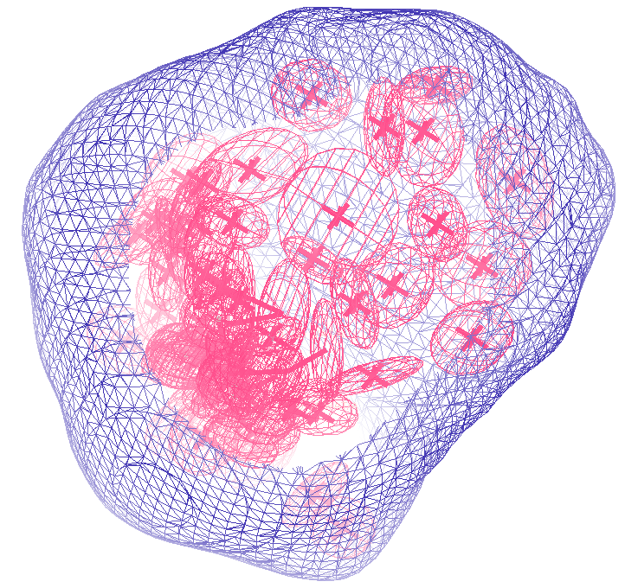
How many conformers are there?
Answer: 40
R_{work} = 0.0506
R_{free} = 0.0556
vs F_{sim}

Slide 52
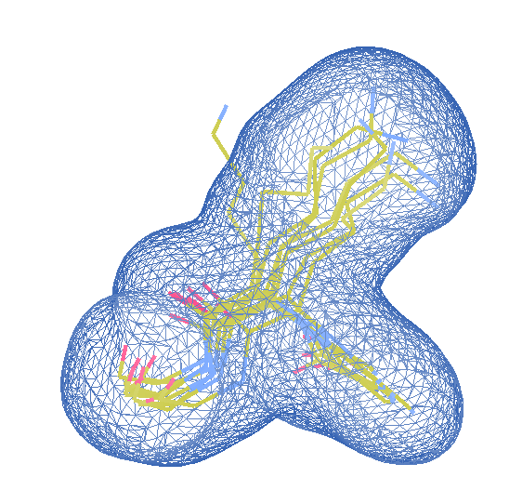
How many conformers are there?
Answer: 8
R_{work} = 0.0297
R_{free} = 0.0293
vs F_{sim}

Slide 53
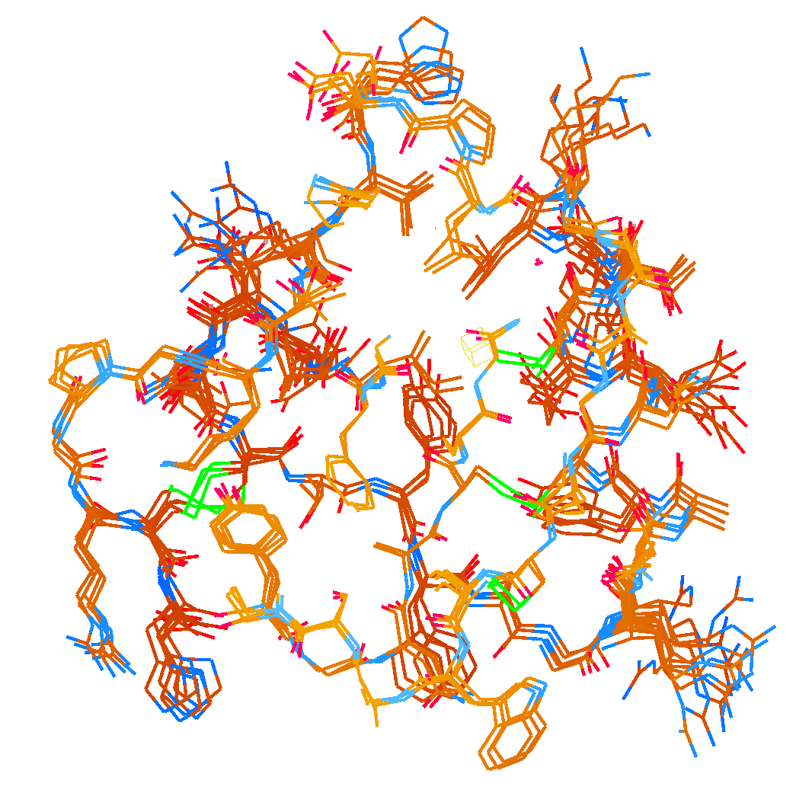
How many conformers are there?
Answer: 2-14
R_{work} = 0.0441
R_{free} = 0.0516
vs F_{sim}
No solvent!

Slide 54
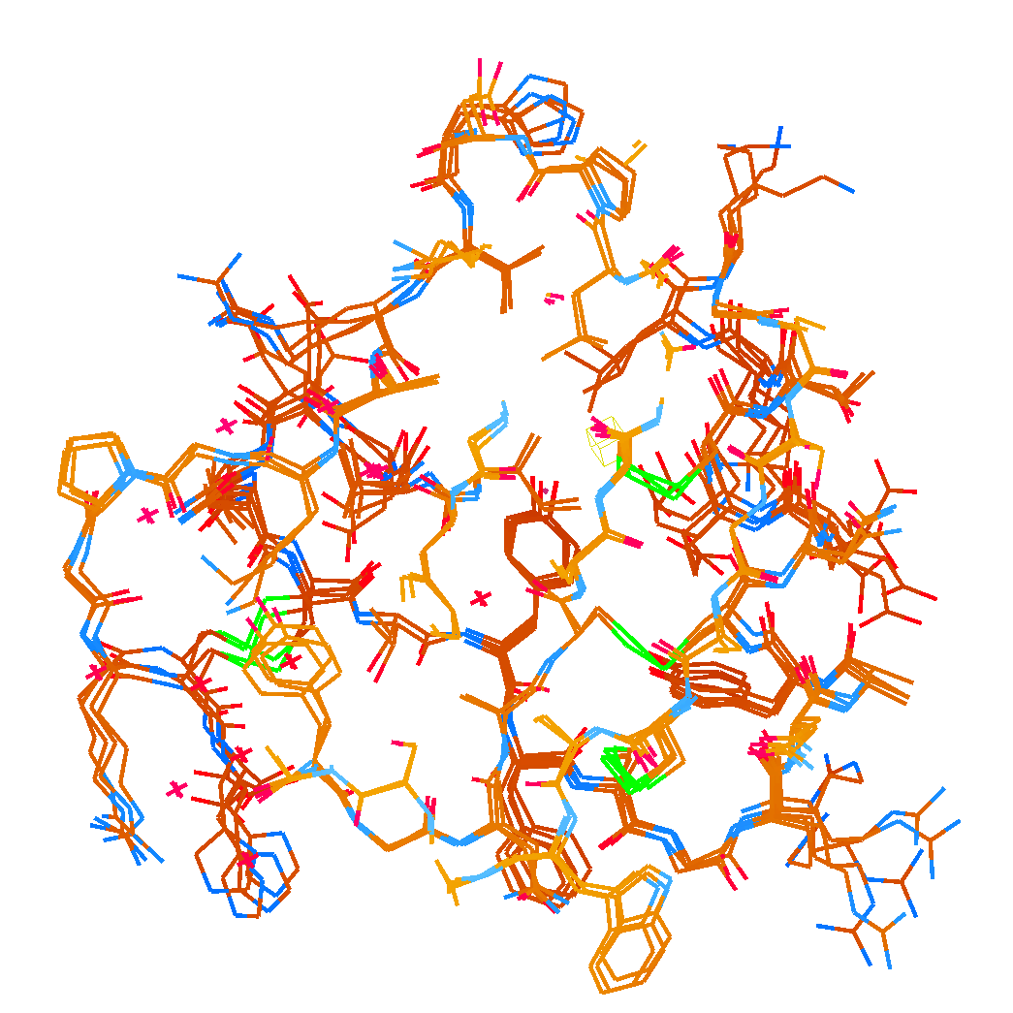
How many conformers are there?
Answer: 1-7
R_{work} = 0.1546
R_{free} = 0.1749
vs F_{obs}
as deposited:
R_{work} = 0.1630
R_{free} = n/d

Slide 55
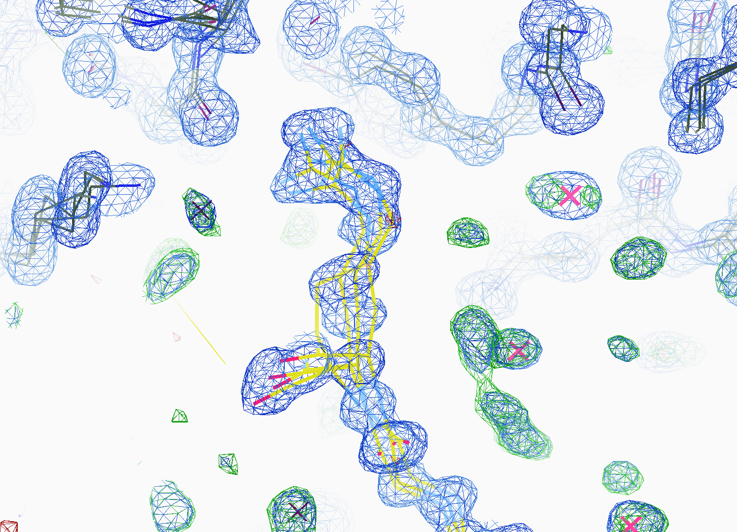
How many conformers are there?
All difference
features
are in
the solvent!
real data

Slide 56
How rough is the solvent?
Electron number density (e⁻/Å³)
x along line y=z=0 (Å)

Slide 57
How rough is the solvent?
Electron number density (e⁻/Å³)
x along line y=z=0 (Å)

Slide 58
How rough is the solvent?
Electron number density (e⁻/Å³)
x along line y=z=0 (Å)

Slide 59
How rough is the solvent?
Electron number density (e⁻/Å³)
x along line y=z=0 (Å)

Slide 60
How rough is the solvent?
Electron number density (e⁻/Å³)
x along line y=z=0 (Å)

Slide 61
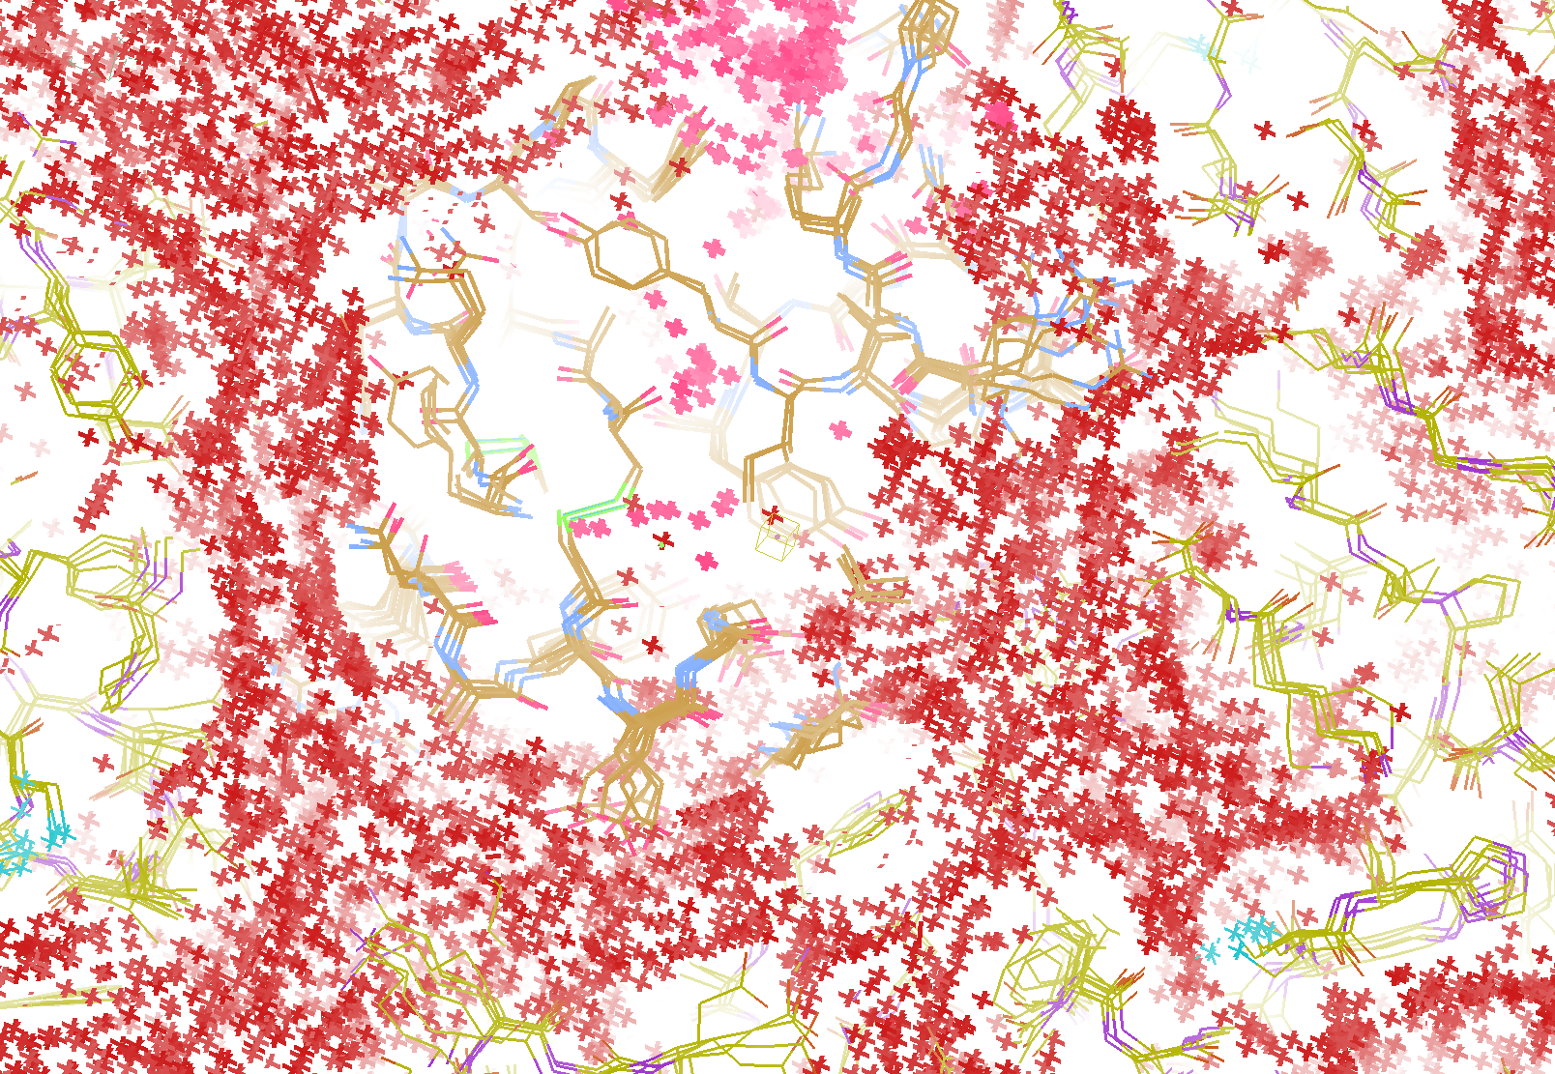
How “rough” is the solvent?
R_{work} = 0.0309
R_{free} = 0.0678
vs F_{sim}

Slide 62
RISM model for “bulk” solvent
Method | R_{work} | R_{free}
Default refmac5: flat bulk solvent | .1784 | .1898
RISM – self-consistent density field based on electrostatics | .1640 | .1808
Explicit MD solvent, protein fixed | .1523 | .1690

Slide 63
Solvent boundary problem

Slide 64
Solvent boundary problem

Slide 65
Solvent boundary problem

Slide 66
Solvent boundary problem

Slide 67
Current implementation

Slide 68
Better implementation?

Slide 69
0.00
0.20
0.39
0.57
0.72
0.86
1.00
Glu 24
A
B
C
D
E
F
0.24
0.41
0.55
0.68
0.79
0.90
Arg 18
A
B
C
D
E
F
G
0.28
0.55
0.80
Tyr 21
A
B
C
D
0.28
0.48
0.65
0.77
0.89
Asp 9
A
B
C
D
E
F
0.3
0.60
0.83
His 54
A
B
C
D
0.3
0.59
0.81
Pro 60
A
B
C
D

Slide 70
20%
0.00
0.20
0.39
0.57
0.72
0.86
1.00
Glu 24
A
B
C
D
E
F
0.24
0.41
0.55
0.68
0.79
0.90
Arg 18
A
B
C
D
E
F
G
0.28
0.55
0.80
Tyr 21
A
B
C
D
0.28
0.48
0.65
0.77
0.89
Asp 9
A
B
C
D
E
F
0.3
0.60
0.83
His 54
A
B
C
D
0.3
0.59
0.81
Pro 60
A
B
C
D

Slide 71
4%
0.00
0.20
0.39
0.57
0.72
0.86
1.00
Glu 24
A
B
C
D
E
F
0.24
0.41
0.55
0.68
0.79
0.90
Arg 18
A
B
C
D
E
F
G
0.28
0.55
0.80
Tyr 21
A
B
C
D
0.28
0.48
0.65
0.77
0.89
Asp 9
A
B
C
D
E
F
0.3
0.60
0.83
His 54
A
B
C
D
0.3
0.59
0.81
Pro 60
A
B
C
D

Slide 72
4%
0.00
0.20
0.39
0.57
0.72
0.86
1.00
Glu 24
A
B
C
D
E
F
0.24
0.41
0.55
0.68
0.79
0.90
Arg 18
A
B
C
D
E
F
G
0.28
0.55
0.80
Tyr 21
A
B
C
D
0.28
0.48
0.65
0.77
0.89
Asp 9
A
B
C
D
E
F
0.3
0.60
0.83
His 54
A
B
C
D
0.3
0.59
0.81
Pro 60
A
B
C
D

Slide 73
2%
0.00
0.20
0.39
0.57
0.72
0.86
1.00
Glu 24
A
B
C
D
E
F
0.24
0.41
0.55
0.68
0.79
0.90
Arg 18
A
B
C
D
E
F
G
0.28
0.55
0.80
Tyr 21
A
B
C
D
0.28
0.48
0.65
0.77
0.89
Asp 9
A
B
C
D
E
F
0.3
0.60
0.83
His 54
A
B
C
D
0.3
0.59
0.81
Pro 60
A
B
C
D

Slide 74
9%
0.00
0.20
0.39
0.57
0.72
0.86
1.00
Glu 24
A
B
C
D
E
F
0.24
0.41
0.55
0.68
0.79
0.90
Arg 18
A
B
C
D
E
F
G
0.28
0.55
0.80
Tyr 21
A
B
C
D
0.28
0.48
0.65
0.77
0.89
Asp 9
A
B
C
D
E
F
0.3
0.60
0.83
His 54
A
B
C
D
0.3
0.59
0.81
Pro 60
A
B
C
D

Slide 75
2%
0.00
0.20
0.39
0.57
0.72
0.86
1.00
Glu 24
A
B
C
D
E
F
0.24
0.41
0.55
0.68
0.79
0.90
Arg 18
A
B
C
D
E
F
G
0.28
0.55
0.80
Tyr 21
A
B
C
D
0.28
0.48
0.65
0.77
0.89
Asp 9
A
B
C
D
E
F
0.3
0.60
0.83
His 54
A
B
C
D
0.3
0.59
0.81
Pro 60
A
B
C
D

Slide 76
7%
0.00
0.20
0.39
0.57
0.72
0.86
1.00
Glu 24
A
B
C
D
E
F
0.24
0.41
0.55
0.68
0.79
0.90
Arg 18
A
B
C
D
E
F
G
0.28
0.55
0.80
Tyr 21
A
B
C
D
0.28
0.48
0.65
0.77
0.89
Asp 9
A
B
C
D
E
F
0.3
0.60
0.83
His 54
A
B
C
D
0.3
0.59
0.81
Pro 60
A
B
C
D

Slide 77
7%
0.00
0.20
0.39
0.57
0.72
0.86
1.00
Glu 24
A
B
C
D
E
F
0.24
0.41
0.55
0.68
0.79
0.90
Arg 18
A
B
C
D
E
F
G
0.28
0.55
0.80
Tyr 21
A
B
C
D
0.28
0.48
0.65
0.77
0.89
Asp 9
A
B
C
D
E
F
0.3
0.60
0.83
His 54
A
B
C
D
0.3
0.59
0.81
Pro 60
A
B
C
D

Slide 78
2%
0.00
0.20
0.39
0.57
0.72
0.86
1.00
Glu 24
A
B
C
D
E
F
0.24
0.41
0.55
0.68
0.79
0.90
Arg 18
A
B
C
D
E
F
G
0.28
0.55
0.80
Tyr 21
A
B
C
D
0.28
0.48
0.65
0.77
0.89
Asp 9
A
B
C
D
E
F
0.3
0.60
0.83
His 54
A
B
C
D
0.3
0.59
0.81
Pro 60
A
B
C
D

Slide 79
2%
0.00
0.20
0.39
0.57
0.72
0.86
1.00
Glu 24
A
B
C
D
E
F
0.24
0.41
0.55
0.68
0.79
0.90
Arg 18
A
B
C
D
E
F
G
0.28
0.55
0.80
Tyr 21
A
B
C
D
0.28
0.48
0.65
0.77
0.89
Asp 9
A
B
C
D
E
F
0.3
0.60
0.83
His 54
A
B
C
D
0.3
0.59
0.81
Pro 60
A
B
C
D

Slide 80
1%
0.00
0.20
0.39
0.57
0.72
0.86
1.00
Glu 24
A
B
C
D
E
F
0.24
0.41
0.55
0.68
0.79
0.90
Arg 18
A
B
C
D
E
F
G
0.28
0.55
0.80
Tyr 21
A
B
C
D
0.28
0.48
0.65
0.77
0.89
Asp 9
A
B
C
D
E
F
0.3
0.60
0.83
His 54
A
B
C
D
0.3
0.59
0.81
Pro 60
A
B
C
D

Slide 81
5%
0.00
0.20
0.39
0.57
0.72
0.86
1.00
Glu 24
A
B
C
D
E
F
0.24
0.41
0.55
0.68
0.79
0.90
Arg 18
A
B
C
D
E
F
G
0.28
0.55
0.80
Tyr 21
A
B
C
D
0.28
0.48
0.65
0.77
0.89
Asp 9
A
B
C
D
E
F
0.3
0.60
0.83
His 54
A
B
C
D
0.3
0.59
0.81
Pro 60
A
B
C
D

Slide 82
3%
0.00
0.20
0.39
0.57
0.72
0.86
1.00
Glu 24
A
B
C
D
E
F
0.24
0.41
0.55
0.68
0.79
0.90
Arg 18
A
B
C
D
E
F
G
0.28
0.55
0.80
Tyr 21
A
B
C
D
0.28
0.48
0.65
0.77
0.89
Asp 9
A
B
C
D
E
F
0.3
0.60
0.83
His 54
A
B
C
D
0.3
0.59
0.81
Pro 60
A
B
C
D

Slide 83
4%
0.00
0.20
0.39
0.57
0.72
0.86
1.00
Glu 24
A
B
C
D
E
F
0.24
0.41
0.55
0.68
0.79
0.90
Arg 18
A
B
C
D
E
F
G
0.28
0.55
0.80
Tyr 21
A
B
C
D
0.28
0.48
0.65
0.77
0.89
Asp 9
A
B
C
D
E
F
0.3
0.60
0.83
His 54
A
B
C
D
0.3
0.59
0.81
Pro 60
A
B
C
D

Slide 84
5%
0.00
0.20
0.39
0.57
0.72
0.86
1.00
Glu 24
A
B
C
D
E
F
0.24
0.41
0.55
0.68
0.79
0.90
Arg 18
A
B
C
D
E
F
G
0.28
0.55
0.80
Tyr 21
A
B
C
D
0.28
0.48
0.65
0.77
0.89
Asp 9
A
B
C
D
E
F
0.3
0.60
0.83
His 54
A
B
C
D
0.3
0.59
0.81
Pro 60
A
B
C
D

Slide 85
2%
0.00
0.20
0.39
0.57
0.72
0.86
1.00
Glu 24
A
B
C
D
E
F
0.24
0.41
0.55
0.68
0.79
0.90
Arg 18
A
B
C
D
E
F
G
0.28
0.55
0.80
Tyr 21
A
B
C
D
0.28
0.48
0.65
0.77
0.89
Asp 9
A
B
C
D
E
F
0.3
0.60
0.83
His 54
A
B
C
D
0.3
0.59
0.81
Pro 60
A
B
C
D

Slide 86
1%
0.00
0.20
0.39
0.57
0.72
0.86
1.00
Glu 24
A
B
C
D
E
F
0.24
0.41
0.55
0.68
0.79
0.90
Arg 18
A
B
C
D
E
F
G
0.28
0.55
0.80
Tyr 21
A
B
C
D
0.28
0.48
0.65
0.77
0.89
Asp 9
A
B
C
D
E
F
0.3
0.60
0.83
His 54
A
B
C
D
0.3
0.59
0.81
Pro 60
A
B
C
D

Slide 87
1%
0.00
0.20
0.39
0.57
0.72
0.86
1.00
Glu 24
A
B
C
D
E
F
0.24
0.41
0.55
0.68
0.79
0.90
Arg 18
A
B
C
D
E
F
G
0.28
0.55
0.80
Tyr 21
A
B
C
D
0.28
0.48
0.65
0.77
0.89
Asp 9
A
B
C
D
E
F
0.3
0.60
0.83
His 54
A
B
C
D
0.3
0.59
0.81
Pro 60
A
B
C
D

Slide 88
2%
0.00
0.20
0.39
0.57
0.72
0.86
1.00
Glu 24
A
B
C
D
E
F
0.24
0.41
0.55
0.68
0.79
0.90
Arg 18
A
B
C
D
E
F
G
0.28
0.55
0.80
Tyr 21
A
B
C
D
0.28
0.48
0.65
0.77
0.89
Asp 9
A
B
C
D
E
F
0.3
0.60
0.83
His 54
A
B
C
D
0.3
0.59
0.81
Pro 60
A
B
C
D

Slide 89
3%
0.00
0.20
0.39
0.57
0.72
0.86
1.00
Glu 24
A
B
C
D
E
F
0.24
0.41
0.55
0.68
0.79
0.90
Arg 18
A
B
C
D
E
F
G
0.28
0.55
0.80
Tyr 21
A
B
C
D
0.28
0.48
0.65
0.77
0.89
Asp 9
A
B
C
D
E
F
0.3
0.60
0.83
His 54
A
B
C
D
0.3
0.59
0.81
Pro 60
A
B
C
D

Slide 90
3%
0.00
0.20
0.39
0.57
0.72
0.86
1.00
Glu 24
A
B
C
D
E
F
0.24
0.41
0.55
0.68
0.79
0.90
Arg 18
A
B
C
D
E
F
G
0.28
0.55
0.80
Tyr 21
A
B
C
D
0.28
0.48
0.65
0.77
0.89
Asp 9
A
B
C
D
E
F
0.3
0.60
0.83
His 54
A
B
C
D
0.3
0.59
0.81
Pro 60
A
B
C
D

Slide 91
1%
0.00
0.20
0.39
0.57
0.72
0.86
1.00
Glu 24
A
B
C
D
E
F
0.24
0.41
0.55
0.68
0.79
0.90
Arg 18
A
B
C
D
E
F
G
0.28
0.55
0.80
Tyr 21
A
B
C
D
0.28
0.48
0.65
0.77
0.89
Asp 9
A
B
C
D
E
F
0.3
0.60
0.83
His 54
A
B
C
D
0.3
0.59
0.81
Pro 60
A
B
C
D

Slide 92
3%
20%
2%
1%
4%
3%
3%
4%
9%
2%
7%
7%
2%
3%
5%
2%
1%
10%
4%
2%
5%
2%
3%
0.00
0.20
0.39
0.57
0.72
0.86
1.00
Glu 24
A
B
C
D
E
F
0.24
0.41
0.55
0.68
0.79
0.90
Arg 18
A
B
C
D
E
F
G
0.28
0.55
0.80
Tyr 21
A
B
C
D
0.28
0.48
0.65
0.77
0.89
Asp 9
A
B
C
D
E
F
0.3
0.60
0.83
His 54
A
B
C
D
0.3
0.59
0.81
Pro 60
A
B
C
D

Slide 93
RISM model for “bulk” solvent
Method | R_{work} | R_{free}
Default refmac5: flat bulk solvent | .1784 | .1898
RISM – self-consistent density field based on electrostatics | .1640 | .1808
Explicit MD solvent, protein fixed | .1523 | .1690
RISM – multi-conformer weighted | .1578 | .1739
Explicit – multi-conformer weighted | .1440 | .1666

Slide 94
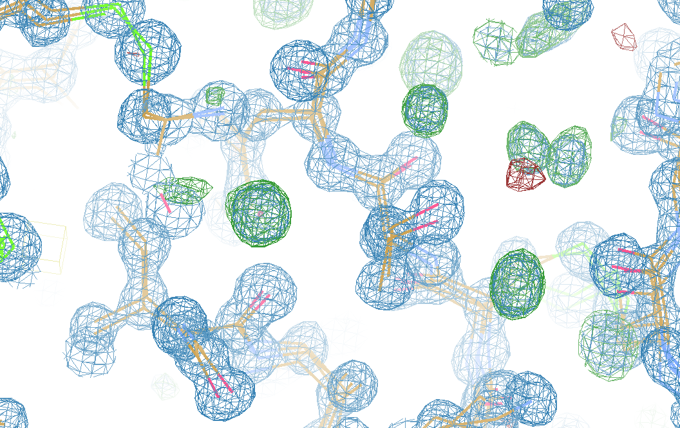
What is “missing”?

Slide 95
Diffraction Take-Home Lesson:
Disorder
Trumps
Everything!

Slide 96
What Causes Disorder?
Function
Radiation damage
Mosaicity
Strain
Xtal abuse
Dehydration

Slide 97
What Causes Disorder?
Function
Radiation damage
Mosaicity
Strain
Xtal abuse
Dehydration

Slide 98
Crystallographer’s view on “models”
What is the resolution?
What is the R factor?
What is the observations/parameters?
Is it “phase bias”?
Is it “model bias”?
Are you “fitting noise”?

Slide 99
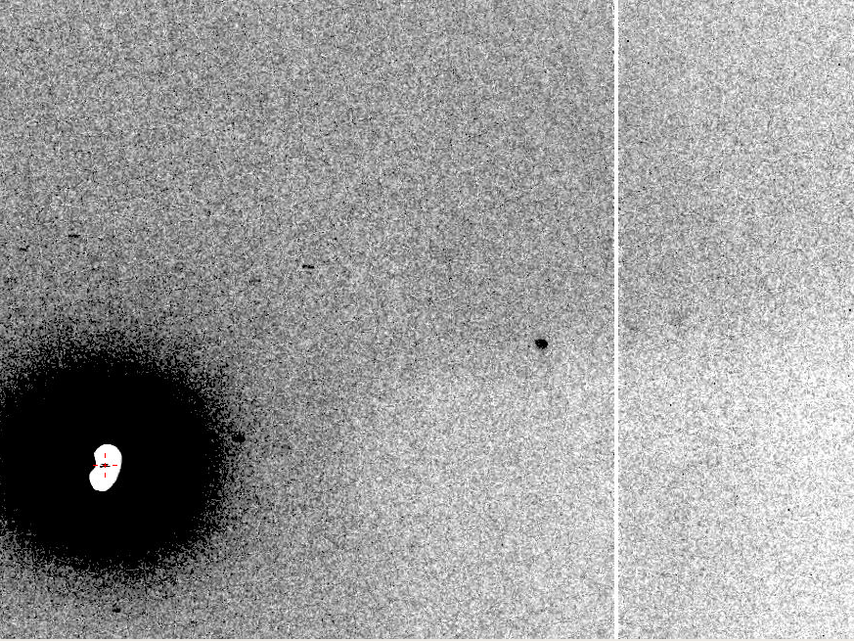
Now What?
10 Å
The “Amplitude Problem” in MX

Slide 100
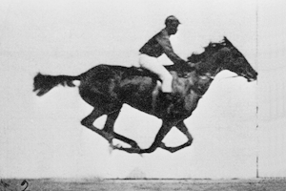
Muybridge’s galloping horse (1878)

Slide 101
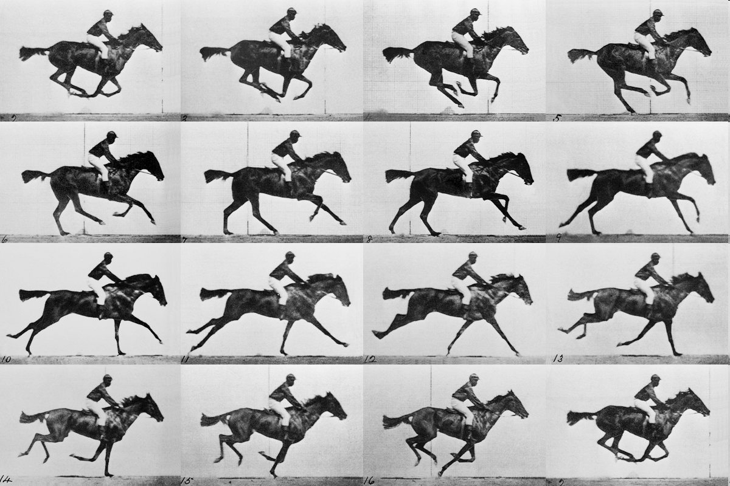
realistic “crystal” of horses

Slide 102
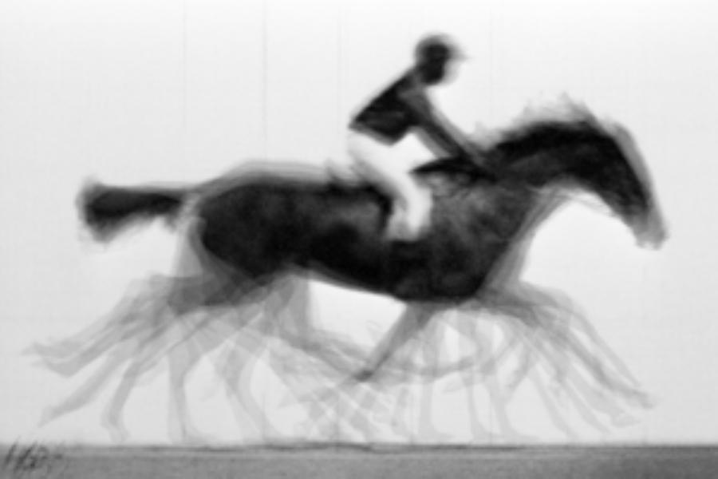
average structure: galloping horse

Slide 103
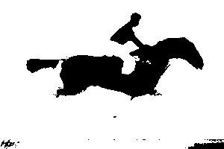
average structure: 1-sigma contour

Slide 104
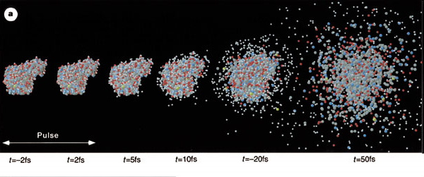
Promise of Single-molecule imaging
R. Neutze et al., Nature 406, pp. 752-757 (2000)

Slide 105
lysozyme: real and reciprocal

Slide 106
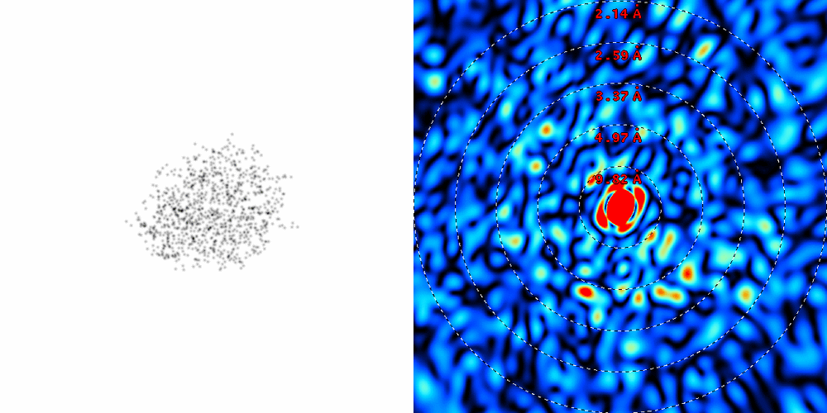
lysozyme: thermal motion

Slide 107
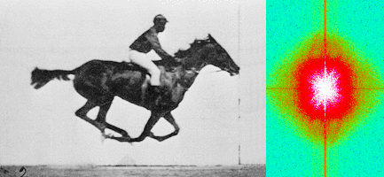
Muybridge’s galloping horse (1878)
“Time-resolved” diffraction
Real space
reciprocal

Slide 108
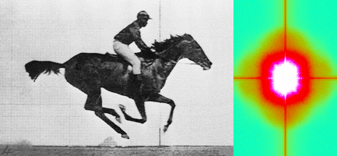
Muybridge’s galloping horse (1878)
Average intensity
Real space
reciprocal

Slide 109
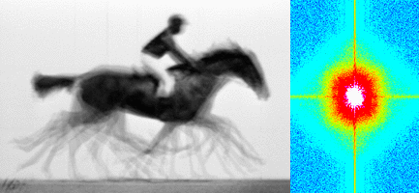
Muybridge’s galloping horse (1878)
Average electron density
Real space
reciprocal

Slide 110
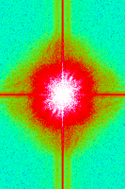
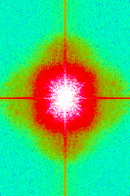
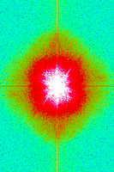
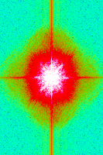
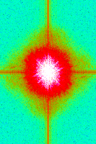
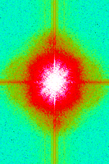
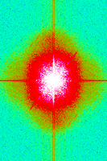
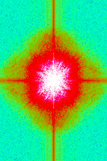
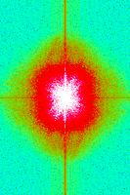
Supporting a model with data

Slide 111
Summary
X-ray data quality is not limiting
MX can help optimize MD params
MD can help build MX models
Solvent is half the battle!
Accurate MD needed for XFEL

Slide 112
Grand Challenges in Structural Biology
Phase Problem
super-high multiplicity isomorphous crystals
Amplitude Problem
Disorder trumps everything
Revolution in sample handling?
R-factor Gap
There is “life” below 1 sigma
MD-inspired models on horizon?
http://bl831.als.lbl.gov/~jamesh/powerpoint/UCSF_Rfactor_2014.pptx

