Slide 1

Acknowledgements
https://bl831.als.lbl.gov/~jamesh/powerpoint/ACA_tangle_2024.pptx
James Fraser Nevan Krogan
Paul Adams John Tainer Greg Hura Nick Sauter
Pavel Afonine Tom Terwilliger
Aina Cohen
UCSF LBNL SLAC
ALS 8.3.1: TomAlberTron
NIH NIGMS R01 GM124149 (Holton)
NIH NIAID P50 AI150476 (Krogan)
NIH NIGMS P30 GM124169 (Adams)
DOE-BER IDAT (Hura)
NIH NIGMS P30 GM133894 (Hodgson)
The Advanced Light Source is supported by the Director, Office of Science, Office of Basic Energy Sciences, Materials Sciences Division, of the US Department of Energy under contract No. DE-AC02-05CH11231 at Lawrence Berkeley National Laboratory.

Slide 2
Why is a beamline guy doing refinement things?
https://bl831.als.lbl.gov/~jamesh/powerpoint/ACA_tangle_2024.pptx
Because: the future of crystallography has alternate conformations
Single-conf models
poor resolution
Low signal/noise
Phase Problem
Dynamics?
Mechanism?
Small signal?
Overlapping states?

Slide 3
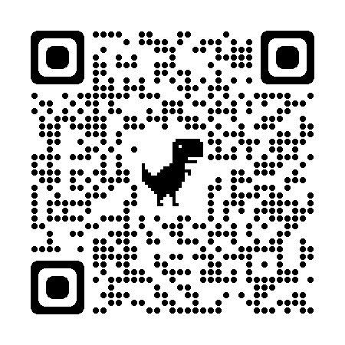
The UNTANGLE Challenge
best.pdb
refme.mtz
11) Build better than the best:
as-good or better wE, R_{free} as best.pdb
non-equivalent ensemble
10) Recover best.pdb from refme.mtz
true phases, auto-building allowed
no cheating (don’t use best.pdb as guide)
Prove: true ensemble is unique
and can be recovered
$1000
$500
https://github.com/jmholton/UnTangle

Slide 4
verified Score sheet
wE | R_{work} | R_{free} | method
185 | 20.6 | 21.4 | Alphafold2
109.6 | 8.87 | 9.44 | Phenix.ensemble_refine
97.3 | 8.84 | 9.27 | qFit best
91.7 | 3.64 | 4.27 | manual
80.5 | 4.31 | 4.75 | lotswrong
65.2 | 6.35 | 6.93 | Amber24
54.6 | 5.87 | 6.57 | single conf w aniso B
33.5 | 2.94 | 3.32 | One thing wrong: Ala39
23.5 | 2.95 | 3.31 | One thing wrong: Val1
21.4 | 3.12 | 3.48 | Rectified Simulated annealing
18.1 | 17.9 | 18.4 | Phenix autobuild
18.2 | 2.79 | 3.14 | best (ground truth)

Slide 5
Untangling models
https://bl831.als.lbl.gov/~jamesh/powerpoint/ACA_tangle_2024.pptx
https://github.com/jmholton/UnTangle
for less noisy maps

Slide 6
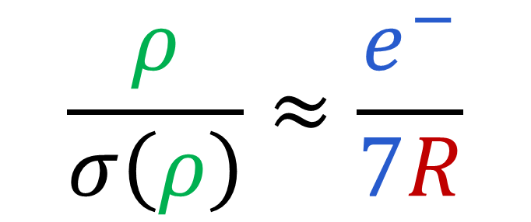
Map Noise: via Parseval’s Theorem
$$\frac{ρ}{σ\left(ρ\right)}≈\frac{e^{−}}{7R}$$
e⁻ number of electrons in peak
7 number of electrons in typical atom
R R_{iso} or R_{free}
ρ electron density peak
σ rms deviation expected

Slide 7
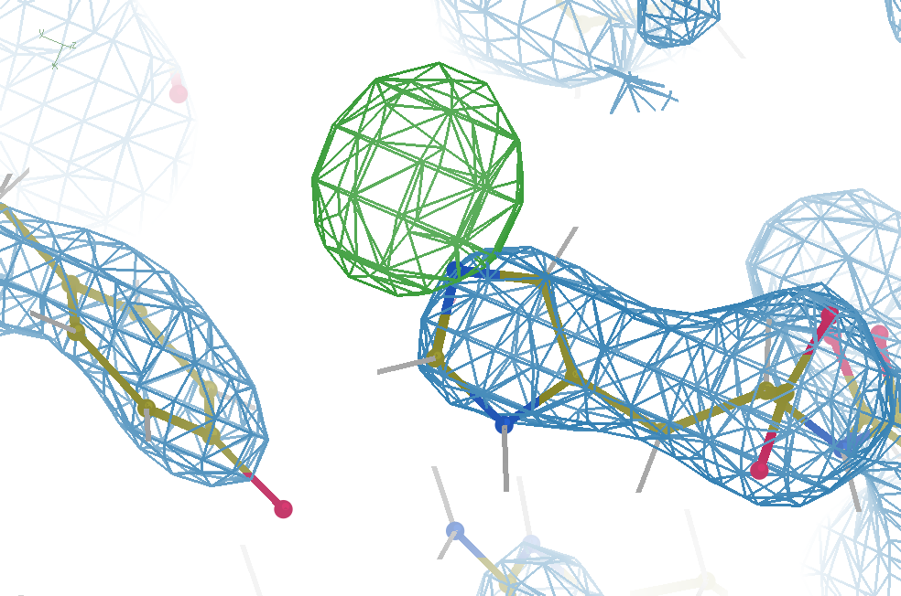
Hydrogen: visible at 3.5 Å resolution!
R_{work} = 0.04
R_{free} = 0.05
6σ = 1 e⁻
cut at 5 Å :
R_{free} = 0.01
Simulation:
Realistic noise
“perfect” model

Slide 8
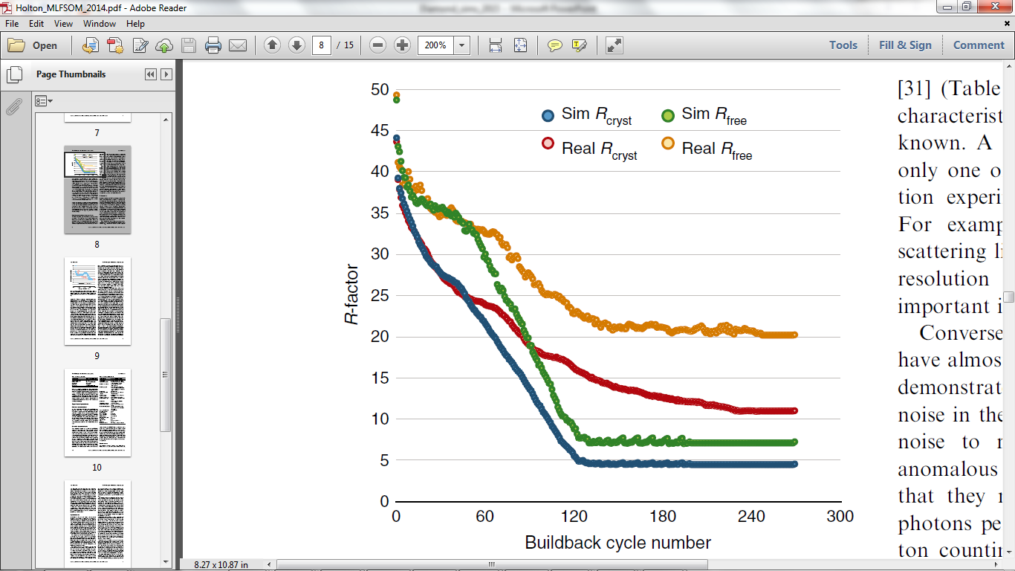
Model building: real vs sim data
multi
single
single
single
multi
multi
multi
single
Holton et al. (2014) "The R-factor gap", FEBS J. 281, 4046-4060.

Slide 9
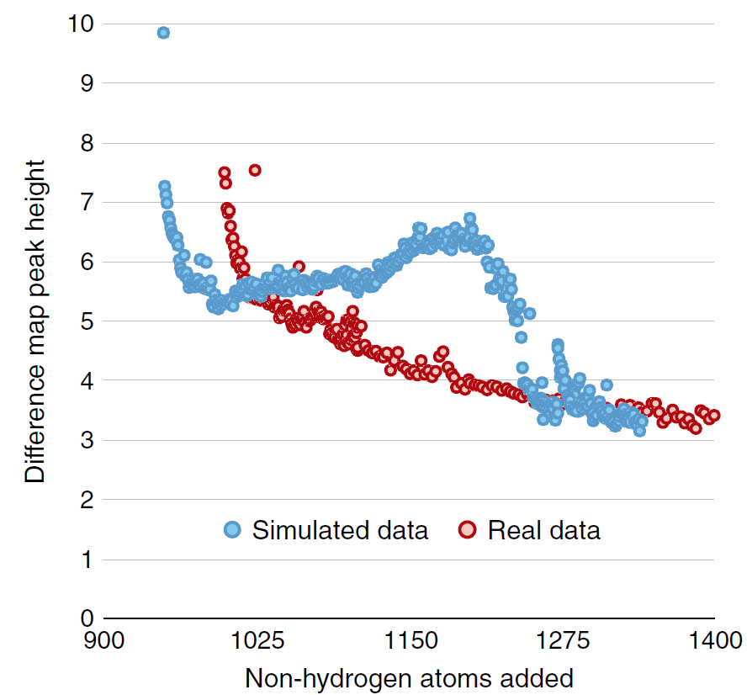
Model building: real vs sim data
multi
single conf
Single conf ground
Multi conf ground truth
Holton et al. (2014) "The R-factor gap", FEBS J. 281, 4046-4060.

Slide 10
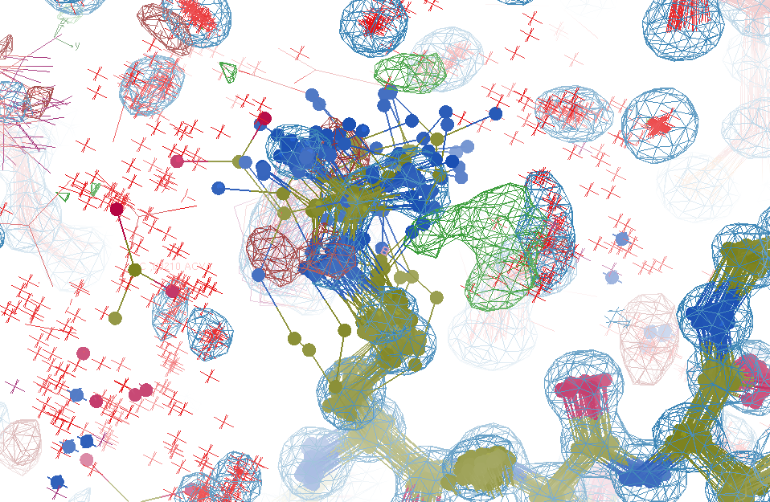
R_{work}: 0.0823
R_{free}: 0.1106
bond: 0.014 Å
angle: 1.92°
Real Data
1.2 σ
48-copy ensemble
3 params
per observation
MoPro: 1.15
Clash: 0.49
Cβdev: 20
Rota: 1.7%
Rama: 0.03%
reso: 1.0 Å
6σ

Slide 11
Over-Fitting data
Map density
position

Slide 12
Over-Fitting data
Map density
position

Slide 13
Over-Fitting data
Map density
position

Slide 14
Over-Fitting data
R_{work} ≈ 0
N_{params}= N_{obs}
Map density
position

Slide 15
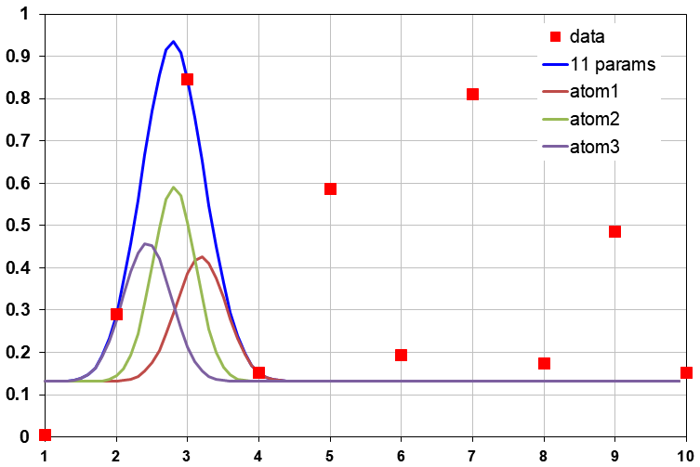
Under-Fitting data
R_{work} > 0
N_{params}> N_{obs}
Map density
position

Slide 16
R_{work}: 0.0823
R_{free}: 0.1106
bond: 0.014 Å
angle: 1.92°
under-fitting:
R_{work} > 0
MoPro: 1.15
Clash: 0.49
Cβdev: 20
Rota: 1.7%
Rama: 0.03%
reso: 1.0 Å
6σ

Slide 17
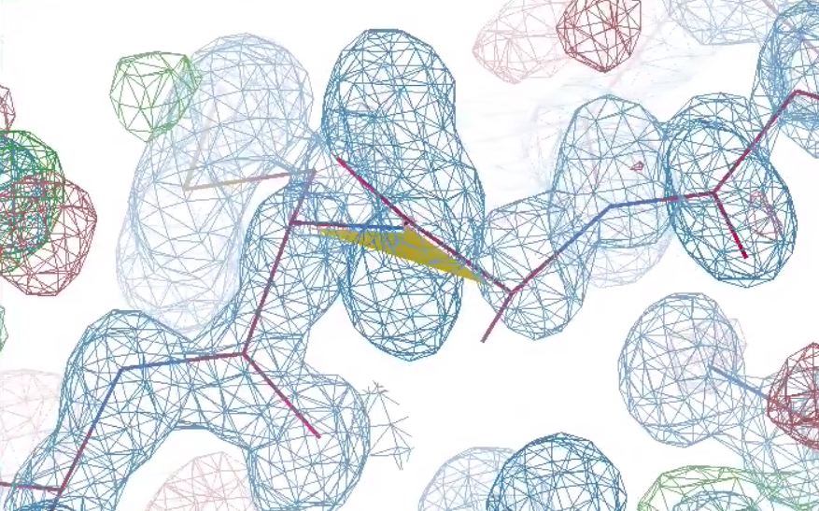
What is holding it back?
48-copy ensemble
3 parameters
per observation!
30°
peptide
bond twist

Slide 18
Why does ensemble refinement suck?
(3 parameters/observation and R_{work} still high!)
The chains are “tangled”

Slide 19
What do you mean, “tangled”?
Ground Truth
Local Minimum

Slide 20
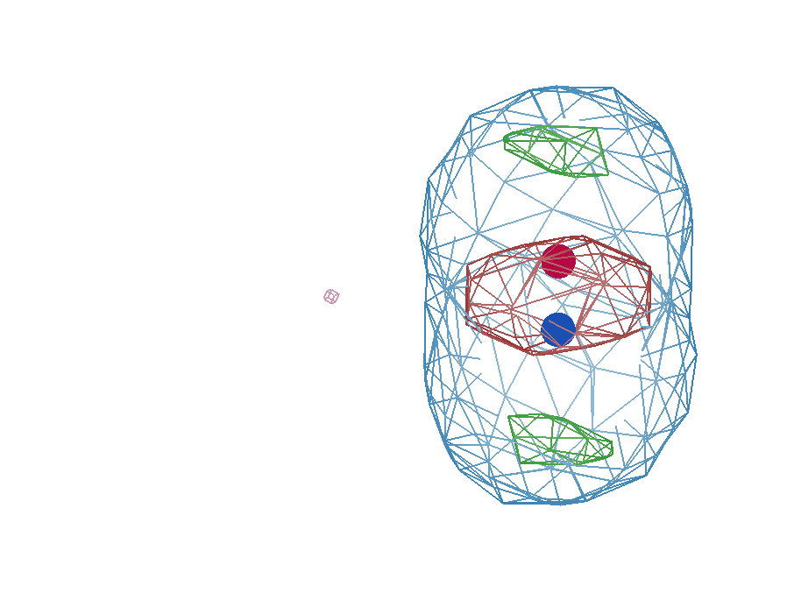
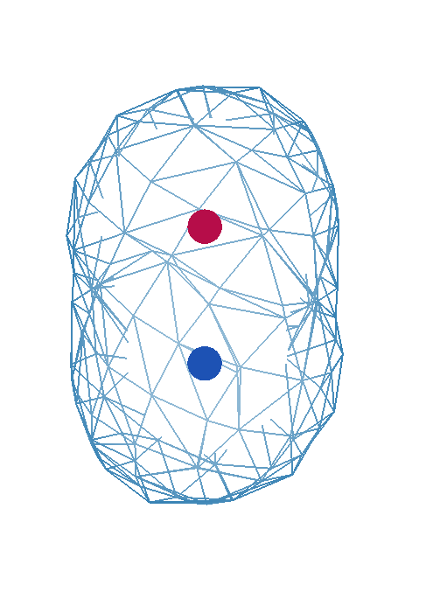
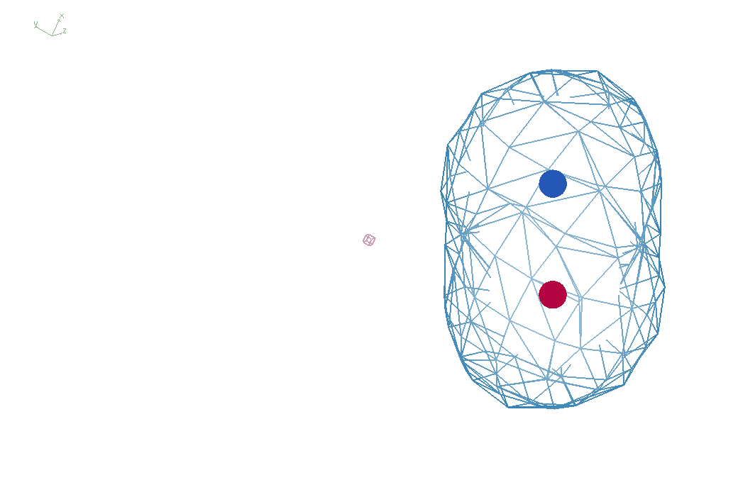
It takes two to tangle
density
fit
Chemical
strain
energy
A
A
B
B
B
A
tangled
barrier
untangled

Slide 21
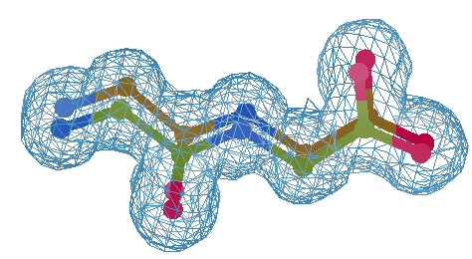
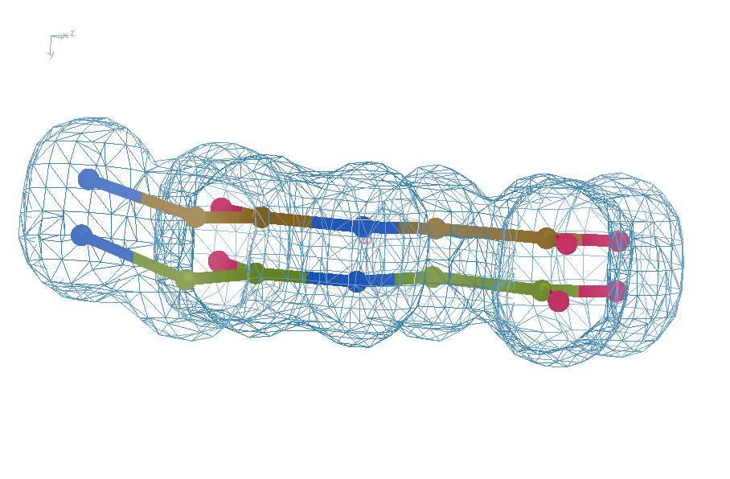
Right answer
R = 0.8%
rms bond = 0.0002

Slide 22
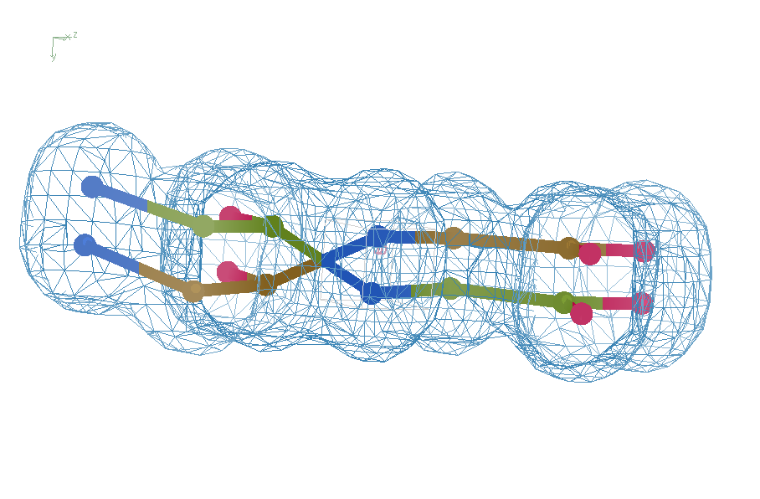
swap assignments
R = 0.8%
rms bond = 0.04

Slide 23
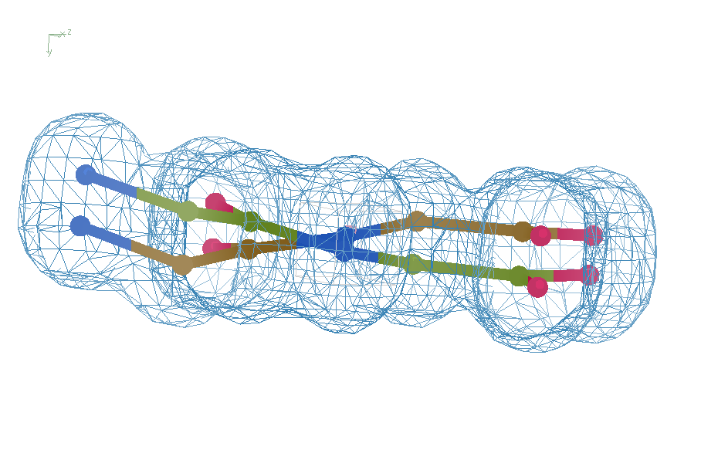
Refine – low x-ray weight
R = 14.3%
rms bond = 0.0002

Slide 24
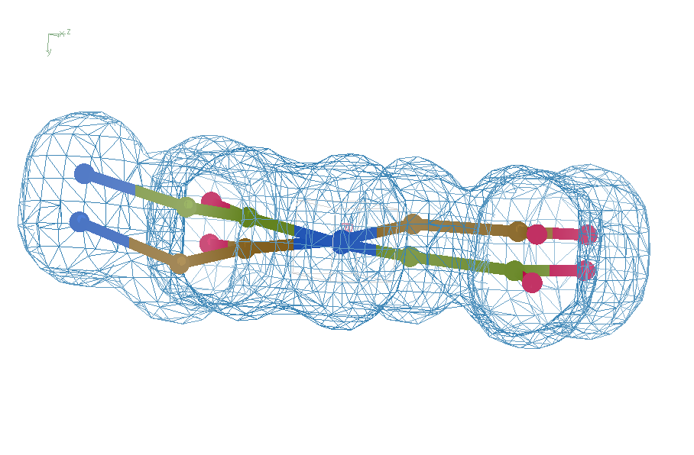
Refine – step 61
R = 6.8%
rms bond = 0.001

Slide 25
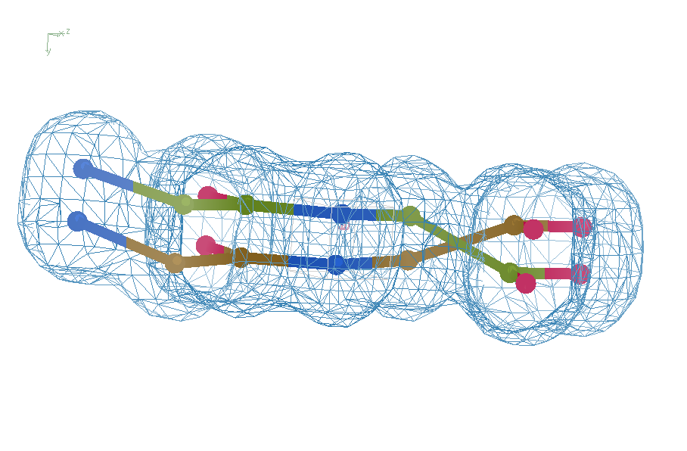
Refine – high x-ray weight
R = 1.2%
rms bond = 0.06

Slide 26
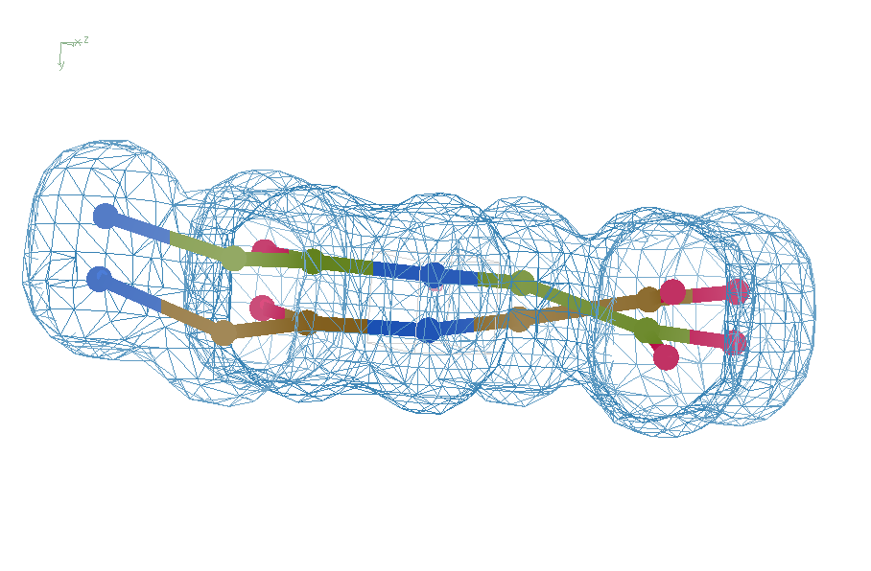
Refine – low x-ray weight
R = 14.3%
rms bond = 0.0002

Slide 27
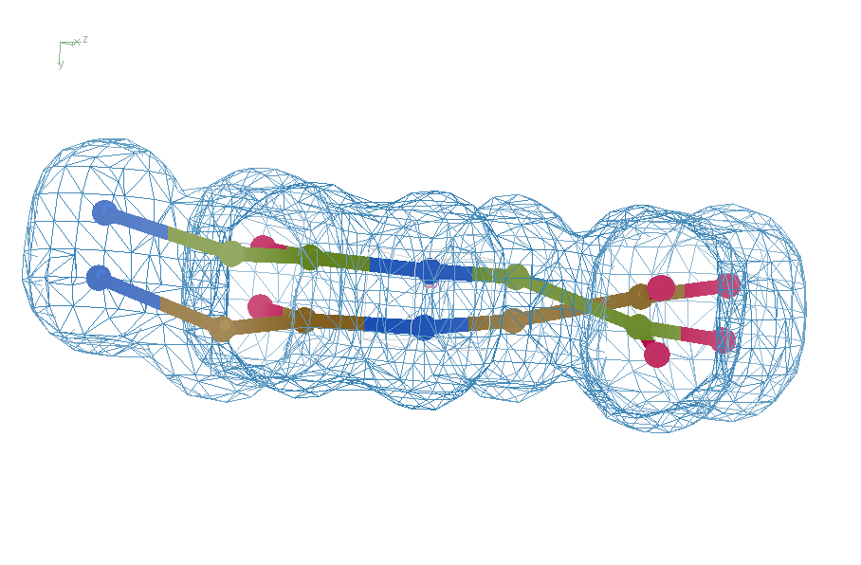
Final compromise
R = 7.07%
rms bond = 0.001

Slide 28
Right answer
R = 0.8%
rms bond = 0.0002

Slide 29
Sim-data Ground Truth
As simple as possible:
  2 conformers
  50:50 occupancy
Accessible
  64 residues
  78 waters
Every chance of success
  1.0 Å reso
  “one thing wrong”
  flat bulk solvent
  no false outliers
  phenix, refmac, shelxl
  clear score
  Experimental error only
  perfect phases

Slide 30
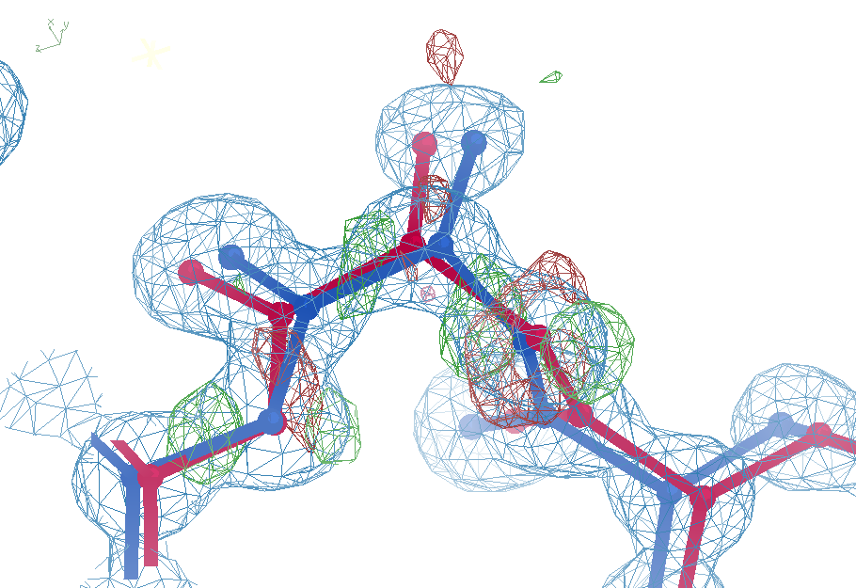
Sim challenge data: “otw39”
Ala39
+11σ
wE=63.5
N-C_{α}
bond
-9σ
5σ
angle
A B conformers

Slide 31
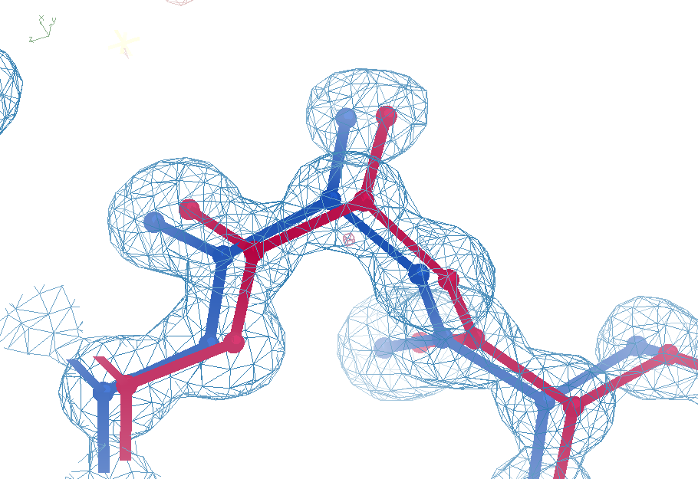
Sim challenge data: “otw39”
Ala39
-0.2σ
wE=18.2
N-C_{α}
bond
-0.3σ
0.8σ
angle
A B conformers

Slide 32
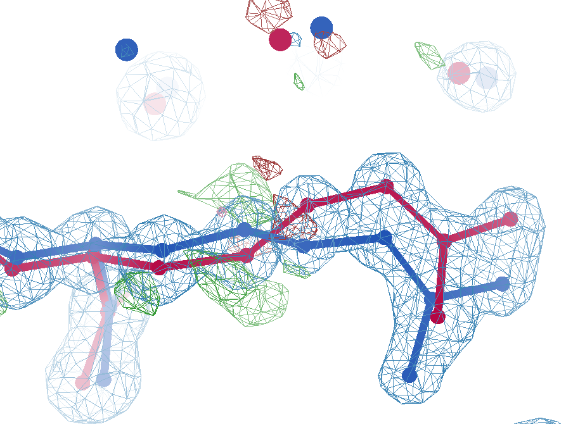
sim data
Arg62
wE=63.5
2.8 Å
4σ
C_{γ}-C_{δ}
bond
2.7σ torsion
A B conformers

Slide 33
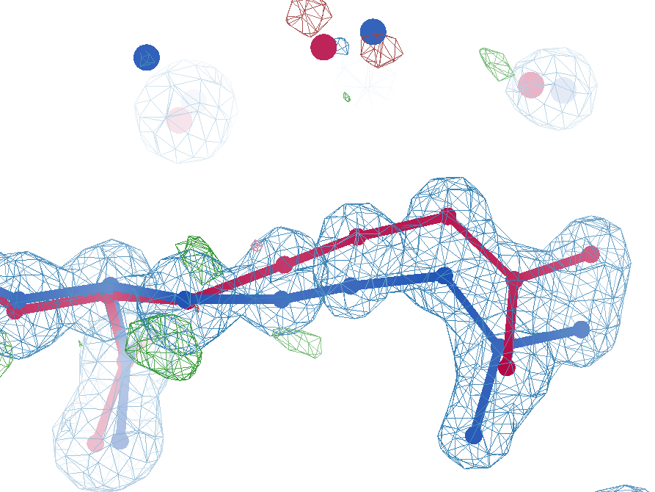
sim data
Arg62
wE=50.7
2.8 Å
2σ
angle
A B conformers

Slide 34
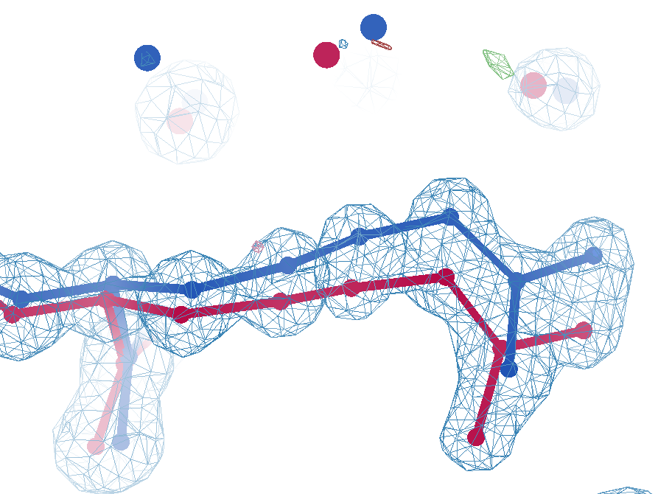
sim data
Arg62
wE=18.2
3.0 Å
0.3σ
C_{γ}-C_{δ}
bond
1σ
angle
1.6σ torsion
A B conformers

Slide 35
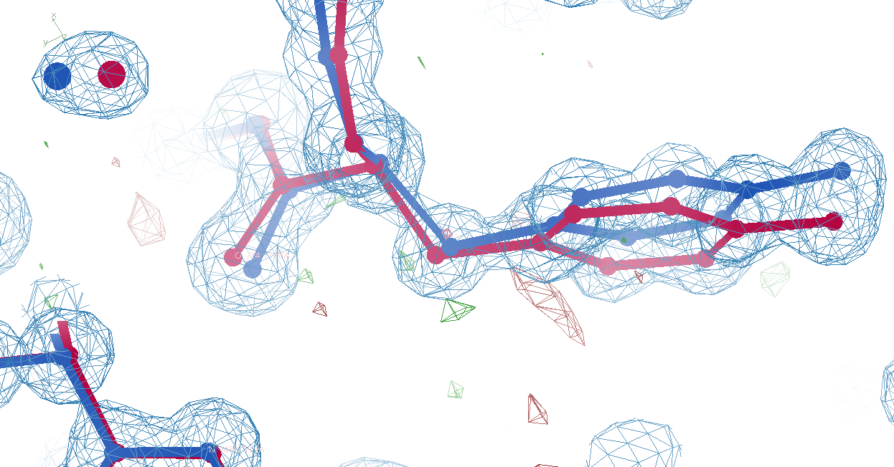
Tyr14
sim data
wE=33.1
3.0 Å
A B conformers

Slide 36
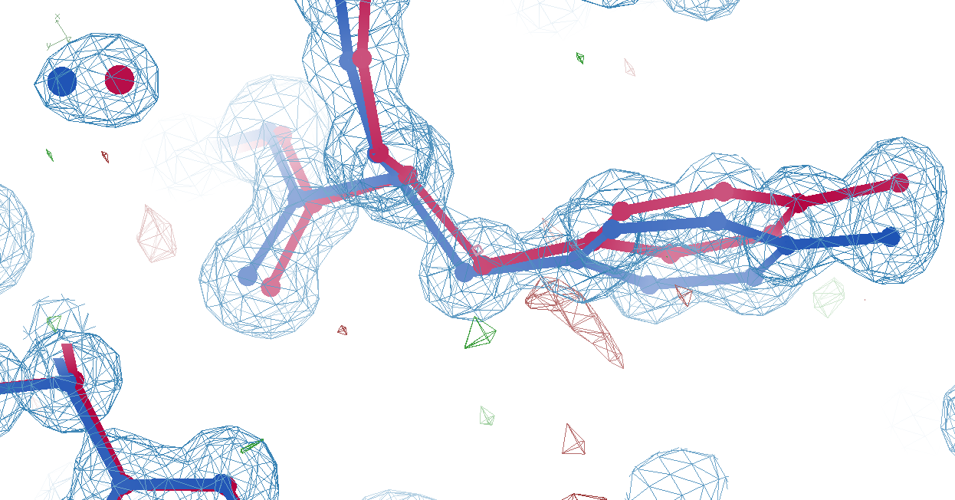
Tyr14
sim data
wE=18.2
3.2 Å
A B conformers

Slide 37
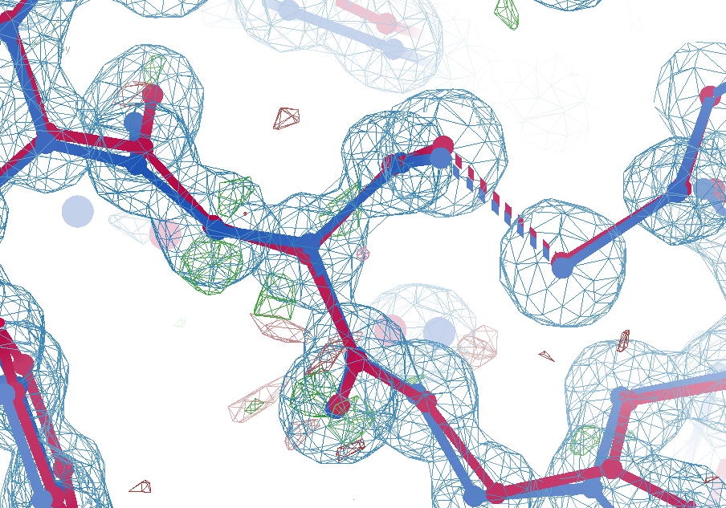
Cys16
sim data
wE=21.4
2.7σ
angle
A B conformers

Slide 38
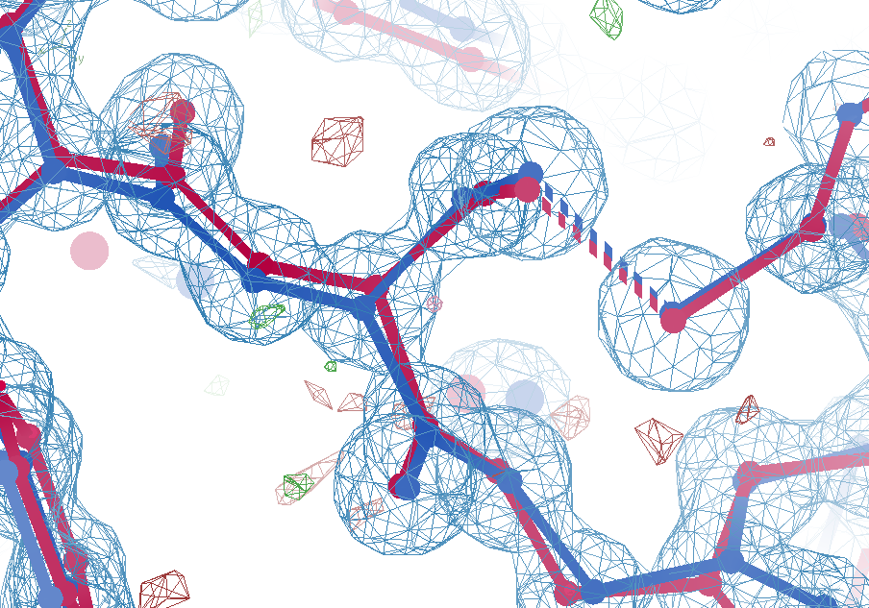
Cys16
sim data
wE=18.2
1.5σ
angle
A B conformers

Slide 39
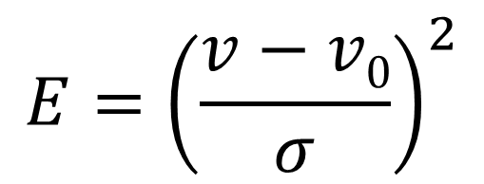
Statistical Potential
$$E={\left(\frac{v−v0}{σ}\right)}^{2}$$
E “energy”
v model value
v₀ ideal value
σ rms deviation expected
1 x 6σ ≈ 36x 1σ
Outlier problem:
solution: weight by
“probability its not noise”

Slide 40
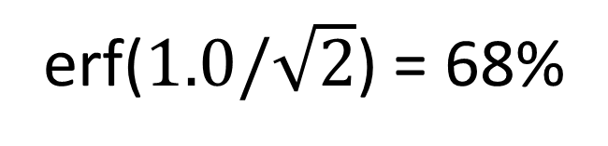
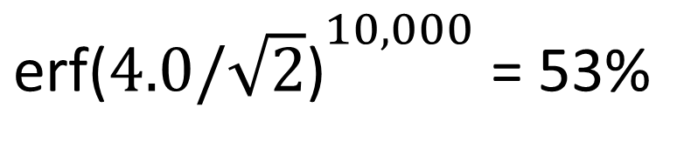
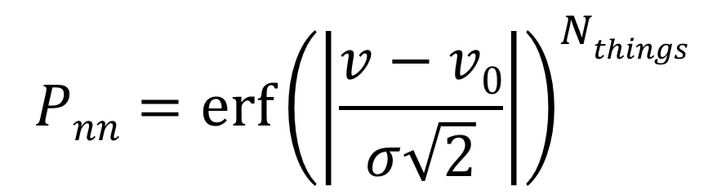
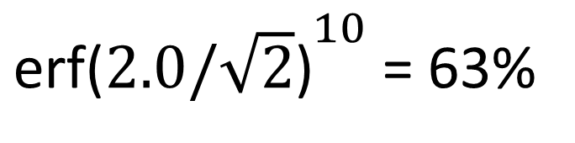
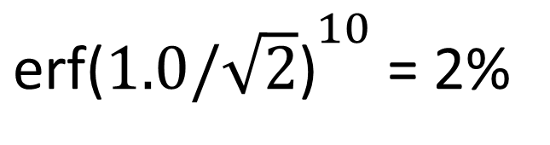
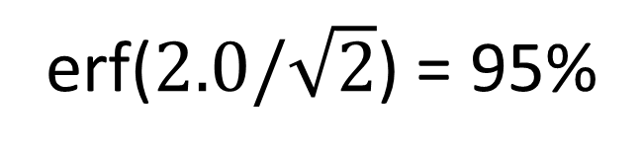
Probability that it’s not noise
$$Pnn={\operatorname{erf}\left(\left|\frac{v−v0}{σ\sqrt{2}}\right|\right)}^{Nthings}$$
P_{nn} probability
v-v₀ deviation from ideal
σ rms deviation expected
erf() integral of a Gaussian
N_{things} number of trials
erf($1.0/\sqrt{2}$) = 68%
${\text{erf}\text{(}1.0/\sqrt{2}\text{)}}^{10}$ = 2%
erf($2.0/\sqrt{2}$) = 95%
${\text{erf}\text{(}2.0/\sqrt{2}\text{)}}^{10}$ = 63%
${\text{erf}\text{(}4.0/\sqrt{2}\text{)}}^{10,000}$ = 53%

Slide 41
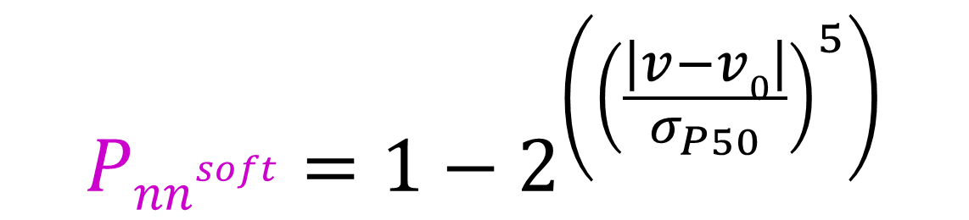
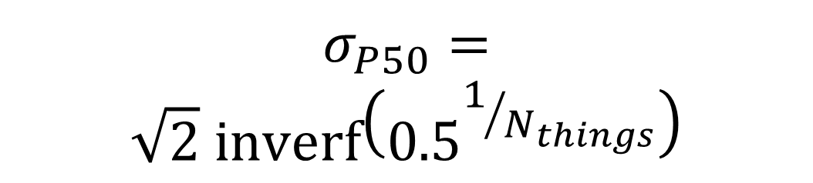
Probability that it’s not noise softer
$${Pnn}^{soft}=1−2^{\left({\left(\frac{\left|v−v0\right|}{σ_{P50}}\right)}^{5}\right)}$$
1
P_{nn} probability
v-v₀ deviation from ideal
σ rms deviation expected
inverf() inverse erf()
N_{things} number of trials
P
N=1
0.5
N=1 soft
$$σ_{P50}=$$
$$\sqrt{2} \text{inverf}\left({0.5}^{1/{N_{things}}}\right)$$
N=10,000
soft
N=10,000
0
1
2
3
4
5
6
max sigma deviate

Slide 42
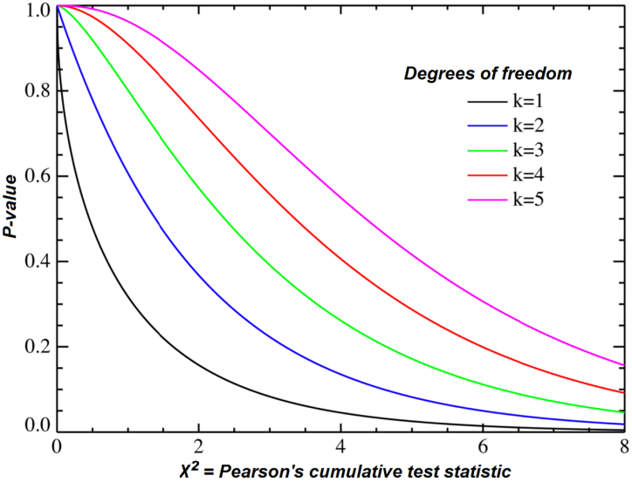
Probability that it’s not noise average/sum of N_{things}
χ² test
N_{things}
Probability
That its
Gaussian
tie breaker

Slide 43
Sensible scoring function
  Statistical potential
    bonds, angles, planes, torsions, chiral
  Leonard-Jones vdW
    non-bond and clashes
  Probability -> σ dev
    - Rota, rama
  Peptide bond
    σ → 5°
  C_{β}dev
    σ = 0.05 Å
4
2
van der Waals
Phenix/refmac
0
Energy
-1
1
2
3
4
5
Atomic separation (Å)

Slide 44
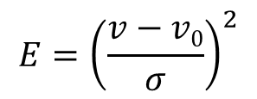
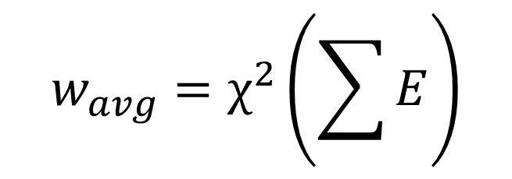
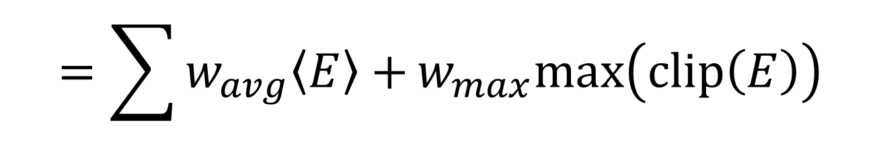
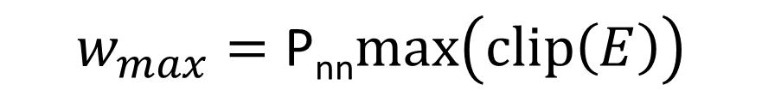
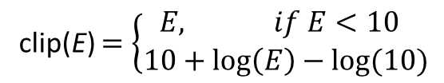
weighted Energy scoring function
$$=\sum{w_{avg}\left\langle E\right\rangle +}w_{max}max\left(clip\left(E\right)\right)$$
wE
validation types
phenix.holton_geometry_validation
$$w_{max}=\text{P}\text{nn}max\left(clip\left(E\right)\right)$$
10
$$w_{avg}=χ^{2}\left(\sum{E}\right)$$
wE
N=10
5
N=10,000
N_{bonds}
$$E={\left(\frac{v−v0}{σ}\right)}^{2}$$
max() = worst outlier
0
clip(E) $=\left\{\begin{matrix}E, if E<10 \\ 10+\log\left(E\right)−log⁡(10)\end{matrix}\right.$
3
6
8
max sigma deviate

Slide 45
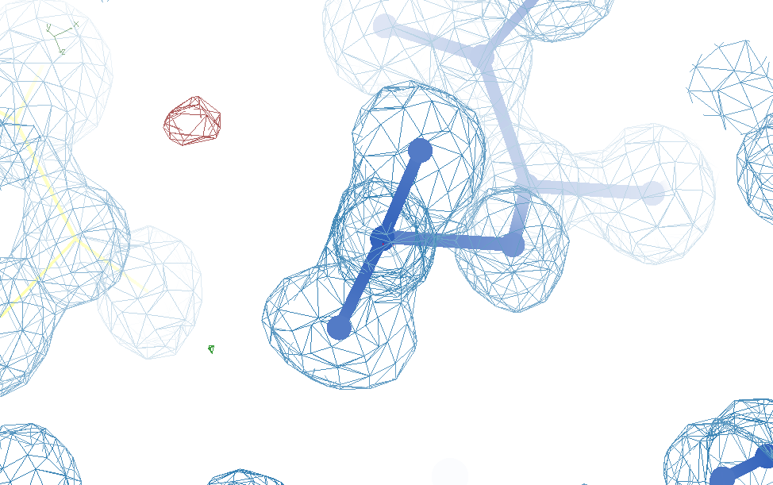
Glu32
Genuine outlier
in ground truth
real data
-80°
Torsion outlier

Slide 46
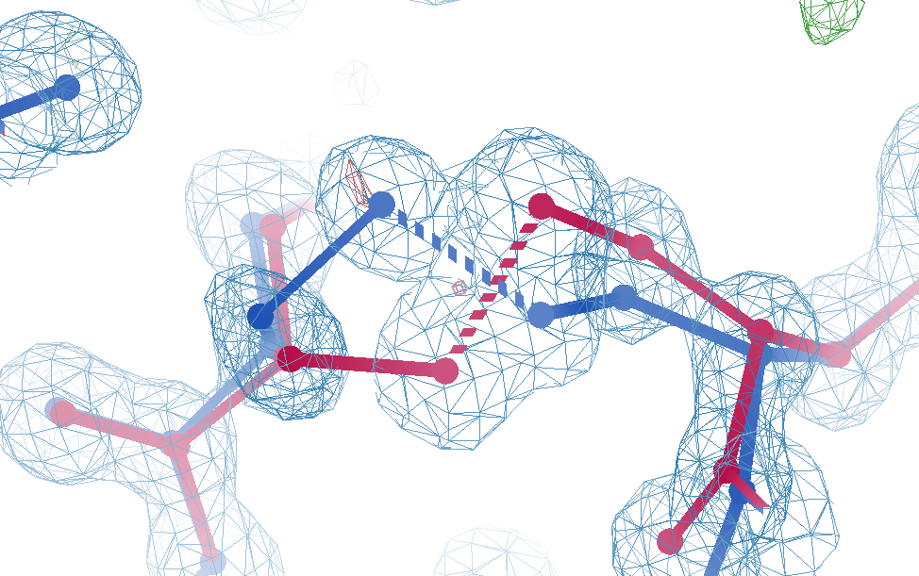
Cys12
Genuine outlier
in ground truth
real data
-107°
torsion outlier
A B conformers

Slide 47
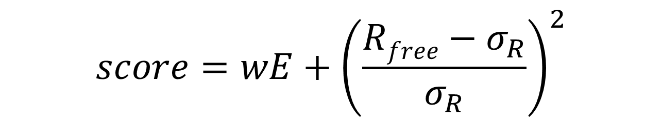
UNTANGLE scoring function
$$score=wE+{\left(\frac{Rfree−σ_{R}}{σ_{R}}\right)}^{2}$$
score UNTANGLE Challenge score
wE weighted energy avg + worst
σ_{R} experimental error (2%)
https://github.com/jmholton/UnTangle

Slide 48
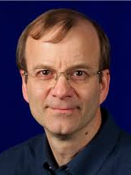
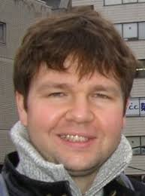
New Tools!
Tom
Terwilliger
phenix.holton_geometry_validation test.pdb
phenix.create_alt_conf phenix_autobuild.pdb refme.mtz \
nproc=48
phenix.refine \
model.pdb refme.mtz \
main.number_of_mac=10 \
fit_altlocs_method=masking \
ordered_solvent=true \
include_altlocs=true \
ordered_solvent.mode=every_macro_cycle_after_first \
refine_oat=true
Pavel Afonine

Slide 49
Summary
Rfree < 3% → single e⁻
  Not over-fitting
Main barrier: tangled ensemble
Sensible scoring function
  Probability its not noise
  some outliers are real
Recover underlying ensemble
  Might be required!
Cooperative motions
$1000
$500

Slide 50
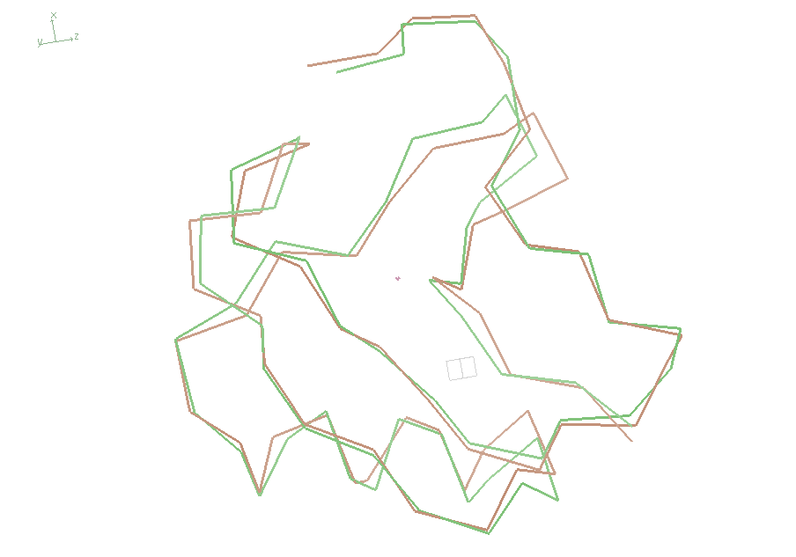
wE=18.2

Slide 51
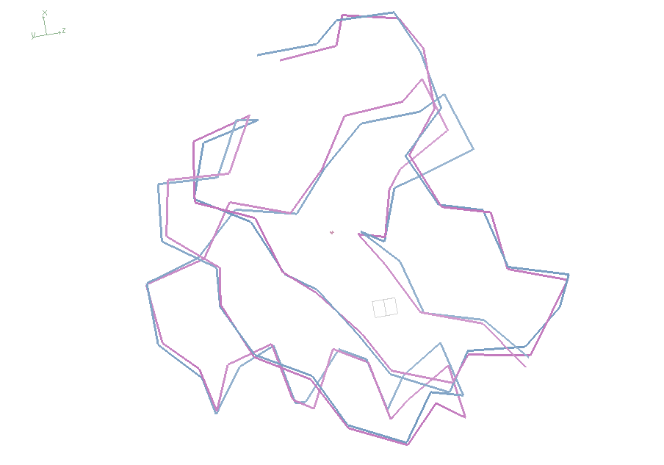
wE=21.4

Slide 52

Muybridge’s galloping horse (1872)

Slide 53

average structure: galloping horse

Slide 54

Horses have bones
+/- 0.01

Slide 55
Horses have bones

Slide 56

Muybridge’s galloping horse 0

Slide 57

Muybridge’s galloping horse 1

Slide 58

Muybridge’s galloping horse 2

Slide 59

Muybridge’s galloping horse 3

Slide 60

Muybridge’s galloping horse 4

Slide 61

Muybridge’s galloping horse 5

Slide 62

Muybridge’s galloping horse 6

Slide 63

Muybridge’s galloping horse 7

Slide 64

Muybridge’s galloping horse 8

Slide 65

Muybridge’s galloping horse 9

Slide 66

Muybridge’s galloping horse 10

Slide 67

Muybridge’s galloping horse 11

Slide 68

Muybridge’s galloping horse 12

Slide 69

Muybridge’s galloping horse 13

Slide 70

Muybridge’s galloping horse 14

Slide 71
ensemble refine ???

Slide 72
Differences
horse
molecule
~2 m
Stiff backbone
Bone sigma ~ 1 mm
4 joints/leg
Continuous angle
No torision
Concerted motion
~100 Å
Stiff backbone
Bond sigma = 0.01 Å
0-4 chi angles
Angle sigma ~ 1°
Rotamers
Concerted motion

