Slide 1
Acknowledgements
http://bl831.als.lbl.gov/~jamesh/powerpoint/ACA_resolution_2017.pptx
Robert Stroud James Fraser
Nick Sauter John Tainer Aina Cohen Ana Gonzalez
UCSF LBNL SLAC
ALS 8.3.1 creator: Tom Alber
UC Multicampus Research Programs and Initiatives (MRPI)
UCSF Program for Breakthrough Biomedical Research (PBBR)
one-time NIH-DOE Inter-agency agreement (IAA)
GM117126 to Sauter (DIALS)
Integrated Diffraction Analysis Technologies (IDAT)
Plexxikon, Inc.
Synchrotron Radiation Structural Biology Resource (SLAC)
The Advanced Light Source is supported by the Director, Office of Science, Office of Basic Energy Sciences, Materials Sciences Division, of the US Department of Energy under contract No. DE-AC02-05CH11231 at Lawrence Berkeley National Laboratory.

Slide 2
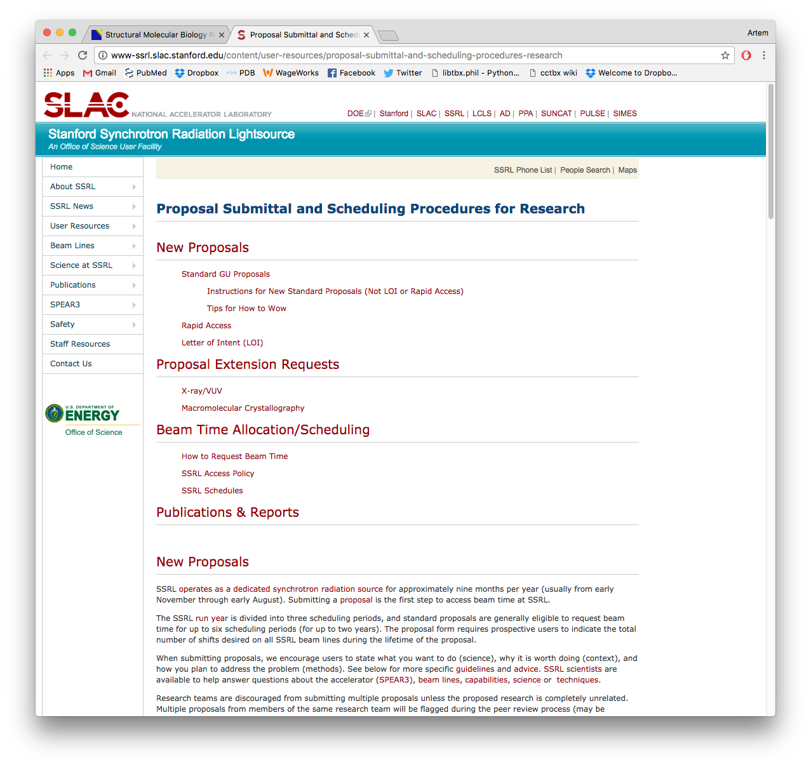
DOE BER Structural Biology Portal
https://www.berstructuralbioportal.org/ssrl/

Slide 3
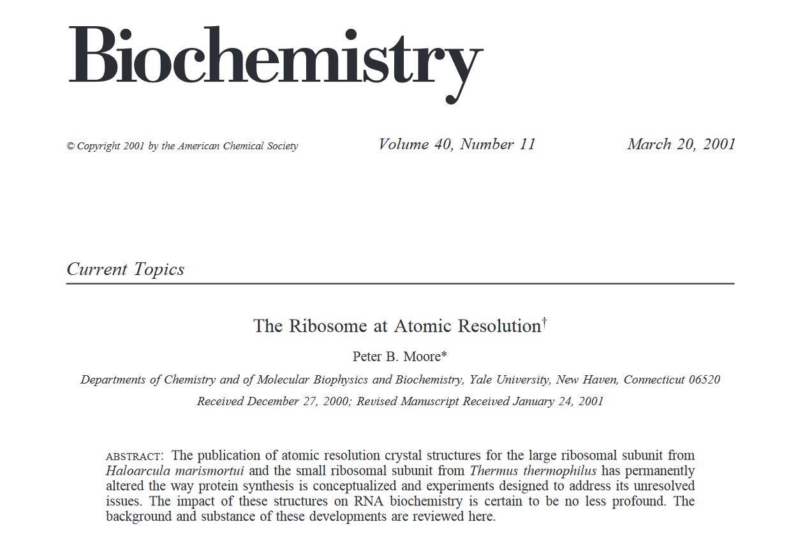

Slide 4
What is “resolution” ?
Where do I cut my data?
What do I give to refinement?
What can I claim in my paper?

Slide 5
What is “resolution” ?
Where do I cut my data?
What do I give to refinement?
What can I claim in my paper?
CC_{1/2}→ 0
R_{merge} meaningless as I_{obs} → 0
“Straighten” Wilson Plot for maps?
Karplus-Diederichs paired refinement
report “R1”
σ(F) only matters for phasing
Stick with tradition! I/σ = 3
Report “3σ resolution” for model?

Slide 6
R_{merge} at the resolution limit
Average outer-shell R_{merge}
Year

Slide 7
Expected R_{merge} as I_{obs} → 0

Slide 8
Averaging Gaussian error
Average value
Number of samples averaged

Slide 9
Averaging Gauss/Gauss error
Average value
Number of samples averaged

Slide 10
Take-home lesson:
R factors are
undefined
as I_{obs} → 0
Report as “ – “ in outer bin

Slide 11
Wisdom of our ancestors
Publication criterion for chemical crystallography:
R1 < 2*R_{sigma}
R1 = F_{o} vs F_{c} for I/σ(I) > 3
R_{sigma} = <σ(I)>/<I>
There are no PDB entries that pass this test!

Slide 12
Where do I cut my data?
Too optimistic: add nothing but noise
Too pessimistic: series-termination error
Happy medium?
Simulate:
Random atoms, compute F²
Add Gaussian noise, RMS = 1
Truncate
Calculate map with perfect phases
Subtract “right” map, RMS difference

Slide 13
Optimal resolution cutoff
Error in map (rms e⁻)
Resolution cutoff (Å)

Slide 14
Optimal resolution cutoff
Correlation Coefficient
Resolution cutoff (Å)

Slide 15
Optimal resolution cutoff
Correlation Coefficient
Resolution cutoff (Å)

Slide 16
Optimal resolution cutoff
Error in map (rms e⁻)
Resolution cutoff (Å)

Slide 17
Wilson Plot
2
log( intensity )
8
2.2 1.6 1.3 1.1 1.0 0.9 0.85 0.8 0.75 0.7
resolution (Å)

Slide 18
Optimum resolution cutoff is:
0.0 Å
Practically: CC_{1/2}→ 0

Slide 19
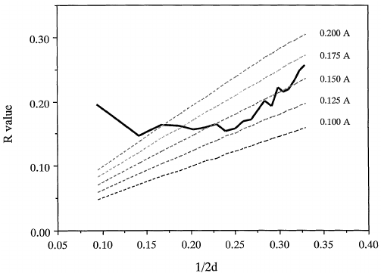
What can I claim in my paper?
RMS error in coordinate position?
Fun fact: σ(F) are NOT used in maximum-likelihood refinement
Bricogne (1988). Acta Cryst. A44, 517-45
Read (1990). Acta Cryst. A46, 900-12
Luzzati (1952). Acta Cryst. 5, 802-10

Slide 20
It’s in the REFMAC log!
Resolution limits = 55.556 1.640
Number of used reflections = 13592
Percentage observed = 96.6545
Percentage of free reflections = 5.1500
Overall R factor = 0.2078
Free R factor = 0.2622
Overall weighted R factor = 0.2006
Free weighted R factor = 0.2470
Overall correlation coefficient = 0.9358
Free correlation coefficient = 0.8989
Cruickshanks DPI for coordinate error= 0.1281
DPI based on free R factor = 0.1305
Overall figure of merit = 0.8292
ML based su of positional parameters = 0.0800
ML based su of thermal parameters = 2.2731

Slide 21
It’s in the phenix log!
|--(resolution: 1.53 - 38.61 A, n_refl.=31822 (all), 4.94 % free)------------|
| |
| r_work= 0.2205 r_free= 0.2135 coordinate error (max.-lik. estimate): 0.02 A |
| |
| x-ray target function (ml) for work reflections: 4.834539 |
|-----------------------------------------------------------------------------|

Slide 22
optical definition of resolution
Electron density (e⁻/Å)
Position (Å)

Slide 23
optical definition of resolution
Electron density (e⁻/Å)
Position (Å)

Slide 24
optical definition of resolution
Electron density (e⁻/Å)
Position (Å)

Slide 25
optical definition of resolution
Electron density (e⁻/Å)
Position (Å)

Slide 26
optical definition of resolution
Electron density (e⁻/Å)
Position (Å)

Slide 27
optical definition of resolution
Electron density (e⁻/Å)
Position (Å)

Slide 28
optical definition of resolution
Electron density (e⁻/Å)
Position (Å)

Slide 29
optical definition of resolution
Electron density (e⁻/Å)
Position (Å)

Slide 30
optical definition of resolution
0.849 FWHM
Electron density (e⁻/Å)
FWHM
Position (Å)

Slide 31
optical definition of resolution
map sharpening
Electron density (e⁻/Å)
Position (Å)

Slide 32
optical definition of resolution
realistic
map sharpening
Electron density (e⁻/Å)
Position (Å)

Slide 33
optical definition of resolution
84%
Electron density (e⁻/Å)
98%
99.9%
Position (Å)

Slide 34
"error bar" for electron density
Refinement
Against
Perturbed
Input
Data
electron density (e⁻/Å³)
fractional coordinate
Lang et al. (2014) PNAS USA 111, 237-242.

Slide 35
Histogram of electron density error (485 PDBs)
0.125 e⁻/Å³
normalized counts
Electron Number Density (e⁻/Å³)
Lang et al. (2014) PNAS USA 111, 237-242.

Slide 36
Map error vs RMS F_{o}-F_{c}
Empirical error (RMS e⁻/Å³)
RMS value of mF_{o}-DF_{c} map (e⁻/Å³)

Slide 37
“3σ resolution” of model from map
RMS map error (e⁻/Å³)
Atomic Resolution (Å)
refined atomic B factor (8πu_{x}²)

Slide 38
It’s in the FFT log!
echo labin F1=FOFCWT PHI=PHFOFCWT | fft hklin refine_out.mtz
Number of columns, rows, sections ............... 160 132 264
Map mode ........................................ 2
Start and stop points on columns, rows, sections 0 159 0 131 0 263
Grid sampling on x, y, z ........................ 132 160 264
Cell dimensions ................................. 43.0000 52.6100 89.1200 90.0000 90.0000 90.0000
Fast, medium, slow axes ......................... Y X Z
Minimum density ................................. -0.09104
Maximum density ................................. 0.35006
Mean density .................................... 0.00000
Rms deviation from mean density ................. 0.01954
Space-group ..................................... 19
Number of titles ................................ 1

Slide 39
B factors are in the PDB file
ATOM 122 N LEU A 13 -3.244 25.808 19.998 1.00 16.96 N
ATOM 123 CA LEU A 13 -2.877 25.448 21.355 1.00 15.29 C
ATOM 124 C LEU A 13 -2.792 23.966 21.561 1.00 17.54 C
ATOM 125 O LEU A 13 -1.814 23.493 22.143 1.00 16.35 O
ATOM 126 CB LEU A 13 -3.907 26.164 22.268 1.00 18.72 C
ATOM 127 CG LEU A 13 -3.577 25.982 23.738 1.00 21.19 C
ATOM 128 CD1 LEU A 13 -2.283 26.820 24.019 1.00 19.43 C
ATOM 129 CD2 LEU A 13 -4.702 26.474 24.639 1.00 24.65 C
ATOM 130 N SER A 14 -3.677 23.149 20.979 1.00 15.96 N
ATOM 131 CA SER A 14 -3.646 21.711 21.061 1.00 18.26 C
ATOM 132 C SER A 14 -2.373 21.203 20.360 1.00 18.71 C
ATOM 133 O SER A 14 -1.747 20.315 20.930 1.00 17.47 O
ATOM 134 CB SER A 14 -4.875 21.077 20.419 1.00 17.62 C
ATOM 135 OG ASER A 14 -4.825 19.665 20.388 0.50 20.89 O
ATOM 136 OG BSER A 14 -6.027 21.408 21.164 0.50 18.67 O
ATOM 137 N LYS A 15 -2.045 21.772 19.215 1.00 18.03 N
ATOM 138 CA LYS A 15 -0.799 21.361 18.555 1.00 18.12 C
ATOM 139 C LYS A 15 0.446 21.707 19.351 1.00 18.81 C
ATOM 140 O LYS A 15 1.400 20.948 19.411 1.00 17.77 O
ATOM 141 CB LYS A 15 -0.700 22.034 17.177 1.00 14.49 C
ATOM 142 CG LYS A 15 -1.727 21.368 16.256 1.00 16.12 C
ATOM 143 CD LYS A 15 -1.663 22.147 14.936 1.00 19.40 C
ATOM 144 CE ALYS A 15 -2.725 21.614 13.986 0.50 17.42 C
ATOM 145 CE BLYS A 15 -1.750 21.211 13.750 0.50 17.01 C
ATOM 146 NZ ALYS A 15 -2.346 21.674 12.559 0.50 18.61 N
ATOM 147 NZ BLYS A 15 -3.052 20.513 13.741 0.50 18.76 N

Slide 40
What is “resolution” ?
Where do I cut my data?
What do I give to refinement?
What can I claim in my paper?
CC_{1/2}→ 0
R_{merge} meaningless as I_{obs} → 0
“Straighten” Wilson Plot for maps?
Karplus-Diederichs paired refinement
report “R1”
σ(F) only matters for phasing
Retain historical relevance? I/σ = 3
Report “3σ resolution” for model?

Slide 41
Resolution vs RMS F_{o}-F_{c}
Map error (RMS e⁻/Å)
Reported Resolution (Å)

Slide 42
"error bar" for electron density
structure factor (e⁻/cell)
spot index
Lang et al. (2014) PNAS USA 111, 237-242.

Slide 43
"error bar" for electron density
structure factor (e⁻/cell)
electron density (e⁻/Å³)
spot index
fractional coordinate
Lang et al. (2014) PNAS USA 111, 237-242.

Slide 44
"error bar" for electron density
structure factor (e⁻/cell)
electron density (e⁻/Å³)
spot index
fractional coordinate
Lang et al. (2014) PNAS USA 111, 237-242.

Slide 45
"error bar" for electron density
structure factor (e⁻/cell)
electron density (e⁻/Å³)
spot index
fractional coordinate
Lang et al. (2014) PNAS USA 111, 237-242.

Slide 46
"error bar" for electron density
structure factor (e⁻/cell)
electron density (e⁻/Å³)
spot index
fractional coordinate
Lang et al. (2014) PNAS USA 111, 237-242.

Slide 47
"error bar" for electron density
structure factor (e⁻/cell)
electron density (e⁻/Å³)
spot index
fractional coordinate
Lang et al. (2014) PNAS USA 111, 237-242.

Slide 48
"error bar" for electron density
structure factor (e⁻/cell)
electron density (e⁻/Å³)
spot index
fractional coordinate
Lang et al. (2014) PNAS USA 111, 237-242.

Slide 49
"error bar" for electron density
structure factor (e⁻/cell)
electron density (e⁻/Å³)
spot index
fractional coordinate
Lang et al. (2014) PNAS USA 111, 237-242.

Slide 50
"error bar" for electron density
structure factor (e⁻/cell)
electron density (e⁻/Å³)
spot index
fractional coordinate
Lang et al. (2014) PNAS USA 111, 237-242.

Slide 51
"error bar" for electron density
structure factor (e⁻/cell)
electron density (e⁻/Å³)
spot index
fractional coordinate
Lang et al. (2014) PNAS USA 111, 237-242.

Slide 52
"error bar" for electron density
structure factor (e⁻/cell)
electron density (e⁻/Å³)
spot index
fractional coordinate
Lang et al. (2014) PNAS USA 111, 237-242.

Slide 53
"error bar" for electron density
structure factor (e⁻/cell)
electron density (e⁻/Å³)
spot index
fractional coordinate
Lang et al. (2014) PNAS USA 111, 237-242.

Slide 54
"error bar" for electron density
Refinement
Against
Perturbed
Input
Data
electron density (e⁻/Å³)
fractional coordinate
Lang et al. (2014) PNAS USA 111, 237-242.

Slide 55
How does the “error” compare to “sigma”?
normalized counts
Electron Number Density (e⁻/Å³)
Lang et al. (2014) PNAS USA 111, 237-242.

Slide 56
How does the “error” compare to “sigma”?
normalized counts
Electron Number Density (e⁻/Å³)
Lang et al. (2014) PNAS USA 111, 237-242.

Slide 57
How does the “error” compare to “sigma”?
0.125 e⁻/Å³
normalized counts
Electron Number Density (e⁻/Å³)
Lang et al. (2014) PNAS USA 111, 237-242.

Slide 58
What is the “error” in 2Fo-Fc “sigma” units?
normalized counts
traditional “sigma” units (multples of rms(ρ-⟨ρ⟩) relative to ⟨ρ⟩)
Lang et al. (2014) PNAS USA 111, 237-242.

Slide 59
What is the “error” in Fo-Fc “sigma” units?
normalized counts
traditional “sigma” units (multples of rms(ρ-⟨ρ⟩) relative to ⟨ρ⟩)
Lang et al. (2014) PNAS USA 111, 237-242.

