Slide 1
Acknowledgements
Robert Stroud James Fraser
Paul Adams John Tainer Greg Hura Nick Sauter
Aina Cohen Art Lyubimov Sabine Hollatz
UCSF LBNL SLAC
ALS 8.3.1: TomAlberTron
NIH NIGMS R01 GM124149
NIH NIGMS P50 GM082250
NIH NIGMS P30 GM124169
NIH NIGMS R01 GM117126
DOE-BER Integrated Diffraction Analysis Technologies (IDAT)
Plexxikon, Inc.
NIH NIGMS P41 GM103393
NSF DBI-1625906
The Advanced Light Source is supported by the Director, Office of Science, Office of Basic Energy Sciences, Materials Sciences Division, of the US Department of Energy under contract No. DE-AC02-05CH11231 at Lawrence Berkeley National Laboratory.

Slide 2
Painting with X-rays
Virtual beams to match any sample
(Some assembly required)

Slide 3
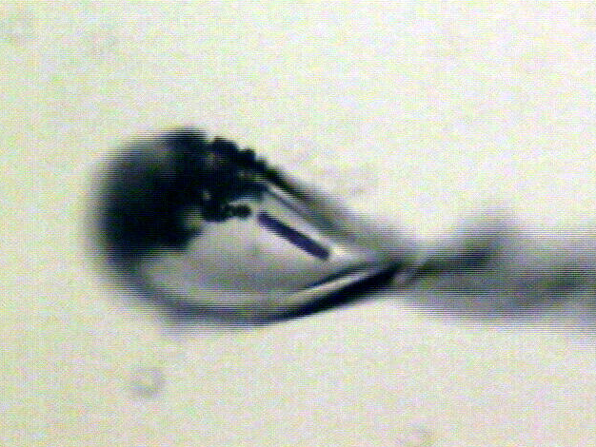
Beam size?

Slide 4
“dose contrast” effects
before

Slide 5
“dose contrast” effects
after

Slide 6
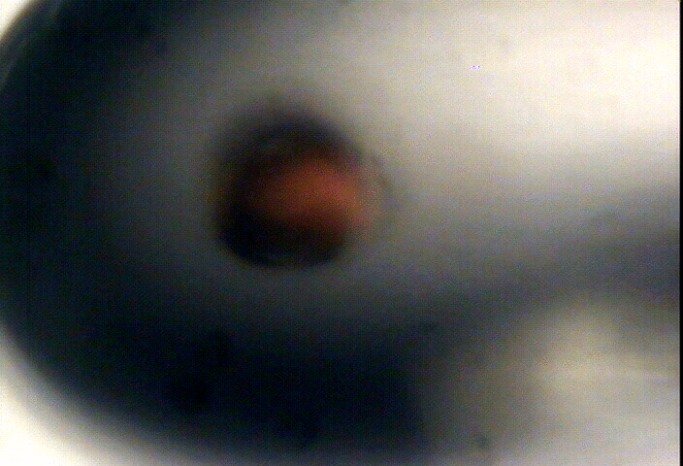
“dose contrast” effects

Slide 7
“dose contrast” effects

Slide 8
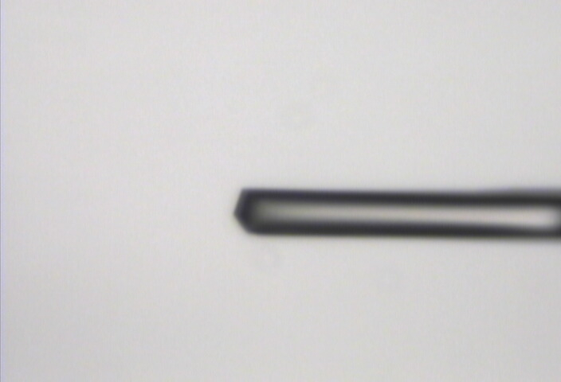
“Cleanup beam” method for flat dose profile
normalized photons/area
position relative to beam center (μm)

Slide 9
“Cleanup beam” method for flat dose profile
normalized photons/area
position relative to beam center (μm)

Slide 10
“Cleanup beam” method for flat dose profile
normalized photons/area
position relative to beam center (μm)

Slide 11
“Cleanup beam” method for flat dose profile
normalized photons/area
position relative to beam center (μm)

Slide 12
“Cleanup beam” method for flat dose profile
normalized photons/area
position relative to beam center (μm)

Slide 13
Exponential spot fading: flat dose
integrated spot intensity
dose (MGy)

Slide 14
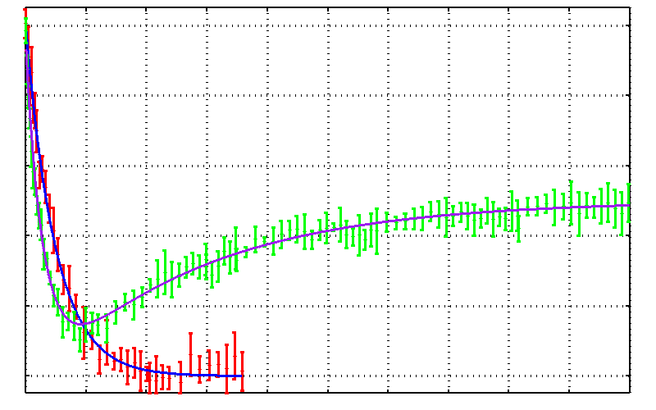
No dose flattening: damage repair?
25mM SeMet in 50 mM bis-tris
Half-dose = 17.0 ± 0.7 MGy
25% glycerol
Half-dose = 10 ± 0.4 MGy
25% threhalose
Drift!
0.0 0.2 0.4 0.6 0.8 1.0
Fraction Se-Met undamaged
Reverse half-dose = 93 ± 5 MGy
0 100 200 300 400 500
Absorbed Dose (MGy)

Slide 15
False “Damage reversal”: from drift
X-ray beam
crystal

Slide 16
False “Damage reversal”: from beam profile
X-ray beam
crystal

Slide 17
False “Damage reversal”: from beam profile
Cold beam
Hot beam
crystal

Slide 18
False “Damage reversal”: from beam profile
Cold beam
Hot beam
crystal

Slide 19
False “Damage reversal”: from beam profile
Cold beam
Hot beam
crystal

Slide 20
False “Damage reversal”: from beam profile
Cold beam
Hot beam
crystal

Slide 21
Gaussian beam
50% of flux
the other 50%

Slide 22
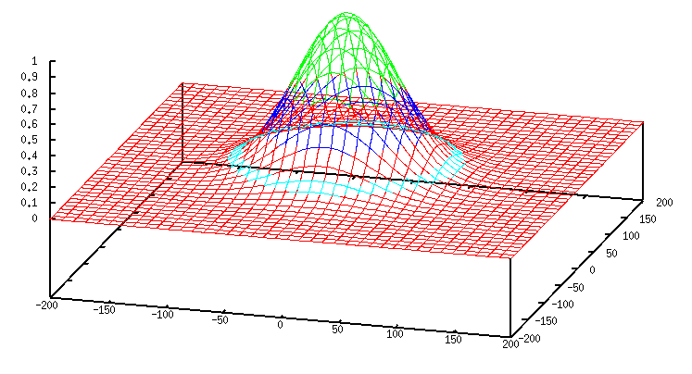
Gaussian beam
50% of flux
25% of flux
12.5 % of flux
6.3 % of flux
6.3%

Slide 23
Collimated beam
100% of flux
0%

Slide 24
What is the dose?

Slide 25
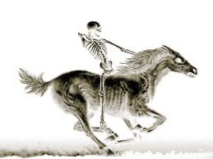
What is the dose?

Slide 26
What is the dose?

Slide 27
Falling into “the drift”
normalized photons/area
position relative to beam center (μm)

Slide 28
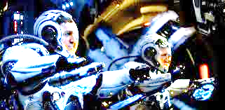
Falling into “the drift”
normalized photons/area
position relative to beam center (μm)

Slide 29
Beam Shape Dichotomy
Flat-top beam
Uniform dose in illuminated region
Sharp edges: most sensitive to drift
Gaussian beam
No sharp edges
High dose contrast
Best of both?
“dose flattening”

Slide 30
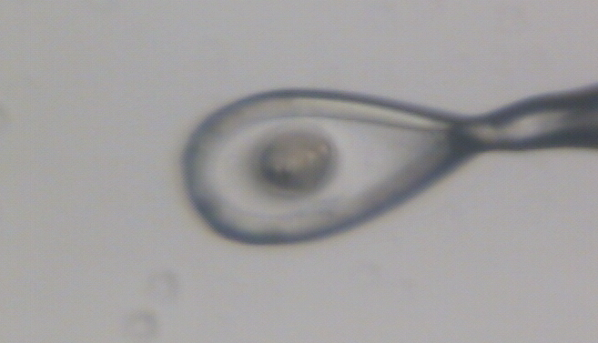
Dose contrast: differential expansion
Protein crystal in sucrose, NaWO4 and oil

Slide 31
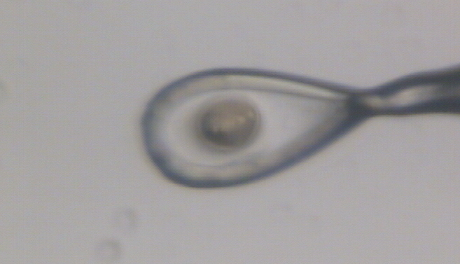
Dose contrast: differential expansion
Protein crystal in sucrose, NaWO4 and oil

Slide 32
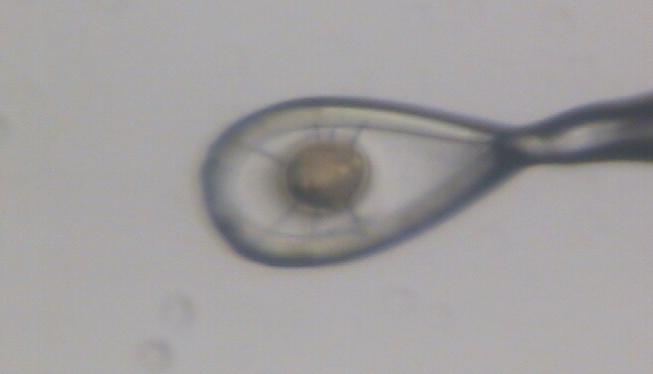
Dose contrast: differential expansion
Protein crystal in sucrose, NaWO4 and oil

Slide 33
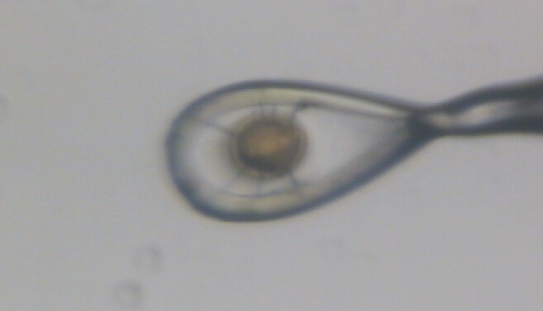
Dose contrast: differential expansion
Protein crystal in sucrose, NaWO4 and oil

Slide 34
dose flattening: two shots
beam1
beam2
Flux density (x10⁶ ph/µm²)
Position (FWHM)

Slide 35
dose flattening: two shots
beam1
beam2
Flux density (x10⁶ ph/µm²)
Position (FWHM)

Slide 36
dose flattening: two shots
beam1
beam2
Flux density (x10⁶ ph/µm²)
Position (FWHM)

Slide 37
dose flattening: two shots
beam1
beam2
Flux density (x10⁶ ph/µm²)
Position (FWHM)

Slide 38
dose flattening: two shots
beam1
beam2
Flux density (x10⁶ ph/µm²)
Position (FWHM)

Slide 39
dose flattening: two shots
beam1
beam2
Flux density (x10⁶ ph/µm²)
Position (FWHM)

Slide 40
dose flattening: two shots
beam1
beam2
Flux density (x10⁶ ph/µm²)
Position (FWHM)

Slide 41
dose flattening: two shots
beam1
beam2
Flux density (x10⁶ ph/µm²)
Position (FWHM)

Slide 42
dose flattening: two shots
beam1
beam2
0.849 FWHM
Flux density (x10⁶ ph/µm²)
FWHM
Position (FWHM)

Slide 43
dose flattening: 3 shots
0.798 FWHM
Flux density (x10⁶ ph/µm²)
Position (FWHM)

Slide 44
dose flattening: 3 shots
0.781 FWHM
12%
Flux density (x10⁶ ph/µm²)
Position (FWHM)

Slide 45
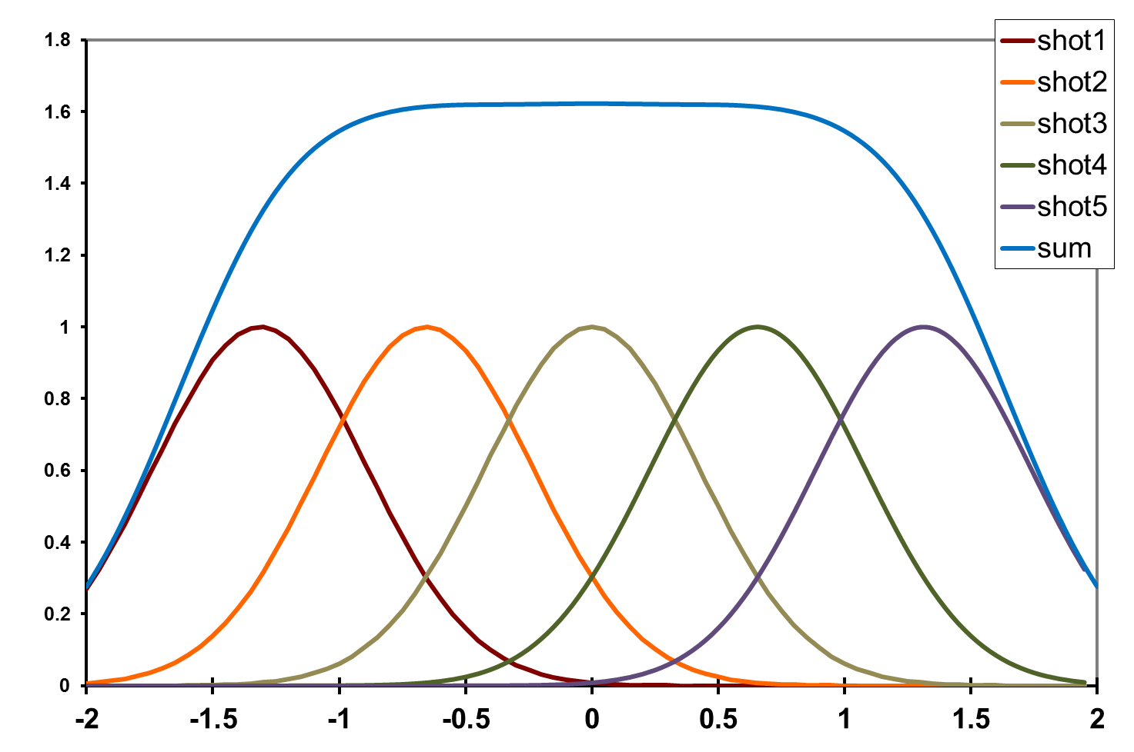
dose flattening: 5 shots
0.656 FWHM
Flux density (x10⁶ ph/µm²)
Position (FWHM)

Slide 46
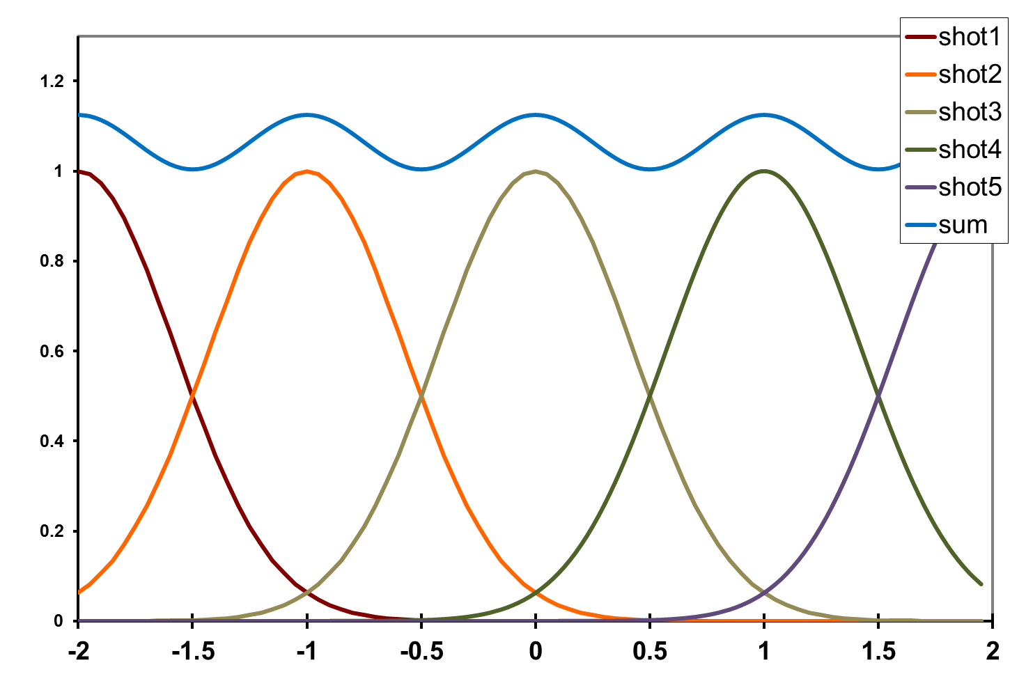
dose flattening: shot train
12%
1.0 FWHM
Flux density (x10⁶ ph/µm²)
Position (FWHM)

Slide 47
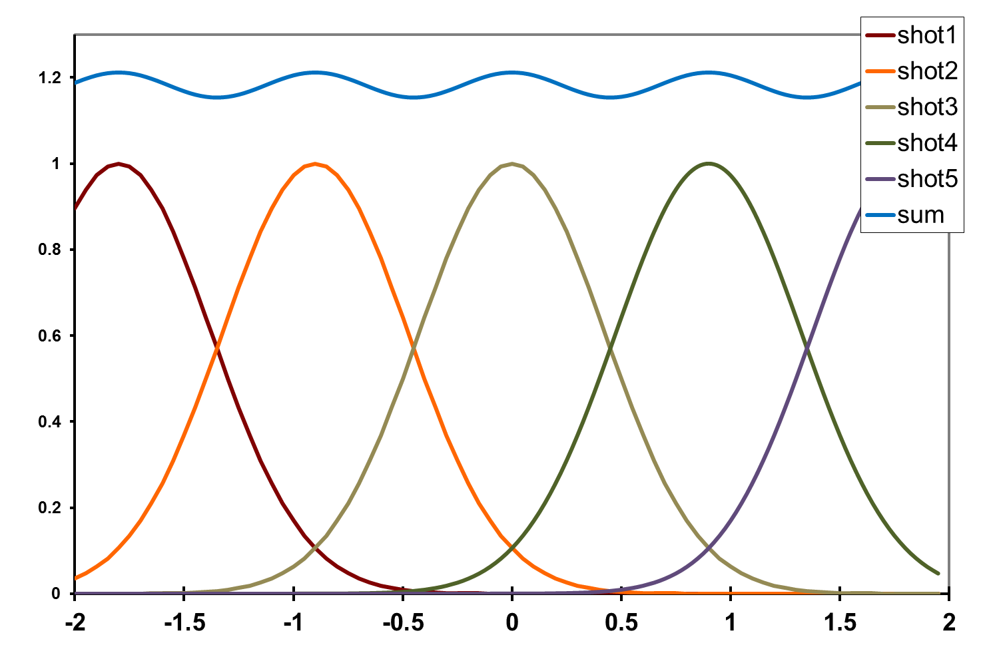
dose flattening: shot train
4.5%
0.9 FWHM
Flux density (x10⁶ ph/µm²)
Position (FWHM)

Slide 48
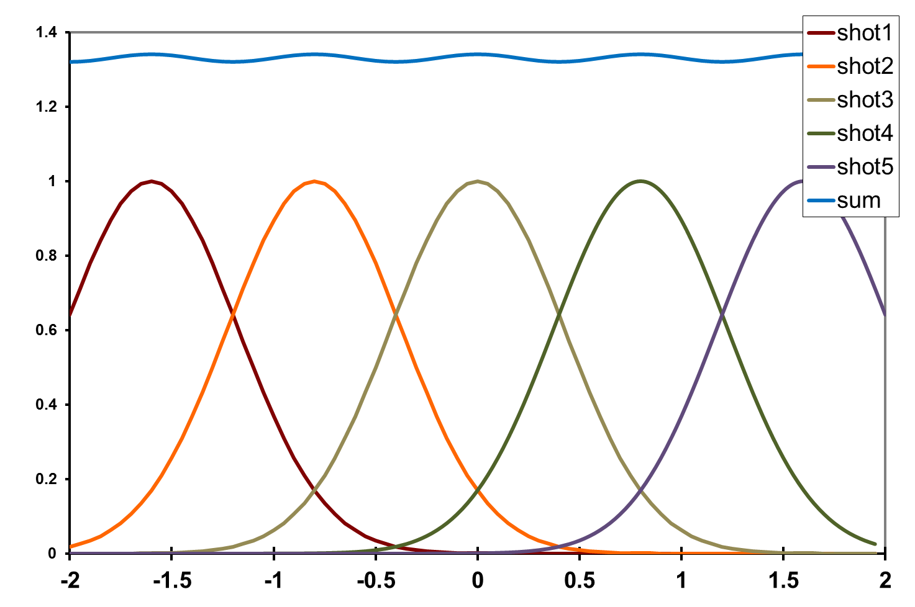
dose flattening: shot train
1.5%
0.8 FWHM
Flux density (x10⁶ ph/µm²)
Position (FWHM)

Slide 49
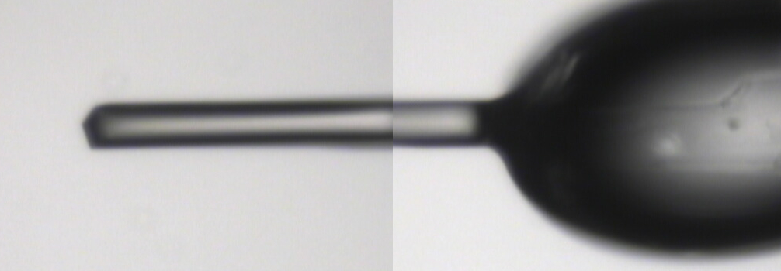
~0 MGy

Slide 50
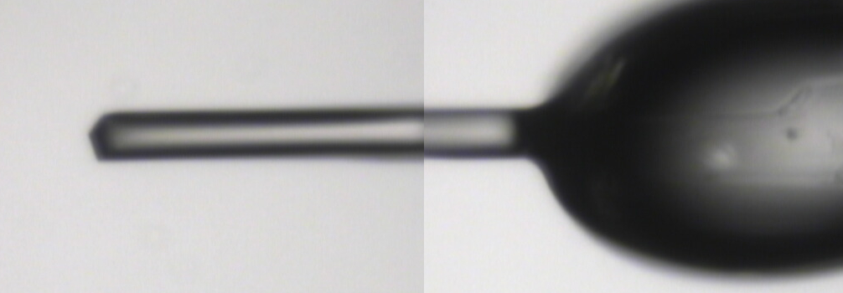
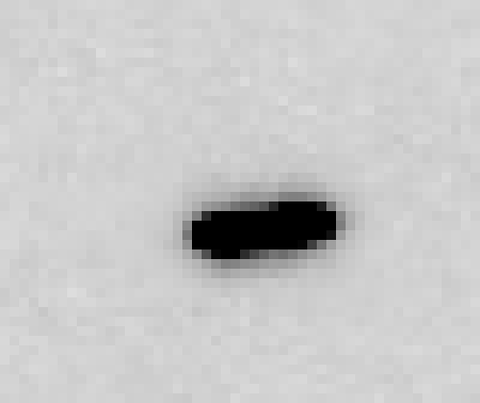
5 MGy

Slide 51
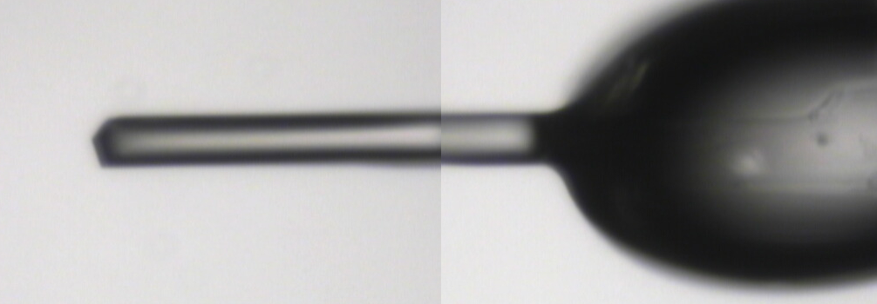
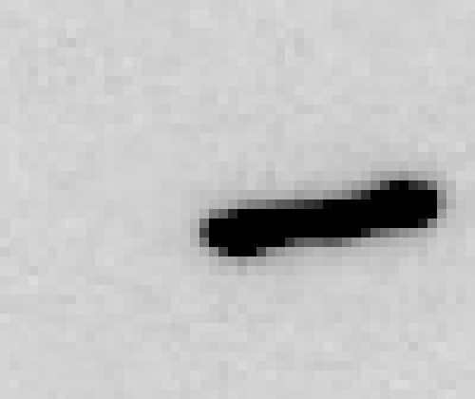
11 MGy

Slide 52
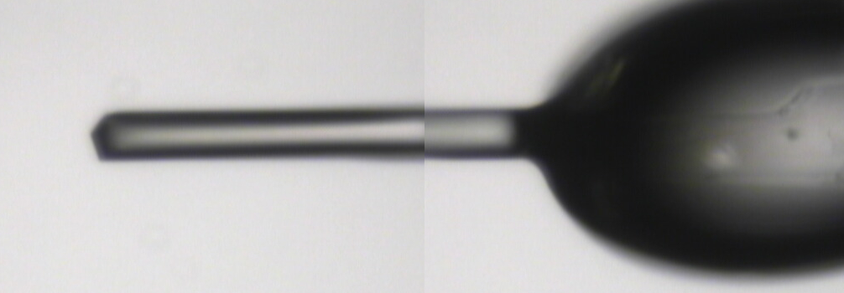
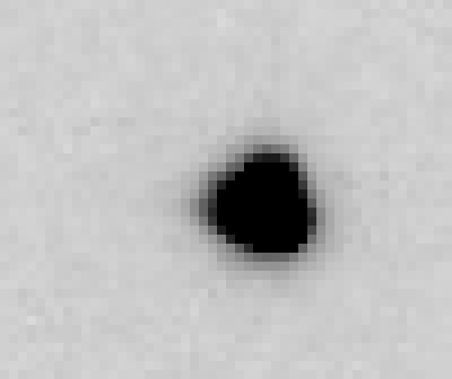
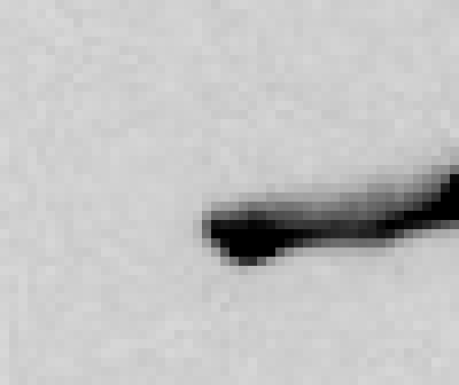
16 MGy

Slide 53
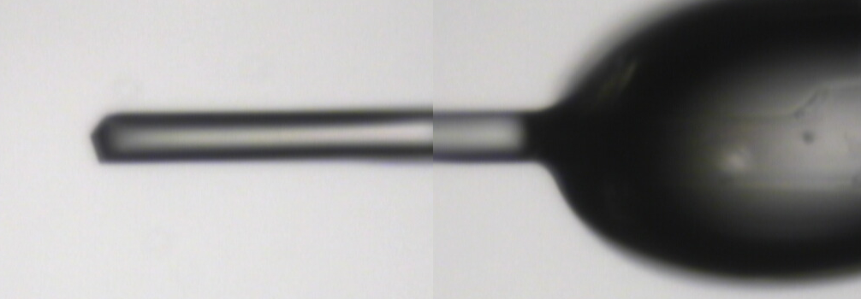
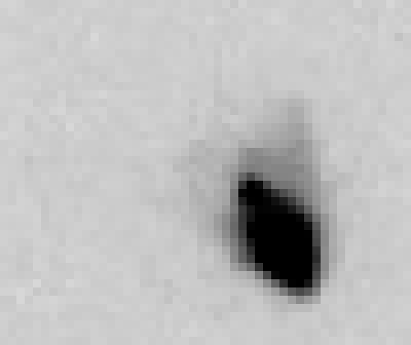
22 MGy

Slide 54
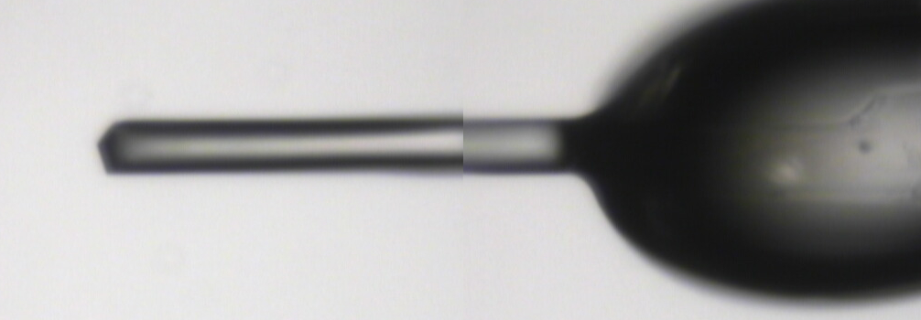
26 MGy

Slide 55
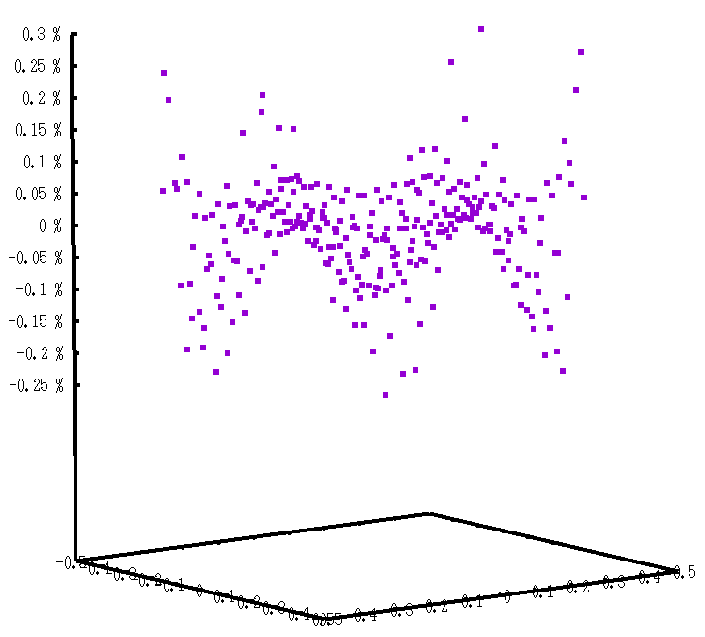
In 2D: hexagonal pattern
Avg dose = 180% peak
0.3%
0.2%
0.1%
0
-0.1%
-0.2%
-0.3%
122%
exposure
0.9 FWHM
Position (FWHM)

Slide 56
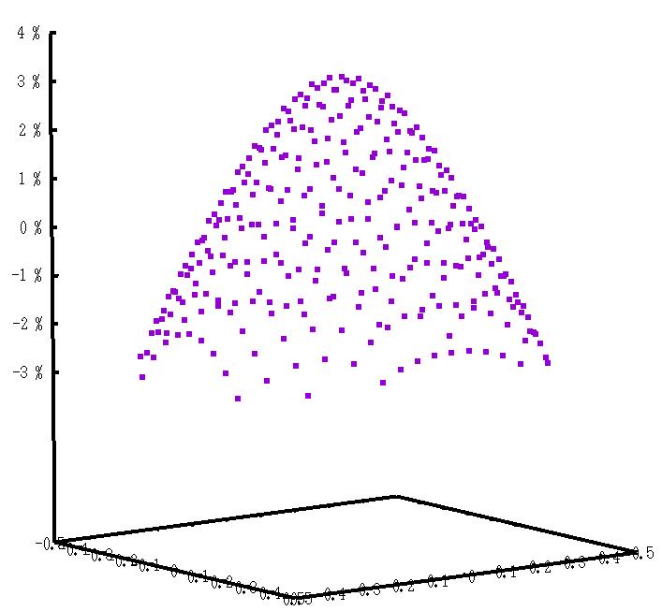
In 2D: hexagonal pattern
Avg dose = 164% peak
3%
2%
1%
0
-1%
-2%
-3%
100%
exposure
0.89 FWHM
Position (FWHM)

Slide 57
In 2D: moving train
Avg dose = 120% +/- 1.5% peak
0.8 FWHM
Position (FWHM)

Slide 58
“rastering” to find the crystal
X-ray beam
ice
Membrane
protein crystal

Slide 59
“rastering” for flat dose

Slide 60
“rastering” for virtual beam

Slide 61
Background for DS

Slide 62
Sample is 3D

Slide 63
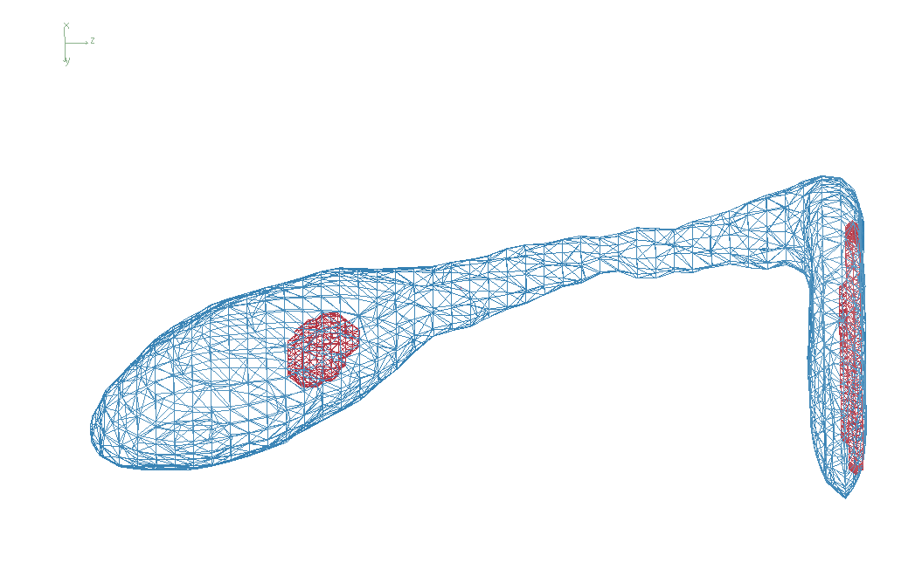
3D mapping of sample

Slide 64
Sample is 3D

Slide 65
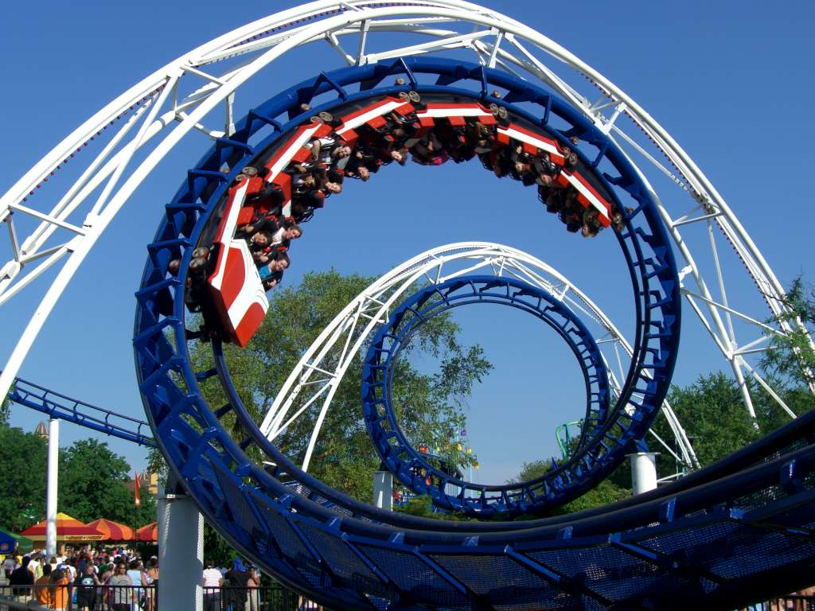
2-motor scans offset data
360°
phi
0°
position

Slide 66
2-motor scans offset data
360°
phi
0°
position

Slide 67
“rastering” for flat dose

Slide 68
How many images?
360° / 0.1° * ( 100 µm / 1 µm )²
⁼ 36x10⁶
28,000 ph/image

Slide 69
The Entropy Limit
bits
s
= log₂(N_{pixels}) * flux * t_{sample} * 1.2x10⁻⁵
minimum data rate with no information loss
N_{pixels} = 4150*4371 for Eiger
flux = photons/s onto the sample
t_{sample} = sample thickness in µm
1.2x10⁻⁵ = 10⁻⁴ cm/µm * cross section of oxygen (0.2 cm²/g)
* density of protein crystal (1.2 g/cm³ )
* ~1/2 of total scattering intersects detector
E.G. 34 GByte/s for 10¹³ photons/s and 100 µm thick

Slide 70
How to lose information
long exposures
>1 photon/image = order of arrivals
Wide phi slice
sum over angle
Large beams
sum over area
Pink/divergent beam
sum over lambda/angle
Background
non-crystal stuff
Systematics
Dose contrast

Slide 71
How long will it take?
Damage & diffraction = flux / area
Gy/s = ph/s /2000 / um²
Example: 30 MGy, 1 mm² area, flux= 10¹² ph/s
1x1 μm beam: 60 ms
100x100 μm beam: 600 s x 10x10 shots =
1x1 mm beam: 60,000 s x 1 shot = 17 hours
x 1000x1000 shots =
17 hours
17 hours
10¹³ ph/s → 1.7 h/mm²
10¹³ ph/s @ RT → 40 s/mm²
Holton (2009)."beginner's guide rad dam", J. Synch. Rad. 16, 133-142.

Slide 72
The number of photons scattered
before crystal is dead
is independent
of flux & time
1 um³ = 10⁵ photons (roomT)
1 um³ = 10⁶ photons (synch)
1 um³ = 10⁸ photons (XFEL)
(synch)
Henderson, 1990; Gonzalez & Nave, 1994; Glaeser et al., 2000; Sliz et al., 2003; Leiros et al., 2006; Owen et al., 2006; Garman & McSweeney, 2006; Garman & Nave, 2009; Holton, 2009

Slide 73
Dose slicing
low
completeness
N
photons
crystal’s useful life
N
photons
too much
read noise
N
photons

Slide 74
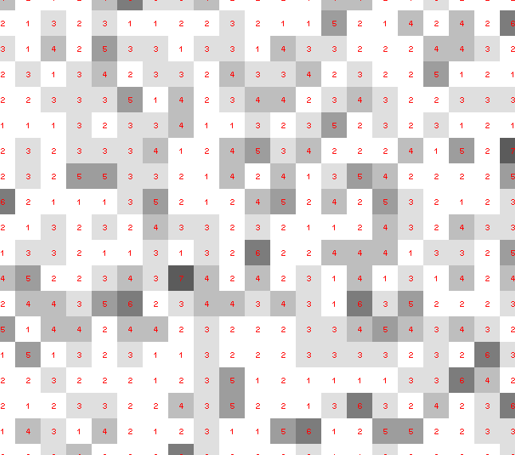
Dose slicing: is that a spot?

Slide 75
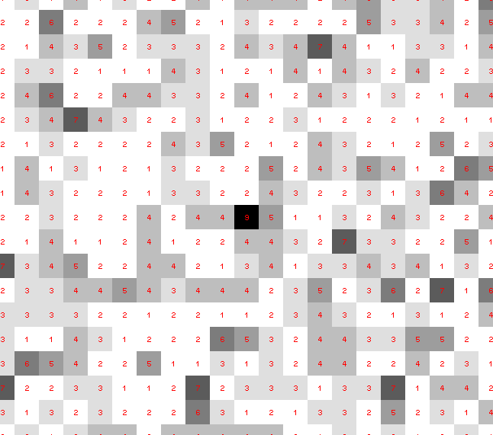
Dose slicing: is that a spot?

Slide 76
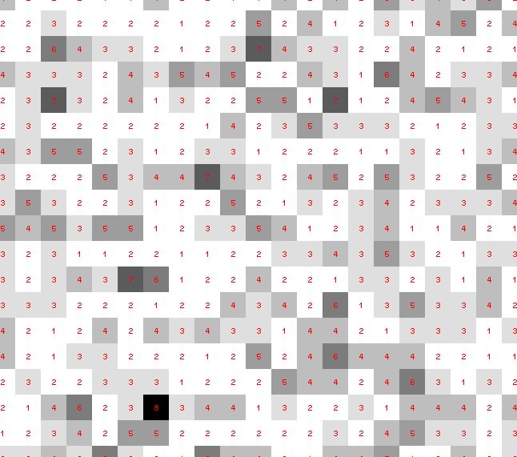
Dose slicing: is that a spot?

Slide 77
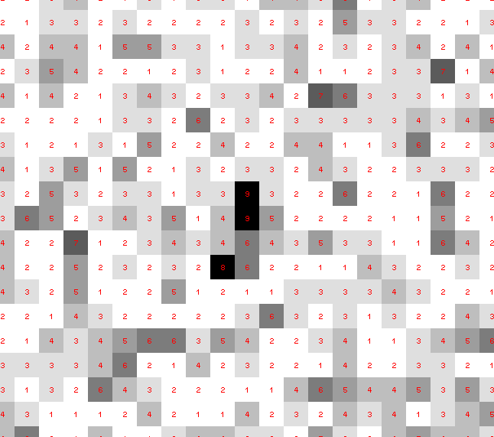
Dose slicing: is that a spot?

Slide 78
Dose slicing: is that a spot?

Slide 79
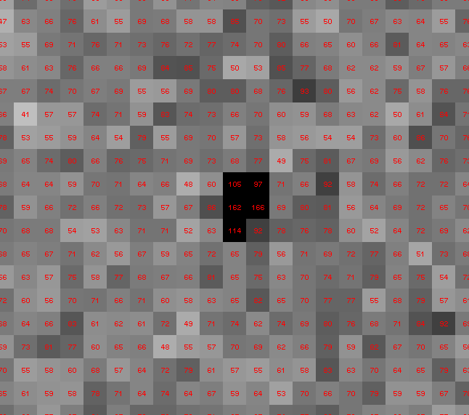
Dose slicing: is that a spot?

Slide 80
What if?
You only have a few small crystals…
Should you:
Collect 360° from each?
Collect 10° from each at 36x exposure?
Glue 36 xtals together, then collect 360° ?

Slide 81
“true” resolution limit
CC vs right answer
Resolution (Å)

Slide 82
“true” resolution vs strategy
Dose slice collection scenario
fine | coarse | glue
3.17700 | 3.14057 | 3.17604
301,640,334 photons/xtal

Slide 83
How to lose information
long exposures
>1 photon/image = order of arrivals
Wide phi slice
sum over angle
Large beams
sum over profile area
Pink/divergent beam
sum over lambda/angle
Background
non-crystal stuff
Systematics
Dose contrast, drift, read-out gap

Slide 84
Summary
http://bl831.als.lbl.gov/~jamesh/powerpoint/
ACA_painting_2019.pptx
“dose contrast” avoided with dose flattening
0.8 FWHM = very flat
data beam can be virtual
Don’t fall into “the drift”!
Long exposures = lossy compression
Rastering as data collection?

Slide 85
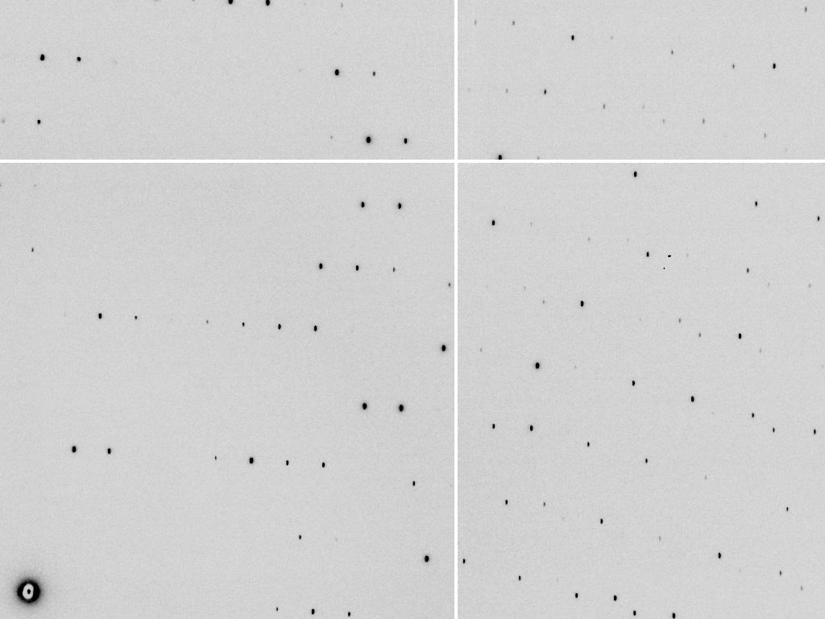
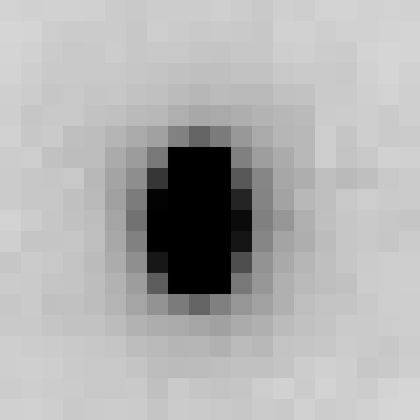
compresses 4.2x
Notes:
Test data set: ADSC Q315r ccd. No loss, compresses 4.2x with gzip, etc.

Slide 86
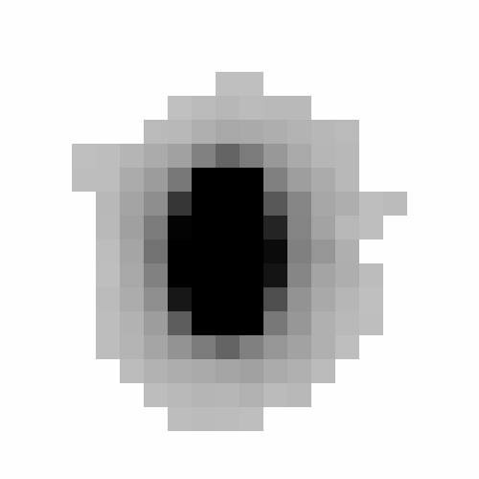
compresses 337x
Notes:
Isolate spots by looking for peaks. Set everything else to zero, compresses almost 100x better!

Slide 87
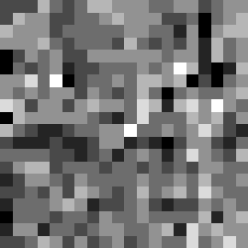
compresses 5x, but only one per dataset!
Notes:
Median background and median absolute deviation from that background, store this separately as two images, compression is > 100x if you consider that there were 100 images in this data set.

Slide 88
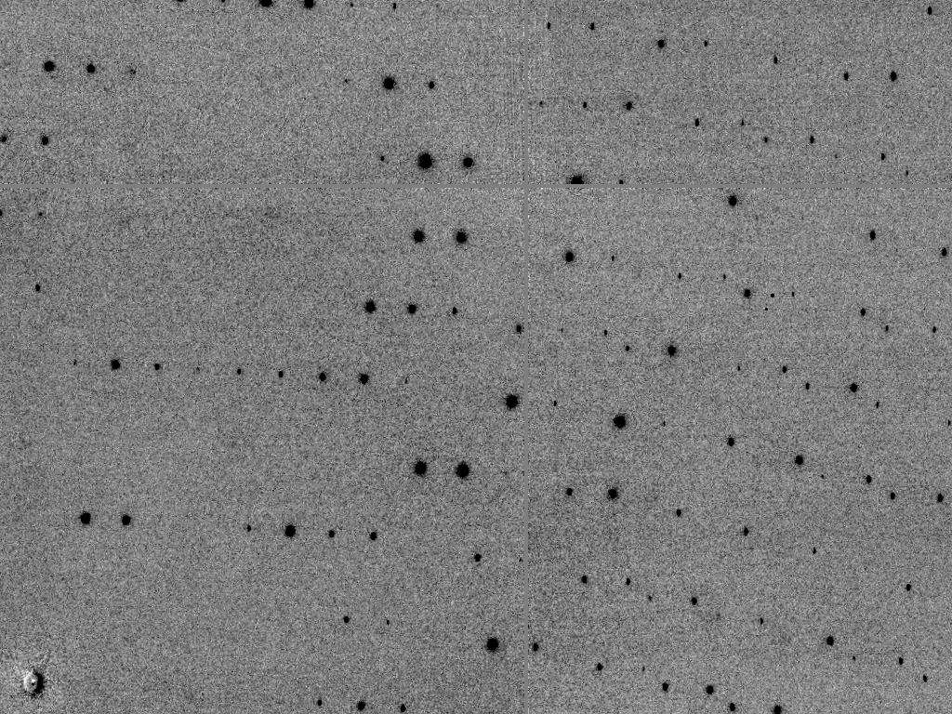
compresses 3.5x
Notes:
Subtract meidan background and spots, left with difference between original image and everything we have compressed so far (spots, median background and median background noize level). This compresses less well than original image because all the “information” in the background is in here.

Slide 89
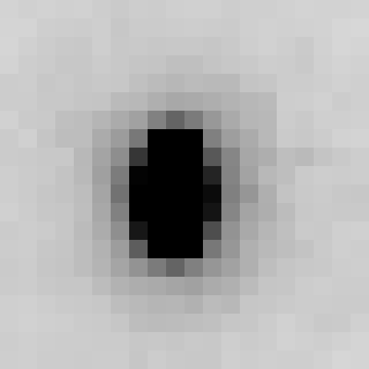
compressed ~50x
Notes:
After doing lossy compression on background, the image can be re-assembled by adding the spots to the median background and then finally adding the lossy-compressed difference image. So, we have only modified background pixels, but achieved 10x more compression!

Slide 90
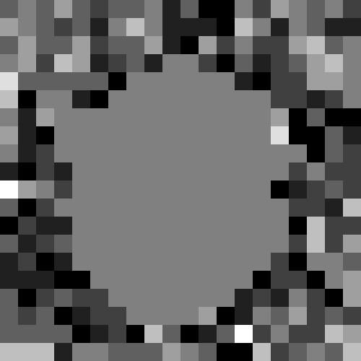
compresses 5.2x
Notes:
Difference between the 50x lossy-compressed image and the original image. Note that the spots are “blank” because they were not modified by the lossy compression. This difference image contains most of the entropy of the original data set, as evidence by how it doesn’t compress very well. Theoretically, the difference data set could be stored separately from the 50x lossy-compressed data. Perhaps on tape or other slow long-term media. That way if anyone wants the original data back they can still get it. But for quick online storage the 50x compressed data can be used.

Slide 91
Lossy compression vs R/R_{free}
R factor
compression ratio
Notes:
By adjusting the h264 lossy compression ratio of the background pixels the impact of the compression on crystallographic statistics can be evaluated. Note that some of these points are actually better than the uncompessed data! This is due to random noise, but could be a misguided argument for lossy compression: it can improve your Rfree

Slide 92
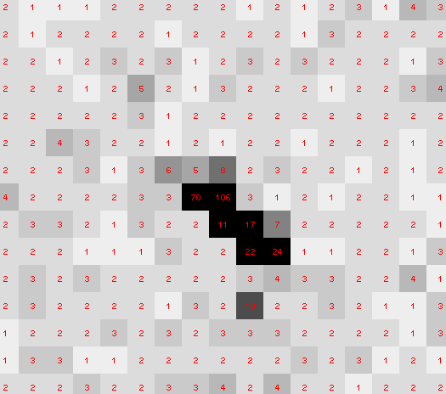
8x8 Max-pool & sqrt filter

Slide 93
Ultimate data rate
bits
s
= log₂(pixels) * flux * thick * 1.2x10⁻⁵
where: bits/s = entropy-limited compressed data rate
pixels = number of pixels in the detector
flux = photons/s onto the sample thick = sample thickness in microns
EG: 1e12 ph/s * 100um thick = 3.4 GBytes/s
The 1.2e-5 scattered photons per incident photon can be derived form the cross section of oxygen (0.2 cm^2/g) and the rough density of protein crystals (1.2 g/cm^3), and the fact that about half of all scattered photons hit a flat detector: 0.2*1.2*1e-4/2 = 1.155e-5 That is, flux*thickness*1.2e-5 is the rate of photon arrivals and log2(pixels) is the number of bits required to store the location of one photon in the entropy-limited regime. Lossless compression cannot be better than this because individual photon arrivals are genuinely random.

Slide 94
How to lose information
long exposures
>1 photon/image = order of arrivals
Wide phi slice
sum over angle
Large beams
sum over area
Pink/divergent beam
sum over lambda/angle
Background
non-crystal stuff
Systematics
Dose contrast

