Slide 1
Acknowledgements
Robert Stroud James Fraser Aina Cohen
Ken Frankel John Tainer
UCSF LBNL SLAC
ALS 8.3.1 creator: Tom Alber
UC Multicampus Research Programs and Initiatives (MRPI)
UCSF Program for Breakthrough Biomedical Research (PBBR)
one-time NIH-DOE Inter-agency agreement (IAA)
Integrated Diffraction Analysis Technologies (IDAT)
Plexxikon, Inc.
M D Anderson CRC
Synchrotron Radiation Structural Biology Resource (SLAC)
The Advanced Light Source is supported by the Director, Office of Science, Office of Basic Energy Sciences, Materials Sciences Division, of the US Department of Energy under contract No. DE-AC02-05CH11231 at Lawrence Berkeley National Laboratory.

Slide 2
Acknowledgements
Robert Stroud James Fraser Aina Cohen
Ken Frankel John Tainer
UCSF LBNL SLAC
ALS 8.3.1 creator: Tom Alber
UC Multicampus Research Programs and Initiatives (MRPI)
UCSF Program for Breakthrough Biomedical Research (PBBR)
one-time NIH-DOE Inter-agency agreement (IAA)
Integrated Diffraction Analysis Technologies (IDAT)
Plexxikon, Inc.
M D Anderson CRC
Synchrotron Radiation Structural Biology Resource (SLAC)
The Advanced Light Source is supported by the Director, Office of Science, Office of Basic Energy Sciences, Materials Sciences Division, of the US Department of Energy under contract No. DE-AC02-05CH11231 at Lawrence Berkeley National Laboratory.

Slide 3
The number of photons scattered
before crystal is dead
is independent
of data collection time
1 um³ = 10⁵ photons (roomT)
1 um³ = 10⁶ photons (synch)
1 um³ = 10⁸ photons (XFEL)
(synch)
Henderson, 1990; Gonzalez & Nave, 1994; Glaeser et al., 2000; Sliz et al., 2003; Leiros et al., 2006; Owen et al., 2006; Garman & McSweeney, 2006; Garman & Nave, 2009; Holton, 2009

Slide 4
Multi-crystal strategy:
You have:
5 μm crystals
5 μm beam
~7 μm loop
a perfect detector
All the flux you want
All the time you want
Should you collect:
10° from each, 1 °/s
“coarse” dose slice
b) 360° from each, 36 °/s
“fine” dose slice
same dose
same photons
which is better?

Slide 5
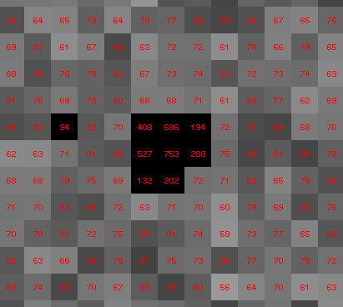
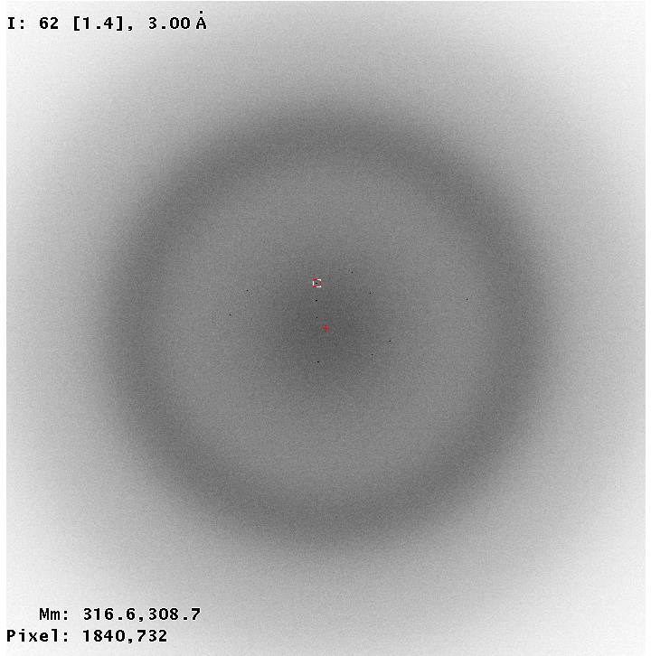
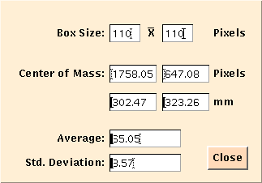
“coarse” dose slicing

Slide 6
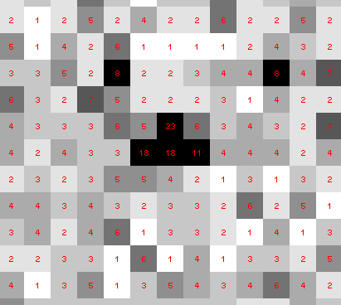
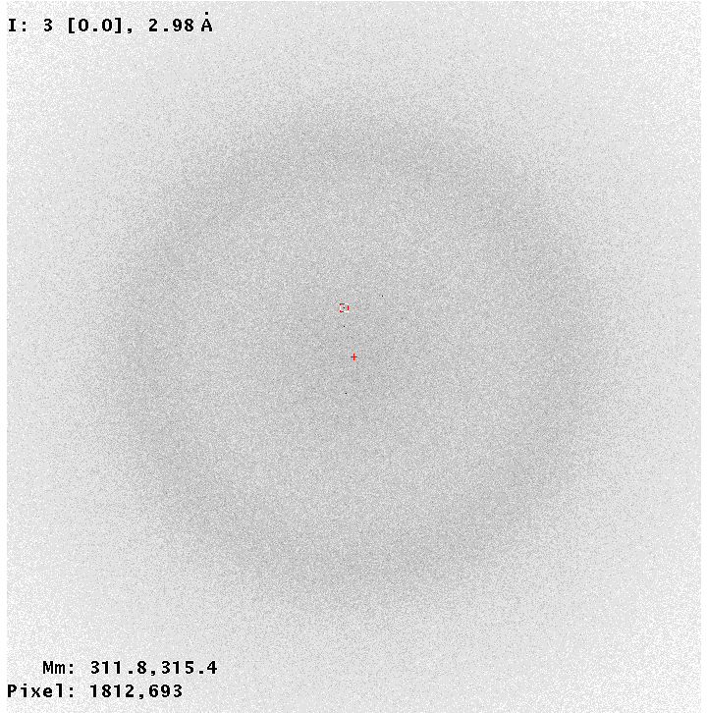
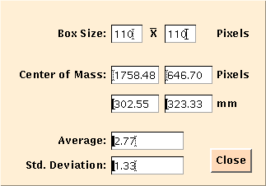
“fine” dose slicing

Slide 7
processing procedure | “true” resolution
 | coarse | fine
XDS/XSCALE | 3.02970 | 3.03874
XDS/aimless | 3.03531 | 3.13351
XDS/noscale | 3.03048 | 3.01449
MOSFLM defaults | x | x
MOSFLM cheat* | 3.04355 | 3.51254
HKL2000 defaults | x | x
HKL2000 cheat* | 3.01415 | 3.04147
DIALS xia2 | x | x
DIALS manual | 2.99456 | 2.96392
DIALS cheat* | x | 2.92007
http://bl1231.als.lbl.gov/~jamesh/dose_slice/results.html

Slide 8
Overcoming with fancy math
non-isomorphism
not same structure thing

Slide 9
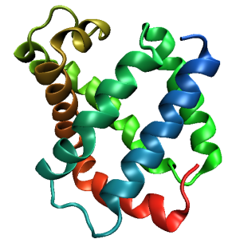
Same structure, different cell
0.5% cell change → 15%
Crick & Magdoff (1956) “theory method isomorphous replacement”, Acta Cryst. 9, 901-8.

Slide 10
Same structure, different cell
0.5% cell change → 15%
Crick & Magdoff (1956) “theory method isomorphous replacement”, Acta Cryst. 9, 901-8.

Slide 11
Uniform stretch
5% change → 0%

Slide 12
Uniform stretch
5% change → 0%

Slide 13
Same cell, rotated protein
0.5° rotation → 16%
Crick & Magdoff (1956) “theory method isomorphous replacement”, Acta Cryst. 9, 901-8.

Slide 14
Same cell, rotated protein
0.5° rotation → 16%
Crick & Magdoff (1956) “theory method isomorphous replacement”, Acta Cryst. 9, 901-8.

Slide 15
Same cell, shifted protein
0.1 Å shift → 17%
Crick & Magdoff (1956) “theory method isomorphous replacement”, Acta Cryst. 9, 901-8.

Slide 16
Same cell, shifted protein
0.1 Å shift → 17%
Crick & Magdoff (1956) “theory method isomorphous replacement”, Acta Cryst. 9, 901-8.

Slide 17
cell angle
0.5° cell angle → 16%
Crick & Magdoff (1956) “theory method isomorphous replacement”, Acta Cryst. 9, 901-8.

Slide 18
cell angle
0.5° cell angle → 16%
Crick & Magdoff (1956) “theory method isomorphous replacement”, Acta Cryst. 9, 901-8.

Slide 19
Δa
ΔΦ
0.5% cell change → 15%
0.5° rotation → 16%
Δx
Δβ
0.1 Å shift → 17%
0.5° cell angle → 16%
Crick & Magdoff (1956) “theory method isomorphous replacement”, Acta Cryst. 9, 901-8.

Slide 20
Magdoff & Crick (1955) “Ribonuclease II. Accuracy of measurement and shrinkage”, Acta Cryst. 8, 461-8.
Crick & Magdoff (1956) “The theory of the method of isomorphous replacement for protein crystals”, Acta Cryst. 9, 901-8.

Slide 21
Non-isomorphism in lysozyme
Dear James
The story of the two forms of lysozyme crystals goes back to about 1964 when it was found that the diffraction patterns from different crystals could be placed in one of two classes depending on their intensities. This discovery was a big set back at the time and I can remember a lecture title being changed from the 'The structure of lysozyme' to 'The structure of lysozyme two steps forward and one step back'. Thereafter the crystals were screened based on intensities of the (11,11,l) rows to distinguish them (e.g. 11,11,4 > 11,11,5 in one form and vice versa in another). Data were collected only for those that fulfilled the Type II criteria. (These reflections were easy to measure on the linear diffractometer because crystals were mounted to rotate about the diagonal axis). As I recall both Type I and Type II could be found in the same crystallisation batch . Although sometimes the external morphology allowed recognition this was not infallible.
The structure was based on Type II crystals. Later a graduate student Helen Handoll examined Type I. The work, which was in the early days and before refinement programmes, seemed to suggest that the differences lay in the arrangement of water or chloride molecules (Lysozyme was crystallised from NaCl). But the work was never written up. Keith Wilson at one stage was following this up as lysozyme was being used to test data collection strategies but I do not know the outcome.
An account of this is given in International Table Volume F (Rossmann and Arnold edited 2001) p760.
Tony North was much involved in sorting this out and if you wanted more info he would be the person to contact. I hope this is helpful. Do let me know if you need more.
Best wishes
Louise

Slide 22
Non-isomorphism in lysozyme
Structure factor (e⁻)
Johnson’s ratio

Slide 23
Non-isomorphism in lysozyme
Structure factor (e⁻)
Johnson’s ratio

Slide 24
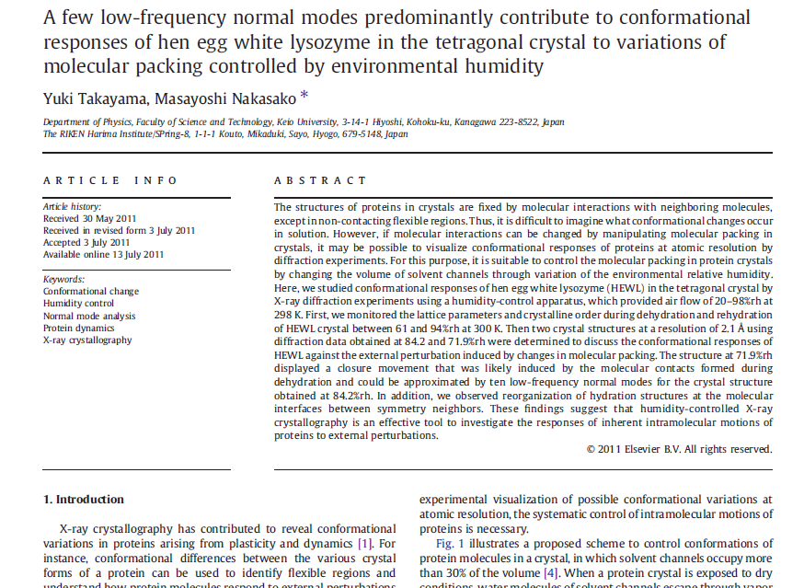

Slide 25
Non-isomorphism in lysozyme
RMSD = 0.18 Å
Δcell = 0.7 %
R_{iso} = 44.5%
3aw6
3aw7
RH: 84.2%
vs 71.9%

Slide 26
Non-isomorphism in lysozyme
RMSD = 0.18 Å
Δcell = 0.7 %
R_{iso} = 44.5%
3aw6
3aw7
RH: 84.2%
vs 71.9%

Slide 27
Non-isomorphism in lysozyme
Dear James
The story of the two forms of lysozyme crystals goes back to about 1964 when it was found that the diffraction patterns from different crystals could be placed in one of two classes depending on their intensities. This discovery was a big set back at the time and I can remember a lecture title being changed from the 'The structure of lysozyme' to 'The structure of lysozyme two steps forward and one step back'. Thereafter the crystals were screened based on intensities of the (11,11,l) rows to distinguish them (e.g. 11,11,4 > 11,11,5 in one form and vice versa in another). Data were collected only for those that fulfilled the Type II criteria. (These reflections were easy to measure on the linear diffractometer because crystals were mounted to rotate about the diagonal axis). As I recall both Type I and Type II could be found in the same crystallisation batch . Although sometimes the external morphology allowed recognition this was not infallible.
The structure was based on Type II crystals. Later a graduate student Helen Handoll examined Type I. The work, which was in the early days and before refinement programmes, seemed to suggest that the differences lay in the arrangement of water or chloride molecules (Lysozyme was crystallised from NaCl). But the work was never written up. Keith Wilson at one stage was following this up as lysozyme was being used to test data collection strategies but I do not know the outcome.
An account of this is given in International Table Volume F (Rossmann and Arnold edited 2001) p760.
Tony North was much involved in sorting this out and if you wanted more info he would be the person to contact. I hope this is helpful. Do let me know if you need more.
Best wishes
Louise

Slide 28
“same drop” ?

Slide 29
Dehydration: 1964 vs 2016?
= 1.5 μL
100 μm
= 1.0 nL
2 mm
= 1.0 pL
10 μm
= 1.0 fL
1 μm

Slide 30
plunge cooling
warm, moist air
ice
cold, dry N₂
liquid N₂
foam insulation

Slide 31
plunge cooling
warm, moist air
ice
cold N₂
liquid N₂
foam insulation

Slide 32
Warkentin method
liquid N₂
foam insulation
Warkentin (2006) J. Appl. Crystallogr. 39, 805-811.

Slide 33
What are we going to do about this,
Rob?
liquid N₂

Slide 34
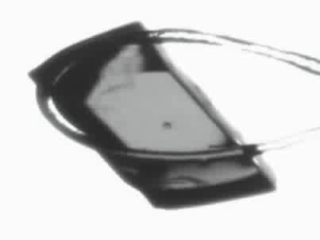
Response to dehydration
www.proteros.de

Slide 35
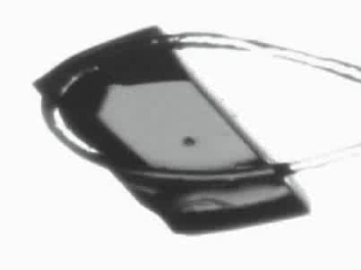
Response to dehydration
www.proteros.de

Slide 36
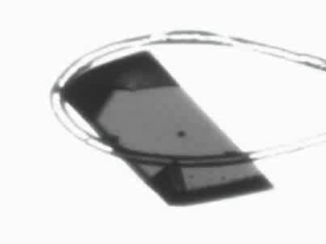
Response to dehydration
www.proteros.de

Slide 37
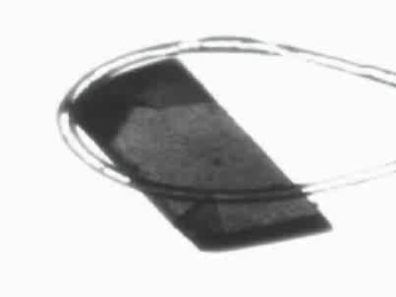
Response to dehydration
www.proteros.de

Slide 38
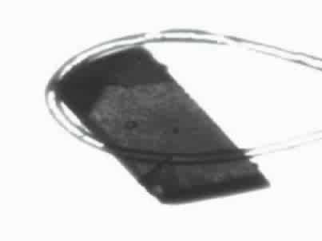
Response to dehydration
www.proteros.de

Slide 39
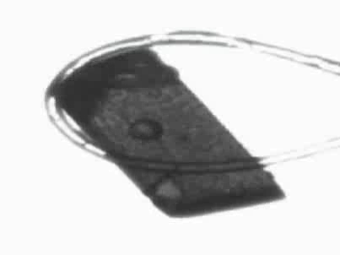
Response to dehydration
www.proteros.de

Slide 40
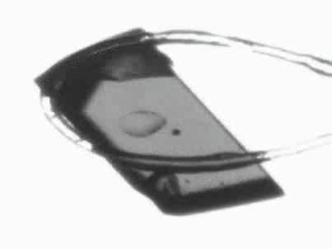
Response to dehydration
www.proteros.de

Slide 41
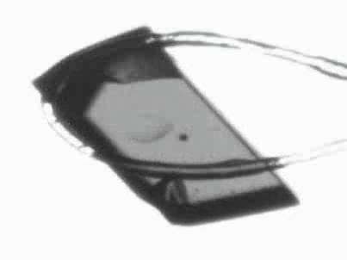
Response to dehydration
www.proteros.de

Slide 42
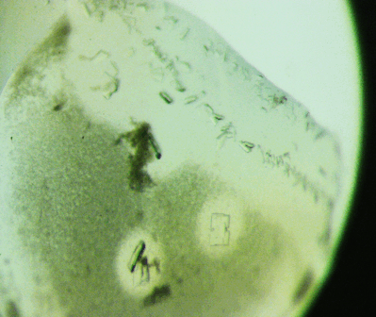
Ostwald Ripening
http://xray.bmc.uu.se/terese/tutorial6.html

Slide 43
… but does it work for membrane proteins?
CCP4BB:
“We used it for a large membrane protein complex and diffraction improved from ~7 to 2.7 A. The crystal is fished out and put into mother liquor solution in the button, sealed with dialysis membrane and the button is then placed into about 5 mls of mother liquor with slightly higher PEG concentration. Then you just exchange outside buffer every day or so for solutions containing higher concentrations of PEG. We went from ~9 to 30 % PEG4000 in about a week. You can easily observe crystal under microscope and if it cracks - you went too far/too quickly with PEG and need to use a bit less next time. Also, this method allows you to control all other components of the dehydrating solution - we needed to decrease salt concentration at the same time as increasing PEG. You can also introduce/increase cryo-protectant concentration at the same time. With these crystals, otherwise excellent dehydration machines already mentioned did not work, possibly because the process had to be really slow.”
Efremov, R. G. & Sazanov, L. A. (2011)."Structure of the membrane domain of respiratory complex I", Nature 476, 414-420.
“To improve diffraction properties, crystals were slowly cooled to 4 C, placed into micro-dialysis buttons, and mother liquor was exchanged by dialysis for 0.1 M sodium acetate (pH 4.8), 0.15 M sodium tartrate (pH 5.0), 30% PEG4000, 0.1% sodium cholate and 12.5% glycerol over a period of 5 days.”

Slide 44
Elastic deformation = non-isomorphism

Slide 45
Elastic deformation = non-isomorphism

Slide 46
Plastic deformation = poor diffraction

Slide 47
Plastic deformation = poor diffraction

Slide 48
What if we can’t control it?

Slide 49
Proteins move! Your crystal may be trying to tell you something…
Beernink, Endrizzi, Alber & Schachman (1999). PNAS USA 96, 5388-5393.

Slide 50
X-ray Data Sets
Singular values & vectors
data
set
h,k,l | structure factors (F)
 | #1 | #2 | #3 | #4
5,3,4 | 523.7 | 559.8 | 579.9 | 603.2
5,4,4 | 168.2 | 166.6 | 177.2 | 196.1
5,5,4 | 34.9 | 26.4 | 19.2 | 17.3
6,1,4 | 305.7 | 301.1 | 298.1 | 296.3
6,2,4 | 353.0 | 353.9 | 356.2 | 366.9
6,3,4 | 300.9 | 285.3 | 273.5 | 259.4
6,3,5 | 223.8 | 226.3 | 234.6 | 251.4
… | … | … | … | …
h,k,l | 100% | 17 % | 13 % | 9 %
 | 1st | 2nd | 3rd | 4th
5,3,4 | -1.46 | -0.02 | 1.84 | -0.72
5,4,4 | -0.88 | -0.29 | -0.34 | 0.15
5,5,4 | -0.42 | -0.65 | 1.02 | 1.47
6,1,4 | -0.90 | -0.85 | 1.44 | -0.40
6,2,4 | -1.20 | -0.37 | 0.67 | 0.01
6,3,4 | -0.75 | 0.31 | 0.48 | 0.00
6,3,5 | -0.75 | -0.85 | 0.72 | -0.82
… | … | … | … | …
value
vector
Singular value decomp.
SVD
-0.68
-0.24
0.32 …
CC1
Data sets
Positioned
in
“Correlation
Space”
Correlation
Coefficients
CC1 CC2 CC3
CC2
data set #1
data set #2
data set #3
CC3

Slide 51
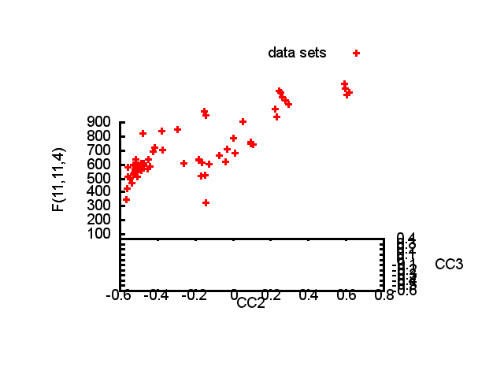

Slide 52
Structure factor (electrons)
Correlation to 2nd & 3rd singular vectors

Slide 53
Structure factor (electrons)
Correlation to 2nd & 3rd singular vectors

Slide 54
Structure factor (electrons)
Correlation to 2nd & 3rd singular vectors

Slide 55
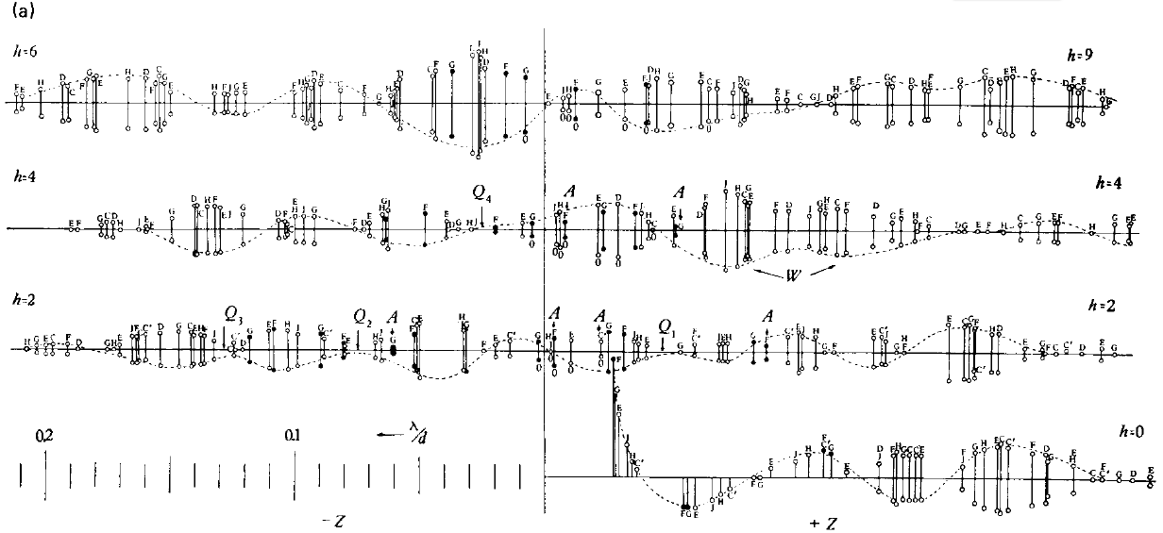
Bragg’s “minimum wavelength principle”
Perutz (1985). “Early Days of Cryst…” Methods in Enzymology, Vol. 114, 3-18.
Bragg & Perutz (1952)."external form haemoglobin I", Acta Cryst. 5, 277-283.

Slide 56
How do you solve the phase problem for macromolecules?
“… by some physical artifice, such as the introduction of a heavy atom, or the observation of intensity changes on dehydration which have not hitherto been carried out in practice."
- J.D. Bernal (1939) “Structure of Proteins”
Nature, 143, 663

Slide 57
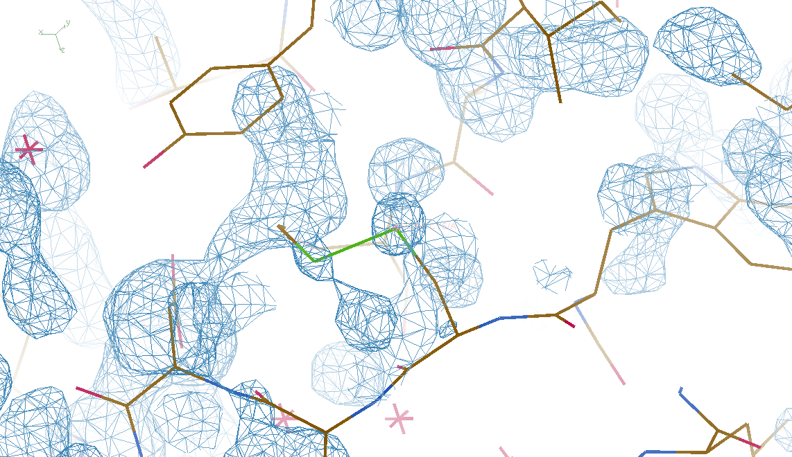
4 deg rotation: 8 “xtals”: before
CC = 0.02

Slide 58
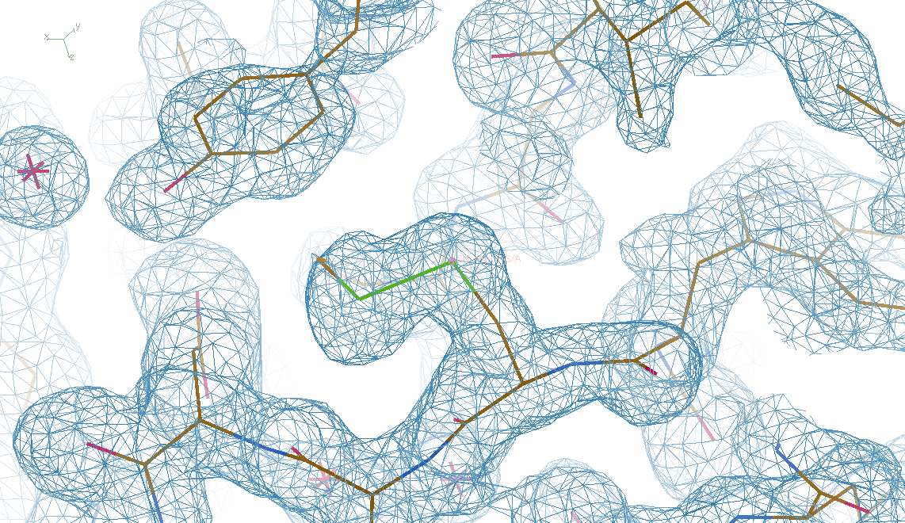
4 deg rotation: 8 “xtals”: after
CC = 0.8

Slide 59
Summary
Careful with dehydration!
Weak images: wave of future?
SVD/PCA instead of averaging
Non-isomorphism phasing (NIP)?
http://bl831.als.lbl.gov/~jamesh/
powerpoint/ACA_multixtal_2016.pptx

Slide 60
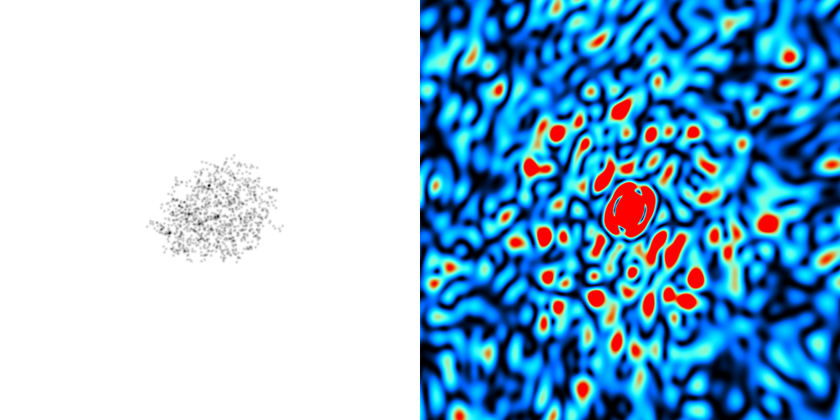
What is the “molecular transform”?
False color intensity
sample
detector

Slide 61
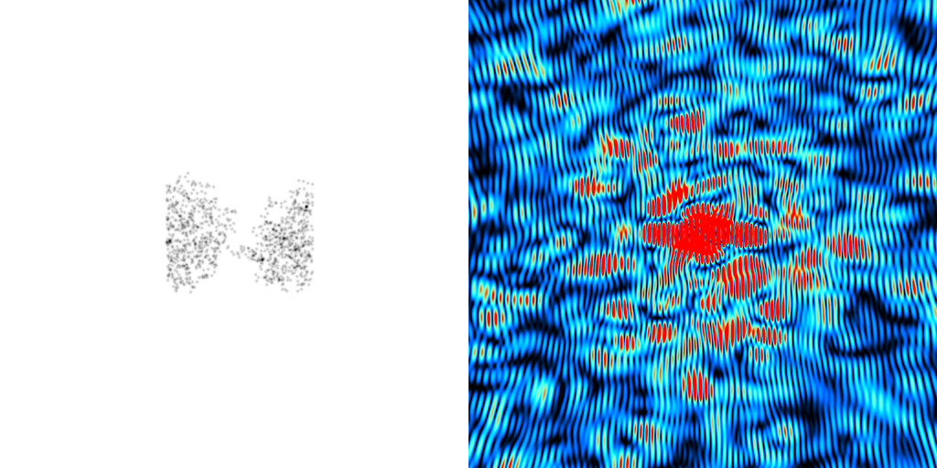
What is the “molecular transform”?
False color intensity
sample
detector

Slide 62
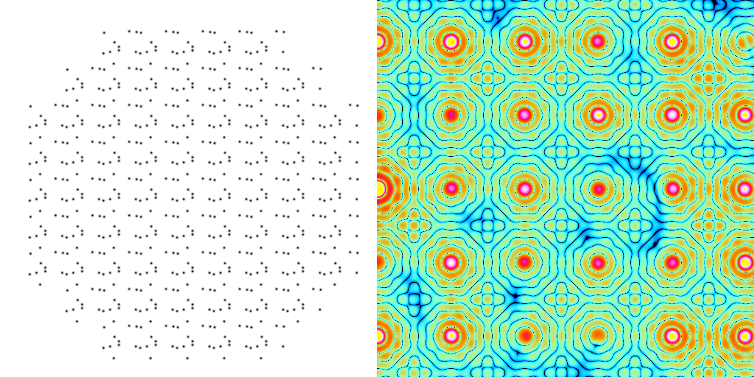
What is the “molecular transform”?
False color intensity
sample
detector

Slide 63
Inter-Bragg spots over-sample unit cell?
Thanks John Spence!

Slide 64
processing procedure | collection scenario
 | fine | coarse | glue | glue_fine
XDS/XSCALE | 3.03874 | 3.02970 | 3.0270 | 3.02948
XDS/aimless | 3.13351 | 3.03531 | 3.02638 | 3.05292
XDS/noscale | 3.01449 | 3.03048 | 3.02576 | 3.31013
MOSFLM-defaults | x | x | x | x
MOSFLM-cheat | 3.51254 | 3.04355 | 3.08244 | x
MOSFLM/noscale | 3.51311 | 3.04287 | 3.21664 | x
HKL2000-defaults | x | x | x | x
HKL2000-cheat | 3.04147 | 3.01415 | 3.01415 | 3.03948
DIALS-defaults | x | x | 3.32378 | x
DIALS-cheat | 2.92007 | x | 2.98204 | 2.92007
DIALS-noscale | 2.96392 | x | 3.26126 | 5.14852
d*Trek | ? | ? | ? | ?
EVAL15 | ? | ? | ? | ?

