Slide 1
Using all your data, even in the presence of non-isomorphism

Slide 2
Using all your data, even in the presence of non-isomorphism
not same structure thing

Slide 3
Non-isomorphism in lysozyme
Dear James
The story of the two forms of lysozyme crystals goes back to about 1964 when it was found that the diffraction patterns from different crystals could be placed in one of two classes depending on their intensities. This discovery was a big set back at the time and I can remember a lecture title being changed from the 'The structure of lysozyme' to 'The structure of lysozyme two steps forward and one step back'. Thereafter the crystals were screened based on intensities of the (11,11,l) rows to distinguish them (e.g. 11,11,4 > 11,11,5 in one form and vice versa in another). Data were collected only for those that fulfilled the Type II criteria. (These reflections were easy to measure on the linear diffractometer because crystals were mounted to rotate about the diagonal axis). As I recall both Type I and Type II could be found in the same crystallisation batch . Although sometimes the external morphology allowed recognition this was not infallible.
The structure was based on Type II crystals. Later a graduate student Helen Handoll examined Type I. The work, which was in the early days and before refinement programmes, seemed to suggest that the differences lay in the arrangement of water or chloride molecules (Lysozyme was crystallised from NaCl). But the work was never written up. Keith Wilson at one stage was following this up as lysozyme was being used to test data collection strategies but I do not know the outcome.
An account of this is given in International Table Volume F (Rossmann and Arnold edited 2001) p760.
Tony North was much involved in sorting this out and if you wanted more info he would be the person to contact. I hope this is helpful. Do let me know if you need more.
Best wishes
Louise

Slide 4
Non-isomorphism in lysozyme
Structure factor (e⁻)
Johnson’s ratio

Slide 5
Non-isomorphism in lysozyme
Structure factor (e⁻)
Johnson’s ratio

Slide 6
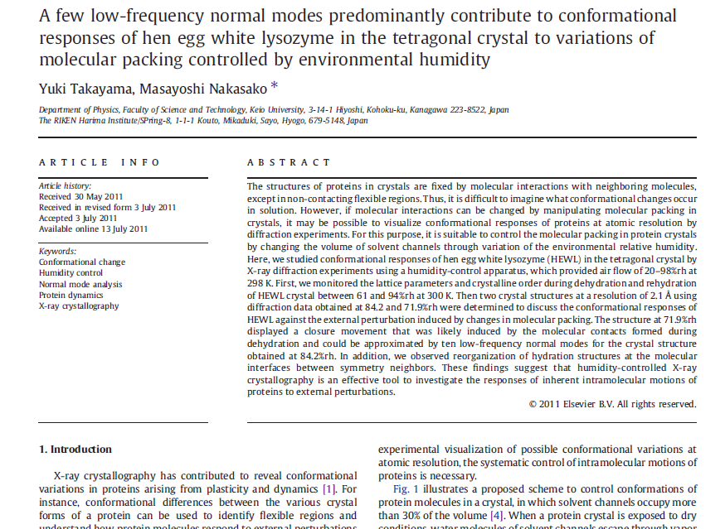

Slide 7
Non-isomorphism in lysozyme
RMSD = 0.18 Å
Δcell = 0.7 %
R_{iso} = 44.5%
3aw6
3aw7
RH: 84.2%
vs 71.9%

Slide 8
Non-isomorphism in lysozyme
RMSD = 0.18 Å
Δcell = 0.7 %
R_{iso} = 44.5%
3aw6
3aw7
RH: 84.2%
vs 71.9%

Slide 9
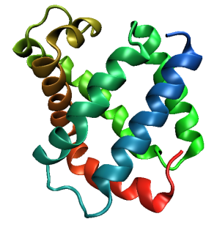
Same structure, different cell
0.5% cell change → 15%
Crick & Magdoff (1956) “theory method isomorphous replacement”, Acta Cryst. 9, 901-8.

Slide 10
Same structure, different cell
0.5% cell change → 15%
Crick & Magdoff (1956) “theory method isomorphous replacement”, Acta Cryst. 9, 901-8.

Slide 11
Same cell, rotated protein
0.5° rotation → 16%
Crick & Magdoff (1956) “theory method isomorphous replacement”, Acta Cryst. 9, 901-8.

Slide 12
Same cell, rotated protein
0.5° rotation → 16%
Crick & Magdoff (1956) “theory method isomorphous replacement”, Acta Cryst. 9, 901-8.

Slide 13
Same cell, shifted protein
0.1 Å shift → 17%
Crick & Magdoff (1956) “theory method isomorphous replacement”, Acta Cryst. 9, 901-8.

Slide 14
Same cell, shifted protein
0.1 Å shift → 17%
Crick & Magdoff (1956) “theory method isomorphous replacement”, Acta Cryst. 9, 901-8.

Slide 15
Uniform stretch
5% change → 0%

Slide 16
Uniform stretch
5% change → 0%

Slide 17
cell angle
0.5° cell angle → 16%
Crick & Magdoff (1956) “theory method isomorphous replacement”, Acta Cryst. 9, 901-8.

Slide 18
cell angle
0.5° cell angle → 16%
Crick & Magdoff (1956) “theory method isomorphous replacement”, Acta Cryst. 9, 901-8.

Slide 19
Δa
ΔΦ
0.5% cell change → 15%
0.5° rotation → 16%
Δx
Δβ
0.1 Å shift → 17%
0.5° cell angle → 16%
Crick & Magdoff (1956) “theory method isomorphous replacement”, Acta Cryst. 9, 901-8.

Slide 20
Magdoff & Crick (1955) “Ribonuclease II. Accuracy of measurement and shrinkage”, Acta Cryst. 8, 461-8.
Crick & Magdoff (1956) “The theory of the method of isomorphous replacement for protein crystals”, Acta Cryst. 9, 901-8.

Slide 21
Non-isomorphism in lysozyme
Dear James
The story of the two forms of lysozyme crystals goes back to about 1964 when it was found that the diffraction patterns from different crystals could be placed in one of two classes depending on their intensities. This discovery was a big set back at the time and I can remember a lecture title being changed from the 'The structure of lysozyme' to 'The structure of lysozyme two steps forward and one step back'. Thereafter the crystals were screened based on intensities of the (11,11,l) rows to distinguish them (e.g. 11,11,4 > 11,11,5 in one form and vice versa in another). Data were collected only for those that fulfilled the Type II criteria. (These reflections were easy to measure on the linear diffractometer because crystals were mounted to rotate about the diagonal axis). As I recall both Type I and Type II could be found in the same crystallisation batch . Although sometimes the external morphology allowed recognition this was not infallible.
The structure was based on Type II crystals. Later a graduate student Helen Handoll examined Type I. The work, which was in the early days and before refinement programmes, seemed to suggest that the differences lay in the arrangement of water or chloride molecules (Lysozyme was crystallised from NaCl). But the work was never written up. Keith Wilson at one stage was following this up as lysozyme was being used to test data collection strategies but I do not know the outcome.
An account of this is given in International Table Volume F (Rossmann and Arnold edited 2001) p760.
Tony North was much involved in sorting this out and if you wanted more info he would be the person to contact. I hope this is helpful. Do let me know if you need more.
Best wishes
Louise

Slide 22
“same drop” ?

Slide 23
Dehydration: 1964 vs 2015?
= 1.5 μL
100 μm
= 1.0 nL
2 mm
= 1.0 pL
10 μm
= 1.0 fL
1 μm

Slide 24
plunge cooling
warm, moist air
ice
cold, dry N₂
liquid N₂
foam insulation

Slide 25
plunge cooling
warm, moist air
ice
cold N₂
liquid N₂
foam insulation

Slide 26
Warkentin method
liquid N₂
foam insulation
Warkentin (2006) J. Appl. Crystallogr. 39, 805-811.

Slide 27
What if we can’t control it?

Slide 28
Proteins move! Your crystal may be trying to tell you something…
Beernink, Endrizzi, Alber & Schachman (1999). PNAS USA 96, 5388-5393.

Slide 29
X-ray Data Sets
Singular values & vectors
data
set
h,k,l | structure factors (F)
 | #1 | #2 | #3 | #4
5,3,4 | 523.7 | 559.8 | 579.9 | 603.2
5,4,4 | 168.2 | 166.6 | 177.2 | 196.1
5,5,4 | 34.9 | 26.4 | 19.2 | 17.3
6,1,4 | 305.7 | 301.1 | 298.1 | 296.3
6,2,4 | 353.0 | 353.9 | 356.2 | 366.9
6,3,4 | 300.9 | 285.3 | 273.5 | 259.4
6,3,5 | 223.8 | 226.3 | 234.6 | 251.4
… | … | … | … | …
h,k,l | 100% | 17 % | 13 % | 9 %
 | 1st | 2nd | 3rd | 4th
5,3,4 | -1.46 | -0.02 | 1.84 | -0.72
5,4,4 | -0.88 | -0.29 | -0.34 | 0.15
5,5,4 | -0.42 | -0.65 | 1.02 | 1.47
6,1,4 | -0.90 | -0.85 | 1.44 | -0.40
6,2,4 | -1.20 | -0.37 | 0.67 | 0.01
6,3,4 | -0.75 | 0.31 | 0.48 | 0.00
6,3,5 | -0.75 | -0.85 | 0.72 | -0.82
… | … | … | … | …
value
vector
Singular value decomp.
SVD
-0.68
-0.24
0.32 …
CC1
Data sets
Positioned
in
“Correlation
Space”
Correlation
Coefficients
CC1 CC2 CC3
CC2
data set #1
data set #2
data set #3
CC3

Slide 30
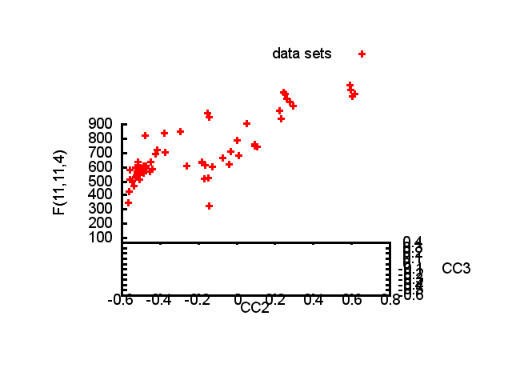

Slide 31
Structure factor (electrons)
Correlation to 2nd & 3rd singular vectors

Slide 32
Structure factor (electrons)
Correlation to 2nd & 3rd singular vectors

Slide 33
Structure factor (electrons)
Correlation to 2nd & 3rd singular vectors

Slide 34
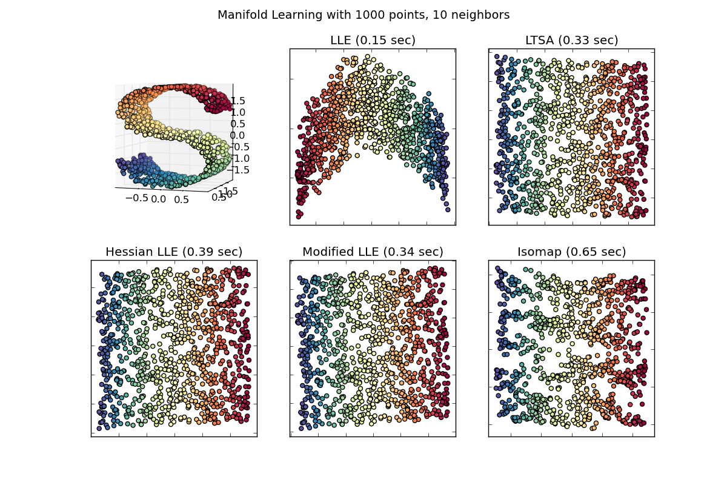
Manifold Embedding: solution for systematics?

Slide 35
What was that about phasing?
Over-sample molecular transform

Slide 36
Inter-Bragg spots over-sample unit cell

Slide 37
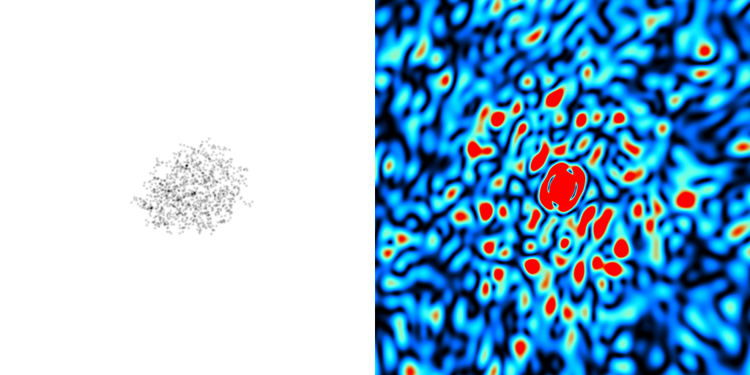
scattering from a crystal structure
False color intensity
sample
detector

Slide 38
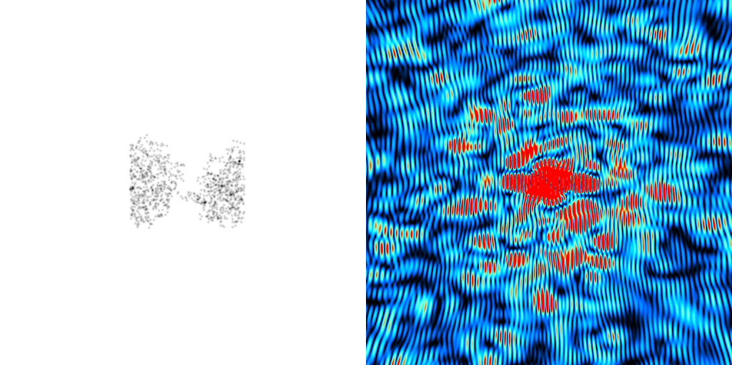
scattering from a crystal structure
False color intensity
sample
detector

Slide 39
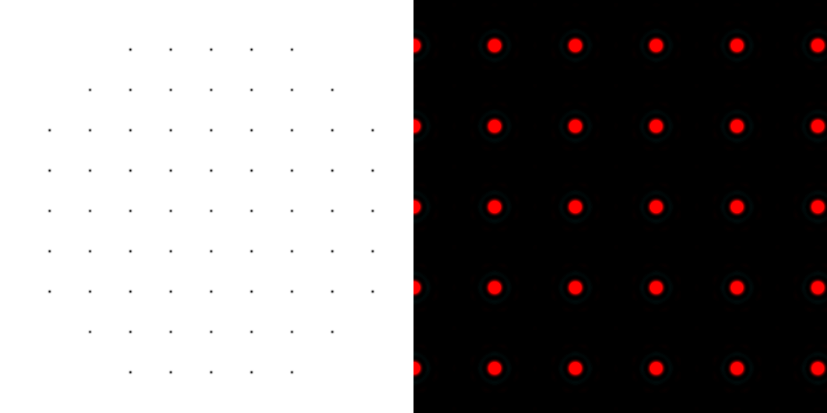
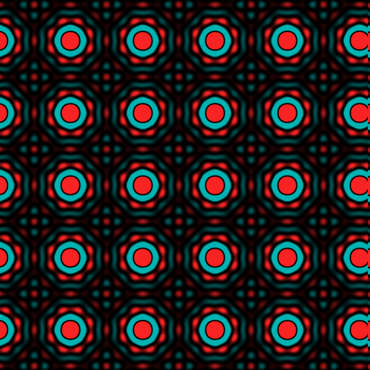
scattering from a lattice
colored by phase
sample
detector

Slide 40
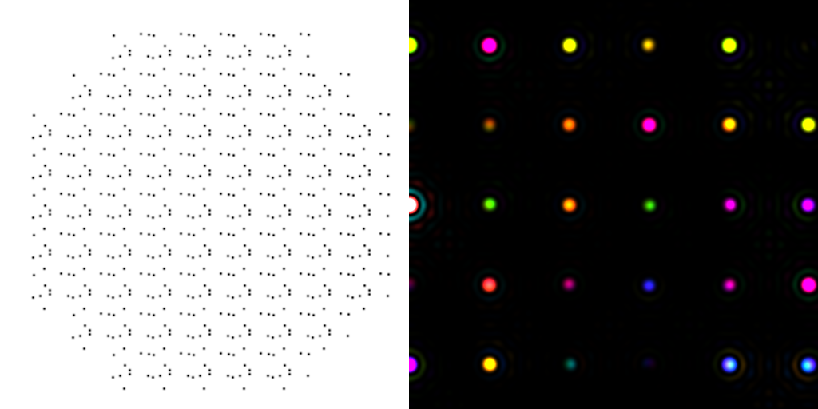
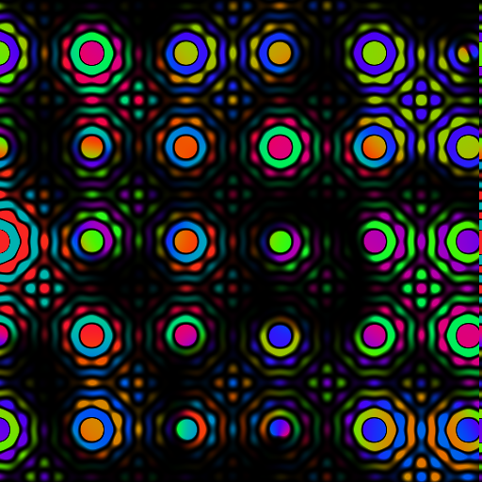
scattering from a crystal structure
colored by phase
sample
detector

Slide 41
scattering from a crystal structure
colored by phase
sample
detector

Slide 42
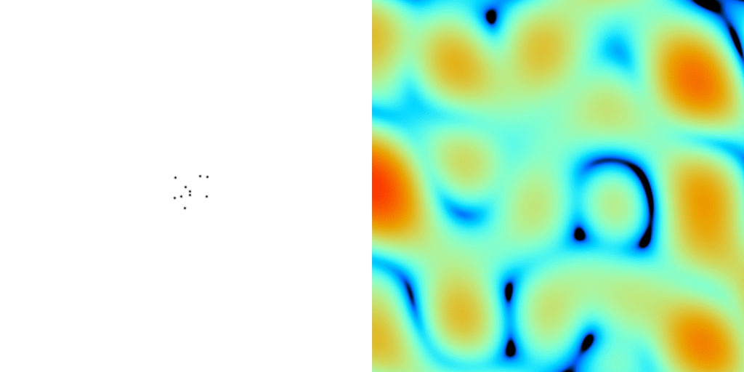
scattering from a crystal structure
False color intensity
sample
detector

Slide 43
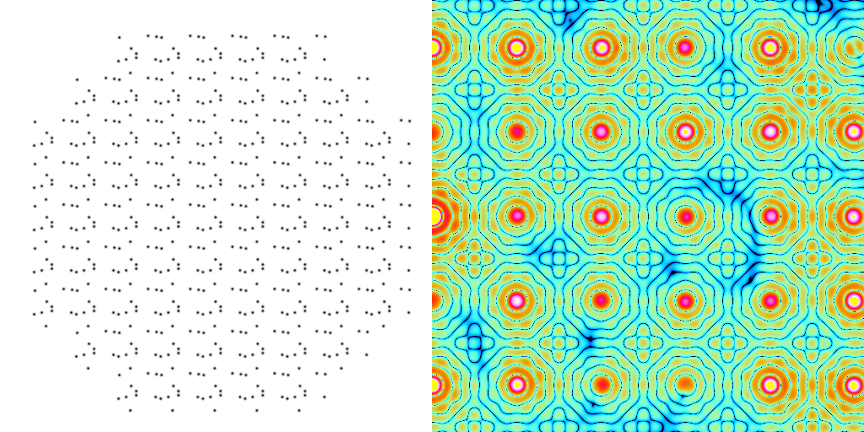
scattering from a crystal structure
False color intensity
sample
detector

Slide 44
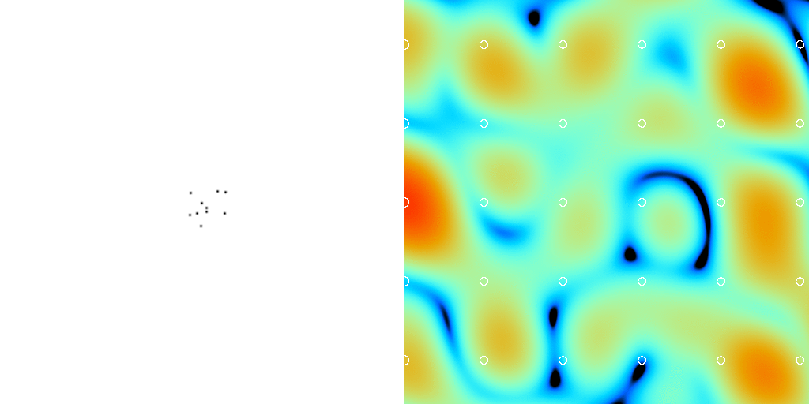
scattering from a crystal structure
False color intensity
sample
detector

Slide 45
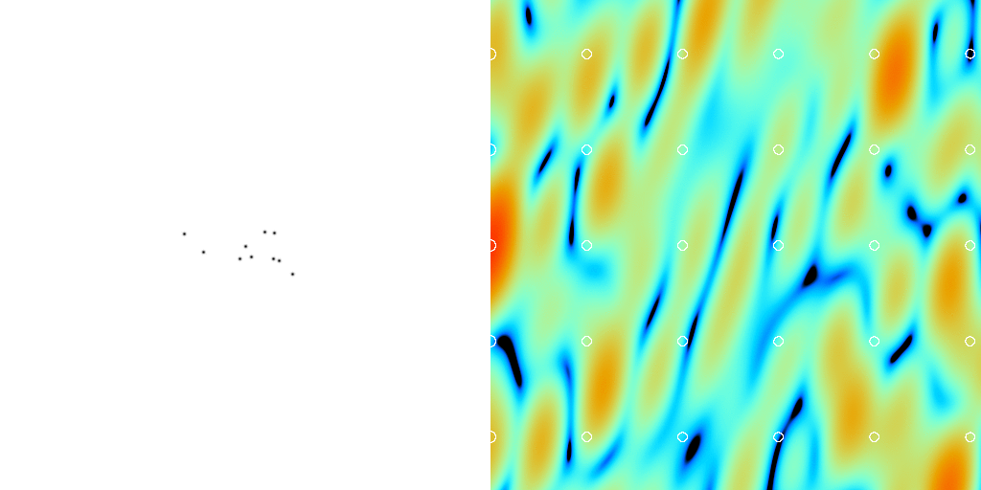
scattering from a crystal structure
False color intensity
sample
detector

Slide 46
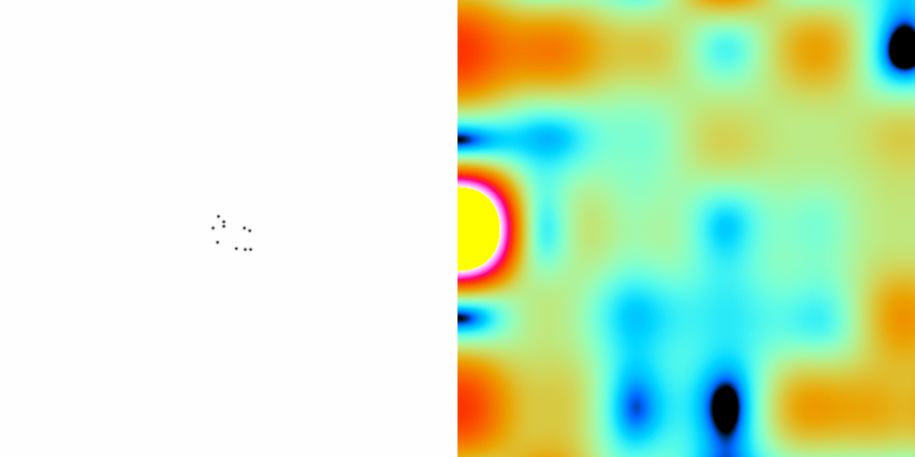
scattering from a crystal structure
False color intensity
sample
detector

Slide 47
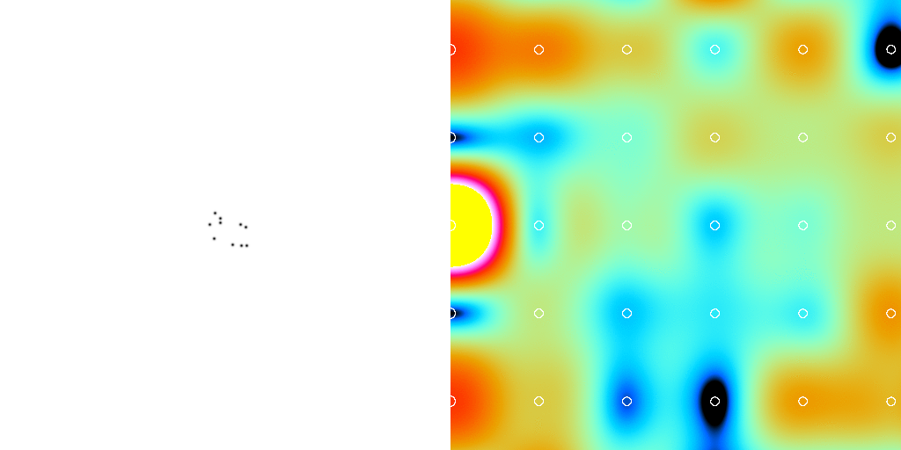
scattering from a crystal structure
False color intensity
sample
detector

Slide 48
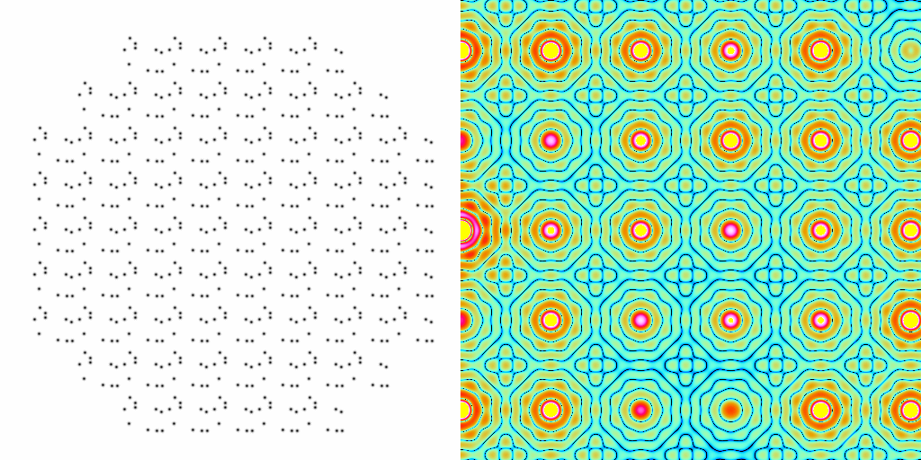
scattering from a crystal structure
False color intensity
sample
detector

Slide 49
Inter-Bragg spots over-sample unit cell?

Slide 50
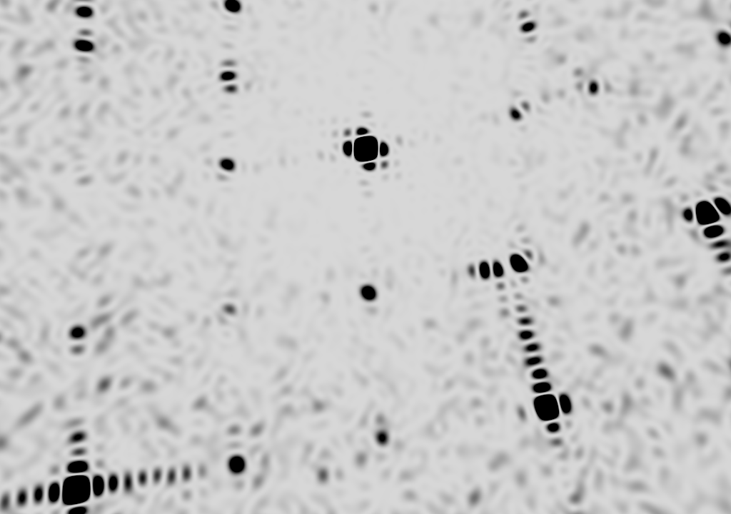
square

Slide 51
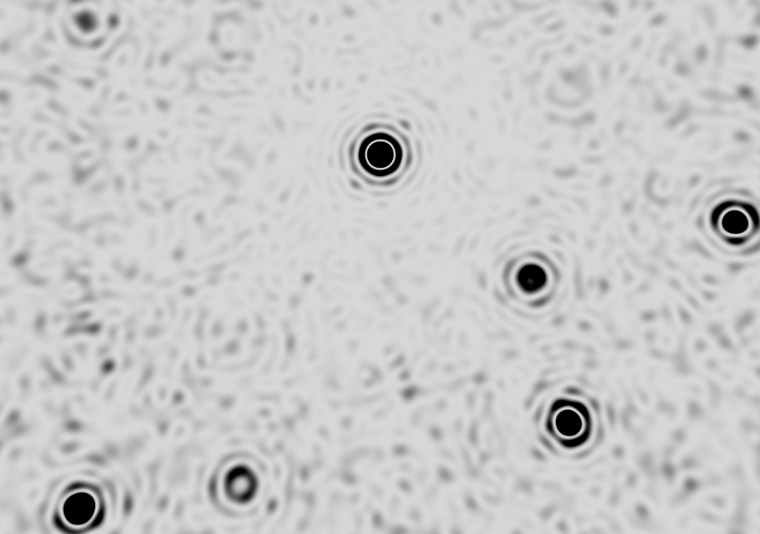
round

Slide 52
What was that about phasing?
How else to access the
molecular transform?

Slide 53
Non-isomorphism in lysozyme
RMSD = 0.18 Å
R_{iso} = 44.5%
3aw6
3aw7

Slide 54
Structure factor (electrons)
Correlation to 2nd & 3rd singular vectors

Slide 55
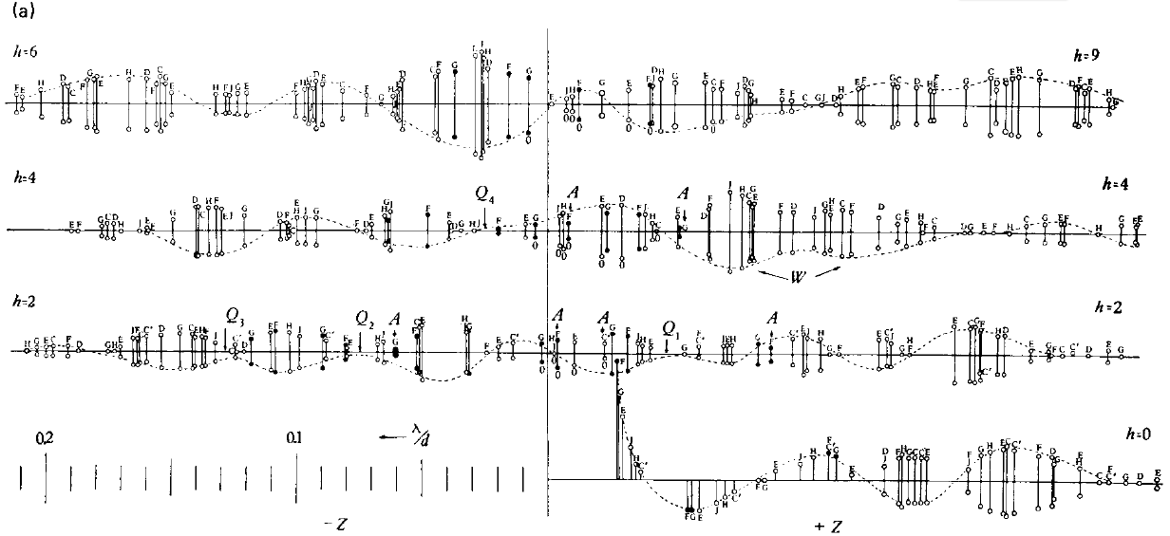
Bragg’s “minimum wavelength principle”
Perutz (1985). “Early Days of Cryst…” Methods in Enzymology, Vol. 114, 3-18.
Bragg & Perutz (1952)."external form haemoglobin I", Acta Cryst. 5, 277-283.

Slide 56
How do you solve the phase problem for macromolecules?
“… by some physical artifice, such as the introduction of a heavy atom, or the observation of intensity changes on dehydration which have not hitherto been carried out in practice."
- J.D. Bernal (1939) “Structure of Proteins”
Nature, 143, 663

Slide 57
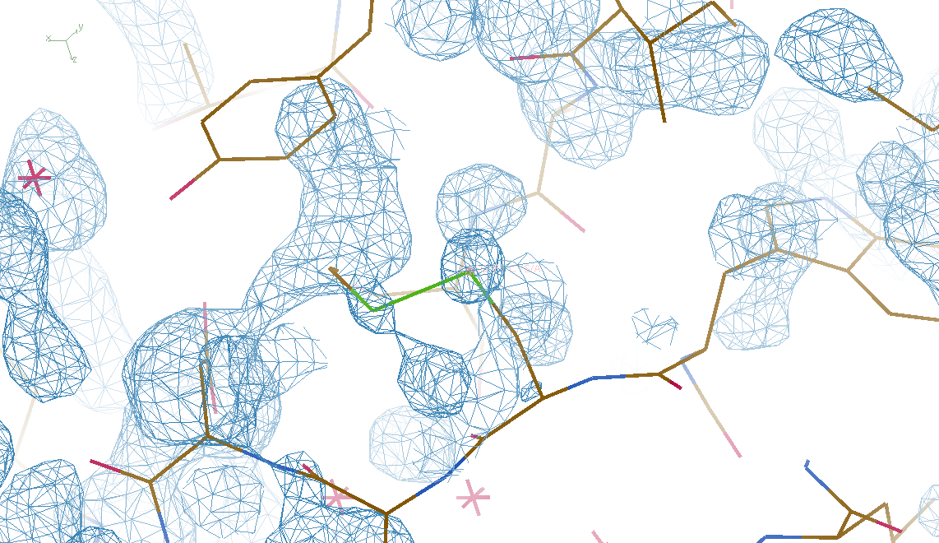
4 deg rotation: 8 “xtals”: before
CC = 0.02

Slide 58
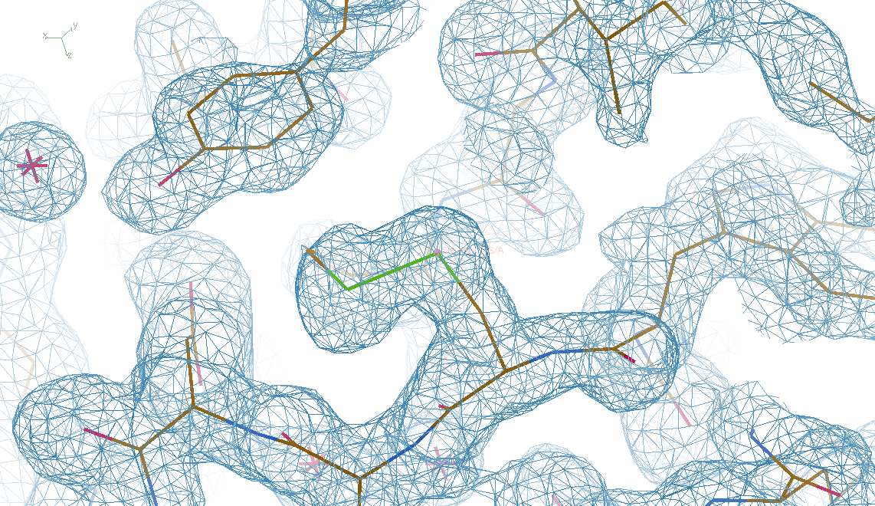
4 deg rotation: 8 “xtals”: after
CC = 0.8

Slide 59
Summary
Careful with dehydration!
SVD instead of avearging
Inter-Bragg stuff = xtal surface
Non-isomorphism as “NCS” phasing?
http://bl831.als.lbl.gov/~jamesh/
powerpoint/ACA_multixtal_2015.pptx

Slide 60
Elastic deformation = non-isomorphism

Slide 61
Elastic deformation = non-isomorphism

Slide 62
Plastic deformation = poor diffraction

Slide 63
Plastic deformation = poor diffraction

Slide 64
Super-cell formalism for diffuse scatter
intensity (F²)
sinθ/λ
Notes:
one cell

Slide 65
Super-cell formalism for diffuse scatter
intensity (F²)
sinθ/λ
Notes:
9 cells

Slide 66
Super-cell formalism for diffuse scatter
intensity (F²)
sinθ/λ
Notes:
supercell

Slide 67
Super-cell formalism for diffuse scatter
intensity (F²)
sinθ/λ
Notes:
supercell with disorder

Slide 68
Super-cell formalism for diffuse scatter
intensity (F²)
sinθ/λ
Notes:
average electron density

Slide 69
Super-cell formalism for diffuse scatter
intensity (F²)
one-cell hkl index

Slide 70
Super-cell formalism for diffuse scatter
intensity (F²)
one-cell hkl index

Slide 71
Super-cell formalism for diffuse scatter
intensity (F²)
one-cell hkl index
Notes:
average cell intensity is relative to “zero”

Slide 72
Super-cell formalism for diffuse scatter
intensity (F²)
one-cell hkl index
Notes:
supercell density gives clue to diffuse scatter, but Bragg peaks are still relative to zero

Slide 73
Super-cell formalism for diffuse scatter
intensity (F²)
one-cell hkl index
Notes:
supercell density gives clue to diffuse scatter, but Bragg peaks are still relative to zero

Slide 74
Super-cell formalism for diffuse scatter
intensity (F²)
“Caspar hole” ???
one-cell hkl index
Notes:
high-angle Brragg peaks have zero intensity and so create “holes” is the background?!

Slide 75
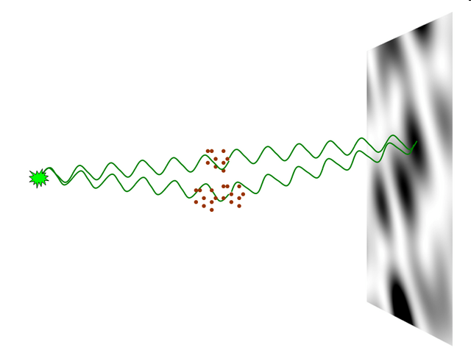
nearBragg program
http://bl831.als.lbl.gov/~jamesh/nearBragg/
“assumption-free” total scattering
no Fourier Transform
no unit cells
no “mosaicity”
arbitrary “atoms”
arbitrary “source”
coherent or not

Slide 76
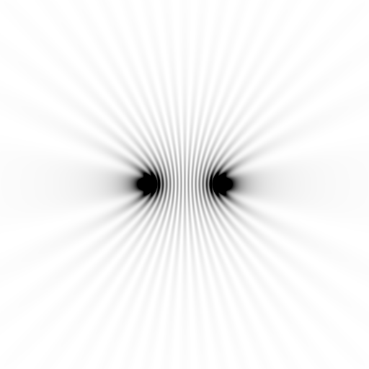
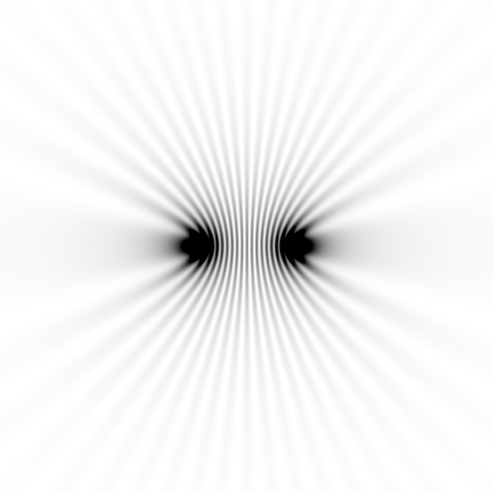
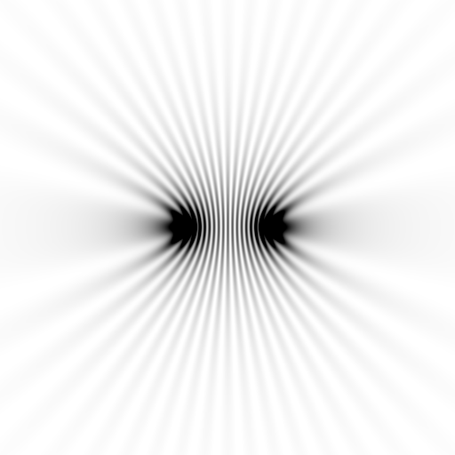
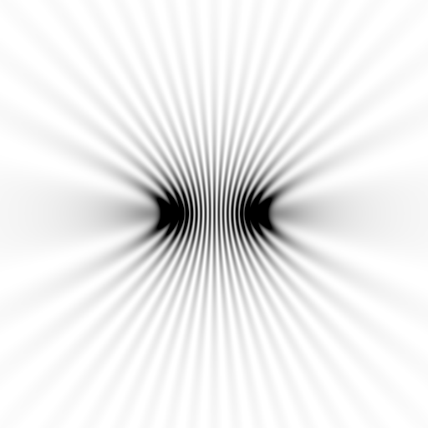
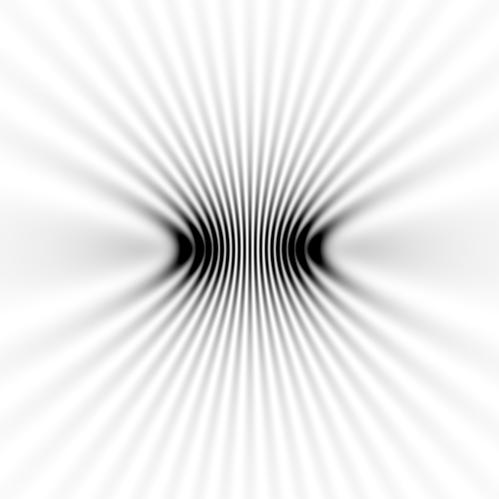
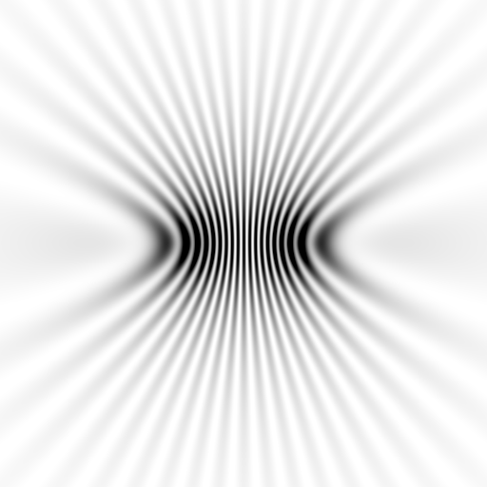
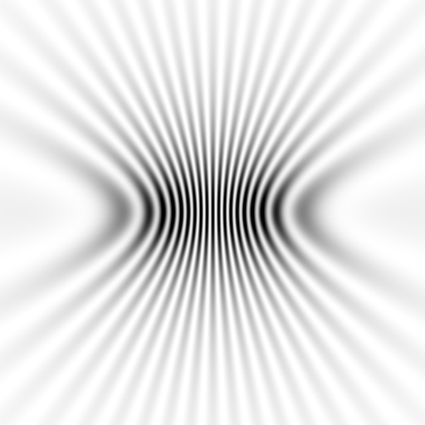
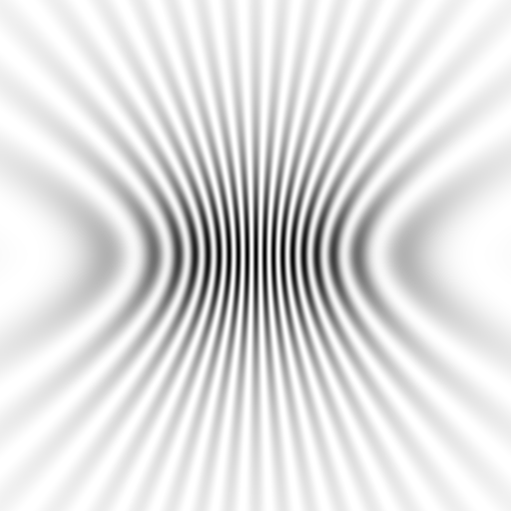
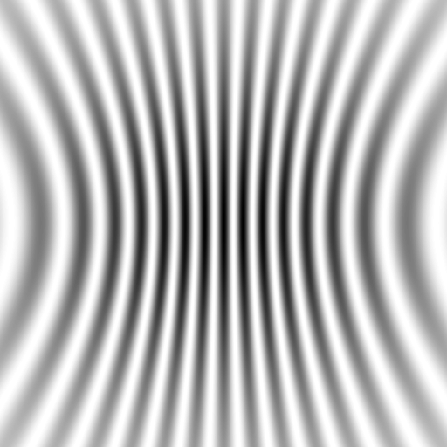
Notes:
to-scale calculation with detector at different distances from a pair of atoms

Slide 77
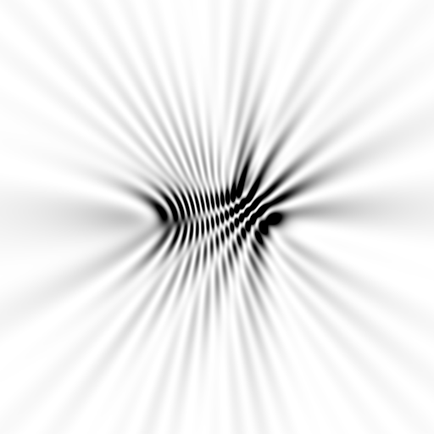
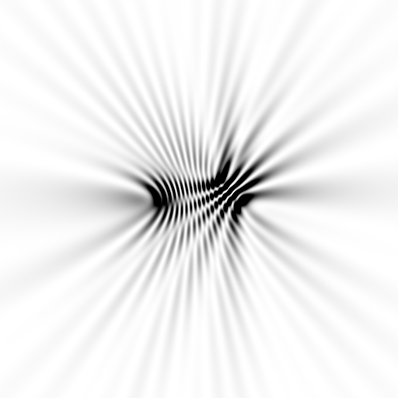
Notes:
to-scale calculation with detector at different distances from a three atoms

Slide 78
average total scattering from points
intensity (relative to one atom)
deviation from Bragg angle
Notes:
when nearBragg is used instead of supercell, the Bragg peaks “ride” on the background and do NOT produce “holes”

Slide 79
fastBragg
http://bl831.als.lbl.gov/~jamesh/fastBragg/
sin(πN·hkl)
I_{pixel} = I_{beam} r_{e}² Ω
P A | F(hkl) |²
sin(π·hkl)

Slide 80
fastBragg program
http://bl831.als.lbl.gov/~jamesh/fastBragg/
Optimized for nanocrystals
Square or round
Takes h,k,l and F
Supports 1 unit cell
no “mosaicity”
arbitrary “source”
arbitrary “phi” steps

Slide 81
fastBragg program
http://bl831.als.lbl.gov/~jamesh/fastBragg/

Slide 82
fastBragg program
http://bl831.als.lbl.gov/~jamesh/fastBragg/

Slide 83
fastBragg program
http://bl831.als.lbl.gov/~jamesh/fastBragg/

Slide 84
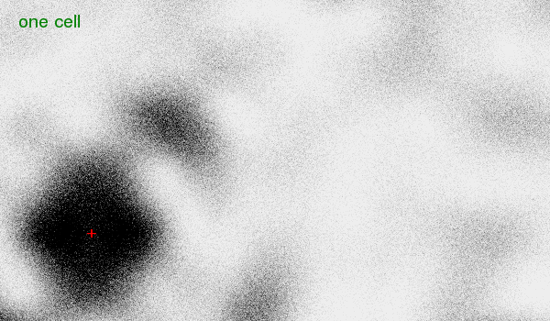
fastBragg program
http://bl831.als.lbl.gov/~jamesh/fastBragg/

Slide 85
fastBragg program
http://bl831.als.lbl.gov/~jamesh/fastBragg/
8x larger

Slide 86
fastBragg program
http://bl831.als.lbl.gov/~jamesh/fastBragg/
64x larger

Slide 87
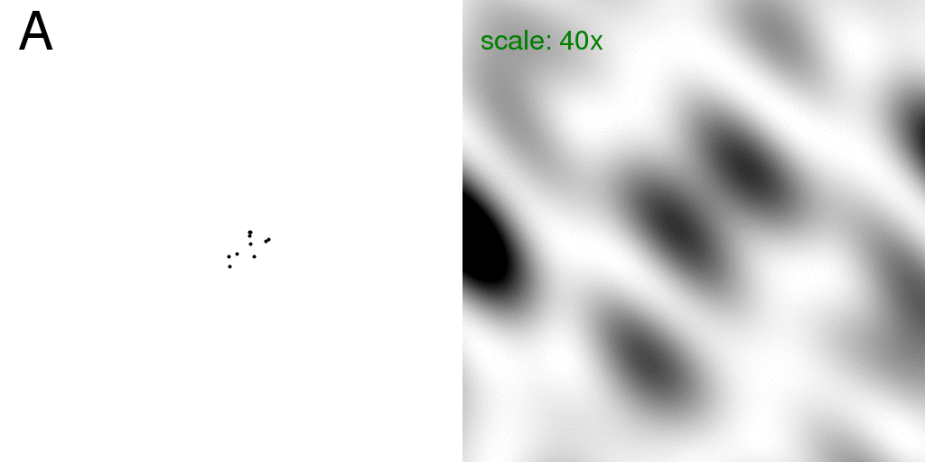
Total scattering from a structure
Move one atom
sample
detector

Slide 88
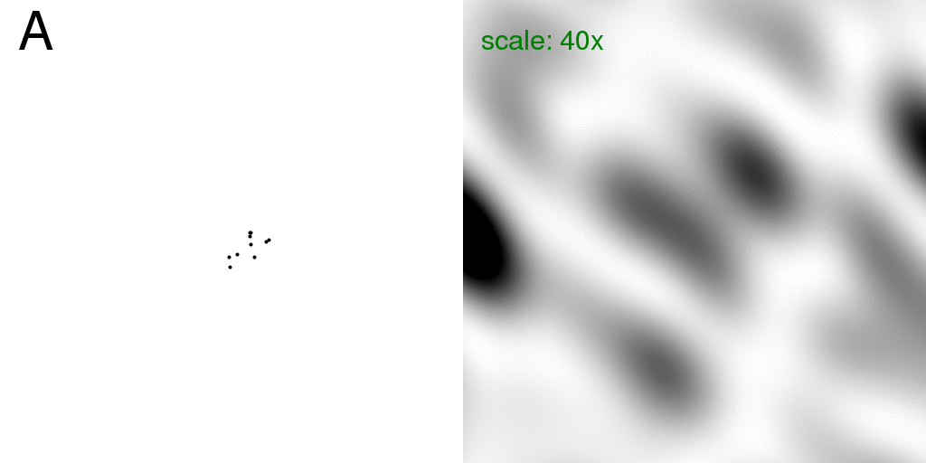
Total scattering from a structure
Intensity sum: F₁²+F₂²
sample
detector

Slide 89
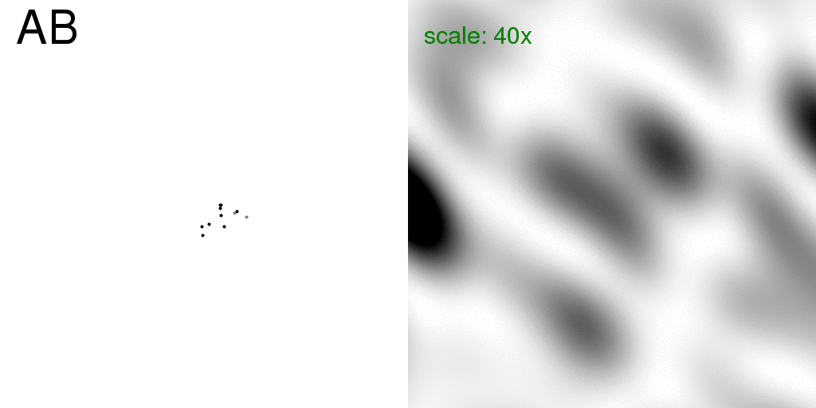
Total scattering from a structure
Coherent sum: (F₁+F₂)²
sample
detector

Slide 90
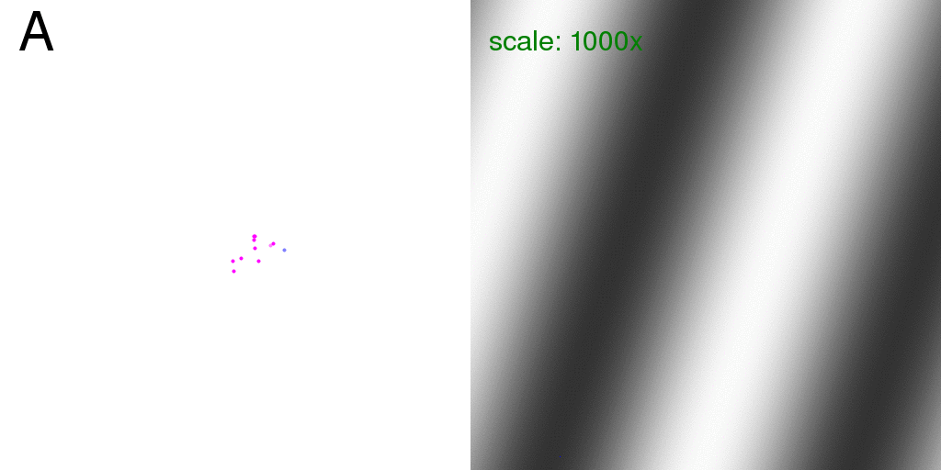
Total scattering from a structure
Incoherent – coherent difference: ( F₁²+F₂²) - (F₁+F₂)²
sample
detector

Slide 91
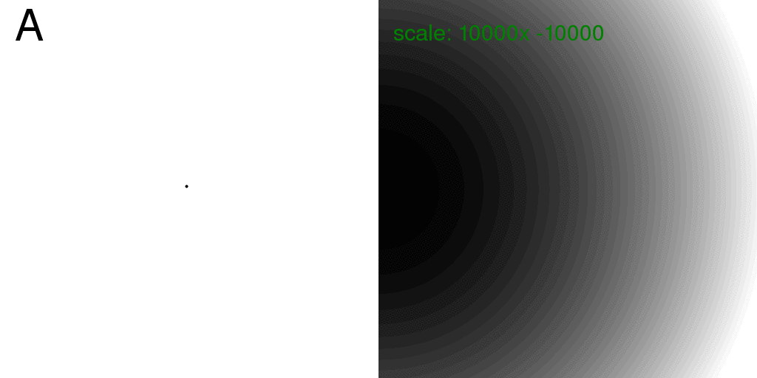
Total scattering from one atom
Intensity sum: F₁²+F₂²
sample
detector

Slide 92
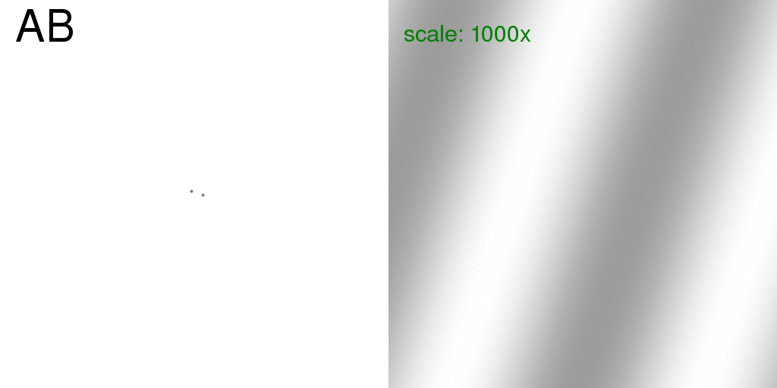
Total scattering from two ½ atoms
Coherent sum: (F₁+F₂)²
sample
detector

Slide 93
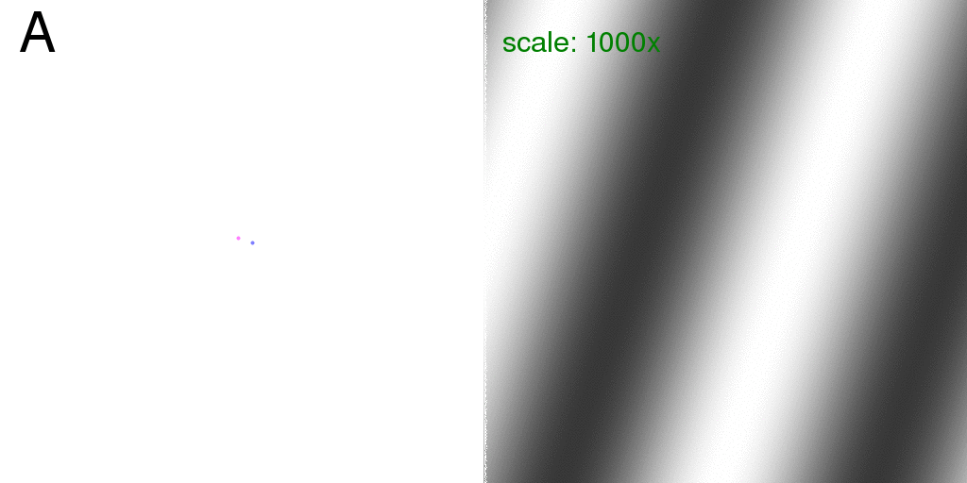
Total scattering from one atom
Incoherent – coherent difference: ( F₁²+F₂²) - (F₁+F₂)²
sample
detector

Slide 94
Total scattering from a structure
Incoherent – coherent difference: ( F₁²+F₂²) - (F₁+F₂)²
sample
detector

Slide 95
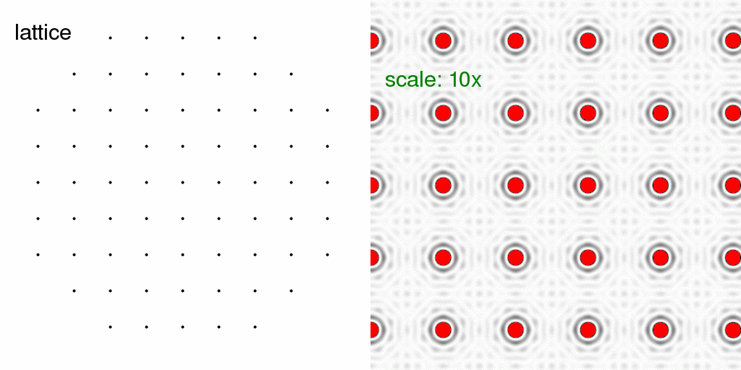
Total scattering from a lattice
Intensity sum: F₁²+F₂²
sample
detector

Slide 96
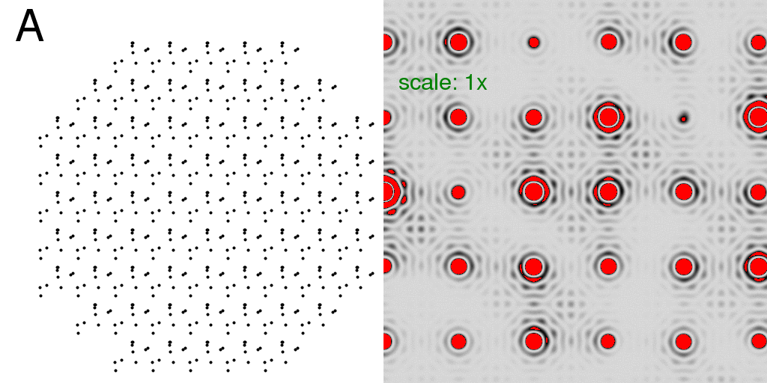
Total scattering from a crystal
Intensity sum: F₁²+F₂²
sample
detector

Slide 97
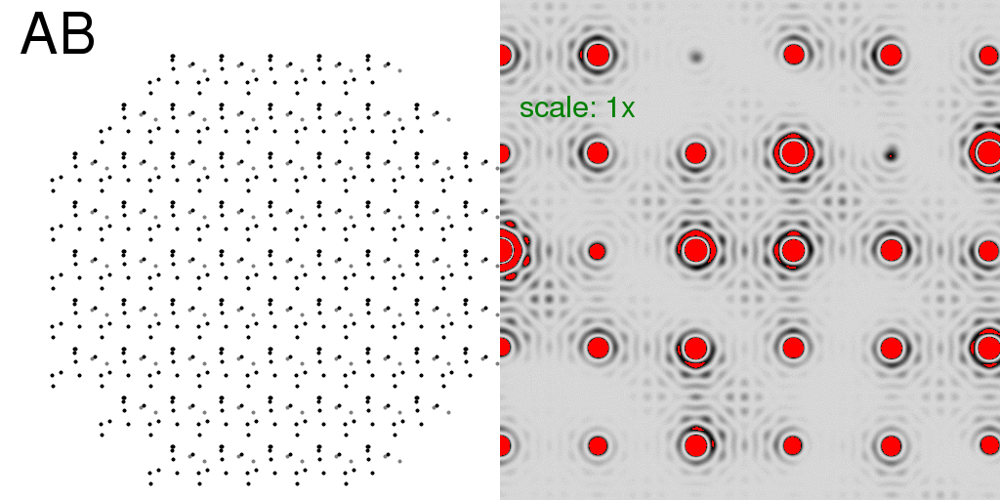
Total scattering from a crystal
Coherent sum: (F₁+F₂)²
sample
detector

Slide 98
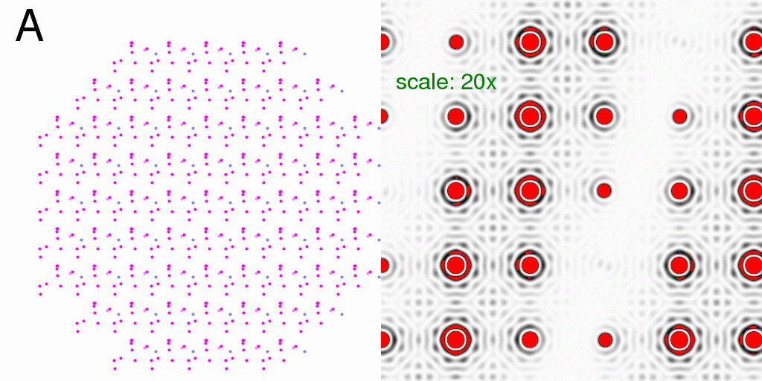
Total scattering from a crystal
Incoherent – coherent difference: ( F₁²+F₂²) - (F₁+F₂)²
sample
detector

Slide 99
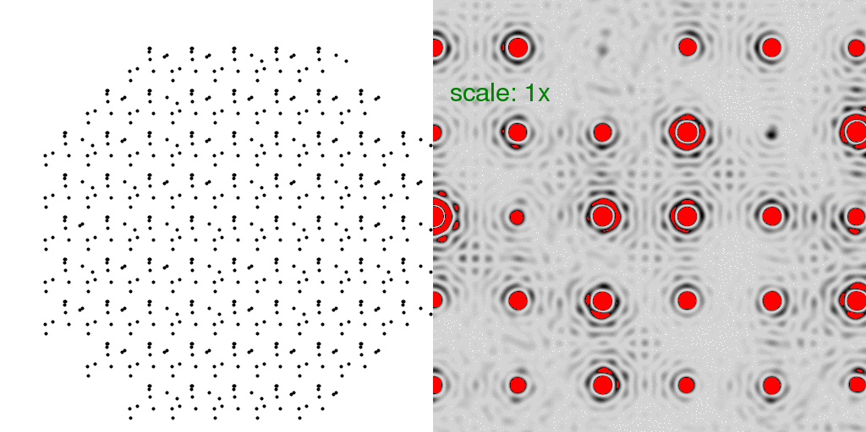
Total scattering from a crystal
Intensity: random fluctuations
sample
detector

Slide 100
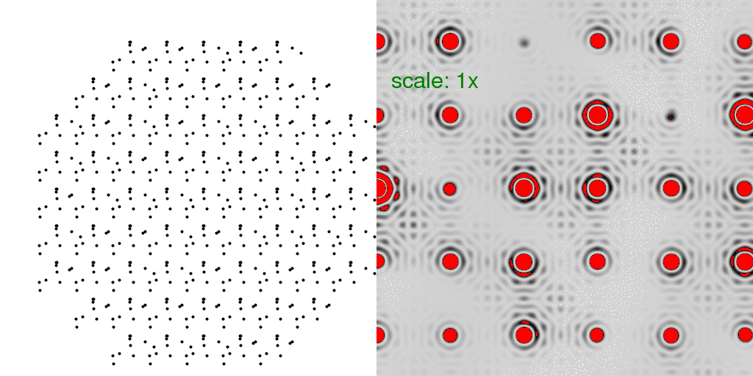
Total scattering from a crystal
Intensity sum: F₁²+F₂²+F₃²+F₄²+ …
sample
detector

Slide 101
Total scattering from a crystal
Random fluctuations - Coherent average
sample
detector

Slide 102
Total scattering from a crystal
Incoherent-coherent difference:
(F₁²+F₂²+F₃²+F₄²+ …) - (F₁+F₂+F₃+F₄+ …)²
sample
detector

Slide 103
Total scattering from one atom
Incoherent – coherent difference: ( F₁²+F₂²) - (F₁+F₂)²
sample
detector

Slide 104
Total scattering from a crystal
“Dilatation” movements
sample
detector

Slide 105
Total scattering from a crystal
Incoherent-coherent difference:
(F₁²+F₂²+F₃²+F₄²+ …) - (F₁+F₂+F₃+F₄+ …)²
sample
detector

Slide 106
Simulation: but can you use it?
http://bl831.als.lbl.gov/example_data_sets/Illuin/lyso_DS

