Slide 1
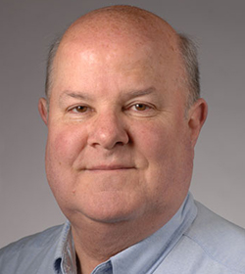
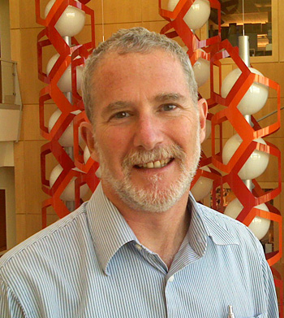
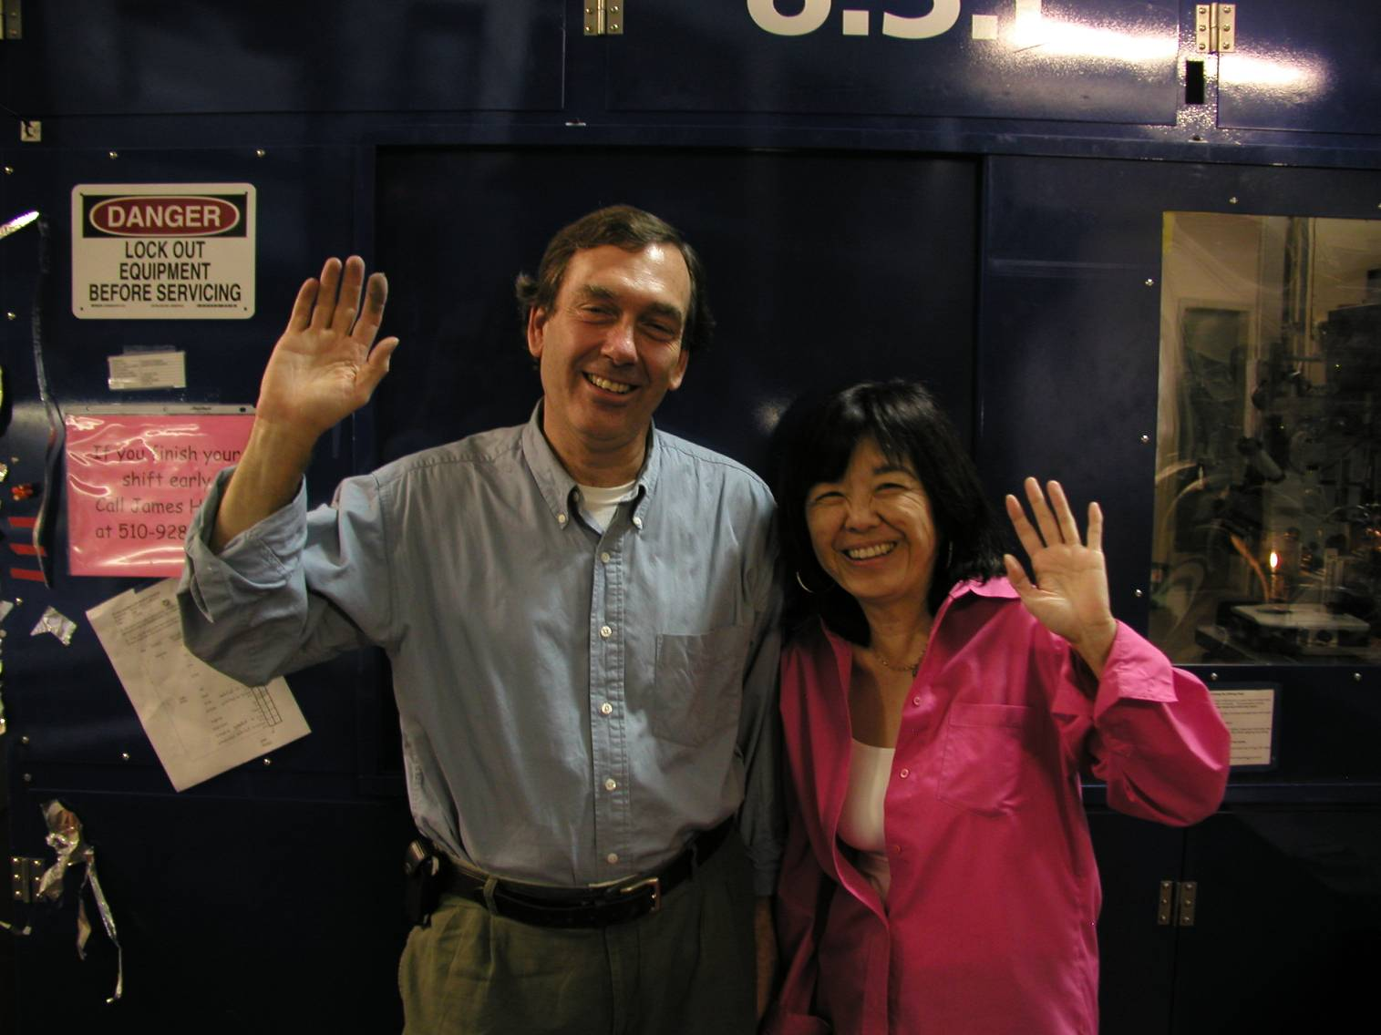
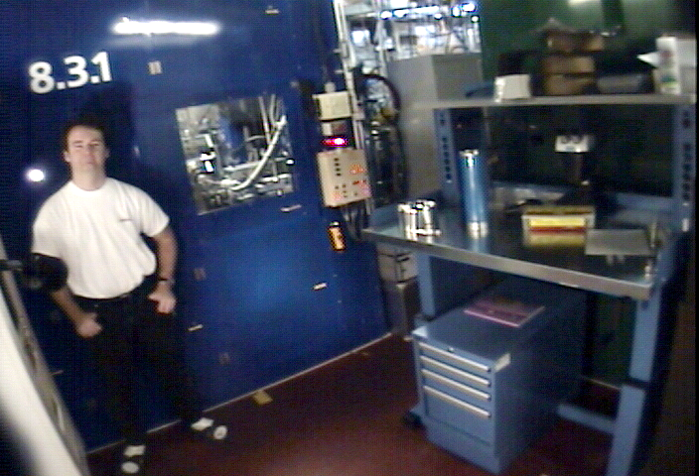

Acknowledgements
Robert Stroud James Fraser Nevan Krogan
Paul Adams John Tainer Greg Hura Nick Sauter Howard Padmore
Aina Cohen Keith Hodgson
UCSF LBNL SLAC
NIH R01 GM124149 P50 AI150476
NIH P30 GM124169 R01 GM117126
DOE-BER “IDAT” Plexxikon, Inc.
DOE-BER NIH P30 GM133894
The Advanced Light Source is supported by the Director, Office of Science, Office of Basic Energy Sciences, Materials Sciences Division, of the US Department of Energy under contract No. DE-AC02-05CH11231 at Lawrence Berkeley National Laboratory
ALS 8.3.1: TomAlberTron
.
Tanamachi
Meigs
Classen

Slide 2
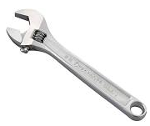
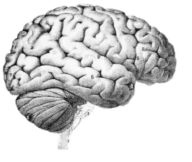
Critical Challenges in Structural Biology
$$$
Predicting crystallization outcomes
Getting crystals to diffract better
Is the ligand there or not?
Anisotropic diffraction
Radiation damage
Phase problem
Metals (anaerobic)
What is “resolution”
Serial crystallography (processing)
Non-isomorphism & multi-crystal methods
?

Slide 3
Goals of Methods Development
Impossible → Expensive
Expensive → Cheaper
  Difficult → Easier

Slide 4
What is a trillion dollars?
1.1 T
~1 T
700 G
500 G
300 G
39 G
5.6 G
217 k
Apple Inc.
3 yr∙lives cancer & heart
USA Department of Defense
global spending “Y2K bug”
NASA Apollo program (adj $)
National Institutes of Health
mentions "cancer"
R01 GM117126 (Holton)

Slide 5
What is a trillion dollars?
80 T
5.0 T
4.5 T
3.6 T
~1 T
39 G
1.4 G
12 M
gross world product
CARES + HEROES Acts
USA Federal Budget (2019)
USA health care (2018)
3 yr∙life∙salary cancer & heart
National Institutes of Health
mentions "virus”
“SARS” NIH grants

Slide 6
A trillion dollars for NIH
Fund all applications (5 yr)
1000 XFELs & 10⁵ Titan Krios
$10 M / biologist
  PI, postdoc, student, tech
Q: would that solve
all your problems?
?

Slide 7
Critical Challenges in Structural Biology
$$$
Predicting crystallization outcomes
Getting crystals to diffract better
Is the ligand there or not?
Anisotropic diffraction
Radiation damage
Phase problem
Metals (anaerobic)
What is “resolution”
Serial crystallography (processing)
Non-isomorphism & multi-crystal methods

Slide 8
If I had a trillion dollars …
Predict crystallization conditions
from sequence
10x
$ 500 M
$ 131 B
$ 527 B
$ 335 B
$ 1.0 T
Re-do all structures in PDB
Buy Google
Buy Facebook
10 zettaflops
Success? → impact?

Slide 9
If I had a trillion dollars …
Solve Phase Problem
(brute force)
10²¹ flops ( $0.03 / Gflop )
5 CPU*min per guess: (autobuild)
2 phase values / hkl
1 year run time
89 hkls = 10²⁷ combinations
50 Å cell, P2₁2₁2₁ → 10 Å resolution
Success? → impact?

Slide 10
Magic Microscope
Visualize a single molecule
spatial resolution 1 Å
temporal resolution: ~100 fs
Watch same molecule indefinitely
No damage to molecule/patient
Ability to tap / tug
Handheld & common
Q: what would you look at first?
Q2: how long before end of disease?
second

Slide 11
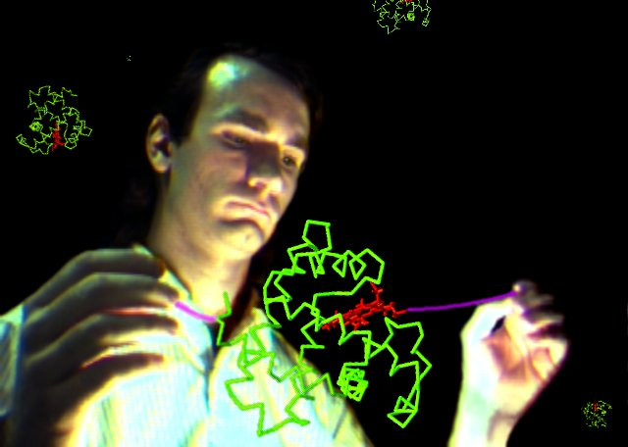
Magic Microscope
Stretching DNA -
Stretch protein?
Smith, Finzi & Bustamante (1992) Science 258, 1122-6

Slide 12

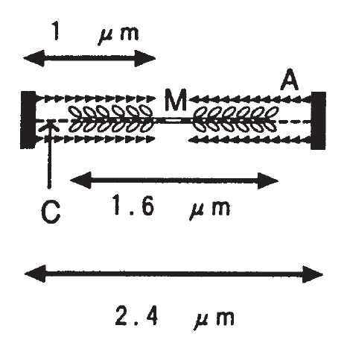
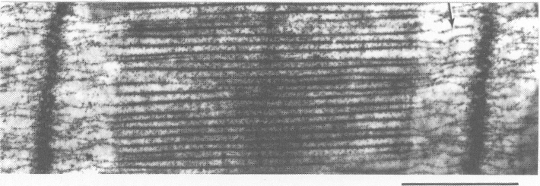
“I can tell you why it’s not going to work”
titin
- Tom Alber
Tskhovrebova & Trinick (2000)
10.1007/978-1-4615-4267-4_10

Slide 13
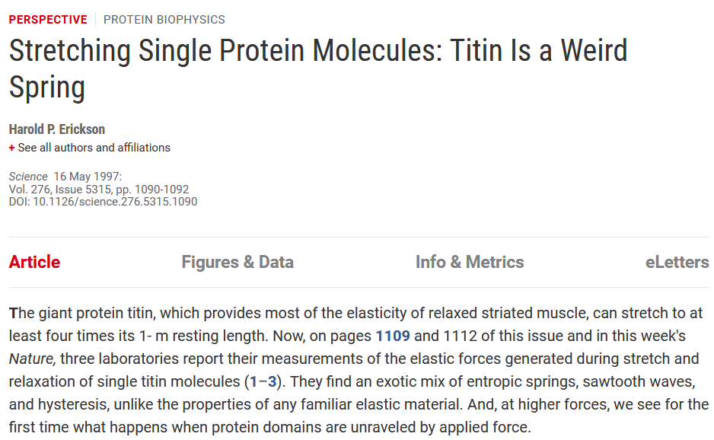
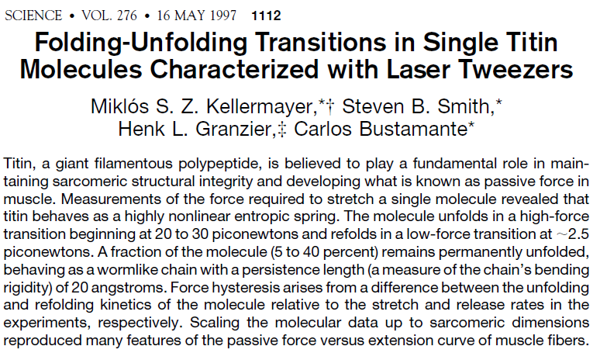
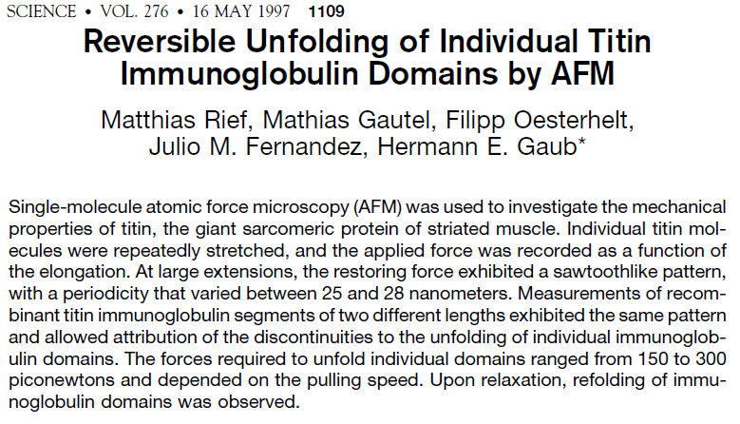
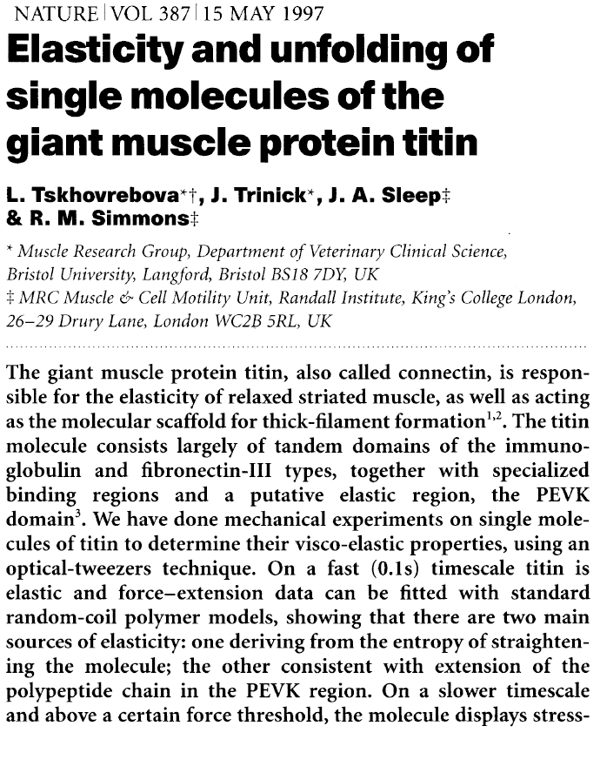
Stretching protein?

Slide 14
I Learned:
Crazy ideas can still work

Slide 15
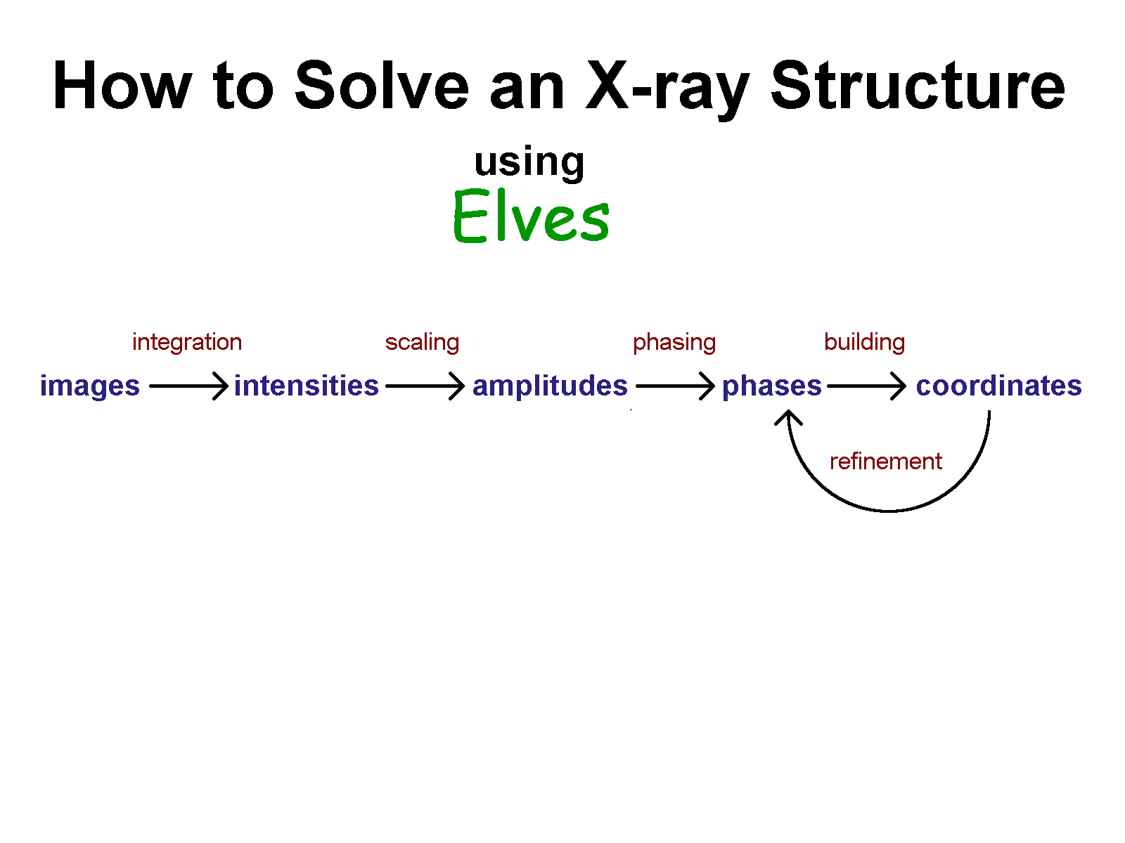
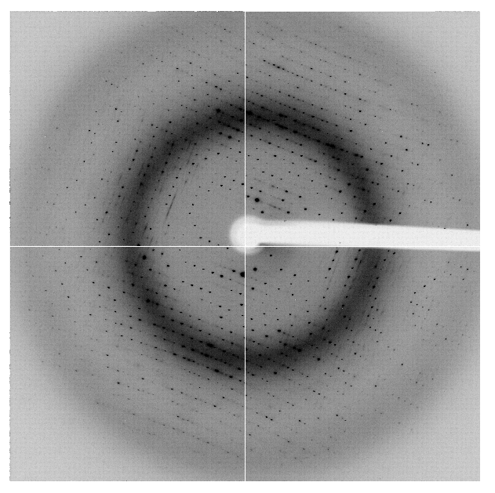
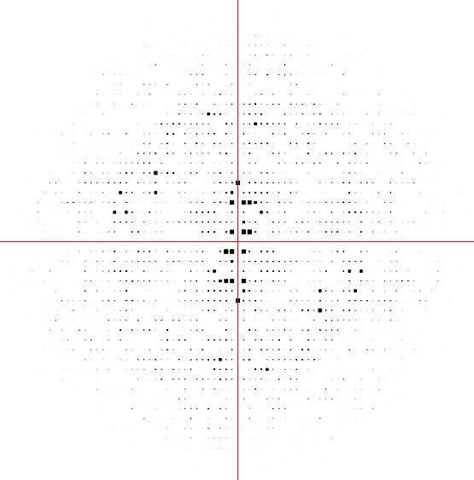
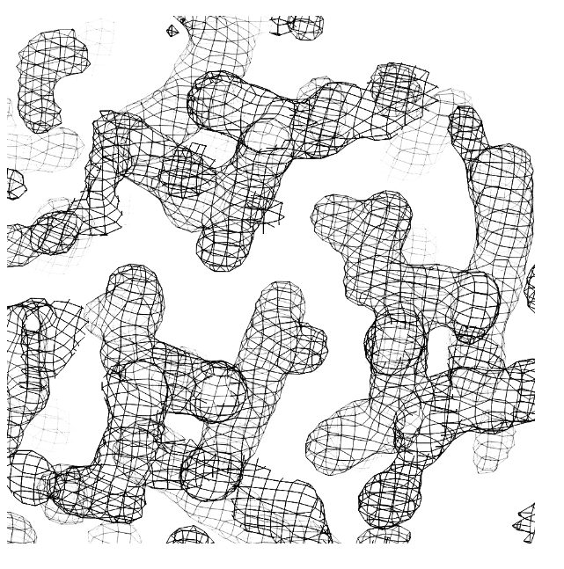
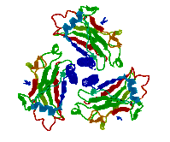

Slide 16
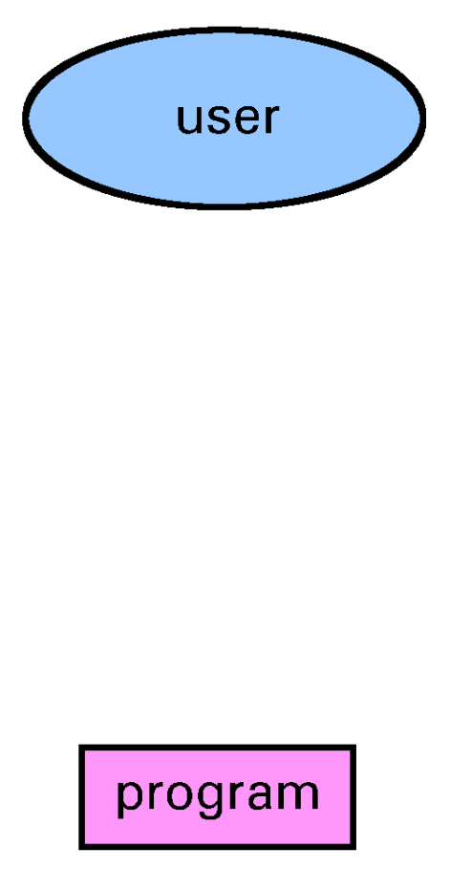
Before Elves

Slide 17
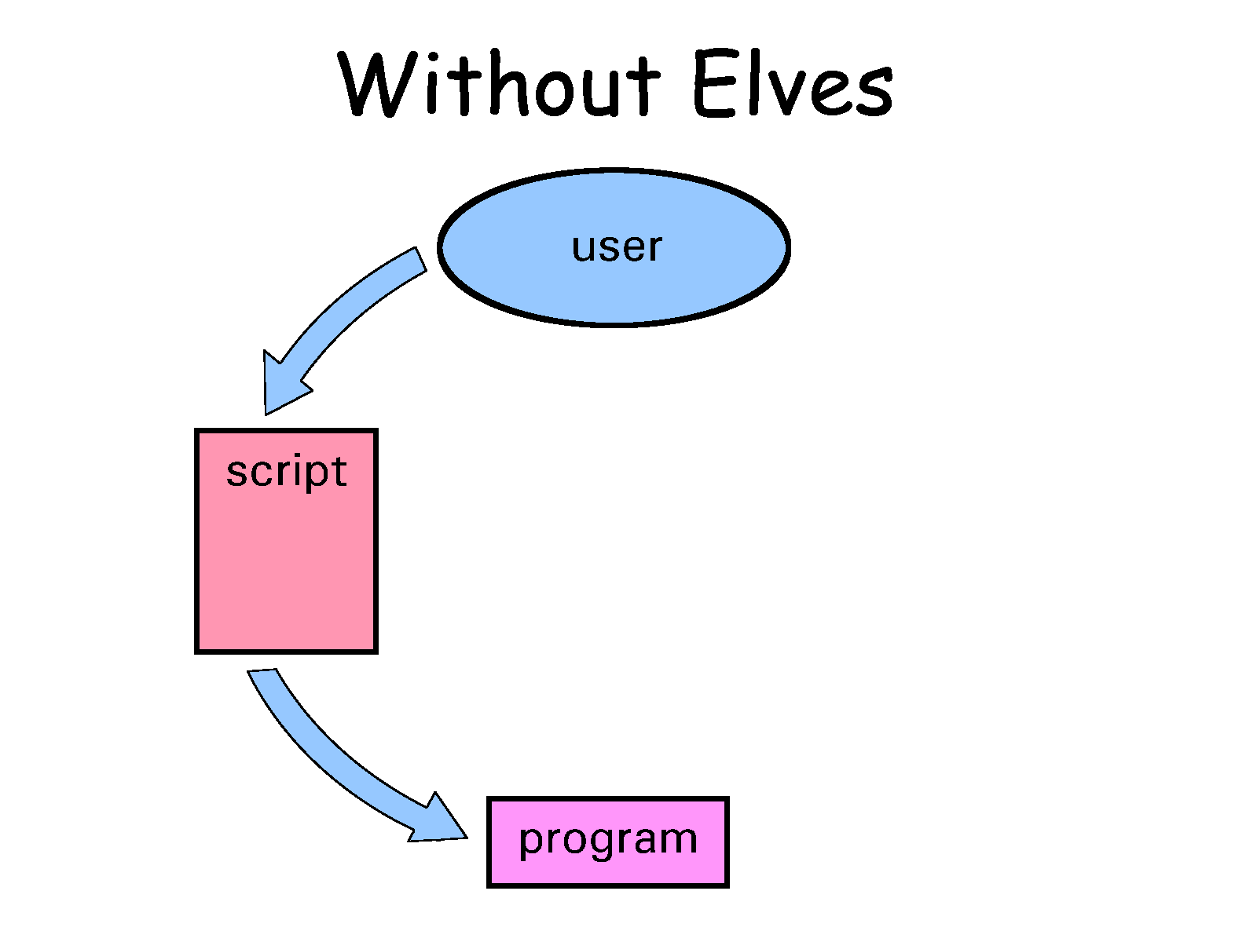
Before Elves

Slide 18
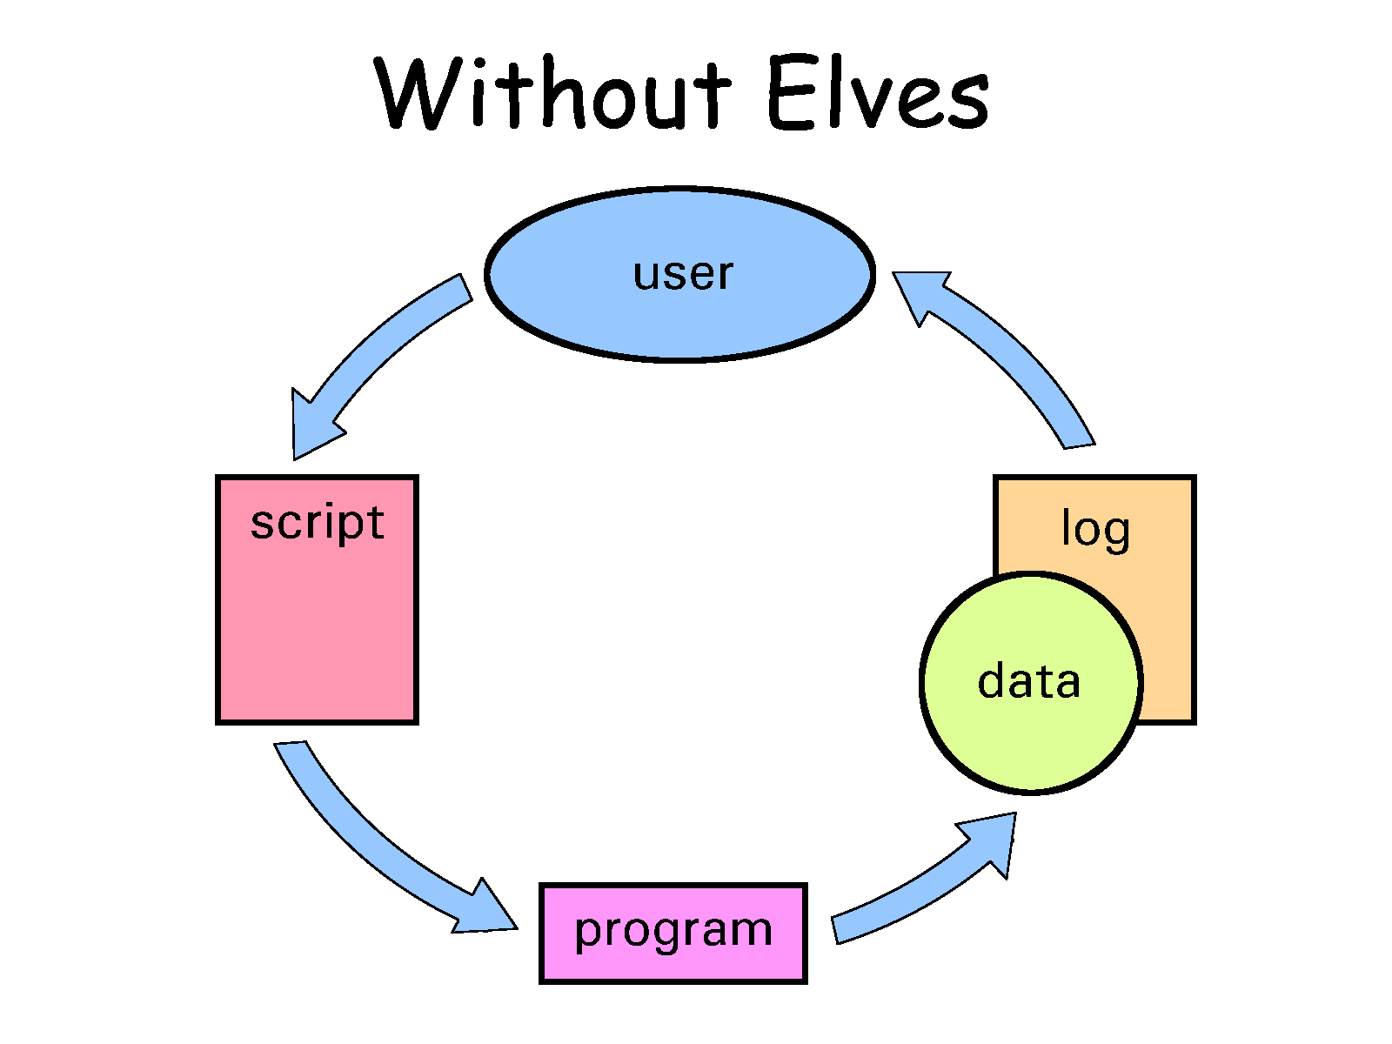
Before Elves

Slide 19
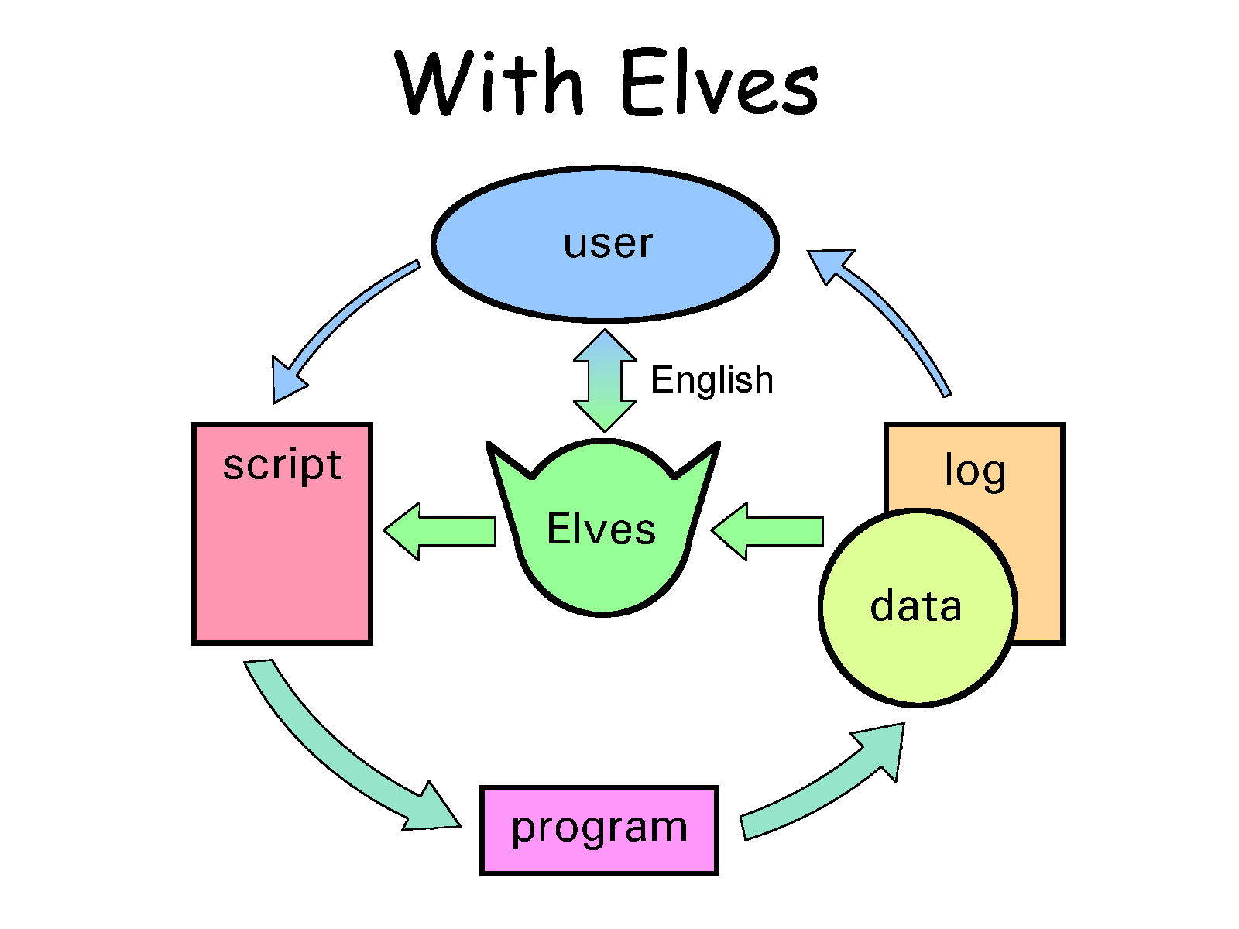
Before Elves
Underling

Slide 20
Before Elves
“That’s not possible”
- Tom Alber
Underling

Slide 21
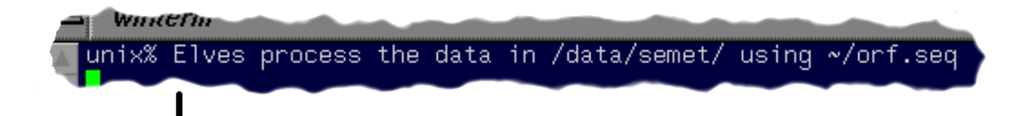
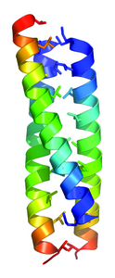
Elven Automation
Elves examine images and
set-up data processing
Elves run…
mosflm
scala
solve
mlphare
dm
arp/warp
Holton, J. & Alber, T. (2004) "ELVES". PNAS 101, 1537-42

Slide 22
I learned from Elves:
Algorithms work
if you don’t make mistakes
Complexity -> mistakes

Slide 24
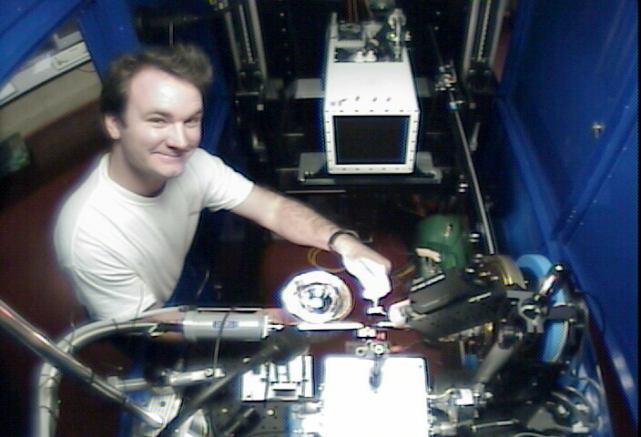


Slide 25
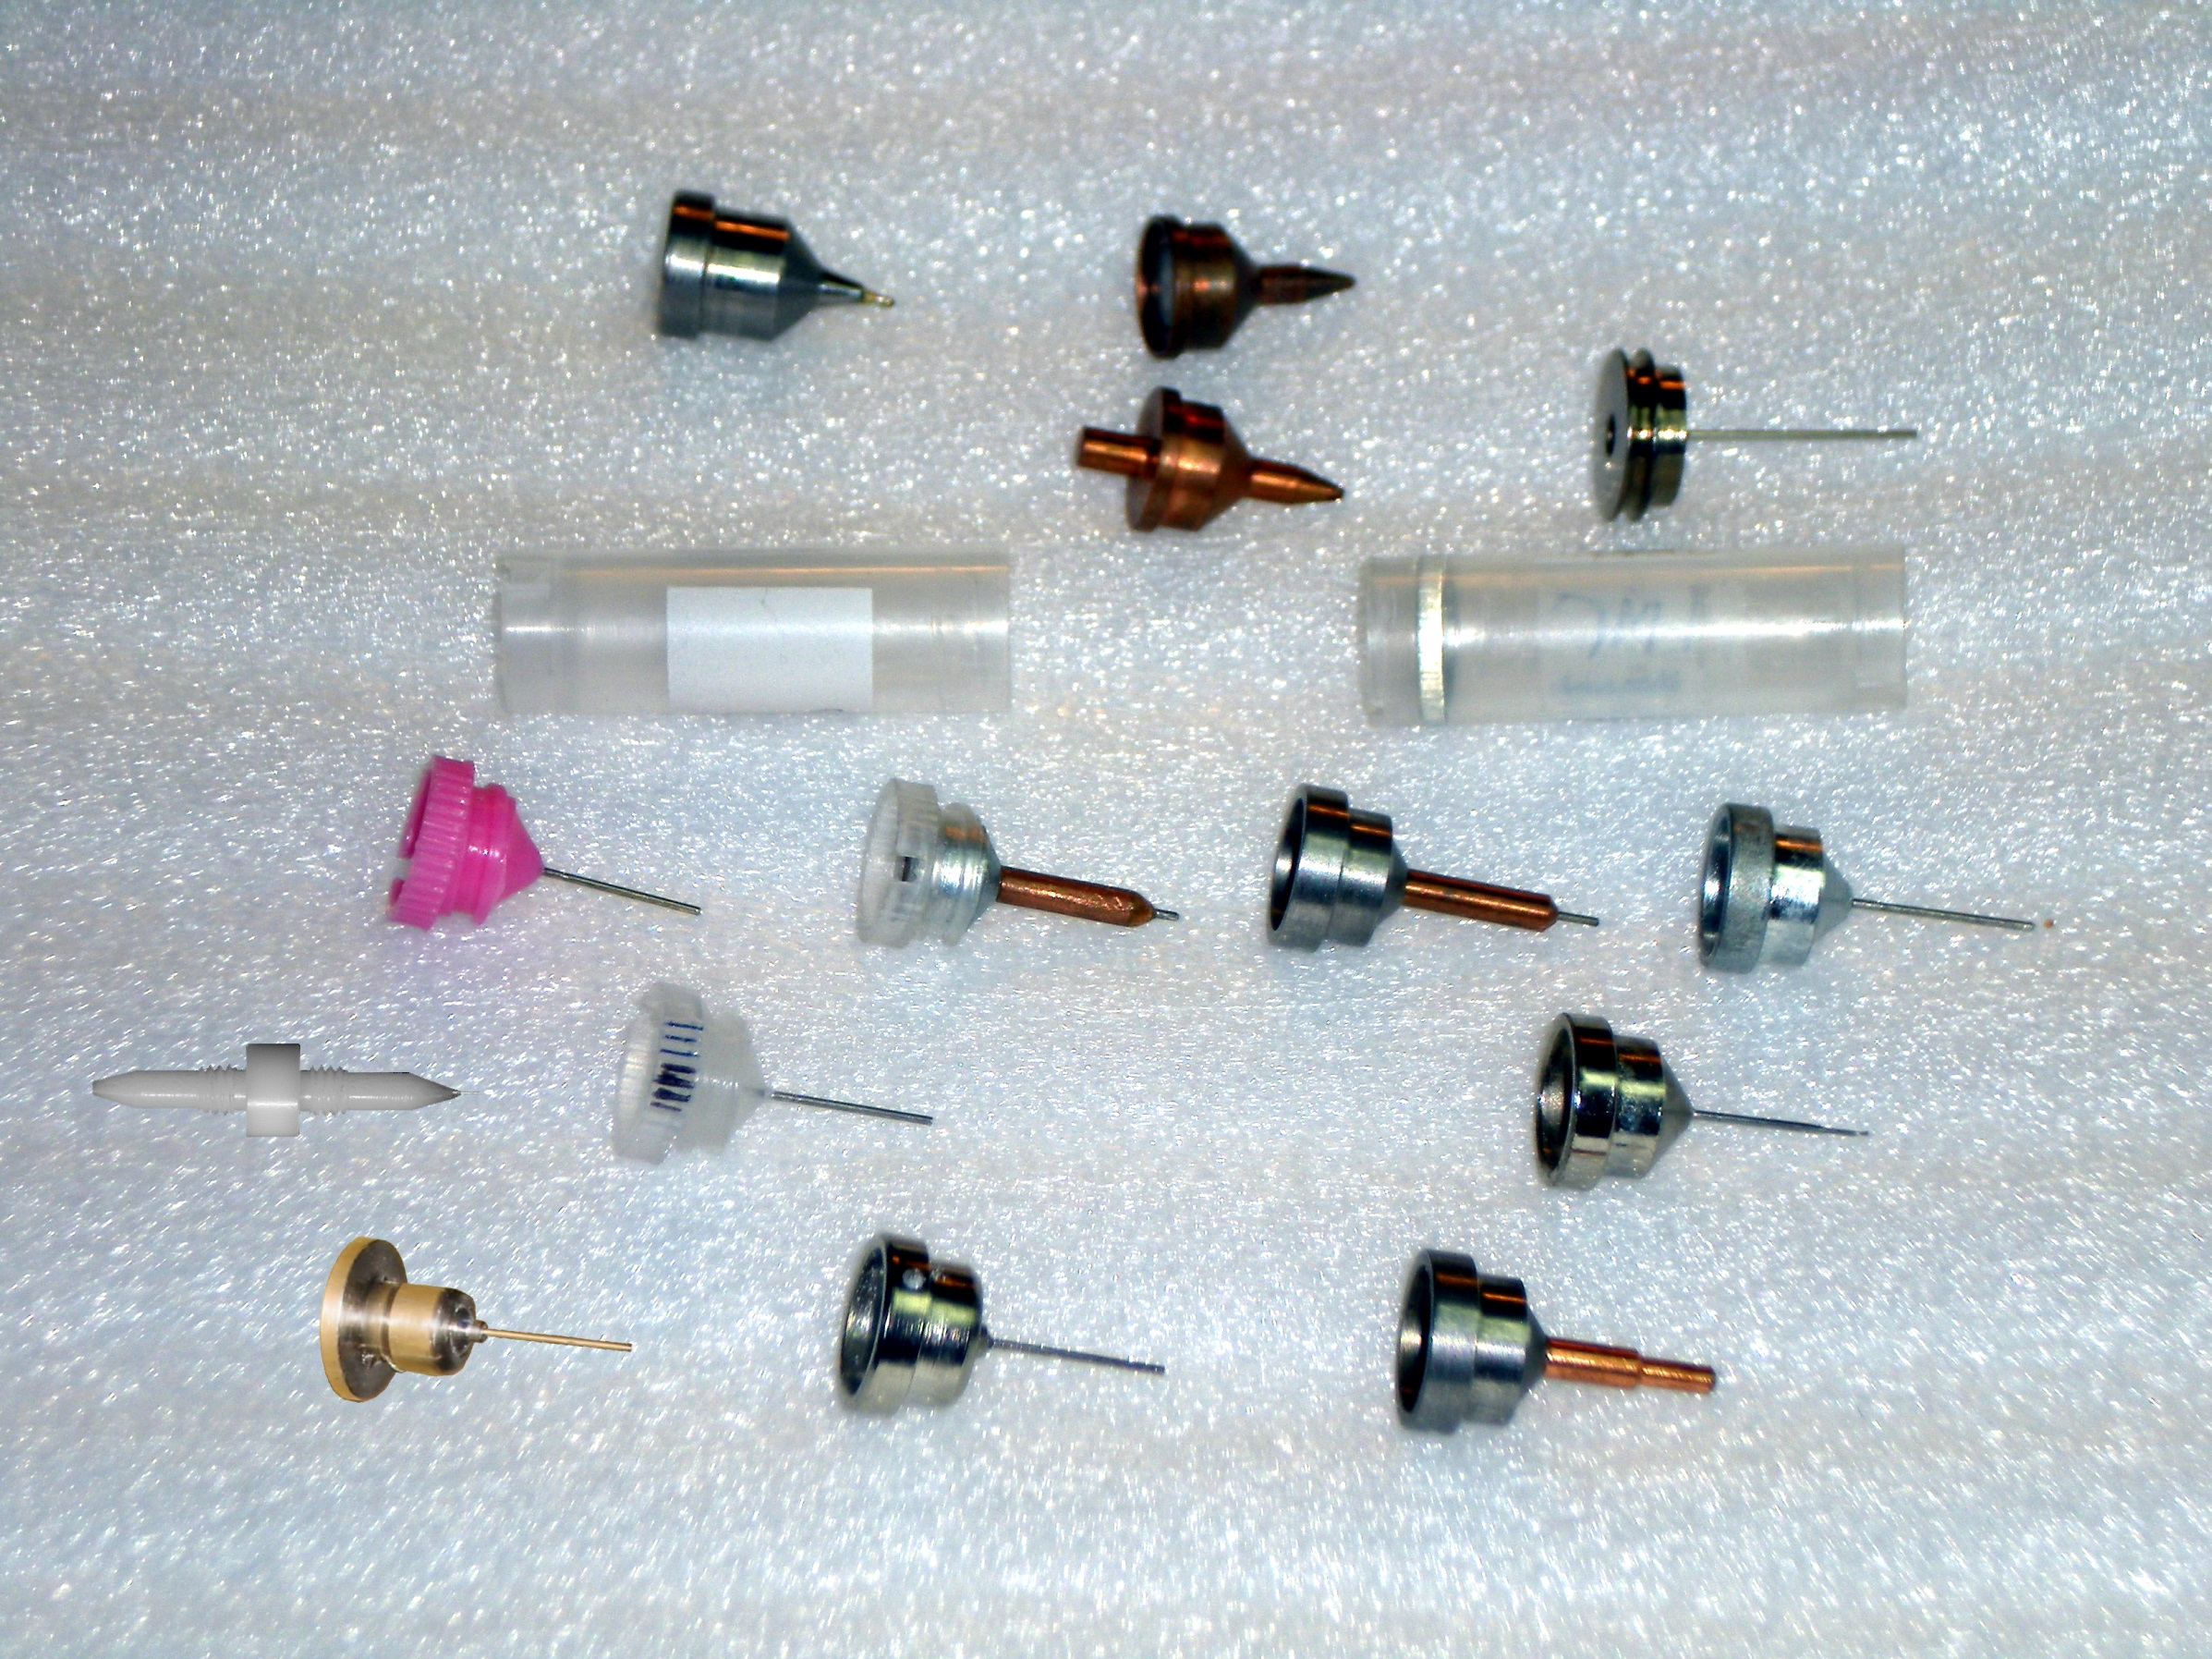
you must choose, but choose wisely!
Caltech
SSRL
Yale
Hampton screw cap
Hampton magnetic
H. colored
H. copper
H. magnetic
H. hybrid
H. screw cap
Syrrx
SPring-8
Oxford
SPINE
MiTeGen RT

Slide 26
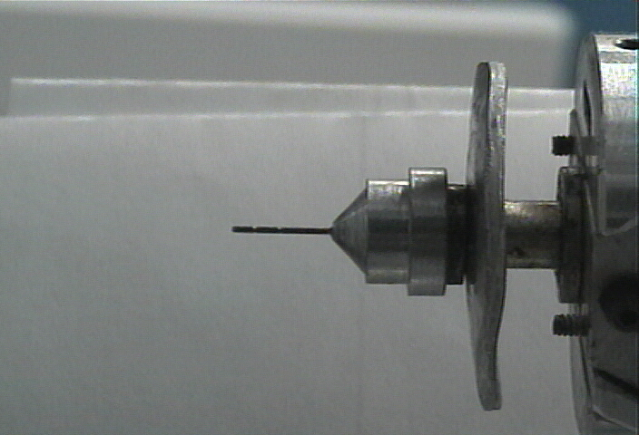
Hampton Pin
Super Tong

Slide 27
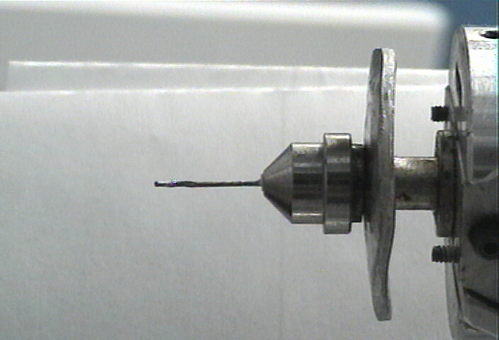
Syrrx Pin
Super Tong

Slide 28
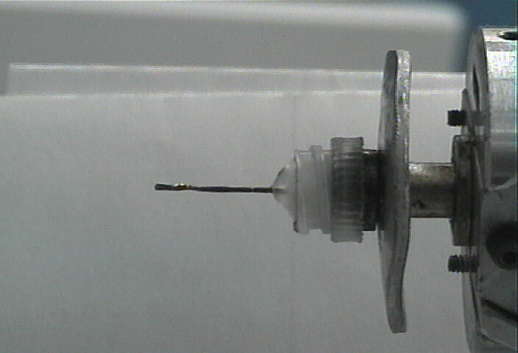
plastic Pin
Super Tong

Slide 29
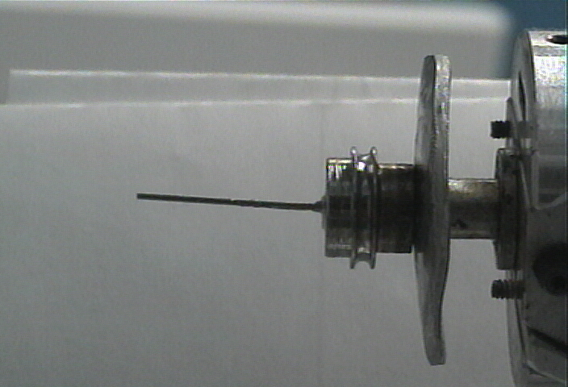
Yale Pin
Super Tong

Slide 30
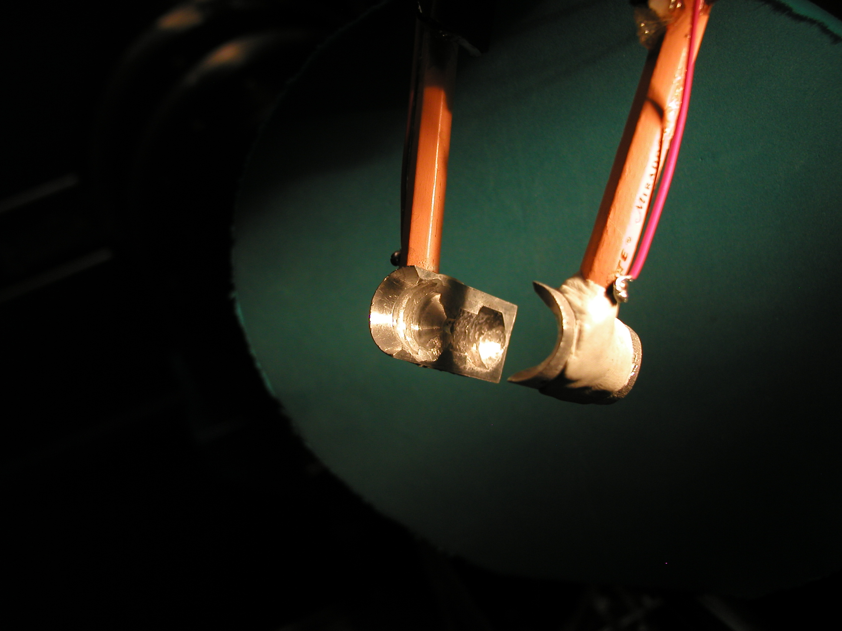
SuperTong

Slide 31
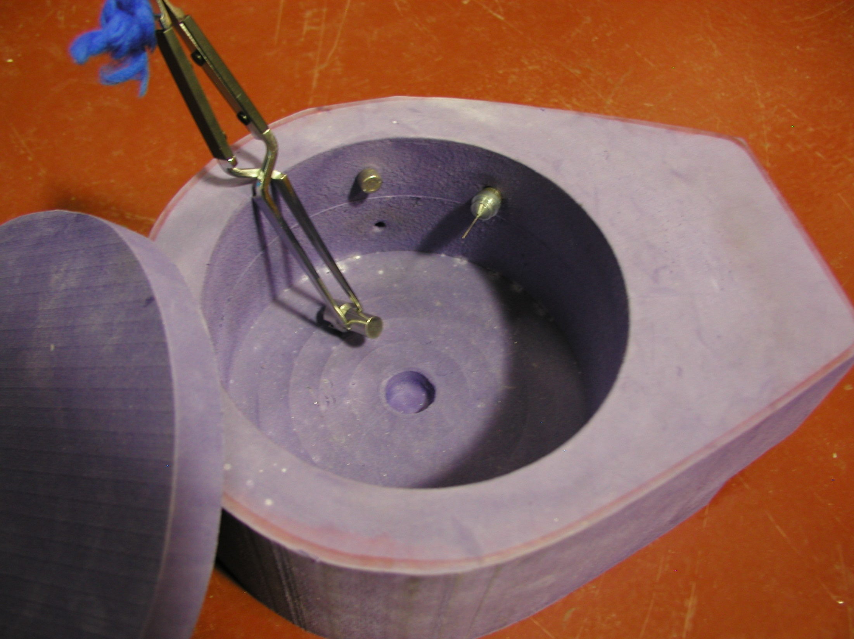
Foam dewars

Slide 32
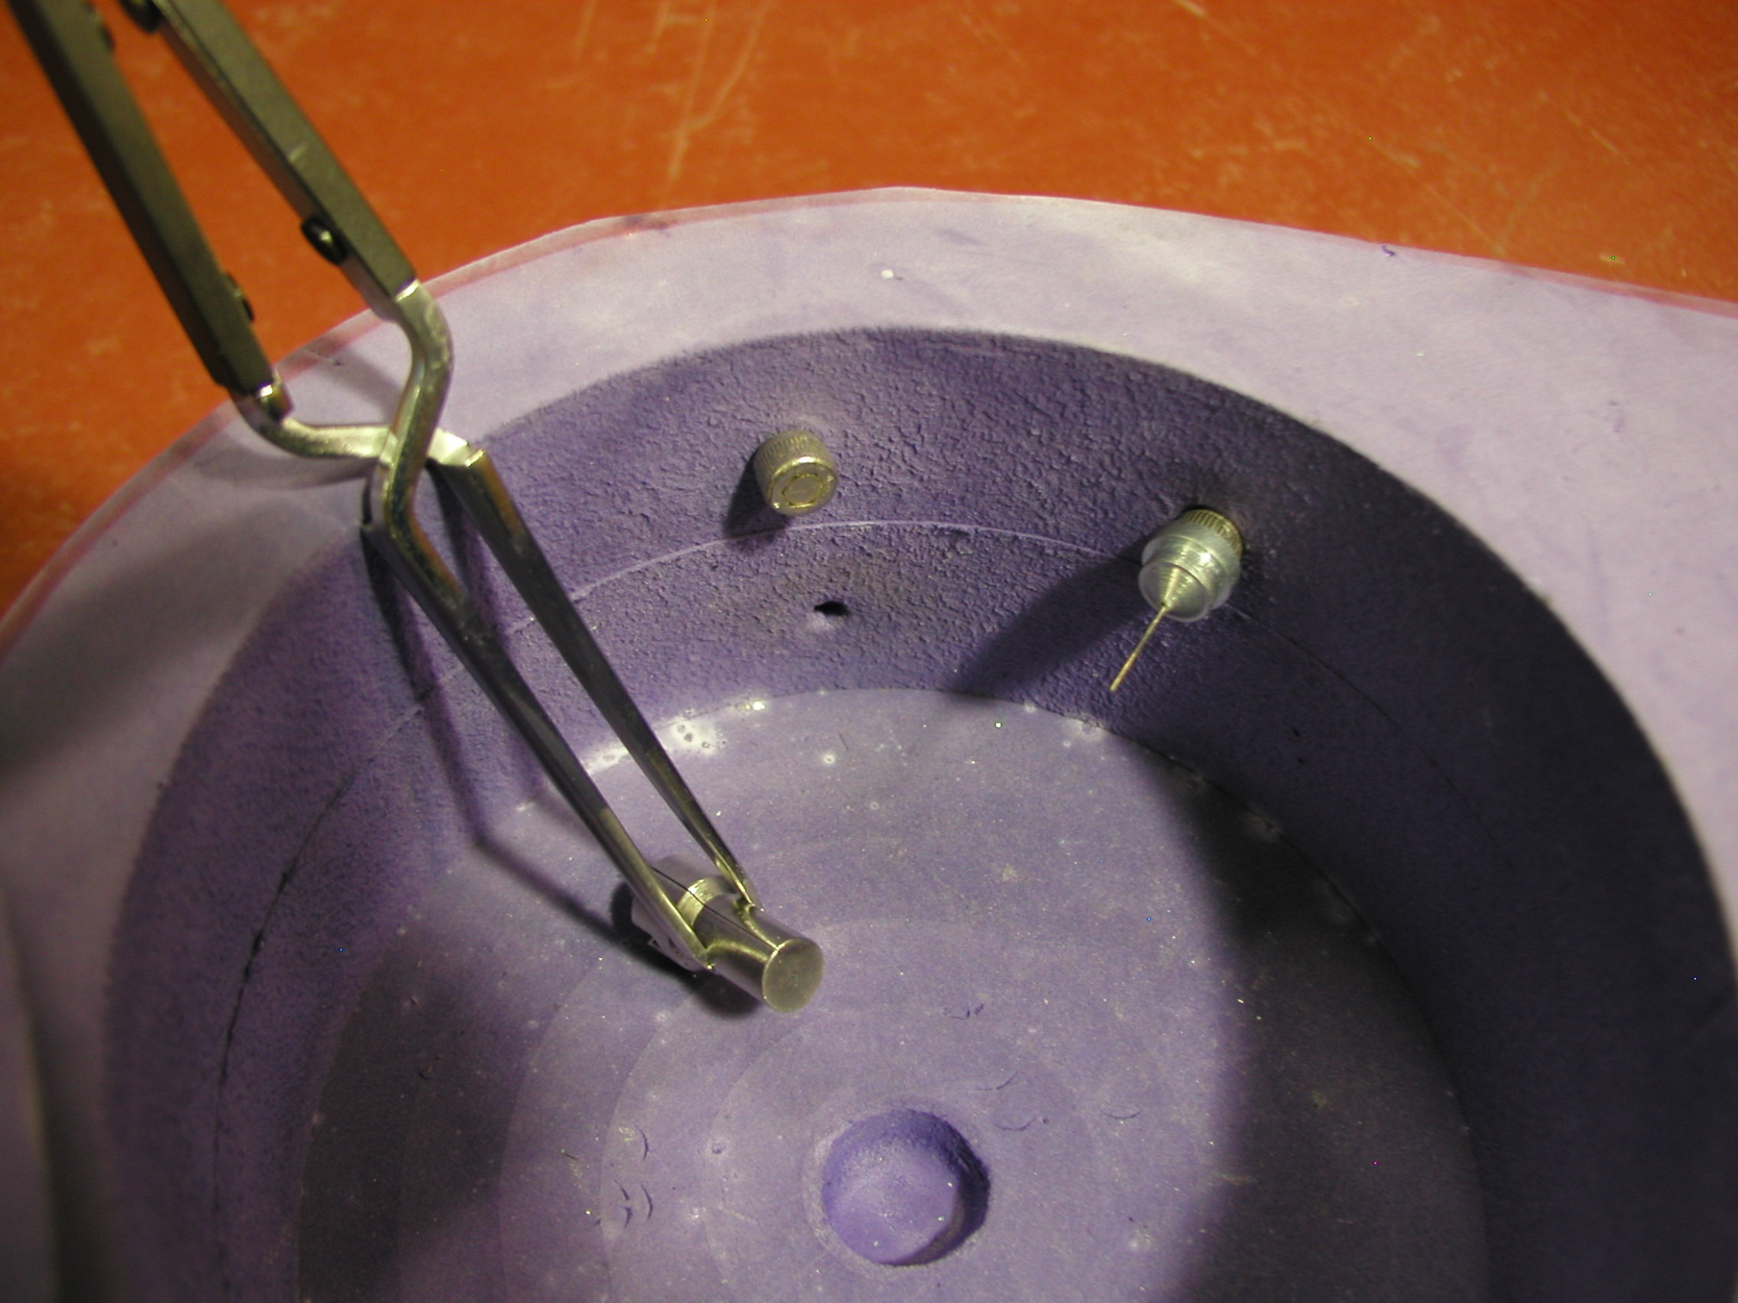
Foam dewars

Slide 33
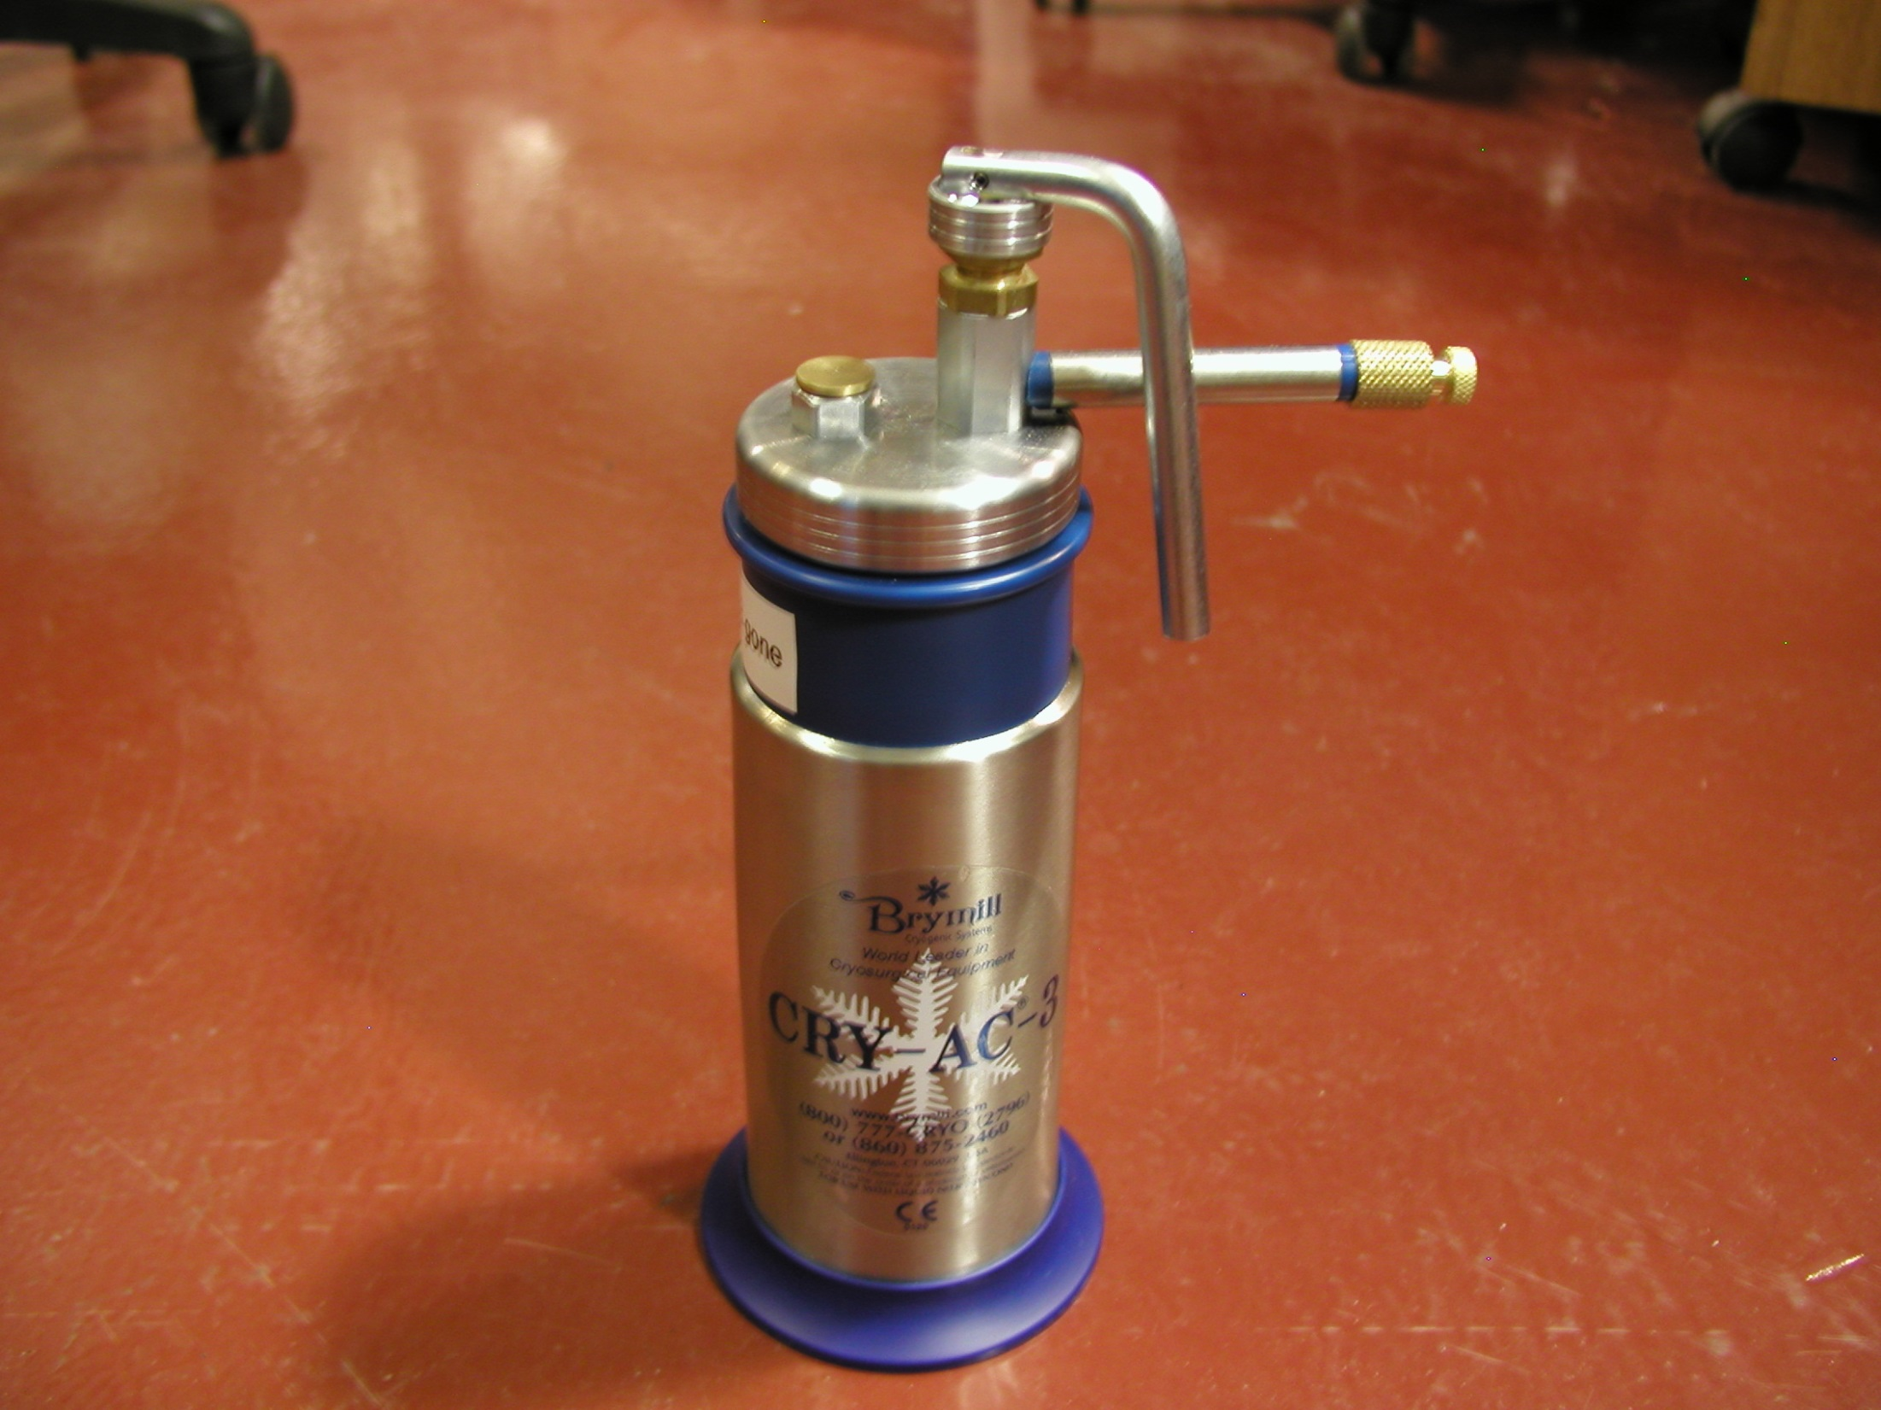
Ice-B-gone

Slide 34
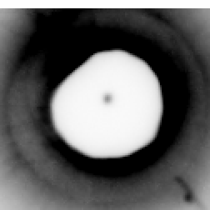
Semi-transparent beam stop
Unambiguous
direct beam
gold
LuAc
gold

Slide 35
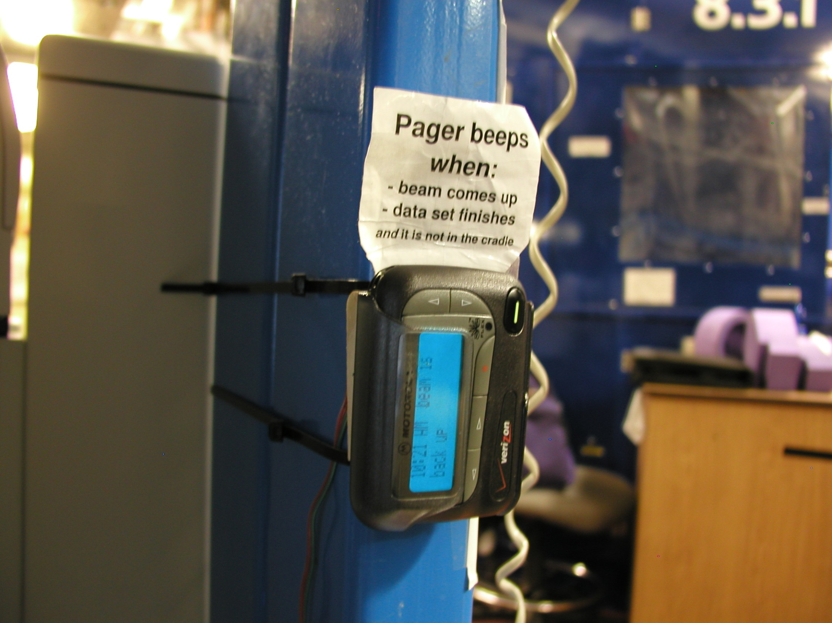
Beamline pager

Slide 36
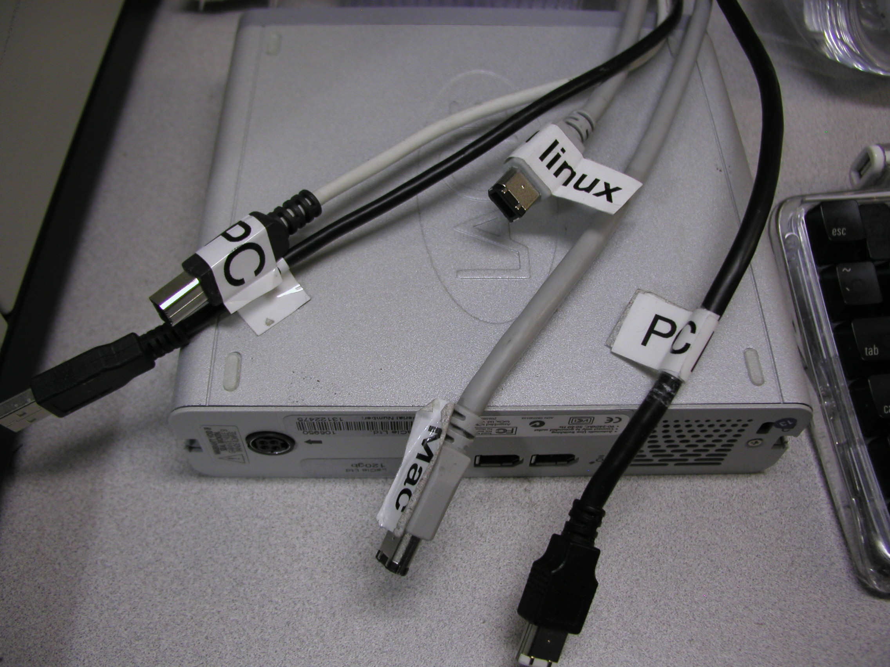
firewire

Slide 37
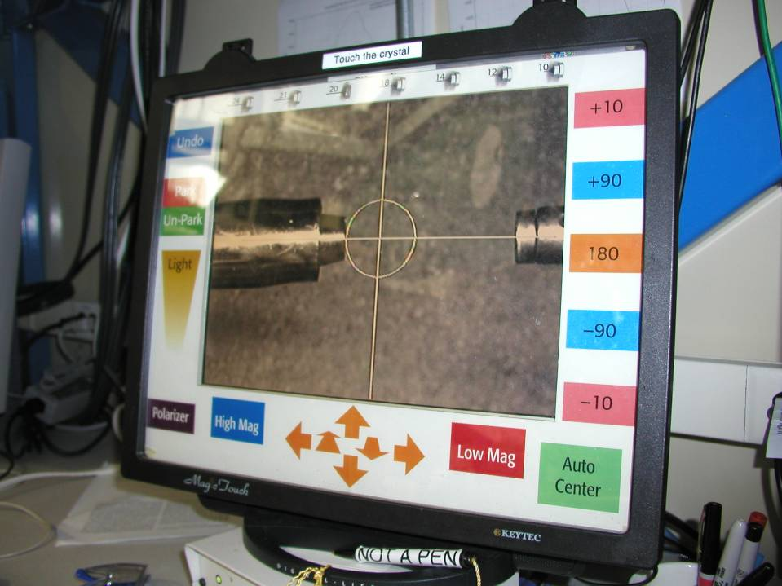
Touch screen

Slide 38
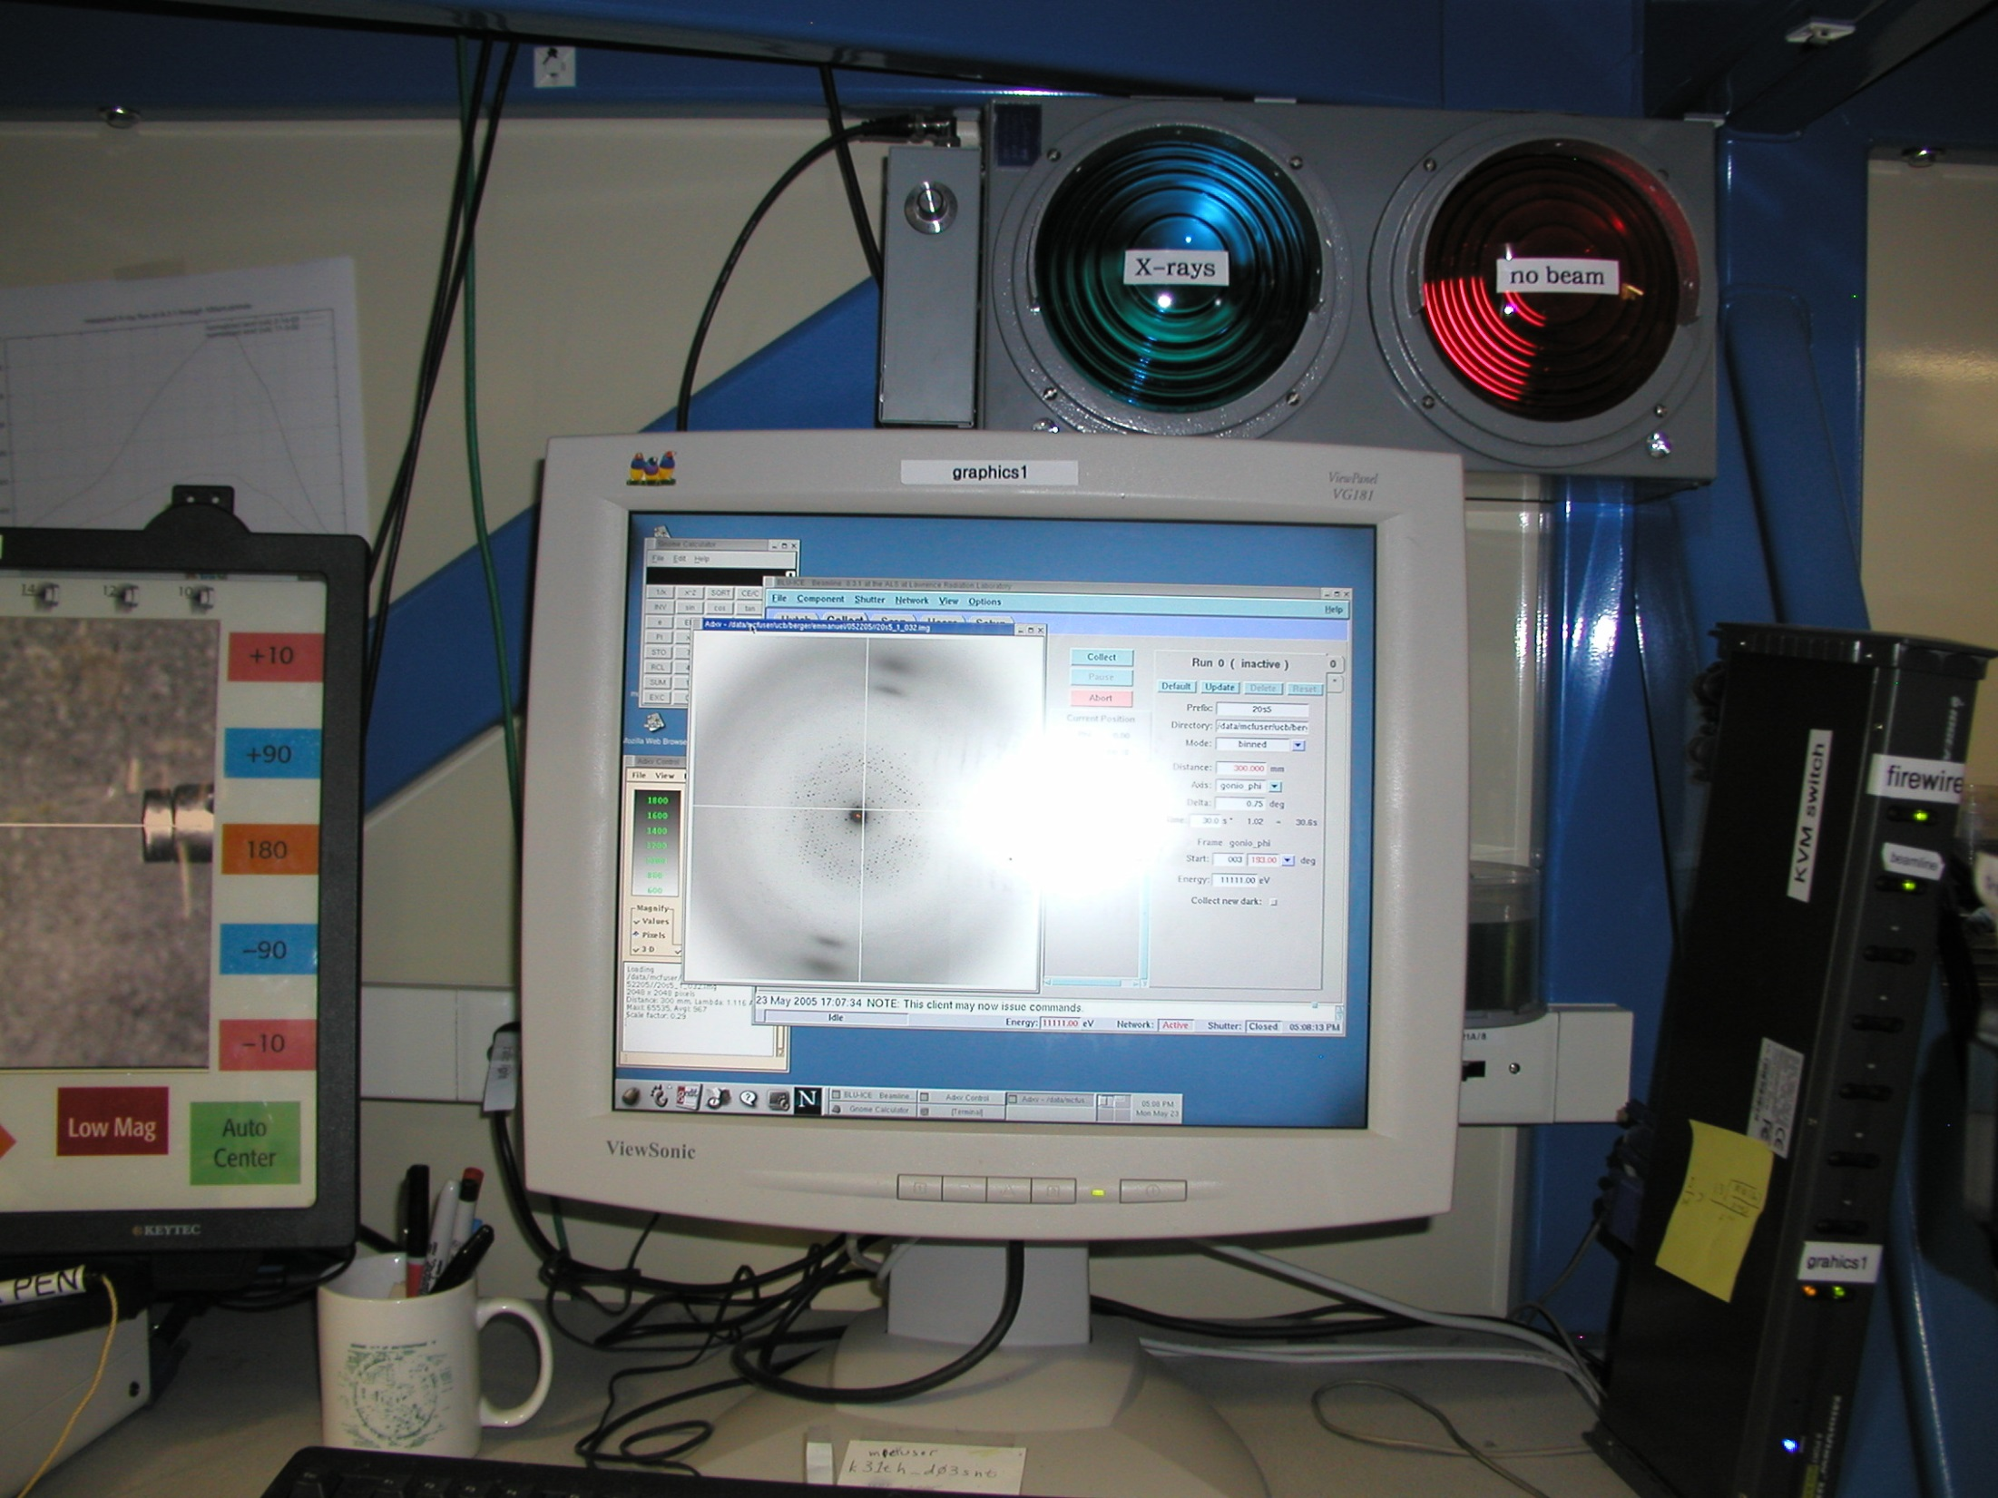
Traffic light

Slide 39
Operational Efficiency
“representative” 8.3.1 user
Seconds | Description | Percent
51806 | Shutter closed | 100%
247s × 45 | Mounting | 22%
229s × 37 | Centering | 16%
179s × 109 | Snap → next | 38%
309s × 37 | end collect → next | 24%

Slide 40
I learned from watching users:
No substitute for
sit down & pay attention

Slide 41
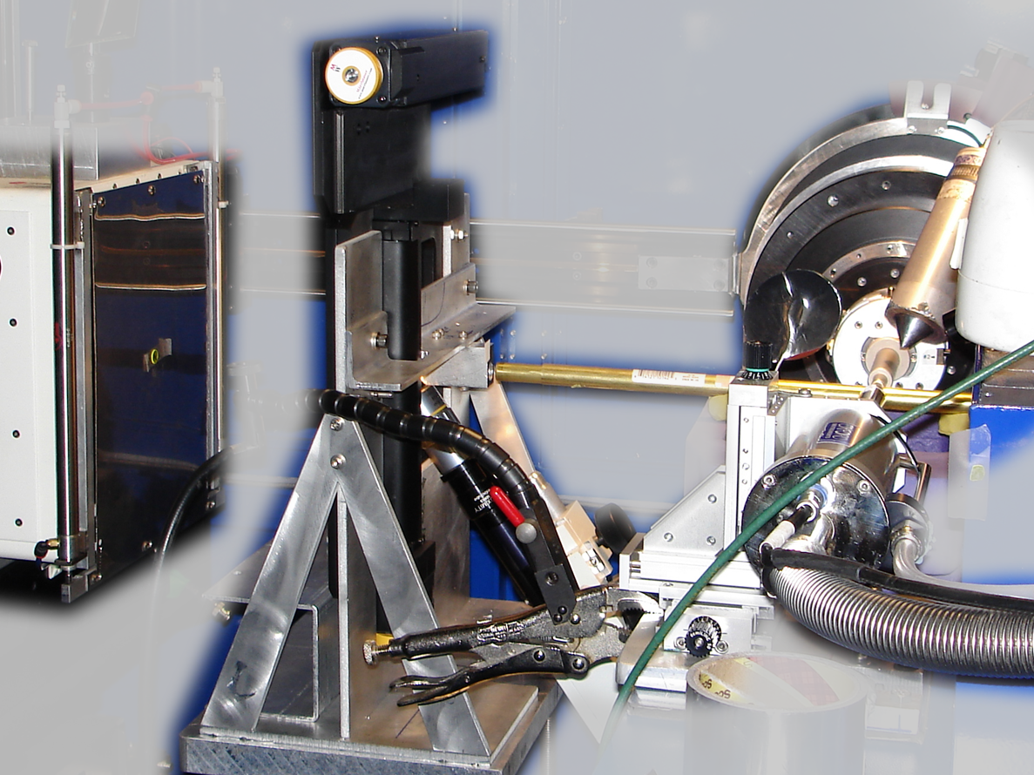
Notes:
non-rotating tray goniometer stage installed in ALS 8.3.1. Note that the “normal” cryo-pin goniometer on the left is still in place and a brass flight tube has been added to contain the air scatter from the main beam on its way to the tray goniometer.

Slide 42
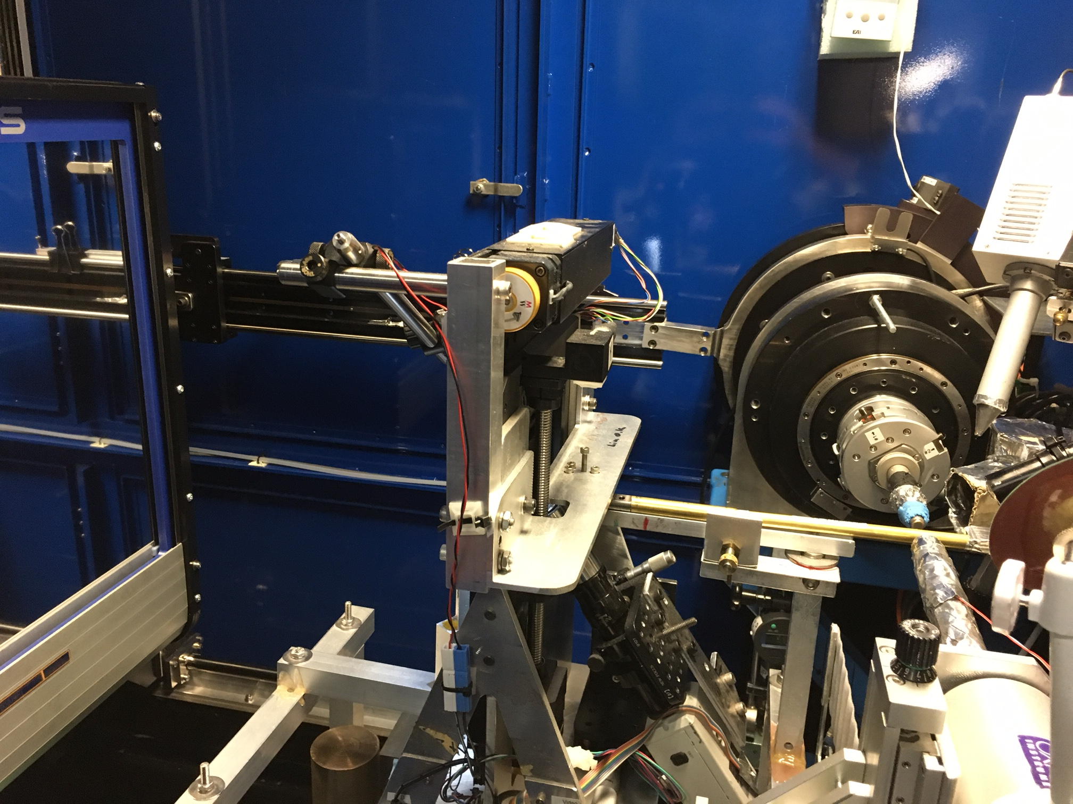

Slide 43
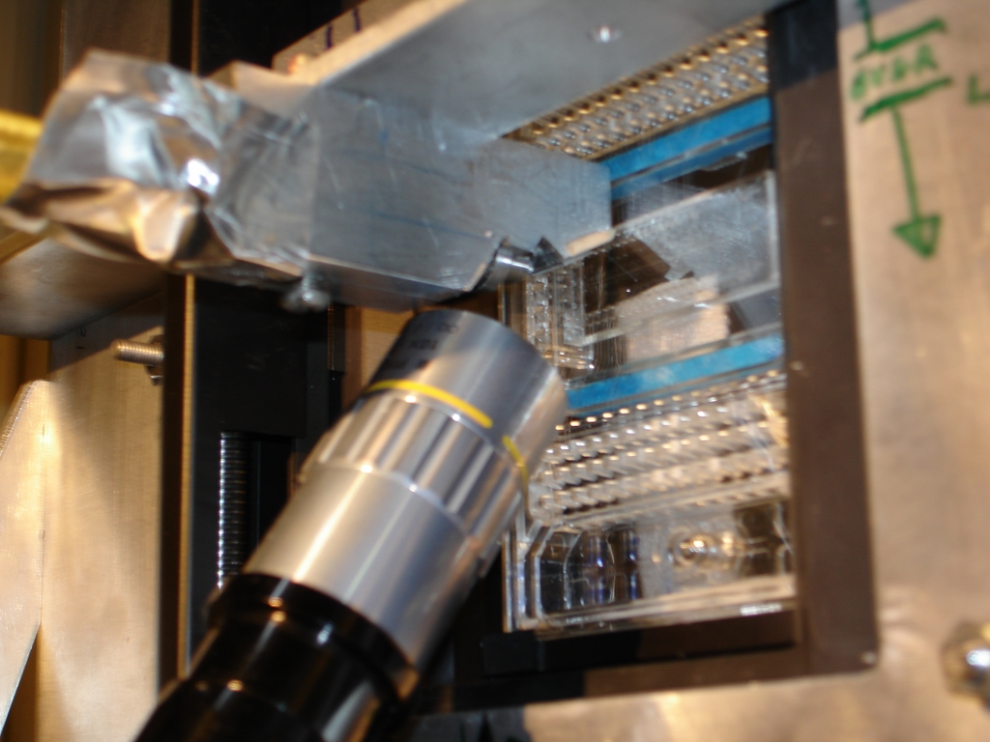

Slide 44
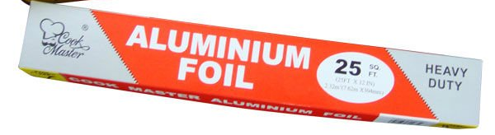
I learned from in-situ:
Need this:
GRAPHENE

Slide 45
The “success rate” of data collection
100 s/dataset
200 days/year
~150 beamlines
~26,000,000 datasets/year
~13,377 PDBs in 2019

Slide 46
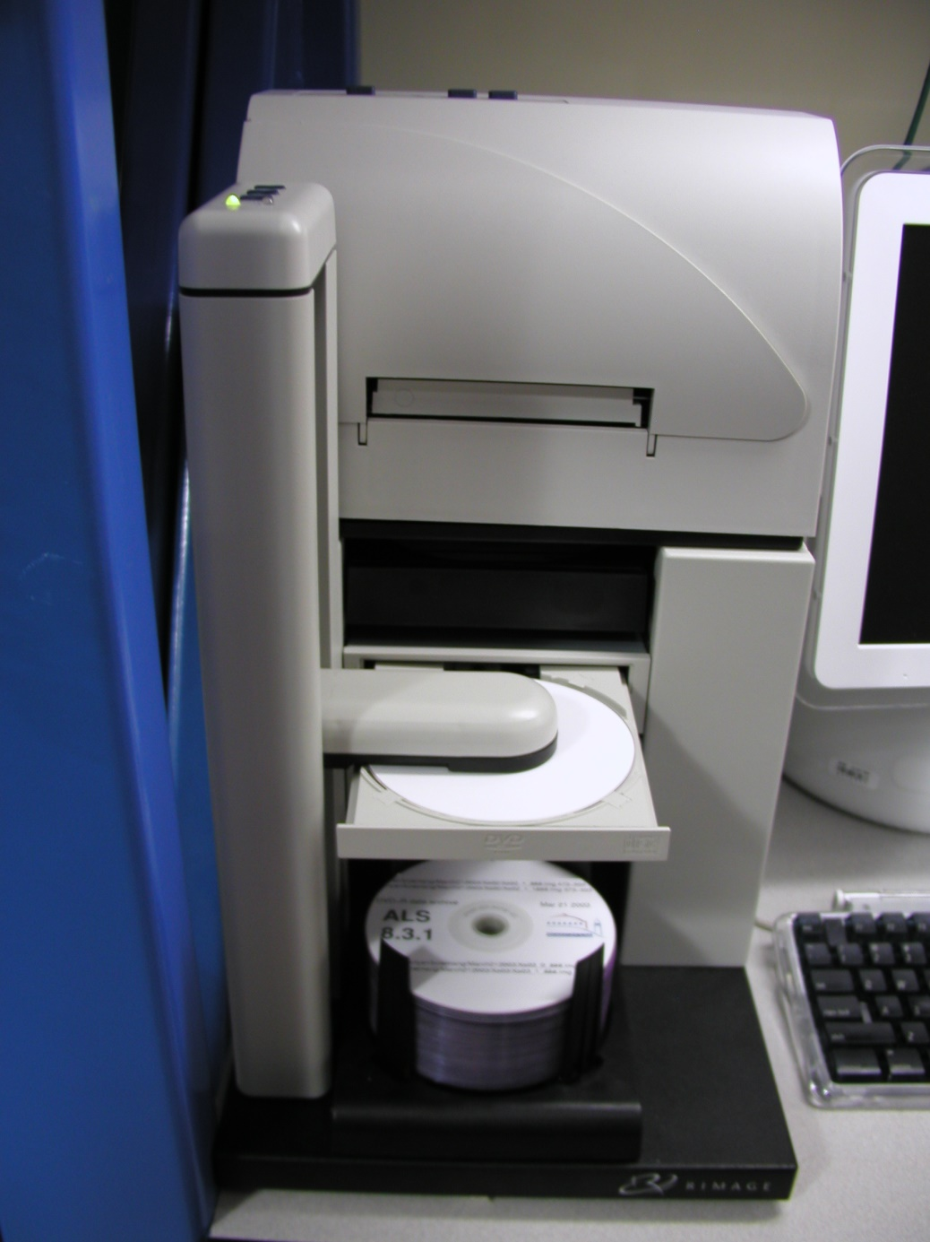
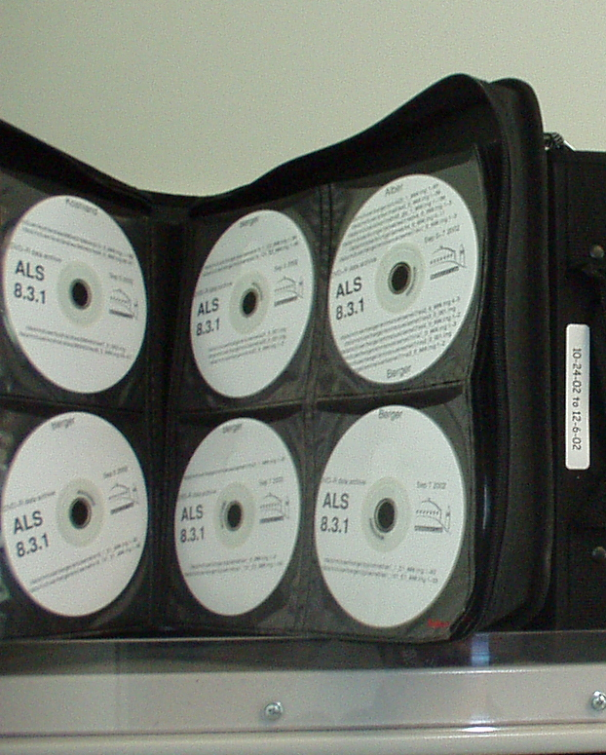
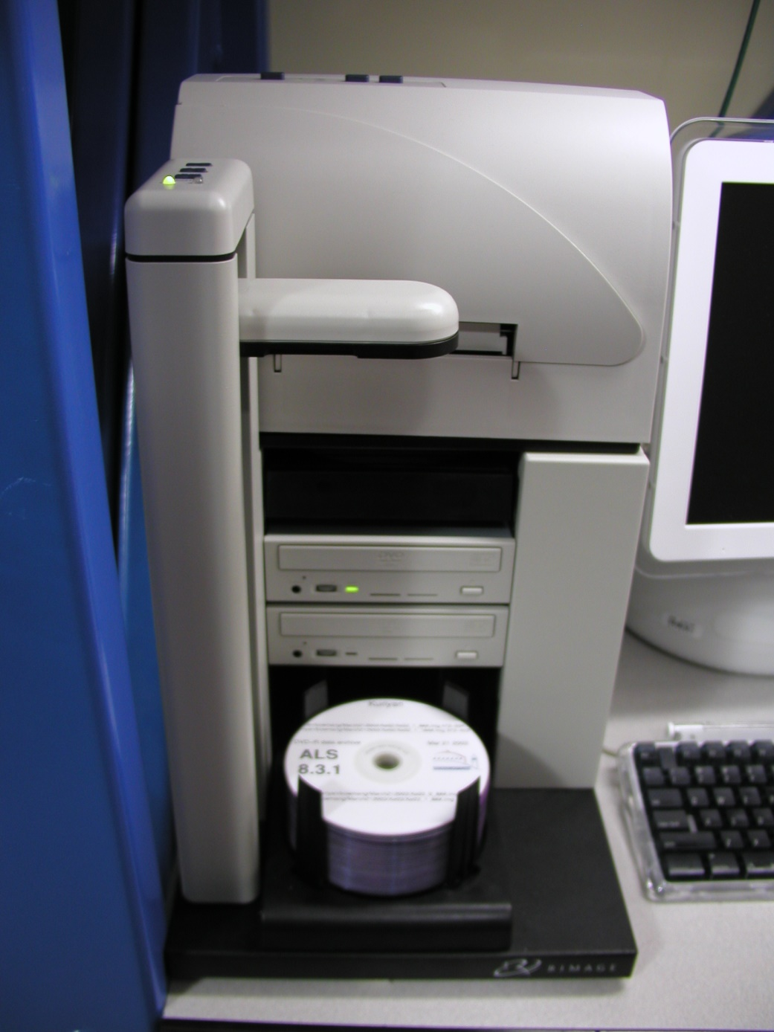
DVD data archive

Slide 47
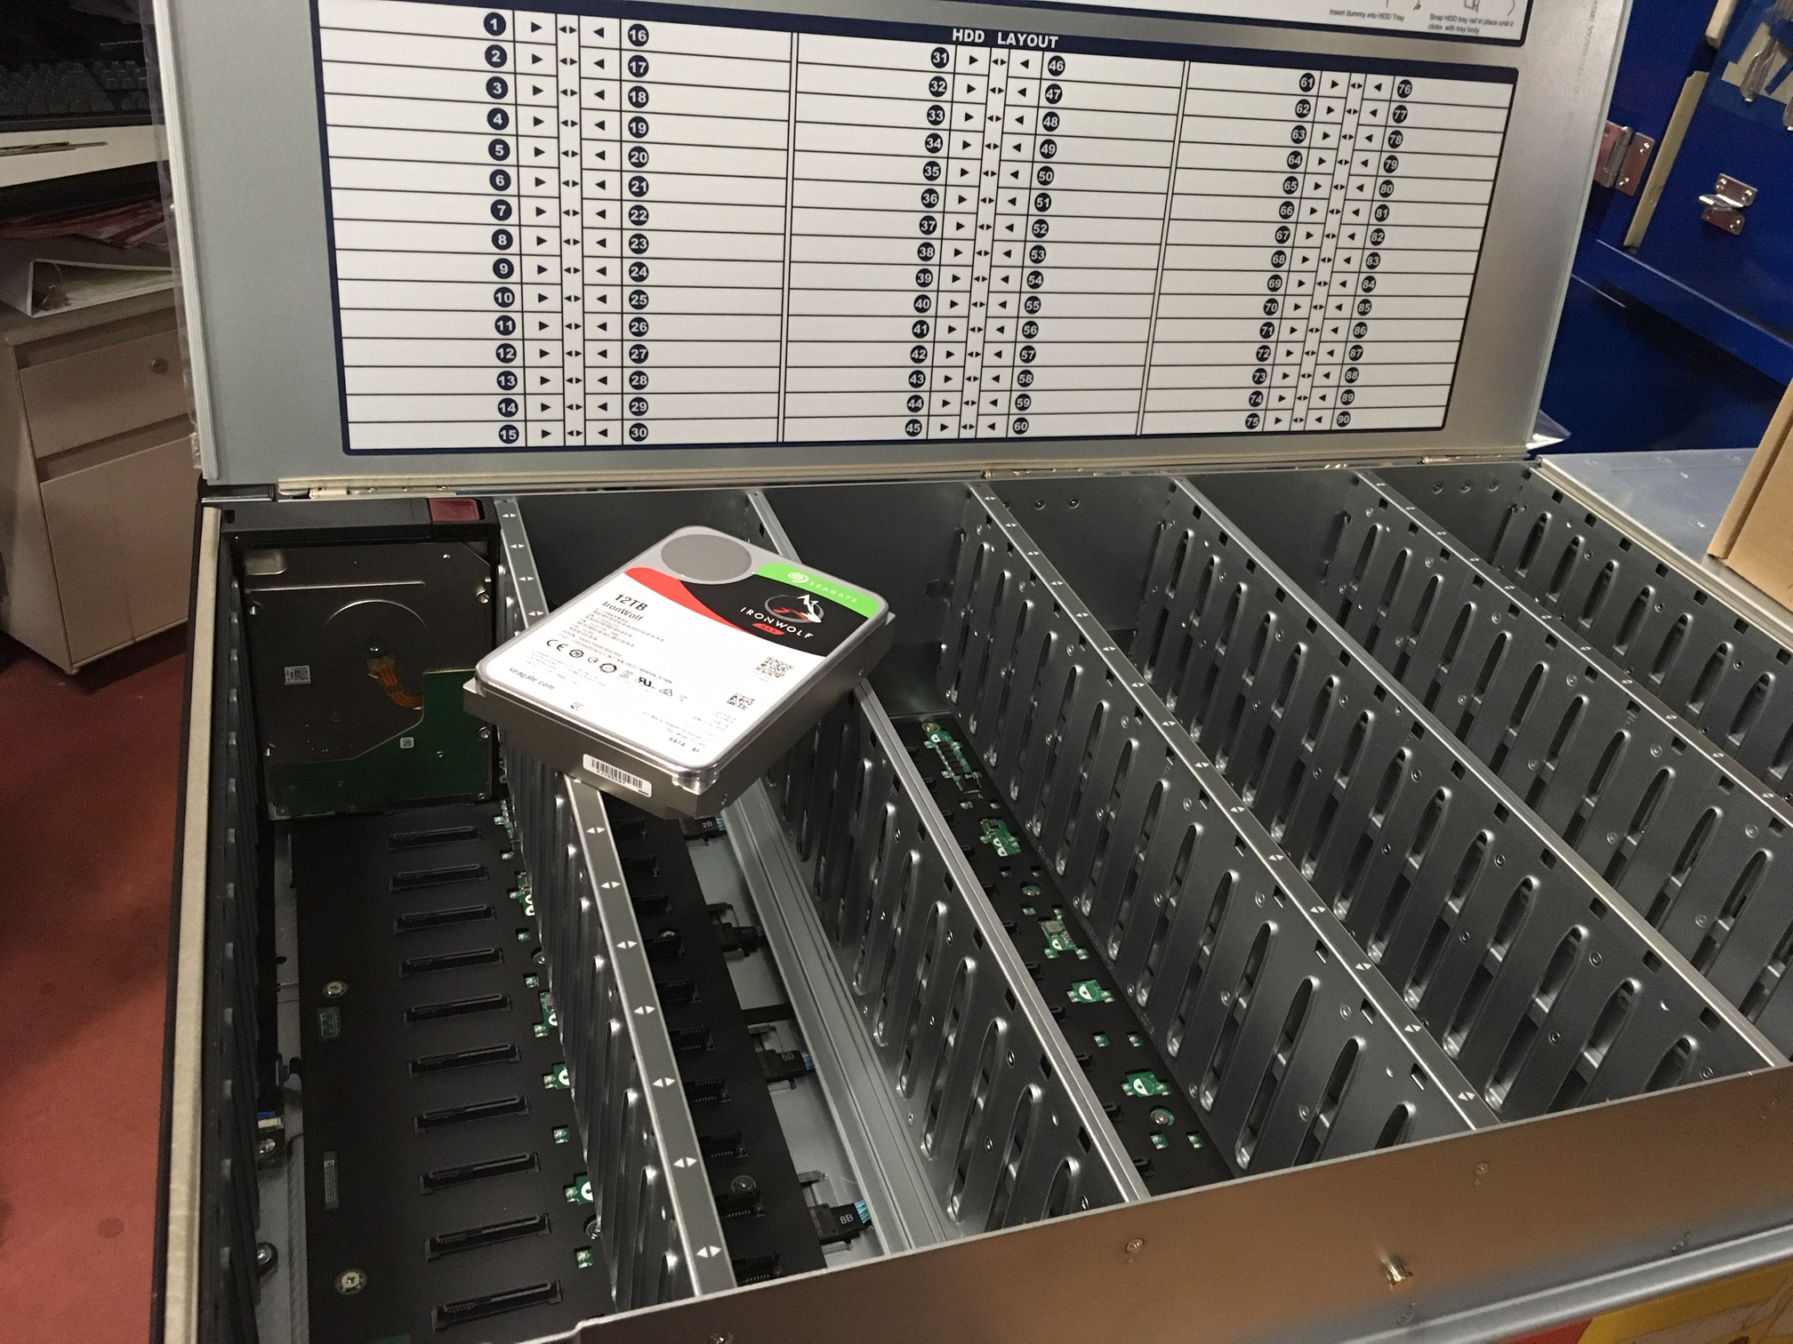

“petabyte” $11k

Slide 48
What went wrong?
MAD/SAD data 2001 - 2006
Number | Description | Percent
682712 | Images (~7 TB)
3331 | Data sets | 47% ph
709 | High quality data | 21%
322 | Same as published (PDB) | 46%
123 | Published form, non-iso | 17%
45 | Known struct, Unk form | 6%
219 | Unique and unsolvable | 31%

Slide 49
MAD/SAD datasets
ALS 8.3.1: 2001-2006
non-isomorphous
Unsolved
R_{iso} vs PDB deposit
Published
best R_{cryst} after rigid-body refinement

Slide 50
What went wrong?
MAD/SAD data 2001 - 2006
Number | Description | Percent
219 | Unique but unsolvable | 57%
36 | twinned | 16%
45 | Unpublished forms | 100%
6 | twinning | 13%
13 | Pseudo-translation | 29%
211/148k | Twinning in PDB | 0.14%

Slide 51
I learned from old data:
Sample is everything
Methods can improve

Slide 52
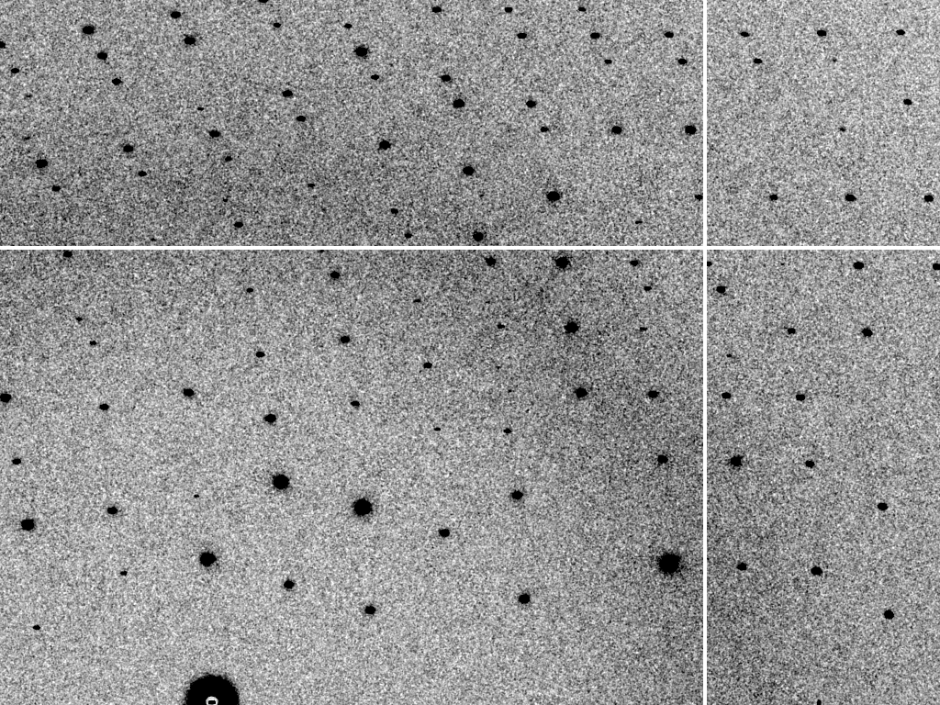
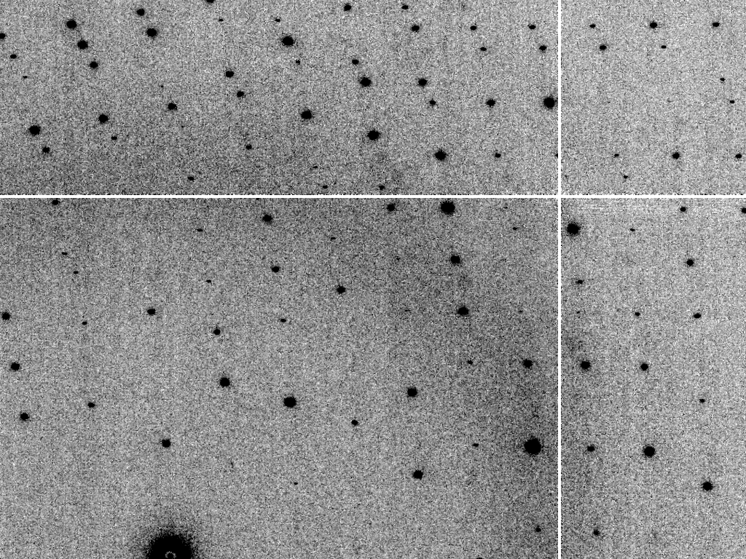
Simulated diffraction image
MLFSOM
simulated
real

Slide 53
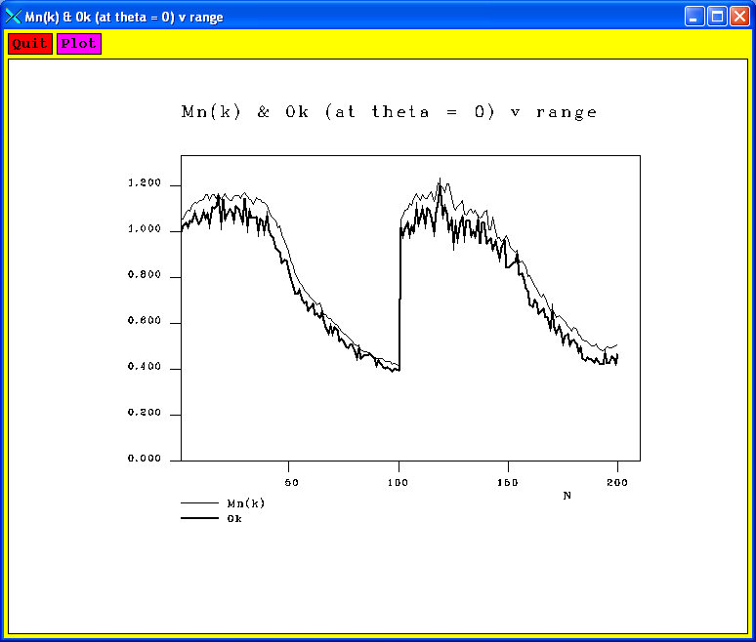
Simulated diffraction image
(2008)
simulated
real

Slide 54
Simulated | statistic | Real
1.45 Å | resolution | 1.45 Å
15 (1.1) | I/sd | 18 (2.0)
6.7% | R_{meas} | 5.3%
5.7% | R_{merge} | 4.5%
99,8 (66) | CC_{1/2} | 99.8 (86)
69 | CC_{ano} | 62
96.4 (85.5) | complete | 96.7 (86.7)
6.1 (2.2) | mult | 6.1 (2.1)
18.8 | Wilson B | 18.3

Slide 55

“R-factor Gap” for macromolecules
single-conformer PDB file
R_{merge} = 6%
R_{work} = 7%
R_{free} = 8%
MLFSOM
Elves
1H87; conf “A”
Holton et al. (2014) "The R-factor gap", FEBS J. 281, 4046-4060.

Slide 56
“R-factor Gap” for macromolecules
multi-conformer PDB file
R_{merge} = 6%
R_{work} = 17%
R_{free} = 20%
MLFSOM
Elves
1H87 ; multi-conf
Holton et al. (2014) "The R-factor gap", FEBS J. 281, 4046-4060.

Slide 57
“R-factor Gap” for macromolecules
multi-conformer PDB file
R_{merge} = 6%
R_{work} = 7%
R_{free} = 8%
MLFSOM
Elves
1H87 ; multi-conf
Holton et al. (2014) "The R-factor gap", FEBS J. 281, 4046-4060.

Slide 58
I learned from MLFSOM:
“R-factor gap” is model
1² + 1² = 1.4²
10² + 1² = 10²

Slide 59
I learned from MLFSOM:
“R-factor gap” is model
1² + 1² = 1.4²
10² + 1² = 10²

Slide 60

Radiation damage

Slide 61
Radiation damage

Slide 62

Se-Met decay >> photon hits
8.6 17 26 34
dose (MGy)
Se cross-section at 12680 eV
half-dose
0.0 0.2 0.4 0.6 0.8 1.0
fraction unconverted
0 20 40 60 80 100
fluence (10¹⁵ photons/mm²)
Holton (2007) J. Synch. Rad. 14, 51-72

Slide 63
750%
660%
protective measure
Holton (2007) J. Synch. Rad. 14, 51-72

Slide 64
MGy reaction reference
~45 global damage Owen et al. (2006)
10/Å global damage Howells et al. (2009)
5 Se-Met Holton (2007)
4 Hg-S Ramagopal et al. (2004)
4 R-C-COOH Garman et al. (2015)
3 S-S Murray et al. (2002)
1 Br-RNA Olieric et al. (2007)
~1? Cl-C ???
0.5 Mn in PS II Yano et al. (2005)
0.06 putidaredoxin Corbett et al. (2007)
0.02 Fe in myoglobin Denisov et al. (2007)
Radiation Damage World Records
Holton (2009) J. Synch. Rad. 16 133-42

Slide 65
what the is a MGy?
1 MGy = 10⁶ J/kg
http://bl831.als.lbl.gov/
damage_rates.pdf
Holton J. M. (2009) J. Synchrotron Rad. 16 133-42

Slide 66

Holton & Frankel (2010) Acta D 66 393-408.

Slide 67


Slide 68
Self-calibrated damage limit
Where:
⟨I⟩_{DL} - average damage-limited intensity (photons/hkl) at a given resolution
10⁵ - converting R from μm to m, r_{e} from m to Å, ρ from g/cm³ to kg/m³ and MGy to Gy
r_{e} - classical electron radius (2.818 x 10⁻¹⁵ m/electron)
h - Planck’s constant (6.626 x 10⁻³⁴ J∙s)
c - speed of light (299792458 m/s)
f_{decayed} - fractional progress toward completely faded spots at end of data set
ρ - density of crystal (~1.2 g/cm³)
R - radius of the spherical crystal (μm)
λ - X-ray wavelength (Å)
f_{NH} - the Nave & Hill (2005) dose capture fraction (1 for large crystals)
n_{ASU} - number of proteins in the asymmetric unit
M_{r} - molecular weight of the protein (Daltons or g/mol)
V_{M} - Matthews’s coefficient (~2.4 Å³/Dalton)
H - Howells’s criterion (10 MGy/Å)
θ - Bragg angle
⟨ƒ_{a}²⟩ - number-averaged squared structure factor per protein atom (electron²)
⟨M_{a}⟩ - number-averaged atomic weight of a protein atom (~7.1 Daltons)
B - average (Wilson) temperature factor (Å²)
μ - attenuation coefficient of sphere material (m⁻¹)
μ_{en} - mass energy-absorption coefficient of sphere material (m⁻¹)
No flux
No symmetry
No exposure time
Holton & Frankel (2010) Acta D 66 393-408.

Slide 69
The number of photons scattered
before crystal is dead
is independent
of flux & time
1 um³ = 10⁵ photons (roomT)
1 um³ = 10⁶ photons (synch)
1 um³ = 10⁸ photons (XFEL)
(synch)
Henderson, 1990; Gonzalez & Nave, 1994; Glaeser et al., 2000; Sliz et al., 2003; Leiros et al., 2006; Owen et al., 2006; Garman & McSweeney, 2006; Garman & Nave, 2009; Holton, 2009

Slide 70
Dose-rate dependence of damage
maximum useful dose (MGy)
dose rate (kGy/s)

Slide 71
I learned from radiation damage:
Can’t avoid it
Amazing community

Slide 72

Real XFEL still
Lyubimov et al. (2016).
eLife 5, e18740.

Slide 73

Best-fit Simulation of XFEL still

Slide 74



Simulation of XFEL still
phix
phiy
phiz
real
VS
phix
phiy
phiz

Slide 75

3-blob texture simulation

Slide 76
Real XFEL still
Lyubimov et al. (2016).
eLife 5, e18740.

Slide 77
1-blob texture simulation

Slide 78
Texture sufficient for poor stats
500 images Results from iota: cctbx & prime
texture | 1 cluster | 3 clusters
R_{true}* | 4% | 16%
*Agreement with F value fed into simulation

Slide 79
Texture sufficient for poor stats
500 images Results from iota: cctbx & prime
texture | 1 cluster | 3 clusters
R_{true}* | 4% | 16%
R_{merge} | 23% | 66%
*Agreement with F value fed into simulation

Slide 80
Texture sufficient for poor stats
500 images Results from iota: cctbx & prime
texture | 1 cluster | 3 clusters
R_{true}* | 4% | 16%
R_{merge} | 23% | 66%
I/σ | 32 (1.1) | 19 (1.2)
*Agreement with F value fed into simulation

Slide 81
Texture sufficient for poor stats
500 images Results from iota: cctbx & prime
texture | 1 cluster | 3 clusters
R_{true}* | 4% | 16%
R_{merge} | 23% | 66%
I/σ | 32 (1.1) | 19 (1.2)
CC_{1/2} | 99 (69) | 99 (58)
*Agreement with F value fed into simulation

Slide 82
Texture sufficient for poor stats
500 images Results from iota: cctbx & prime
texture | 1 cluster | 3 clusters
R_{true}* | 4% | 16%
R_{merge} | 23% | 66%
I/σ | 32 (1.1) | 19 (1.2)
CC_{1/2} | 99 (69) | 99 (58)
resolution | 1.55 | 1.94
*Agreement with F value fed into simulation

Slide 83
I learned from simulating stills:
“texture”
is why XFEL R-factors suck

Slide 84

100% SeMet incorporation
Trivial to solve

Slide 85

100% S -Met incorporation
Impossible to solve

Slide 86
Phase Problem: Se vs S
correlation coefficient
fraction Sulfur

Slide 87
Phase Problem: Se vs S
correlation coefficient
fraction Sulfur

Slide 88
Phase Problem: Se vs S
correlation coefficient
fraction Sulfur

Slide 89
Phase Problem: Se vs S
correlation coefficient
fraction Sulfur

Slide 90

Phase Problem: Se vs S
correlation coefficient
fraction Sulfur

Slide 91
I learned from simulated challenges:
Community effort
makes technology better

Slide 92


2020 at ALS 8.3.1
3.0
2.5
2.0
1.5
1.0
0.5
0
macrodomain
data release
10⁶ images
California
Lockdown
QCRG
UCSF
Feb Mar Apr May Jun Jul Aug

Slide 93
Seven billion tests for seven billion dollars
(How to end a pandemic in 1 day)
Problem
$1000/test is infeasible
PPE
Centralization -> logistics
Specialized equipment
Specialized skills
Antibodies unreliable?
Solution
$1 test
Self-test
decentralize
Pre-distributed hw
YouTube training
Robust reagents

Slide 94

https://physicsworld.com/a/smartphone-based-device-detects-norovirus/

Slide 95






SARS-CoV-2 test with smartphone and $1 reagents
End user
= patient
self-
quench
-
saliva
sample
Q
+
no virus
COVID-19
detected
Q
dye
+
gttgaccgtcattggtctt
cagattcaactggcagtaaccagaatggag
virus genome
heat
kill
blue
filter
absorb
RNA
on
surface
dry chemical
blister pack
(reflective &
light tight)
Place directly
over camera
blister pack
becomes reflector

Slide 96
Seven billion tests for seven billion dollars
(How to end a pandemic in 1 day)
Smartphones can detect 10⁶ particles/mL
  www.nature.com/articles/srep40203.pdf
Virus titer in saliva is 10⁴-10⁷ particles/mL
  www.thelancet.com/journals/laninf/article/PIIS1473-3099(20)30196-1/
Multi-tag = signal boost (30 kb)
Denaturing conditions = no RNAse
Plan A: “molecular beacon”
  ATTO465
Plan B: time-resolved
  Tb or Gd, “afterglow”

Slide 97


reflecting dome
sample
pressure
pressure
Black rubber sheet
light
tight
seal
blue filter
green filter
Al foil
Al foil
lens
flash
LED
CMOS
sensor
smartphone

Slide 98

Q
Q
Q
Q
anchor
oligo
(multiple sequences)
Q
Q
>300x
brigher
Q
molecular
beacon
(~1000 sequences)
Q
Q
self-
quench
Q
Viral
genome
Q
Q
Q
Q
no lens!
max solid angle
= more light
blue filter
green filter
window
smart
phone
flash
LED
CMOS
sensor

Slide 99



The (pixel array) Detector
RAW
mode
https://arxiv.org/abs/1906.04155

Slide 100











The (advanced) Light Source
~100 lumens
= ~4x10¹⁷ ph/s
300 350 400 450 500 550 600 650 700
Singh, Subhash. (2009). Basics of Light Emitting diodes, Characterizations and Applications.

Slide 101
Lights, camera, ATTO465?
300 350 400 450 500 550 600 650 700

Slide 102
Lights, camera, ATTO465?
300 350 400 450 500 550 600 650 700

Slide 103

Sharpie and Scotch tape as filters
https://www.techadvisor.co.uk/how-to/mobile-phone/
how-turn-your-phone-into-black-light-3651570/

Slide 104

“rolling shutter”

Slide 105

LED flash turn-on time

Slide 106

LED flash turn-off time

Slide 107


Slide 108


Slide 109


PMC4596616

Slide 110
Quantum Dots?
Pro
10x brighter
Tunable
Versatile
La-based possible
upconverting
Con
Large radius
< 10% FRET
Cd toxic
fragile
No acceptors

Slide 111
Things I could use help with
Design ~1000 oligos
Concentration step?
Hybridization in urea?
Filters, dyes & tests!
Establish detection limits
Tell me why this is impossible

Slide 112
I learned:
Crazy ideas are possible
Simplify
Watch the user
Sample is everything
1 + 1 = 1.4
Community improves technology

Slide 113
Acknowledgements
Robert Stroud James Fraser Nevan Krogan
Paul Adams John Tainer Greg Hura Nick Sauter Howard Padmore
Aina Cohen Keith Hodgson
UCSF LBNL SLAC
ALS 8.3.1: TomAlberTron
NIH NIGMS R01 GM124149
NIH NIAID P50 AI150476
NIH NIGMS P30 GM124169
NIH NIGMS R01 GM117126
Integrated Diffraction Analysis Technologies (IDAT)
Plexxikon, Inc.
Synchrotron Radiation Structural Biology Resource (SLAC)
The Advanced Light Source is supported by the Director, Office of Science, Office of Basic Energy Sciences, Materials Sciences Division, of the US Department of Energy under contract No. DE-AC02-05CH11231 at Lawrence Berkeley National Laboratory.

Slide 114
Easy in lab, hard at “home”
Centrifuge
    ~10 g
Constant temperature
    4, 25, 37, 100 C
Pipette
    “drop” ~ 50 µL

Slide 115



























Slide 116



























Slide 117

mosaic spread = 0 º

Slide 118

mosaic spread = 0.1º

Slide 119

mosaic spread = 0.2º

Slide 120

mosaic spread = 0.4º

Slide 121

mosaic spread = 0.6º

Slide 122

mosaic spread = 0.8º

Slide 123

mosaic spread = 1.0º

Slide 124

mosaic spread = 1.5º

Slide 125

mosaic spread = 2.0º

Slide 126

mosaic spread = 2.5º

Slide 127

mosaic spread = 3.2º

Slide 128

mosaic spread = 6.4º

Slide 129

mosaic spread = 12.8º

Slide 130


The true nature of “mosaic spread”
Any function can be approximated by a family of Gaussians
Lovelace JJ, Murphy CR, Pahl R, Brister K & Borgstahl GEO (2006)."Tracking reflections through cryogenic cooling with topography", J. Appl. Cryst. 39, 425-432.

Slide 131

3 domains within 1°

Slide 132

3 domains within 0.2°

Slide 133

Multi- micro crystal challenge
5 µm xtals
5 µm beam
~ 5 img / xtal
P2₁2₁2₁
XDS thinks:
P422
http://bl831.als.lbl.gov/~jamesh/challenge/microfocus/

Slide 134
Elven Philosophy
Drive existing interfaces
Bring own lunch
Forgiving input
Consistent output
Can’t decide? Do all

Slide 135


Slide 136

Elves failed? not a setback

Slide 137
Elves failed? not a setback

Slide 138
Elves failed? not a setback

Slide 139

Pick up where you left off

Slide 140
Pick up where you left off

Slide 141
Elven Philosophy
Drive existing interfaces
Bring own lunch
Forgiving input
Consistent output
Can’t decide? Do all

Slide 142

Pack light
one file

Slide 143

Minimize dependencies
one file
shell script

Slide 144

Figure it out
one file
shell script
self-configuring

Slide 145
Elven Philosophy
Drive existing interfaces
Bring own lunch
Forgiving input
Consistent output
Can’t decide? Do all

Slide 146
Conversational User Interface
user input ->

Slide 147
Conversational User Interface
user input -> process the data in /data/semet

Slide 148
Conversational User Interface
user input -> process the data in /data/semet
recognition blah blah blah blah /data/semet

Slide 149
Conversational User Interface
user input -> process the data in /data/semet
recognition blah blah blah blah /data/semet
simplify /data/semet

Slide 150
Conversational User Interface
user input -> process the data in /data/semet
recognition blah blah blah blah /data/semet
simplify /data/semet
preempt /data/semet contains image files

Slide 151
Conversational User Interface
user input -> process the data in /data/semet
report Elves will process from
/data/semet/frame001.img to
/data/semet/frame100.img
Data were collected from 0º to 100º in 1º steps with an ADSC Q4 detector 100 mm from the crystal using 1.54 Å x-rays.

Slide 152
Conversational User Interface
user input -> process the data in /data/semet
report Elves will process from
/data/semet/frame001.img to
/data/semet/frame100.img
Data were collected from 0º to 100º in 1º steps with an ADSC Q4 detector 100 mm from the crystal using 1.54 Å x-rays.
confirm Everything look okay? [Yes]
->

Slide 153
Conversational User Interface
user input -> process the data in /data/semet
report Elves will process from
/data/semet/frame001.img to
/data/semet/frame100.img
Data were collected from 0º to 100º in 1º steps with an ADSC Q4 detector 100 mm from the crystal using 1.54 Å x-rays.
confirm Everything look okay? [Yes]
->
user input distance was more like 110

Slide 154
Conversational User Interface
user input -> distance was more like 110

Slide 155
Conversational User Interface
user input -> distance was more like 110
recognition distance blah blah blah 110

Slide 156
Conversational User Interface
user input -> distance was more like 110
recognition distance blah blah blah 110
simplify DISTANCE 110

Slide 157
Conversational User Interface
user input -> distance was more like 110
report Elves will process from
/data/semet/frame001.img to
/data/semet/frame100.img
Data were collected from 0º to 100º in 1º steps with an ADSC Q4 detector 110 mm from the crystal using 1.54 Å x-rays.

Slide 158
Conversational User Interface
user input -> distance was more like 110
report Elves will process from
/data/semet/frame001.img to
/data/semet/frame100.img
Data were collected from 0º to 100º in 1º steps with an ADSC Q4 detector 110 mm from the crystal using 1.54 Å x-rays.
confirm Everything look okay? [Yes]
->

Slide 159
Conversational User Interface
user input -> distance was more like 110
report Elves will process from
/data/semet/frame001.img to
/data/semet/frame100.img
Data were collected from 0º to 100º in 1º steps with an ADSC Q4 detector 110 mm from the crystal using 1.54 Å x-rays.
confirm Everything look okay? [Yes]
user input -> wavelength is wrong

Slide 160
Conversational User Interface
user input -> wavelength is wrong

Slide 161
Conversational User Interface
user input -> wavelength is wrong
recognition wavelength = -NOT

Slide 162
Conversational User Interface
user input -> wavelength is wrong
recognition wavelength = -NOT
simplify WAVELENGTH

Slide 163
Conversational User Interface
user input -> wavelength is wrong
recognition wavelength = -NOT
simplify WAVELENGTH
query What is the x-ray wavelength? [1.54Å]
->

Slide 164
Conversational User Interface
user input -> wavelength is wrong
recognition wavelength = -NOT
simplify WAVELENGTH
query What is the x-ray wavelength? [1.54Å]
user input -> 1

Slide 165
Conversational User Interface
user input -> wavelength is wrong
query What is the x-ray wavelength? [1.54Å]
user input -> 1

Slide 166
Conversational User Interface
user input -> wavelength is wrong
query What is the x-ray wavelength? [1.54Å]
user input -> 1
report Elves will process from
/data/semet/frame001.img to
/data/semet/frame100.img
Data were collected from 0º to 100º in 1º steps with an ADSC Q4 detector 110 mm from the crystal using 1 Å x-rays.

Slide 167
Conversational User Interface
user input -> wavelength is wrong
query What is the x-ray wavelength? [1.54Å]
user input -> 1
report Elves will process from
/data/semet/frame001.img to
/data/semet/frame100.img
Data were collected from 0º to 100º in 1º steps with an ADSC Q4 detector 110 mm from the crystal using 1 Å x-rays.
confirm Everything look okay? [Yes]
->

Slide 168
Conversational User Interface
user input -> wavelength is wrong
query What is the x-ray wavelength? [1.54Å]
user input -> 1
report Elves will process from
/data/semet/frame001.img to
/data/semet/frame100.img
Data were collected from 0º to 100º in 1º steps with an ADSC Q4 detector 110 mm from the crystal using 1 Å x-rays.
confirm Everything look okay? [Yes]
user input -> Yes

Slide 169
Elven Philosophy
Drive existing interfaces
Bring own lunch
Forgiving input
Consistent output
Can’t decide? Do all

Slide 170

table1.com

Slide 171

table1.com

Slide 172
Elven Philosophy
Drive existing interfaces
Bring own lunch
Forgiving input
Consistent output
Can’t decide? Do all

Slide 173
What is your Space Group?
the first question asked and the last to be answered
P622-ish?
P6₁22 P6₅22 P6₂22 P6₄22 P6₃22
P6 P6₁ P6₅ P6₂ P6₄ P6₃
P3₁2 P321 P3₁12 P3₁21 P3₂12 P3₂21
P3 P3₁ P3₂
P2 P2₁ C2 C222 C222₁
P1

