Slide 1
PowerPoint File available:
http://bl831.als.lbl.gov/
~jamesh/powerpoint/
ACA_RFG_2018.pptx

Slide 2
“R-factor Gap” small vs macro molecules
Publication criterion for chemical crystallography:
R1 < 2*R_{sigma}
R1 = F_{o} vs F_{c} for I/σ(I) > 3
R_{sigma} = <σ(I)>/<I>
There are no PDB entries that pass this test!
Holton et al. (2014) "The R-factor gap", FEBS J. 281, 4046-4060.

Slide 3
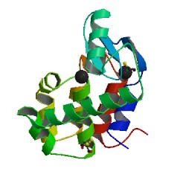
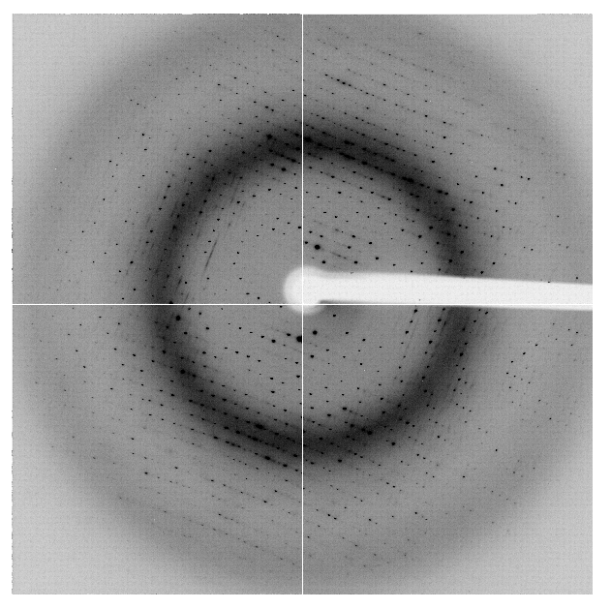
“R-factor Gap” for macromolecules
single-conformer PDB file
R_{merge} = 6%
R_{work} = 7%
R_{free} = 8%
MLFSOM
Elves
1H87; conf “A”
Holton et al. (2014) "The R-factor gap", FEBS J. 281, 4046-4060.

Slide 4
“R-factor Gap” for macromolecules
multi-conformer PDB file
R_{merge} = 6%
R_{work} = 17%
R_{free} = 20%
MLFSOM
Elves
1H87
Holton et al. (2014) "The R-factor gap", FEBS J. 281, 4046-4060.

Slide 5
“R-factor Gap” for macromolecules
multi-conformer PDB file
R_{merge} = 6%
R_{work} = 7%
R_{free} = 8%
MLFSOM
Elves
1H87
Holton et al. (2014) "The R-factor gap", FEBS J. 281, 4046-4060.

Slide 6
Acknowledgements
David Case David Cerruti
Robert Stroud James Fraser Scott Classen John Tainer
Chris Nielsen Clemens Schulze-Briese Aina Cohen Ana Gonzalez
UCSF LBNL SLAC
ALS 8.3.1: TomAlberTron
UC Multicampus Research Programs and Initiatives (MRPI)
NIH NIGMS R01 GM124149
NIH NIGMS P30 GM124169
Integrated Diffraction Analysis Technologies (IDAT)
Plexxikon, Inc.
Synchrotron Radiation Structural Biology Resource (SLAC)
The Advanced Light Source is supported by the Director, Office of Science, Office of Basic Energy Sciences, Materials Sciences Division, of the US Department of Energy under contract No. DE-AC02-05CH11231 at Lawrence Berkeley National Laboratory.

Slide 7
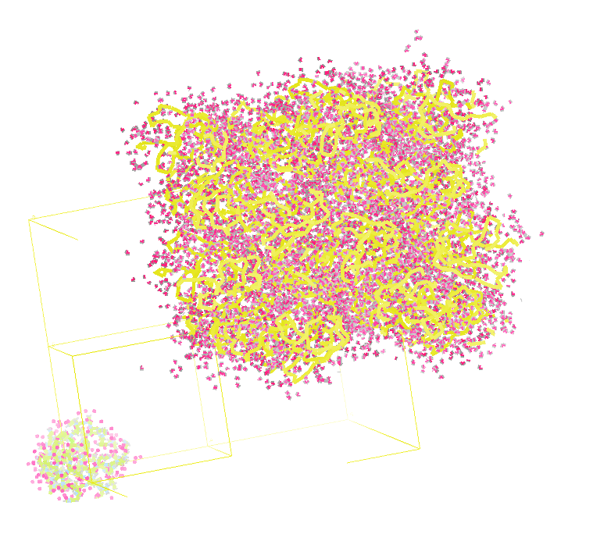
Molecular Dynamics Simulation
using real
crystal’s lattice
1aho
Scorpion toxin
0.96 Å resolution
64 residues
Solvent: H₂0 + acetate
Cerutti et al. (2010).J. Phys. Chem. B 114, 12811-12824.

Slide 8
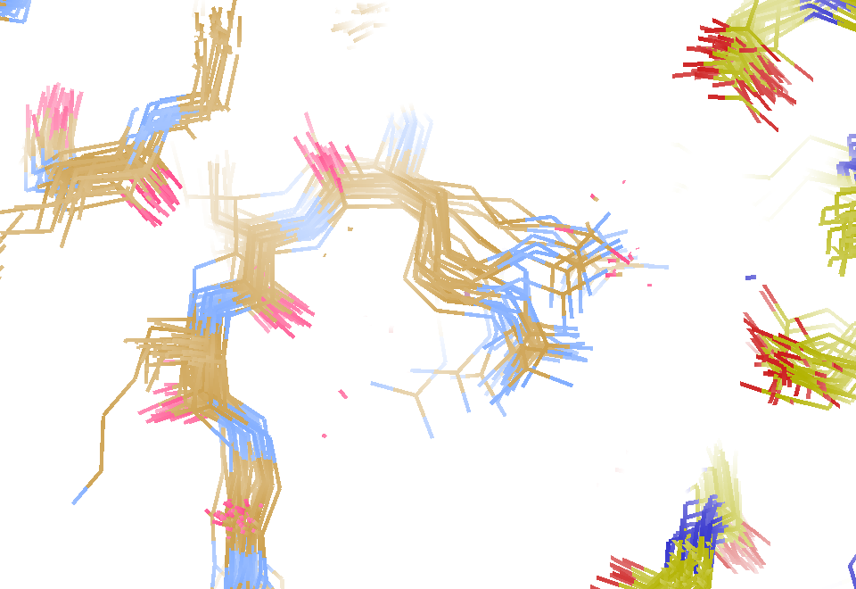
MD simulation: 30 conformers from 24,000
Cerutti et al. (2010).J. Phys. Chem. B 114, 12811-12824.

Slide 9
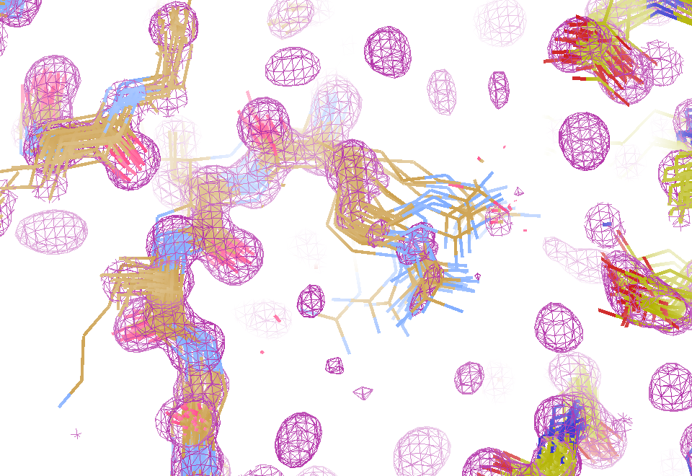
Electron density from 24,000 conformers

Slide 10
MLFSOM simulation
Holton, Classen, Frankel & Tainer (2014) "R-factor gap" FEBS 281 4046-60

Slide 11
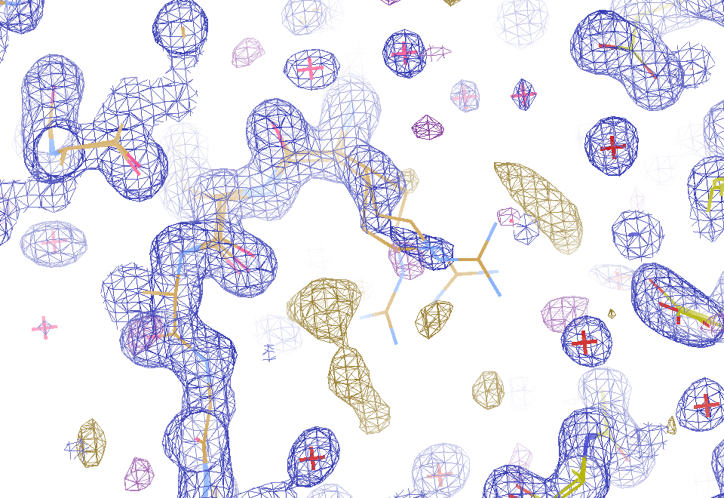
2F_{sim}-F_{calc} and F_{sim}-F_{calc} maps
1.0 Å data
R_{work}= 0.137
R_{free} = 0.159
1 “sigma” 2F_{sim}-F_{c}
2.5 “sigma” F_{sim}-F_{c}

Slide 12
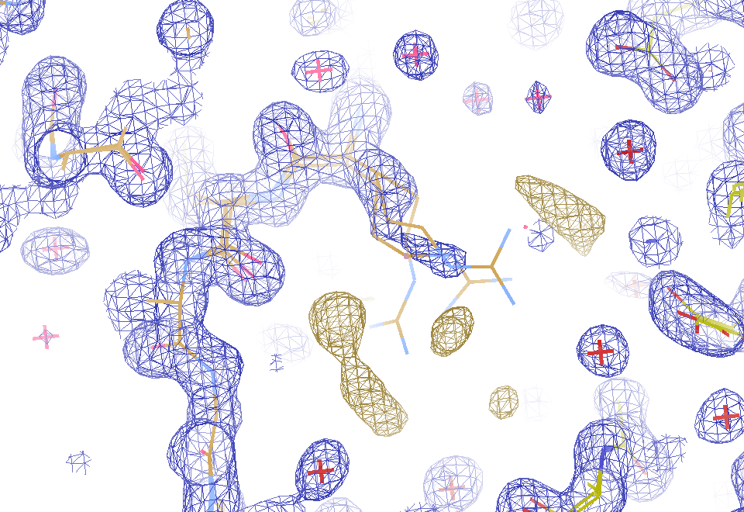
2F_{sim}-F_{calc} and “true difference” maps
1.0 Å data
R_{work}= 0.137
R_{free} = 0.159
1 “sigma” 2F_{sim}-F_{c}
F_{right} – (2F_{sim}-F_{c})

Slide 13
30 conformers from 24,000

Slide 14
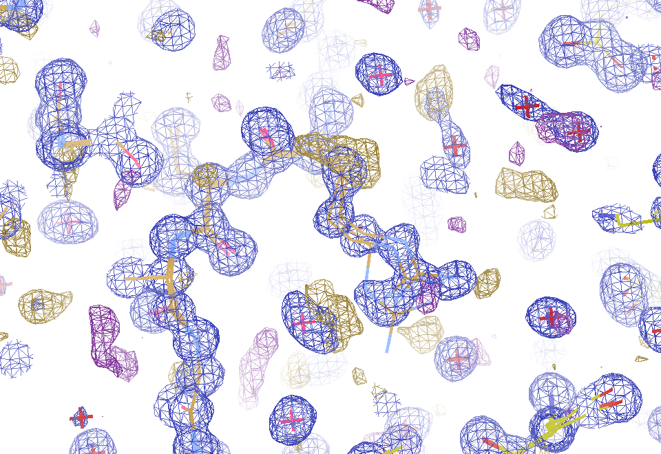
Conventional model vs X-ray data
1.0 Å data
R_{work} = 0.116
R_{free} = 0.135
1 “sigma” 2F_{obs}-F_{c}
2.5 “sigma” F_{obs}-F_{c}

Slide 15
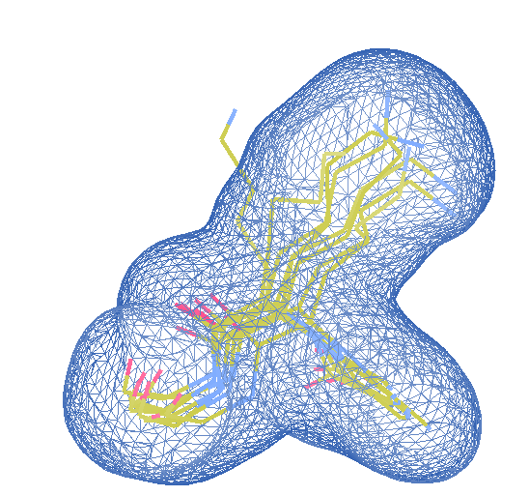
Cheating! Use MD as a guide
e⁻ density from all 24000 copies
only side chain in cell
Rotamers from MD
Perfect phases
SA refine
Occ ref
Discard zero occ
R < 2%

Slide 16
“de-conform” protocol
Discard one conformer
SA refine
Repeat for all confs
Pick least important
Remove it
goto 1
Stop when R > 3%

Slide 17
“deconform” to parsimonious model
R factor (%)
Number of conformers

Slide 18
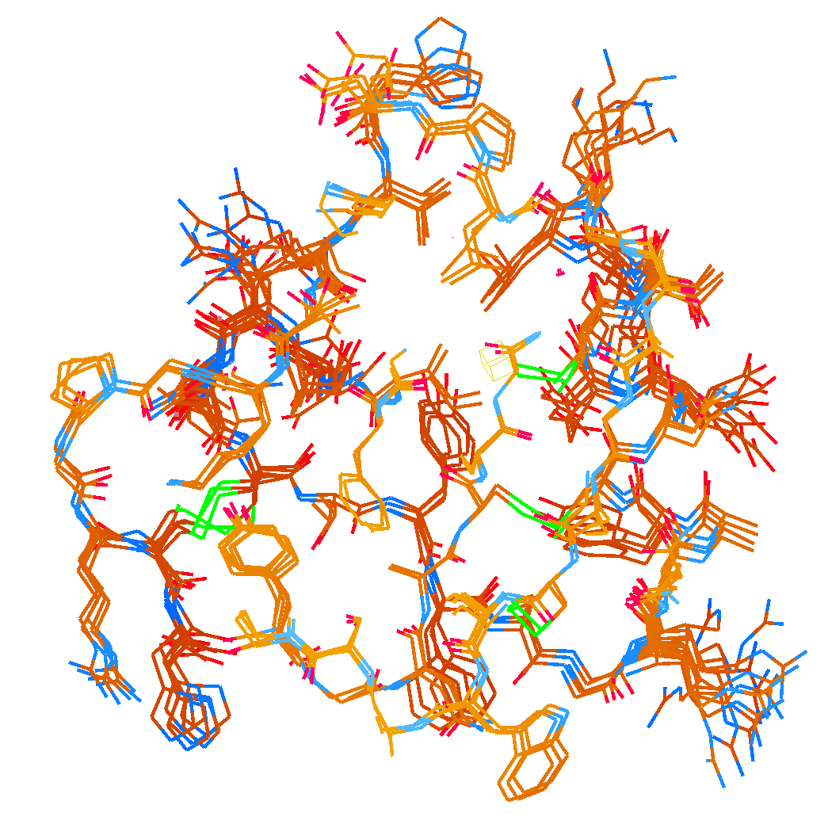
How many conformers are needed?
Answer: 2-14
R_{work} = 0.0441
R_{free} = 0.0516
vs F_{sim}
MD-derived fake data
protein only

Slide 19
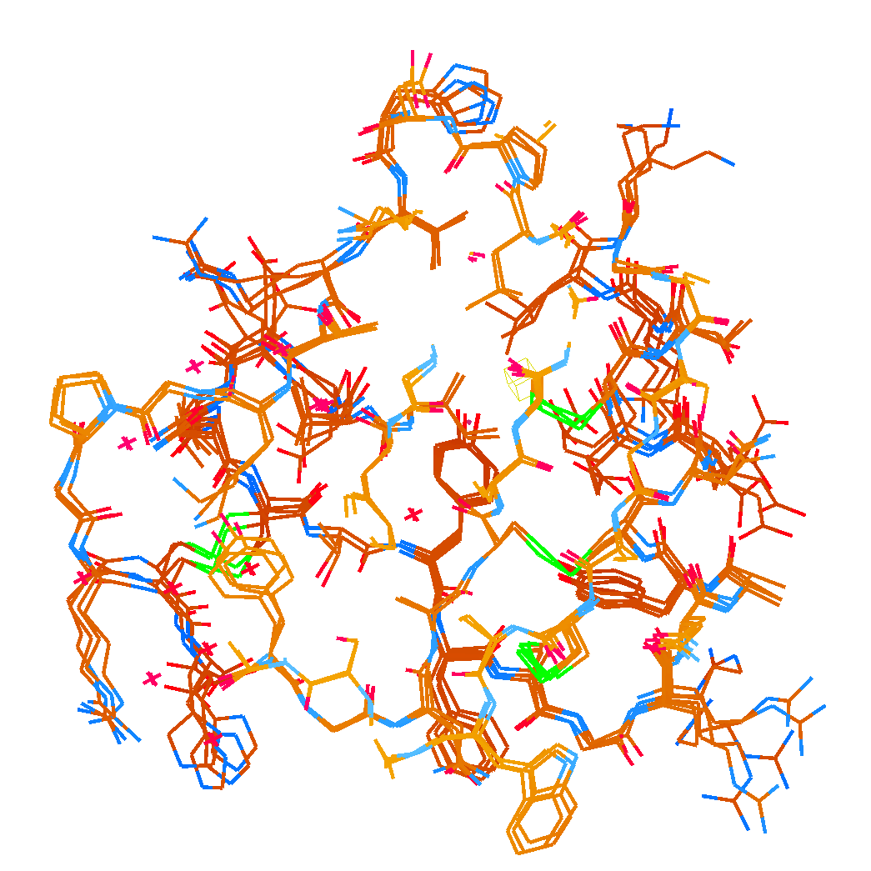
How many conformers are needed?
Answer: 1-7
R_{work} = 0.135
R_{free} = 0.158
vs F_{obs}
Observed x-ray data
1aho:
R_{work} = 0.1475
R_{free} = 0.1685

Slide 20
Adding noise

Slide 21
Adding noise
1² + 1² = 1.4²

Slide 22
Adding noise
1² + 1² = 1.4²
3² + 1² = 3.2²
σ_{total}² = σ₁² + σ₂²

Slide 23
Adding noise
12%² + 12%² = 17%²
R_{protein} + R_{solvent} ≈ R_{work}

Slide 24
Adding noise
4%² + 12%² = 12.6%²
R_{protein} + R_{solvent} ≈ R_{work}

Slide 25
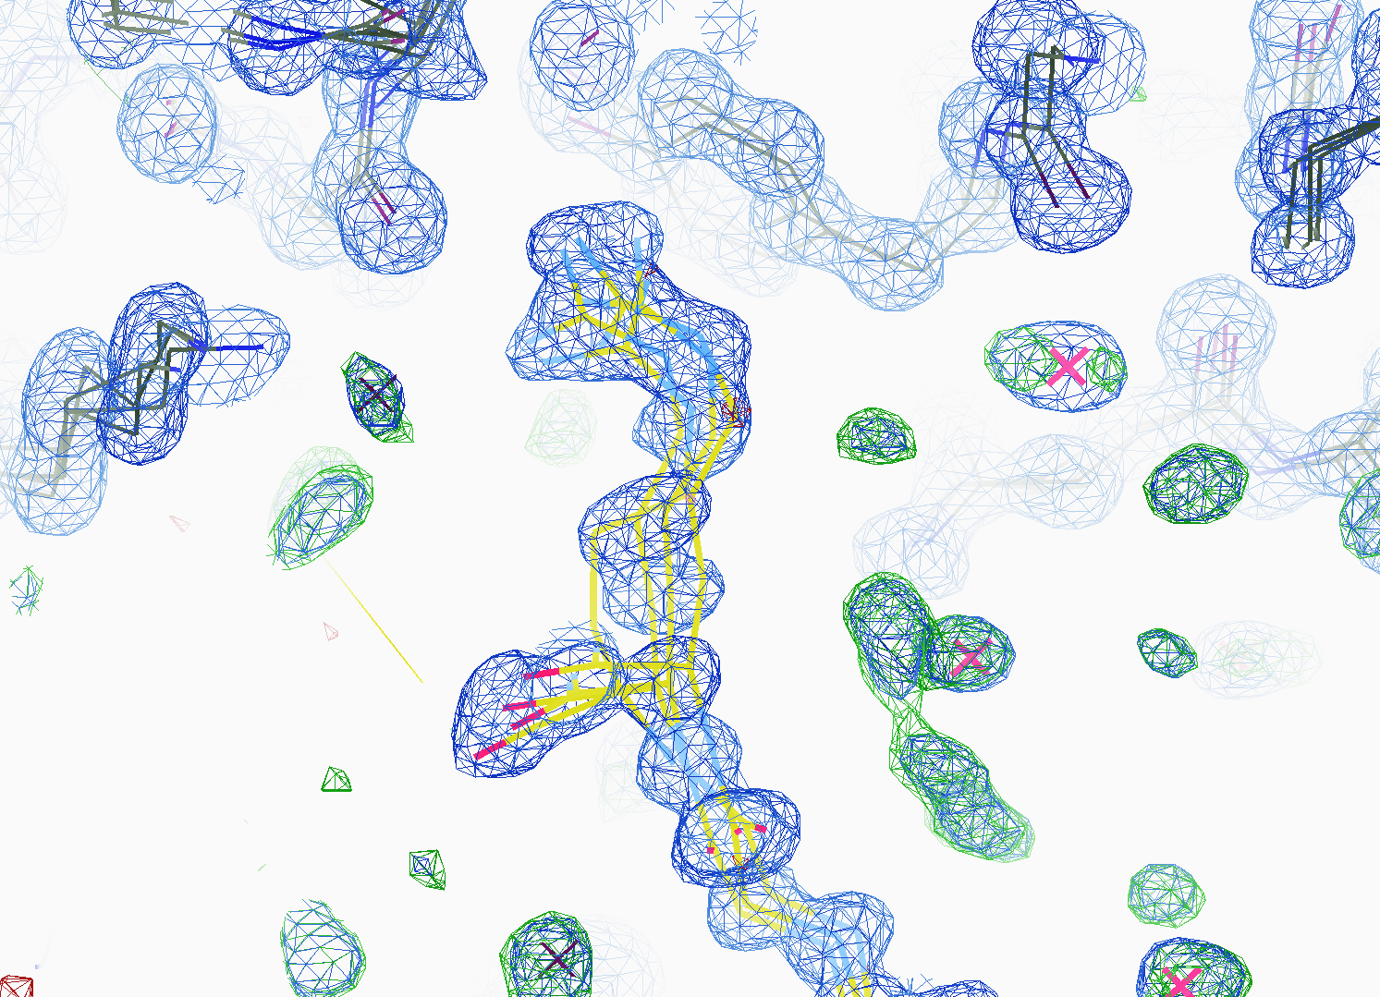
How many conformers are there?
All difference
features
are in
the solvent!
real data

Slide 26
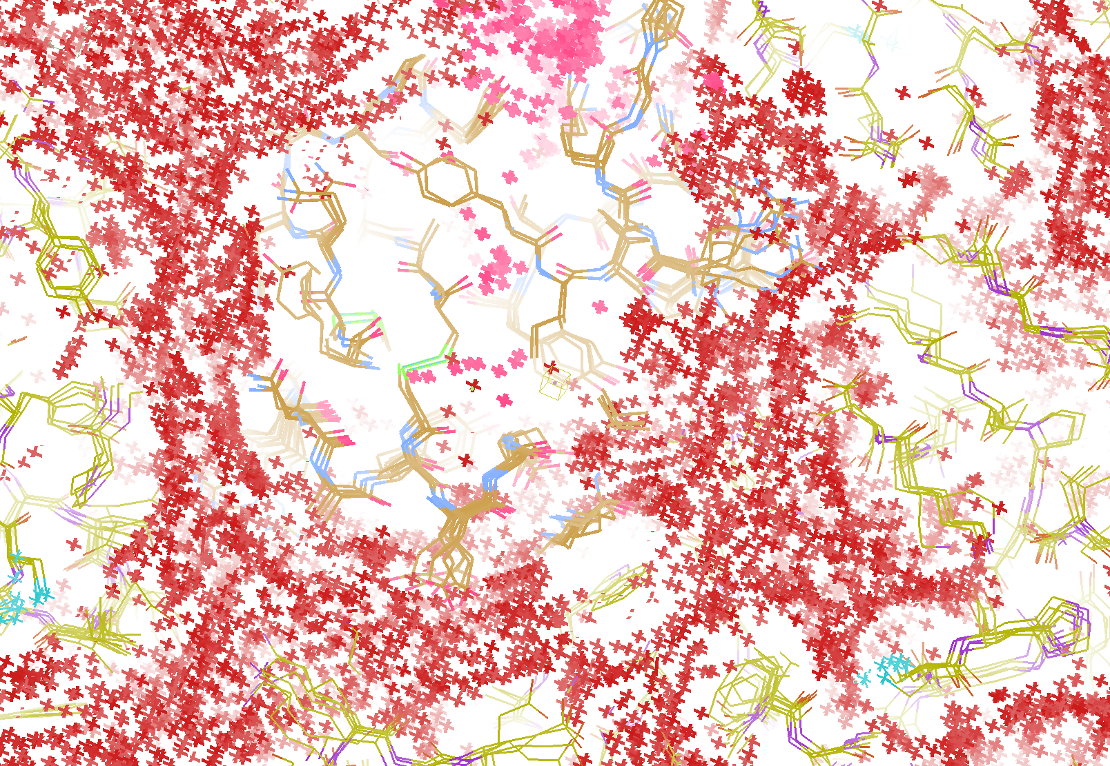
How do you model solvent?
R_{work} = 0.0309
R_{free} = 0.0678
vs F_{sim}
Problem: diverges with more cycles

Slide 27
“hydrogen cloud” solvent: unstable
R factor (%)
Phenix macro-cycle

Slide 28
Summary
If we got model “right”, it would blow up
Maps are telling us what to do
“de-conform” → parsimonious
Solvent is half the battle!
http://bl831.als.lbl.gov/~jamesh/powerpoint/ACA_RFG_2018.pptx

Slide 29
Closing the R-factor Gap
Explain data to within error bars
extract & validate dynamics
Ligand bound or not?
error bar → p value
Single-electron changes
20% * 6 e⁻ = 1.2
Make reviewers shut up
statistics = end of story

Slide 30
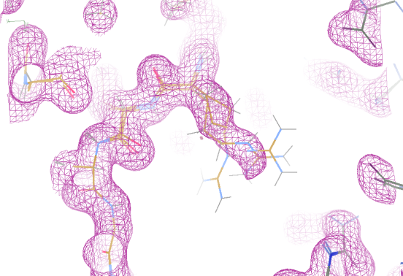
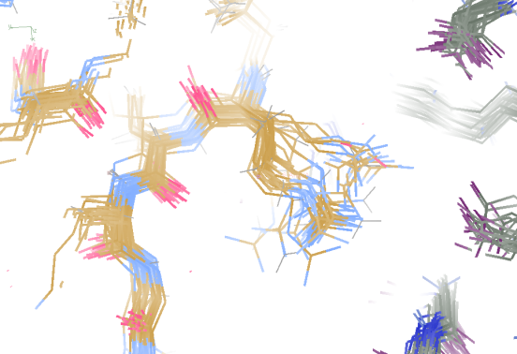
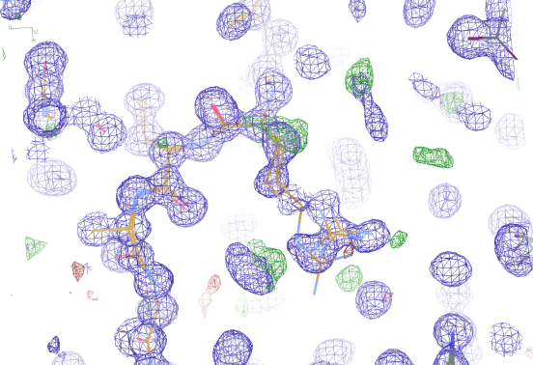
Molecular Dynamics vs Observation
1aho 64-residue scorpion toxin in water to 1.0 Å resolution
refined_vs_Fsim.pdb
1aho.cif
1aho.pdb
F_{calc}
F_{sim}
F_{obs}
F_{calc}
R_{vault} = 0.69
R_{work}= 0.137
R_{iso} =
R_{work}= 0.116
R_{vault} = 0.48 to 4 Å
rmsd = 1.05 Å
LSQ rmsd = 0.43Å

Slide 31
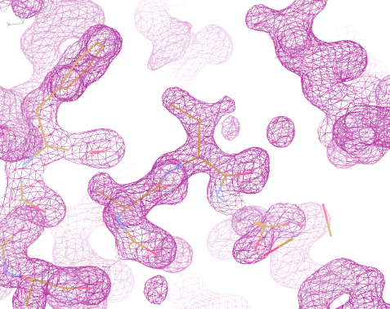
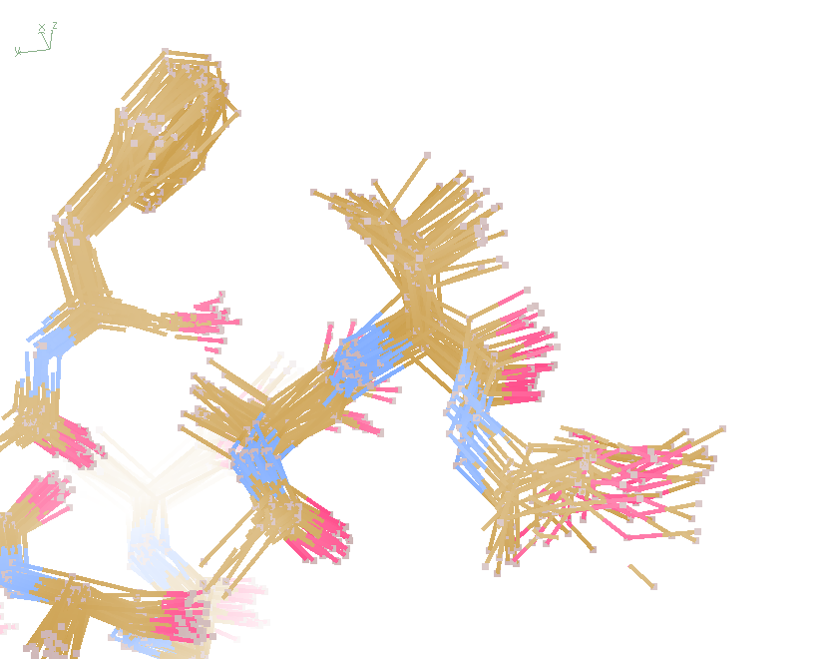
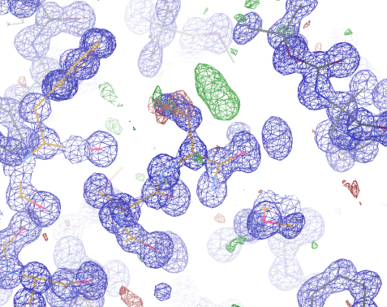
Molecular Dynamics vs Observation
“fav8” 8-residue aromatic peptide with 4 waters to 1.0 Å resolution
refined_vs_Fsim.pdb
fav8.fcf
fav8.cif
F_{calc}
F_{sim}
F_{obs}
F_{calc}
R_{work}= 0.13
R_{vault}= 0.23
R_{work}= 0.16
R_{vault} = 0.20 to 2Å
R1 = 0.041
With 4σ cutoff!
rmsd = 0.20 Å
LSQ rmsd = 0.091Å & 0.15 Å

Slide 32
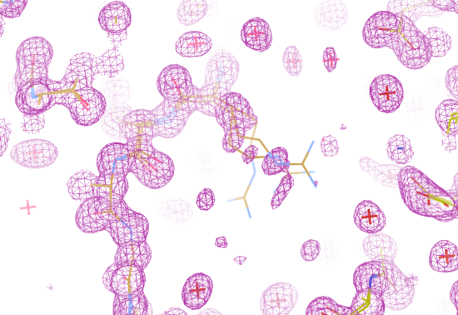
Molecular Dynamics vs X-rays
1aho 64-residue scorpion toxin in water to 1.0 Å resolution
refined_vs_Fsim.pdb
1aho.cif
1aho.pdb
F_{calc}
F_{sim}
F_{obs}
F_{calc}
R_{free} = 0.69
R_{work} = 0.137
R_{free} =
R_{work} = 0.116
R_{free} = 0.48 to 4 Å
rmsd = 1.05 Å
LSQ rmsd = 0.43Å

Slide 33
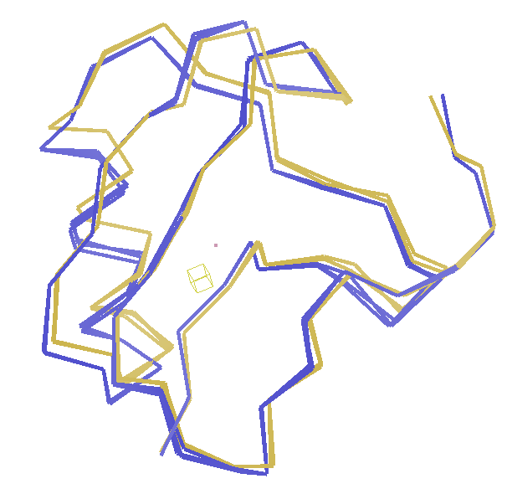
Molecular Dynamics vs X-rays
RMSD
1.05 Å

Slide 34
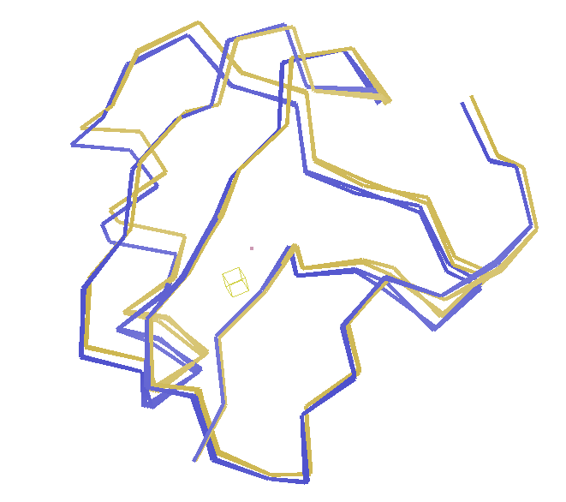
Molecular Dynamics vs X-rays
RMSD
0.45 Å
aligned

Slide 35
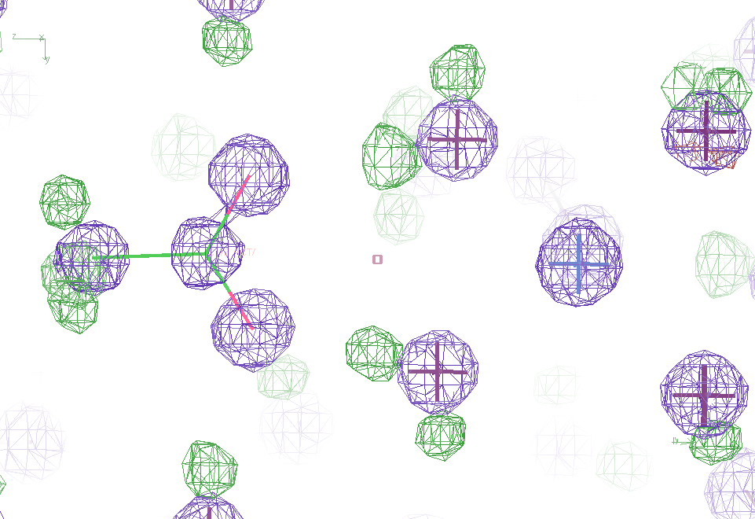
Molecular Dynamics vs X-rays
Sodium acetate trihydrate
5 atoms
3 waters
0.9 Å resolution
C2/c
R_{vault} = 0.03

Slide 36
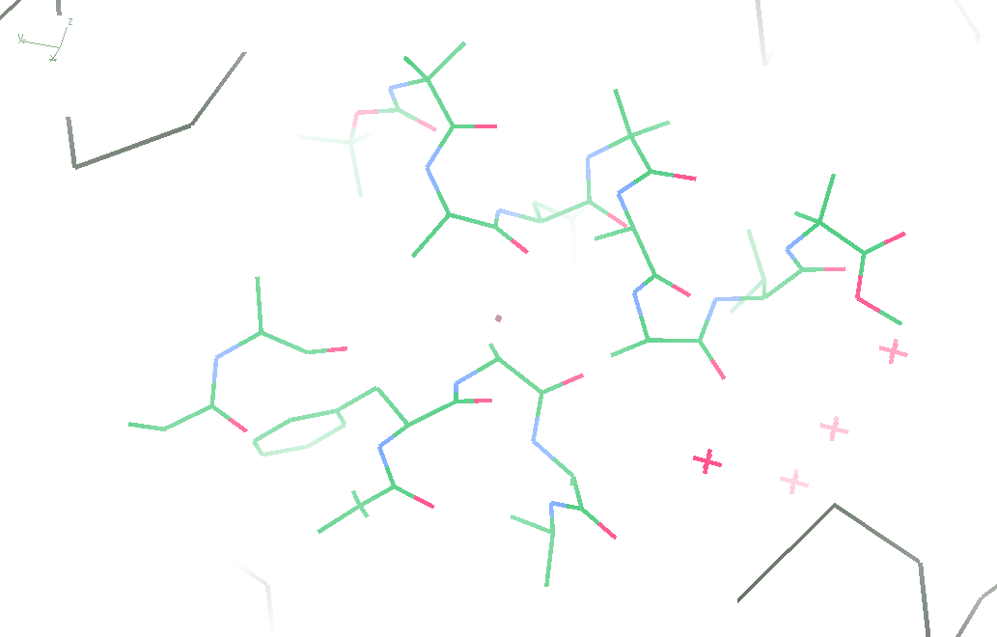
Molecular Dynamics vs X-rays
fav8
8 residues
4 waters
1.0 Å resolution
P1

Slide 37
Molecular Dynamics vs X-rays
“fav8” 8-residue aromatic peptide with 4 waters to 1.0 Å resolution
refined_vs_Fsim.pdb
fav8.fcf
fav8.cif
F_{calc}
F_{sim}
F_{obs}
F_{calc}
R_{work} = 0.13
R_{free}= 0.23
R_{work} = 0.16
R_{free} = 0.20 to 2Å
R1 = 0.041
With 4σ cutoff!
rmsd = 0.20 Å
LSQ rmsd = 0.091Å & 0.15 Å

