Slide 1
Where do the
X-rays come from?

Slide 2
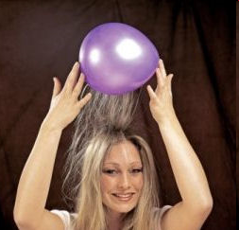
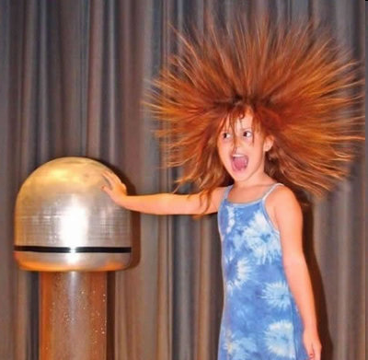
Electric charge
balloon
-
-
-
-
-
-
Wool Sweater
+ + + + + +

Slide 3
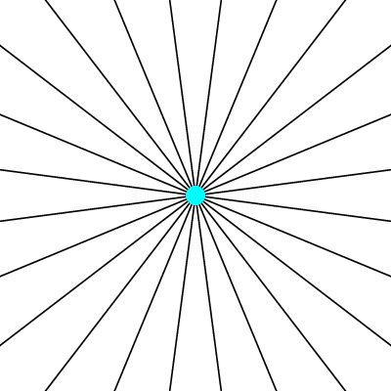
Electric field of a moving charge

Slide 4
Electric field of a moving charge
accelerating charges
make
electromagnetic waves
(light)

Slide 5
Bending Magnet
S
electron beam
X-rays !
N

Slide 6
Two Bending Magnets
S
N
electron beam
N
S
2x X-rays !

Slide 7
Wiggler
8x X-rays !
S
N
S
N
S
N
S
N
N
S
N
S
N
S
N
S

Slide 8
Undulator
> 8x X-rays !
S
N
S
N
S
N
S
N
N
S
N
S
N
S
N
S

Slide 9
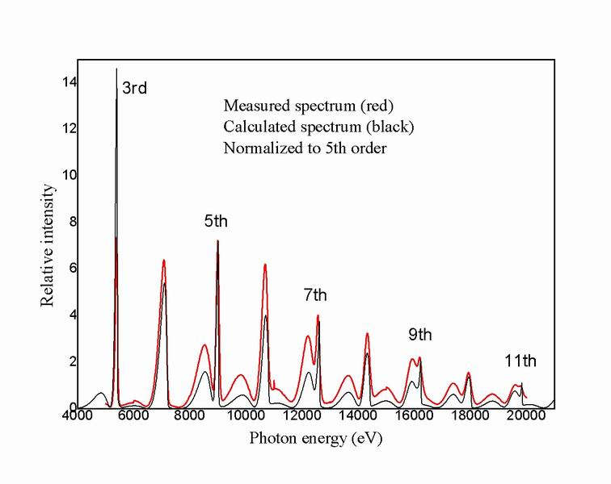
Undulator emission spectrum

Slide 10
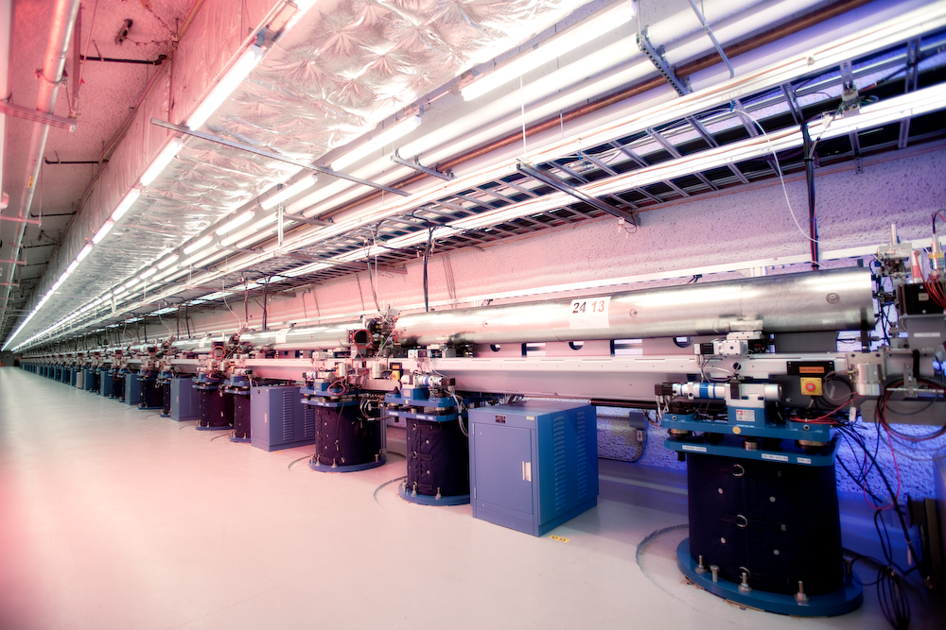
LCLS undulator hall

Slide 11
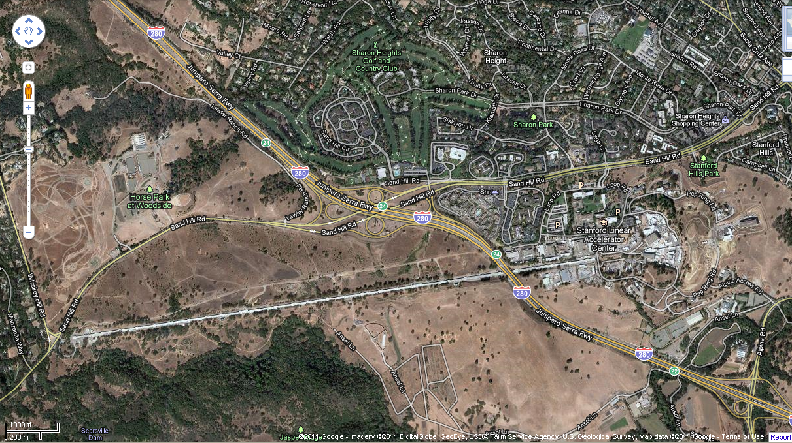
LCLS at SLAC

Slide 12
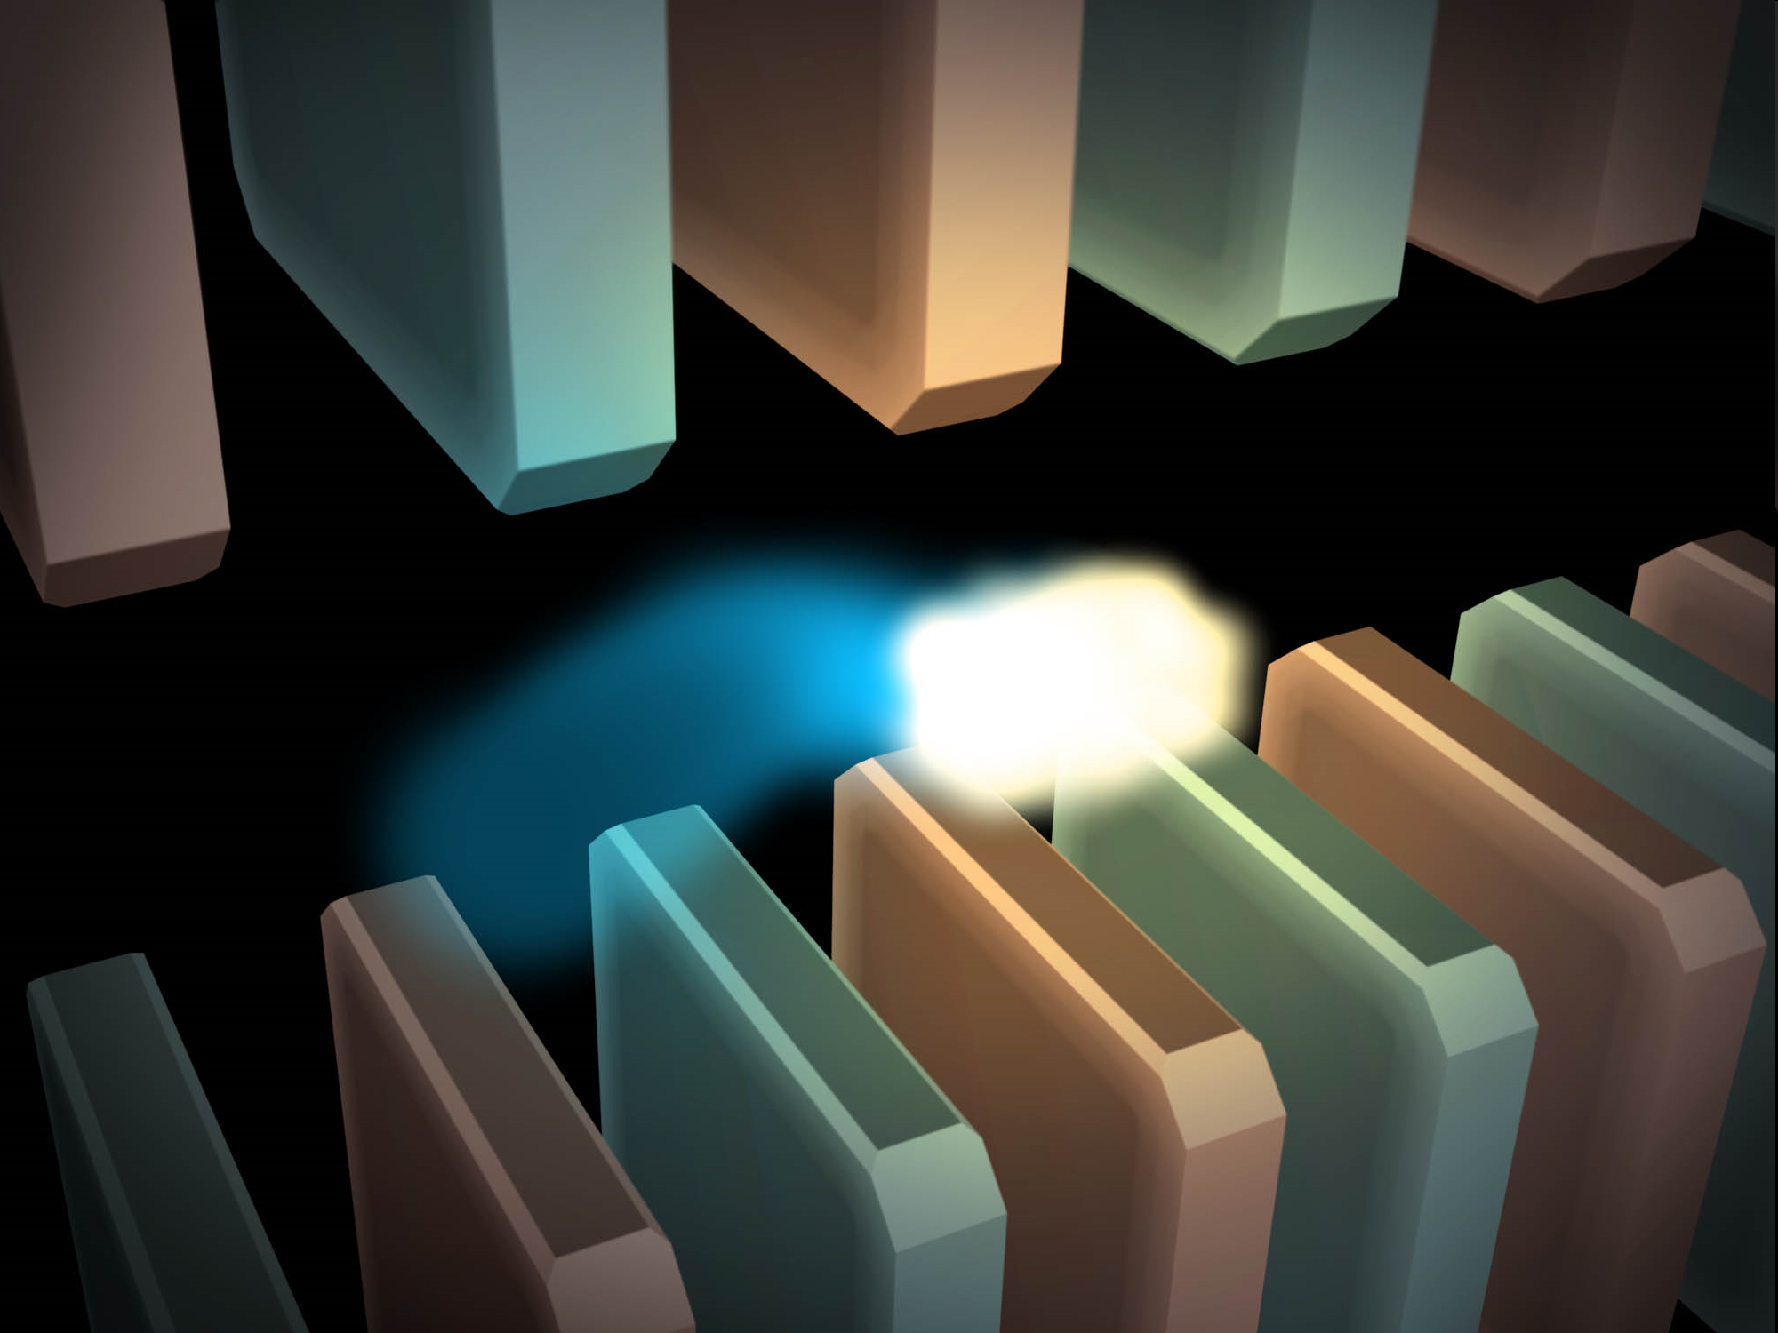
Electric field of a moving charge

Slide 13
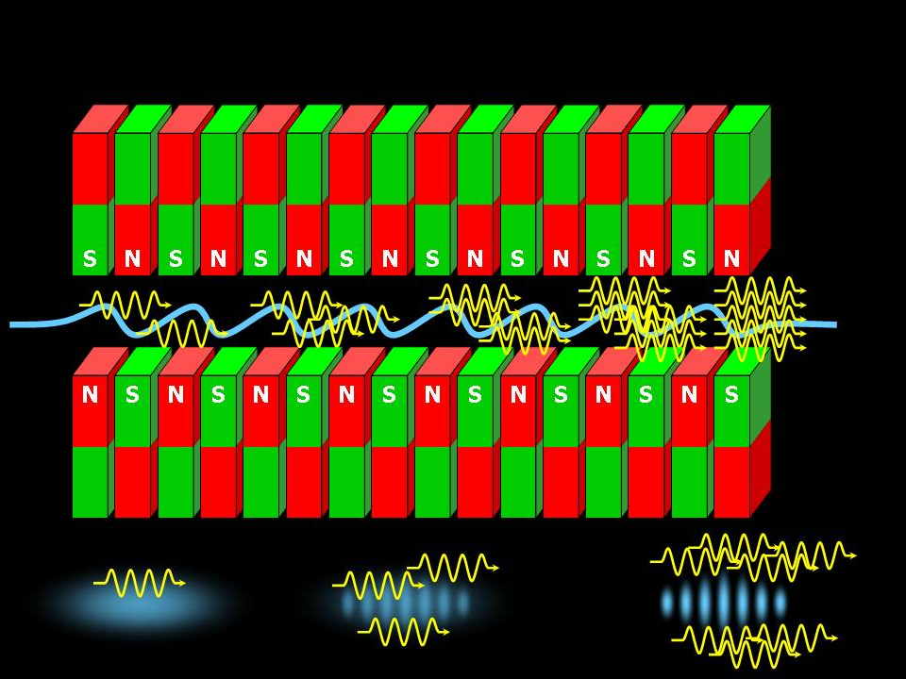
SASE effect

Slide 14
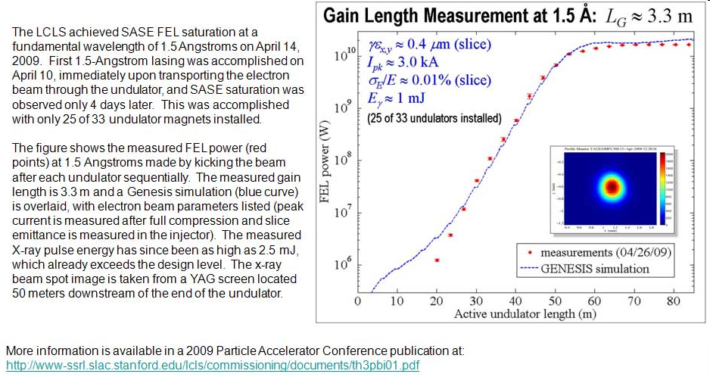
Self-Amplified Stimulated Emission (SASE) effect

Slide 15
Accelerator-based light source terminology
Code name Translation
First Generation Bending Magnet
Second Generation Wiggler
Third Generation Undulator
Fourth Generation Free electron laser

Slide 16
What does all that stuff in the concrete tunnel do?

Slide 17
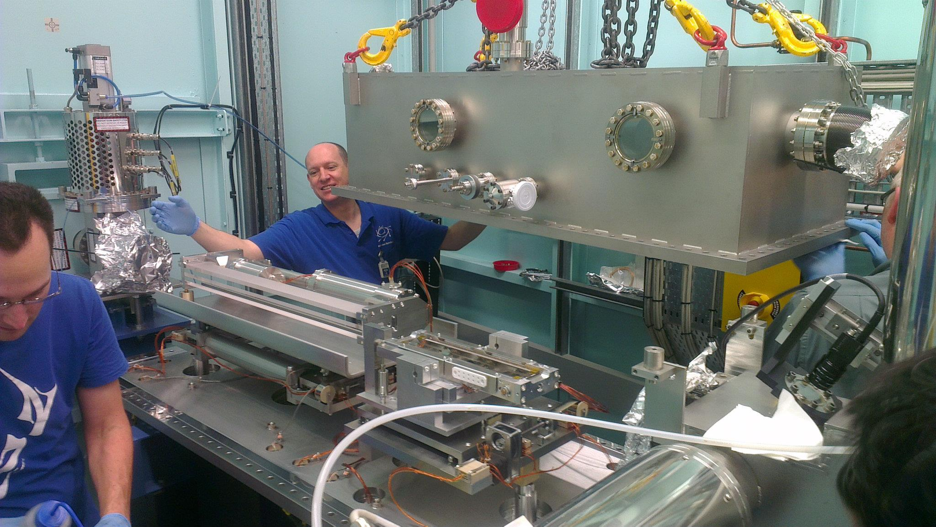
X-ray optics: mirrors
Notes:
Next slide please

Slide 18
Why are the mirrors so long?
Must be < 0.2°
3 mm
1000 mm
Notes:
Next slide please

Slide 19
Monochromators
Si
λ = 1 Å
λ = 1 Å
Si
d = 3.135 Å
DCM = Double Crystal Monochromator
Notes:
Next slide please

Slide 20
Monochromators
nλ = 2d sin(θ)
λ = 1.54 Å
λ = 1.54 Å
Mo/C
d = 24 Å
θ = 1.84°
Multilayer optics
Notes:
Next slide please

Slide 21
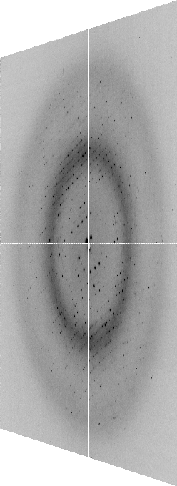

The “beam line”
focused
beam
slits
Scatter
guard
Secondary
mirror
Primary
mirror
Source
Area Detector
Unfocused
beam
slits
Si(111)
monochromator
Sample
Notes:
Most notable acheivements are high brightness with very little “wasted” light. The discovery made by Howard Padmore? At ALS showed that a 2:1 demagnification cancels nearly all of the spherical abberations in the parabolic/torroid system. 30-50% of the total x-ray intensity passes through the 100um pinhole. The flux through the 100um pinhole at the superbend beamlines is comparable to that of the 5.0.2 wiggler or an APS bending magnet, but only 150 Watts of power must be dissipated by the beamline optics. In contrast, wiggler beamlines must disipate kilowatts. The optics here are much simpler and not exotic in any way. The system is stable and robust. There is never a need to re-focus the beam at a new wavelength. Only a 2-minute automatic tuneup is recommended for very large energy changes (more than 1-2 keV).

Slide 22
The truth about x-ray beams
Term units significance
Flux photons/s duration of experiment
Beam Size μm match to crystal
Divergence mrad spot size vs distance
Wavelength Å resolution and absorption
Dispersion Δλ/λ spot size
Flux density ph/s/area scattering/damage rate
Fluence ph/area scattering/damage

Slide 23
The truth about x-ray beams
quantity | units | home source | MX2
flux | Photons/second | 2.5 x 10⁹ | 2 x 10¹²
exposure | seconds | 400 | 1
Dispersion | wavelength range / wavelength | 0.2% (Kα₁ - Kα₂) | 0.014% (Si111)
Divergence | milliRadian | 4.8 | 1.8 (h) 0.18 (v)
Beam size | microns | 100 | 24 (h) 12 (v)
Spectral brightness | Photons/s/mm²/ mR²/0.1%BW | 5.4 x 10⁹ | 1.5 x 10¹⁷

Slide 24
The truth about x-ray beams
quantity | units | home source | MX2
flux | Photons/second | 8 x 10⁴ | 2 x 10¹²
exposure | time | 5 months | 1 second
Dispersion | wavelength range / wavelength | 0.014% (Si111) | 0.014% (Si111)
Divergence | milliRadian | 0.6 | 1.8 (h) 0.18 (v)
Beam size | microns | 17 | 24 (h) 12 (v)
Spectral brightness | Photons/s/mm²/ mR²/0.1%BW | 5.4 x 10⁹ | 1.5 x 10¹⁷

Slide 25
The number of photons scattered
before crystal is dead
is independent
of data collection time
Henderson, 1990; Gonzalez & Nave, 1994; Glaeser et al., 2000; Sliz et al., 2003; Leiros et al., 2006; Owen et al., 2006; Garman & McSweeney, 2006; Garman & Nave, 2009; Holton, 2009

Slide 26
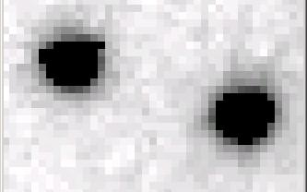
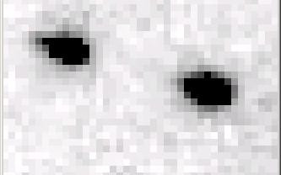
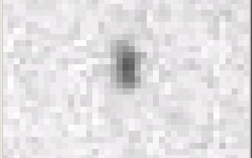
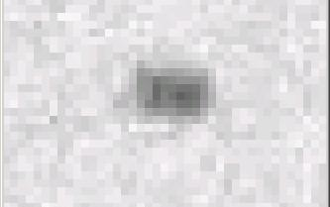
Si(111) vs multilayers
0.014%
Si(111)
spectral
dispersion
1%
multilayer
4 Å
resolution
1.9 Å

Slide 27
spectral dispersion
Ewald sphere
Φ circle
(h,k,l)
λ’*
d*
spindle axis
diffracted ray
λ’*

Slide 28
beam divergence
Ewald sphere
Φ circle
(h,k,l)
d*
λ*
diffracted ray
spindle axis
λ*

Slide 29
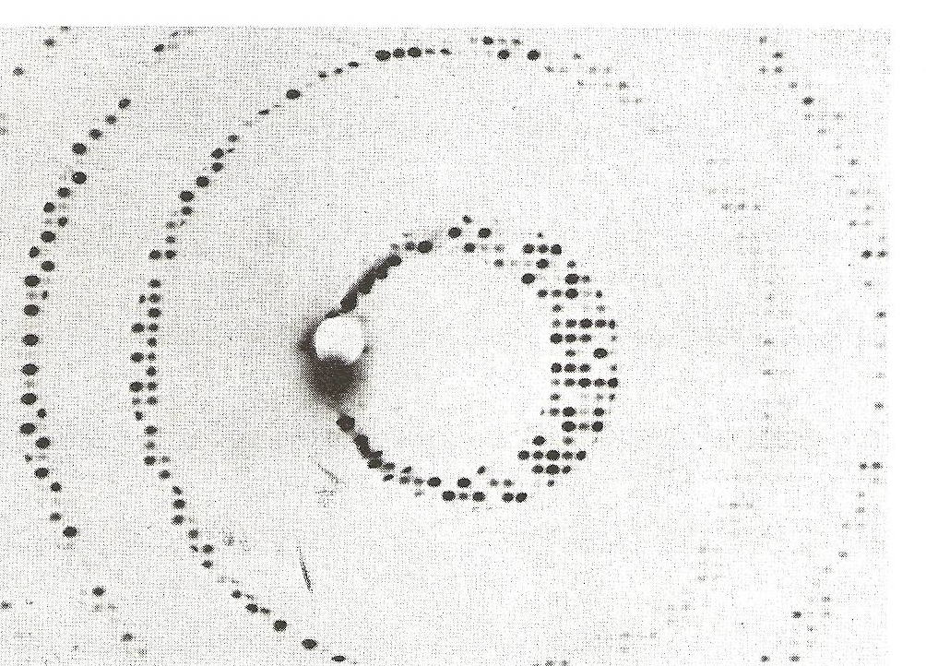
Divergence
Arndt & Wonacott (1977)

Slide 30
Air absorption
transmittance
Distance from sample (mm)

Slide 31
Data quality - simple rules:
  Put your crystal into the beam
  Shoot the whole crystal
  Shoot nothing but the crystal
  Back off!
  The crystal must rotate

Slide 32
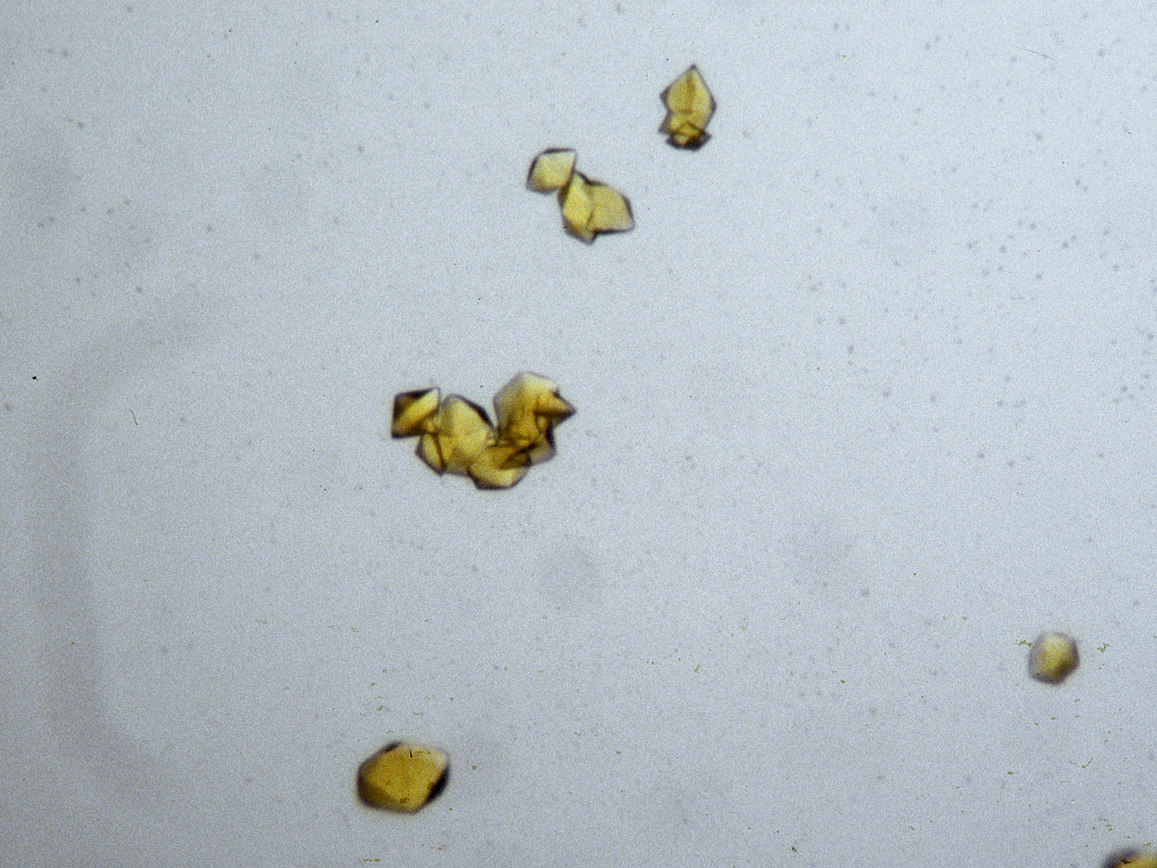
“crystal” = thing you want to shoot
Membrane Protein Expression Center © 2012

Slide 33
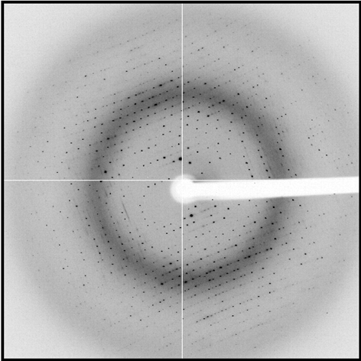
shoot the whole crystal

Slide 34
shoot the whole crystal

Slide 35
shoot the whole crystal

Slide 36

mosaic spread = 12.8º

Slide 37
How many crystals do you see?
Shoot the crystal (singular)

Slide 38
shoot nothing but the crystal

Slide 39
shoot nothing but the crystal

Slide 40
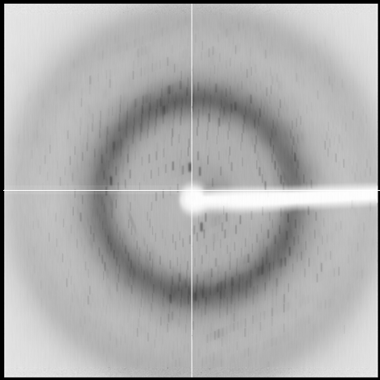
shoot nothing but the crystal

Slide 41
shoot nothing but the crystal

Slide 42
shoot nothing but the crystal

Slide 43
Background scattering

Slide 44
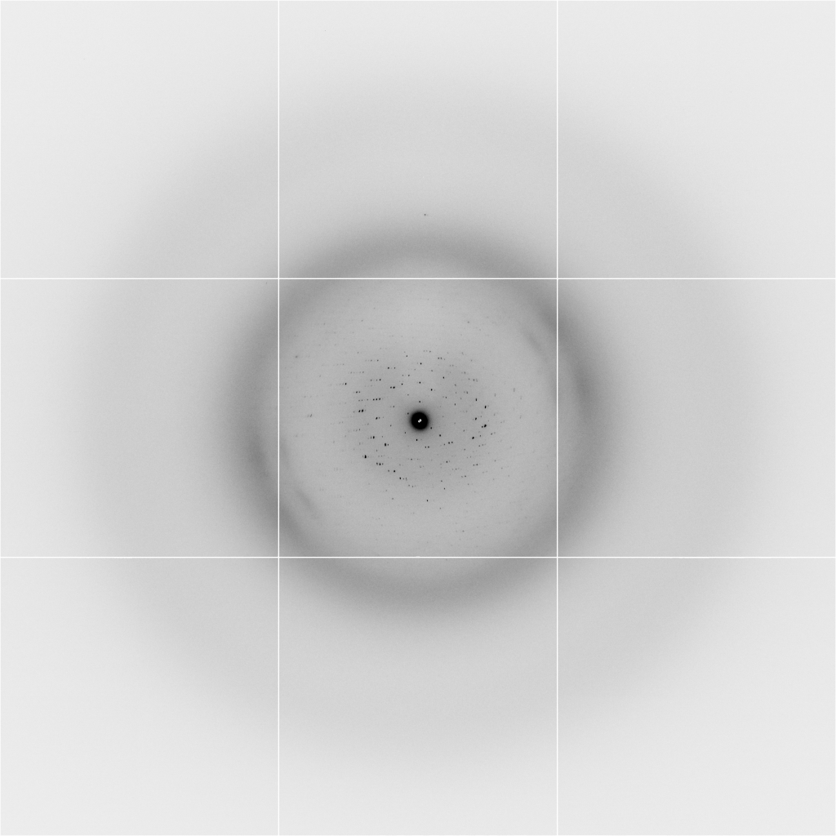
Background scattering
$100,000.00
$100,000.00
$100,000.00
real estate is
expensive
use it!
$100,000.00
$100,000.00
$100,000.00
$100,000.00
$100,000.00

Slide 45
Fine Slicing
background
background
Pflugrath, J. W. (1999)."The finer things in X-ray diffraction data collection", Acta Cryst. D 55, 1718-1725.

Slide 46

Optimal exposure time
(faint spots)
t_{hr} Optimal exposure time for data set (s)
t_{ref} exposure time of reference image (s)
bg_{ref} background level near weak spots on
reference image (ADU)
bg₀ ADC offset of detector (ADU)
bg_{hr} optimal background level (via t_{hr})
σ₀ rms read-out noise (ADU)
gain ADU/photon
m multiplicity of data set (including partials)
adjust exposure
so this is ~100

Slide 47
The crystal rotates!

Slide 48
The crystal rotates!
Membrane Protein Expression Center © 2012

Slide 49
Basic Principles
“Hell, there are NO RULES here - we're trying to accomplish something.”
Thomas A. Edison – inventor
“You’ve got to have an ASSAY.”
Arthur Kornberg – Nobel Laureate
“Control, control, you must learn CONTROL!”
Yoda – Jedi Master

Slide 50
Summary
Shoot the crystal
Do not bend!
Multi-crystal strategies
assay, control and open mind
Membrane Protein Expression Center © 2013

