Slide 1
Where do the
X-rays come from?

Slide 2
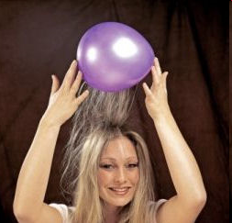
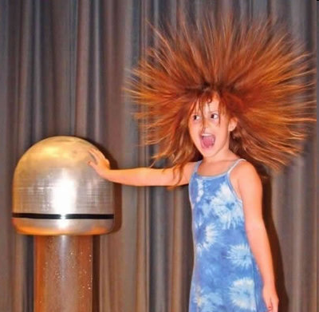
Electric charge
balloon
-
-
-
-
-
-
Wool Sweater
+ + + + + +

Slide 3
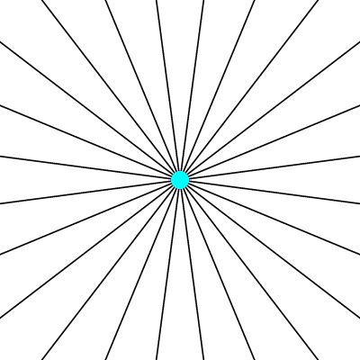
Electric field of a moving charge

Slide 4
Electric field of a moving charge
accelerating charges
make
electromagnetic waves
(light)

Slide 5
Bending Magnet
S
electron beam
X-rays !
N

Slide 6
Two Bending Magnets
S
N
electron beam
N
S
2x X-rays !

Slide 7
Wiggler
8x X-rays !
S
N
S
N
S
N
S
N
N
S
N
S
N
S
N
S

Slide 8
Undulator
> 8x X-rays !
S
N
S
N
S
N
S
N
N
S
N
S
N
S
N
S

Slide 9
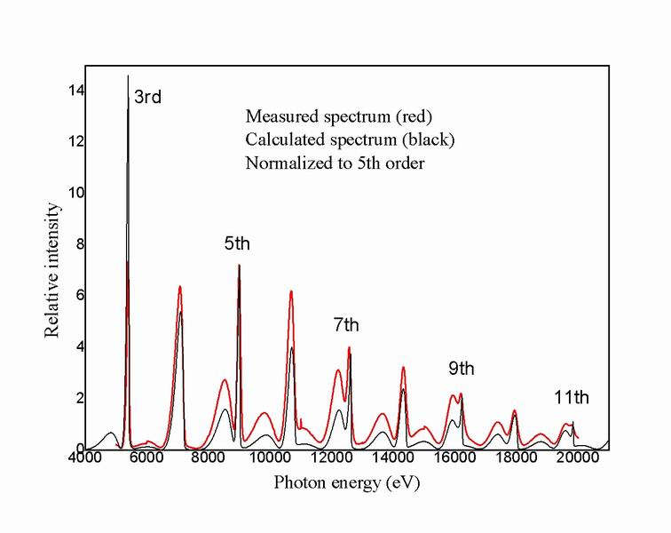
Undulator emission spectrum

Slide 10
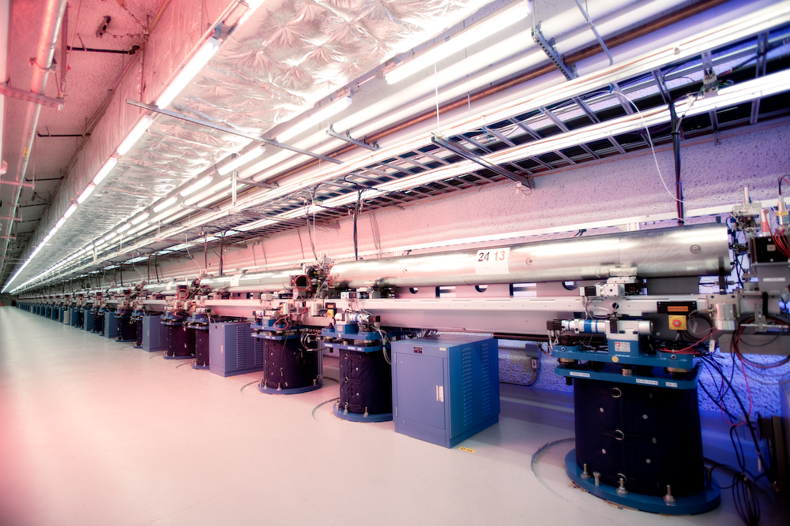
LCLS undulator hall

Slide 11
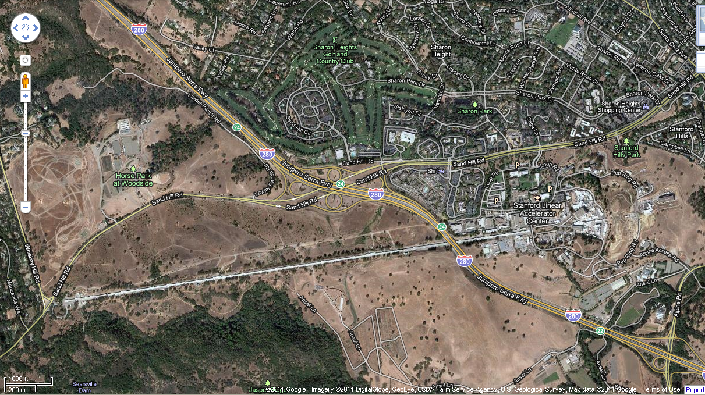
LCLS at SLAC

Slide 12
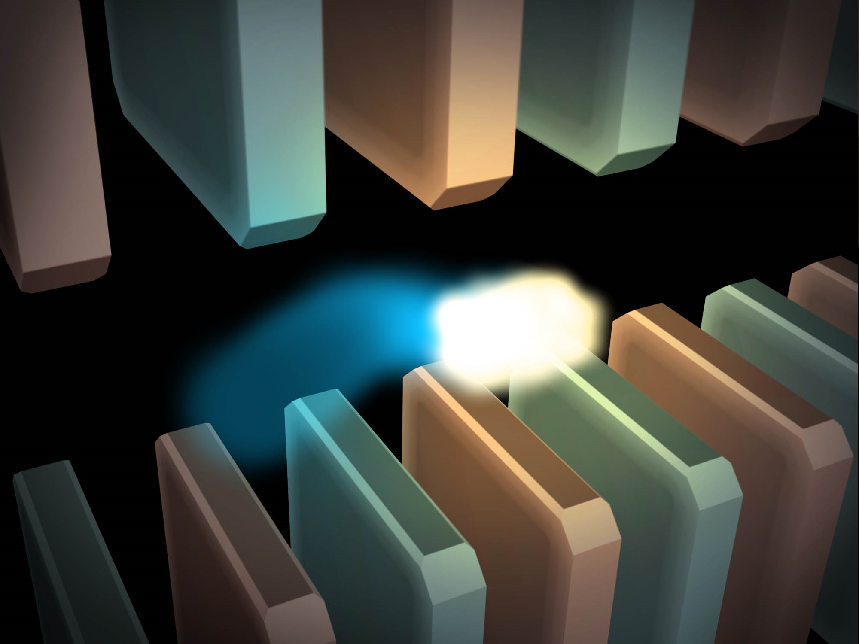
Electric field of a moving charge

Slide 13
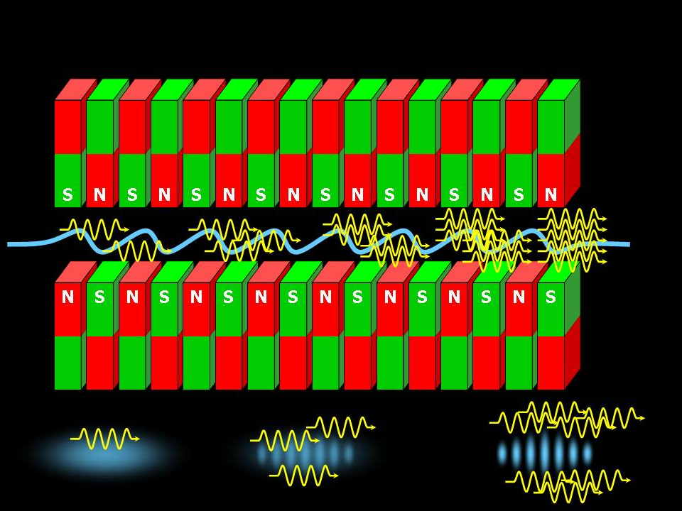
SASE effect

Slide 14
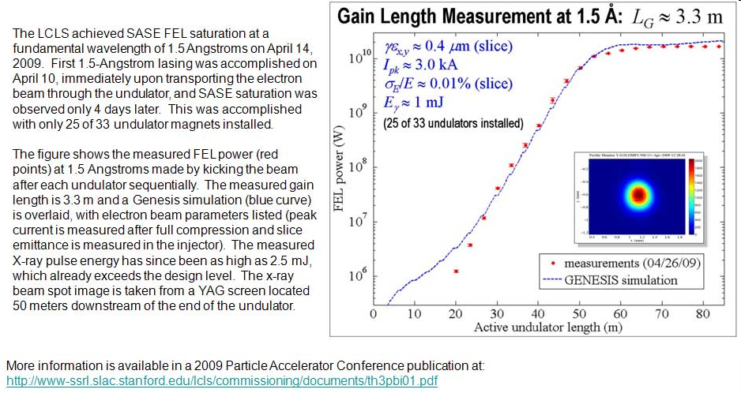
Self-Amplified Stimulated Emission (SASE) effect

Slide 15
Accelerator-based light source terminology
Code name Translation
First Generation Bending Magnet
Second Generation Wiggler
Third Generation Undulator
Fourth Generation Free electron laser

Slide 16
What does all that stuff in the concrete tunnel do?

Slide 17
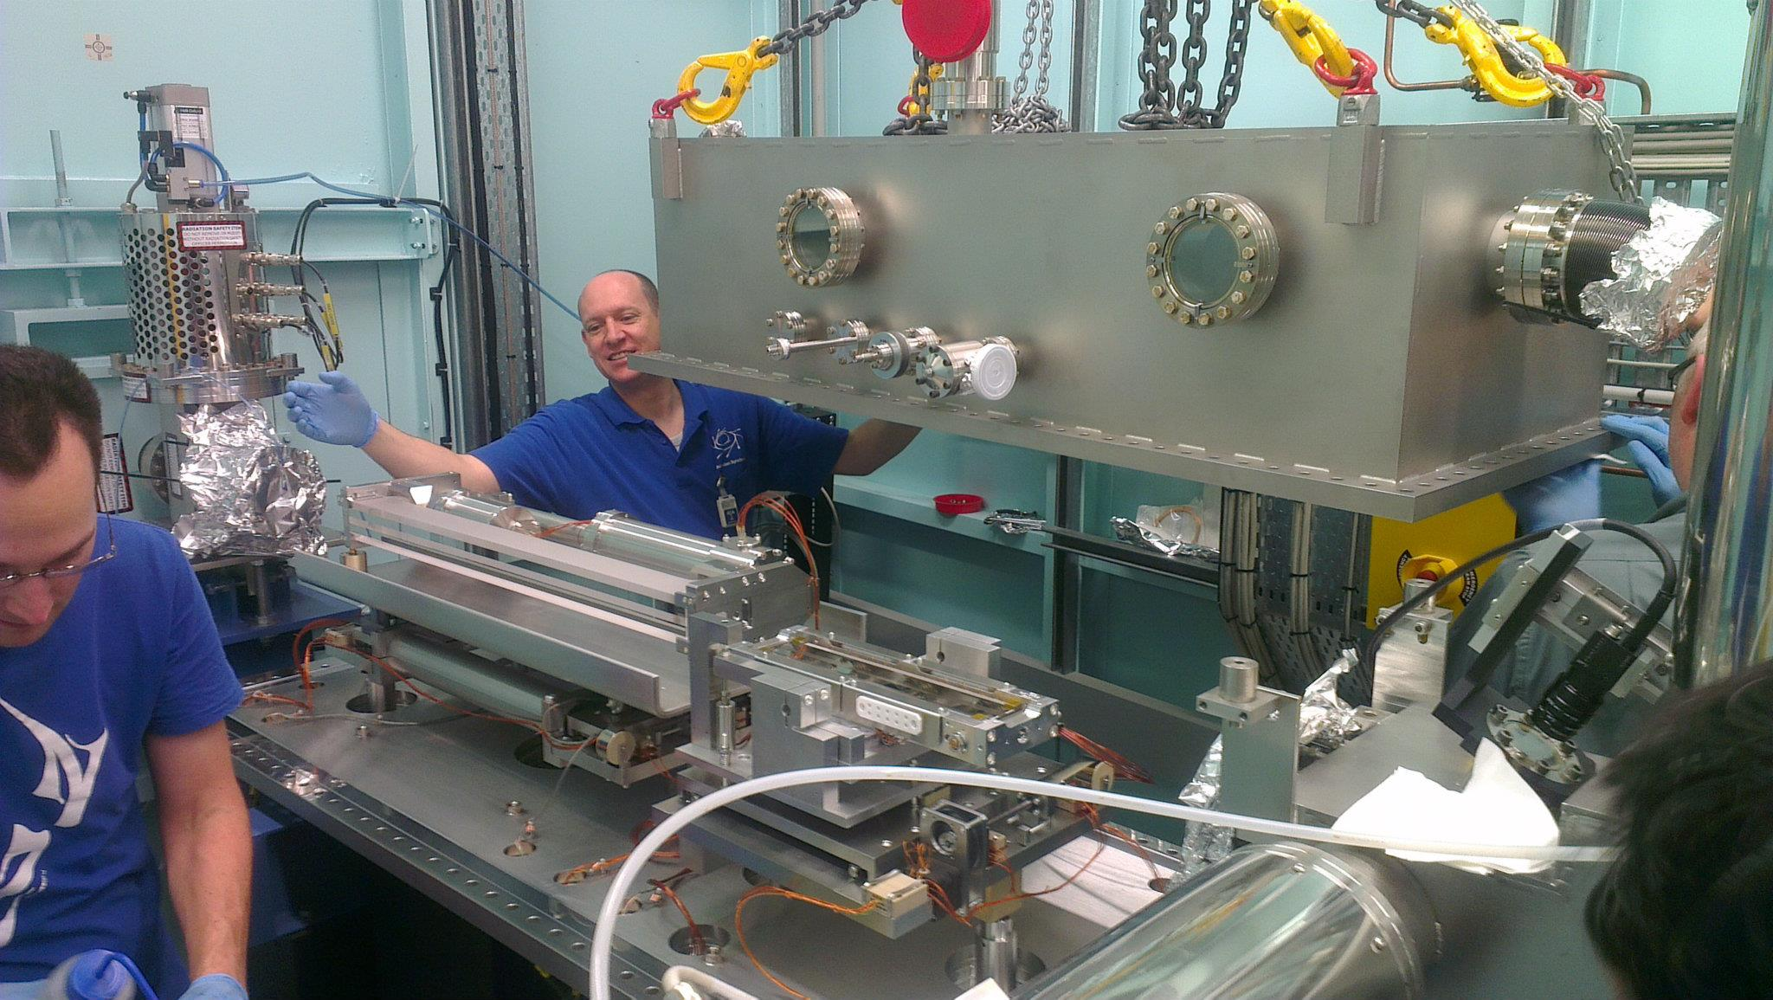
X-ray optics: mirrors
Notes:
Next slide please

Slide 18
Why are the mirrors so long?
Must be < 0.2°
3 mm
1000 mm
Notes:
Next slide please

Slide 19
Monochromators
λ = 1 Å
Si
Notes:
Next slide please

Slide 20
Monochromators
nλ = 2d sin(θ)
λ = 1 Å
λ = 1 Å
Si
d = 3.135 Å
θ = 9.177°
Notes:
Next slide please

Slide 21
Monochromators
nλ = 2d sin(θ)
λ = 1.1 Å
Si
d = 3.135 Å
θ = 9.177°
Notes:
Next slide please

Slide 22
Monochromators
nλ = 2d sin(θ)
λ = 1.1 Å
λ = 1.1 Å
Si
d = 3.135 Å
θ = 10.104°
Notes:
Next slide please

Slide 23
Monochromators
nλ = 2d sin(θ)
λ = 1 Å
λ = 1 Å
Si
d = 3.135 Å
θ = 9.177°
Notes:
Next slide please

Slide 24
Monochromators
Si
λ = 1 Å
λ = 1 Å
Si
d = 3.135 Å
DCM = Double Crystal Monochromator
Notes:
Next slide please

Slide 25
Monochromators
Si
λ = 1.1 Å
λ = 1.1 Å
Si
d = 3.135 Å
DCM = Double Crystal Monochromator
Notes:
Next slide please

Slide 26
Monochromators
nλ = 2d sin(θ)
λ = 1.54 Å
λ = 1.54 Å
Mo/C
d = 24 Å
θ = 1.84°
Multilayer optics
Notes:
Next slide please

Slide 27

The “beam line”
focused
beam
slits
Scatter
guard
Secondary
mirror
Primary
mirror
Source
Area Detector
Unfocused
beam
slits
Si(111)
monochromator
Sample

Slide 28
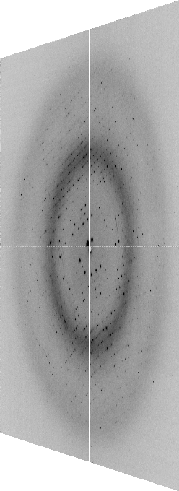
The “beam line”
focused
beam
slits
Scatter
guard
Secondary
mirror
Primary
mirror
Source
Area Detector
Unfocused
beam
slits
Si(111)
monochromator
Sample
Notes:
Most notable acheivements are high brightness with very little “wasted” light. The discovery made by Howard Padmore? At ALS showed that a 2:1 demagnification cancels nearly all of the spherical abberations in the parabolic/torroid system. 30-50% of the total x-ray intensity passes through the 100um pinhole. The flux through the 100um pinhole at the superbend beamlines is comparable to that of the 5.0.2 wiggler or an APS bending magnet, but only 150 Watts of power must be dissipated by the beamline optics. In contrast, wiggler beamlines must disipate kilowatts. The optics here are much simpler and not exotic in any way. The system is stable and robust. There is never a need to re-focus the beam at a new wavelength. Only a 2-minute automatic tuneup is recommended for very large energy changes (more than 1-2 keV).

Slide 29
X-ray optics
MacDowell et. al. (2004) J. Sync. Rad. 11 447-455
pinhole
Scatter
guard
X-ray
Source
Area Detector
Protein Crystal
Notes:
Most notable acheivements are high brightness with very little “wasted” light. The discovery made by Howard Padmore? At ALS showed that a 2:1 demagnification cancels nearly all of the spherical abberations in the parabolic/torroid system. 30-50% of the total x-ray intensity passes through the 100um pinhole. The flux through the 100um pinhole at the superbend beamlines is comparable to that of the 5.0.2 wiggler or an APS bending magnet, but only 150 Watts of power must be dissipated by the beamline optics. In contrast, wiggler beamlines must disipate kilowatts. The optics here are much simpler and not exotic in any way. The system is stable and robust. There is never a need to re-focus the beam at a new wavelength. Only a 2-minute automatic tuneup is recommended for very large energy changes (more than 1-2 keV).

Slide 30
The truth about x-ray beams
Term units significance
Flux photons/s duration of experiment
Beam Size μm match to crystal
Divergence mrad spot size vs distance
Wavelength Å resolution and absorption
Dispersion Δλ/λ spot size
Flux density ph/s/area scattering/damage rate
Fluence ph/area scattering/damage

Slide 31
The truth about x-ray beams
Term units significance
Flux photons/s duration of experiment
Beam Size μm match to crystal
Divergence mrad spot size vs distance
Wavelength Å resolution and absorption
Dispersion Δλ/λ spot size
Flux density ph/s/area scattering/damage rate
Fluence ph/area scattering/damage

Slide 32
The truth about x-ray beams
quantity | units | home source | MX2
flux | Photons/second | 2.5 x 10⁹ | 2 x 10¹²
exposure | seconds | 400 | 1

Slide 33
The truth about x-ray beams
quantity | units | home source | MX2
flux | Photons/second | 2.5 x 10⁹ | 2 x 10¹²
exposure | seconds | 400 | 1
Dispersion | wavelength range / wavelength | 0.2% (Kα₁ - Kα₂) | 0.014% (Si111)
Divergence | milliRadian | 4.8 | 1.8 (h) 0.18 (v)
Beam size | microns | 100 | 24 (h) 12 (v)
Spectral brightness | Photons/s/mm²/ mR²/0.1%BW | 5.4 x 10⁹ | 1.5 x 10¹⁷

Slide 34
The truth about x-ray beams
quantity | units | home source | MX2
flux | Photons/second | 72 x 10⁶ | 2 x 10¹²
exposure | time | 4 hours | 1 second
Dispersion | wavelength range / wavelength | 0.2% (Kα₁ - Kα₂) | 0.014% (Si111)
Divergence | milliRadian | 4.8 | 1.8 (h) 0.18 (v)
Beam size | microns | 17 | 24 (h) 12 (v)
Spectral brightness | Photons/s/mm²/ mR²/0.1%BW | 5.4 x 10⁹ | 1.5 x 10¹⁷

Slide 35
The truth about x-ray beams
quantity | units | home source | MX2
flux | Photons/second | 1 x 10⁶ | 2 x 10¹²
exposure | time | 10 days | 1 second
Dispersion | wavelength range / wavelength | 0.2% (Kα₁ - Kα₂) | 0.014% (Si111)
Divergence | milliRadian | 0.6 | 1.8 (h) 0.18 (v)
Beam size | microns | 17 | 24 (h) 12 (v)
Spectral brightness | Photons/s/mm²/ mR²/0.1%BW | 5.4 x 10⁹ | 1.5 x 10¹⁷

Slide 36
The truth about x-ray beams
quantity | units | home source | MX2
flux | Photons/second | 8 x 10⁴ | 2 x 10¹²
exposure | time | 5 months | 1 second
Dispersion | wavelength range / wavelength | 0.014% (Si111) | 0.014% (Si111)
Divergence | milliRadian | 0.6 | 1.8 (h) 0.18 (v)
Beam size | microns | 17 | 24 (h) 12 (v)
Spectral brightness | Photons/s/mm²/ mR²/0.1%BW | 5.4 x 10⁹ | 1.5 x 10¹⁷

Slide 37
The number of photons scattered
before crystal is dead
is independent
of data collection time
Henderson, 1990; Gonzalez & Nave, 1994; Glaeser et al., 2000; Sliz et al., 2003; Leiros et al., 2006; Owen et al., 2006; Garman & McSweeney, 2006; Garman & Nave, 2009; Holton, 2009

Slide 38
The truth about x-ray beams
Term units significance
Flux photons/s duration of experiment
Beam Size μm match to crystal
Divergence mrad spot size vs distance
Wavelength Å resolution and absorption
Dispersion Δλ/λ spot size
Flux density ph/s/area scattering/damage rate
Fluence ph/area scattering/damage

Slide 39
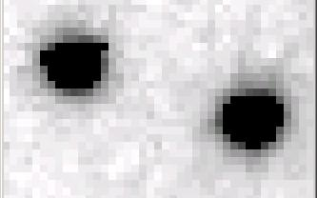
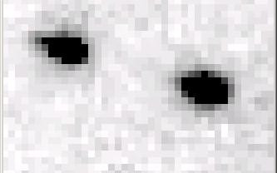
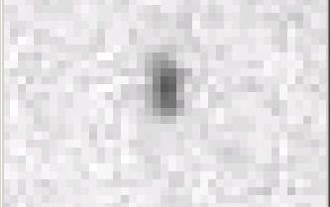
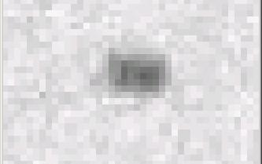
Si(111) vs multilayers
0.014%
Si(111)
spectral
dispersion
1%
multilayer
4 Å
resolution
1.9 Å

Slide 40
spectral dispersion
Ewald sphere
Φ circle
(h,k,l)
λ*
d*
spindle axis
diffracted ray
λ*

Slide 41
spectral dispersion
Ewald sphere
Φ circle
(h,k,l)
λ’*
d*
spindle axis
diffracted ray
λ’*

Slide 42
The truth about x-ray beams
Term units significance
Flux photons/s duration of experiment
Beam Size μm match to crystal
Divergence mrad spot size vs distance
Wavelength Å resolution and absorption
Dispersion Δλ/λ spot size
Flux density ph/s/area scattering/damage rate
Fluence ph/area scattering/damage

Slide 43
beam divergence
Ewald sphere
Φ circle
(h,k,l)
λ*
d*
spindle axis
diffracted ray
λ*

Slide 44
beam divergence
Ewald sphere
Φ circle
(h,k,l)
d*
λ*
diffracted ray
spindle axis
λ*

Slide 45
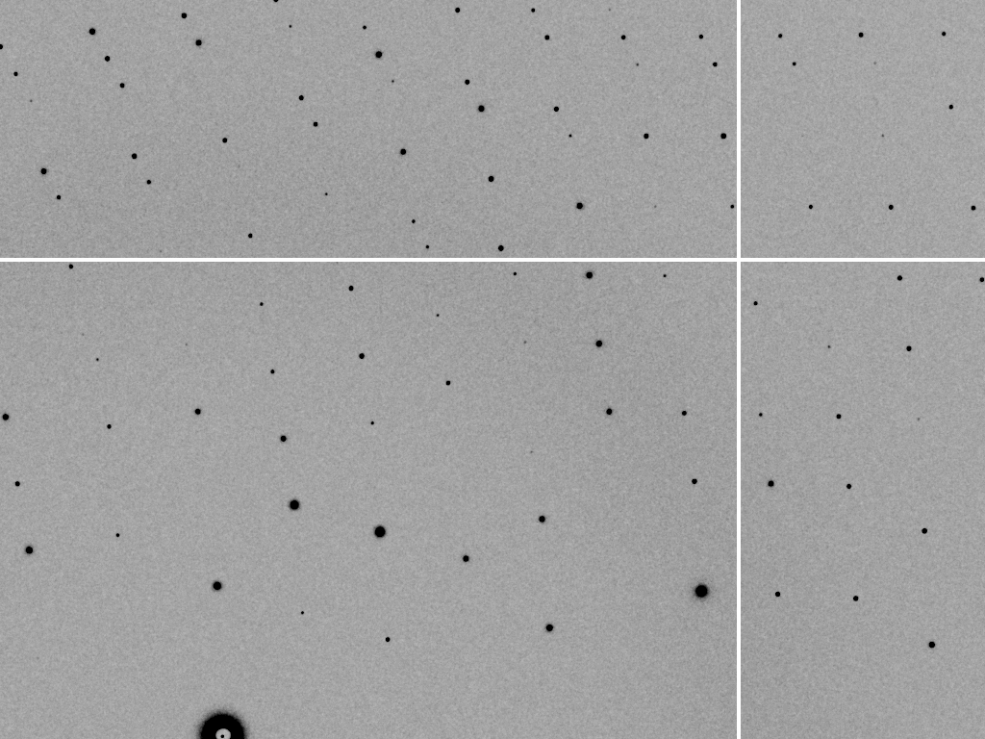
divergence = 0 º

Slide 46
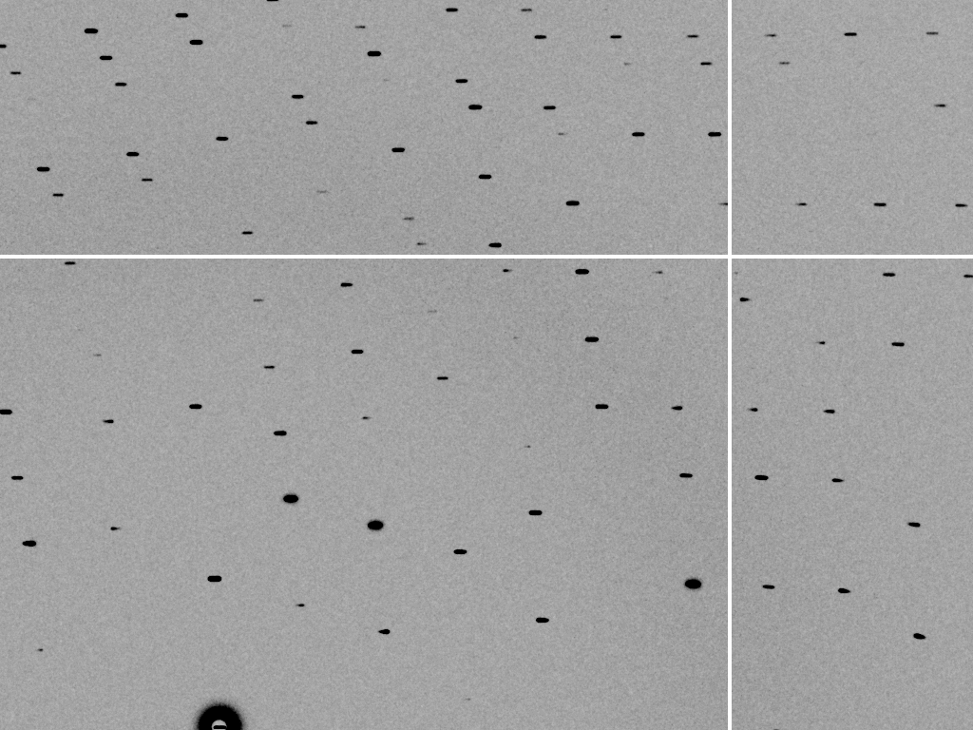
divergence = 0.3 º

Slide 47
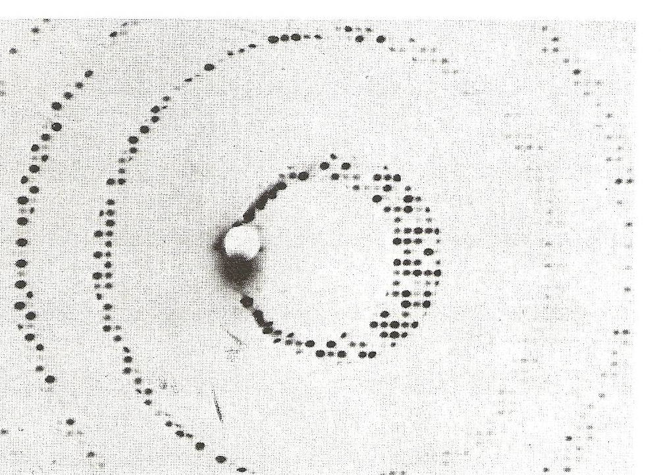
Divergence
Arndt & Wonacott (1977)

Slide 48
The truth about x-ray beams
Term units significance
Flux photons/s duration of experiment
Beam Size μm match to crystal
Divergence mrad spot size vs distance
Wavelength Å resolution and absorption
Dispersion Δλ/λ spot size
Flux density ph/s/area scattering/damage rate
Fluence ph/area scattering/damage

Slide 49
Air absorption
transmittance
Distance from sample (mm)

Slide 50
The truth about x-ray beams
Term units significance
Flux photons/s duration of experiment
Beam Size μm match to crystal
Divergence mrad spot size vs distance
Wavelength Å resolution and absorption
Dispersion Δλ/λ spot size
Flux density ph/s/area scattering/damage rate
Fluence ph/area scattering/damage

Slide 51
Data quality - simple rules:
  Put your crystal into the beam

Slide 52
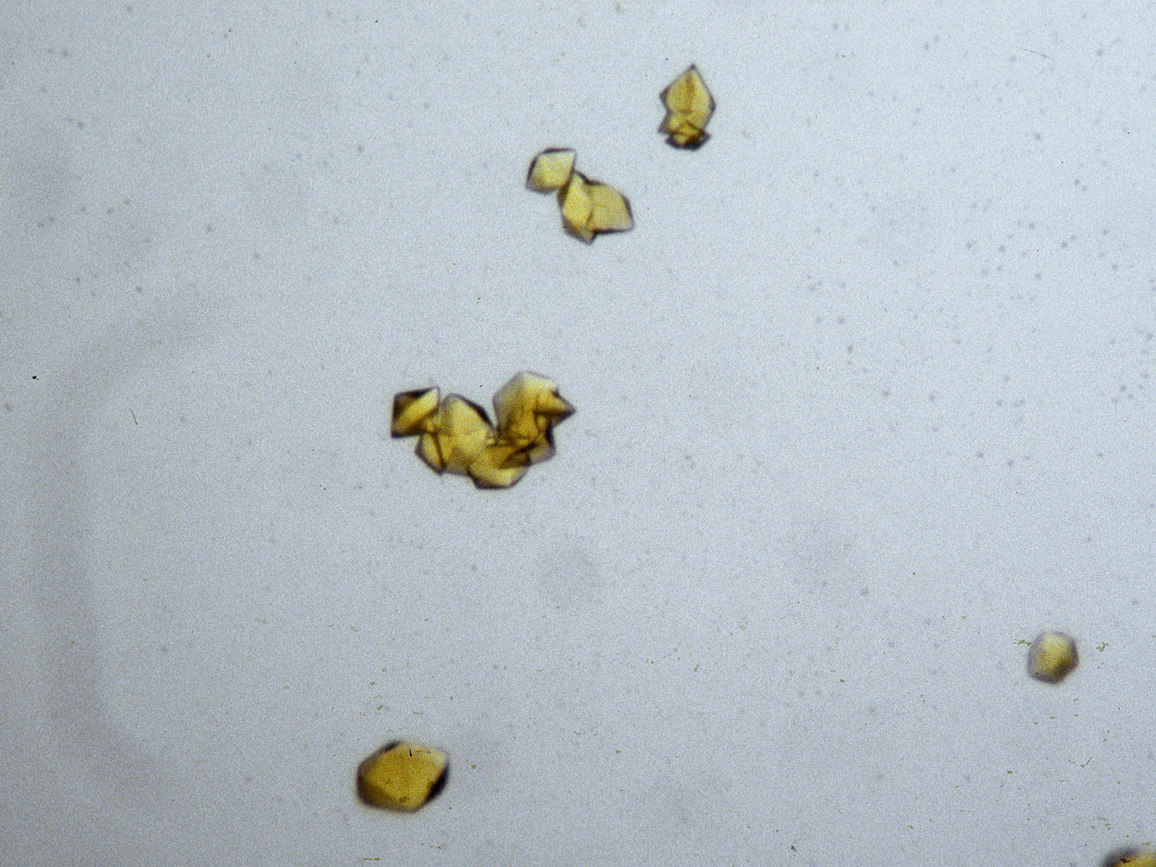
“crystal” = thing you want to shoot
Membrane Protein Expression Center © 2012

Slide 53
Data quality - simple rules:
  Put your crystal into the beam
  Shoot the whole crystal

Slide 54
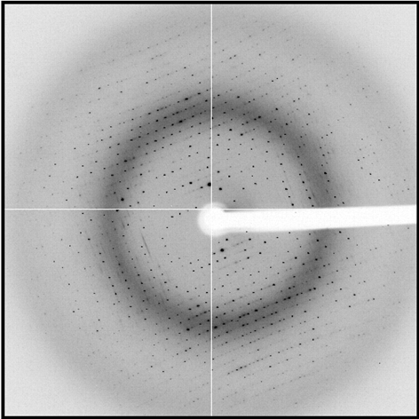
shoot the whole crystal

Slide 55
shoot the whole crystal

Slide 56
shoot the whole crystal

Slide 57
shoot the whole crystal

Slide 58

mosaic spread = 0 º

Slide 59

mosaic spread = 0.1º

Slide 60

mosaic spread = 0.2º

Slide 61

mosaic spread = 0.4º

Slide 62

mosaic spread = 0.6º

Slide 63

mosaic spread = 0.8º

Slide 64

mosaic spread = 1.0º

Slide 65

mosaic spread = 1.5º

Slide 66

mosaic spread = 2.0º

Slide 67

mosaic spread = 2.5º

Slide 68

mosaic spread = 3.2º

Slide 69

mosaic spread = 6.4º

Slide 70

mosaic spread = 12.8º

Slide 71
How many crystals do you see?
Shoot the crystal (singular)

Slide 72
mosaic spread
Ewald sphere
Φ circle
(h,k,l)
λ*
d*
diffracted ray
d*
spindle axis
λ*

Slide 73
mosaic spread
Ewald sphere
Φ circle
(h,k,l)
d*
diffracted rays
d*
spindle axis

Slide 74
shoot the whole crystal

Slide 75
Data quality - simple rules:
  Put your crystal into the beam
  Shoot the whole crystal
  Shoot nothing but the crystal

Slide 76
“crystal” = thing you want to shoot
Membrane Protein Expression Center © 2012

Slide 77
shoot nothing but the crystal

Slide 78
shoot nothing but the crystal

Slide 79
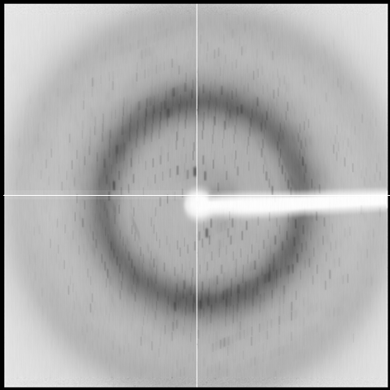
shoot nothing but the crystal

Slide 80
shoot nothing but the crystal

Slide 81
shoot nothing but the crystal

Slide 82
Data quality - simple rules:
  Put your crystal into the beam
  Shoot the whole crystal
  Shoot nothing but the crystal
  Back off!

Slide 83
Background scattering

Slide 84
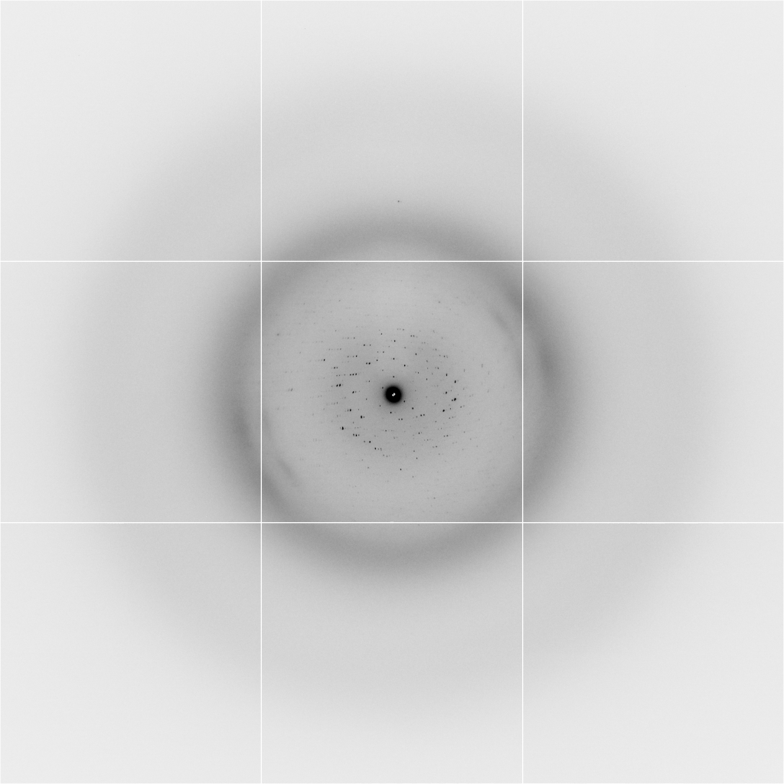
Background scattering
$100,000.00
$100,000.00
$100,000.00
real estate is
expensive
use it!
$100,000.00
$100,000.00
$100,000.00
$100,000.00
$100,000.00

Slide 85
Fine Slicing
background
background
Pflugrath, J. W. (1999)."The finer things in X-ray diffraction data collection", Acta Cryst. D 55, 1718-1725.

Slide 86

Optimal exposure time
(faint spots)
t_{hr} Optimal exposure time for data set (s)
t_{ref} exposure time of reference image (s)
bg_{ref} background level near weak spots on
reference image (ADU)
bg₀ ADC offset of detector (ADU)
bg_{hr} optimal background level (via t_{hr})
σ₀ rms read-out noise (ADU)
gain ADU/photon
m multiplicity of data set (including partials)
adjust exposure
so this is ~100

Slide 87
Data quality - simple rules:
  Put your crystal into the beam
  Shoot the whole crystal
  Shoot nothing but the crystal
  Back off!
  The crystal must rotate

Slide 88
The crystal rotates!

Slide 89
The crystal rotates!
Membrane Protein Expression Center © 2012

Slide 90
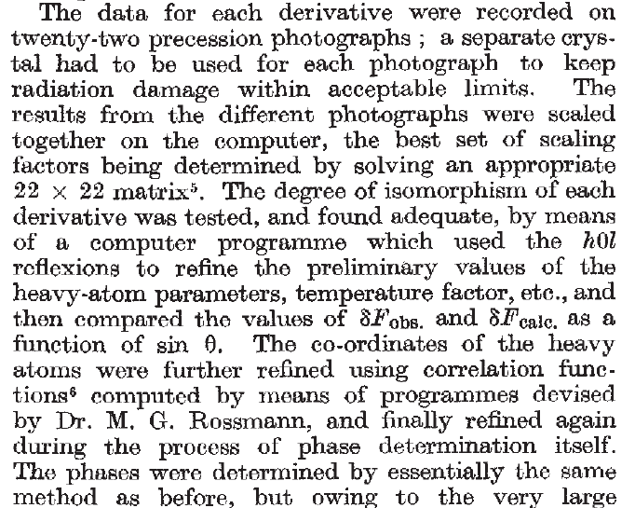
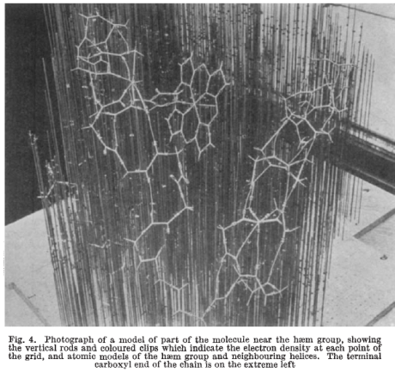
Multi-crystal strategies
Kendrew et al. (1960) "Structure of Myoglobin” Nature 185, 422-427.

Slide 91
Basic Principles
“Hell, there are NO RULES here - we're trying to accomplish something.”
Thomas A. Edison – inventor
“You’ve got to have an ASSAY.”
Arthur Kornberg – Nobel Laureate
“Control, control, you must learn CONTROL!”
Yoda – Jedi Master

Slide 92
Summary
Shoot the crystal
Do not bend!
Multi-crystal strategies
assay, control and open mind
Membrane Protein Expression Center © 2013

