Slide 1
Diffraction
When “scattering”
is not random

Slide 2
scattering
x-ray beam
sample
detector
detector

Slide 3
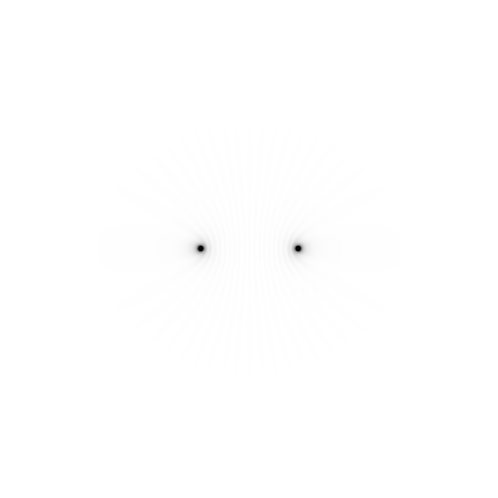
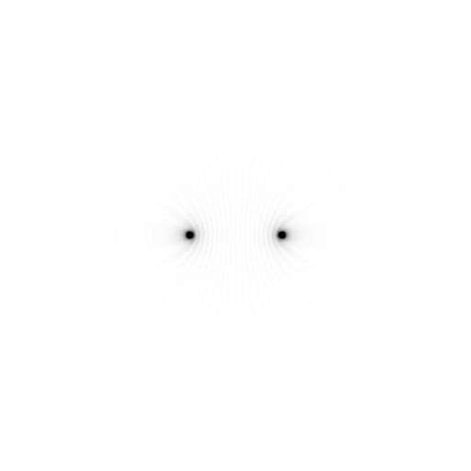
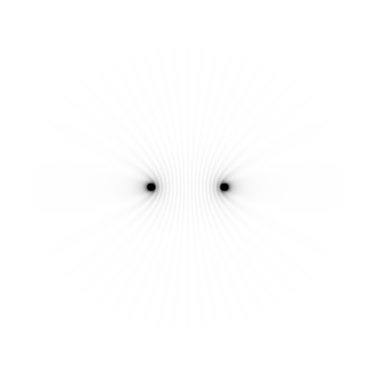
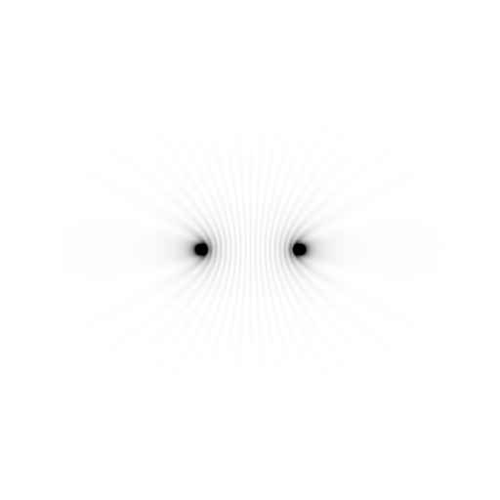
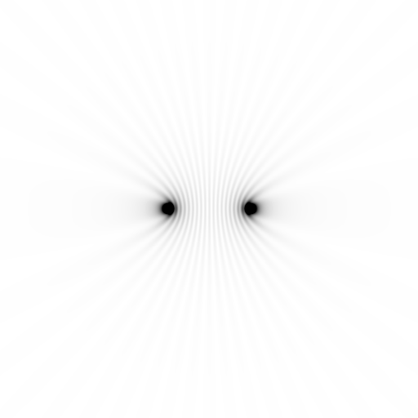
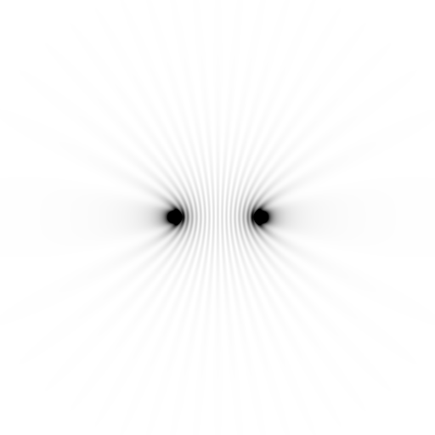
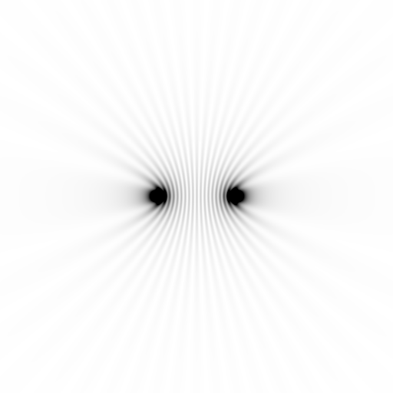
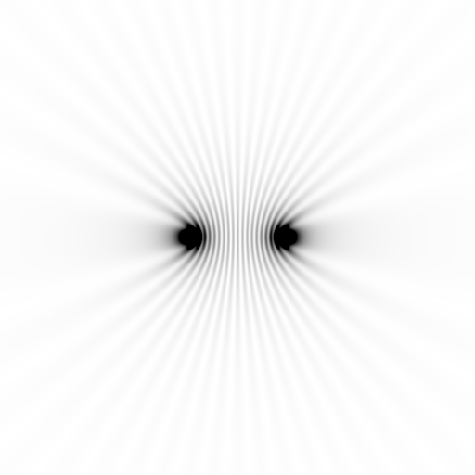
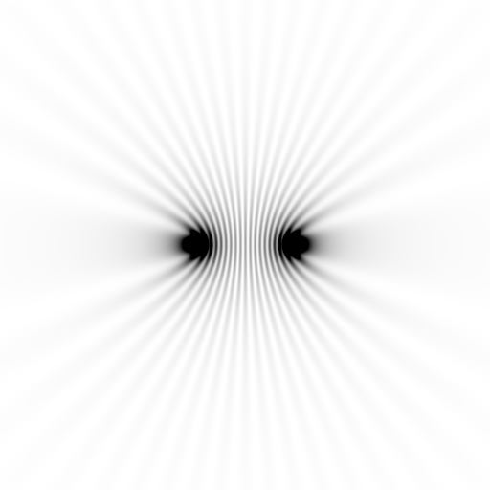
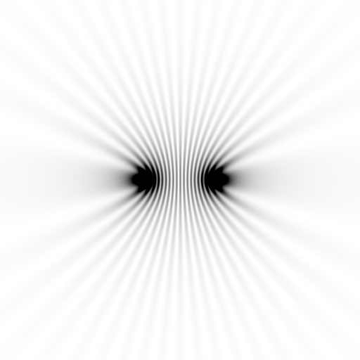
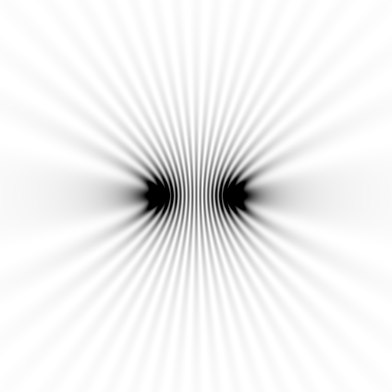
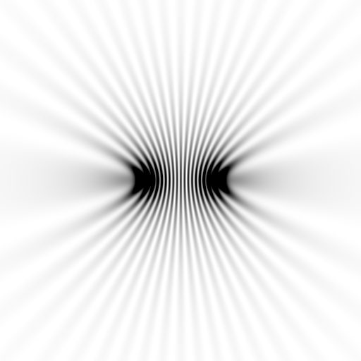
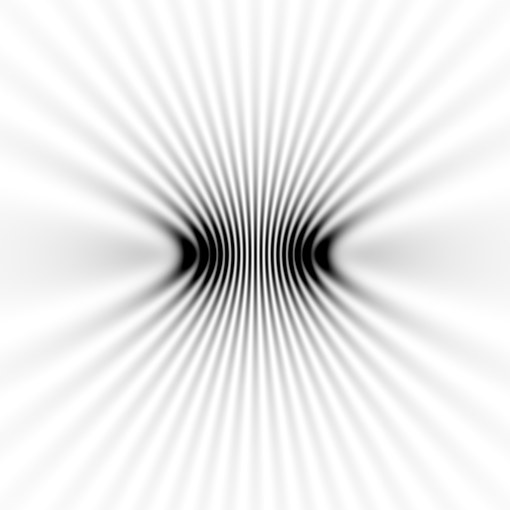
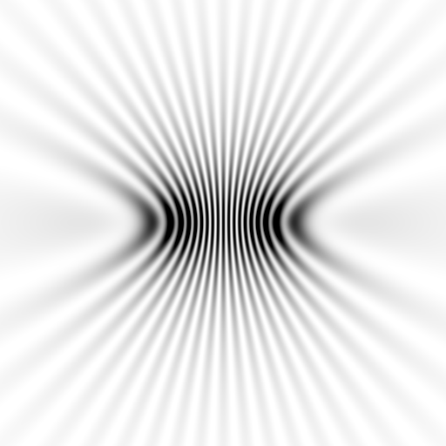
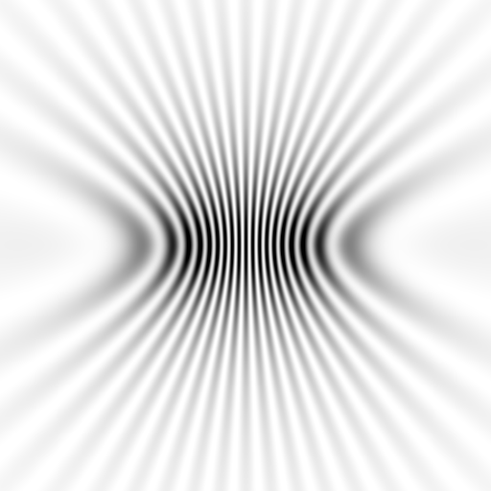
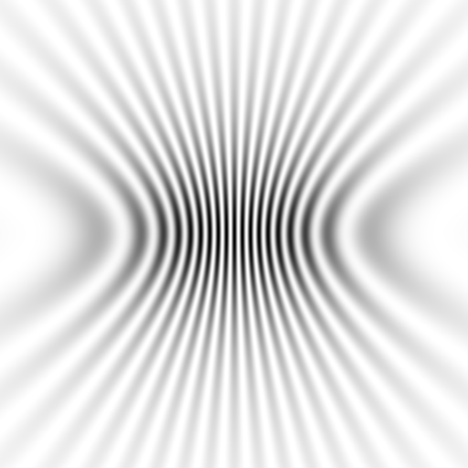
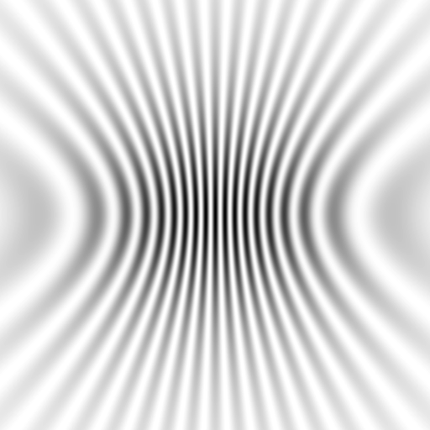
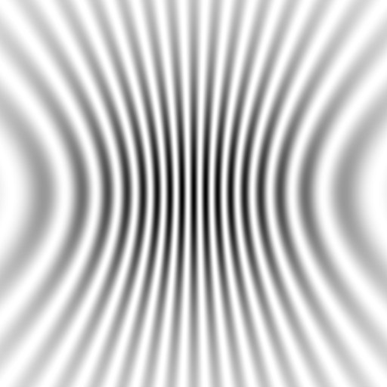
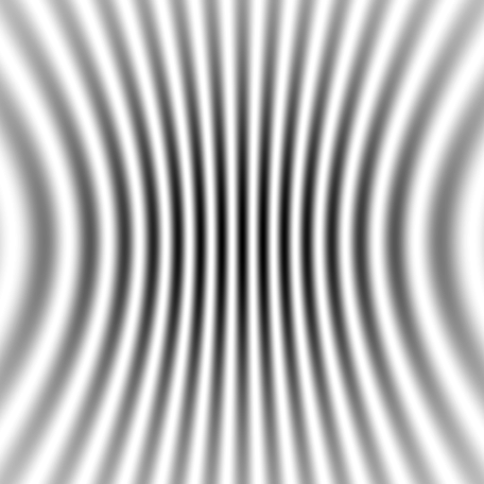
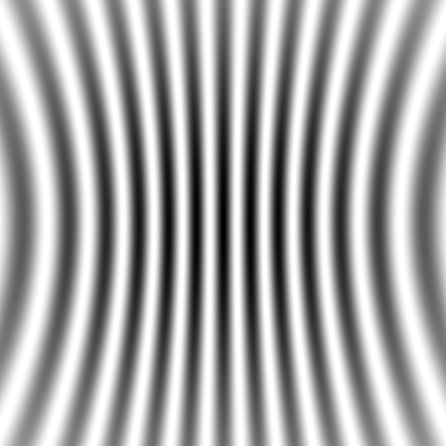
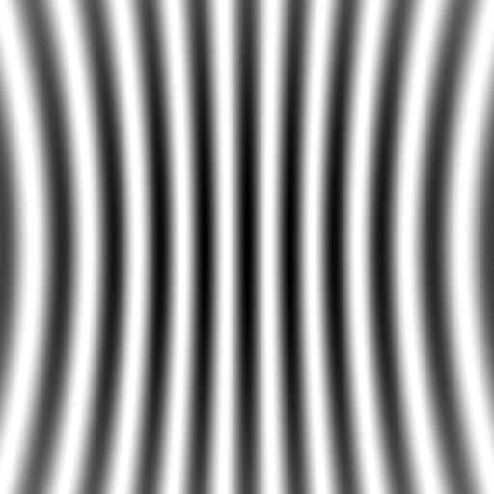
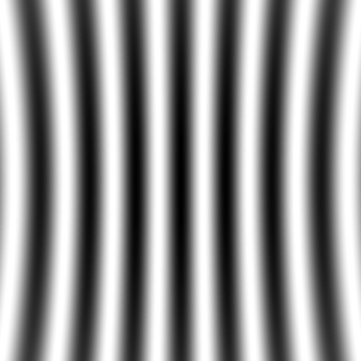

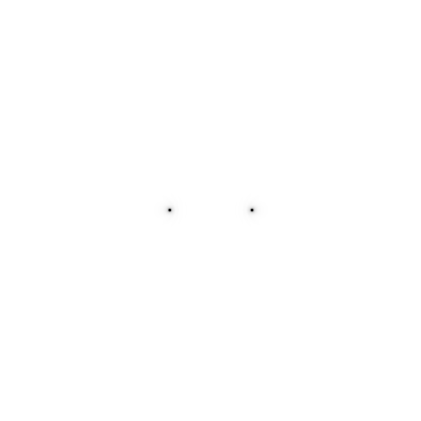
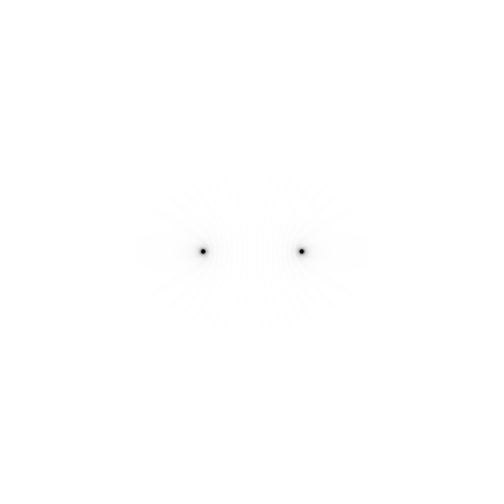
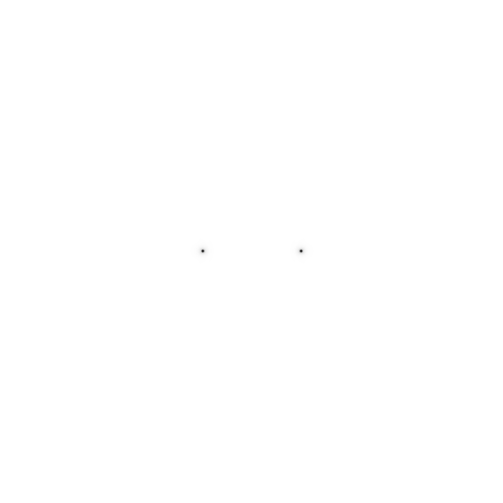

Slide 4
Scattering: atom by atom
intensity
h index

Slide 5
Scattering: atom by atom
intensity
h index

Slide 6
Bragg’s Law
to detector
nλ = 2d sin(θ)
atom #1
θ
d
to source
atom #2
d∙sin(θ)

Slide 7
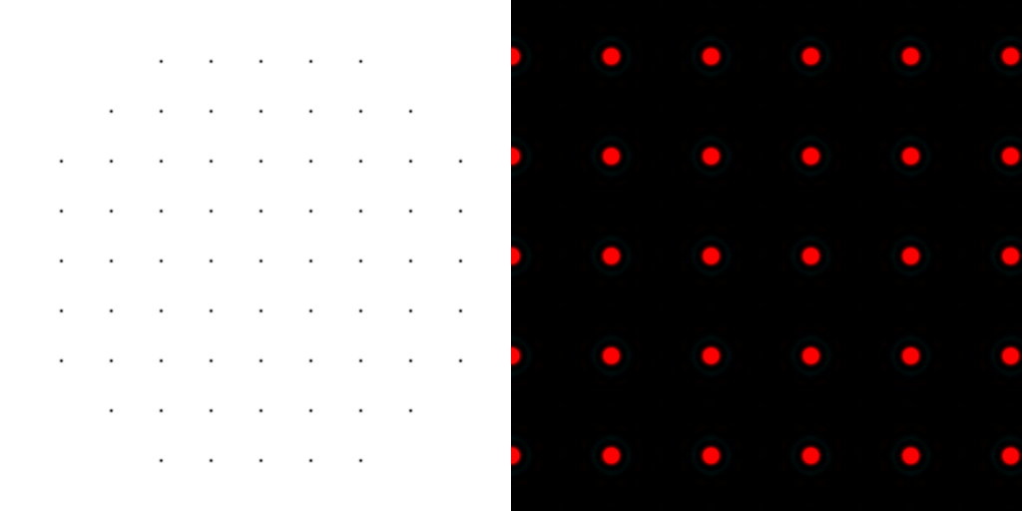
scattering from a lattice
colored by phase
sample
detector

Slide 8
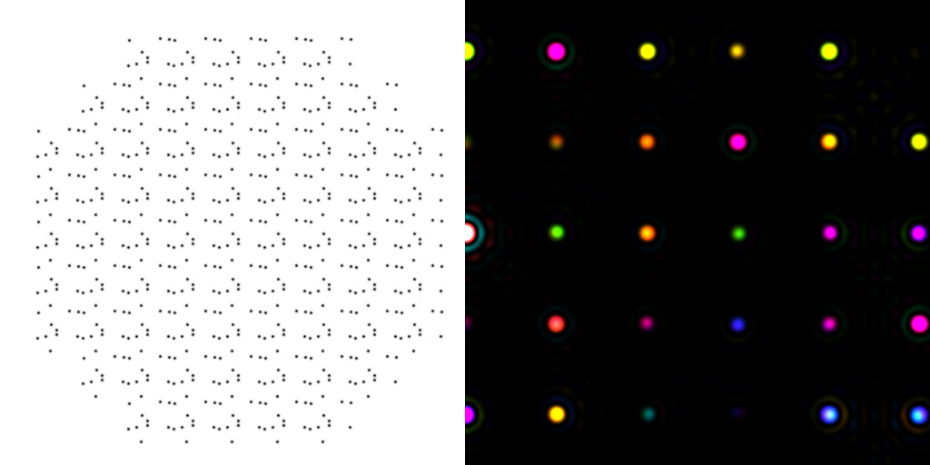

scattering from a molecule
colored by phase
sample
detector

Slide 9
scattering from a crystal structure
colored by phase
sample
detector

Slide 10
Spot shape
Ewald sphere
Φ circle
(h,k,l)
λ*
d*
spindle axis
diffracted ray
λ*

Slide 11
mosaic spread
Ewald sphere
Φ circle
(h,k,l)
d*
diffracted rays
d*
spindle axis

Slide 12

mosaic spread = 12.8º

Slide 13
beam divergence
Ewald sphere
Φ circle
(h,k,l)
d*
λ*
diffracted ray
spindle axis
λ*

Slide 14
spectral dispersion
Ewald sphere
Φ circle
(h,k,l)
λ’*
d*
spindle axis
diffracted ray
λ’*

Slide 15
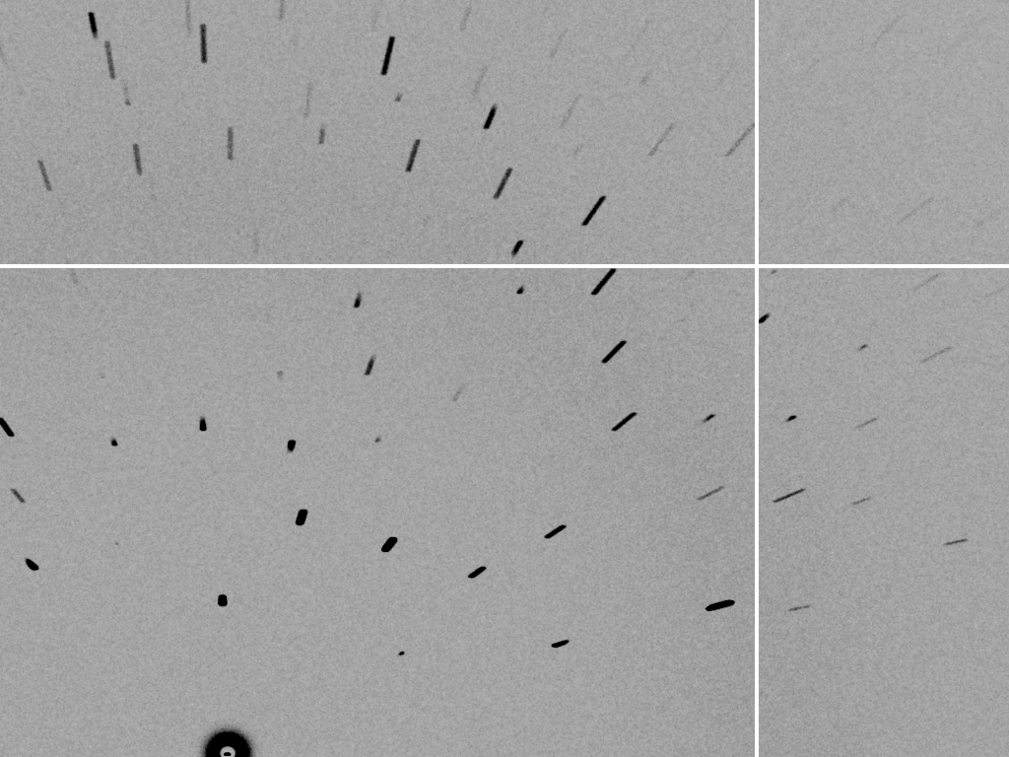
dispersion = 5.1%

Slide 16
spot shape
Ewald sphere
Ewald sphere
Ewald sphere
Ewald sphere
Φ circle
Φ circle
Φ circle
Φ circle
(h,k,l)
(h,k,l)
(h,k,l)
(h,k,l)
λ’*
λ*
d*
d*
d*
λ*
d*
spindle axis
spindle axis
spindle axis
diffracted rays
d*
spindle axis
diffracted ray
diffracted ray
diffracted ray
λ’*
λ*
λ*

Slide 17
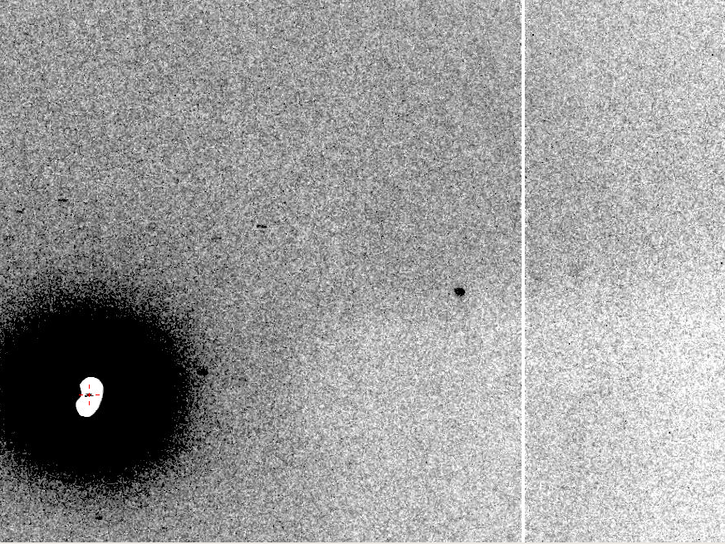
Now What?
10 Å

Slide 18
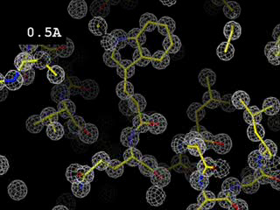
Resolution
http://bl831.als.lbl.gov/~jamesh/movies/resolution.mpeg

Slide 19

What is “disorder”?
order
order
B-factor
disorder

Slide 20
“B” factors
ATOM 122 N LEU A 13 -3.244 25.808 19.998 1.00 16.96 N
ATOM 123 CA LEU A 13 -2.877 25.448 21.355 1.00 15.29 C
ATOM 124 C LEU A 13 -2.792 23.966 21.561 1.00 17.54 C
ATOM 125 O LEU A 13 -1.814 23.493 22.143 1.00 16.35 O
ATOM 126 CB LEU A 13 -3.907 26.164 22.268 1.00 18.72 C
ATOM 127 CG LEU A 13 -3.577 25.982 23.738 1.00 21.19 C
ATOM 128 CD1 LEU A 13 -2.283 26.820 24.019 1.00 19.43 C
ATOM 129 CD2 LEU A 13 -4.702 26.474 24.639 1.00 24.65 C
ATOM 130 N SER A 14 -3.677 23.149 20.979 1.00 15.96 N
ATOM 131 CA SER A 14 -3.646 21.711 21.061 1.00 18.26 C
ATOM 132 C SER A 14 -2.373 21.203 20.360 1.00 18.71 C
ATOM 133 O SER A 14 -1.747 20.315 20.930 1.00 17.47 O
ATOM 134 CB SER A 14 -4.875 21.077 20.419 1.00 17.62 C
ATOM 135 OG ASER A 14 -4.825 19.665 20.388 0.50 20.89 O
ATOM 136 OG BSER A 14 -6.027 21.408 21.164 0.50 18.67 O
ATOM 137 N LYS A 15 -2.045 21.772 19.215 1.00 18.03 N
ATOM 138 CA LYS A 15 -0.799 21.361 18.555 1.00 18.12 C
ATOM 139 C LYS A 15 0.446 21.707 19.351 1.00 18.81 C
ATOM 140 O LYS A 15 1.400 20.948 19.411 1.00 17.77 O
ATOM 141 CB LYS A 15 -0.700 22.034 17.177 1.00 14.49 C
ATOM 142 CG LYS A 15 -1.727 21.368 16.256 1.00 16.12 C
ATOM 143 CD LYS A 15 -1.663 22.147 14.936 1.00 19.40 C
ATOM 144 CE ALYS A 15 -2.725 21.614 13.986 0.50 17.42 C
ATOM 145 CE BLYS A 15 -1.750 21.211 13.750 0.50 17.01 C
ATOM 146 NZ ALYS A 15 -2.346 21.674 12.559 0.50 18.61 N
ATOM 147 NZ BLYS A 15 -3.052 20.513 13.741 0.50 18.76 N

Slide 21
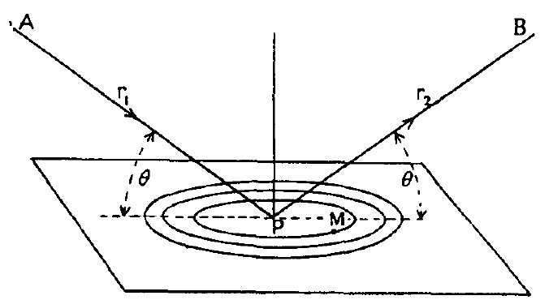
“B” factors
B = 8π² u_{x}²
u_{x} = RMS variation perpendicular to plane

Slide 22
“B” factors
electron density (e⁻/Å³)
position (Å)

Slide 23
“B” factors
B ≈ 4d² + 12
d = resolution in Å
essentially, the “resolution” of an atom

Slide 24
Debye-Waller-Ott factor
F = F₀ exp( - A∙s - B∙s² - C∙s³ - … )
F - structure factor
A - something Debye said was zero
B - canonical Debye-Waller factor
C - something else Debye said was zero
s - 0.5/d
d - resolution of spot (Å)

Slide 25
Debye-Waller-Ott factor
Reciprocal Space
Gaussian
normalized total intensity
Exponential
∞ 5 2.5 1.7 1.25 1.0
Resolution (Ǻ)

Slide 26
Debye-Waller-Ott factor
Direct Space
Gaussian
normalized number of atoms
Lorentzian
magnitude of displacement (Å)

Slide 27
Wilson plot
R_{cryst}/R_{free}
0.355/0.514
0.257/0.449
0.209/0.407
scaled <F²>
4.1 3.5 3.2 2.9 2.7 2.5 2.4 2.2 2.1
resolution (Å)
(sin(θ)/λ)²

Slide 28
Purity is crucial!
important for
resolution
McPherson, A., Malkin, A. J., Kuznetsov, Y. G. & Plomp, M. (2001)."Atomic force microscopy applications in macromolecular crystallography", Acta Cryst. D 57, 1053-1060.
not important for
initial hits

Slide 29
What can I improve?
Purity!
is 95% good enough? 99%?
Purity!
conformational (homogeneous)
Purity!
kinetic (stable over time)

Slide 30
What can I improve?
add a column
fractional recrystallization
heat shock
mutate Lys
avoid stress
Newman J. (2006) Acta Cryst. D62 27-31.

Slide 31
causes of stress
physical contact
don’t touch the part you intend to shoot
osmotic shock
equilibrate, or calculate matching solution
changes in dielectric constant
Petsko (1975) J. Mol. Biol. 96, 381-388.
cooled density mismatch
Juers & Matthews (2004) Acta Cryst. D 60, 412-421.
basically: no sudden moves!

Slide 32
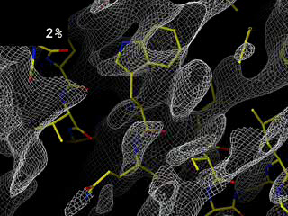
Completeness: missing wedge
http://bl831.als.lbl.gov/~jamesh/movies/osc.mpeg

Slide 33
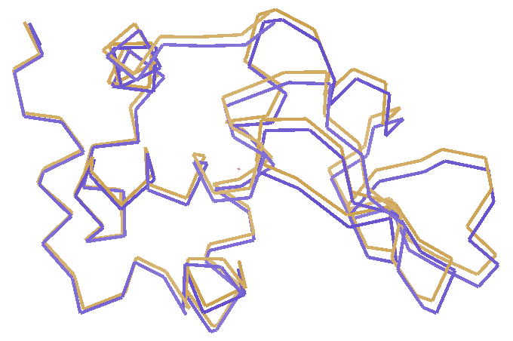
Non-isomorphism in lysozyme
RH 84.2% vs 71.9%
RMSD = 0.18 Å
R_{iso} = 44.5%

Slide 34
oiled drop: you have ~3 hours
oil

Slide 35
signal vs noise
“photon counting”
Read-out noise
Shutter jitter
Beam flicker
spot shape
radiation damage
σ(N) = sqrt(N)
rms 11.5 e-/pixel
rms 0.57 ms
0.15 %/√Hz
pixels? mosaicity?
B/Gray?

Slide 36
signal vs noise
fractional noise
“photon counting”
constant noise
σ(I) = k x I “% error”
σ(I) = k x sqrt(I)
σ(I) = k

Slide 37

Optimal exposure time
(faint spots)
t_{hr} Optimal exposure time for data set (s)
t_{ref} exposure time of reference image (s)
bg_{ref} background level near weak spots on
reference image (ADU)
bg₀ ADC offset of detector (ADU)
bg_{hr} optimal background level (via t_{hr})
σ₀ rms read-out noise (ADU)
gain ADU/photon
m multiplicity of data set (including partials)
adjust exposure
so this is ~100

Slide 38
anomalous scattering
x-ray beam
sample
detector

Slide 39
anomalous signal
ΔF
F
√
# sites
MW (Da)
≈ 1.2 f”
f” | Element
0.5 | S P
4 | Se Br Fe
10 | Hg Gd Au Pt
World record!
ΔF/F = 0.5%
Wang, Dauter & Dauter (2006) Acta Cryst. D 62, 1475-1483.
Crick, F. H. C. & Magdoff, B. S. (1956) Acta Crystallogr. 9, 901-908.
Hendrickson, W. A. & Teeter, M. M. (1981) Nature 290, 107-113.

Slide 40
Fractional error
no “scale factor” is perfectly known
no source of light is perfectly stable
no shutter is perfectly reproducible
no crystal is perfectly still
no detector is perfectly calibrated

Slide 41
Darwin’s Formula
V_{xtal}
λ³ L
I(hkl) = I_{beam} r_{e}²
P A | F(hkl) |²
V_{cell}
ωV_{cell}
I(hkl) - photons/spot (fully-recorded)
I_{beam} - incident (photons/s/m² )
r_{e} - classical electron radius (2.818x10⁻¹⁵ m)
V_{xtal} - volume of crystal (in m³)
V_{cell} - volume of unit cell (in m³)
λ - x-ray wavelength (in meters!)
ω - rotation speed (radians/s)
L - Lorentz factor (speed/speed)
P - polarization factor
(1+cos²(2θ) -Pfac∙cos(2Φ)sin²(2θ))/2
A - attenuation factor
exp(-μ_{xtal}∙l_{path})
F(hkl) - structure amplitude (electrons)
C. G. Darwin (1914)

Slide 42
attenuation factor
μ_{solvent}
t_{so}
t_{xo}
t_{si}
t_{xi}
μ_{xtal}
t_{so}
t_{xo}
t_{si}
t_{xi}
t_{so}
t_{xo}
I_{T}
I_{beam}
t_{si}
t_{xi}
A = = exp[-μ_{xtal}(t_{xi}+ t_{xo})
-μ_{solvent}(t_{si} + t_{so})]
Bouguer, P. (1729). Essai d'optique sur la gradation de la lumière.
Lambert, J. H. (1760). Photometria: sive De mensura et gradibus luminis, colorum et umbrae. E. Klett.
Beer, A. (1852)."Bestimmung der Absorption des rothen Lichts in farbigen Flüssigkeiten", Ann. Phys. Chem 86, 78-90.

Slide 43
Lorentz Factor
Ewald sphere
Φ circle
(h,k,l)
diffracted ray
spindle axis

Slide 44
% error from rad dam
R_{iso} ≈ 0.7 %/MGy
R_{iso} (%)
change in dose (MGy)
data taken from Banumathi, et al. (2004) Acta Cryst. D 60, 1085-1093.

Slide 45
Beam Flicker
1/f noise or “flicker noise”
comes from everything

Slide 46
Shutter Jitter
open
closed
shutter jitter

Slide 47
xtal vibration noise
diffracted beam
incident beam

Slide 48
Shutter Jitter
CC to correct model
rms timing error (% exposure)

Slide 49
Beam Flicker
CC to correct model
flicker noise (%/√Hz)

Slide 50
Solution to vibration:
attenu-wait!
reduce flux
increase exposure

Slide 51
Detector calibration
x-rays
air
plastic
Gd₂O₂S:Tb
fibers

Slide 52

Spatial Noise
down
up
R_{separate}

Slide 53
Spatial Noise
separate:
mixed:
2.5%
0.9%
2.5%²-0.9%² = 2.3%²

Slide 54
Required multiplicity
^{mult >} (—)²
~3%
<ΔF/F>

Slide 55
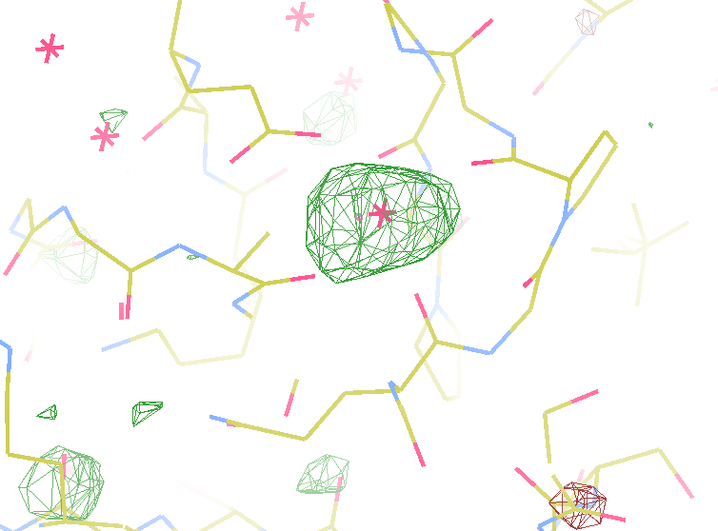
140-fold multiplicity
7.4σ = Na
DELFAN residual anomalous difference
data Courtesy of Tom & Janet

Slide 56
Detector calibration
good!
good!
calibration error (%)
bad!
photon energy (keV)

Slide 57

Holton & Frankel (2010) Acta D 66 393-408.

Slide 58
What is holding us back?
( if not rad dam! )
Weak spots (high-res)
  background
  solution: use as few pixels as possible
MAD/SAD (small differences)
  fractional errors
  solution: use as many pixels as possible

Slide 59
Summary
http://bl831.als.lbl.gov/xtalsize.html
http://bl831.als.lbl.gov/~jamesh/mlfsom/
http://bl831.als.lbl.gov/~jamesh/powerpoint/AACS_diffraction_2013.ppt
100 ADU/pixel
10 μm for lysozyme
~3% error per spot, 1%/MGy
7235 eV for S-SAD

