Slide 1
Diffraction
When “scattering”
is not random

Slide 2
scattering
x-ray beam
sample
detector
detector

Slide 3
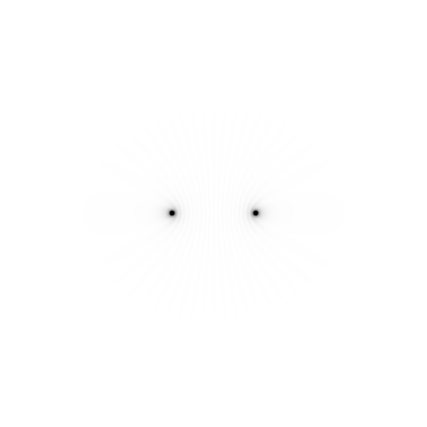
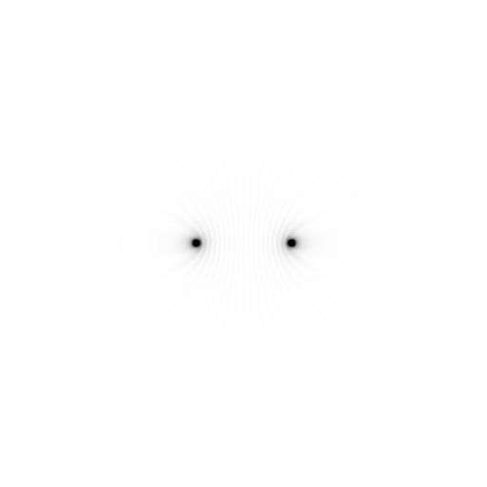
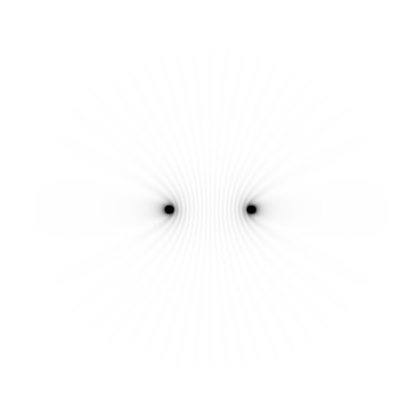
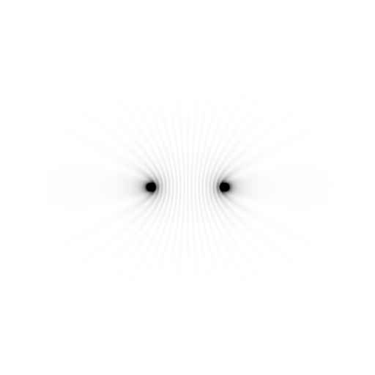
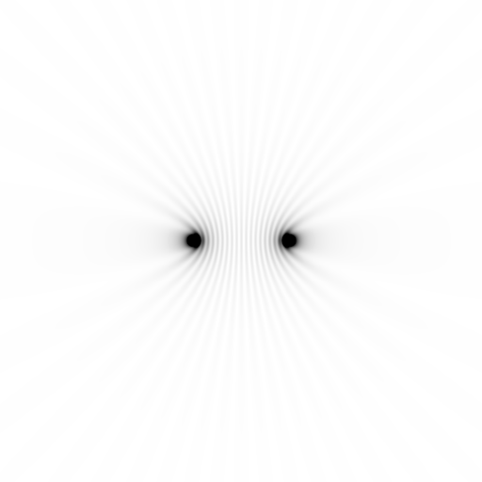
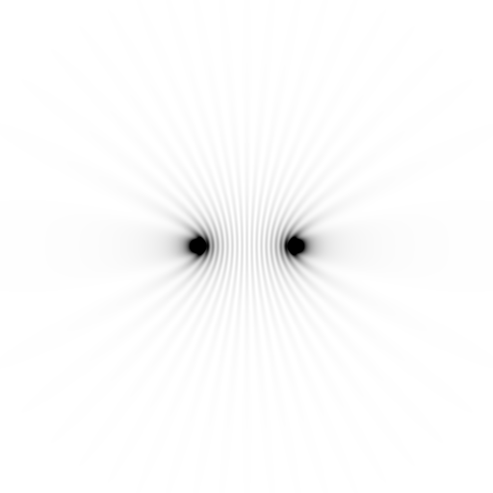
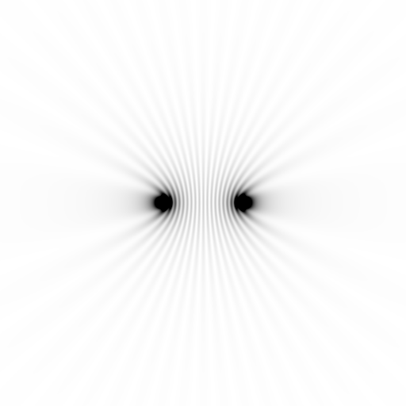
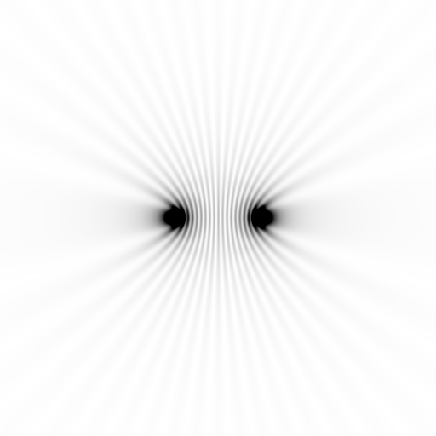
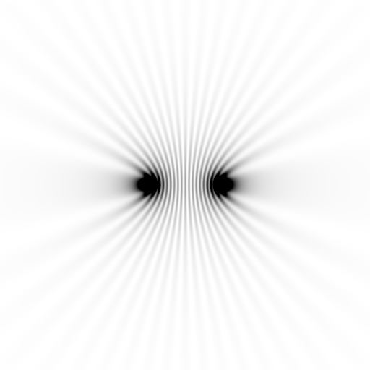
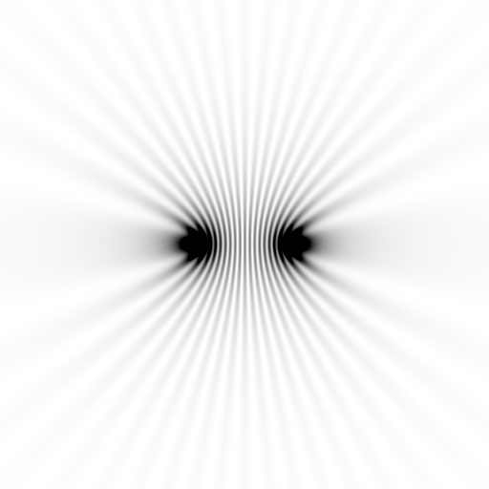
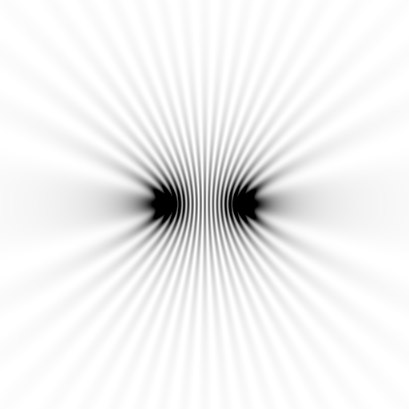
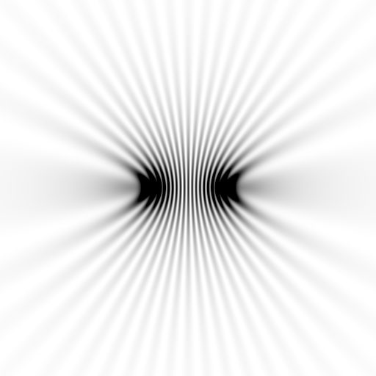
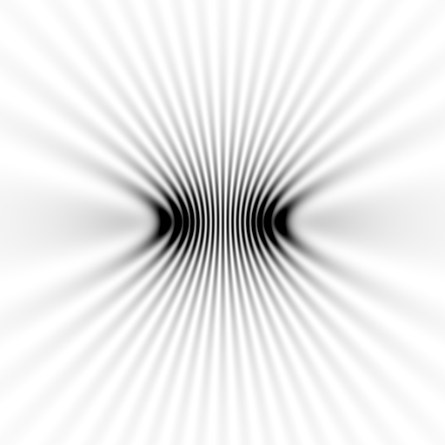
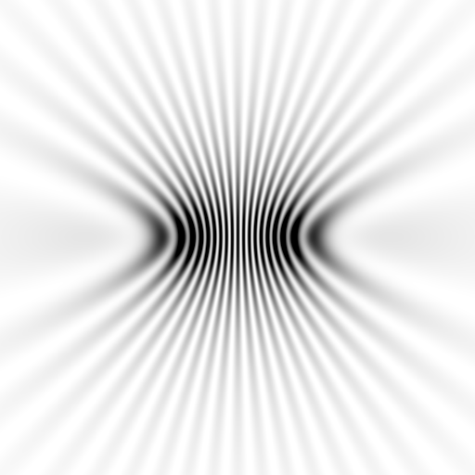
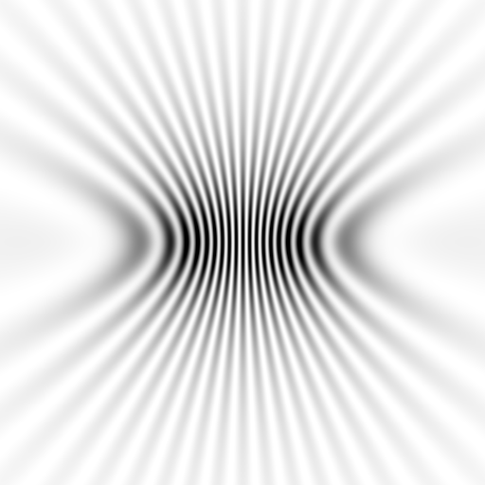
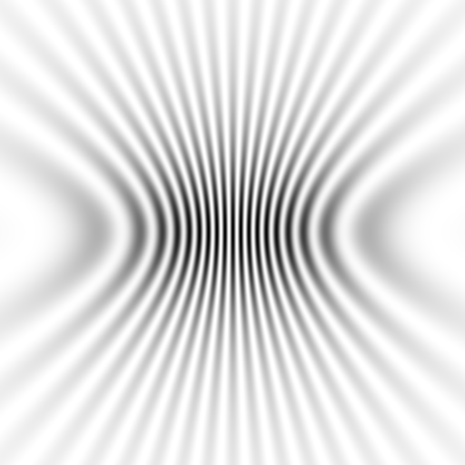
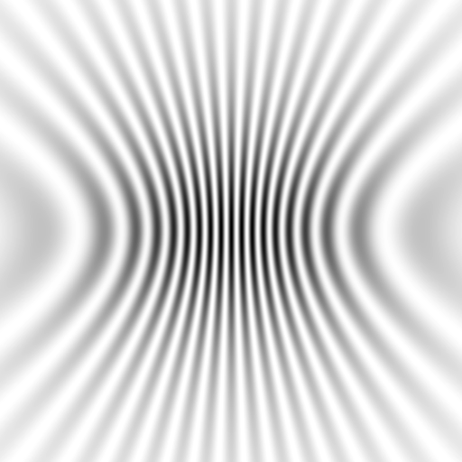
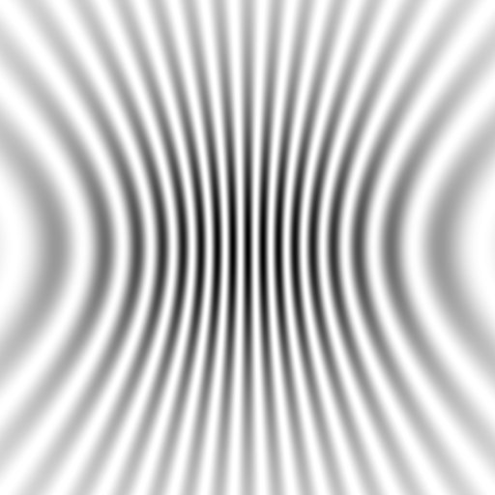
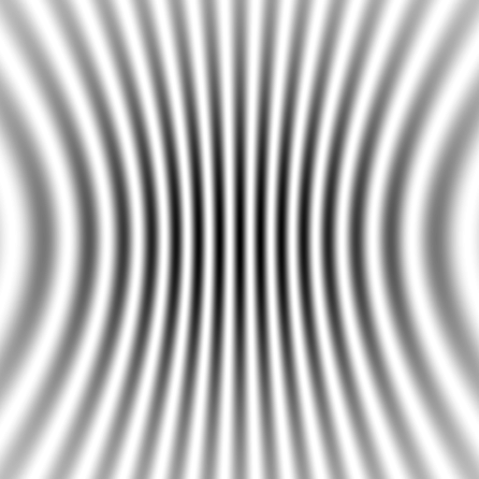
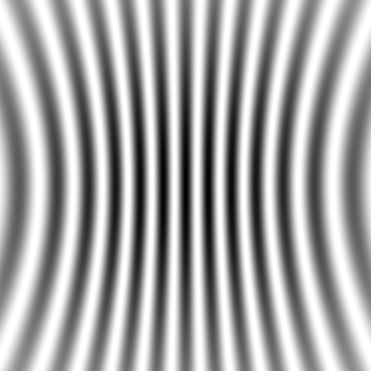



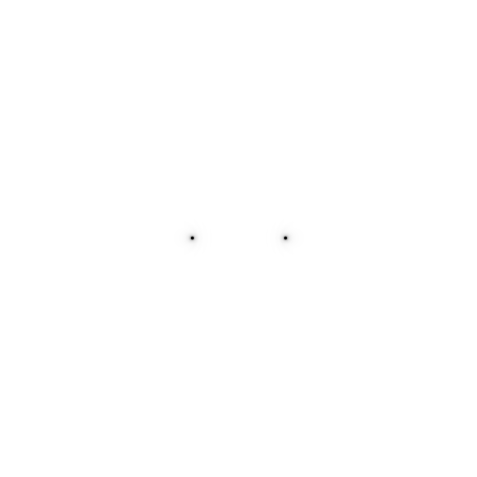
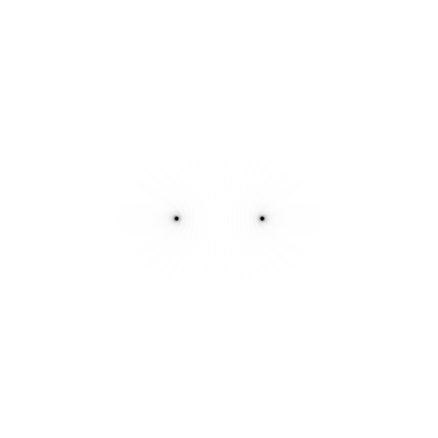
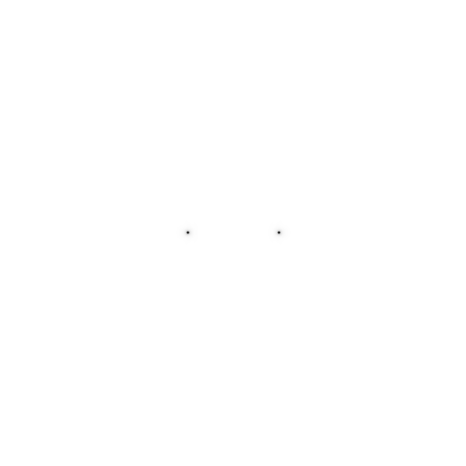

Slide 4
Scattering: atom by atom
intensity
h index

Slide 5
Scattering: atom by atom
intensity
h index

Slide 6
Scattering: atom by atom
intensity
h index

Slide 7
Scattering: atom by atom
intensity
h index

Slide 8
Scattering: atom by atom
intensity
h index

Slide 9
Scattering: atom by atom
intensity
h index

Slide 10
Scattering: atom by atom
intensity
h index

Slide 11
Scattering: atom by atom
intensity
h index

Slide 12
Scattering: atom by atom
intensity
h index

Slide 13
scattering
x-ray beam
sample
detector

Slide 14
scattering
x-ray beam
sample
detector

Slide 15
scattering
x-ray beam
sample
detector

Slide 16
Bragg’s Law
to detector
nλ = 2d sin(θ)
atom #1
θ
d
to source
atom #2
d∙sin(θ)

Slide 17
Bragg’s Law
to detector
nλ = 2d sin(θ)
atom #1
θ
d
to source
atom #2
d∙sin(θ)

Slide 18
Bragg’s Law
to detector
nλ = 2d sin(θ)
atom #1
θ
to source
d
atom #2
d∙sin(θ)

Slide 19
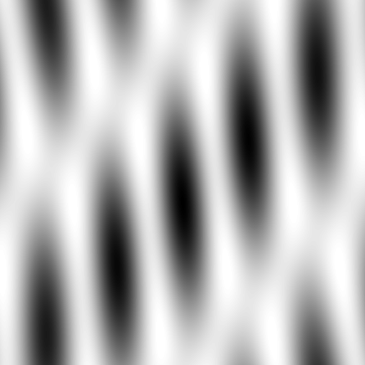



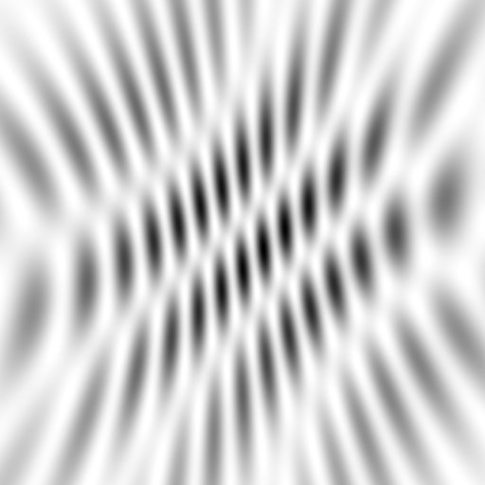
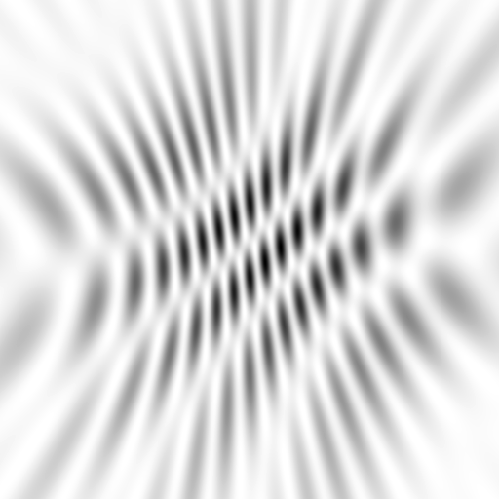
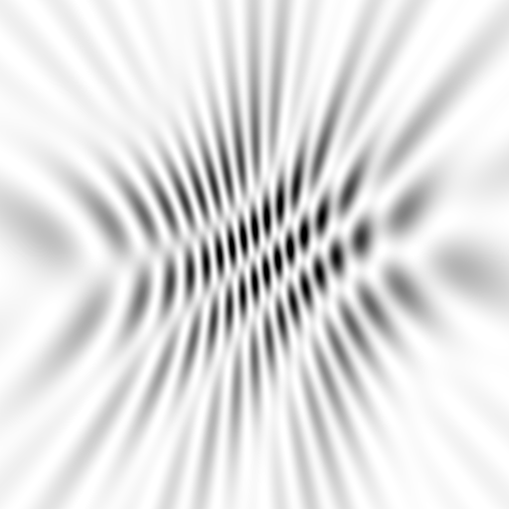
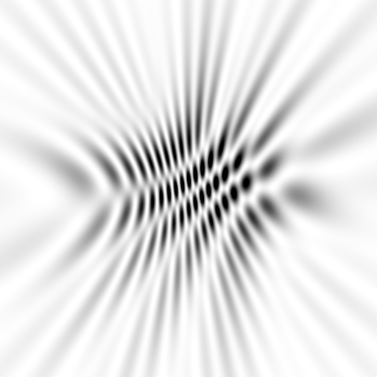
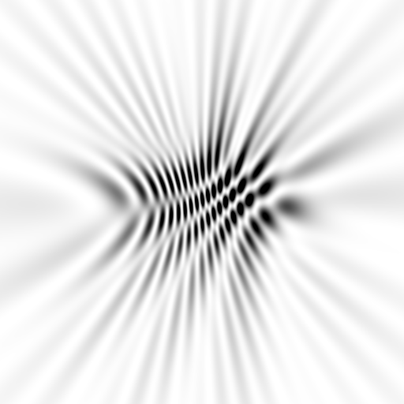
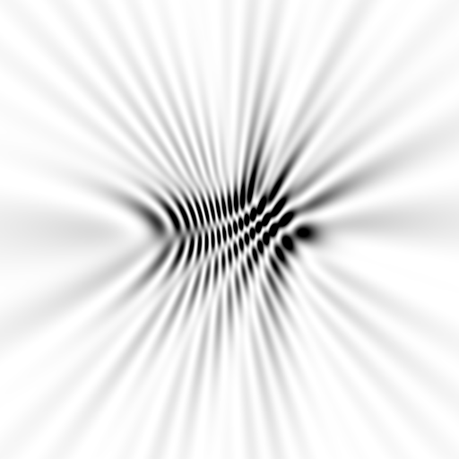
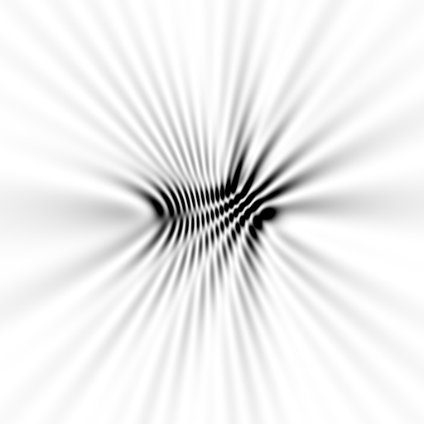
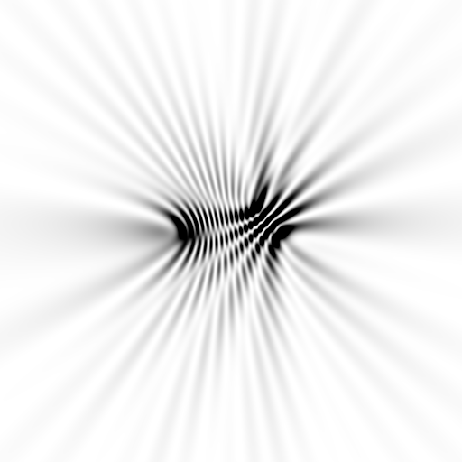
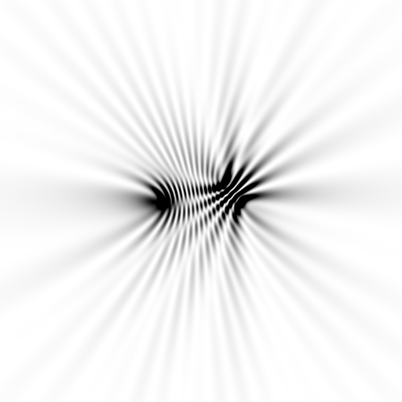
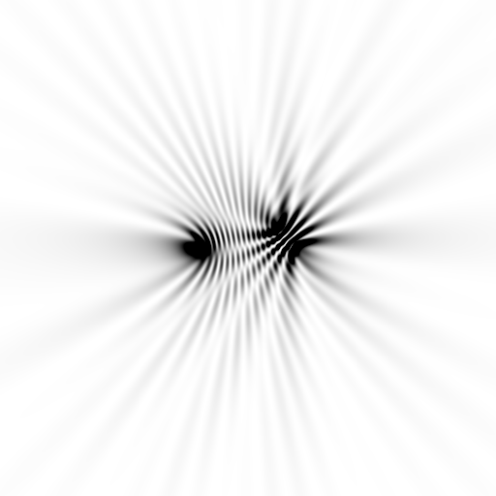
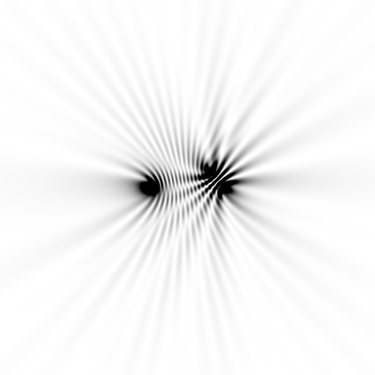






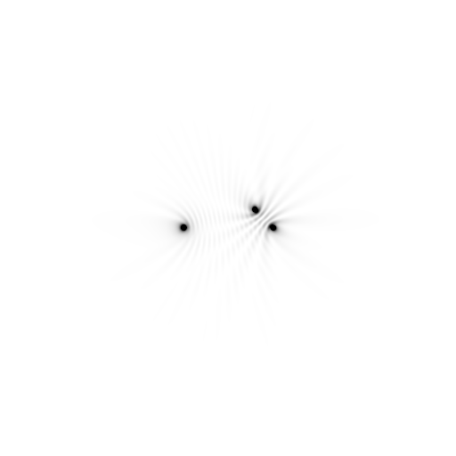





Slide 20



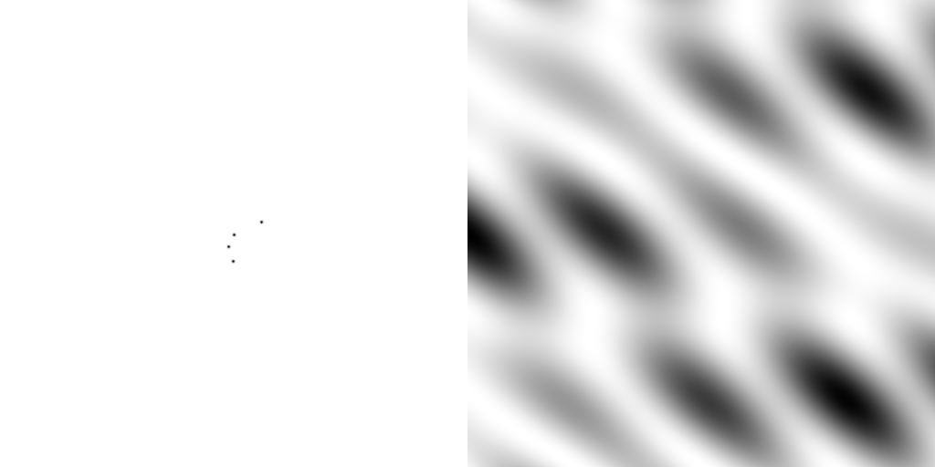
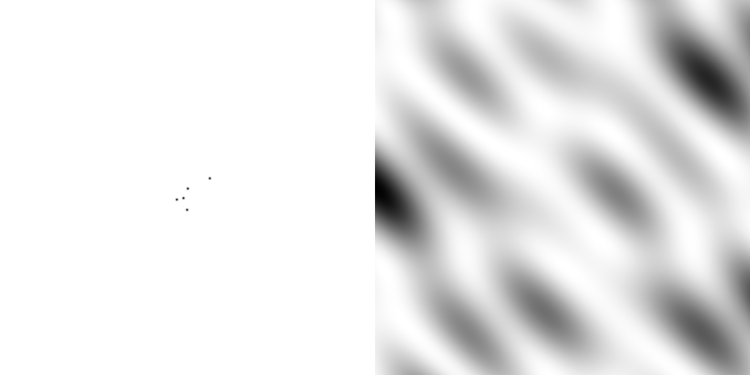
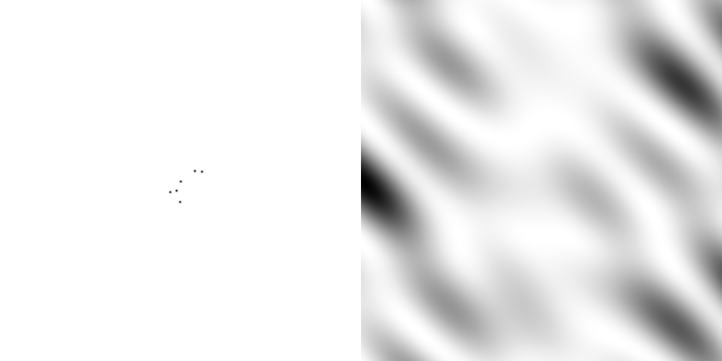
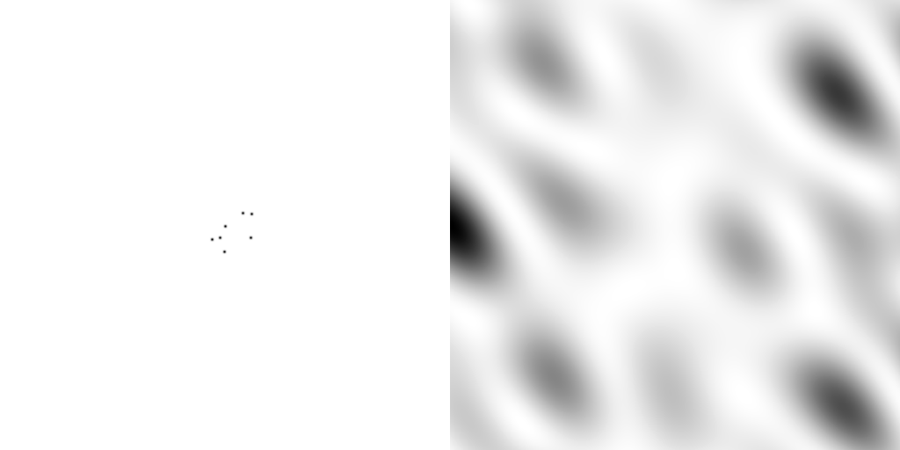
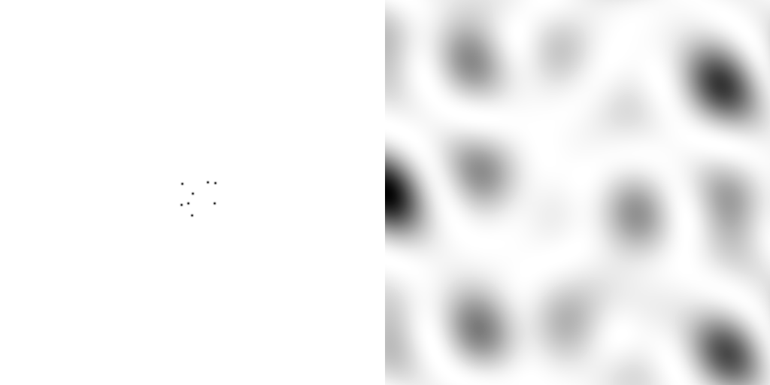
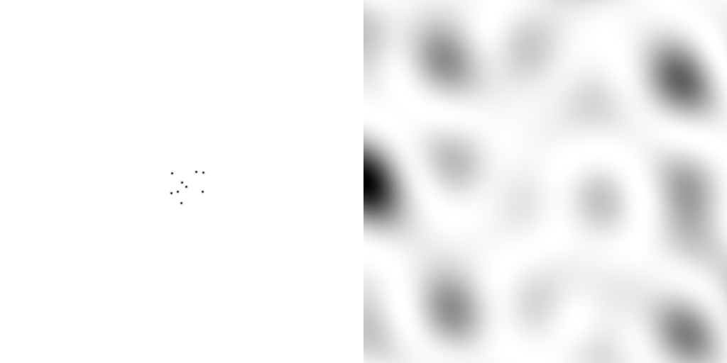
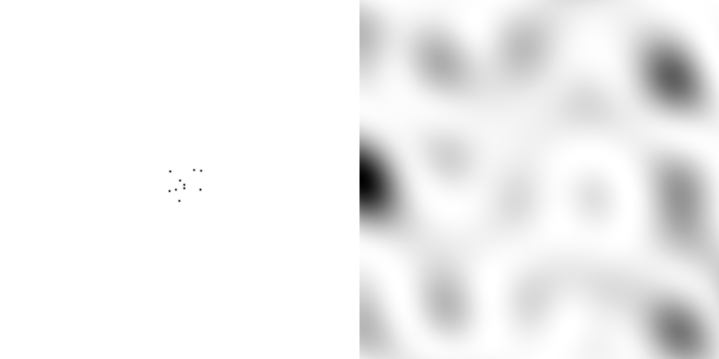
scattering from a structure
sample
detector

Slide 21
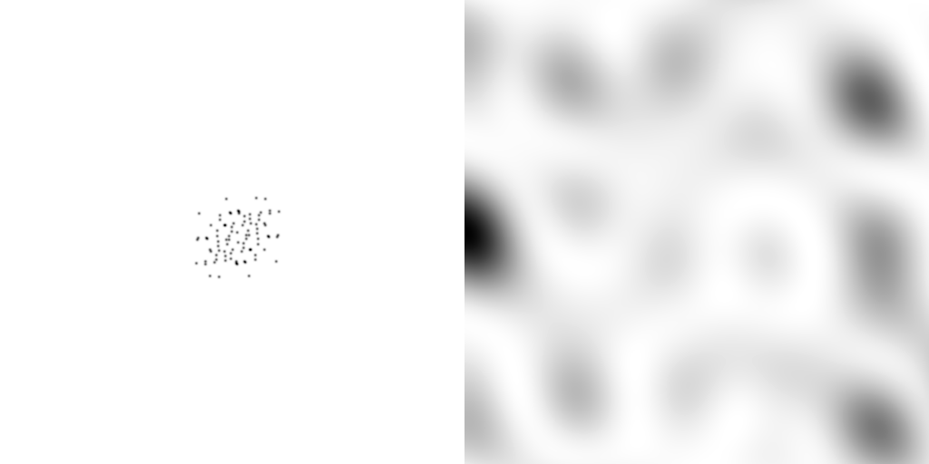
forward Fourier Transform
inverse Fourier Transform
no phase

Slide 22
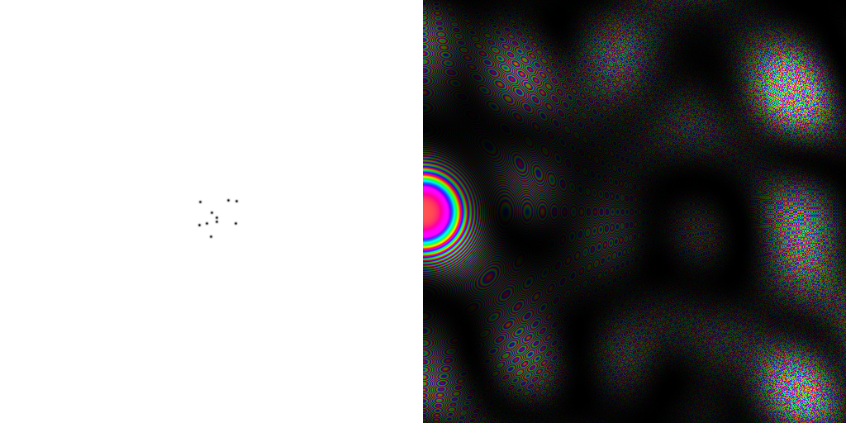










inverse Fourier Transform
scattering from a structure
colored by phase
sample
detector

Slide 23



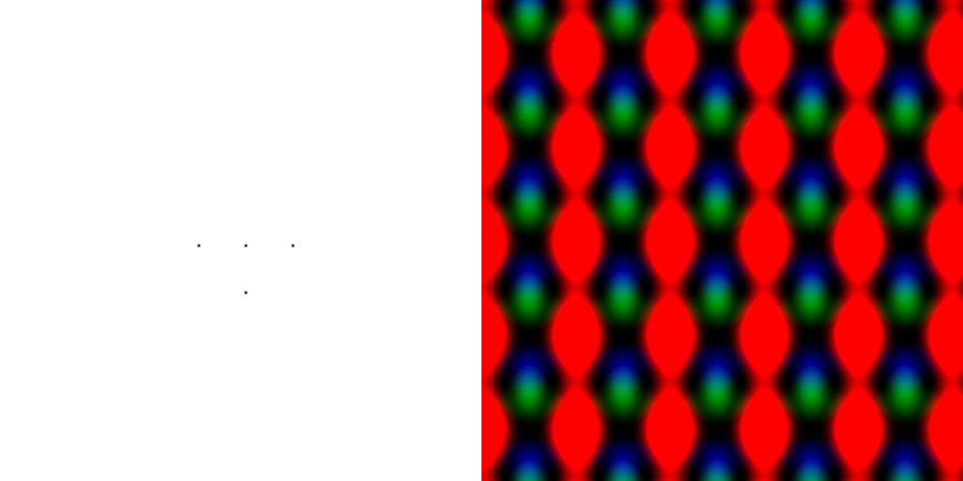
scattering from a lattice
colored by phase
sample
detector

Slide 24

scattering from a lattice
colored by phase
sample
detector

Slide 25
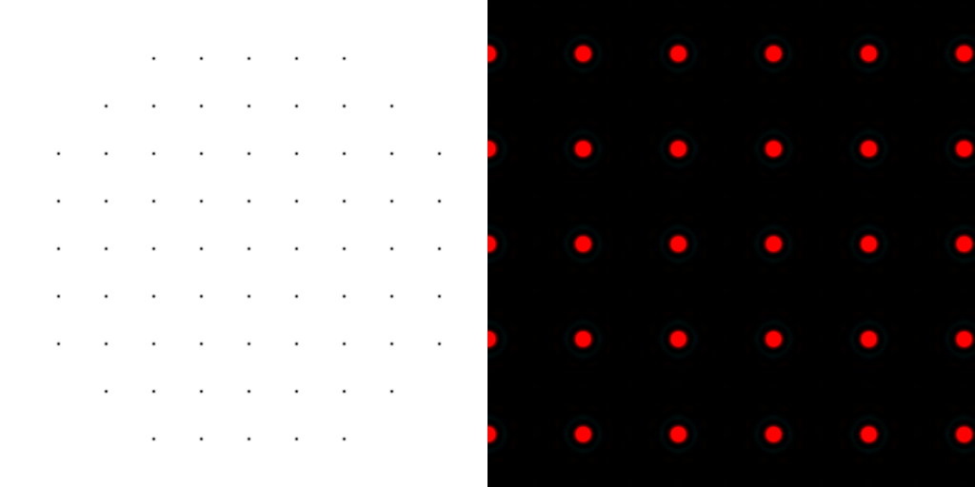
scattering from a lattice
colored by phase
sample
detector

Slide 26
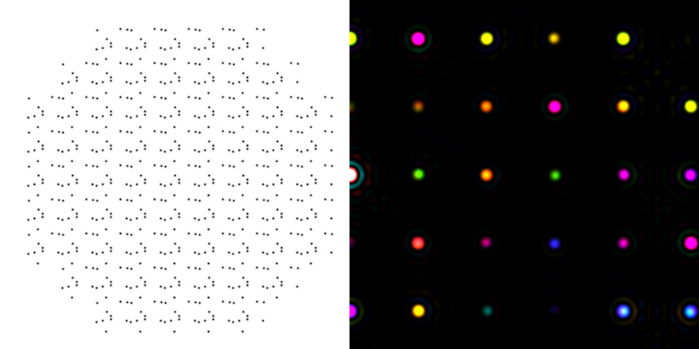
scattering from a crystal structure
colored by phase
sample
detector

Slide 27
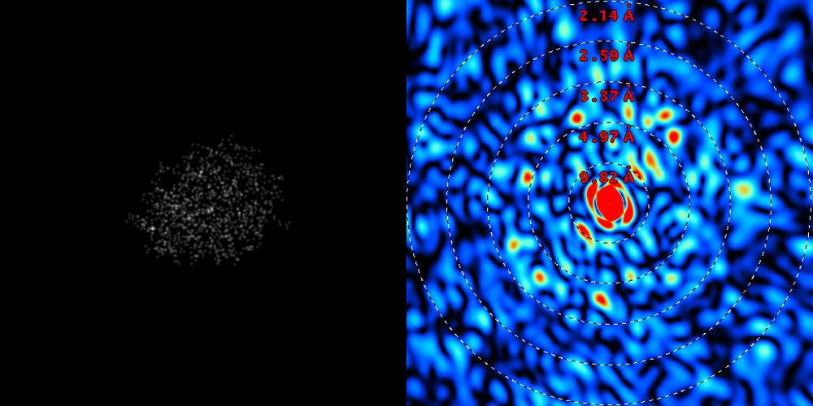
lysozyme: real and reciprocal

Slide 28
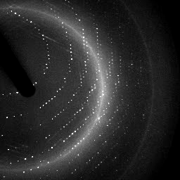

X-ray data are 3D!

Slide 29
Ewald's construction
Ewald sphere
(h,k,l)

Slide 30
Ewald's construction
Ewald sphere
(h,k,l)
d*

Slide 31
Ewald's construction
Ewald sphere
(h,k,l)
spindle axis
d*

Slide 32
Ewald's construction
Ewald sphere
Φ circle
(h,k,l)
spindle axis

Slide 33
Ewald's construction
Ewald sphere
Φ circle
(h,k,l)
spindle axis

Slide 34
Ewald's construction
Ewald sphere
Φ circle
(h,k,l)
diffracted ray
spindle axis

Slide 35
Ewald's construction
Ewald sphere
Φ circle
(h,k,l)
λ*
d*
spindle axis
diffracted ray
λ*

Slide 36
Ewald's construction
Ewald sphere
Φ circle
(h,k,l)
λ*
d*
spindle axis
diffracted ray
θ
λ*
λ = 2 d sin(θ)

Slide 37
Ewald's construction
Ewald sphere
Φ circle
(h,k,l)
λ*
d*
spindle axis
diffracted ray
λ*

Slide 38
mosaic spread
Ewald sphere
Φ circle
(h,k,l)
λ*
d*
diffracted ray
d*
spindle axis
λ*

Slide 39
mosaic spread
Ewald sphere
Φ circle
(h,k,l)
d*
diffracted rays
d*
spindle axis

Slide 40

mosaic spread = 0 º

Slide 41

mosaic spread = 0.1º

Slide 42

mosaic spread = 0.2º

Slide 43

mosaic spread = 0.4º

Slide 44

mosaic spread = 0.6º

Slide 45

mosaic spread = 0.8º

Slide 46

mosaic spread = 1.0º

Slide 47

mosaic spread = 1.5º

Slide 48

mosaic spread = 2.0º

Slide 49

mosaic spread = 2.5º

Slide 50

mosaic spread = 3.2º

Slide 51

mosaic spread = 6.4º

Slide 52

mosaic spread = 12.8º

Slide 53
Ewald’s “mosaic” picture

Slide 54
Ewald’s “mosaic” picture

Slide 55
Ewald’s “mosaic” picture
What is
this stuff?

Slide 56
“near”-ly Bragg’s Law
detector
atom #1
source
d
atom #2

Slide 57

mosaic block = “coherence length”
James R. W. (1962) Optical Principles of the Diffraction of X rays. Ox Bow press.

Slide 58
Scattering: line of atoms
x-ray beam
peak
intensity
integrated
intensity
“crystal”
detector

Slide 59








Scattering: line of atoms
10 atoms
50 atoms
100 atoms
200 atoms
300 atoms
400 atoms
500 atoms
1000 atoms
0.1 μm
0.5 μm
1 μm
2 μm
3 μm
4 μm
5 μm
10 μm
intensity (photons/SR/atom)
position on detector (mm)

Slide 60

Scattering: line of atoms
mosaic
block
size
mosaic
spread
peak intensity (photons/SR)
B factor
depends on detector distance !!!
integrated intensity never changes
number of atoms in line

Slide 61
Ewald’s “mosaic” picture
What is
this stuff?

Slide 62
Darwin’s original picture

Slide 63

“mosaicity” with visible light

Slide 64
mosaic spread = 12.8º

Slide 65

Now What?
10 Å

Slide 66

Resolution
http://bl831.als.lbl.gov/~jamesh/movies/resolution.mpeg

Slide 67
What is “disorder”?

Slide 68
What is “disorder”?

Slide 69
What is “disorder”?

Slide 70

What is “disorder”?
order
order
B-factor
disorder

Slide 71
“B” factors
ATOM 122 N LEU A 13 -3.244 25.808 19.998 1.00 16.96 N
ATOM 123 CA LEU A 13 -2.877 25.448 21.355 1.00 15.29 C
ATOM 124 C LEU A 13 -2.792 23.966 21.561 1.00 17.54 C
ATOM 125 O LEU A 13 -1.814 23.493 22.143 1.00 16.35 O
ATOM 126 CB LEU A 13 -3.907 26.164 22.268 1.00 18.72 C
ATOM 127 CG LEU A 13 -3.577 25.982 23.738 1.00 21.19 C
ATOM 128 CD1 LEU A 13 -2.283 26.820 24.019 1.00 19.43 C
ATOM 129 CD2 LEU A 13 -4.702 26.474 24.639 1.00 24.65 C
ATOM 130 N SER A 14 -3.677 23.149 20.979 1.00 15.96 N
ATOM 131 CA SER A 14 -3.646 21.711 21.061 1.00 18.26 C
ATOM 132 C SER A 14 -2.373 21.203 20.360 1.00 18.71 C
ATOM 133 O SER A 14 -1.747 20.315 20.930 1.00 17.47 O
ATOM 134 CB SER A 14 -4.875 21.077 20.419 1.00 17.62 C
ATOM 135 OG ASER A 14 -4.825 19.665 20.388 0.50 20.89 O
ATOM 136 OG BSER A 14 -6.027 21.408 21.164 0.50 18.67 O
ATOM 137 N LYS A 15 -2.045 21.772 19.215 1.00 18.03 N
ATOM 138 CA LYS A 15 -0.799 21.361 18.555 1.00 18.12 C
ATOM 139 C LYS A 15 0.446 21.707 19.351 1.00 18.81 C
ATOM 140 O LYS A 15 1.400 20.948 19.411 1.00 17.77 O
ATOM 141 CB LYS A 15 -0.700 22.034 17.177 1.00 14.49 C
ATOM 142 CG LYS A 15 -1.727 21.368 16.256 1.00 16.12 C
ATOM 143 CD LYS A 15 -1.663 22.147 14.936 1.00 19.40 C
ATOM 144 CE ALYS A 15 -2.725 21.614 13.986 0.50 17.42 C
ATOM 145 CE BLYS A 15 -1.750 21.211 13.750 0.50 17.01 C
ATOM 146 NZ ALYS A 15 -2.346 21.674 12.559 0.50 18.61 N
ATOM 147 NZ BLYS A 15 -3.052 20.513 13.741 0.50 18.76 N

Slide 72
“B” factors
B = 8π² u_{x}²
u_{x} = RMS variation perpendicular to plane

Slide 73
“B” factors
electron density (e⁻/Å³)
position (Å)

Slide 74
“B” factors
electron density (e⁻/Å³)
position (Å)

Slide 75
“B” factors
electron density (e⁻/Å³)
position (Å)

Slide 76
“B” factors
electron density (e⁻/Å³)
position (Å)

Slide 77
“B” factors
B ≈ 4d² + 12
d = resolution in Å
essentially, the “resolution” of an atom

Slide 78
What causes disorder?
Thermal vibration (B factor)
Micron-scale cracks (mosaic spread)
Stress and strain (sample handling)
Radiation Damage

Slide 79

Radiation damage
Howells, et al. (2009) J. Electron Spectrosc. Relat. Phenom. 170, 4-12.

Slide 80

Completeness: missing wedge
http://bl831.als.lbl.gov/~jamesh/movies/osc.mpeg

Slide 81
Global damage
10³
100
maximum tolerable dose (MGy)
10
1
1 2 3 5 7 10 20 40 70 100
resolution (Å)
Howells et al. (2009) J. Electron. Spectrosc. Relat. Phenom. 170 4-12

Slide 82
Global damage
10³
10 MGy/Å
100
maximum tolerable dose (MGy)
10
1
1 2 3 5 7 10 20 40 70 100
resolution (Å)
Howells et al. (2009) J. Electron. Spectrosc. Relat. Phenom. 170 4-12

Slide 83
10 MGy/Å
what the is a MGy?
http://bl831.als.lbl.gov/
damage_rates.pdf
Holton J. M. (2009) J. Synchrotron Rad. 16 133-42

Slide 84

How long will my crystal last?

Slide 85
Damage is done
by dose (MGy)
proportional to photons/area
not time
not heat

Slide 86
Minimum size for complete data set
1 Å
X-rays
2 Å
spots
B = 24
50%
solvent
crystal diameter (μm)
100 Da 1 kDa 10 kDa 100 kDa 1 MDa 10 MDa
molecular weight
Holton & Frankel (2010) Acta D 66 393-408.

Slide 87

Holton & Frankel (2010) Acta D 66 393-408.

Slide 88
Ratio of scattering to absorption
Elastic/photoelectric cross section
Atomic number (Z)

Slide 89
How do the
X-rays interact with my crystal?

Slide 90
Where do photons go?
Protein
1A x-rays
Transmitted (98%)
beamstop

Slide 91
Photonuclear absorption

Slide 92
Photonuclear absorption

Slide 93
Elastic scattering

Slide 94
Elastic scattering

Slide 95
How big is an atom?
C
N
O
H
S
U
1 Ångstrom (Å)
1 nanometer (10⁻⁹ m)

Slide 96
How big is an atom?
U
S
C
N
O
H
as seen by X-rays

Slide 97

Where do photons go?
Protein
1A x-rays
elastic scattering (6%)
Transmitted (98%)
beamstop

Slide 98
Elastic scattering

Slide 99
Inelastic scattering

Slide 100
Where do photons go?
Protein
1A x-rays
elastic scattering (6%)
Transmitted (98%)
beamstop

Slide 101
Where do photons go?
Protein
1A x-rays
elastic scattering (6%)
Transmitted (98%)
beamstop
inelastic scattering (7%)

Slide 102
Where do photons go?
Protein
1A x-rays
elastic scattering (6%)
Transmitted (98%)
beamstop
inelastic scattering (7%)
Re-emitted (99%)
Absorbed (~0%)

Slide 103
Photoelectric absorption

Slide 104
Photoelectric absorption
e⁻
+

Slide 105
Fluorescence
+

Slide 106
Fluorescence
e⁻
+

Slide 107




Fluorescence-based x-ray sources

Slide 108
What limits the source?
Fluorescence-based source:
Thermal distortion of anode
Accelerator-based source
Quality of optics
Electric bill

Slide 109
Auger emission
+

Slide 110
Auger emission
e⁻
++

Slide 111
Where do photons go?
Protein
1A x-rays
elastic scattering (6%)
Transmitted (98%)
beamstop
inelastic scattering (7%)
Re-emitted (99%)
Absorbed (~0%)

Slide 112
Where do photons go?
Protein
1A x-rays
elastic scattering (6%)
Transmitted (98%)
beamstop
inelastic scattering (7%)
Photoelectric (87%)
Re-emitted (99%)
Absorbed (~0%)

Slide 113
Where do photons go?
Protein
1A x-rays
elastic scattering (6%)
Transmitted (98%)
beamstop
inelastic scattering (7%)
Photoelectric (87%)
Re-emitted (99%)
Absorbed (~0%)
Re-emitted (~0%)
Absorbed (99%)

Slide 114
Where do photons go?
Protein
1A x-rays
elastic scattering (6%)
Transmitted (98%)
beamstop
inelastic scattering (7%)
Photoelectric (87%)
Re-emitted (99%)
Absorbed (~0%)
Re-emitted (~0%)
Absorbed (99%)
useful/absorbed energy: 7.3%

Slide 115
Photoelectric absorption

Slide 116
Photoelectric absorption
e⁻
+

Slide 117
Secondary ionization
e⁻

Slide 118
Secondary ionization
+
e⁻
e⁻

Slide 119
Sample atoms

Slide 120
Sample atoms

Slide 121
Primary ionization
e⁻
+

Slide 122
Secondary ionizations
e⁻
e⁻
+
e⁻
e⁻
+
+
+
+
+
e⁻
e⁻

Slide 123
Ionization track
e⁻
e⁻
e⁻
e⁻
+
e⁻
+
+
+
e⁻
e⁻
+
+
+
+
+
e⁻
+
e⁻
e⁻

Slide 124
Ionization track
e⁻
e⁻
e⁻
e⁻
+
e⁻
+
+
+
e⁻
e⁻
+
+
+
+
+
e⁻
+
e⁻
e⁻

Slide 125
Ionization track

Slide 126

Ionization track

Slide 127
Ionization track
~ 3 microns!

Slide 128
Excitation
e⁻

Slide 129
Excitation
e⁻

Slide 130
Excitation
e⁻

Slide 131
Excitation

Slide 132
Electron attachment
e⁻

Slide 133
Electron attachment
-

Slide 134


Solvated electron
e⁻

Slide 135

Solvated electron
e⁻

Slide 136


Slide 137


Slide 138
Excitation transfer

Slide 139
Excitation transfer
UV photon

Slide 140
Excitation transfer

Slide 141
Excitation transfer
r⁻⁶
Förster transfer

Slide 142
Excitation transfer

Slide 143
t = 0 s

Slide 144
t ≈ 10⁻¹⁵ s
e⁻
+
+
-

Slide 145
Timescales of radiation damage
LCLS
AS
bunch
Garret et. al. (2005) Chem. Rev. 105, 355-389

Slide 146
What does all that absorbed energy do?

Slide 147

D_{1/2} ~ 10 Gy
D_{1/2} >> 10¹² Gy

Slide 148

Sodium Chloride is Immortal!
D_{1/2} > 1 GGy

Slide 149

Sodium acetate trihydrate
D_{1/2} = 15 MGy
resolution: 0.92 Å
C2/c
R/Rfree: ~4%
avg B: ~ 0

Slide 150
lowest-angle spot: (1,1,0) 7.7 Å
integrated spot intensity
dose (MGy)

Slide 151


Slide 152


Slide 153


Slide 154


Slide 155


Slide 156


Slide 157


Slide 158


Slide 159


Slide 160


Slide 161


Slide 162


Slide 163


Slide 164


Slide 165


Slide 166


Slide 168


Slide 169


Slide 170


Slide 171


Slide 172


Slide 173


Slide 174
Specific damage rates
world records:
MGy reaction reference
~45 global damage Owen et al. (2006)
5 Se-Met Holton (2007)
4 Hg-S Ramagopal et al. (2004)
3 S-S Murray et al. (2002)
1 Br-RNA Olieric et al. (2007)
? Cl-C ???
0.5 Mn in PS II Yano et al. (2005)
0.02 Fe in myoglobin Denisov et al. (2007)
Holton (2009) J. Synchrotron Rad. 16 133-42

Slide 175
% error from rad dam
R_{iso} (%)
change in dose (MGy)
data taken from Banumathi, et al. (2004) Acta Cryst. D 60, 1085-1093.

Slide 176
% error from rad dam
R_{iso} ≈ 0.7 %/MGy
R_{iso} (%)
change in dose (MGy)
data taken from Banumathi, et al. (2004) Acta Cryst. D 60, 1085-1093.

Slide 177

The “non-isomorphism” problem
RMSD = 0.18 Å
Rel. Humidity: 84.2% vs 71.9%
R_{iso} = 44.5%

Slide 178
opened drop: you have ~30 seconds!
equilibrated drop

Slide 179
opened drop: you have ~30 seconds!
oil

Slide 180
oiled drop: you have ~3 hours
oil

Slide 181




oil is your friend

Slide 182
signal vs noise
“photon counting”
Read-out noise
Shutter jitter
Beam flicker
spot shape
radiation damage
σ(N) = sqrt(N)
rms 11.5 e-/pixel
rms 0.57 ms
0.15 %/√Hz
pixels? mosaicity?
B/Gray?

Slide 183
signal vs noise
fractional noise
“photon counting”
constant noise
σ(I) = k x I “% error”
σ(I) = k x sqrt(I)
σ(I) = k

Slide 184
signal vs noise
fractional noise
“photon counting”
constant noise
σ(I) = k x I “% error”
σ(I) = k x sqrt(I)
σ(I) = k

Slide 185
signal vs noise
fractional noise
“photon counting”
constant noise
σ(I) = k x I “% error”
σ(I) = k x sqrt(I)
σ(I) = k

Slide 186

Optimal exposure time
(faint spots)
t_{hr} Optimal exposure time for data set (s)
t_{ref} exposure time of reference image (s)
bg_{ref} background level near weak spots on
reference image (ADU)
bg₀ ADC offset of detector (ADU)
bg_{hr} optimal background level (via t_{hr})
σ₀ rms read-out noise (ADU)
gain ADU/photon
m multiplicity of data set (including partials)
adjust exposure
so this is ~100

Slide 187
Adding noise

Slide 188
Adding noise
1² + 1² = 1.4²

Slide 189
Adding noise
1² + 1² = 1.4²
3² + 1² = 3.2²
σ_{total}² = σ₁² + σ₂²

Slide 190
Adding noise
1² + 1² = 1.4²
3² + 1² = 3.2²
σ_{total}² = σ₁² + σ₂²

Slide 191
Adding noise
1² + 1² = 1.4²
3² + 1² = 3.2²
σ_{total}² = σ₁² + σ₂²

Slide 192
Adding noise
1² + 1² = 1.4²
3² + 1² = 3.2²
10² + 1² = 10.05²

Slide 193
signal vs noise
fractional noise
“photon counting”
constant noise
σ(I) = k x I “% error”
σ(I) = k x sqrt(I)
σ(I) = k

Slide 194
anomalous scattering
x-ray beam
sample
detector

Slide 195
anomalous scattering
x-ray beam
sample
detector

Slide 196
anomalous scattering
x-ray beam
sample
detector

Slide 197
anomalous scattering
x-ray beam
sample
detector

Slide 198
anomalous scattering
x-ray beam
sample
detector

Slide 199
anomalous signal
ΔF
F
√
# sites
MW (Da)
≈ 1.2 f”
f” | Element
0.5 | S P
4 | Se Br Fe
10 | Hg Gd Au Pt
World record!
ΔF/F = 0.5%
Wang, Dauter & Dauter (2006) Acta Cryst. D 62, 1475-1483.
Crick, F. H. C. & Magdoff, B. S. (1956) Acta Crystallogr. 9, 901-908.
Hendrickson, W. A. & Teeter, M. M. (1981) Nature 290, 107-113.

Slide 200
Fractional error
no “scale factor” is perfectly known
no source of light is perfectly stable
no shutter is perfectly reproducible
no crystal is perfectly still
no detector is perfectly calibrated

Slide 201
Darwin’s Formula
V_{xtal}
λ³ L
I(hkl) = I_{beam} r_{e}²
P A | F(hkl) |²
V_{cell}
ωV_{cell}
I(hkl) - photons/spot (fully-recorded)
I_{beam} - incident (photons/s/m² )
r_{e} - classical electron radius (2.818x10⁻¹⁵ m)
V_{xtal} - volume of crystal (in m³)
V_{cell} - volume of unit cell (in m³)
λ - x-ray wavelength (in meters!)
ω - rotation speed (radians/s)
L - Lorentz factor (speed/speed)
P - polarization factor
(1+cos²(2θ) -Pfac∙cos(2Φ)sin²(2θ))/2
A - attenuation factor
exp(-μ_{xtal}∙l_{path})
F(hkl) - structure amplitude (electrons)
C. G. Darwin (1914)

Slide 202
Darwin’s Formula
V_{xtal}
λ³ L
I(hkl) = I_{beam} r_{e}²
P A | F(hkl) |²
V_{cell}
ωV_{cell}
I(hkl) - photons/spot (fully-recorded)
I_{beam} - incident (photons/s/m² )
r_{e} - classical electron radius (2.818x10⁻¹⁵ m)
V_{xtal} - volume of crystal (in m³)
V_{cell} - volume of unit cell (in m³)
λ - x-ray wavelength (in meters!)
ω - rotation speed (radians/s)
L - Lorentz factor (speed/speed)
P - polarization factor
(1+cos²(2θ) -Pfac∙cos(2Φ)sin²(2θ))/2
A - attenuation factor
exp(-μ_{xtal}∙l_{path})
F(hkl) - structure amplitude (electrons)
C. G. Darwin (1914)

Slide 203
attenuation factor
μ
I_{T}
I_{beam}
A = = exp(-μt)
t
Bouguer, P. (1729). Essai d'optique sur la gradation de la lumière.
Lambert, J. H. (1760). Photometria: sive De mensura et gradibus luminis, colorum et umbrae. E. Klett.
Beer, A. (1852)."Bestimmung der Absorption des rothen Lichts in farbigen Flüssigkeiten", Ann. Phys. Chem 86, 78-90.

Slide 204
attenuation factor
μ
t_{out}
t_{in}
I_{T}
I_{beam}
I_{T}
I_{beam}
A = = exp(-μ(t_{in}+ t_{out}))
A = = exp(-μt)
t
Bouguer, P. (1729). Essai d'optique sur la gradation de la lumière.
Lambert, J. H. (1760). Photometria: sive De mensura et gradibus luminis, colorum et umbrae. E. Klett.
Beer, A. (1852)."Bestimmung der Absorption des rothen Lichts in farbigen Flüssigkeiten", Ann. Phys. Chem 86, 78-90.

Slide 205
attenuation factor
t_{out}
t_{in}
μ
t_{out}
t_{in}
t_{out}
I_{T}
I_{beam}
t_{in}
A = = exp(-μ(t_{in}+ t_{out}))
Bouguer, P. (1729). Essai d'optique sur la gradation de la lumière.
Lambert, J. H. (1760). Photometria: sive De mensura et gradibus luminis, colorum et umbrae. E. Klett.
Beer, A. (1852)."Bestimmung der Absorption des rothen Lichts in farbigen Flüssigkeiten", Ann. Phys. Chem 86, 78-90.

Slide 206
attenuation factor
μ_{solvent}
t_{so}
t_{xo}
t_{si}
t_{xi}
μ_{xtal}
t_{so}
t_{xo}
t_{si}
t_{xi}
t_{so}
t_{xo}
I_{T}
I_{beam}
t_{si}
t_{xi}
A = = exp[-μ_{xtal}(t_{xi}+ t_{xo})
-μ_{solvent}(t_{si} + t_{so})]
Bouguer, P. (1729). Essai d'optique sur la gradation de la lumière.
Lambert, J. H. (1760). Photometria: sive De mensura et gradibus luminis, colorum et umbrae. E. Klett.
Beer, A. (1852)."Bestimmung der Absorption des rothen Lichts in farbigen Flüssigkeiten", Ann. Phys. Chem 86, 78-90.

Slide 207
Fractional error
no “scale factor” is perfectly known
no source of light is perfectly stable
no shutter is perfectly reproducible
no crystal is perfectly still
no detector is perfectly calibrated

Slide 208
Darwin’s Formula
V_{xtal}
λ³ L
I(hkl) = I_{beam} r_{e}²
P A | F(hkl) |²
V_{cell}
ωV_{cell}
I(hkl) - photons/spot (fully-recorded)
I_{beam} - incident (photons/s/m² )
r_{e} - classical electron radius (2.818x10⁻¹⁵ m)
V_{xtal} - volume of crystal (in m³)
V_{cell} - volume of unit cell (in m³)
λ - x-ray wavelength (in meters!)
ω - rotation speed (radians/s)
L - Lorentz factor (speed/speed)
P - polarization factor
(1+cos²(2θ) -Pfac∙cos(2Φ)sin²(2θ))/2
A - attenuation factor
exp(-μ_{xtal}∙l_{path})
F(hkl) - structure amplitude (electrons)
C. G. Darwin (1914)

Slide 209
Darwin’s Formula
V_{xtal}
λ³ L
I(hkl) = I_{beam} r_{e}²
P A | F(hkl) |²
V_{cell}
ωV_{cell}
I(hkl) - photons/spot (fully-recorded)
I_{beam} - incident (photons/s/m² )
r_{e} - classical electron radius (2.818x10⁻¹⁵ m)
V_{xtal} - volume of crystal (in m³)
V_{cell} - volume of unit cell (in m³)
λ - x-ray wavelength (in meters!)
ω - rotation speed (radians/s)
L - Lorentz factor (speed/speed)
P - polarization factor
(1+cos²(2θ) -Pfac∙cos(2Φ)sin²(2θ))/2
A - attenuation factor
exp(-μ_{xtal}∙l_{path})
F(hkl) - structure amplitude (electrons)
C. G. Darwin (1914)

Slide 210
Lorentz Factor
Ewald sphere
Φ circle
(h,k,l)
diffracted ray
spindle axis

Slide 211
Lorentz Factor
Ewald sphere
diffracted ray
spindle axis

Slide 212
Lorentz Factor
Ewald sphere
diffracted ray
spindle axis

Slide 213
Lorentz Factor
Ewald sphere
diffracted ray
spindle axis

Slide 214
Lorentz Factor
Ewald sphere
Φ circle
(h,k,l)
diffracted ray
spindle axis

Slide 215

Lorentz Factor
refined mis-setting angle (degrees)
-0.2 -0.1 0 0.1 0.2
50 100 150 200 250 300 350 400 450 500
phi position (degrees)

Slide 216
Fractional error
no “scale factor” is perfectly known
no source of light is perfectly stable
no shutter is perfectly reproducible
no crystal is perfectly still
no detector is perfectly calibrated

Slide 217
Fractional error
no “scale factor” is perfectly known
no source of light is perfectly stable
no shutter is perfectly reproducible
no crystal is perfectly still
no detector is perfectly calibrated

Slide 218
Darwin’s Formula
V_{xtal}
λ³ L
I(hkl) = I_{beam} r_{e}²
P A | F(hkl) |²
V_{cell}
ωV_{cell}
I(hkl) - photons/spot (fully-recorded)
I_{beam} - incident (photons/s/m² )
r_{e} - classical electron radius (2.818x10⁻¹⁵ m)
V_{xtal} - volume of crystal (in m³)
V_{cell} - volume of unit cell (in m³)
λ - x-ray wavelength (in meters!)
ω - rotation speed (radians/s)
L - Lorentz factor (speed/speed)
P - polarization factor
(1+cos²(2θ) -Pfac∙cos(2Φ)sin²(2θ))/2
A - attenuation factor
exp(-μ_{xtal}∙l_{path})
F(hkl) - structure amplitude (electrons)
C. G. Darwin (1914)

Slide 219
Beam Flicker
1/f noise or “flicker noise”
comes from everything

Slide 220
Beam Flicker
1/f noise or “flicker noise”
comes from everything

Slide 221
Beam Flicker
1/f noise or “flicker noise”
comes from everything

Slide 222
Beam Flicker
1/f noise or “flicker noise”
comes from everything

Slide 223
Beam Flicker
1/f noise or “flicker noise”
comes from everything

Slide 224
Beam Flicker
1/f noise or “flicker noise”
comes from everything

Slide 225
Beam Flicker
1/f noise or “flicker noise”
comes from everything

Slide 226
Beam Flicker
1/f noise or “flicker noise”
comes from everything

Slide 227
Beam Flicker
1/f noise or “flicker noise”
comes from everything

Slide 228
Beam Flicker
1/f noise or “flicker noise”
comes from everything

Slide 229
Beam Flicker
normalized flux
time (seconds)

Slide 230
Beam Flicker
pinhole
removed
normalized flux
time (seconds)

Slide 231
Fractional error
no “scale factor” is perfectly known
no source of light is perfectly stable
no shutter is perfectly reproducible
no crystal is perfectly still
no detector is perfectly calibrated

Slide 232
Shutter Jitter
open
closed
shutter jitter

Slide 233
Fractional error
no “scale factor” is perfectly known
no source of light is perfectly stable
no shutter is perfectly reproducible
no crystal is perfectly still
no detector is perfectly calibrated

Slide 234
Darwin’s Formula
V_{xtal}
λ³ L
I(hkl) = I_{beam} r_{e}²
P A | F(hkl) |²
V_{cell}
ωV_{cell}
I(hkl) - photons/spot (fully-recorded)
I_{beam} - incident (photons/s/m² )
r_{e} - classical electron radius (2.818x10⁻¹⁵ m)
V_{xtal} - volume of crystal (in m³)
V_{cell} - volume of unit cell (in m³)
λ - x-ray wavelength (in meters!)
ω - rotation speed (radians/s)
L - Lorentz factor (speed/speed)
P - polarization factor
(1+cos²(2θ) -Pfac∙cos(2Φ)sin²(2θ))/2
A - attenuation factor
exp(-μ_{xtal}∙l_{path})
F(hkl) - structure amplitude (electrons)
C. G. Darwin (1914)

Slide 235
xtal vibration noise
diffracted beam
incident beam

Slide 236
xtal vibration noise
diffracted beam
incident beam

Slide 237
xtal vibration noise
diffracted beam
incident beam

Slide 238
xtal vibration noise
diffracted beam
incident beam

Slide 239
xtal vibration noise
diffracted beam
incident beam

Slide 240
xtal vibration noise
diffracted beam
incident beam

Slide 241
Shutter Jitter
CC to correct model
rms timing error (% exposure)

Slide 242
Beam Flicker
CC to correct model
flicker noise (%/√Hz)

Slide 243
Solution to vibration:
attenu-wait!
reduce flux
increase exposure
Solution to systematic error:
Never use same pixel twice

Slide 244
Fractional error
no “scale factor” is perfectly known
no source of light is perfectly stable
no shutter is perfectly reproducible
no crystal is perfectly still
no detector is perfectly calibrated

Slide 245
Detector calibration
air
plastic
Gd₂O₂S:Tb
fibers

Slide 246
Detector calibration
x-rays
air
plastic
Gd₂O₂S:Tb
fibers

Slide 247
Detector calibration
x-rays
air
plastic
Gd₂O₂S:Tb
fibers

Slide 248
Detector calibration
x-rays
air
plastic
Gd₂O₂S:Tb
fibers

Slide 249
Detector calibration
x-rays
air
plastic
Gd₂O₂S:Tb
fibers

Slide 250
Detector calibration
x-rays
air
plastic
Gd₂O₂S:Tb
fibers

Slide 251
Detector calibration
x-rays
air
plastic
Gd₂O₂S:Tb
fibers

Slide 252

Detector calibration: 7247 eV
target:
oil
distance:
900 mm
2θ: 12°

Slide 253

Detector calibration: 7235 eV
target:
oil
distance:
900 mm
2θ: 12°

Slide 254

Detector calibration
+10%
-10%

Slide 255

Detector calibration errors: detector 2

Slide 256

Detector calibration errors: detector 3

Slide 257

Detector calibration errors
Pixel arrays are not immune!
Dan Schuette PhD Thesis (2008) Fig 6.22 page 198, Gruner Lab, Cornell University.

Slide 258

Spatial Noise

Slide 259
Spatial Noise
down

Slide 260
Spatial Noise
down
up

Slide 261
Spatial Noise
down
up
R_{separate}

Slide 262
Spatial Noise
odd
even
R_{mixed}

Slide 263
Spatial Noise
separate:
2.5%

Slide 264
Spatial Noise
separate:
mixed:
2.5%
0.9%

Slide 265
Spatial Noise
separate:
mixed:
2.5%
0.9%
2.5%²-0.9%² = 2.3%²

Slide 266

Spatial Noise: Q315r vs Pilatus
3.5
3.0
2.5
2.0
1.5
1.0
0.5
Q315r
average change in spot intensity (%)
anomalous mates typically
> 100 mm apart
Pilatus
0.1 1 10 100
distance between spots (mm)
Holton, Frankel, Gonzalez, Waterman and Wang (2010) in preparation

Slide 267
Required multiplicity
^{mult >} (—)²
~3%
<ΔF/F>

Slide 268


Multi-crystal strategies
Kendrew et al. (1960) "Structure of Myoglobin” Nature 185, 422-427.

Slide 269

140-fold multiplicity
16 crystals
7.4σ = Na
DELFAN residual anomalous difference
data Courtesy of Tom & Janet

Slide 270
Discerning Na⁺ from Mg⁺⁺
DELFAN peak height (σ)
N
O
F
Ne
Na
Mg
f’’ (electrons)

Slide 271
Detector calibration
good!
good!
calibration error (%)
bad!
photon energy (keV)

Slide 272

7247 eV

Slide 273

7235 eV

Slide 274

Detector calibration
7223 eV

Slide 275
Holton & Frankel (2010) Acta D 66 393-408.

Slide 276
What is holding us back?
( if not rad dam! )
Weak spots (high-res)
  background
  solution: use as few pixels as possible
MAD/SAD (small differences)
  fractional errors
  solution: use as many pixels as possible

Slide 277
Summary
http://bl831.als.lbl.gov/xtalsize.html
http://bl831.als.lbl.gov/~jamesh/powerpoint/AACS_diffraction_2013.pptx
100 ADU/pixel
10 MGy/Å
~3% error per spot, 1%/MGy
7235 eV for S-SAD

