Slide 1
Pattersons
The “third space”
of crystallography

Slide 2
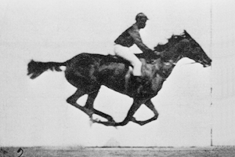
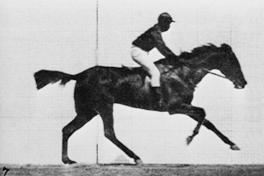
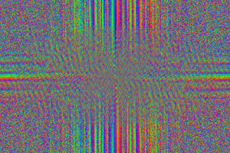
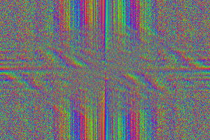
The “phase problem”

Slide 3
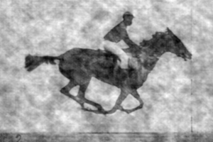
The “phase problem”
Phases
Amplitudes

Slide 4
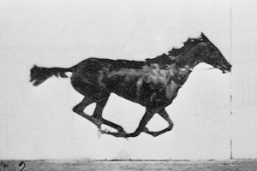
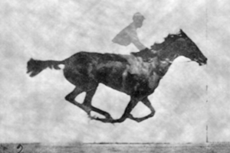
The “phase problem”
Phases
Amplitudes

Slide 5
The “spaces” of crystallography
Direct/real space
Distances are in Å, Angles are in degrees
Reciprocal space
Distances in 1/Å, Angles are different
Patterson space
Distances are in Å , Angles are in degrees
Relative distances only, origin lost
“direction” is preserved

Slide 6
scattering
x-ray beam
sample
detector
detector

Slide 7
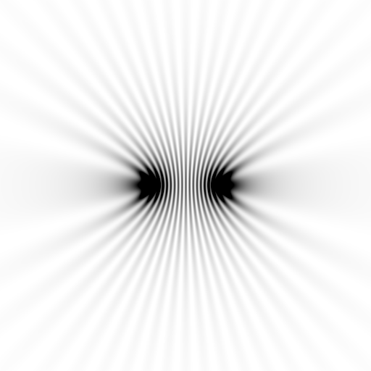
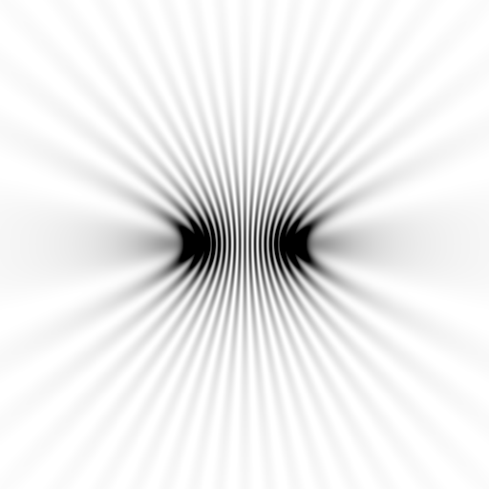
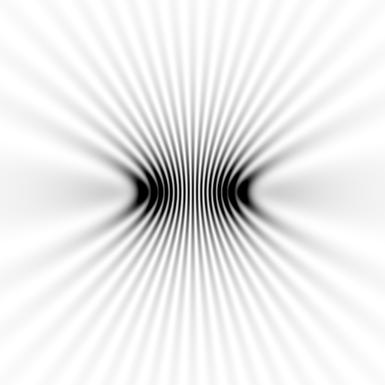
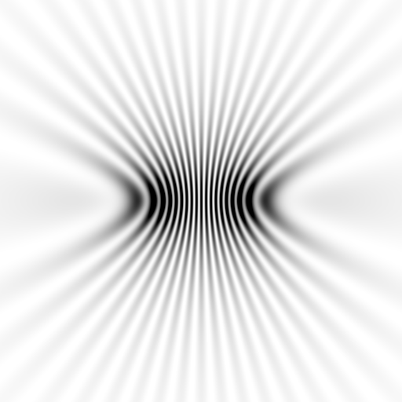
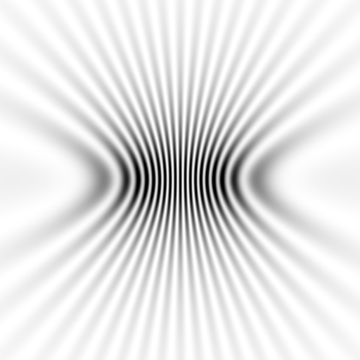
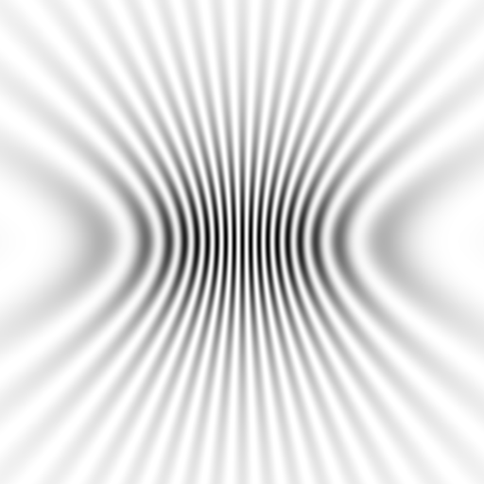

Slide 8
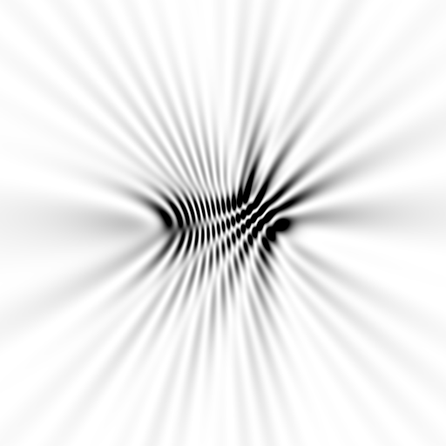
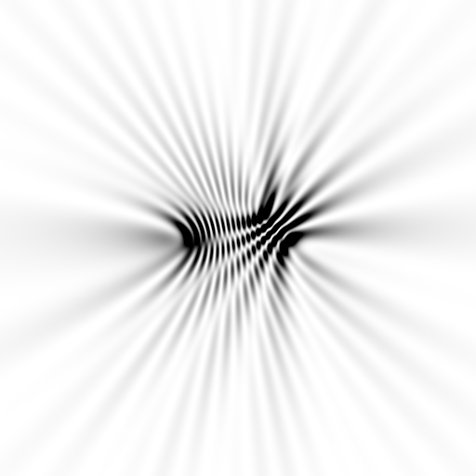

Slide 9
How to make a Patterson map:
Set all phases to zero
Square all structure factors
Calculate Fourier transform

Slide 10
One atom in unit cell
Electron density
Fraction across unit cell

Slide 11
Patterson: one atom
Electron density
Fraction across unit cell

Slide 12
Patterson: one atom
Electron density
Fraction across unit cell

Slide 13
Patterson: one atom
Electron density
Fraction across unit cell

Slide 14
Patterson: two atoms
Electron density
Fraction across unit cell

Slide 15
Patterson: three atoms
Electron density
Fraction across unit cell

Slide 16
Patterson: three atoms
Better resolution!
Electron density
Fraction across unit cell

Slide 17
Patterson: five atoms
Electron density
Fraction across unit cell

Slide 18
Patterson: five atoms
Electron density
Fraction across unit cell

Slide 19
scattering from a structure
sample
detector

Slide 20
forward Fourier Transform
inverse Fourier Transform
no phase
Patterson map!

Slide 21
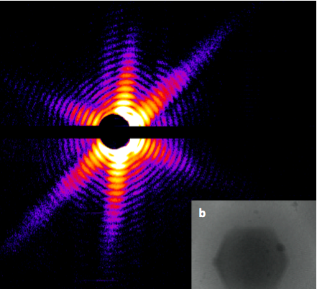
Snapshot from single virus particle
2 keV LCLS 200 fs Mimi virus single-shot.
_{200 nm}
_{Reconstructed image}
_{Resolution 20nm}
_{TEM}
Seibert, et al. (2011). Nature 470, 78-81.
Notes:
what limits single-particle resolution ?
get 100 times more photons/shot if correctly focussed beam
get 100 times more with submicron beam focus on CXI chamber
Problem – scattering goes from N^2 to N (Wilson statistics).
So use a-priori information – modelling Axel Brummer
Make beam smaller than jet to elliminate streak
₂₁

Slide 22
lysozyme: real and reciprocal

Slide 23
forward Fourier Transform
9 atoms

Slide 24
forward Fourier Transform
10 atoms

Slide 25
Patterson map
10 atoms

Slide 26
Patterson map
9 atoms

Slide 27
Difference Patterson
Still no phases!

Slide 28
forward Fourier Transform
9 atoms

Slide 29
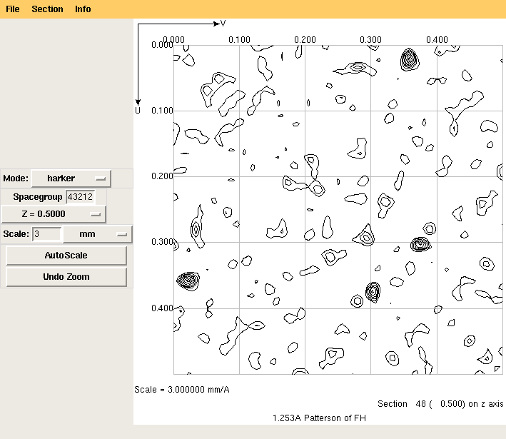
Harker Section of a Patterson

Slide 30
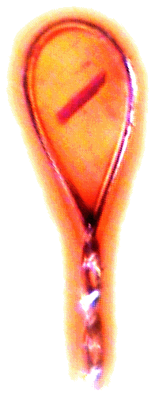
X-ray data are 3D!

Slide 31
Patterson: five atoms + 3-fold symmetry
Electron density
Fraction across unit cell

Slide 32
Patterson: five atoms + 3-fold symmetry
Electron density
Fraction across unit cell

Slide 33
Major Phasing techniques
Molecular Replacement
Multiple Isomorphous Replacement
Anomalous Diffraction
Direct methods

Slide 34
2Fo-Fc maps
Electron density
Fraction across unit cell

Slide 35
2Fo-Fc maps
Electron density
Fraction across unit cell

Slide 36
2Fo-Fc maps
Electron density
Fraction across unit cell

Slide 37
2Fo-Fc maps
Electron density
Fraction across unit cell

Slide 38
2Fo-Fc maps
Electron density
Fraction across unit cell

Slide 39
2Fo-Fc maps
Electron density
Fraction across unit cell

Slide 40
2Fo-Fc maps
Electron density
Fraction across unit cell

Slide 41
2Fo-Fc maps
Electron density
Fraction across unit cell

Slide 42
2Fo-Fc maps
Electron density
Fraction across unit cell

Slide 43
2Fo-Fc maps
Electron density
Fraction across unit cell

Slide 44
2Fo-Fc maps
Electron density
Fraction across unit cell

Slide 45
2Fo-Fc maps
Electron density
Fraction across unit cell

Slide 46
2Fo-Fc maps
Electron density
Fraction across unit cell

Slide 47
2Fo-Fc maps
Electron density
Fraction across unit cell

Slide 48
2Fo-Fc maps
Electron density
Fraction across unit cell

Slide 49
The “phase problem”
Phases
Amplitudes
F_{obs}

Slide 50
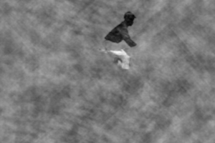
The “phase problem”
Phases & Amplitudes
Amplitudes
F_{obs}-F_{calc}

Slide 51
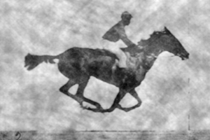
The “phase problem”
Phases & Amplitudes
Amplitudes
2F_{obs}-F_{calc}

Slide 52
The “phase problem”
Phases
Amplitudes

Slide 53
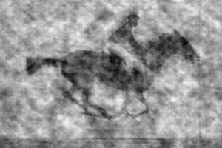
The “phase problem”
Phases & Amplitudes
Amplitudes
2F_{obs}-F_{calc}

Slide 54
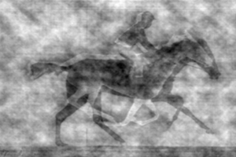
The “phase problem”
Phases & Amplitudes
Amplitudes
2mF_{obs}-F_{calc} (σ_{A} weighting)

Slide 55
anomalous scattering
x-ray beam
sample
detector

Slide 56
anomalous scattering
x-ray beam
sample
detector

Slide 57
anomalous scattering
x-ray beam
sample
detector

Slide 58
anomalous scattering
x-ray beam
sample
detector

Slide 59
anomalous scattering
x-ray beam
sample
detector

Slide 60
Harker Section of a Patterson

Slide 61
Summary
Patterson = real-space representation of all information in diffraction pattern
“small”, high-resolution structures solved with no phases!
Difference Pattersons for finding heavy atom sites
Native Patterson for symmetry

