Slide 1
Where do the
X-rays come from?

Slide 2
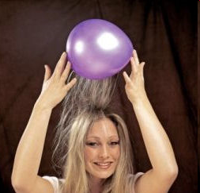
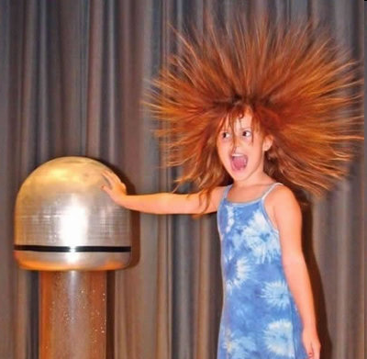
Electric charge
balloon
-
-
-
-
-
-
Wool Sweater
+ + + + + +

Slide 3

Electric field of a moving charge

Slide 4
Electric field of a moving charge
accelerating charges
make
electromagnetic waves
(light)

Slide 5
Bending Magnet
S
electron beam
X-rays !
N

Slide 6
Two Bending Magnets
S
N
electron beam
N
S
2x X-rays !

Slide 7
Wiggler
8x X-rays !
S
N
S
N
S
N
S
N
N
S
N
S
N
S
N
S

Slide 8
Undulator
> 8x X-rays !
S
N
S
N
S
N
S
N
N
S
N
S
N
S
N
S

Slide 9
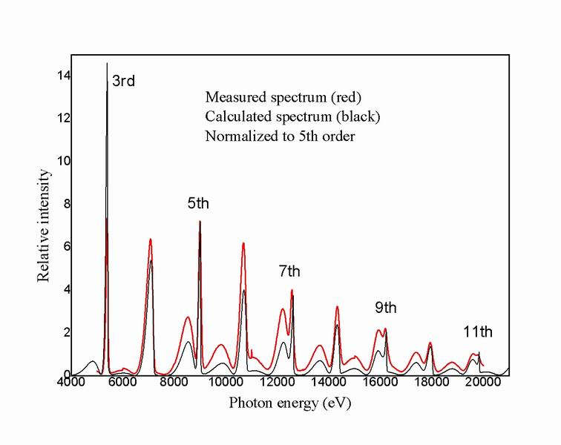
Undulator emission spectrum

Slide 10
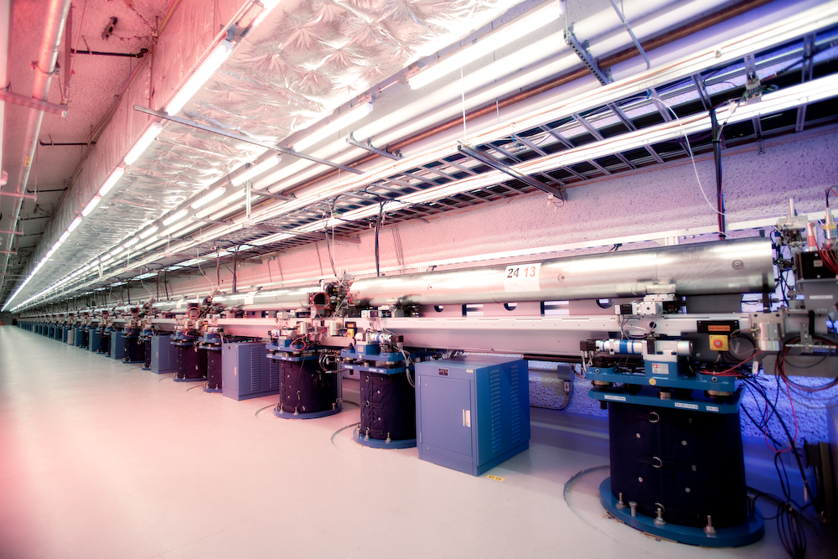
LCLS undulator hall

Slide 11

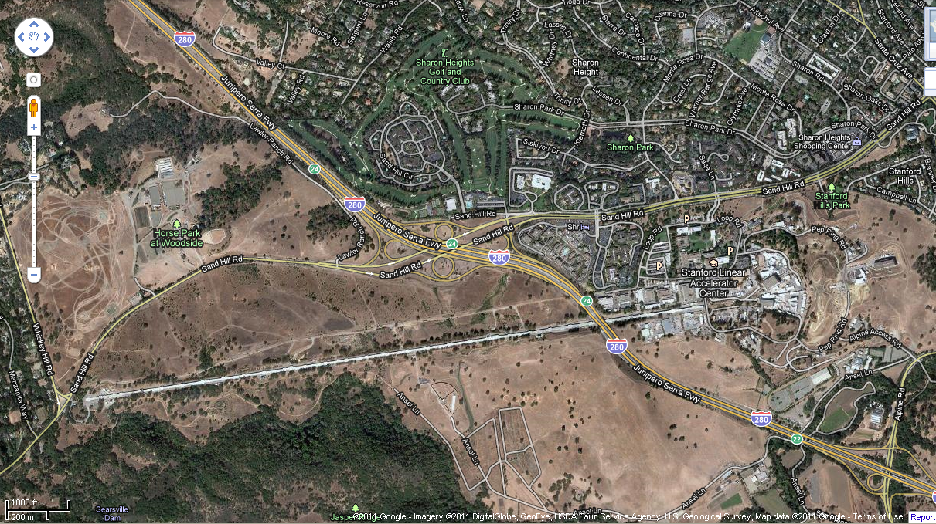
LCLS at SLAC

Slide 12
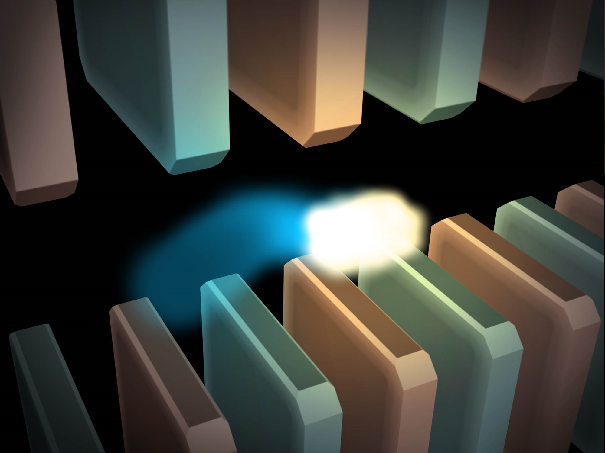
Electric field of a moving charge

Slide 13
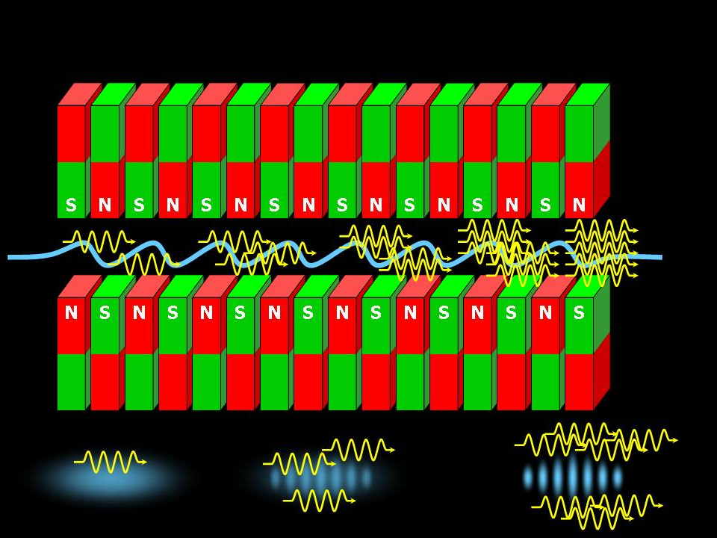
SASE effect

Slide 14
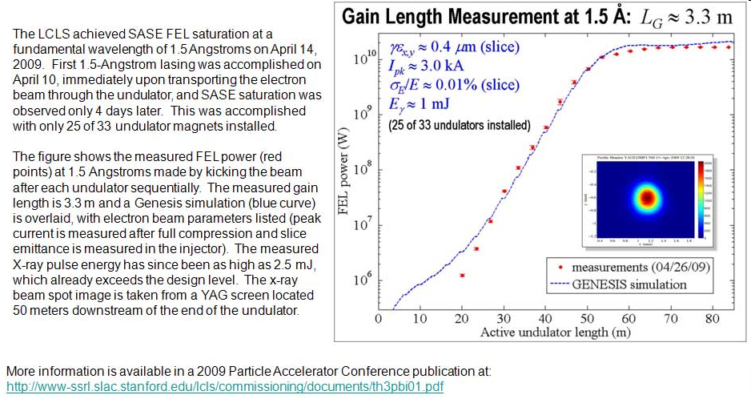
Self-Amplified Stimulated Emission (SASE) effect

Slide 15
Accelerator-based light source terminology
Code name Translation
First Generation Bending Magnet
Second Generation Wiggler
Third Generation Undulator
Fourth Generation Free electron laser

Slide 16
The truth about x-ray beams
Term units significance
Flux photons/s duration of experiment
Beam Size μm match to crystal
Divergence mrad spot size vs distance
Wavelength Å resolution and absorption
Emittance size x div constant limited by source/optics
Flux density ph/s/area scattering/damage rate
Fluence ph/area radiation damage

Slide 17
Spot Shape
Ewald sphere
(h,k,l)

Slide 18
Spot Shape
Ewald sphere
(h,k,l)
d*

Slide 19
Spot Shape
Ewald sphere
(h,k,l)
spindle axis
d*

Slide 20
Spot Shape
Ewald sphere
Φ circle
(h,k,l)
spindle axis

Slide 21
Spot Shape
Ewald sphere
Φ circle
(h,k,l)
spindle axis

Slide 22
Spot Shape
Ewald sphere
Φ circle
(h,k,l)
diffracted ray
spindle axis

Slide 23
Spot Shape
Ewald sphere
Φ circle
(h,k,l)
λ*
d*
spindle axis
diffracted ray
λ*

Slide 24
Spot Shape
Ewald sphere
Φ circle
(h,k,l)
λ*
d*
spindle axis
diffracted ray
θ
λ*
λ = 2 d sin(θ)

Slide 25
Spot shape
Ewald sphere
Φ circle
(h,k,l)
λ*
d*
spindle axis
diffracted ray
λ*

Slide 26
beam divergence
Ewald sphere
Φ circle
(h,k,l)
λ*
d*
spindle axis
diffracted ray
λ*

Slide 27
beam divergence
Ewald sphere
Φ circle
(h,k,l)
d*
λ*
diffracted ray
spindle axis
λ*

Slide 28
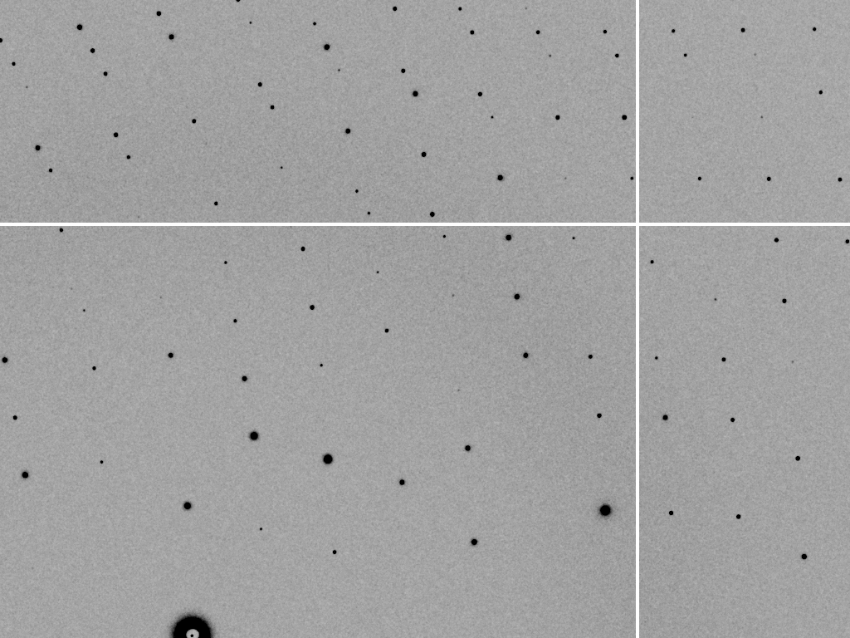
divergence = 0 º

Slide 29
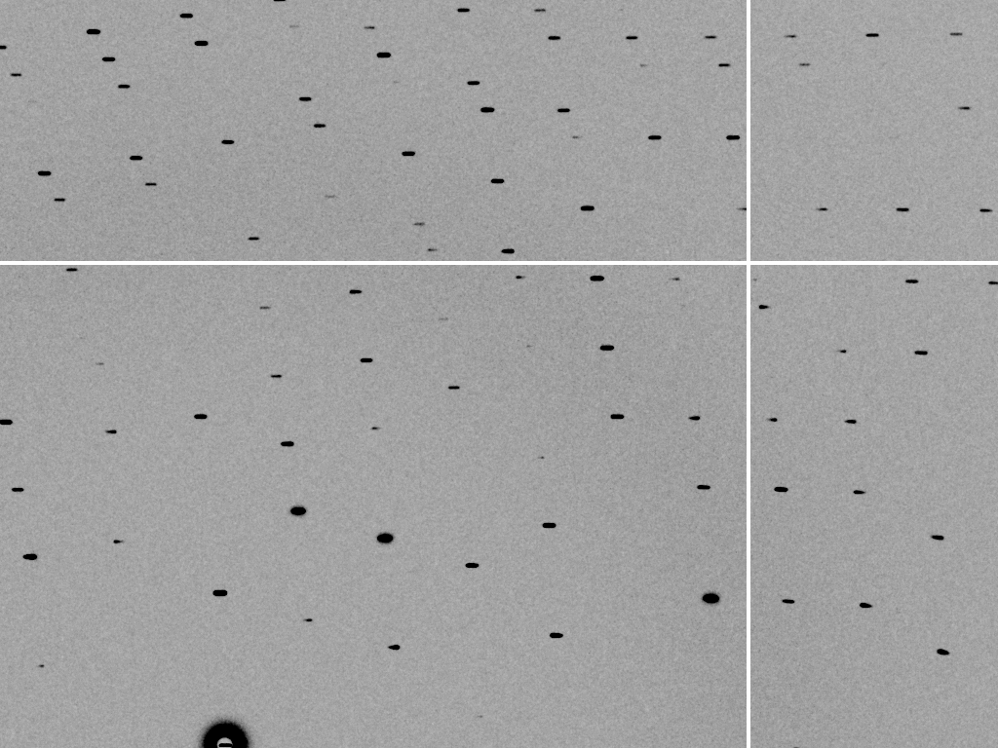
divergence = 0.3 º

Slide 30
beam divergence
Ewald sphere
Φ circle
(h,k,l)
λ*
d*
spindle axis
diffracted ray
λ*

Slide 31
spectral dispersion
Ewald sphere
Φ circle
(h,k,l)
λ*
d*
spindle axis
diffracted ray
λ*

Slide 32
spectral dispersion
Ewald sphere
Φ circle
(h,k,l)
λ’*
d*
spindle axis
diffracted ray
λ’*

Slide 33
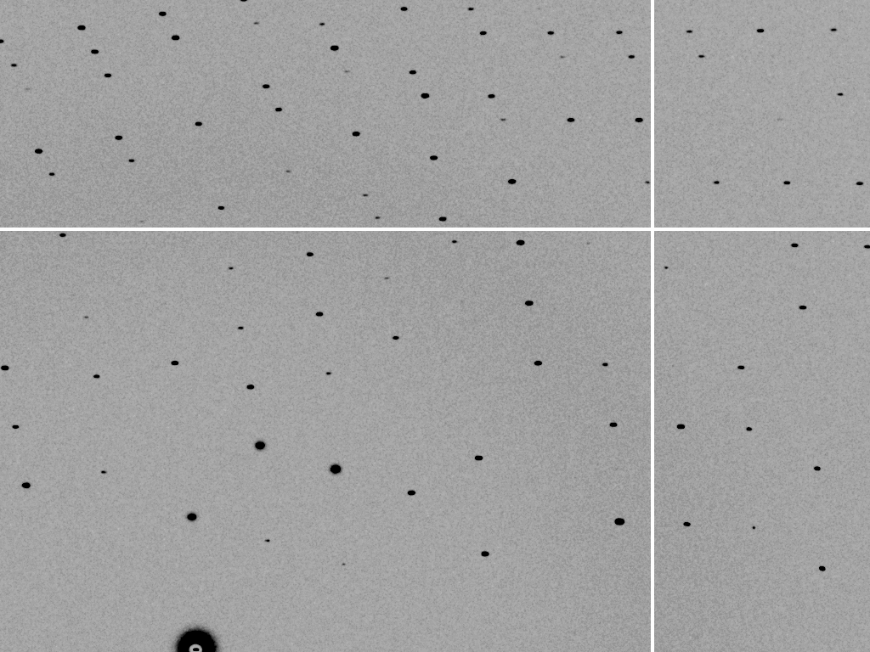
dispersion = 0

Slide 34

dispersion = 0.014% (Si 111)

Slide 35
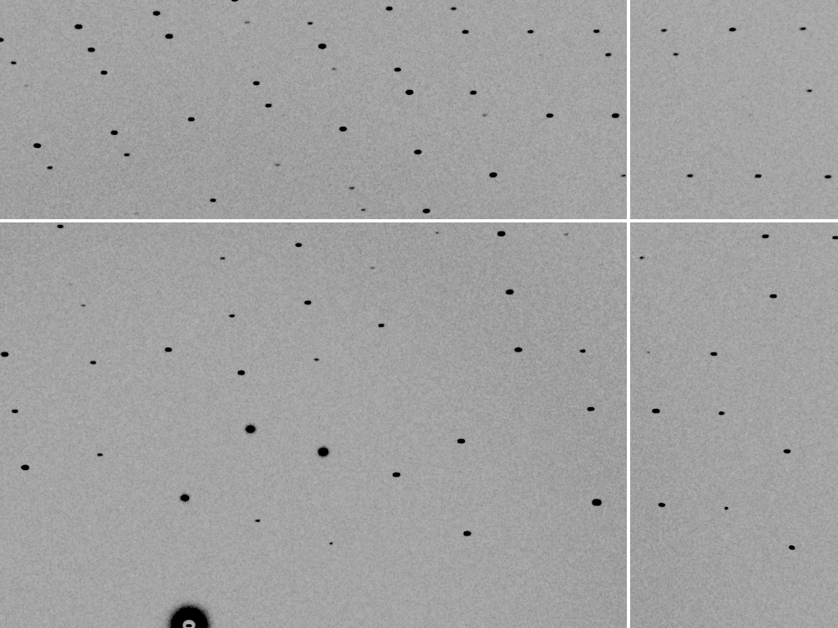
dispersion = 0.25% (CuK_{α})

Slide 36
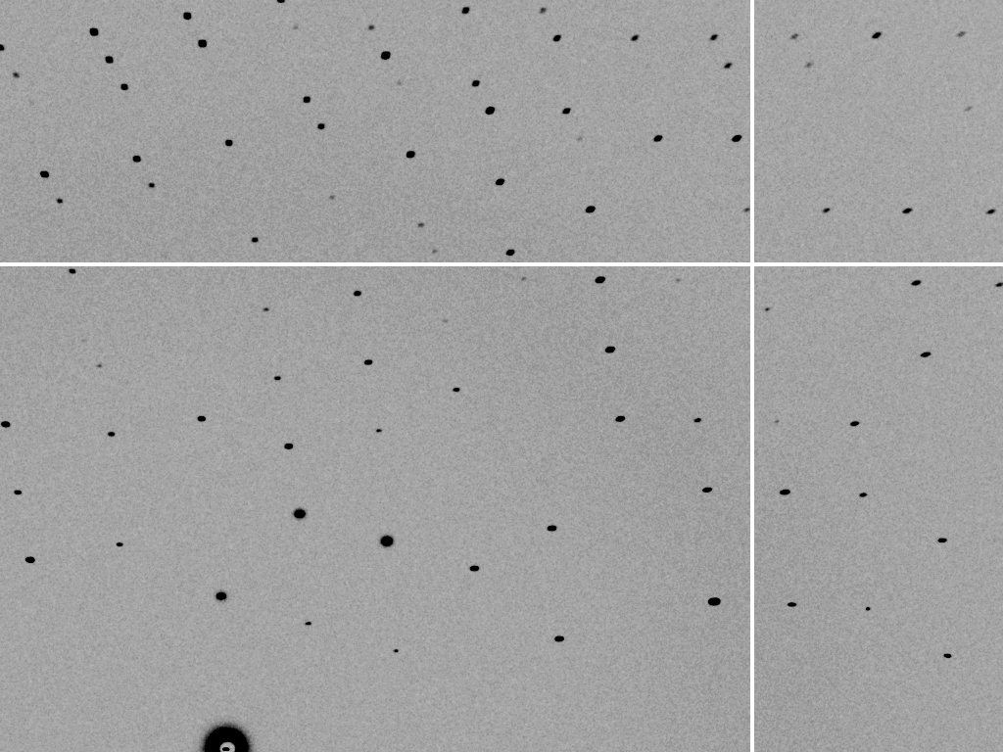
dispersion = 0.6%

Slide 37

dispersion = 1.3%

Slide 38

dispersion = 2.6%

Slide 39

dispersion = 5.1%

Slide 40
mosaic spread
Ewald sphere
Φ circle
(h,k,l)
λ*
d*
diffracted ray
d*
spindle axis
λ*

Slide 41
mosaic spread
Ewald sphere
Φ circle
(h,k,l)
d*
diffracted rays
d*
spindle axis

Slide 42

mosaic spread = 0 º

Slide 43

mosaic spread = 0.1º

Slide 44

mosaic spread = 0.2º

Slide 45

mosaic spread = 0.4º

Slide 46

mosaic spread = 0.6º

Slide 47

mosaic spread = 0.8º

Slide 48

mosaic spread = 1.0º

Slide 49

mosaic spread = 1.5º

Slide 50

mosaic spread = 2.0º

Slide 51

mosaic spread = 2.5º

Slide 52

mosaic spread = 3.2º

Slide 53

mosaic spread = 6.4º

Slide 54

mosaic spread = 12.8º

Slide 55
Ewald’s “mosaic” picture
What is
this stuff?

Slide 56
Darwin’s original picture

Slide 57
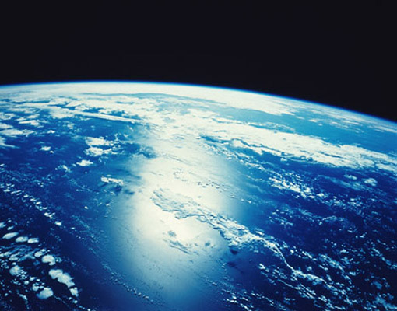
“mosaicity” with visible light

Slide 58
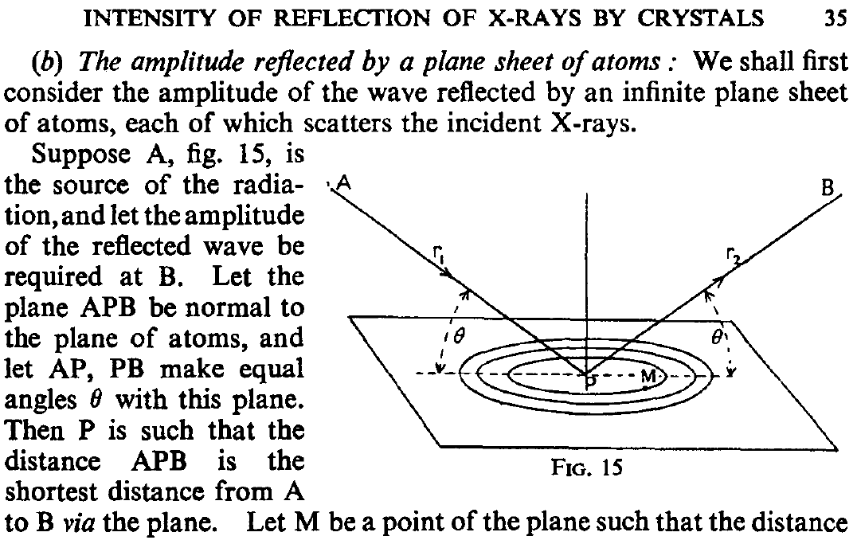
mosaic block = “coherence length”
James R. W. (1962) Optical Principles of the Diffraction of X rays. Ox Bow press.

Slide 59
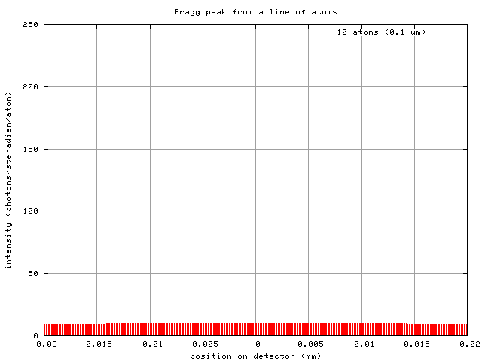
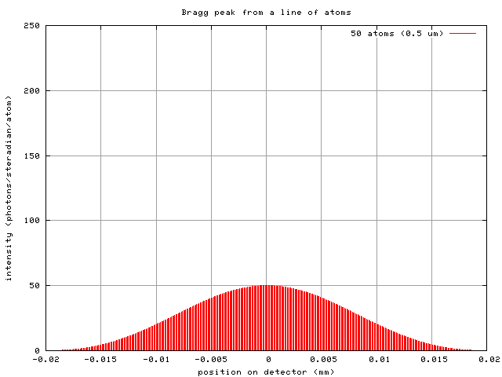
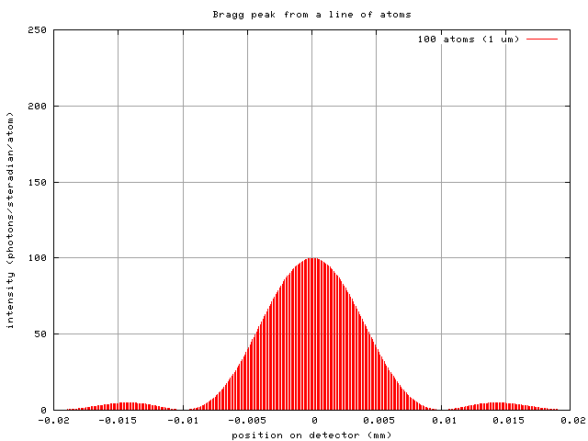
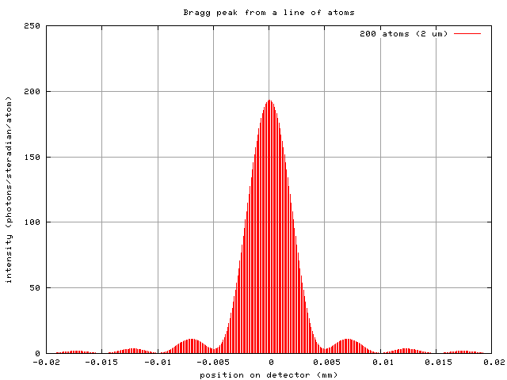
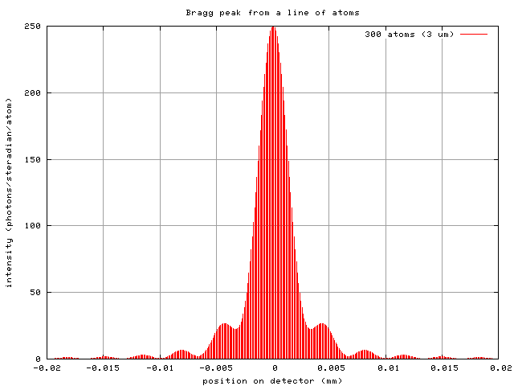
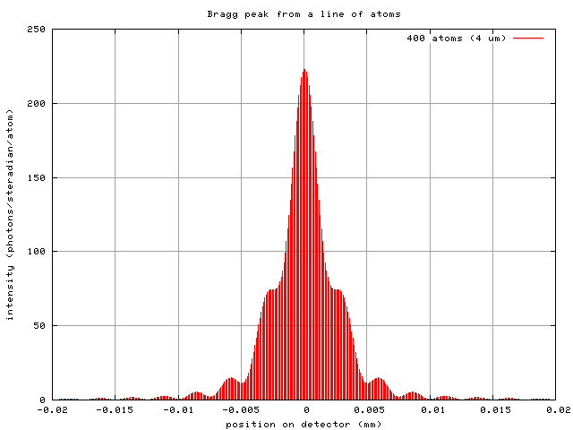
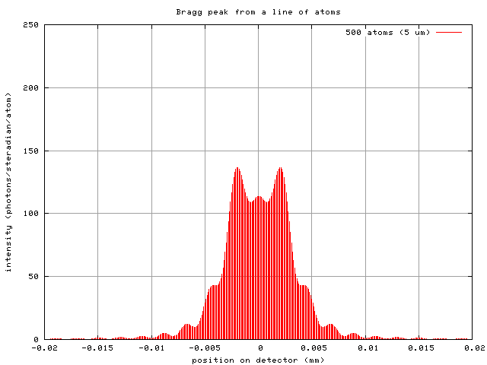
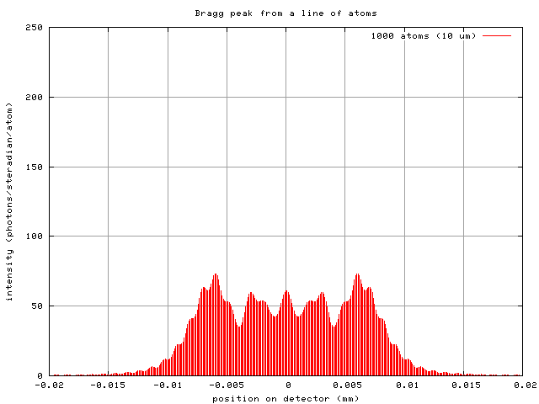
Scattering: line of atoms
10 atoms
50 atoms
100 atoms
200 atoms
300 atoms
400 atoms
500 atoms
1000 atoms
0.1 μm
0.5 μm
1 μm
2 μm
3 μm
4 μm
5 μm
10 μm
intensity (photons/SR/atom)
position on detector (mm)

Slide 60
Scattering: line of atoms
x-ray beam
peak
intensity
integrated
intensity
“crystal”
detector

Slide 61
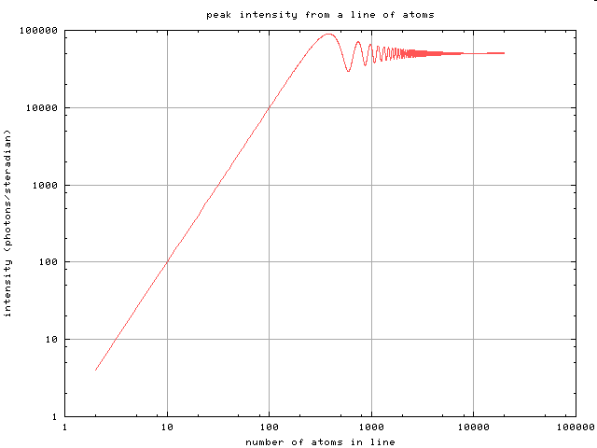
Scattering: line of atoms
mosaic
block
size
mosaic
spread
peak intensity (photons/SR)
B factor
depends on detector distance !!!
integrated intensity never changes
number of atoms in line

Slide 62
spot shape
Ewald sphere
Ewald sphere
Ewald sphere
Ewald sphere
Φ circle
Φ circle
Φ circle
Φ circle
(h,k,l)
(h,k,l)
(h,k,l)
(h,k,l)
λ’*
λ*
d*
d*
d*
λ*
d*
spindle axis
spindle axis
spindle axis
diffracted rays
d*
spindle axis
diffracted ray
diffracted ray
diffracted ray
λ’*
λ*
λ*

Slide 63
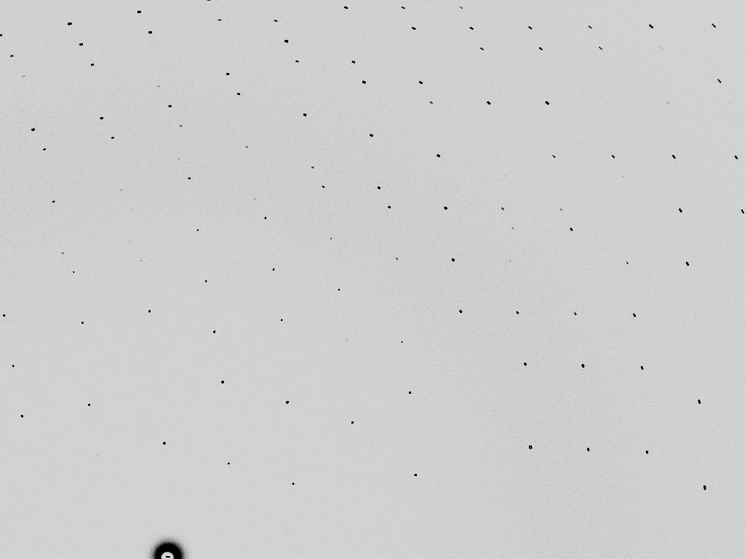
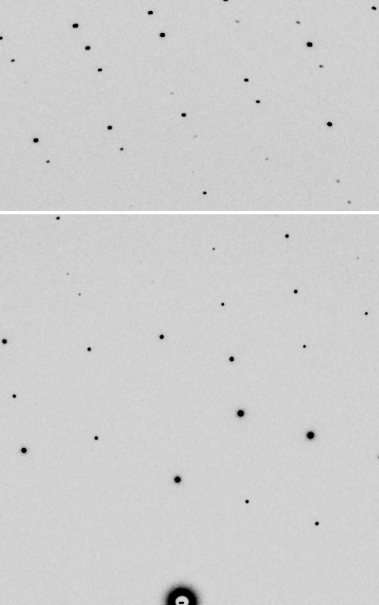
Point Spread Function
“no” PSF
“realistic” PSF

Slide 64
Law of Convolution
1² + 1² = 1.4²
3² + 1² = 3.2²
σ_{total}² = σ₁² + σ₂²

Slide 65
Where do the
X-rays go?

Slide 66
Where do photons go?
Protein
1A x-rays
Transmitted (98%)
beamstop

Slide 67
Photonuclear absorption

Slide 68
Photonuclear absorption

Slide 69
Elastic scattering

Slide 70
Elastic scattering

Slide 71
How big is an atom?
C
N
O
H
S
U
1 Ångstrom (Å)
1 nanometer (10⁻⁹ m)

Slide 72
How big is an atom?
U
S
C
N
O
H
as seen by X-rays

Slide 73

Where do photons go?
Protein
1A x-rays
elastic scattering (6%)
Transmitted (98%)
beamstop

Slide 74
Elastic scattering

Slide 75
Inelastic scattering

Slide 76
Where do photons go?
Protein
1A x-rays
elastic scattering (6%)
Transmitted (98%)
beamstop

Slide 77
Where do photons go?
Protein
1A x-rays
elastic scattering (6%)
Transmitted (98%)
beamstop
inelastic scattering (7%)

Slide 78
Where do photons go?
Protein
1A x-rays
elastic scattering (6%)
Transmitted (98%)
beamstop
inelastic scattering (7%)
Re-emitted (99%)
Absorbed (~0%)

Slide 79
Photoelectric absorption

Slide 80
Photoelectric absorption
e⁻
+

Slide 81
Fluorescence
+

Slide 82
Fluorescence
e⁻
+

Slide 83
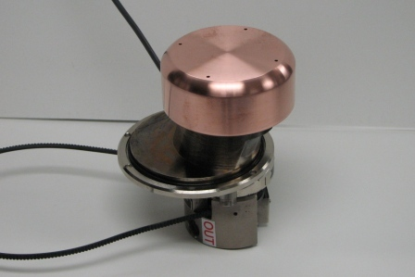
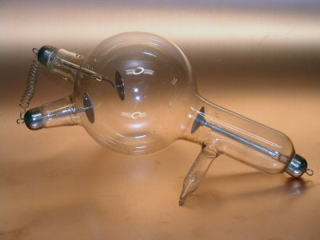
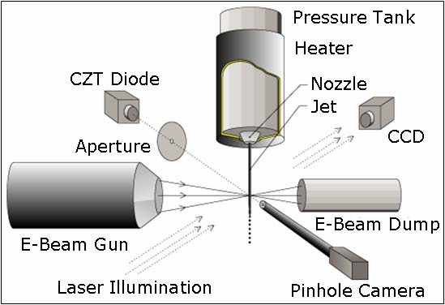
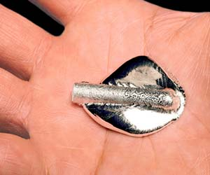
Fluorescence-based x-ray sources

Slide 84
What limits the source?
Fluorescence-based source:
Thermal distortion of anode
Accelerator-based source
Quality of optics
Electric bill

Slide 85
How much brighter is the synchrotron?
Gallium liquid METALJET
1.4 x 10⁸ photons/s/mm²/mrad²/0.1%BW
MX2:
2 x 10¹² photons/s
10 μm beam size
0.1 mrad divergence
0.014% BW (Si 111)
= 1.4 x 10¹⁹ photons/s/mm²/mrad²/0.1%BW
3000 years
With same beam size, divergence & dispersion
1 s at MX2 =

Slide 86
Auger emission
+

Slide 87
Auger emission
e⁻
++

Slide 88
Where do photons go?
Protein
1A x-rays
elastic scattering (6%)
Transmitted (98%)
beamstop
inelastic scattering (7%)
Re-emitted (99%)
Absorbed (~0%)

Slide 89
Where do photons go?
Protein
1A x-rays
elastic scattering (6%)
Transmitted (98%)
beamstop
inelastic scattering (7%)
Photoelectric (87%)
Re-emitted (99%)
Absorbed (~0%)

Slide 90
Where do photons go?
Protein
1A x-rays
elastic scattering (6%)
Transmitted (98%)
beamstop
inelastic scattering (7%)
Photoelectric (87%)
Re-emitted (99%)
Absorbed (~0%)
Re-emitted (~0%)
Absorbed (99%)

Slide 91
Where do photons go?
Protein
1A x-rays
elastic scattering (6%)
Transmitted (98%)
beamstop
inelastic scattering (7%)
Photoelectric (87%)
Re-emitted (99%)
Absorbed (~0%)
Re-emitted (~0%)
Absorbed (99%)
useful/absorbed energy: 7.3%

Slide 92
Where do photons go?
SelenoProtein
1A x-rays
elastic scattering (6%)
Transmitted (97%)
beamstop
inelastic scattering (5%)
Photoelectric (88%)
Re-emitted (99%)
Absorbed (~0%)
Re-emitted (~0%)
Absorbed (99%)
useful/absorbed energy: 7.6%

Slide 93
Where do photons go?
SelenoProtein
0.92A x-rays
just above the edge
elastic scattering (2%)
Transmitted (91%)
beamstop
inelastic scattering (2%)
Photoelectric (96%)
Re-emitted (99%)
Absorbed (~0%)
Re-emitted (57%)
Absorbed (44%)
useful/absorbed energy: 5.1%

Slide 94
Where do photons go?
SelenoProtein
0.97A x-rays
far above the edge
elastic scattering (2%)
Transmitted (90%)
beamstop
inelastic scattering (2%)
Photoelectric (96%)
Re-emitted (99%)
Absorbed (~0%)
Re-emitted (60%)
Absorbed (40%)
useful/absorbed energy: 5.1%

Slide 95
Photoelectric absorption

Slide 96
Photoelectric absorption
e⁻
+

Slide 97
Secondary ionization
e⁻

Slide 98
Secondary ionization
+
e⁻
e⁻

Slide 99
Excitation
e⁻

Slide 100
Excitation
e⁻

Slide 101
Excitation
e⁻

Slide 102
Excitation

Slide 103
Electron attachment
e⁻

Slide 104
Electron attachment
-

Slide 105
Sample atoms

Slide 106
Sample atoms

Slide 107
Primary ionization
e⁻
+

Slide 108
Secondary ionizations
e⁻
e⁻
+
e⁻
e⁻
+
+
+
+
+
e⁻
e⁻

Slide 109
Ionization track
e⁻
e⁻
e⁻
e⁻
+
e⁻
+
+
+
e⁻
e⁻
+
+
+
+
+
e⁻
+
e⁻
e⁻

Slide 110
Ionization track
e⁻
e⁻
e⁻
e⁻
+
e⁻
+
+
+
e⁻
e⁻
+
+
+
+
+
e⁻
+
e⁻
e⁻

Slide 111
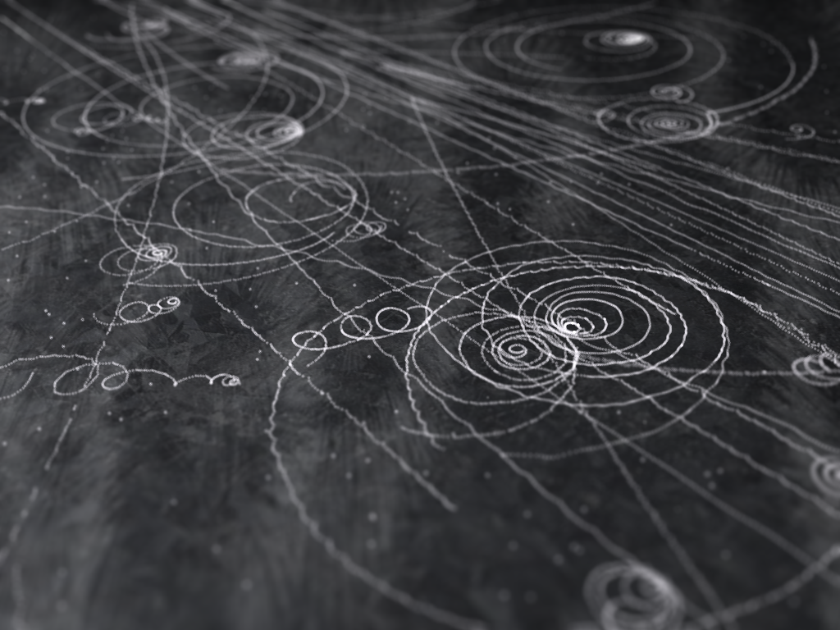
Ionization track

Slide 112
Ionization track

Slide 113
Ionization track
Linear Energy Transfer

Slide 114
Ionization track
initial effects

Slide 115
Ionization track
initial effects
Homogeneous reactions

Slide 116
initial effects
e⁻
e⁻
e⁻
e⁻
+
e⁻
+
+
+
e⁻
e⁻
+
+
+
+
+
e⁻
+
e⁻
e⁻

Slide 117
initial effects
e⁻
e⁻
e⁻
e⁻
+
e⁻
+
+
+
e⁻
neutralization
e⁻
+
+
+
+
+
e⁻
+
e⁻
e⁻

Slide 118
initial effects
e⁻
e⁻
e⁻
e⁻
+
e⁻
+
+
neutralization
e⁻
+
+
+
+
+
e⁻
+
e⁻
e⁻

Slide 119
initial effects
e⁻
e⁻
e⁻
e⁻
+
neutralization
+
e⁻
+
+
+
+
+
neutralization
e⁻
e⁻

Slide 120
initial effects
e⁻
e⁻
e⁻
e⁻
+
+
e⁻
+
+
+
+
+
e⁻
attachment
e⁻

Slide 121
initial effects
e⁻
e⁻
e⁻
e⁻
+
+
e⁻
+
+
+
+
+
-
attachment
e⁻

Slide 122
initial effects
e⁻
e⁻
e⁻
attachment
e⁻
+
+
e⁻
+
+
+
+
+
-
e⁻
attachment

Slide 123
initial effects
e⁻
-
e⁻
e⁻
+
+
e⁻
+
+
+
+
+
-
-

Slide 124
initial effects
-
-
-
e⁻
+
+
+
+
+
+
-
-

Slide 125
initial effects
-
-
-
e⁻
solvation
+
+
+
+
+
+
-
-

Slide 126
initial effects
-
-
-
solvation
+
e⁻
+
+
+
+
+
-
-

Slide 127
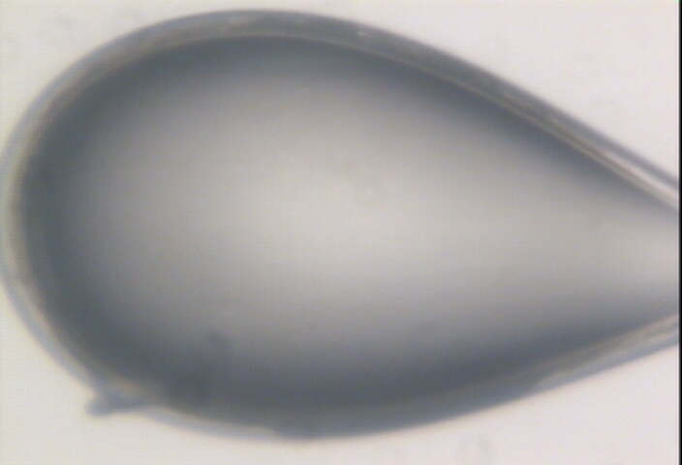

Slide 128
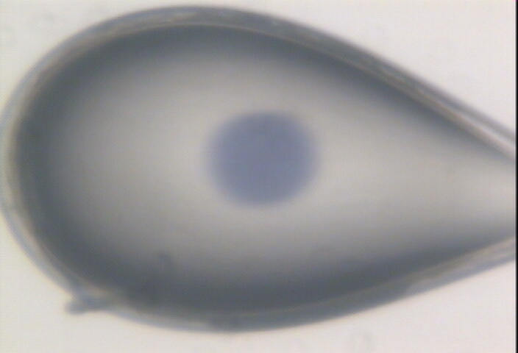

Slide 129
initial effects
-
-
-
+
e⁻
+
+
+
+
+
-
-

Slide 130
initial effects
-
-
-
+
e⁻
+
+
+
+
+
-
-

Slide 131
initial effects
-
-
+
e⁻
+
+
+
+
-
-

Slide 132
initial effects
e⁻
+
+
+
-
-

Slide 133
initial effects
e⁻
+
+
-

Slide 134
Excitation transfer

Slide 135
Excitation transfer
UV photon

Slide 136
Excitation transfer

Slide 137
Excitation transfer
r⁻⁶
Förster transfer

Slide 138
Excitation transfer

Slide 139
t = 0 s

Slide 140
t ≈ 10⁻¹⁵ s
e⁻
+
+
-

Slide 141
Timescales of radiation damage
Garret et. al. (2005) Chem. Rev. 105, 355-389

Slide 142
Ionization track
Heterogeneous reactions
Homogeneous reactions

Slide 143
Timescales of radiation damage
Garret et. al. (2005) Chem. Rev. 105, 355-389

Slide 144
Timescales of radiation damage
LCLS
ALS
bunch
Garret et. al. (2005) Chem. Rev. 105, 355-389

Slide 145
Where do photons go?
Protein
1A x-rays
elastic scattering (6%)
Transmitted (98%)
beamstop
inelastic scattering (7%)
Photoelectric (87%)
Re-emitted (99%)
Absorbed (~0%)
Re-emitted (~0%)
Absorbed (99%)
useful/absorbed energy: 7.3%

Slide 146
Where do photons go?
SelenoProtein
1A x-rays
elastic scattering (6%)
Transmitted (97%)
beamstop
inelastic scattering (5%)
Photoelectric (88%)
Re-emitted (99%)
Absorbed (~0%)
Re-emitted (~0%)
Absorbed (99%)
useful/absorbed energy: 7.6%

Slide 147
Where do photons go?
SelenoProtein
0.92A x-rays
just above the edge
elastic scattering (2%)
Transmitted (91%)
beamstop
inelastic scattering (2%)
Photoelectric (96%)
Re-emitted (99%)
Absorbed (~0%)
Re-emitted (57%)
Absorbed (44%)
useful/absorbed energy: 5.1%

Slide 148
Where do photons go?
SelenoProtein
0.97A x-rays
far above the edge
elastic scattering (2%)
Transmitted (90%)
beamstop
inelastic scattering (2%)
Photoelectric (96%)
Re-emitted (99%)
Absorbed (~0%)
Re-emitted (60%)
Absorbed (40%)
useful/absorbed energy: 5.1%

Slide 149
scattering
x-ray beam
sample
detector
detector

Slide 150
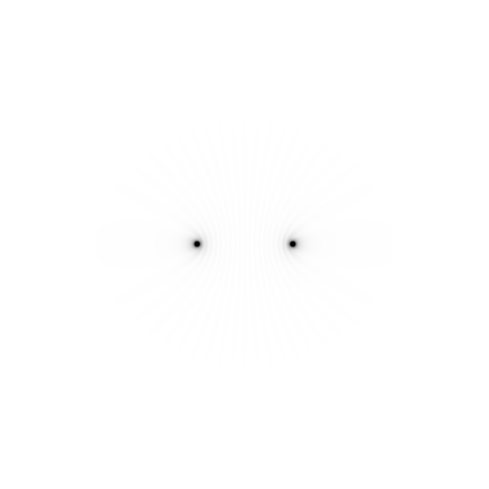
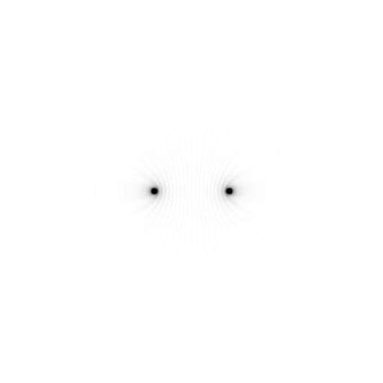
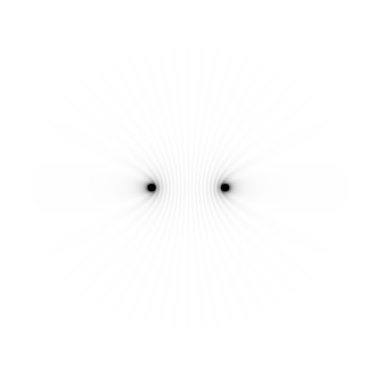
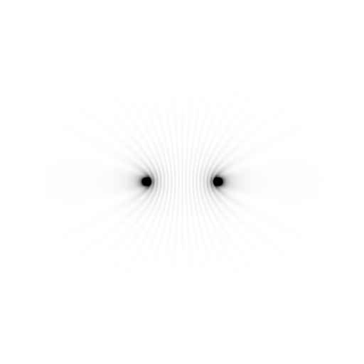
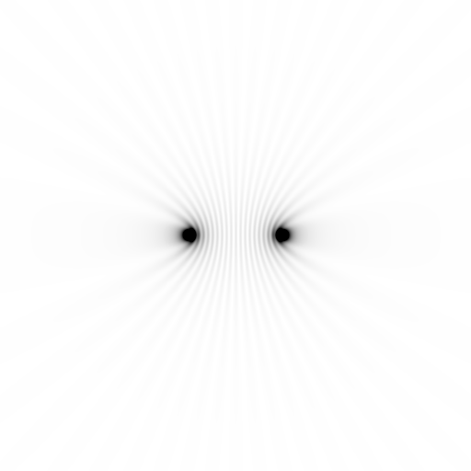
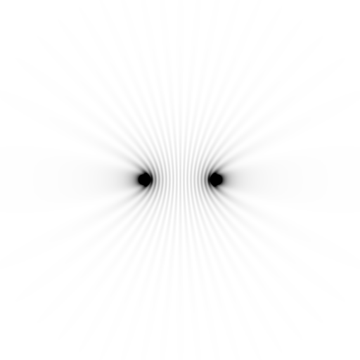
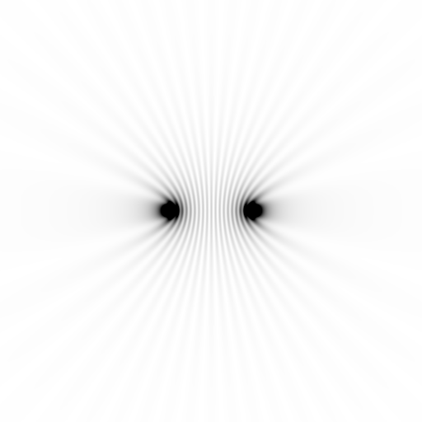
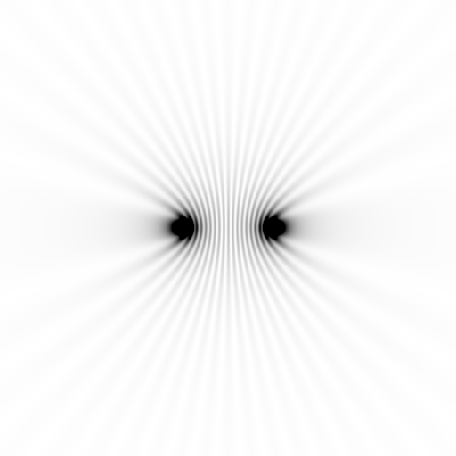
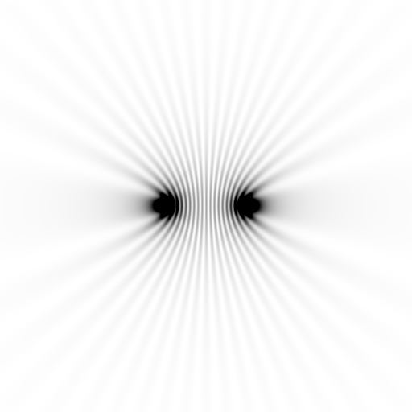
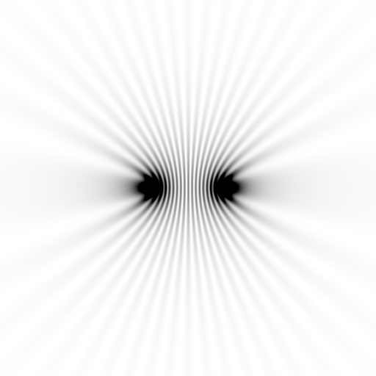
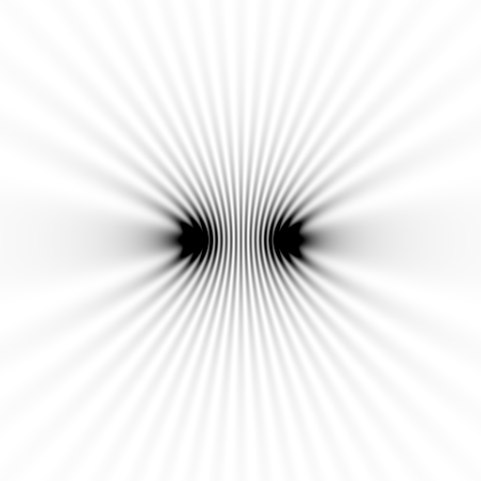
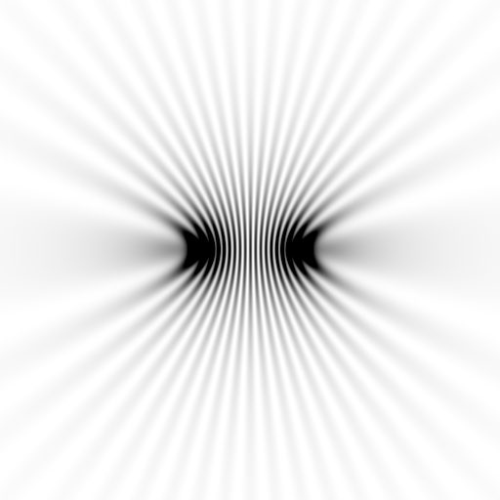
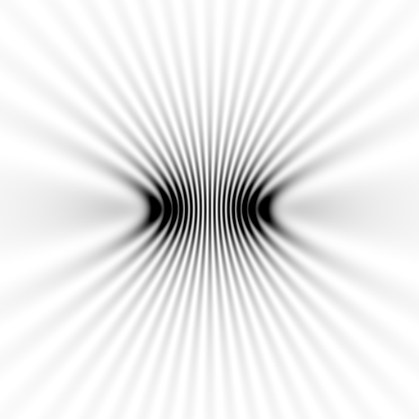
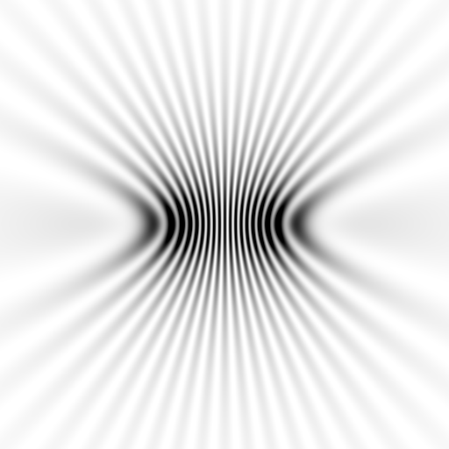
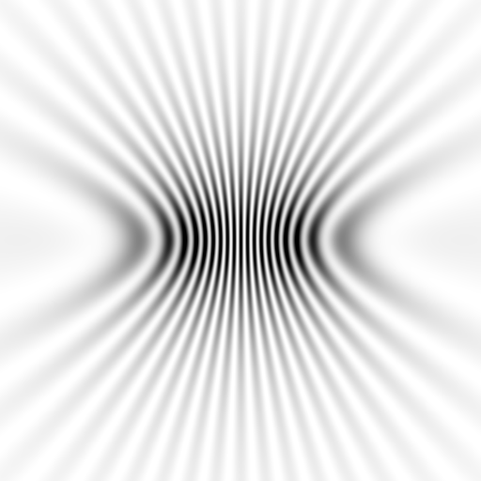
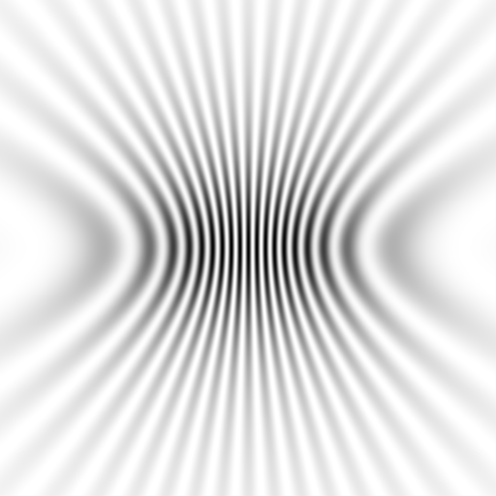
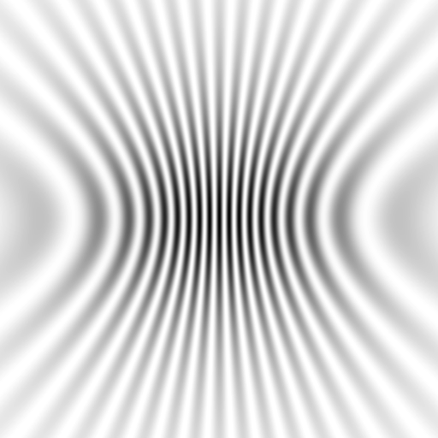










Slide 151



























Slide 152
scattering
x-ray beam
sample
detector

Slide 153
scattering
x-ray beam
sample
detector

Slide 154
scattering
x-ray beam
sample
detector

Slide 155
Bragg’s Law
to detector
nλ = 2d sin(θ)
atom #1
θ
d
to source
atom #2
d∙sin(θ)

Slide 156
Bragg’s Law
to detector
nλ = 2d sin(θ)
atom #1
θ
d
to source
atom #2
d∙sin(θ)

Slide 157
Bragg’s Law
to detector
nλ = 2d sin(θ)
atom #1
θ
to source
d
atom #2
d∙sin(θ)

Slide 158
“near”-ly Bragg’s Law
detector
atom #1
source
d
atom #2

Slide 160










scattering from a structure
sample
detector

Slide 161

forward Fourier Transform
inverse Fourier Transform
no phase

Slide 162











inverse Fourier Transform
scattering from a structure
colored by phase
sample
detector

Slide 163




scattering from a lattice
colored by phase
sample
detector

Slide 164

scattering from a lattice
colored by phase
sample
detector

Slide 165

scattering from a lattice
colored by phase
sample
detector

Slide 166

scattering from a crystal structure
colored by phase
sample
detector

Slide 167

lysozyme: real and reciprocal

Slide 168


X-ray data are 3D!

Slide 169
Major Phasing techniques
Molecular Replacement
Multiple Isomorphous Replacement
Multiwavelength Anomalous Diffraction
Single-wavelength Anomalous Diffraction

Slide 170
inverse Fourier Transform
no phase

Slide 171


inverse Fourier Transform
no phase

Slide 172
Major Phasing techniques
Molecular Replacement
Multiple Isomorphous Replacement
Multiwavelength Anomalous Diffraction
Single-wavelength Anomalous Diffraction

Slide 173
anomalous scattering
x-ray beam
sample
detector

Slide 174
anomalous scattering
x-ray beam
sample
detector

Slide 175
anomalous scattering
x-ray beam
sample
detector

Slide 176
anomalous scattering
x-ray beam
sample
detector

Slide 177
anomalous scattering
x-ray beam
sample
detector

Slide 178
Major Phasing techniques
Molecular Replacement
Multiple Isomorphous Replacement
Multiwavelength Anomalous Diffraction
Single-wavelength Anomalous Diffraction

Slide 179


Molecular Replacement
correct structure and intensities
?
http://www.ysbl.york.ac.uk/~cowtan/fourier/coeff.html

Slide 180


Molecular Replacement
use something similar as a starting model

Slide 181

Model Building
current model is missing something

Slide 182
Model Building
phases from model

Slide 183


Model Building
missing bits show up in “difference map”

Slide 184


Model Building
missing bits show up better in F_{O} + (F_{O} - F_{C}) map

Slide 185




The “phase problem”

Slide 186

The “phase problem”
Phases
Amplitudes

Slide 187


The “phase problem”
Phases
Amplitudes

Slide 188

The “phase problem”
Phases & Amplitudes
Amplitudes
2F_{obs}-F_{calc}

Slide 189
The “phase problem”
Phases
Amplitudes

Slide 190

The “phase problem”
Phases & Amplitudes
Amplitudes
2F_{obs}-F_{calc}

Slide 191

The “phase problem”
Phases & Amplitudes
Amplitudes
2mF_{obs}-F_{calc} (σ_{A} weighting)

Slide 192
What is “disorder”?

Slide 193
What is “disorder”?

Slide 194
What is “disorder”?

Slide 195

What is “disorder”?
order
order
B-factor
disorder

Slide 196

Debye-Waller-Ott factor
James R. W. (1962) Optical Principles of the Diffraction of X rays. Ox Bow press.

Slide 197
Debye-Waller-Ott factor
F = F₀ exp( - A∙s - B∙s² - C∙s³ - … )
F - structure factor
A - something Debye said was zero
B - canonical Debye-Waller factor
C - something else Debye said was zero
s - 0.5/d
d - resolution of spot (Å)

Slide 198
Debye-Waller-Ott factor
Reciprocal Space
Gaussian
normalized total intensity
Exponential
∞ 5 2.5 1.7 1.25 1.0
Resolution (Ǻ)

Slide 199
Debye-Waller-Ott factor
Direct Space
Gaussian
normalized number of atoms
Lorentzian
magnitude of displacement (Å)

Slide 200
Wilson plot
R_{cryst}/R_{free}
0.355/0.514
scaled <F²>
4.1 3.5 3.2 2.9 2.7 2.5 2.4 2.2 2.1
resolution (Å)
(sin(θ)/λ)²

Slide 201
Wilson plot
R_{cryst}/R_{free}
0.355/0.514
0.257/0.449
0.209/0.407
scaled <F²>
4.1 3.5 3.2 2.9 2.7 2.5 2.4 2.2 2.1
resolution (Å)
(sin(θ)/λ)²

Slide 202
Wilson plot
R_{cryst}/R_{free}
0.355/0.514
0.257/0.449
0.209/0.407
scaled <F²>
4.1 3.5 3.2 2.9 2.7 2.5 2.4 2.2 2.1
resolution (Å)
(sin(θ)/λ)²

Slide 203
“B” factors
ATOM 122 N LEU A 13 -3.244 25.808 19.998 1.00 16.96 N
ATOM 123 CA LEU A 13 -2.877 25.448 21.355 1.00 15.29 C
ATOM 124 C LEU A 13 -2.792 23.966 21.561 1.00 17.54 C
ATOM 125 O LEU A 13 -1.814 23.493 22.143 1.00 16.35 O
ATOM 126 CB LEU A 13 -3.907 26.164 22.268 1.00 18.72 C
ATOM 127 CG LEU A 13 -3.577 25.982 23.738 1.00 21.19 C
ATOM 128 CD1 LEU A 13 -2.283 26.820 24.019 1.00 19.43 C
ATOM 129 CD2 LEU A 13 -4.702 26.474 24.639 1.00 24.65 C
ATOM 130 N SER A 14 -3.677 23.149 20.979 1.00 15.96 N
ATOM 131 CA SER A 14 -3.646 21.711 21.061 1.00 18.26 C
ATOM 132 C SER A 14 -2.373 21.203 20.360 1.00 18.71 C
ATOM 133 O SER A 14 -1.747 20.315 20.930 1.00 17.47 O
ATOM 134 CB SER A 14 -4.875 21.077 20.419 1.00 17.62 C
ATOM 135 OG ASER A 14 -4.825 19.665 20.388 0.50 20.89 O
ATOM 136 OG BSER A 14 -6.027 21.408 21.164 0.50 18.67 O
ATOM 137 N LYS A 15 -2.045 21.772 19.215 1.00 18.03 N
ATOM 138 CA LYS A 15 -0.799 21.361 18.555 1.00 18.12 C
ATOM 139 C LYS A 15 0.446 21.707 19.351 1.00 18.81 C
ATOM 140 O LYS A 15 1.400 20.948 19.411 1.00 17.77 O
ATOM 141 CB LYS A 15 -0.700 22.034 17.177 1.00 14.49 C
ATOM 142 CG LYS A 15 -1.727 21.368 16.256 1.00 16.12 C
ATOM 143 CD LYS A 15 -1.663 22.147 14.936 1.00 19.40 C
ATOM 144 CE ALYS A 15 -2.725 21.614 13.986 0.50 17.42 C
ATOM 145 CE BLYS A 15 -1.750 21.211 13.750 0.50 17.01 C
ATOM 146 NZ ALYS A 15 -2.346 21.674 12.559 0.50 18.61 N
ATOM 147 NZ BLYS A 15 -3.052 20.513 13.741 0.50 18.76 N

Slide 204
“B” factors
electron density (e⁻/Å³)
position (Å)

Slide 205
“B” factors
electron density (e⁻/Å³)
position (Å)

Slide 206
“B” factors
electron density (e⁻/Å³)
position (Å)

Slide 207
“B” factors
electron density (e⁻/Å³)
position (Å)

Slide 208
“B” factors
B ≈ 4d² + 12
d = resolution in Å
essentially, the “resolution” of an atom

Slide 209

Resolution
http://bl831.als.lbl.gov/~jamesh/movies/resolution.mpeg

Slide 210

Resolution: low-angle cutoff
http://bl831.als.lbl.gov/~jamesh/movies/lo_cut.mpeg

Slide 211

R-factor
http://bl831.als.lbl.gov/~jamesh/movies/rfactor.mpeg

Slide 212

Figure of Merit
http://bl831.als.lbl.gov/~jamesh/movies/dephase.mpeg

Slide 213

Overloads
http://bl831.als.lbl.gov/~jamesh/movies/overloads.mpeg

Slide 214

Completeness: missing wedge
http://bl831.als.lbl.gov/~jamesh/movies/osc.mpeg

Slide 215

Completeness: random deletion
http://bl831.als.lbl.gov/~jamesh/movies/completeness.mpeg

Slide 216
What does all that stuff in the beamline do?

Slide 217


X-ray optics
Superbend
pinhole
Scatter
guard
Plane
Parabolic
mirror
Torroidal
mirror
ADSC Quantum 210
divergence
slits
Si(111)
monochromator
Protein Crystal
2:1 demagnification cancels spherical aberrations
comparable flux to a wiggler with < 1% of the heat
Notes:
Next slide please

Slide 218
X-ray optics
Superbend
pinhole
Scatter
guard
Plane
Parabolic
mirror
Torroidal
mirror
ADSC Quantum 210
divergence
slits
Si(111)
monochromator
Protein Crystal
2:1 demagnification cancels spherical aberrations
comparable flux to a wiggler with < 1% of the heat
Notes:
Most notable acheivements are high brightness with very little “wasted” light. The discovery made by Howard Padmore? At ALS showed that a 2:1 demagnification cancels nearly all of the spherical abberations in the parabolic/torroid system. 30-50% of the total x-ray intensity passes through the 100um pinhole. The flux through the 100um pinhole at the superbend beamlines is comparable to that of the 5.0.2 wiggler or an APS bending magnet, but only 150 Watts of power must be dissipated by the beamline optics. In contrast, wiggler beamlines must disipate kilowatts. The optics here are much simpler and not exotic in any way. The system is stable and robust. There is never a need to re-focus the beam at a new wavelength. Only a 2-minute automatic tuneup is recommended for very large energy changes (more than 1-2 keV).

Slide 219

X-ray optics
MacDowell et. al. (2004) J. Sync. Rad. 11 447-455
pinhole
Scatter
guard
X-ray
Source
ADSC Quantum 315r
Protein Crystal
Notes:
Most notable acheivements are high brightness with very little “wasted” light. The discovery made by Howard Padmore? At ALS showed that a 2:1 demagnification cancels nearly all of the spherical abberations in the parabolic/torroid system. 30-50% of the total x-ray intensity passes through the 100um pinhole. The flux through the 100um pinhole at the superbend beamlines is comparable to that of the 5.0.2 wiggler or an APS bending magnet, but only 150 Watts of power must be dissipated by the beamline optics. In contrast, wiggler beamlines must disipate kilowatts. The optics here are much simpler and not exotic in any way. The system is stable and robust. There is never a need to re-focus the beam at a new wavelength. Only a 2-minute automatic tuneup is recommended for very large energy changes (more than 1-2 keV).

Slide 220
Debye-Waller-Ott factor
How can the distribution of atom displacements
NOT
be Gaussian?
(central limit theorem)
what can cause a Lorentzian distribution?

Slide 221

stress and strain

Slide 222
stress and strain
normalized number of atoms
magnitude of displacement (fractional)

Slide 223
stress and strain
normalized number of atoms
magnitude of displacement (fractional)

Slide 224
stress and strain
normalized number of atoms
magnitude of displacement (fractional)

Slide 225
non-Gaussian
Debye-Waller-Ott factor
Is there any evidence that this actually happens?

Slide 226



crystal expansion
48 MGy
20 MGy
2 MGy

Slide 227



~0 MGy

Slide 228


5 MGy

Slide 229



11 MGy

Slide 230



16 MGy

Slide 231



22 MGy

Slide 232



26 MGy

Slide 233
How does “dose” fade spots?
A simple case…

Slide 234

D_{1/2} ~ 10 Gy
D_{1/2} >> 10¹² Gy

Slide 235

Sodium Chloride is Immortal!
D_{1/2} > 1 GGy

Slide 236

Sodium acetate trihydrate
D_{1/2} = 15 MGy
resolution: 0.92 Å
C2/c
R/Rfree: ~4%
avg B: ~ 0

Slide 237
lowest-angle spot: (1,1,0) 7.7 Å
integrated spot intensity
dose (MGy)

Slide 238


Slide 239


Slide 240


Slide 241


Slide 242


Slide 243


Slide 244


Slide 245


Slide 246


Slide 247


Slide 248


Slide 249


Slide 250


Slide 251


Slide 252


Slide 253


Slide 255


Slide 256


Slide 257


Slide 258


Slide 259


Slide 260


Slide 261
Reaction #1
water “rotation”

Slide 262

~0 MGy

Slide 263

2.3 MGy

Slide 264

4.5 MGy

Slide 265

6.8 MGy

Slide 266

9.0 MGy

Slide 267

11 MGy

Slide 268

14 MGy

Slide 269

16 MGy

Slide 270

18 MGy

Slide 271

21 MGy

Slide 272

23 MGy

Slide 273

25 MGy

Slide 274

27 MGy

Slide 275

29 MGy

Slide 276

32 MGy

Slide 277

34 MGy

Slide 278

36 MGy

Slide 279

38 MGy

Slide 280

41 MGy

Slide 281

43 MGy

Slide 282

45 MGy

Slide 283

48 MGy

Slide 284
Reaction #2
acetate “bump”

Slide 285


Slide 286


Slide 287


Slide 288
Interesting spots: (2,6,1) 1.6 Å
integrated spot intensity
dose (MGy)

Slide 289
Interesting spots: (3,3,-3) 2.3 Å
integrated spot intensity
dose (MGy)

Slide 290
Interesting spots: (6,2,-5) 1.6 Å
integrated spot intensity
dose (MGy)

Slide 291
Interesting spots: (2,0,0) 5.7 Å
integrated spot intensity
dose (MGy)

Slide 292
Overall Scale Factor
scale from phenix.refine
dose (MGy)

Slide 293
Global Damage: protein
normalized total intensity
accumulated dose (MGy)

Slide 294
stress and strain
What about
undamaged crystals?
radiation damage = defects

Slide 295
Purity is crucial!
important for
resolution
McPherson, A., Malkin, A. J., Kuznetsov, Y. G. & Plomp, M. (2001)."Atomic force microscopy applications in macromolecular crystallography", Acta Cryst. D 57, 1053-1060.
not important for
initial hits

Slide 296
What can I improve?
Purity!
is 95% good enough? 99%?
Purity!
conformational (homogeneous)
Purity!
kinetic (stable over time)

Slide 297
What can I improve?
add a column
fractional recrystallization
heat shock
mutate Lys
avoid stress
Newman J. (2006) Acta Cryst. D62 27-31.

Slide 298
causes of stress
physical contact
don’t touch the part you intend to shoot
osmotic shock
equilibrate, or calculate matching solution
changes in dielectric constant
Petsko (1975) J. Mol. Biol. 96, 381-388.
cooled density mismatch
Juers & Matthews (2004) Acta Cryst. D 60, 412-421.
basically: no sudden moves!

Slide 299
causes of stress
physical contact
don’t touch the part you intend to shoot
osmotic shock
equilibrate, or calculate matching solution
changes in dielectric constant
Petsko (1975) J. Mol. Biol. 96, 381-388.
cooled density mismatch
Juers & Matthews (2004) Acta Cryst. D 60, 412-421.

Slide 300


Vicker’s hardness
Tachibana et al. (1999) J. Cryst. Growth 198, 661-664.
Koizumi et al. (2009) Physical Review E 79, 61917.

Slide 301
Pattersons
The “third space”
of crystallography

Slide 302
The “spaces” of crystallography
Direct/real space
  Distances are in Å, Angles are in degrees
Reciprocal space
  Distances in 1/Å, Angles are different
Patterson space
  Distances are in Å , Angles are in degrees
  Relative distances only, origin lost
  “direction” is preserved

Slide 303
How to make a Patterson:
Set all phases to zero
Square all structure factors
Calculate Fourier transform

Slide 304
One atom in unit cell
Electron density
Fraction across unit cell

Slide 305
Patterson: one atom
Electron density
Fraction across unit cell

Slide 306
Patterson: one atom
Electron density
Fraction across unit cell

Slide 307
Patterson: one atom
Electron density
Fraction across unit cell

Slide 308
Patterson: two atoms
Electron density
Fraction across unit cell

Slide 309
Patterson: three atoms
Electron density
Fraction across unit cell

Slide 310
Patterson: three atoms
Better resolution!
Electron density
Fraction across unit cell

Slide 311
Patterson: five atoms
Electron density
Fraction across unit cell

Slide 312
Patterson: five atoms
Electron density
Fraction across unit cell

