Slide 1
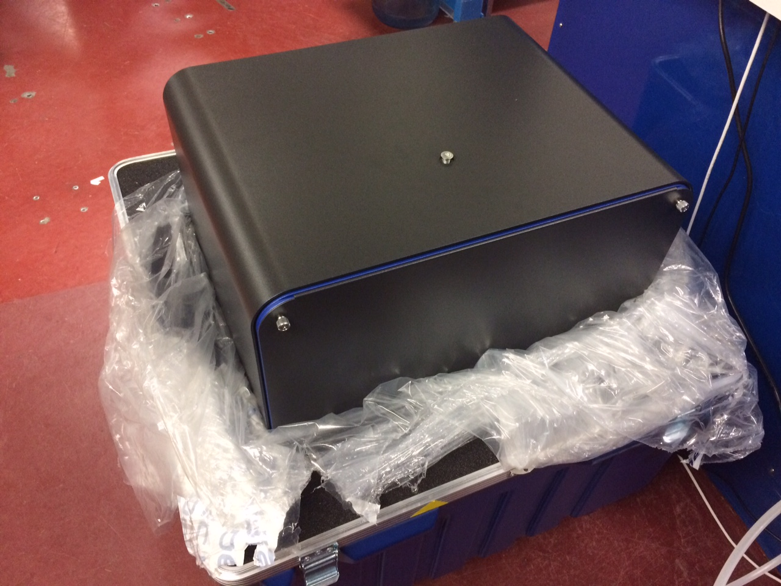

Slide 3
What will change?
Old detector
New detector
Read-out noise: 2 ph/pix
100 ADU/pixel
1.15s read-out, ~0.3 Hz
23 min data set @ 30 MGy
rastering impractical
16 bits
0.7% inactive area
315 mm face; 80 μm PSF
1312 orders across face
No max count rate
3% SHSSS error
7235 eV optimal
No read-out noise
no more strategy
2.03 ms read-out, 25 Hz
200 s data set @ 30 MGy
10 min/mm² raster 1% lifedose
20 bits
8.5% inactive area
430 mm face, 172 μm PSF
833 orders across face
Max 10⁷ ph/s/pix
< 1% SHSSS error
S-SAD, 5 keV?

Slide 4
What will change?
Old detector
New detector
Read-out noise: 2 ph/pix
100 ADU/pixel
1.15s read-out, ~0.3 Hz
23 min data set @ 30 MGy
rastering impractical
16 bits
0.7% inactive area
315 mm face; 80 μm PSF
1312 orders across face
No max count rate
3% SHSSS error
7235 eV optimal
No read-out noise
no more strategy
2.03 ms read-out, 25 Hz
200 s data set @ 30 MGy
10 min/mm² raster 1% lifedose
20 bits
8.5% inactive area
430 mm face, 172 μm PSF
833 orders across face
Max 10⁷ ph/s/pix
< 1% SHSSS error
S-SAD, 5 keV?

Slide 5
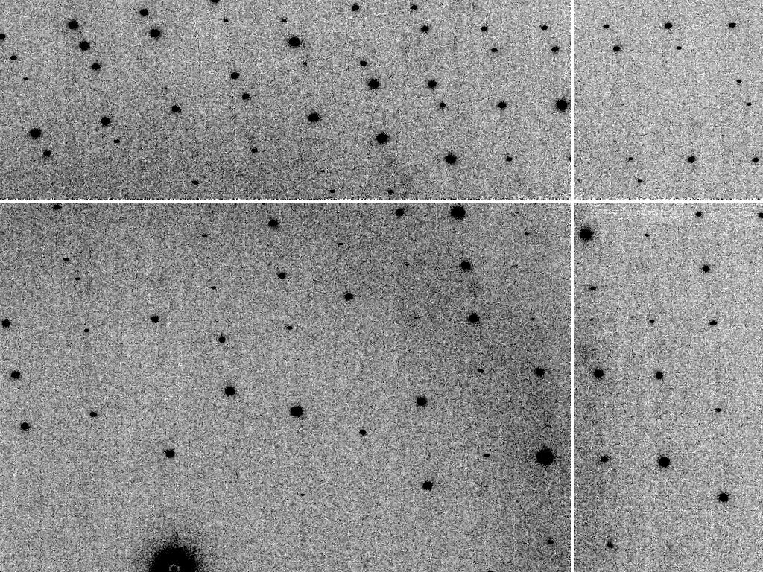
Simulated diffraction image MLFSOM

Slide 6
Simulated diffraction image MLFSOM
simulated
real

Slide 7
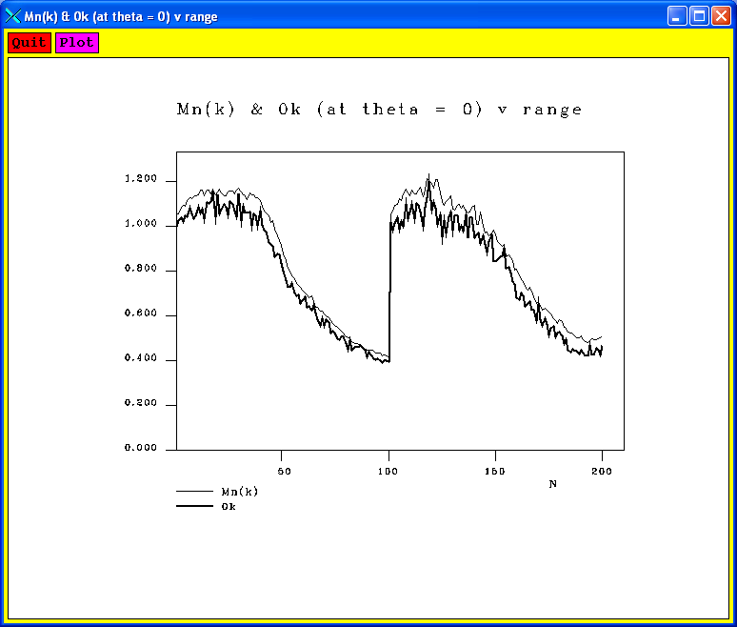
Simulated diffraction image (2008)
simulated
real

Slide 8
Simulated | statistic | Real
5.4% | R_{merge} | 6.2%
18.9 | I/sd | 16.2
1.9 | I/sd (1.4 Ǻ) | 1.6
1.7 4.0 0.020 | SDCORR | 1.0 2.2 0.065
36.8 | PADFPH | 31.46
3.871 | mlphare f” | 3.476
0.178 | FOM | 0.192
0.545 | FOMDM | 0.664
0.6270 | CC(1H87) | 0.6090
0.170 | R_{cryst} | 0.184
0.205 | R_{free} | 0.231

Slide 9
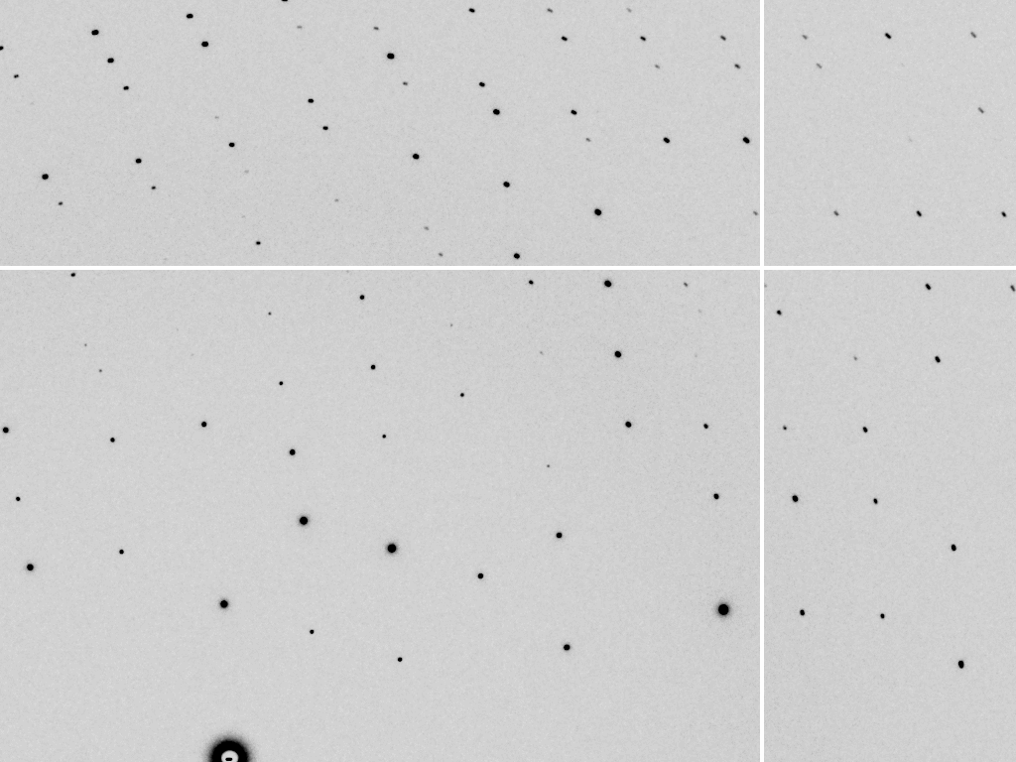
a perfect detector
“normal”
“perfect”

Slide 10
normal | statistic | perfect
4.0% | R_{merge} | 3.9%
24.3 | I/sd | 28.1
3.7 | I/sd (1.4 Ǻ) | 7.3
1.37 3 0.02 | SDCORR | 0.98 11 0.05
38.01 | PADFPH | 35.16
4.104 | mlphare f” | 3.973
0.224 | FOM | 0.272
0.579 | FOMDM | 0.563
0.7113 | CC(1H87) | 0.7051
15.72 | R_{cryst} | 16.64
18.30 | R_{free} | 19.38

Slide 11
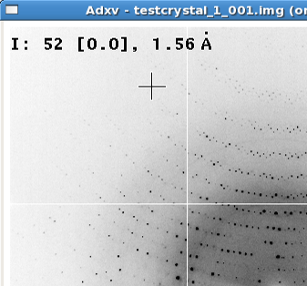
Optimal exposure time (faint spots)
t_{hr} Optimal exposure time for data set (s)
t_{ref} exposure time of reference image (s)
bg_{ref} background level near weak spots on
reference image (ADU)
bg₀ ADC offset of detector (ADU)
bg_{hr} optimal background level (via t_{hr})
σ₀ rms read-out noise (ADU)
gain ADU/photon
m multiplicity of data set (including partials)
adjust exposure
so this is ~15

Slide 12
What will change?
Old detector
New detector
Read-out noise: 2 ph/pix
100 ADU/pixel
1.15s read-out, ~0.3 Hz
23 min data set @ 30 MGy
rastering impractical
16 bits
0.7% inactive area
315 mm face; 80 μm PSF
1312 orders across face
No max count rate
3% SHSSS error
7235 eV optimal
No read-out noise
no more strategy
2.03 ms read-out, 25 Hz
200 s data set @ 30 MGy
10 min/mm² raster 1% lifedose
20 bits
8.5% inactive area
430 mm face, 172 μm PSF
833 orders across face
Max 10⁷ ph/s/pix
< 1% SHSSS error
S-SAD, 5 keV?

Slide 13
Damage is done
by dose (MGy)
proportional to photons/area
not time
not heat
Sliz P, Harrison SC & Rosenbaum G (2003). Structure 11, 13-19.
Garman EF & McSweeney SM (2006). J. Sync. Rad. 14, 1-3.
Owen RL, Rudino-Pinera E & Garman EF (2006). PNAS 103, 4912-4917.
Leiros et al. (2006). Acta Cryst. D 62, 125-132.
Holton JM (2007). J. Synch Rad. 14, 51-72.

Slide 14
The amount of data you get
from any given crystal
is independent
of data collection time
1 um³ = 10⁶ photons

Slide 15
10 MGy/Å
what the is a MGy?
http://bl831.als.lbl.gov/
damage_rates.pdf
Holton J. M. (2009) J. Synchrotron Rad. 16 133-42

Slide 16
How long will my crystal last?
synch line type flux beamsize flux density dose max xtal min site
ph/s μm ph/μm2/s rate lifetime lifetime
ALS 4.2.2 MAD 2.2e11 75x80 3.7e+07 27.3 kGy/s 18 m 73 s
ALS 5.0.1 mono 1.6e11 100 2.0e+07 10.4 kGy/s 48 m 3.2 m
ALS 5.0.2 MAD 8e11 100 1.0e+08 51.8 kGy/s 9.6 m 39 s
ALS 5.0.3 mono 1.7e11 100 2.2e+07 11 kGy/s 45 m 3 m
ALS 8.2.1 MAD 1.8e11 100 2.3e+07 11.7 kGy/s 43 m 2.9 m
ALS 8.2.2 MAD 2.3e11 100 2.9e+07 14.9 kGy/s 34 m 2.2 m
ALS 8.3.1 MAD 9e11 70 2.3e+08 119 kGy/s 4.2 m 17 s
ALS 8.3.1 typical 6e11 70 1.6e+08 115 kGy/s 4.3 m 17 s
ALS 12.3.1 MAD 1.8e11 100 2.3e+07 11.7 kGy/s 43 m 2.9 m
ALS 12.3.1 ML 4.0e12 100 5.1e+08 513 kGy/s 58 s 3.9 s
APS 8-BM MAD 1e11 200 2.5e+06 1.27 kGy/s 6.6 h 26 m
APS 14-BM-C mono 5.8e10 200 1.4e+06 738 Gy/s 11 h 45 m
APS 14-BM-D MAD 3.3e9 200 8.2e+04 42 Gy/s 8.3 d 13 h
APS 14-ID-B MAD 6.0e10 200 1.5e+06 763 Gy/s 11 h 44 m
APS 17-BM MAD 1.1e11 200 2.8e+06 1.4 kGy/s 6 h 24 m
APS 17-ID MAD 2.3e11 200 5.8e+06 2.93 kGy/s 2.8 h 11 m
APS 19-BM MAD 2.0e11 70x60 4.8e+07 24.2 kGy/s 21 m 83 s
APS 19-ID MAD 1.3e13 80x40 4.1e+09 2.07 MGy/s 15 s 0.97 s
APS 19-ID typical 5.5e11 100x100 5.5e+07 28 kGy/s 18 m 71 s
APS 22-BM MAD 7e12 80x40 2.2e+09 1.23 MGy/s 24 s 1.6 s
APS 22-ID MAD 7e12 80x40 2.2e+09 1.23 MGy/s 24 s 1.6 s
APS 22-ID typical 1.5e12 80 2.3e+08 119 kGy/s 4.2 m 17 s
APS 23-ID-B MAD 1e13 75x25 5.3e+09 3.01 MGy/s 10 s 0.66 s
APS 23-ID typical 1.5e12 80 2.3e+08 119 kGy/s 4.2 m 17 s
APS 24-ID-C MAD 1.3e13 20x60 1.1e+10 5.23 MGy/s 5.7 s 0.38 s
APS 24-ID-E MAD 0.5e13 20x100 2.5e+09 1.19 MGy/s 25 s 1.7 s
APS 31-ID MAD 2e12 70 4.1e+08 194 kGy/s 2.6 m 10 s

Slide 18
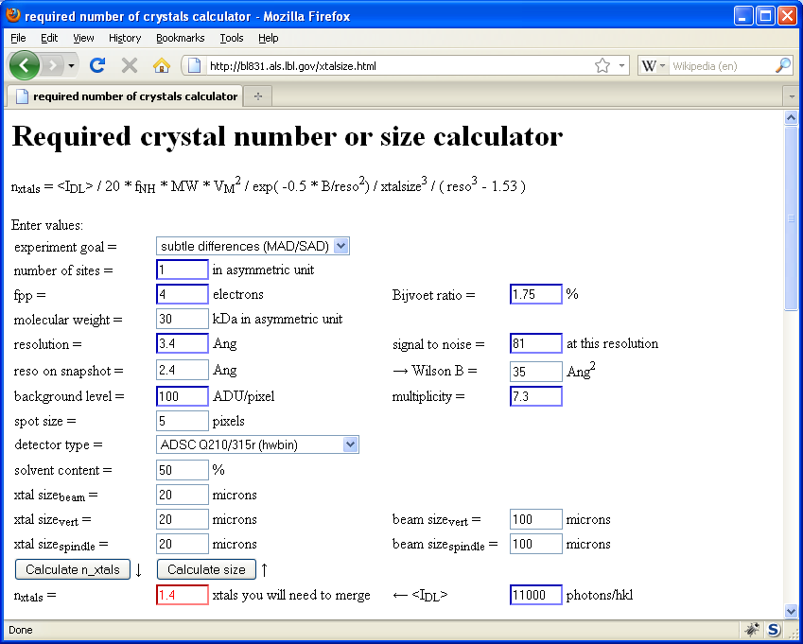
Holton & Frankel (2010) Acta D 66 393-408.

Slide 19
Self-calibrated damage limit
Where:
⟨I⟩_{DL} - average damage-limited intensity (photons/hkl) at a given resolution
10⁵ - converting R from μm to m, r_{e} from m to Å, ρ from g/cm³ to kg/m³ and MGy to Gy
r_{e} - classical electron radius (2.818 x 10⁻¹⁵ m/electron)
h - Planck’s constant (6.626 x 10⁻³⁴ J∙s)
c - speed of light (299792458 m/s)
f_{decayed} - fractional progress toward completely faded spots at end of data set
ρ - density of crystal (~1.2 g/cm³)
R - radius of the spherical crystal (μm)
λ - X-ray wavelength (Å)
f_{NH} - the Nave & Hill (2005) dose capture fraction (1 for large crystals)
n_{ASU} - number of proteins in the asymmetric unit
M_{r} - molecular weight of the protein (Daltons or g/mol)
V_{M} - Matthews’s coefficient (~2.4 Å³/Dalton)
H - Howells’s criterion (10 MGy/Å)
θ - Bragg angle
⟨ƒ_{a}²⟩ - number-averaged squared structure factor per protein atom (electron²)
⟨M_{a}⟩ - number-averaged atomic weight of a protein atom (~7.1 Daltons)
B - average (Wilson) temperature factor (Å²)
μ - attenuation coefficient of sphere material (m⁻¹)
μ_{en} - mass energy-absorption coefficient of sphere material (m⁻¹)
No flux
No symmetry
Holton & Frankel (2010) Acta D 66 393-408.

Slide 20
Bigger is better, but not by much
B = 20
B = 60
B = 0
B = 170
B = 330
B = 560
Resolution (Å)
B = 850
Crystal diameter (micron)

Slide 21
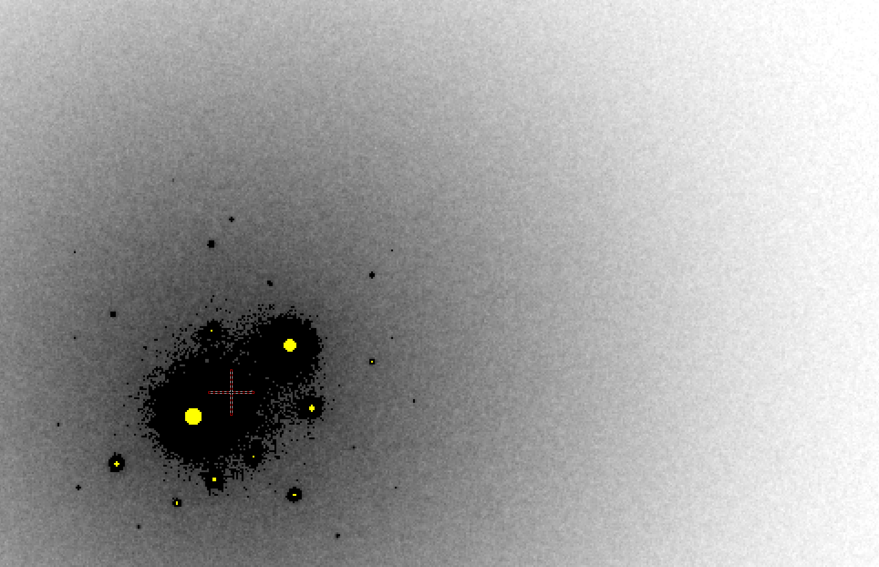
B factor from image analysis
B = 500

Slide 22
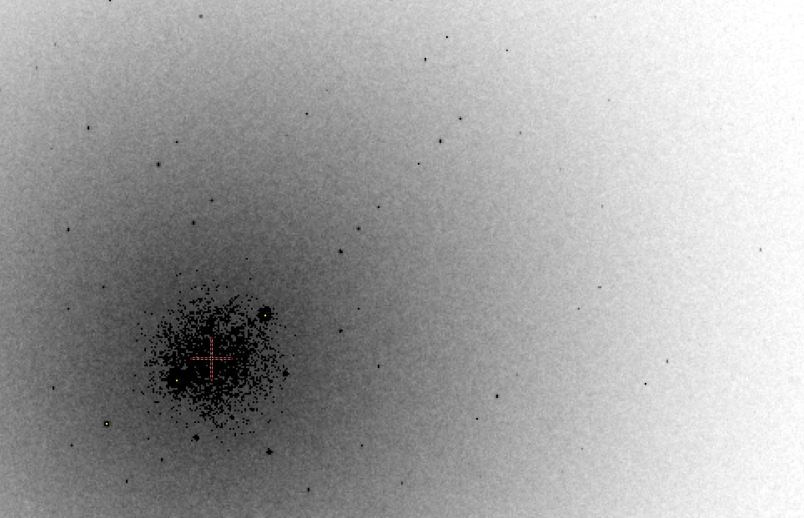
B factor from image analysis
B = 20

Slide 23
lysozyme: real and reciprocal

Slide 24
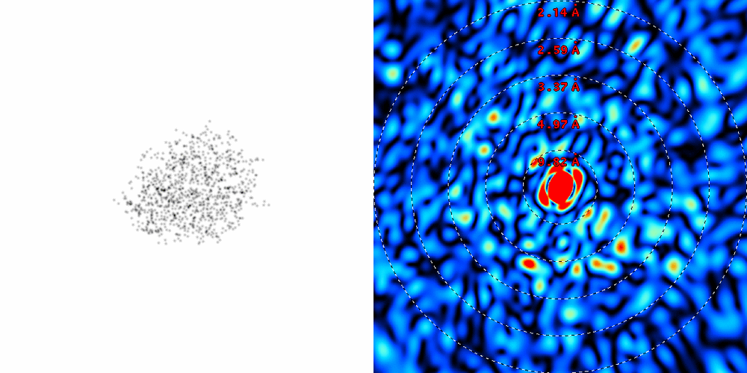
lysozyme: thermal motion

Slide 25
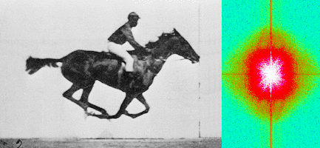
Muybridge’s galloping horse (1878)
“Time-resolved” diffraction
Real space
reciprocal

Slide 26
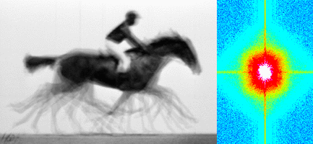
Muybridge’s galloping horse (1878)
Average electron density
Real space
reciprocal

Slide 27
Predicting resolution limits
Synchrotron Resolution (Å)
Home Lab Resolution (Å)

Slide 28
Predicting resolution limits
XFEL Resolution (Å)
Synchrotron Resolution (Å)

Slide 29
Resolution (Å)
too big
too small
just right
X-ray beam size (μm)

Slide 30
“8-shooter” adjustable beam size
rotary
pinholes:
300
100
75
50
30
25
10
“small”

Slide 31
How to get time at LCLS
Work there
Hot biological project
Tons of small crystals
Can’t be done at synchrotron
Showcase LCLS
Won’t waste valuable beam time ($20/s)

Slide 32
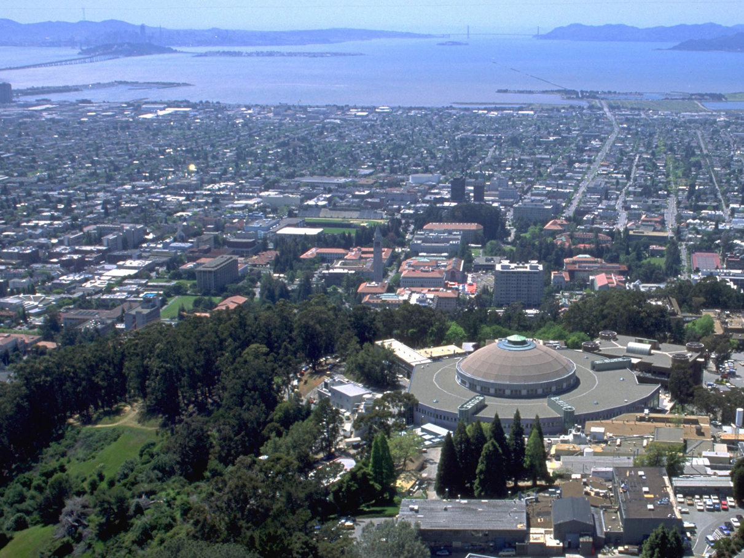
Advanced Light Source

Slide 33
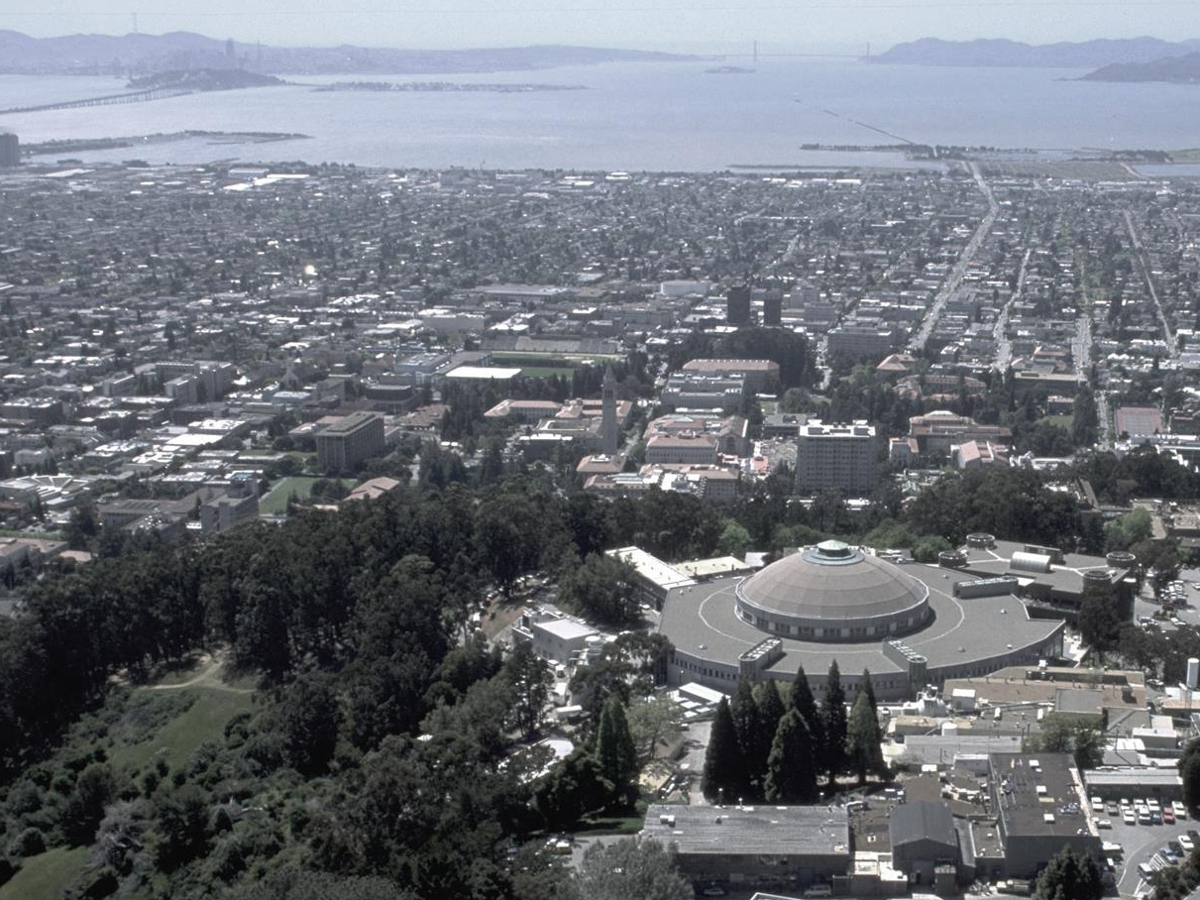
Advanced Light Source
1.9 GeV | 500 mA
2 x 0.04 nm·rad
251 x 8 μm
63 m dia. | 12 sectors
175 staff | 43 beamlines

Slide 34
Advanced Light Source
Macromolecular
Crystallography
Facility
5.0.2
ALS MX ca 1996

Slide 35
Advanced Light Source
Macromolecular
Crystallography
Facility
5.0.2
ALS MX ca 1996

Slide 36
Advanced Light Source
Macromolecular
Crystallography
Facility
5.0.2
5.0.3
5.0.1
ALS MX ca 2000

Slide 37
Advanced Light Source
Macromolecular
Crystallography
Facility
5.0.2
5.0.3
5.0.1
ALS MX ca 2001

Slide 38
Advanced Light Source
Macromolecular
Crystallography
Facility
8.3.1
UCB/UCSF
5.0.2
5.0.3
5.0.1
ALS MX ca 2001

Slide 39
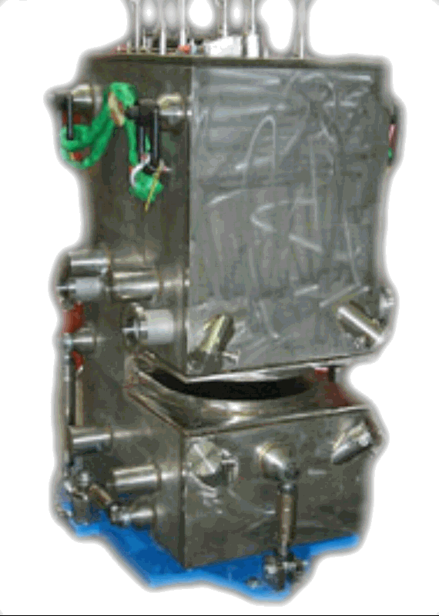
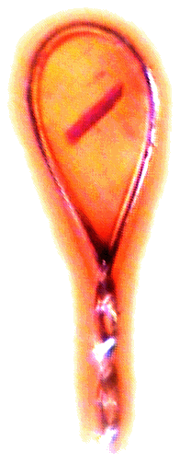
ALS 8.3.1 optics
MacDowell et. al. (2004) J. Sync. Rad. 11 447-455
Superbend
pinhole
Scatter
guard
Plane
Parabolic
mirror
Torroidal
mirror
ADSC Quantum 315r
divergence
slits
Si(111)
monochromator
Protein Crystal
2:1 demagnification cancels spherical aberrations
Pt/Rh mirrors 1.3 x 10⁸ ph/s/μm² ≈ 300 s/xtal
total power dissipation: 100 W
Notes:
Most notable acheivements are high brightness with very little “wasted” light. The discovery made by Howard Padmore? At ALS showed that a 2:1 demagnification cancels nearly all of the spherical abberations in the parabolic/torroid system. 30-50% of the total x-ray intensity passes through the 100um pinhole. The flux through the 100um pinhole at the superbend beamlines is comparable to that of the 5.0.2 wiggler or an APS bending magnet, but only 150 Watts of power must be dissipated by the beamline optics. In contrast, wiggler beamlines must disipate kilowatts. The optics here are much simpler and not exotic in any way. The system is stable and robust. There is never a need to re-focus the beam at a new wavelength. Only a 2-minute automatic tuneup is recommended for very large energy changes (more than 1-2 keV).

Slide 40
ALS 8.3.1 optics
MacDowell et. al. (2004) J. Sync. Rad. 11 447-455
Superbend
pinhole
Scatter
guard
Plane
Parabolic
mirror
Torroidal
mirror
Dectris Pilatus3 6M
divergence
slits
Si(111)
monochromator
Protein Crystal
2:1 demagnification cancels spherical aberrations
Pt/Rh mirrors 1.3 x 10⁸ ph/s/μm² ≈ 300 s/xtal
total power dissipation: 100 W
Notes:
Most notable acheivements are high brightness with very little “wasted” light. The discovery made by Howard Padmore? At ALS showed that a 2:1 demagnification cancels nearly all of the spherical abberations in the parabolic/torroid system. 30-50% of the total x-ray intensity passes through the 100um pinhole. The flux through the 100um pinhole at the superbend beamlines is comparable to that of the 5.0.2 wiggler or an APS bending magnet, but only 150 Watts of power must be dissipated by the beamline optics. In contrast, wiggler beamlines must disipate kilowatts. The optics here are much simpler and not exotic in any way. The system is stable and robust. There is never a need to re-focus the beam at a new wavelength. Only a 2-minute automatic tuneup is recommended for very large energy changes (more than 1-2 keV).

Slide 41
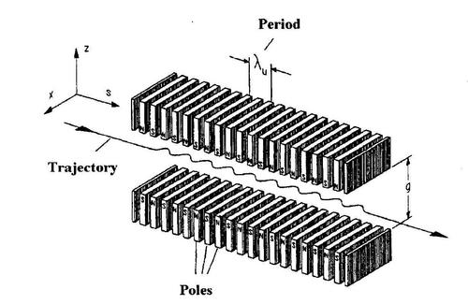
ALS 5.0.2 optics
Zwart et. al. (2015) SRN 28 22-27
Sample
slits
Plane
Parabolic
mirror
Torroidal
mirror
16-pole wiggler
Dectris Pilatus3 6M
divergence
slits
Si(111)
monochromator
Protein Crystal
1 x 10⁸ ph/s/μm² ≈ 300 s/xtal
Notes:
Most notable acheivements are high brightness with very little “wasted” light. The discovery made by Howard Padmore? At ALS showed that a 2:1 demagnification cancels nearly all of the spherical abberations in the parabolic/torroid system. 30-50% of the total x-ray intensity passes through the 100um pinhole. The flux through the 100um pinhole at the superbend beamlines is comparable to that of the 5.0.2 wiggler or an APS bending magnet, but only 150 Watts of power must be dissipated by the beamline optics. In contrast, wiggler beamlines must disipate kilowatts. The optics here are much simpler and not exotic in any way. The system is stable and robust. There is never a need to re-focus the beam at a new wavelength. Only a 2-minute automatic tuneup is recommended for very large energy changes (more than 1-2 keV).

Slide 42
Advanced Light Source
Macromolecular
Crystallography
Facility
8.3.1
UCB/UCSF
5.0.2
5.0.3
5.0.1
ALS MX ca 2001

Slide 43
Advanced Light Source
8.2.1
Macromolecular
Crystallography
Facility
8.2.2
8.3.1
UCB/UCSF
5.0.2
5.0.3
5.0.1
ALS MX ca 2002

Slide 44
Advanced Light Source
8.2.1
Berkeley
Center for
Structural
Biology
8.2.2
8.3.1
UCB/UCSF
5.0.2
5.0.3
5.0.1
ALS MX ca 2002

Slide 45
Advanced Light Source
8.2.1
Berkeley
Center for
Structural
Biology
8.2.2
8.3.1
UCB/UCSF
5.0.2
5.0.3
5.0.1
MBC 4.2.2
ALS MX ca 2005

Slide 46
ALS 4.2.2 optics
Superbend
Plane
parabolic
mirror
Sample
slits
Plane
Parabolic
mirror
Research Detectors CMOS 8M
divergence
slits
sagital
monochromator
Protein Crystal
1 x 10⁸ ph/s/μm² ≈ 300 s/xtal
Notes:
Most notable acheivements are high brightness with very little “wasted” light. The discovery made by Howard Padmore? At ALS showed that a 2:1 demagnification cancels nearly all of the spherical abberations in the parabolic/torroid system. 30-50% of the total x-ray intensity passes through the 100um pinhole. The flux through the 100um pinhole at the superbend beamlines is comparable to that of the 5.0.2 wiggler or an APS bending magnet, but only 150 Watts of power must be dissipated by the beamline optics. In contrast, wiggler beamlines must disipate kilowatts. The optics here are much simpler and not exotic in any way. The system is stable and robust. There is never a need to re-focus the beam at a new wavelength. Only a 2-minute automatic tuneup is recommended for very large energy changes (more than 1-2 keV).

Slide 47
Advanced Light Source
8.2.1
Berkeley
Center for
Structural
Biology
8.2.2
8.3.1
UCB/UCSF
5.0.2
5.0.3
5.0.1
MBC 4.2.2
ALS MX ca 2005

Slide 48
Advanced Light Source
8.2.1
Berkeley
Center for
Structural
Biology
8.2.2
8.3.1
UCB/UCSF
5.0.2
5.0.3
5.0.1
MBC 4.2.2
ALS MX ca 2006
12.3.1 SIBYLS
MX & SAXS

Slide 49
ALS 12.3.1 optics
Superbend
Sample
slits
Plane
Parabolic
mirror
Torroidal
mirror
ADSC Quantum 315r
divergence
slits
Si(111)
monochromator
Protein Crystal
4 x 10⁷ ph/s/μm² ≈ 1600 s/xtal
Notes:
Most notable acheivements are high brightness with very little “wasted” light. The discovery made by Howard Padmore? At ALS showed that a 2:1 demagnification cancels nearly all of the spherical abberations in the parabolic/torroid system. 30-50% of the total x-ray intensity passes through the 100um pinhole. The flux through the 100um pinhole at the superbend beamlines is comparable to that of the 5.0.2 wiggler or an APS bending magnet, but only 150 Watts of power must be dissipated by the beamline optics. In contrast, wiggler beamlines must disipate kilowatts. The optics here are much simpler and not exotic in any way. The system is stable and robust. There is never a need to re-focus the beam at a new wavelength. Only a 2-minute automatic tuneup is recommended for very large energy changes (more than 1-2 keV).

Slide 50
ALS 12.3.1 optics
Superbend
Sample
slits
Plane
Parabolic
mirror
Torroidal
mirror
ADSC Quantum 315r
divergence
slits
1% ML
monochromator
Protein Crystal
1.5 x 10⁹ ph/s/μm² ≈ 40 s/xtal
Notes:
Most notable acheivements are high brightness with very little “wasted” light. The discovery made by Howard Padmore? At ALS showed that a 2:1 demagnification cancels nearly all of the spherical abberations in the parabolic/torroid system. 30-50% of the total x-ray intensity passes through the 100um pinhole. The flux through the 100um pinhole at the superbend beamlines is comparable to that of the 5.0.2 wiggler or an APS bending magnet, but only 150 Watts of power must be dissipated by the beamline optics. In contrast, wiggler beamlines must disipate kilowatts. The optics here are much simpler and not exotic in any way. The system is stable and robust. There is never a need to re-focus the beam at a new wavelength. Only a 2-minute automatic tuneup is recommended for very large energy changes (more than 1-2 keV).

Slide 51
ALS 12.3.1 double endstation

Slide 52
Advanced Light Source
8.2.1
Berkeley
Center for
Structural
Biology
8.2.2
8.3.1
UCB/UCSF
5.0.2
5.0.3
5.0.1
MBC 4.2.2
ALS MX ca 2006
12.3.1 SIBYLS
MX & SAXS

Slide 53
Advanced Light Source
8.2.1
Berkeley
Center for
Structural
Biology
8.2.2
8.3.1
UC
5.0.2
5.0.3
5.0.1
MBC 4.2.2
ALS ca 2015
12.3.1 SIBYLS
MX & SAXS

Slide 54
Advanced Light Source
8.2.1
Berkeley
Center for
Structural
Biology
8.2.2
8.3.1
UC
5.0.2
5.0.3
5.0.1
MBC 4.2.2
ALS ca 2018
Gemini 2.0.1
μfocus 2.0.2
12.3.1 SIBYLS
MX & SAXS

Slide 55
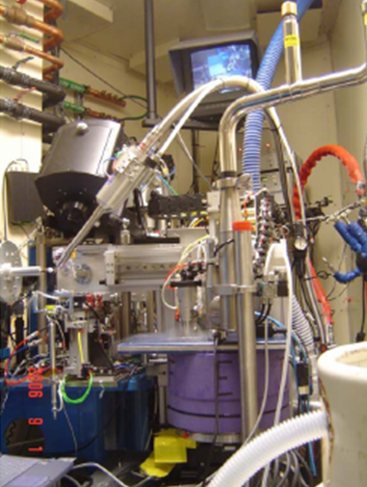
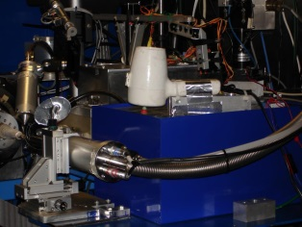
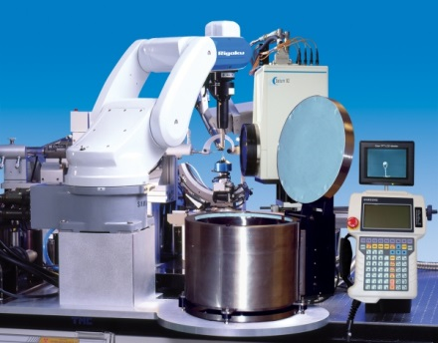
ALS robots
8.2.1
ACTOR
Berkeley
Auto-
Mounter
8.2.2
8.3.1
Cool Hand Luke
5.0.2
5.0.3
5.0.1
MBC 4.2.2
ACTOR
ALS MX robots
Stanford
Auto-
Mounter
12.3.1 SIBYLS

Slide 56
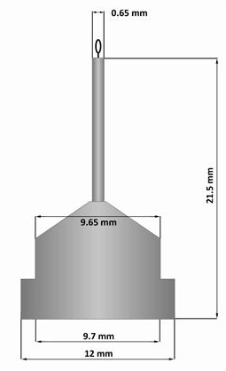
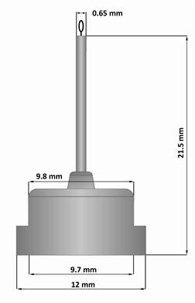
Pin compatibility
SLAC
ALS
SPINE

Slide 57
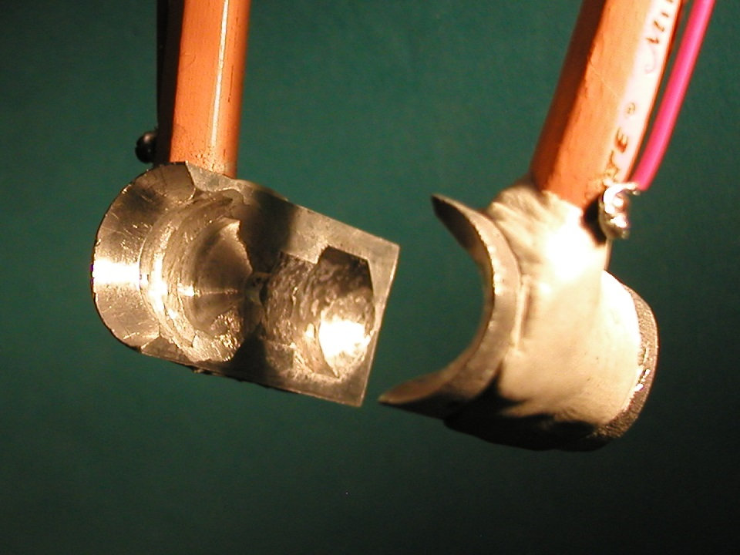
SuperTong

Slide 58
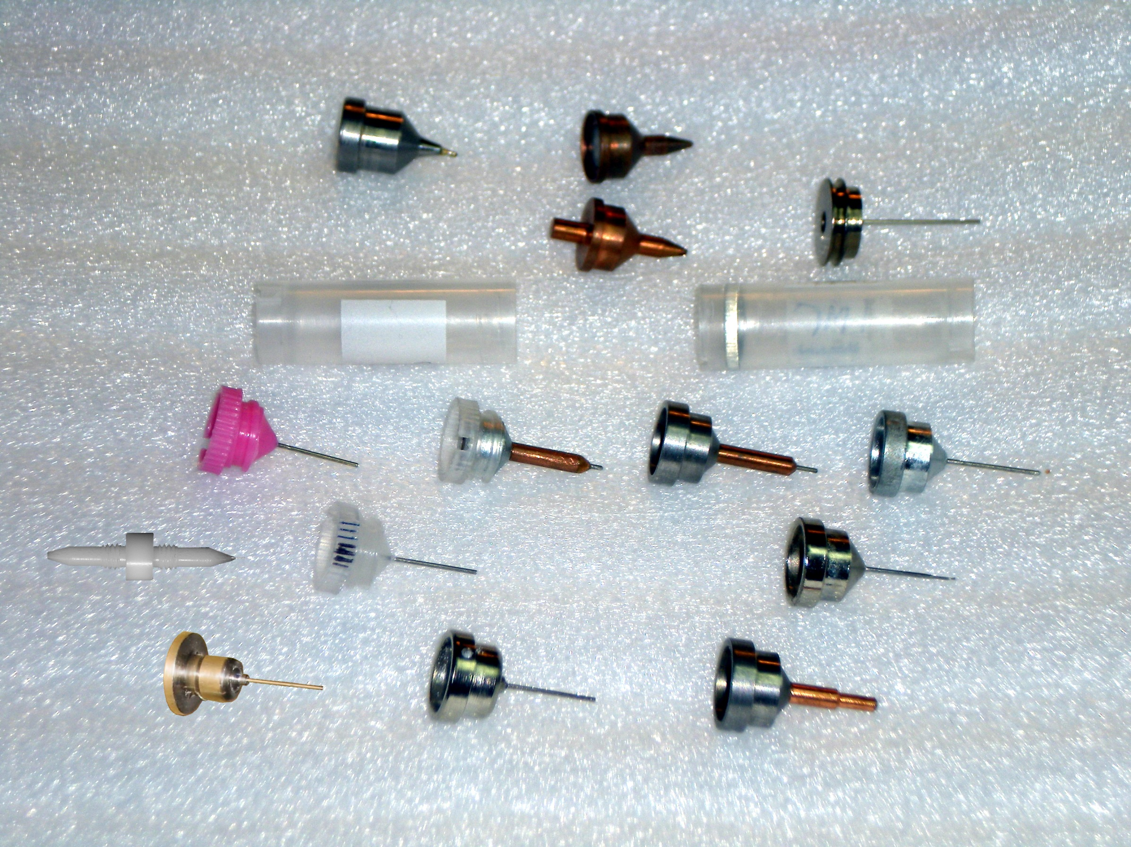
What if we didn’t have to choose?
Caltech
SSRL
Yale
Hampton screw cap
Hampton magnetic
H. colored
H. copper
H. magnetic
H. hybrid
H. screw cap
Syrrx
SPring-8
Oxford
SPINE
MiTeGen RT

Slide 59
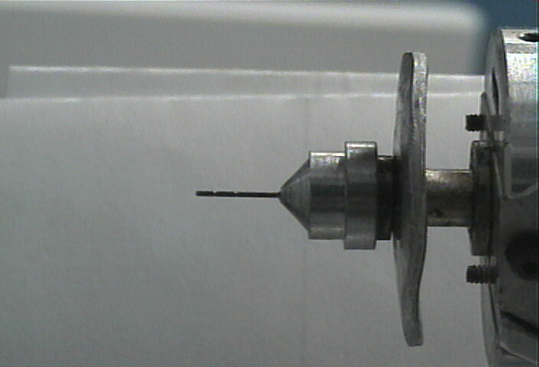
Hampton Pin
SuperTong

Slide 60
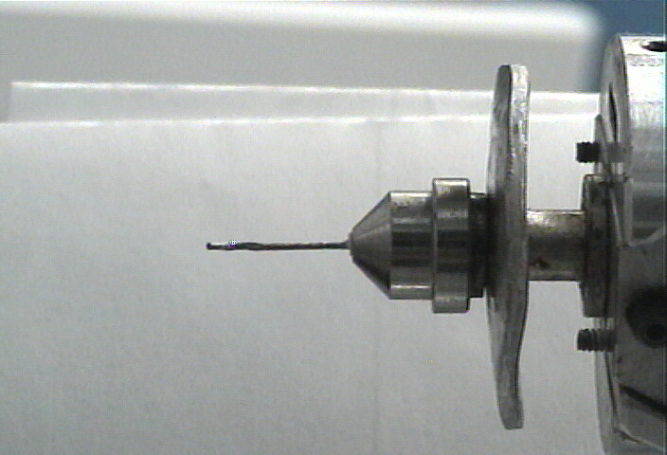
Syrrx Pin
SuperTong

Slide 61
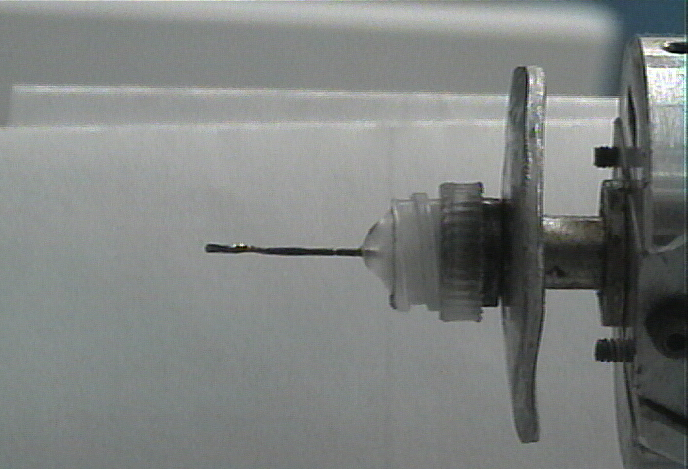
plastic Pin
SuperTong

Slide 62
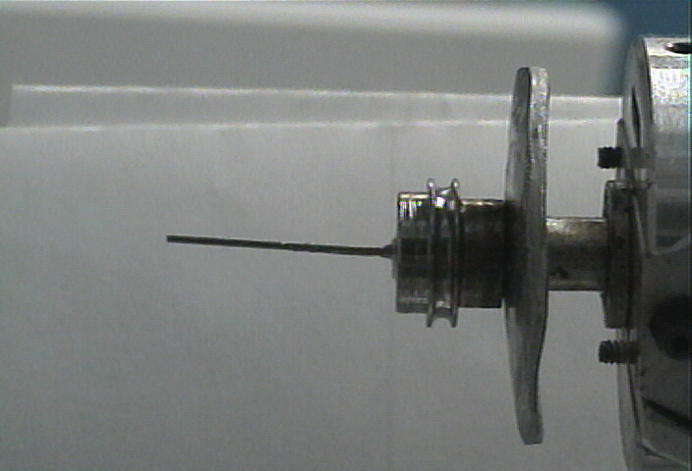
Yale Pin
SuperTong

Slide 63
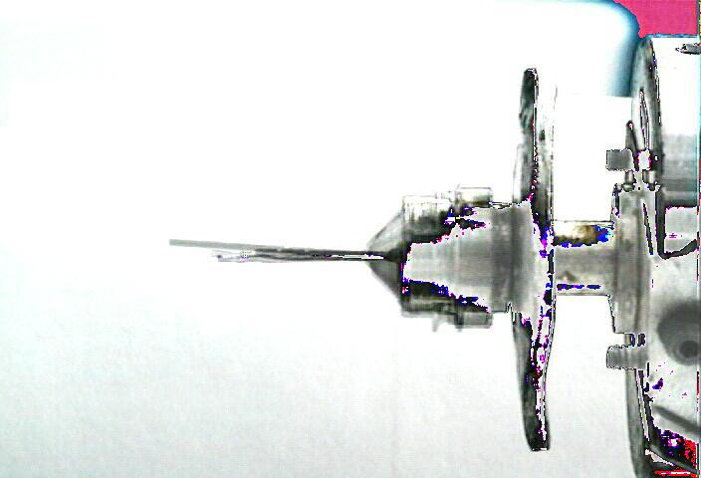
SuperTong
SuperTong

Slide 64
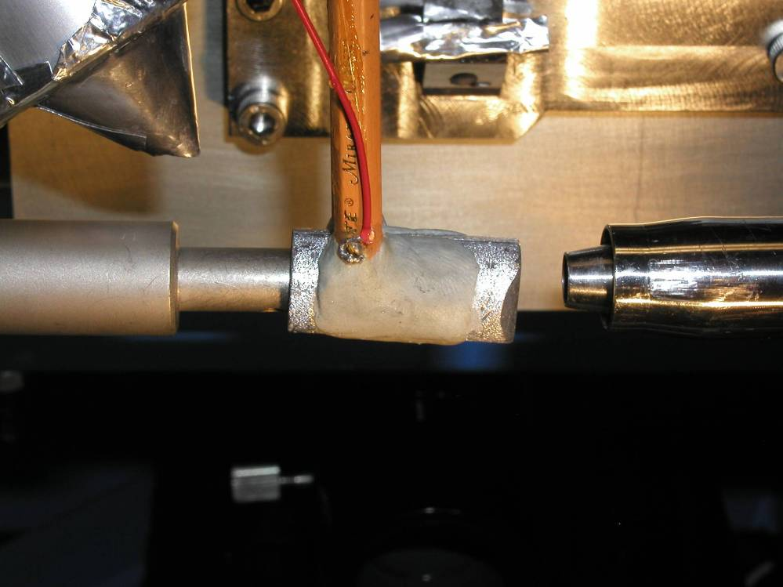
Robix ongonio

Slide 65
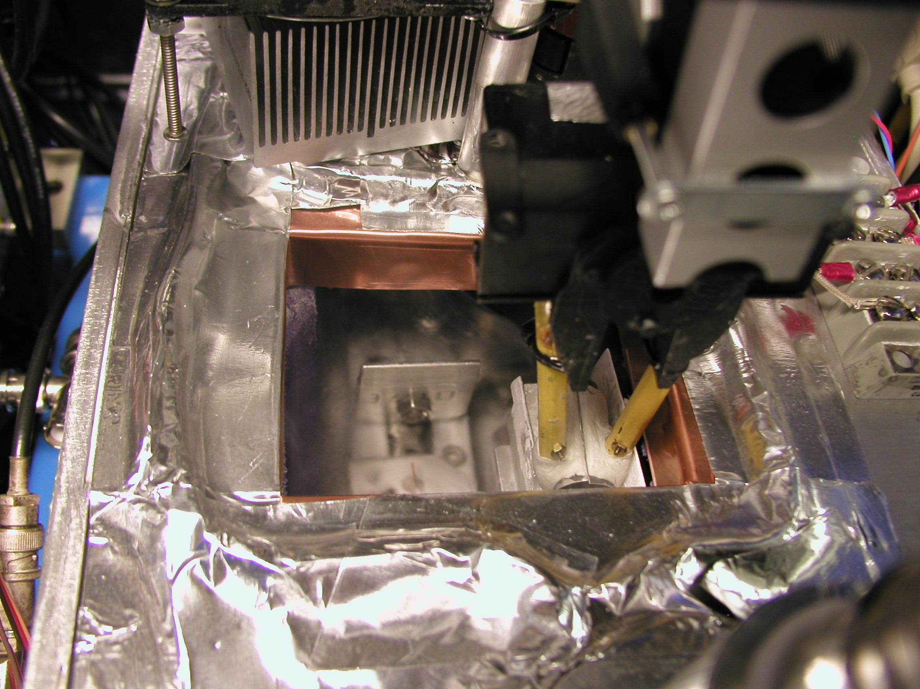
CHL idlepos

Slide 66
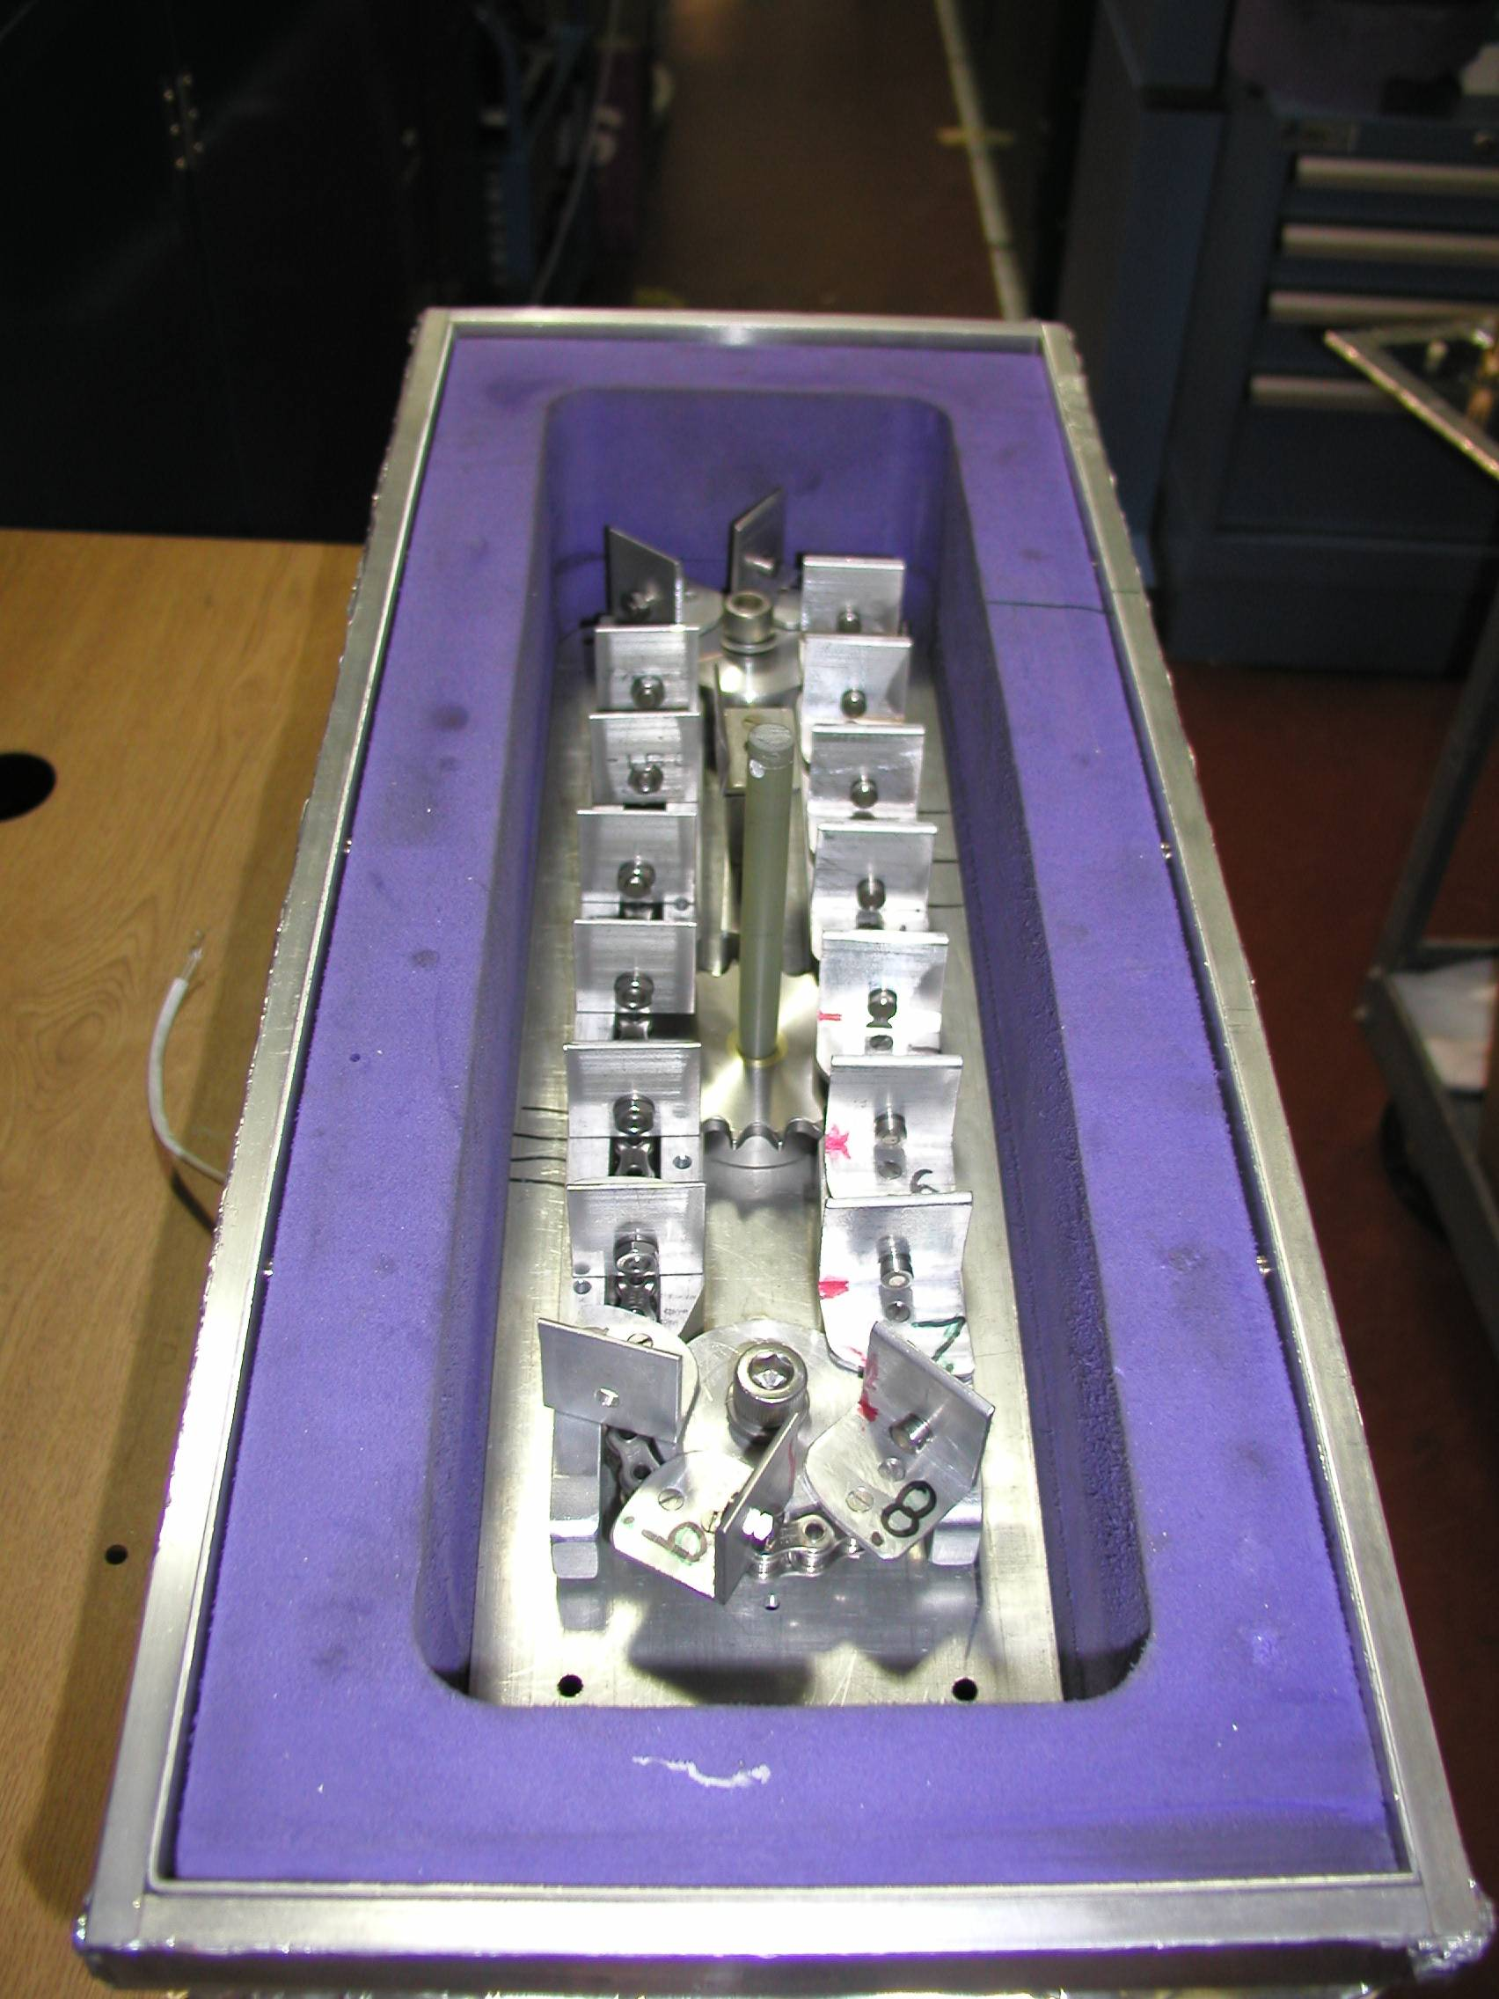
Carousel open

Slide 67
“infinite capacity” sample carousel

Slide 68
Global “success rate” of structure determination
100 s/dataset
200 days/year
~150 beamlines
~26,000,000 datasets/year
9640 PDBs in 2014
0.04% “success”

Slide 69
Measured success rate: ALS 8.3.1
1250
1000
750
500
250
0
images x 10⁶
PDB entries
Notes:
Of the 1275 PDB deposits involving ALS 8.3.1, 1038 of them mention a data collection date. The timeline between collection and deposition for each PDB entry is shown in blue. For example, in April 2004 only 46 PDBs had been deposited, but the data for 252 had already been collected. The red line indicates the cumulative number of images collected at a given date. The kink in the red line in mid-2003 is coincident with an optics upgrade that tripled the flux. In 2014 another flux upgrade brought another factor of 4.5.

Slide 70
Turning data into models
8.3.1 in 2004
Number | Description | Percent
446028 | Images (~7 TB) | 33%
2346 | Data sets | 47%
449 | MAD/SAD (1:2) | 19%
120 | Published | 5.1%

Slide 71
Operational Efficiency
Seconds | Description | Percent
104490 | Assigned and available | 100%
42093 | Shutter open | 40%
52684 | Collecting (3026 images) | 50%
247s × 45 | Mounting | 11%
229s × 37 | Centering | 8%
 | Thinking | 31%

Slide 72
The 100 structure/year club
PDBs | Sync | BL | Flux
2829 | APS | 19-ID | 1.3E+13
2110 | NSLS | X29A | 2.9E+11
1830 | APS | 22-ID | 7.0E+12
1651 | SLS | X06SA | 4.0E+12
1517 | SLS | X10SA | 2.5E+12
1475 | ESRF | ID29 | 1.0E+13
1447 | SSRF | BL17U | 4.0E+12
1384 | ESRF | ID14-4 | 5.0E+12
PDBs | Sync | BL | Flux
1384 | ESRF | ID14-4 | 5.0E+12
1362 | ESRF | ID23-1 | 4.0E+12
1285 | SSRL | BL11-1 | 4.0E+11
1282 | APS | 24-ID-C | 1.3E+13
1153 | ESRF | ID14-1 | 1.0E+11
1137 | SSRL | BL9-2 | 7.0E+11
1122 | ALS | 8.3.1 | 1.8E+11
1042 | APS | 17-ID | 7.0E+11
1026 | NSLS | X25 | 2.4E+11
8% of all membrane
protein structures!
USA
Europe
Decommissioned

Slide 73
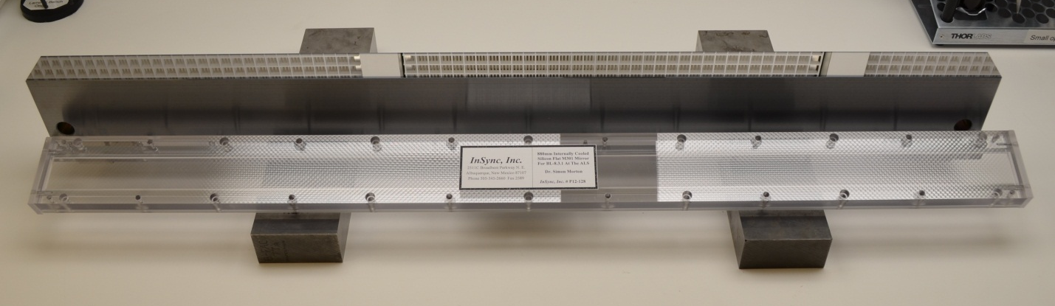
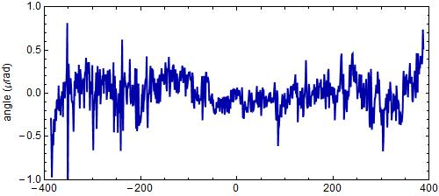
“The flattest thing we have ever seen”
- LBNL Metrology Group
Old mirror: 800 nRad
New mirror: < 200 nRad
Dec 17 2014
Flux at
460%

Slide 75
What will change?
Old detector
New detector
Read-out noise: 2 ph/pix
100 ADU/pixel
1.15s read-out, ~0.3 Hz
23 min data set @ 30 MGy
rastering impractical
16 bits
0.7% inactive area
315 mm face; 80 μm PSF
1312 orders across face
No max count rate
3% SHSSS error
7235 eV optimal
No read-out noise
no more strategy
2.03 ms read-out, 25 Hz
200 s data set @ 30 MGy
10 min/mm² raster 1% lifedose
20 bits
8.5% inactive area
430 mm face, 172 μm PSF
833 orders across face
Max 10⁷ ph/s/pix
< 1% SHSSS error
S-SAD, 5 keV?

Slide 76
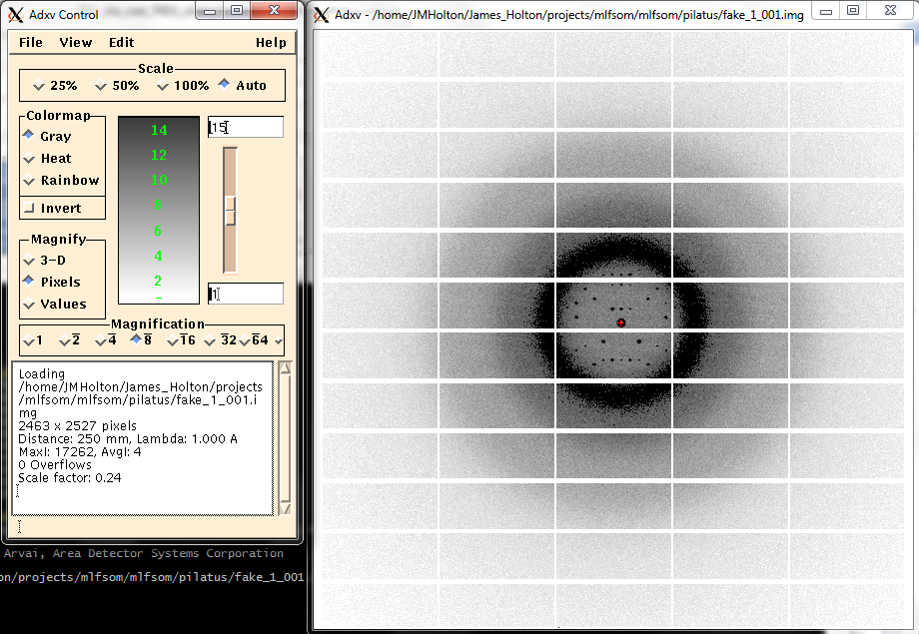
MLFSOM: now available in “Pilatus”

Slide 77
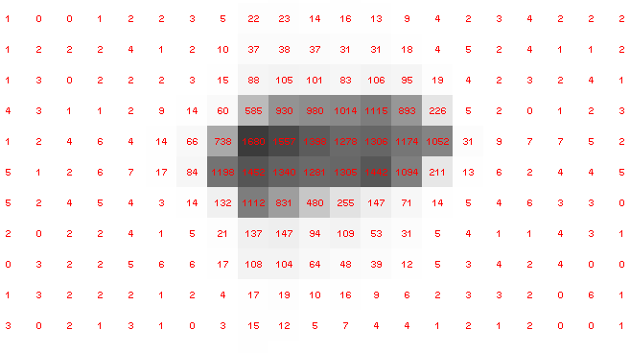
Pilatus pile-up for RT MX? same photons, different speeds
1 shot with
no attenuation

Slide 78
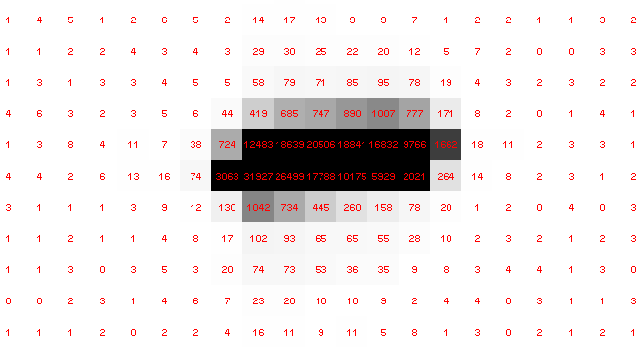
Pilatus pile-up for RT MX? same photons, different speeds
Sum of 193 shots with
193-fold attenuation

Slide 79
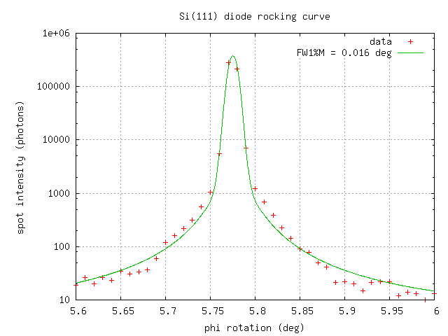
Pilatus pile-up for RT MX: same photons, different speeds
Collaboroators:
Aina Cohen
Ana Gonzalez

Slide 80
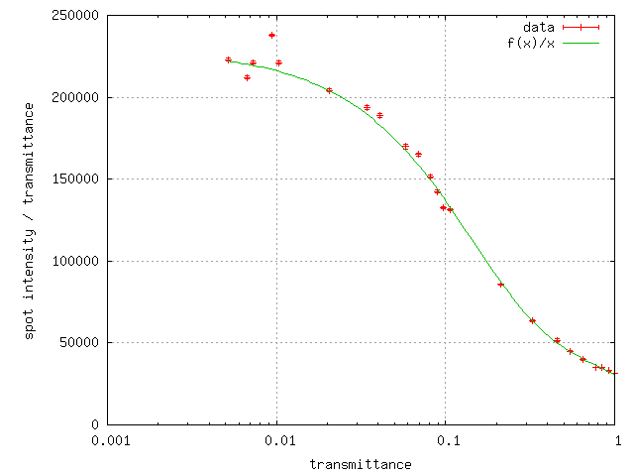
Pilatus pile-up for RT MX: same photons, different speeds
Collaboroators:
Aina Cohen
Ana Gonzalez

Slide 81
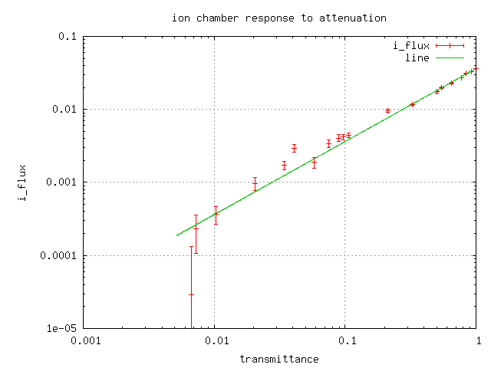
Pilatus pile-up for RT MX: same photons, different speeds
Collaboroators:
Aina Cohen
Ana Gonzalez

Slide 82
What will change?
Old detector
New detector
Read-out noise: 2 ph/pix
100 ADU/pixel
1.15s read-out, ~0.3 Hz
23 min data set @ 30 MGy
rastering impractical
16 bits
0.7% inactive area
315 mm face; 80 μm PSF
1312 orders across face
No max count rate
3% SHSSS error
7235 eV optimal
No read-out noise
no more strategy
2.03 ms read-out, 25 Hz
200 s data set @ 30 MGy
10 min/mm² raster 1% lifedose
20 bits
8.5% inactive area
430 mm face, 172 μm PSF
833 orders across face
Max 10⁷ ph/s/pix
< 1% SHSSS error
S-SAD, 5 keV?

Slide 83
Averaging with systematic error

Slide 84
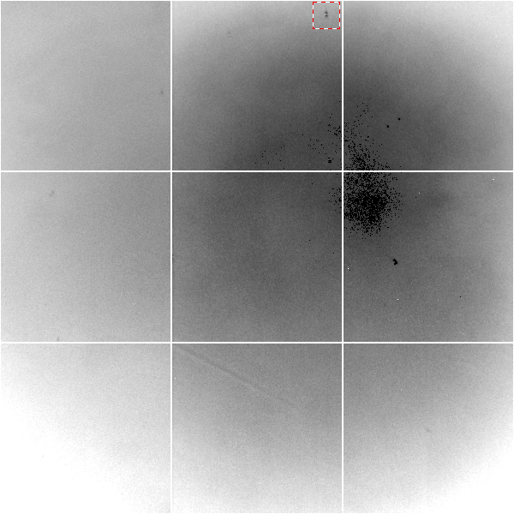
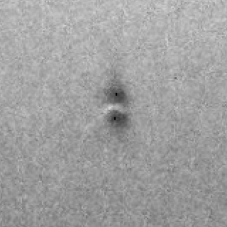
Gd edge-contrast map of ADSC Q315r detector
10% high
average
10% low

Slide 85
Gadox calibration vs energy
same = good!
Relative absorption depth
bad!
photon energy (keV)

Slide 86
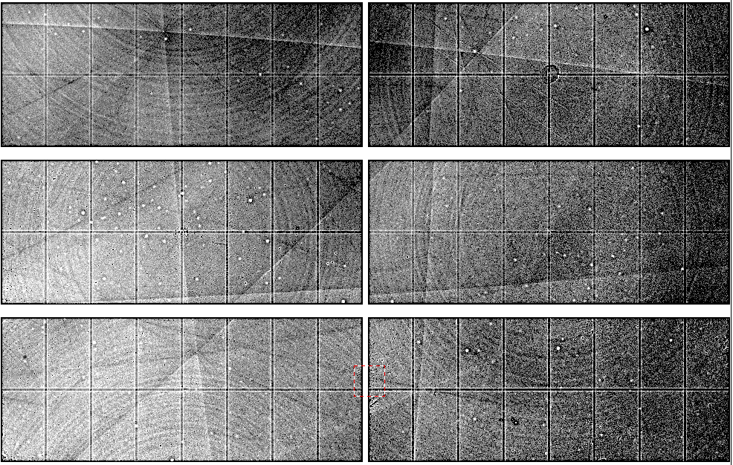
Pilatus: subtract smooth baseline
~3x10⁵ photon/pixel → 0.3% error
Bragg
glitch
“tree rings”
Pick-up tool mark
Gollwitzer & Krumrey (2014)
J. Appl. Cryst. 47, 378
oxygen
inclusions
1% high
average
1% low

Slide 87
Detector pixels are 3D
51 μm
172 μm
75 μm
8%
side
loss
53%
side
loss
76%
side
loss
photon
17%
loss
photon
31 μm thick
Pilatus
320 μm thick
Eiger
Typical CCD
26% loss
450 μm thick
Arrival angle of 2 Å spot: 29°
Mean Penetration depth 12 keV:
17.5 μm Gd₂O₂S 237 μm Si
15%
loss

Slide 88
PAD: need more than flood-field
θ
incoming
photon
λ
detection
event
N
N
N

Slide 89
PAD: need more than flood-field
θ
Bragg
glitch
width
incoming
photon
λ
oxygen
inclusion
thickness
detection
event
N
N
N

Slide 90
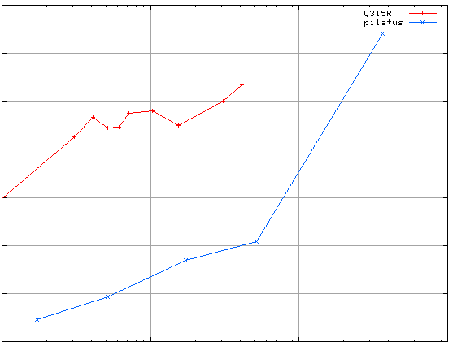
3.5
3.0
2.5
2.0
1.5
1.0
0.5
CCD detector
different
modules
anomalous mates are always on
different modules
SHSSS
Systematic component of R_{sseparate} (%)
Pilatus
SN001
Pilatus
SN113
0.1 1 10 100
distance between spots (mm)
Notes:
Comparision of SHSSS measured by the detector-shift experiment on three different detectors:
The Q315R in ALS 8.3.1
The first Pilatus detector at the Swiss Light Soruce
A newer Pilatus detector at Stanford
Improvements in calibration technology have finally made
Pilatus competitive with calibration on CCDs

Slide 91
Beam Flicker
pinhole
removed
normalized flux through pinhole
0.15%/√Hz
time (seconds)

Slide 92
Threshold of a revolution in phasing
Source of error | realistic simulation | No SHSSS | Perfect detector
Photon counting | + | + | +
Shutter jitter | + | + | -
Beam flicker | + | + | -
Sample absorption | + | + | -
Radiation damage | + | + | -
Imperfect spindle | + | + | -
vignette | + | + | -
Corner correction | + | + | -
SHSSS | + | - | -
R_{meas} (∞-10 Å) | 2.8% | 0.7% | 0.7%
I/σ asymptotic | 26.8 | 74.2 | 81.0
Holton et al (2014) "R-factor gap", FEBS Journal 281, 4046-4060.

Slide 93
CCD
& early PAD
new PAD
(uncalibrated)
Goal
Solve-able proteins (%)
Required signal-to-noise (I/σ)

Slide 94
Can you count to 1,000,000 ?
sqrt(1,000,000)
1,000,000
Theoretically:
= 0.1%
R_{meas} ≈ 0.1% ?
ISa = 1000
In reality:
ISa ~ 33
R_{meas =} ≈ 3%
sqrt(1,000)
1,000
= 3%
photon
spot
> 1000 is a waste!

Slide 95
140-fold multiplicity
16 crystals, 360° each, < 1 MGy, inverse beam
7235 eV ADSC Q210r Australian Synchrotron MX1
SUBSET OF INTENSITY DATA WITH SIGNAL/NOISE >= -3.0 AS FUNCTION OF RESOLUTION
RESOLUTION NUMBER OF REFLECTIONS COMPLETENESS R-FACTOR R-FACTOR COMPARED I/SIGMA R-meas CC(1/2) Anomal SigAno Nano
LIMIT OBSERVED UNIQUE POSSIBLE OF DATA observed expected Corr
9.17 188919 1061 1071 99.1% 3.9% 4.8% 188919 257.47 3.9% 100.0* 91* 5.024 450
6.49 356827 1933 1933 100.0% 5.2% 5.5% 356827 214.33 5.2% 100.0* 86* 3.836 882
5.30 466503 2515 2515 100.0% 7.2% 7.0% 466503 165.13 7.2% 100.0* 76* 3.257 1175
4.59 548405 2974 2974 100.0% 7.2% 6.6% 548405 175.42 7.3% 100.0* 67* 2.589 1403
4.10 615117 3353 3355 99.9% 7.7% 6.7% 615117 174.13 7.7% 100.0* 59* 2.264 1594
3.74 684947 3734 3737 99.9% 9.4% 8.3% 684947 143.09 9.4% 100.0* 49* 1.953 1783
3.47 743557 4051 4051 100.0% 11.2% 10.1% 743557 120.17 11.2% 100.0* 39* 1.696 1942
3.24 799722 4366 4366 100.0% 14.1% 13.9% 799722 91.14 14.1% 100.0* 30* 1.333 2103
3.06 839252 4598 4603 99.9% 19.5% 20.2% 839252 65.79 19.5% 100.0* 23* 1.117 2214
2.90 891398 4904 4908 99.9% 29.0% 31.7% 891398 44.85 29.1% 99.9* 17* 1.008 2369
2.77 931622 5148 5151 99.9% 40.5% 44.8% 931622 32.58 40.6% 99.8* 11* 0.901 2493
2.65 969629 5384 5387 99.9% 52.8% 58.8% 969629 25.16 52.9% 99.8* 10* 0.866 2605
2.54 997213 5574 5574 100.0% 67.4% 76.0% 997213 19.47 67.6% 99.6* 2 0.804 2705
2.45 1031222 5889 5889 100.0% 88.9% 101.2% 1031222 14.58 89.2% 99.2* 4 0.831 2859
2.37 788617 6008 6008 100.0% 109.3% 125.5% 788617 9.97 109.7% 98.1* 5 0.829 2925
2.29 614145 6252 6252 100.0% 138.2% 161.4% 614145 6.87 138.9% 96.1* 1 0.760 3037
2.22 470283 6481 6481 100.0% 197.1% 231.7% 470283 4.03 198.6% 83.5* -1 0.721 3159
2.16 259836 6629 6631 100.0% 227.3% 268.7% 259831 2.41 230.8% 46.9* -1 0.677 3224
2.10 36259 4169 6807 61.2% 154.4% 169.4% 36229 1.28 163.6% 47.0* -2 0.660 1999
2.05 13567 3372 7037 47.9% 170.1% 187.0% 13503 0.68 196.5% 25.7* 3 0.629 1578
total 12247040 88395 94730 93.3% 15.7% 16.4% 12246941 54.30 15.8% 100.0* 12* 1.217 42499
I/SIGMA
257.47

Slide 96
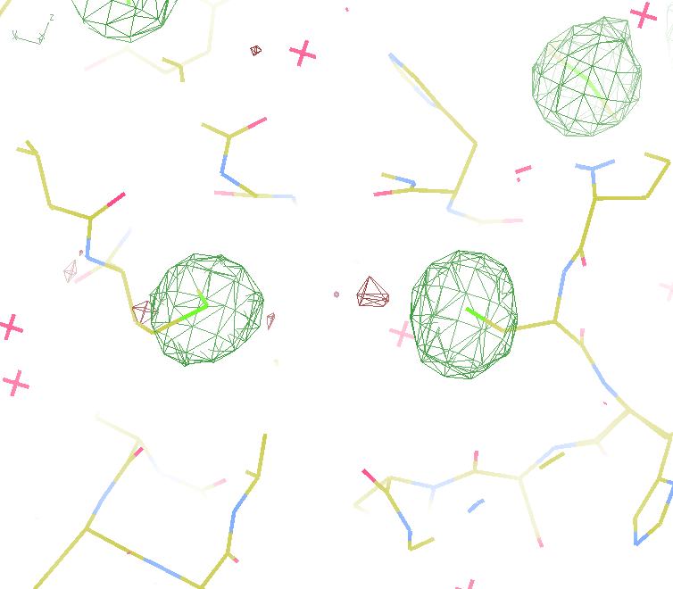
140-fold multiplicity
Not
Lysozyme!
18 σ
16 σ
Phased anomalous difference Fourier
data Courtesy of Tom Peat & Janet Newman

Slide 97
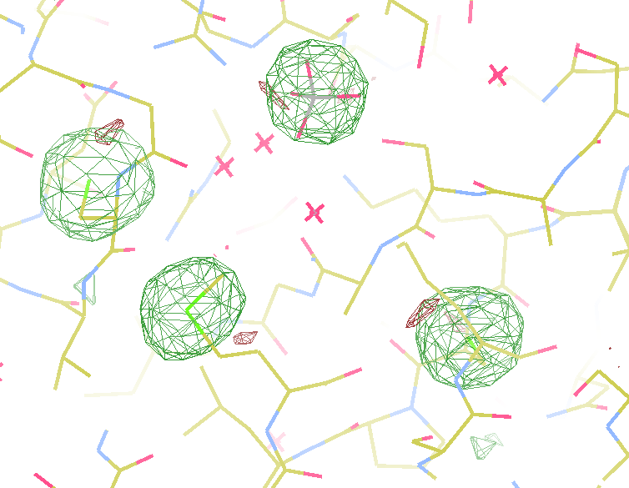
140-fold multiplicity
Not
Lysozyme!
15σ = PO₄
Phased anomalous difference Fourier
data Courtesy of Tom Peat & Janet Newman

Slide 98
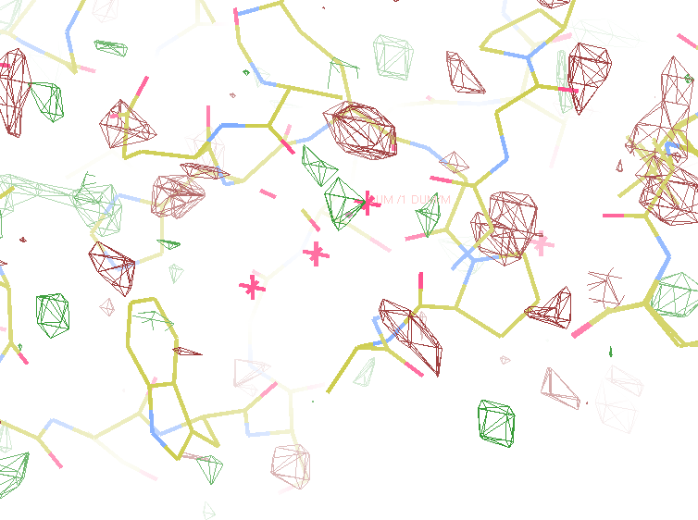
140-fold multiplicity
Not
Lysozyme!
~2σ = Mg?
Phased anomalous difference Fourier
data Courtesy of Tom Peat & Janet Newman

Slide 99
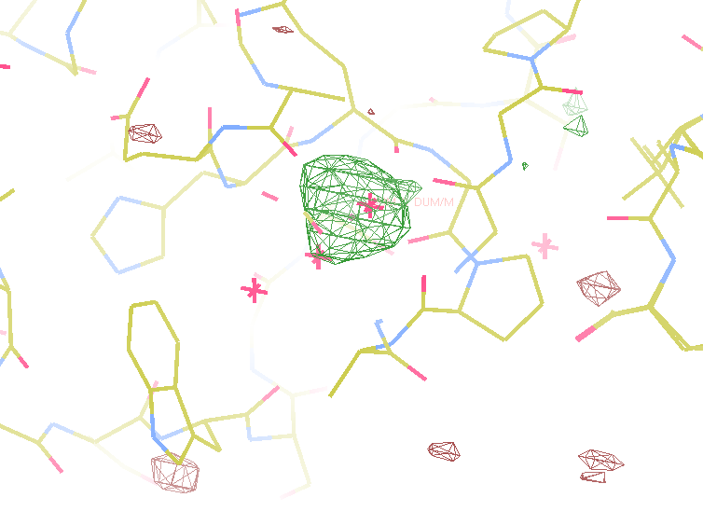
140-fold multiplicity
Not
Lysozyme!
10 σ is enough for phasing!
Bunkoczi et al. (2015)."weak, single-wavelength anomalous", Nat. Meth. 12, 127-130.
8.2σ = Na
f” = 0.15
DELFAN residual anomalous difference
data Courtesy of Tom Peat & Janet Newman

Slide 100
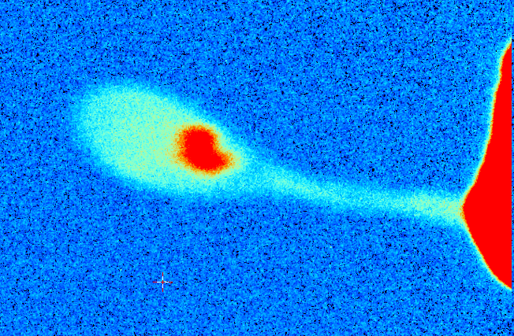
3%
2%
1%
0
ADSC
area
detector
beam center
crystal in loop
Cu foil
X-ray excited
fluorescent
X-ray source
x-ray beam

Slide 101
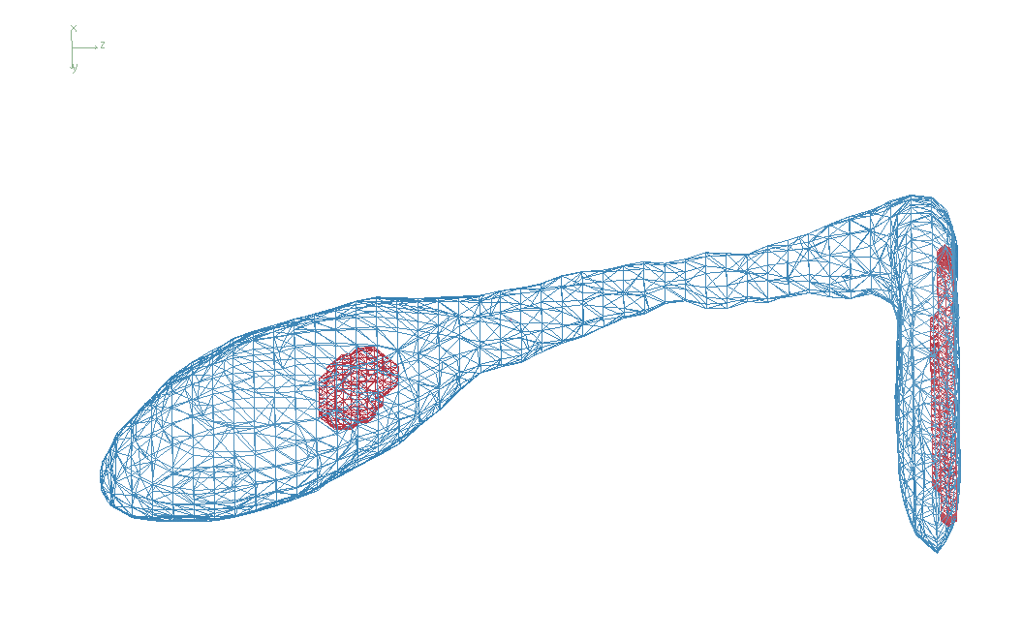
Cone-Beam Online X-ray Absorption Radiograph

Slide 102
What will change?
Old detector
New detector
Read-out noise: 2 ph/pix
100 ADU/pixel
1.15s read-out, ~0.3 Hz
23 min data set @ 30 MGy
rastering impractical
16 bits
0.7% inactive area
315 mm face; 80 μm PSF
1312 orders across face
No max count rate
3% SHSSS error
7235 eV optimal
No read-out noise
no more strategy
2.03 ms read-out, 25 Hz
200 s data set @ 30 MGy
10 min/mm² raster 1% lifedose
20 bits
8.5% inactive area
430 mm face, 172 μm PSF
833 orders across face
Max 10⁷ ph/s/pix
< 1% SHSSS error
S-SAD, 5 keV?

