Slide 1
What is “MRPI”?
Multi-campus Research Programs and Initiatives
Offered by: UC Office of Research and Graduate Studies
Wide range of fields
Nanotech, Arts, Climate, Gender Studies, Sustainability, Health
Total Budget: $9.5M, we got $2.6M
ALS 8.3.1 MRPI Project Goals:
Upgrade ALS 8.3.1 to latest technology
Open up access to all UC structural biology labs
Transition to sustainable funding sources
Notes:
Brief description of what MRPI is. The University of California seeks to support collaboration between campuses in ways that benefit the entire system the most.
Funding was very limited, and it is extremely remarkable that we got this and our budget was not cut.

Slide 2
ALS 8.3.1 MRPI Business meeting
Overview of the Beamline
PRT Structure
Scheduling and Allocation
Future upgrade plans
Financial report

Slide 3
ALS 8.3.1 MRPI Business meeting
Overview of the Beamline
PRT Structure
Scheduling and Allocation
Future upgrade plans
Financial report

Slide 4
It’s Official

Slide 5
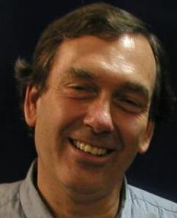
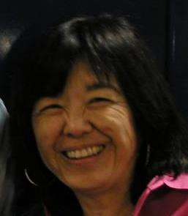
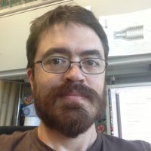
What is ALS Beamline 8.3.1 ?
Macromolecular Crystallography (MX)
MAD, 1x10¹² ph/s, Pilatus 6M
Technology development
Room temp, Elves, multi-crystal
Staff: Holton, Meigs, Tanamachi, Classen*
Landmark and highly productive facility
1st ALS SuperBend beamline – constructed 2001
1 of 10 in USA with >1000 PDBs/10 years running
Others: 2 at SSRL, 7 at APS
8% of all membrane protein structures
996 distinct users from 57 institutions
1407 structures, 636 pubs, 227 high-impact
45% MRPI
20% MRPI
25% * 6 month
Notes:
ALS 8.3.1 is a very productive facility. Our focus is on maximizing efficiency of the user experience.
The MRPI funds are not just to maintain this facility, but to upgrade it. The new detector is 50x faster, more sensitive and more accurate than the existing detector, and an optics upgrade will match these capabilities.
We will exceed the modern standard of screening and data collection by offering completely automated mail-in raster-based screening
This will position ALS 8.3.1 as the centerpiece of structural biology for the UC system

Slide 6
Apr 20 2016

Slide 7
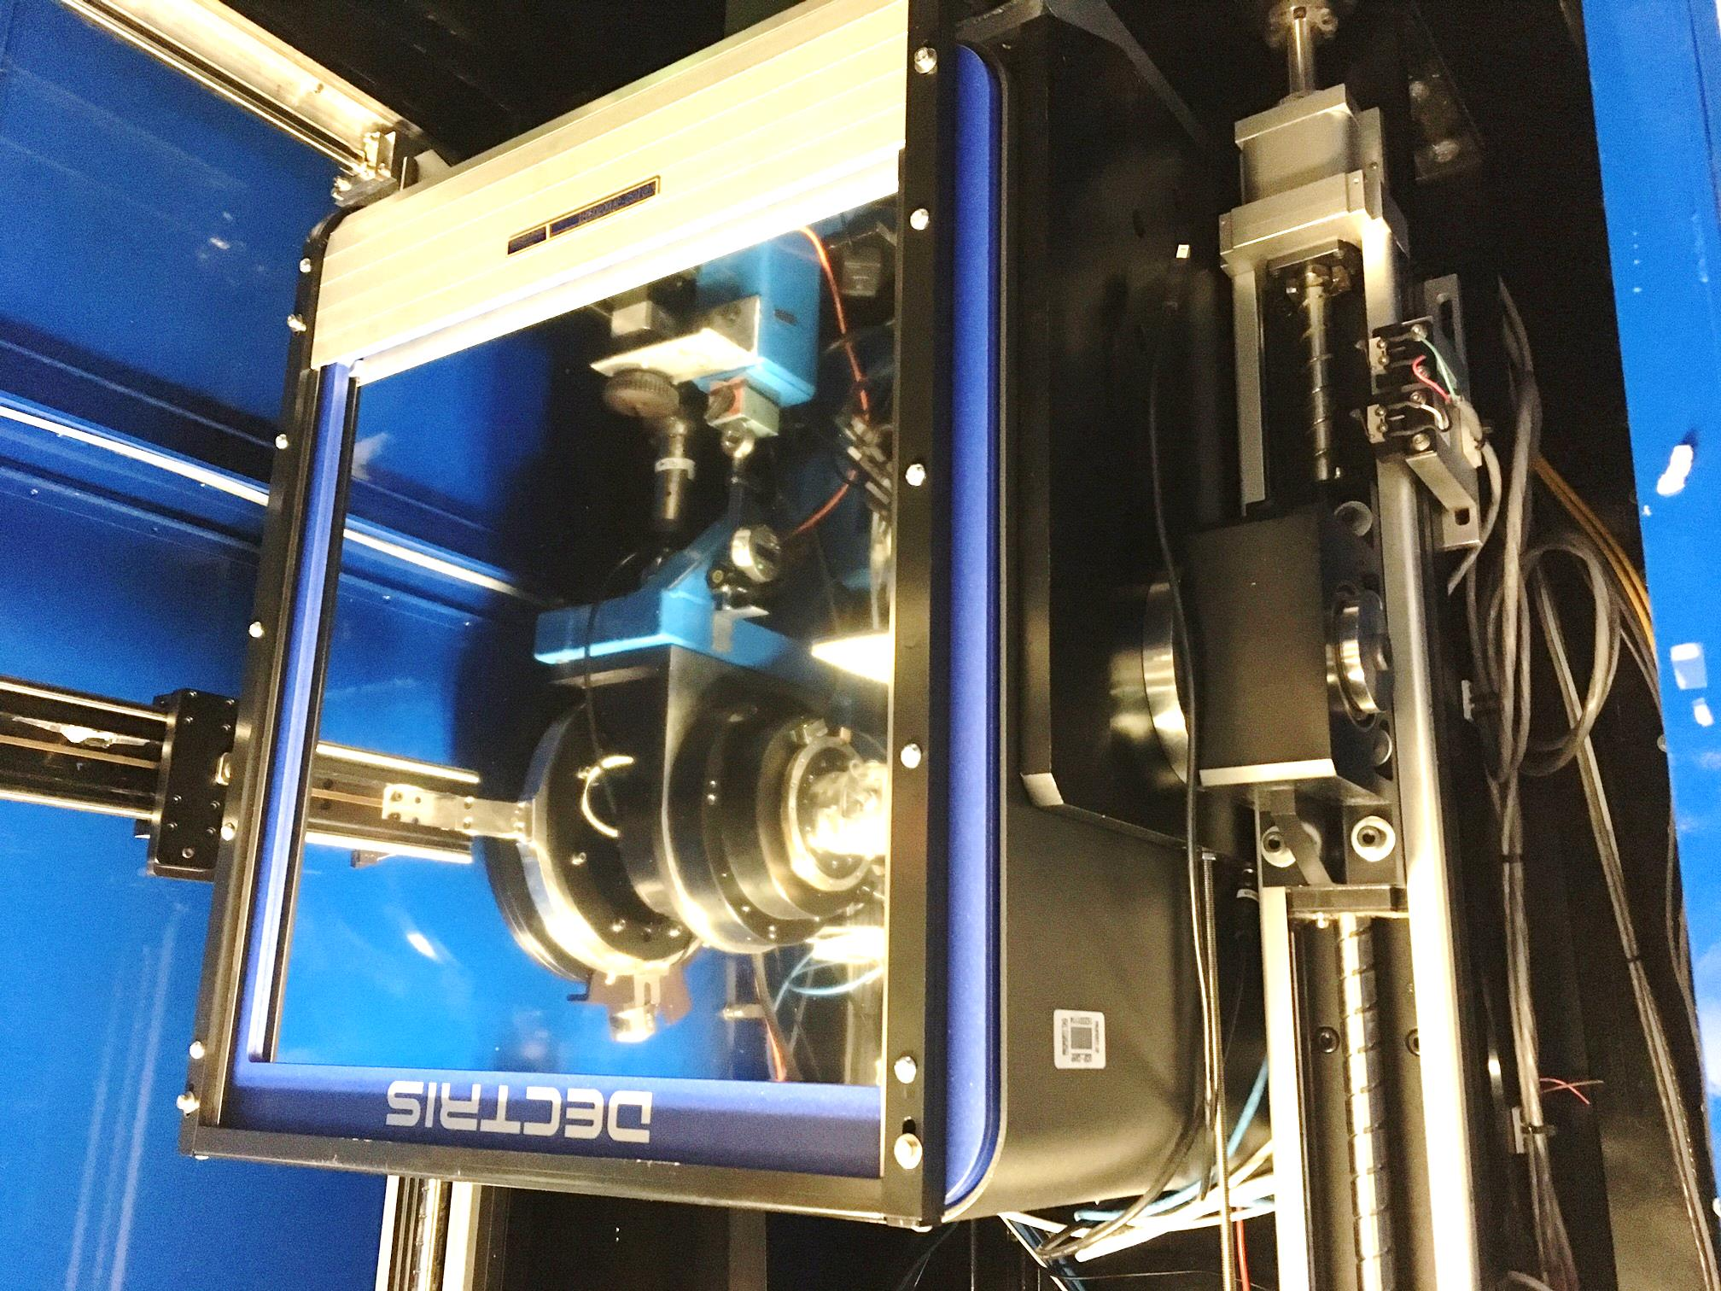

Slide 8
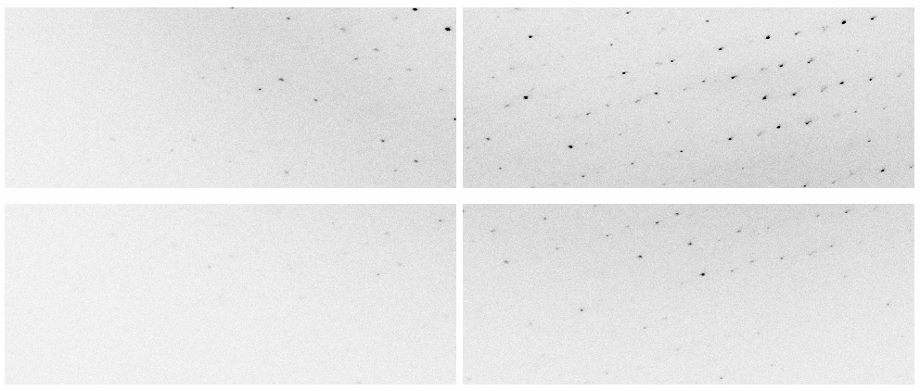
New Pilatus3 6M at ALS 8.3.1
Apr 20 2016

Slide 9
New Pilatus3 6M at ALS 8.3.1
13:41 9-22-2016 Plexxkon’s first Pilatus shift

Slide 10
MRPI Technical Highlights
Dectris Pilatus3 6M installation - May 2016
25 Hz framing, 2 ms dead time, previously 0.3 Hz
0.8% calibration error, previously 2.5%
Repaired and re-installed 6 times, 10% replaced
Complete control system update
Shutterless data collection
“Rastering” automated sample alignment
Re-write 64k lines of code
Overhaul of data archiving infrastructure
LTO4 to LTO6, support USB3 user hard drives
First remote data collection – Apr 2017

Slide 11
ALS 8.3.1 data collection history
images x 10⁶

Slide 12
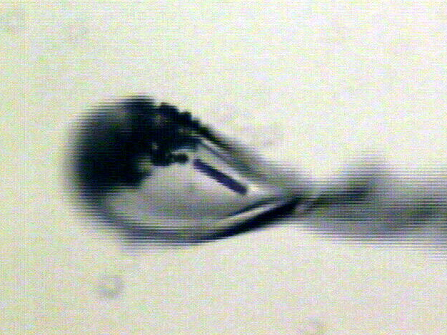
Shutterless rastering now available
X-ray beam
ice
Membrane
protein crystal

Slide 13
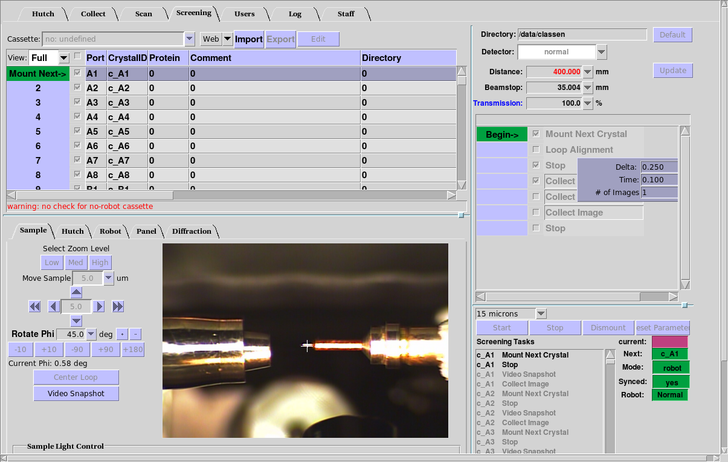
BLU-ICE “screening tab” almost integrated

Slide 14
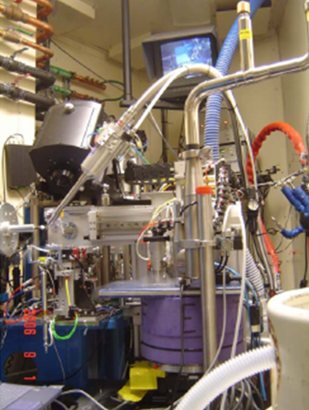
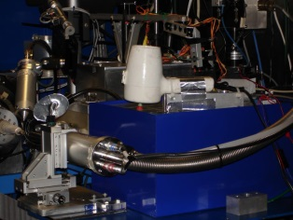
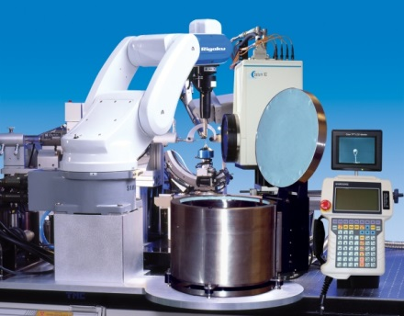
ALS robots
8.2.1
ACTOR
Berkeley
Auto-
Mounter
8.2.2
8.3.1
Cool Hand Luke
5.0.2
5.0.3
5.0.1
MBC 4.2.2
ACTOR
ALS MX robots
Stanford
Auto-
Mounter
12.3.1 SIBYLS

Slide 15
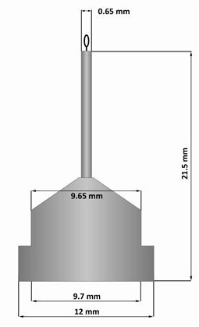
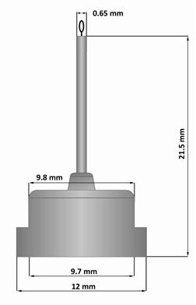
Pin compatibility
SLAC
ALS
SPINE

Slide 16
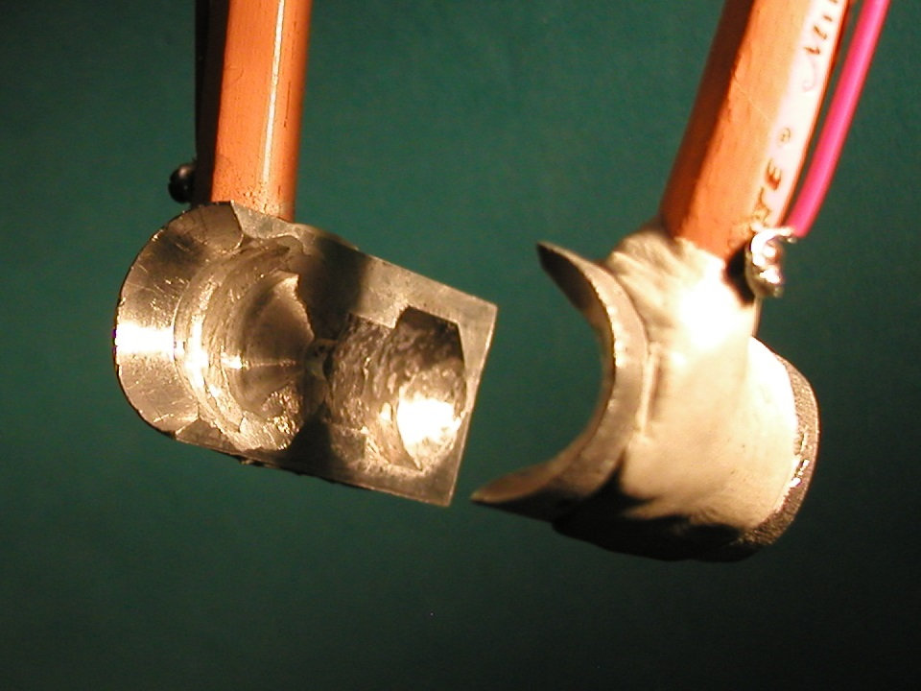
SuperTong

Slide 17
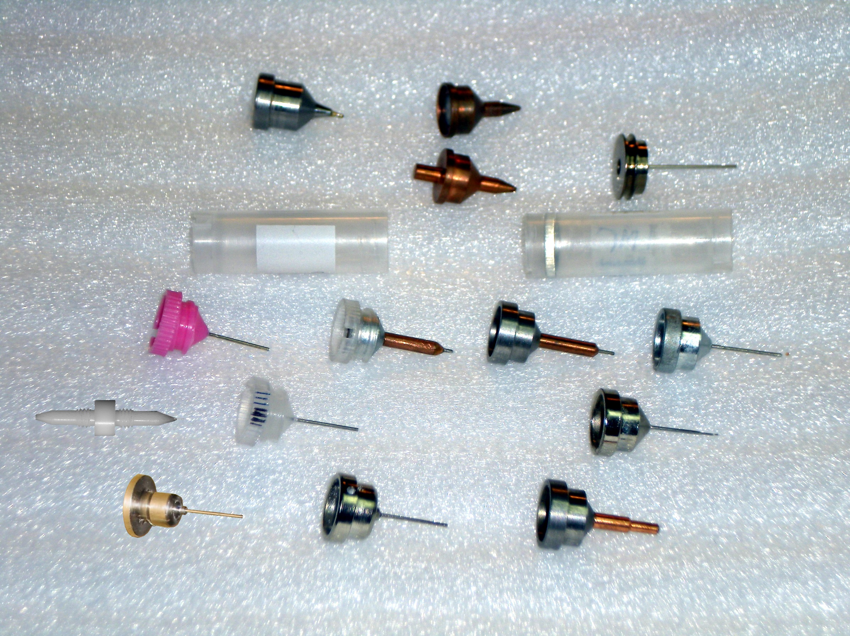
What if we didn’t have to choose?
Caltech
SSRL
Yale
Hampton screw cap
Hampton magnetic
H. colored
H. copper
H. magnetic
H. hybrid
H. screw cap
Syrrx
SPring-8
Oxford
SPINE
MiTeGen RT

Slide 18
“infinite capacity” sample carousel

Slide 19
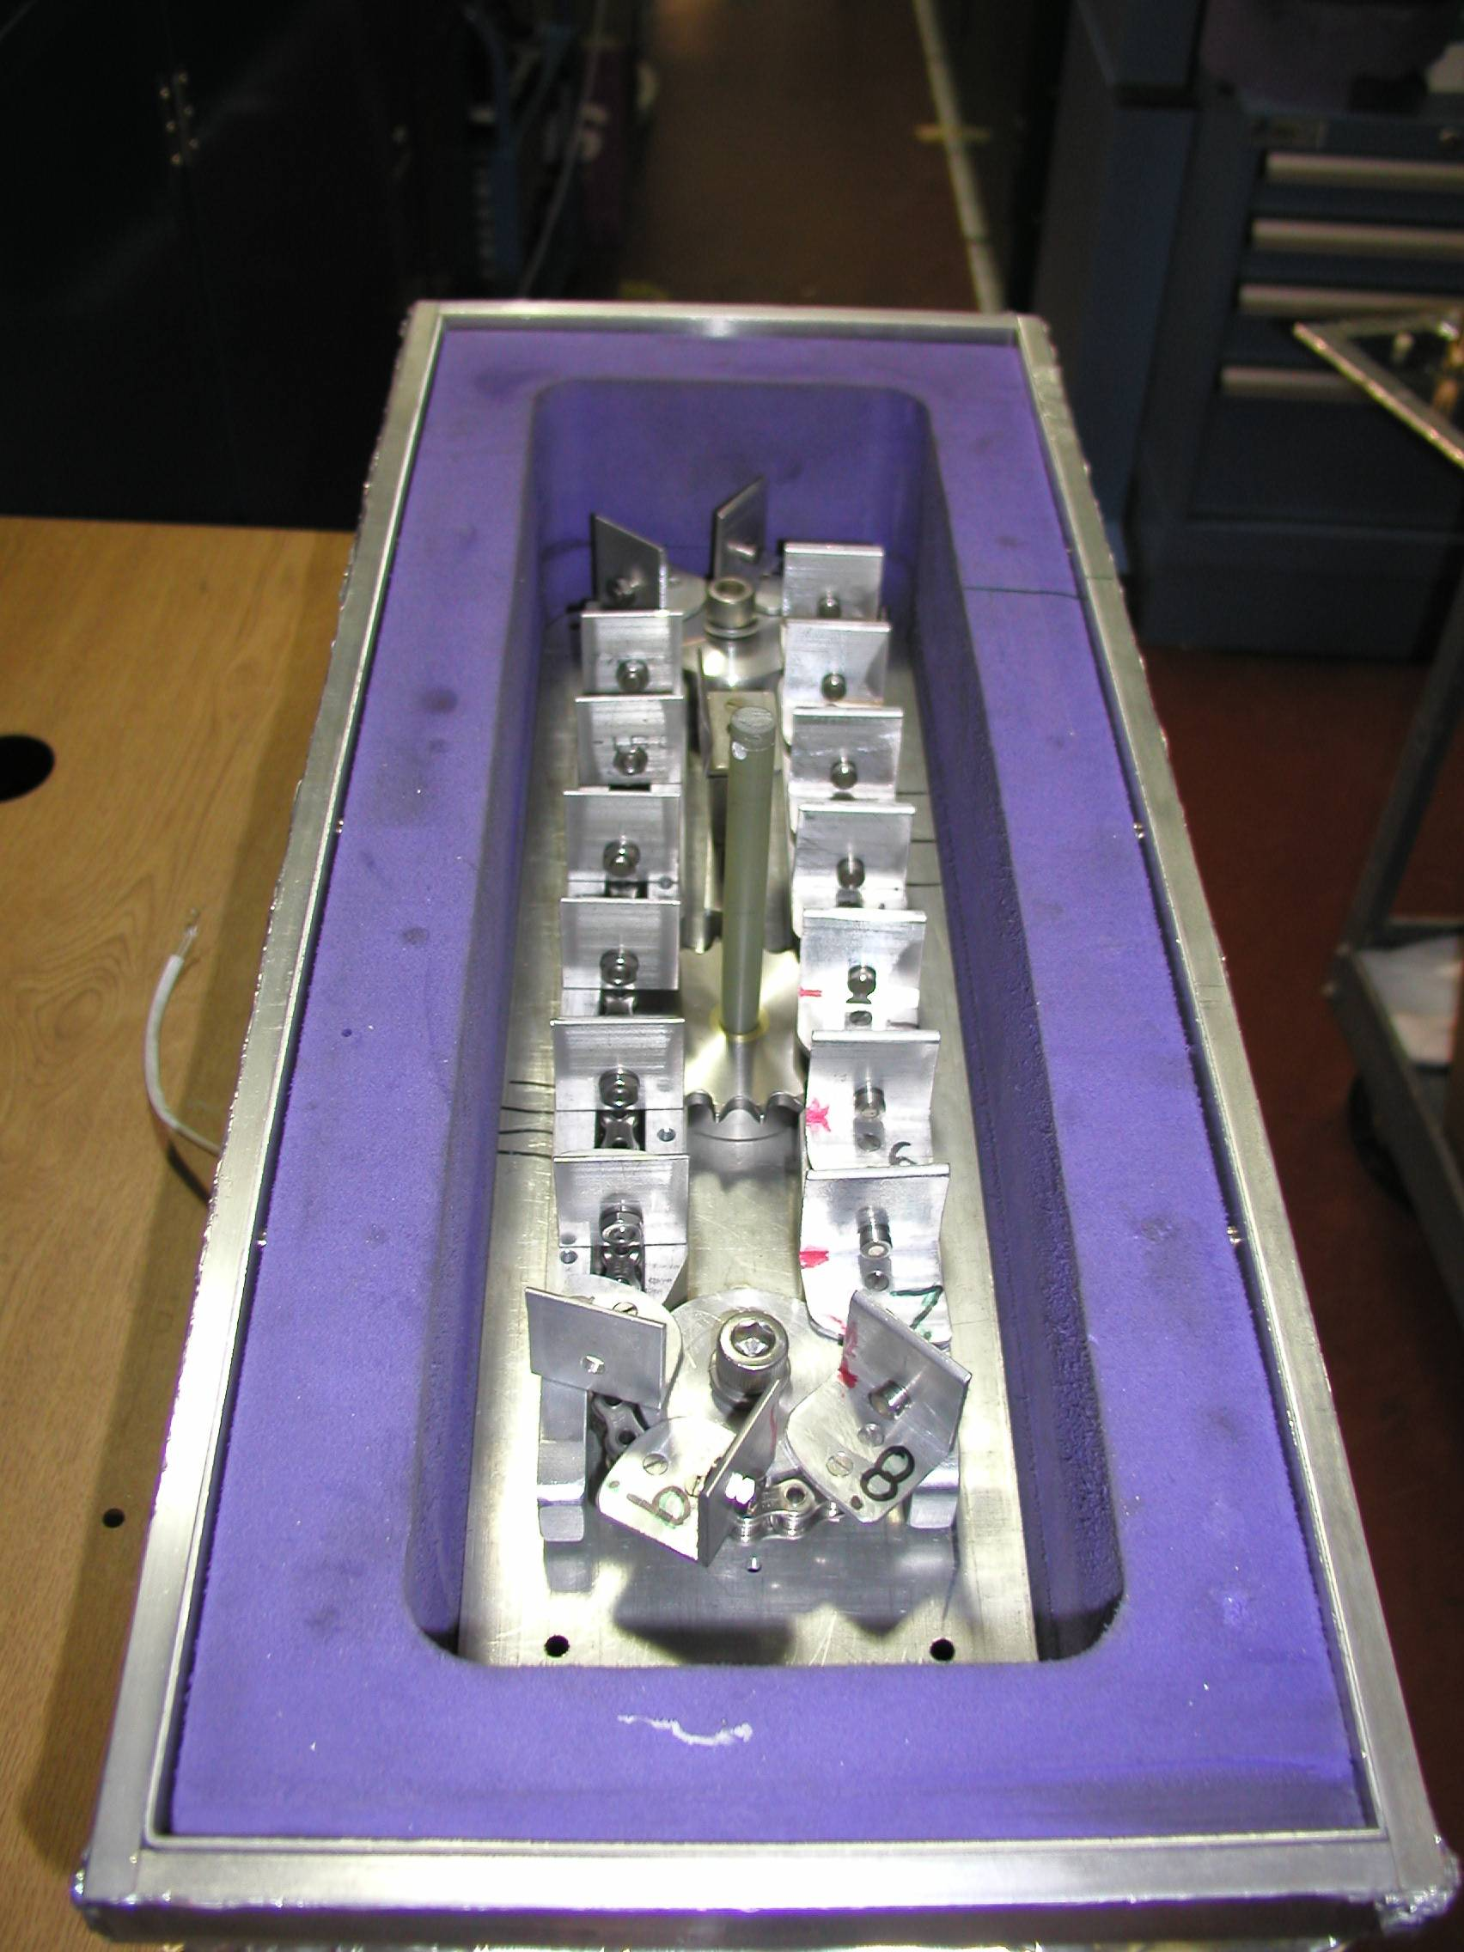
Carousel open

Slide 20
SBS
format
crystallization
tray
mirror
pinhole
microscope
Notes:
Inspired by the ESRF microcrystal camera, the superbend endstations are all equipped with zero-paralax optics. The user sees their sample from the point of view of the x-ray beam. Sample alignment is not only more stable but more intuitive than an off-axis camera. Placing the crystal into the microscope crosshairs gaurantees that it will be hit by the beam.

Slide 21
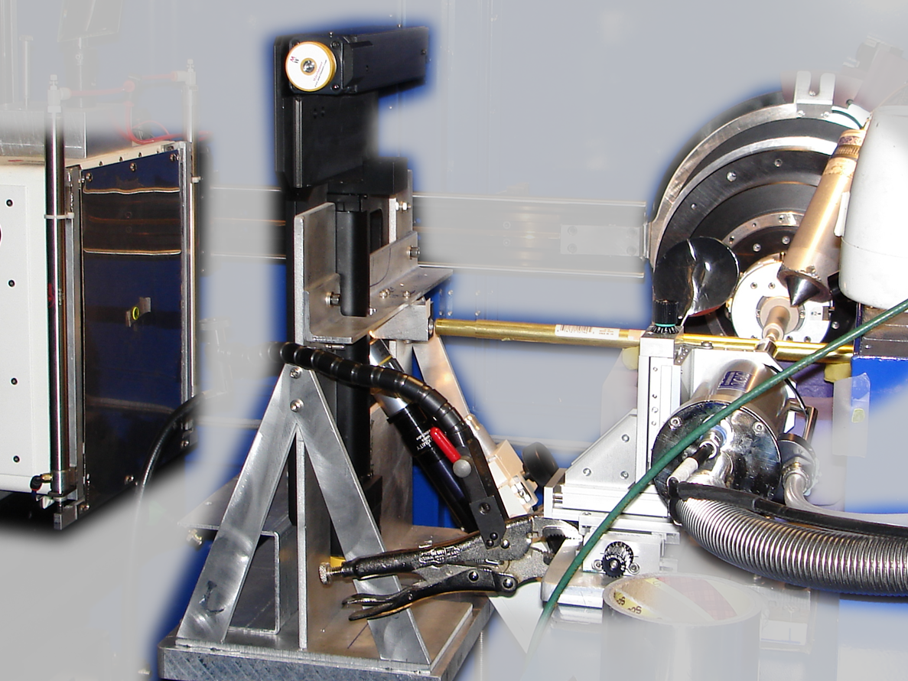
Notes:
non-rotating tray goniometer stage installed in ALS 8.3.1. Note that the “normal” cryo-pin goniometer on the left is still in place and a brass flight tube has been added to contain the air scatter from the main beam on its way to the tray goniometer.

Slide 22
in-situ diffraction trays
~50 μm tape
~50 μm tape
~50 μm tape
PDMS
PDMS
250 μm
100 μm
25 μm
200 μm
1000 μm
Fluidigm
Topaz® DC
Microlytic
Crystal Former™
NatX-ray
CrystalQuick™ X
MiTeGen
in-situ-1
CrystalDirect
Notes:
Next slide please

Slide 23
scattering/absorptoin “rules”:
1 μm crystal ≈ 1 μm water
≈ 1 μm plastic
≈ 0.1 μm glass
≈ 1000 μm air
Optimum: support thickness = crystal thickness

Slide 24
Match crystal to beam
Resolution (Å)
too big
too small
just right
X-ray beam size (μm)

Slide 25
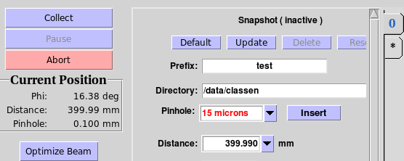
“8-shooter” adjustable beam size
rotary
pinholes:
300
100
75
50
30
25
15

Slide 26
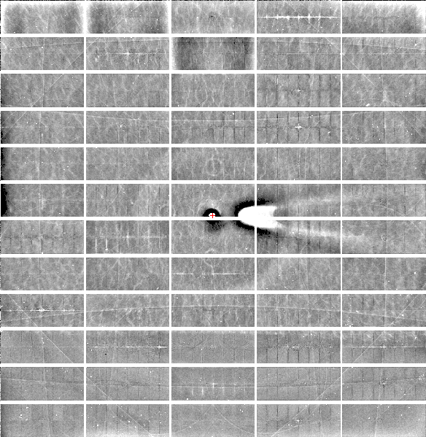
Relative Pixel
Calibration
ALS 8.3.1
Pilatus3 6M
0.9793 Å x-rays
RMS = 0.8%
1% high
average
1% low

Slide 27
Threshold of a revolution in phasing
CCD
old Pilatus
Goal
Solve-able proteins (%)
8.3.1’s Pilatus
Required signal-to-noise (I/σ)

Slide 28
ALS 8.3.1 capabilities
200s data sets in shutterless mode
Support for room temperature
in-situ screening from trays
15-100 μm beam sizes
True BLU-ICE interface
Touch screen centering
Infinite capacity sample carousel
Automated data backup
Remote operation

Slide 29
ALS 8.3.1 MRPI Business meeting
Overview of the Beamline
PRT Structure
Scheduling and Allocation
Future upgrade plans
Financial report

Slide 30
What is a PRT?
Participating Research Team
25% free
General Users
Advanced
Light Source
8.3.1
PRT
Memorandum
of Understanding
(MOU)
UCB
UCSF
Plexxikon Inc.
MD Anderson CRC

Slide 31
What is a PRT?
Participating Research Team
25% free
General Users
Advanced
Light Source
8.3.1
PRT
Memorandum
of Understanding
(MOU)
UC
Plexxikon Inc.

Slide 32
UC – beamline organization
UCOP
Janet Napolitano
LBNL
Director: Michael Witherall
Dep. Director: Horst Simon
UCD
MRPI
Bob Stroud
UCSF
UCB
MBIB
Paul Adams
ALS
Roger Falcone
Plexxikon
UCSC
James Holton
UCI
8.3.1
UCLA
Jane Tanamachi
George Meigs
UCSD

Slide 33
ALS 8.3.1 MRPI Business meeting
Overview of the Beamline
PRT Structure
Scheduling and Allocation
Future upgrade plans
Financial report

Slide 34
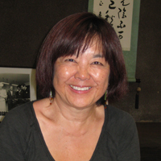
How do I get time on ALS 8.3.1?
Check for available shifts on the schedule:
http://bl831.als.lbl.gov/
Contact Jane Tanamachi!
JTanamachi@LBL.GOV
510-495-2404
No proposals, no reviews, no kidding

Slide 35
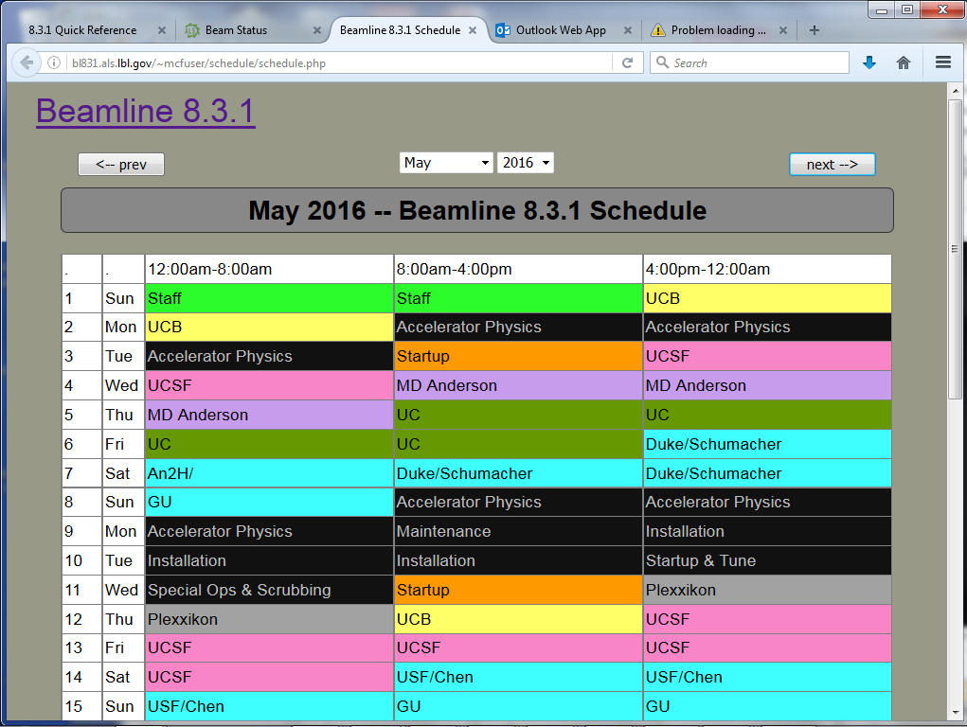
BL8.3.1 online schedule

Slide 36
ALS 8.3.1 beam time allocation
PRT Member | allocation | Details
General Users | 25% | Mandated by DOE
Staff | 9% | development & testing
Plexxikon | 5% | 5-year contract just renewed
UC | 35.5% total | MRPI ends Dec 2018
UCSF | 18.5% | Sandler, ETAC & NIH IAA
UCB | 7.1% | Same as other UCs
Total | 600 shifts | 200 days/year

Slide 37
Please Acknowledge!
UC Office of the President, Multicampus Research Programs and Initiatives (MRPI) grant MR‐15‐328599
and the “Program for Breakthrough Biomedical Research (PBBR), which is partially funded by the Sandler Foundation”

Slide 38
Please email !
Has MRPI support led to any additional extramural funds being brought into UC?
Describe in lay terms one major accomplishment or success of your project to date.
JTanamachi@LBL.GOV

Slide 39
ALS 8.3.1 MRPI Business meeting
Overview of the Beamline
PRT Structure
Scheduling and Allocation
Future upgrade plans
Financial report

Slide 40
ALS 8.3.1 possible upgrades
Unattended screening ~1 y
Shutterless helical scans ~3 mo
Upgrade to Pilatus X $700k
Multilayers for rastering ~$300k
Kappa goniostat $140k
ALS-U in 2022 ~$10M

Slide 41
ALS 8.3.1 possible upgrades
Unattended screening ~1 y
Shutterless helical scans ~3 mo
Upgrade to Pilatus X $700k
Multilayers for rastering ~$300k
Kappa goniostat $140k
ALS-U in 2022 ~$10M

Slide 42
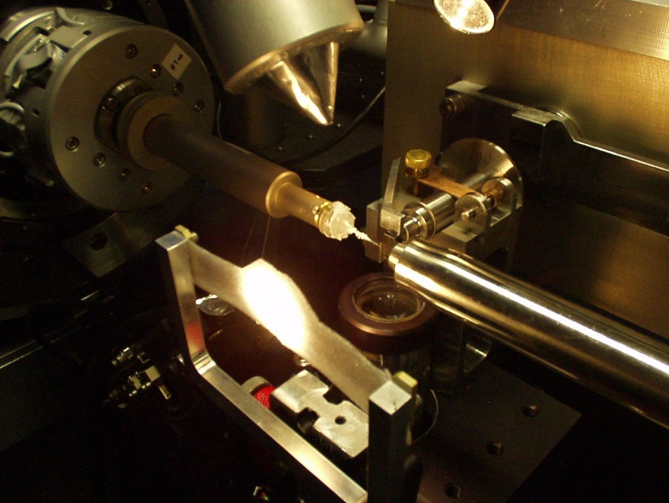
Interleaved Scheduling
experiment queue
beamline
Minor 30s
Choe 120s
Alberta 60s
Alberta 60s
Choe 30s
Minor 30s

Slide 43
ALS 8.3.1 possible upgrades
Unattended screening ~1 y
Shutterless helical scans ~3 mo
Upgrade to Pilatus X $700k
Multilayers for rastering ~$300k
Kappa goniostat $140k
ALS-U in 2022 ~$10M

Slide 44
“rastering” to find the crystal
X-ray beam
ice
Membrane
protein crystal

Slide 45
ALS 8.3.1 possible upgrades
Unattended screening ~1 y
Shutterless helical scans ~3 mo
Upgrade to Pilatus X $700k
Multilayers for rastering ~$300k
Kappa goniostat $140k
ALS-U in 2022 ~$10M

Slide 46
PAD full vs partial
Summed intensity
iteration

Slide 47
Optimal exposure time (anomalous on a PAD)
2.03 ms
intensity
time

Slide 48
Optimal exposure time (anomalous on EIGER)
0.003 ms
intensity
time

Slide 49
Optimal exposure time (anomalous on a PAD)
Pilatus S
>0.2 s/frame
Upgrade:
>0.1 s/frame
t_{mad} Optimal exposure time (s)
t_{ro} read-out time (s)
2.03 ms on Pilatus³ S
0.95 ms on Pilatus³ X
8.3.1 is too
hot for Pilatus
Attenuate for MAD

Slide 50
ALS 8.3.1 possible upgrades
Unattended screening ~1 y
Shutterless helical scans ~3 mo
Upgrade to Pilatus X $700k
Multilayers for rastering ~$300k
Kappa goniostat $140k
ALS-U in 2022 ~$10M

Slide 51
Fast “death ray” switching
0.014 % (5 min)
Existing mono
Si(111)
ML
Si(111)
ML

Slide 52
Fast “death ray” switching
1 % (~4 s)
Existing mono
Si(111)
ML
ML
Si(111)

Slide 53
Wide bandpass reveals mosaicity from a still
low mosaic
high mosaic
Δ_{radial} = 2ηD/cos²2θ
Snell EH, Weisgerber S, Helliwell JR, Holzer K & Schroer K (1995)."Improvements in lysozyme protein crystal perfection through microgravity growth", Acta crystallographica. Section D, Biological crystallography 51, 1099-1102.

Slide 54
Si(111) vs multilayers
0.014%
Si(111)
spectral
dispersion
1%
multilayer
4 Å
resolution
1.9 Å

Slide 55
Wide-bandpass MX?
Mono | Si(111) | multilayer | Difference (%) | good
Energy (eV) | 11111 | 12027.5 | +8.2 | Same
Scale | 1.0000 | 1.0964 | +9.6 | Yes
R_{merge} (%) | 7.5 | 8.4 | +12 | No
R_{anom} (%) | 5.6 | 5.5 | -1.8 | Same
I/sd | 13.2 | 12.3 | -6.8 | Same
I/sd (1.5Å) | 2.3 | 1.8 | -21.7 | No
Ano Patt | 5.96 | 4.75 | -20.3 | Same
Ano Phased | 41 | 39.33 | -4.1 | Same
FOM | 0.238 | 0.192 | -19.3 | Same
CC | 0.555 | 0.647 | -6.1 | Yes
R_{cryst} (%) | 26.70 | 26.48 | -0.2 | Same
Ligand peak | 8.213 | 8.250 | +0.4 | Same

Slide 56
ALS 8.3.1 possible upgrades
Unattended screening ~1 y
Shutterless helical scans ~3 mo
Upgrade to Pilatus X $700k
Multilayers for rastering ~$300k
Kappa goniostat $140k
ALS-U in 2022 ~$10M

Slide 57
SmarAct’s
“SmarGon”
Commercialized
PRIGo

Slide 58
ALS 8.3.1 possible upgrades
Unattended screening ~1 y
Shutterless helical scans ~3 mo
Upgrade to Pilatus X $700k
Multilayers for rastering ~$300k
Kappa goniostat $140k
ALS-U in 2022 ~$10M

Slide 59
ALS-U ring upgrade in 2022
Pros
Cons
Diffraction-limited source
Coherent up to 2 keV
Smaller source
6x flux onto 6 μm xtal
Undulator:
5x flux of 8.3.1
~2x more flux after ALS-U
0.7 μm beam vs 10 μm
Serial xtallography
Fine, fast rastering
1 year of dark
No coherence effect in MX
No flux increase (ph/s)
No change for xtals > 36 μm
$10M to keep superbend
Undulator BL = $10M
Only 1 more undulator slot
Xtals die in 2.4 ms
Are your xtals 0.7 μm ?

Slide 60
ALS-U: Small, soft beams

Slide 61
ALS-U: Small, soft beams
Diamond
($100, reusable)

Slide 62
ALS-U: Small, soft beams
oil ?
Diamond
($100, reusable)

Slide 63
ALS-U: Small, soft beams
oil ?
Diamond
($100, reusable)

Slide 64
ALS-U: Small, soft beams
oil ?
λ=2d sinθ
2.5 Å data
with 5 Å X-rays
Only analytic absorption correction:
International Tables for Crystallography, Vol. C, 2nd ed., chapter 6.3

Slide 65
2472.7 2473.5
Anomalous f” (electrons)
Photon Energy (eV)
Bohic et al. Anal. Chem. 2008; 80(24):9557. doi: 10.1021/ac801817k

Slide 66
S-MAD Sample size Dilemma

Slide 67
Threshold of a revolution in phasing
Single-spot limit
latest PAD
(uncalibrated)
Single-spot limit
Perfect detector
Solve-able proteins (%)
Single-spot limit
CCD
& early PAD
Required signal-to-noise (I/σ)

Slide 68
ALS 8.3.1 possible upgrades
Unattended screening ~1 y
Shutterless helical scans ~3 mo
Upgrade to Pilatus X $700k
Multilayers for rastering ~$300k
Kappa goniostat $140k
ALS-U in 2022 ~$10M

Slide 69
ALS 8.3.1 MRPI Business meeting
Overview of the Beamline
PRT Structure
Scheduling and Allocation
Future upgrade plans
Financial report

Slide 70
8.3.1 beam time distribution: 2017
Plexxikon
UC San Diego
5%
General User
Program
UC Davis
7.1%
7.1%
26.5%
UC Santa Cruz
25%
7.1%
UC Irvine
7.1%
9%
Staff/Development
7.1%
UCLA
9%
7.1%
18.5%
UC Berkeley

Slide 71
ALS 8.3.1 total funding: Sep 2017
$140k
UC
Office of the
President
MRPI
Inter-Agency
Agreement
$212k
R01 GM124149
Stroud
$405
Holton
Adams
ALS-ENABLE
LBNL
full-cost recovery
P30 GM124169
$303k
Stroud
Plexxikon
Inc.
$480k
Sandler
$145k
$0
$156k
LBNL overhead
must be paid out of unrestricted funds
Deputy Director Horst Simon awarded: Jul 26 2017

Slide 72
BL8.3.1 PRT member contributions ($k)
Year | 2012 | 2013 | 2014 | 2015 | 2016 | 2017
Gen. Users | 0 | 0 | 0 | 0 | 0 | 0
7x UC | 0 | 0 | 0 | 644 | 644 | 644
Plexxikon | 250 | 125 | 125 | 125 | 325 | 125
MD Anderson | 75 | 130 | 130 | 130 | 10 | 0
UCSF | 180 | 180 | 180 | 325 | 395 | 811
UCB | 0 | 0 | 0 | 0 | 0 | 0
Total | 505 | 435 | 435 | 1255 | 1455 | 1580

Slide 73
Long-term funding plans
NIH support requested since MRPI
P41 $7.0M, score = 26, not funded Council
IAA $750k awarded to Holton @LBNL
P30 $1.8M/5 awarded to Adams @LBNL
R01 $1M/5 awarded to Holton @UCSF
Cost-saving plans
Move Meigs position to UCSF
Large equipment purchased by UCSF

Slide 74
BL8.3.1 Beam Time Allocation (%)
Year | 2012 | 2013 | 2014 | 2015 | 2016
Gen. Users | 25 | 25 | 25 | 25 | 25
R&D | 9 | 9 | 9 | 9 | 9
Plexxikon | 8 | 6 | 6 | 6 | 6
MD Anderson | 3 | 5 | 8 | 8 | 8
UCSF | 27.5 | 27.5 | 26 | 18.5 | 25
UCB | 27.5 | 27.5 | 26 | 9.7 | 6.8
4 other UC | 0 | 0 | 0 | 6.2 | 5.3
Total | 100 | 100 | 100 | 100 | 100

Slide 75
What we ask of you
Tell us about your accomplishments
Tell us when you get grants
Tell us what you need!
Support our petition to LBL Deputy Director to continue MRPI
Acknowledge beamline in your papers
MR‐15‐328599
P30 GM124169
R01 GM124149

Slide 76
BL8.3.1 Financial Support: 2016
Award | dates | source
$2,578,000 | 01/01/15 – 12/31/18 | MRPI: University of California Office of the President (not renewable), $240k at LBNL
$357,492 | 12/15/14 – 12/15/16 | UCSF-PBBR: Program for Breakthrough Biomedical Research (not renewable)
$70,000 | 01/01/16 – 01/01/17 | UCSF-ETAC: shared equipment grant
$750,000 | 08/22/14 – 09/30/19 | National Institutes of Health Inter-Agency Agreement (non renewable)
$625,000 | 05/01/12 – 04/30/16 | Plexxikon Inc.
$500,000 | 05/01/16 – 04/30/21 | Plexxikon Inc.
$130,000 | 08/12/15 – 08/11/16 | M. D. Anderson Cancer Research Center
Planned:
$6,567,804 | 04/01/16 – 03/31/21 | NIH P41 – X-ray Structural Biology Resource
$130,000 | 08/12/16 – 08/11/17 | M. D. Anderson Cancer Research Center

Slide 77
BL8.3.1 Staff Effort
Year | 2010 | 2011 | 2012 | 2013 | 2014 | 2015
sci: James Holton | 0.9 | 0.9 | 0.9 | 0.9 | 0.6 | 0.75
tec: George Meigs | 0.9 | 0.9 | 0.9 | 0.9 | 1.0 | 1.0
adm: Jane Tanamachi | 0.2 | 0.2 | 0.2 | 0.2 | 0.2 | 0.2
Total | 2.00 | 2.00 | 2.00 | 2.00 | 1.80 | 1.95

Slide 78
UCOP MRPI Budget
https://proposalcentral.altum.com

Slide 79
UCOP MRPI Award status
https://proposalcentral.altum.com

Slide 80
University of California MRPI Multicampus Research Programs and Initiatives
Offered by: UC Office of Research and Graduate Studies
Wide range of fields: Nanotech, Arts, Climate, Gender Studies, Sustainability, Health
Total Budget: $9.5M / 2 years
2-4 year projects
We asked for: $2.7M / 4 years
Got $2.6M
Notes:
Brief description of what MRPI is. The University of California seeks to support collaboration between campuses in ways that benefit the entire system the most.
Funding was very limited, and it is extremely remarkable that we got this and our budget was not cut.

Slide 81
On-site users from new campuses
Fisher, Andrew | UC Davis
Wilson, David | UC Davis
Matthews, Melissa | UC Davis
Hurlburt, Nicholas | UC Davis
Lal, Neeraj | UC Davis
Feng, Yinghui | UC Davis
Liu, Yuandong | UC Davis
Monteleone, Leanna | UC Davis
McPherson, Alex | UC Irvine
Egea, Pascal | UCLA
Jose Rodriguez | UCLA (Aug 25)
Podust, Larissa | UC San Diego
Pereira, Caibe Alves | UC San Diego
Rubin, Seth | UC Santa Cruz
Tripathi, Sarvind | UC Santa Cruz
Marceau, Aimee | UC Santa Cruz
Guiley, Keelan | UC Santa Cruz
Partch, Carrie | UC Santa Cruz
Goularte, Nicolette | UC Santa Cruz
Luu, Jansen | UC Santa Cruz
Liban, Tyler | UC Santa Cruz
Heisler, Joel | UC Santa Cruz
Liwang, Andy | UC Santa Cruz
Parameshwaran, Ramanan | UC Santa Cruz
Fedechkin, Stas | UC Santa Cruz
Notes:
Since access to 8.3.1 was opened up by the MRPI award, a growing number of new users have been coming to 8.3.1. Those shown here have been on-site and traveled to LBNL to use the facility. Now that we have remote operation capabilities we expect this list to grow sharply.

