Slide 1
ALS 8.3.1 MRPI Business meeting
Overview of the Beamline
PRT Structure
Scheduling and Allocation
Future upgrade plans
Financial report

Slide 2
ALS 8.3.1 MRPI Business meeting
Overview of the Beamline
PRT Structure
Scheduling and Allocation
Future upgrade plans
Financial report

Slide 3
What is a PRT?
Participating Research Team
25% free
General Users
Advanced
Light Source
8.3.1
PRT
Memorandum
of Understanding
(MOU)
UCB
UCSF
Plexxikon Inc.
MD Anderson CRC

Slide 4
What is a PRT?
Participating Research Team
25% free
General Users
Advanced
Light Source
8.3.1
PRT
Memorandum
of Understanding
(MOU)
UC
Plexxikon Inc.
MD Anderson CRC

Slide 5
UC – beamline organization
UCOP
Janet Napolitano
LBNL
Director: Michael Witherall
Dep. Director: Horst Simon
UCD
MRPI
Bob Stroud
UCSF
UCB
MBIB
Paul Adams
ALS
Roger Falcone
Plexxikon
UCSC
MD Anderson
James Holton
UCI
8.3.1
UCLA
Jane Tanamachi
George Meigs
UCSD

Slide 6
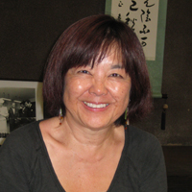
How do I get time on ALS 8.3.1?
Check for available shifts on the schedule:
http://bl831.als.lbl.gov/
Contact Jane Tanamachi!
JTanamachi@LBL.GOV
510-495-2404
No proposals, no reviews, no kidding

Slide 7
Please Acknowledge!
UC Office of the President, Multicampus Research Programs and Initiatives (MRPI) grant MR‐15‐328599
and the “Program for Breakthrough Biomedical Research (PBBR), which is partially funded by the Sandler Foundation”

Slide 8
Please email !
Has MRPI support led to any additional extramural funds being brought into UC?
Describe in lay terms one major accomplishment or success of your project to date.
JTanamachi@LBL.GOV

Slide 9
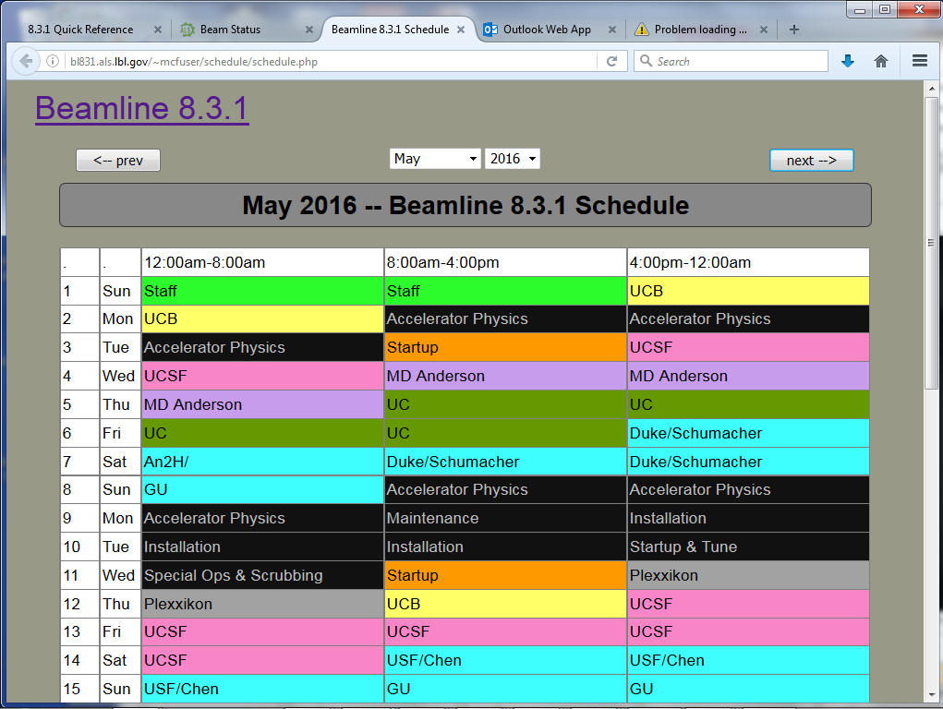
BL8.3.1 online schedule

Slide 10
ALS 8.3.1 beam time allocation
PRT Member | allocation | Details
General Users | 25% | Mandated by DOE
Staff | 9% | development & testing
Plexxikon | 5% | 5-year contract just renewed
MD Anderson | 3 shifts/month | Effectively 8% 1-year contract
UC | 53% total | 3 more years MRPI
UCSF | 18.5% | Sandler, ETAC & NIH IAA
UCB | 9.7% | part of HARC in NIH IAA
Total | 600 shifts | 200 days/year

Slide 11
8.3.1 beam time distribution: 2015
Plexxikon
General User
Program
6%
5%
UC Davis
6.2%
UC Santa Cruz
25%
6.2%
6.2%
UC Irvine
9%
6.2%
Staff/Development
UCLA
9.7%
18.5%
UC Berkeley

Slide 12
8.3.1 beam time distribution: 2016
Plexxikon
General User
Program
6%
5%
UC Davis
UC Santa Cruz
5.3%
5.3%
25%
UC Irvine
5.3%
5.3%
9%
UCLA
Staff/Development
6.8%
UC Berkeley
25%

Slide 13
8.3.1 financial contributions ($k): 2016
Plexxikon
General User
Program
130
325
UC Davis
UC Santa Cruz
107
107
0/100,000
UC Irvine
107
107
0
UCLA
Staff/Development
138
UC Berkeley
502

Slide 14
ALS 8.3.1 MRPI Business meeting
Overview of the Beamline
PRT Structure
Scheduling and Allocation
Future upgrade plans
Financial report

Slide 15
8.3.1 financial contributions ($k): 2016
Plexxikon
General User
Program
130
325
UC Davis
UC Santa Cruz
107
107
0/100,000
UC Irvine
107
107
0
UCLA
Staff/Development
138
UC Berkeley
502

Slide 16
8.3.1 financial contributions ($k): 2016
130
325
502
Plexxikon
General User
Program
107
Staff/Development
Davis
138
107
107
107
UC Berkeley
Santa Cruz
UCLA
Irvine

Slide 17
BL8.3.1 PRT member contributions ($k)
Year | 2012 | 2013 | 2014 | 2015 | 2016
Gen. Users | 0 | 0 | 0 | 0 | 0
6x UC | 0 | 0 | 0 | 644 | 644
Plexxikon | 250 | 125 | 125 | 125 | 325
MD Anderson | 75 | 130 | 130 | 130 | 130
UCSF | 180 | 180 | 180 | 325 | 395
UCB | 0 | 0 | 0 | 31 | 31
Total | 505 | 435 | 435 | 1255 | 1455

Slide 18
BL8.3.1 Financial Support: 2016
Award | dates | source
$2,578,000 | 01/01/15 – 12/31/18 | MRPI: University of California Office of the President (not renewable), $240k at LBNL
$357,492 | 12/15/14 – 12/15/16 | UCSF-PBBR: Program for Breakthrough Biomedical Research (not renewable)
$70,000 | 01/01/16 – 01/01/17 | UCSF-ETAC: shared equipment grant
$750,000 | 08/22/14 – 09/30/19 | National Institutes of Health Inter-Agency Agreement (non renewable)
$625,000 | 05/01/12 – 04/30/16 | Plexxikon Inc.
$500,000 | 05/01/16 – 04/30/21 | Plexxikon Inc.
$130,000 | 08/12/15 – 08/11/16 | M. D. Anderson Cancer Research Center
Planned:
$6,567,804 | 04/01/16 – 03/31/21 | NIH P41 – X-ray Structural Biology Resource
$130,000 | 08/12/16 – 08/11/17 | M. D. Anderson Cancer Research Center

Slide 19
MRPI at LBNL: full-cost recovery
2016
2017

Slide 20
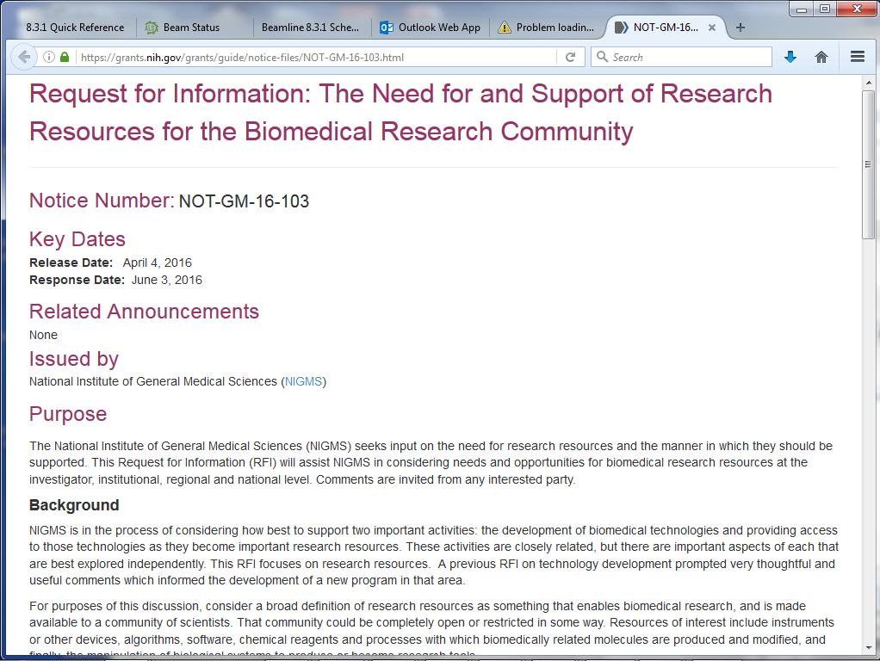
Please contribute !
NOT-GM-16-103

Slide 21
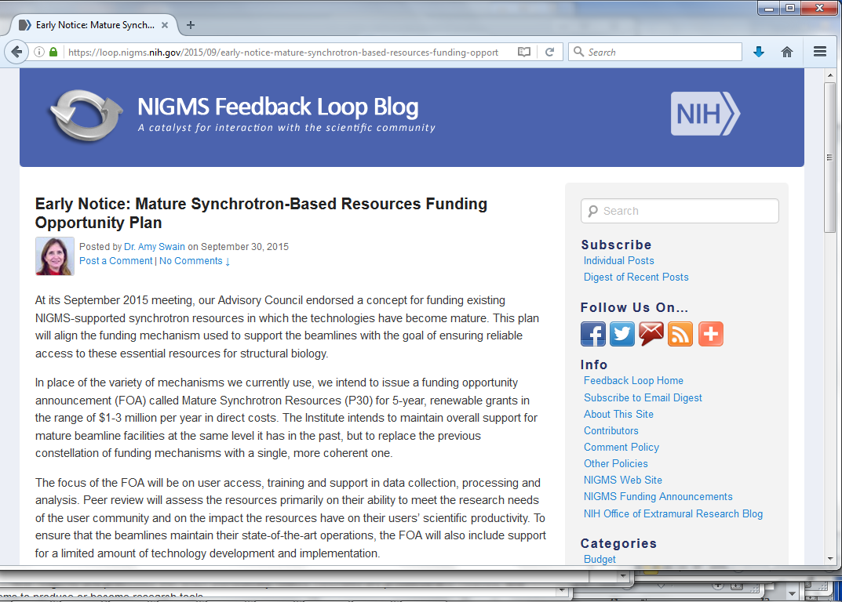
Support from NIH?

Slide 22
Future financial opportunities
NIH NOT-GM-16-103
NIH P30 ?
NIH R01 ?
DOE = climate change
MRPI = multi-campus collaborations

Slide 23
What we ask of you
Tell us about your accomplishments
Tell us when you get grants
Tell us what you need!
Support our petition to LBL Deputy Director to continue MRPI
Acknowledge beamline in your papers
MR‐15‐328599
Send email to NOT-GM-16-103
Otherwise: fewer beamlines, not free, less support

Slide 24
BL8.3.1 Beam Time Allocation (%)
Year | 2012 | 2013 | 2014 | 2015 | 2016
Gen. Users | 25 | 25 | 25 | 25 | 25
R&D | 9 | 9 | 9 | 9 | 9
Plexxikon | 8 | 6 | 6 | 6 | 6
MD Anderson | 3 | 5 | 8 | 8 | 8
UCSF | 27.5 | 27.5 | 26 | 18.5 | 25
UCB | 27.5 | 27.5 | 26 | 9.7 | 6.8
4 other UC | 0 | 0 | 0 | 6.2 | 5.3
Total | 100 | 100 | 100 | 100 | 100

Slide 25
BL8.3.1 Publication Record
Year | 2010 | 2011 | 2012 | 2013 | 2014 | 2015
Refereed | 48 | 38 | 47 | 48 | 36 | 29
High Impact | 20 | 16 | 16 | 16 | 16 | 8

Slide 26
BL8.3.1 Staff Effort
Year | 2010 | 2011 | 2012 | 2013 | 2014 | 2015
sci: James Holton | 0.9 | 0.9 | 0.9 | 0.9 | 0.6 | 0.75
tec: George Meigs | 0.9 | 0.9 | 0.9 | 0.9 | 1.0 | 1.0
adm: Jane Tanamachi | 0.2 | 0.2 | 0.2 | 0.2 | 0.2 | 0.2
Total | 2.00 | 2.00 | 2.00 | 2.00 | 1.80 | 1.95

Slide 27
BL8.3.1 Non-salary direct costs ($k)
Year | 2010 | 2011 | 2012 | 2013 | 2014 | 2015
general Purchases | 89 | 24 | 66 | 13 | 16 | 24
Cryojet | 37
New Computers | 30
New M1 mirror |  |  |  |  | 105
M1 mirror mount |  |  |  |  | 60
Mono access |  |  |  |  | 5

