Slide 1
Acknowledgements
Robert Stroud James Fraser Aina Cohen Ana Gonzalez
Axel Brunger Monarin Uervirojnangkoorn Artem Lyubimov David Case Nick Sauter
UCSF LBNL SLAC
ALS 8.3.1 creator: Tom Alber
UC Multicampus Research Programs and Initiatives (MRPI)
UCSF Program for Breakthrough Biomedical Research (PBBR)
one-time NIH-DOE Inter-agency agreement (IAA)
Integrated Diffraction Analysis Technologies (IDAT)
Plexxikon, Inc.
M D Anderson CRC
Synchrotron Radiation Structural Biology Resource (SLAC)
The Advanced Light Source is supported by the Director, Office of Science, Office of Basic Energy Sciences, Materials Sciences Division, of the US Department of Energy under contract No. DE-AC02-05CH11231 at Lawrence Berkeley National Laboratory.

Slide 2
Major points for today
Radiation damage
Signal vs noise
Noise vs systematic error
Simulation of diffraction

Slide 3
Structural Biologists Want:
Resolution
Phases

Slide 4
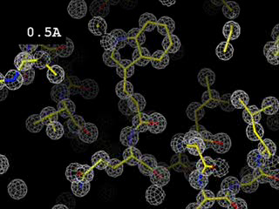
Resolution
http://bl831.als.lbl.gov/~jamesh/movies/resolution.mpeg

Slide 5
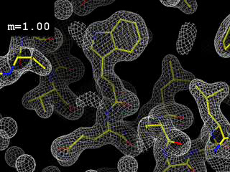
Phases
http://bl831.als.lbl.gov/~jamesh/movies/dephase.mpeg

Slide 6
Structural Biologists Want:
Resolution
Phases
  problem: fractional errors

Slide 7

100% SeMet incorporation
Trivial to solve

Slide 8

100% S -Met incorporation
Impossible to solve

Slide 9
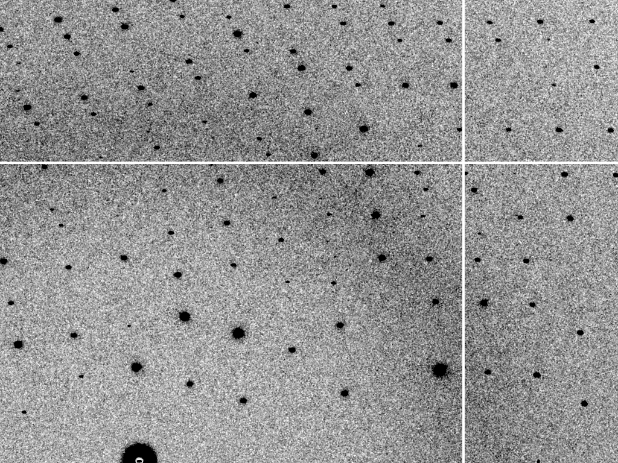
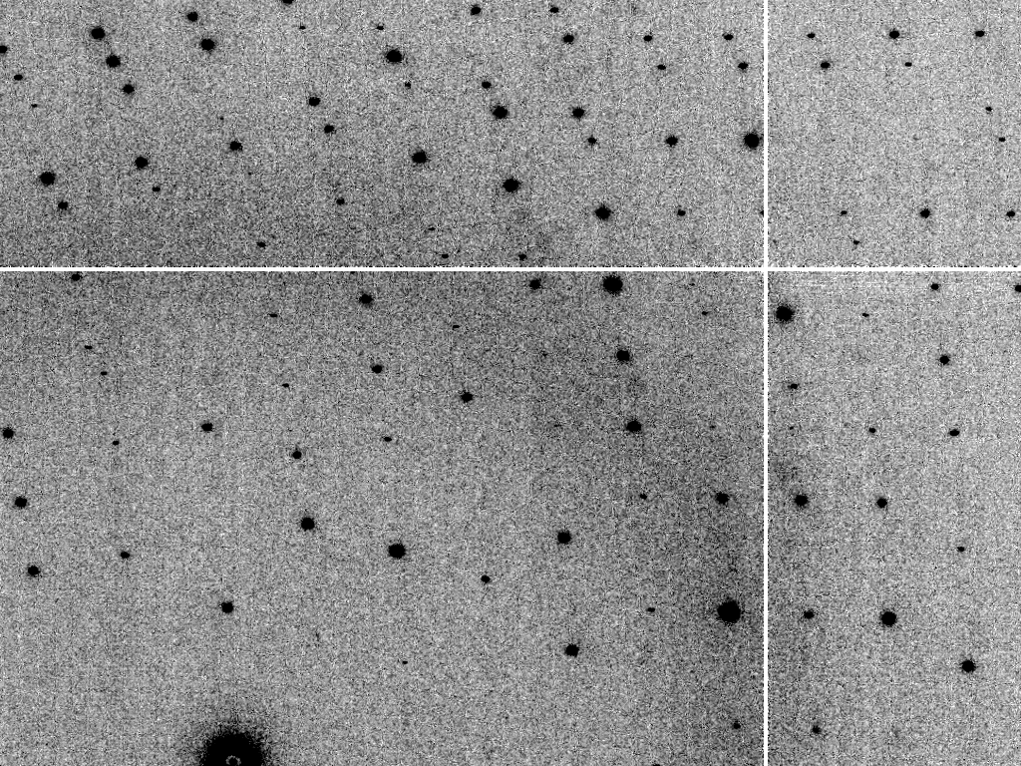
Is it Real? Or is it MLFSOM
simulated
real

Slide 10
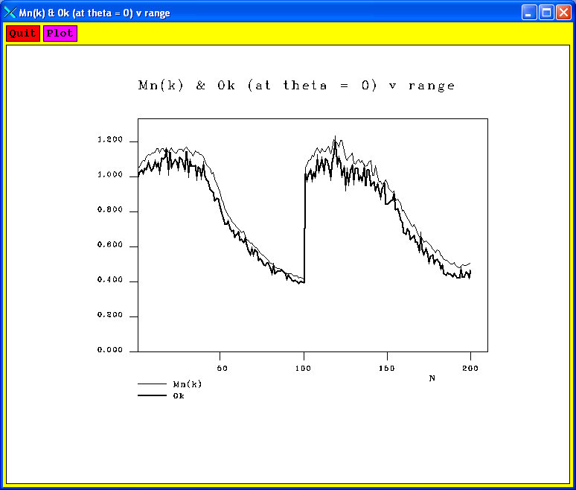
Simulated diffraction image
(2008)
simulated
real

Slide 11
Simulated | statistic | Real
5.4% | R_{merge} | 6.2%
18.9 | I/sd | 16.2
1.9 | I/sd (1.4 Ǻ) | 1.6
1.7 4.0 0.020 | SDCORR | 1.0 2.2 0.065
36.8 | PADFPH | 31.46
3.871 | mlphare f” | 3.476
0.178 | FOM | 0.192
0.545 | FOMDM | 0.664
0.6270 | CC(1H87) | 0.6090
0.070 | R_{work} | 0.184
0.080 | R_{free} | 0.231

Slide 12
Global Challenge: Se phasing
correlation coefficient
fraction Sulfur

Slide 13
Global Challenge: Se phasing
correlation coefficient
fraction Sulfur

Slide 14
Global Challenge: Se phasing
correlation coefficient
fraction Sulfur

Slide 15
Global Challenge: Se phasing
correlation coefficient
fraction Sulfur

Slide 16
Global Challenge: Se phasing
correlation coefficient
fraction Sulfur

Slide 17
How to install: MLFSOM
wget http://bl831.als.lbl.gov/~jamesh/
mlfsom/development_snapshot.tgz
tar xvzf development_snapshot.tgz
wget http://ftp.esrf.eu/pub/expg/FIT2D/
fit2d_10.132_i686_linuxV2.2.10
ln –sf fit2d_* fit2d
yum install gnuplot
gedit example.com mlfsom.params
./ano_sfall.com lysozyme.pdb
mv ideal_ano.mtz pristine.mtz
./mlfsom.com frames=100

Slide 18
mosaic spread
Ewald sphere
F(h,k,l)
λ*
d*
diffracted ray
λ*
F(0,0,0)

Slide 19
mosaic spread
Ewald sphere
F(h,k,l)
λ*
d*
diffracted ray
d*
λ*
F(0,0,0)

Slide 20

mosaic spread = 0 º

Slide 21

mosaic spread = 0.1º

Slide 22

mosaic spread = 0.2º

Slide 23

mosaic spread = 0.4º

Slide 24

mosaic spread = 0.6º

Slide 25

mosaic spread = 0.8º

Slide 26

mosaic spread = 1.0º

Slide 27

mosaic spread = 1.5º

Slide 28

mosaic spread = 2.0º

Slide 29

mosaic spread = 2.5º

Slide 30

mosaic spread = 3.2º

Slide 31

mosaic spread = 6.4º

Slide 32

mosaic spread = 12.8º

Slide 33
beam divergence
Ewald sphere
F(h,k,l)
λ*
d*
diffracted ray
λ*
F(0,0,0)

Slide 34
beam divergence
Ewald sphere
λ*
d*
diffracted ray
F(0,0,0)
λ*

Slide 35
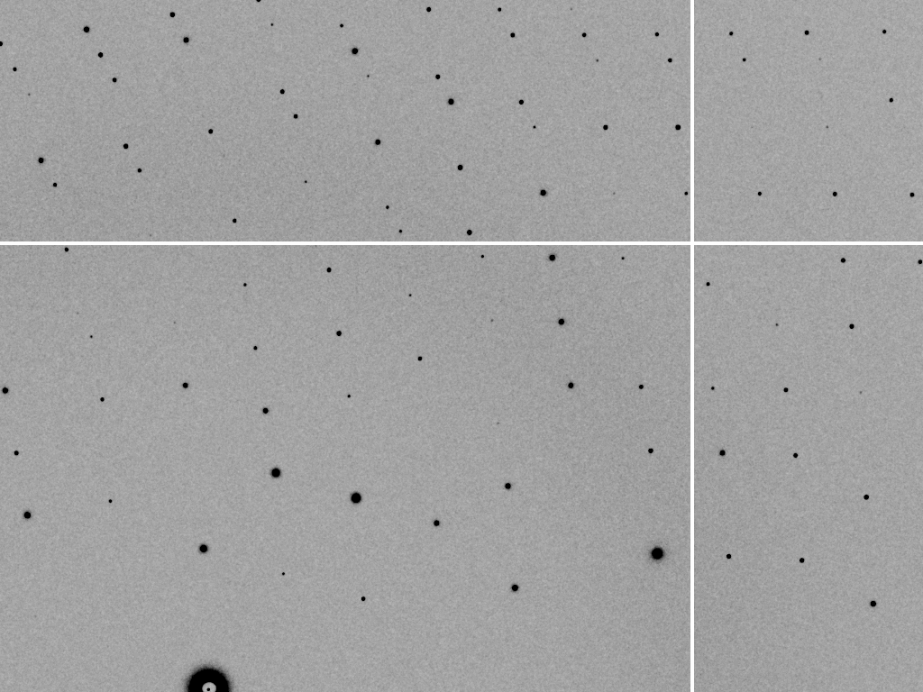
divergence = 0 º

Slide 36
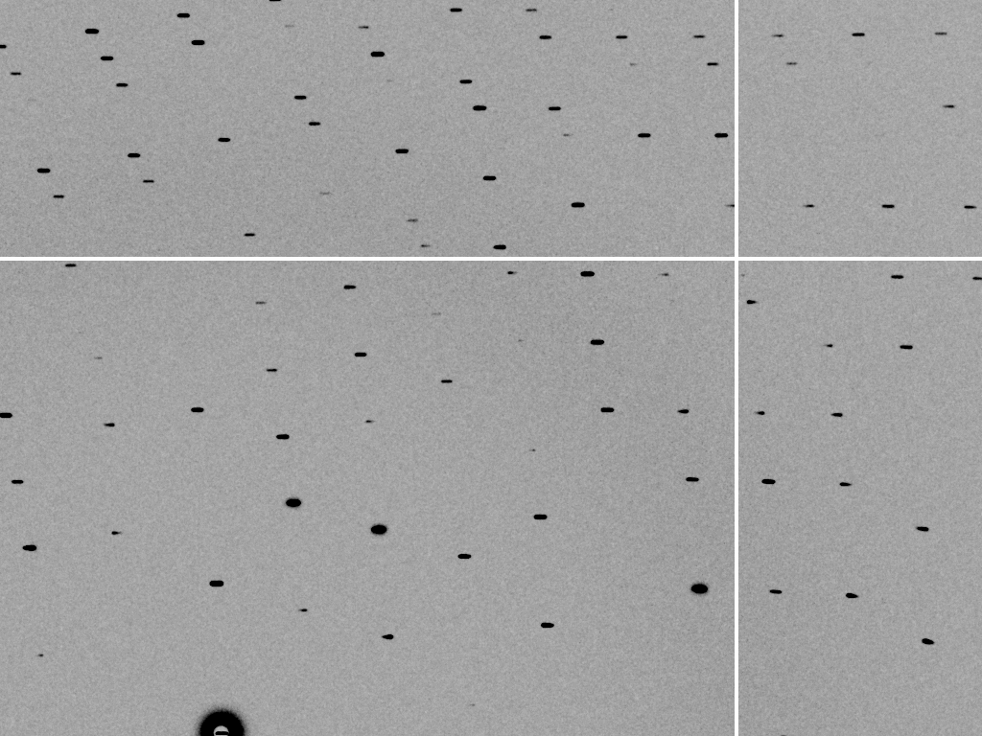
divergence = 0.3 º

Slide 37
spectral dispersion
Ewald sphere
F(h,k,l)
λ*
d*
diffracted ray
λ*
F(0,0,0)

Slide 38
spectral dispersion
Ewald sphere
F(h,k,l)
λ’*
d*
diffracted ray
λ’*
F(0,0,0)

Slide 39
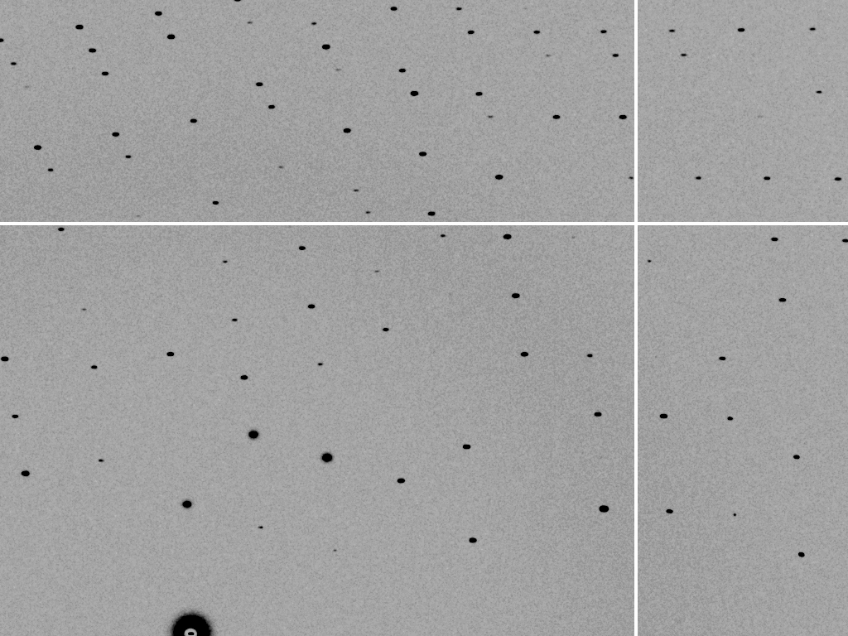
dispersion = 0

Slide 40

dispersion = 0.014% (Si 111)

Slide 41
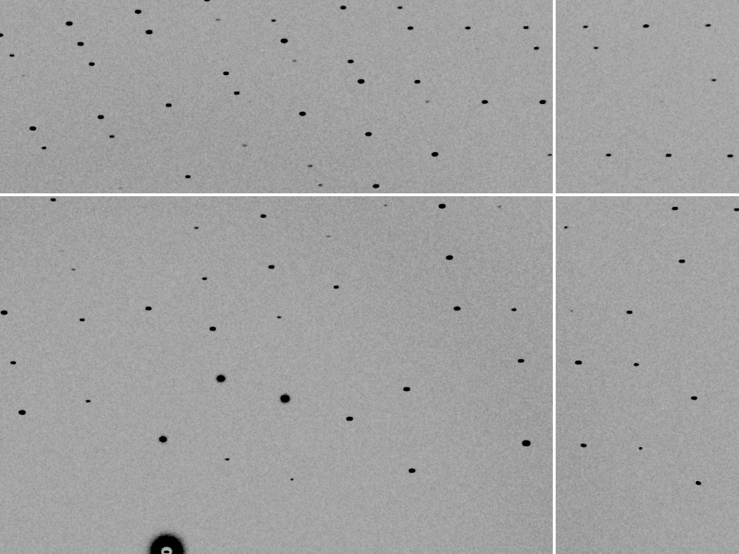
dispersion = 0.25% (CuK_{α})

Slide 42
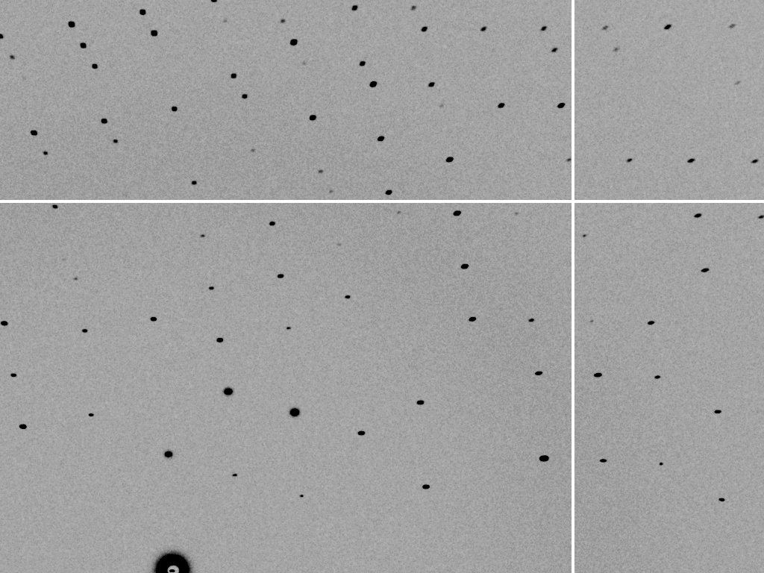
dispersion = 0.6%

Slide 43

dispersion = 1.3%

Slide 44

dispersion = 2.6%

Slide 45

dispersion = 5.1%

Slide 46
spot shape
Ewald sphere
Ewald sphere
Ewald sphere
Ewald sphere
λ’*
λ*
d*
d*
d*
λ*
diffracted rays
d*
d*
diffracted ray
diffracted ray
diffracted ray
λ’*
λ*
λ*

Slide 47

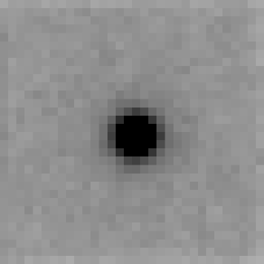
Detector Point-spread function
http://bl831.als.lbl.gov/~jamesh/bin_stuff/noisify.html

Slide 48
How to install: noisify
wget http://bl831.als.lbl.gov/
~jamesh/fastBragg/noisify.c
wget http://bl831.als.lbl.gov/
~jamesh/fastBragg/float_add.c
wget http://bl831.als.lbl.gov/
~jamesh/fastBragg/float_func.c
gcc –o noisify noisify.c –lm
gcc –o float_add float_add.c –lm
gcc –o float_func float_func.c –lm

Slide 49
Threshold of a revolution in phasing
Source of error | realistic simulation | No SHSSS | Perfect detector
Photon counting | + | + | +
Shutter jitter | + | + | -
Beam flicker | + | + | -
Sample absorption | + | + | -
Radiation damage | + | + | -
Imperfect spindle | + | + | -
vignette | + | + | -
Corner correction | + | + | -
SHSSS | + | - | -
R_{meas} (∞-10 Å) | 2.8% | 0.7% | 0.7%
I/σ asymptotic | 26.8 | 74.2 | 81.0
Holton et al (2014) "R-factor gap", FEBS Journal 281, 4046-4060.

Slide 50
Threshold of a revolution in phasing
Current
technology
Goal
Solve-able proteins (%)
Required signal-to-noise (I/σ)

Slide 51
Can you count to 1,000,000 ?
sqrt(1,000,000)
1,000,000
Theoretically:
= 0.1%
R_{meas} ≈ 0.1% ?
ISa = 1000
In reality:
ISa ~ 33
R_{meas =} ≈ 3%
sqrt(1,000)
1,000
= 3%
photon
spot
> 1000 is a waste!

Slide 52
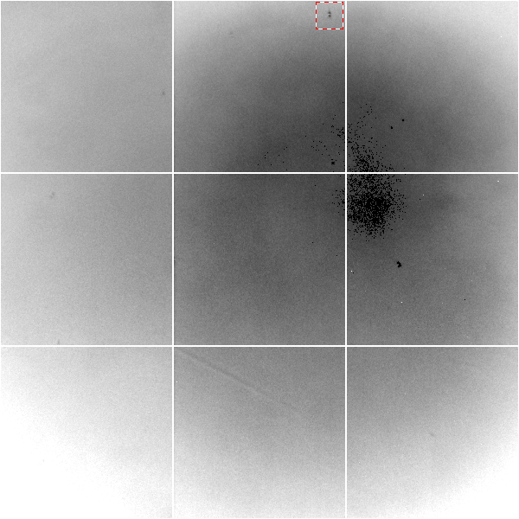
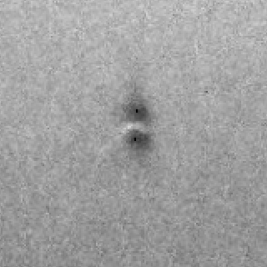
Gd edge-contrast map of ADSC Q315r detector
10% high
average
10% low

Slide 53

Pilatus: subtract smooth baseline
~3x10⁵ photon/pixel
Bragg
glitch
“tree rings”
Pick-up tool mark
oxygen
inclusions
1% high
average
1% low

Slide 54
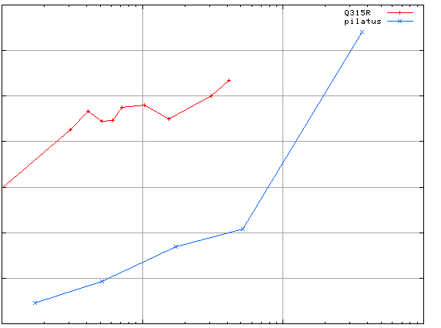
3.5
3.0
2.5
2.0
1.5
1.0
0.5
CCD detector
different
modules
anomalous mates are always on
different modules
SHSSS
Systematic component of R_{sseparate} (%)
Pilatus
SN001
Pilatus
SN113
0.1 1 10 100
distance between spots (mm)
Notes:
Comparision of SHSSS measured by the detector-shift experiment on three different detectors:
The Q315R in ALS 8.3.1
The first Pilatus detector at the Swiss Light Soruce
A newer Pilatus detector at Stanford
Improvements in calibration technology have finally made
Pilatus competitive with calibration on CCDs

Slide 55
2472.7 2473.5
Anomalous f” (electrons)
Photon Energy (eV)
Bohic et al. Anal. Chem. 2008; 80(24):9557. doi: 10.1021/ac801817k

Slide 56
S-MAD Sample size Dilemma

Slide 57
Small, soft beams

Slide 58
Small, soft beams
Diamond
($100, reusable)

Slide 59
Small, soft beams
oil ?
Diamond
($100, reusable)

Slide 60
Small, soft beams
oil ?
Diamond
($100, reusable)

Slide 61
Small, soft beams
oil ?
λ=2d sinθ
2.5 Å data
with 5 Å X-rays
Only analytic absorption correction:
International Tables for Crystallography, Vol. C, 2nd ed., chapter 6.3

Slide 62
(h,k,l)
Ewald sphere 2
λ*
diffracted ray
d*
θ
λ*
λ*
θ
d*
diffracted ray
λ*
Ewald sphere
1
(-h,-k,-l)

Slide 63
Si(111)
52.87deg
Si(111)
2 Multilayer mirrors
d=2nm, W/B4C
KB Horiz focus
KB vertical focus
Si(111)
Detector
Detector
λ = 5 Å
h,k,l
sample
injector
-h,-k,-l
Si(111)
Detector
Detector
~ 1m
Si(111)
Si(111)
Notes:
Proposed 5-crystal monochromator for colliding-beam crystallography. The generation of two opposing Ewald spheres means that for every h,k,l index reflected from the protein crystal, the Friedel mate is reflected in the opposite direction, allowing for very accurate anomalous difference measurements. The wavelength need not be set precisely at the sulfur or phosphorous edge, but merely at a wavelength where the f” of those elements are strong. For fs-class pulses, the distances above will have to be precise to withing ~3 microns, and for accurate reproduction of the partiality of the Friedel mates, the angular precision of the colliding beams must be within ~1% of the sample crystal’s rocking width, or ~100 microrads.

Slide 64
Structural Biologists Want:
Resolution
  problem: background & disorder
Phases
  problem: fractional errors

Slide 65
X-ray scattering “rules”:
Optimum: support thickness = crystal thickness
1 μm crystal ≈ 1 μm water
≈ 1 μm plastic
≈ 0.1 μm glass
≈ 1000 μm air
~ 50 mm He
≈ 370 mm sat water vapor @ 4C

Slide 66
Background scattering

Slide 67
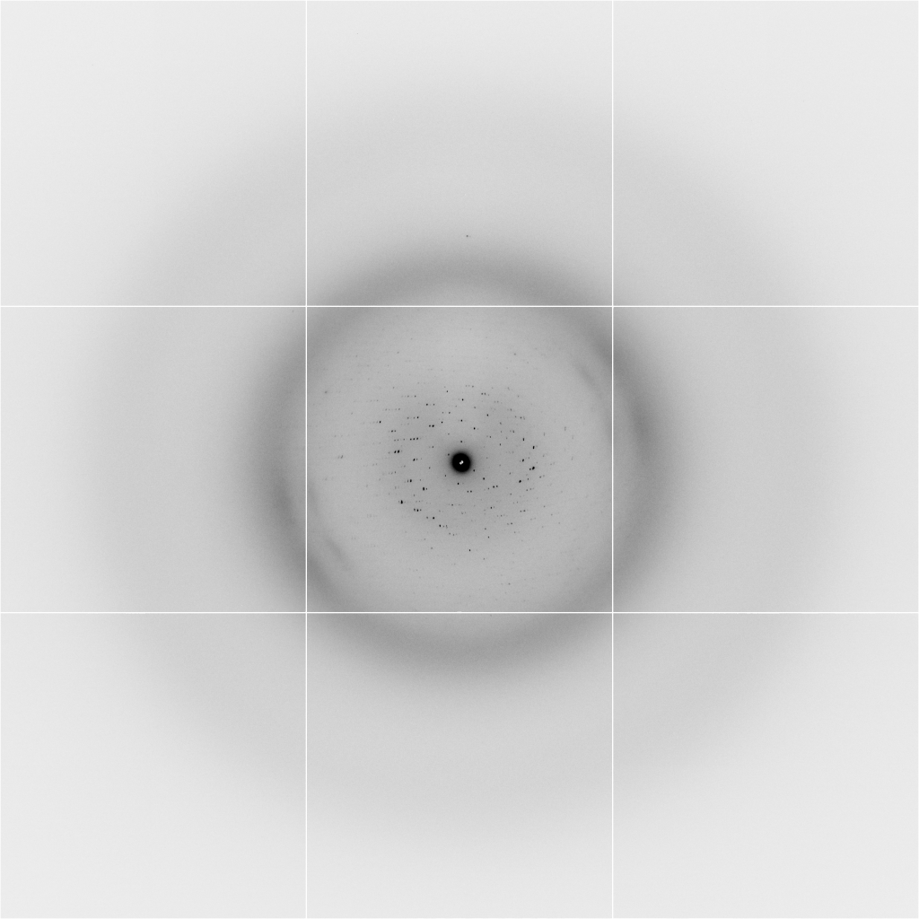
Background scattering
$100,000.00
$100,000.00
$100,000.00
real estate is
expensive
use it!
$100,000.00
$100,000.00
$100,000.00
$100,000.00
$100,000.00

Slide 68
Mosquito tips cost $0.15 each
So do Pilatus pixels!
We bought 6,224,001
Use them!
(they are reusable)

Slide 69
Structural Biologists Want:
Resolution
  problem: background & disorder
Phases
  problem: fractional errors
Problem for both: radiation damage

Slide 70
Self-calibrated damage limit
Where:
⟨I⟩_{DL} - average damage-limited intensity (photons/hkl) at a given resolution
10⁵ - converting R from μm to m, r_{e} from m to Å, ρ from g/cm³ to kg/m³ and MGy to Gy
r_{e} - classical electron radius (2.818 x 10⁻¹⁵ m/electron)
h - Planck’s constant (6.626 x 10⁻³⁴ J∙s)
c - speed of light (299792458 m/s)
f_{decayed} - fractional progress toward completely faded spots at end of data set
ρ - density of crystal (~1.2 g/cm³)
R - radius of the spherical crystal (μm)
λ - X-ray wavelength (Å)
f_{NH} - the Nave & Hill (2005) dose capture fraction (1 for large crystals)
n_{ASU} - number of proteins in the asymmetric unit
M_{r} - molecular weight of the protein (Daltons or g/mol)
V_{M} - Matthews’s coefficient (~2.4 Å³/Dalton)
H - Howells’s criterion (10 MGy/Å)
θ - Bragg angle
⟨ƒ_{a}²⟩ - number-averaged squared structure factor per protein atom (electron²)
⟨M_{a}⟩ - number-averaged atomic weight of a protein atom (~7.1 Daltons)
B - average (Wilson) temperature factor (Å²)
μ - attenuation coefficient of sphere material (m⁻¹)
μ_{en} - mass energy-absorption coefficient of sphere material (m⁻¹)
No flux
No symmetry
Holton & Frankel (2010) Acta D 66 393-408.

Slide 71
Bigger is better, but not by much
B = 20
B = 60
B = 0
B = 170
B = 330
B = 560
Resolution (Å)
B = 850
Crystal diameter (micron)

Slide 72
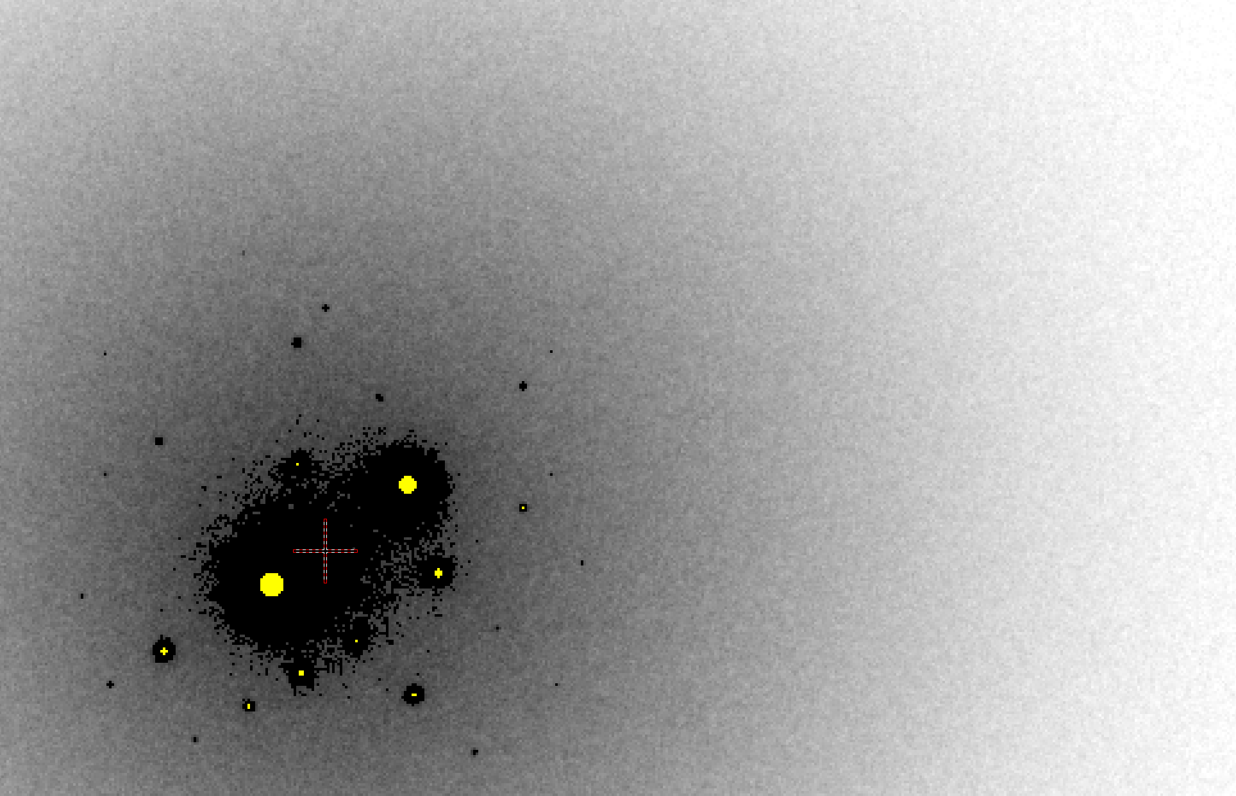
B factor from image analysis
B = 500

Slide 73
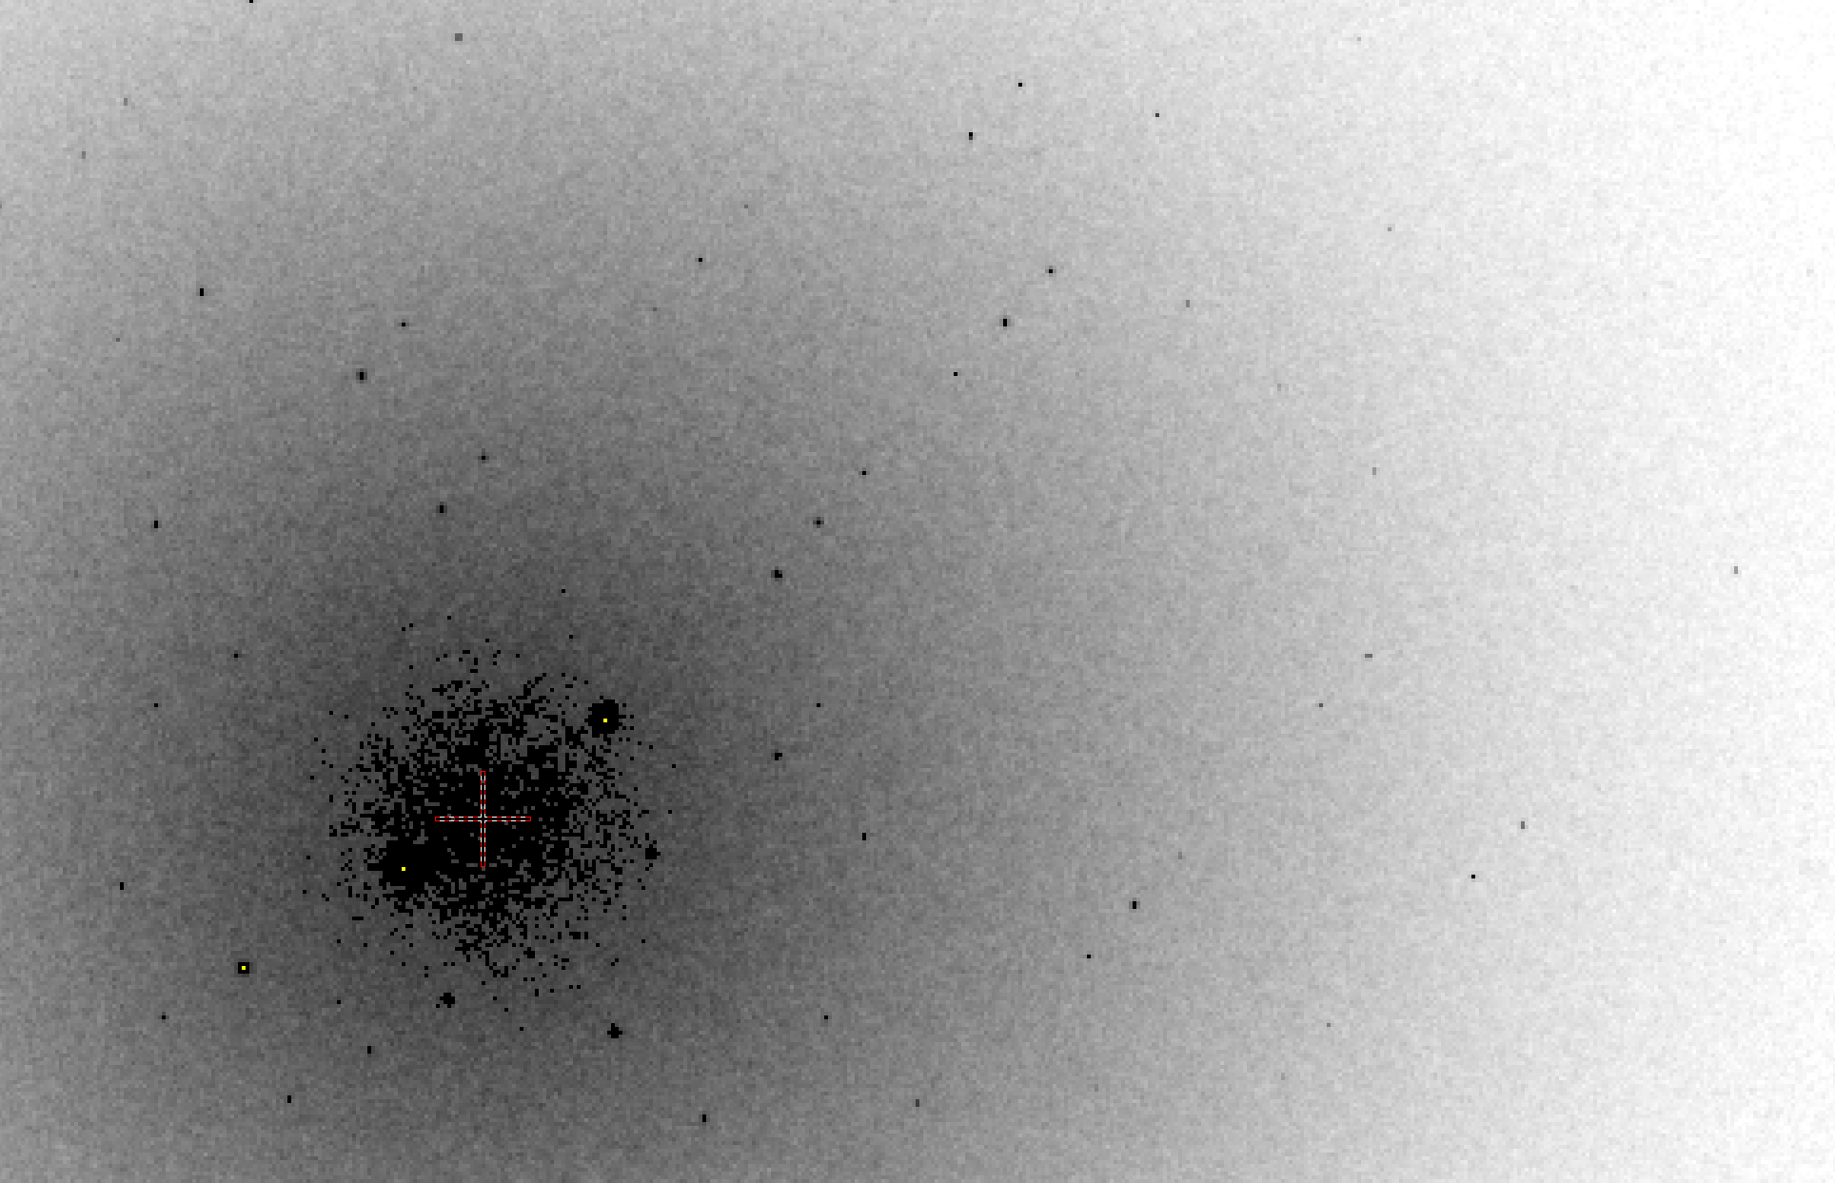
B factor from image analysis
B = 20

Slide 74
The number of photons scattered
before crystal is dead
is independent
of data collection time
1 um³ = 10⁵ photons (roomT)
1 um³ = 10⁶ photons (synch)
1 um³ = 10⁸ photons (XFEL)
(synch)
Henderson, 1990; Gonzalez & Nave, 1994; Glaeser et al., 2000; Sliz et al., 2003; Leiros et al., 2006; Owen et al., 2006; Garman & McSweeney, 2006; Garman & Nave, 2009; Holton, 2009

Slide 75
Predicting resolution limits
XFEL Resolution (Å)
Synchrotron Resolution (Å)

Slide 76

Dose slicing
Low
completeness
N
photons
crystal’s useful life
N
photons
unacceptable
readout noise?
N
photons

Slide 77
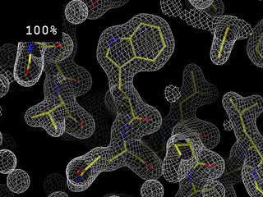
Completeness: random deletion
http://bl831.als.lbl.gov/~jamesh/movies/completeness.mpeg

Slide 78
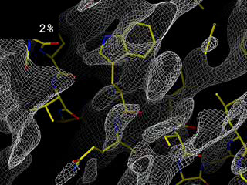
Completeness: missing wedge
http://bl831.als.lbl.gov/~jamesh/movies/osc.mpeg

Slide 79
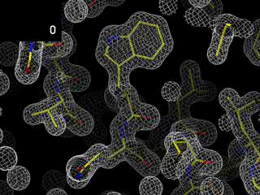
Overloads
http://bl831.als.lbl.gov/~jamesh/movies/overloads.mpeg

Slide 80
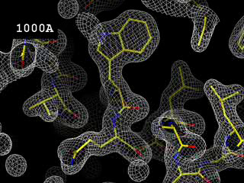
Resolution: low-angle cutoff
http://bl831.als.lbl.gov/~jamesh/movies/lo_cut.mpeg

Slide 81
Can radiation damage be “outrun”?

Slide 82
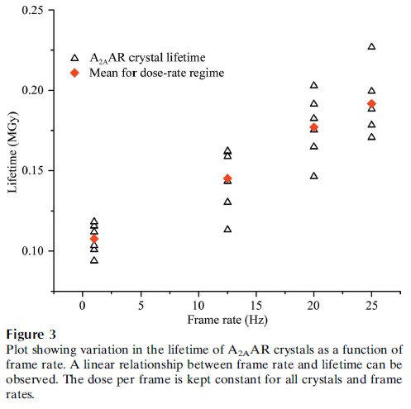
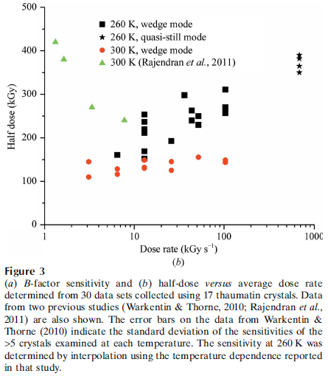
Dose-rate effect at Room Temp?
Owen RL, Axford D, Nettleship JE, Owens RJ, Robinson JI, Morgan AW, Dore AS, Lebon G, Tate CG, Fry EE, Ren J, Stuart DI & Evans G (2012)."Outrunning free radicals in room-temperature macromolecular crystallography", Acta Cryst. D 68, 810-818.
Warkentin M, Badeau R, Hopkins JB, Mulichak AM, Keefe LJ & Thorne RE (2012)."Global radiation damage at 300 and 260 K with dose rates approaching 1 MGy s-1", Acta Cryst. D 68, 124-133.

Slide 83
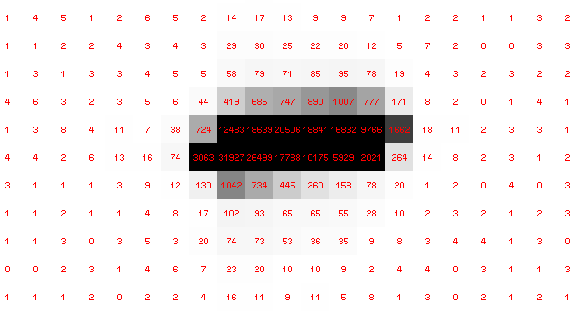
Pilatus pile-up for RT MX? same photons, different speeds
SLOW
Sum of 193 shots with
193-fold attenuation

Slide 84
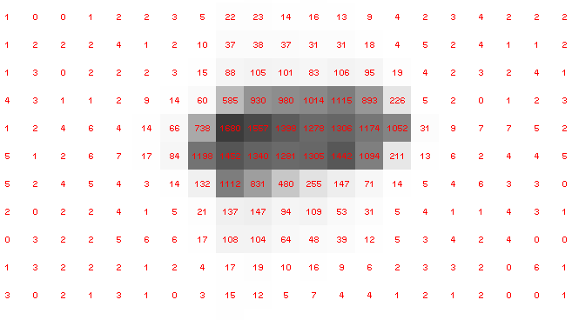
Pilatus pile-up for RT MX? same photons, different speeds
FAST
1 shot with
no attenuation

Slide 85
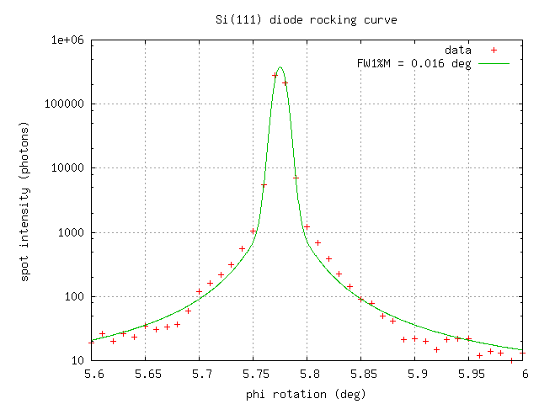
Pilatus pile-up for RT MX? same photons, different speeds

Slide 86
Do we expect this with protein?
Mosaic spread (η) < 0.02°
20°/s rotation
50x50x50 μm lysozyme crystal
I_{still} = 0.07*(F/mosaic)²
F=130 → 3e6 photons/s/spot
Max Eiger count rate = 3e6 photons/s/spot
35% of Fs > 130 (lysozyme @ 2.0 Å)
45% under-counting expected

Slide 87
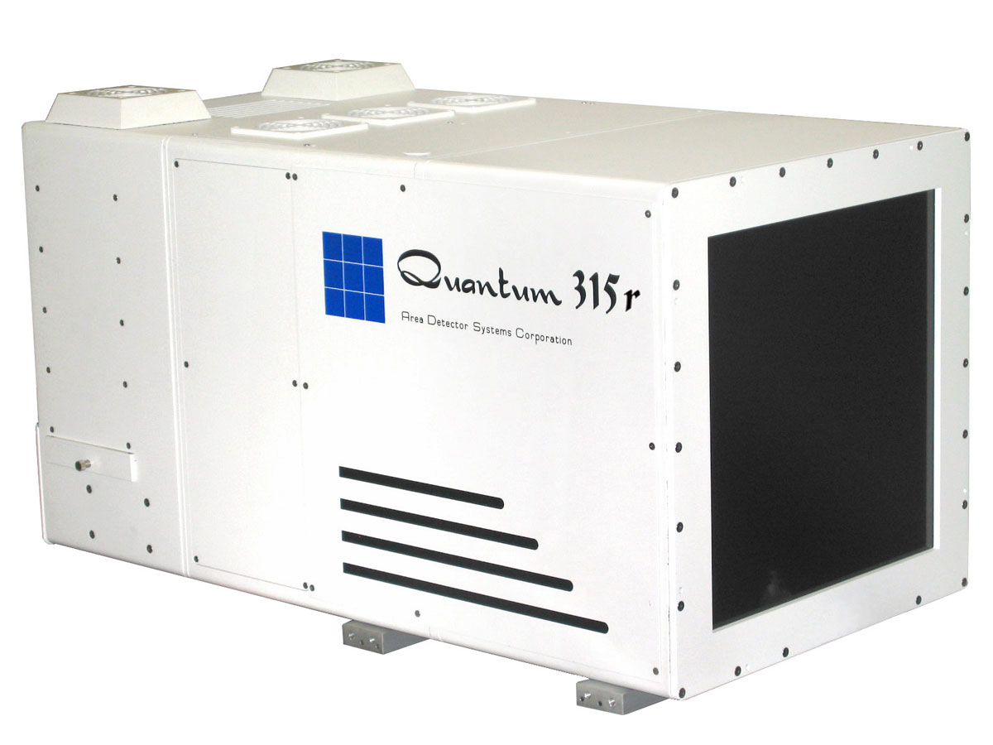
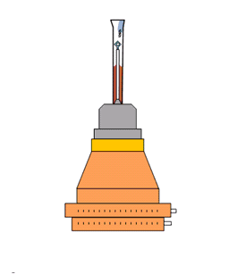
What is a “streak camera”?

Slide 88
What is a “streak camera”?
0.1 mm/pixel
= 4 ms/pixel
25 mm/s

Slide 89
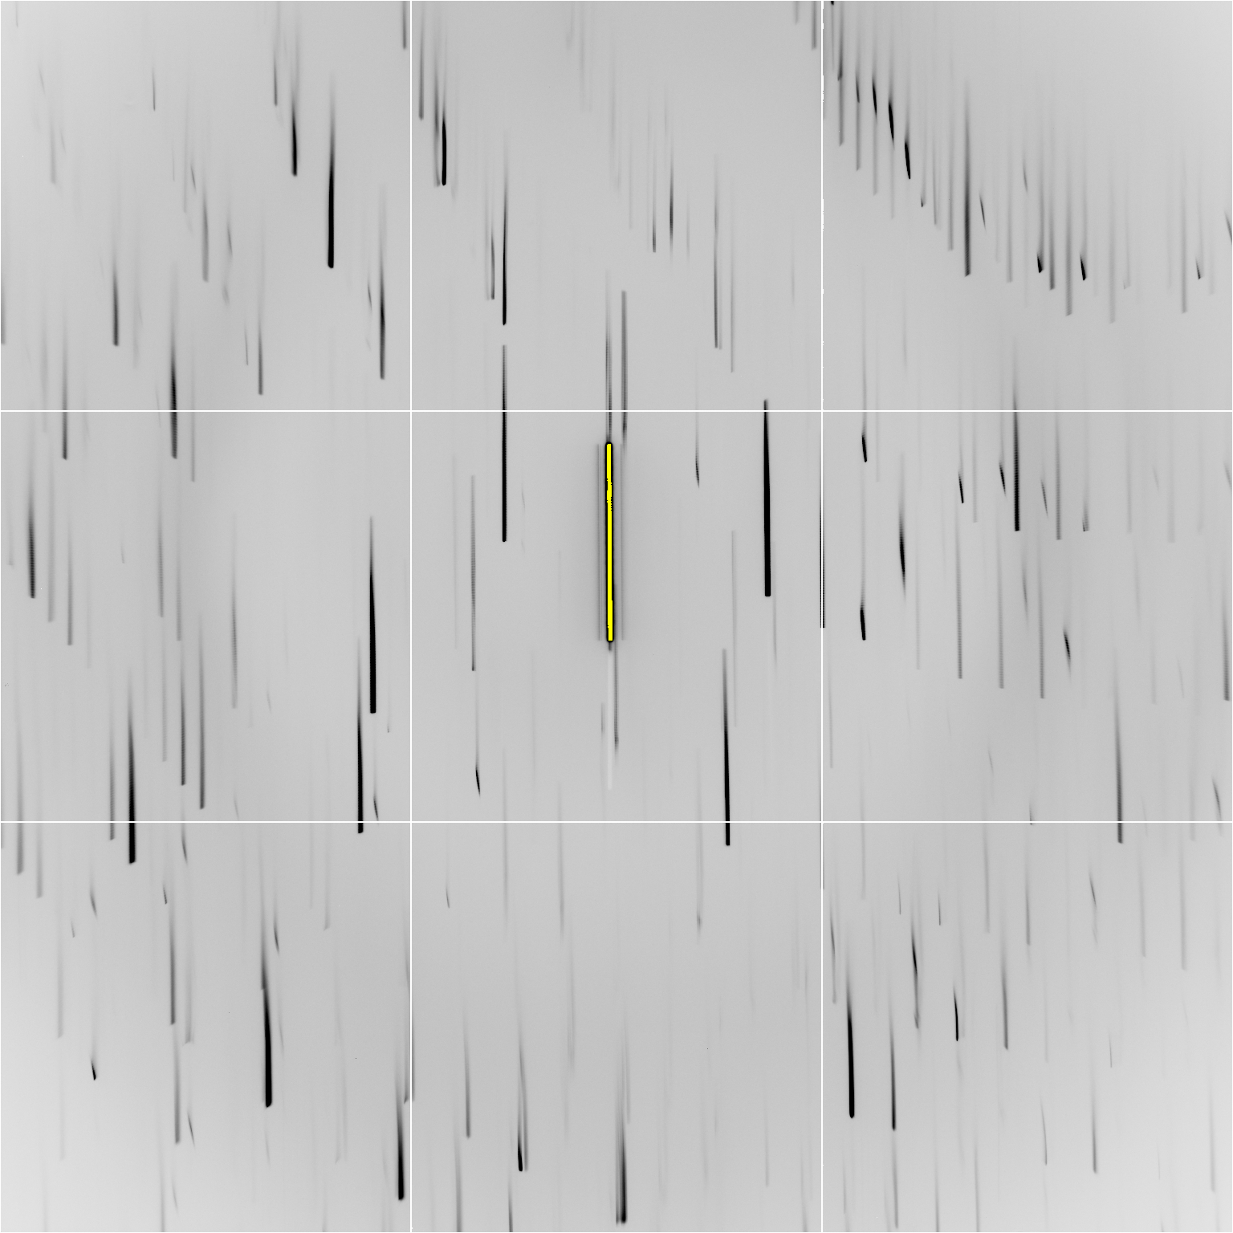

Slide 91
Individual spots at 768 kGy/s
Intensity (photons)
0
Dose (kGy)
Same xtal, different spots

Slide 92
Double-tap: no dark progression at 675 kGy/s
Intensity (photons)
Dose (kGy)

Slide 93
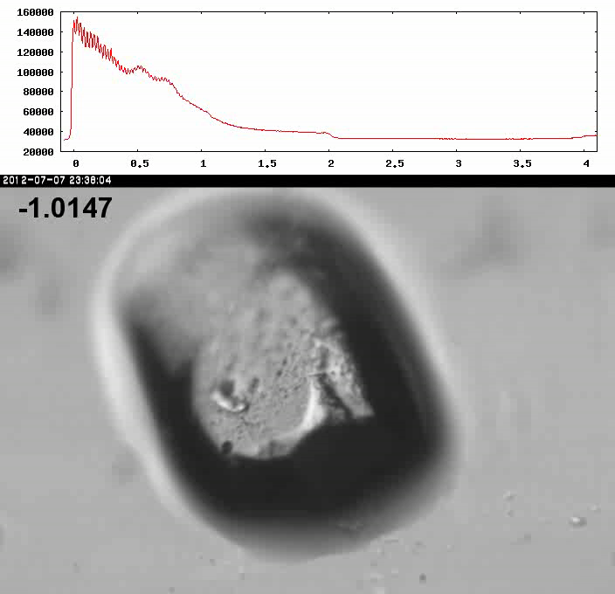
Xtal5_t1 graph

Slide 94
How much H₂ are we making?
Meents et al. (2010) claimed:
"400 molecules of H2 for every 12.5 keV photon“
= 3.3x10⁻⁷ mol/J
200 kGy to 100 um³ = 0.24 J
= 1.2x10⁻⁸ mol H₂
100 um³ of water = 6.7x10⁻⁸ mol
→ 18% of water has reacted!

Slide 95
Dose-rate dependence of damage
maximum useful dose (MGy)
dose rate (kGy/s)

Slide 96
Elastic scattering

Slide 97
Elastic scattering

Slide 98

Where do photons go?
Protein
1A x-rays
elastic scattering (6%)
Transmitted (98%)
beamstop

Slide 99
Elastic scattering

Slide 100
Inelastic scattering

Slide 101
Where do photons go?
Protein
1A x-rays
elastic scattering (6%)
Transmitted (98%)
beamstop

Slide 102
Where do photons go?
Protein
1A x-rays
elastic scattering (6%)
Transmitted (98%)
beamstop
inelastic scattering (7%)

Slide 103
Where do photons go?
Protein
1A x-rays
elastic scattering (6%)
Transmitted (98%)
beamstop
inelastic scattering (7%)
Re-emitted (99%)
Absorbed (~0%)

Slide 104
Photoelectric absorption

Slide 105
Photoelectric absorption
e⁻
+

Slide 106
Fluorescence
+

Slide 107
Fluorescence
e⁻
+

Slide 108
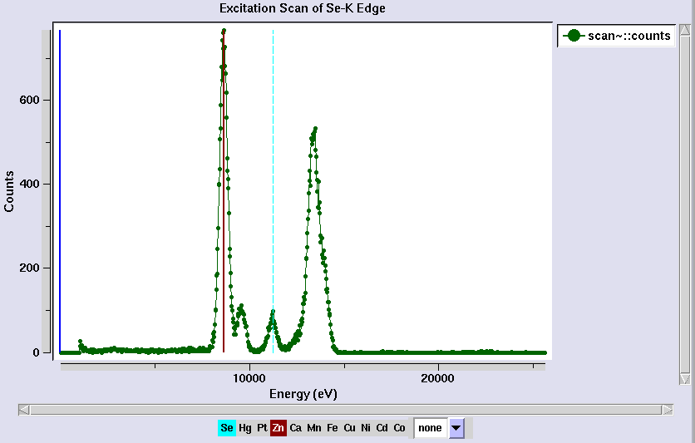
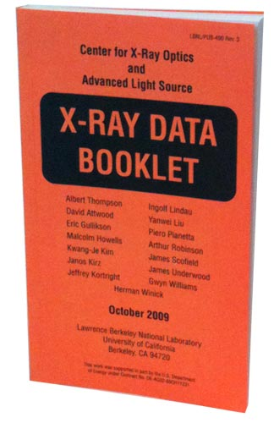
Metal identification

Slide 109
Auger emission
+

Slide 110
Auger emission
e⁻
++

Slide 111
Where do photons go?
Protein
1A x-rays
elastic scattering (6%)
Transmitted (98%)
beamstop
inelastic scattering (7%)
Re-emitted (99%)
Absorbed (~0%)

Slide 112
Where do photons go?
Protein
1A x-rays
elastic scattering (6%)
Transmitted (98%)
beamstop
inelastic scattering (7%)
Photoelectric (87%)
Re-emitted (99%)
Absorbed (~0%)

Slide 113
Where do photons go?
Protein
1A x-rays
elastic scattering (6%)
Transmitted (98%)
beamstop
inelastic scattering (7%)
Photoelectric (87%)
Re-emitted (99%)
Absorbed (~0%)
Re-emitted (~0%)
Absorbed (99%)

Slide 114
Where do photons go?
Protein
1A x-rays
elastic scattering (6%)
Transmitted (98%)
beamstop
inelastic scattering (7%)
Photoelectric (87%)
Re-emitted (99%)
Absorbed (~0%)
Re-emitted (~0%)
Absorbed (99%)
useful/absorbed energy: 7.3%

Slide 115
Photoelectric absorption

Slide 116
Photoelectric absorption
e⁻
+

Slide 117
Secondary ionization
e⁻

Slide 118
Secondary ionization
+
e⁻
e⁻

Slide 119
Excitation
e⁻

Slide 120
Excitation
e⁻

Slide 121
Excitation
e⁻

Slide 122
Excitation

Slide 123
Electron attachment
e⁻

Slide 124
Electron attachment
-

Slide 125
Sample atoms

Slide 126
Sample atoms

Slide 127
Primary ionization
e⁻
+

Slide 128
Secondary ionizations
e⁻
e⁻
+
e⁻
e⁻
+
+
+
+
+
e⁻
e⁻

Slide 129
Ionization track
e⁻
e⁻
e⁻
e⁻
+
e⁻
+
+
+
e⁻
e⁻
+
+
+
+
+
e⁻
+
e⁻
e⁻

Slide 130
Ionization track
e⁻
e⁻
e⁻
e⁻
+
e⁻
+
+
+
e⁻
e⁻
+
+
+
+
+
e⁻
+
e⁻
e⁻

Slide 131
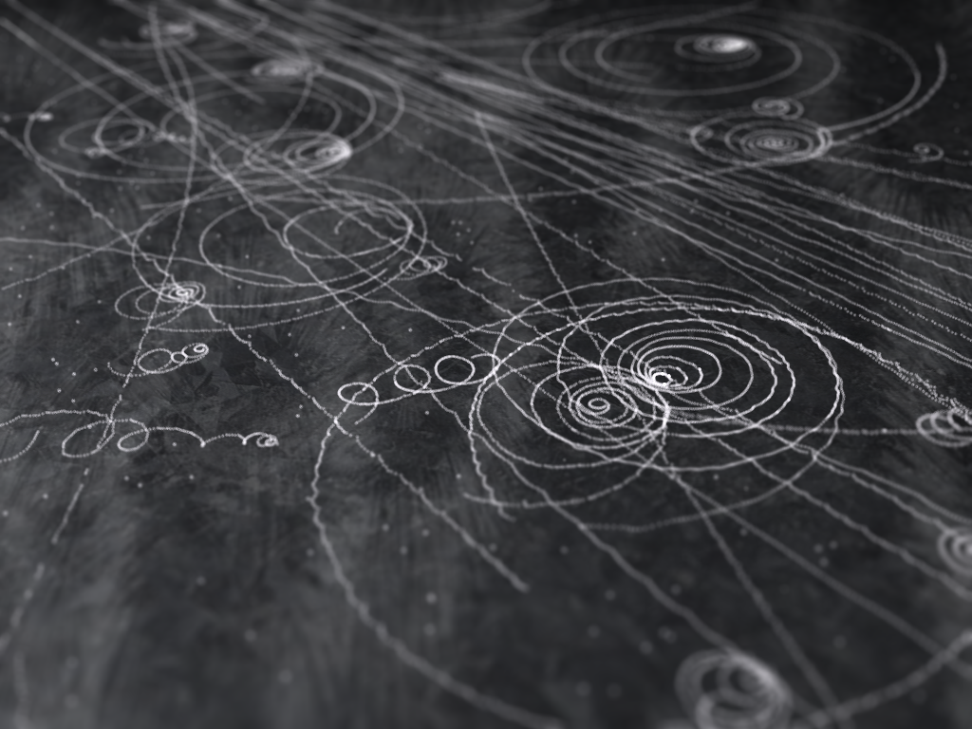
Ionization track

Slide 132
Ionization track

Slide 133
Ionization track
3 μm

Slide 134
Ionization track
Linear Energy Transfer

Slide 135
Ionization track
initial effects

Slide 136
Ionization track
initial effects
Homogeneous reactions

Slide 137
initial effects
e⁻
e⁻
e⁻
e⁻
+
e⁻
+
+
+
e⁻
e⁻
+
+
+
+
+
e⁻
+
e⁻
e⁻

Slide 138
initial effects
e⁻
e⁻
e⁻
e⁻
+
e⁻
+
+
+
e⁻
neutralization
e⁻
+
+
+
+
+
e⁻
+
e⁻
e⁻

Slide 139
initial effects
e⁻
e⁻
e⁻
e⁻
+
e⁻
+
+
neutralization
e⁻
+
+
+
+
+
e⁻
+
e⁻
e⁻

Slide 140
initial effects
e⁻
e⁻
e⁻
e⁻
+
neutralization
+
e⁻
+
+
+
+
+
neutralization
e⁻
e⁻

Slide 141
initial effects
e⁻
e⁻
e⁻
e⁻
+
+
e⁻
+
+
+
+
+
e⁻
attachment
e⁻

Slide 142
initial effects
e⁻
e⁻
e⁻
e⁻
+
+
e⁻
+
+
+
+
+
-
attachment
e⁻

Slide 143
initial effects
e⁻
e⁻
e⁻
attachment
e⁻
+
+
e⁻
+
+
+
+
+
-
e⁻
attachment

Slide 144
initial effects
e⁻
-
e⁻
e⁻
+
+
e⁻
+
+
+
+
+
-
-

Slide 145
initial effects
-
-
-
e⁻
+
+
+
+
+
+
-
-

Slide 146
initial effects
-
-
-
e⁻
solvation
+
+
+
+
+
+
-
-

Slide 147
initial effects
-
-
-
solvation
+
e⁻
+
+
+
+
+
-
-

Slide 148
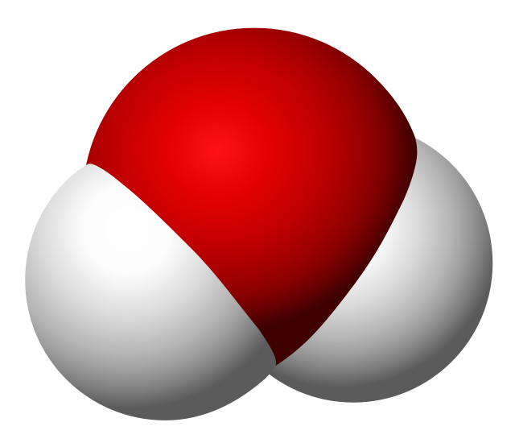
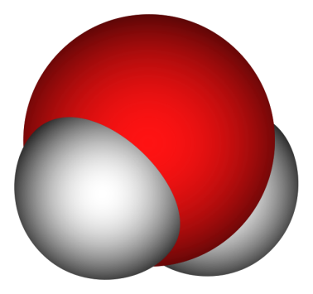
Solvated electron
e⁻

Slide 149
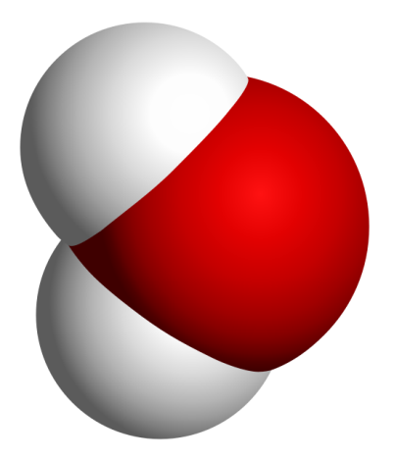
Solvated electron
e⁻

Slide 150
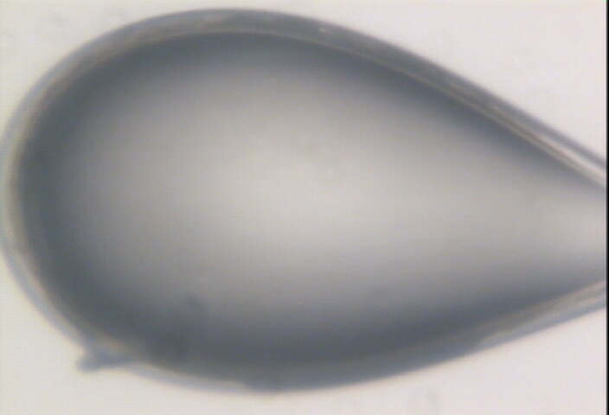

Slide 151
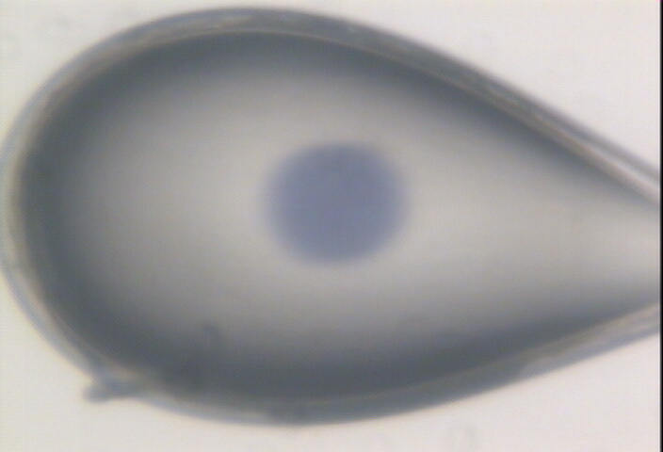

Slide 152
initial effects
-
-
-
+
e⁻
+
+
+
+
+
-
-

Slide 153
initial effects
-
-
-
+
e⁻
+
+
+
+
+
-
-

Slide 154
initial effects
-
-
+
e⁻
+
+
+
+
-
-

Slide 155
initial effects
e⁻
+
+
+
-
-

Slide 156
initial effects
e⁻
+
+
-

Slide 157
Excitation transfer

Slide 158
Excitation transfer
UV photon

Slide 159
Excitation transfer

Slide 160
Excitation transfer
r⁻⁶
Förster transfer

Slide 161
Excitation transfer

Slide 162
t = 0 s

Slide 163
t ≈ 10⁻¹⁵ s
e⁻
+
+
-

Slide 164
Timescales of radiation damage
Garret et. al. (2005) Chem. Rev. 105, 355-389

Slide 165
Timescales of radiation damage
LCLS
ALS
bunch
Garret et. al. (2005) Chem. Rev. 105, 355-389

Slide 166
Ionization track
Heterogeneous reactions
Homogeneous reactions

Slide 167
Rough values of energy quanta
1 MeV 100 GJ/mol Medical radiation therapy
100 keV 10 GJ/mol Medical imaging
10 keV 1 GJ/mol X-ray crystallography
1 keV 100 MJ/mol S and P K-edges
100 eV 10 MJ/mol “water window”
10 eV 1 MJ/mol C≡C bond
1 eV 100 kJ/mol C-C bond, visible light
100 meV 10 kJ/mol hydrogen bond
10 meV 1 kJ/mol heat (~300 K)

Slide 168

Energy Transfer Analogy
37 C

Slide 169
Damage at 100K is done
by dose (MGy)
proportional to photons/area
not time
not heat
Sliz P, Harrison SC & Rosenbaum G (2003). Structure 11, 13-19.
Garman EF & McSweeney SM (2006). J. Sync. Rad. 14, 1-3.
Owen RL, Rudino-Pinera E & Garman EF (2006). PNAS 103, 4912-4917.
Leiros et al. (2006). Acta Cryst. D 62, 125-132.
Holton JM (2007). J. Synch Rad. 14, 51-72.

Slide 170
what the is a MGy?
energy
mass
http://bl831.als.lbl.gov/
damage_rates.pdf
Holton J. M. (2009) J. Synchrotron Rad. 16 133-42

Slide 171
How long will my crystal last?
synch line type flux beamsize flux density dose max xtal min site
ph/s μm ph/μm2/s rate lifetime lifetime
ALS 4.2.2 MAD 2.2e11 75x80 3.7e+07 27.3 kGy/s 18 m 73 s
ALS 5.0.1 mono 1.6e11 100 2.0e+07 10.4 kGy/s 48 m 3.2 m
ALS 5.0.2 MAD 8e11 100 1.0e+08 51.8 kGy/s 9.6 m 39 s
ALS 5.0.3 mono 1.7e11 100 2.2e+07 11 kGy/s 45 m 3 m
ALS 8.2.1 MAD 1.8e11 100 2.3e+07 11.7 kGy/s 43 m 2.9 m
ALS 8.2.2 MAD 2.3e11 100 2.9e+07 14.9 kGy/s 34 m 2.2 m
ALS 8.3.1 MAD 9e11 70 2.3e+08 119 kGy/s 4.2 m 17 s
ALS 8.3.1 typical 6e11 70 1.6e+08 115 kGy/s 4.3 m 17 s
ALS 12.3.1 MAD 1.8e11 100 2.3e+07 11.7 kGy/s 43 m 2.9 m
ALS 12.3.1 ML 4.0e12 100 5.1e+08 513 kGy/s 58 s 3.9 s
APS 8-BM MAD 1e11 200 2.5e+06 1.27 kGy/s 6.6 h 26 m
APS 14-BM-C mono 5.8e10 200 1.4e+06 738 Gy/s 11 h 45 m
APS 14-BM-D MAD 3.3e9 200 8.2e+04 42 Gy/s 8.3 d 13 h
APS 14-ID-B MAD 6.0e10 200 1.5e+06 763 Gy/s 11 h 44 m
APS 17-BM MAD 1.1e11 200 2.8e+06 1.4 kGy/s 6 h 24 m
APS 17-ID MAD 2.3e11 200 5.8e+06 2.93 kGy/s 2.8 h 11 m
APS 19-BM MAD 2.0e11 70x60 4.8e+07 24.2 kGy/s 21 m 83 s
APS 19-ID MAD 1.3e13 80x40 4.1e+09 2.07 MGy/s 15 s 0.97 s
APS 19-ID typical 5.5e11 100x100 5.5e+07 28 kGy/s 18 m 71 s
APS 22-BM MAD 7e12 80x40 2.2e+09 1.23 MGy/s 24 s 1.6 s
APS 22-ID MAD 7e12 80x40 2.2e+09 1.23 MGy/s 24 s 1.6 s
APS 22-ID typical 1.5e12 80 2.3e+08 119 kGy/s 4.2 m 17 s
APS 23-ID-B MAD 1e13 75x25 5.3e+09 3.01 MGy/s 10 s 0.66 s
APS 23-ID typical 1.5e12 80 2.3e+08 119 kGy/s 4.2 m 17 s
APS 24-ID-C MAD 1.3e13 20x60 1.1e+10 5.23 MGy/s 5.7 s 0.38 s
APS 24-ID-E MAD 0.5e13 20x100 2.5e+09 1.19 MGy/s 25 s 1.7 s
APS 31-ID MAD 2e12 70 4.1e+08 194 kGy/s 2.6 m 10 s

Slide 172
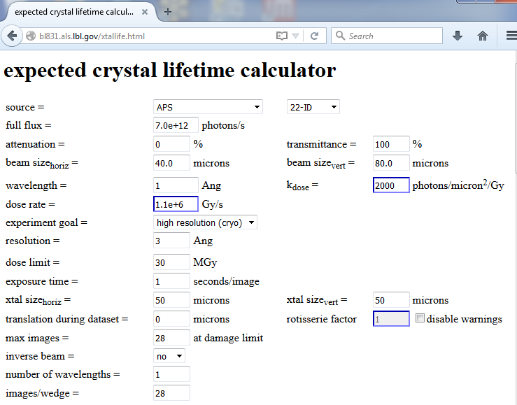

Slide 173

Holton & Frankel (2010) Acta D 66 393-408.

Slide 174
resolution dependence of global damage
10³
100
maximum tolerable dose (MGy)
10
1
1 2 3 5 7 10 20 40 70 100
resolution (Å)
Howells et al. (2009) J. Electron. Spectrosc. Relat. Phenom. 170 4-12

Slide 175
resolution dependence of global damage
10³
10 MGy/Å
100
maximum tolerable dose (MGy)
10
1
1 2 3 5 7 10 20 40 70 100
resolution (Å)
Howells et al. (2009) J. Electron. Spectrosc. Relat. Phenom. 170 4-12

Slide 176
R_{iso} vs dose
R_{iso} (%)
change in dose (MGy)
data taken from Banumathi, et al. (2004) Acta Cryst. D 60, 1085-1093.

Slide 177
R_{iso} vs dose
R_{iso} ≈ 0.7 %/MGy
R_{iso} (%)
change in dose (MGy)
data taken from Banumathi, et al. (2004) Acta Cryst. D 60, 1085-1093.

Slide 178
Dose-doubling concentration
molar, at the Se edge based on RADDOSE
Na | 44
Mg | 27
P | 9
S | 7
Cl | 5
K | 3.3
Ca | 2.7
Fe | 1.0
Cu | 0.67
Zn | 0.58
As | 0.44
Se | 0.42
Br | 2.9
I | 0.47
Gd | 0.21
Ta | 0.13
Pt | 0.17
Au | 0.16
Hg | 0.16
U | 0.23

Slide 179
Dose-doubling concentration
molar, at the Se edge based on RADDOSE
Na | 44
Mg | 27
P | 9
S | 7
Cl | 5
K | 3.3
Ca | 2.7
Fe | 1.0
Cu | 0.67
Zn | 0.58
As | 0.44
Se | 0.42
Br | 2.9
I | 0.47
Gd | 0.21
Ta | 0.13
Pt | 0.17
Au | 0.16
Hg | 0.16
U | 0.23

Slide 180
Specific Damage
World Records
MGy reaction reference
~45 global damage Owen et al. (2006)
5 Se-Met Holton (2007)
4 Hg-S Ramagopal et al. (2004)
3 S-S Murray et al. (2002)
1 Br-RNA Olieric et al. (2007)
? Cl-C ???
0.5 Mn in PS II Yano et al. (2005)
0.02 Fe in myoglobin Denisov et al. (2007)
Holton (2009) J. Synchrotron Rad. 16 133-42

Slide 181
Structural Biologists Want:
Resolution
  problem: background
Phases
  problem: fractional errors
Publications
  problem: R factors

Slide 182
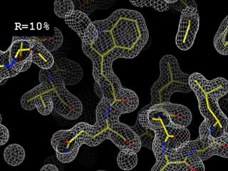
R-factor
http://bl831.als.lbl.gov/~jamesh/movies/rfactor.mpeg

Slide 183
Is this good enough?
d_{max} = 4.5 Å
R_{cryst} = 27%
R_{free} = 38%

Slide 184
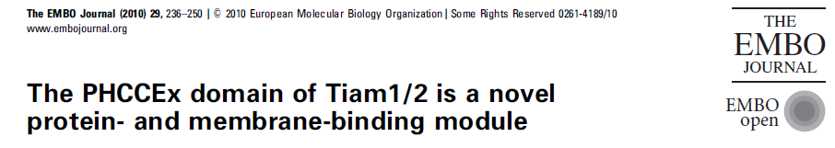
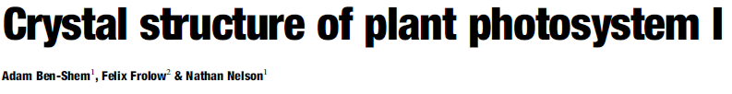
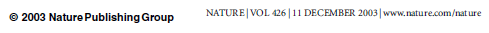
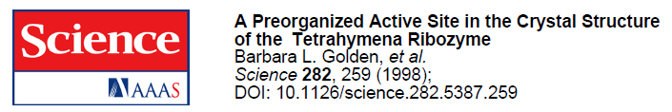
Is this good enough?
3a8n 4.5 Å R_{merge} = 0.15 R/R_{free} = 0.306/0.396
1qzv 4.44 Å R_{merge} = 0.099 R/R_{free} = 0.41/0.42
1grz 5 Å R_{merge} = 0.052 R/R_{free} = 0.369/0.428

Slide 185
The R-factor Gap
Publication criterion for chemical crystallography:
R1 < 2*R_{sigma}
R1 = F_{o} vs F_{c} for I/σ(I) > 3
R_{sigma} = <σ(I)>/<I>
There are no PDB entries that pass this test!
Holton et al. (2014). FEBS J. 281, 4046-60.

Slide 186
The R-factor Gap
R_{merge} = 3%
R_{work} = 20%
R_{free} = 24%
Experimental
error
“systematic”
error
20% of carbon atom = 1.2 e⁻
5% of carbon atom = 0.3 e⁻
Closing the R-factor gap will enable study of 1-electron changes

Slide 187

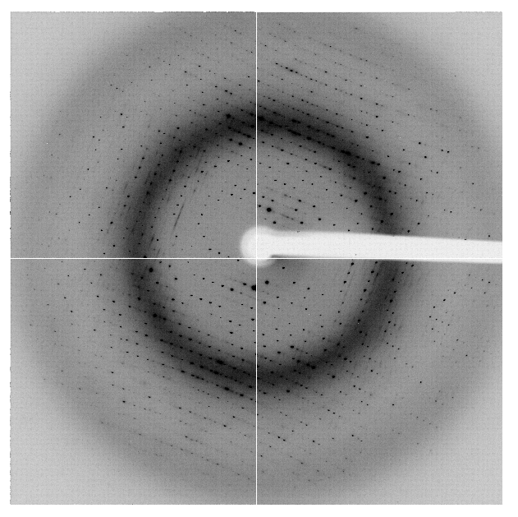
The R-factor Gap
multi-conformer PDB file
R_{merge} = 6%
R_{cryst} = 17%
R_{free} = 20%
MLFSOM
Elves
1H87
Holton, Classen, Frankel & Tainer (2014)."The R-factor gap in macromolecular crystallography: an untapped potential for insights on accurate structures", FEBS J. 281, 4046-4060.

Slide 188
The R-factor Gap
multi-conformer PDB file
R_{merge} = 6%
R_{cryst} = 7%
R_{free} = 8%
MLFSOM
Elves
1H87
Holton, Classen, Frankel & Tainer (2014)."The R-factor gap in macromolecular crystallography: an untapped potential for insights on accurate structures", FEBS J. 281, 4046-4060.

Slide 189
The R-factor Gap
single-conformer PDB file
R_{merge} = 6%
R_{cryst} = 7%
R_{free} = 8%
MLFSOM
Elves
ARP/wARP
1H87; conf “A”
Holton, Classen, Frankel & Tainer (2014)."The R-factor gap in macromolecular crystallography: an untapped potential for insights on accurate structures", FEBS J. 281, 4046-4060.

Slide 190
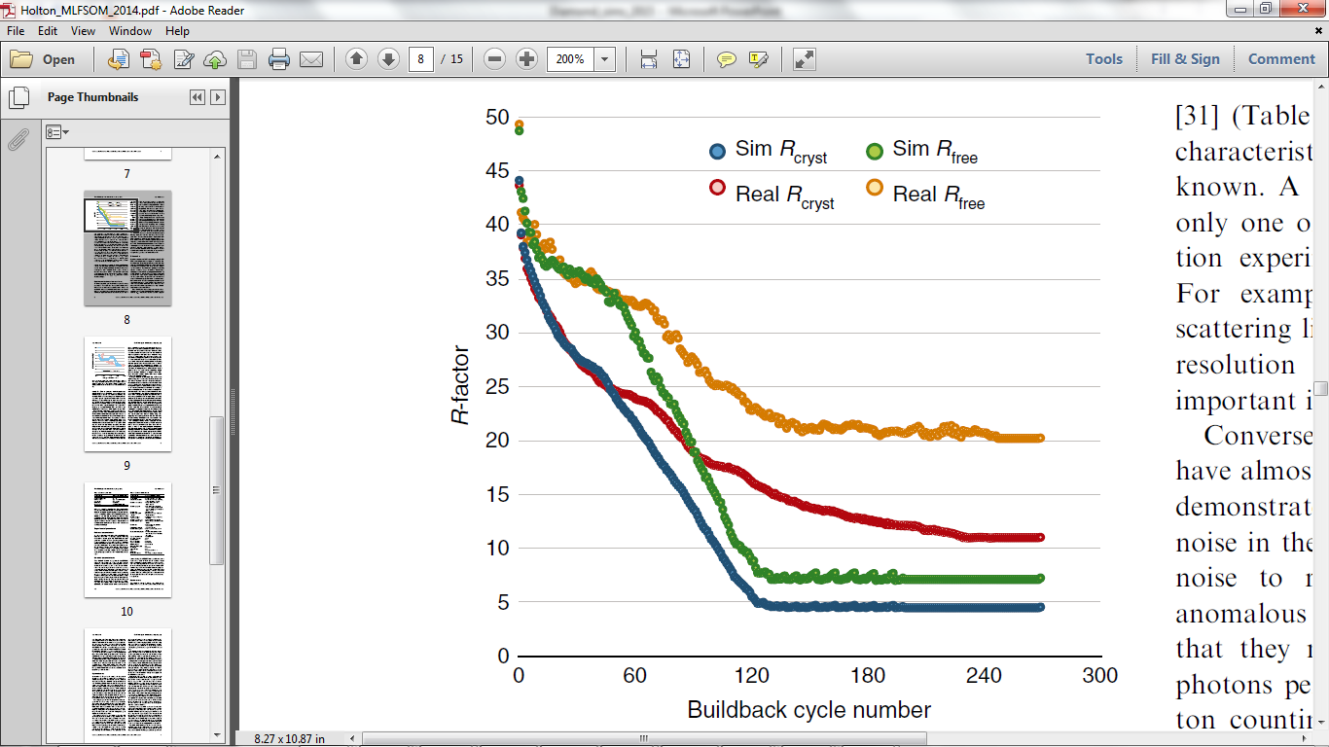
The R-factor Gap
Holton et al. (2014) "The R-factor gap", FEBS J. 281, 4046-4060.

Slide 191
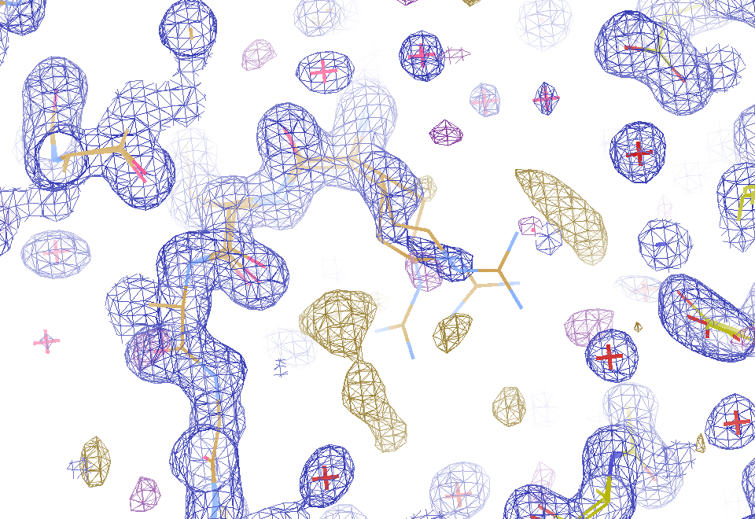
2F_{sim}-F_{calc} and F_{sim}-F_{calc} maps
1.0 Å data
R_{cryst}= 0.137
R_{free} = 0.159
1 “sigma” 2F_{sim}-F_{c}
2.5 “sigma” F_{sim}-F_{c}

Slide 192
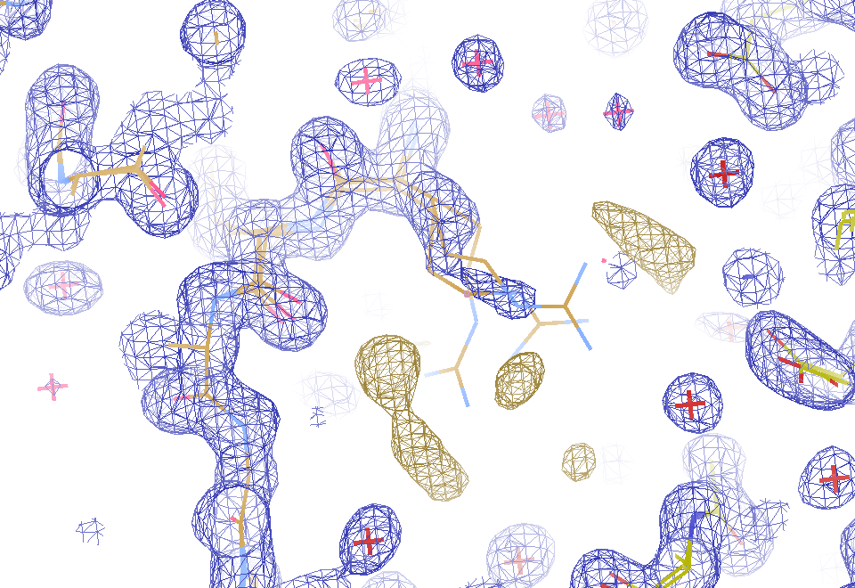
2F_{sim}-F_{calc} and (F_{sim} Φ_{sim}) - (F_{calc} Φ_{calc}) maps
1.0 Å data
R_{cryst}= 0.137
R_{free} = 0.159
1 “sigma” 2F_{sim}-F_{c}
F_{right} – (2F_{sim}-F_{c})

Slide 193
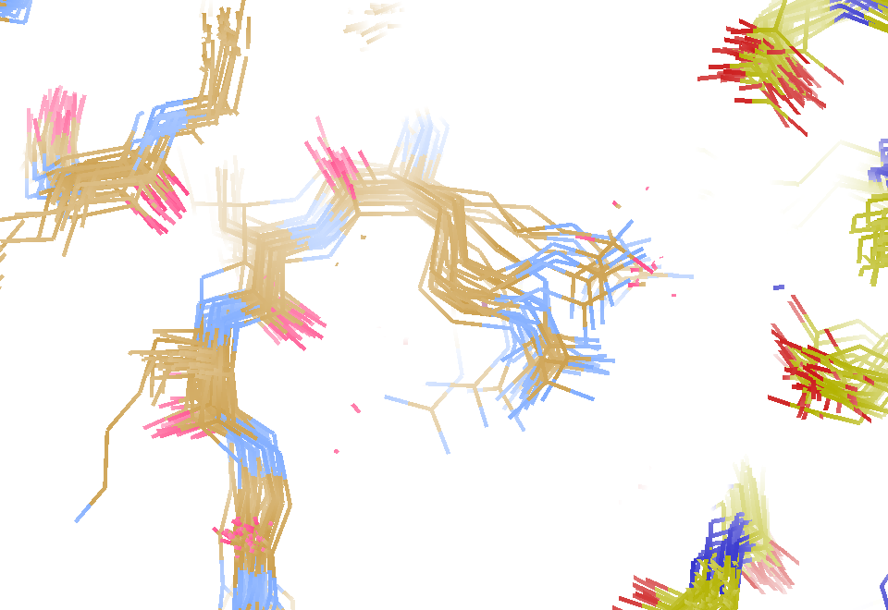
30 conformers from 24,000

Slide 194
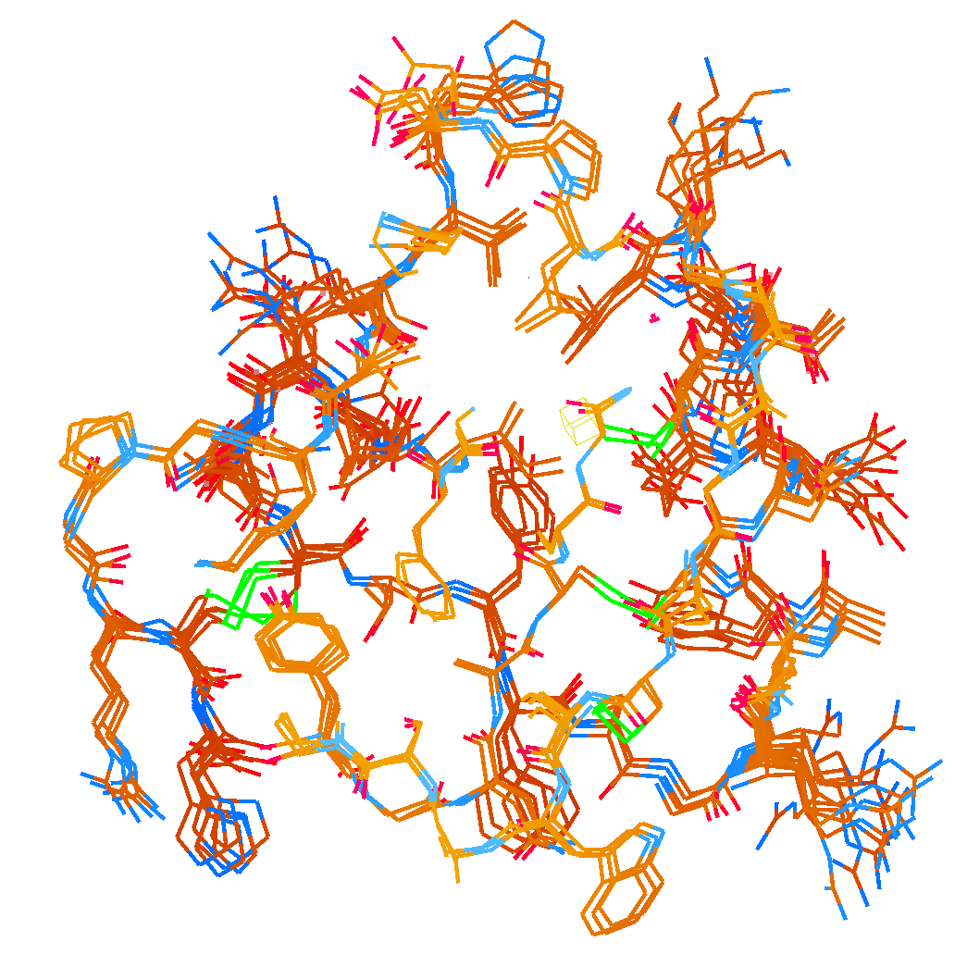
How many conformers are there?
Answer: 2-14
R_{cryst} = 0.0441
R_{free} = 0.0516
vs F_{sim}

Slide 195

How many conformers are there?
Answer: 1-7
R_{cryst} = 0.1546
R_{free} = 0.1749
vs F_{obs}
1aho:
R_{cryst} = 0.1630
R_{free} = n/d

Slide 196

How many conformers are there?
All difference
features
are in
the solvent!
real data

Slide 197
The R-factor Gap
MX data quality is not limiting
Hypotheses:
  Hidden systematic error?
  Model-building problem?
  Representation problem?

Slide 198
RISM model for “bulk” solvent
Method | R_{work} | R_{free}
Default refmac5: flat bulk solvent | .1784 | .1898
RISM – self-consistent density field based on electrostatics | .1640 | .1808
Explicit MD solvent, protein fixed | .1523 | .1690
RISM – protein fixed multi-conformer weighted | .1578 | .1739
Explicit – protein fixed multi-conformer weighted | .1440 | .1666

Slide 199

Systematic error does not “average out”

Slide 200
non-isomorphism

Slide 201

Same structure, different cell
0.5% cell change → 15%
Crick & Magdoff (1956) “theory method isomorphous replacement”, Acta Cryst. 9, 901-8.

Slide 202
Same structure, different cell
0.5% cell change → 15%
Crick & Magdoff (1956) “theory method isomorphous replacement”, Acta Cryst. 9, 901-8.

Slide 203
Same cell, rotated protein
0.5° rotation → 16%
Crick & Magdoff (1956) “theory method isomorphous replacement”, Acta Cryst. 9, 901-8.

Slide 204
Same cell, rotated protein
0.5° rotation → 16%
Crick & Magdoff (1956) “theory method isomorphous replacement”, Acta Cryst. 9, 901-8.

Slide 205
Uniform stretch
5% change → 0%

Slide 206
Uniform stretch
5% change → 0%

Slide 207
Non-isomorphism in lysozyme
Dear James
The story of the two forms of lysozyme crystals goes back to about 1964 when it was found that the diffraction patterns from different crystals could be placed in one of two classes depending on their intensities. This discovery was a big set back at the time and I can remember a lecture title being changed from the 'The structure of lysozyme' to 'The structure of lysozyme two steps forward and one step back'. Thereafter the crystals were screened based on intensities of the (11,11,l) rows to distinguish them (e.g. 11,11,4 > 11,11,5 in one form and vice versa in another). Data were collected only for those that fulfilled the Type II criteria. (These reflections were easy to measure on the linear diffractometer because crystals were mounted to rotate about the diagonal axis). As I recall both Type I and Type II could be found in the same crystallisation batch . Although sometimes the external morphology allowed recognition this was not infallible.
The structure was based on Type II crystals. Later a graduate student Helen Handoll examined Type I. The work, which was in the early days and before refinement programmes, seemed to suggest that the differences lay in the arrangement of water or chloride molecules (Lysozyme was crystallised from NaCl). But the work was never written up. Keith Wilson at one stage was following this up as lysozyme was being used to test data collection strategies but I do not know the outcome.
An account of this is given in International Table Volume F (Rossmann and Arnold edited 2001) p760.
Tony North was much involved in sorting this out and if you wanted more info he would be the person to contact. I hope this is helpful. Do let me know if you need more.
Best wishes
Louise

Slide 208

Non-isomorphism in lysozyme
RMSD = 0.18 Å
Δcell = 0.7 %
R_{iso} = 44.5%
3aw6
3aw7
RH: 84.2%
vs 71.9%

Slide 209
X-ray Data Sets
Singular values & vectors
data
set
h,k,l | structure factors (F)
 | #1 | #2 | #3 | #4
5,3,4 | 523.7 | 559.8 | 579.9 | 603.2
5,4,4 | 168.2 | 166.6 | 177.2 | 196.1
5,5,4 | 34.9 | 26.4 | 19.2 | 17.3
6,1,4 | 305.7 | 301.1 | 298.1 | 296.3
6,2,4 | 353.0 | 353.9 | 356.2 | 366.9
6,3,4 | 300.9 | 285.3 | 273.5 | 259.4
6,3,5 | 223.8 | 226.3 | 234.6 | 251.4
… | … | … | … | …
h,k,l | 100% | 17 % | 13 % | 9 %
 | 1st | 2nd | 3rd | 4th
5,3,4 | -1.46 | -0.02 | 1.84 | -0.72
5,4,4 | -0.88 | -0.29 | -0.34 | 0.15
5,5,4 | -0.42 | -0.65 | 1.02 | 1.47
6,1,4 | -0.90 | -0.85 | 1.44 | -0.40
6,2,4 | -1.20 | -0.37 | 0.67 | 0.01
6,3,4 | -0.75 | 0.31 | 0.48 | 0.00
6,3,5 | -0.75 | -0.85 | 0.72 | -0.82
… | … | … | … | …
value
vector
Singular value decomp.
SVD
-0.68
-0.24
0.32 …
CC1
Data sets
Positioned
in
“Correlation
Space”
Correlation
Coefficients
CC1 CC2 CC3
CC2
data set #1
data set #2
data set #3
CC3

Slide 210


Slide 211
Structure factor (electrons)
Correlation to 2nd & 3rd singular vectors

Slide 212
Structure factor (electrons)
Correlation to 2nd & 3rd singular vectors

Slide 213
Structure factor (electrons)
Correlation to 2nd & 3rd singular vectors

Slide 214

Bragg’s “minimum wavelength principle”
Perutz (1985). “Early Days of Cryst…” Methods in Enzymology, Vol. 114, 3-18.
Bragg & Perutz (1952)."external form haemoglobin I", Acta Cryst. 5, 277-283.

Slide 215

DMMULTI – fake data
4 deg rotation: 8 “xtals”: before
CC = 0.02

Slide 216

DMMULTI – fake data
4 deg rotation: 8 “xtals”: after
CC = 0.8

Slide 217
Systematic error can “average out” if you can change up the source

Slide 218



Partiality > 25% error per spot!
$$=\sqrt{7.7 ∗{3\%}^{−2}}$$
$$=\sqrt{37.9 ∗{25\%}^{−2}}$$
Kabsch W (2014)."Processing of X-ray snapshots from crystals in random orientations", Acta Cryst D 70, 2204-2216.

Slide 219
What is “partiality”?
Ewald sphere

Slide 220
What is “partiality”?
Ewald sphere

Slide 221
The “partiality problem”
0.006°
1 μm xtal
1 Å x-rays

Slide 222
Multiplicity required to phase
Monte Carlo
  100% /obs → 10,000 fold
nXDS
  25% /obs → 625 fold
Synchrotron
  3% /obs → 9 fold
  Assuming ΔF/F ~ 1%
Beam time:
$2/s

Slide 223



Can’t we just rotate the crystal?
9 nm
= 90 km/s
100 fs
1°
1 μm
(90 km/s)²
0.5 μm
17.26 km/s
= 1.5 x 10¹⁵ G
= 0.5 nN

Slide 224
Can’t we just rotate the crystal?
NO
Why do we want to
rotate the crystal?

Slide 225
The “nanocrystal advantage”
2
I_{spot} = k N_{cells}
caveat: 100% error!
Ewald sphere
range

Slide 226

nearBragg program
http://bl831.als.lbl.gov/~jamesh/nearBragg/
“assumption-free” total scattering
no Fourier Transform
no unit cells
no “mosaicity”
arbitrary “atoms”
arbitrary “source”
coherent or not

Slide 227
How to install: nearBragg
wget http://bl831.als.lbl.gov/
~jamesh/nearBragg/nearBragg.c
gcc –o nearBragg nearBragg.c –lm
./nearBragg

Slide 228
What has been learned from nearBragg?
Fundamentals of scattering
What is “molecular transform”?
What is “Coherence length”?
Diffuse scatter vs unit cell
Inter-Bragg is not what you think
Phases from non-isomorphism

Slide 229
What has been learned from nearBragg?
Fundamentals of scattering
What is “molecular transform”?
What is “Coherence length”?
Diffuse scatter vs unit cell
Inter-Bragg is not what you think
Phases from non-isomorphism

Slide 230



























Slide 231



























Slide 232










scattering from a structure
sample
detector

Slide 233

forward Fourier Transform
inverse Fourier Transform
no phase

Slide 234











inverse Fourier Transform
scattering from a structure
colored by phase
sample
detector

Slide 235




scattering from a lattice
colored by phase
sample
detector

Slide 236

scattering from a lattice
colored by phase
sample
detector

Slide 237

scattering from a lattice
colored by phase
sample
detector

Slide 238

scattering from a crystal structure
colored by phase
sample
detector

Slide 239
What has been learned from nearBragg?
Fundamentals of scattering
What is “molecular transform”?
What is “Coherence length”?
Diffuse scatter vs unit cell
Inter-Bragg is not what you think
Phases from non-isomorphism

Slide 240

Definition of unit cell defines MT
False color intensity
sample
detector

Slide 241

Definition of unit cell defines MT
False color intensity
sample
detector

Slide 242

Definition of unit cell defines MT
False color intensity
sample
detector

Slide 243

Definition of unit cell defines DS
False color intensity
sample
detector

Slide 244
What has been learned from nearBragg?
Fundamentals of scattering
What is “molecular transform”?
What is “Coherence length”?
Diffuse scatter vs unit cell
Inter-Bragg is not what you think
Phases from non-isomorphism

Slide 245

Meaning of “coherence length”

Slide 246
What has been learned from nearBragg?
Fundamentals of scattering
What is “molecular transform”?
What is “Coherence length”?
Diffuse scatter vs unit cell
Inter-Bragg is not what you think
Phases from non-isomorphism

Slide 247

Total scattering from a structure
Move one atom
sample
detector

Slide 248

Total scattering from a structure
Intensity sum: F₁²+F₂²
sample
detector

Slide 249

Total scattering from a structure
Coherent sum: (F₁+F₂)²
sample
detector

Slide 250

Total scattering from a structure
Incoherent – coherent difference: ( F₁²+F₂²) - (F₁+F₂)²
sample
detector

Slide 251

Total scattering from one atom
Intensity sum: F₁²+F₂²
sample
detector

Slide 252

Total scattering from two ½ atoms
Coherent sum: (F₁+F₂)²
sample
detector

Slide 253

Total scattering from one atom
Incoherent – coherent difference: ( F₁²+F₂²) - (F₁+F₂)²
sample
detector

Slide 254
Total scattering from a structure
Incoherent – coherent difference: ( F₁²+F₂²) - (F₁+F₂)²
sample
detector

Slide 255

Total scattering from a lattice
Intensity sum: F₁²+F₂²
sample
detector

Slide 256

Total scattering from a crystal
Intensity sum: F₁²+F₂²
sample
detector

Slide 257

Total scattering from a crystal
Coherent sum: (F₁+F₂)²
sample
detector

Slide 258

Total scattering from a crystal
Incoherent – coherent difference: ( F₁²+F₂²) - (F₁+F₂)²
sample
detector

Slide 259

Total scattering from a crystal
Intensity: random fluctuations
sample
detector

Slide 260

Total scattering from a crystal
Intensity sum: F₁²+F₂²+F₃²+F₄²+ …
sample
detector

Slide 261

Total scattering from a crystal
Random fluctuations - Coherent average
sample
detector

Slide 262

Total scattering from a crystal
Incoherent-coherent difference:
(F₁²+F₂²+F₃²+F₄²+ …) - (F₁+F₂+F₃+F₄+ …)²
sample
detector

Slide 263
Total scattering from one atom
Incoherent – coherent difference: ( F₁²+F₂²) - (F₁+F₂)²
sample
detector

Slide 264

Total scattering from a crystal
“Dilatation” movements
sample
detector

Slide 265

Total scattering from a crystal
Incoherent-coherent difference:
(F₁²+F₂²+F₃²+F₄²+ …) - (F₁+F₂+F₃+F₄+ …)²
sample
detector

Slide 266
Super-cell formalism for diffuse scatter
intensity (F²)
sinθ/λ
Notes:
one cell

Slide 267
Super-cell formalism for diffuse scatter
intensity (F²)
sinθ/λ
Notes:
9 cells – same cell contents so diffraction pattern is the same

Slide 268
Super-cell formalism for diffuse scatter
intensity (F²)
sinθ/λ
Notes:
Supercell – don’t change the atoms, just remove the cell borders – diffraction pattern is, of course, the same

Slide 269
Super-cell formalism for diffuse scatter
intensity (F²)
sinθ/λ
Notes:
supercell with disorder – by jiggling the atoms around a bit they become non-equivalent and off-Bragg scattering is apparent.

Slide 270
Super-cell formalism for diffuse scatter
intensity (F²)
sinθ/λ
Notes:
average electron density – translate all these “disordered” atoms back into the original cell, however, and the inter-Bragg stuff goes away. This is because the FFT can only report on the average electron density in a single unit cell

Slide 271
Super-cell formalism for diffuse scatter
intensity (F²)
one-cell hkl index
Notes:
By repeating the “jiggle the atoms in a supercell” trick many times and averaging, the relative intensity of the diffuse scatter becomes apparent.

Slide 272
Super-cell formalism for diffuse scatter
intensity (F²)
one-cell hkl index
Notes:
Here we show the average supercell scattering over many atomic “jiggles”, superimposed on the average electron density. The intensity at the integral structure factors is the same in both cases.

Slide 273
Super-cell formalism for diffuse scatter
intensity (F²)
one-cell hkl index
Notes:
average cell intensity is relative to “zero”. Here we zoom in on the diffuse scattering. The 1-exp(-x^2) shape of the scattering left over
After subtracting a B factor is apparent.

Slide 274
Super-cell formalism for diffuse scatter
intensity (F²)
one-cell hkl index
Notes:
supercell density gives clue to diffuse scatter, but Bragg peaks are still relative to zero

Slide 275
Super-cell formalism for diffuse scatter
intensity (F²)
one-cell hkl index
Notes:
supercell density gives clue to diffuse scatter, but Bragg peaks are still relative to zero

Slide 276
Super-cell formalism for diffuse scatter
intensity (F²)
“Caspar hole” ???
one-cell hkl index
Notes:
high-angle Brragg peaks have zero intensity and so create “holes” is the background?! This is an artefact of the Supercell formalism.

Slide 277
average total scattering from points
intensity (relative to one atom)
deviation from Bragg angle
Notes:
when nearBragg is used instead of supercell, the Bragg peaks “ride” on the background and do NOT produce “holes”. This is consistent with the background-subtracted spot intensities being related directly to the structure factor of the average electron density, which is as expected.
Unfortunately, nearBragg is very slow, but extrapolating this “riding spot” behavior from a supercell formalism is tricky.

Slide 278

Diffuse Scatter Challenge
http://bl831.als.lbl.gov/example_data_sets/Illuin/lyso_DS

Slide 279
What has been learned from nearBragg?
Fundamentals of scattering
What is “molecular transform”?
What is “Coherence length”?
Diffuse scatter vs unit cell
Inter-Bragg is not what you think
Phases from non-isomorphism

Slide 280

Inter-Bragg spots over-sample unit cell

Slide 281

square

Slide 282

round

Slide 283


fastBragg program
http://bl831.als.lbl.gov/~jamesh/fastBragg/
Optimized for nanocrystals
Square or round
Takes h,k,l and F
Supports 1 unit cell
no “mosaicity”
arbitrary “source”
arbitrary “phi” steps

Slide 284

fastBragg program
http://bl831.als.lbl.gov/~jamesh/fastBragg/

Slide 285

fastBragg program
http://bl831.als.lbl.gov/~jamesh/fastBragg/

Slide 286

fastBragg program
http://bl831.als.lbl.gov/~jamesh/fastBragg/

Slide 287

fastBragg program
http://bl831.als.lbl.gov/~jamesh/fastBragg/

Slide 288

fastBragg program
http://bl831.als.lbl.gov/~jamesh/fastBragg/
8x larger

Slide 289

fastBragg program
http://bl831.als.lbl.gov/~jamesh/fastBragg/
64x larger

Slide 290



nonBragg for background

Slide 291

How to run: nonBragg for SAXS
pdbset xyzin lysozyme.pdb xyzout bigcell.pdb << EOF
CELL 250 250 250 90 90 90
SPACEGROUP 1
EOF
phenix.fmodel bigcell.pdb high_resolution=10 k_sol=0.35 b_sol=46.5 mask.solvent_radius=0.5 mask.shrink_truncation_radius=0.16
mtz_to_stol.com bigcell.pdb.mtz
nonBragg -stol mtz.stol -lambda 1 -dispersion 0 \
-distance 1000 -detsize 100 -pixel 0.172 \
-flux 1e13 -thick 1.2 -MW 14000 -density 0.01
adxv noiseimage.img

Slide 292
How to install: nonBragg
wget http://bl831.als.lbl.gov/
~jamesh/nonBragg/nonBragg.c
gcc –o nonBragg nonBragg.c –lm
./nonBragg

Slide 293
“fit” simulation to reality
Dispersion
Divergence
Mosaicity
Wavelength
Unit cell parameters (3)
Crystal orientation (3)
Mosaic domain size (3)
Beam center (2)
Beam direction (2)
Detector distance

Slide 294

Real XFEL still

Slide 295

Simulation of XFEL stills

Slide 296



Simulation of XFEL stills
phix
phiy
phiz
real
VS
phix
phiy
phiz

Slide 297
Fitting individual “mosaic domains”
Fraction pixels predicted
Best of
262,140 trials
Angle about y axis (°)

Slide 298

The “Lorentz zone”

Slide 299


The “partiality problem”
0.006°
1 μm xtal
1 Å x-rays
Lovelace et al. (2006)."topography", J. Appl. Cryst. 39, 425-432.

Slide 300

Simulation of XFEL stills
Sauter (2015). JSR 22, 239.
Beam center from autoindexing

Slide 301

Simulation of XFEL stills
Color is
time
Sauter (2015). JSR 22, 239.
Beam center from autoindexing

Slide 302
Sanity check on beam position?
pinhole
~1 m
100 μm
~1000 m
0.3 m

Slide 303
How to install: fastBragg
wget http://bl831.als.lbl.gov/
~jamesh/fastBragg/fastBragg.c
gcc –o fastBragg fastBragg.c –lm
./fastBragg

Slide 304

How to run: fastBragg for single particle
pdbset xyzin lysozyme.pdb xyzout bigcell.pdb << EOF
CELL 250 250 250 90 90 90
SPACEGROUP 1
EOF
phenix.fmodel bigcell.pdb high_resolution=10 k_sol=0.35 b_sol=46.5 mask.solvent_radius=0.5 mask.shrink_truncation_radius=0.16
mtz_to_P1hkl.com bigcell.pdb.mtz
fastBragg –cell 250 250 250 90 90 90 –misset 10 20 30 -hkl P1.hkl -lambda 1 -distance 1000 -detsize 100 -fluence 1e32 -N 1
adxv noiseimage.img

Slide 305
How to run: fastBragg for single particle
UBtoA.awk << EOF > A.mat
CELL 250 250 250 90 90 90
RANDOM
EOF
fastBragg -hkl P1.hkl -lambda 1 -distance 1000 -detsize 100 -fluence 1e32 -N 1 –mat A.mat
adxv noiseimage.img
UBtoA.awk << EOF > A.mat
CELL 250 250 250 90 90 90
MISSET 10 20 30
RANDOM 1 12345
EOF

Slide 306

How to run: nearBragg for single particle
egrep “^ATOM|^HETAT” lysozyme.pdb |\
awk ‘{print substr($0,31,36)}’ |\
cat >! atoms.txt
./rotate.awk -v phix=10 -v phiy=20 -v phiz=30 atoms.txt >! rotated.txt
nearBragg –atoms rotated.txt -lambda 1 -distance 1000 -detsize 100 -fluence 1e32
(200s)
adxv intimage.img

Slide 307

How to run: nearBragg for single particle
egrep “^ATOM|^HETAT” lysozyme.pdb |\
awk ‘{print substr($0,31,36)}’ |\
cat >! atoms.txt
./rotate.awk -v phix=10 -v phiy=20 -v phiz=30 atoms.txt >! rotated.txt
nearBragg –atoms rotated.txt -lambda 1 -distance 1000 -detsize 100 -fluence 1e32
(200s)
noisify –header intimage.bin –floatfile floatimage.bin
adxv noiseimage.img

Slide 308


Realistic single-particle prediction
10¹² photon/pulse
100 nm focus

Slide 309

Realistic single-particle prediction
10¹² photon/pulse
3 nm focus

Slide 310

lysozyme: real and reciprocal

Slide 311

lysozyme: thermal motion

Slide 312

Muybridge’s galloping horse (1878)
“Time-resolved” diffraction
Real space
reciprocal

Slide 313

Muybridge’s galloping horse (1878)
Average electron density
Real space
reciprocal

Slide 314

Muybridge’s galloping horse (1878)
Average electron density: 1 sigma contour
Real space
reciprocal

Slide 315















Sparse validation supporting a 4D model with 2D data

Slide 316
URLs & Summary
http://bl831.als.lbl.gov/~jamesh/powerpoint/
SLAC_uxss_2016.pptx
http://bl831.als.lbl.gov/~jamesh/bin_stuff/
http://bl831.als.lbl.gov/~jamesh/mlfsom/
Phasing is limited by detectors
R-factors limited by model complexity
Resolution limited by disorder
Use simulation to predict your experiment!
How do we make our molecules sit still?

